Slide 1



Using reforecasts to improve probabilistic weather forecast guidance
NOAA Earth System
Research Laboratory
Tom Hamill
NOAA Earth System Research Lab, Boulder, CO USA
tom.hamill@noaa.gov

Slide 2
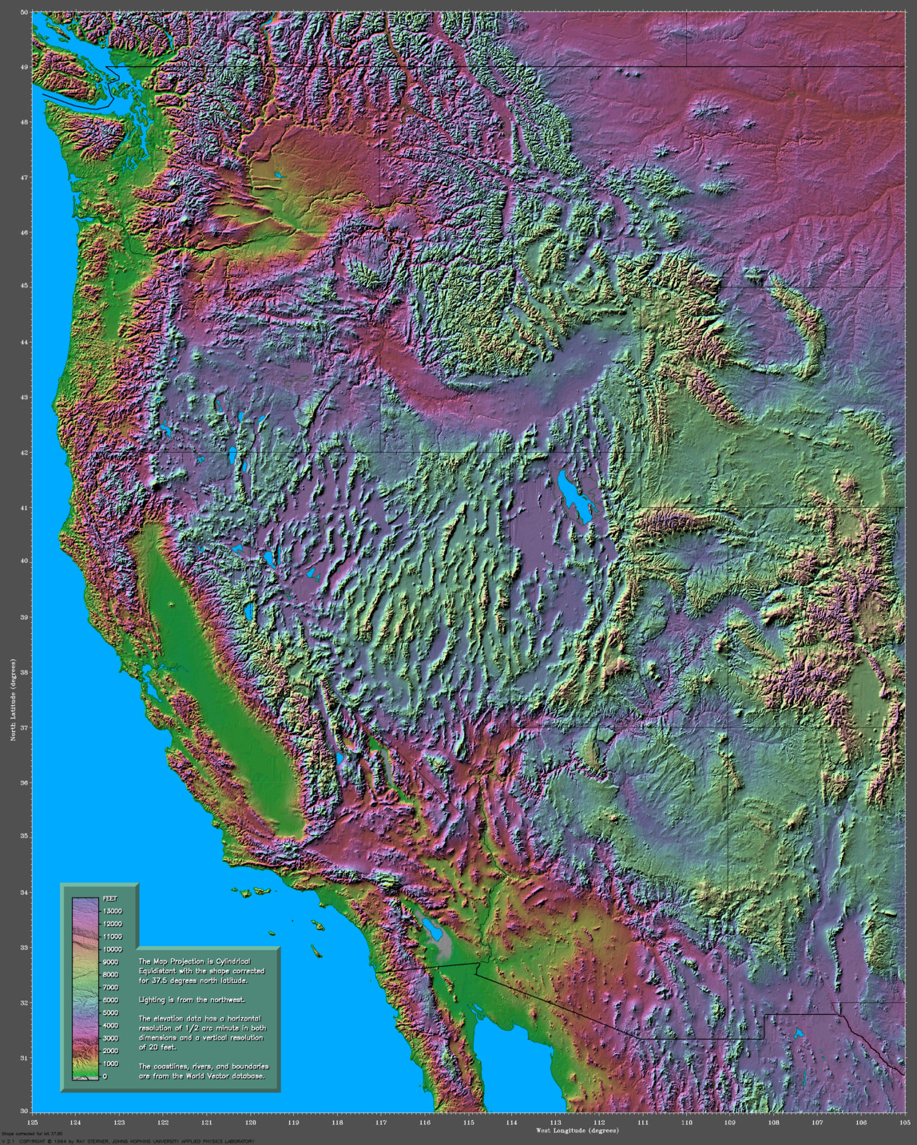
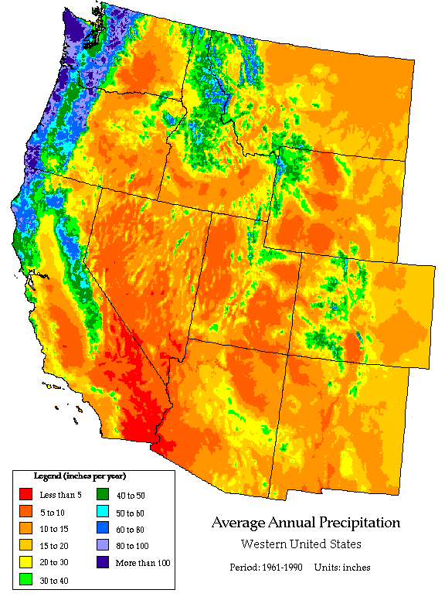
Terrain and precipitation patterns in western US.
We have mountains, too, and they modulate our weather.
http://birrell.org/andrew/reliefMaps/image.php?zone=west&type=jpg&scale=50
http://www.wrcc.dri.edu/pcpn/westus_precip.gif

Slide 3
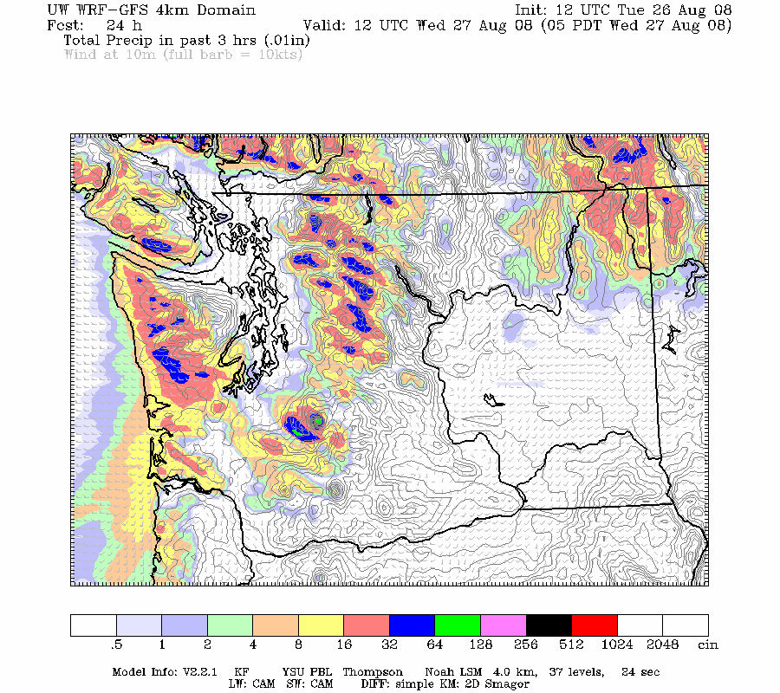
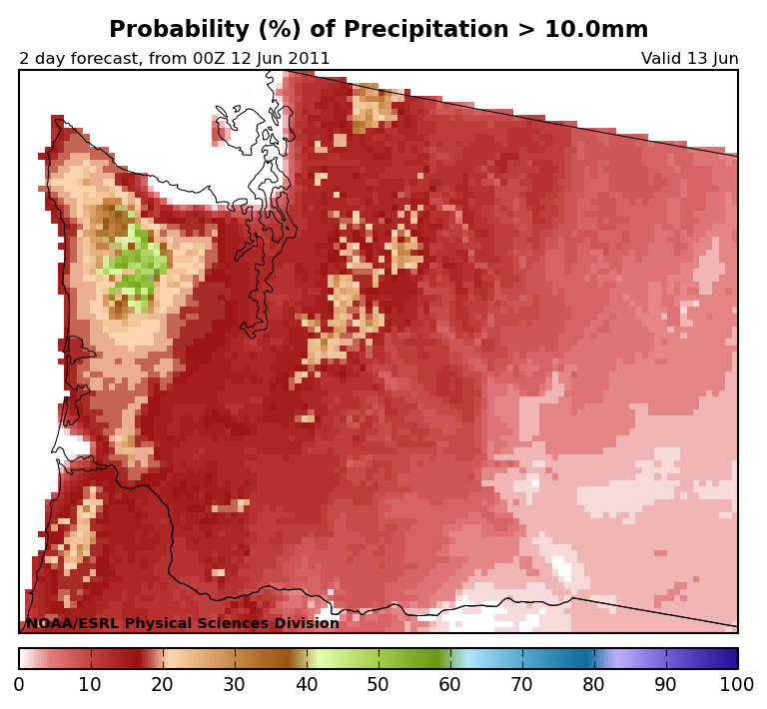
How can we provide spatially detailed weather forecasts in such regions?
Dynamical downscaling;
high-resolution NWP
(2) Statistical downscaling;
relate high-resolution
measurements to
lower-res. model forecast
http://www.atmos.washington.edu/~cliff/cliff.php
http://www.esrl.noaa.gov/psd/forecasts/reforecast/narr/

Slide 4
How can we provide spatially detailed weather forecasts in such regions?
Dynamical downscaling;
high-resolution NWP
(2) Statistical downscaling;
relate high-resolution
measurements to
lower-res. model forecast
This will be the focus
of today’s talk;
statistical downscaling
and how it can be
aided by reforecasts.
http://www.atmos.washington.edu/~cliff/cliff.php
http://www.esrl.noaa.gov/psd/forecasts/reforecast/narr/

Slide 5
Definition
Reforecasts are retrospective numerical forecasts, ideally conducted using the same model, the same data assimilation system that is used operationally. Also called “hindcasts”
We prefer “reforecast” to emphasize connection with reanalyses and having quality initial conditions.

Slide 6
Outline
Why generate reforecasts? Advantages and disadvantages of relying on statistical downscaling to produce forecasts.
What reforecast data sets are/will be available for NWP?
  details on our upcoming reforecasts.

Slide 7
Why generate and use reforecasts?
Why not?

Slide 8
What can post-processing with reforecasts do that other NWP techniques cannot?
Provide extra “resolution,” but via statistical downscaling.
  Also: compensate for systematic model biases, thereby increase reliability, increase forecast skill.
  High-resolution models may have lots of detail but are not free from bias!
Provide sufficient samples to quantify forecast errors for particular locations, hydrologic basins.
Provide context on how unusual today’s forecast event is, relative to other forecast events.

Slide 9
Disadvantages of post-processing with reforecasts
Right answer perhaps, but for wrong reason? We prefer to directly improve the model in physically realistic ways.
  Also, some errors are too complex to adjust via post-processing; for these, there is no substitute for improving the model.
Additional computational and infrastructural burden to compute reforecasts and reanalyses, compile observation time series.
  ECMWF’s (relatively sparse) weekly 5-member reforecast * 20 years = 100 extra members / week to compute.
  Generally greater benefit the more years, more days, more members in reforecast, but proportionally more expensive.
  Without high-quality, long observation time series, many of the benefits of reforecasts + statistical post-processing are lost.
  Need to keep computing reforecasts with current model version, else improvements are temporary.
If real climate or model-error statistics change significantly during reforecast period, decreased accuracy of post-processed estimates

Slide 10
Post-processing and reforecast advantages
(all results using T62 GFS reforecast unless otherwise noted)

Slide 11
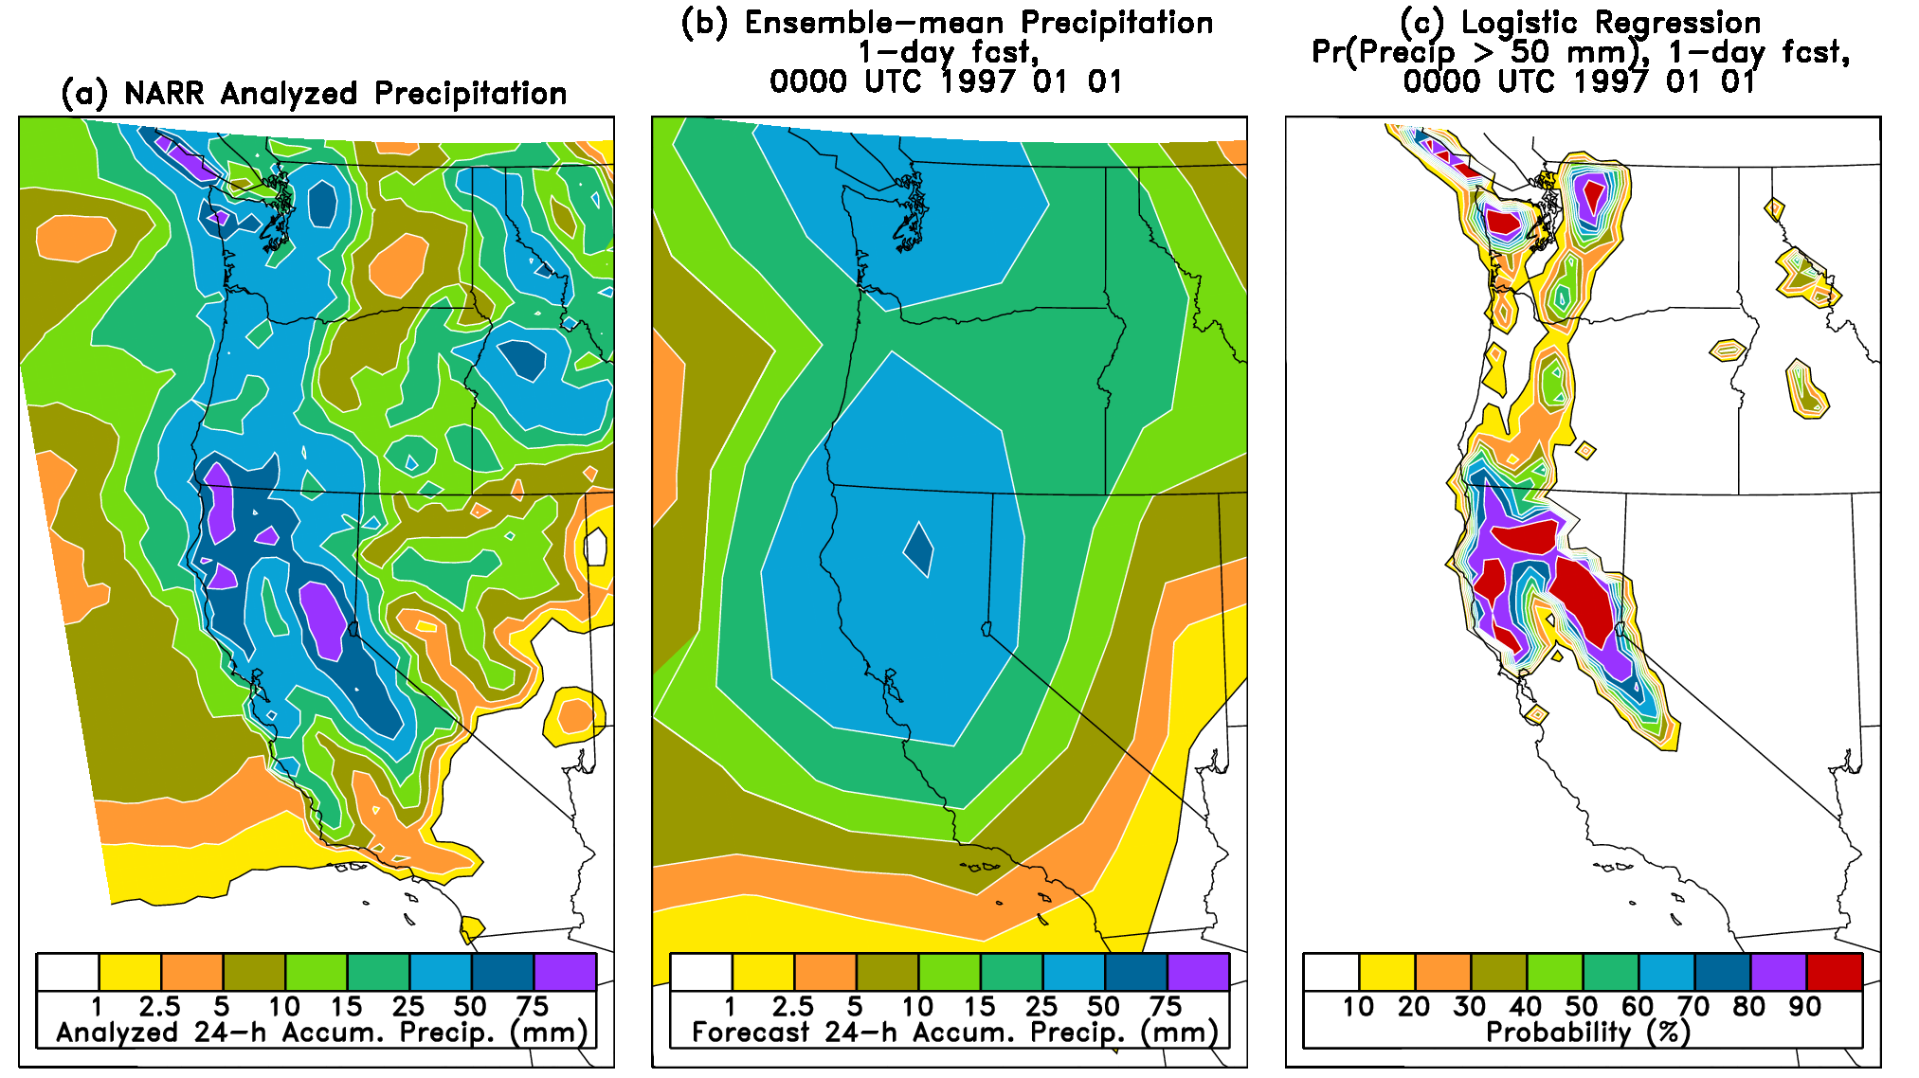
Statistical downscaling example
Coarse resolution model forecasts the large-scale precipitation anomaly realistically, but without small-scale detail. Statistical downscaling fills in this detail, relating past forecasts and observations to correct the real-time forecast. Methods of statistical downscaling discussed later.

Slide 12
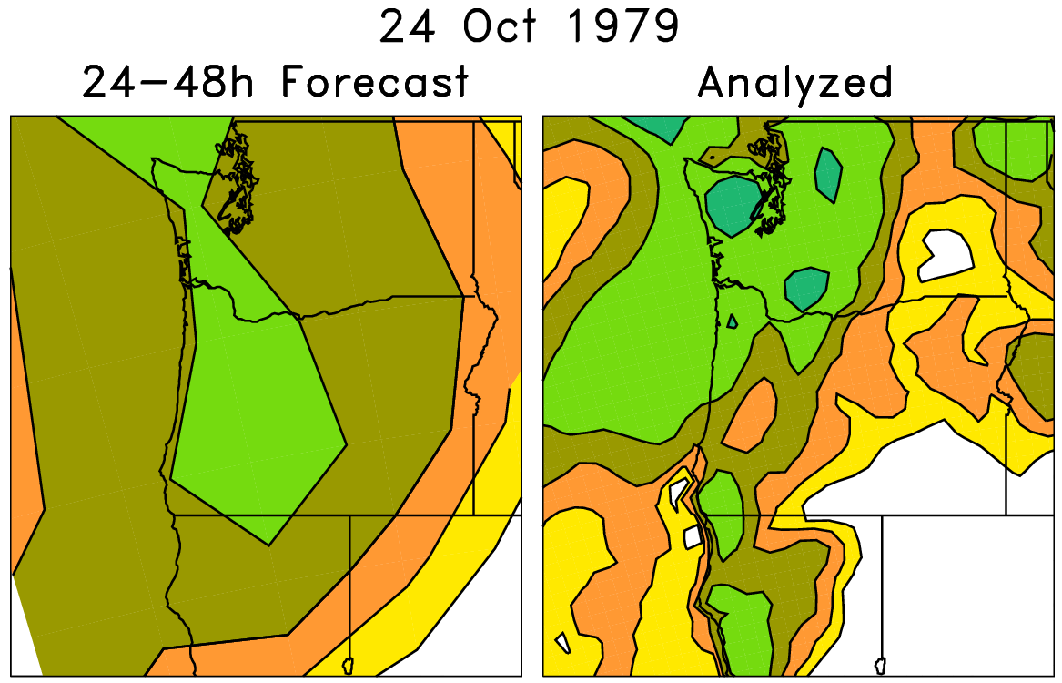
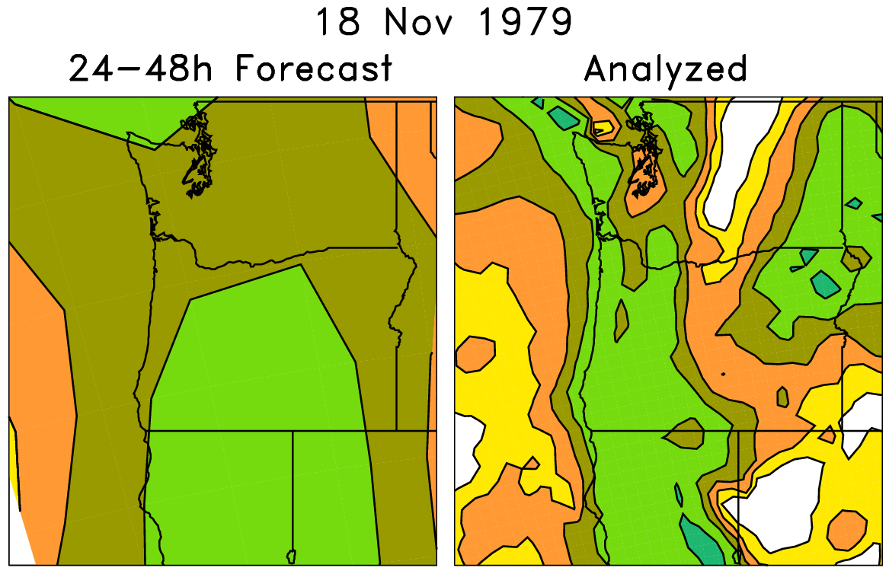
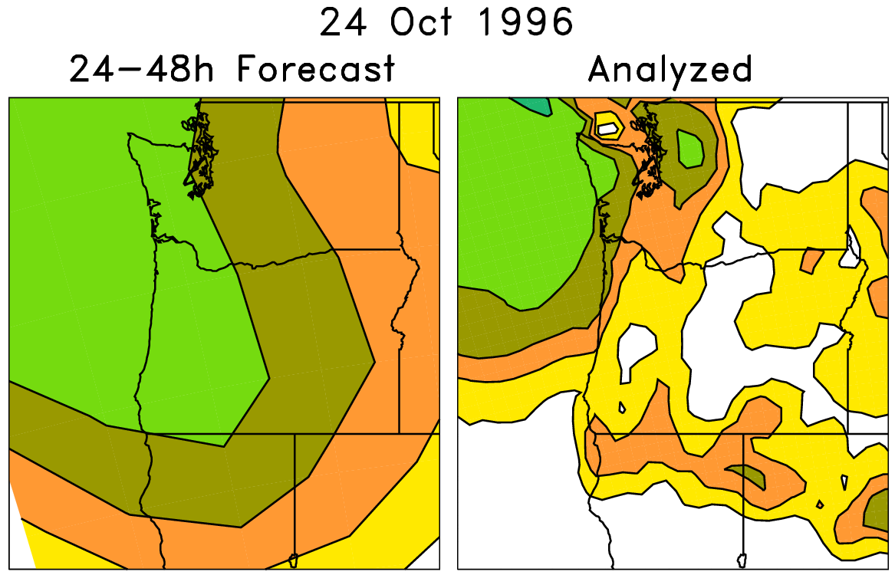
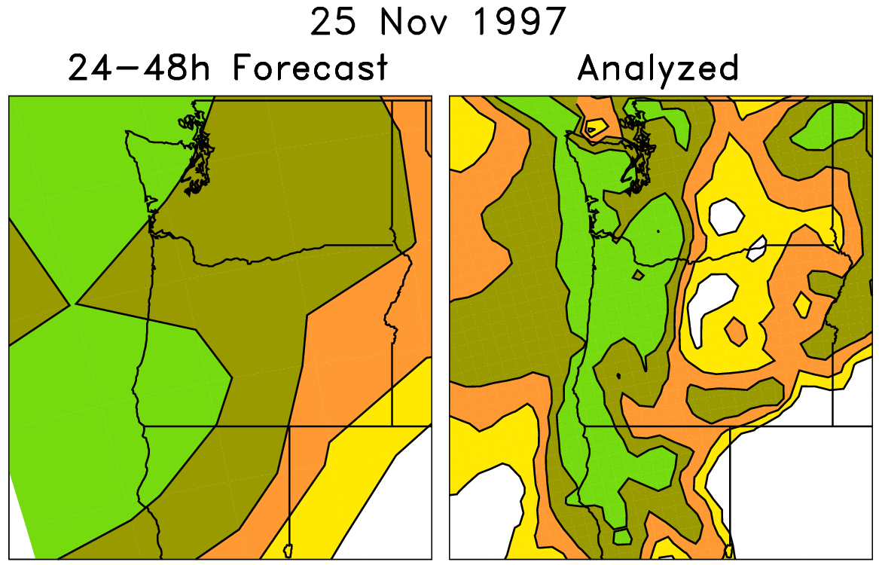
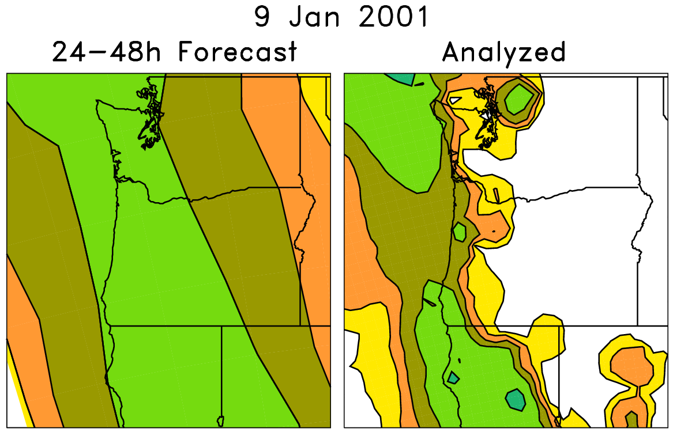
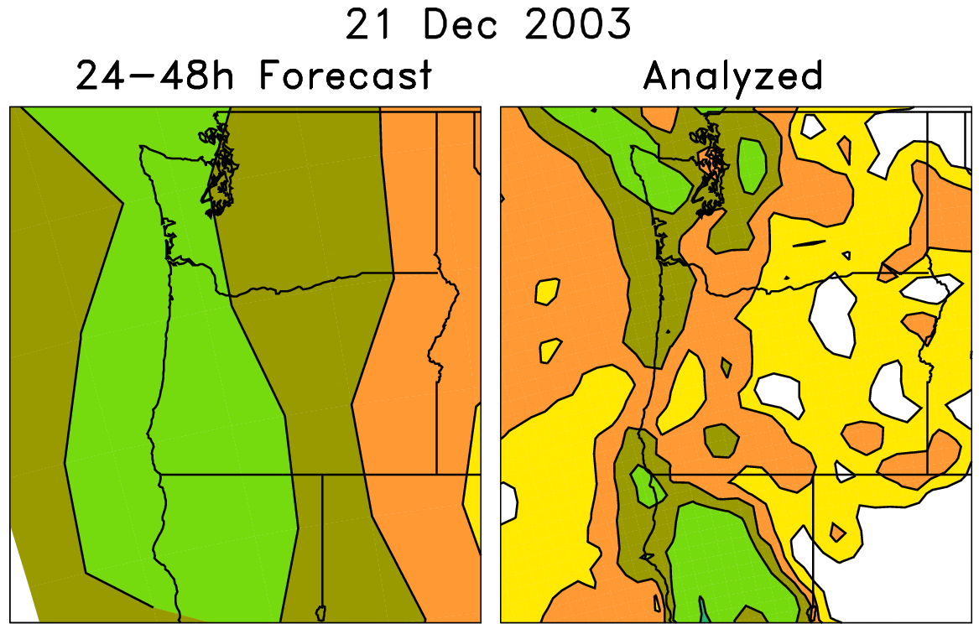
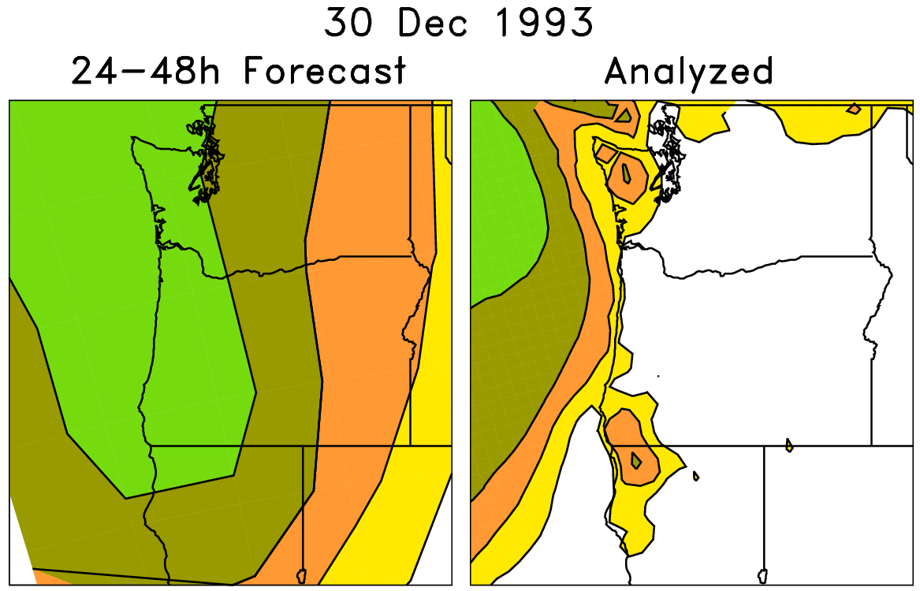
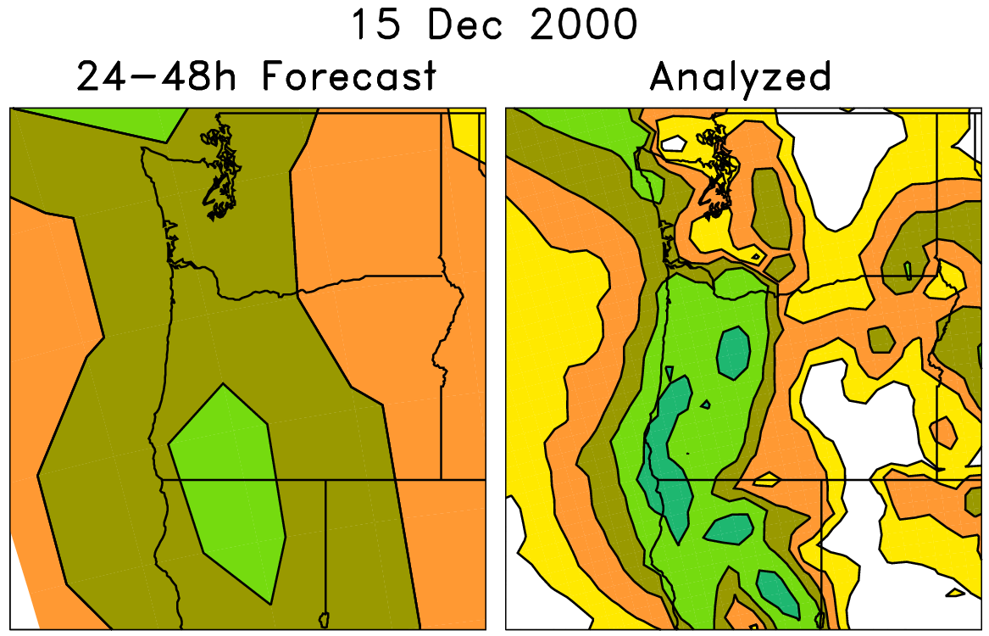
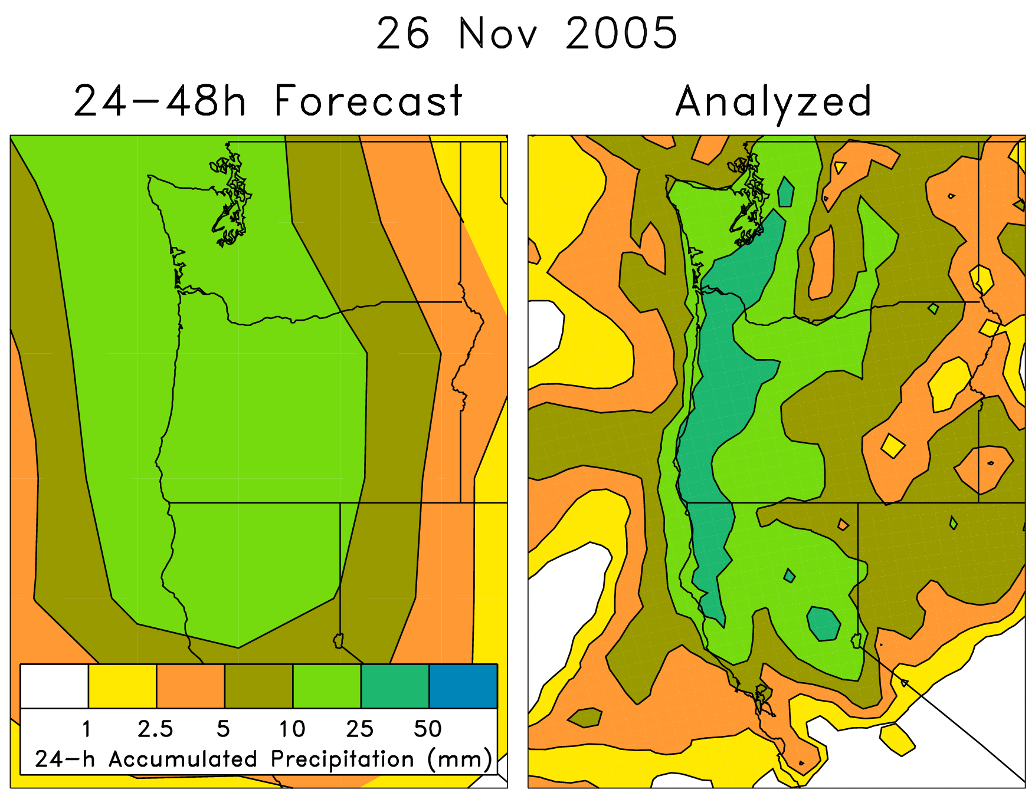
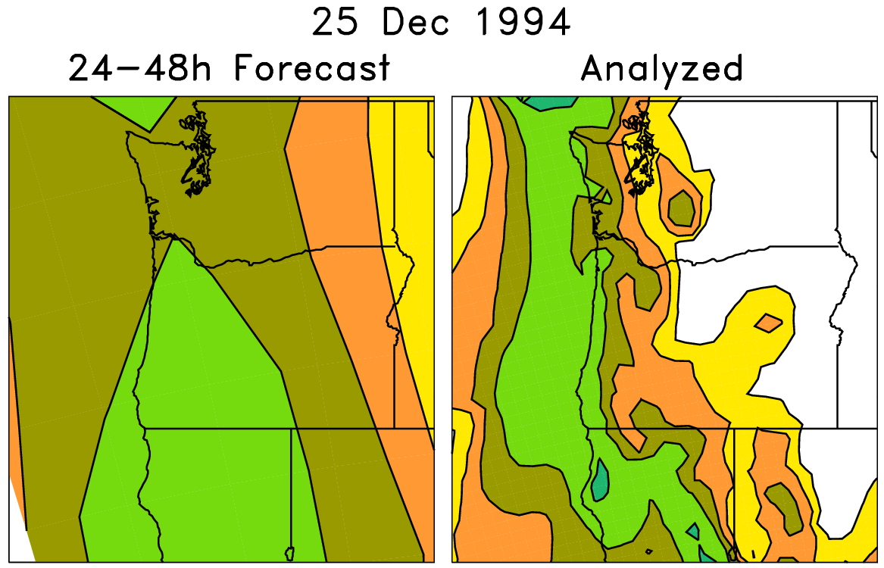
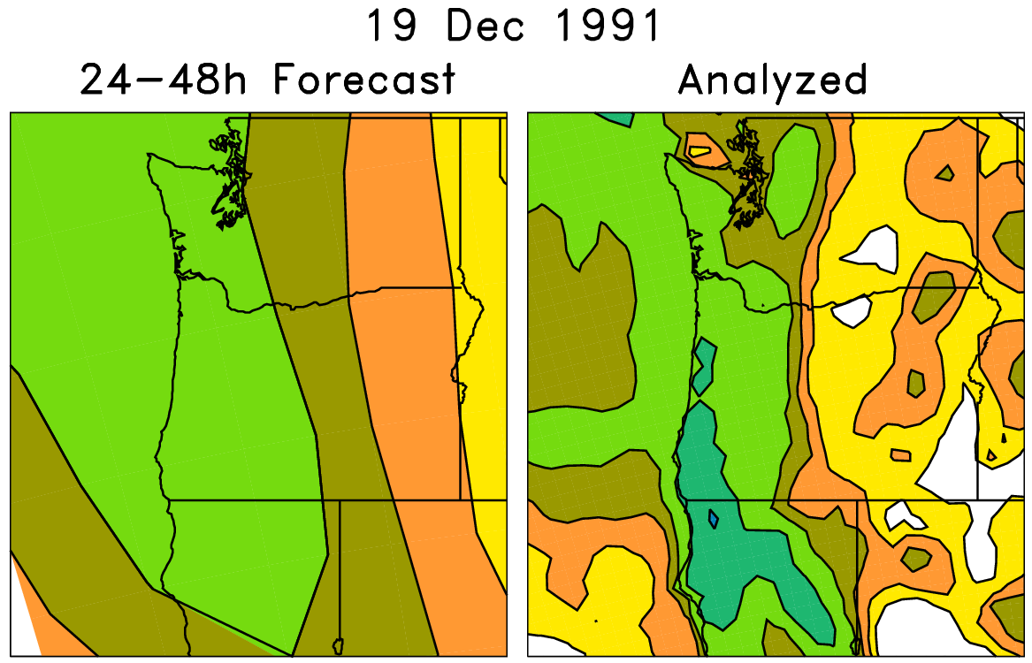
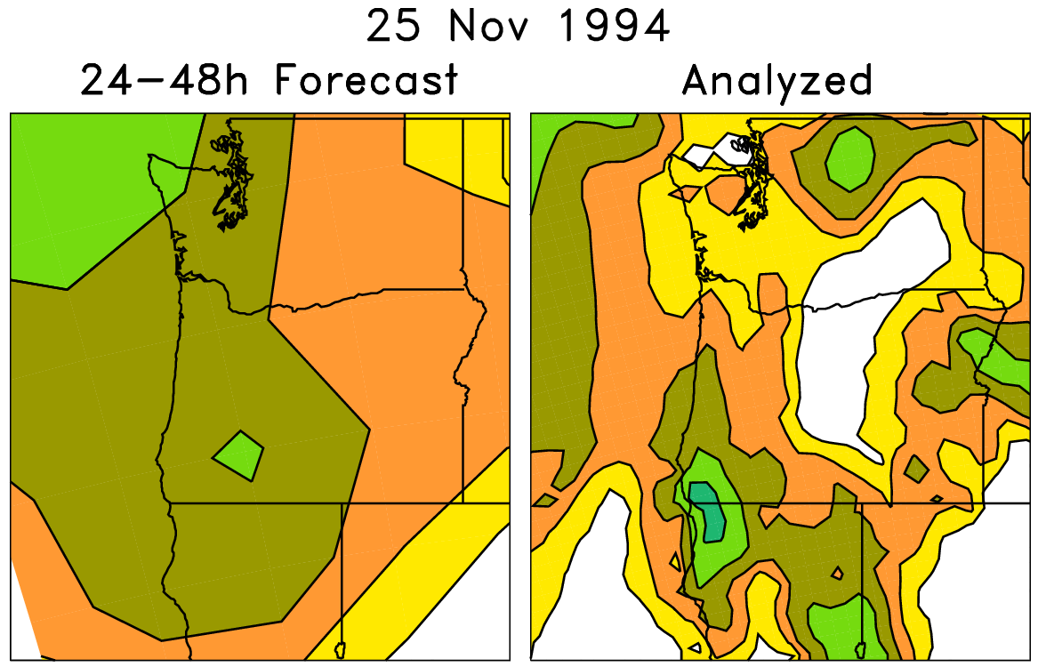
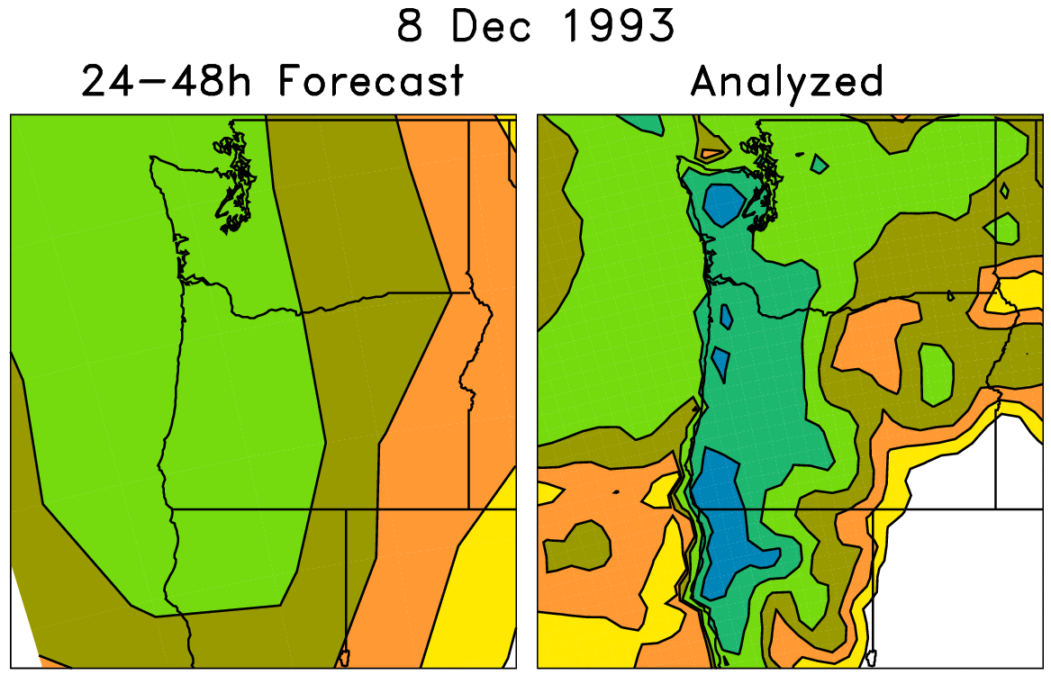
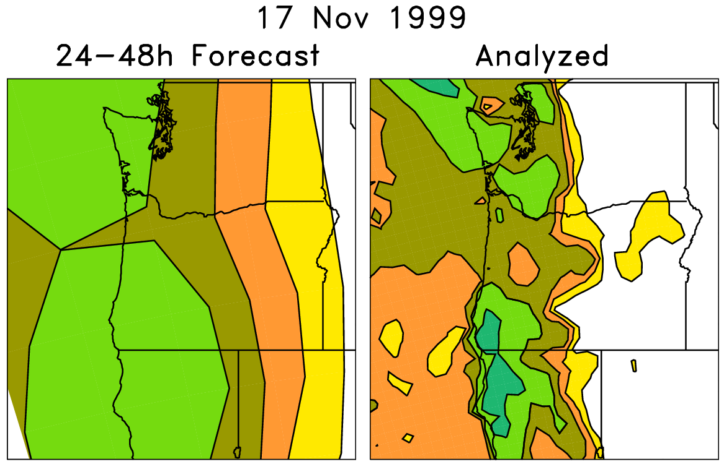
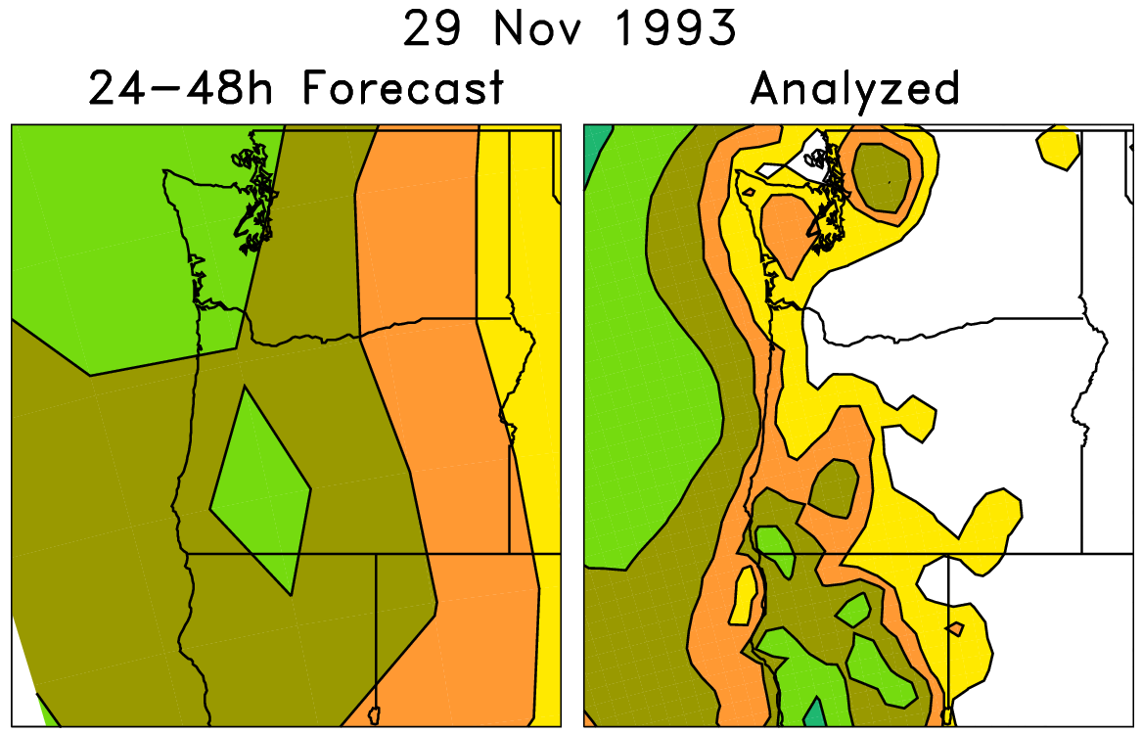
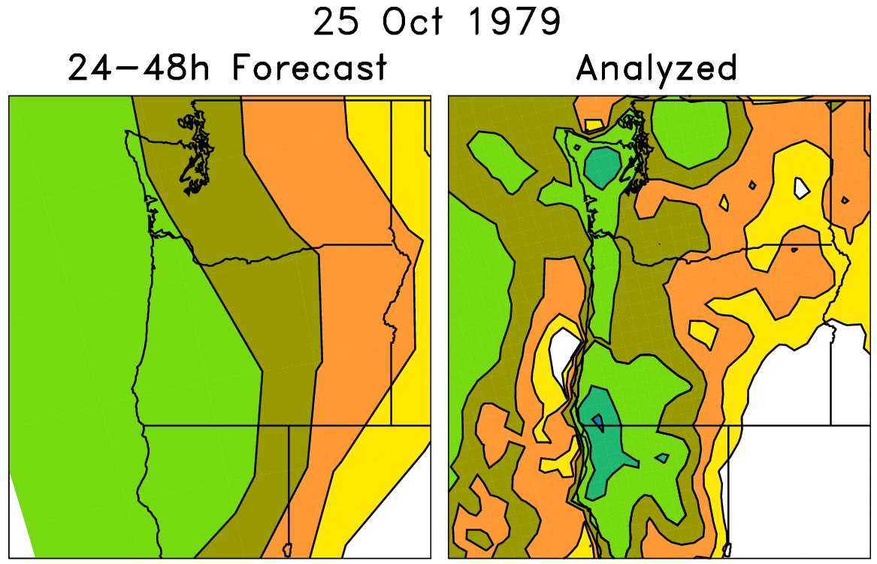
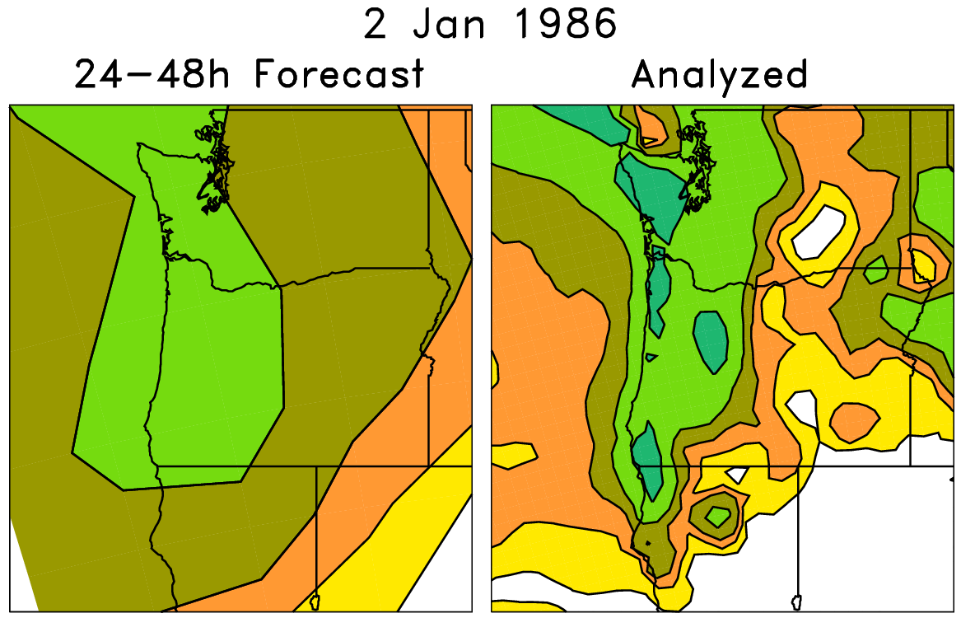
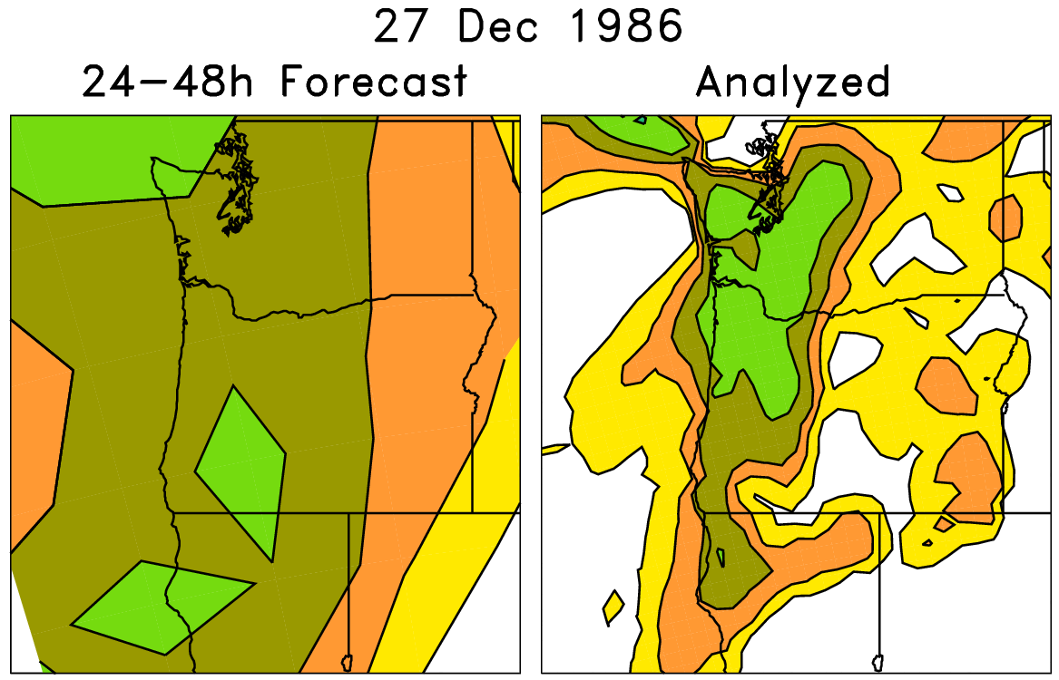
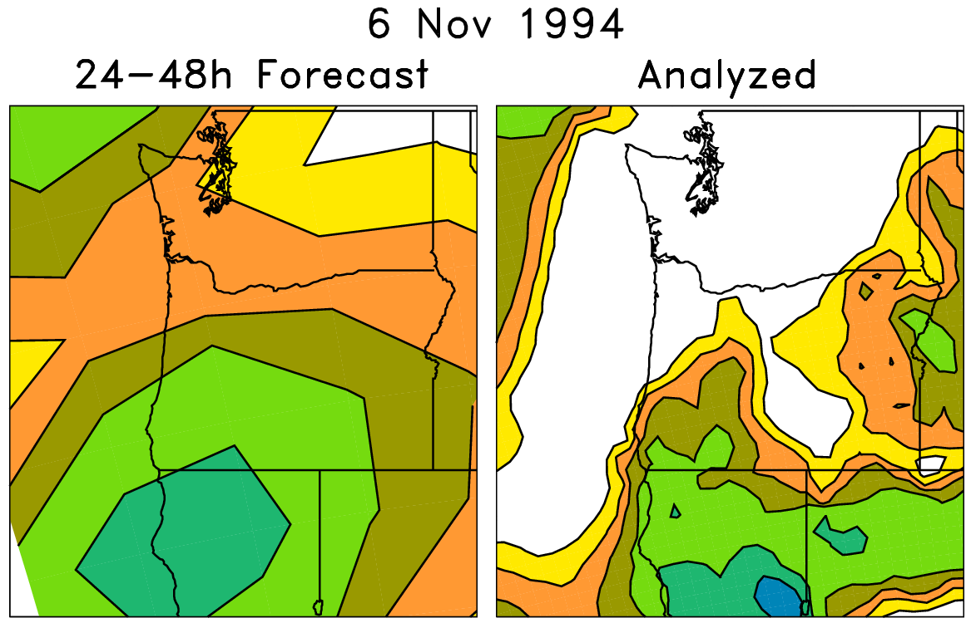
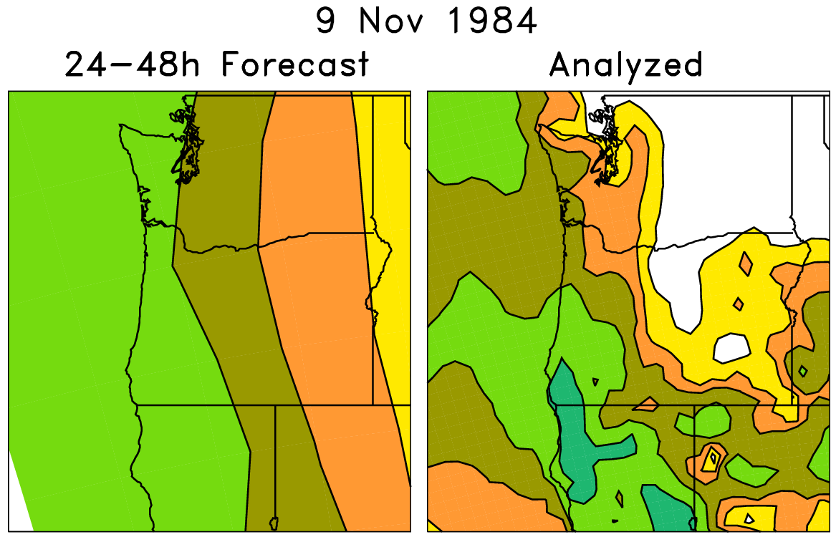
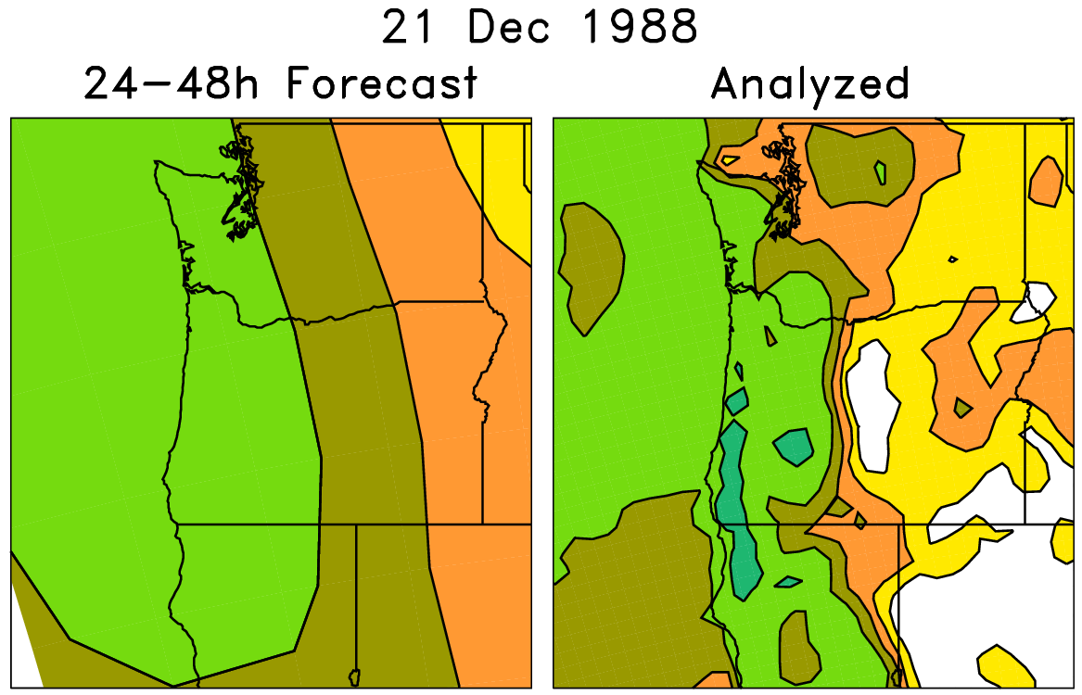
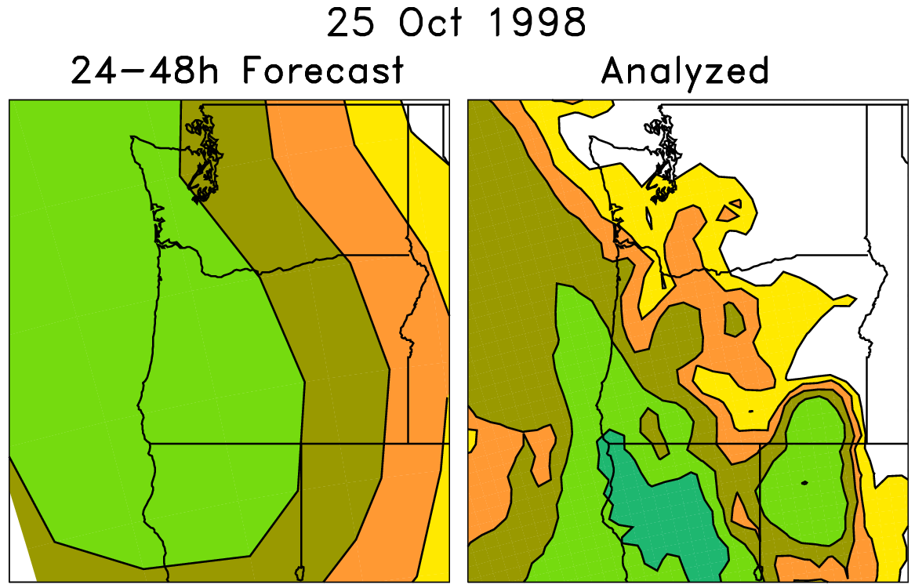
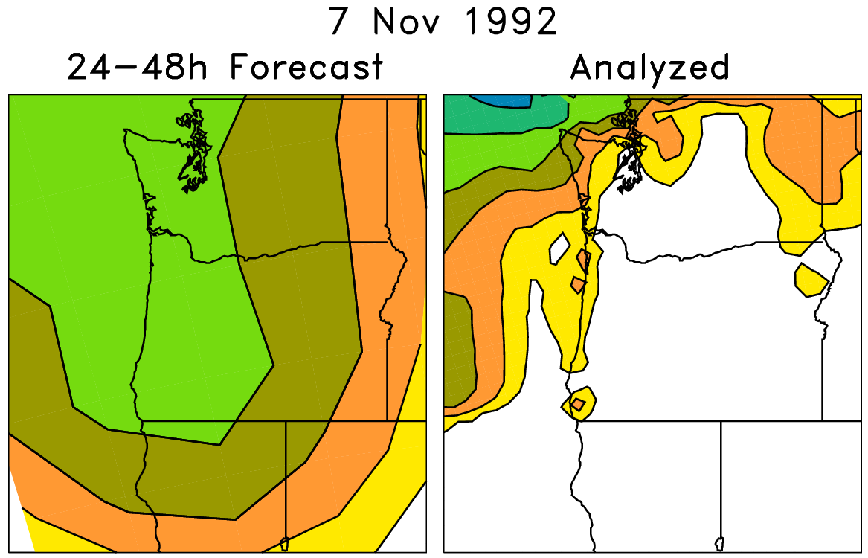
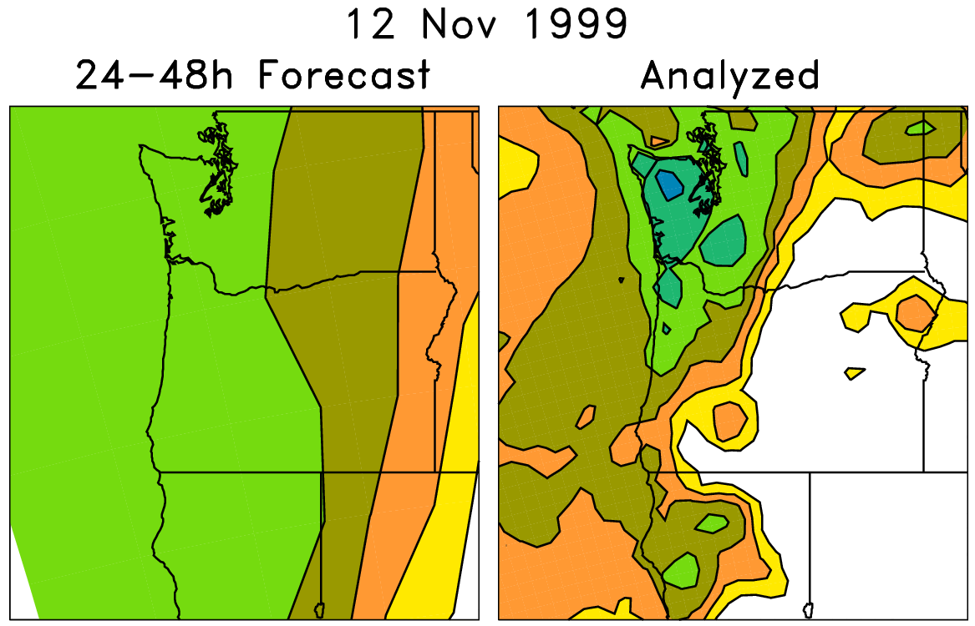
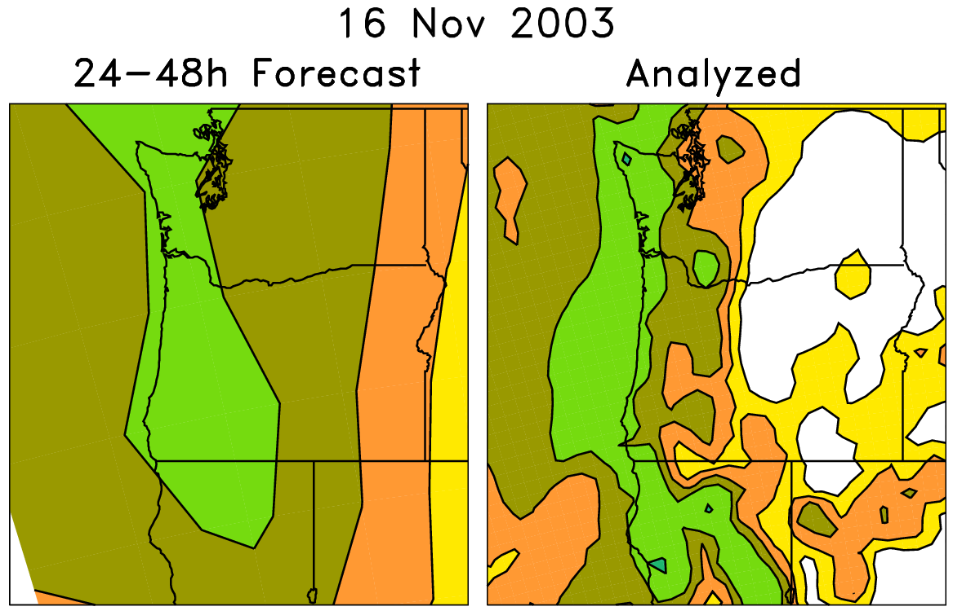
Analog technique for statistical downscaling
Today’s ens. mean forecast + a posteriori analyzed precip.
On the left are old forecasts
similar to today’s ensemble-
mean forecast. For making
probabilistic forecasts,
form an ensemble from
the accompanying
analyzed weather on the
right-hand side.

Slide 13
Analog technique for statistical downscaling
Form an
ensemble from
these

Slide 14
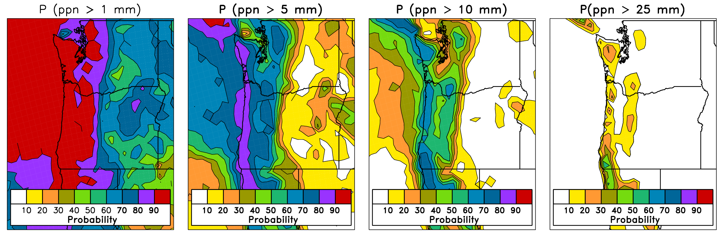
Downscaled analog probability forecasts

Slide 15
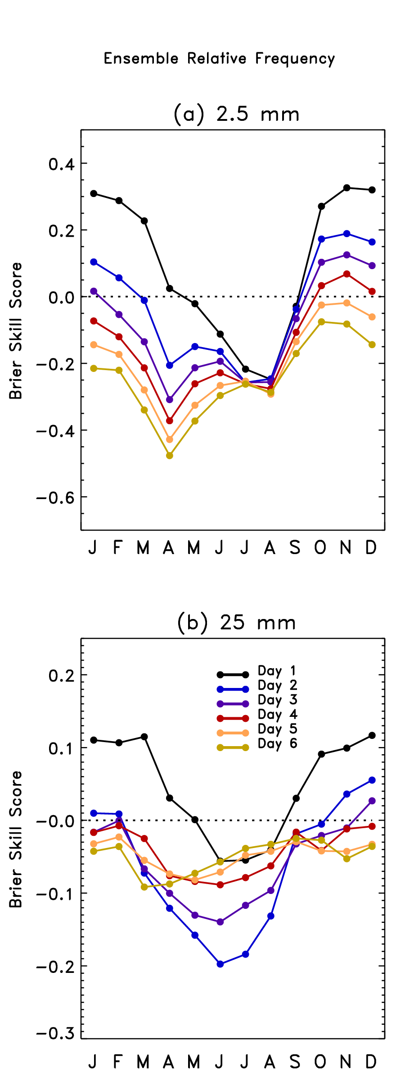
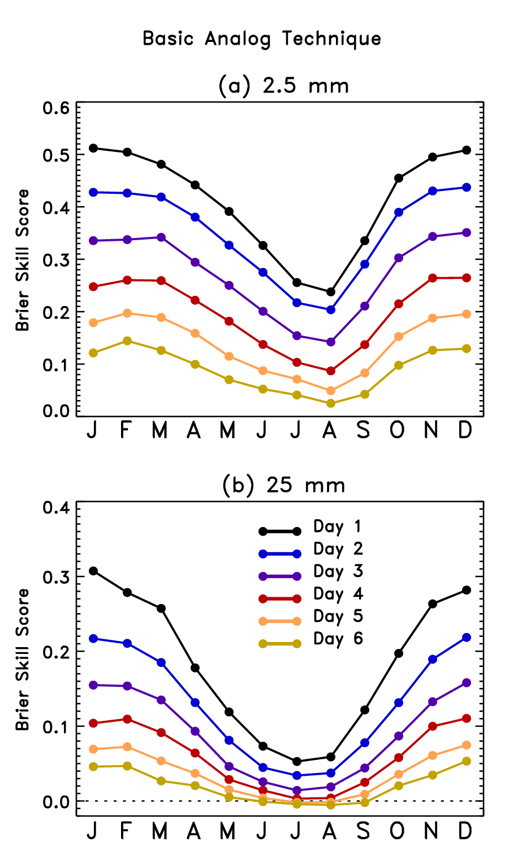
Verified over 25 years of forecasts;
skill scores use conventional
method of calculation which may
overestimate skill
(Hamill and Juras, QJRMS, Oct 2006).

Slide 16
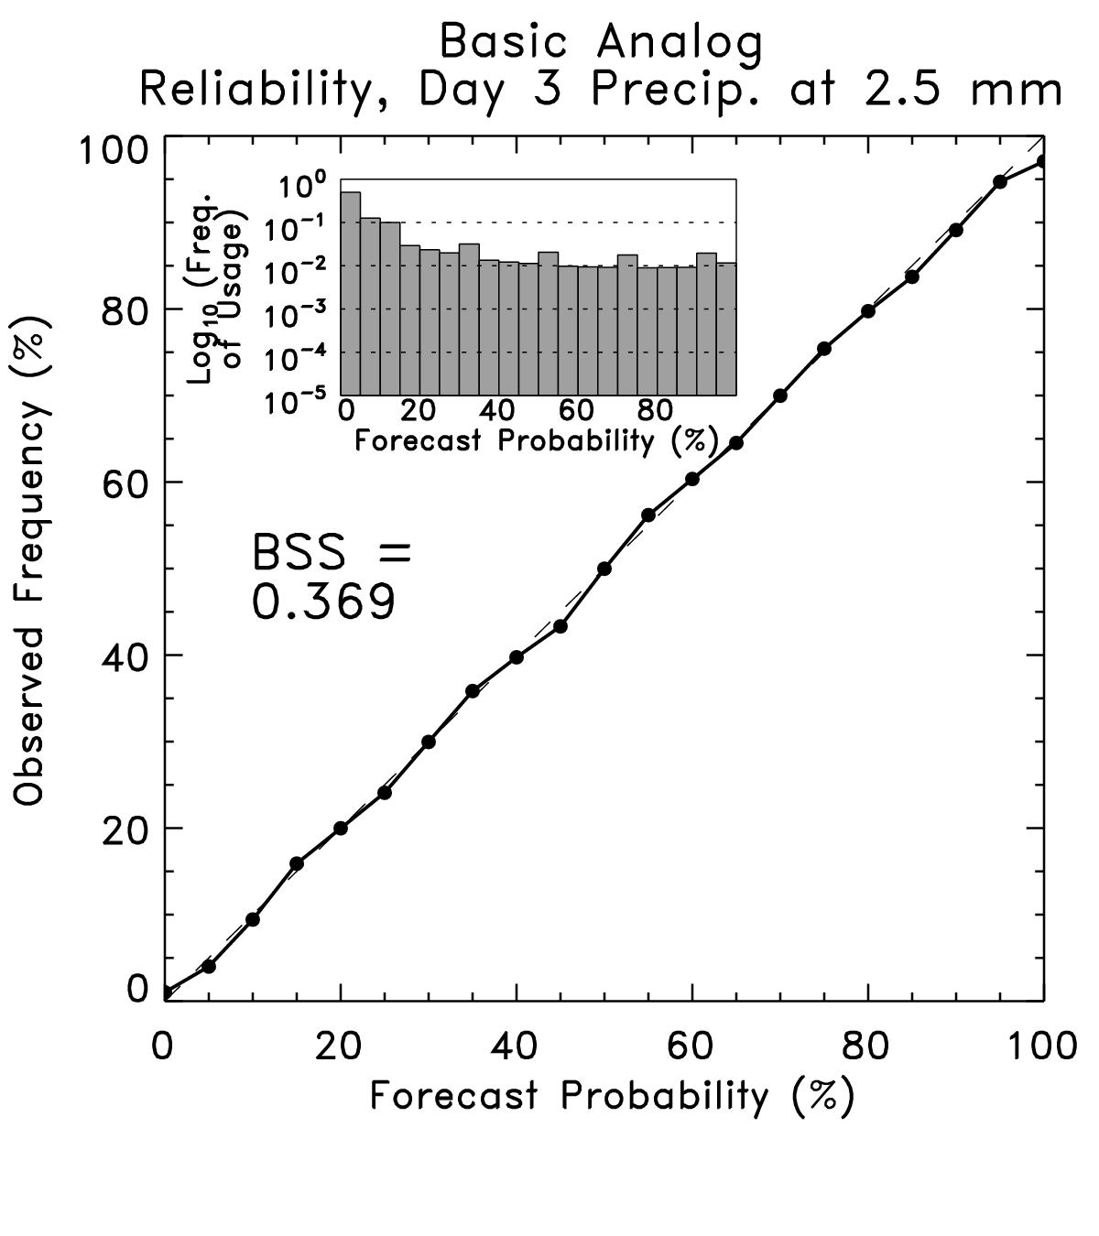
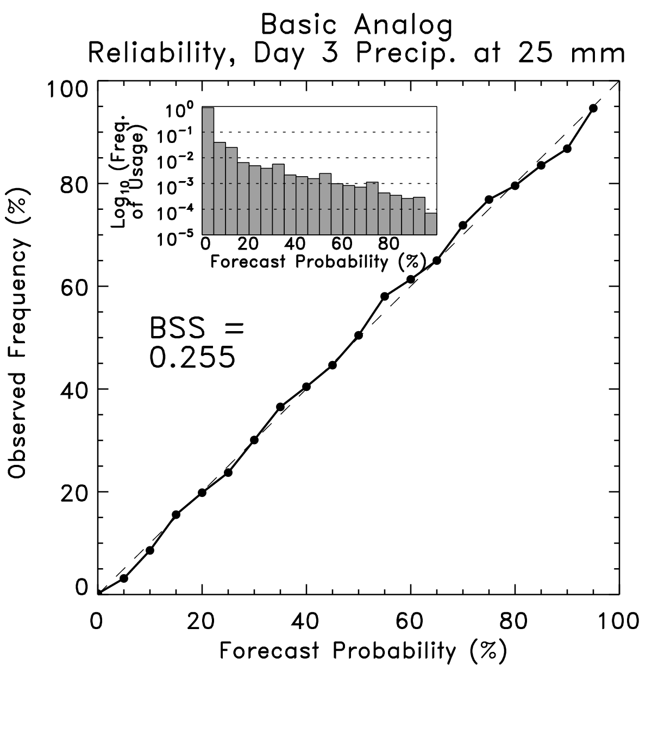
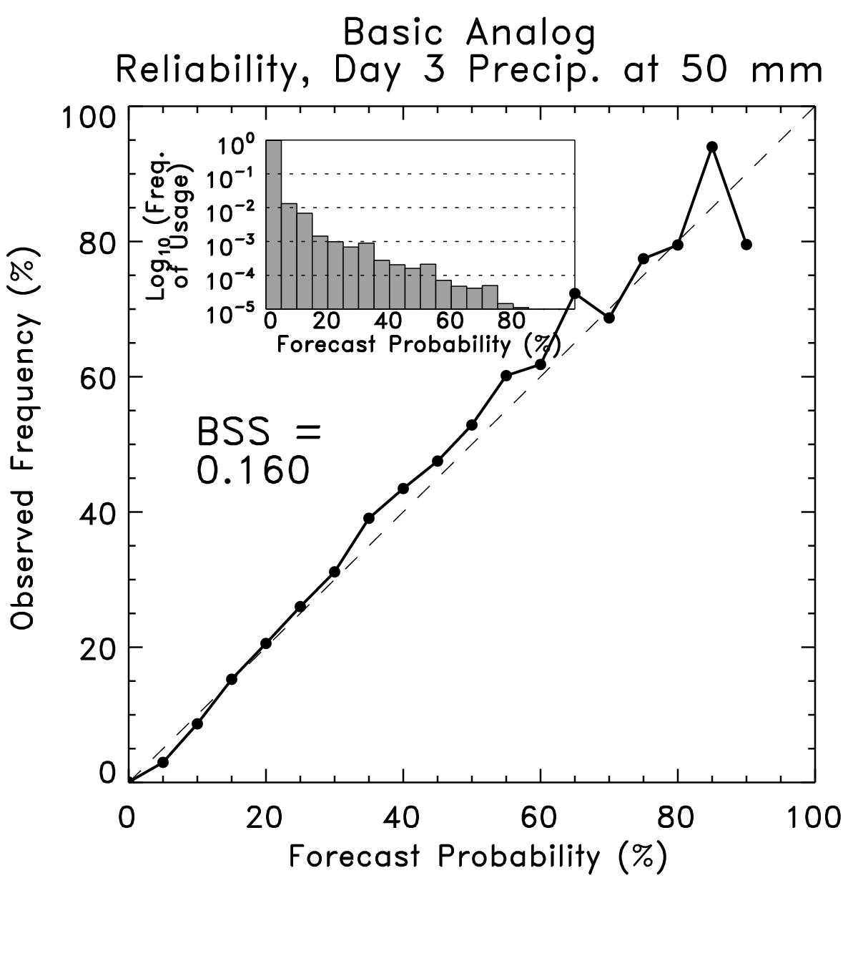
Reliability, analog day +3 forecast
2.5 mm
25 mm
50 mm
Can post-process to achieve reliable, skillful PQPFs

Slide 17
Post-processing of heavy precipitation and other rare events: importance of sample size
Effective calibration is aided by having old forecast cases that were similar to today’s forecast. Then the difference between the observed and forecast on those days can be used to calibrate today’s forecast.
In an example like this, the last 45 days of forecasts weren’t very useful.

Slide 18
Effect of training sample size: analog technique sensitivity to training sample size
colors of dots indicate which size analog ensemble
provided the largest amount of skill.

Slide 19
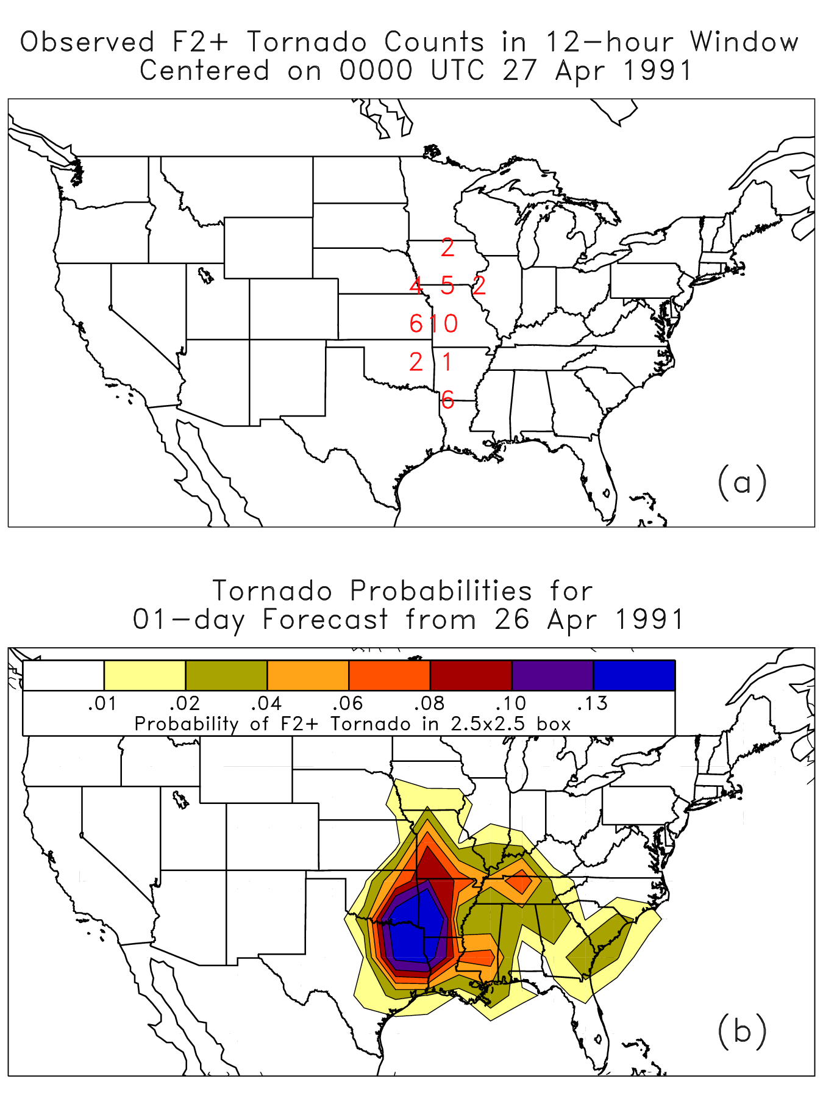
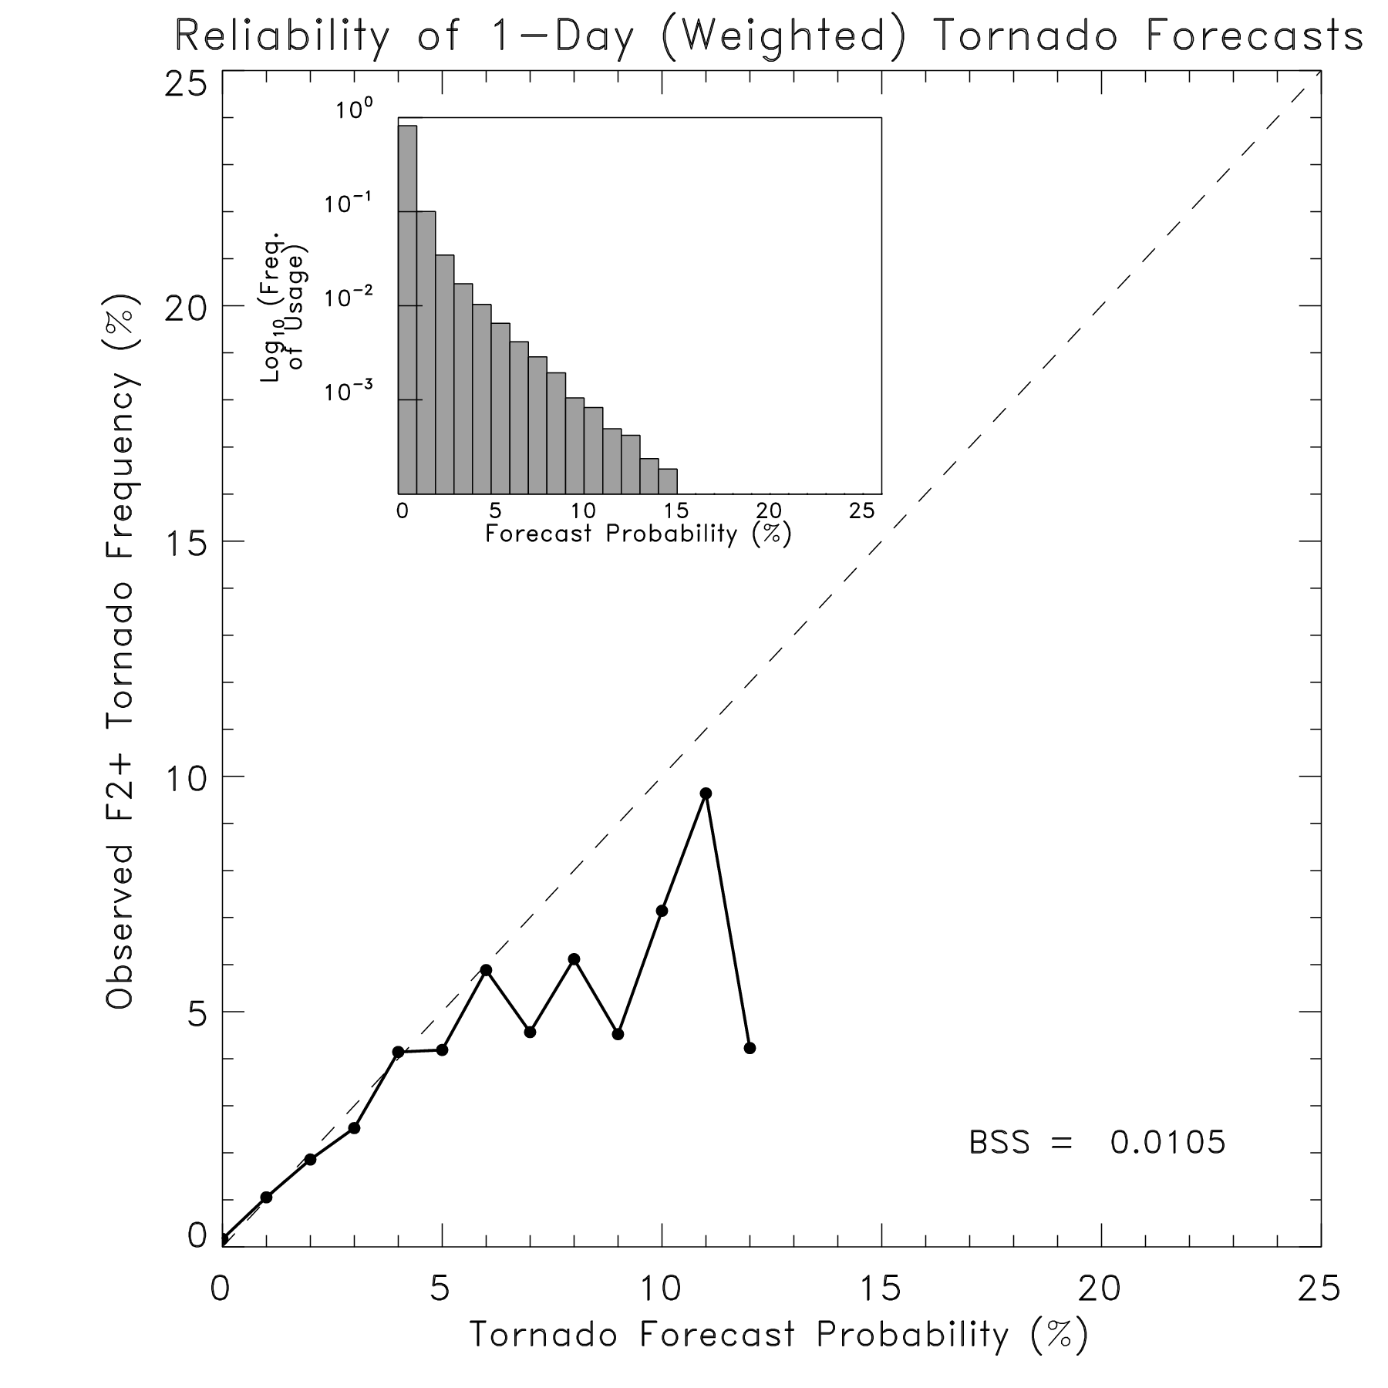
More exotic post-processing application: tornado probabilities
We used CAPE, vertical wind shear
and analog approach to find dates
of similar old cases, then estimated
tornado probabilities from occurrence
on those dates.

Slide 20
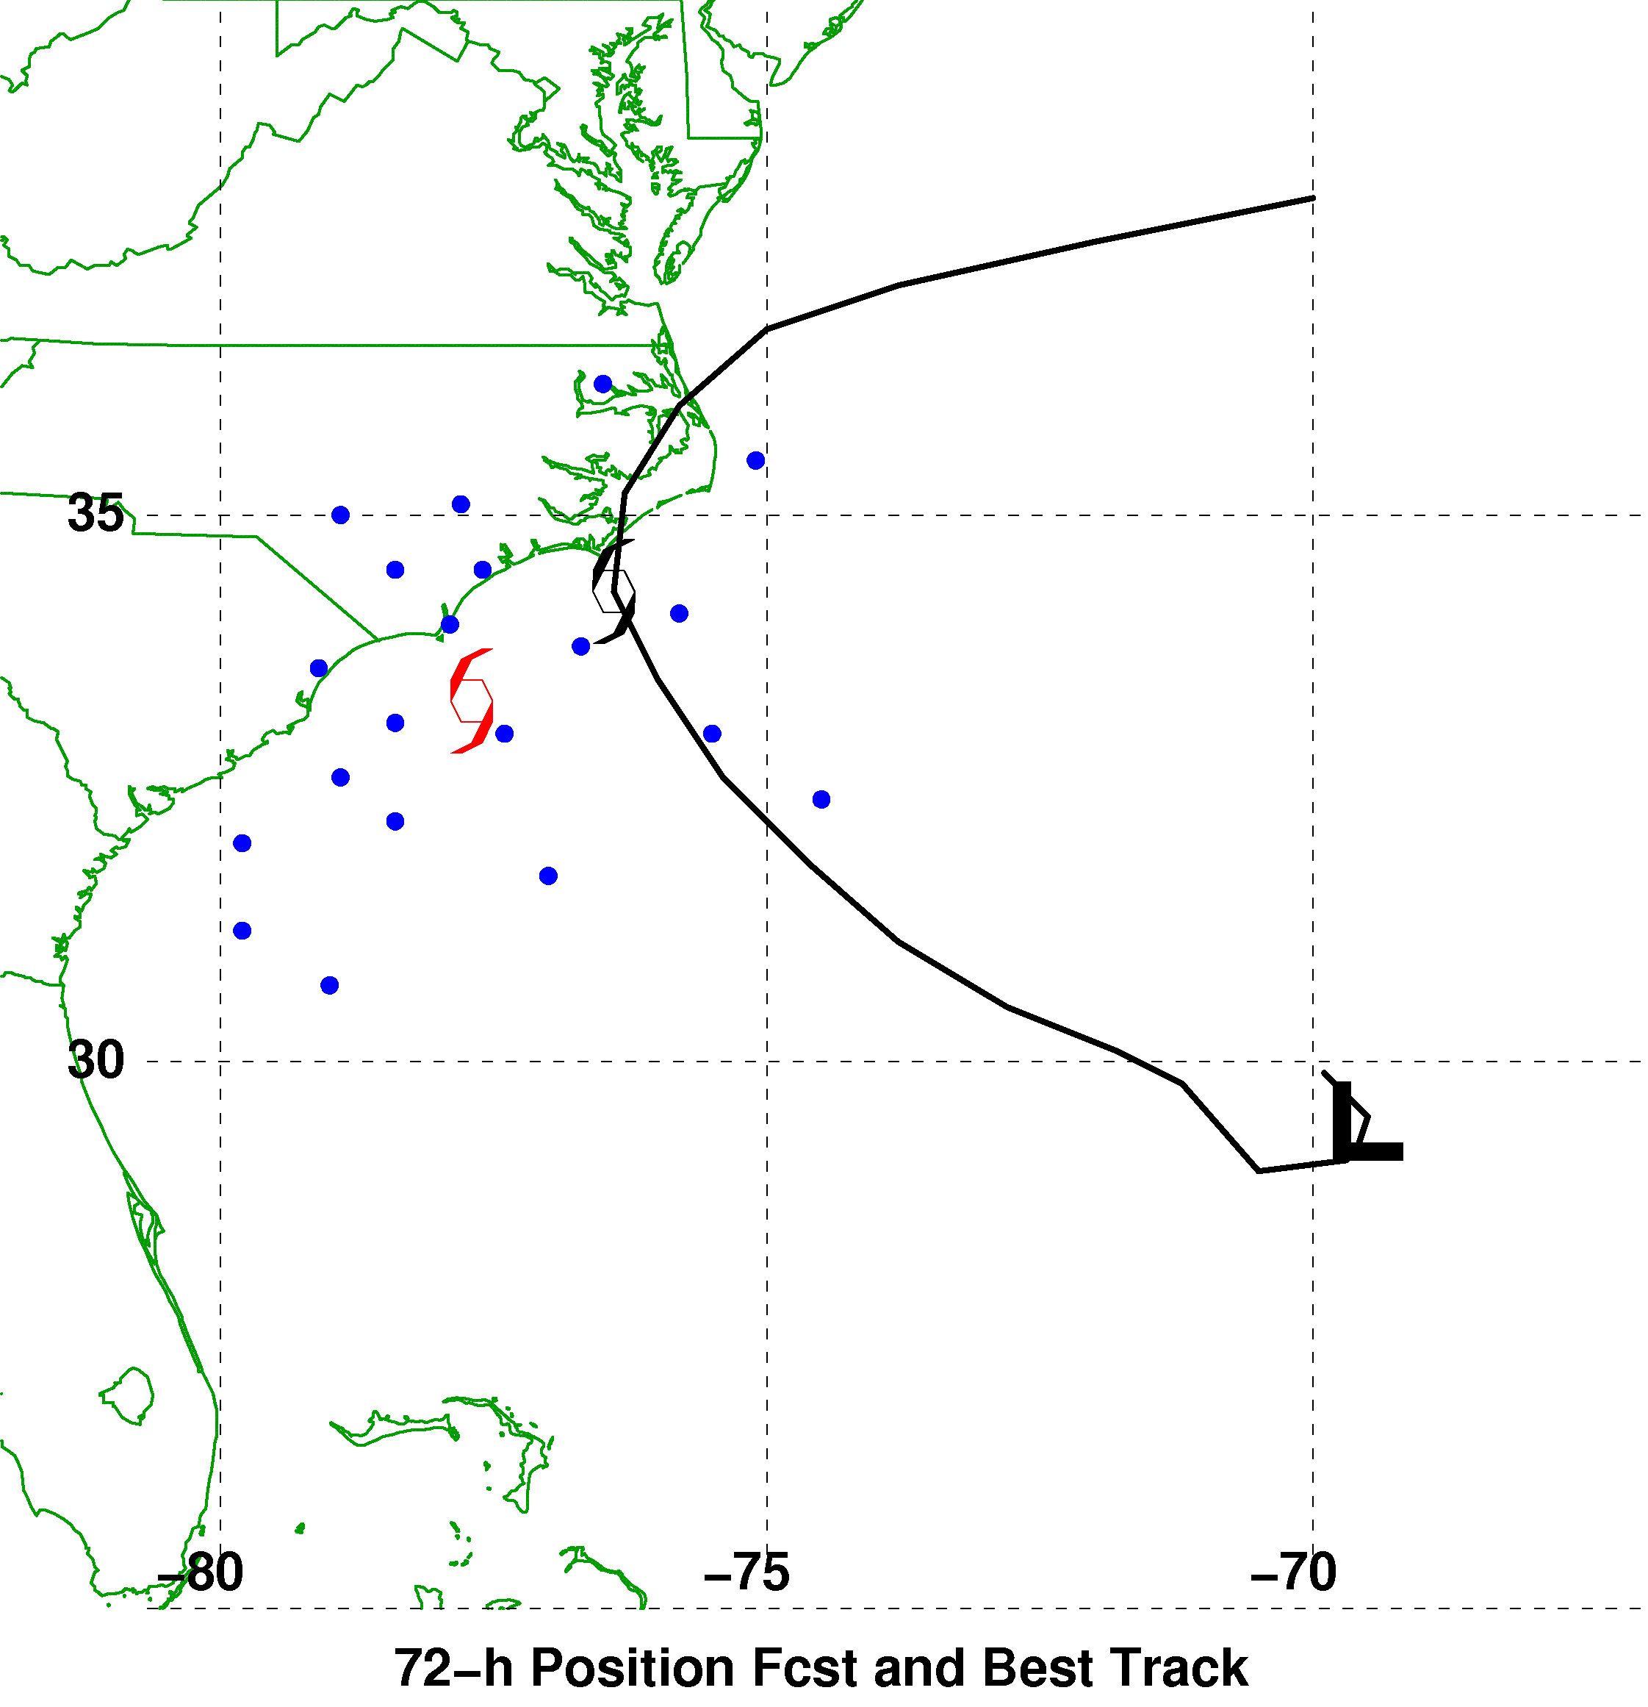
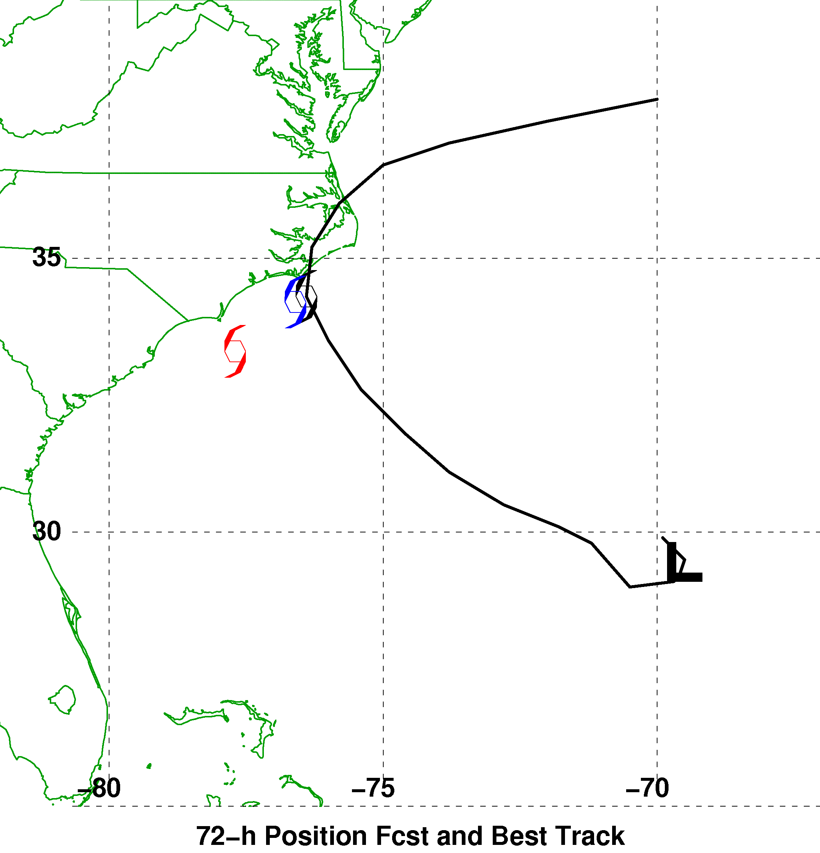
Hurricane track corrections?
72-h Forecast Verifying 1200 UTC 9 September
Ensemble Mean, Reforecast Analog,
and Observed Positions
Reforecast Analog
Position Errors
N
Bias-Corrected Ensemble Mean Position
and Probability Ellipse
W
E
Observed
S
Error (km)

Slide 21
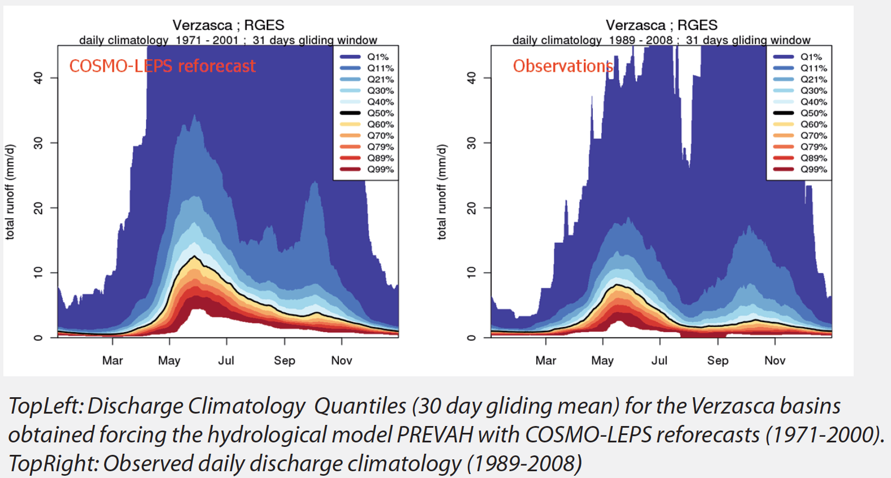
Another use of reforecasts: assessing usefulness of model output for hydrologic forecasting
from Felix Fundel et al. poster, ftp://ftp.wsl.ch/pub/zappa/imprints/del3_1/cleps_bcn.pdf

Slide 22
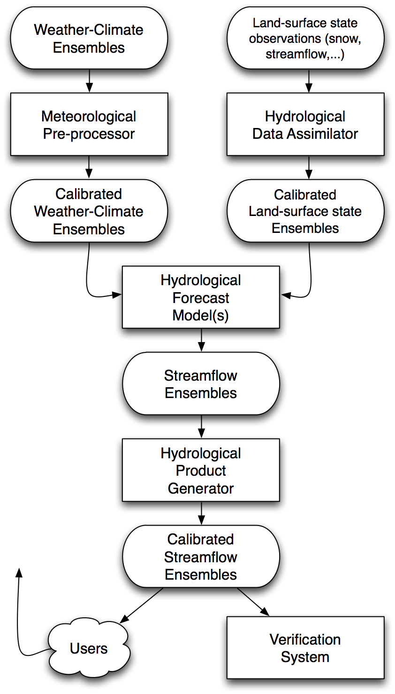
Hydrologic
Ensemble
Prediction
Experiment
Note that hydrologists envision
a step to make sure that ensemble
inputs to their hydrologic system
are as reliable and sharp as possible.
Reforecasts may be needed for this
step.
from Schaake et al. 2007 BAMS article

Slide 23
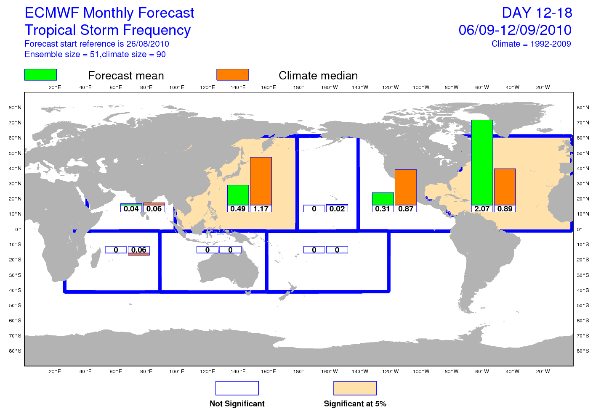
Reforecast use: tropical cyclogenesis
Many forecast models over-forecast tropical cyclogenesis. This ECMWF product
uses TCgenesis from reforecasts to provide some calibration for possible biases.
Ref: D. Richardson, personal communication, ECMWF.

Slide 24
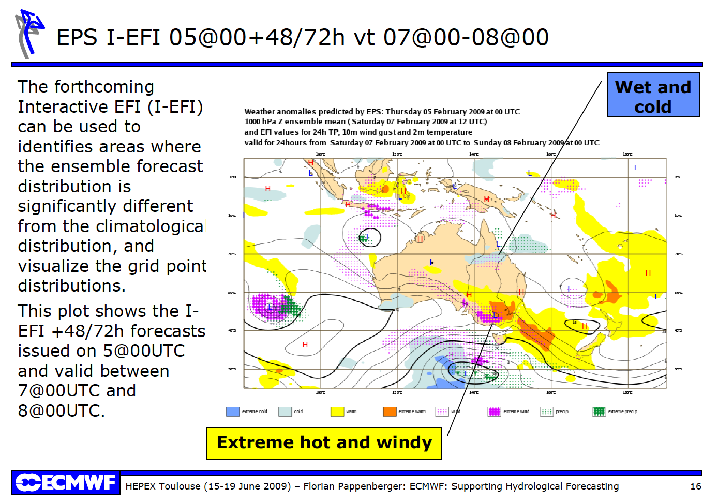
Another reforecast use: facilitates quantitatively assessing how unusual an event is (EFI)

Slide 25
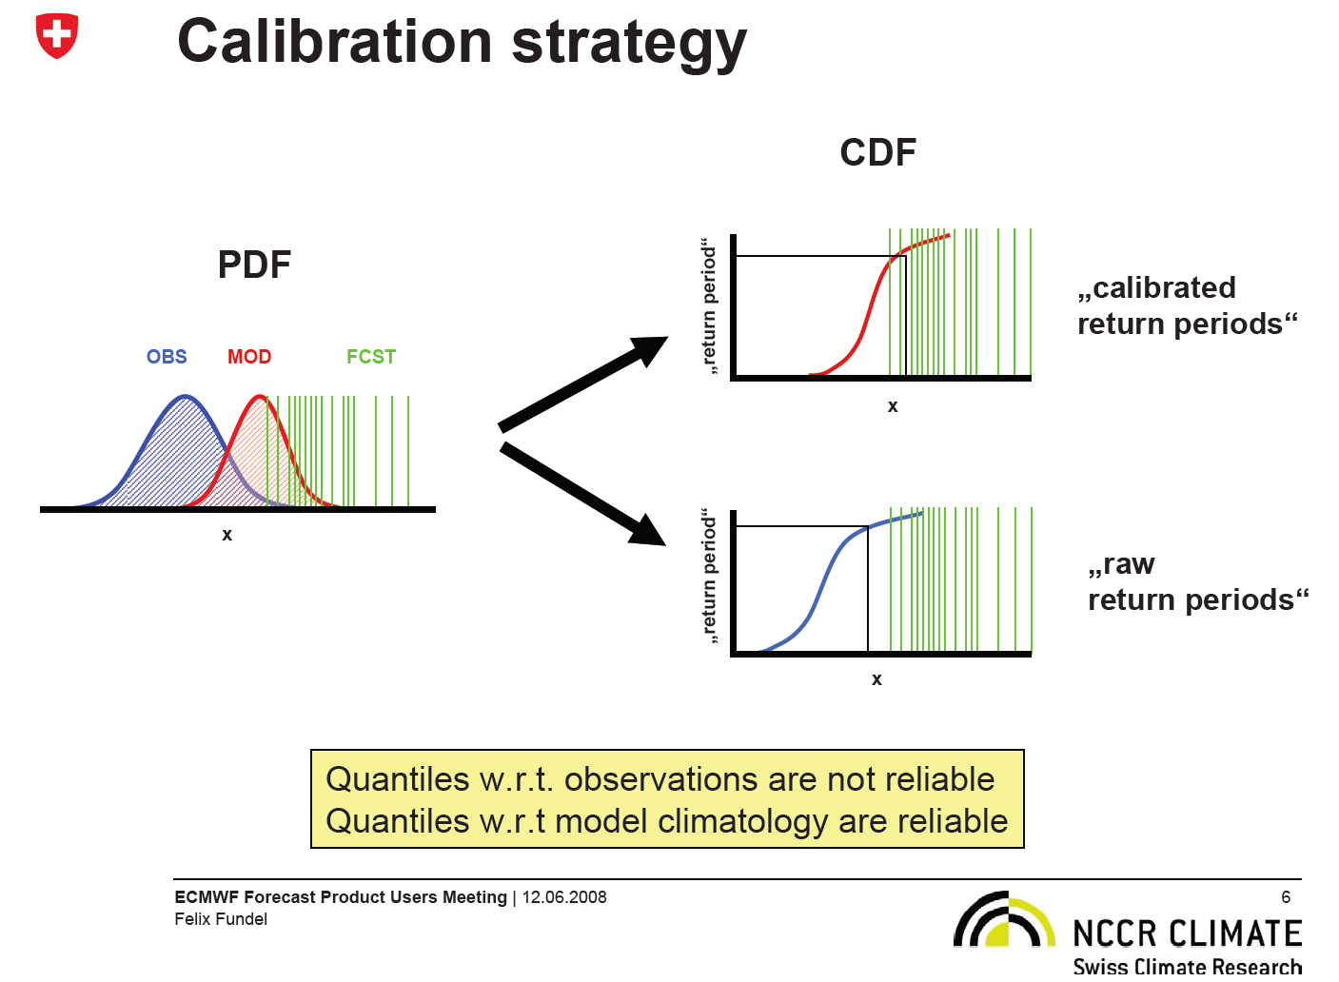

Slide 26
Extreme Forecast Index
(needs accurate forecast climatology, such as provided by reforecasts)
p is the percentile of the cumulative distribution estimated from the ensemble; F_{f} (p) is how the p-percentile of the climate record ranks in the EPS (0 the minimum, 1 the maximum). This “Anderson-Darling” version introduces a weighted statistic that
gives more power in the tails of the distribution. 2/π is normalization factor to keep -1 ≤ EFI ≤ 1.
From: LaLaurette, QJRMS, 2003, and http://www.ecmwf.int/products/forecasts/efi_guide.pdf

Slide 27
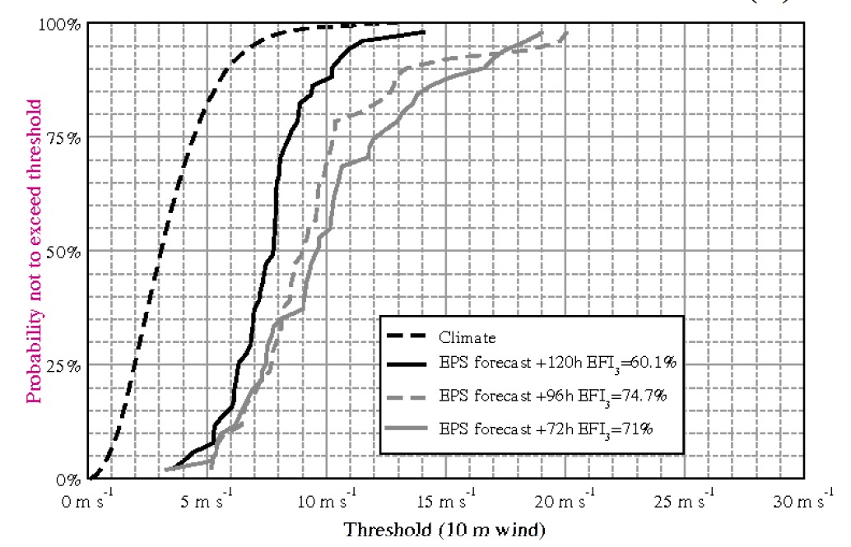
EFI
Ref: ibid

Slide 28
Reforecast / calibration disadvantages

Slide 29
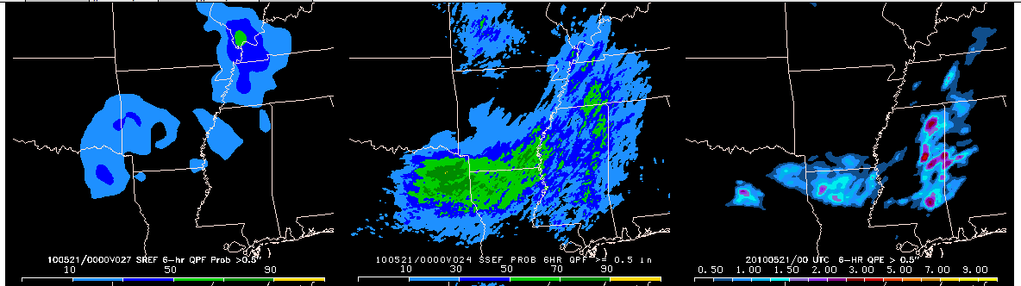
Advantage of dynamical downscaling: forecasts of some processes very bad without high resolution, explicit convection
An example from NSSL-SPC Hazardous Weather Test Bed, forecast initialized 20 May 2010
http://tinyurl.com/2ftbvgs
30-km SREF P > 0.5”
4-km SSEF P > 0.5 “
Verification
With warm-season QPF, the comparatively coarse resolution and parameterized convection
in operational 30-km ensemble system produces a forecast that is clearly inferior to the 4-km,
resolved convection ensemble. Statistical downscaling will only work if the model generally
has some predictable signal at the larger scales.

Slide 30
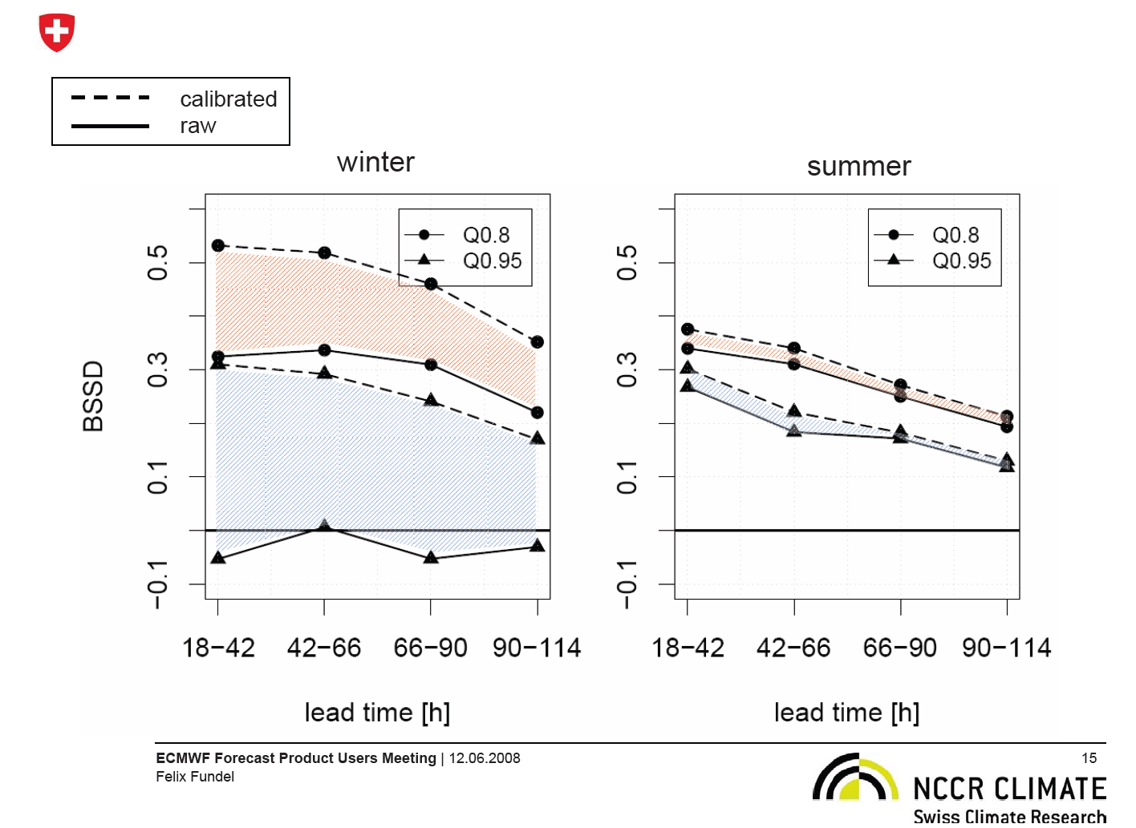

Slide 31
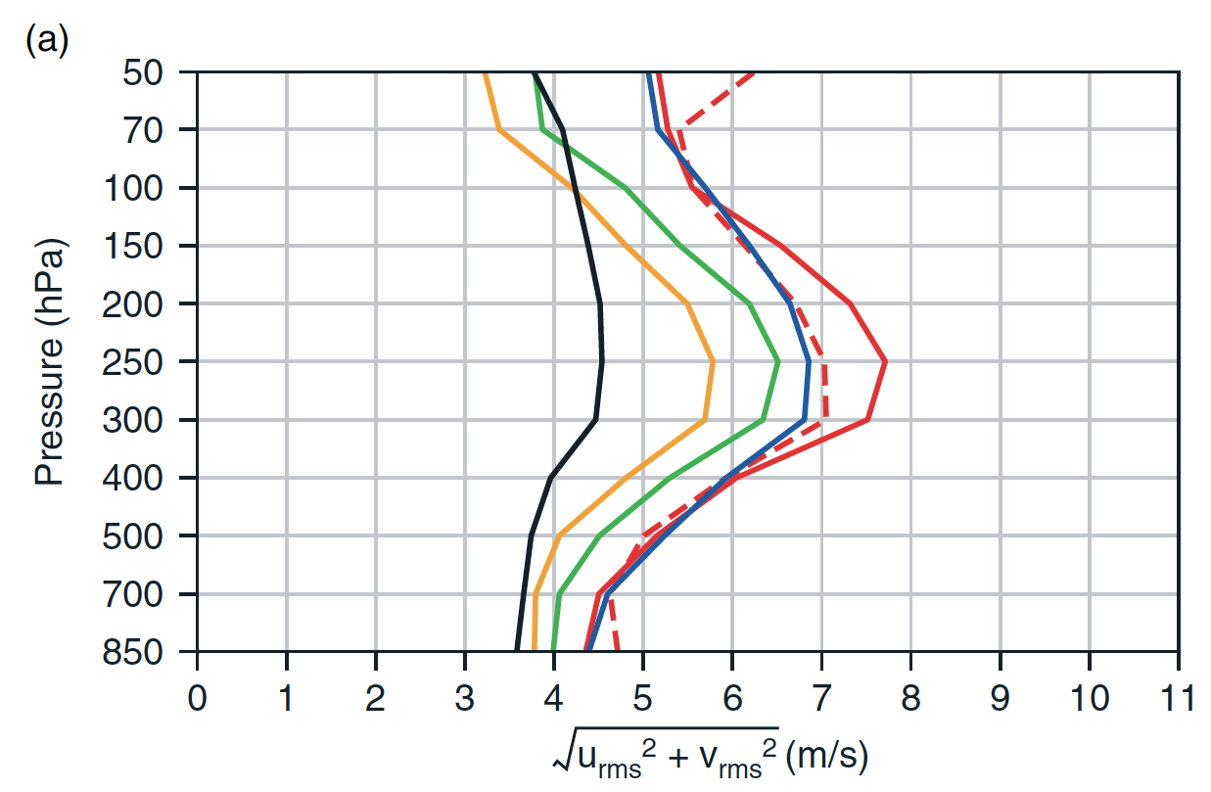
Disadvantage: non-stationary forecast errors in reforecasts?
If real climate or model-error statistics change significantly during reforecast period, decreased accuracy of post-processed estimates.
Short-term forecast fit to radiosondes
From Dee et al., QJRMS, 2011 article on ERA-Interim

Slide 32
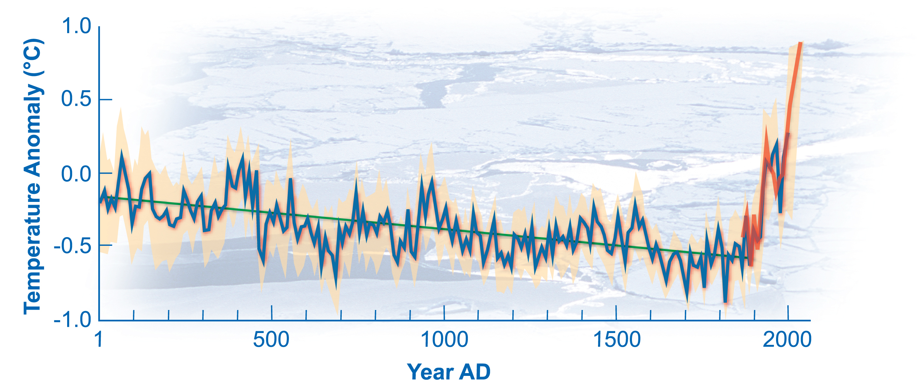
Changing climate: today’s forecasts warmer than those in training data set?
If forecast today is warmer than any in the reforecast training data set, we’ll be
“extrapolating the regression” when we apply statistical corrections.

Slide 33
Computational burden of reforecasting
Real-time ensemble: assume 50 members, 2x daily = 100/day = 700/week
Minimal reforecast: 5 members, 20 years, 1x weekly = 100/week : 1/7 extra
Moderate reforecast: 10 members, 30 years, 1x daily = 2100/week : 3x extra.
Full reforecast: 50 members, 30 years, 2x daily = 21000/week : 30x extra!

Slide 34
Two general approaches to generating a reforecast data set
Compute once, freeze the model (our approach). Repeat only once every couple years.
  Offline calculation of reforecasts, we can afford to generate a larger number of them.
Real-time computation. For whatever model version you’re running, make sure you have reforecasts to calibrate (ECMWF approach).

Slide 35
What reforecast data sets are or will be available for NWP?

Slide 36
Available weather reforecast data sets
Producer | # years | # members | frequency | real-time or offline? | resolution | forecast duration
ECMWF EPS | 18 | 5 | weekly | real-time | T639 then T319 after 10 days | 30 days
NCEP GEFS(1998 version) | 32 | 15 | daily | offline | T62 | 15 days
NCEP GEFS (late 2011 version) | 30+ | 11 | daily | offline | T254 then T190 after 8 days | 16 days
COSMO-LEPS | 30 (1971- 2000) | 1 | daily | offline | ~10 km | 90 h

Slide 37
2011 GEFS reforecast: design principles
Reforecasts will be computed with a (smaller-ensemble) version of the GEFS that will be operational in 2011.
We hope that GEFS will remain in this configuration, or will be changed only slightly, for several years thereafter.
Once GEFS changes, either NCEP/EMC or ESRL will continue to run the reforecast version until a next-generation reforecast is in place.

Slide 38
Anticipated configuration
Every 00Z, every day, 1980-current
11-member forecast (control + 10 perturbed)
Lead time to 16 days.
  T254L42 to day 8
  T190L42 from days 7.5 to day 16.
“CFSR” reanalysis initial conditions (GSI, 3D-Var).
Mimics the expected operational configuration in late 2011.
Data saved 3-hourly, to 3-day lead, thereafter every 6 hours.

Slide 39
Storage of reforecast data set
Storing of “important” agreed-upon subset of data ~= 170 TB. Which fields described in a subsequent slide.
  ESRL / PSD has purchasing ~ 170 TB of storage and server capability for this data set. Cost ~ $200K for hardware.
  Will design software to serve this out to you in several manners (http, ftp, OPeNDAP, etc.).
  Back this up to tape.
Storing full 00Z reforecasts and initial conditions ~= 800 TB.
  Useful for LBC’s to run regional reforecasts, or if more fields added to “important” subset.
  US Department of Energy will archive this for us.

Slide 40
Proposed fields for “fast” archive
Mean and every member
“Fast” archive will be on disk, readily accessible
Mandatory level data:
  Geopotential height, temperature, u, v, at 1000, 925, 850, 700, 500, 300, 250, 200, 100, 50, and 10 hPa.
  Specific humidity at 1000, 925, 850, 700, 500, 300, 250, 200
PV (K m² kg⁻¹ s⁻¹ ) on θ = 320K surface.
Wind components, potential temperature on 2 PVU surface.

Slide 41
Fixed fields to save once
  field capacity
  wilting point
  land-sea mask
  terrain height

Slide 42
Expected single-level fields for “fast” archive
Surface pressure (Pa)
Sea-level pressure (Pa)
Surface (2-m) temperature (K)
Skin temperature (K)
Maximum temperature since last storage time (K)
Minimum temperature since last storage time (K)
Soil temperature (0-10 cm; K)
Volumetric soil moisture content (proportion, 0-10 cm) –
Total accumulated precipitation since beginning of integration (kg/m²)
Precipitable water (kg/m², vapor only, no condensate)
Specific humidity at 2-m AGL (kg/kg; instantaneous) –
Water equivalent of accumulated snow depth (kg/m²) –
CAPE (J/kg)
CIN (J/kg)
Total cloud cover (%)
10-m u- and v-wind component (m/s)
80-m u- and v-wind component (m/s)
Sunshine duration (min)
Snow depth water equivalent (kg/m²)
Runoff
Solid precipitation
Liquid precipitation
Vertical velocity (850 hPa)
Geopotential height of surface
Wind power (=windspeed³ at 80 m*density)

Slide 43
Proposed fields for “fast” archive
Fluxes (W/m² ; average since last archive time)
  sensible heat net flux at surface
  latent heat net flux at surface
  downward long-wave radiation flux at surface
  upward long-wave radiation flux at surface
  upward short-wave radiation at surface
  downward short-wave radiation flux at surface
  upward long-wave radiation at nominal top
  ground heat flux.

Slide 44
Where we are now
170 TB storage in place.
Control run done.
Perturbed initial conditions done.
Are just beginning to compute the perturbed member reforecasts.

Slide 45
Issues in reforecasting
Relative benefits of statistical vs. dynamical downscaling for particular phenomena.
What is the appropriate compromise (large reforecast, large computational burden) vs. (small reforecast, small computational burden).
What are the best statistical post-processing techniques for a particular phenomenon
  may differ for T_{sfc}, precipitation, hurricane track, severe weather likelihood, etc.
Examining errors in low-frequency processes in the model (MJO, NAO, etc.).
Relative benefits of multi-model vs. single-model + reforecast.

Slide 46
Reforecast vs. multi-model, T_{sfc}
courtesy of Renate Hagedorn, ECMWF & DWD

Slide 47

Reforecast vs. multi-model precipitation over US, Jul-Oct 2010
Now, the following forecasts are plotted:
20-member ECMWF forecasts (black);
ECMWF, calibrated via logistic regression
using 9 years of ECMWF 4-member
weekly reforecasts (green); multi-model
(blue) and multi-model, calibrated using
the last 30 days of forecasts/analyses.
Reforecasts appear to provide most
improvement at heavy precipitation
thresholds.

Slide 48

Sample reliability diagrams
ECMWF, reforecast-calibrated, multi-model
(more reliable) (sharper)

Slide 49
Conclusions
We believe reforecast data sets can be used to improve forecast guidance for a wide range of phenomena.
There are still many issues where your research can help us understand the role of reforecasting in the larger weather prediction effort.
We look forward to further discussions and possible collaborations.

Slide 50
Statistical post-processing, holistic view
Would like probability distribution ϕ of true state T (or samples thereof) given all available information, including today’s ensemble forecast
z might be past observations and/or forecasts, output from other modeling systems, your intuition, etc.
ϕ might be a field rather than a scalar

Slide 51
A quick survey of common post-processing techniques
Simpler methods
  Gross bias correction
  Kalman-inspired filters
  CDF-based bias corrections
  Linear regression
Some more complex methods
  Logistic regression
  Analog approach
  Bayesian model averaging (MDL’s EKDMOS very similar)
  Bayesian processor of forecasts
  Non-homogeneous Gaussian regression
  Rank histogram-based calibration

Slide 52

Gross bias correction
Given sample of past forecasts x₁, … , x_{n} and observations y₁, … , y_{n} , gross bias correction is simply
In surface-temperature calibration experiments with NCEP’s GFS and ECMWF,
simple gross bias correction achieved a large percentage of the improvement
that was achieved through more sophisticated, bias+spread correction.
Ref: Hagedorn et al., MWR, 2008, in press.

Slide 53
Gross bias correction
Effectively, the implied statistical model is the following:
  assumes normality of errors; uncorrelated errors, error not state dependent (next slide).

Slide 54

State-dependent errors
For this 10-m wind,
the bias is conditional,
depends on the forecast
amount. Linear regression
(discussed later) a
much better choice.

Slide 55
“Kalman-inspired” filter
Today’s
forecast bias
estimate
Yesterday’s
bias estimate
Yesterday’s
observed bias
Kalman gain: weighting applied
to residual. Larger K_{t}, more weight
to recent data, and vice versa.
Pro:
memory in system, amount tunable through K_{t}
adaptive
Con:
assuming there is state-dependent bias, takes time to adapt
after regime change and change of state.
Ref: Cheng and Steenburg, conferences.dri.edu/WxPrediction/Weather12/Cheng_Steenburgh.ppt

Slide 56
An alternative “analog” formulation
PRED
Standard Kalman-type filter
OBS
day₋₇
day₋₆
day₋₅
day₋₄
day₋₃
day₋₂
day₋₁
t = 0
PRED
Analog
Kalman-type filter
OBS
day₋₆
day₋₅
day₋₃
day₋₂
day₋₁
day₋₇
day₋₄
farthest analog
closest analog
c/o Luca delle Monache, NCAR/RAL, MWR, submitted.

Slide 57

CDF-based bias corrections
Use difference
in CDFs to correct
each ensemble
member’s forecast.
In example shown,
raw 7-mm forecast
corrected to ~5.6 mm
forecast.
NOTE: bias only, not
spread correction or
downscaling.
Ref: Zhu and Toth, 2005 AMS Annual Conf., and many others

Slide 58



CDF corrections: example of problem
1-day forecasts in Northern Mississippi (US), mid-August.
Consider a forecast precipitation of 25 mm.
Raw
CDF bias
corrected
O | F
CDF-based corrections at high amounts suggest further increasing precipitation amount forecast. O|F indicates
decrease.
At root of problem is assumption that Corr (F,O) ≅ 1.0

Slide 59

Linear regression
Corrects for state-dependent
bias; when no predictive
skill of forecast, regresses
to observed sample climatology.
Diagnostics include statistics
on error, so can infer (largely
non-state dependent) pdf.
Ref: any applied statistics textbook

Slide 60
When is linear regression approach useful?
Some assumptions:
  Normality of errors.
  Linear relation between predictors and predictand.
  Homoscedasticity, error variance doesn’t depend on state x.
  Errors are uncorrelated between samples.
Ref: any applied stats text, e.g., Neter, Wasserman, and Kutner, Applied Linear Statistical Models.

Slide 61
When is linear regression approach useful?
Some assumptions:
  Normality of errors.
  Linear relation between predictors and predictand.
  Homoscedasticity, error variance doesn’t depend on state x.
  Errors are uncorrelated between samples.
Well, there goes using
this for precipitation!
Ref: any applied stats text, e.g., Neter, Wasserman, and Kutner, Applied Linear Statistical Models.

Slide 62
When is linear regression approach useful?
Some assumptions:
  Normality of errors.
  Linear relation between predictors and predictand.
  Homoscedasticity, error variance doesn’t depend on state x.
  Errors are uncorrelated between samples.
Problematic for weather, if samples every day.
“Serial correlation,” smaller “effective sample size.”
But can deal with this problem.
Ref: any applied stats text, e.g., Neter, Wasserman, and Kutner, Applied Linear Statistical Models.

Slide 63
Linear regression – big assumption!
unknown,
with error
known, assumed no error
In our practice, the Y’s typically have some small error (obs)
and the X’s have larger error (forecast model state).
Practically, the method works well enough to gloss over what
error ε_{i} represents, but there is a whole branch of statistics
(regression with “errors in variables”) that deals with this more
formally. This incorrect assumption applies to most of the rest
of the methods discussed, too.
Ref: Casella and Berger, Statistical Inference, 1990. Also Vannitsem & Nicolis, Feb 2008 MWR (though I
think their analysis is unfairly critical of MOS)

Slide 64
Model Output Statistics (“MOS”) most elements based on multiple linear regression
KBID GFS MOS GUIDANCE 2/16/2005 1800 UTC
DT /FEB 17 /FEB 18 /FEB 19
HR 00 03 06 09 12 15 18 21 00 03 06 09 12 15 18 21 00 03 06 12 18
N/X 32 40 25 35 19
TMP 42 39 36 33 32 36 38 37 35 33 30 28 27 30 32 31 28 25 23 19 27
DPT 34 29 26 22 19 18 17 17 17 17 17 15 14 13 11 8 7 6 5 2 4
CLD OV FW CL CL SC BK BK BK BK BK BK BK SC BK BK BK BK FW CL CL CL
WDR 26 30 32 32 32 31 29 28 30 32 31 31 31 31 30 29 31 32 33 33 27
WSP 12 12 12 11 08 08 09 08 09 09 10 10 10 12 13 13 15 16 15 09 08
P06 17 0 0 0 4 0 10 6 8 0 0
P12 17 0 10 17 8
Q06 0 0 0 0 0 0 0 0 0 0 0
Q12 0 0 0 0 0
T06 0/ 2 0/ 0 1/ 0 1/ 2 0/ 1 0/ 1 1/ 0 0/ 1 0/ 0 0/ 0
T12 1/ 0 1/ 2 1/ 1 0/ 1 0/ 0
POZ 0 0 0 0 0 0 0 0 0 0 0 0 0 0 0 0 0 0 0 0 0
POS 13 47 70 84 91100 96100100100100 92100 98100100100 94 92100100
TYP R S S S S S S S S S S S S S S S S S S S S
SNW 0 0
CIG 7 8 8 8 8 8 8 8 8 7 7 7 8 7 7 7 8 8 8 8 8
VIS 7 7 7 7 7 7 7 7 7 7 7 7 7 7 7 7 7 7 7 7 7
OBV N N N N N N N N N N N N N N N N N N N N N
US: Statistical corrections to operational US NWS models, some fixed (NGM),
some not (Eta, GFS). Refs: http://www.nws.noaa.gov/mdl/synop/index.htm,
Carter et al., WAF, 4, p 401, Glahn and Lowry, JAM, 11, p 1580. Canadian models discussed in Wilson and Vallee, WAF, 17, p. 206, and WAF, 18, p 288. Britain: Met Office uses “updateable MOS” much like perfect prog.

Slide 65

Logistic regression
Useful for making probabilistic forecasts for some binary event, e.g, precip above threshold.
For each grid point (or station) let x = continuous predictor data (ens. mean forecast value), y = binary predictand data (1.0 if predicted event happened, 0.0 if not).
Problem: Compute P( y =1.0 | x ) as a continuous function of x.
Logistic Regression:
Ref: any applied statistics text.
Notes:
We tried various methods for statistically correcting the model output, Tom suggested Logistic regression - turned out to be the best as well as the simplest.
This is how it works --
• given x and y the problem is to determine P(y=1 | x).
• many people use ordinary linear regression (NGM MOS) - but it really isn’t well suited to this problem.
• Logistic regression was designed specifically for this problem - P is modelled as ??
(don’t ask me where this equation comes from - it’s a long and irrelevant story).

Slide 66

Logistic regression using a long data set of observed and forecast anomalies
Seeking to predict probability of warmer than normal conditions (upper tercile of observed). Using reforecasts
(a later talk), we have 23 years of data. Let’s use old data in a 31-day window around the
date of interest to make statistical corrections.
Dashed lines: tercile boundaries
Red points: samples above upper tercile
Blue points: samples below upper tercile
Solid bars: probabilities by bin count
Dotted line: logistic regression curve
Ref: Hamill et al. MWR, June 2004
Notes:
A concrete example to illustrate how we do this:
T850 for a given grid point - scatter plot of all forecasts and verifications over 23*31 cases.
If we just calculate the observed frequency for discrete bins, you get probs given by the solid horiz lines. If you use logistic regression, you get the smooth dotted curve
Note there may be problems with extrapolation - over-forecast extreme probs

Slide 67
Logistic regression drawbacks
Doesn’t generate full pdf (though see Wilks, 2009, Met Apps, p. 361).
With ensembles, what do you use as predictors? Ens. mean? Spread? Every member?
Iterative technique, can be slower.
Better have training set with distribution of 1’s and 0’s, otherwise software will croak.

Slide 68

Analog technique using reforecasts
On the left are old forecasts
similar to today’s ensemble-
mean forecast. The data on
the right, the analyzed
precipitation conditional upon
the forecast, can be used to
statistically adjust and
downscale the forecast.
Analog approaches like this
may be particularly useful for
hydrologic ensemble applications, where an ensemble of realizations is needed.

Slide 69


Rank histogram technique for ensemble calibration
NCEP MRF precipitation forecasts,
from Eckel and Walters, 1998
-4 -2 0 2 4 6 8
P(T < -4)
= 0.30
P(3 ≤ T < 5)
= 0.19
P(-4 ≤ T < -1)
= 0.15
P(-1 ≤ T < 3)
= 0.07
P(5 ≤ T)
= 0.29
Advantages: Demonstrated skill gain
Disadvantages:
Odd pdfs, especially when two ensemble members close in value.
Sensitive to shape of rank histogram, and shape of histogram may vary with aspects like precip amount --> sample size issues.
Fitted parametric distributions as skillful
References: Hamill and Colucci (MWR, 1997, 1998; Eckel and Walters, WAF, 1998; used at Met Office)

Slide 70


Bayesian model averaging (BMA)
Weighted sum of kernels
centered around individual,
bias-corrected forecasts.
Advantages: Theoretically
appealing. No parameterized
distribution assumed, weights
applied proportional to their
independent information
(in concept).
Disadvantages: When trained
with small sample, BMA radically
de-weighted some members
due to “overfitting” See Hamill,
MWR, Dec. 2007.
MM5/GFS
MM5/Eta
MM5/Canada
MM5/Navy
MM5/NGM
Ref: Raftery et al.,
MWR, 2005. Wilson
et al., MWR, 2007

Slide 71
Why BMA’s unequal weights?
(1) regression correction accentuates error correlations.
Ref: Hamill,
MWR, Dec. 2007

Slide 72
Why BMA’s unequal weights?
(2) E-M overfits with little training data
An “estimation-minimization” (E-M) algorithm is used to determine the weights applied to ensemble members. If two forecasts have highly co-linear errors, E-M will weight one very highly, the other very little.
E-M is an iterative technique, and we can measure
the accuracy of the fit to the data through the
log-likelihood. Something odd happens here; as
the E-M convergence criteria is tightened, the fit
of the algorithm to independent data gets worse.
This plots the ratio of the weights of the highest-weighted member to the lowest-weighted member. As the convergence criterion is tightened, the method increasingly weights a few select members and de-weights others.

Slide 73
(BMA overfitting not a problem with 2+ decades training data)
With reforecast data set, we can train with a very large amount of data. When we do so, the weights applied to individual members are much more equal. This indicates that the unequal weighting previously is incorrect.

Slide 74
BMA’s problem: an example
BMA
pdf
Climo
pdf
Bias-corrected
members
Here’s a test of BMA in the winter season for a grid point
near Montreal. BMA ends up highly weighting the warmest
members (inappropriately so), thus producing a very high
probability of a warm forecast.
Ref: Laurie Wilson, Met Service Canada, personal correspondence. See also upcoming Bishop et al. MWR manuscript.

Slide 75
“Bayesian Processor of Forecasts”
Two key ideas:
  (1) Bayes’ Rule: leverage prior non-NWP information, whether from climatology, persistence, whatever. Update with NWP information
  (2) If data non-normally distributed, transform data to space where normally distributed before performing regression analysis.
Ref: Krzysztofowicz and Evans, WAF, April 2008

Slide 76
Non-homogeneous
Gaussian regression
Reference: Gneiting et al., MWR, 133, p. 1098
Predictors: ensemble mean and ensemble spread
Output: mean, spread of calibrated Gaussian distribution
Advantage: leverages possible spread/skill relationship appropriately. Large spread/skill relationship, c ≈ 0.0, d ≈1.0. Small, d ≈ 0.0
Disadvantage: iterative method, slow…no reason to bother (relative to using simple linear regression) if there’s little or no spread/skill relationship.

Slide 77

Is there a “best” calibration technique?
Using Lorenz ‘96 toy model, direct model output (DMO), rank histogram technique, MOS applied to each member, dressing, logistic regression, non-homogeneous Gaussian regression (NGR), “forecast assimilation”, and Bayesian model averaging (with perturbed members assigned equal weights) were compared. Comparisons generally favored logistic regression and NGR, though differences were not dramatic, and results may not generalize to other forecast problems such as ones with non-Gaussian errors.
Ref: Wilks, Met. Apps, 2006, 13, p. 243

