Slide 1

Statistical post-processing and downscaling of precipitation forecasts
Tom Hamill
(and Michael Scheuerer)
NOAA Earth System Research Lab
Physical Sciences Division
tom.hamill@noaa.gov
(303) 497-3060
a seminar to Cornell’s Earth and Atmospheric Sciences department, 15 Oct 2014

Slide 2
Outline
The backbone of probabilistic precipitation forecasts – “ensemble prediction” overview.
Statistical post-processing of precipitation to correct for ensemble system deficiencies
  Our supporting “reforecast” data set
  A non-parametric analog method using reforecasts.
  Parametric methods using reforecasts.
  A comparative test of Cornell’s Eureqa using symbolic regression (“genetic programming”) vs. parametric methods.
  Time permitting, a simpler method using multi-model ensembles and short training data sets.

Slide 3
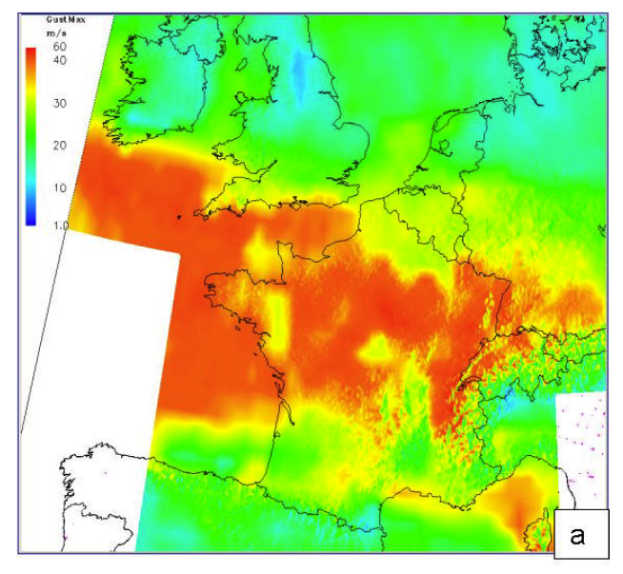
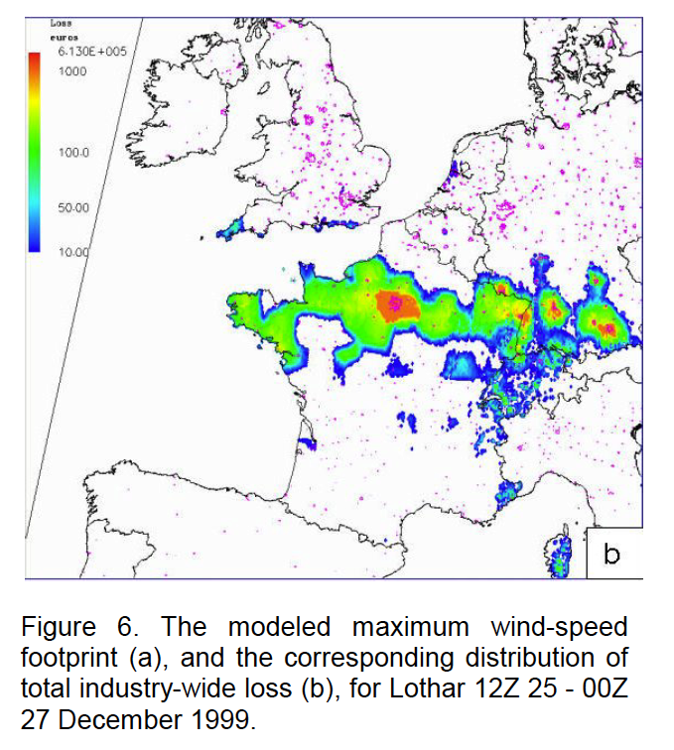
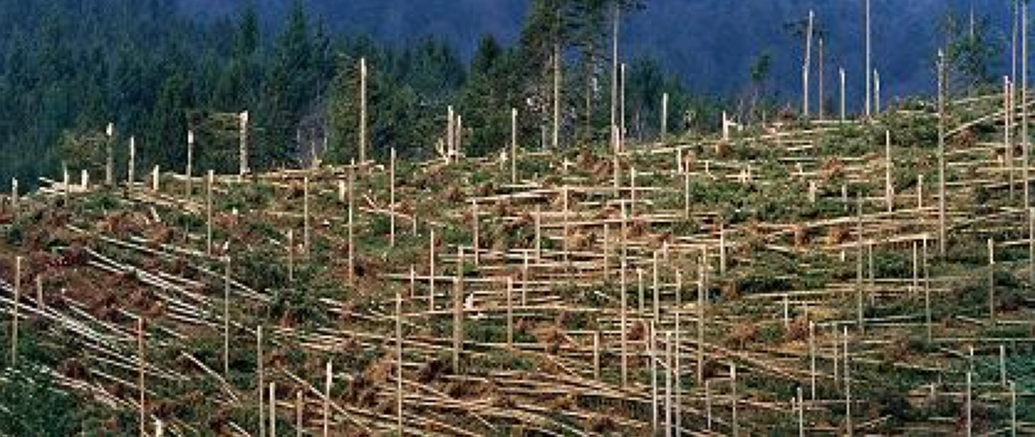
1999 storm “Lothar”
Black Forest damage
from Neil Stringfellow (ETH) presentation
from Keller et al. AMS Conf. preprint

Slide 4
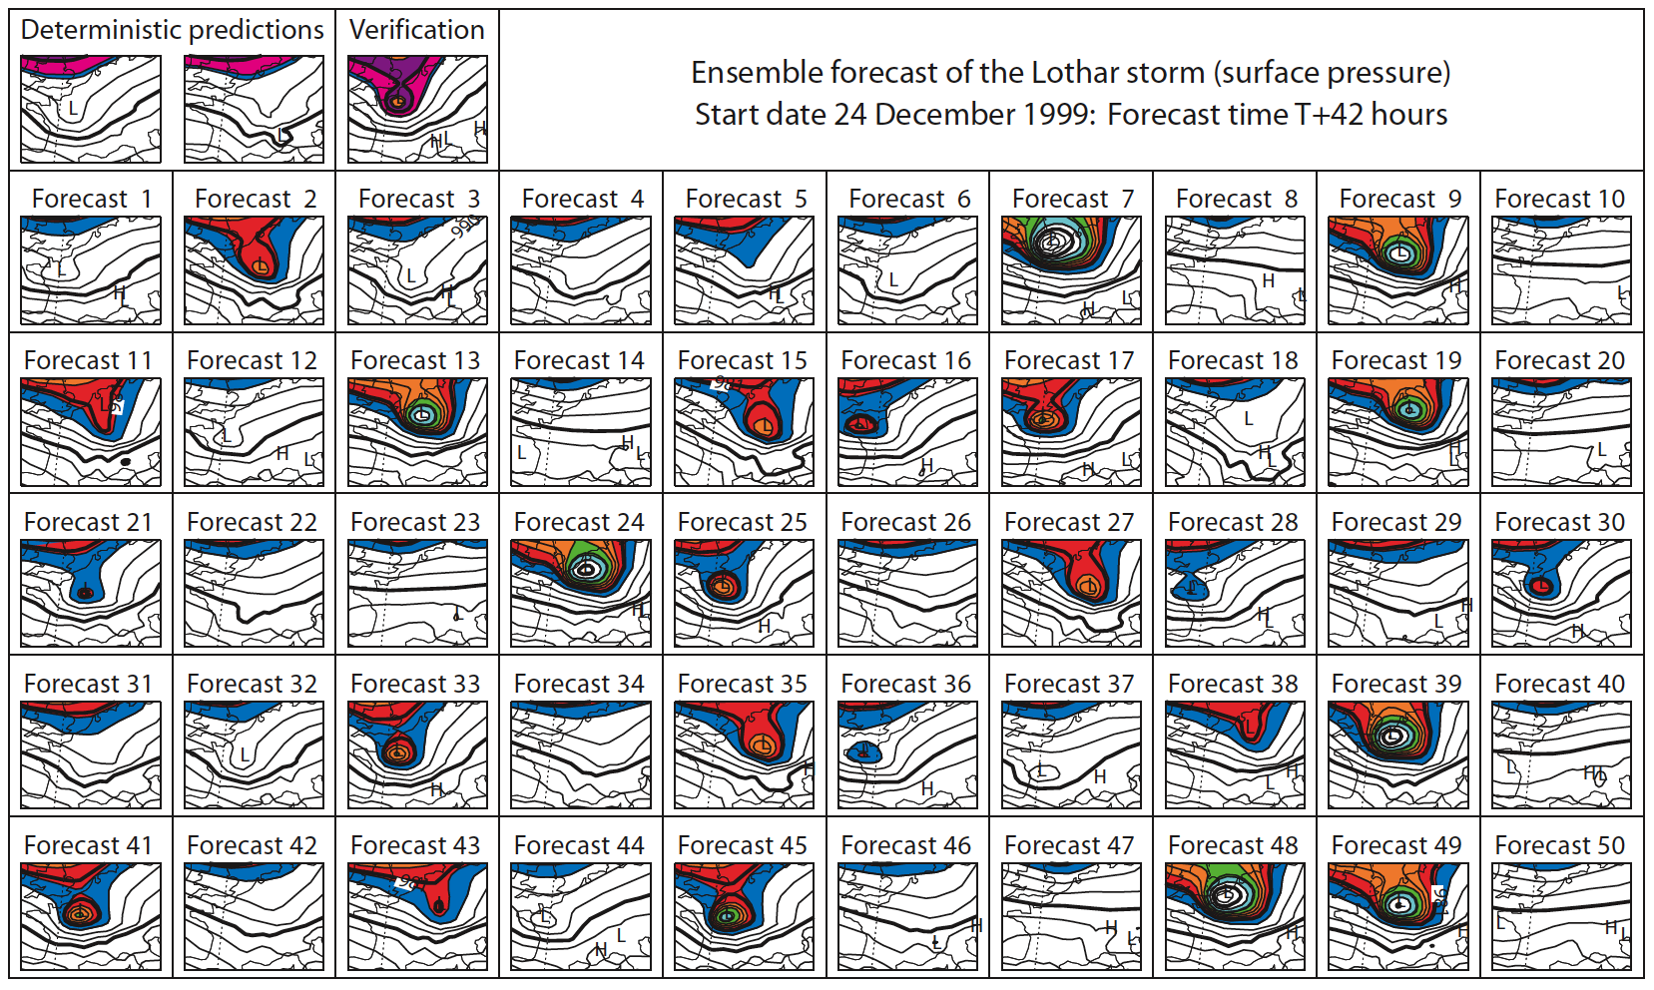
“Ensemble prediction” or “ensemble forecasting”
Multiple simulations of the weather from slightly different initial conditions, perhaps different forecast models
deterministic
forecast
totally misses
damaging
storm over
France.
from Tim Palmer’s
book chapter, 2006.

Slide 5
“Ensemble prediction” or “ensemble forecasting”
Multiple simulations of the weather from slightly different initial conditions, perhaps different forecast models
many
ensemble
members
forecast it
well.
Probabilities commonly estimated from frequency of event in the ensemble.
from Tim Palmer’s
book chapter, 2006.

Slide 6
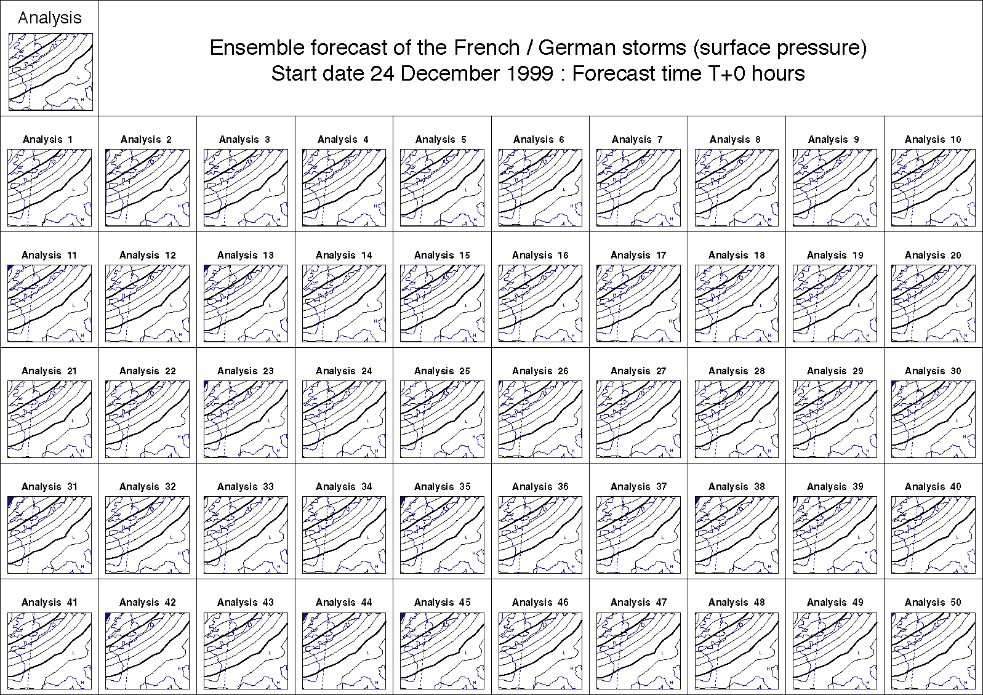
Initial conditions for Lothar ensemble forecasts

Slide 7
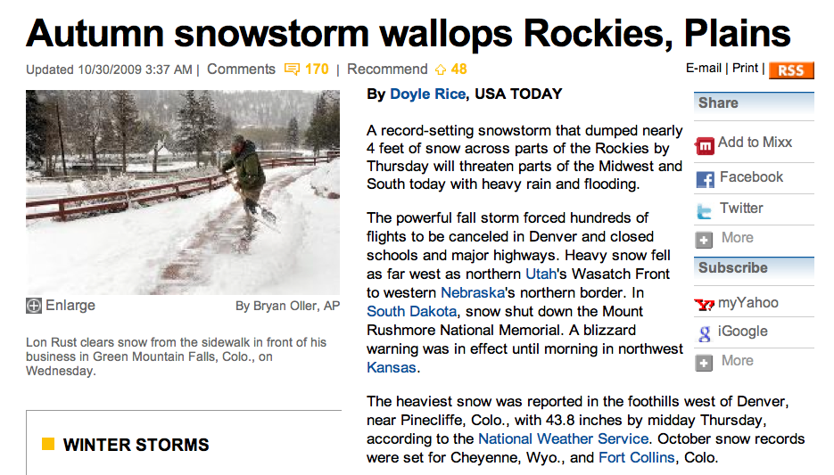
The difference between a lower- and a
higher-quality ensemble prediction can matter.
USA Today, 30 Oct 2009
Here’s the sort of high-impact event it would be extremely useful to
be able to have advanced warning of with several days lead time.

Slide 8
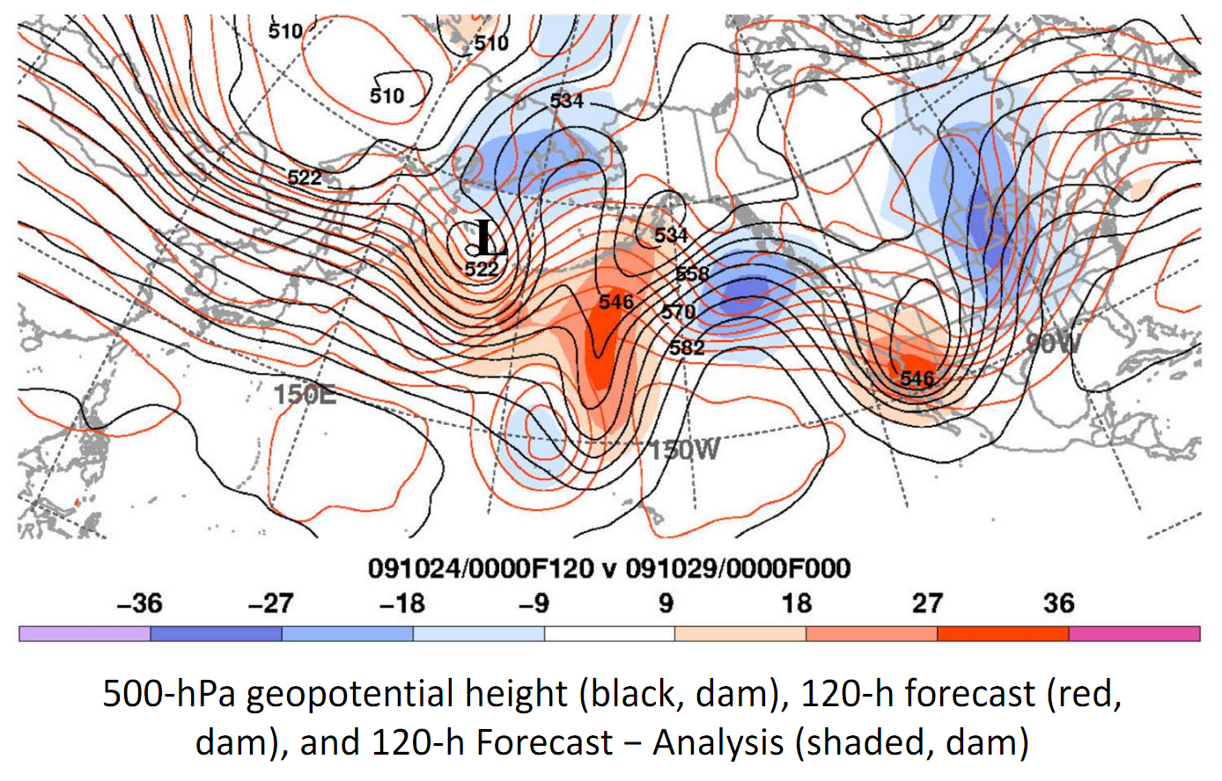
Massive bust of day +5 NWS global deterministic; totally misses jet stream pattern
Perhaps small initial condition errors led to the bust?
What about ensemble systems?
c/o Heather Archambault, SUNY/Albany and NRL/Monterey

Slide 9
“Spaghetti plots”, NWS ensemble
(546 dam contour, + 5 day forecast)
__ day +0 __day +1 __day +3 __ day +5
NWS NCEP “GEFS” ensemble has only a hint in a few members
of a major system affecting the southwest US.

Slide 10
“Spaghetti plots”, ECMWF ensemble
(546 dam contour + 5 day forecast)
__ day +0 __day +1 __day +3 __ day +5
European system much better at predicting event in central Rockies. Lessons:
(1) Probabilistic, not deterministic forecasts, are definitely needed.
(2) A high-quality ensemble prediction system is a necessity for weather-climate prediction.

Slide 11
Reliability and skill of global ensembles
Probability forecasts
(here, probability of
nonzero precipitation)
are somewhat
unreliable from all
current global
ensemble forecast
systems.
(Verified against
1/8-degree CCPA
precipitation analysis
over contiguous US)
ECMWF
(Europe)
US NWS
CMC
(Canada)
UK Met Office

Slide 12
Scientifically, what must be done to produce high-quality ensembles?
ensemble
members’
trajectories
t=t+Δt
t=0
reality
If this situation happens more than infrequently,
we need to improve our ensemble prediction system.

Slide 13
Scientifically, what must be done to produce high-quality ensembles?
ensemble
members’
trajectories
t=t+Δt
Problem 1: Specifying
the initial conditions
t=0
Theory tells us we want to
sample the ensemble from
the distribution of plausible
analysis states. How do we
do that? How big should
the differences be? What
structure should they have?
reality
[more]

Slide 14
Scientifically, what must be done to produce high-quality ensembles?
ensemble
members’
trajectories
t=t+Δt
t=0
Problem 2: Estimating
uncertainty caused by
imperfect model
reality
[more]

Slide 15
Ways to estimate model uncertainty
Multiple forecast models used amongst members – “multi-model ensemble”
Multiple “physical parameterizations” (e.g., of the effects that sub-gridscale thunderstorms have on the resolved scale) within a model).
Stochastic physics – build random processes right into the physical equations and parameterizations of the forecast model.
(we’re working on this)

Slide 16
Statistical post-processing and downscaling (of precipitation)
(another way to improve probabilistic forecasts while you wait for ensemble prediction systems to be improved)

Slide 17
Statistical post-processing in its simplest form
Observed
(y)
Forecast (x)

Slide 18
Statistical post-processing in its simplest form
Observed
(y)
y = b₀ + b₁ x
Forecast (x)

Slide 19
A few challenges with precipitation post-processing
Precipitation data is not normally distributed
Data is bounded by zero on the left
Ensemble “spread” (standard deviation about mean) is not
  independent of mean…
… and especially challenging is

Slide 20
Statistical post-processing for rare events is challenging without a large training sample
Say you want to statistically post-process your model precipitation forecast to improve it.
Heavy precipitation events like the one today are the ones you care about the most. How
do you calibrate today’s forecast given past short sample of forecasts and observations?

Slide 21
Reforecasts (hindcasts)
Numerical simulations of the past weather (or climate) using the same forecast model and assimilation system that (ideally) is used operationally.
  Common with climate, uncommon with weather models.

Slide 22
GEFS reforecast v2 details
Seeks to mimic GEFS (NCEP Global Ensemble Forecast System) operational configuration as of February 2012.
Once daily from 00 UTC initial conditions, we produce an 11-member forecast, 1 control + 10 perturbed.
These reforecasts were produced every day, for 1984120100 to current ( > 17M CPU hours, > 150 TB data stored on disk).
CFSR (NCEP’s Climate Forecast System Reanalysis) initial conditions (3D-Var) + ETR perturbations (cycled with 10 perturbed members). After ~ 22 May 2012, initial conditions from hybrid EnKF/3D-Var.
Resolution: T254L42 to day 8 (~47-km grid spacing), T190L42 (~ 70 km) from days 7.5 to day 16.
Data storage:
  Fast data archive at ESRL of 99 variables, 28 of which stored at original ~1/2-degree resolution during week 1. All stored at 1 degree. Also: mean and spread to be stored.
  Full archive at DOE/Lawrence Berkeley Lab, where data set was created under DOE grant.

Slide 23
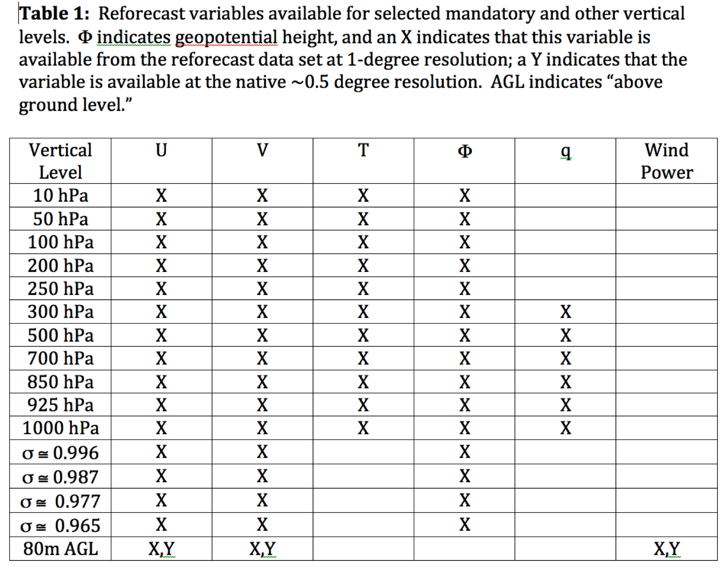
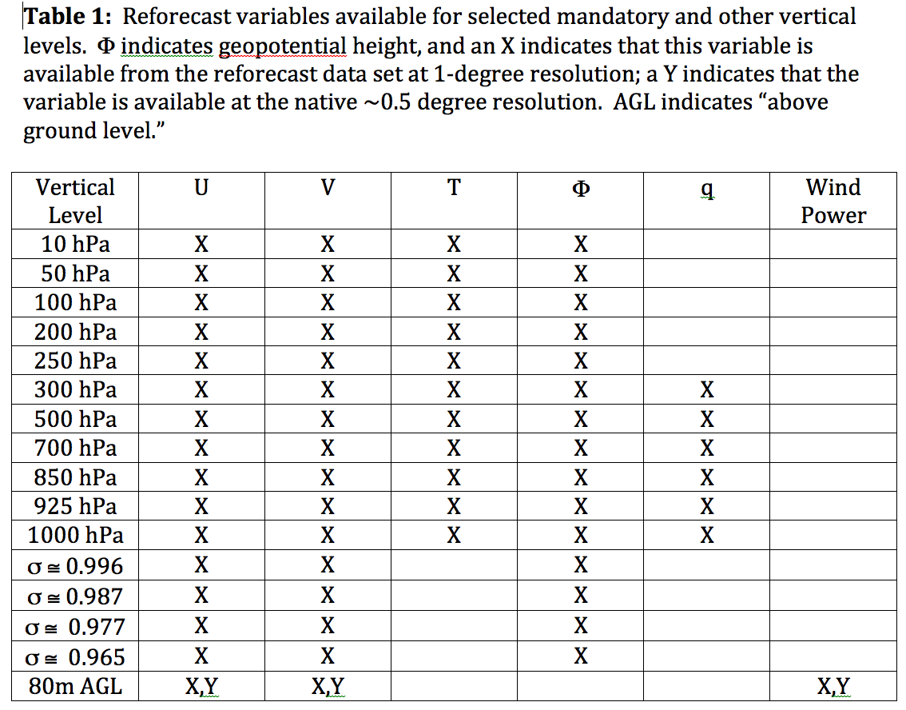
Data that is readily available from ESRL
Also: hurricane track files

Slide 24
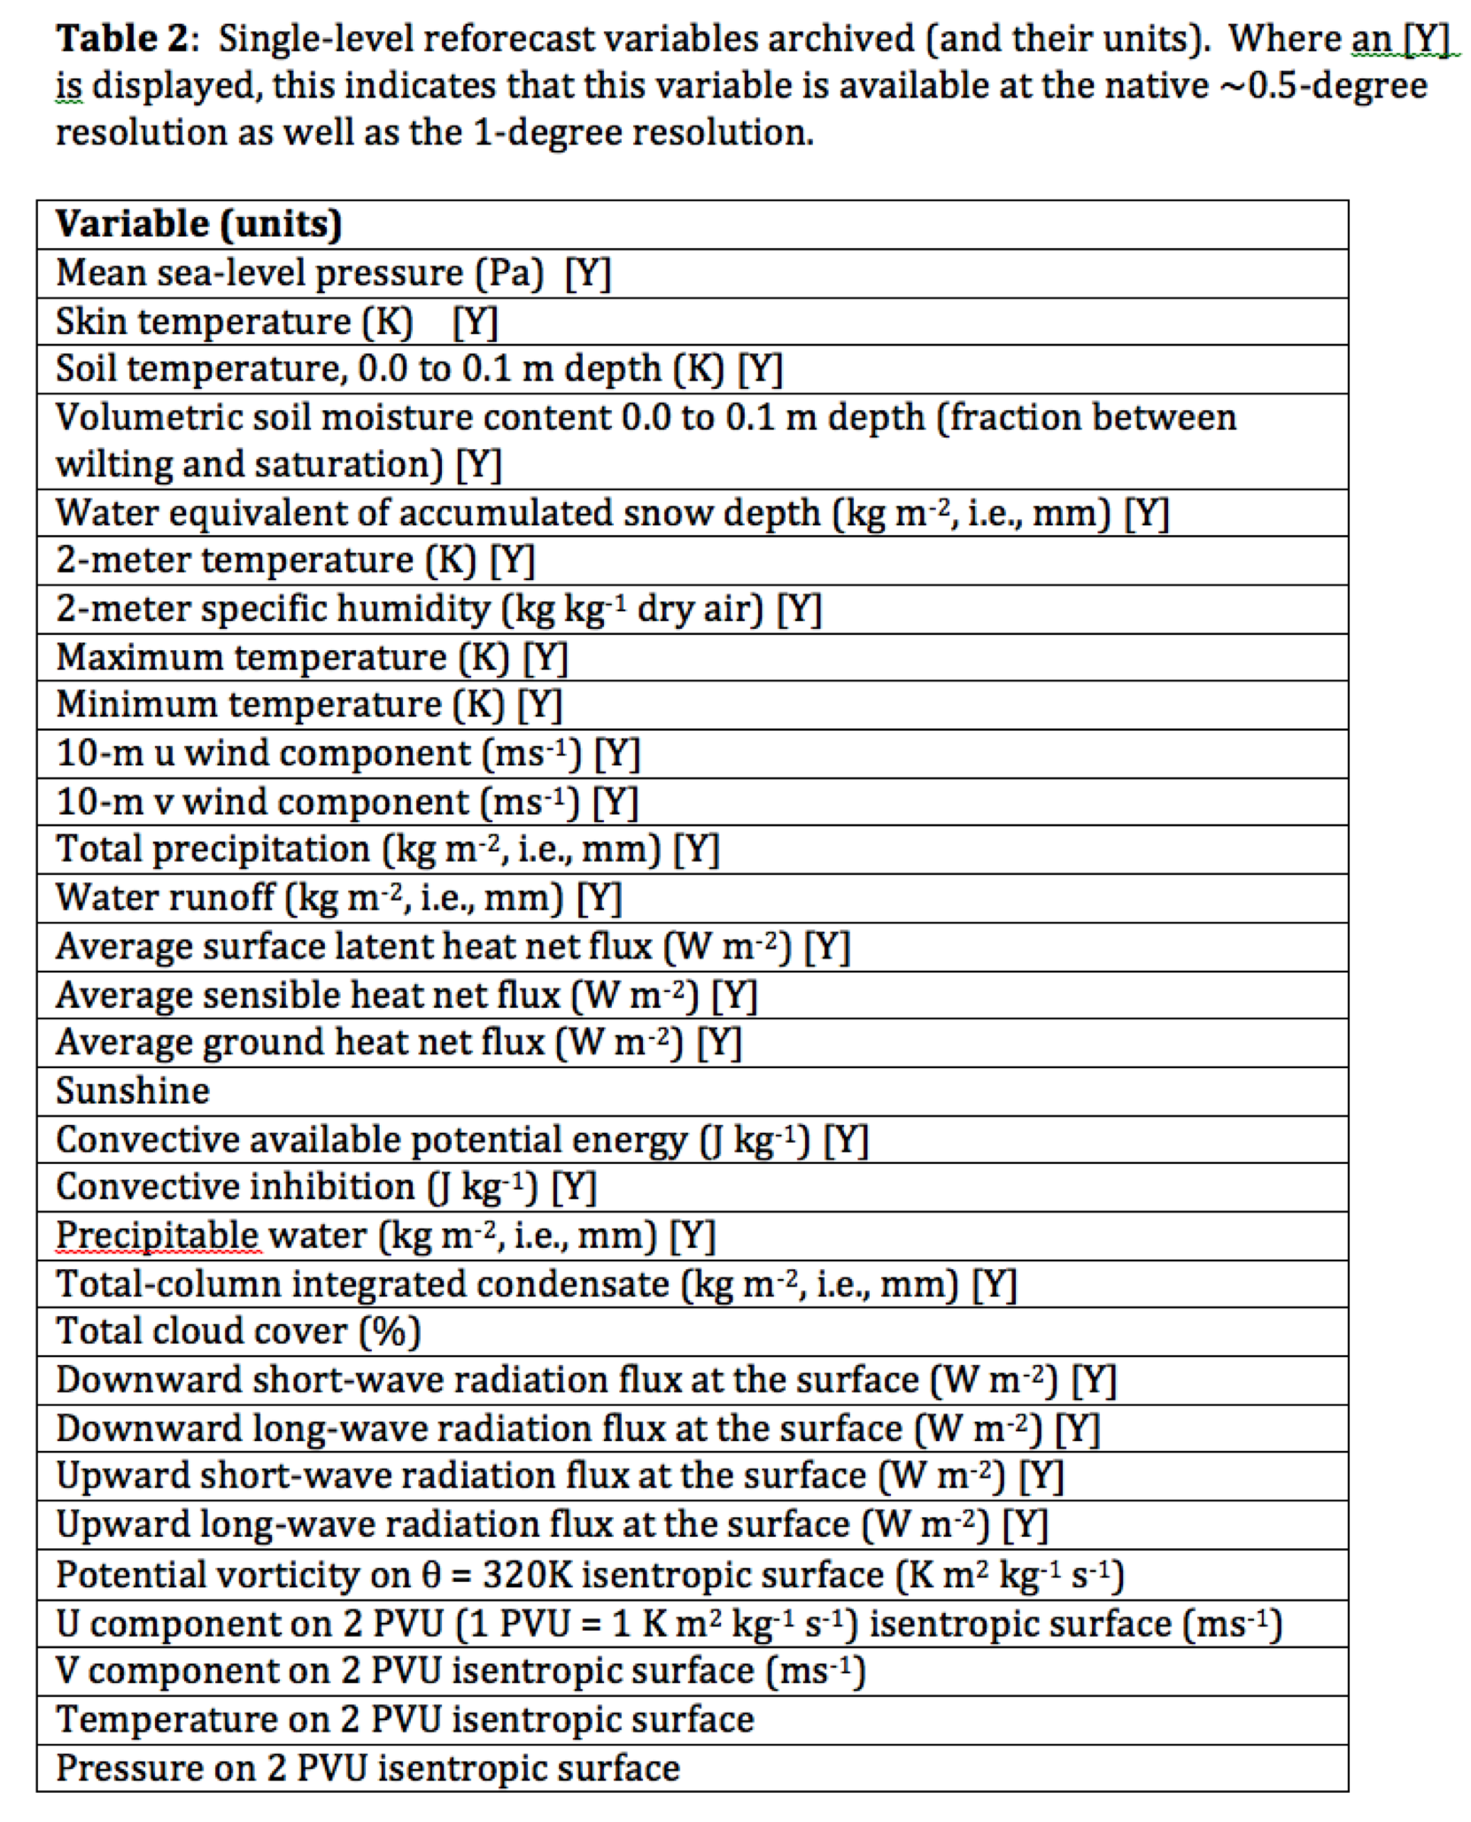
Data that is readily available from ESRL

Slide 25
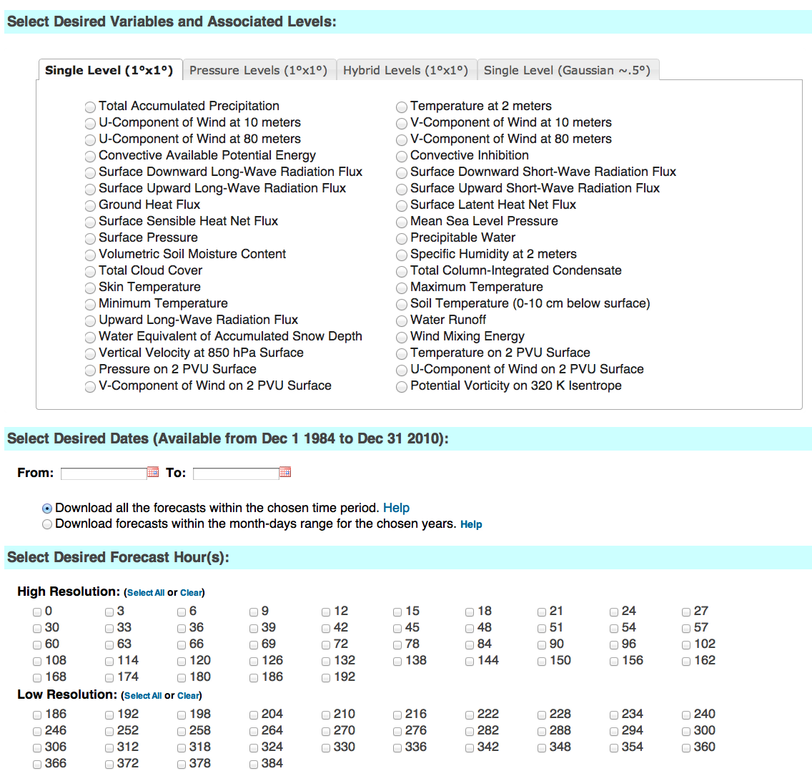
esrl.noaa.gov/psd/forecasts/reforecast2/download.html
Produces
netCDF files.
Also: direct
ftp access to
allow you to
read the raw
grib files.

Slide 26
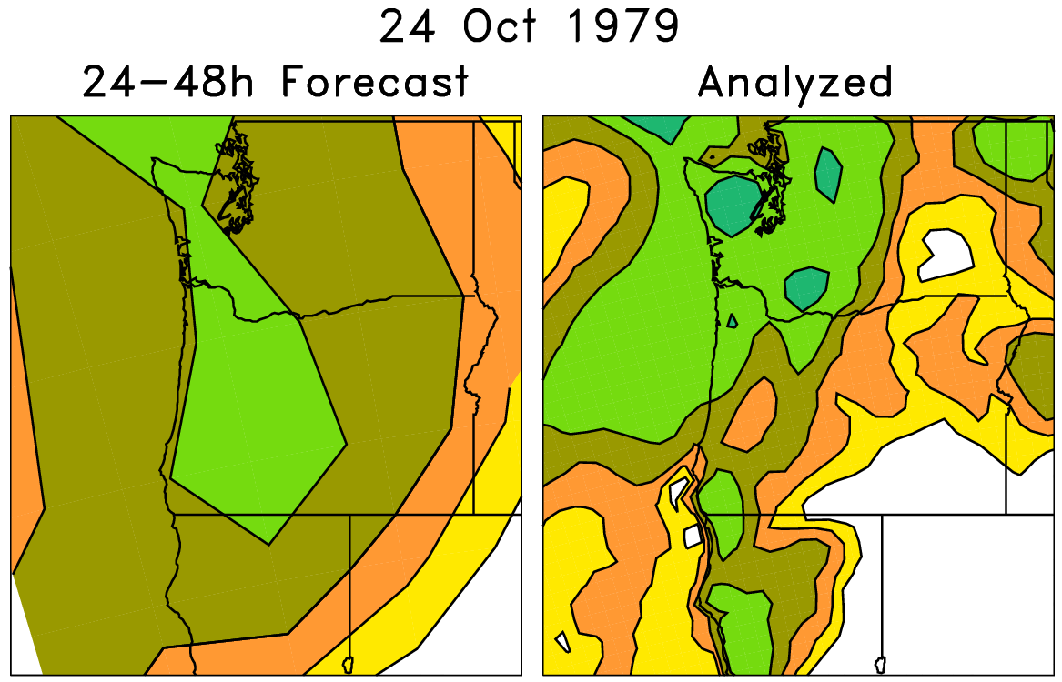
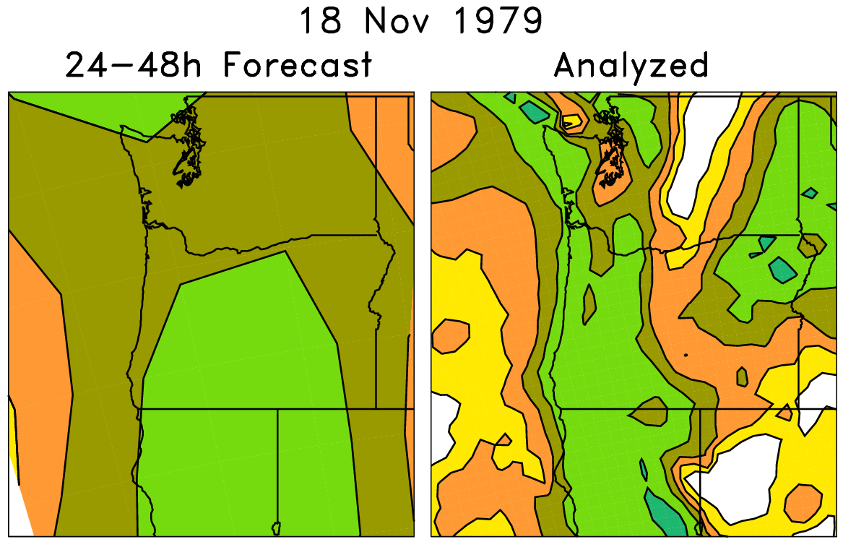
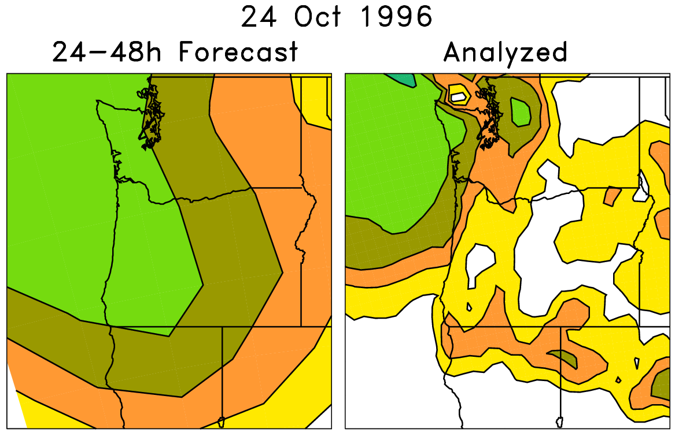
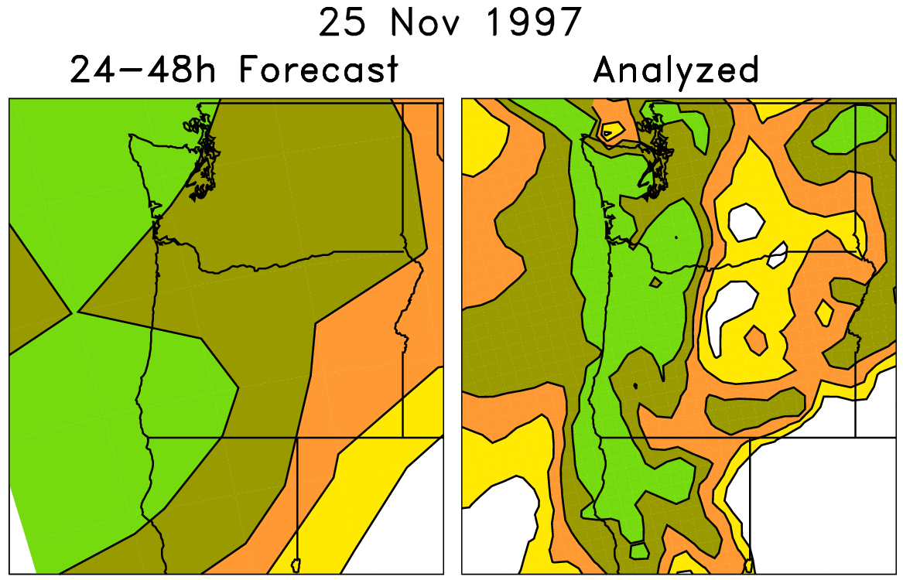
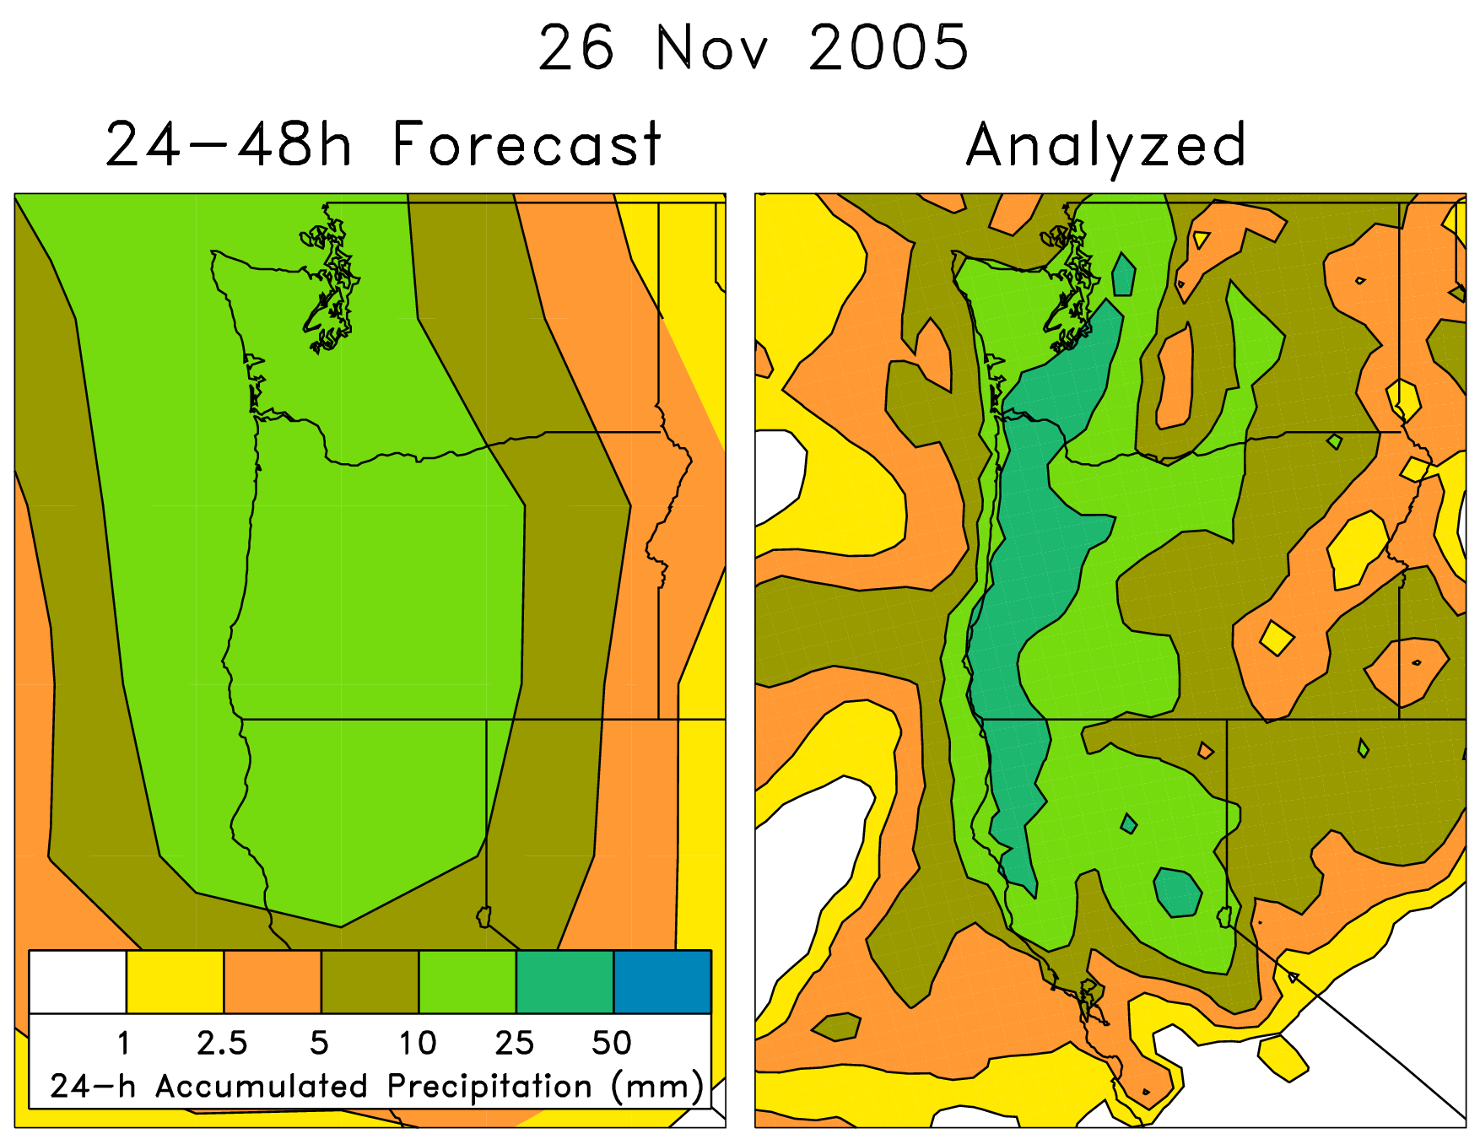
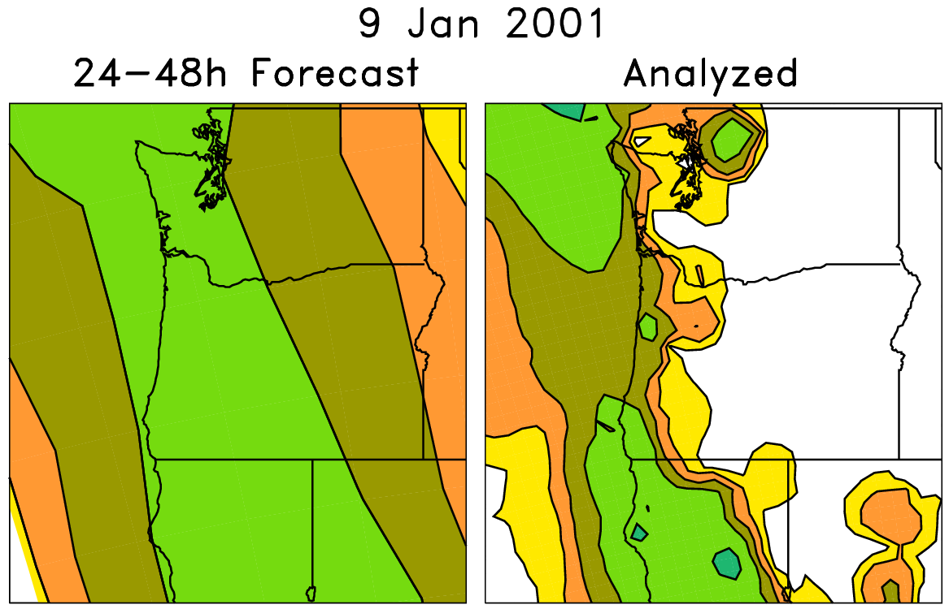
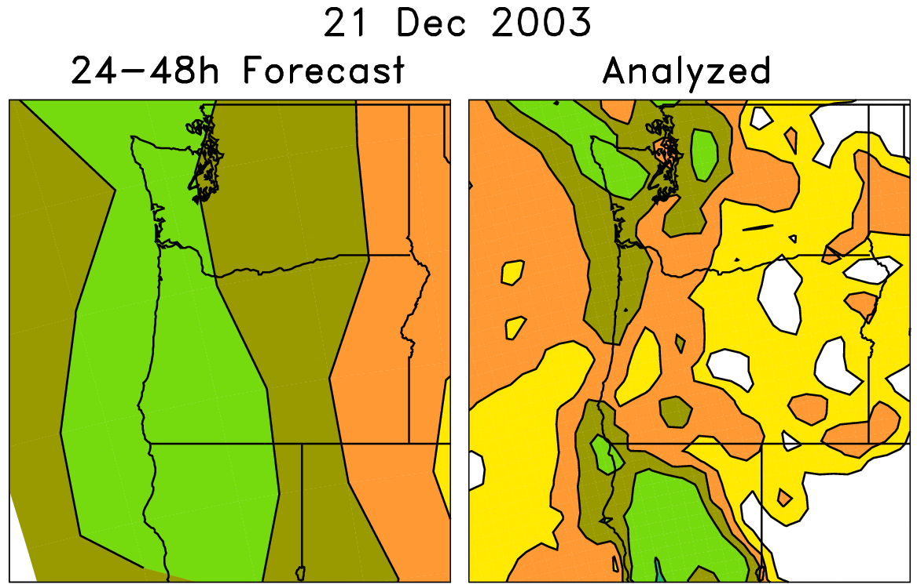
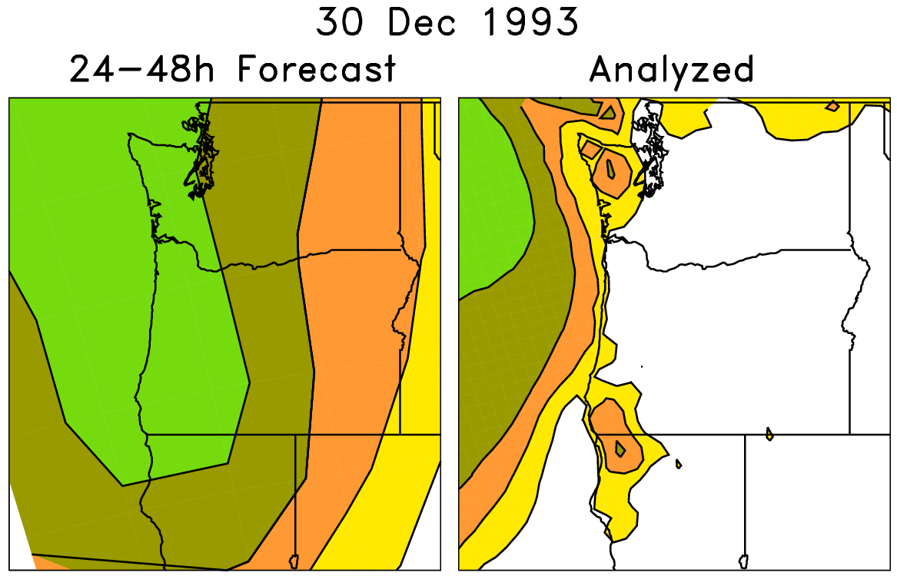
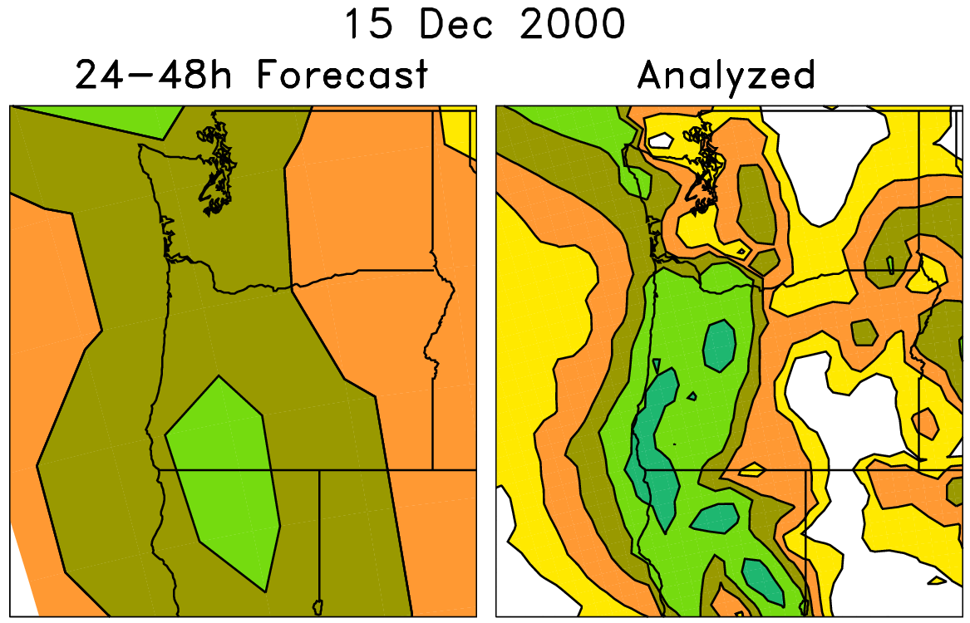
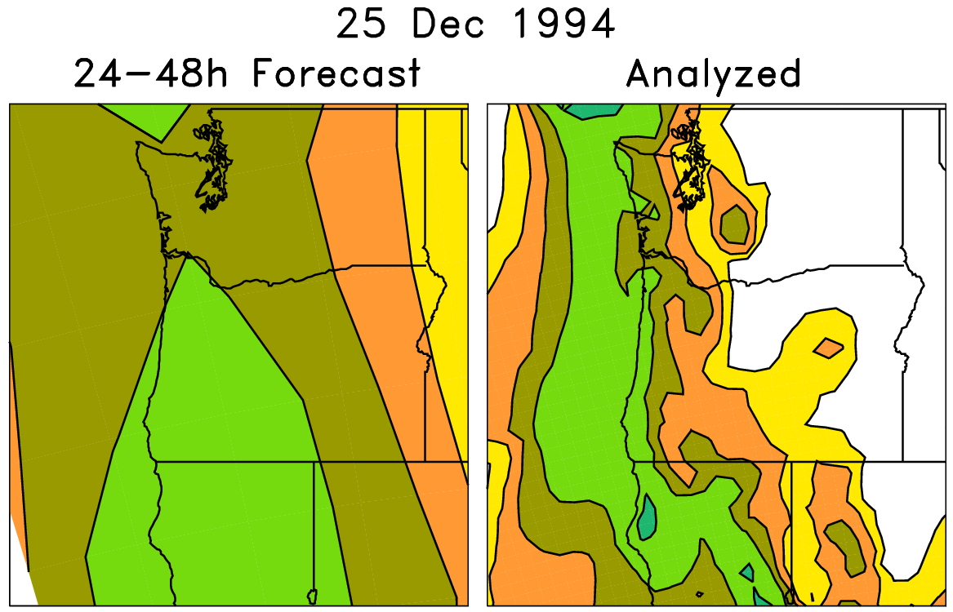
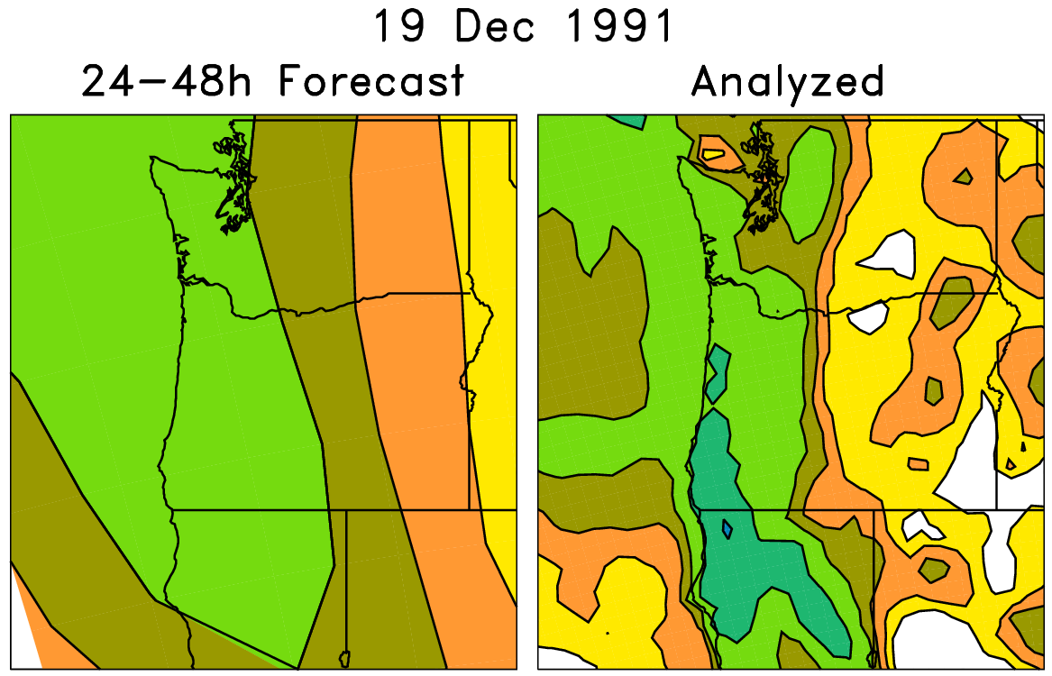
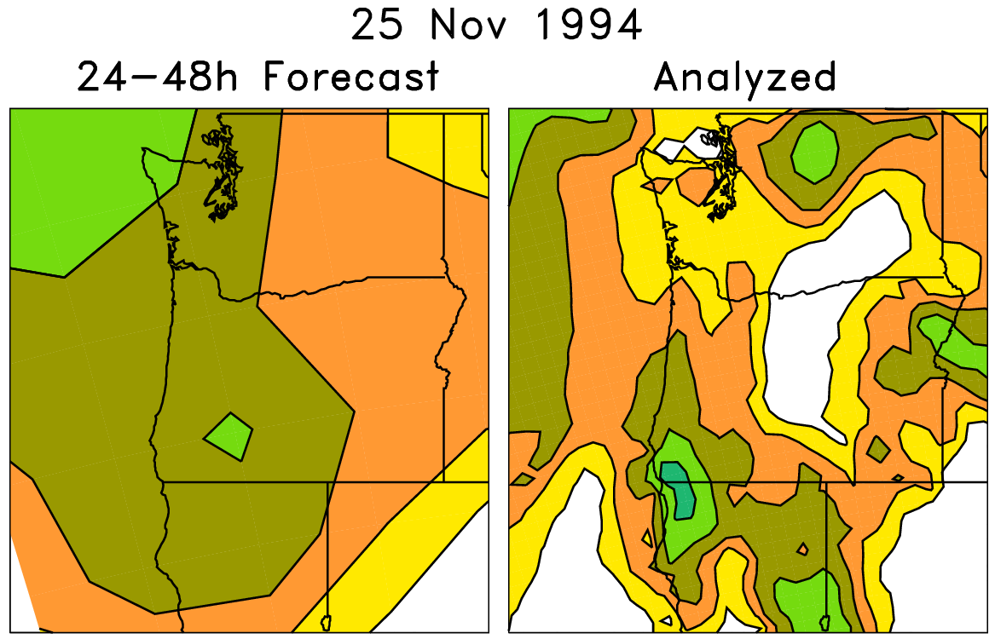
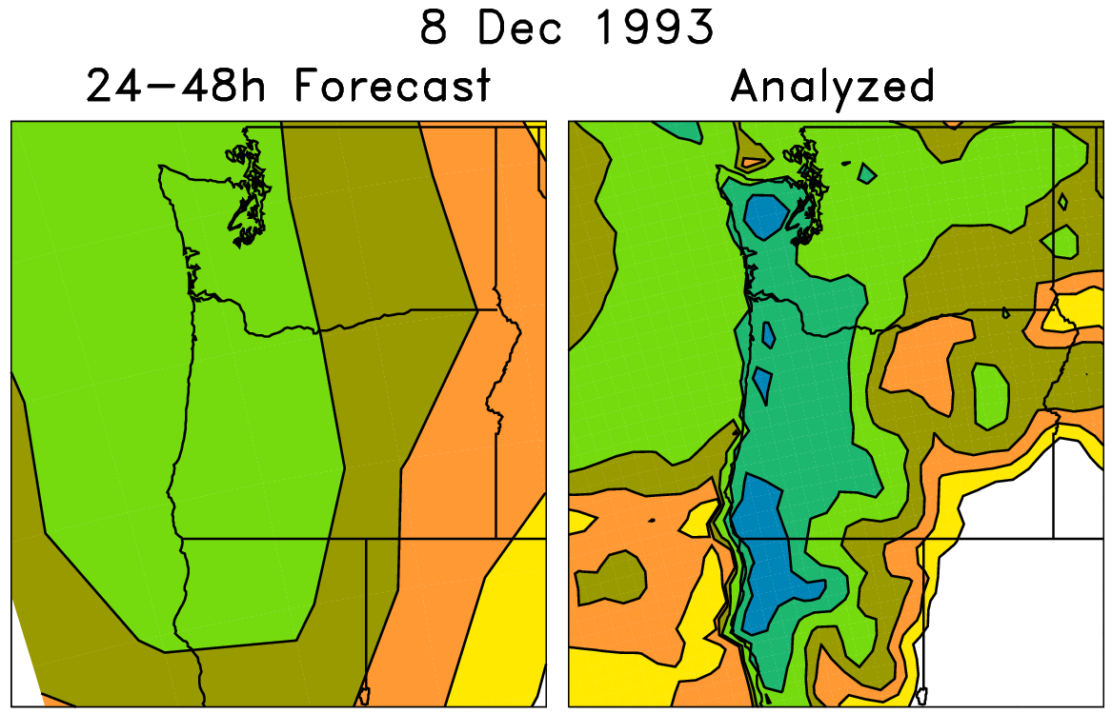
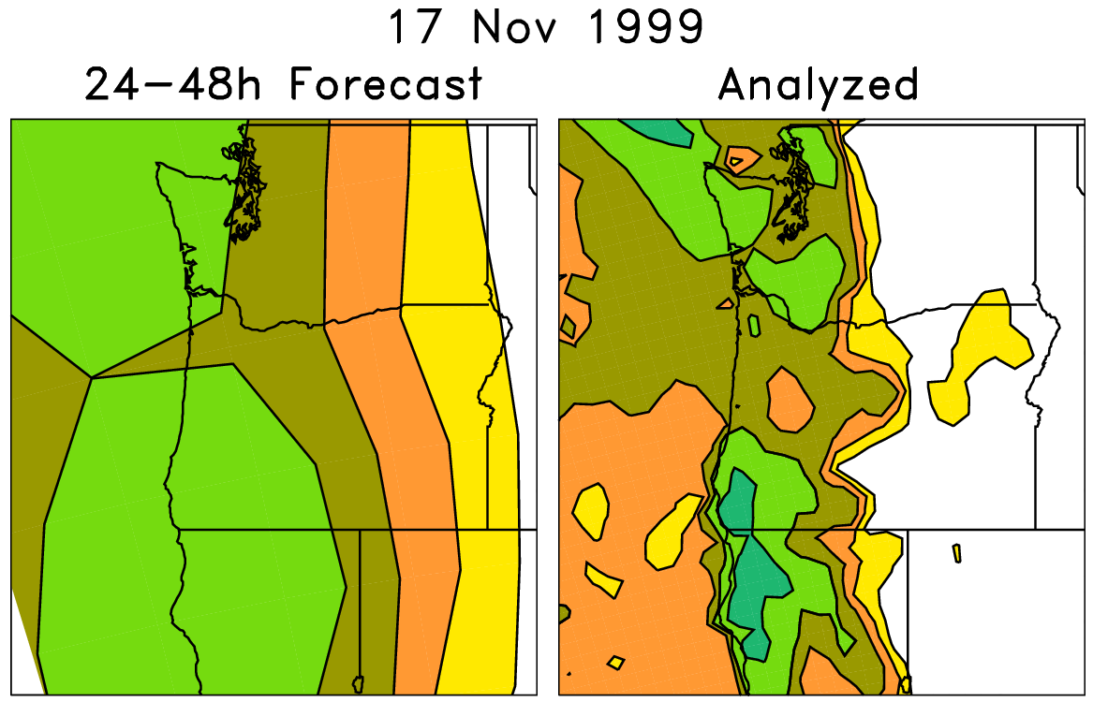
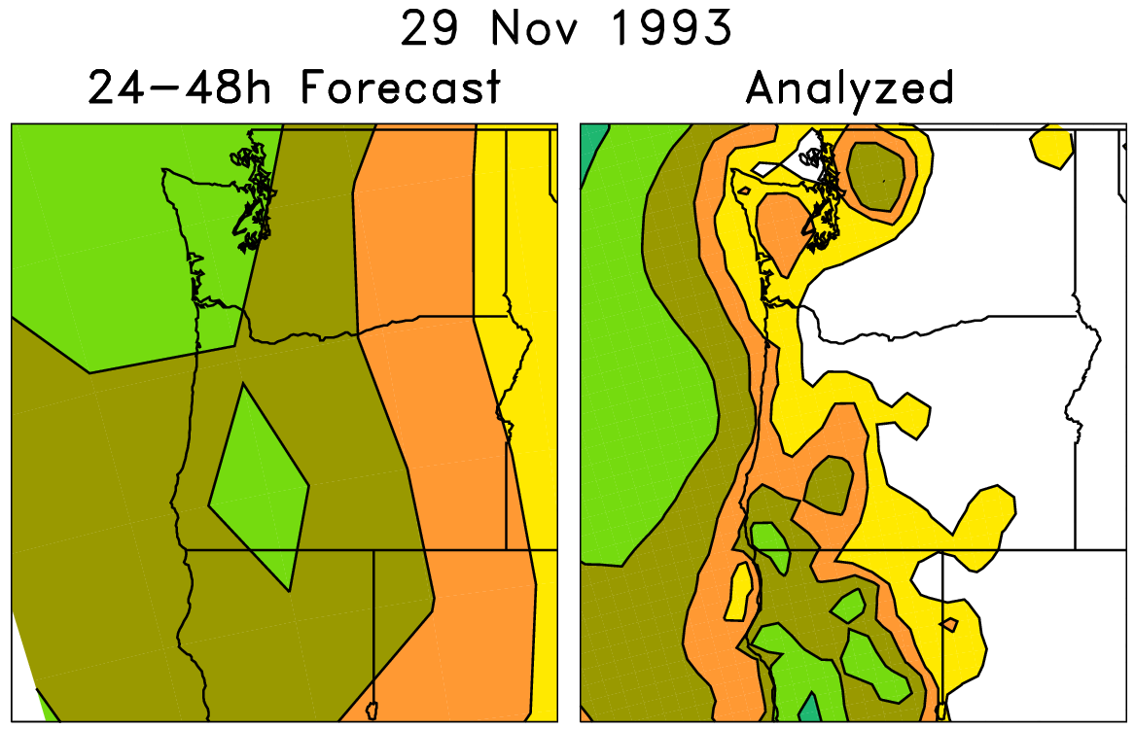
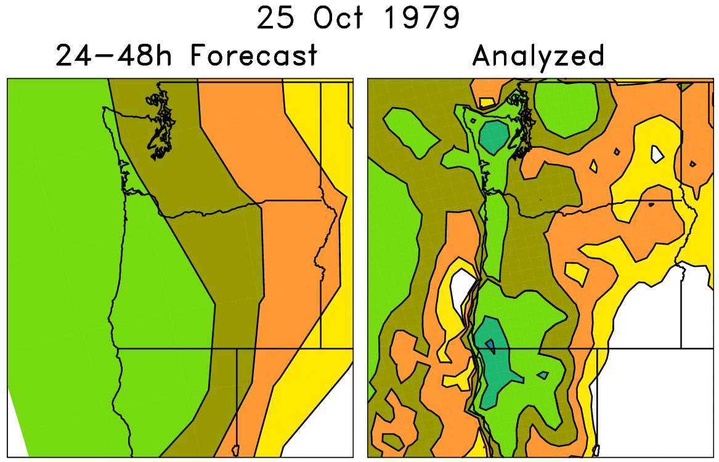
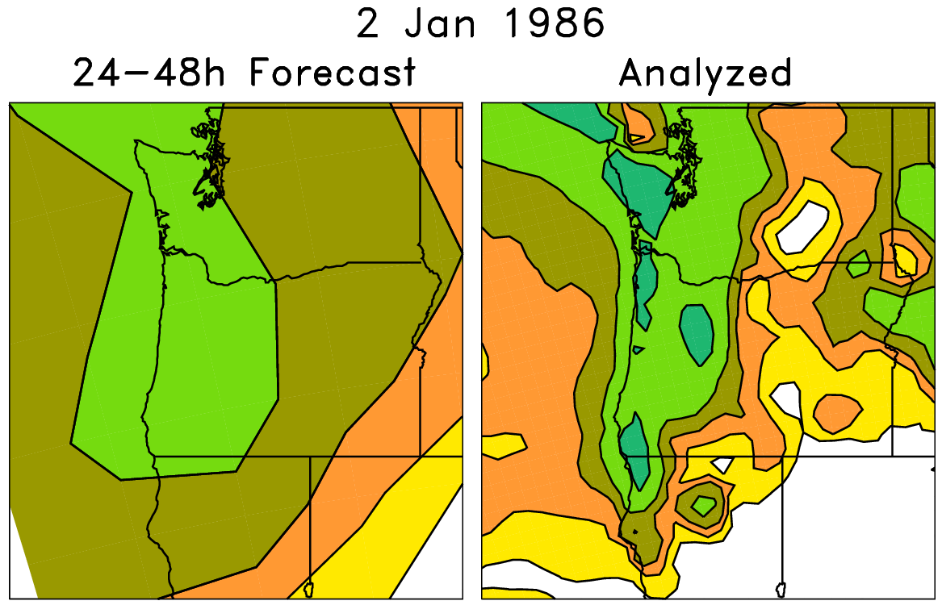
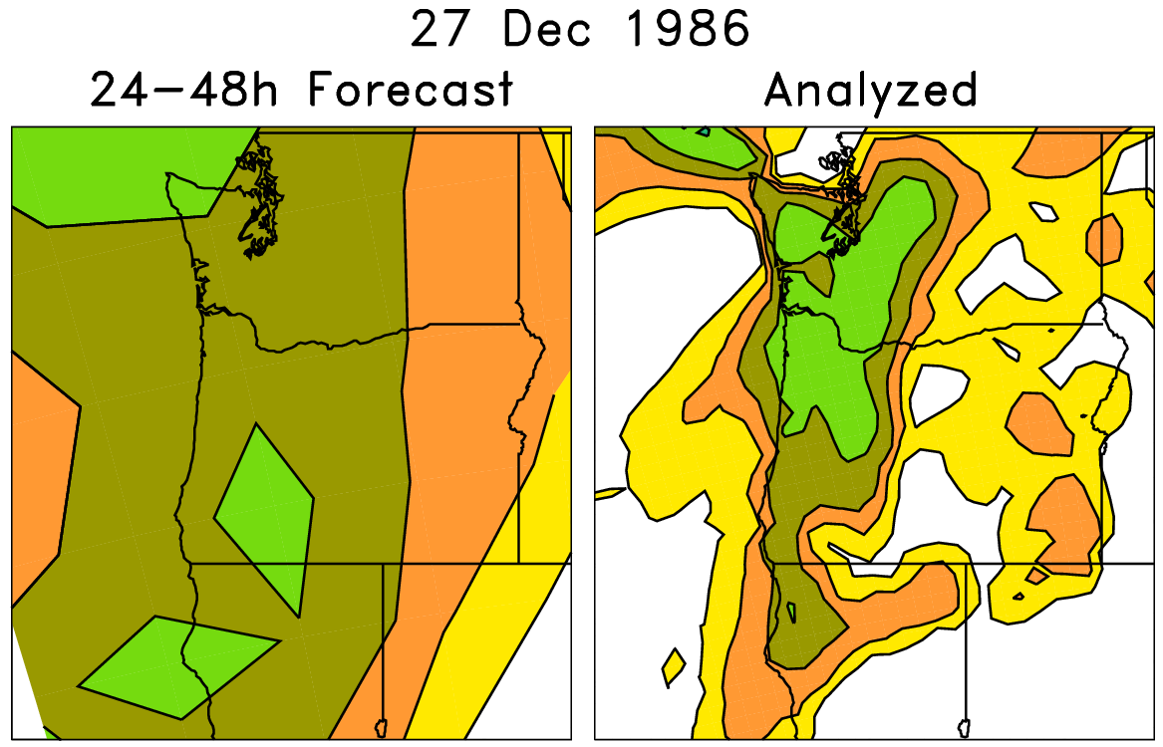
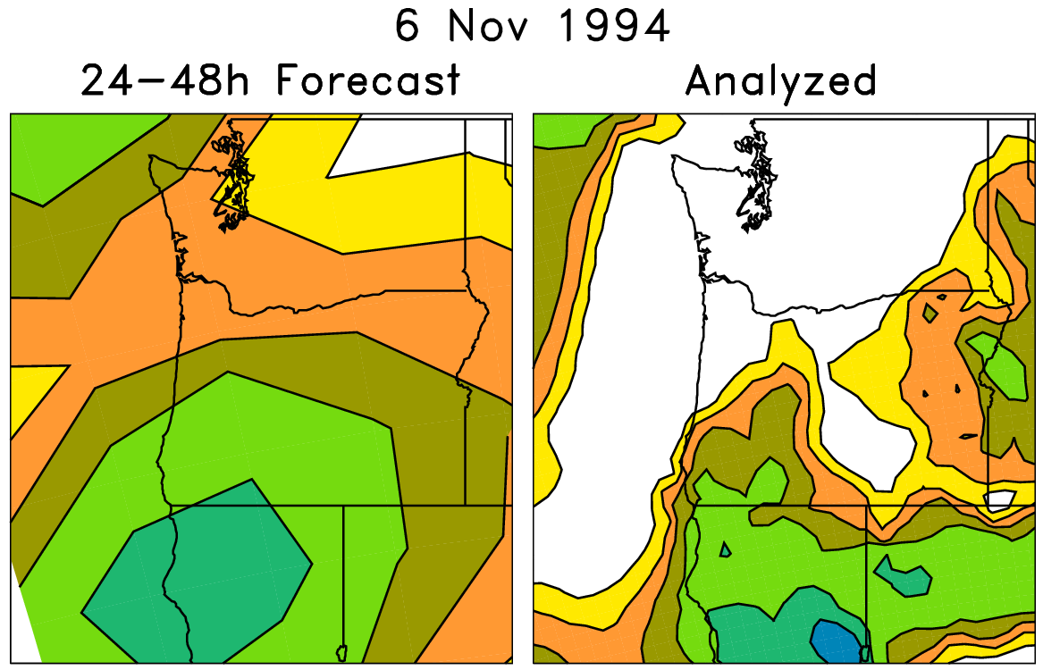
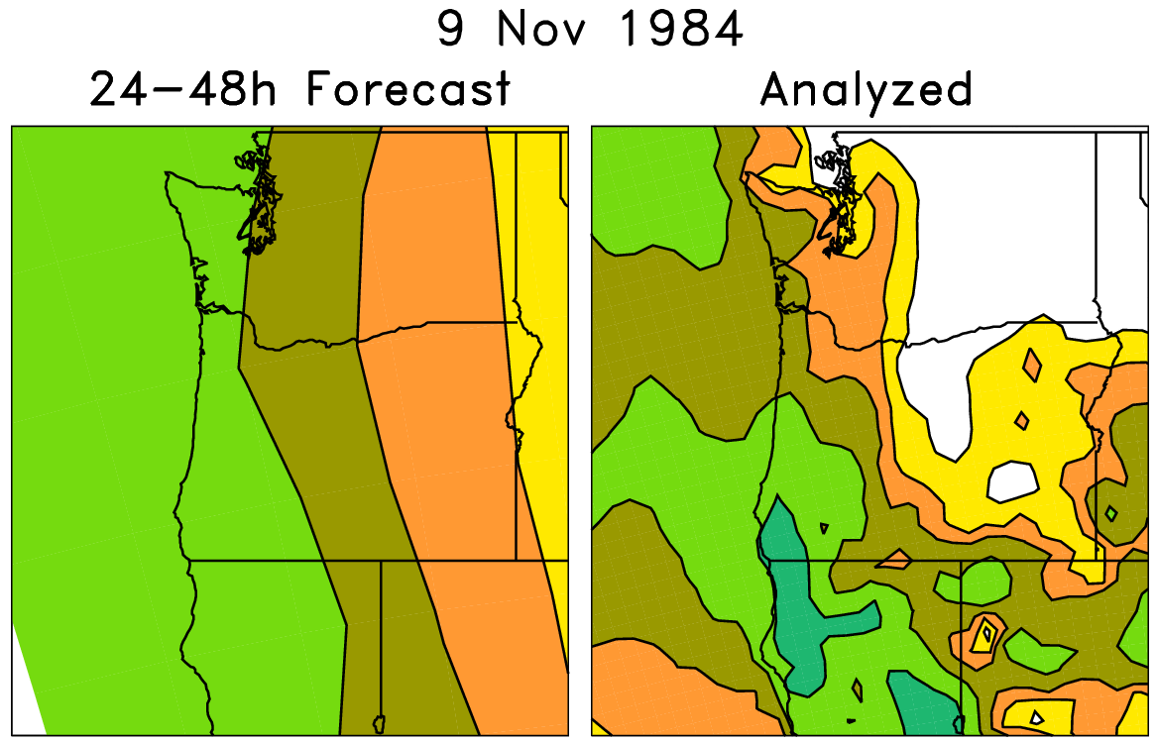
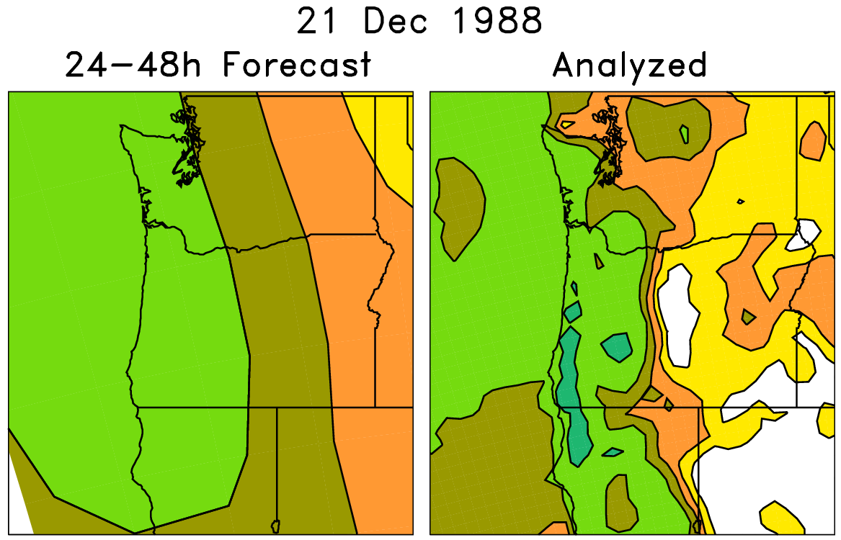
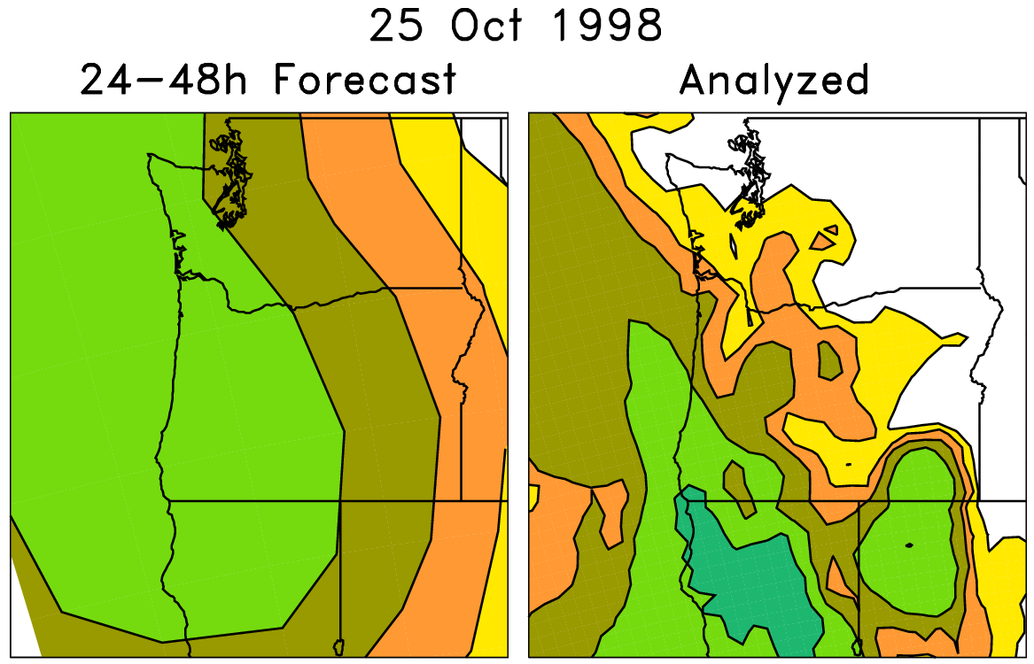
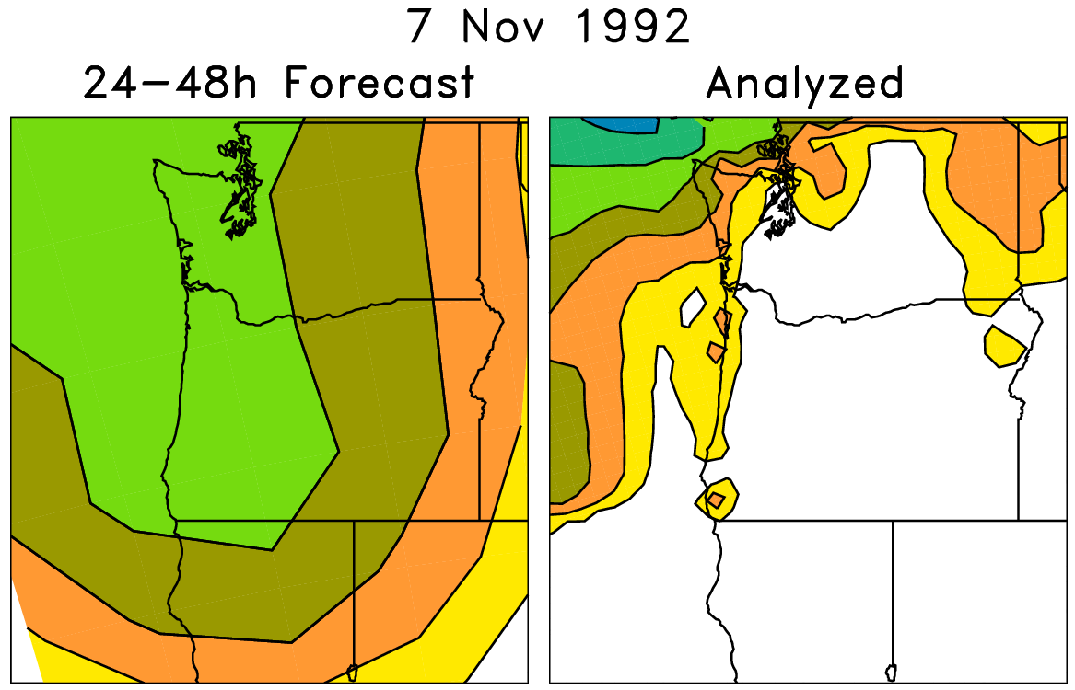
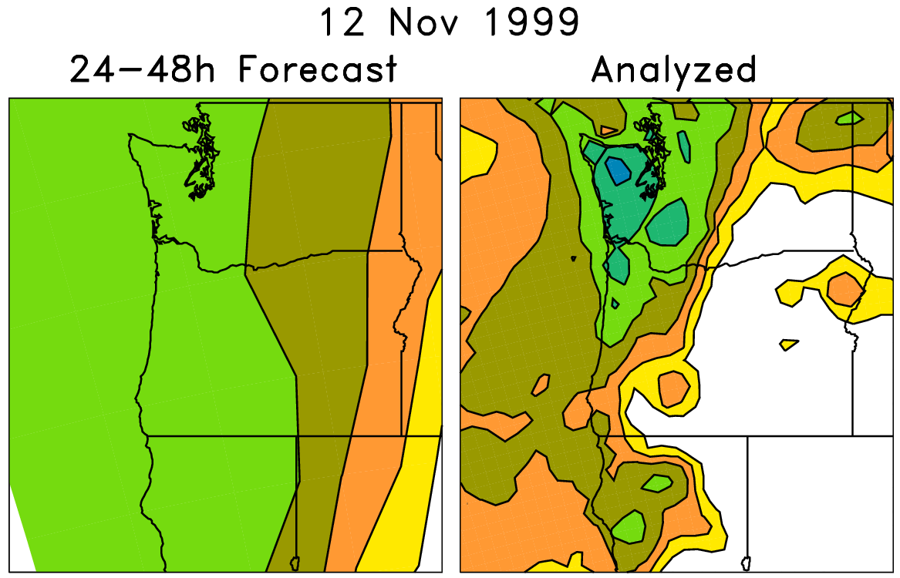
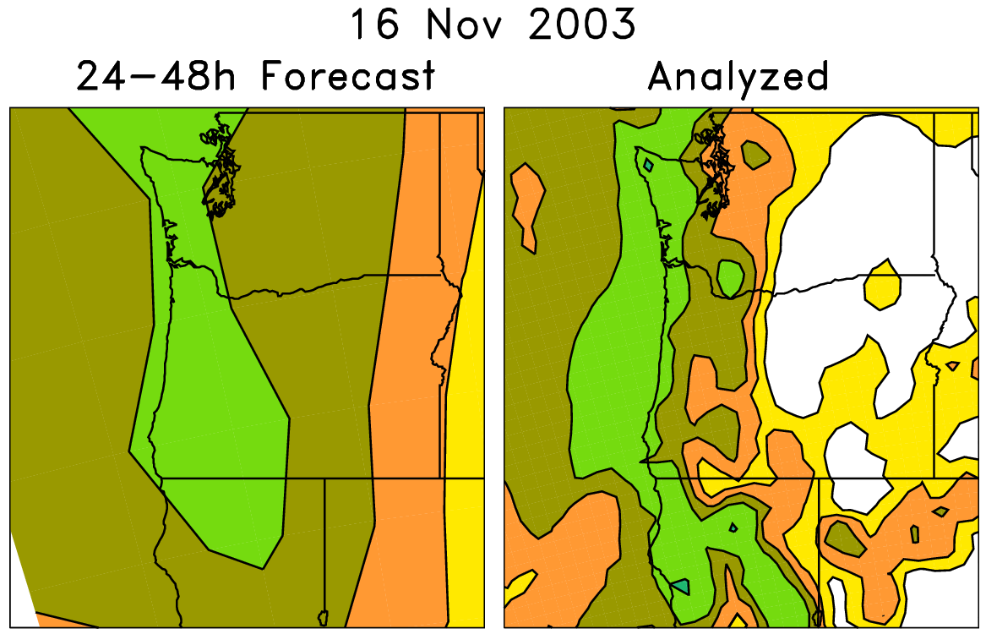
An example of a non-parametric “analog” post-processing leveraging reforecasts
Today’s forecast (& observed)
For each pair (e.g. red box), on the left are old forecasts that are somewhat similar to this day’s ensemble-mean forecast. The boxed data on the right, the analyzed precipitation for the same dates as the chosen analog forecasts, can be used to
statistically adjust and downscale the forecast.
Analog approaches like this
may be particularly useful for
hydrologic ensemble applications, where an ensemble of weather realizations is needed as inputs to a hydrologic ensemble streamflow system.

Slide 27
Analog post-processing and implicit downscaling: skill

Slide 28
> 10 mm event

Slide 29
Supplemental data locations to increase training sample size
Idea is to supplement
training data at
each grid point using
n extra grid points
that have similar
observed climatology
and similar
forecast-observed
relationships, as
determined from
GEFS reforecasts.
In this plot, big symbol
is where we’re training,
smaller symbol where
we’re supplementing
training data.

Slide 30
Reliability, 108-120 h, > 1 mm
Here, 2002-2013 skill and reliability over CONUS, over all months of the year.

Slide 31
Reliability, 108-120 h, > 10 mm

Slide 32
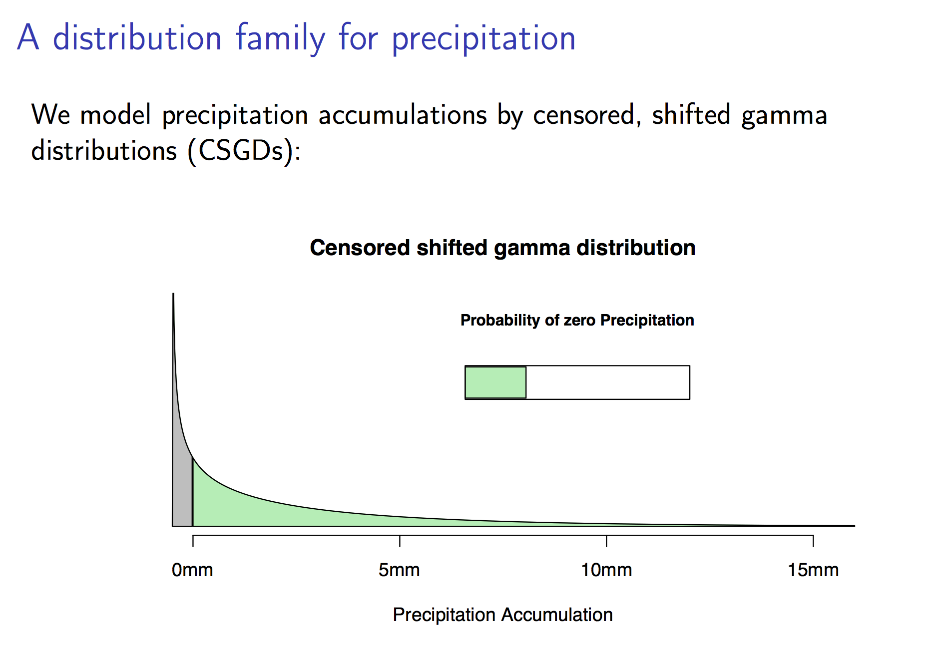
Parametric methods tested with reforecasts
ongoing research of my colleague, Michael Scheuerer

Slide 33
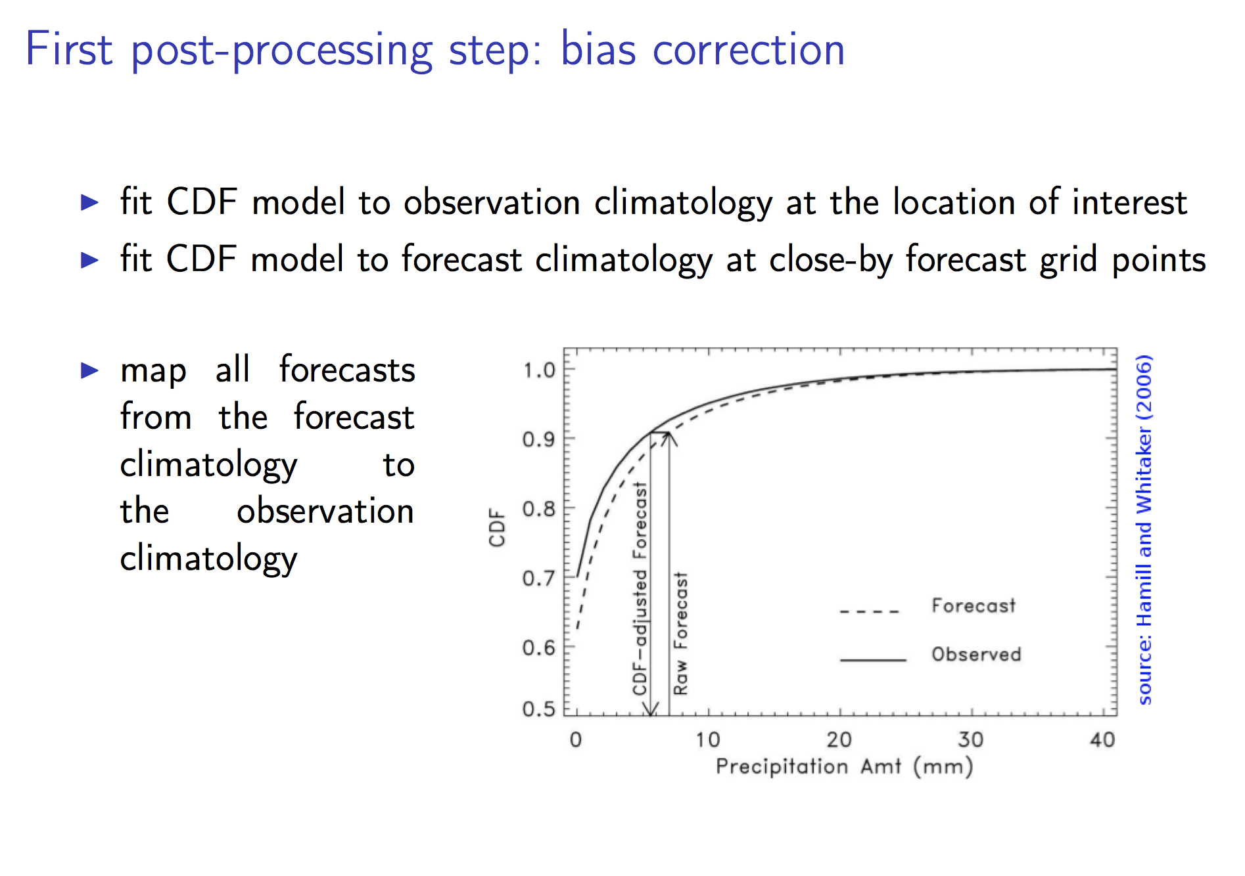

Slide 34
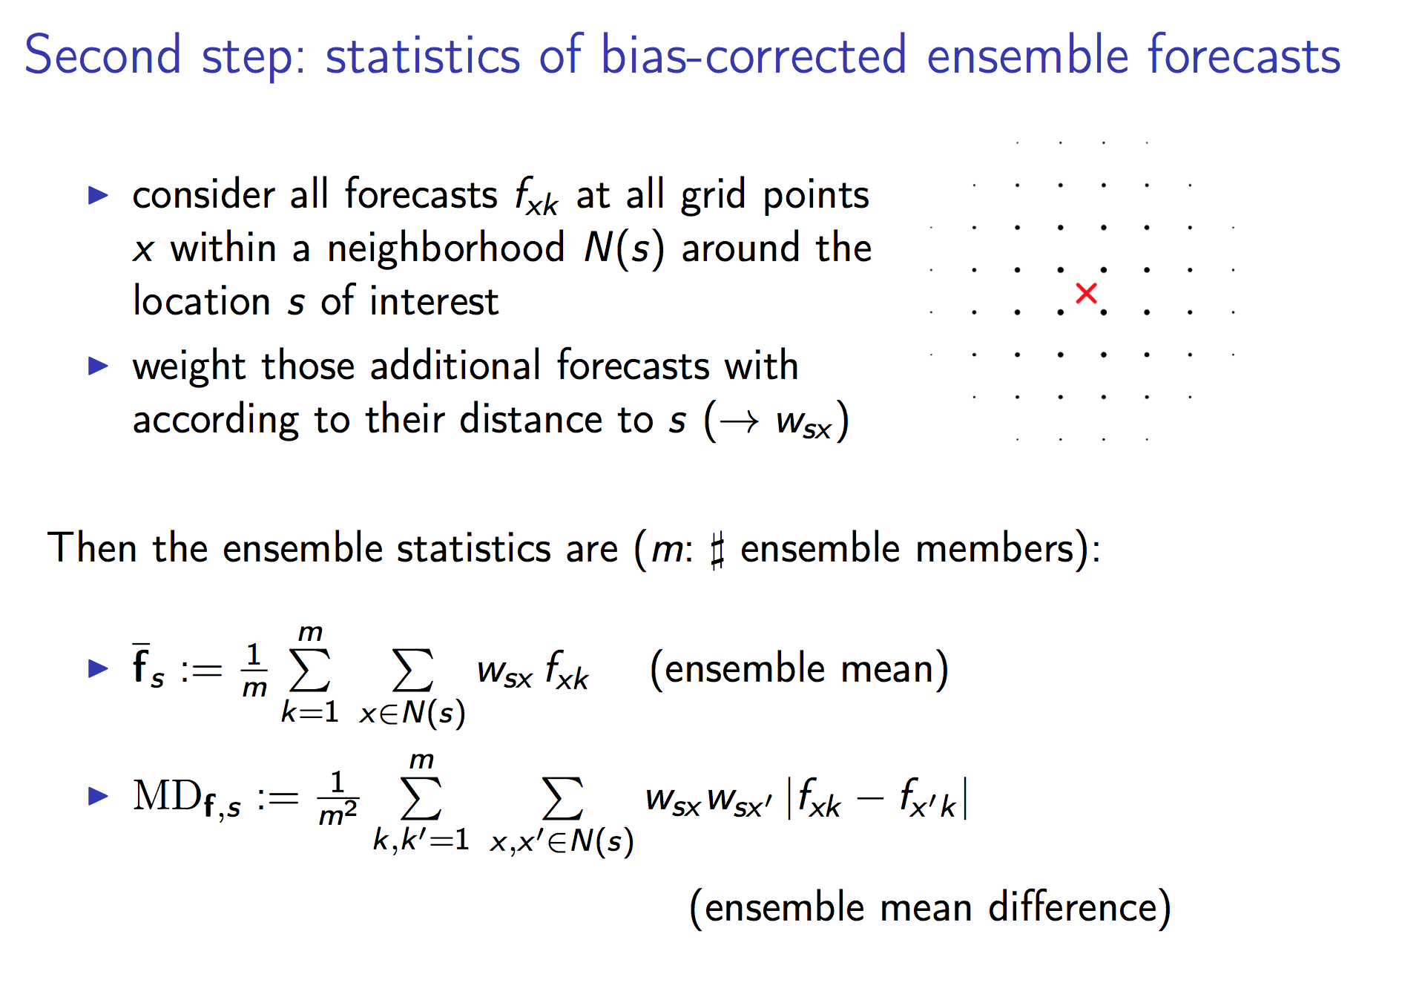

Slide 35
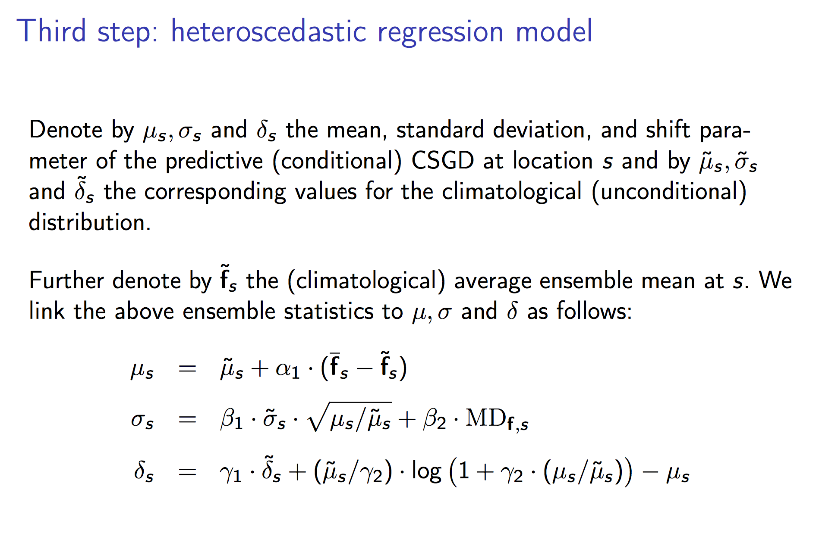

Slide 36
incorporates climatology
utilizes ensemble forecast information

Slide 37
Regression models
Which is a better fit to the mean, linear or non-linear?

Slide 38
γ₂ controls the amount of nonlinearity in the relationship
between the mean forecast and observed.

Slide 39
γ₂ controls the amount of nonlinearity in the relationship
between the mean forecast and observed.

Slide 40
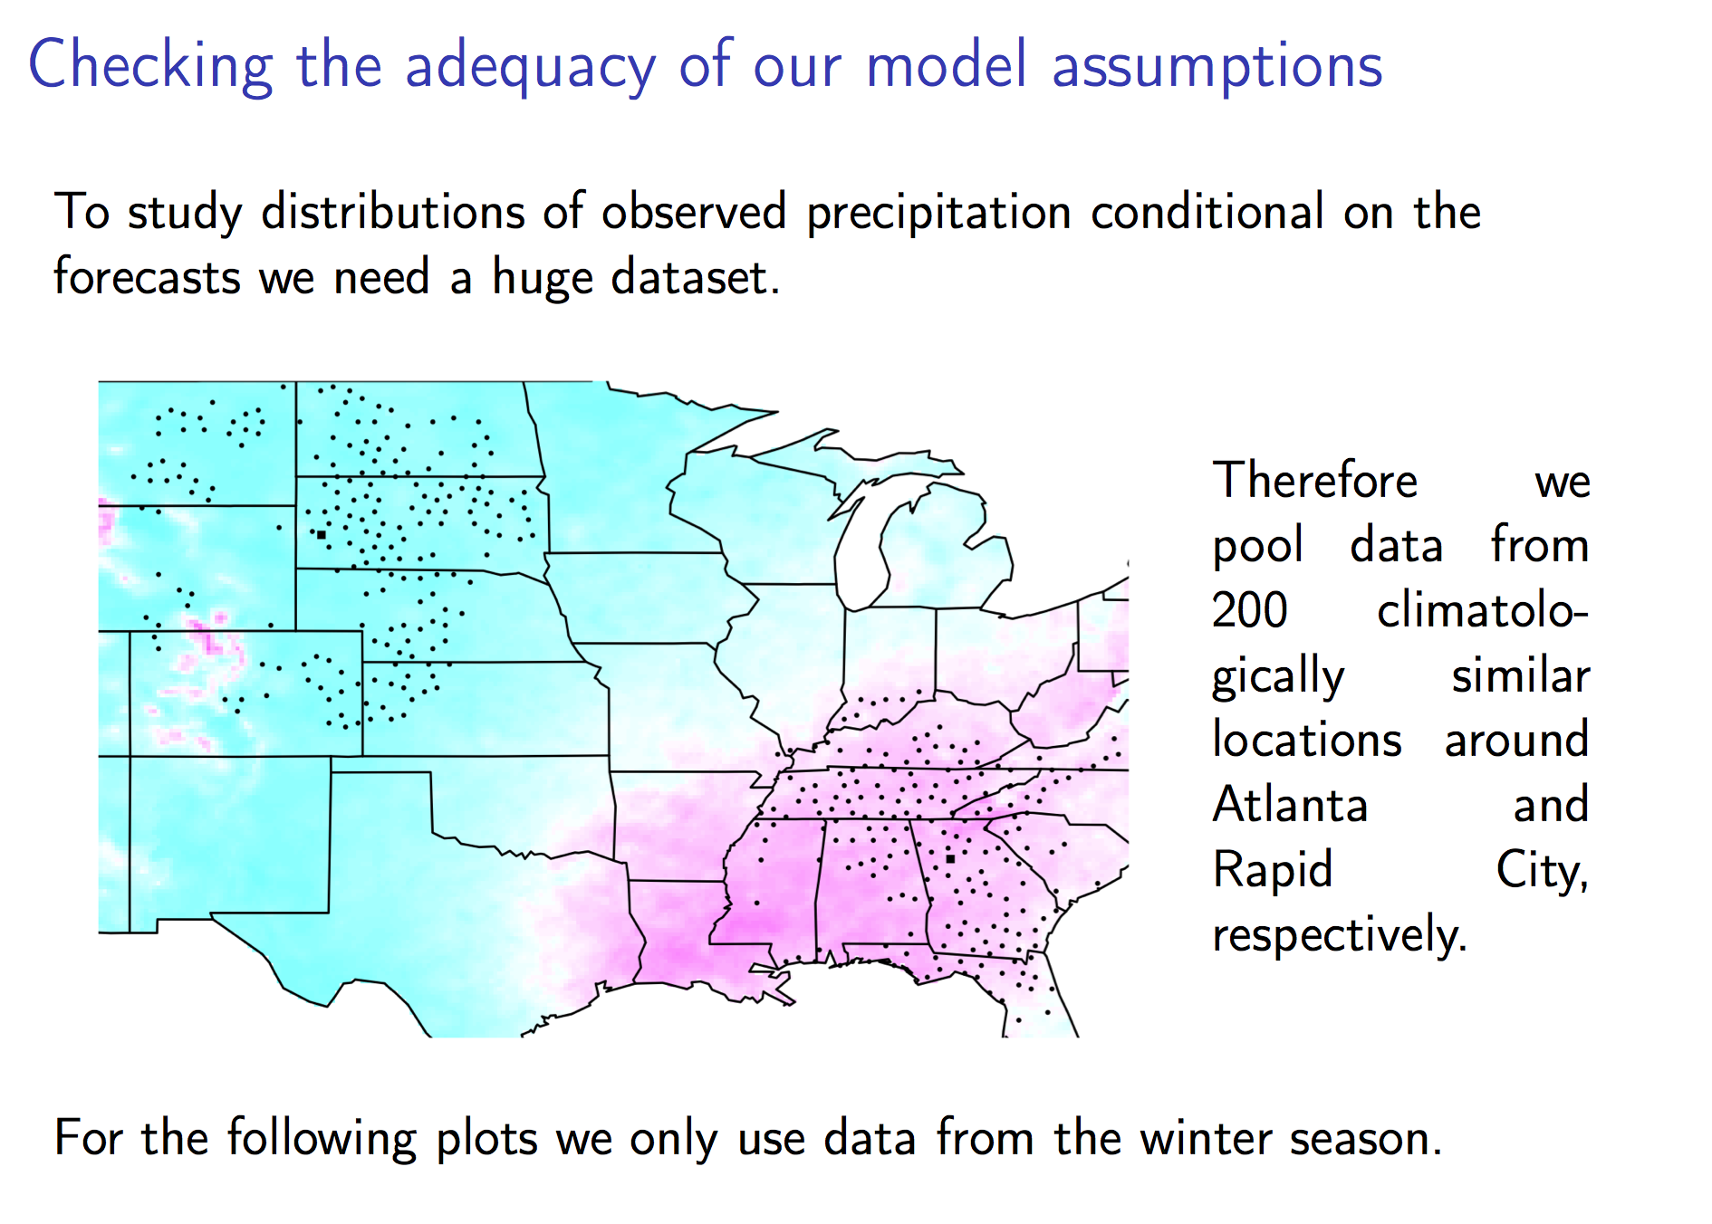

Slide 41
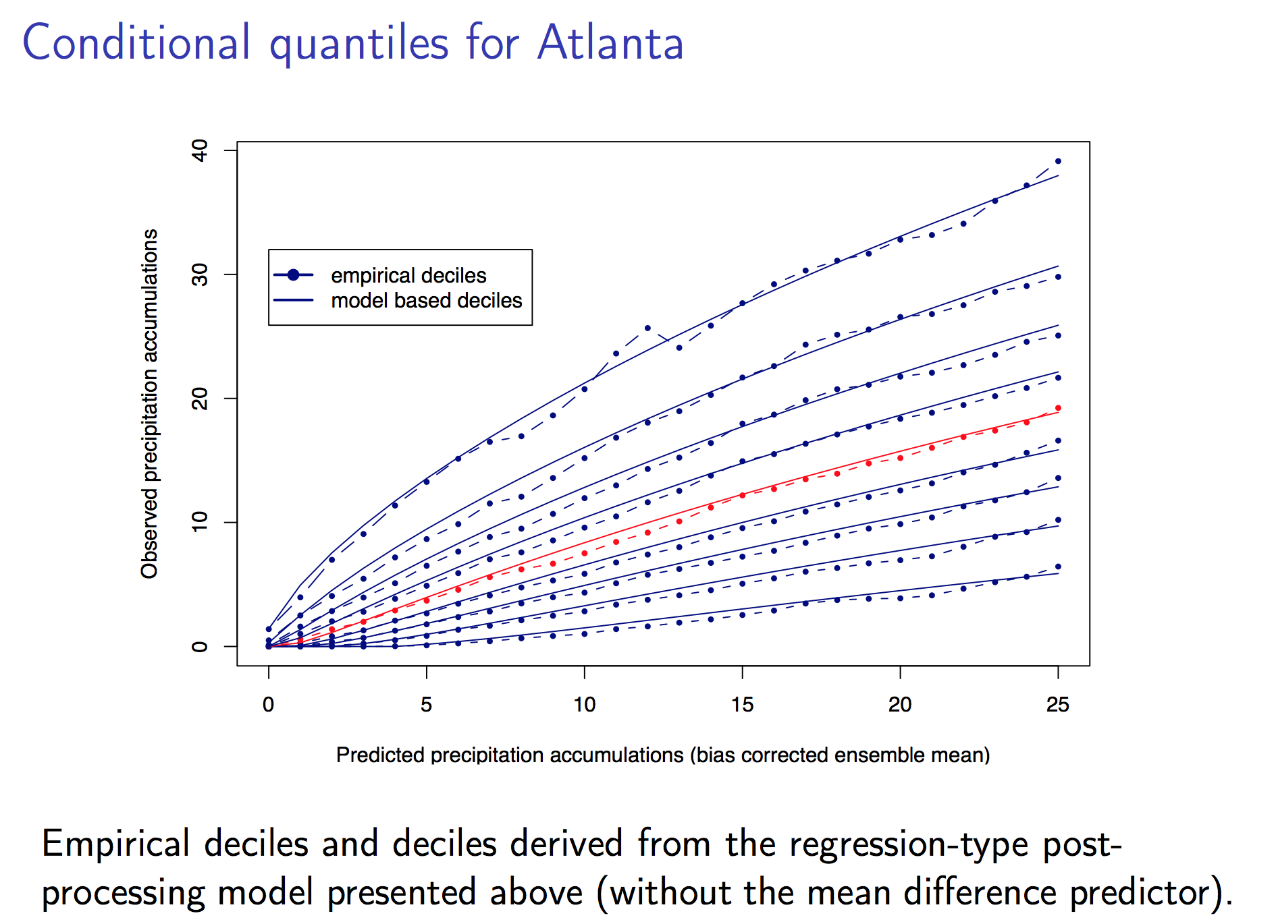

Slide 42
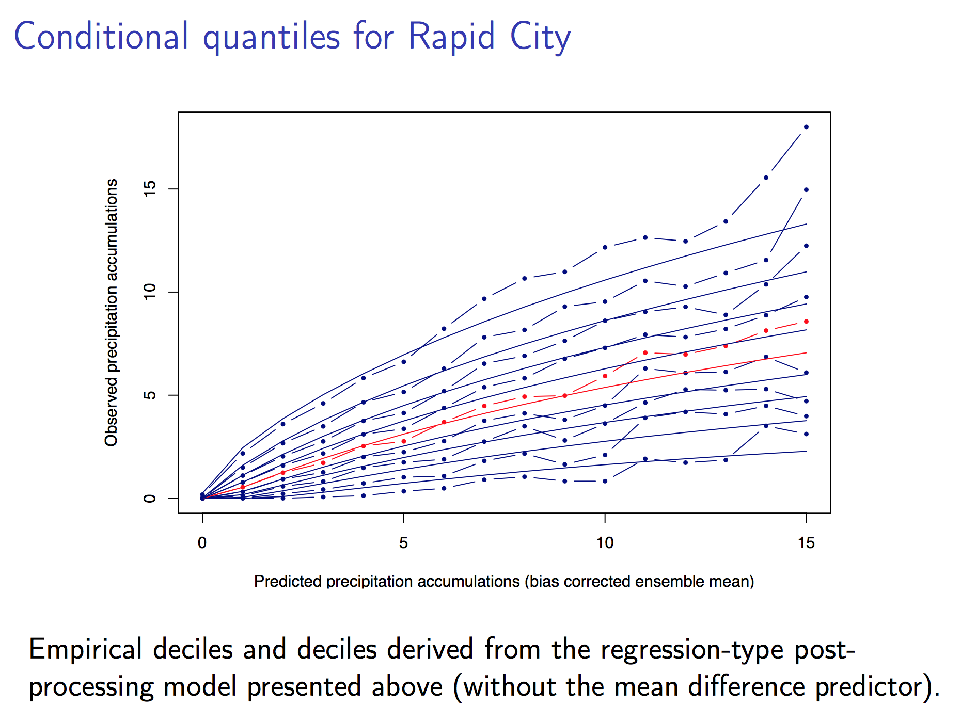

Slide 43
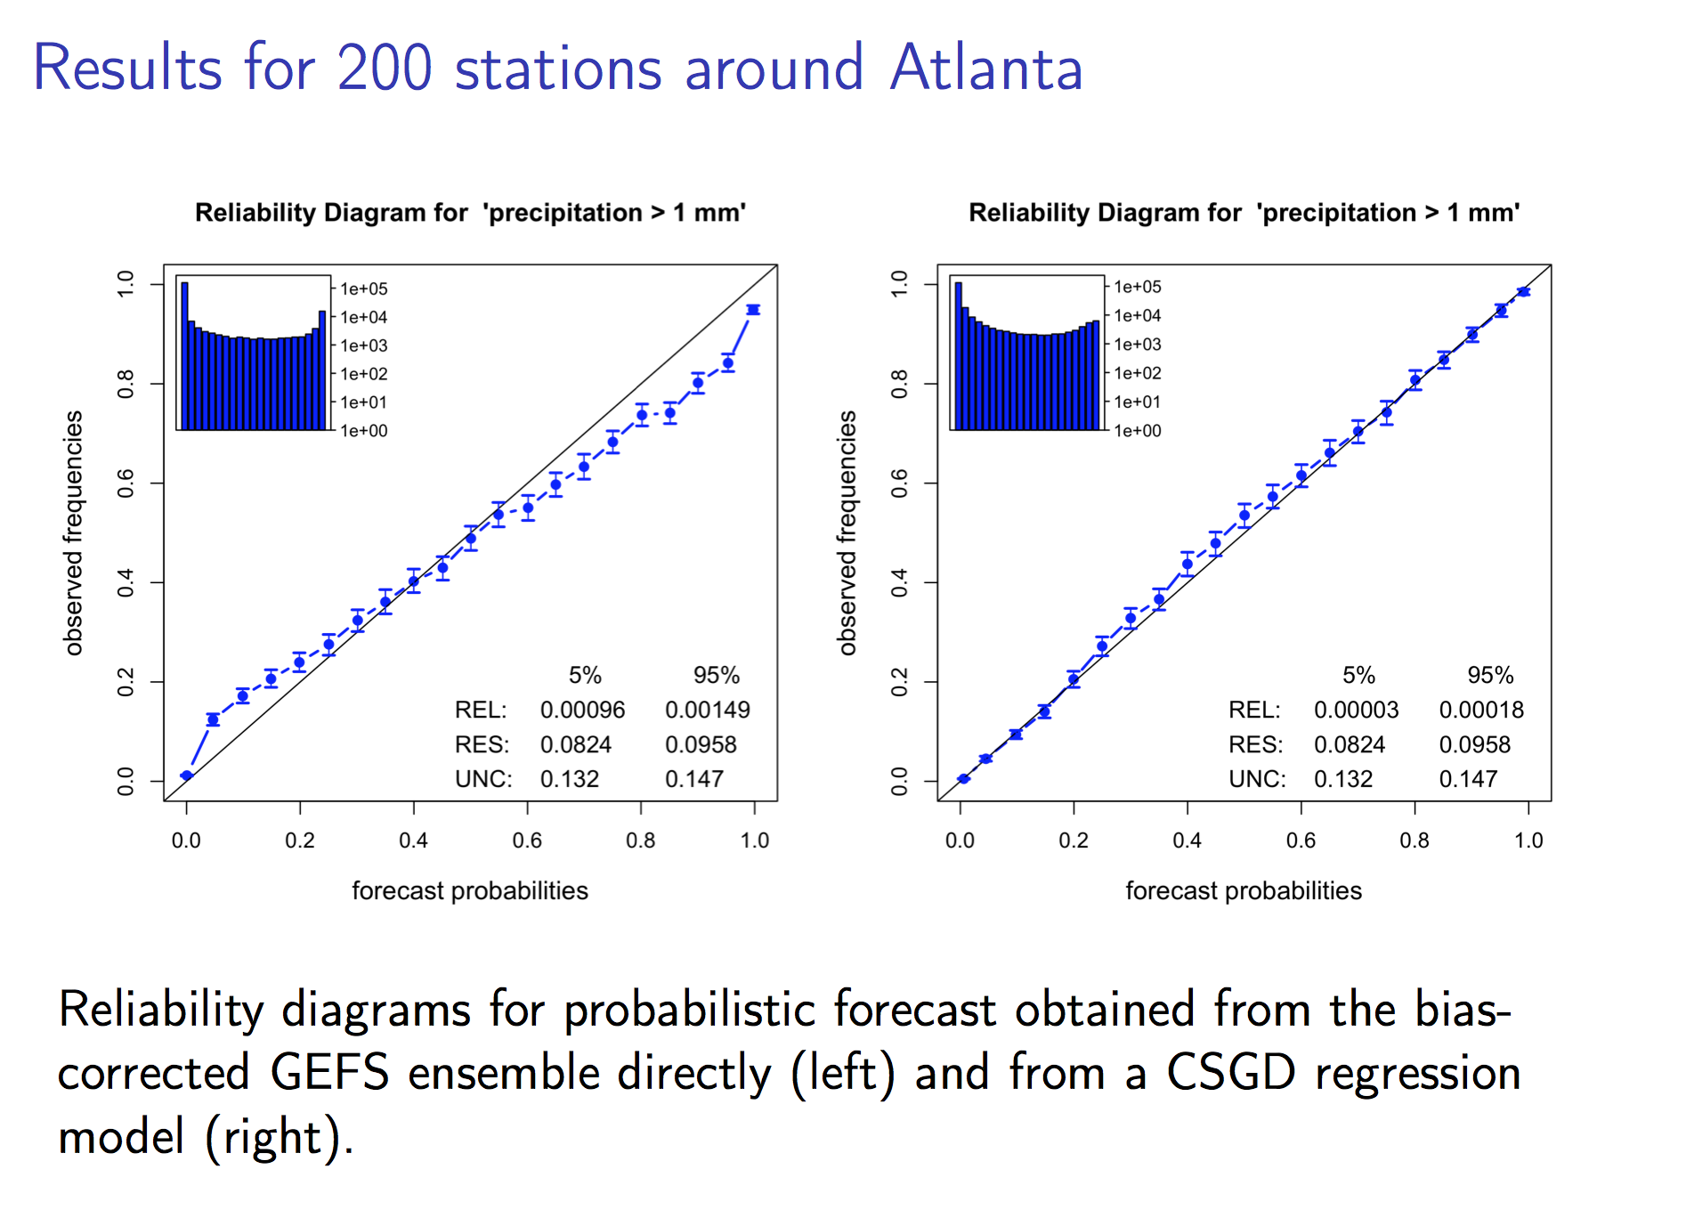

Slide 44
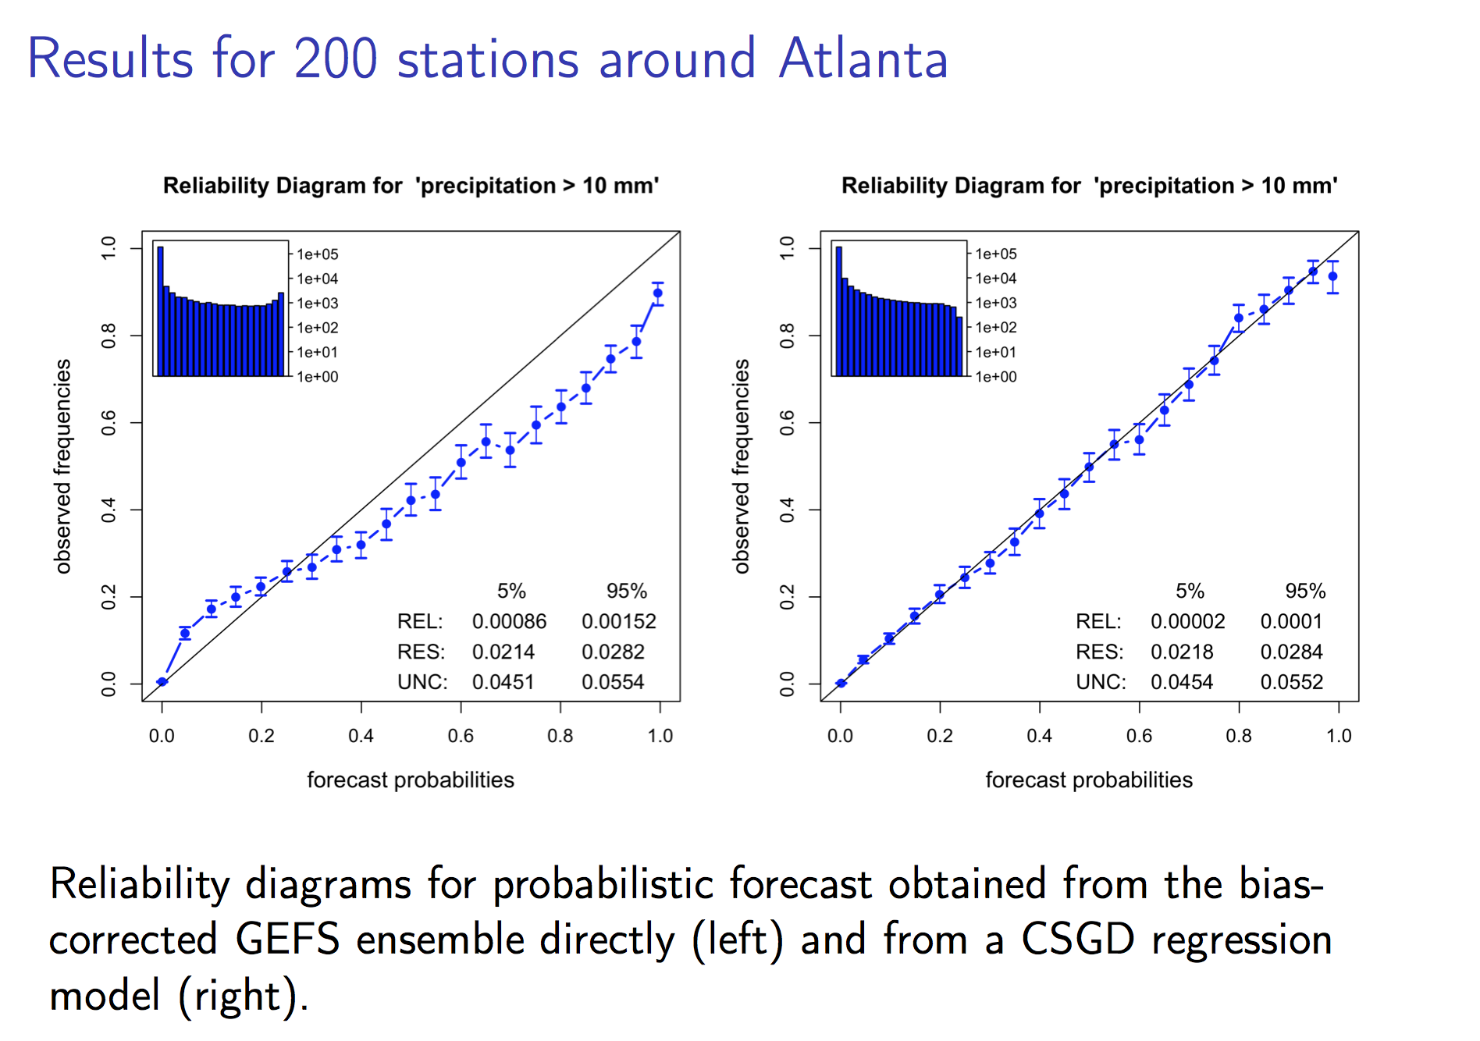

Slide 45
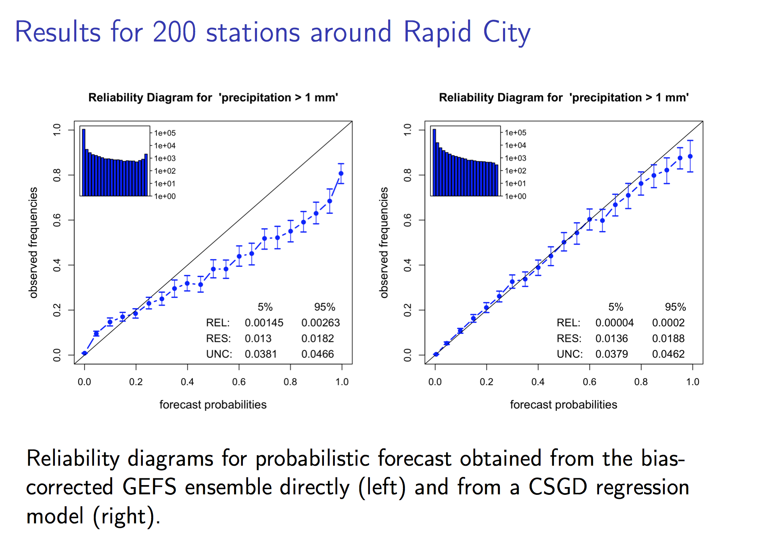

Slide 46
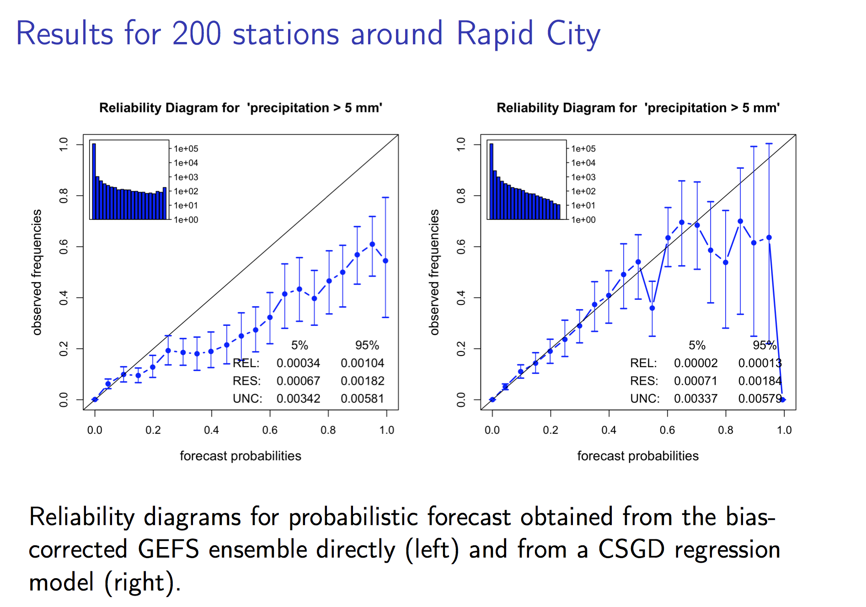

Slide 47

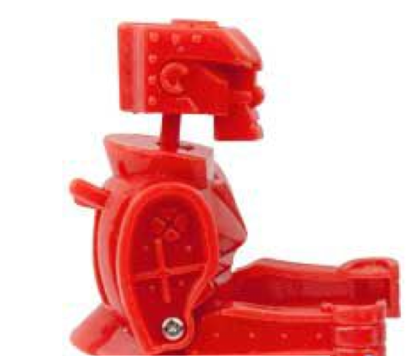
Man vs. machine
Compare my colleague Michael Scheuerer’s forecast methodology for Ithaca NY data, 36-48 forecast lead, Jun-Jul-Aug 2002-2014
“Machine” is Cornell’s Eureqa genetic programming algorithm, constrained to find an equation that is similar in form to Dan Wilks’ extended logistic regression.
Compare against Dan’s “extended” logistic regression also.
Training is not separated from validation data here, but this shouldn’t matter too much with 13 years of data, and for comparative estimates of skill.

Slide 48
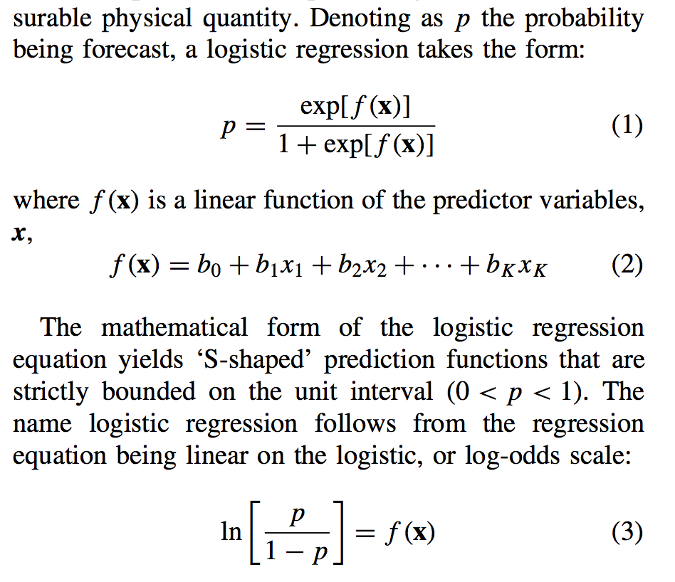
Conventional logistic regression
from Dan Wilk’s article on extended logistic regression, Met Apps, 2009

Slide 49
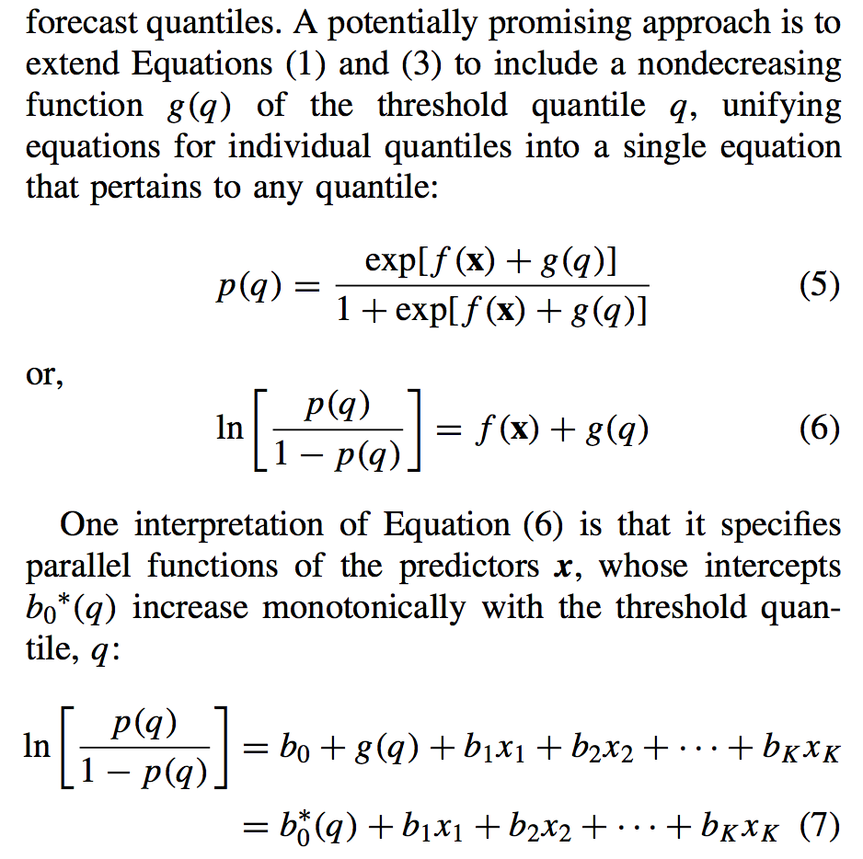
Wilks’ extended logistic regression
g(q) = SQRT(q); square-root transformation applied to precipitation data as well.

Slide 50

Eureqa diagnostics

Slide 51

Eureqa’s data and constraints
Equation form:
Error metric: logarithm squashed form (didn’t have metric like minimization of CRPS)
  Minimizes the squashed error log(1 + |error|)
Data (see next page)

Slide 52

Sample
training data

Slide 53
Brier skill scores, ITH 36-48 h precip.
Methods | BSS > 1 mm | BSS > 2.5 mm | BSS > 5 mm | BSS > 10 mm | BSS > 25 mm
Eureqa (genetic programming) | 0.288 | 0.240 | 0.161 | 0.041 | -0.054
Extended logistic regression | 0.276 | 0.228 | 0.166 | 0.108 | -0.064
3-parameter shifted, censored gamma of Scheuerer | 0.314 | 0.258 | 0.183 | 0.132 | 0.036
A Brier score measures the squared error of the probabilistic forecast averaged over all
samples. The Brier skill score measures the skill relative to a climatological probability
forecast

Slide 54
Conclusions
Adjusting numerical weather prediction forecast guidance of precipitation is difficult.
It is aided tremendously if one has a long time series of past forecasts generated with the same forecast system used operationally (reforecasts).
A variety of post-processing methods have been tried.
The best method that works well with limited training data is an important area for future research (discussed more in supplementary slides).

Slide 55
Challenge: for NWS real-time applications, there is little training data, or it’s hard to get.
GEFS: will change soon to new version, obviating the existing reforecasts.
ECMWF: ~20-year, 1x weekly reforecasts, but have not been made available to us (yet).
CMC: ~ 5 years of reforecasts based on ERA-Interim with near-surface adjustment; not available for this project (yet).
No reforecasts for control/deterministic of various centers.

Slide 56

What might we reasonably do to post-process multi-model ensemble guidance?
Previously (Hamill, July 2012 MWR) multi-model ensembles for POP (July-Oct 2010) verified against 1-degree CCPA produced reliable POP forecasts
1-degree forecasts are not high-enough resolution for Blender; desire on 2.5-km grid.

Slide 57

Notice much detail in western US at scales of O(10 km), below the
model grid spacing. Can we statistically downscale the multi-model ensemble?

Slide 58
Thought process behind
POP statistical downscaling
Large scales: raw multi-model ensemble (MME) reasonably reliable and skillful.
Small scales: raw MME will lack information on the subgrid-scale detail, be unreliable and less skillful than possible. Coarser-resolution ensemble will lack:
  Climatological variations of POP from one region of the box to another.
  The extra forecast uncertainty contributed by these small-scale variations; small scales harder to predict than larger scales.

Slide 59

Proposed downscaling methodology
Here, the left-hand panel shows a member’s forecast precipitation amount at one coarse-res. grid box. The middle figure shows a selected coarse-resolution analysis, chosen to have a value near that of the forecast. The fine-resolution deviations from that coarse-resolution analysis are also shown. The third panel shows our downscaling process: add the fine-scale deviations to the member forecast. A similar process is repeated, choosing a different analysis date, for every forecast member.

Slide 60
Smoothing the POP forecasts
After statistical downscaling, POP forecasts noisy.
Savitzky-Golay (S-G) filter applied. For more details, see:
  http://research.microsoft.com/en-us/um/people/jckrumm/SavGol/SavGol.htm
  http://www.wire.tu-bs.de/OLDWEB/mameyer/cmr/savgol.pdf (good tutorial)
  Numerical Recipes text.
I coded up the S-G filter with a window size of 9 and using 3rd-order polynomial fitting.

Slide 61

without
Savitzky-Golay) with
Savitzky-Golay

Slide 62

Savitzky-Golay filter
designed to preserve amplitudes, unlike more common nxn block smoothers
from Press et al. Numerical Recipes text

Slide 63

Another problem: systematic biases such as over-forecasting of drizzle.
Some regions,
such as in N
Nevada, models
tend to produce
precipitation
unrealistically,
day after day.

Slide 64

CDF-based bias correction
A challenge is that the CDFs from small samples (with CDFs computed separately for each
grid point) may be noisy if computed using a small training sample size.

Slide 65
Potential remedy for small sample size: use supplemental data locations
Idea is to supplement
training data at
each grid point using
n extra grid points
that have similar
observed climatology
and similar
forecast-observed
relationships, as
determined from
GEFS reforecasts.
In this plot, big symbol
is where we’re training,
smaller symbol where
we’re supplementing
training data.

Slide 66
Planned approach for POP during Blender demo period
For demo, final products at 1/8 degree res. as stepping stone to 2.5 km.
Add CDF-based bias correction and statistical downscaling to multi-model ensemble guidance.
Data used in subsequent slides:
  108-120 h coarse res. precip forecasts, ensembles and deterministic for Jan 2014 from ECMWF, NCEP GEFS, UK Met, CMC.
  CDF bias correction trained using Nov-Dec 2013 108-120 h forecasts
  Long time series of both hi-res. and coarse-res. precip analyses (2002-2013) for statistical downscaling.
Technique:
(1) CDF bias correct the forecasts using the past 60 days of forecasts and observations.
(2) Statistically downscale each member
    Find past coarse-res. precip analyses that were most similar to today’s forecasts; similarity evaluated at resolution which forecasts will be stored (47 km or 95-km polar stereo grid). (This is as opposed to our previous analog methodology, which found dates when the past forecast was similar to today’s forecast, then formed ensemble of analyses using those dates).
    The high-resolution precipitation analyses differences from the coarse resolution precip analyses will be added to each member (or multiplied by each member) to produce a higher-resolution downscaled forecast.
  (3) Compute probability from ensemble relative frequency.
  (4) Apply Savitzky-Golay smoothing to mimimize noise from sampling error.

Slide 67
Reliability and skill, before & after
BSS numbers look rather high,
even for the raw ensembles
(next slide). I think this is
because:
perhaps no big “dropouts”
this month?
(b) forecasts were very
different than the long-term
climatology, so skill relative
to climatology was larger
(the month was abnormally
dry in many locations).

Slide 68
Reliability and skill, before & after
BSS numbers look rather high,
even for the raw ensembles
(next slide). I think this is
because:
perhaps no big “dropouts”
this month?
(b) forecasts were very
different than the long-term
climatology, so skill relative
to climatology was larger
(the month was abnormally
dry in many locations).

Slide 69
Reliability and skill of raw ensembles
Over this sample, the
multi-model raw
ensemble skill wasn’t
better than that of
the best forecast,
from ECMWF.
ECMWF
NCEP
CMC
UK Met Office

Slide 70

Jan 2014 accumulated precipitation

Slide 71

Jan 2014 deviation from normal

Slide 72
Benefits of CDF correction may not generalize to higher precipitation amounts
Applying the same methodology
to > 10 mm 12h-1 forecasts, we
see little improvement as a
result of statistical downscaling
or CDF-based bias corrections.
It’s likely that 60 days, even with
supplemental locations, is not
enough samples to properly
adjust > 10 mm forecasts
(reforecasts needed)

Slide 73
State estimation (“data assimilation”)
observations for time t
forecast for time t
data assimilation
state estimate for time t
weather
forecast
model
forecast for
time t+Δt

Slide 74
State estimation (“data assimilation”)
observations for time t
+ observation-error
statistics
forecast for time t
data assimilation
state estimate for time t
weather
forecast
model
forecast for time t+Δt
+ forecast-error
statistics

Slide 75

The ensemble Kalman filter: a schematic
(This schematic
is a bit of an
inappropriate
simplification,
for EnKF uses
every member
to estimate
background-
error covariances.
We also developed
a method that
bypasses
perturbing the
observations.)
[back]

Slide 76

Stochastic parameterization: scientific basis
Shrinking grid spacings in many models violate assumptions underlying many deterministic parameterizations, whereby the process (here, effects of thunderstorms) is occurring in a only a small fraction of the grid box.
Plant and Craig’s (2008 JAS) experiments with 2-km, 128 x 128 doubly periodic grid simulation of tropical convection run to statistical equilibrium.
Note that the mass flux when averaged over large boxes has a narrow distribution, i.e., behaves quasi-deterministically. When considering the mass flux at
reduced grid spacing, there is much more variability.
This is one result (many others, too) showing that there is a breakdown in the validity of using deterministic parameterizations as model resolution is increased.

Slide 77
Stochastic parameterization: scientific basis
Some subgrid-scale processes depend on unknowable sub-grid details, not just grid-scale details, such as the radiation/microphysics dependence on estimated cloud droplet size spectrum.
upward
solar via
reflectance
upward
solar via
reflectance
downward
solar
downward
solar
transmitted
transmitted
Example: two grid columns with same cloud liquid water. Left-hand column has more small
droplets and higher albedo, right-hand column has fewer droplets, smaller albedo.

Slide 78
Stochastic parameterization: scientific basis
Some details of grid-scale characteristics may be mis-estimated and should be treated as random variables.
downward
solar
downward
solar
large latent
heat flux
small latent
heat flux
assumed
rough surface
assumed
smooth surface
assumed
porous soil
assumed less
porous soil
Here, given our imprecise knowledge of roughness lengths and soil hydraulic
conductivity make them amenable to treatment as random variables.

Slide 79
Stochastic parameterization: scientific basis
Some processes are highly chaotic and have stochastic characteristics even when resolved. e.g. in large eddy or direct numerical simulations. Example: lateral entrainment in convective plumes.
[back]

