Slide 1

Improved Statistical Postprocessing of Precipitation for NWS Forecasts and Hydrologic Applications
Tom Hamill
ESRL Physical Sciences Division, Boulder, Colorado
tom.hamill@noaa.gov +1 (303) 497-3060

Slide 2
Outline
1. Describe the technique behind the multi-model ensemble statistical postprocessing of precipitation for the “National Blend of Models” project, with results and examples.
2. Describe the technique for re-creating synthetic ensemble members that have appropriate space / time relationships, suitable for initializing hydrologic ensemble predictions.
  Work to date: a procedure that works well in small basins.
  Upcoming work: large basins like the Great Lakes.

Slide 3
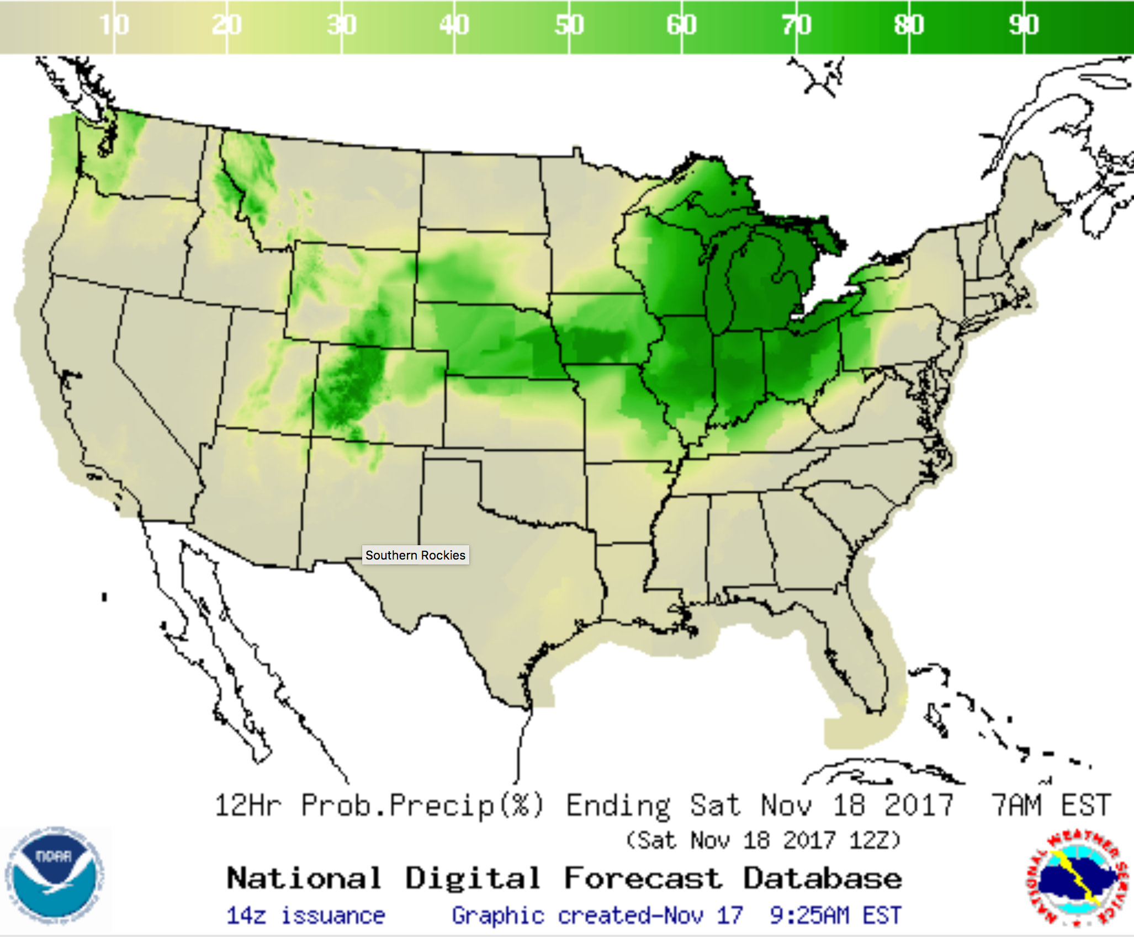
Why the National Blend? Look at recent data from the NDFD (National Digital Forecast Database)
Multiple forecast offices
read centrally prepared
digital guidance from the
NDFD, modify that in
their local region, and
write it back out.
Differences in opinion
about the forecast lead
to discontinuities in the
NDFD.
What if the centrally
produced digital guidance
was so good that no
forecaster modification was
necessary?
Denver/Boulder
WFO
Pueblo WFO
etc.

Slide 4
Louis Uccellini’s directive, and our work
“Produce high quality, statistically postprocessed, multi-model ensemble guidance for initializing the National Digital Forecast Database.”
  implicitly “so good that the forecasters leave it alone.”
My colleagues and I are responsible for the advanced development of QPF and PQPF algorithms.
We hand them off to MDL (Meteorological Development Lab). They have incorporated some of our ideas; others await tech transition.

Slide 5
What do we mean by postprocessing?
Recent GEFS
ensemble
predictions
Observations
or analyses
Train postprocessing method
Post-processed
guidance
NCEP GEFS
or similar system
Real-time
ensemble
predictions
Corrections
Apply postprocessing method

Slide 6
What qualities do we want in the post-processed guidance?
Statistical downscaling: if there is predictable sub-grid scale information.
Correction of mean bias: correct, for example, the tendency to over-forecast light precipitation and under-forecast heavy precipitation.
Correction of spread deficiency: ensembles are over-confident in their forecasts.
Address the sampling variability from the limited ensemble size.
Reliability: when 30% event probability issued, that happens 30% of the time.
Sharpness: forecasts are as specific as possible (near 0 or 1 probability, not climatological probability).

Slide 7
High-level concept of National Blend PQPF
Model A
Model B
Model C
Model D
Currently the data from various ensemble prediction systems are combined at an early stage of the National Blend postprocessing. The technique I’ll describe in subsequent slides is an update of this.
Statistical
Postprocessing
Ideally, the NDFD is so good in accuracy, detail, spatial consistency that forecasters see no need to manually modify.
NDFD
WFOs

Slide 8
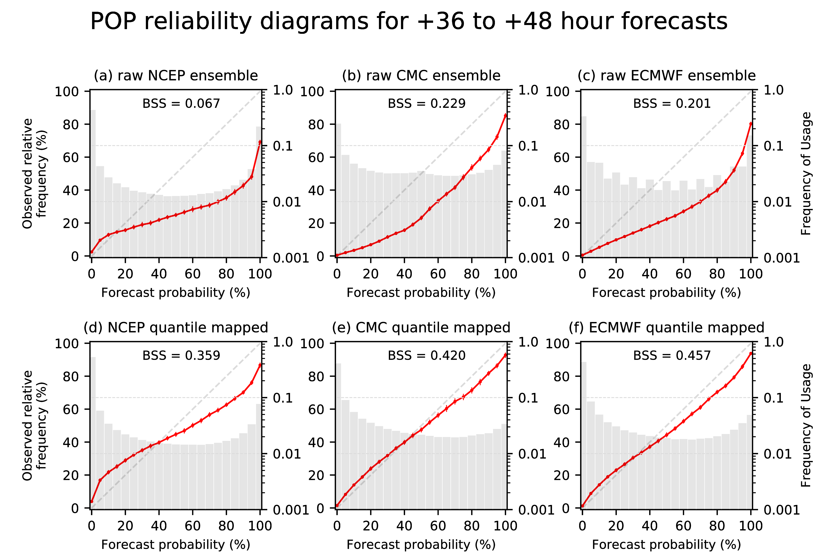
Reliability diagrams for raw ensemble guidance, verified against 1/8-degree CCPA, Apr-Jun 2016, CONUS
Raw ensemble guidance is quite unreliable, due to many issues, including insufficient resolution, treatment of model uncertainty in the ensemble prediction system, sampling issues from limited ensemble size. We need post-processing methods to improve skill and reliability and synthesize information from multiple systems.

Slide 9
How do we get around the problem of a lack of training data?
Say you want to statistically post-process your model precipitation forecast to improve it. Training only with data at this particular point, we don’t have enough information to make a statistically meaningful correction to the most recent forecast.

Slide 10
A high-level description of the algorithm
Process each modeling system independently.
“Supplemental locations” to increase training sample size (train with last 60 days of forecast and analyzed precipitation).
Quantile mapping to address biases in mean forecasts.
Form probability from ensemble members:
  Different sorted members have different weights.
  Different sorted members have different dressing distributions.
Linearly combine probabilities from multiple systems.

Slide 11
Future Blend PQPF algorithm
CMC ensemble data
CMC deterministic data
NCEP ensemble data
NCEP deterministic data
FNMOC ensemble data
FNMOC deterministic data
Enhanced National Blend algorithm
Enhanced National Blend algorithm
Enhanced National Blend algorithm
Enhanced National Blend algorithm
Enhanced National Blend algorithm
Enhanced National Blend algorithm
CMC ensemble
PQPF
CMC deterministic
PQPF
NCEP ensemble
PQPF
NCEP deterministic
PQPF
FNMOC ensemble
PQPF
FNMOC deterministic
PQPF
Weighted linear combination
Final maps of PQPF

Slide 12
Future Blend algorithm
straightforward to deal with data outage;
just change weights of existing systems.
CMC ensemble data
CMC deterministic data
NCEP ensemble data
NCEP deterministic data
FNMOC ensemble data
FNMOC deterministic data
Enhanced National Blend algorithm
Enhanced National Blend algorithm
Enhanced National Blend algorithm
Enhanced National Blend algorithm
Enhanced National Blend algorithm
Enhanced National Blend algorithm
CMC ensemble
PQPF
CMC deterministic
PQPF
NCEP ensemble
PQPF
NCEP deterministic
PQPF
FNMOC ensemble
PQPF
FNMOC deterministic
PQPF
Weighted linear combination
Final maps of PQPF

Slide 13
Future Blend algorithm
Can swap out algorithm for systems with
more training data (GEFS), or different quality (HRRRE).
CMC ensemble data
CMC deterministic data
NCEP ensemble data
NCEP deterministic data
FNMOC ensemble data
FNMOC deterministic data
Enhanced National Blend algorithm
Enhanced National Blend algorithm
Reforecast Blend algorithm
Enhanced National Blend algorithm
Enhanced National Blend algorithm
Enhanced National Blend algorithm
CMC ensemble
PQPF
CMC deterministic
PQPF
NCEP ensemble
PQPF
NCEP deterministic
PQPF
FNMOC ensemble
PQPF
FNMOC deterministic
PQPF
Weighted linear combination
Final maps of PQPF

Slide 14
How do we get around the problem of a lack of training data?
Say you want to statistically post-process your model precipitation forecast to improve it. Training only with data at this particular point, we don’t have enough information to make a statistically meaningful correction to the most recent forecast.

Slide 15
Pool training data in the surrounding region?
Biases can be related to geographic location.
Illustration of how two nearby locations can have very different conditional systematic
bias.
CDFs here were built from more than a decade of daily reforecasts from the NCEP GEFS system (Hamill et al., BAMS, 2013).
Naïve pooling of training data
together across wide regions
will be harmful in some areas
like western US.

Slide 16
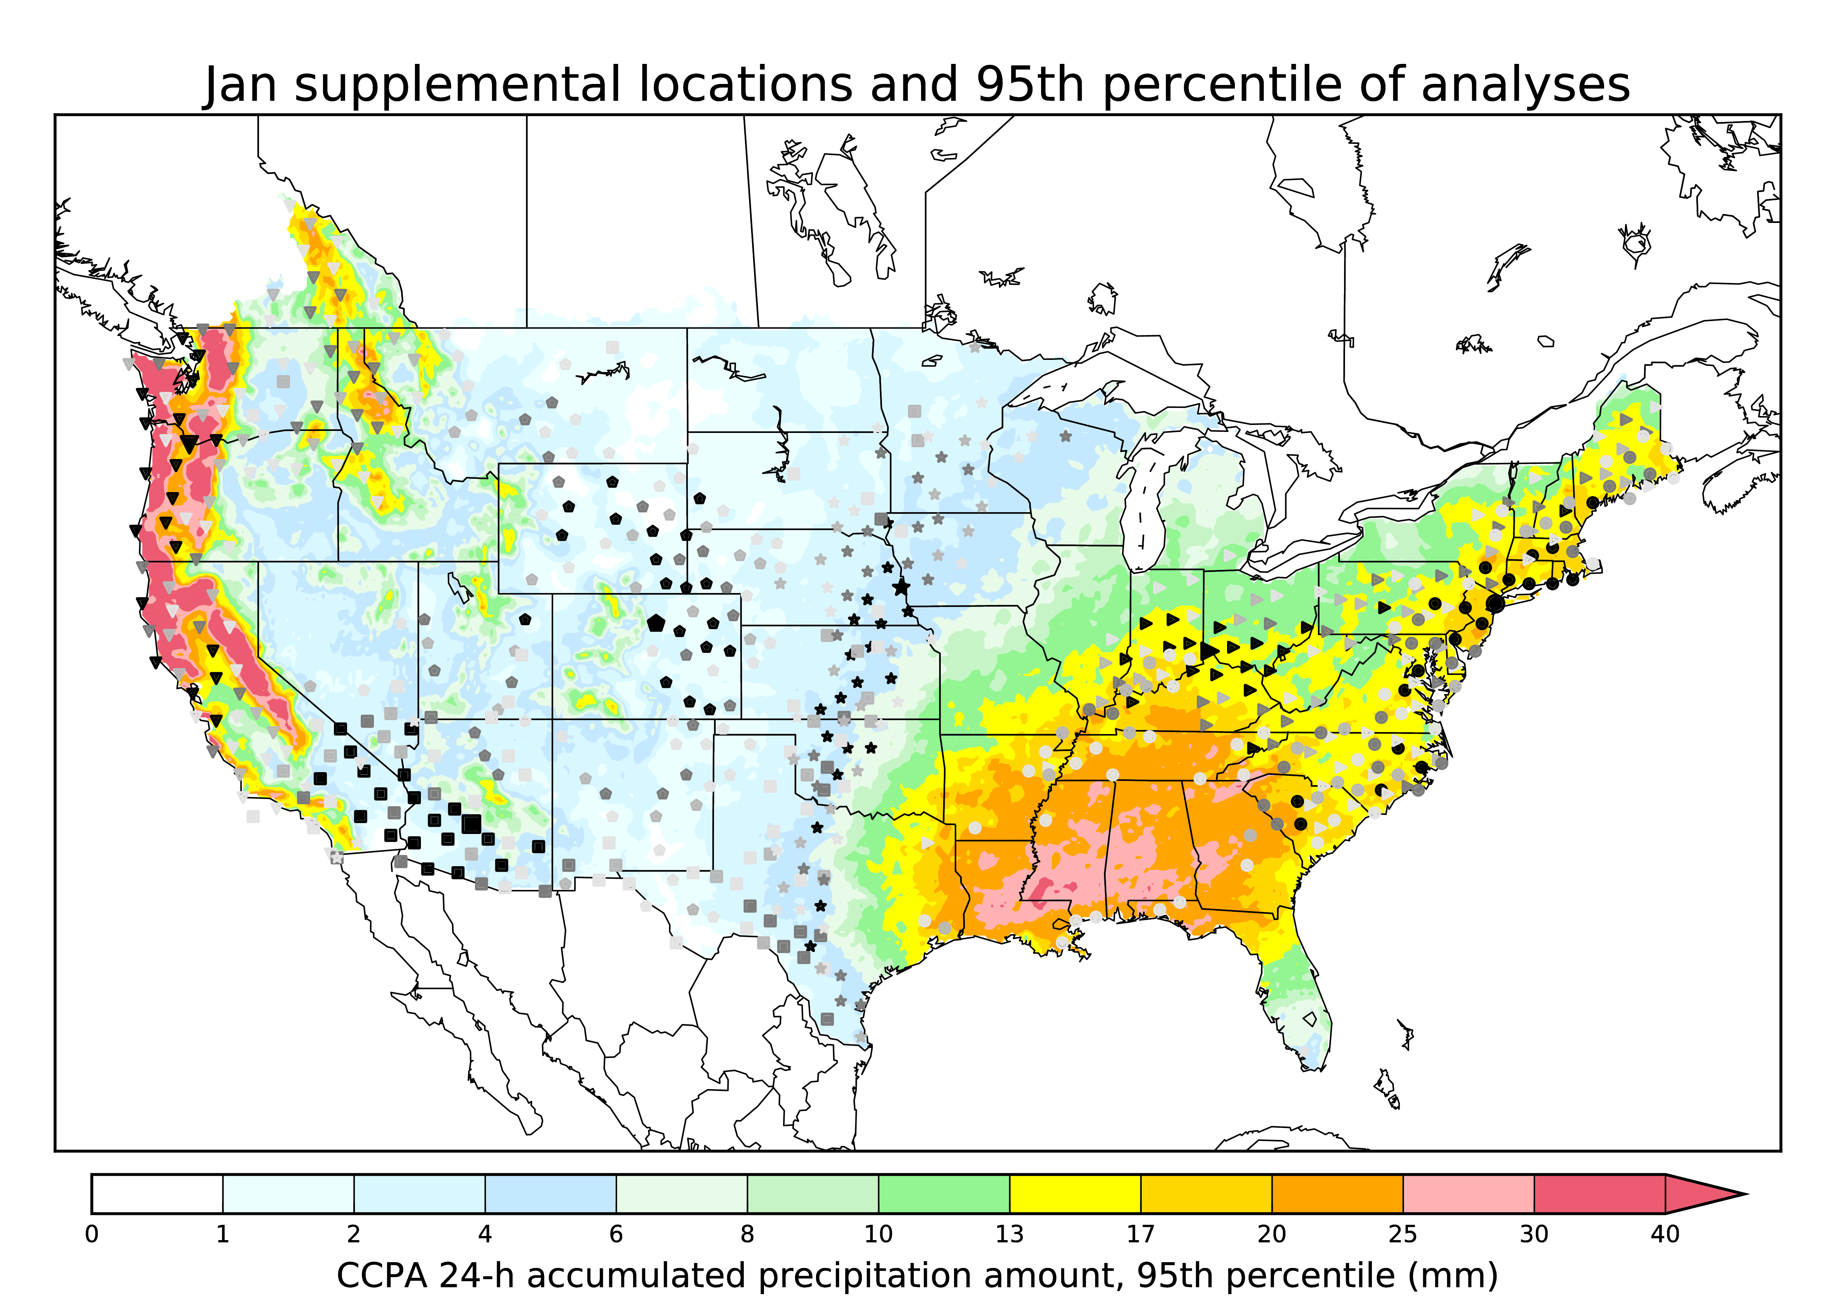
Enlarging training sample size with supplemental locations.
Large symbol = where we are defining the supplemental locations.
Small symbol = supplemental locations, chosen for similarity of precipitation climatology, terrain aspect and height.
Darkness of the symbol indicates the penalty function (lighter symbols are a poorer fit).
While only a few locations are shown, this procedure was used to define supplemental locations for every 1/8-degree grid point across the CONUS.
These were then used to populate the CDFs used in the later quantile mapping step.
See Appendix A of this for more: Hamill, T. M., E. Engle, D. Myrick, M. Peroutka, C. Finan, and M. Scheuerer, 2016: The US National Blend of Models statistical post-processing of probability of precipitation and deterministic precipitation amount. Mon. Wea. Rev., conditionally accepted. Appendix A and Appendix B.

Slide 17
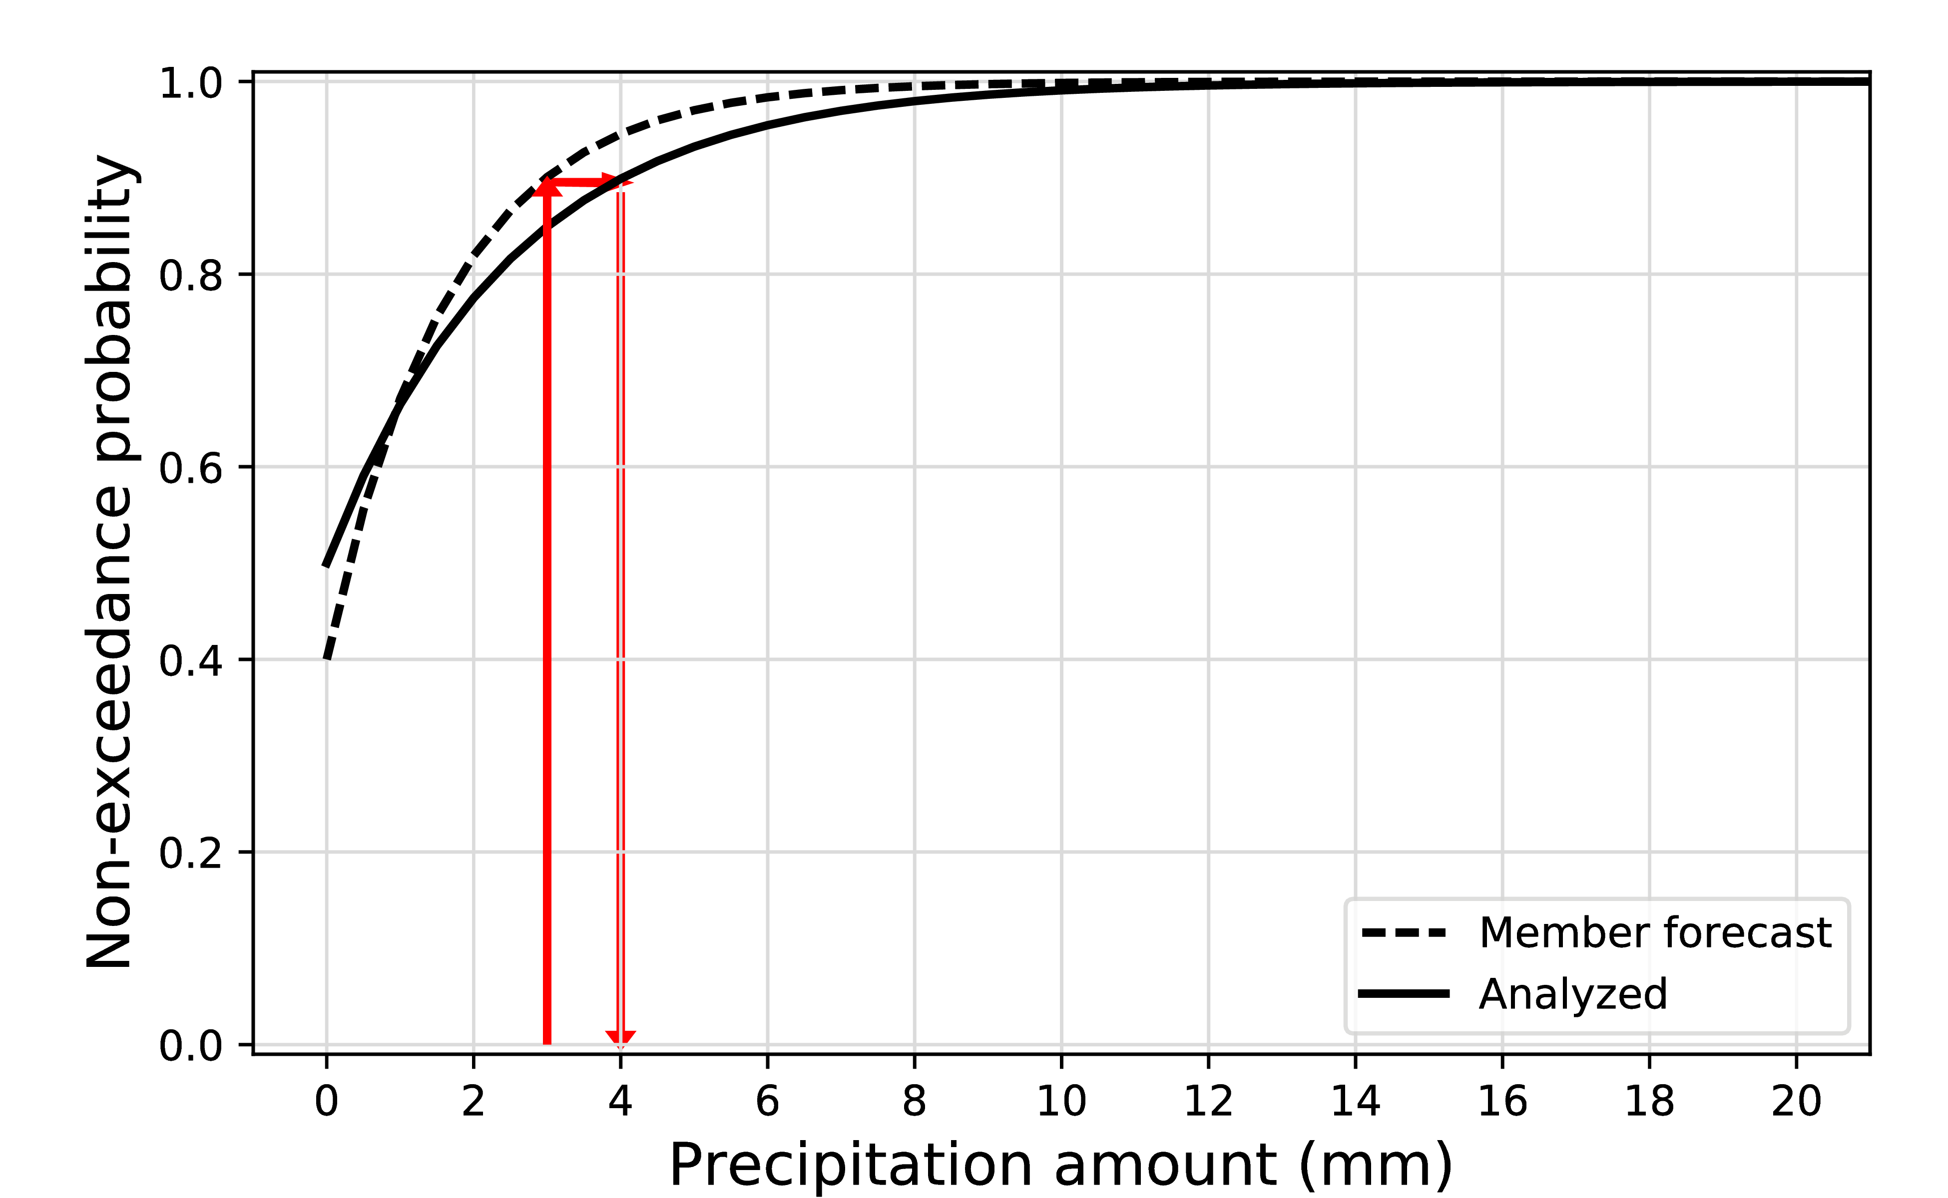
Using supplemental locations, apply quantile mapping.
Replace the forecast value with the observed value associated with the same cumulative percentile of the distribution.
This procedure is repeated independently for each ensemble member. Different forecast CDFs are permitted for different members in CMC ensemble.

Slide 18
Why quantile mapping to adjust for conditional bias?
Regression will not preserve diversity of adjusted ensemble at long leads; all members regress toward mean, resulting in loss of more spread.
Non-linear mapping relationships preferable to linear regression.
In this example, the
CDFs were constructed
only from the data at
this location, but using
2002-2015 data from
our GEFS reforecast
data set (same forecast
system for all dates).

Slide 19
Regression of longer-lead forecasts: a synthetic example
Analyzed Amount
Regression line
Forecast Amount

Slide 20
Regression of longer-lead forecasts: a synthetic example
The diversity in the forecast ensemble is
greatly limited through the regression process,
especially for longer-lead forecasts with
less relationship between forecast and analysis.
This leads to a greater spread deficiency in the
regressed ensembles, one of the problems we are seeking to correct.
Analyzed Amount
Forecast Amount

Slide 21
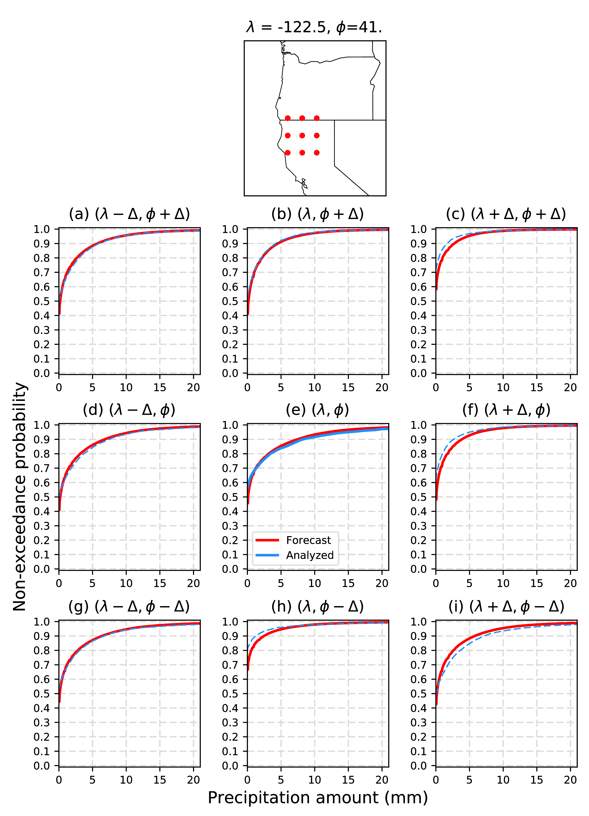
Enlarging ensemble size and dealing with overconfidence in precipitation location: quantile mapping using surrounding points.
We seek an enlarged, quantile-mapped ensemble at the center point,
and a way of implicitly accounting for over-confidence of ensemble
prediction systems in the spatial location of precipitation features.
Forecasts at the 3 x 3 array of points are all quantile mapped to central grid point. The trick here is to use the forecast CDFs unique to each of the 3x3 array of points (red curves) but the CDF for the central point. Note: a recent change is that I now use a 5 x 5 stencil.
In this way, ensemble forecasts are all adjusted such that they are consistent with the analyzed climatology at the center point.
This process is repeated independently for each model grid point in the CONUS.
Inspired by Michael Scheuerer; see Scheuerer and Hamill (2015) MWR.

Slide 22
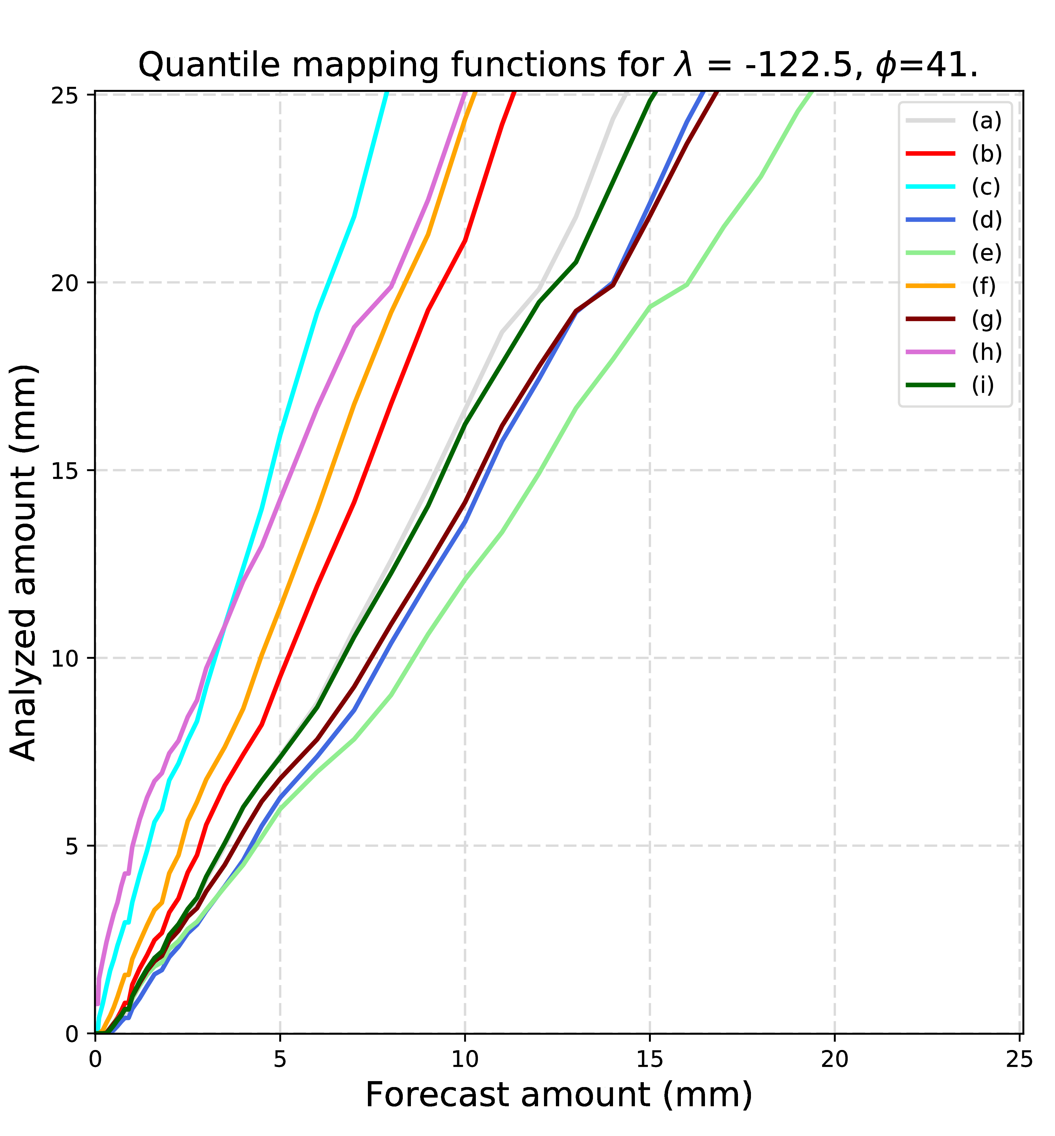
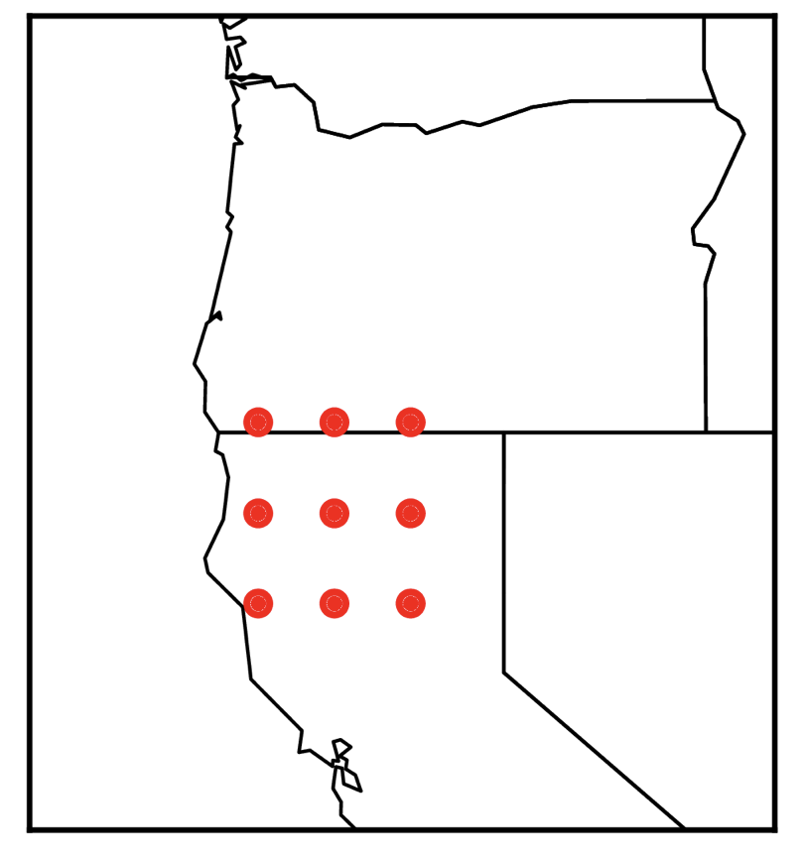
Mapping relationships implied in previous example.
This illustrates how it’s possible to take forecast information
from locations a through i and bias correct them to be consistent with the climatology from location e, at
the center point.
a b c
d e f
g h i

Slide 23
Raw and quantile-mapped results, POP
Quantile mapping
with supplemental
locations dramatically
improved forecast
guidance skill and
reliability, especially
with the under-performing
NCEP system. But there
are still issues with
reliability to varying
degrees.

Slide 24
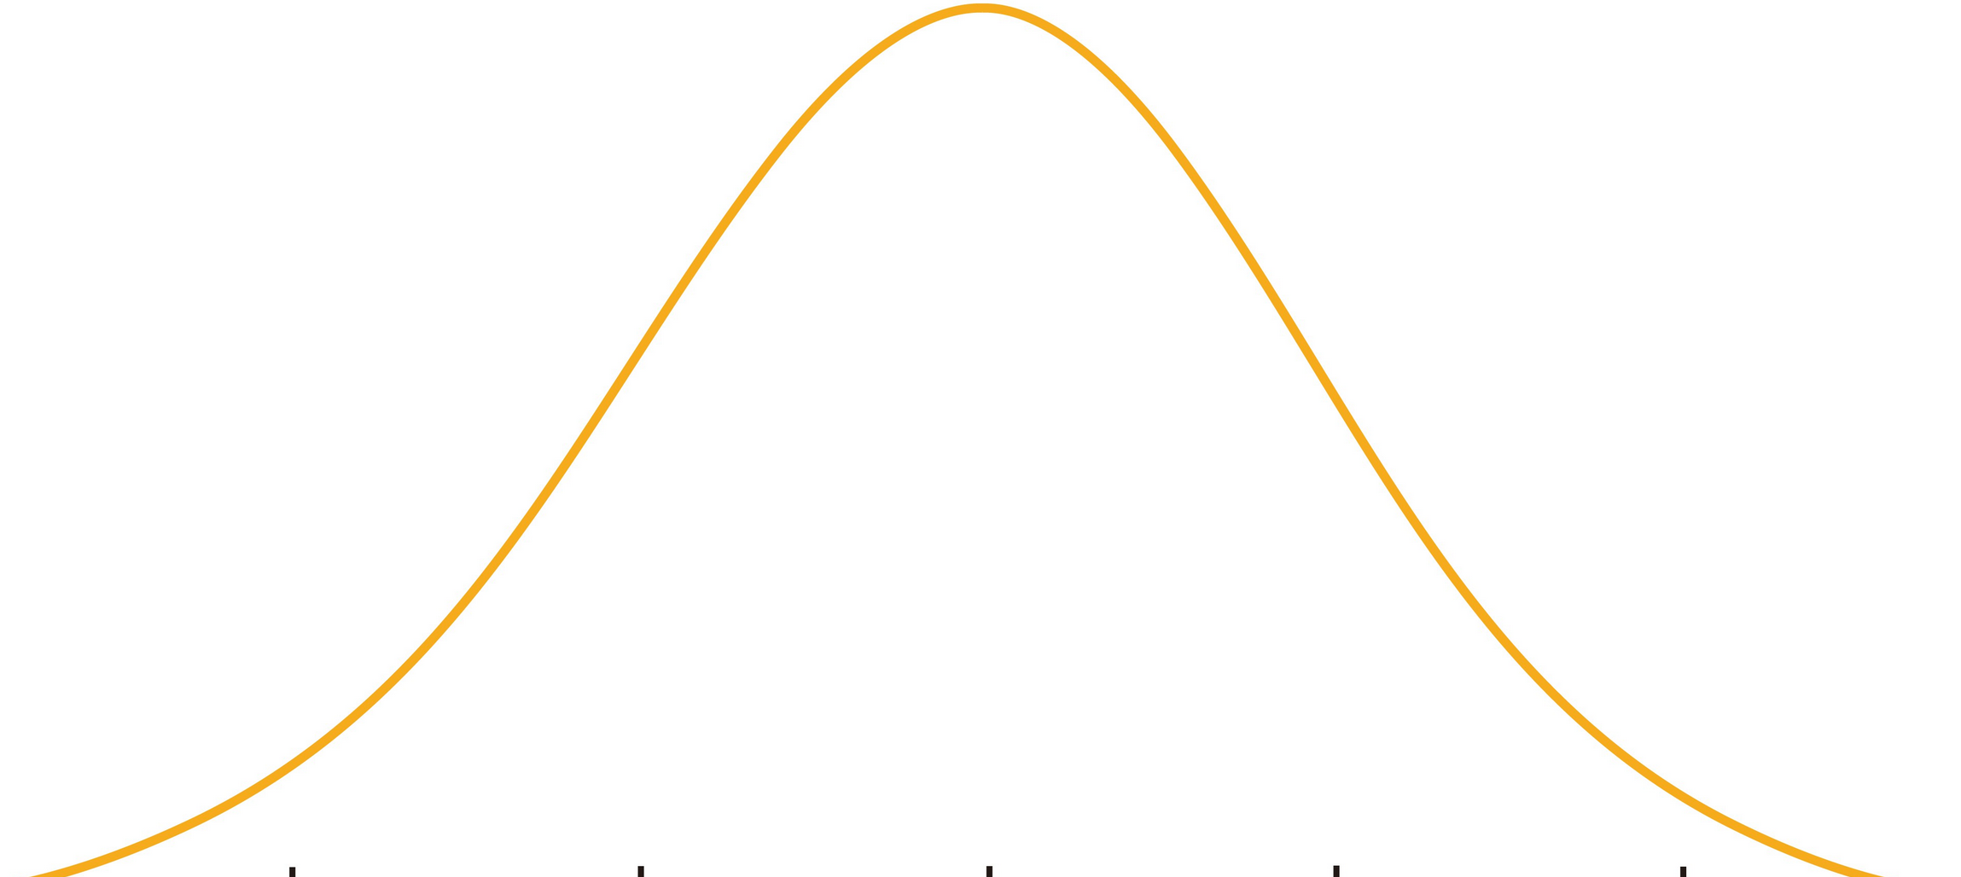
“Dressing”: Fortin’s two ways to address overconfidence
1. Increase ensemble spread by “dressing” with pdfs.
BEFORE
(more sharp)
probability from relative frequency = 9/10
0 mm
1 mm
2 mm
3 mm
4 mm
POP
threshold
AFTER
(less sharp)
probability from integrating kernel densities ~ 85 %
0 mm
1 mm
2 mm
3 mm
4 mm
POP
threshold
Fortin extends this even farther, permitting the kernels to vary in their characteristic, member by member
Ref: http://onlinelibrary.wiley.com/doi/10.1256/qj.05.167/abstract

Slide 25
Dressing: Fortin’s two ways to address overconfidence
2. Re-weight the ensemble
probability from weighted relative frequency = 0.75
0.08
0.08
0.08
0.25
0.08
0.08
0.08
0.08
0.08
0.13
0 mm
1 mm
2 mm
3 mm
4 mm
To objectively re-weight the ensemble, we need evidence from the data of past quantile-mapped forecasts as to which sorted member is closest to the analyzed state. These provide weights to apply to each member.
Ref: http://onlinelibrary.wiley.com/doi/10.1256/qj.05.167/abstract

Slide 26
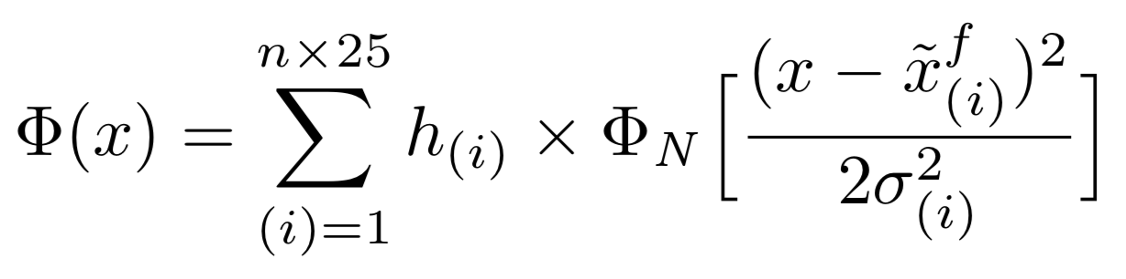
New PQPF dressing procedure.
Generate a post-processed CDF F(x) as a function of precipitation amount x. The overall CDF will be obtained from the weighted summation of CDFs associated with dressed, quantile-mapped ensemble members.
see next slide for explanation of terms

Slide 27
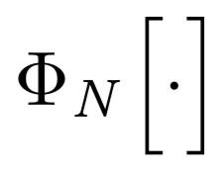
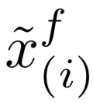

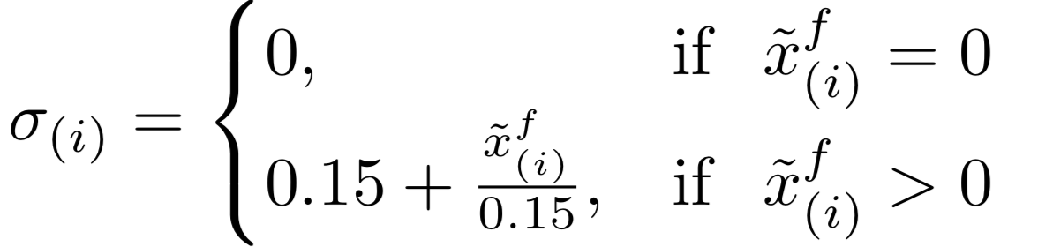
weighting
dressing CDF applied to
(i)th sorted member
h_{(i)} is a weighting applied to the (i)th sorted member, based on the “closest-member histogram” discussed in subsequent slides.
is a Gaussian-distributed dressing distribution (converted here to a CDF)
is the (i)th-ranked, quantile-mapped forecast in the stencil.
dressing distribution widens with increasing precipitation amount
Ref: http://onlinelibrary.wiley.com/doi/10.1256/qj.05.167/abstract

Slide 28
weighting
dressing CDF applied to
(i)th sorted member
h_{(i)} is a weighting applied to the (i)th sorted member, based on the “closest-member histogram” discussed in subsequent slides.
is a Gaussian-distributed dressing distribution (converted here to a CDF)
is the (i)th-ranked, quantile-mapped forecast in the stencil.
dressing distribution widens with increasing precipitation amount
Ref: http://onlinelibrary.wiley.com/doi/10.1256/qj.05.167/abstract

Slide 29
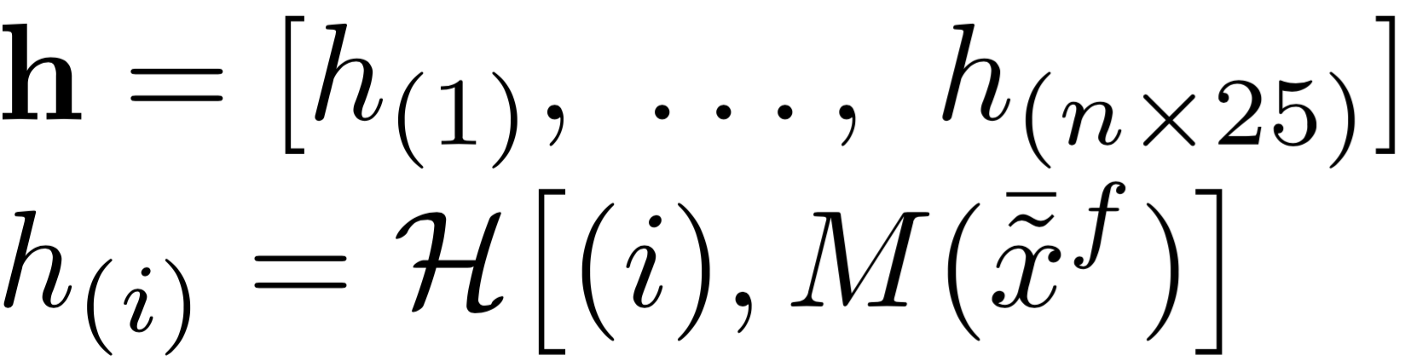
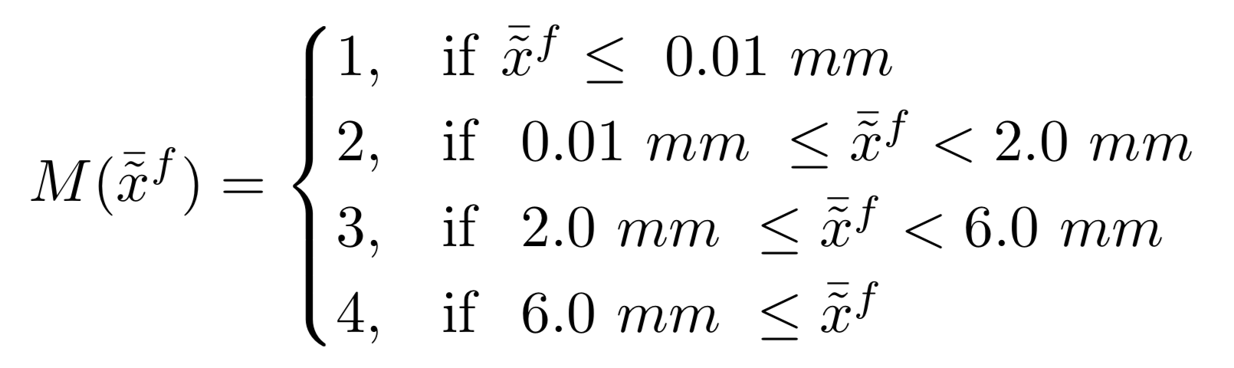
h_{(i)} is a weighting applied to the (i)th sorted member, based on the “closest-member histogram” discussed in next slide.
The histogram weights depend on the rank (i), and an index based on the mean quantile-mapped precipitation amount

Slide 30
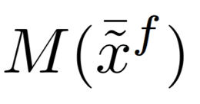
Closest-member histograms used in weighting the quantile-mapped ensemble members.
(index 2 for M)
To generate these histograms, we sort the quantile-mapped and twenty-five-fold enlarged ensemble from lowest to highest. Compare this to the analyzed precipitation. Only one member (except in the case of ties) can be the best, the closest to the analyzed.
For various mean precipitation amounts, we tally statistics of which sorted member was closest to the analyzed over the CONUS and over the training sample. Savitzky-Golay smoothed curves in blue are the actual ones used. This provides the h_{(i)} discussed in previous slides. The histograms are very similar to rank histograms.
The histogram we choose to use will vary with quantile-mapped forecast mean precipitation amount (the three panels to the left). This is from previous page.
Note that the outlying members have much greater probability of being the “closest” member, consistent with an overconfident ensemble. Those outlying members are thus weighted more, increasing ensemble spread.
(index 3 for M)
(index 4 for M)

Slide 31
Postprocessing results.
(data on 1/8 degree grid over CONUS, April-June 2016, trained and evaluated against CCPA precipitation analyses. Previous 60 days of forecasts/analyses used to train).

Slide 32
quantile mapping
with 5 x 5 stencil of
surrounding points
makes a significant
improvement to
reliability and
skill of POP.

Slide 33
POP after closest histogram weighting, dressing
Further improvement in reliability and skill
with closest-histogram weighting and dressing.
Slight improvement of MME over best
system, ECMWF.

Slide 34
Raw & quantile-mapped results, > 10 mm
Quantile mapping
(using 5x5 stencil of
surrounding points)
does not substantially
improve reliability
and skill at this
higher event threshold.

Slide 35
After closest-histogram weighting, dressing, > 10 mm
Fairly reliable probabilities (with short training data!)
Very light improvement of MME over best
system, ECMWF.

Slide 36
Quantile mapping helps tremendously with improving the skill of probabilistic forecasts for this light threshold, 0.254 mm / 12 (POP).
Further weighting and dressing provides a slight further improvement, less for the more skillful systems.

Slide 37
Here, the variable closest histogram weighting provides more of an improvement than the quantile mapping. Likely the mapping is quite noisy at high amounts due to insufficient sample size, even w. supplemental locations.
For both POP and > 10 mm, it’s hard for MME to improve upon best system, ECMWF.

Slide 38
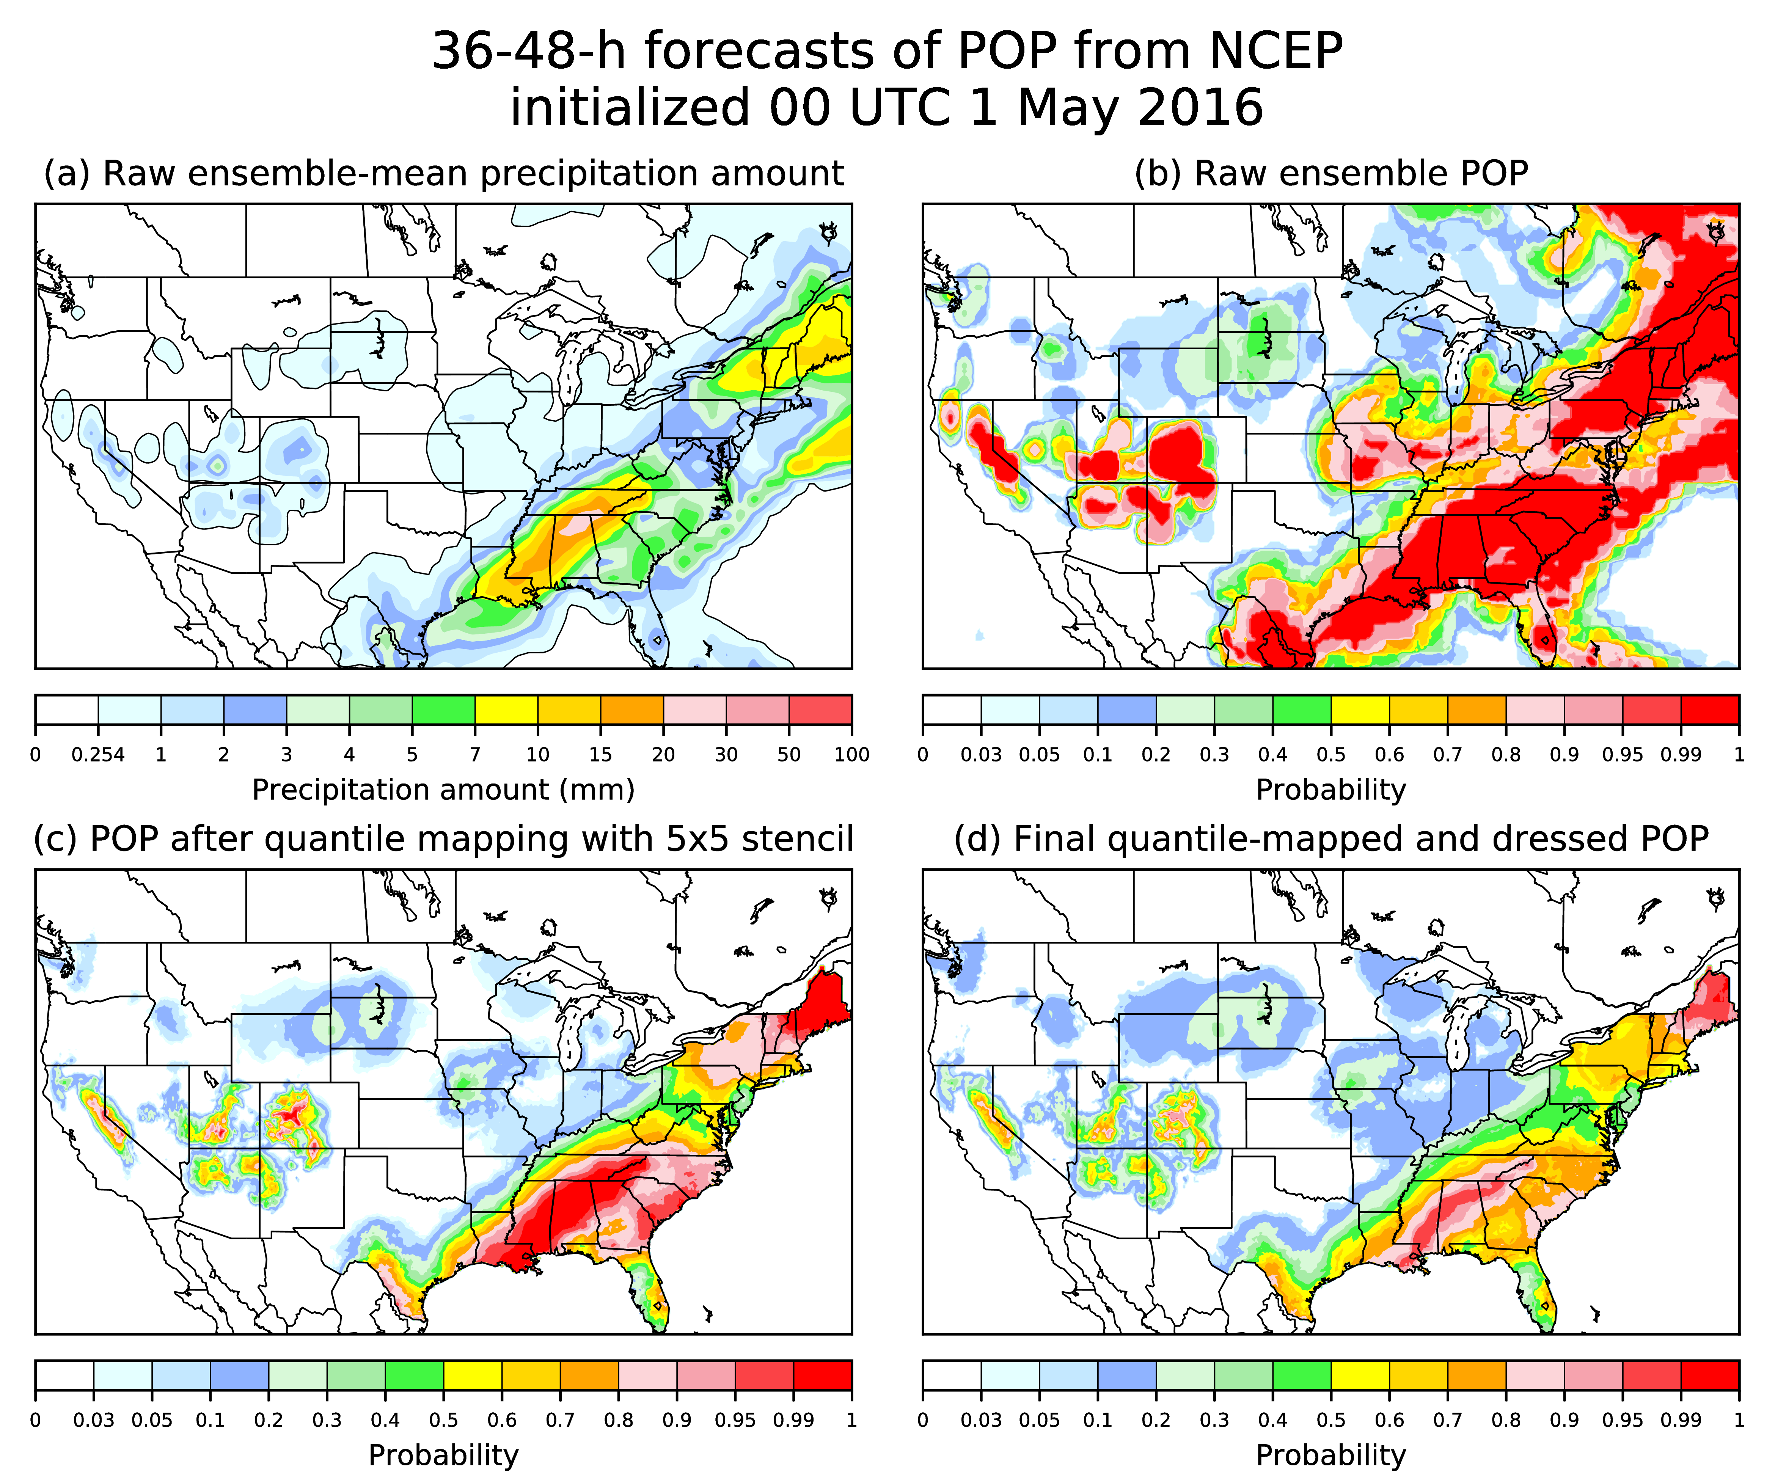
A quick case study (NCEP GEFS).
Notice a few things from this system’s postprocessing:
Quantile mapping in panel (c) adds spatial detail, i.e., is performing statistical downscaling against higher-resolution analysis data. Some decrease in sharpness too.
Dressing in panel (d) generally further moderates extreme probabilities.

Slide 39
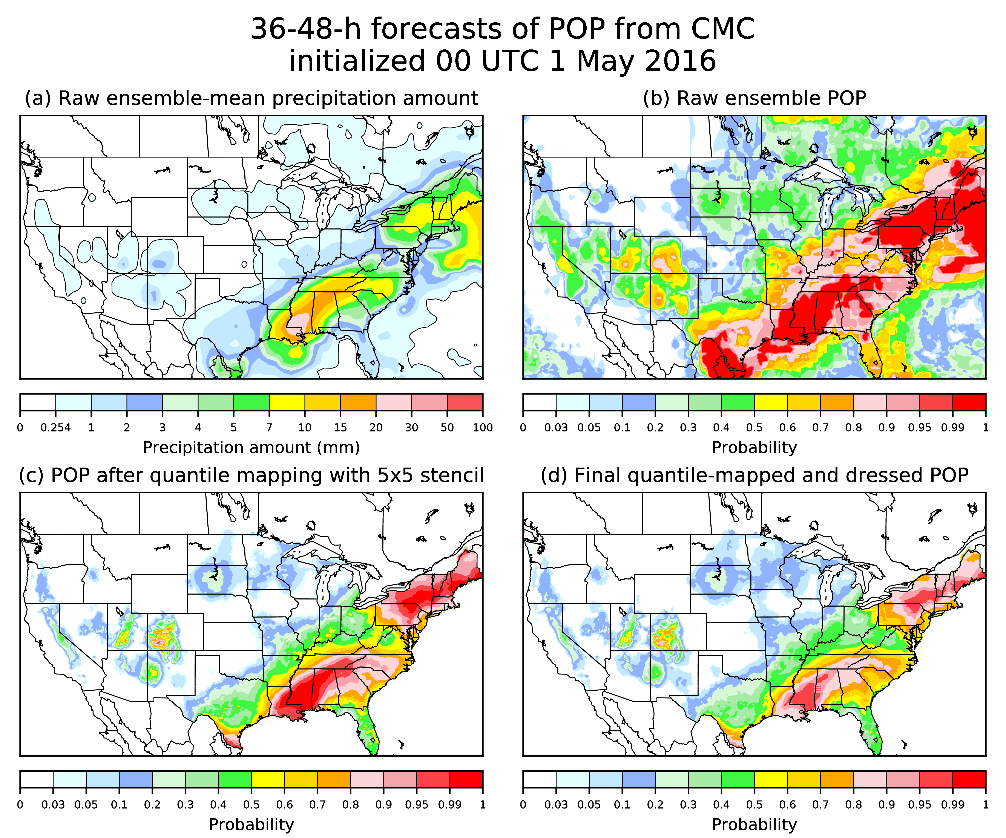
A quick case study (CMC ensemble).

Slide 40
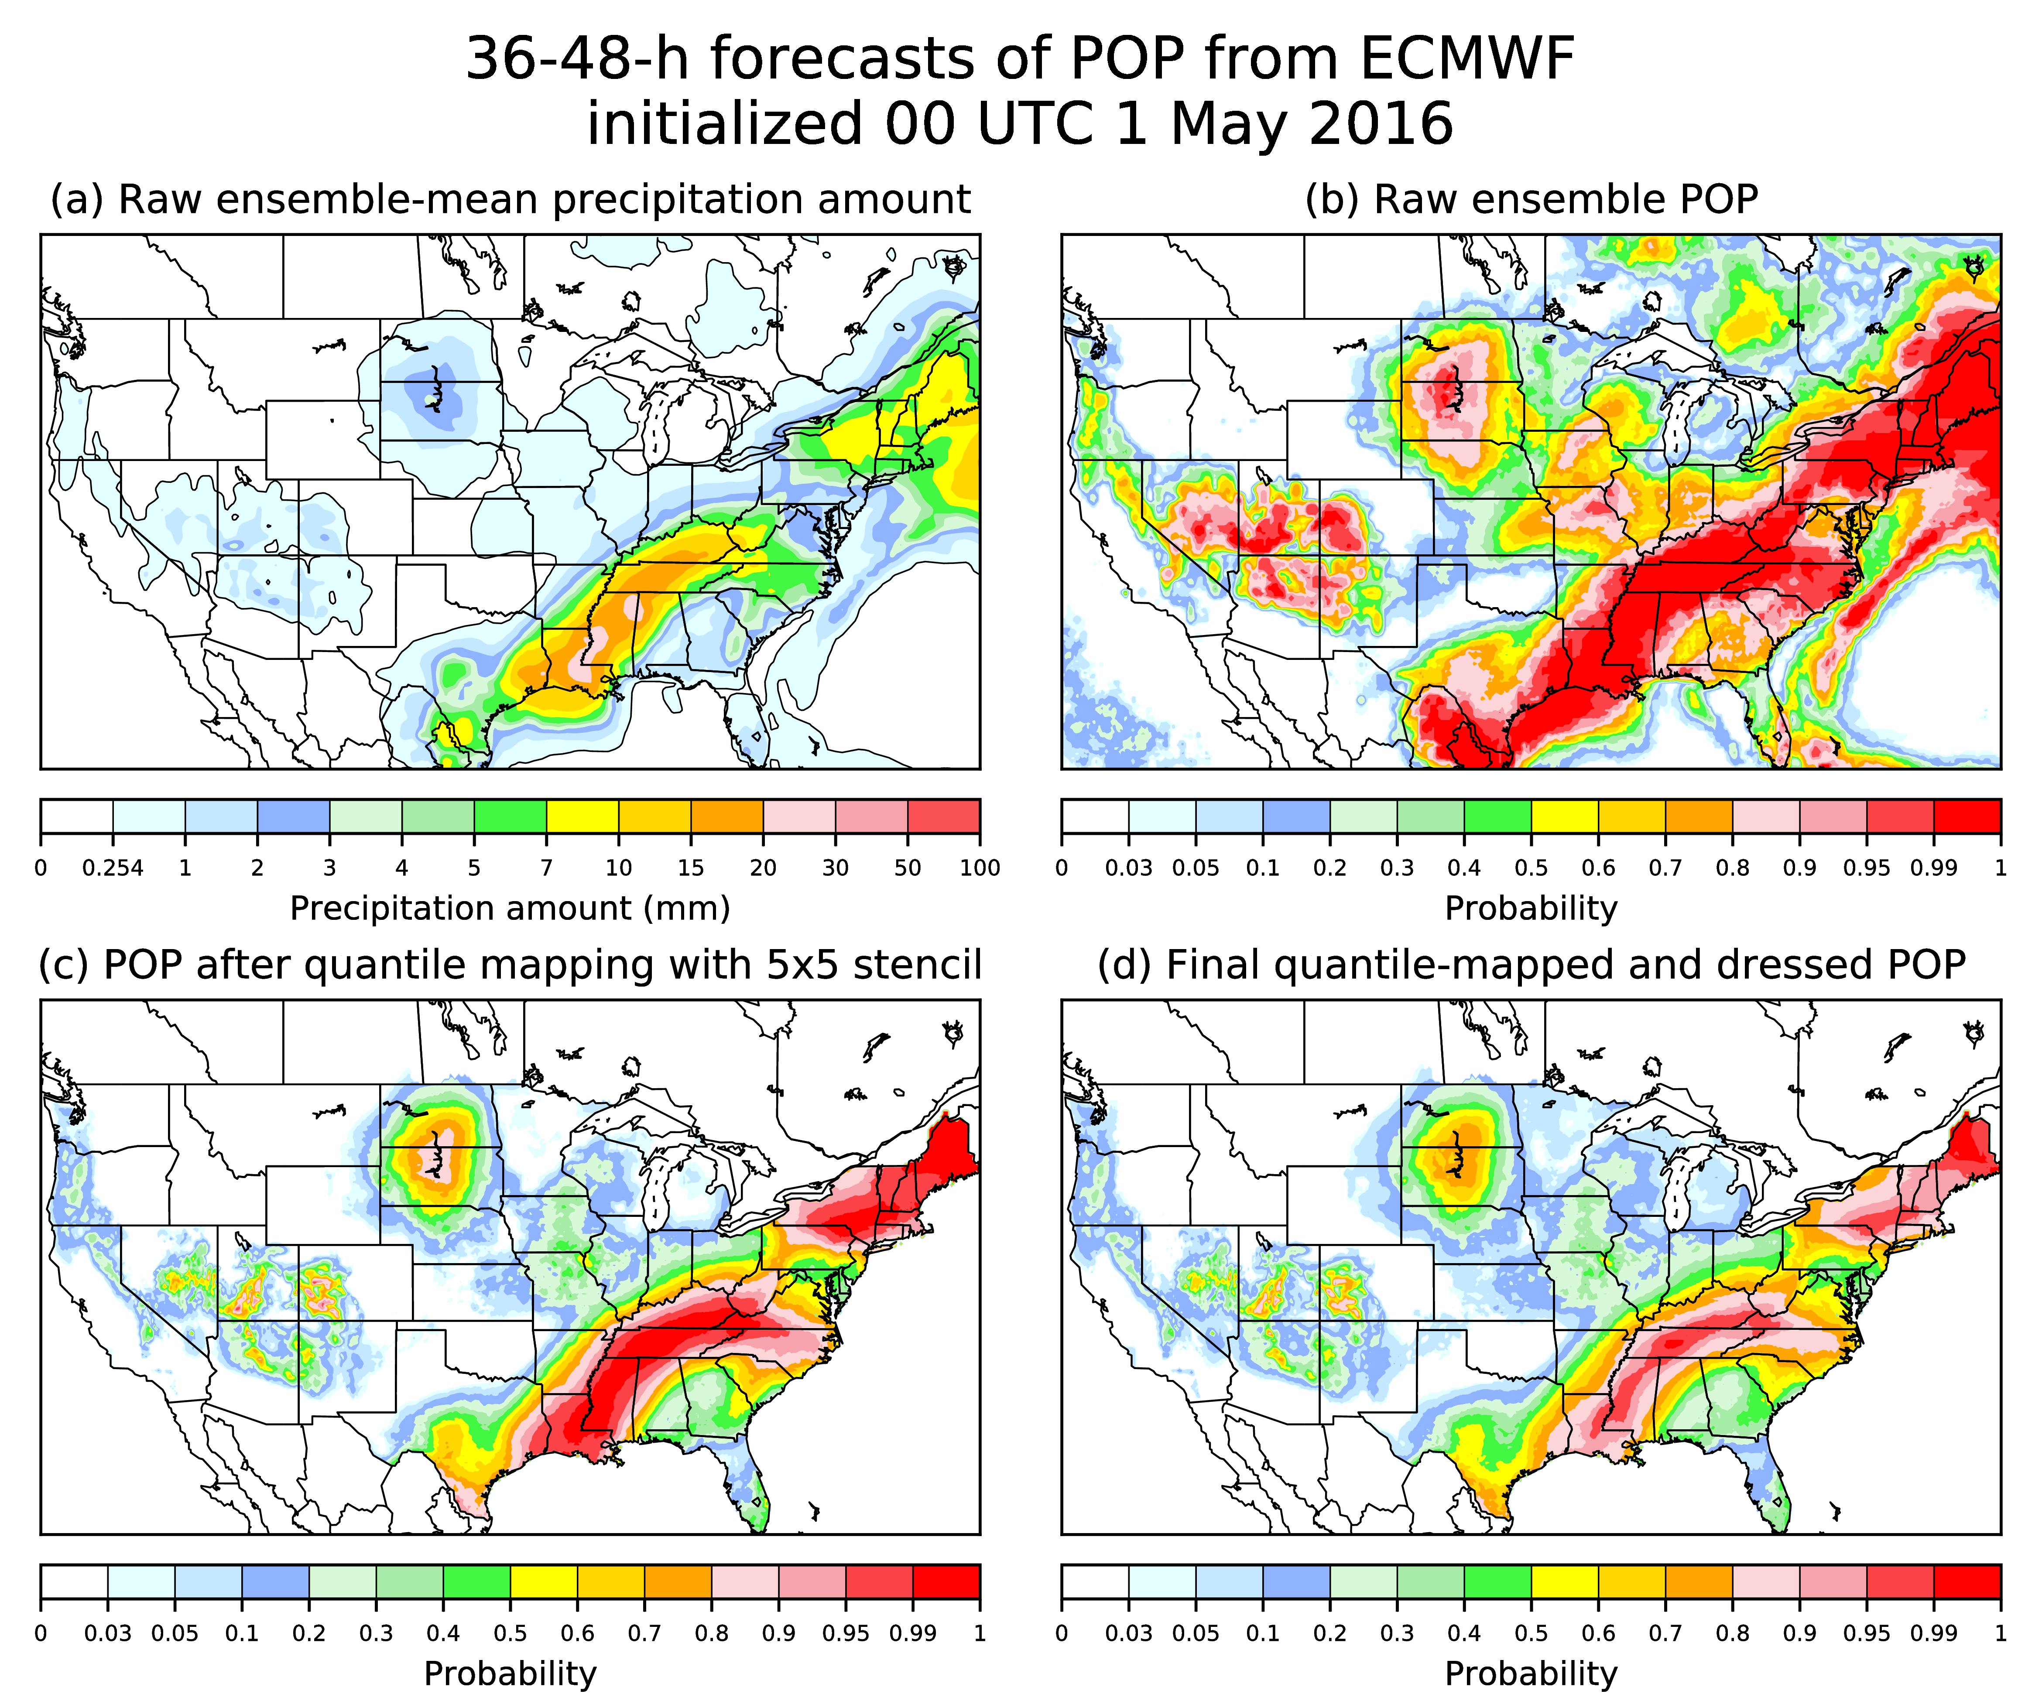
A quick case study (ECMWF).

Slide 41
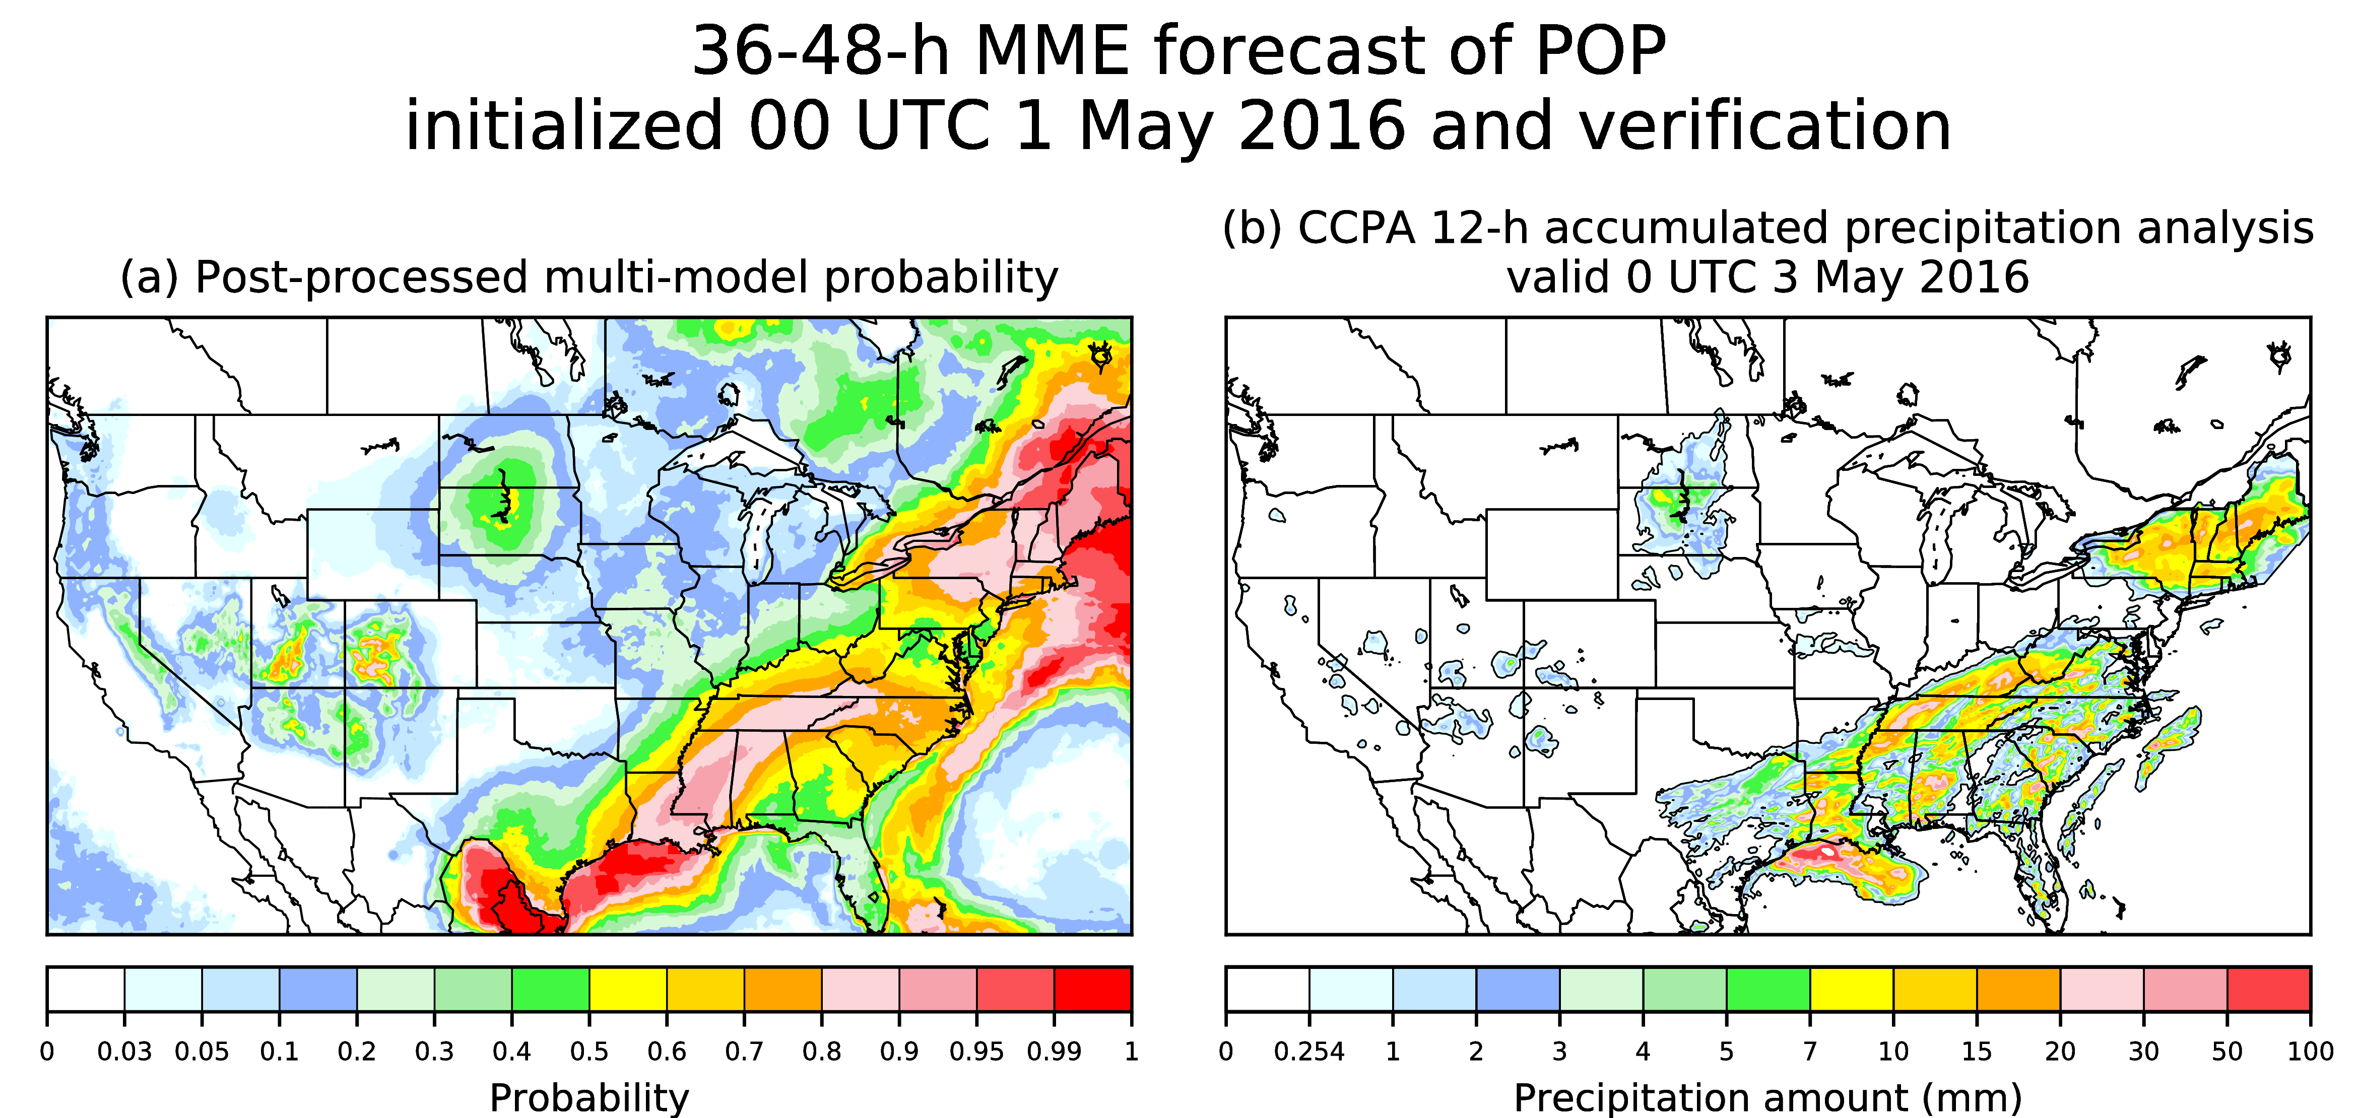
Multi-model POP and verifying analysis
50% ECMWF, 25% NCEP, 25% CMC

Slide 42
Advantages / disadvantages of National Blend algorithm as developed here.
Advantages:
  Algorithm is quite skillful and reliable.
  It provides significant spatial detail that to my own eye looks realistic.
  It exploits multi-model data, even with short training data sets.
Disadvantages:
  At high precipitation amounts, bias removal is difficult with short training data sets.
    But we are constructing a next-generation multi-decadal GEFS reforecast for our own system to help with this.
  There is some training data management in constructing the dressing statistics. It may be slightly challenging for MDL to maintain this software.

Slide 43
Part 2:
Modelling the space-time variability in post-processed ensemble precipitation forecasts
Michael Scheuerer (with a very small amount of help from me).

Slide 44
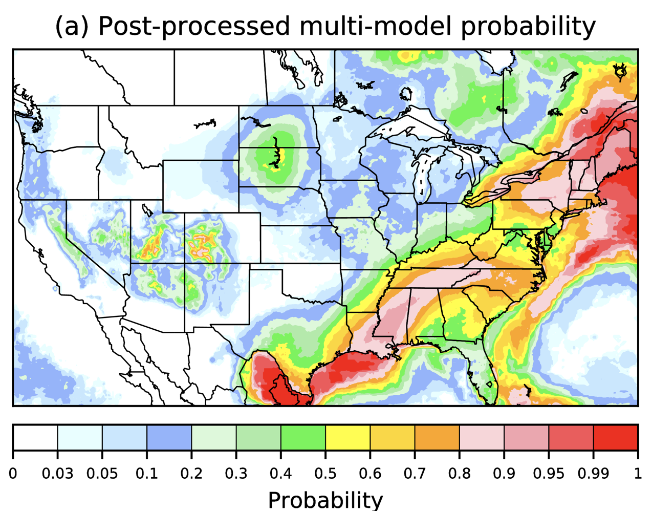
For hydrologic ensemble prediction:
No Yes
Calibrated
member 1
precip, t, etc.
Calibrated
member 2
precip, t, etc.
Calibrated
member 3
precip, t, etc.
Hydrologic
prediction
system
Hydrologic
prediction
system
Hydrologic
prediction
system
Streamflow
prediction 1
Streamflow
prediction 1
Streamflow
prediction 1
Hydrologic
postprocessor
Probabilistic
streamflow

Slide 45
For hydrologic ensemble prediction:
No Yes
Calibrated
member 1
precip, t, etc.
Calibrated
member 2
precip, t, etc.
Calibrated
member 3
precip, t, etc.
Hydrologic
prediction
system
Hydrologic
prediction
system
Hydrologic
prediction
system
Streamflow
prediction 1
Streamflow
prediction 1
Streamflow
prediction 1
These synthetic ensembles should be
consistent with the postprocessed
guidance above, but also should have
realistic small-scale variability in time
and space.
Hydrologic
postprocessor
Probabilistic
streamflow

Slide 46
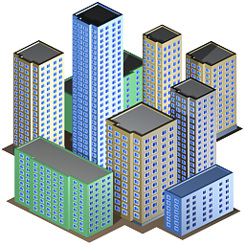
Spatial dependence of precipitation forecast fields
Hydrologists want to know not only the intensity of rainfall, but whether or not that intense rainfall will fall simultaneously in many nearby sub-basins.
What is the “copula”
structure, i.e., the joint
probabilities?
Reservoir
Reservoir
Dam
Dam
a problem
when marginal & joint probs.
are not well
forecast
No problem

Slide 47
Serial dependence of precipitation forecast fields
By calculating certain quantiles, the post-processed, predictive forecast distributions can be turned into an ensemble of any desired size.
Univariate post-processing, however, does not provide any information about serial dependence, i.e. we don’t know how to connect the samples at different lead times.

Slide 48
Existing approach #1: the “Schaake Shuffle”
- Select a number of past dates, e.g. the same date in the previous 11 years
- At each grid point and each lead time determine the rank ordering of this historic ensemble
- Order the samples from the predictive distribution in the exact same way, thereby
associating each sample value with one particular historic field
- The resulting Schaake shuffle ensemble has the same rank correlations as the historic ensemble

Slide 49
The Schaake Shuffle
- Select a number of past dates, e.g. the same date in the previous 11 years
- At each grid point and each lead time determine the rank ordering of this historic ensemble
- Order the samples from the predictive distribution in the exact same way, thereby
associating each sample value with one particular historic field
- The resulting Schaake shuffle ensemble has the same rank correlations as the historic ensemble

Slide 50
The Minimum-Divergence Schaake Shuffle
The standard implementation of the Schaake shuffle selects historic dates ad hoc, i.e. independent of the anticipated weather situation. This does not guarantee that there is always a sufficient number of non-zero values available that define a rank ordering for the predictive samples.
Scheuerer et al. (WRR, 2017) suggested an extension where a set of historic dates is chosen such that the marginal distributions of the historic ensemble resemble the predictive samples:

Slide 51
The Minimum-Divergence Schaake Shuffle
The standard implementation of the Schaake shuffle selects historic dates ad hoc, i.e. independent of the anticipated weather situation. This does not guarantee that there is always a sufficient number of non-zero values available that define a rank ordering for the predictive samples.
Scheuerer et al. (WRR, 2017) suggested an extension where a set of historic dates is chosen such that the marginal distributions of the historic ensemble resemble the predictive samples:

Slide 52
Ensemble Copula Coupling
Ensemble copula coupling (ECC) is an alternative strategy for modeling space-time variability of ensemble precipitation forecasts that uses again the idea of reordering forecast samples.
In contrast to to the Schaake shuffle, however, it is based on the rank ordering of the raw ensemble forecasts rather than those of a historic set of observations. It therefore cannot resolve sub-grid scale variability, but space-time correlations are automatically flow-dependent:

Slide 53
Ensemble Copula Coupling
Ensemble copula coupling (ECC) is an alternative strategy for modeling space-time variability of ensemble precipitation forecasts that uses again the idea of reordering forecast samples.
In contrast to to the Schaake shuffle, however, it is based on the rank ordering of the raw ensemble forecasts rather than those of a historic set of observations. It therefore cannot resolve sub-grid scale variability, but space-time correlations are automatically flow-dependent:

Slide 54
Generating high-resolution precipitation forecast fields
We illustrate strengths and limitations of these methods in a case study where we generate statistically calibrated, high-resolution precipitation forecast fields over the Russian River basin.
11 grid points of the ~0.5 degree GEFS grid
4 consecutive 6-h accumulation periods starting 1/19/2010, 00 UTC
forecast lead times: 54-60h, 60-66h, 66-72h, 72-78h
calibration/downscaling to climatology corrected precipitation analyses (CCPA, resolution 2.5km)
The censored shifted gamma distribution (CSGD, Scheuerer and Hamill, MWR, 2015) approach is used to post-process & downscale the GEFS forecasts to the 2.5km grid.
For the ensemble copula coupling (ECC) and the minimum divergence Schaake shuffle method, we use some extensions that make this methods more adequate in this setting with high spatial resolution.

Slide 55
Predicted and analyzed precipitation fields
The raw GEFS ensemble mean predicts precipitation during all four 6-h periods, but intensity, location, and timing are subject to significant errors.
Univariate statistical post-processing adds spatial detail and corrects systematic biases.
To generate high-resolution ensembles, the multivariate techniques discussed above are needed.

Slide 56
Wettest (standard) Schaake shuffle ensemble member
The standard implementation of the Schaake shuffle is challenged by the relatively dry conditions in all of the historic fields that are used to model the rank correlations of the forecast ensemble.
Even the wettest, historic field has large areas without precipitation, where no reordering information is provided.
The predictive samples are then ordered randomly, which results in unrealistic spatial structures.

Slide 57
Wettest Minimum Divergence Schaake shuffle member
In this high-resolution setup, we implement the minimum divergence Schaale shuffle (MDSS) by performing the univariate post-processing at the GEFS scale.
The MDSS algorithm selects a set of dates such that the upscaled analysis fields have marginal distributions that resemble the univariate predictive samples (1st row) and reorders these coarse scale samples (2nd row).
Then it constructs a multiplicative adjust-ment factor that maps the 1st to the 2nd row.

Slide 58
Rescaling needed …
Even with a carefully selected subset of dates, the set of draws from climatology will not exactly produce PDFs with marginal distributions that match the predictive marginal distributions of the postprocessed guidance. So the trajectories are scaled up or down at each lead time (or grid point) so that they match the predictive marginal distributions.

Slide 59
Wettest Minimum Divergence Schaake shuffle member
When the adjustment factor derived above is applied to the original historic field, the adjusted field has the desired precipitation amounts at the coarse scale.
In addition, it has a similar spatial and temporal structure as the historic analysis field on which it is based.
This way, it also accounts for sub-grid scale variability that the raw ensemble cannot resolve.

Slide 60
Wettest ECC-Q ensemble member
The ensemble copula coupling implementation described above is based on the rank order of the raw (interpolated) GEFS ensemble, it is referred to as ECC-Q.
Where the values of these interpolated raw ensemble members intersect, the rank changes, and this translates into an abrupt change of the values of the ECC-Q ensemble.

Slide 61
Wettest ECC-Q ensemble member
We developed an implementation of the ECC-T variant of the ensemble copula coupling approach, which constructs a quantile mapping function and applies it to the raw ensemble.
This new implemen-tation preserves the statistical properties of the ECC-Q ensemble, but it avoids the sharp gradients and produces more physically realistic, fine-scale ensemble members.

Slide 62
Verification of forecasts of sub-grid precipitation maxima
For a quantitative comparison of the quality of the different post-processed ensemble forecast fields, we calculate the maximum analyzed precipitation amount over all fine scale grid points associated with each coarse scale grid point and across all four lead time periods.
We do the same for each post-processed ensemble member, and derive probabilities for the maximum sub-grid scale precipitation amounts exceeding a certain threshold.
Brier skill scores suggest that our MDSS method and our new ECC-T implementation compare favorably with the established Schaake shuffle and ECC-Q approach.

Slide 63
Conclusion
Under National Blend, we have developed a complicated but skillful algorithm for PQPF that dramatically improves reliability and skill.
Leverages MMEs, per Louis Uccellini’s strong desire.
With supplemental locations process, skirts many of the challenges associated with small training data sets.
Will underlie NDFD, the database the NWS uses, for years to come.
Interested in comparisons against algorithms hydrologists use.
Ref: Hamill, T.M., E. Engle, D. Myrick, M. Peroutka, C. Finan, and M. Scheuerer, 2017: The U.S. National Blend of Models for Statistical Postprocessing of Probability of Precipitation and Deterministic Precipitation Amount. Mon. Wea. Rev., 145, 3441-3463, https://doi.org/10.1175/MWR-D-16-0331.1 . Additional article(s) to come describing recent dressing improvements.

