Slide 1


Weather-climate and ensemble prediction methods
NOAA Earth System
Research Laboratory
Jeff Whitaker and Tom Hamill
NOAA Earth System Research Lab
Physical Sciences Division
jeffrey.s.whitaker@noaa.gov; tom.hamill@noaa.gov
NCAR ASP Colloquium, June 2012

Slide 2


We are often confused. Don’t be.
Jeff. Moonlighting as
super-villain.
Tom. Slacker.

Slide 3
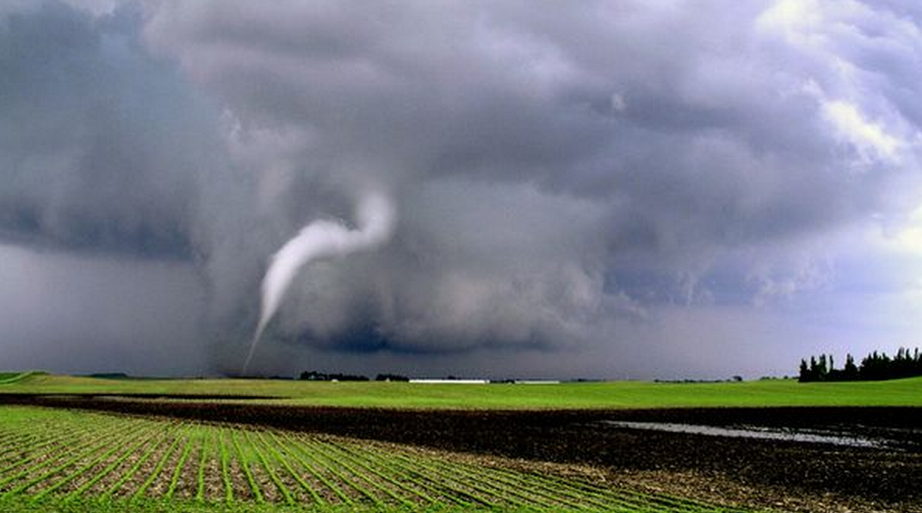
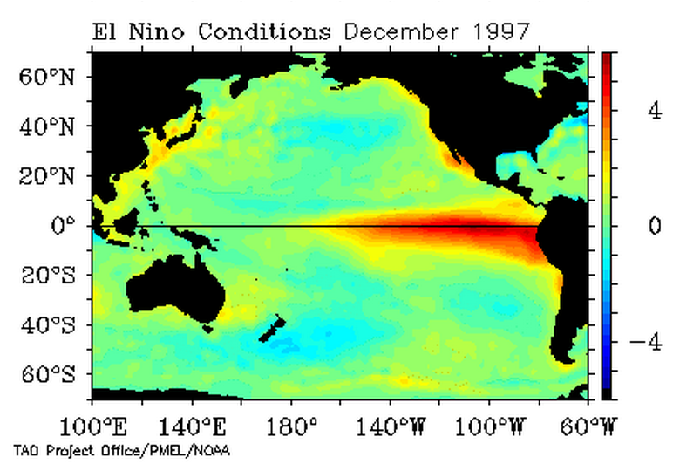
What does weather-climate mean?
A process-oriented view
How do climate variations
modulate weather extremes?
What are the physical processes
governing this modulation?
Weather
Can weather events trigger major shifts in seasonal climate, and how?
Can you simulate the weather components that seem to be intimately tied with the slower-scale climate variations?
Climate

Slide 4
What does weather-climate mean?
How do climate variations
modulate weather extremes?
What are the physical processes
governing this modulation?
Weather
σ
To be scientific, you
have to quantify
your uncertainty
Can weather events trigger major shifts in seasonal climate, and how?
Can you simulate the weather components that seem to be intimately tied with the slower-scale climate variations?
Climate

Slide 5
What does weather-climate mean?
A predictability-oriented view
How does uncertainty in the depiction
of climate variations affect our ability
to predict weather extremes?
How does uncertain understanding
of mother nature affect our ability
to predict this modulation?
Weather
What does our uncertain prediction of
weather imply about our ability to
predict intraseasonal and seasonal
climate variability?
Climate

Slide 6
Another definition of “weather-climate”
1.0
Skill contributed
by atmospheric
initial condition
Forecast
skill
relative
to the
long-term
climatology
Skill contributed by current
boundary conditions
(ocean, land, ice) and
forecasts of these
0.0
1 week
2 weeks
3 weeks
4 weeks

Slide 7
Another definition of “weather-climate”
1.0
Weather-climate: the period of time when
both the atmospheric state and the boundary
conditions are comparable in magnitude,
and both contribute to forecast skill.
Skill contributed
by atmospheric
initial condition
Forecast
skill
relative
to the
long-term
climatology
Skill contributed by current
boundary conditions
(ocean, land, ice) and
forecasts of these
0.0
1 week
2 weeks
3 weeks
4 weeks

Slide 8

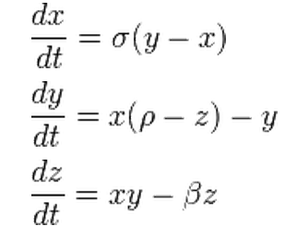
Weather-climate forecasts will be uncertain.
Their uncertainty will be state dependent.
Lorenz (1963 JAS) “attractor”
figure c/o Tim Palmer, ECMWF

Slide 9
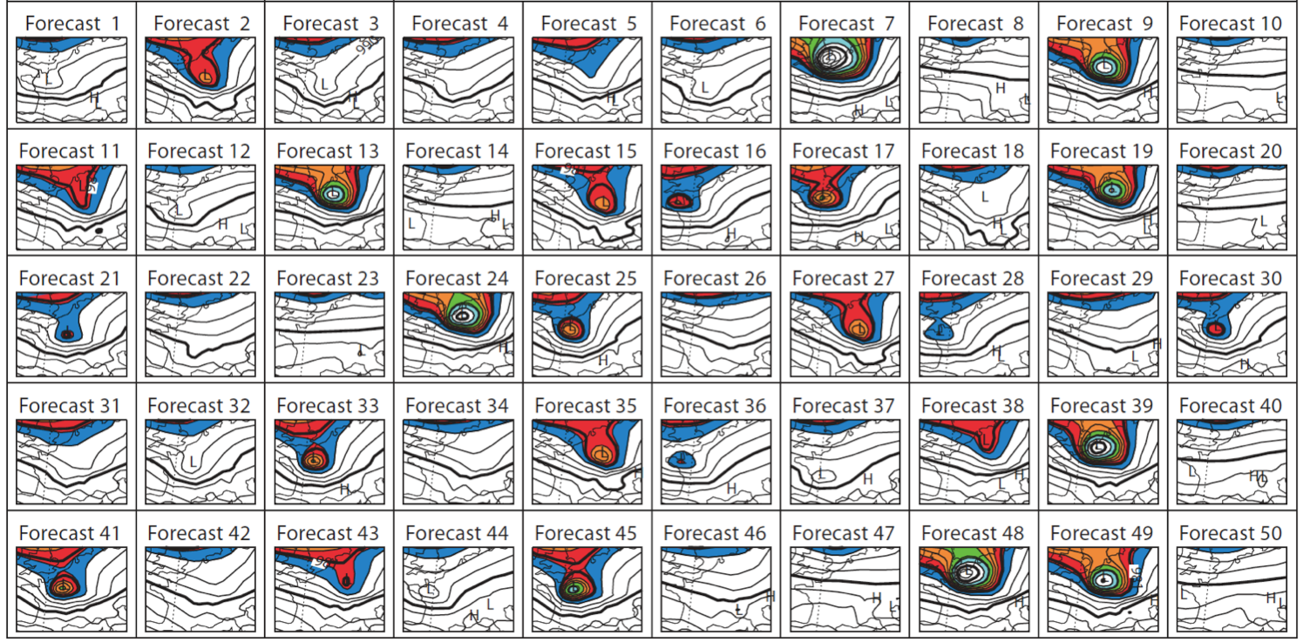
Ensemble predictions used to quantify uncertainty
Different initial conditions to estimate errors due to uncertainty in analyzed state.
Different models or stochastic physics to estimate errors due to forecast model imperfections
“Monte-Carlo integration”
c/o Tim Palmer, ECMWF

Slide 10
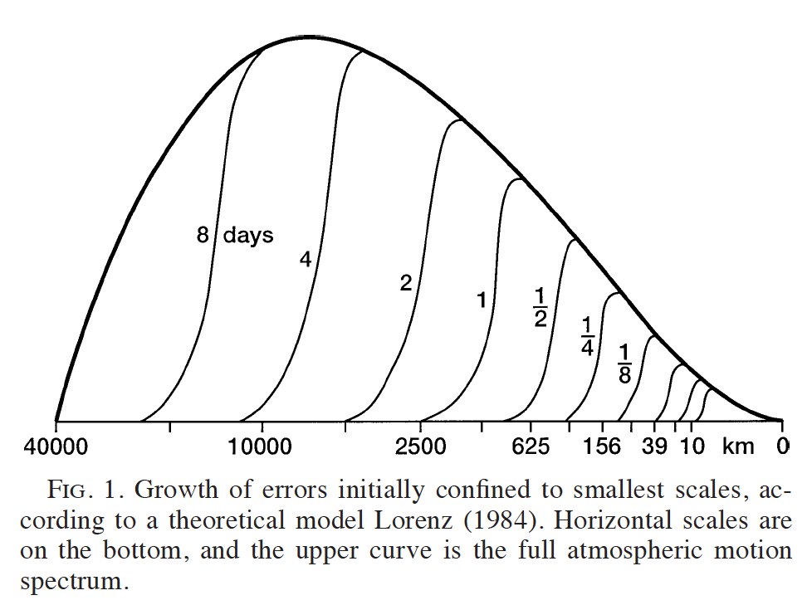
Mid-latitude predictability theory
Lorenz (1969, 1984), based on assumed k ^{-5/3} slope to energy spectrum, predicted rapid upscale cascade of errors and a finite predictability timescale. This suggests that the predictive skill that can be attributed to information from the atmospheric initial condition is limited in time to a few weeks at best.
Tribbia and Baumhefner (2004 MWR, subsequent slides) suggest more nuanced view.

Slide 11
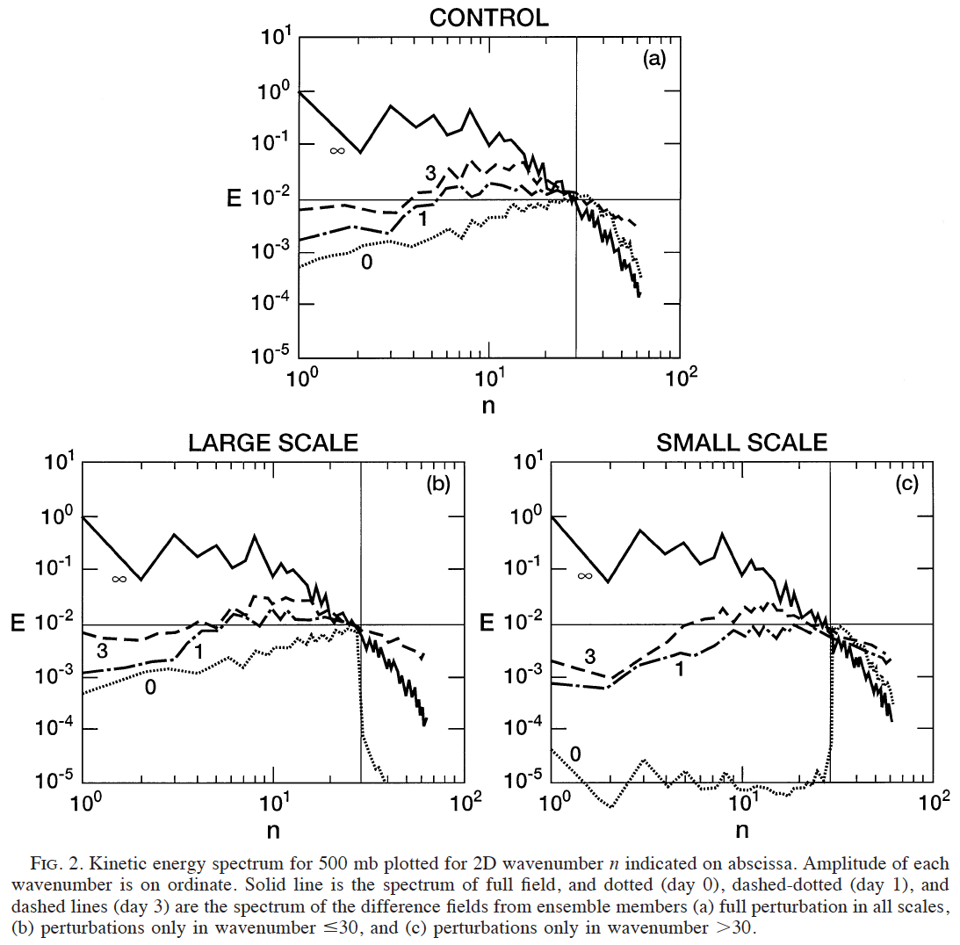
Mid-latitude predictability theory
Experiment with T63 NCAR
CCM3. Nature run + perturbed
initial conditions generally
consistent with analysis
error. Consider the growth
of the error in kinetic energy.
0, 1, and 3 lines denote
spectrum of the error in
kinetic energy for 0, 1, 3 - day
lead. Solid black line is kinetic
energy spectrum of full field.
Ref: Tribbia and Baumhefner,
MWR, March 2004

Slide 12
Mid-latitude predictability theory
When errors are initially
confined to the large scales but
with perfect small-scale
information, the errors
in the small scales grow
very, very quickly; the
small-scale detail and error
is determined by the large scales.
Ref: Tribbia and Baumhefner,
MWR, March 2004

Slide 13
Mid-latitude predictability theory
When errors are initially
confined to the small scales but
with perfect large-scale
information, the errors
in the larger scales are generally
reduced; it takes a while for
errors to cascade upscale,
whence they grow baroclinically
(exponential growth till saturation).
Ref: Tribbia and Baumhefner,
MWR, March 2004

Slide 14
Conclusions from modern predictability experiments
3-D turbulence at the small scales will limit the ability to predict their detail to a short period of time.
Errors at the small scales are inevitable, will grow upscale, and will inject errors into the baroclinic scales.
Fortunately, these errors grow more modally, so to the extent these errors can be reduced, the time scale of useful predictive skill of these phenomena can potentially be lengthened.
Uncertainty inevitable. At least we can attempt to quantify it, right?

Slide 15
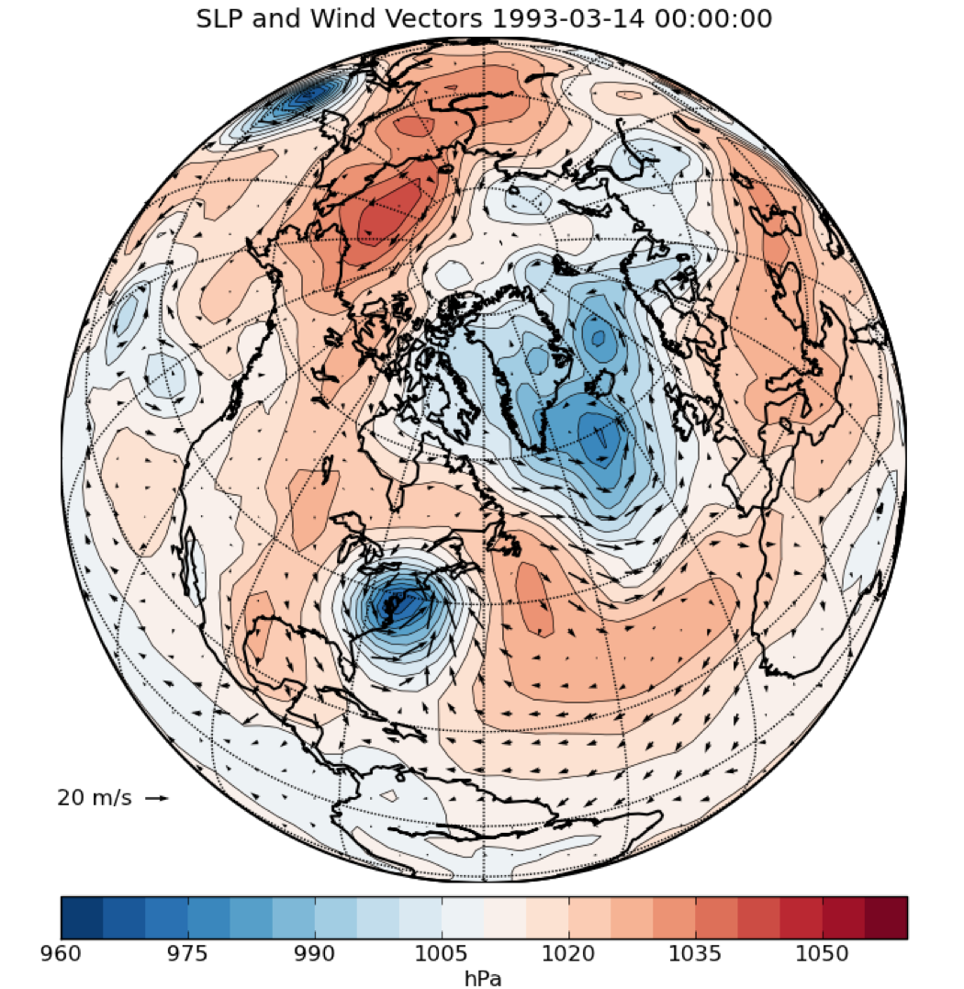
There is a science to the quantification of meteorological uncertainty.
Better ensemble prediction methods → more useful weather-climate forecasts

Slide 16
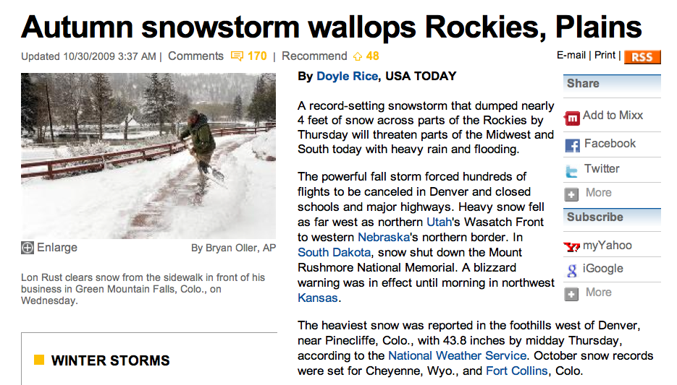
A case study: a not-so-good and a
better ensemble prediction
USA Today, 30 Oct 2009
Here’s the sort of high-impact event it would be extremely useful to
be able to have advanced warning of at the weather-climate timescales.

Slide 17
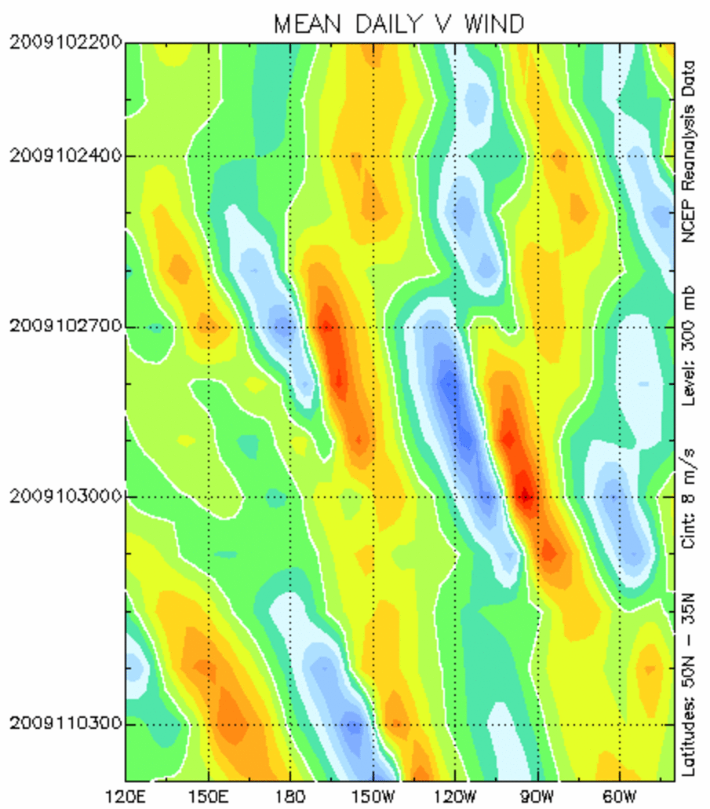
Hovmöller of 250 hPa meridional wind analyses
In 3.5 days, the wave train has covered a third of the globe.
Use of a global forecast model is clearly necessary, if not sufficient.
“Downstream development”
ridge-building
caused by
heating
associated
with recurving
Typhoon Lupit
the southerly surge
of momentum (and
moisture) into the
Colorado Front Range

Slide 18
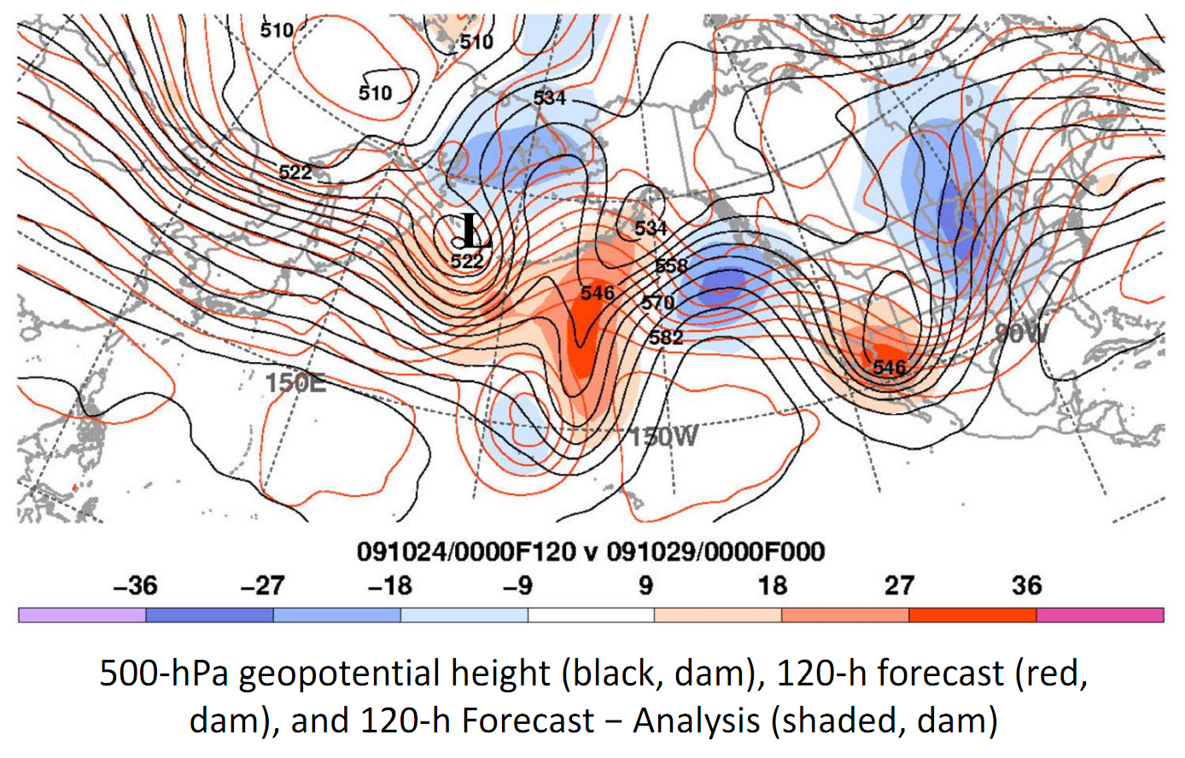
Massive bust of day +5 NCEP global deterministic; totally misses jet stream pattern
Perhaps small initial condition errors led to the bust?
What about ensemble systems?
c/o Heather Archambault, SUNY/Albany and NRL/Monterey

Slide 19
“Spaghetti plots”, NCEP ensemble
(546 dam contour, + 5 day forecast)
__ day +0 __day +1 __day +3 __ day +5
NCEP ensemble has only a hint in a few members
of a major system affecting the southwest US.

Slide 20
“Spaghetti plots”, ECMWF ensemble
(546 dam contour + 5 day forecast)
__ day +0 __day +1 __day +3 __ day +5
ECMWF system much better at predicting event in central Rockies. Lessons:
(1) Probabilistic, not deterministic forecasts, are definitely needed.
(2) A high-quality ensemble prediction system is a necessity for weather-climate prediction.

Slide 21
What then comprises a “good” weather – climate ensemble?

Slide 22
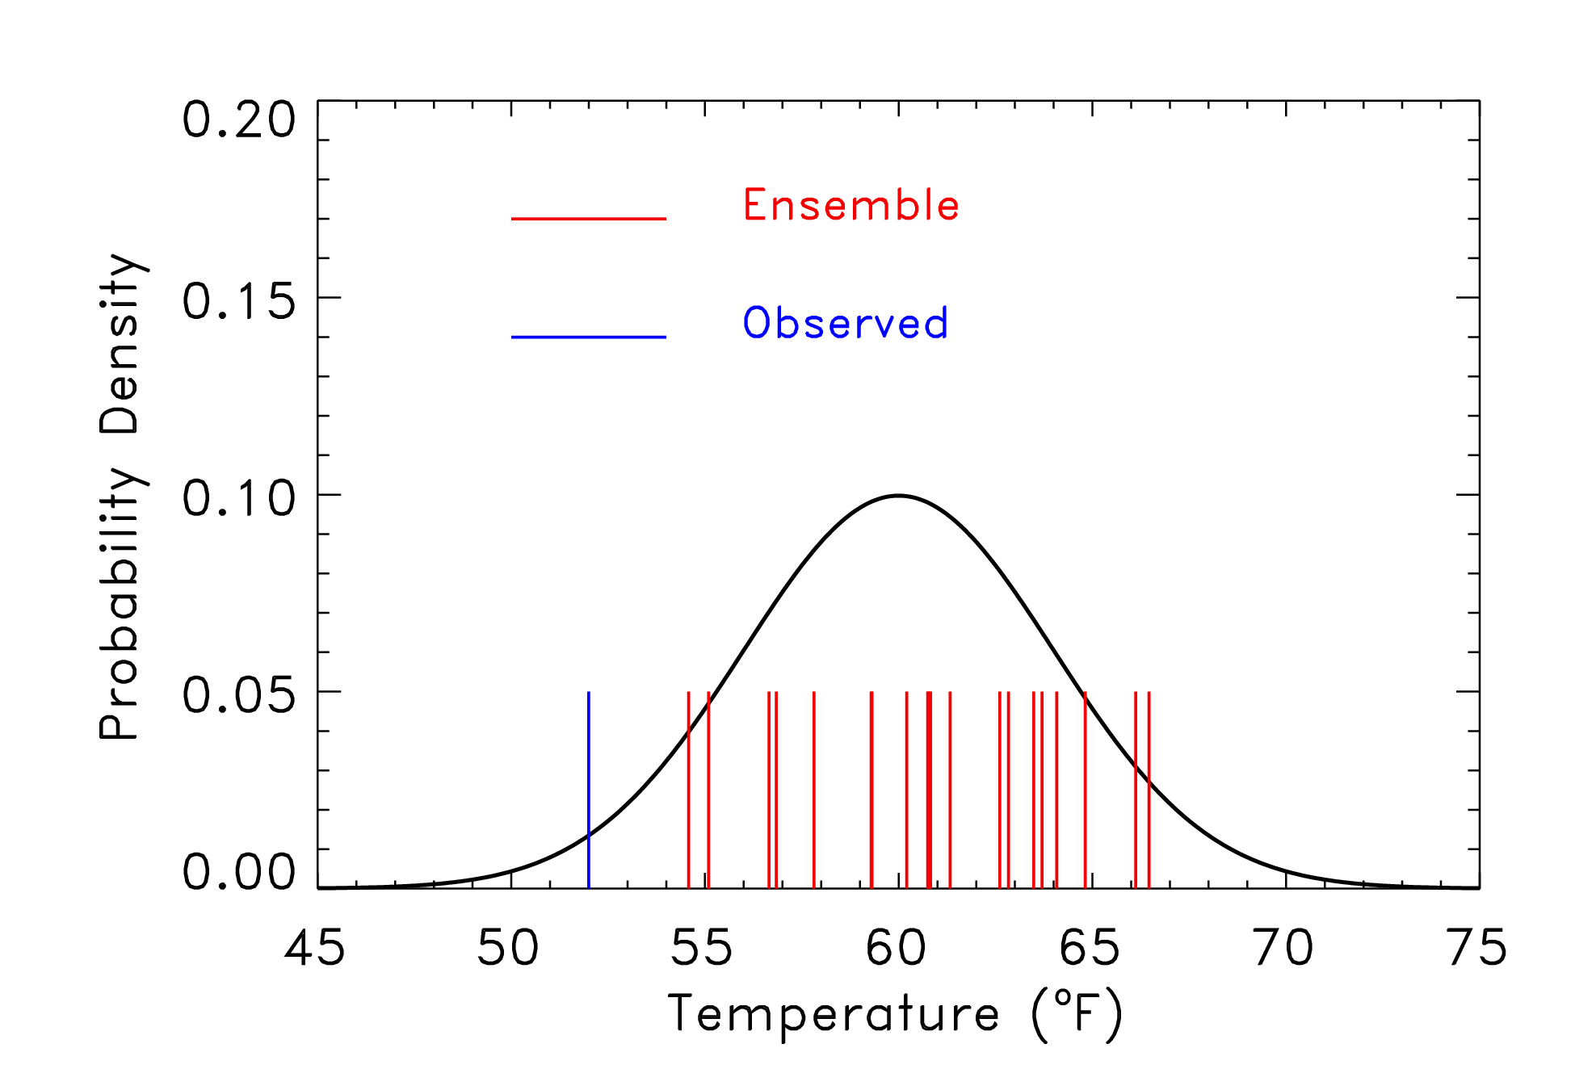
Unreliable ensemble?
Here, the observed is outside of the range of the ensemble,
which was sampled from the pdf shown. Is this a sign of
a poor ensemble forecast?

Slide 23
Unreliable ensemble?
You just don’t know; it’s only one sample.
You just don’t know…it’s only one sample
Here, the observed is outside of the range of the ensemble,
which was sampled from the pdf shown. Is this a sign of
a poor ensemble forecast?

Slide 24
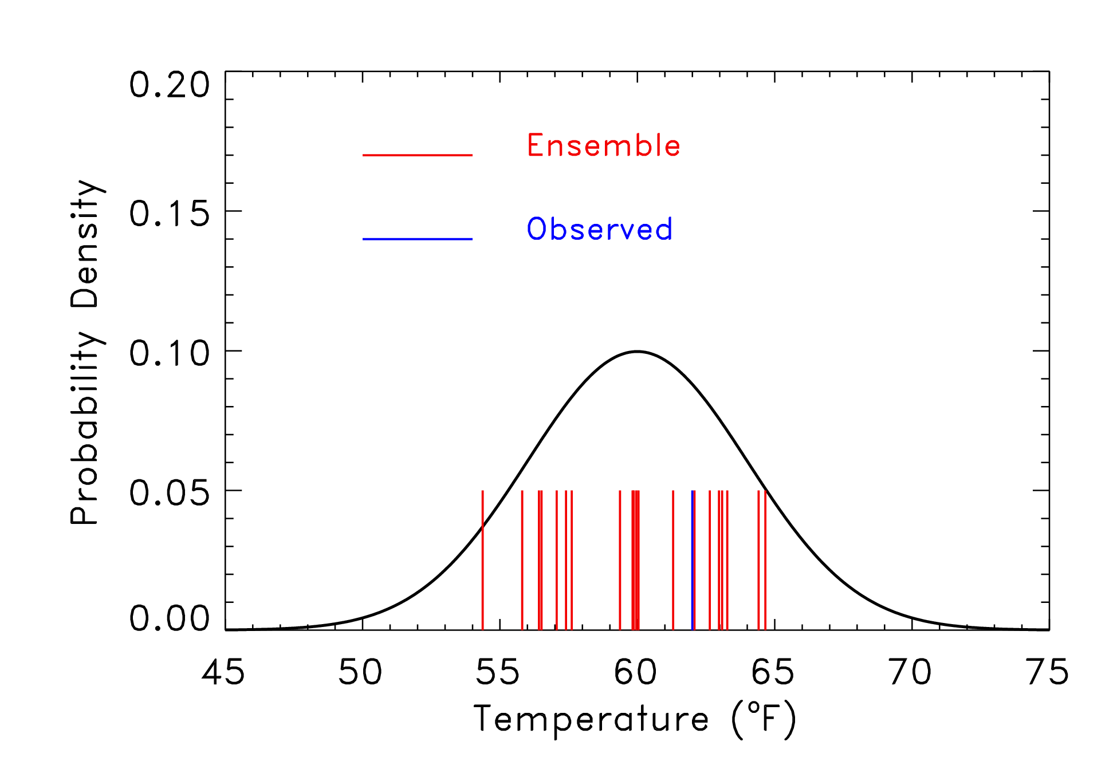
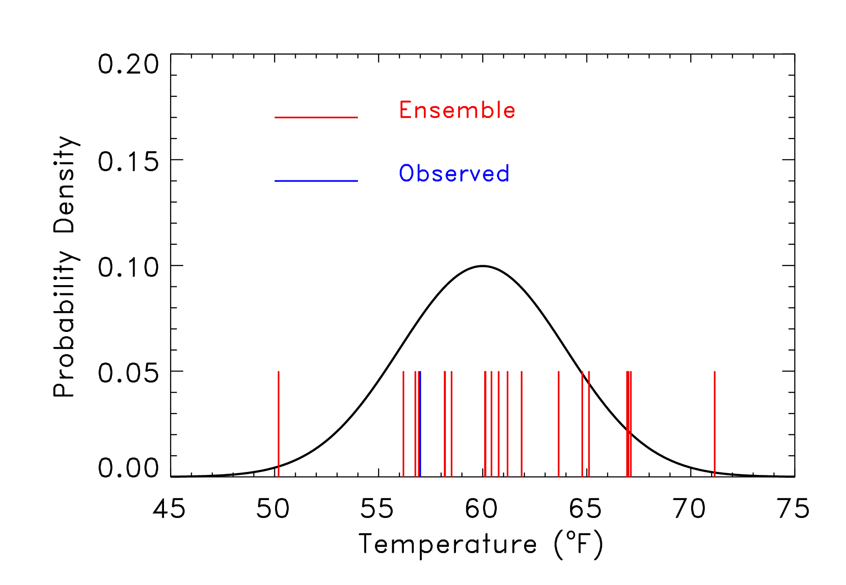
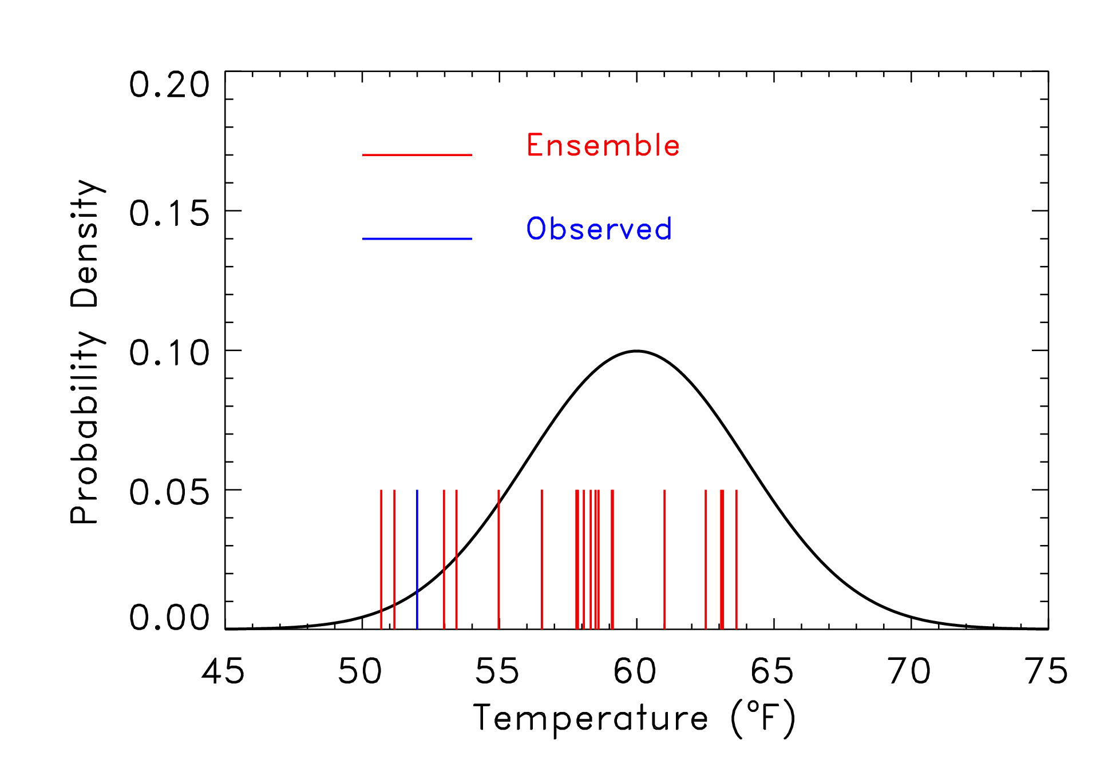
Rank 1 of 21
Rank 14 of 21
Rank 5 of 21
Rank 3 of 21

Slide 25
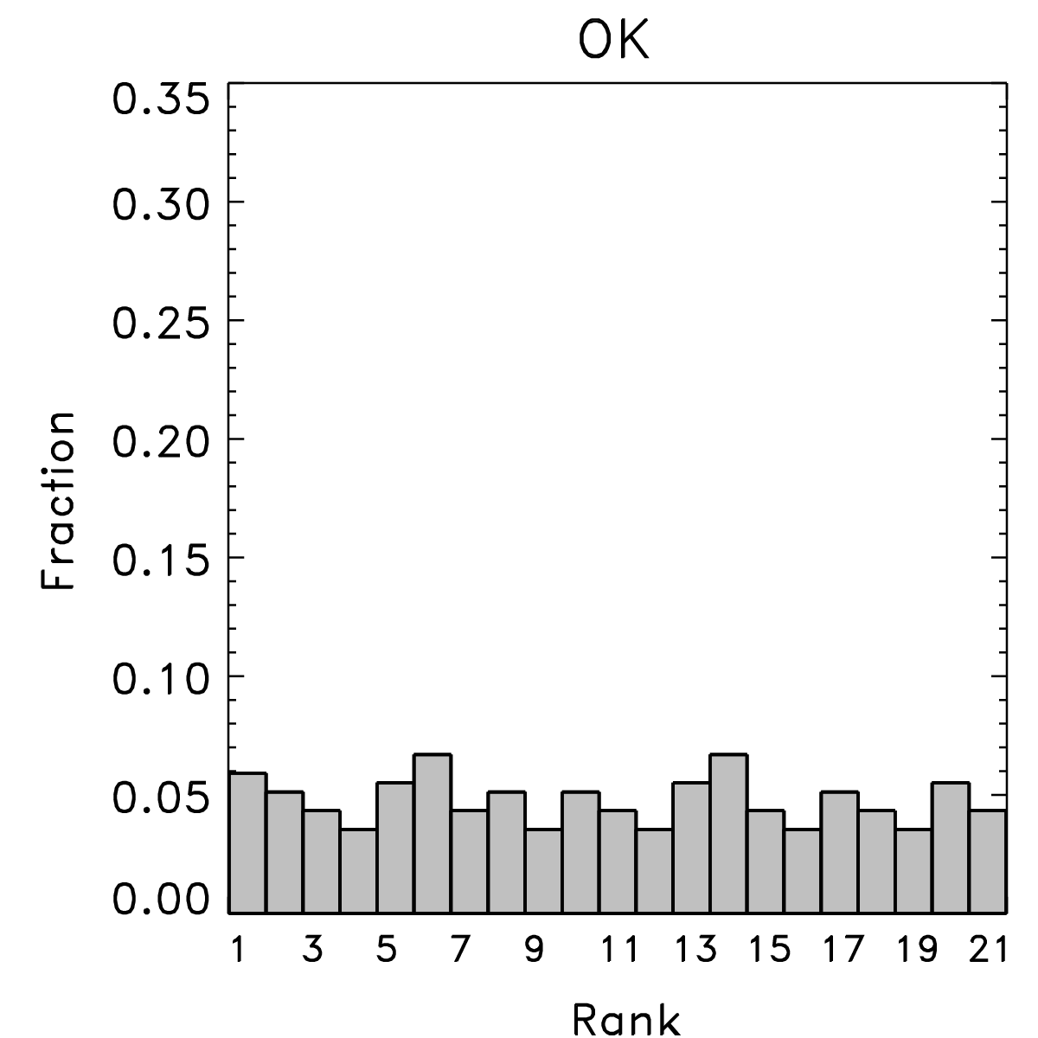
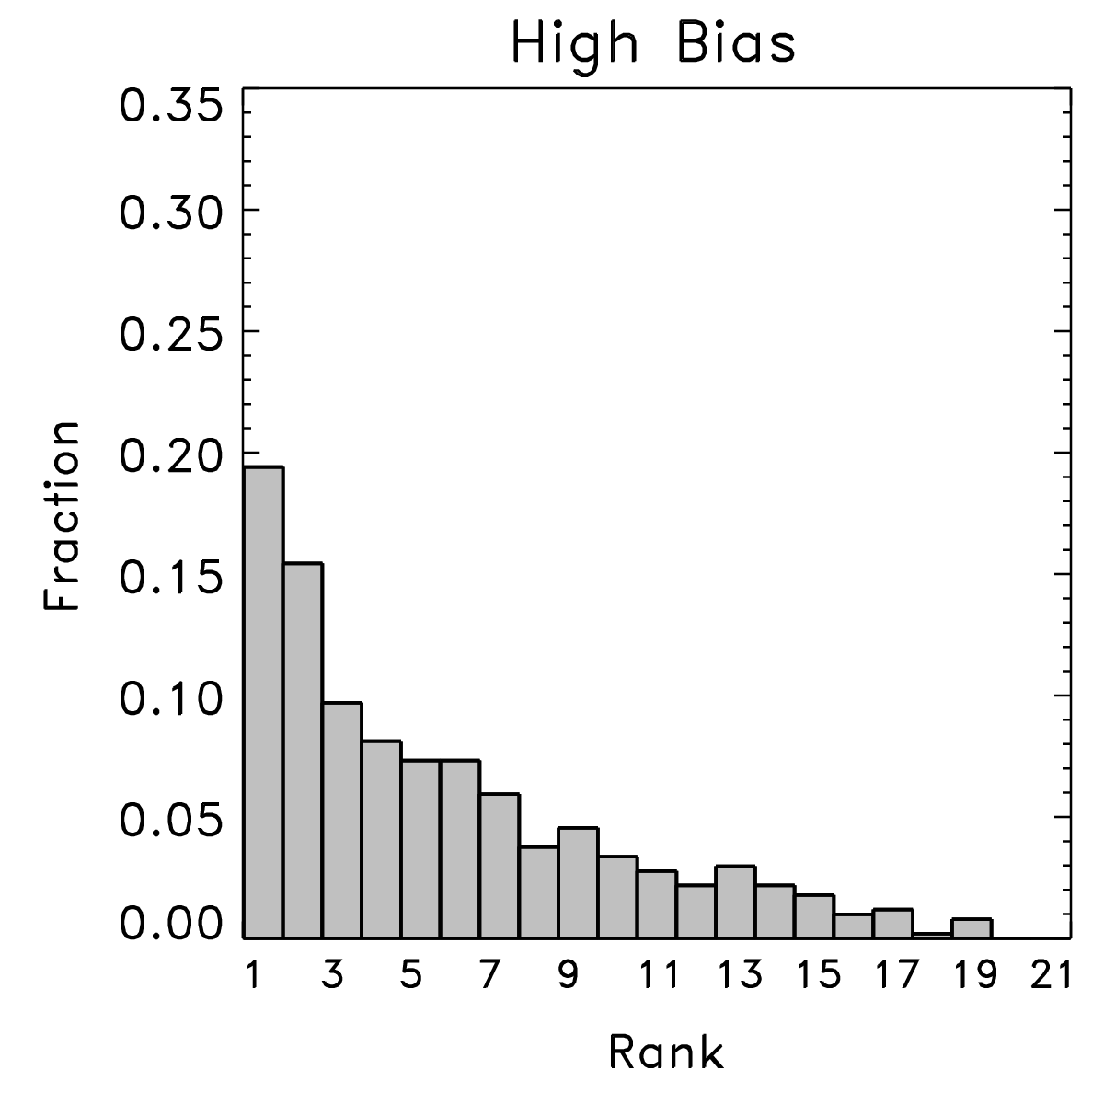
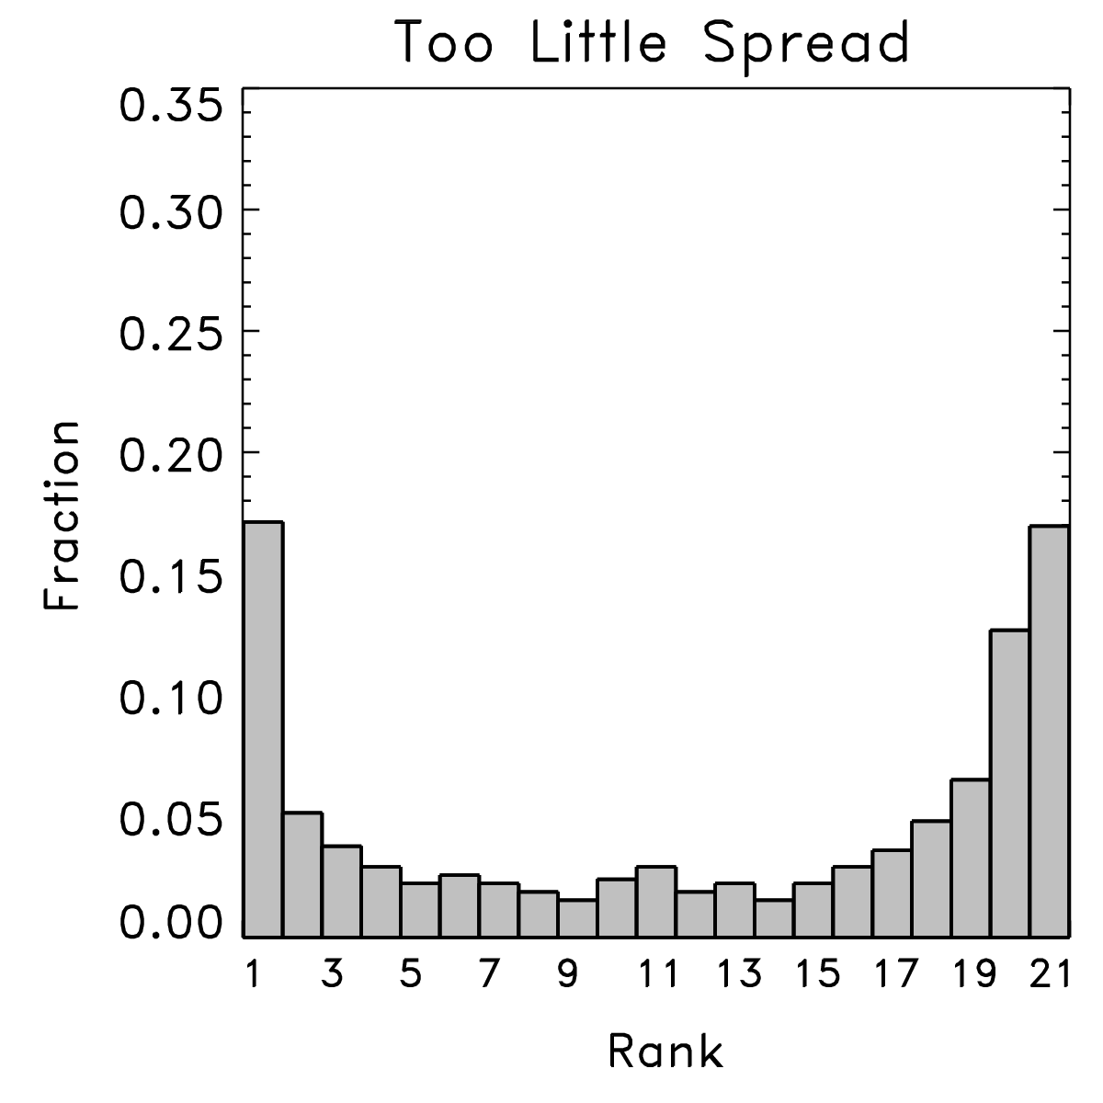
“Rank histograms,” aka “Talagrand diagrams”
With lots of samples from many situations, can evaluate the characteristics of the ensemble.
Happens when
observed is
indistinguishable
from any other
member of the
ensemble. Ensemble
hopefully is reliable.
Happens when
observed too
commonly is
lower than the
ensemble members.
Happens when
there are either
some low and some
high biases, or when
the ensemble doesn’t
spread out enough.
ref: Hamill, MWR, March 2001

Slide 26
Also: “reliability diagrams”

Slide 27
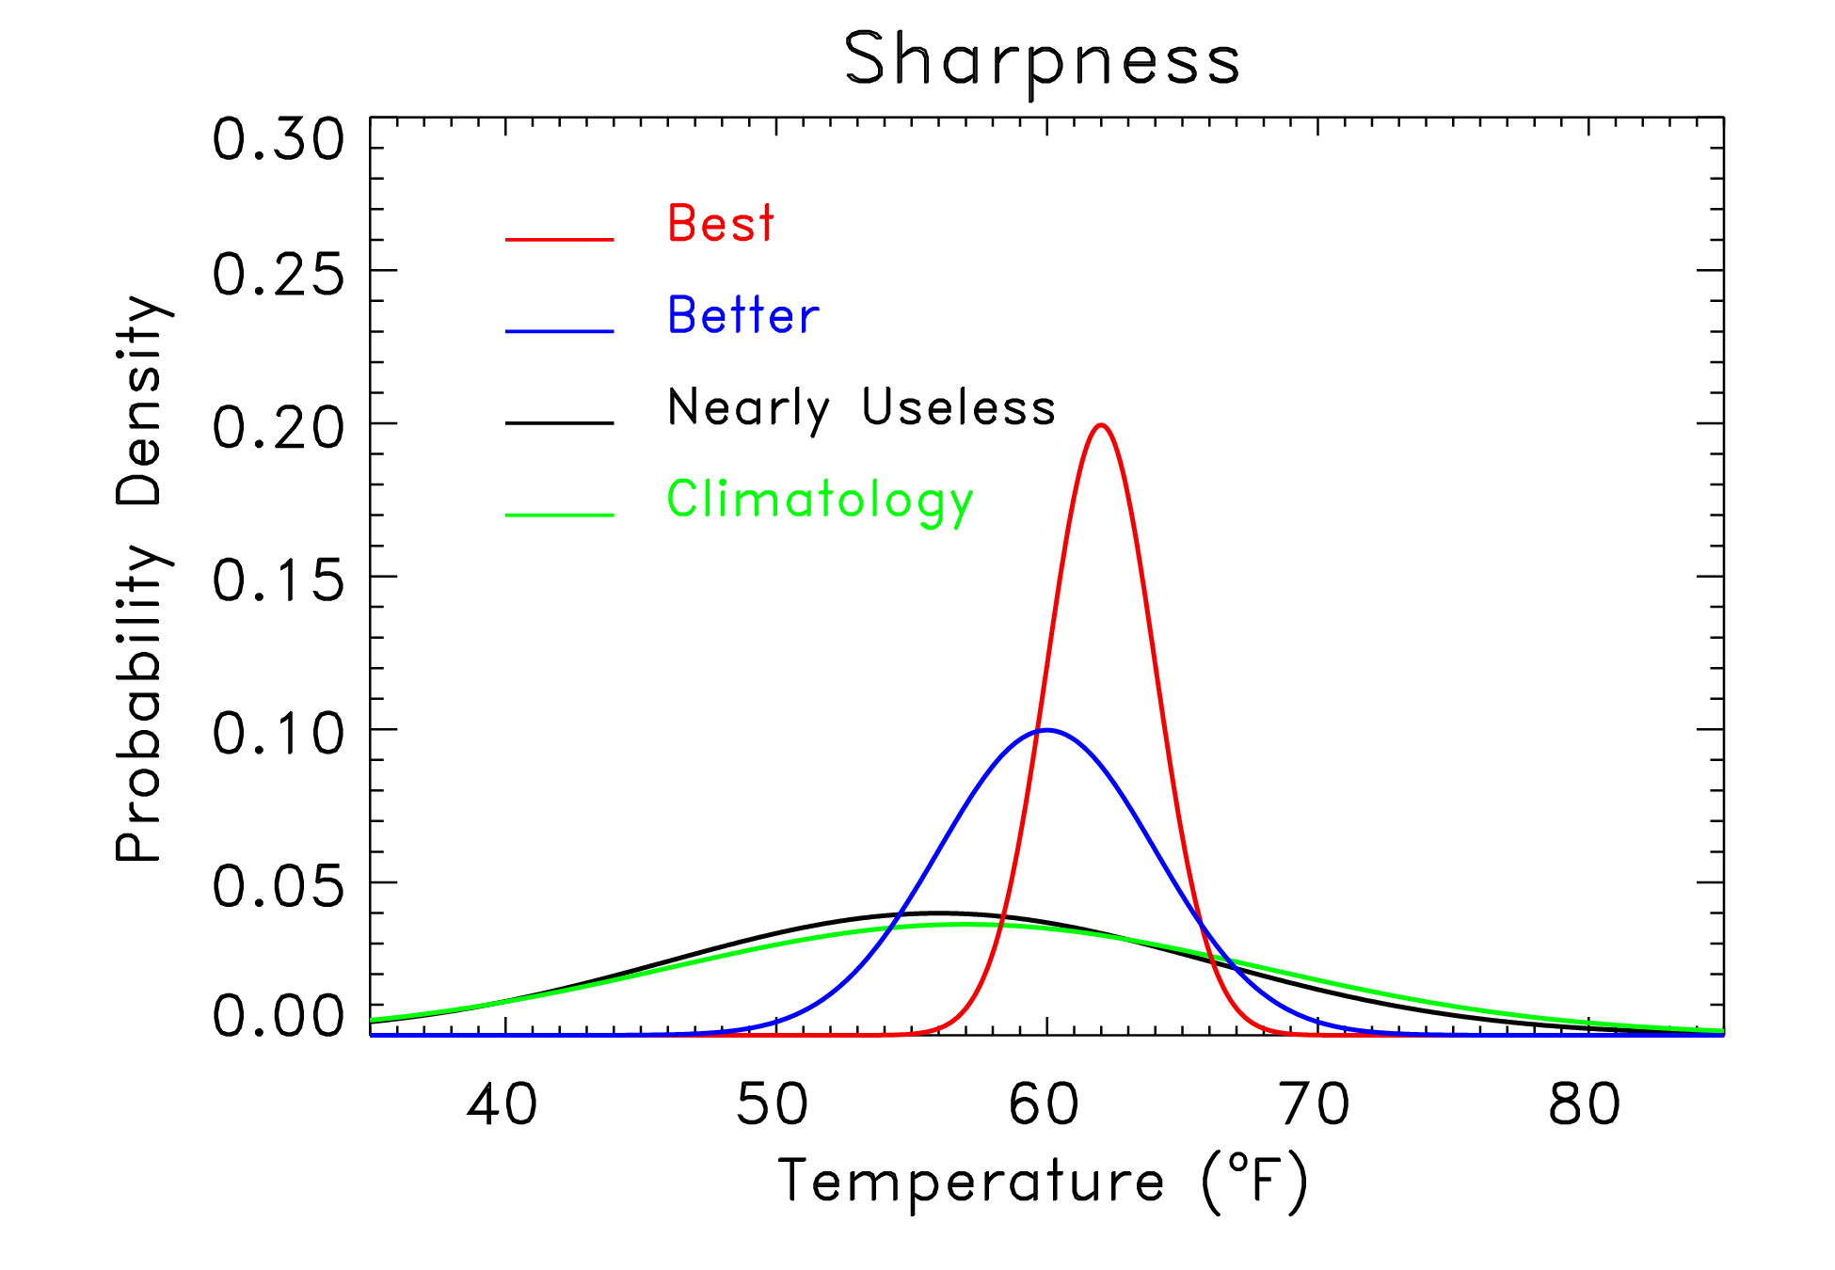
Sharpness also important
“Sharpness”
measures the
specificity of
the probabilistic
forecast. Given
two reliable forecast
systems, the one
producing the
sharper forecasts
is preferable.
But: don’t want
sharp if not reliable.
Implies unrealistic
confidence.

Slide 28
“Spread-error” relationships are important, too.
Small-spread ensemble forecasts should have less ensemble-mean error than large-spread forecasts, in some sense a conditional reliability dependent upon amount of sharpness.
ensemble-mean
error from a sample
of this pdf on avg.
should be low.
ensemble-mean
error should be
moderate on avg.
ensemble-mean
error should be
large on avg.

Slide 29
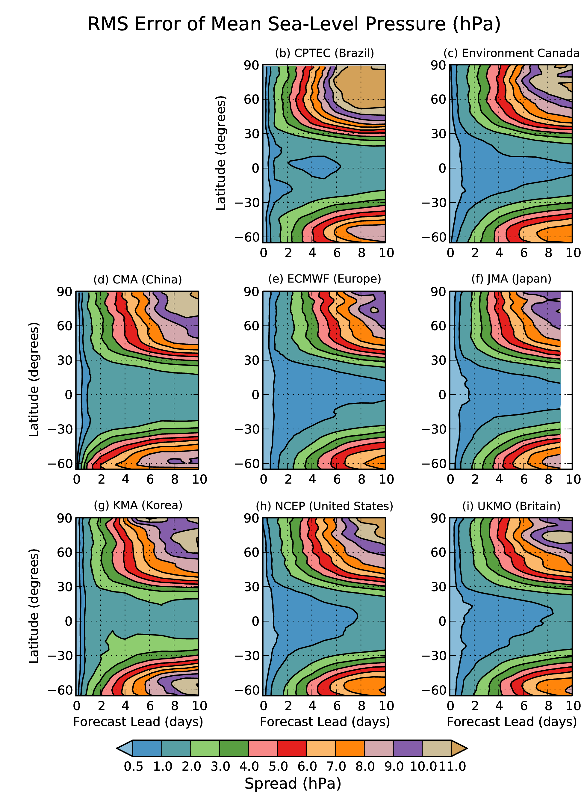
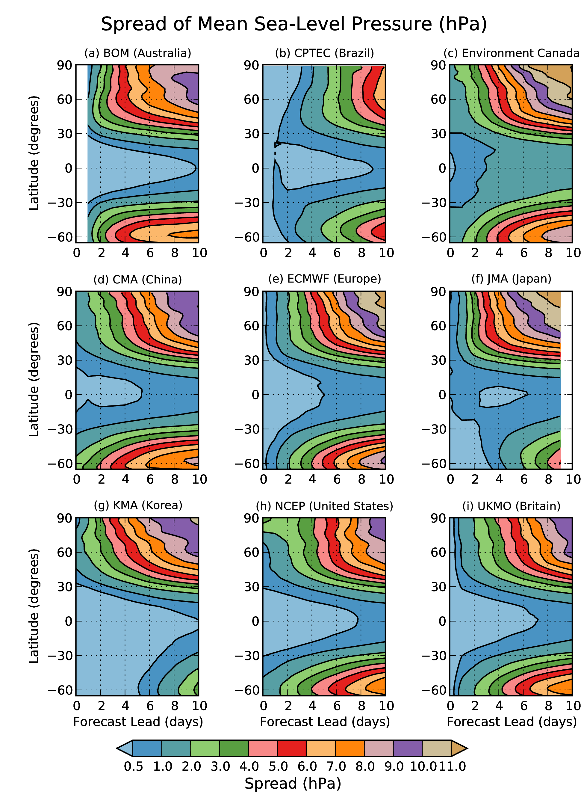
Consistency between spread and error in global ensemble prediction systems ?

Slide 30
Scientifically, what must be done to produce high-quality ensembles?
ensemble
members’
trajectories
t=t+Δt
t=0
reality

Slide 31
Scientifically, what must be done to produce high-quality ensembles?
ensemble
members’
trajectories
t=t+Δt
Problem: Specifying
the initial conditions
t=0
Theory tells us we want to
sample the ensemble from
the distribution of plausible
analysis states. How do we
determine what is a range
of plausible analysis states?
reality

Slide 32
Scientifically, what must be done to produce high-quality ensembles?
ensemble
members’
trajectories
t=t+Δt
Problem: Specifying
the initial conditions
t=0
What’s to say we shouldn’t
be sampling from this
distribution instead?
reality

Slide 33
Possible approaches:
  Take our best estimate of the current state and add perturbations to it that we think represent the statistics of expected analysis error and/or will grow rapidly during the forecast.
  Singular vectors (ECMWF)
  Ensemble Transform with Rescaling (NCEP)

Slide 34
Possible approaches:
  Take our best estimate of the current state and add perturbations to it that we think represent the statistics of expected analysis error and/or will grow rapidly..
  Take analyses from different operational centers (different analysis systems with different errors, but all of them of similar quality).

Slide 35
TIGGE analysis spread, temperature at 850 hPa
derived
from
CMA,
CMC,
NCEP,
ECMWF,
UKMO
analyses

Slide 36
Analysis spread,
250 hPa u component
What’s going on
in tropical
eastern Pacific
and tropical
western Indian
Oceans?

Slide 37
Possible approaches:
  Take our best estimate of the current state and add perturbations to it that we think represent the statistics of expected analysis error.
  Take analyses from different operational centers (different analysis systems with different errors, but all of them of similar quality).
  Use the data assimilation system itself!

Slide 38
State estimation (“data assimilation”)
A statistical process that combines prior information (a first-guess forecast) with new observations.
observations for time t
forecast for time t
data assimilation
state estimate for time t
weather
forecast
model
forecast for
time t+Δt

Slide 39
State estimation (“data assimilation”)
observations for time t
+ observation PDF
forecast for time t
data assimilation
state estimate for time t
weather
forecast
model
forecast for time t+Δt
Prior forecast PDF

Slide 40
State estimation (“data assimilation”)
For purposes of discussion today, assume these are determined ahead of time by the data provider (ob + normally distributed errors with a given variance).
observations for time t
+ observation PDF
forecast for time t
data assimilation
state estimate for time t
weather
forecast
model
forecast for time t+Δt
Prior forecast pdf

Slide 41
State estimation (“data assimilation”)
observations for time t
+ observation PDF
forecast for time t
data assimilation
state estimate for time t
weather
forecast
model
forecast for time t+Δt
Prior forecast pdf
This is the hard part. Together with the obs. error PDF determines the analysis PDF. Should be flow dependent!

Slide 42
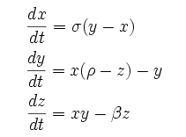
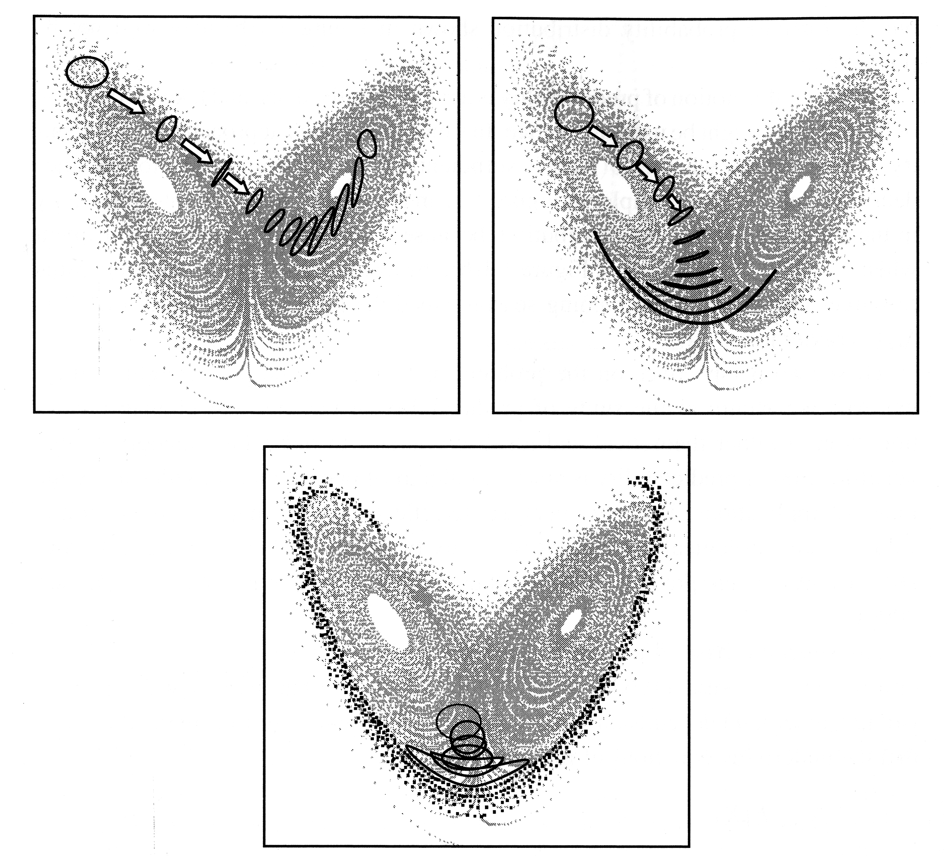
Forecast errors may be very different from one day to the next because of “chaos”
The Lorenz (1963) model
Errors grow more quickly for some
initial conditions than others. Hence, the need for state-dependent forecast PDFs.
from Tim Palmer’s
2006 book chapter

Slide 43
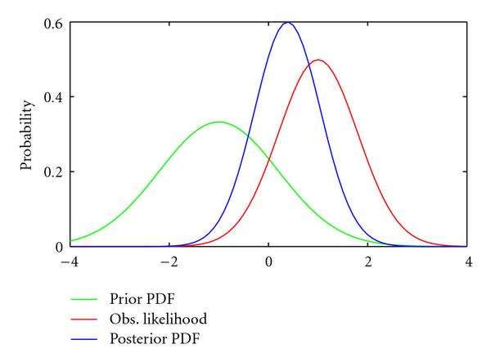
Data Assimilation – Bayes Rules!
Analysis PDF (product of red and green PDFs)
PDF of temp given T_{ob} observed
PDF of first-guess forecast given all past obs
Temp ob (T_{ob}) in Boulder

Slide 44
The Ensemble Kalman Filter
(skipping all the math)
EnKF solves Bayes theorem assuming prior and observation PDFs are Gaussian, uses an ensemble of forecasts to represent the prior and posterior PDF.
Amounts to linear regression (covariances in the ensemble are used to spread out the information in the observations into unobserved regions and variables).
If done right, the posterior ensemble is a random draw from the distribution of possible model states given the uncertainties in the prior forecast and the observations.
Notes:
Data assimilation is the problem of estimating the state of the model given a model forecast and current observations. All DA systems are based on Bayes theorem, which is a general statement relating the PDF of a modelled system to the prior information and all available observations.

Slide 45
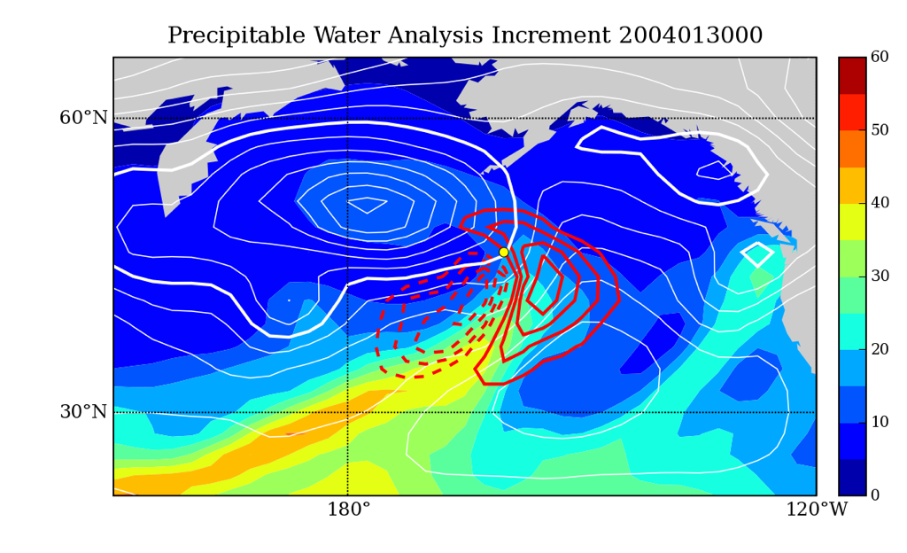
A full NWP example
p_{s} ob
First-Guess Precipitable Water
First-Guess SLP contours
Surface pressure observation can improve analysis of integrated water vapor (through flow-dependent cross-variable covariance).
Notes:
45
Ebda methods designed to give fully-flow dependent B info. To the extent that flow-dependent B are really important, we would expect EB to do really well if the ensemble can represent those flow-dependent B errors. Here I’ll show two examples of dynamical situations where flow-dependent background errors should be very important for extracting information from the observations, and illustrate how an EnKF does it with real obs.
First case is a warm-conveyor belt situation ahead of a maritime cyclone (aka atmospheric river). White contours are background MSLP, colored field is background total column water vapor, and red contours are TCWV increment for a single surface pressure observation at the location denoted by the yellow dot. Covariance between surface pressure at the observation location and the TCWV field allows the pressure ob to adjust the position ‘atmopsheric river consistent with the surface cyclone. DA system ‘knows’ there is a cyclone/wcb in the background, makes adjustments when given observations taking the dynamics into account.
Coupled DA – obs from ocean can increment atmosphere (and vice versa) through cross-covariances in coupled state vector.

Slide 46
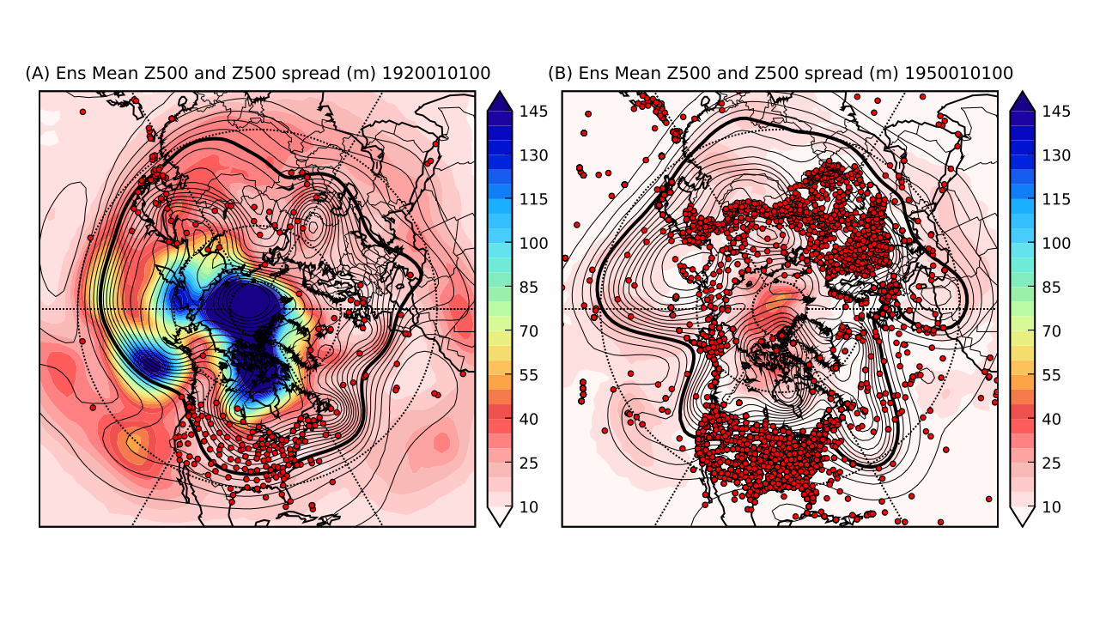
Climate reanalysis example
(20th Century Reanalysis Project: http://www.esrl.noaa.gov/psd/data/20thC_Rean/) only surface pressure observations used (red dots) shading: 500 hPa Z analysis ensemble spread contours: 500 hPa Z analysis mean
EnKF captures changing uncertainty as observing network changes.
Notes:
Reference Gil’s talk (poster?)
Doesn’t show application.

Slide 47
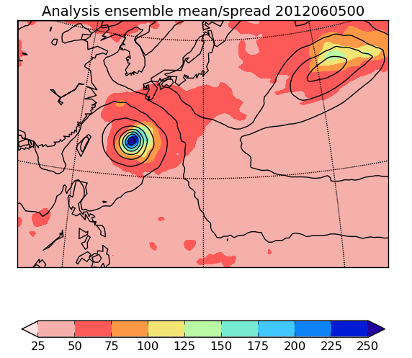
NCEP EnKF
MSLP (Pa)
Typhoon Mawar
EnKF captures state-dependent uncertainty associated with coherent dynamical features

Slide 48
Where is the EnKF used?
Env. Canada has used an EnKF to initialize ensembles since 2005.
NCEP just implemented an EnKF system on May 22 (for now it just provides the forecast error stats used in the analysis, but does not initialize the ensemble).
NCAR provides EnKF software for the research community (http://www.image.ucar.edu/DAReS/DART) with interfaces for WRF and CAM.

Slide 49
What limits EnKF performance?
Sampling error (noisy covariance estimate when sample size is small and/or covariance signal is small).
Model error (ensemble needs to represent all sources of forecast uncertainty, including the model itself).
Assumption of Gaussian error statistics, unbiased model prior.
All of these lead to spread-deficient initial ensembles, so ad-hoc methods are often used to inflate the variance.

Slide 50
Dealing with model uncertainty
Make the forecast model better.
  e.g., higher resolution, improved dynamics, improved physical parameterizations, coupled land-ocean-atmosphere-chemistry-ecosystem.
Estimate the uncertainty due to the forecast model imperfections in the ensemble system
  Multi-models/parameterizations
  Stochastically simulate sources of error in forecasts

Slide 51
Dealing with model uncertainty
Estimate the uncertainty due to the forecast model imperfections directly in the ensemble system.

Slide 52
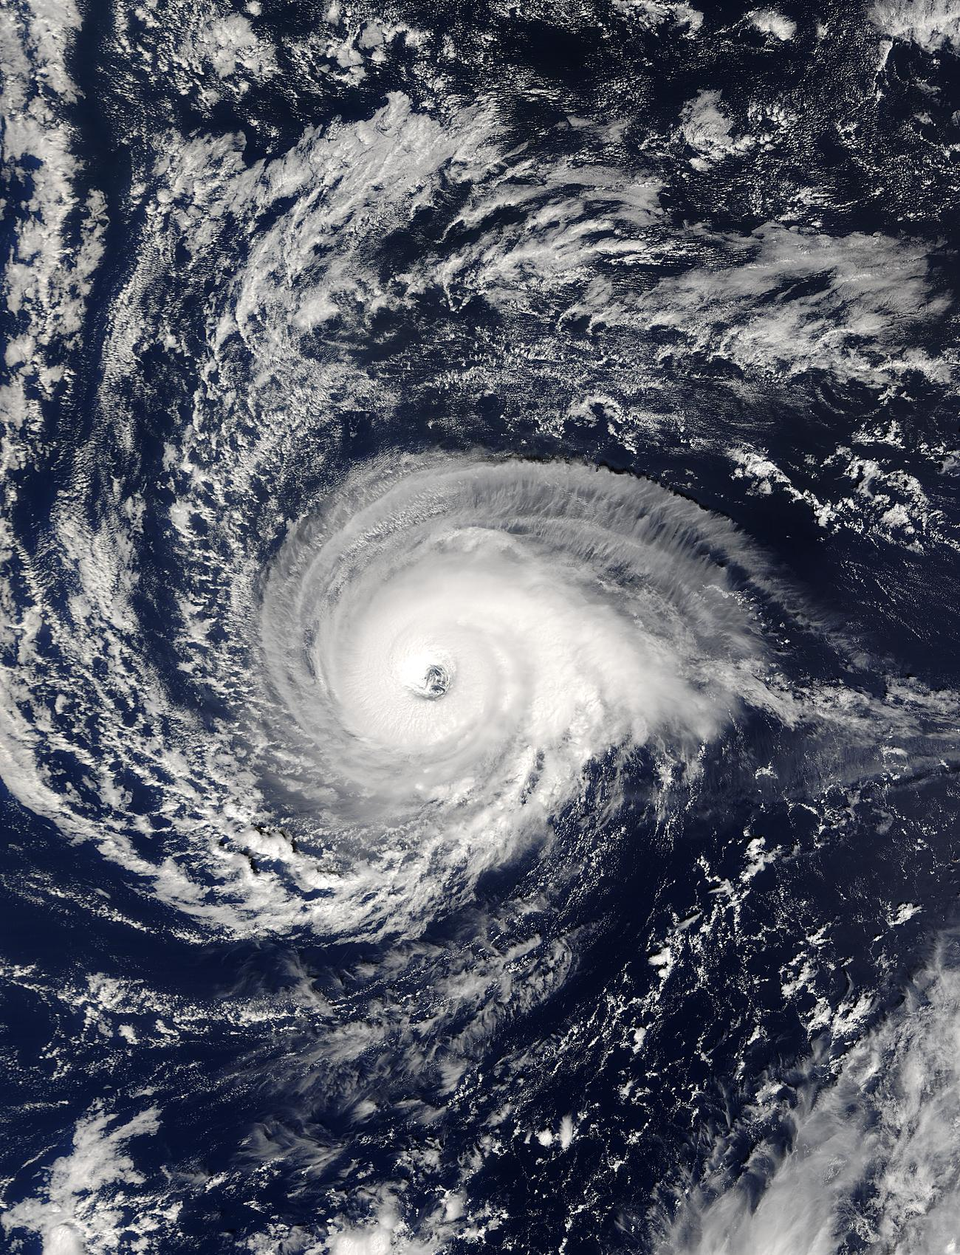
“Stochastic parameterization”
Suppose two red boxes have ~ identical
grid-box average vertical profiles of
temperature and humidity (though
the sub-grid scale distribution differs).
Convective parameterizations will
treat these two boxes the same,
producing identical amounts of rainfall.
In ensemble systems, this can
contribute to a lack of diversity among
ensemble members. Hence, the field
is moving toward stochastic
parameterizations.

Slide 53
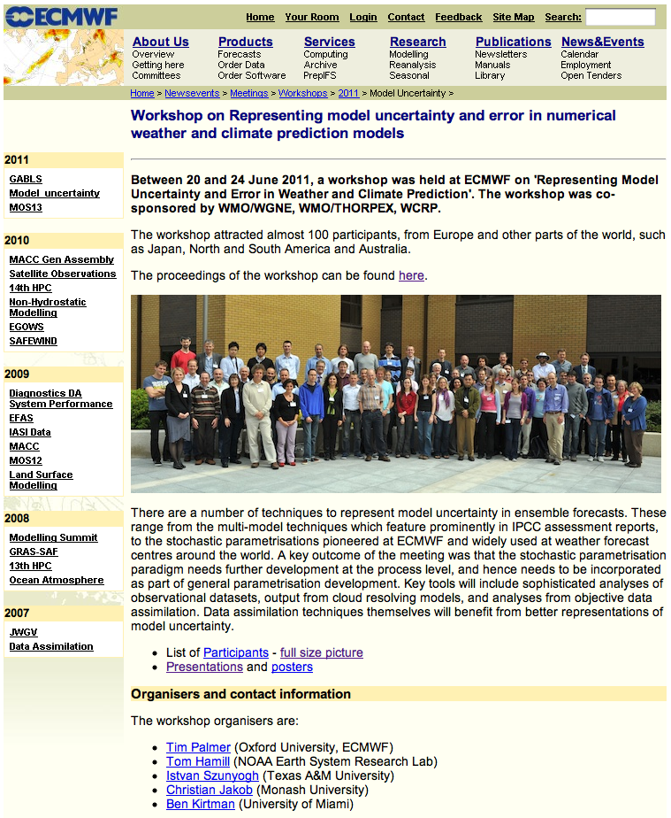
Physically based
stochastic
parameterization
is a hot topic, at the
forefront of ensemble
R&D.

Slide 54
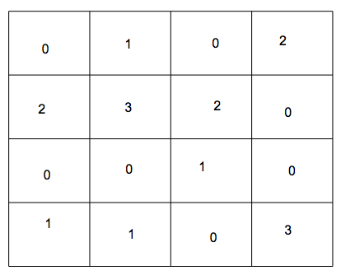
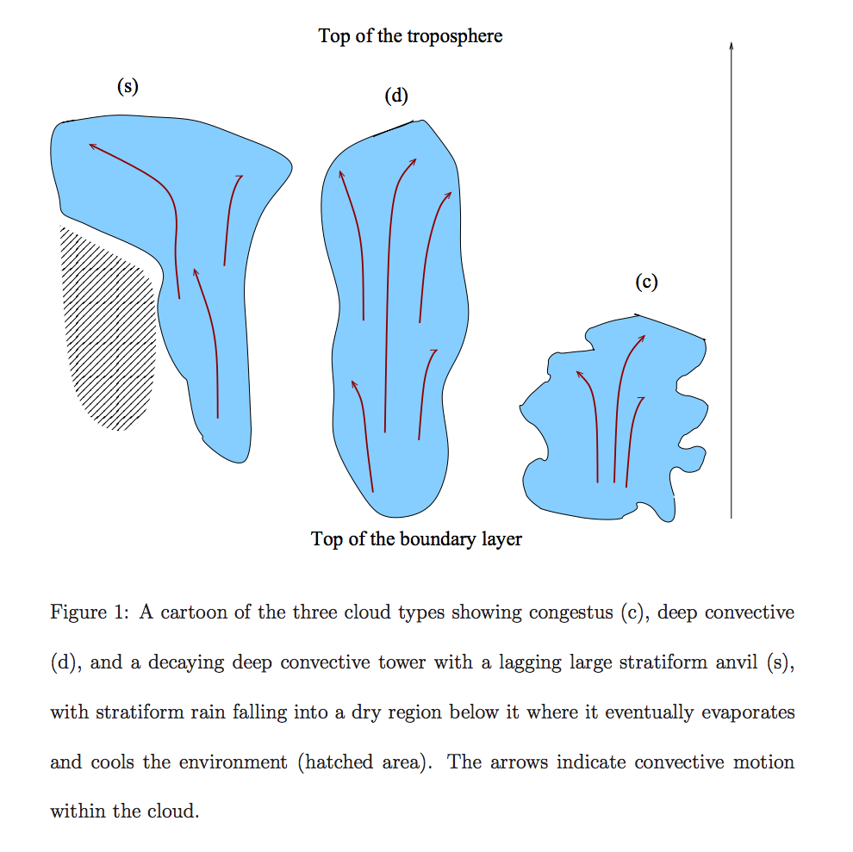
Stochastic lattice: a sample non-deterministic convective parameterization
A grid box is divided up into 0 (clear sky),
1 (congestus), 2 (deep convection),
3 (stratiform anvil). The relative fractions
of each are determined by large-scale
conditions. Transition matrices describe
the relative likelihood of one classification
switching to another.
Ref: many recent Majda, Khouider articles. See also their presentations later in this colloquium.

Slide 55
Initializing ensembles - summary
The EnKF provides a framework for unifying ensemble prediction and data assimilation.
If a “good” ensemble is available (samples all sources of forecast uncertainty), and the KF assumptions apply, the EnKF provides an initial ensemble that samples analysis uncertainty.
R&D now focused on better ways to deal with sampling error and model uncertainty.
We will never be able to make models perfect, or capture all sources of uncertainty in ensembles, so there will always be a need to post-process, (statistically adjust the ensemble using prior forecasts and observations).

Slide 56
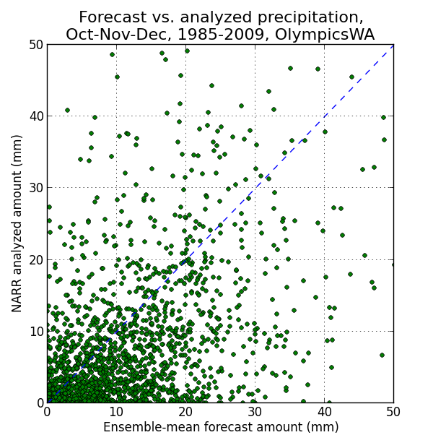
Using reforecasts
Reforecasts are hindcasts, large data
sets of past forecasts using ~ the same
model and assimilation system as is
used operationally. The samples of
many past forecasts can aid in the
statistical adjustment of today’s
forecasts.
ECMWF and NCEP/GEFS now have
accompanying reforecasts. NCEP
also has reforecast for their CFSR,
the Climate Forecast System
Reanalysis/Reforecast.

Slide 57
Using reforecasts
Suppose today’s forecast at heavy
green line. Use analyzed state
for forecasts with similar conditions
(between green dashed lines) to
estimate probabilities.
Simple, but effective with such a
large training sample.

Slide 58
These forecasts are very reliable.

Slide 59
New reforecast data set
1985-current, 11 members, once daily, using 2012 operational GEFS (T254 for week 1, T190 for week 2).
We have computed on DOE machines with renewable energy supercomputer grant.
Archiving ~170 TB of data, making this readily available to the community.
Will have web/ftp interface for you in a few weeks.
Developing experimental forecast products from this.

Slide 60
Wrap-up
Chaos limits predictability – need ensembles to represent forecast uncertainty.
A “good” ensemble needs to
  start from a set of equally-likely model states (given uncertainties in obs and first-guess).
  Represent uncertainty in the model itself (and boundary conditions) during the forecast.
Reforecasts can be used to take care of missing/mis-represented sources of forecast uncertainty, model biases.

Slide 61
Rank histogram
underlying mathematics
n-member sorted ensemble at
some point
probability the truth V is less than the
ith sorted member if V and X’s
members sample the same distribution
… equivalently
our rank histogram vector
overbar denotes the sample average
over many (hopefully independent)
samples
ref: ibid.

