Slide 1
Testing of the GFS EnKF for 2010’s tropical cyclones
ESRL
Tom Hamill, Jeff Whitaker, Phil Pegion,
and Mike Fiorino
ESRL/PSD and GSD
tom.hamill@noaa.gov

Slide 2
This year’s EnKF
Data assimilation: 80-member T254L64 using 2010 GFS on ESRL’s tjet, vs. last year’s 60-member T382L64 using 2009 GFS on NSF’s TACC.
Ensemble forecasts: 20 members to 5 days lead
T574L64 and T254L64 control from ens mean also
Bug fixes, mid-August 2010:
Assimilate more hyperspectral data (AIRS and IASI) ; last year’s we mistakenly used only lowest ~1000 channels.
Fixed scan-angle bias correction bug for satellite radiances; wasn’t updating bias.

Slide 3
Ongoing EnKF development
Development of EnKF/Var hybrid for operational implementation at NCEP/EMC (THORPEX funding); testing T254 ensemble to modify background error covariances for T574 GSI (& eventual 4D-Var); Whitaker and NCEP/EMC’s Daryl Kleist, Dave Parrish, John Derber, OU’s Xuguang Wang
Quantifying observation/representativeness errors for TCVitals minimum SLP data (informed by Ryan Torn’s work).
Assimilating TCVitals minimum SLP separately as position / intensity data, rather than treating it as any other SLP observation (again, Ryan Torn, Chun-Chieh Wu, etc have tested this previously).
parallel tests being conducted right now.
New graphical displays (Paula McCaslin’s Google Map tracker; Hamill’s fitted ellipses on spaghetti plots; stamp maps).
Test assimilation of eye dropsondes (no results yet).

Slide 4
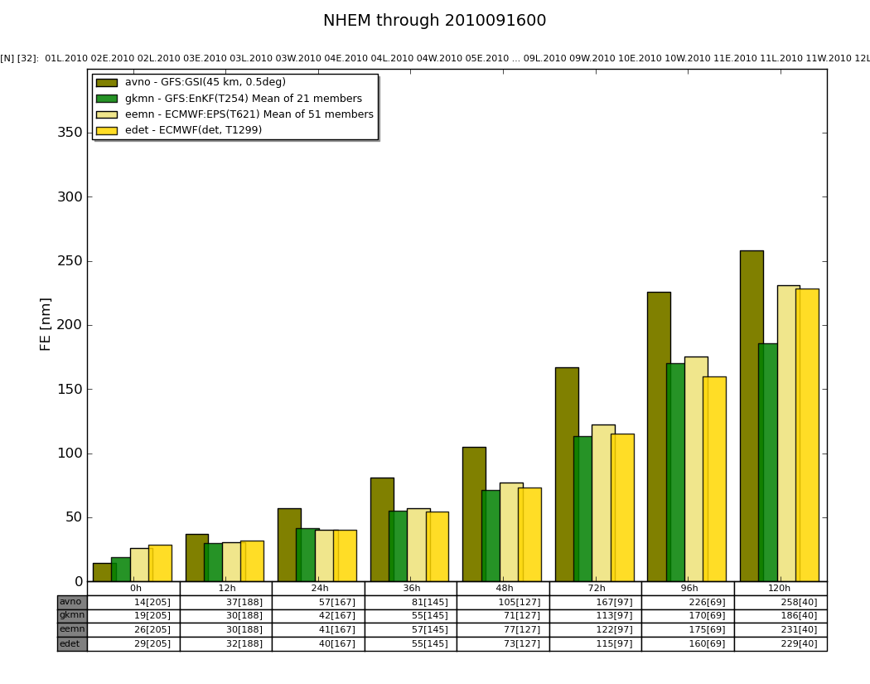
Global stats (as of 16 Sep) c/o Fiorino
GFS/EnKF
competitive
with
ECMWF
ensemble
mean and
their
deterministic
forecast. AVN
deterministic
much worse.

Slide 5
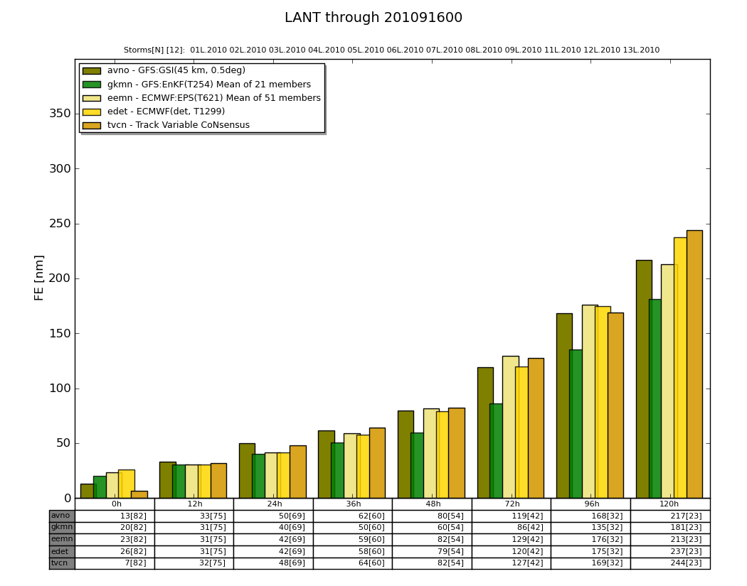
Atlantic stats (as of 16 Sep) c/o Fiorino
GFS/EnKF
lower
than
ECMWF
after
~36 h.

Slide 6
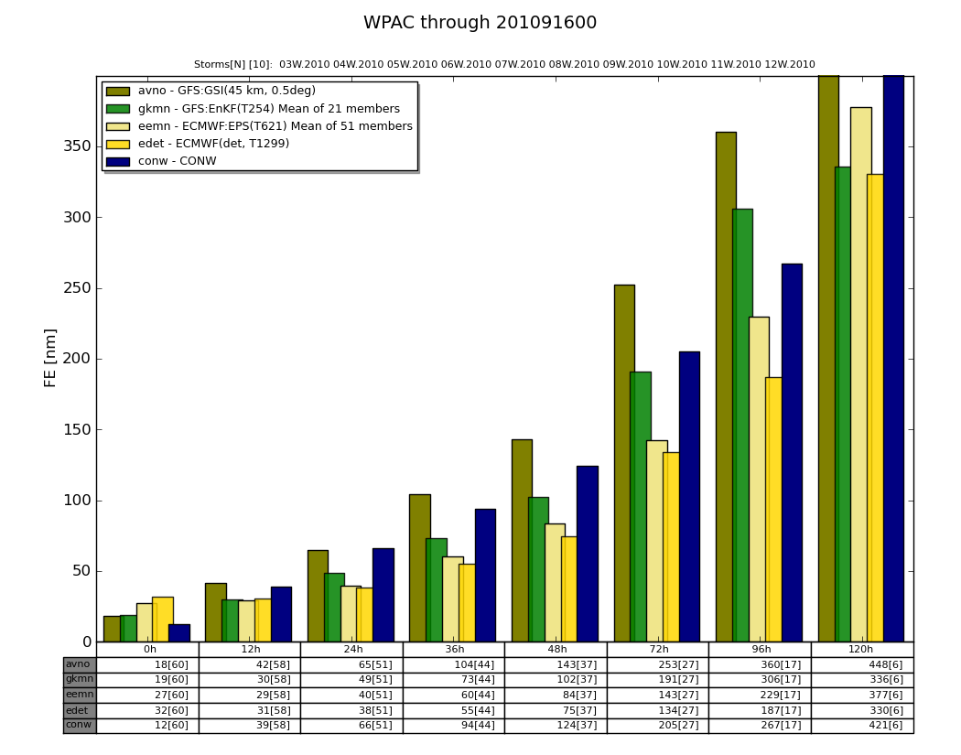
West Pac stats (as of 16 Sep) c/o Fiorino
ECMWF
deterministic
and ensemble
ahead of
GFS/EnKF;
AVN worse.

Slide 7
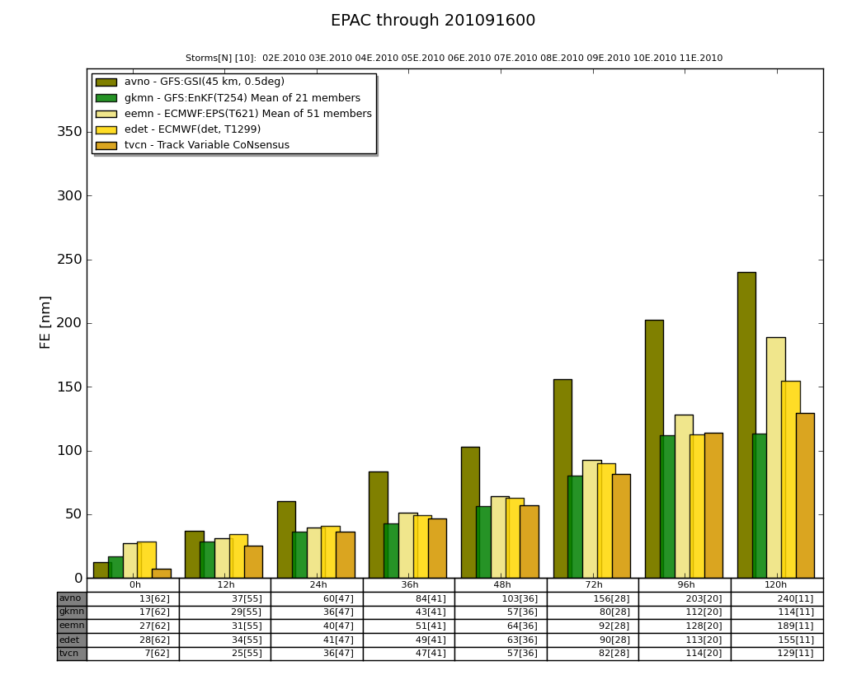
East Pac stats (as of 16 Sep) c/o Fiorino
GFS/EnKF
competitive
with or
ahead of
ECMWF

Slide 8
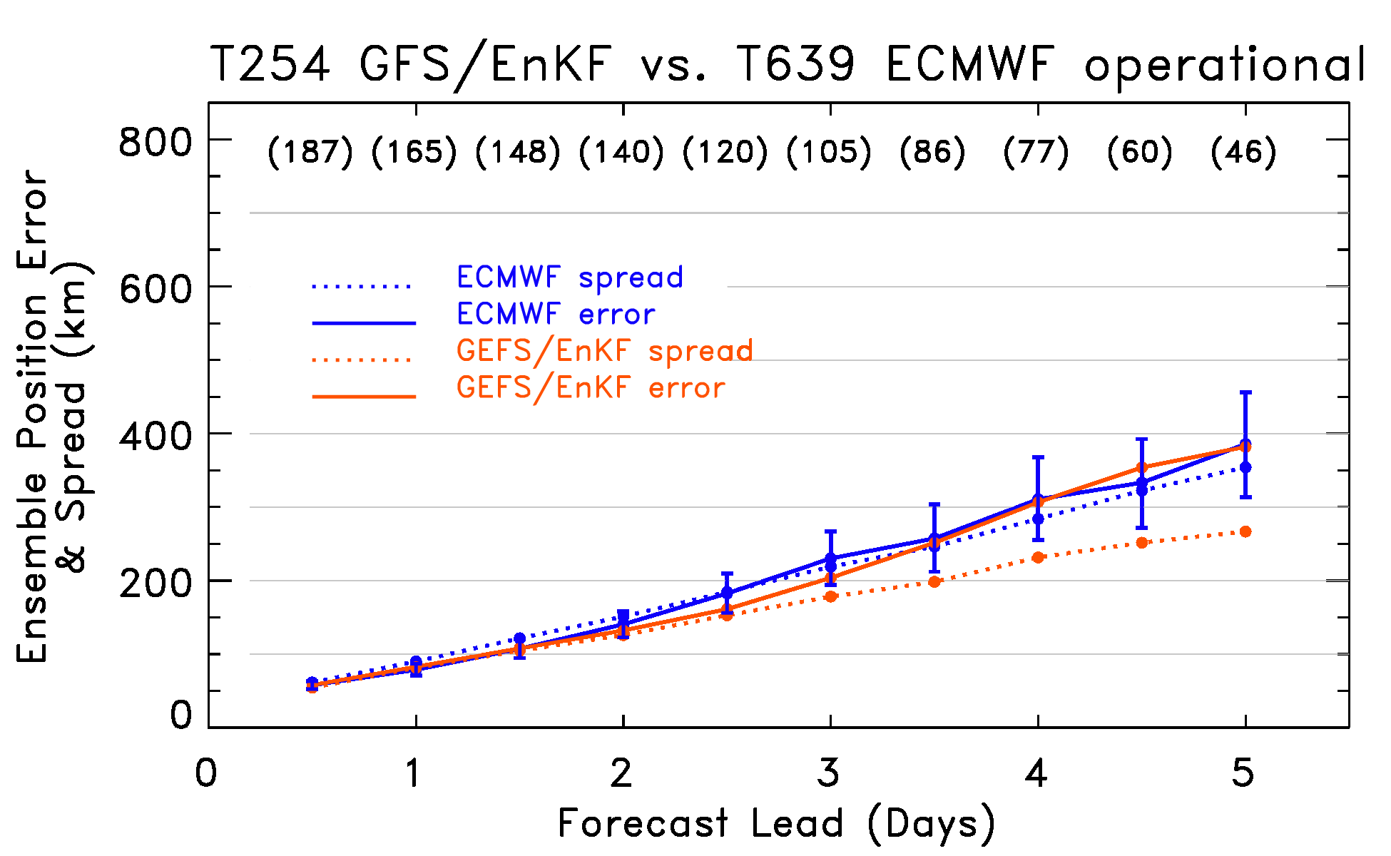
Global statistics, GFS/EnKF vs. ECMWF (ensemble statistics, 5 June to 21 Sep 2010; all basins together)
GFS/EnKF competitive despite lower resolution (T254 vs. ECMWF’s T639). GFS/EnKF has less
spread than error this year, more similar last year. Is this due to this year’s T254 vs.
last year’s T382?

Slide 9
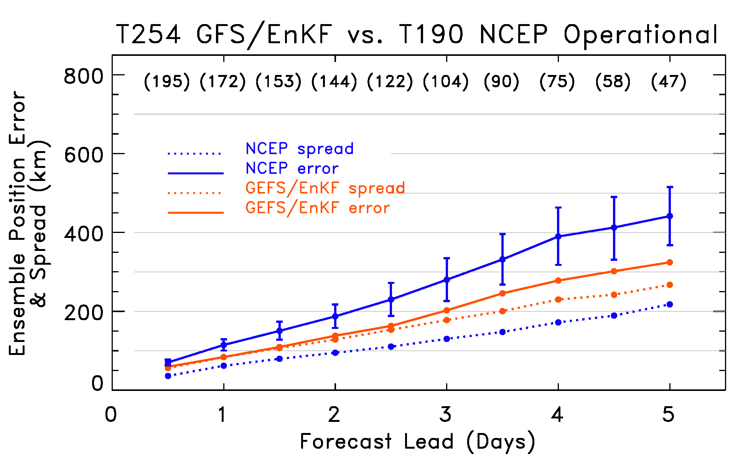
Global statistics, GFS/EnKF vs. NCEP
At most every lead, GFS/EnKF is statistically significantly better than NCEP operational ens.,
which uses (a) older GFS model, lower resolution; (b) ETR perturbations around GSI control,
and (c) vortex relocation.

Slide 10
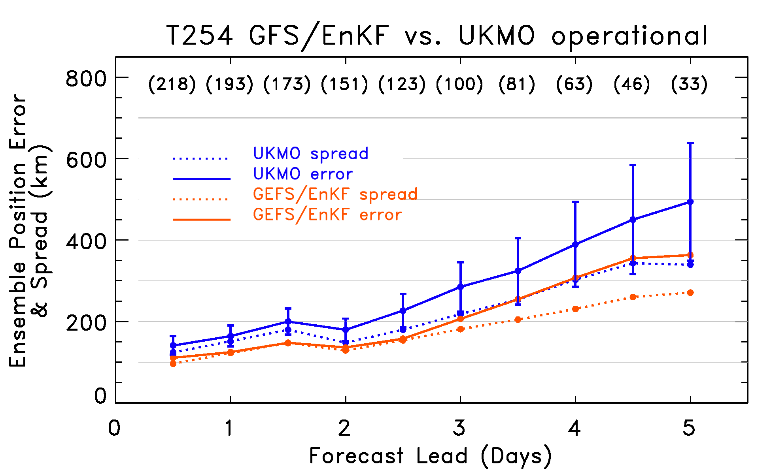
Global statistics, GFS/EnKF vs. UKMO
Again, improvement is mostly statistically significant, outside 5/95 block bootstrap CI’s.

Slide 11
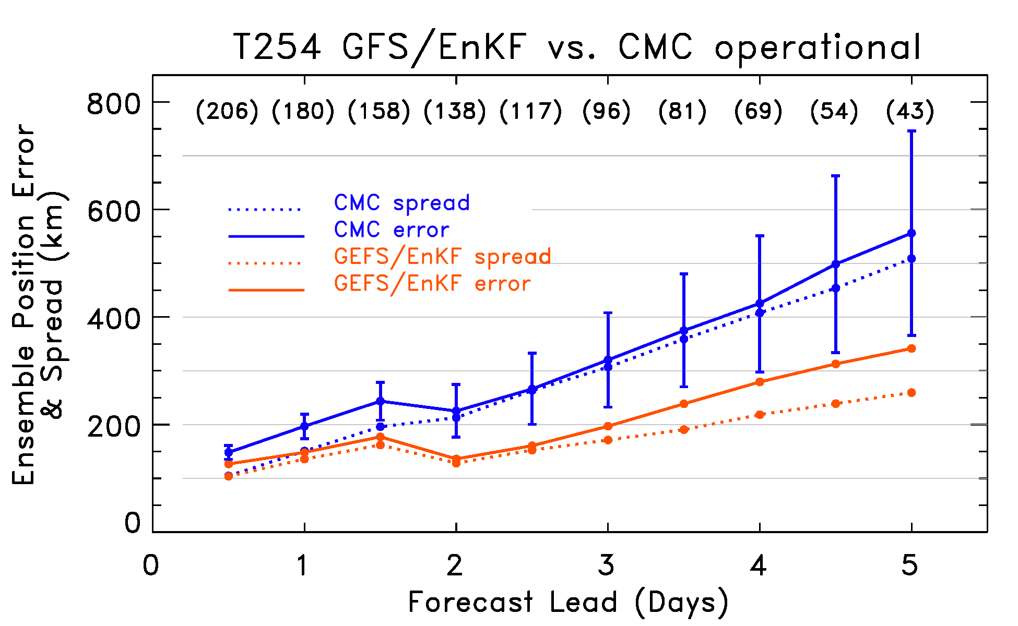
Global statistics, GFS/EnKF vs. CMC
CMC less skillful, but at least their error is consistent with their spread in general.

Slide 12
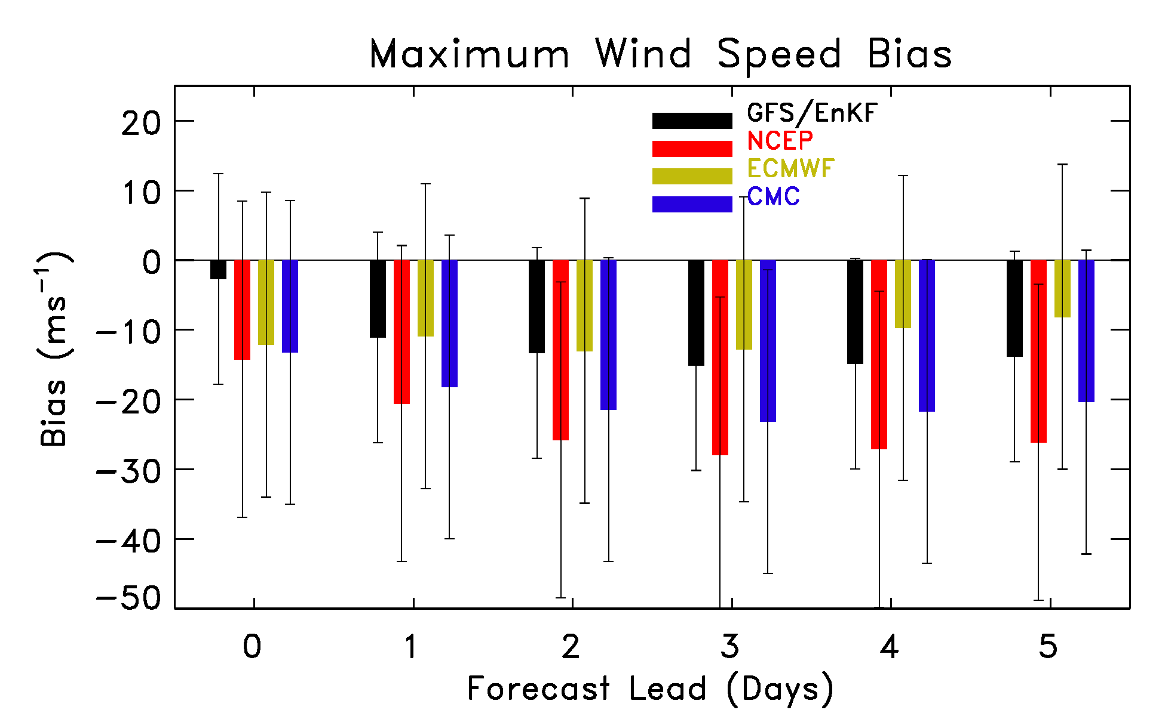
Lead-dependent bias

Slide 13
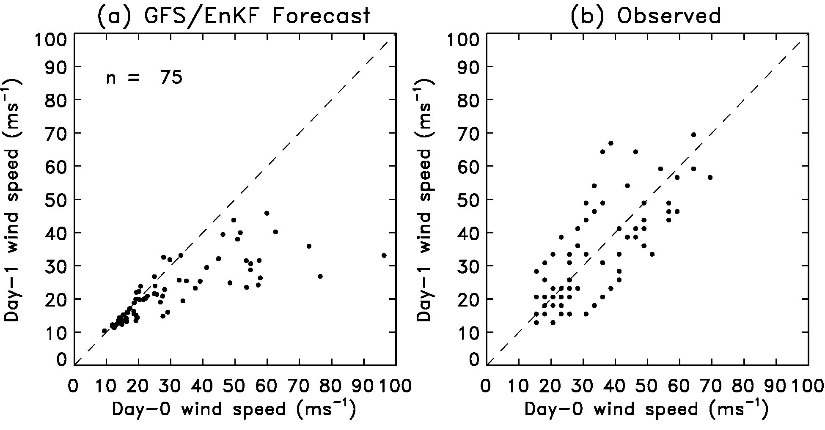
Decrease in intensity with most intense storms early in forecast – same as last year
have not made switch yet with this to separate position/intensity assimilation
and further tweaks of obs error statistics.

Slide 14
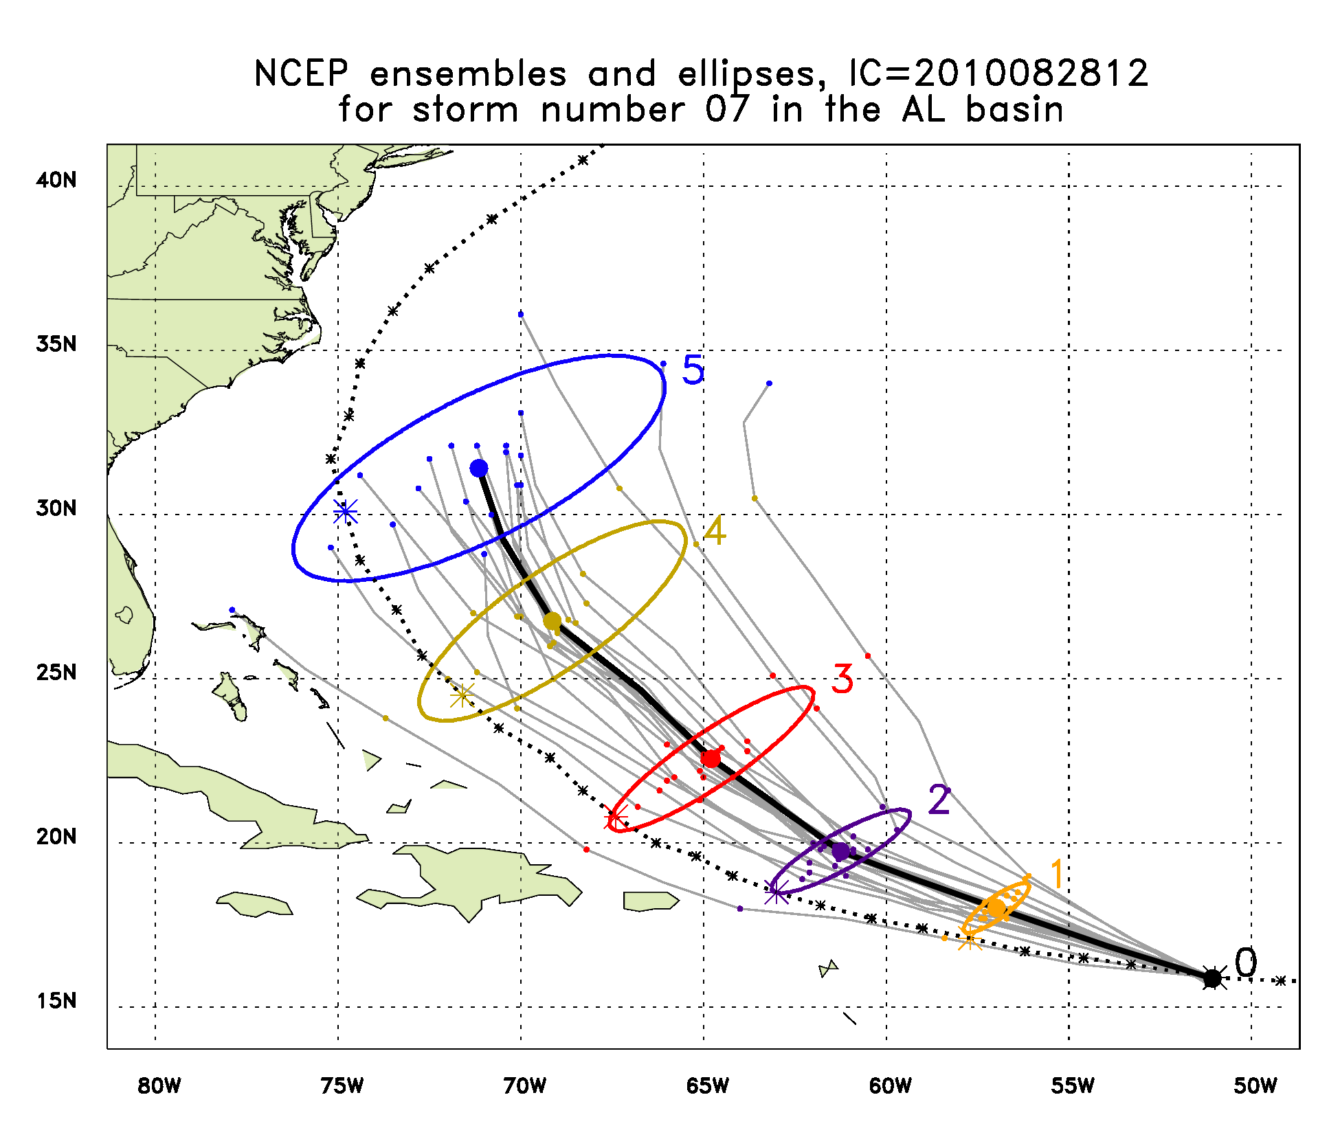
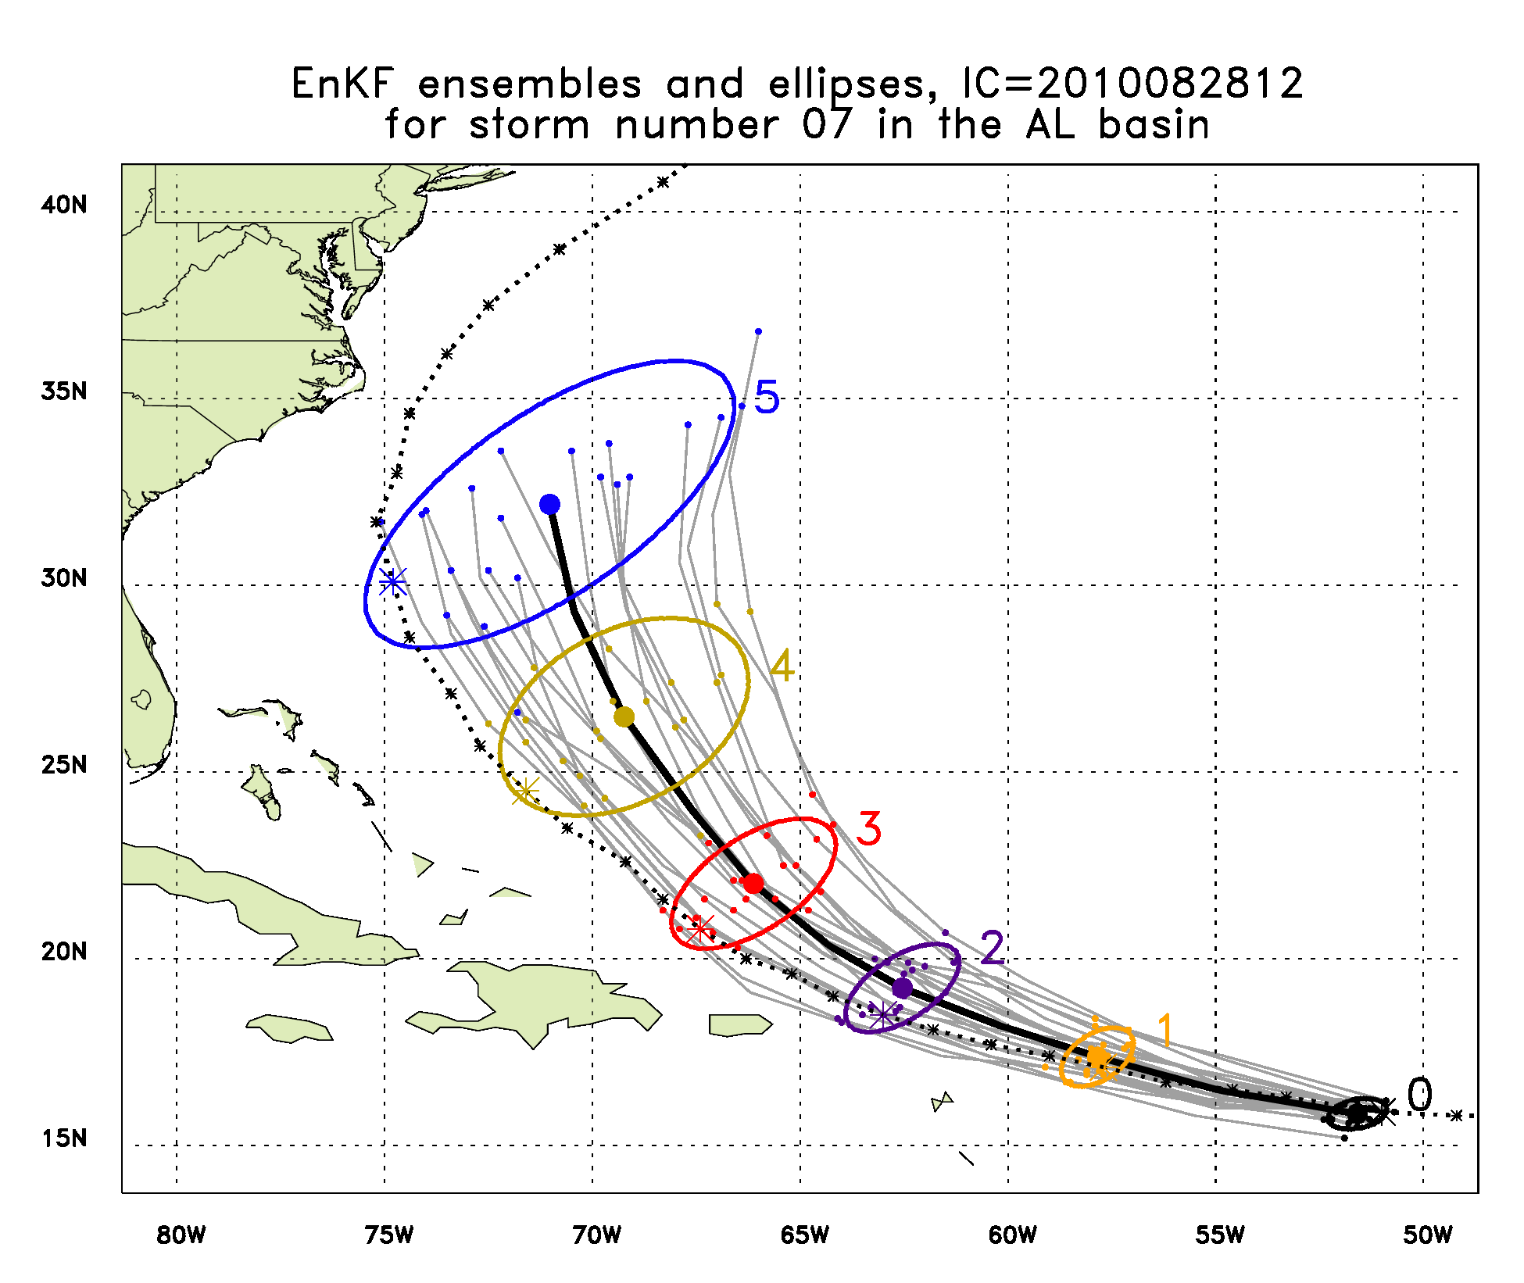
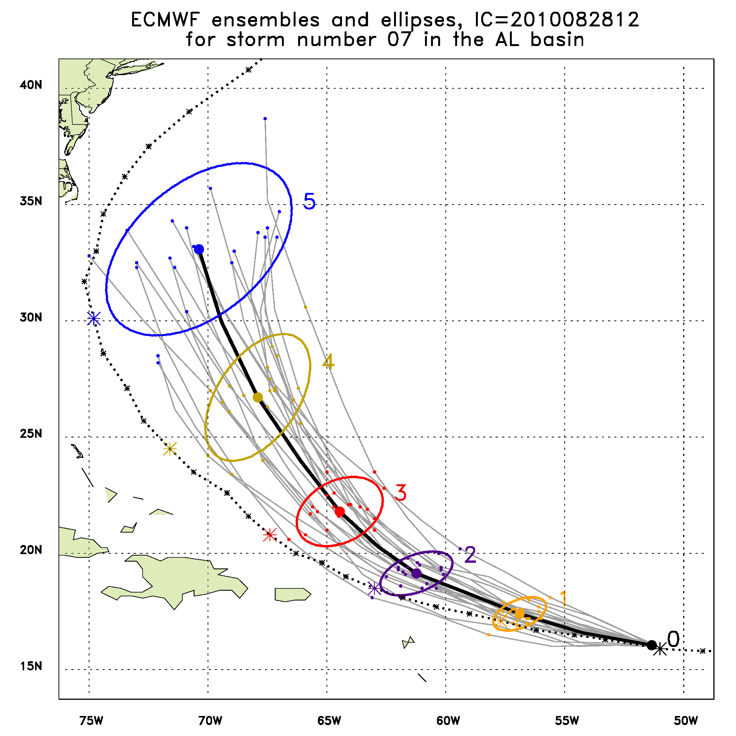
Earl, 2010/08/28/12Z

Slide 15
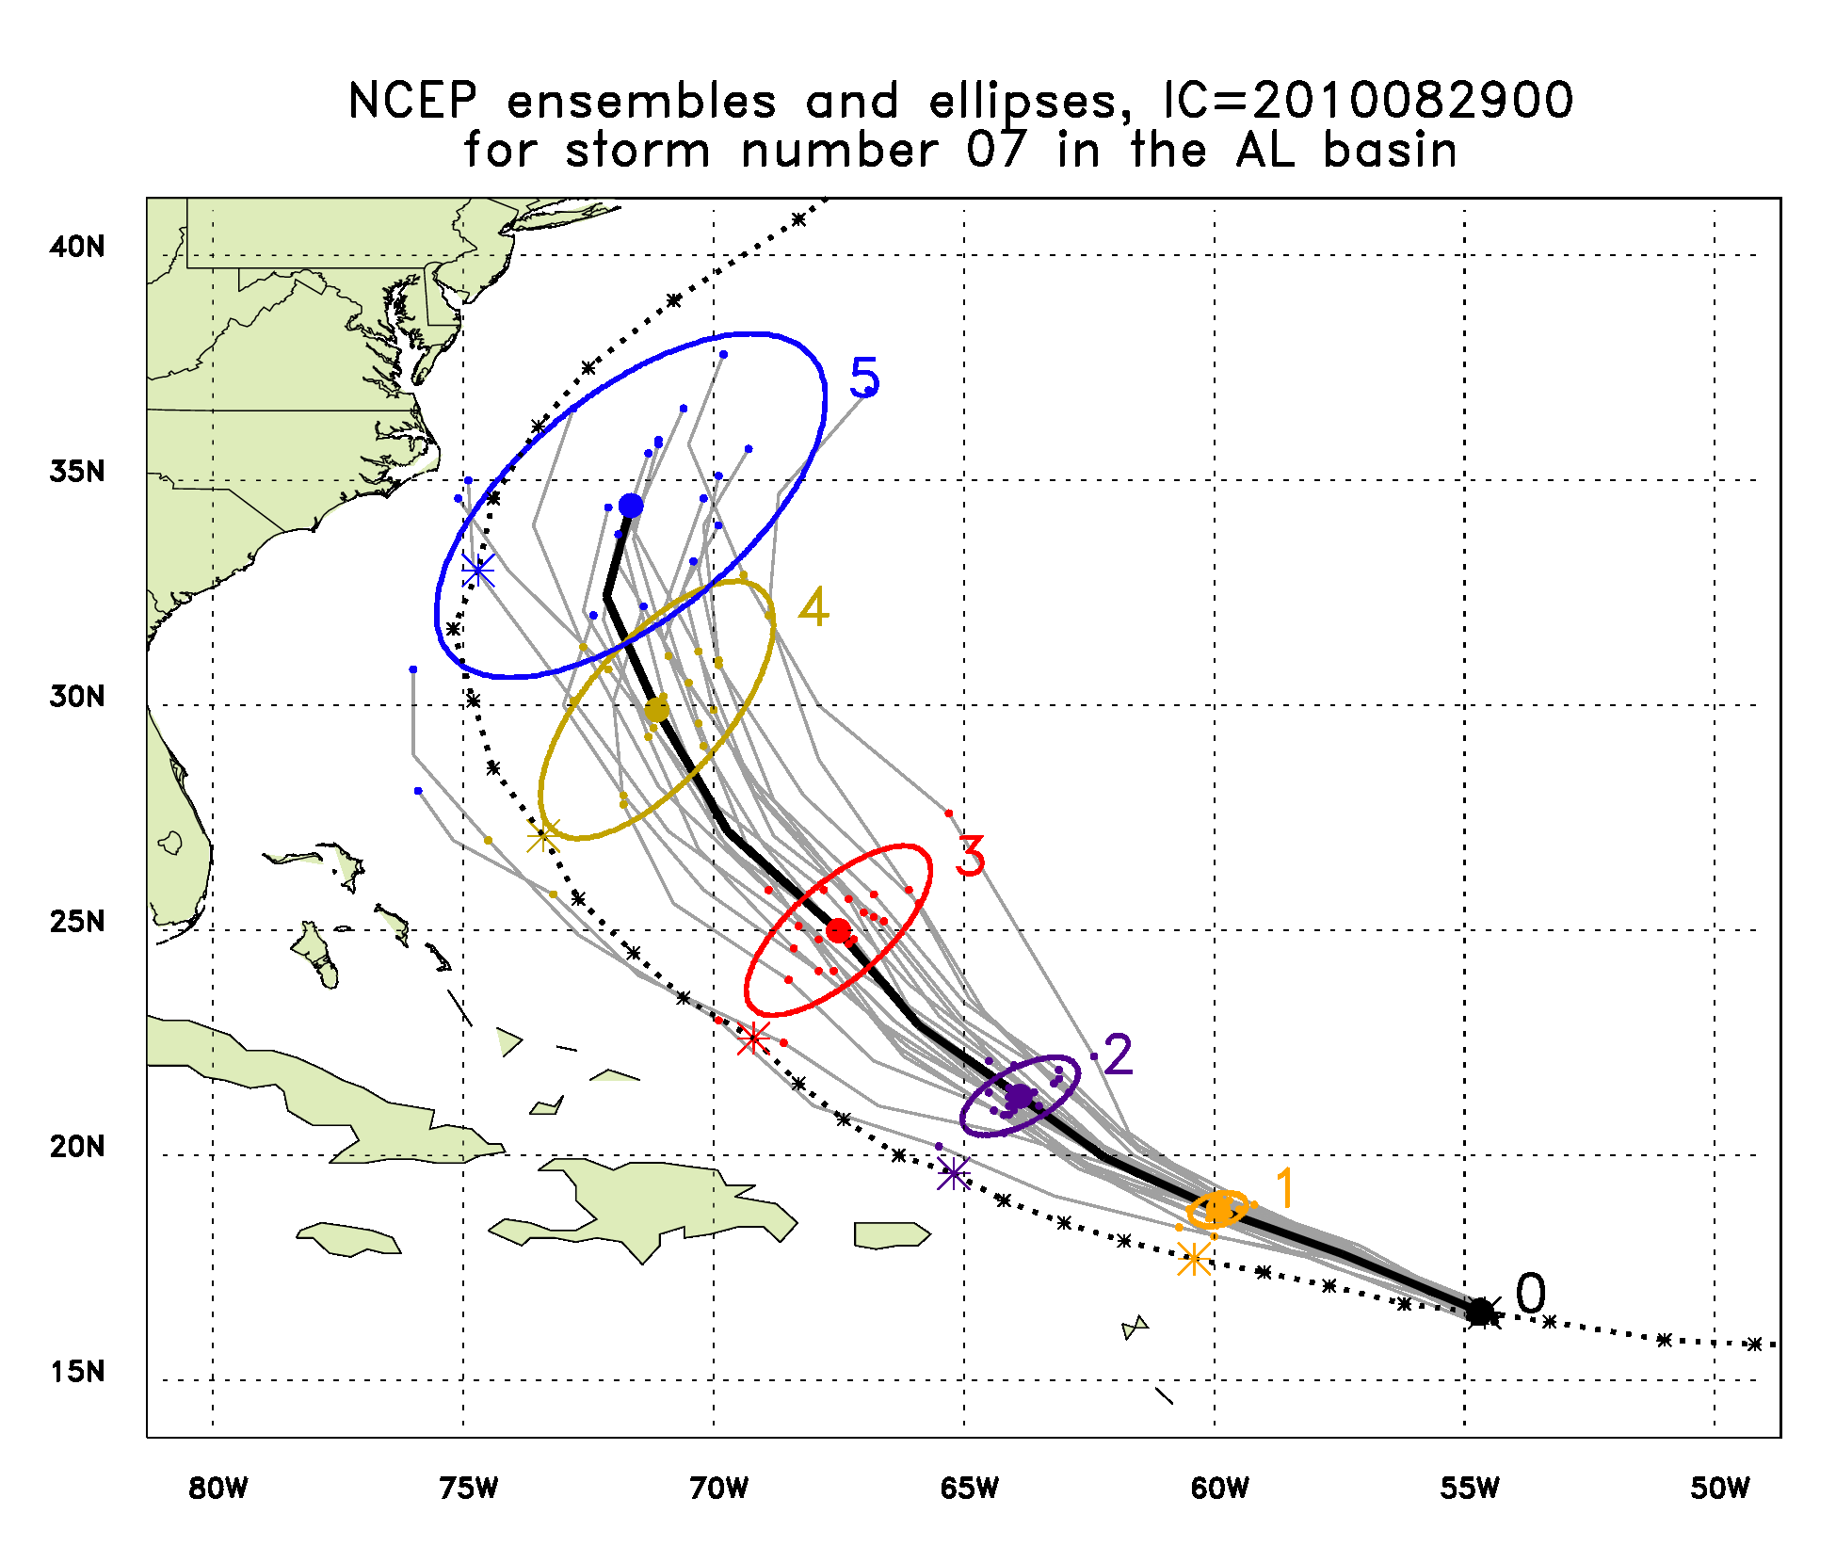
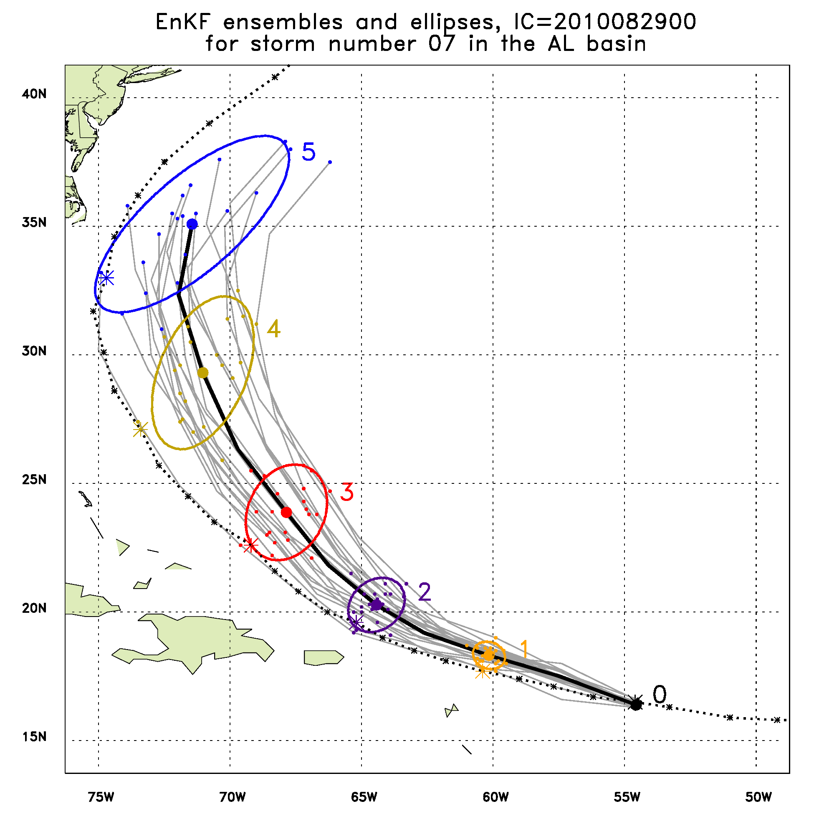
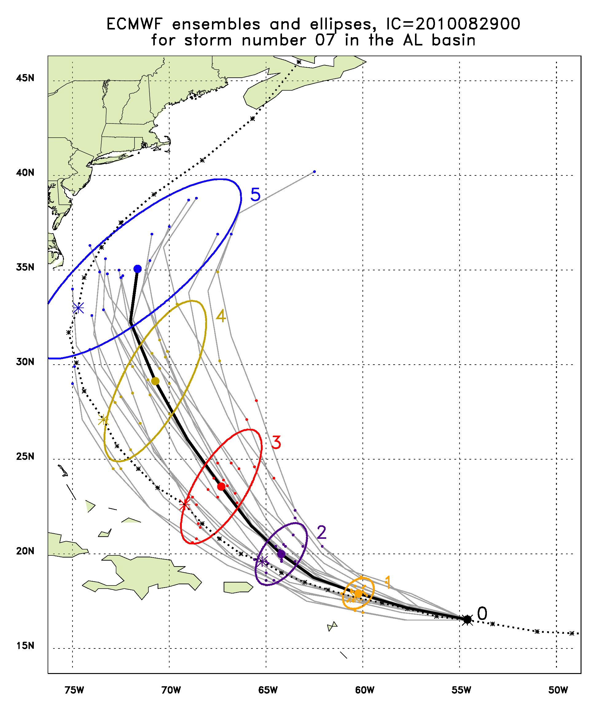
Earl, 2010/08/29/00Z

Slide 16
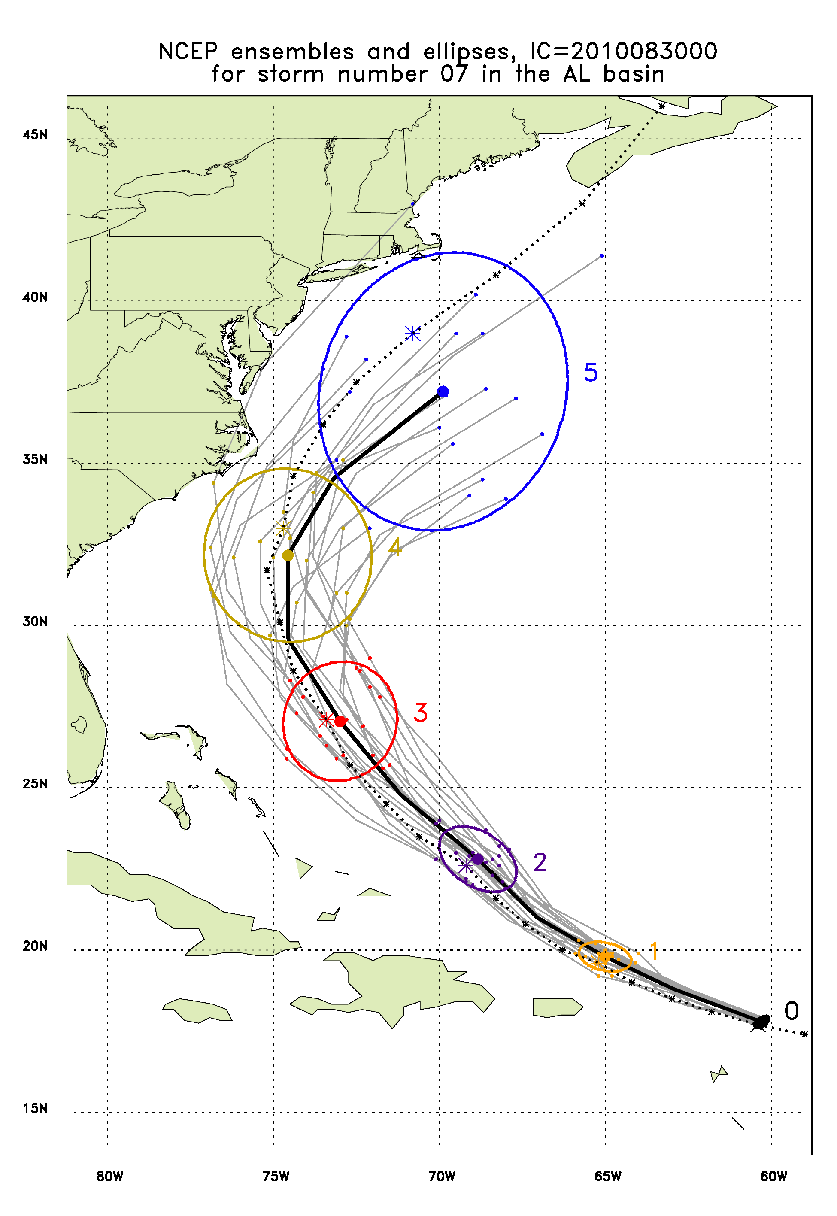
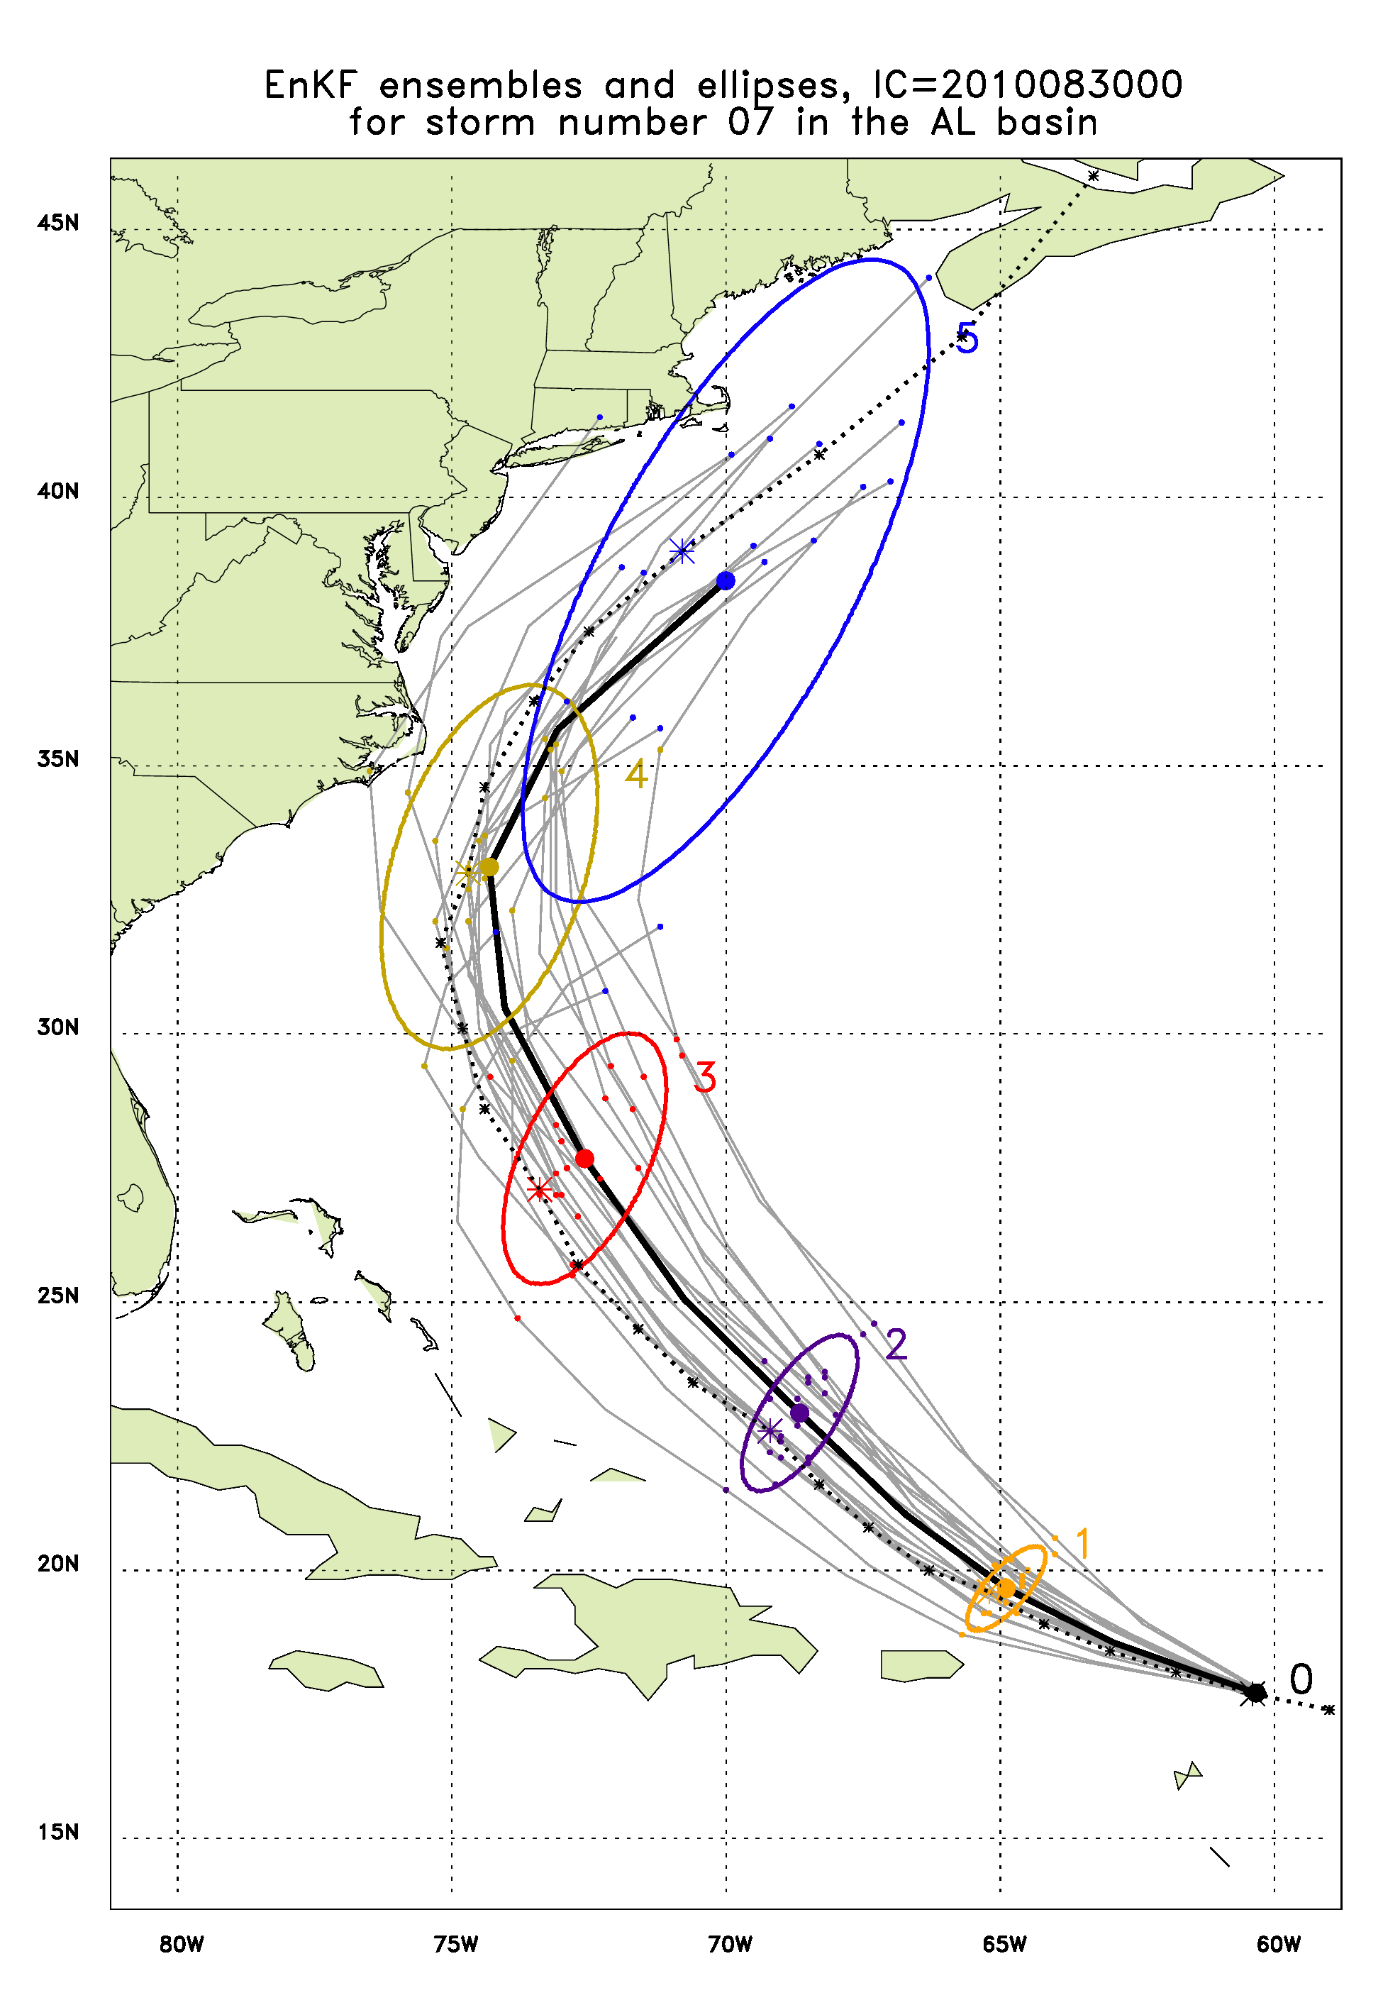
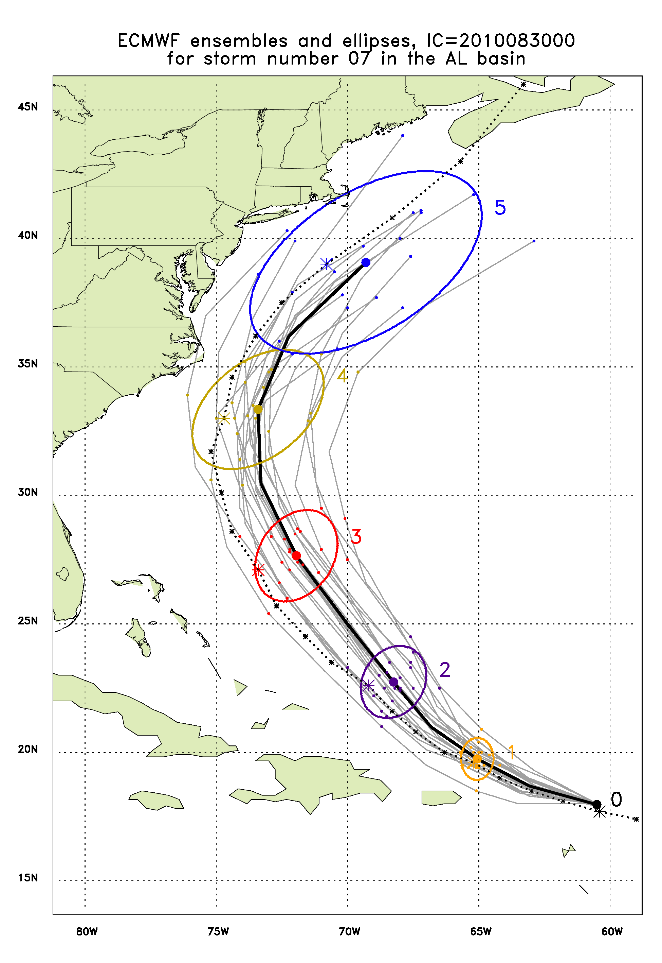
Earl, 2010/08/30/00Z

Slide 17
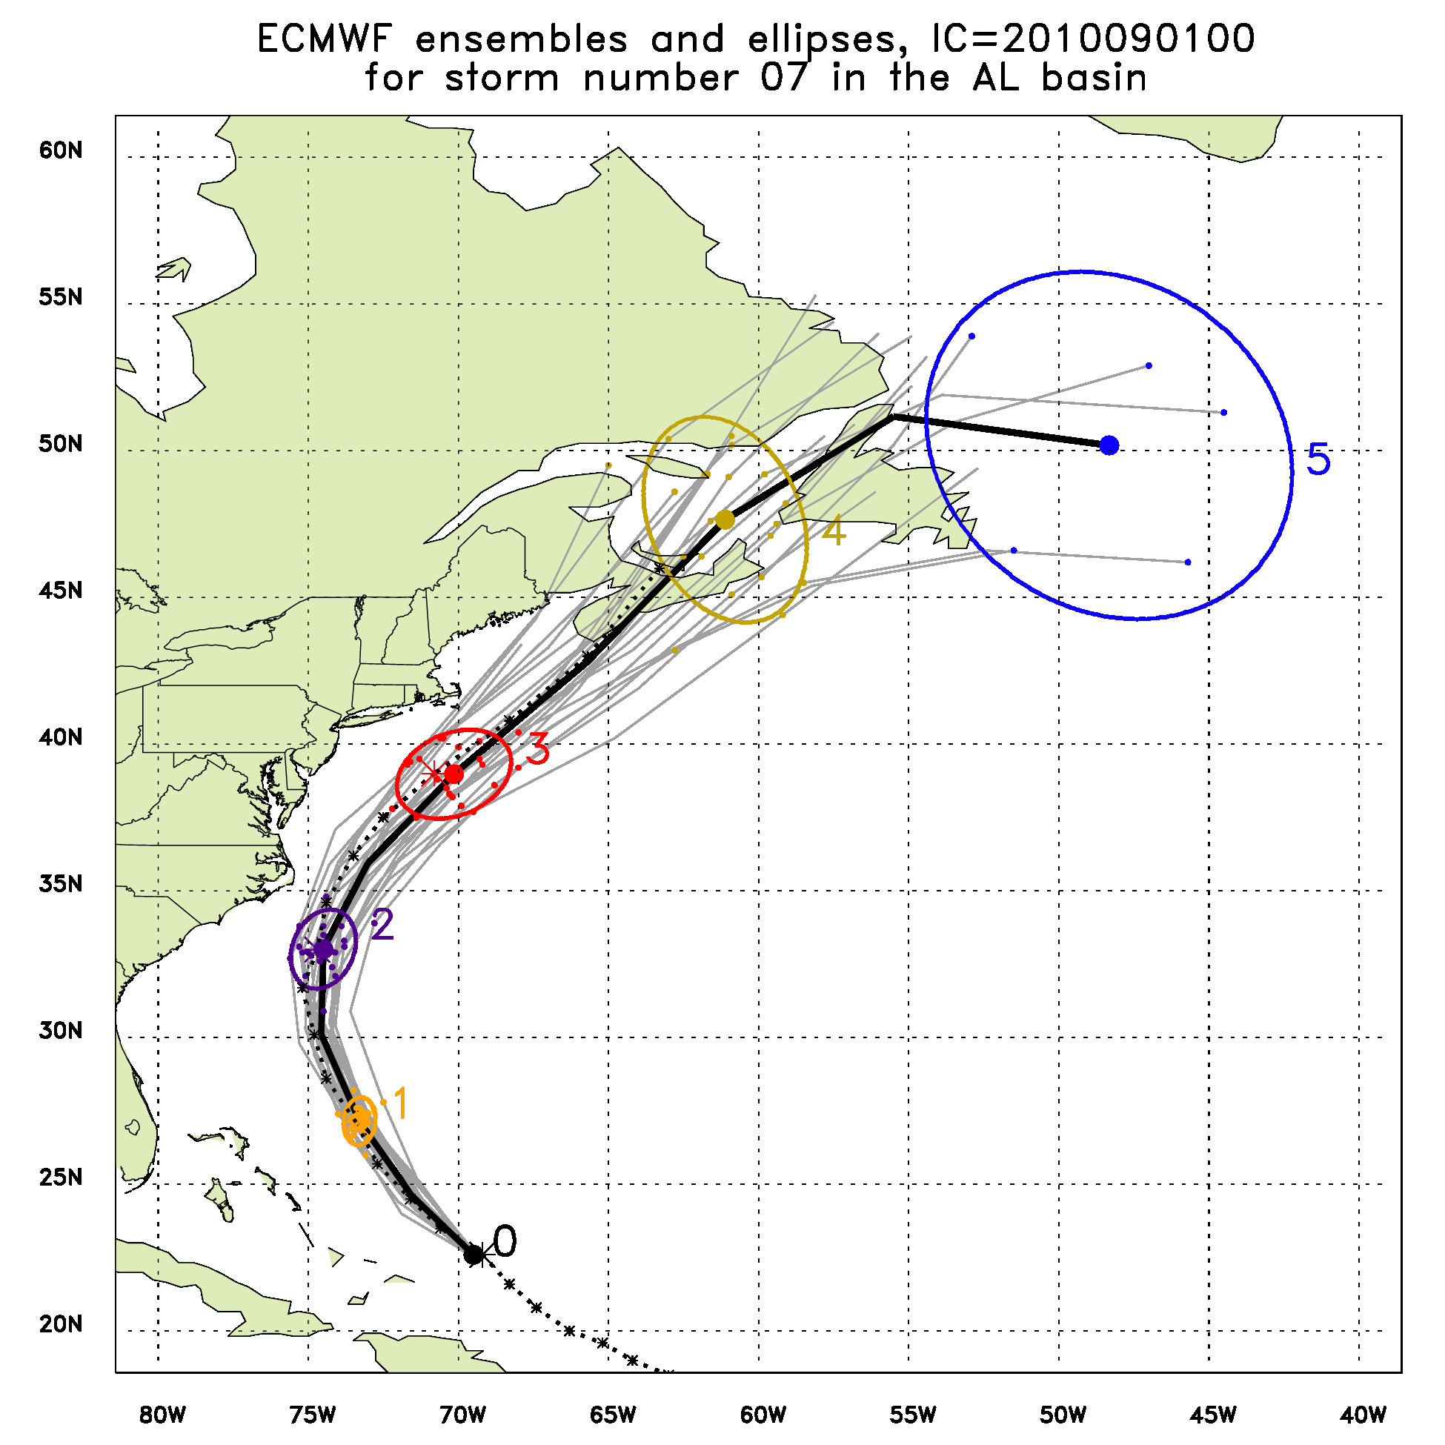
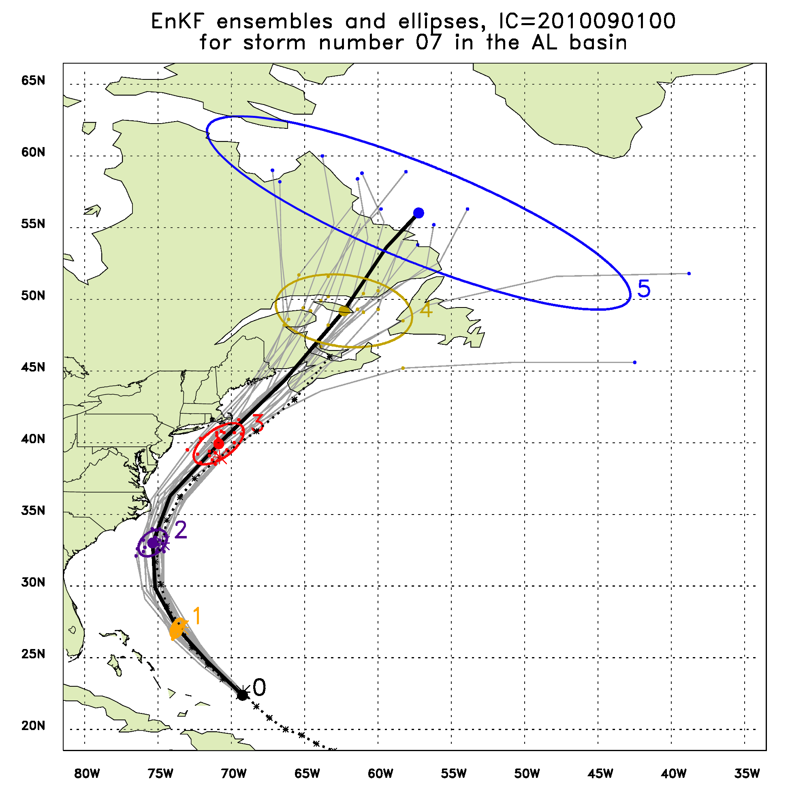
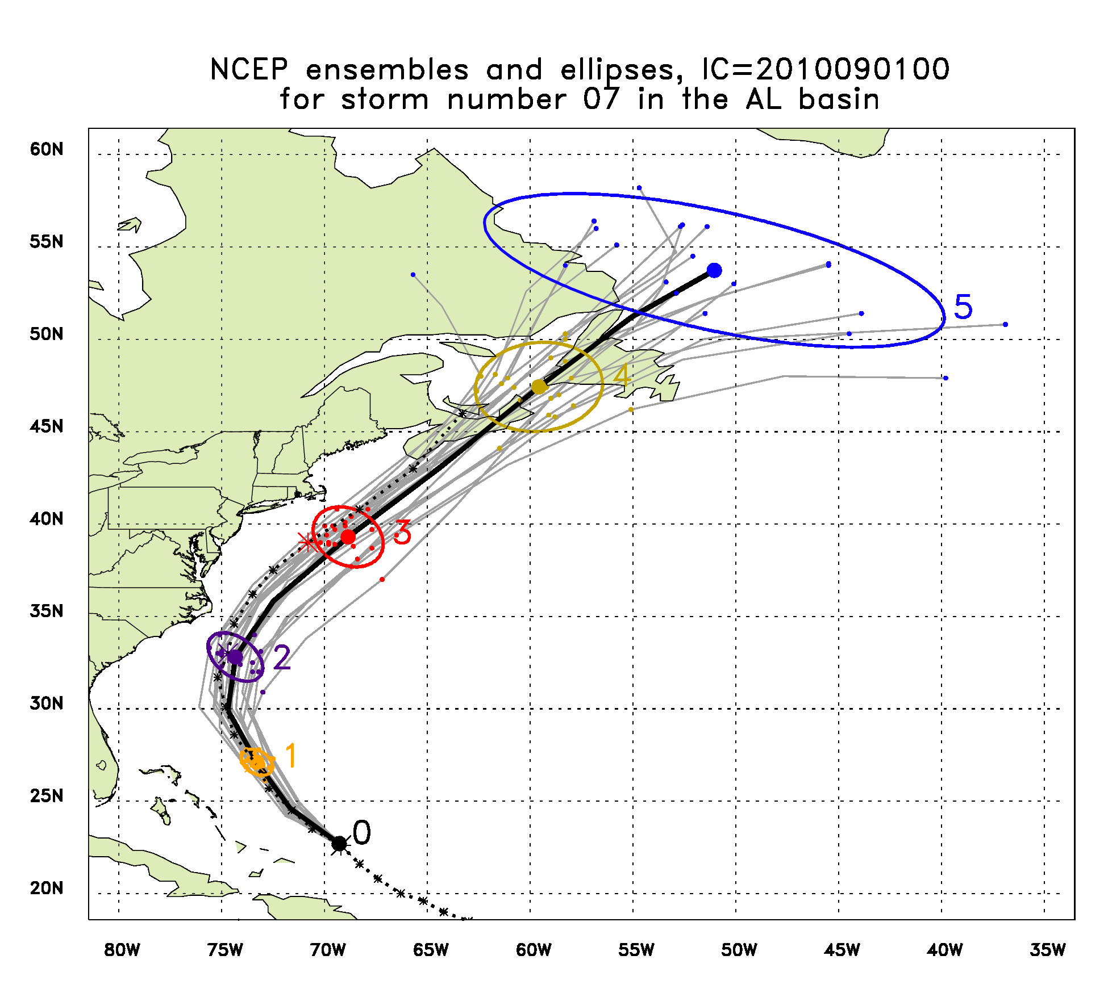
Earl, 2010/09/01/00Z

Slide 18
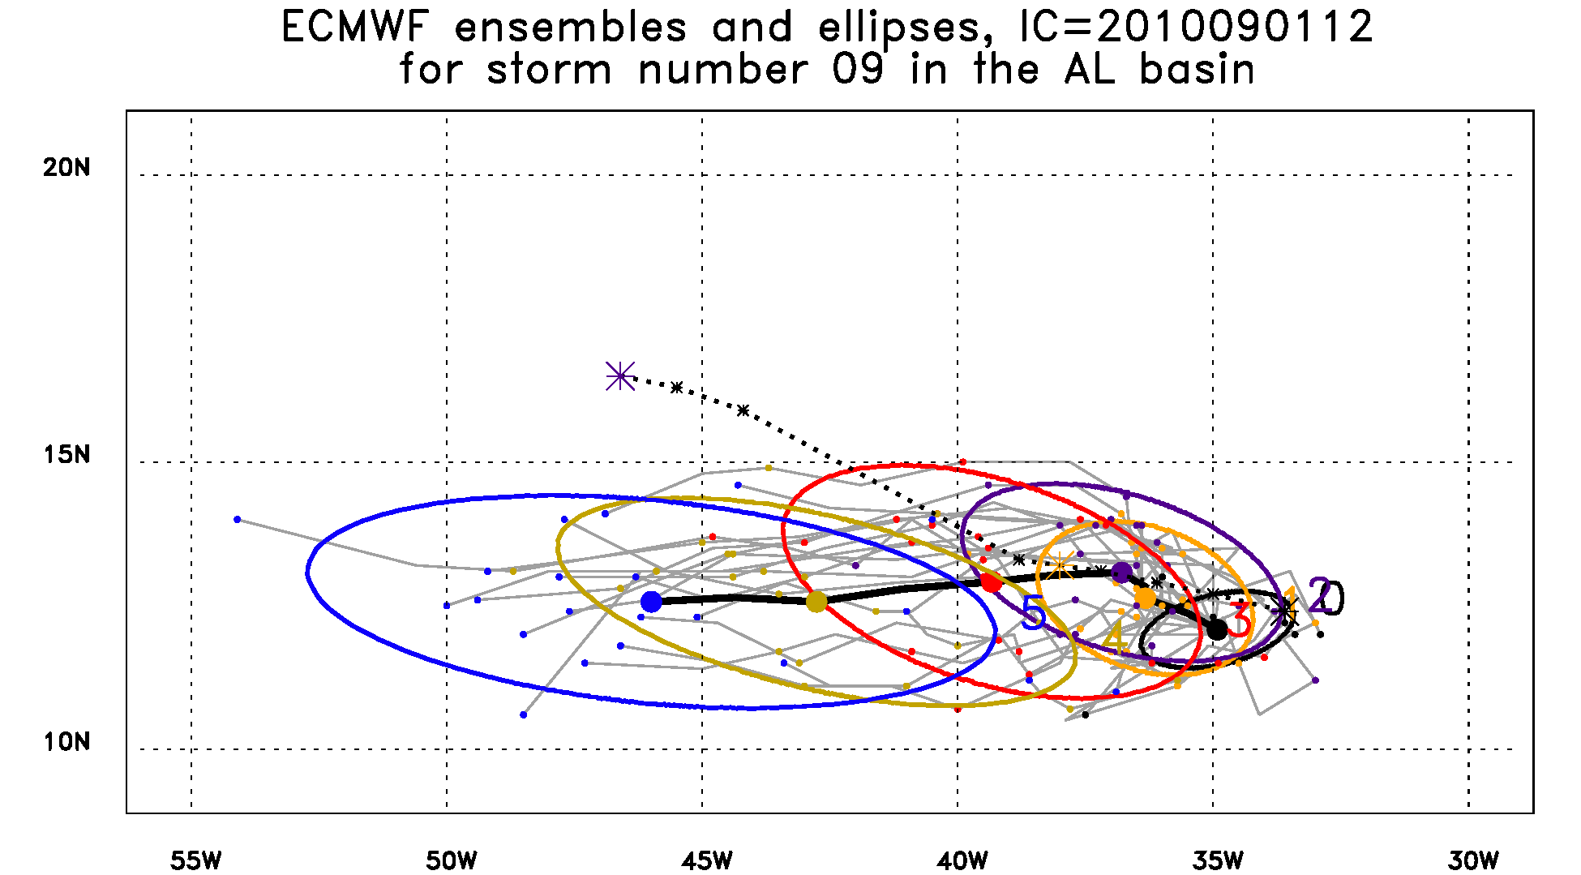
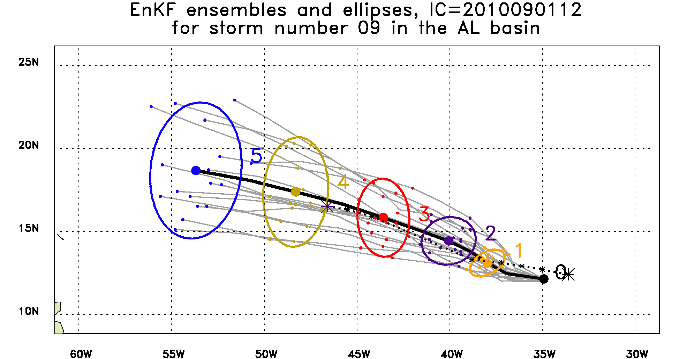
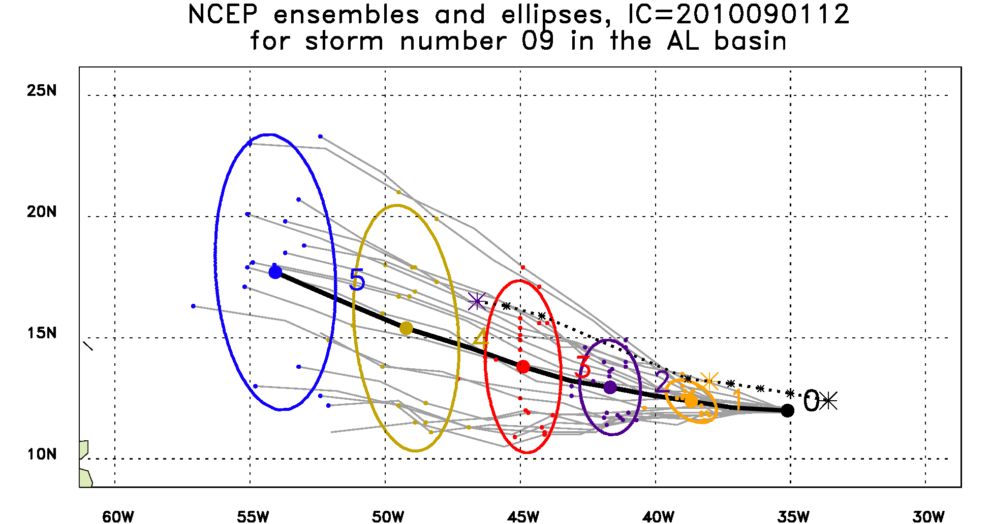
Gaston, 2010/09/01/12Z

Slide 19
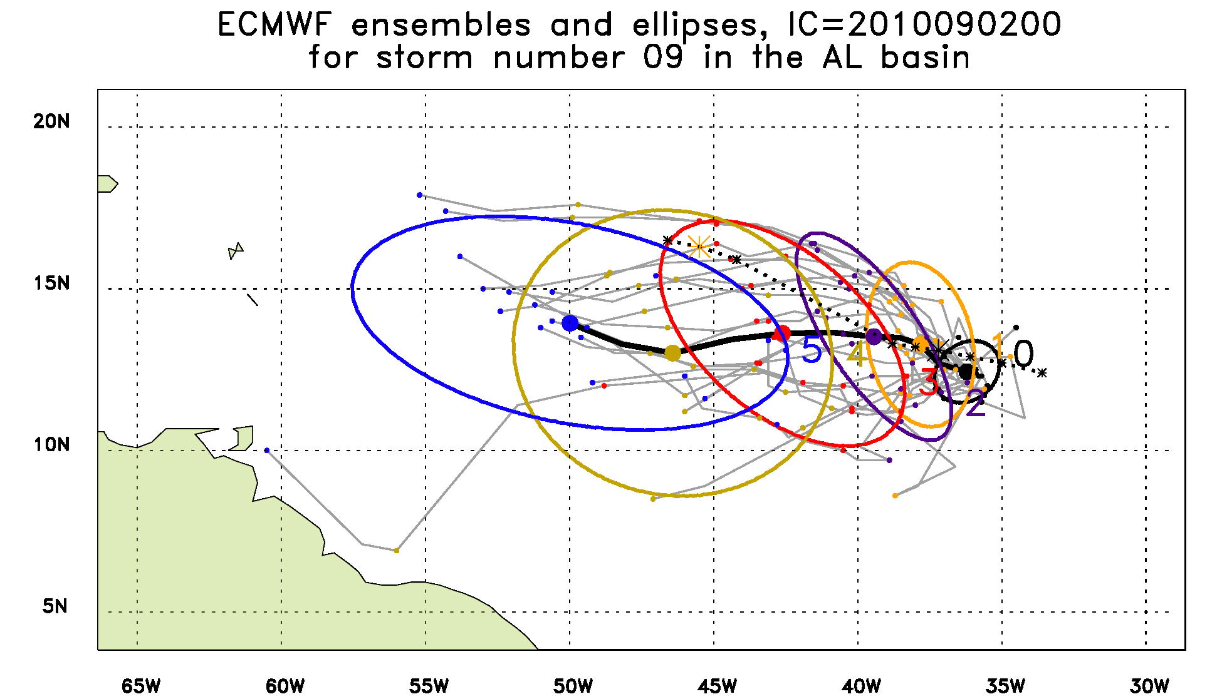
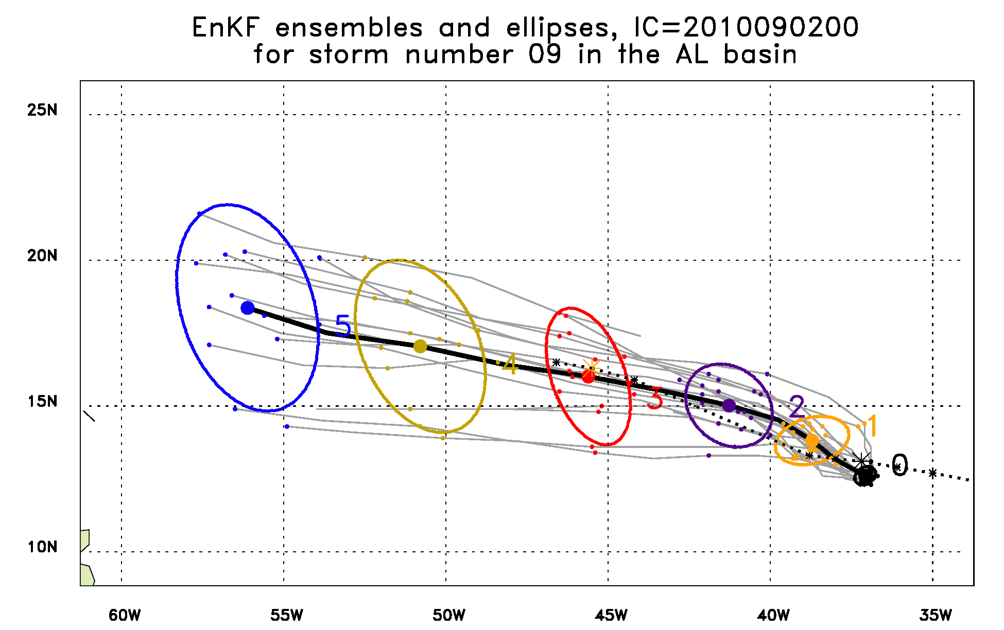
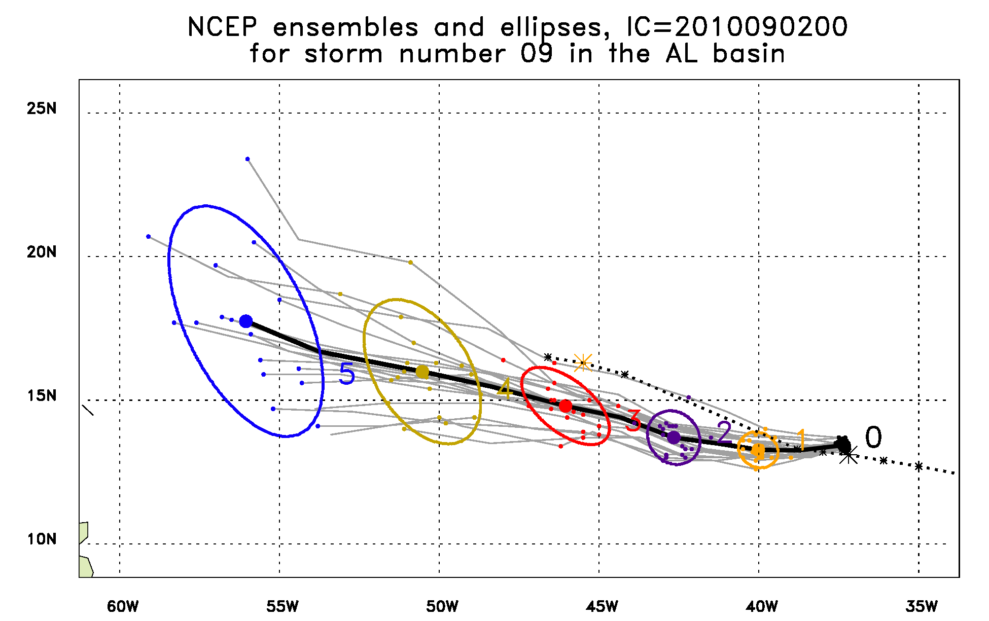
Gaston, 2010/09/02/12Z

Slide 20
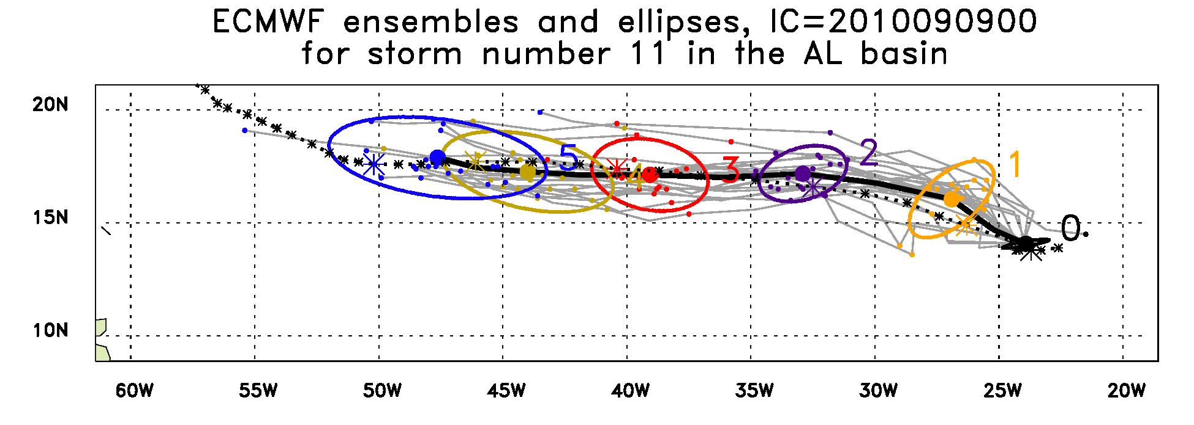
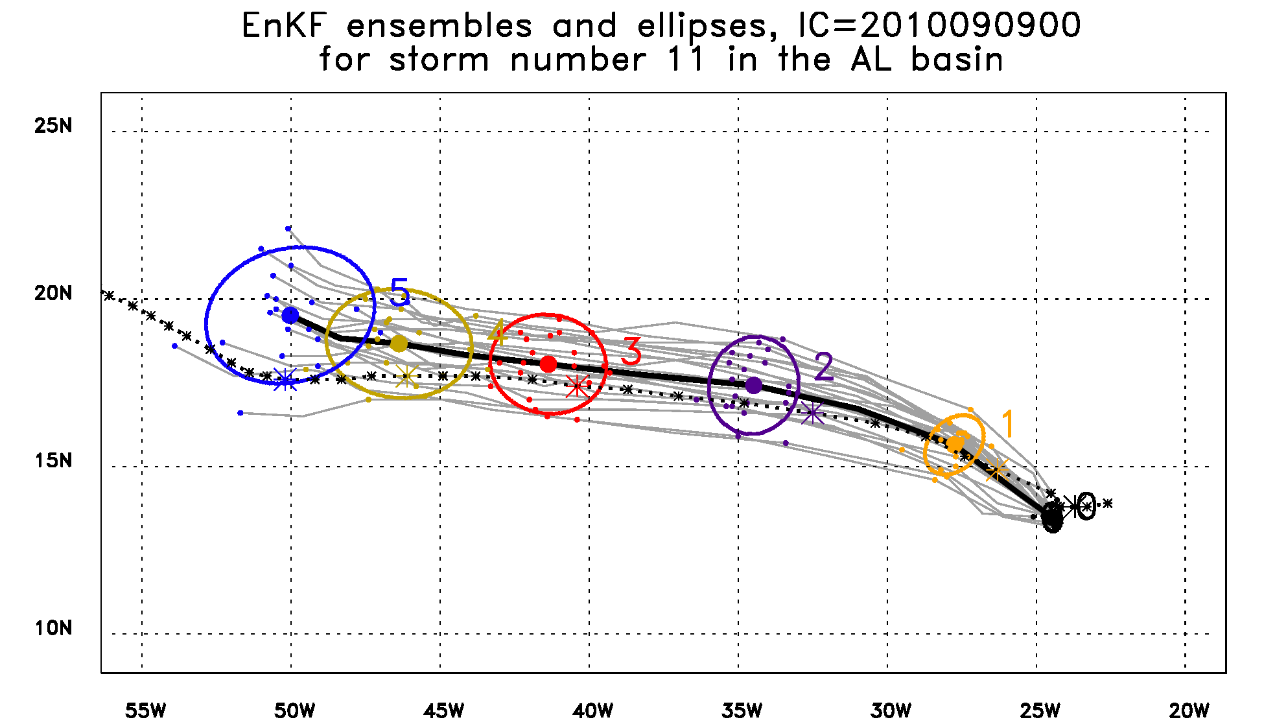
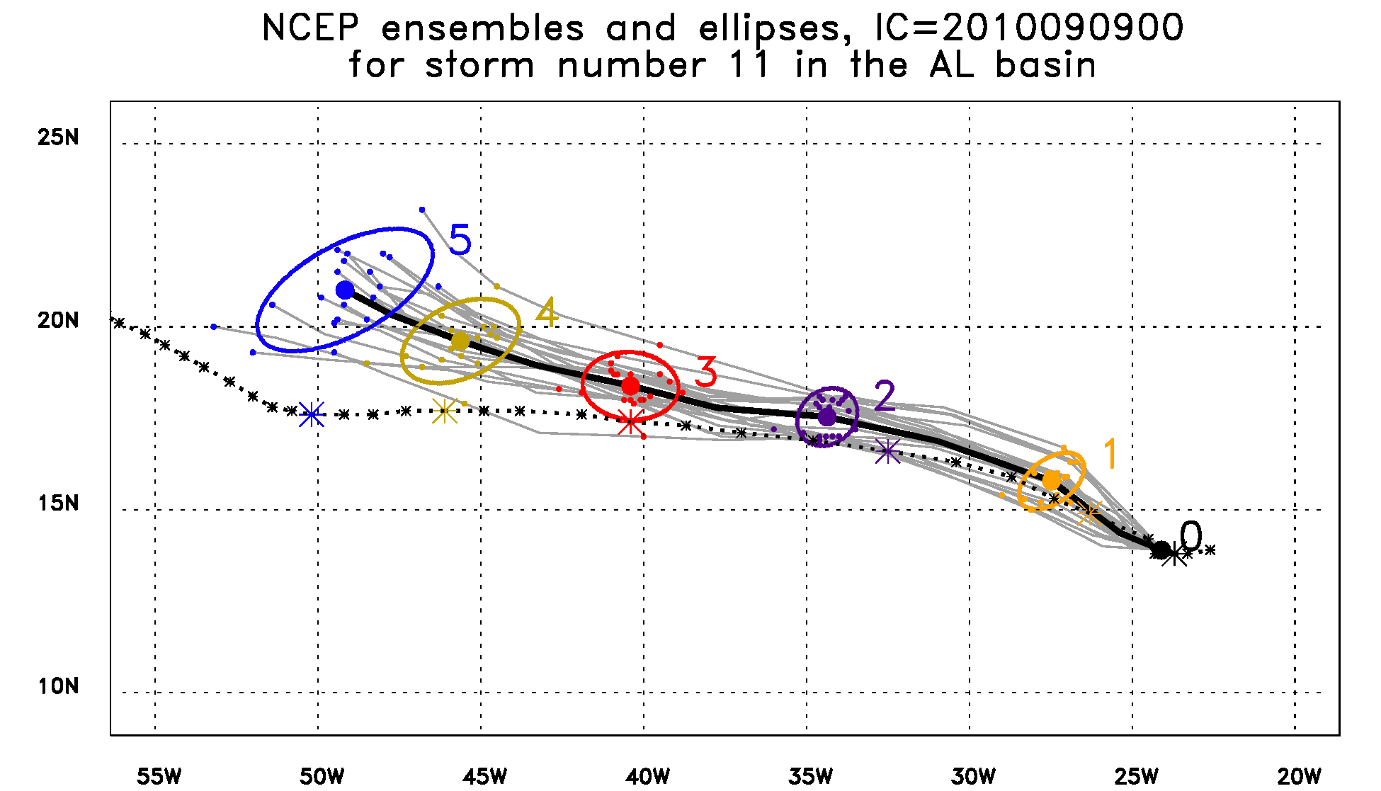
Igor, 2010/09/09/00Z

Slide 21
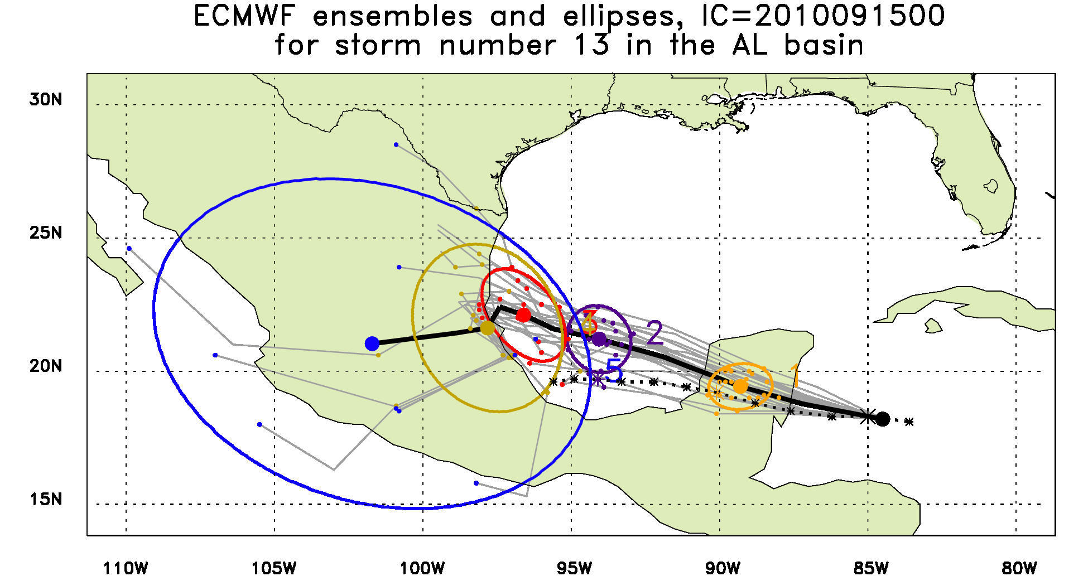
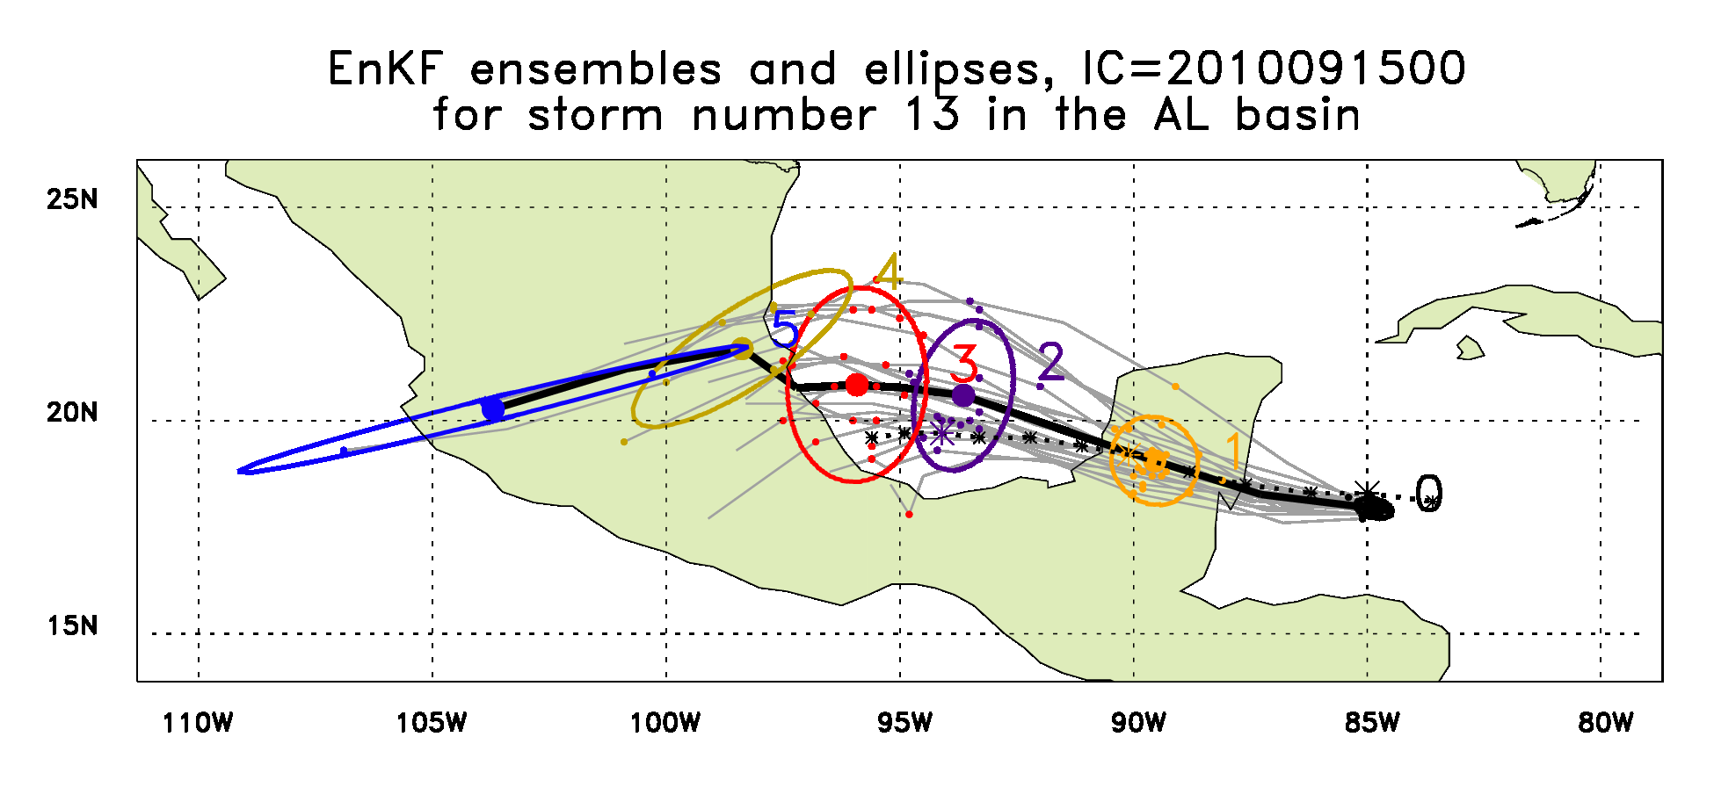
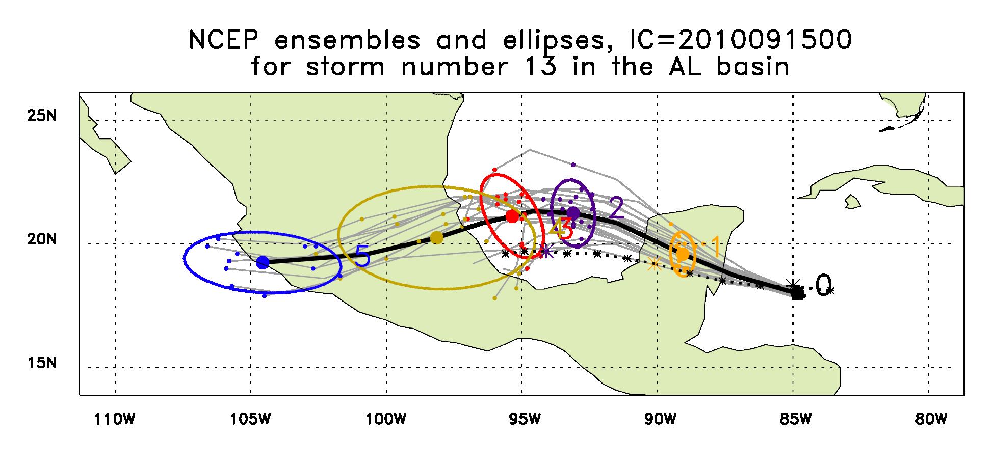
Karl, 2010/09/15/00Z

Slide 22
Karl, 2010/09/16/00Z

