Slide 1


Blocking and the MJO in GEFS reforecasts: forecast skill and interactions
NOAA Earth System
Research Laboratory
Tom Hamill
NOAA Earth System Research Lab
Physical Sciences Division
(303) 497-3060
tom.hamill@noaa.gov
presentation to 37th Climate Diagnostics and Prediction Workshop, Ft. Collins, CO, October 2012

Slide 2
Dec-Jan-Feb 1985-2010 CFSR data. Blocks defined here by Tibaldi/Molteni algorithm.

Slide 3
Questions
How well are blocking and MJO predicted in GEFS?
Is blocking frequency and skill related to MJO, ENSO?
Does GEFS predict interactions of blocking with MJO and ENSO well?
(Interactions between these somewhat uncommon phenomena
easier to diagnose if one has a large reforecast data set)

Slide 4
Data sets and methods
GEFS Reforecast
  Every day from 1985-present (through 2010 here).
  11 members, 1x daily (00 UTC). Forecasts to +16 days.
  CFSR (prior to 2011), operational GSI (since 2011) + ensemble transform with rescaling (ETR) cycled initial conditions.
  Model: 2012 GEFS configuration; T254L24 in week 1 (~40 km at 40°N), T190L24 in week 2.
  Reforecast archive and documentation (incl. BAMS submitted article) at http://esrl.noaa.gov/psd/forecasts/reforecast2/
MJO: RMM1 and RMM2 defined from CFSR reanalysis U850, U200, and OLR following standard Wheeler & Hendon algorithm.

Slide 5
v2
v1
CFSR initial conditions used in GEFS generally improve over the decades, leading to slight improvements in GEFS skill.
(2) About a +2 day improvement relative to 1998 GEFS T62 reforecasts.

Slide 6
MJO diagnostics

Slide 7
MJO, analyzed and deterministic forecast, W. Indian Ocean
Let’s examine a subset of cases that start off with initial conditions that have large negative
RMM1 and 2, i.e., they suggest a relatively strong MJO emerging from African continent.
We have lots of cases of this afforded by multi-decadal reforecasts.
It appears that GEFS is too regular with the amplitude of its RMM1/RMM2 forecasts, while the
analyzed evolution of amplitude is more scattered.

Slide 8
MJO, analyzed and deterministic forecast, E. Indian Ocean
Again, it appears that GEFS is too regular with its RMM1/RMM2
amplitude forecasts.

Slide 9

Find the initial-condition samples with analyzed magnitudes between 1.95 and 2.05 and RMM1 < 0, RMM2 < 0. Then follow analyzed and forecast magnitude evolution and plot pdf.
• analyzed mean • forecast mean
A bit more spreading out of the analyzed magnitudes relative to the
forecast magnitudes in the first few days of the forecast.
Also, amplitude of forecast decreases more.

Slide 10
Find the initial-condition samples with analyzed magnitudes between 1.95 and 2.05 and RMM1 < 0, RMM2 < 0. Then follow analyzed and forecast change in MJO phase per day.
• analyzed mean • forecast mean
Observed MJO propagates in phase more regularly than forecast MJO,
especially at longer forecast lead times.
Observed MJO retains ~ 7 degrees/day phase change. Forecast phase changes decrease to near zero with increasing lead time.

Slide 11
Rank histograms, RMM1 and RMM2 composited
GEFS forecasts quickly develop insufficient spread and/or biased mean.
Most under-spread and/or biased at the medium range.

Slide 12
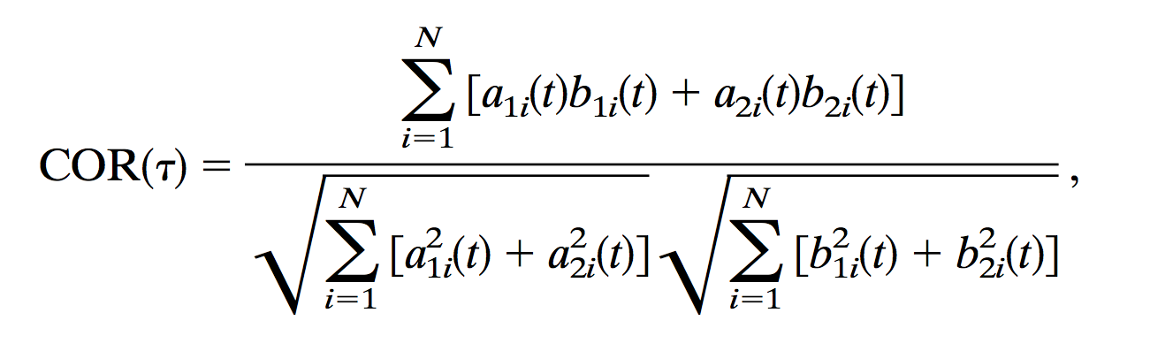
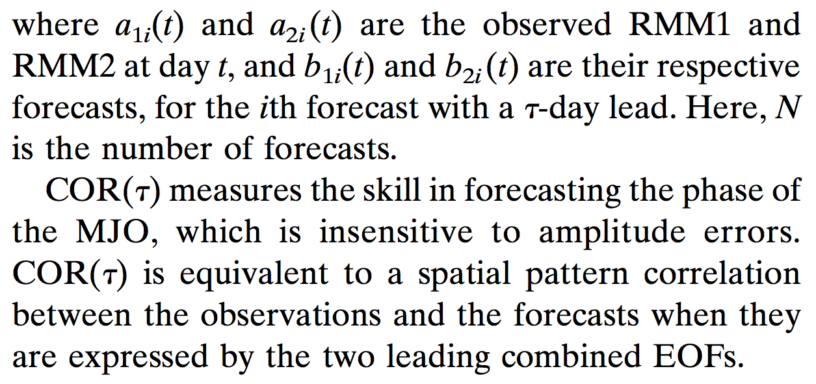
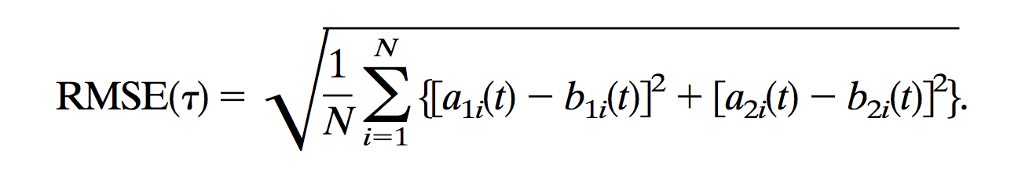
MJO deterministic verification metrics
from Lin et al., Nov 2008 MWR.

Slide 13
Bi-variate RMM1 and RMM2 correlation and RMSE
Low amplitude: √(RMM1²+RMM2²) < 1
High amplitude: √(RMM1²+RMM2²) ≥ 1

Slide 14
Bi-variate RMM1 and RMM2 correlation and RMSE by half decade
The first 10 years are much less skillful than the subsequent 16.

Slide 15
Comparing against MJO task force data…
Nov 2008-Dec 2010 data
GEFS reforecast
c/o Jon Gottschalk

Slide 16
Probabilistic forecast verification: CRPSS
Method for computing CRPSS discussed in supplementary slides. Reference is
climatology. A tougher reference like lagged persistence (slides 7-8) would
show the forecasts have a much quicker loss of skill.

Slide 17
Northern Hemisphere atmospheric blocking

Slide 18
N Hem. blocking: more common in winter, spring
Blocking as defined in Tibaldi and Molteni (1990) using Z500. Hereafter, let’s focus on
Dec-Jan-Feb. Grey bands defines Euro/Atlantic and Pacific blocking sectors in subsequent plots.

Slide 19
NH blocking skill in GEFS reforecasts
Pacific
BSS (Brier skill score) as defined in supplementary slides.
Perfect model uses one member of
ensemble as surrogate for analyzed.
Real model: skill in blocking to ~12 days
Perfect model: ~ 3-4 days longer skill.
Onset: date when there are more than 10 subsequent days where at least 20 degrees of longitude in a sector are blocked.
Cessation: date of end of that period.
Statistics include onset and previous 3 days, cessation and previous 3 days.
Atlantic

Slide 20
GEFS blocking skill by half decade
Decreased Atlantic sector skill in 1985-1989 period stands out.

Slide 21
Under-forecasting of Atlantic block frequency after day +3

Slide 22
MJO – blocking interactions

Slide 23
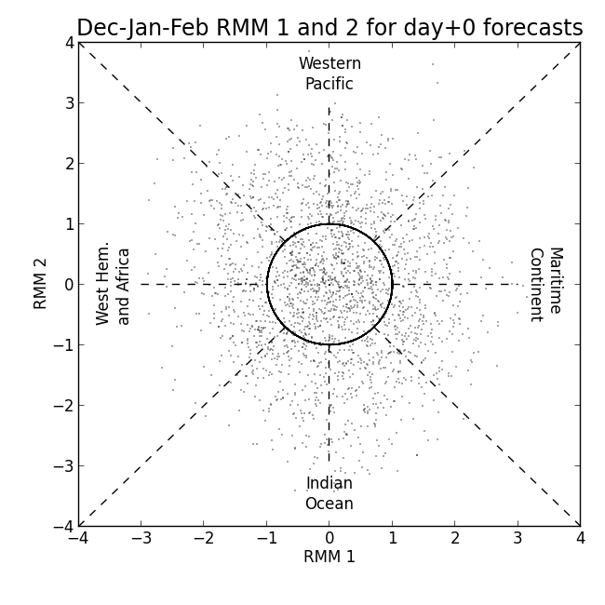
My method of quantifying MJO phase
In subsequent plots you’ll see
I refer to the phase of MJO by
its angle from x axis, a θ in
conventional polar coordinates.
When examining statistics
for θ=θ₀ , I use RMM 1/2
samples with associated
θ₀ +/- 22.5 degrees.
Example below for θ₀=-90
uses samples in blue cone.
A “strong” MJO is in the
top 25% of RMM 1/2
amplitudes within the cone.
θ=+45
θ=0
θ=-45
θ=-135
θ=-90

Slide 24
Change in blocking frequency under strong Indian Ocean MJO
Shaded areas are confidence 5/95%
confidence intervals.
Suppression of blocking frequency
in the east Pacific and Atlantic
under strong MJO. Day +6 GEFS
nicely replicates this suppression.

Slide 25
Z500 anomalies under strong
(6-day lagged) Indian Ocean MJO

Slide 26
How does (observed) blocking frequency change according to the lag time of the MJO?
Top panel is unconditional DJF blocking
frequency, for reference. Bottom panel is
difference in strong MJO blocking frequency
from unconditional DJF average as a function
of latitude and time lag of MJO data
relative to blocking data. Blue = less blocks.
Here, θ= -90, i.e., ~ Indian Ocean MJO.
Here, n-day negative lag means the MJO data was preceding the blocking calculation by n days.
Again, note strong suppression of blocking
in Pacific both prior to and subsequent to
strong Indian Ocean MJO. Very strong
suppression of Atlantic block subsequent
to Indian Ocean MJO.
⬅data from previous 2 slides➔

Slide 27
How does (observed) blocking frequency change according to the lag time of the MJO?
What the heck is happening here?
3-10 days prior to active MJOs in
the Indian Ocean, there is a strong
suppression of blocking in the
Pacific, apparently.

Slide 28
Observed and forecast blocking frequency change according to the lag time of the MJO

Slide 29
Observed and forecast blocking frequency change according to the lag time of the MJO
forecast frequency of Pacific
blocks prior to Indian Ocean MJO
not suppressed like analyzed.

Slide 30
Flow anomalies associated with suppressed Pacific blocking 5 days prior to active Indian Ocean MJO

Slide 31
Conclusions
MJO:
  Forecasts decrease in amplitude, slow down relative to analyzed.
  Ensemble forecasts under-dispersed/biased.
  Some skill, though, especially for high amplitude MJOs
Blocking:
  Some skill, but much less than perfect model.
  Reasonable replication of blocking climatological frequencies in forecasts.
Blocking and MJO
  Blocking frequency decreased under active Indian-Ocean MJO
Acknowledgments: George Kiladis, Steve Colucci, Klaus Weickmann, Jeff Whitaker.

Slide 32
Define BSS for evaluating blocking skill
The blocking Brier Skill score is calculated after summing forecast and climatological Brier scores over the relevant longitudes in either the Pacific or Atlantic basins, respectively, then averaged. For example (Pac):

Slide 33
Computing the CRPSS of
GEFS RMM1 and RMM2 forecasts
CRPSS = 1 – CRPS(forecast) / CRPS(climatology)
Φ(.) estimated from normal distribution fit to sample mean and standard deviation.

Slide 34
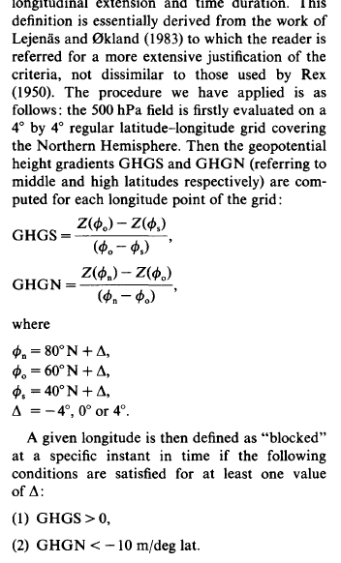
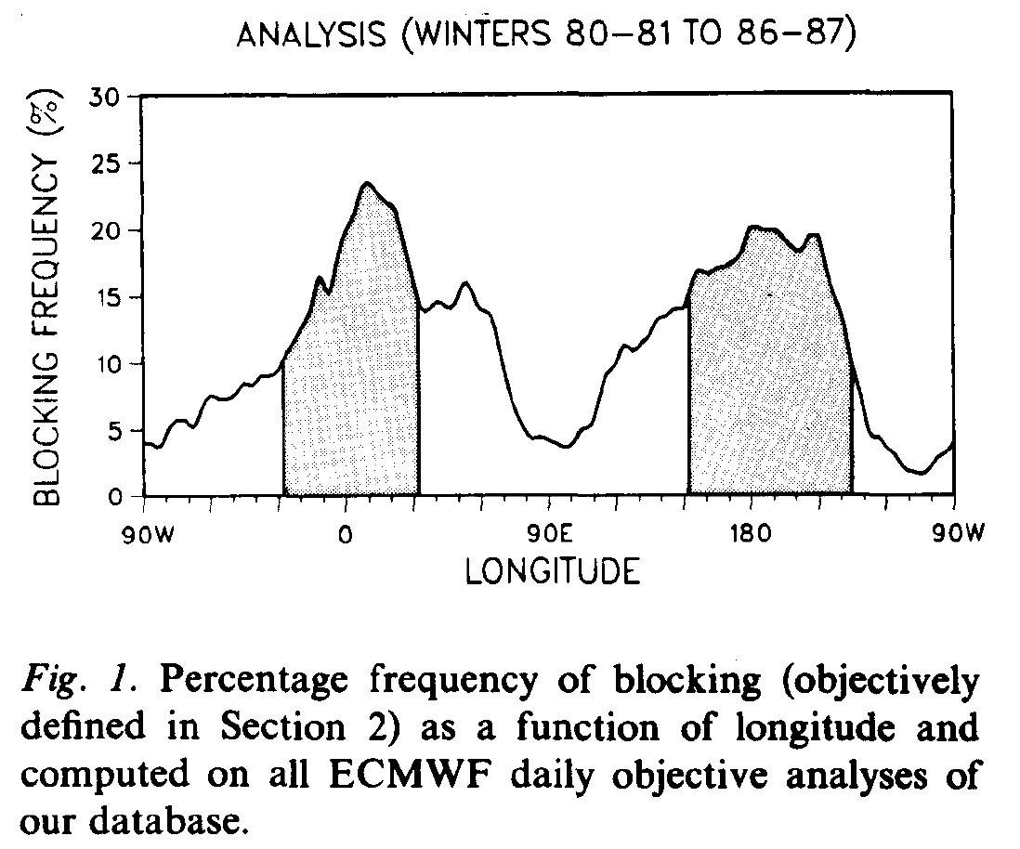
Blocking computation method: follows Tibaldi and Molteni, 1990 Tellus
There are alternatives, such as PV-based
index by Pelly and Hoskins. While these
may have some advantages, this old
standard used hereafter.

Slide 35
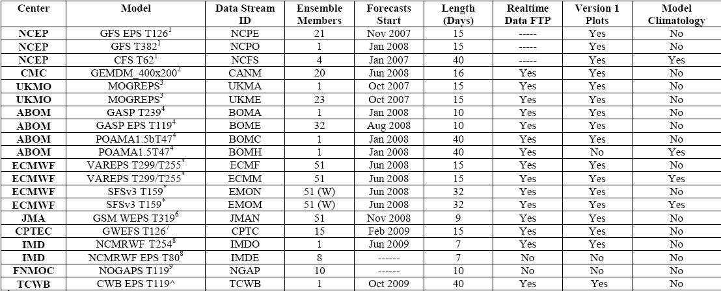
MJO task force data

