Slide 1
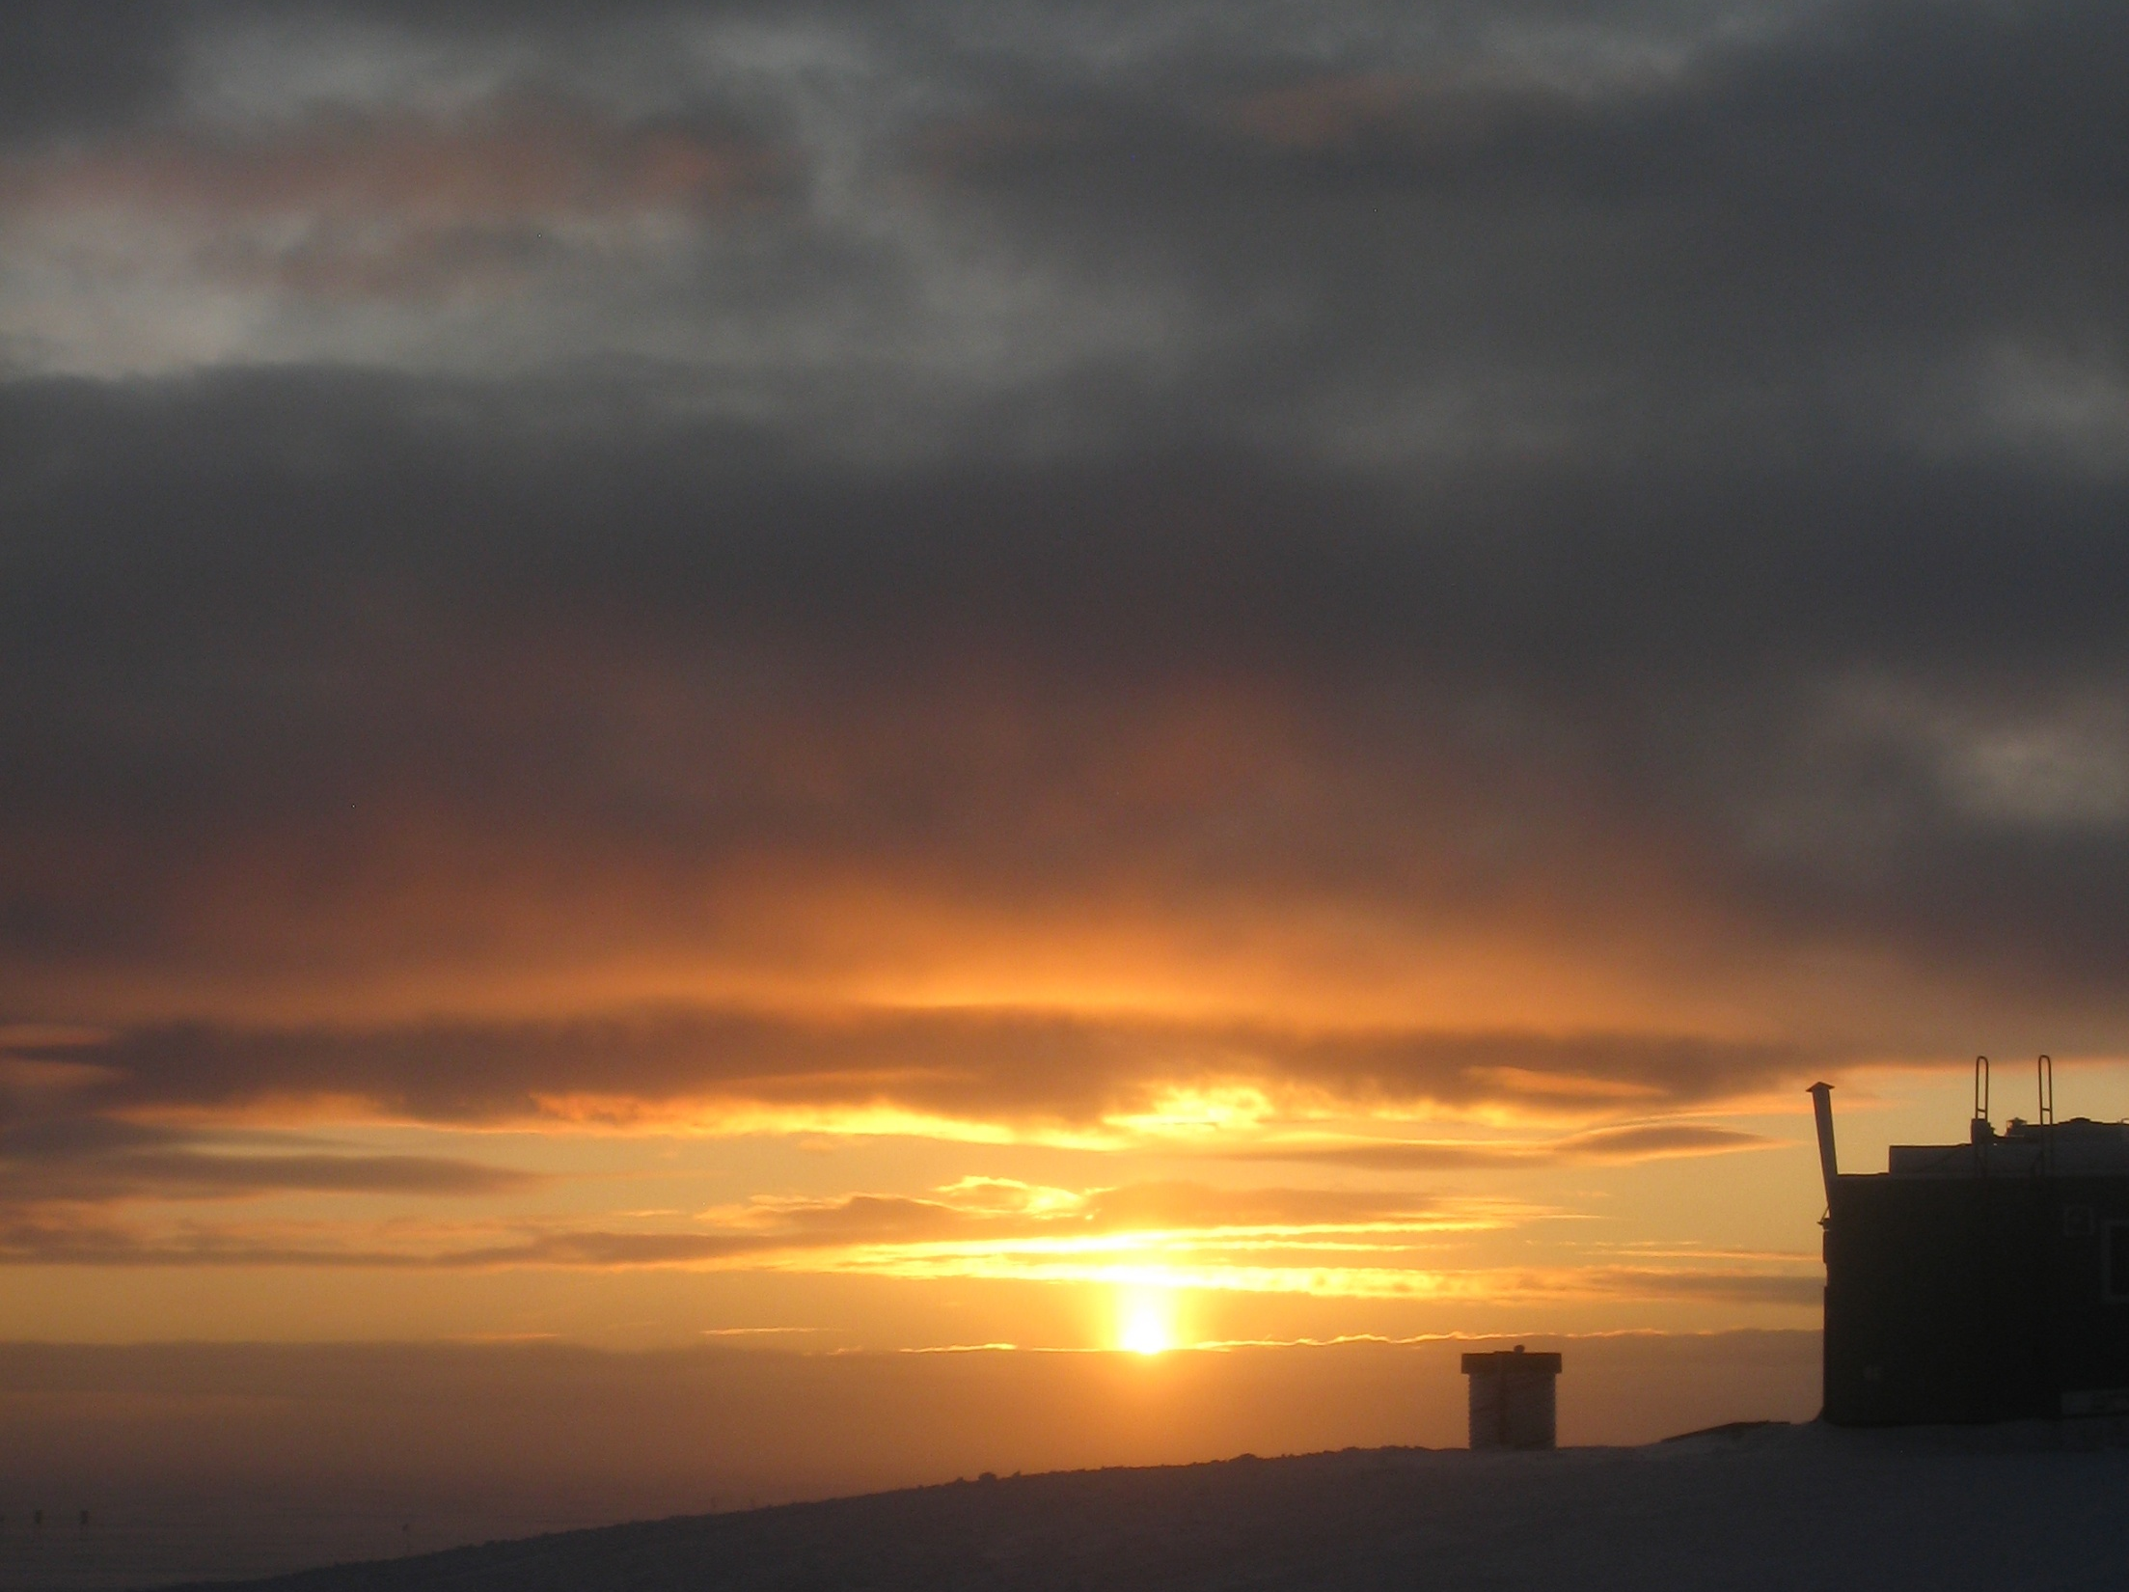
New Cloud Observations
at Summit, Greenland:
Expanding the IASOA Network
Matthew Shupe Von Walden David Turner
U. Colorado/NOAA-ESRL U. Idaho NOAA - NSSL
Special thanks to the ICECAPS team, including: Ralf Bennartz, Maria Cadeddu, Ben Castellani, Chris Cox, David Hudak, Mark Kulie, Nate Miller, Ryan Neely, William Neff, and many others

Slide 2
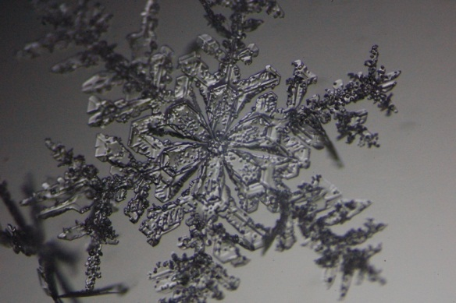
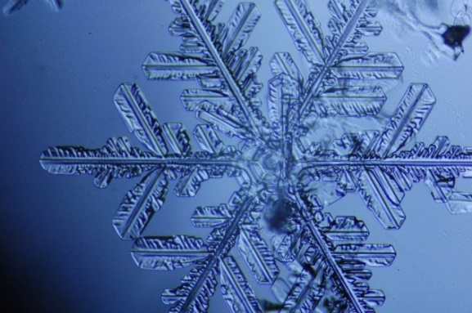
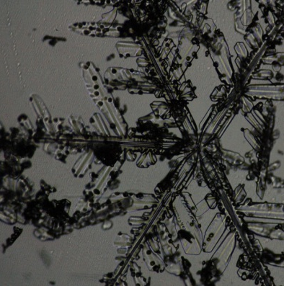
Why Are Clouds Important… Particularly in the Arctic?
Relatively few observations = less understanding relative to low latitudes
Mixed-phase processes occur frequently
Complex interactions/feedbacks with seasonally high-reflective surface
Atmosphere is cold and dry (increasing cloud radiative importance)
Little is known about Arctic aerosol populations and sources
Large-scale Arctic meteorology is poorly constrained in models/reanalyses

Slide 3
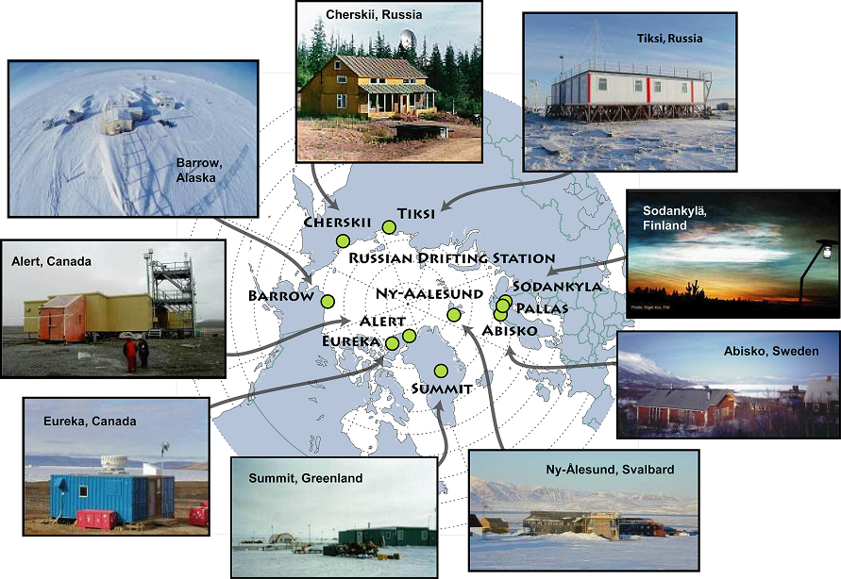
IASOA: International Arctic Systems for Observing the Atmosphere
www.iasoa.org
SHEBA
Detailed Cloud Observatories
Newest Cloud Observatory: Summit, est. 2010

Slide 4
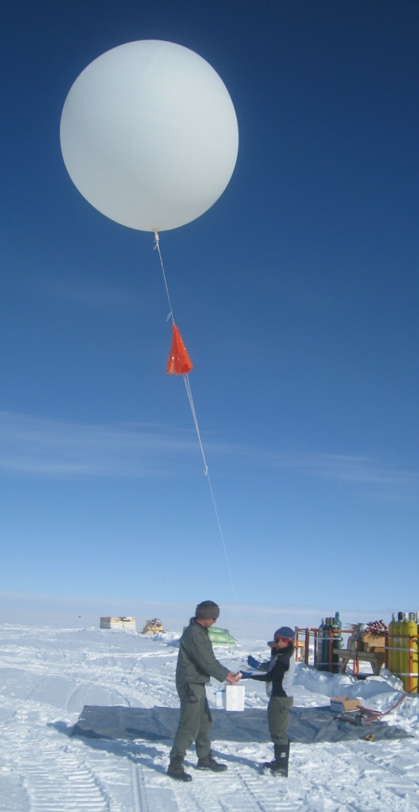
Anatomy of a Cloud Observatory
Broadband Radiometers
LW, SW
Radiosondes
T, q, winds, phase
Microwave radiometer
LWP, PWV
Cloud radar
Boundaries, micro, phase, dynamics
Lidar or ceilometer
Cld base, phase, micro
AERI
Emissivity, phase, size
These instruments together can be used to characterize cloud macrophysical, microphysical, radiative, and dynamical properties.

Slide 5
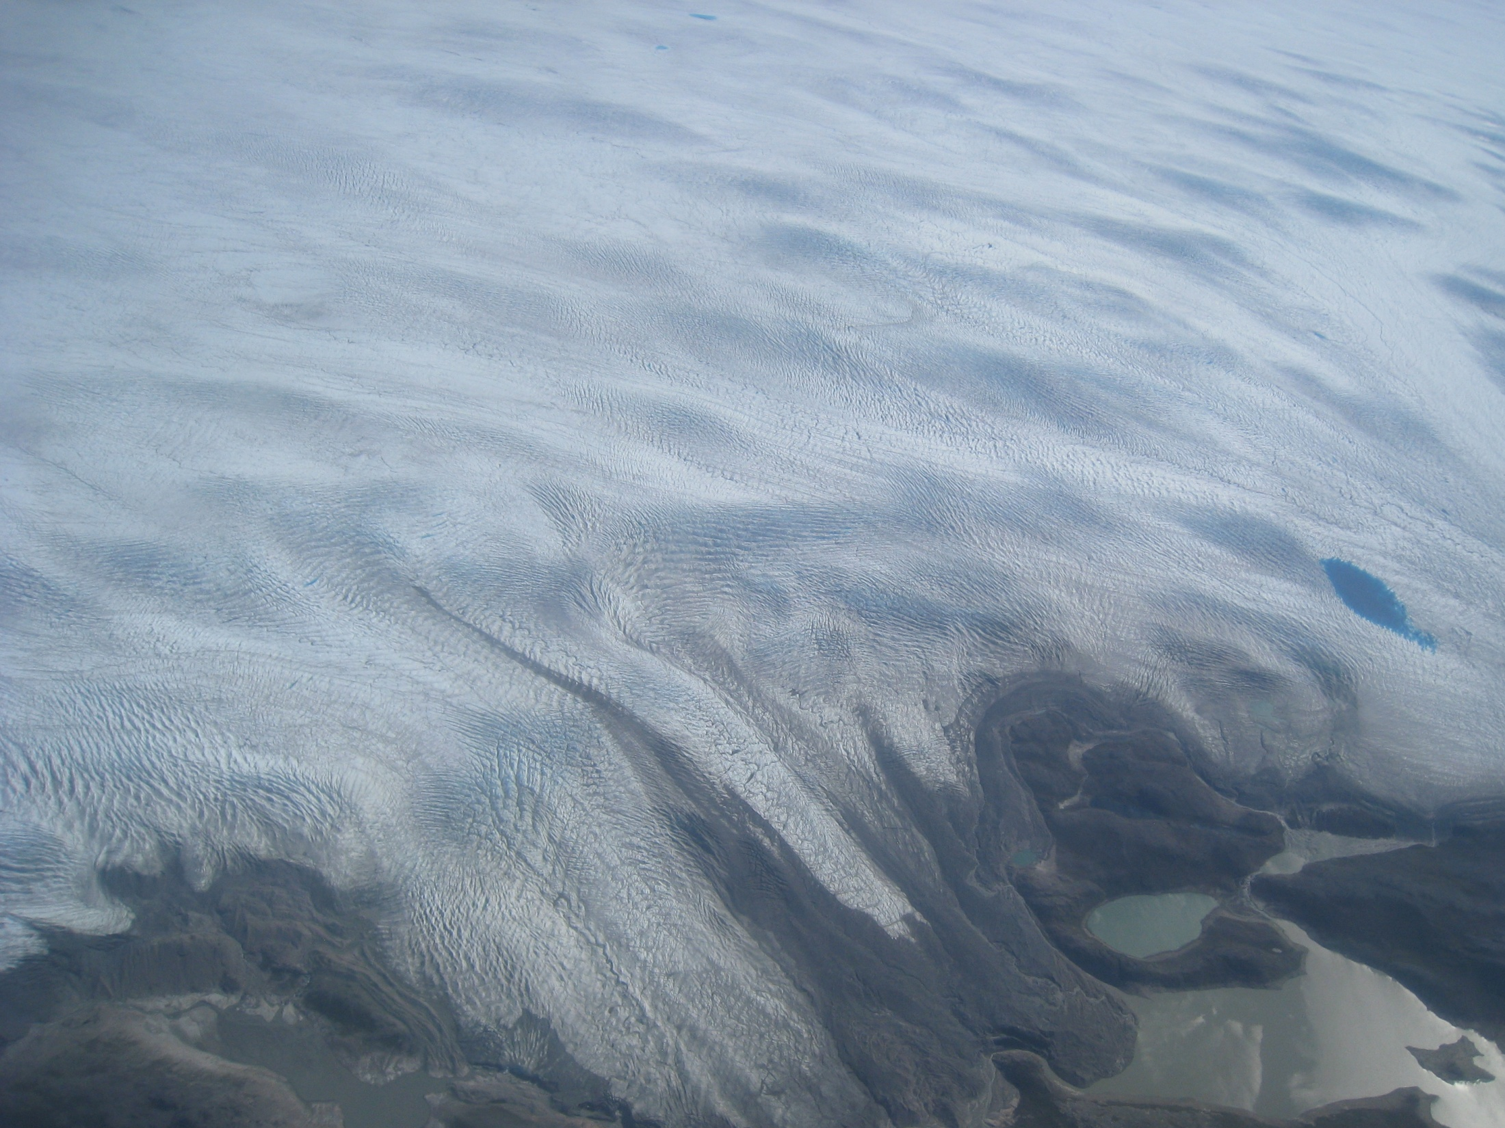
Why is it important to observe/study clouds over the Greenland Ice Sheet?
Source: Precipitation => The Mass Budget
Sink: Radiation => The Energy Budget
What have we learned from the first 1.5 years
of cloud observations at Summit?

Slide 6
Total Cloud Occurrence
“Cloud” is defined as hydrometeors in the atmosphere that are detected by the remote sensor suite.
Summit is very cloudy, more than Arctic average.
NyAlesund and Atqasuk are likely underestimated

Slide 7
Cloud Occurrence with Height
Instrument outages at Summit result in limited statistics in some months
Summit has frequent low-level fogs and layers of ice crystals

Slide 8
Occurrence of Cloud Liquid Water
Similar annual cycle trend at all sites: summer/fall maximum.
Despite cold temperatures, and long distances to moisture sources, cloud liquid water occurs 25% of the time at Summit (Similar to Eureka, Canada)

Slide 9
Low-cloud Liquid Water Amount
LWP derived from microwave radiometer brightness temperatures
Most Arctic clouds are thin ( LWP < 50 g/m²)
“Thick” clouds are virtually non-existent at Summit

Slide 10
Low-cloud Boundaries
Remarkable similarity between Summit and other observatories, despite dramatic difference in elevation!

Slide 11
Mixed-Phase Cloud Structure
q
θ_{E}
High reflectivity + high depol
= ice precip
Velocity variability
High backscatter + low depol = liquid

Slide 12
Cloud microphysical-dynamical relations are similar!
Cloud mixed-layer
Cloud-generated turbulence
Cloud ice nucleates in liquid
W-LWP-IWP correlation

Slide 13
Thermodynamic profiles and clouds
Surface-based T and q inversions at ~ 100-300m, almost always present
Clouds occur when there is relatively moist & warm advection aloft
(~15 C warmer, 4x moister)

Slide 14
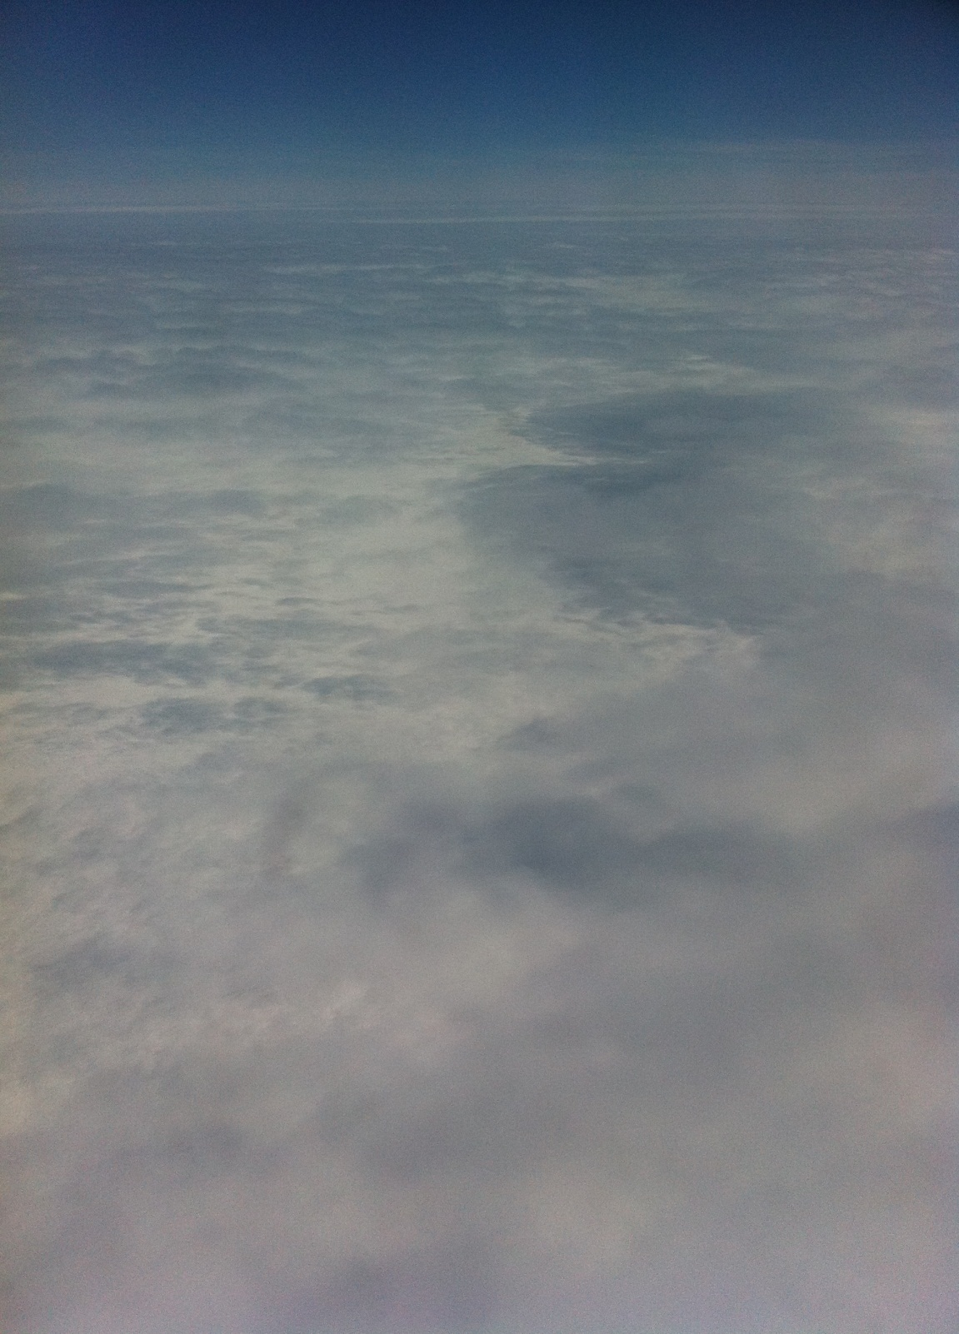
Final Thoughts
New cloud observatory at Summit provides the first detailed view of cloud processes over the GIS
Initial Results:
Summit is very cloudy
Less liquid water than most other observatories, but still 10-50% by month.
Similar low-cloud properties and processes
Striking similarities suggest that cloud processes might be relatively consistent across the Arctic (while the meteorological context varies).
Future directions:
Impact of clouds on surface energy budget
Better understanding of precipitation budget
Collaborations welcome and encouraged!

