Slide 1
An Object-Based Approach for Identifying and Evaluating Convective Initiation
Forecast Impact and Quality Assessment Section, NOAA/ESRL/GSD

Slide 2
Convective Initiation Problem
Modelers are continually trying to improve the initiation of convective activity in their solutions
How do you quantify that the model is improving convective initiation?
Qualitative assessments are often misleading
Improvement of performance measures at typical initiation times misleading
Isolating CI in observations and forecasts to validate improvement is not widely applied
A solution: use an object-oriented verification approach to assist in the automated identification of CI in the observation and the forecast

Slide 3
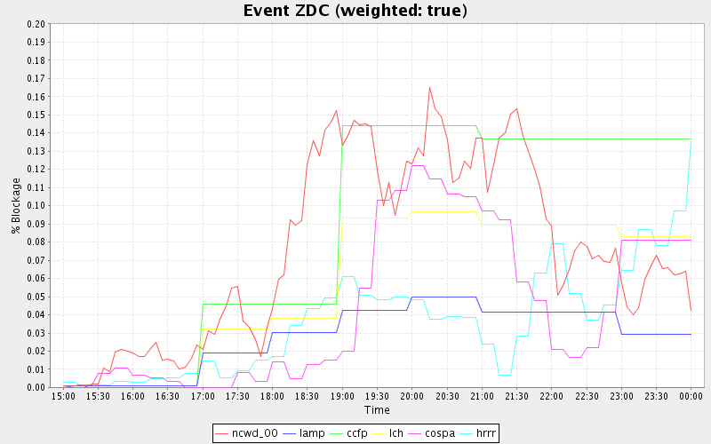
Initiation Confusion
Cessation
Onset
The above plot (Layne and Lack, 2010) shows a measure of impact to an ARTCC over time. It is important to note that initiation is not the same as onset. Onset could have been caused by advection into a particular domain. Likewise, cessation of an event is not the same as decay or dissipation.

Slide 4
Procrustes Verification Approach
Procrustes verification approach (Lack et al. 2010 WAF) identifies objects by using threshold/minimum size of object criteria or FFT transform for signal strength object detection
Object matches are based on minimizing a user-defined weighted cost function
Observed objects are matched to all forecast objects and vice versa to be tagged hits, misses, and false alarms
Error statistics are broken down into components
displacement magnitude and direction, intensity, rotation, and shape

Slide 5
Procrustes Scheme for Initiation
A weakness of object-oriented approaches is from counter-intuitive matching that may occur during matching forecast and observation objects (esp. large time steps)
This is minimized when using small time steps and examining consecutive observation fields or forecast fields (High spatio-temporal correlation for convection)
Hits, miss, false alarm detection in Procrustes scheme helps identify new initiation from growth, decay, and advection
Misses from t=0 to t-5 generally are initiation cells
Decay of larger storms into smaller ones to avoid initiation on cluster breakdown is also implemented

Slide 6
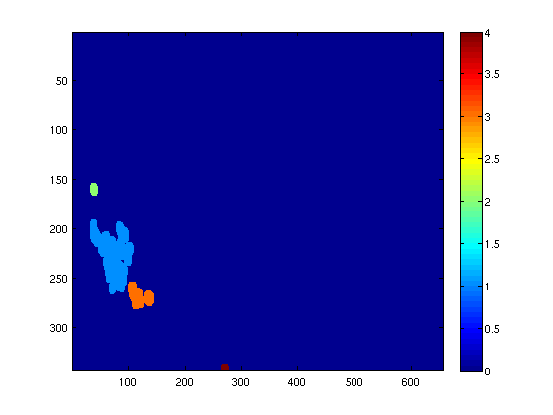
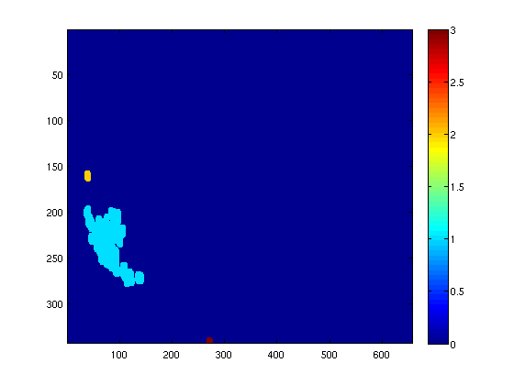
No Initiation Example (threshold method)
2
2
1
1
3
4
3
T-5=2105Z
T0=2110Z
Procrustes matching is from T=0 to T-5, so 1 matches to 1, 2 matches to 2, and 3 is matched to 4. 3 in the T-5 is tagged as a false alarm and there is no initiation just growth.

Slide 7
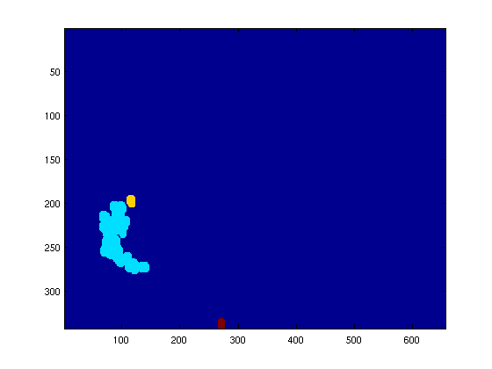
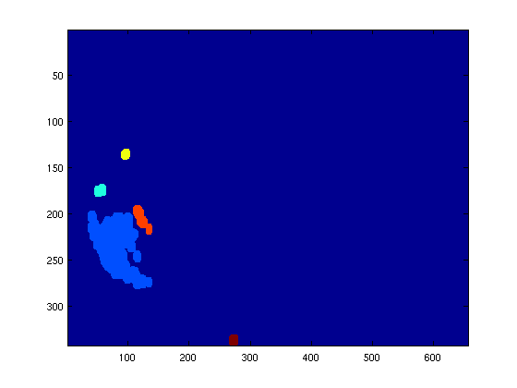
Initiation Example (threshold method)
3
2
2
4
1
1
3
5
T-5=2105Z
T0=2110Z
In this case there are 2 new areas of initiation: Cells 2 and 3 at T=0 on the right (tagged as misses in the scheme). Cells 1 ,4 and 5 at T=0 on the right are growing cells from 1,2, and 3, respectively.

Slide 8
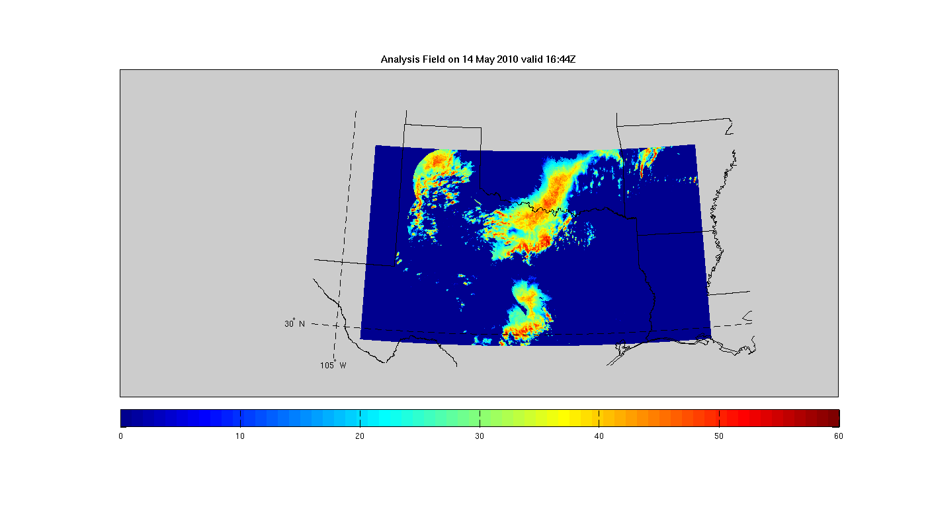
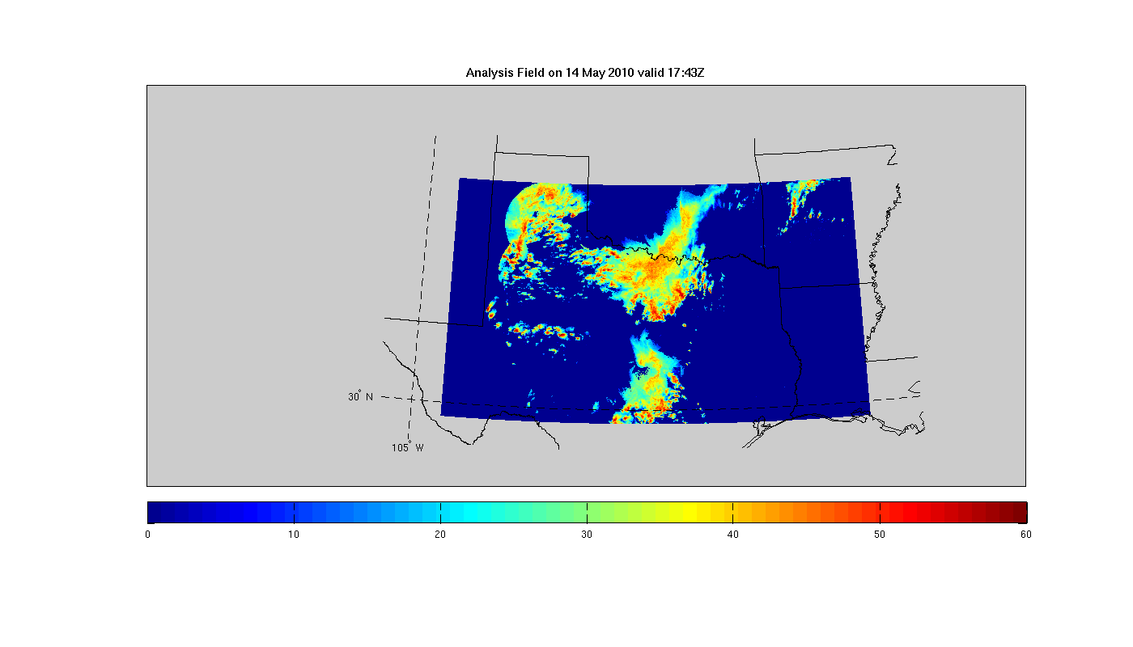
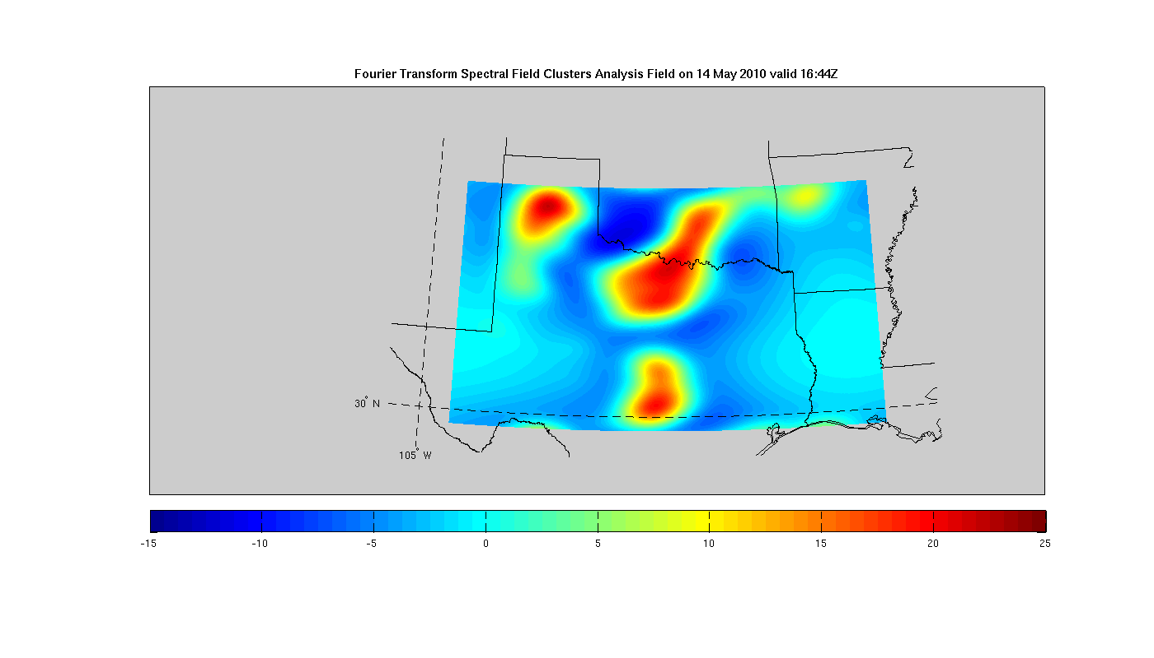
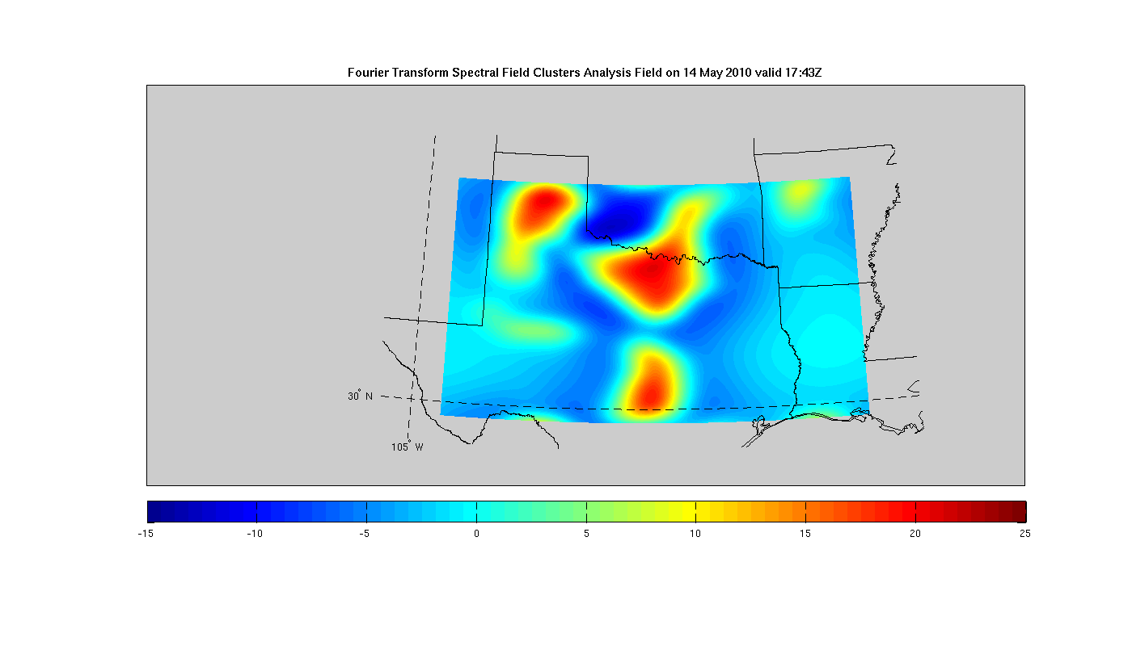
Initiation at 1-h intervals (FFT method)
New Initiation

Slide 9
Initiation Detection Challenges
Sensitivity in what defines an initiation cell (object)
No standard definition for evaluation
Radar outages or coverage gaps
Large cells may appear during outage and tagged as initiation
Inconsistent radar time steps…(e.g. Δt=5,6, 10-min) especially on merged radar products
Growth may appear inconsistent
Radar QC (different modes, clutter)
When switching to different modes, initiation objects may spike at those time steps
Some mitigation is applied to the initiation
Ex: Minimum size restrictions for radar outages and gaps
9
Notes:
9

Slide 10
Verification Methodology
Initiation area 1 (top blue object) has a nest of initiation 2 and has 3 cells nearby. It has 1 intersection (distance 0) and 2 cells distance x1 and distance x2 away within +/- z minutes from forecast valid time.
Initiation area 2 (bottom blue object) has 1 cell distance y away from it within +/- z minutes from forecast valid time.
If no forecast initiation zone is present and initiation cells are present, the forecast tagged as a total miss.
ANC-like example
x1
x2
y
Procrustes error decomposition allows for distributions of distances, etc.
10

Slide 11
Example Results
ANC HITL Pilot Evaluation for ZFW
HITL (regime selection and boundary input) altered initiation potential regions (intensity and some location)
May adjust time window for initiation and define alternate initiation thresholds

Slide 12
Future Directions
Aforementioned study focused on comparing convective forecasts using radar data as the observation
Using radar has its challenges but may have value as a verification methodolgy for CI
Expand approach to include other parameters or fields
Use of satellite data, especially for oceanic applications
Total lightning for a “truer” convective initiation measure, although model comparisons become more challenging
GOES-R
Test concept on sample HRRR CI explicit fields
3 different CI fields
Can bring in LMA data along with reflectivity to test CI detection and evaluation

