Slide 1


Black Carbon and Coating Measurements at Pasadena
James Allan, Jonathan Taylor, Michael Flynn, Hugh Coe (University of Manchester, UK)
Tim Onasch, Doug Worsnop (Aerodyne Research)
Greg Kok (Droplet Measurement Technologies)

Slide 2
Motivation
Black Carbon (BC) is a major climate forcing component, particular on regional scales
Its lifetime and optical properties are heavily dependent on composition and coatings
BC is also seen as an important air quality metric and is measured using filter-based optical methods
There is a need to quantitatively link composition and coatings with source, atmospheric ageing, optical properties and network metrics

Slide 3
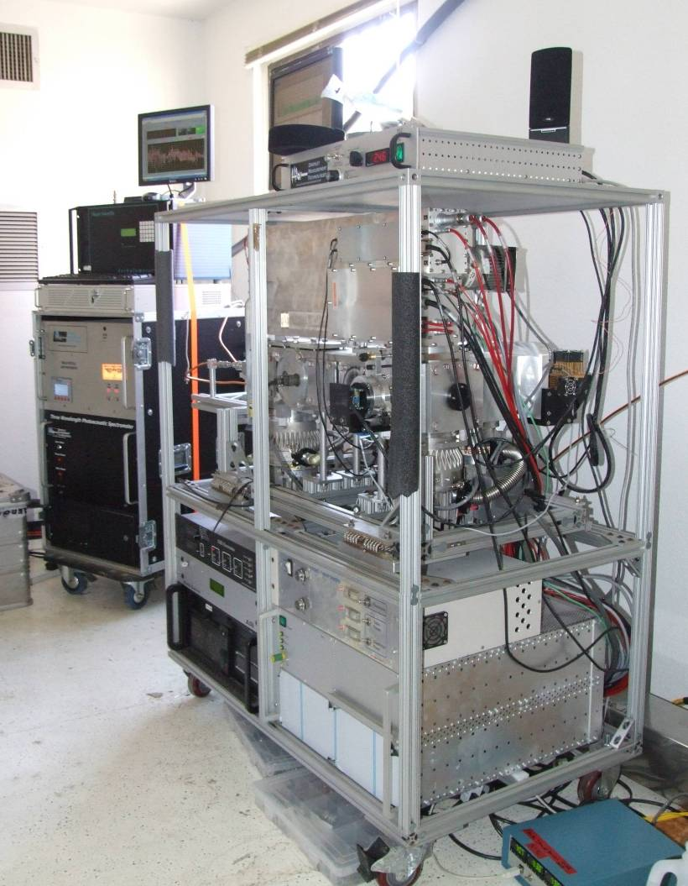
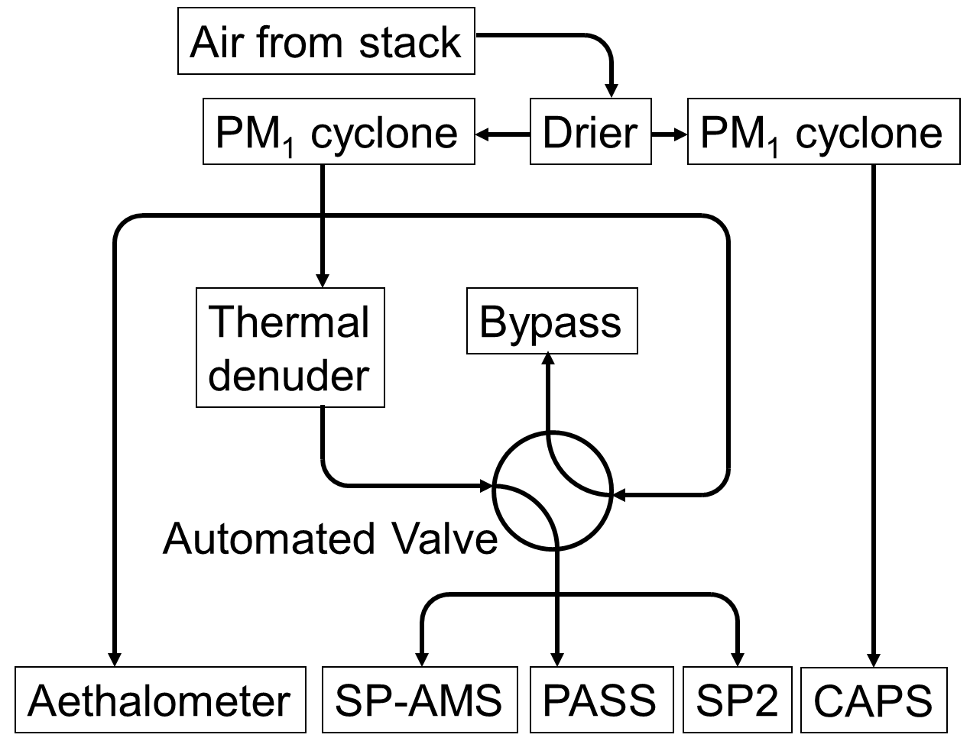
Overall set-up

Slide 4
Aethalometer
Magee AE-31 7-wavelength Aethalometer
Filter loading correction applied based on SP2 data
No scattering correction applied
Data reported as µg m⁻³ equivalent black carbon, using the manufacturer’s calibration

Slide 5
PASS
3 wavelength DMT photoacoustic spectrometer
Green channel calibrated using absorbing PSLs compared with SP2 scattering channel
Red and blue channels calibrated relative to green using fullerene soot and assuming an AAE of 1

Slide 6
SP-2
Calibrated using glassy carbon spheres selected using a DMA
Primary data products are black carbon mass and number concentrations
Higher-order data products will include mass corrected for detection limit cutoff and coating thicknesses

Slide 7
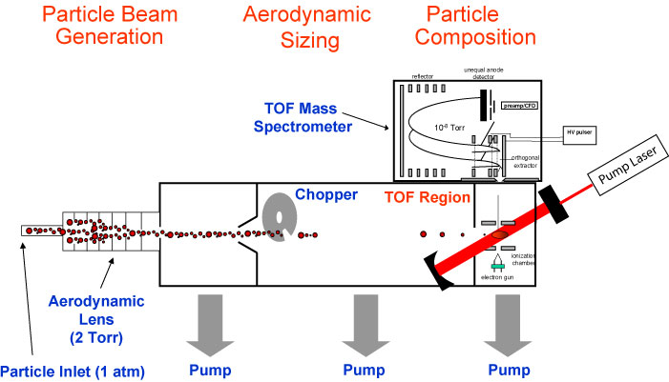
SP-AMS
Cross calibrated against SP2 using glassy carbon
Size calibrated using absorbing PSLs

Slide 8
SP2 vs aeth & EC

Slide 9
Forklift influence

Slide 10
SP-AMS results

Slide 11
Particle transmission modification?

Slide 13
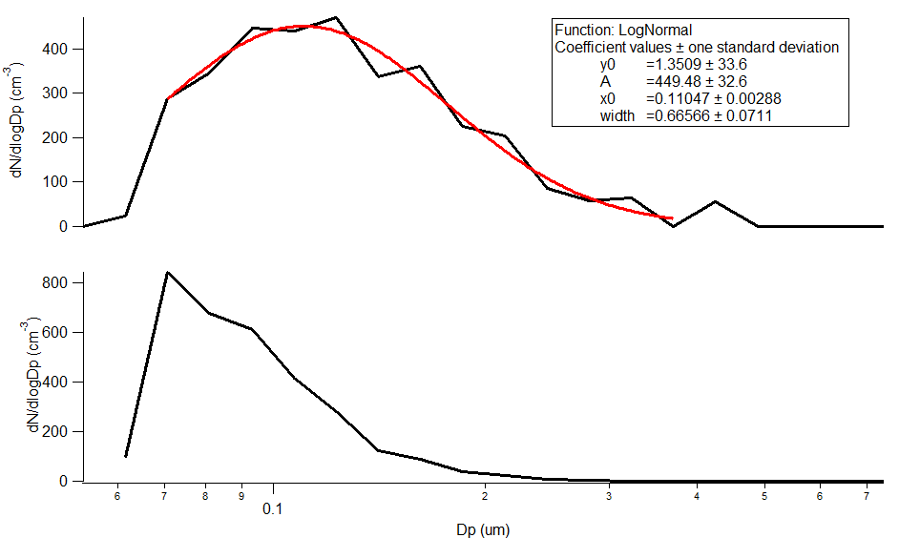
SP2 size distribution
dM/dlogDp (ng m⁻³)

Slide 14
PMF analysis

Slide 15
Thermograms

Slide 16
SP2 vs PASS

Slide 17
Ambient MAC

Slide 19
Denuder MAC 3-9 June

Slide 20
Photacoustic Angstrom exponent

Slide 21
SP2 Leading Edge Only (LEO) fitted scattering signals

Slide 22
SP2 LEO 120nm cores thermogram

Slide 23
WSOC absorption

Slide 24
Conclusions
The BC particles at Pasadena were found to be smaller than ‘normal’ and principally in the Aitken mode
Little statistically significant variation was found in the Angstrom exponent
Variation was found in the MAC of the particles, which can be qualitatively linked to chemical coatings through SP2, SP-AMS and thermal denuder data, however the magnitude was small (~20%)
Need to fully quantify size-dependent losses in thermal denuder
More work is needed to try to assess performance of models in capturing this behaviour

Slide 25



Acknowledgements
This work was supported by:
  NERC grant Multiscale Chemical Composition of Carbonaceous particles and Coatings (MC4), ref: NE/H008136/1
  California EPA Air Resources Board
  Caltech
Additional thanks:
  Jim Smith (NCAR) for the loan of the thermal denuder
  Tim Bates (NOAA) for the loan of the beam width probe (results not shown)
  Karl Froyd, Shane Murphy and Dan Murphy (NOAA) for the use of the NOAA inlet stack.
  Rodney Weber and Xiaolu Zhang (GATech) and Patrick Heyes and Jose Jimenez (CU) for supporting data

