Slide 1
Hybrid Variational/Ensemble Data Assimilation for the NCEP GFS
Tom Hamill, for Jeff Whitaker
NOAA Earth System Research Lab, Boulder, CO, USA
jeffrey.s.whitaker@noaa.gov
Daryl Kleist, Dave Parrish and John Derber
National Centers for Environmental Prediction, Camp Springs, MD, USA
Xuguang Wang
University of Oklahoma, Norman, OK, USA

Slide 2
Hybrid: best of both worlds?
Features from EnKF | Features from VAR
Extra flow-dependence in B | Localization done correctly (in model space)
More flexible treatment of model error | Reduction in sampling error in time-lagged covariances.
Automatic initialization of ensemble | Ease of adding extra constraints to cost function

Slide 3
NCEP GSI 3D-Var Hybrid
Incorporate ensemble perturbations directly into variational cost function through extended control variable
Lorenc (2003), Buehner (2005), Wang et. al. (2007), etc.
β_{f} & β_{e}: weighting coefficients for fixed and ensemble covariance respectively
x_{t}: (total increment) sum of increment from fixed/static B (x_{f}) and ensemble B
α_{k}: extended control variable; :ensemble perturbation
L: correlation matrix [localization on ensemble perturbations]

Slide 4
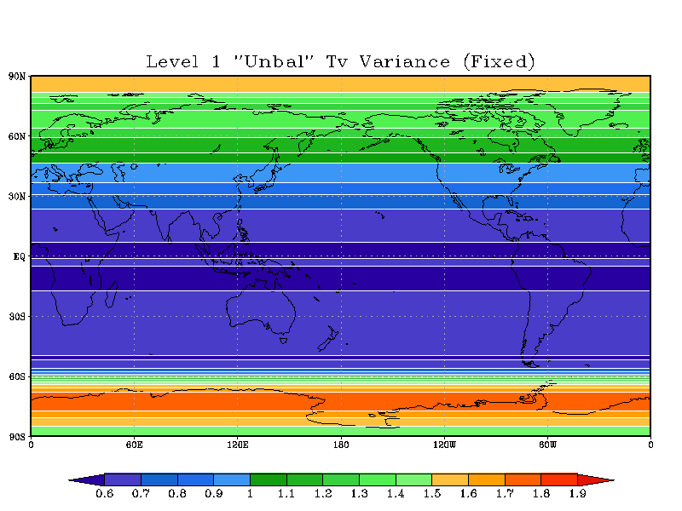
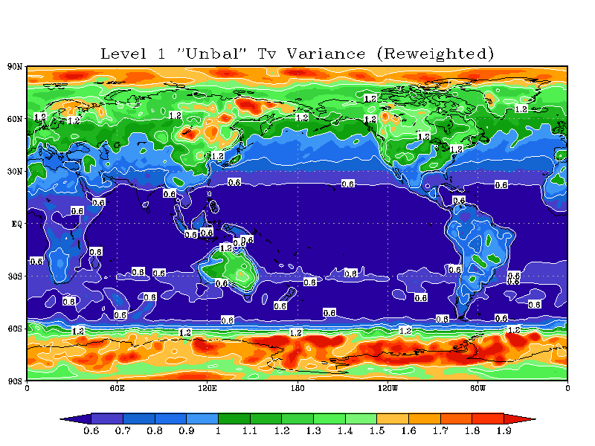
Current background error for NCEP GSI
Although flow-dependent variances are used, confined to be a rescaling of fixed estimate based on time tendencies
No multivariate or length scale information used
Does not necessarily capture ‘errors of the day’
Does not have a very significant impact on forecast scores.

Slide 5
Importance of Ensemble Generation Method?
GEFS (already operational)
80 cycled members
ETR, “Ensemble Transform with Rescaling”
Virtually no additional computational cost beyond forward integrations
Uses analysis error mask derived for 500 hPa streamfunction
Tuned for medium range forecast spread and fast “error growth”
T190L28 version of the GFS model
Not designed to represent 6-h forecast error covariances - viable for hybrid paradigm?
EnKF
80 cycled members
Perturbations specifically designed to represent analysis and background errors (parameters tuned by running DA stand-alone)
T254L64 version of the GFS
Extra computational costs worth it for hybrid?

Slide 6
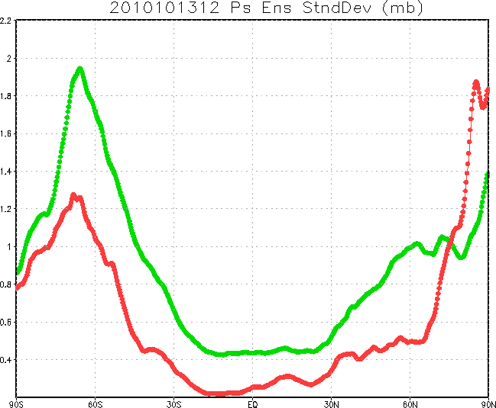
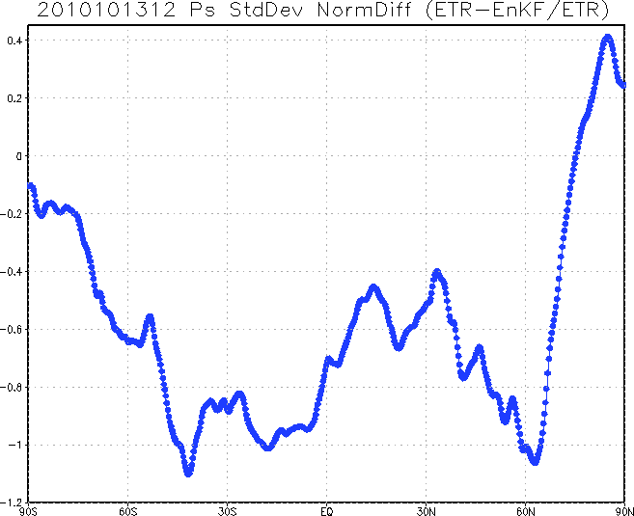
EnKF/ETR Comparison
EnKF (green) versus ETR (red) spread/standard deviation for surface pressure (mb) valid 2010101312
Surface Pressure spread normalized difference (ETR has much less spread, except poleward of 70N)

Slide 7
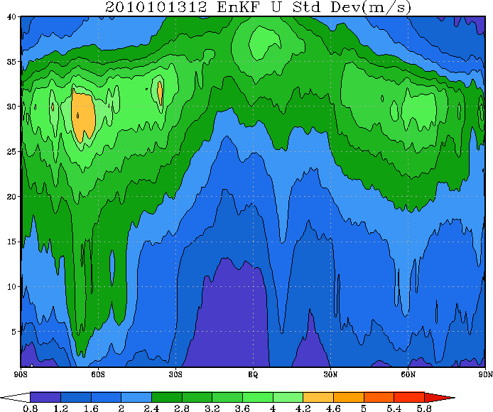
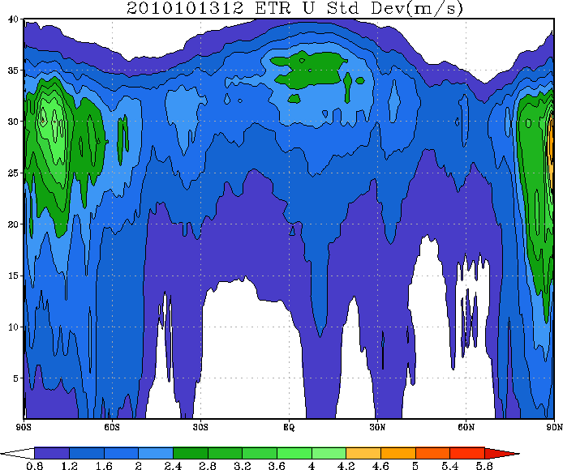
EnKF/ETR Comparison
EnKF zonal wind (m/s) ensemble standard deviation valid 2010101312
ETR zonal wind (m/s) ensemble standard deviation valid 2010101312

Slide 8
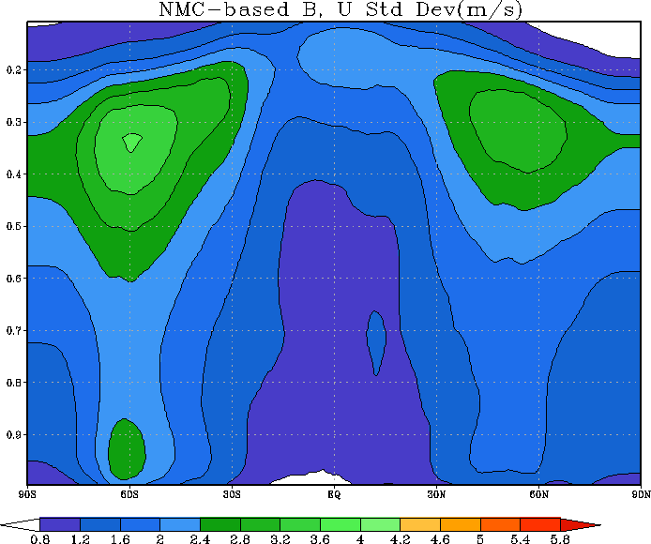
EnKF / NMC B Compare
EnKF zonal wind (m/s) ensemble standard deviation valid 2010101312
Zonal Wind standard deviation (m/s) from “NMC-method”

Slide 9
Hybrid with (global) GSI
Control variable has been implemented into GSI 3D-Var*
Full B preconditioning
Working on extensions to B^{1/2} preconditioned minimization options
Spectral filter for horizontal part of L
Eventually replace with (anisotropic) recursive filters
Recursive filter used for vertical
Dual resolution capability
Ensemble can be from different horizontal resolution than background/analysis.
Various localization options for L
Grid units or scale height
Level dependent (plans to expand)
Option to apply tangent-linear normal mode constraint (TLNMC - Kleist et al. 2009) to analysis increment
*Acknowledgement: Dave Parrish for original implementation of extended control variable

Slide 10
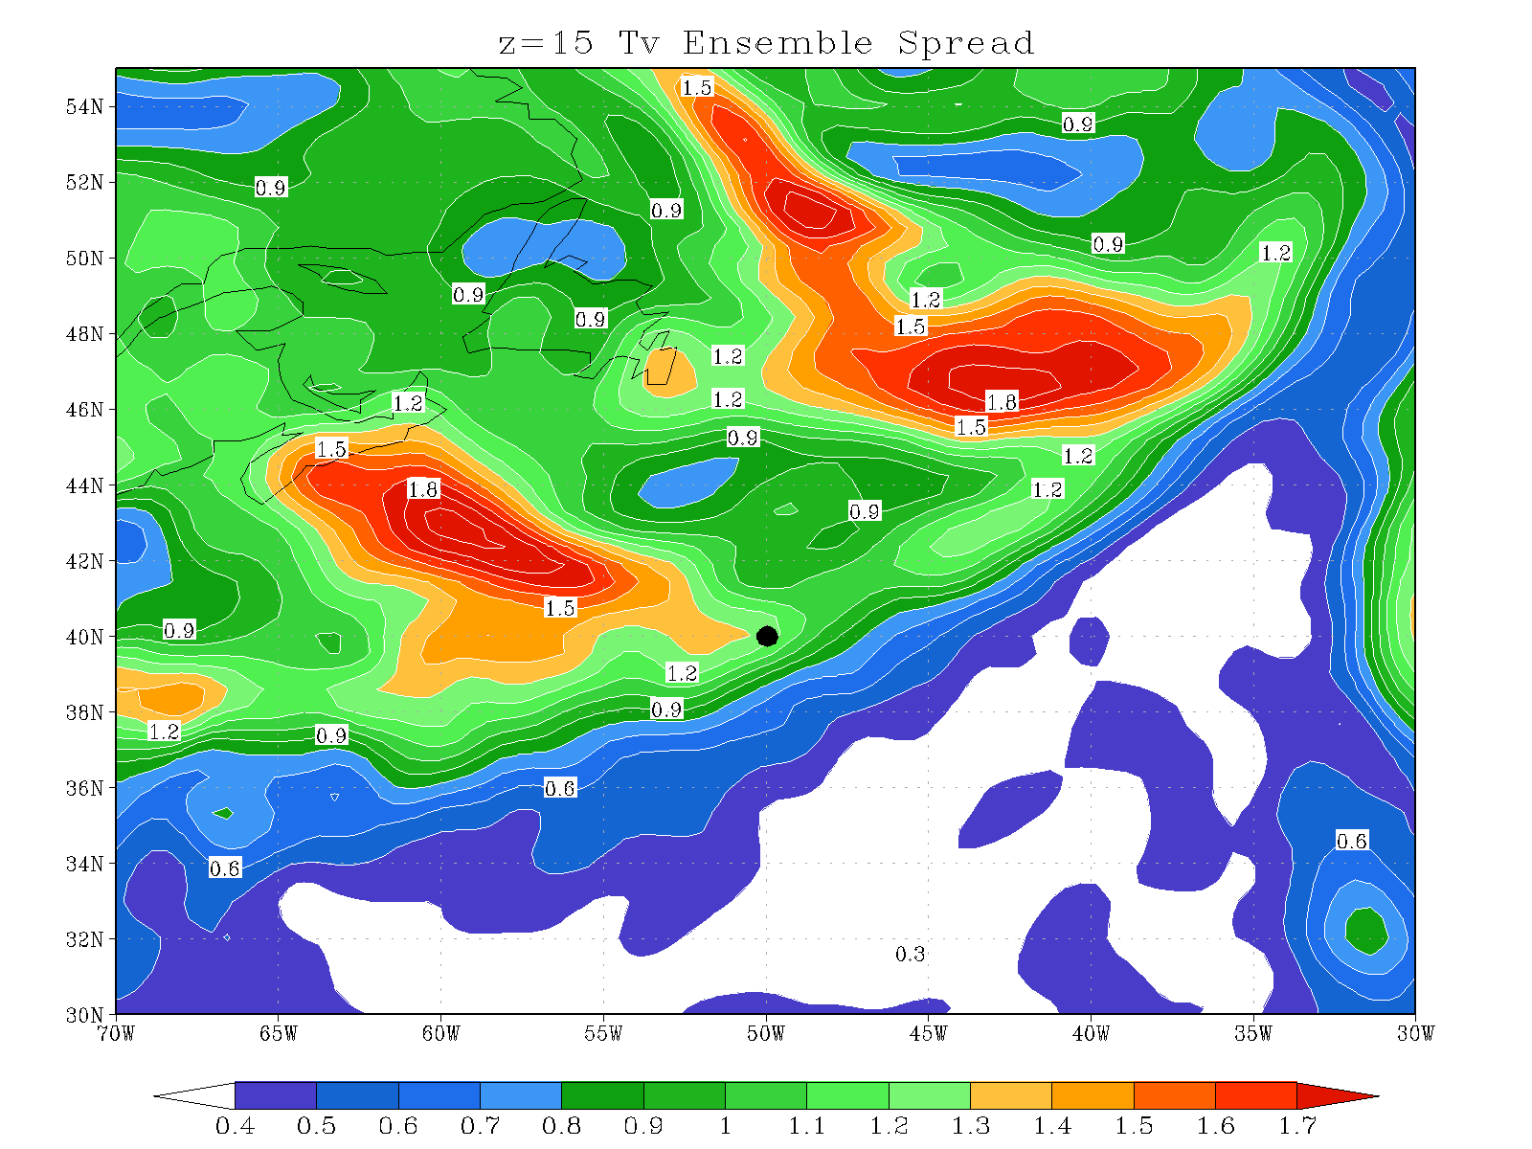
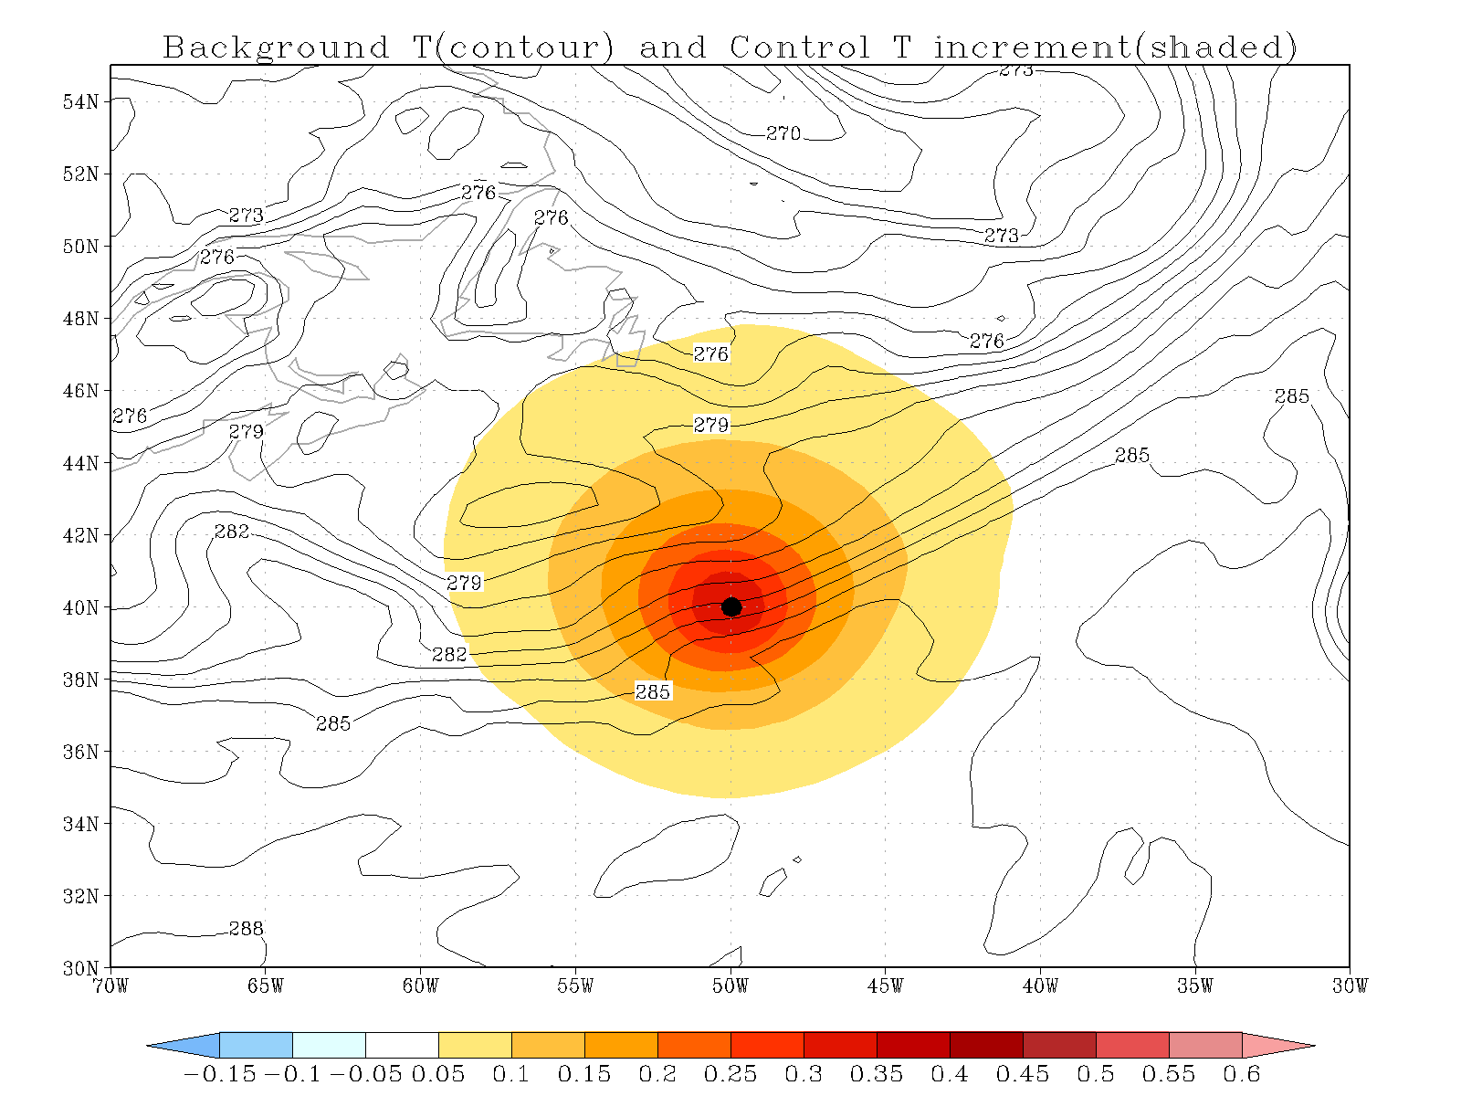
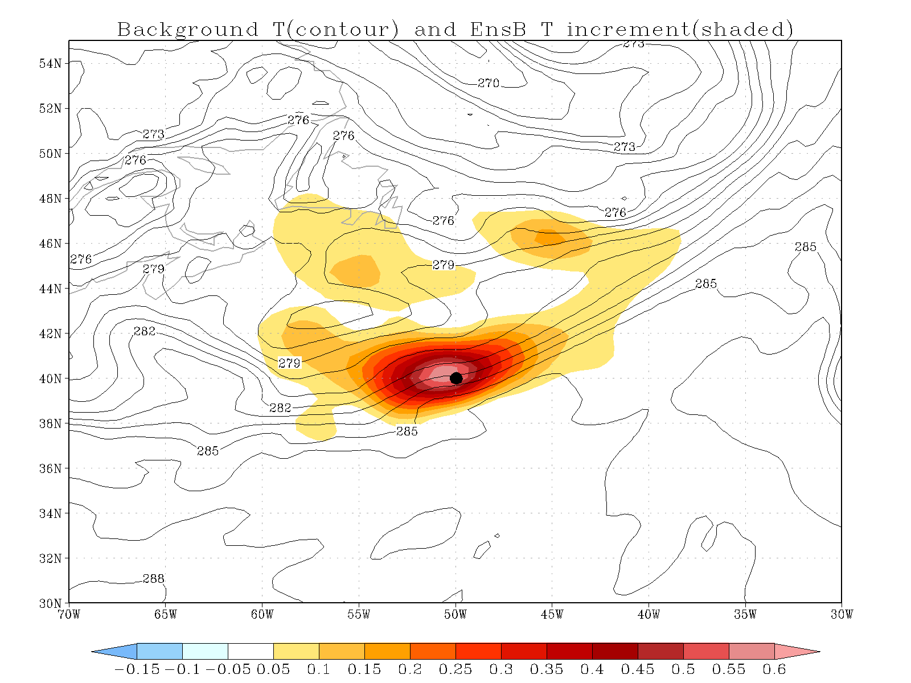
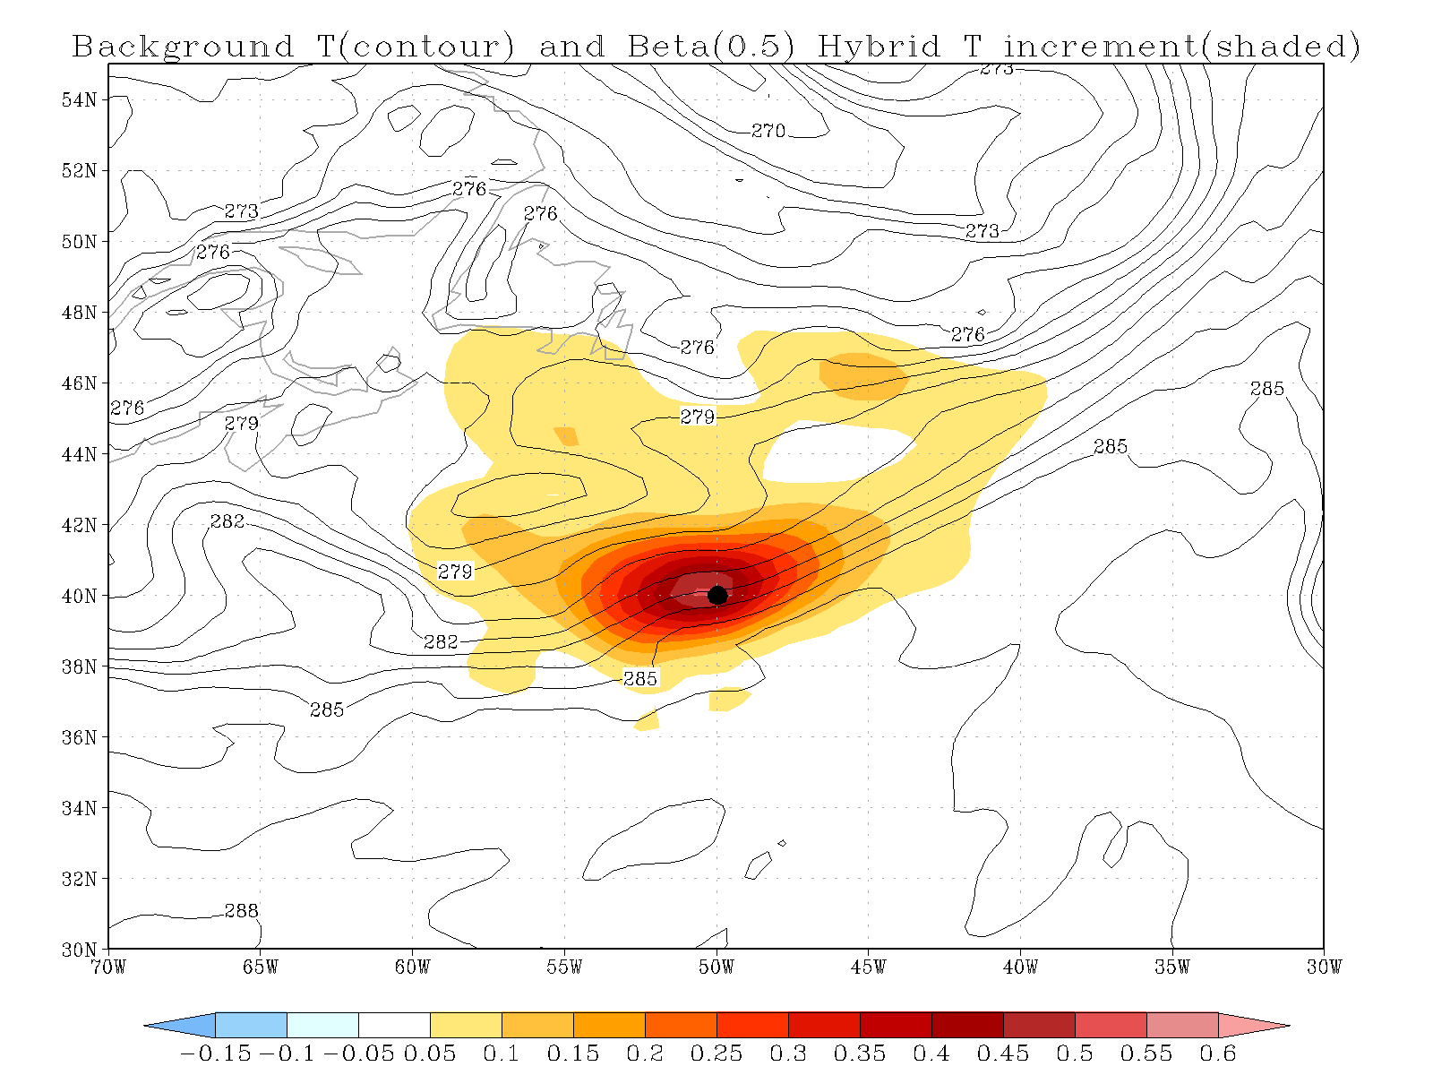
Single observation
Single 850 hPa T_{v} observation (1K O-F, 1K error)

Slide 11
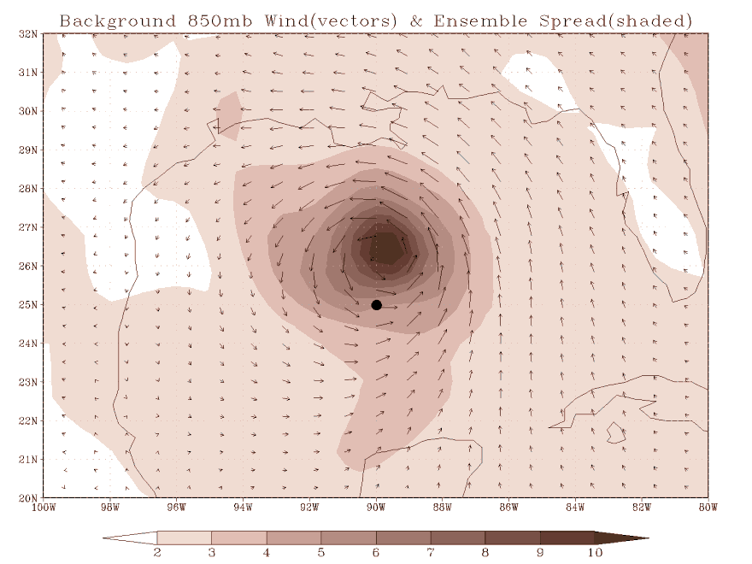
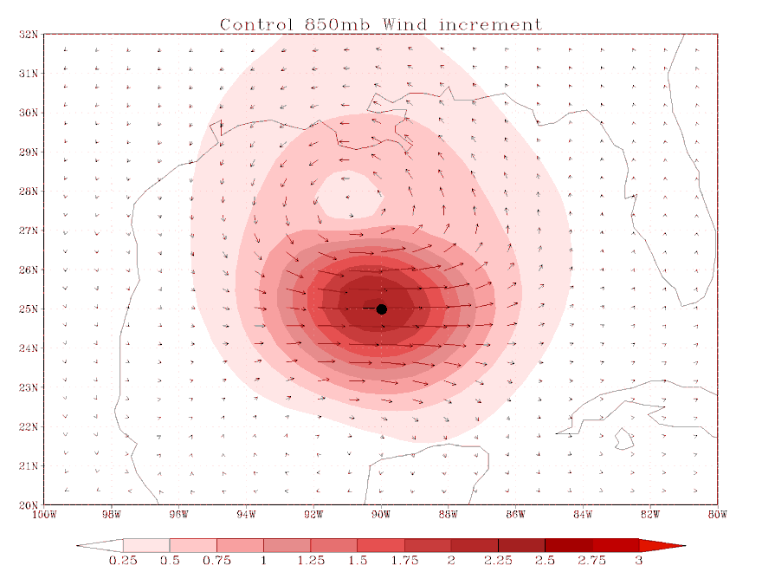
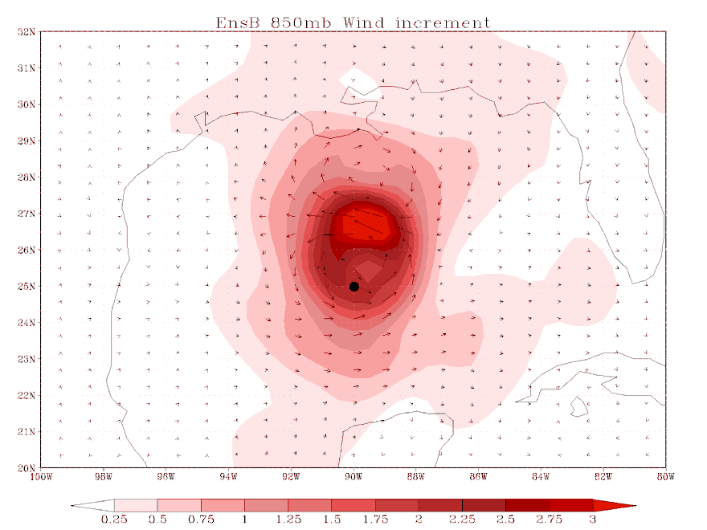
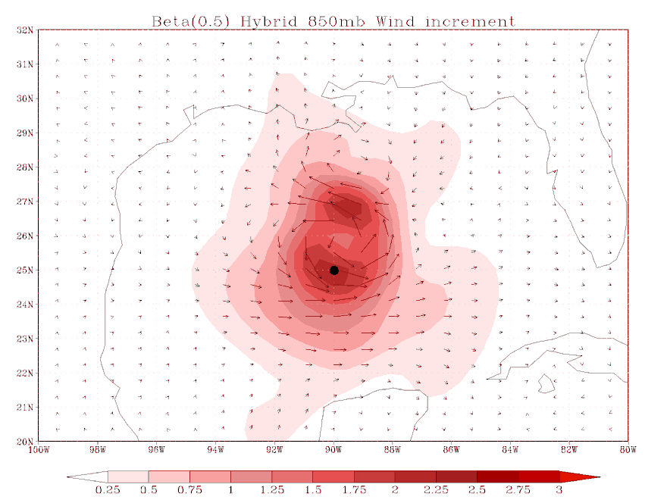
Single Observation
Single 850 hPa zonal wind observation (3 m/s O-F, 1m/s error) in Hurricane Ike circulation

Slide 12
Dual-Res Coupled Hybrid
member 1
forecast
member 1
analysis
member 2
forecast
EnKF
member update
recenter analysis ensemble
member 2
analysis
member 3
analysis
member 3
forecast
GSI
Hybrid Ens/Var
high res
forecast
high res
analysis
Previous Cycle
Current Update Cycle

Slide 13
Hybrid Var-EnKF GFS experiment
Model
GFS deterministic (T574L64; current operational version)
GFS ensemble (T254L64)
80 ensemble members, EnKF update, GSI for observation operators
Observations
All operationally available observations (including radiances)
Includes early (GFS) and late (GDAS/cycled) cycles as in production
Dual-resolution/Coupled
High resolution control/deterministic component
Includes TC Relocation on guess (will probably drop)
Ensemble is re-centered every cycle about hybrid analysis
Discard ensemble mean analysis
Satellite bias corrections
Coefficients come from GSI/VAR (although EnKF can compute it’s own)
Parameter settings
1/3 static B, 2/3 ensemble
Fixed localization: 2000km & 1.5 scale heights
Additive and multiplicative inflation.
Test Period
15 July 2010 – 15 October 2010 (first two weeks ignored for “spin-up”)

Slide 14
500 hPa AC (3D-Var, Hybrid)
Day 5 0.871 0.883
Day 5 0.824 0.846

Slide 15
RMS errors, 20100807 - 20101022
Zonal wind (Tropics)
Temperature (NH)
3D-Var
Hybrid - 3D-Var

Slide 16
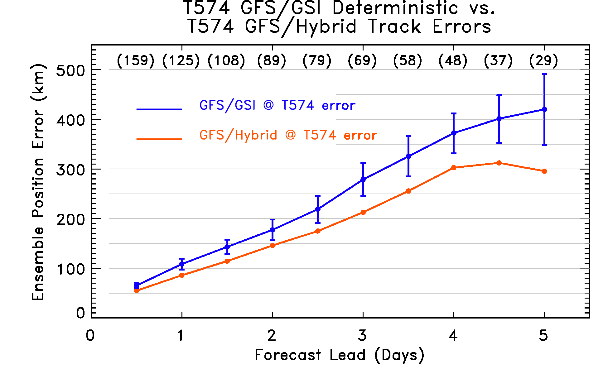
GSI/EnKF Hybrid vs. GSI opn’l TC track errors
Hybrid has significantly lower track errors than operational GSI (using static covariance)

Slide 17
Computational expense
Analysis / GSI side
Minimal additional cost (mostly I/O reading ensemble)
Additional “GDAS” Ensemble (T254L64 GDAS)
EnKF ensemble update
Cost comparable to current GSI 3D-Var
Includes ensemble of GSI runs to get O-F and actual ensemble update step
9-h forecasts, needs to be done only in time for next (not current) cycle. Already done for ETR, but with fewer vertical levels and only to 6-h.

Slide 18
Conclusions / Plans
Clear improvement seen in using EnKF-based ensemble covariances in GSI 3D-Var, but
EnKF analyses are noisy – post analysis balancing degrades performance.
Increments to wind/temp from stratospheric ozone obs can be quite large (unrealistic?)
Schedule (deadlines already slipping…)
Testing at NCEP and ESRL, now-August 2011
Code frozen late Oct 2011
Final real-time parallel testing Dec 2011-Jan 2012
Final field evaluation late Jan 2012
Operational implementation Feb 2012

Slide 19
Extensions and Improvements
Scale-dependent weighting of fixed and ensemble covariances?
Expand hybrid to 4D
Hybrid within‘traditional 4D-Var’(with adjoint)
Pure ensemble 4D-Var (non-adjoint)
Ensemble 4D-Var with static B supplement (non-adjoint)
EnKF improvements
Adaptive localization
Stochastic physics
Perturbed SSTs
Balance
Non-GFS applications in development
Other global models (NASA GEOS-5, NOAA FIM, GFDL)
NAM /Mesoscale Modeling
Hurricanes/HWRF
Storm-scale initialization
Rapid Refresh
NCEP strives to have single DA system to develop, maintain, and run operationally (global, mesoscale, severe weather, hurricanes, etc.)
GSI (including hybrid development) is community code supported through DTC
EnKF used for GFS-based hybrid being expanded for use with other applications

Slide 20
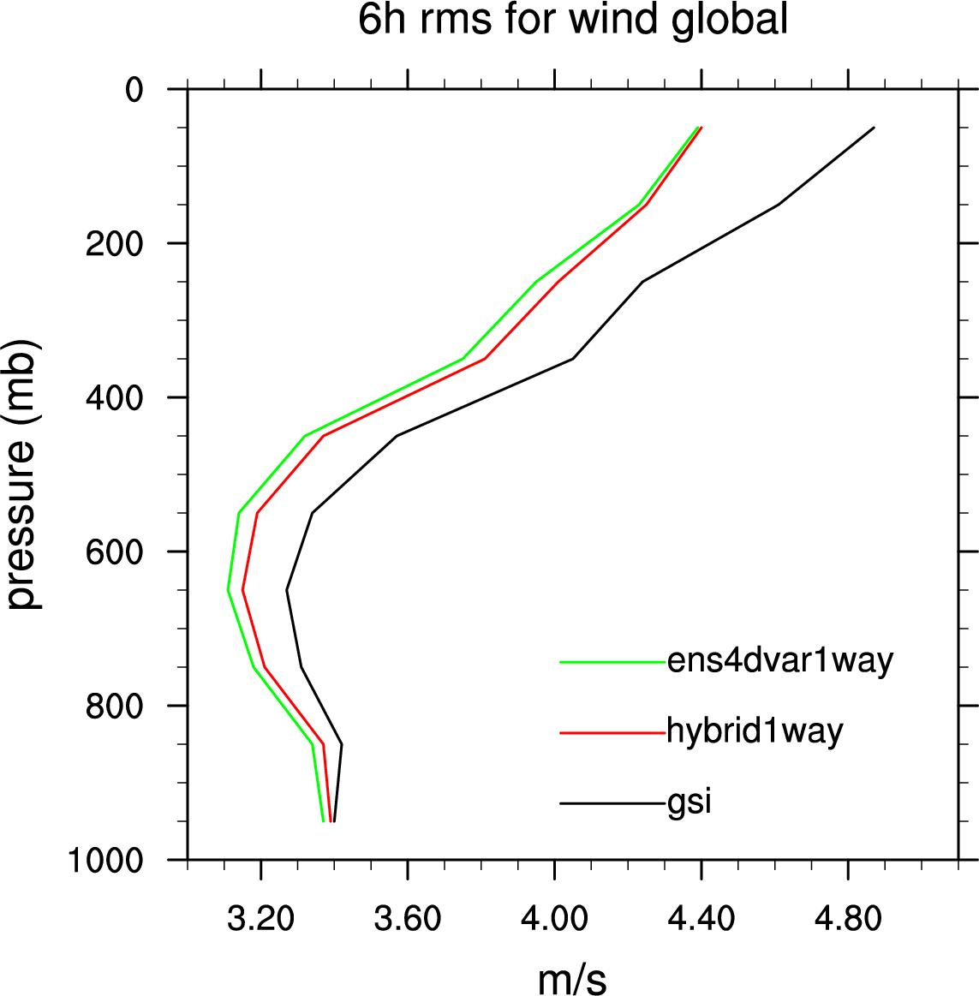
Pure Ensemble 4D-Var (Xuguang Wang, Ting Lei: Univ of Oklahoma)
Extension of 3D-Var hybrid using 4D- ensemble covariances at hourly intervals in assimilation window without TLM/Adjoint (similar to Buehner et al 2010).
T190L64 experiments show Improvement over 3D-Var hybrid – similar to pure EnKF.
To do: Dual resolution, 2-way coupling, addition of static B component.

Slide 21
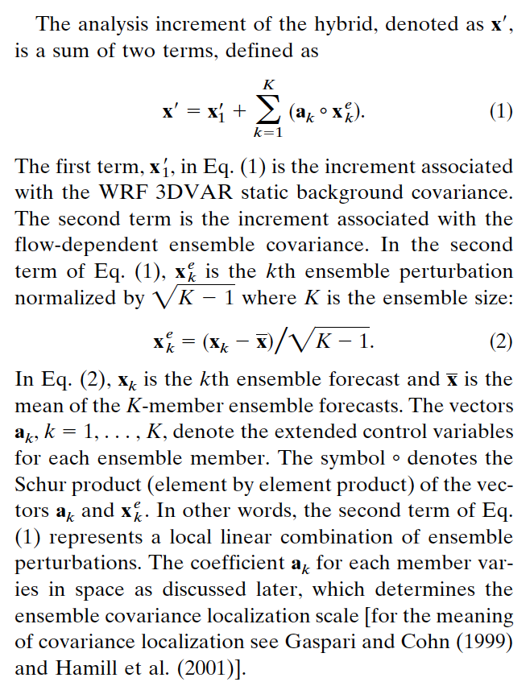
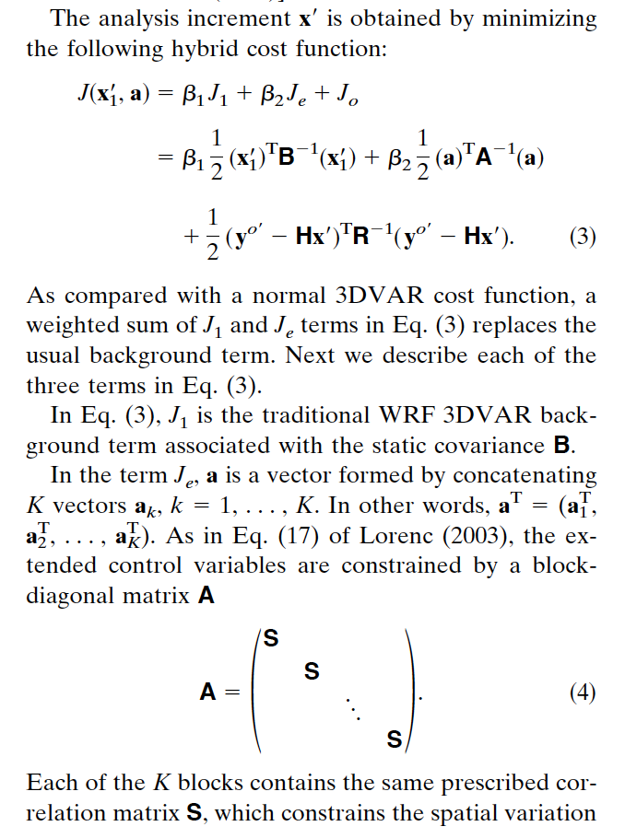
More on extended control variable approach

Slide 22
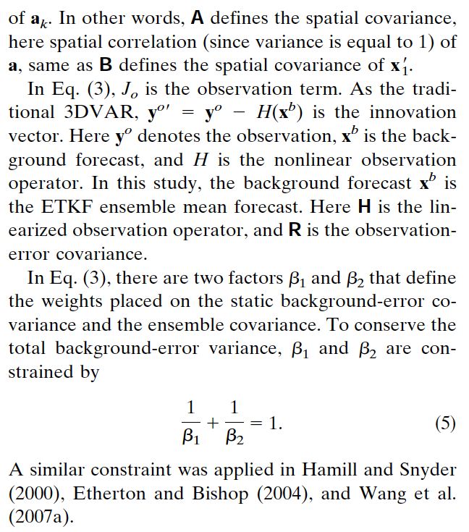
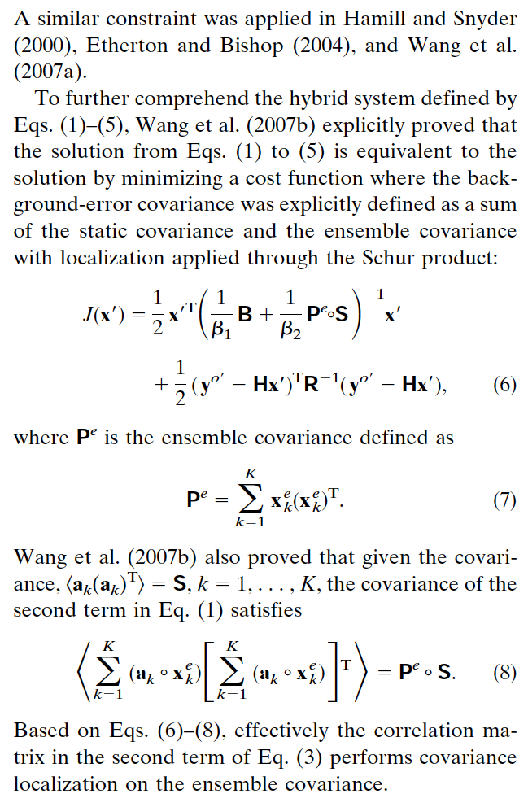
More on extended control variable approach

