Slide 1


Addressing model uncertainty through statistical post-processing
NOAA Earth System
Research Laboratory
Tom Hamill
NOAA Earth System Research Lab, Boulder, Colorado, USA
tom.hamill@noaa.gov
001 (303) 497-3060
Acknowledgments: Jeff Whitaker, Renate Hagedorn, Florian Pappenberger

Slide 2
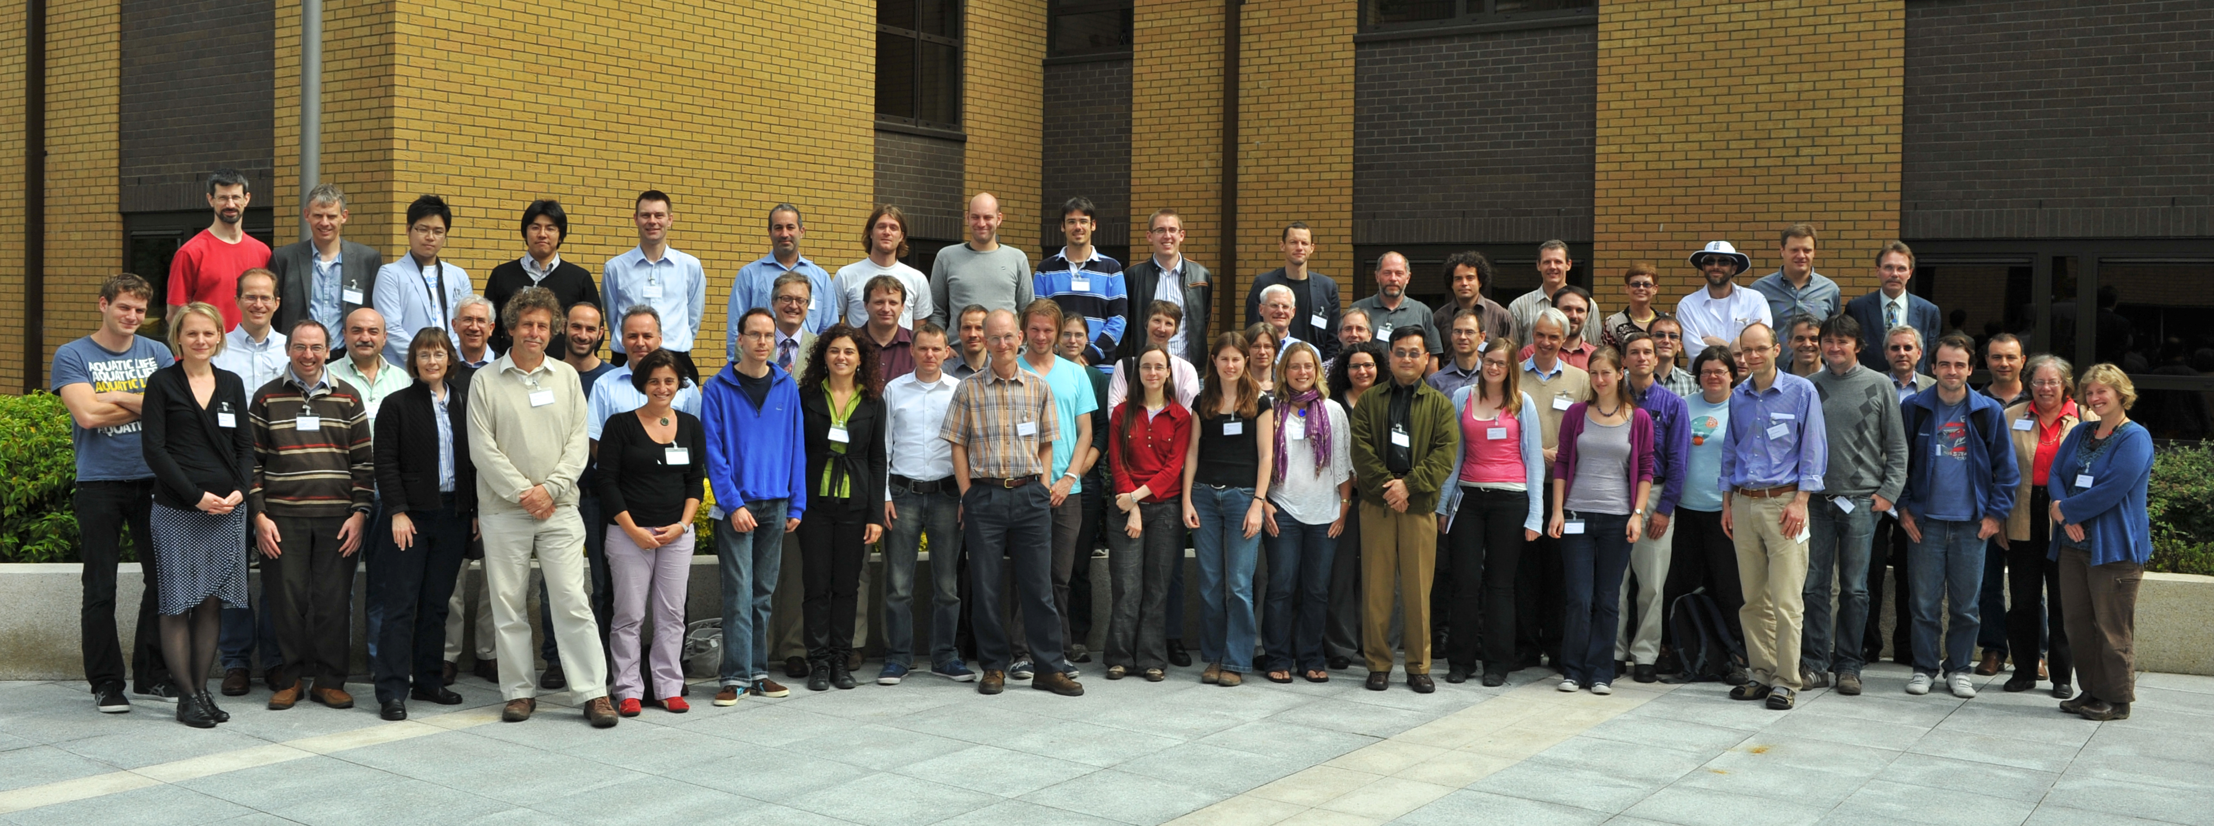
Workshop on representing model uncertainty and error in numerical weather and climate prediction models
20-24 June 2011, at ECMWF
Sponsored by ECMWF, WGNE, THORPEX, WCRP
There are a number of techniques to represent model uncertainty in ensemble forecasts. These range from the multi-model techniques which feature prominently in IPCC assessment reports, to the stochastic parametrisations pioneered at ECMWF and widely used at weather forecast centres around the world. A key outcome of the meeting was that the stochastic parametrisation paradigm needs further development at the process level, and hence needs to be incorporated as part of general parametrisation development. Key tools will include sophisticated analyses of observational datasets, output from cloud resolving models, and analyses from objective data assimilation. Data assimilation techniques themselves will benefit from better representations of model uncertainty.

Slide 3

Statistical post-processing and its niche in addressing model uncertainty
Statistical post-processing is the janitorial
service of ensemble prediction.
If ensemble forecasts were consistently
unbiased, reliable, and sharp, with
physically based model uncertainty
parameterizations, there would be little
need for this activity.
For the foreseeable future, we there will
be enough “mess” to clean up from the
raw model guidance that you’ll need
our services.

Slide 4
Statistical post-processing and its niche in addressing model uncertainty
Reforecasts, the tool that
helps us NWP janitors do our job.

Slide 5
Basic idea
Old “reforecasts”
(from stable
modeling system)
Old
analyses or
observations
Synthesize
information
on forecasts,
discrepancies
Today’s
real-time forecast
Adjust
today’s
forecast
Improved
forecast
guidance

Slide 6
Basic idea
Old “reforecasts”
(from stable
modeling system)
Old
analyses or
observations
This talk will be more about issues with the
supporting data sets
than on the specific
post-processing
techniques
Synthesize
information
on forecasts,
discrepancies
Today’s
real-time forecast
Adjust
today’s
forecast
Improved
forecast
guidance

Slide 7
What can post-processing and reforecasts do that other model error corrections cannot?
Provide context on how unusual today’s forecast event is, relative to other forecast events.
Compensate for errors due to finite ensemble size.
Provide extra “resolution” via statistical downscaling.
Compensate for remaining systematic model biases not addressed through stochastic techniques, thereby increase reliability, increase forecast skill.
Provide sufficient samples to quantify forecast errors for particular locations, hydrologic basins

Slide 8
Disadvantages of post-processing
Right answer perhaps, but for wrong reason? We prefer to directly improve the model in physically realistic ways.
  Also, some errors are too complex to adjust via post-processing; for these, there is no substitute for improving the model.
Additional computational and infrastructural burden to compute reforecasts and reanalyses, compile observation time series.
  ECMWF’s (relatively sparse) weekly 5-member reforecast * 20 years = 100 extra members / week to compute.
  Generally greater benefit the more years, more days, more members in reforecast, but proportionally more expensive.
  Without high-quality, long observation time series, many of the benefits of reforecasts + statistical post-processing are lost.
  Need to keep computing reforecasts with current model version, else improvements are temporary.
If real climate or model-error statistics change significantly during reforecast period, decreased accuracy of post-processed estimates

Slide 9
Post-processing and reforecast advantages

Slide 10
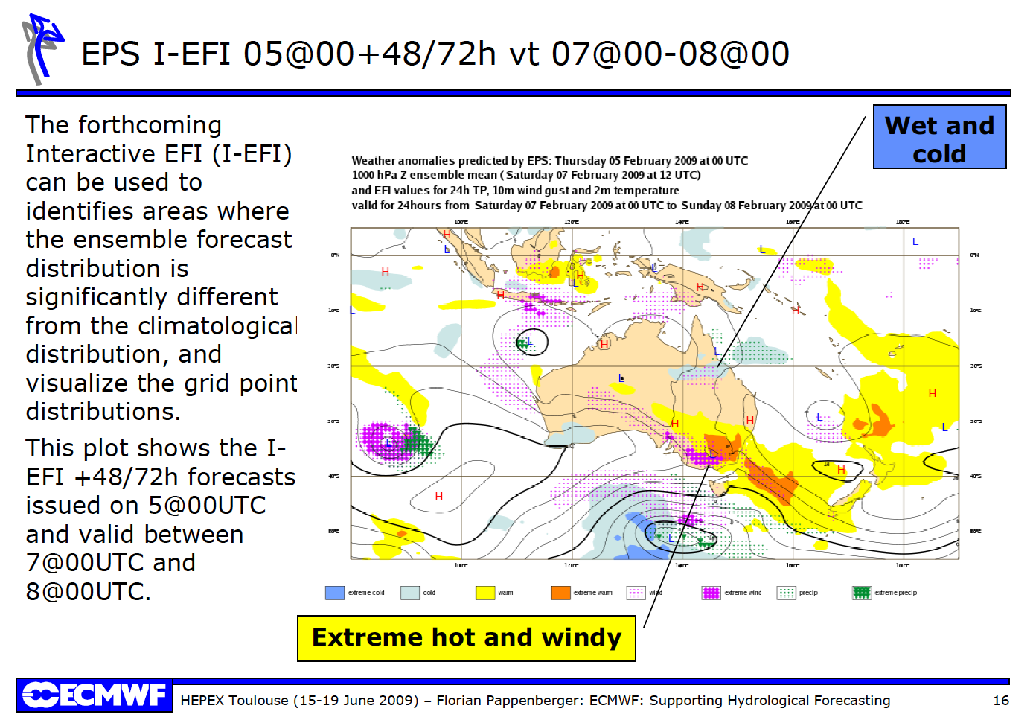
Reforecast advantage: facilitates quantitatively assessing how unusual an event is (EFI)

Slide 11
Extreme Forecast Index
(needs accurate forecast climatology, such as provided by reforecasts)
p is the percentile of the cumulative distribution estimated from the ensemble; F_{f} (p) is how the p-percentile of the climate record ranks in the EPS (0 the minimum, 1 the maximum). This “Anderson-Darling” version introduces a weighted statistic that
gives more power in the tails of the distribution. 2/π is normalization factor to keep -1 ≤ EFI ≤ 1.
From: LaLaurette, QJRMS, 2003, and http://www.ecmwf.int/products/forecasts/efi_guide.pdf

Slide 12
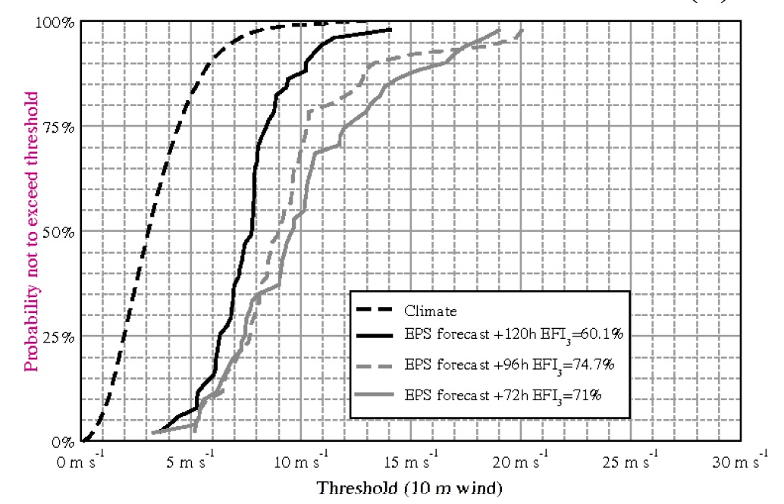
EFI
Ref: ibid

Slide 13
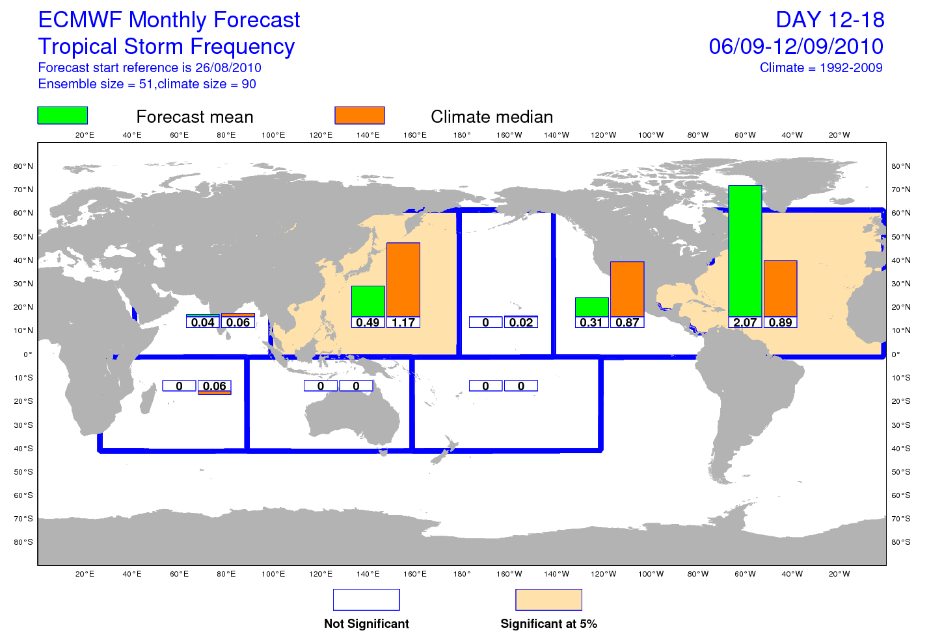
Reforecast use: tropical cyclogenesis
Many forecast models over-forecast tropical cyclogenesis. This ECMWF product
uses TCgenesis from reforecasts to provide some calibration for possible biases.
Ref: D. Richardson, personal communication, ECMWF.

Slide 14
Adjusting for errors due to finite ensemble size.
Imagine: your
20-member
storm-scale ensemble
(which is a calibrated
system, truth consistent
with a random draw
from ensemble)
Your job: estimate
reliable probabilities
on the grid.

Slide 15
Adjusting for errors due to finite ensemble size.
Imagine: your
20-member
storm-scale ensemble
(which is a calibrated
system, truth consistent
with a random draw
from ensemble)
Your job: estimate
reliable probabilities
on the grid.
Zero probability
for this cell? Yes if
you use ensemble
relative frequency

Slide 16
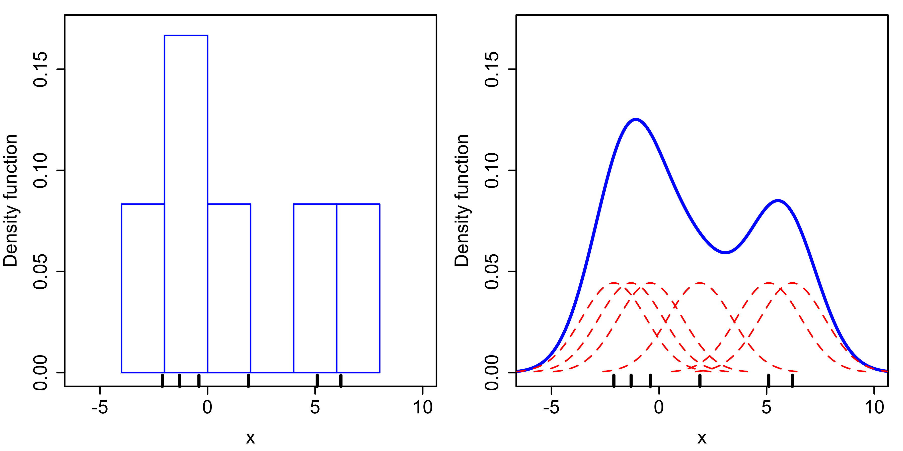
Kernel density estimation to produce smooth pdf from limited-size ensemble

Slide 17
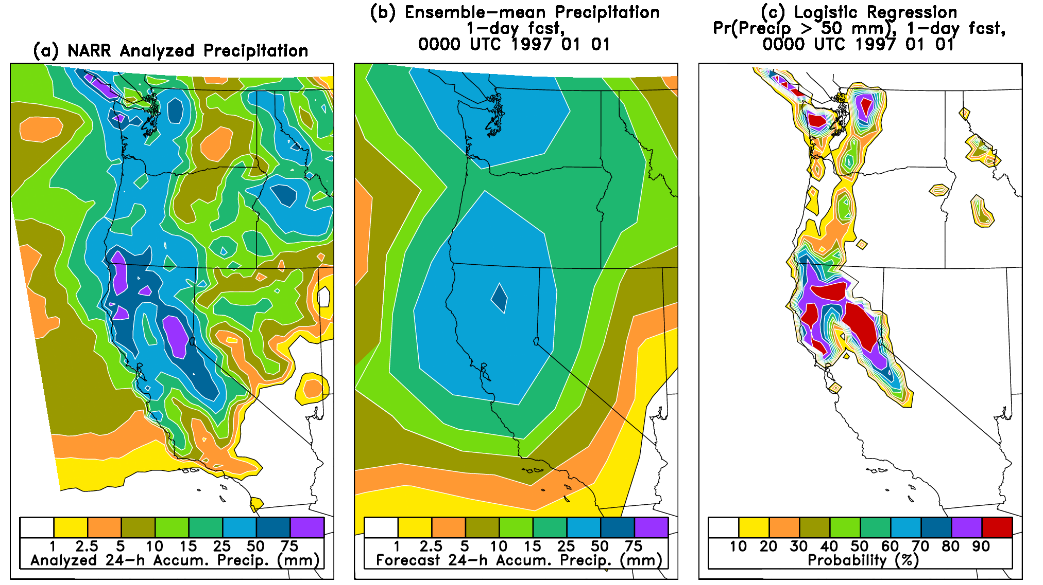
Provide extra “resolution” via statistical downscaling
“resolution” here is used as in its definition in the Brier Score decomposition, the ability of
a forecast model to successfully forecast deviations from the overall climatological probability.

Slide 18
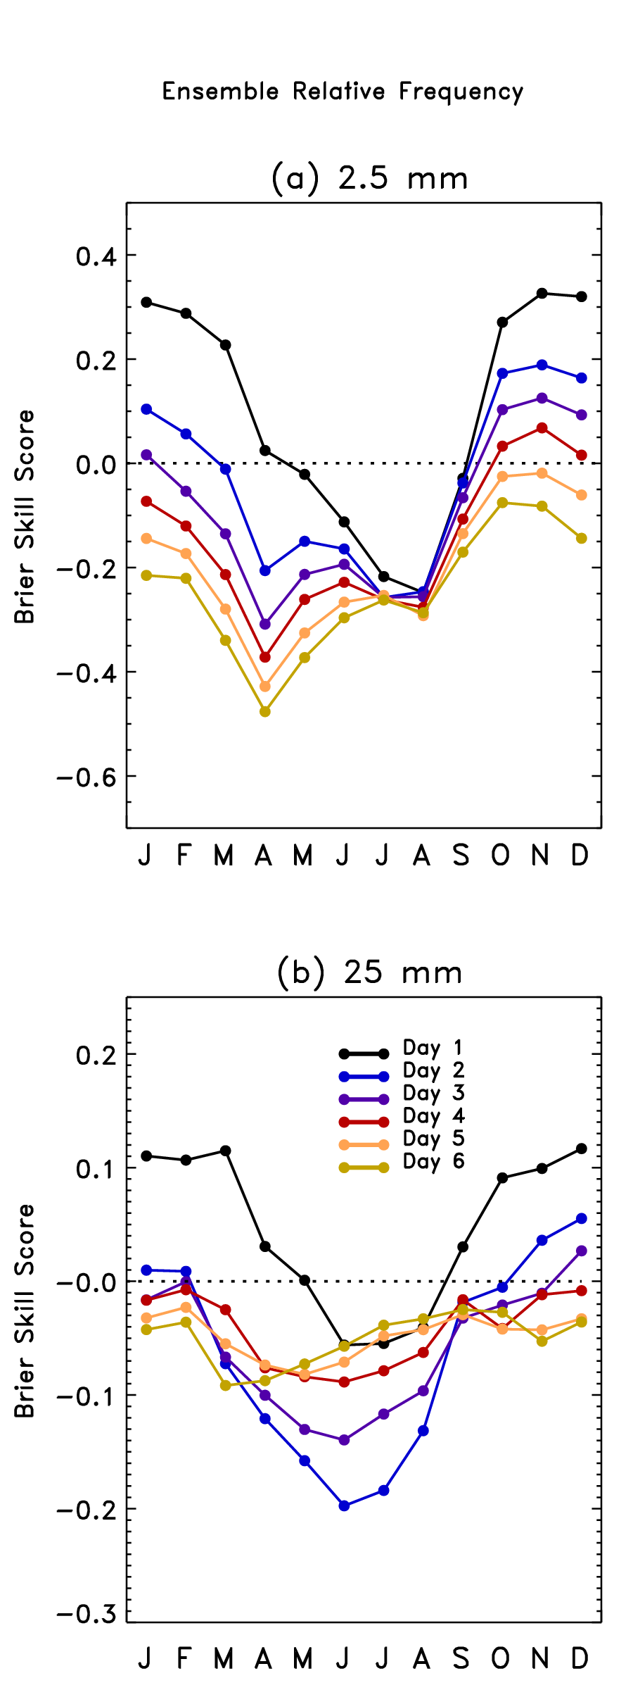
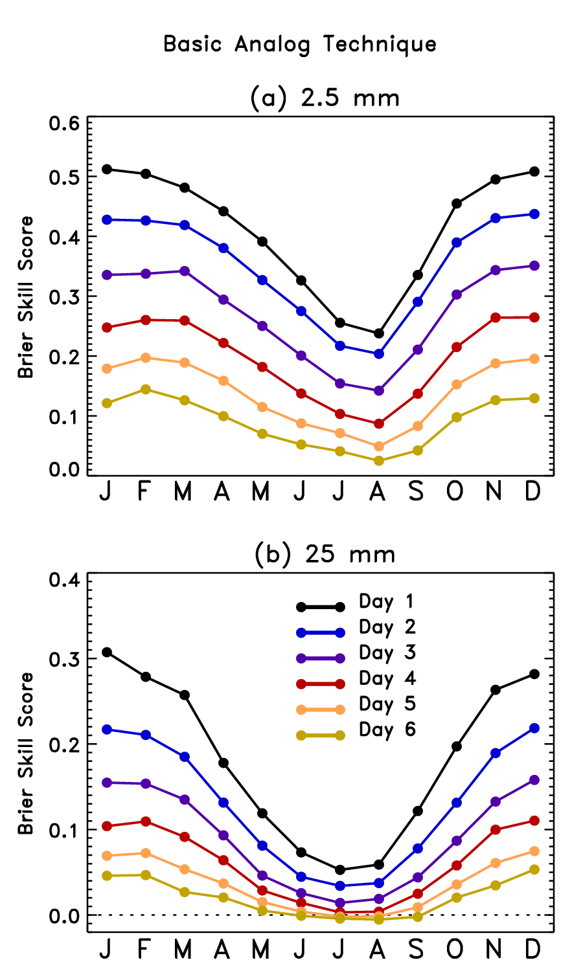
Verified over 25 years of forecasts;
skill scores use conventional
method of calculation which may
overestimate skill
(Hamill and Juras, QJRMS, Oct 2006).

Slide 19
Reforecast vs. multi-model, T_{sfc}
ECMWF’s forecasts were corrected here using a blend of bias correction from the past
30 days of forecasts and a more sophisticated regression approach using reforecasts.
courtesy of Renate Hagedorn, ECMWF & DWD

Slide 20
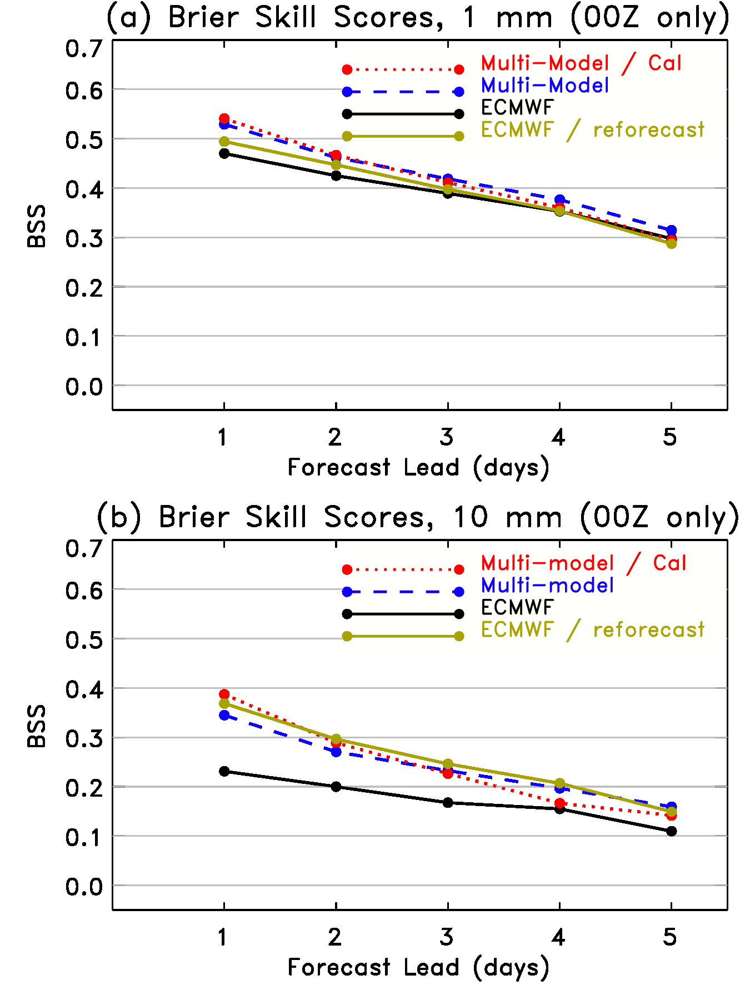
Reforecast vs. multi-model precipitation over US, Jul-Oct 2010
Verification of 1-degree resolution forecasts
against 1-degree precipitation analyses over
CONUS.
The following forecasts are plotted:
20-member ECMWF forecasts (black);
ECMWF, calibrated via logistic regression
using 9 years of ECMWF 4-member
weekly reforecasts (green); multi-model
(blue) and multi-model, calibrated using
the last 30 days of forecasts/analyses.
Reforecasts appear to provide most
improvement at heavy precipitation
thresholds, consistent with other previous
results.

Slide 21
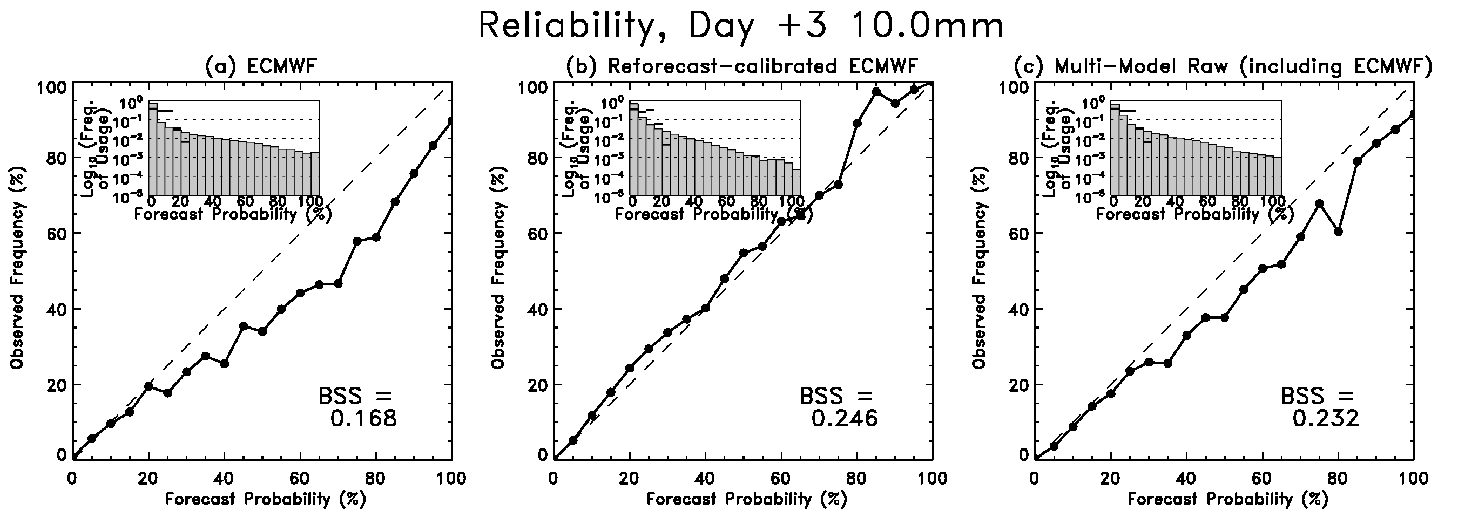
Sample reliability diagrams
ECMWF, reforecast-calibrated, multi-model
(more reliable) (sharper)

Slide 22
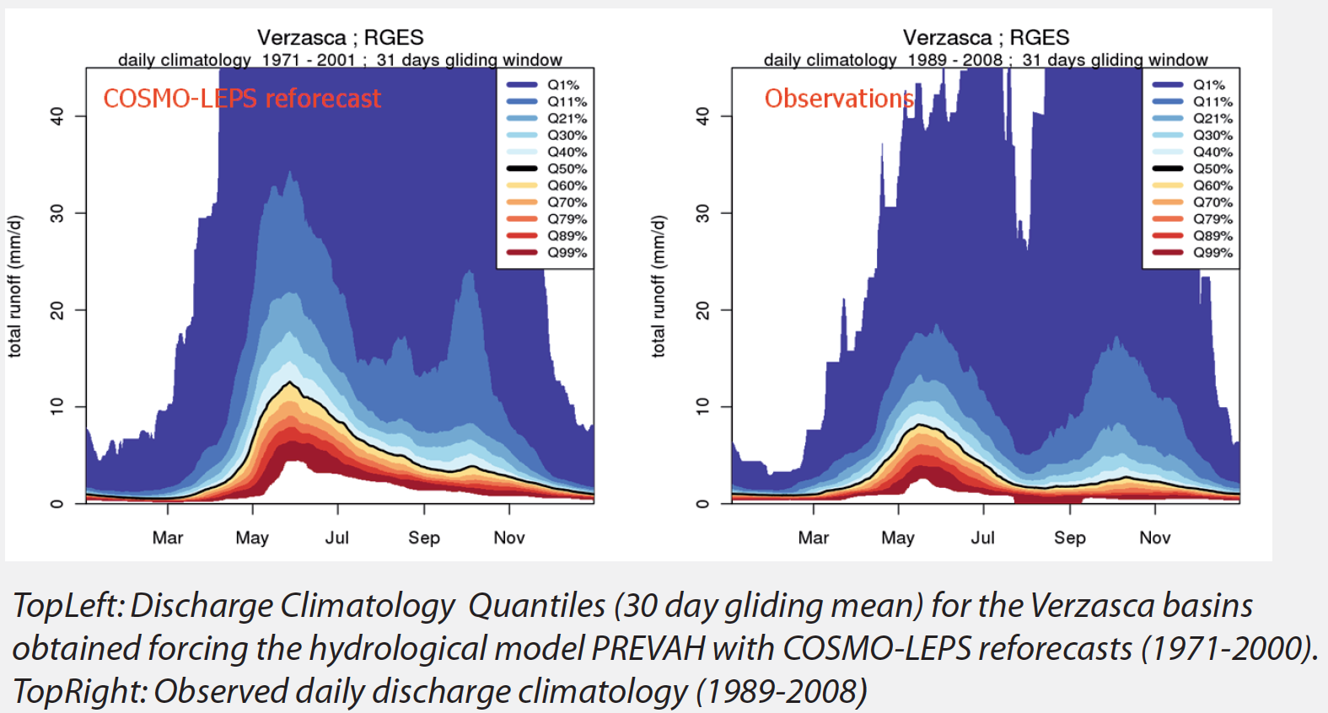
Reforecast advantage: permits quantifying forecast errors for particular locations, basins
from Felix Fundel et al. poster, ftp://ftp.wsl.ch/pub/zappa/imprints/del3_1/cleps_bcn.pdf

Slide 23
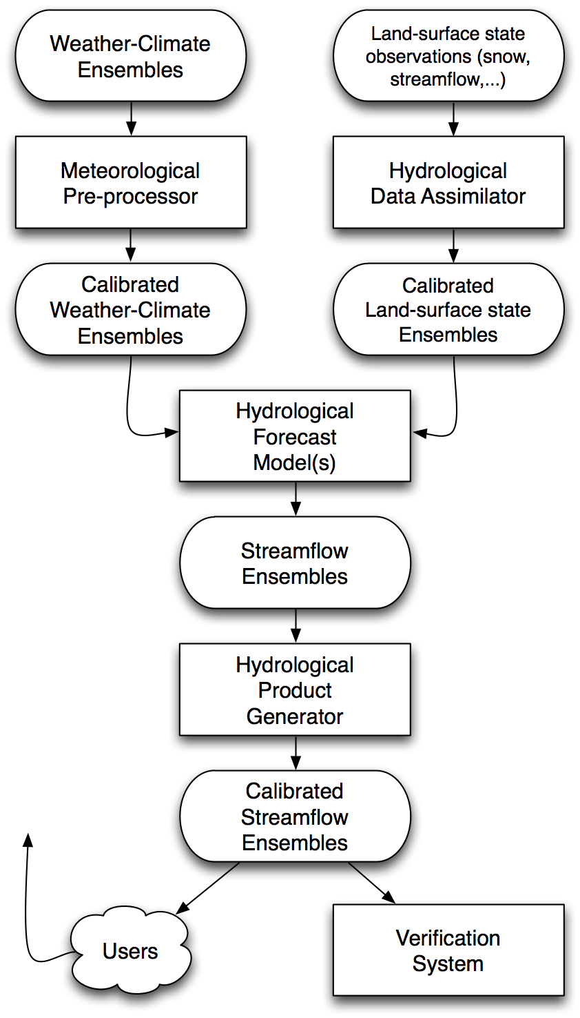
Hydrologic
Ensemble
Prediction
Experiment
Note that hydrologists envision
a step to make sure that ensemble
inputs to their hydrologic system
are as reliable and sharp as possible.
from Schaake et al. 2007 BAMS article

Slide 24
Reforecast / calibration disadvantages

Slide 25
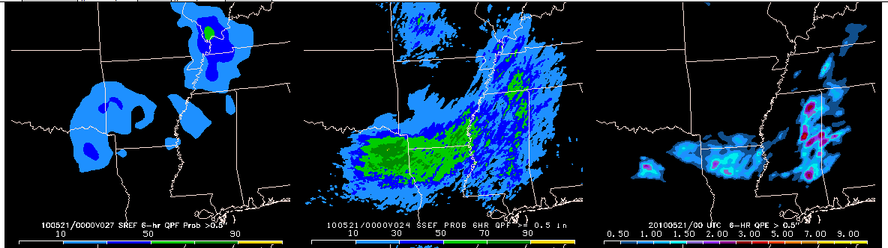
Not all model deficiencies can be addressed easily through post-processing
An example from NSSL-SPC Hazardous Weather Test Bed, forecast initialized 20 May 2010
http://tinyurl.com/2ftbvgs
30-km SREF P > 0.5”
4-km SSEF P > 0.5 “
Verification
With warm-season QPF, comparatively coarse resolution and parameterized convection
in operational SREF system produces forecast that is clearly inferior to the 4-km,
resolved convection in SSEF. Calibration isn’t likely to provide nearly the improvement
that the extra resolution will provide.

Slide 26
Computational burden
Real-time ensemble: assume 50 members, 2x daily = 100/day = 700/week
Minimal reforecast: 5 members, 20 years, 1x weekly = 100/week : 1/7 extra
Moderate reforecast: 10 members, 30 years, 1x daily = 2100/week : 3x extra.
Full reforecast: 50 members, 30 years, 2x daily = 21000/week : 30x extra!

Slide 27
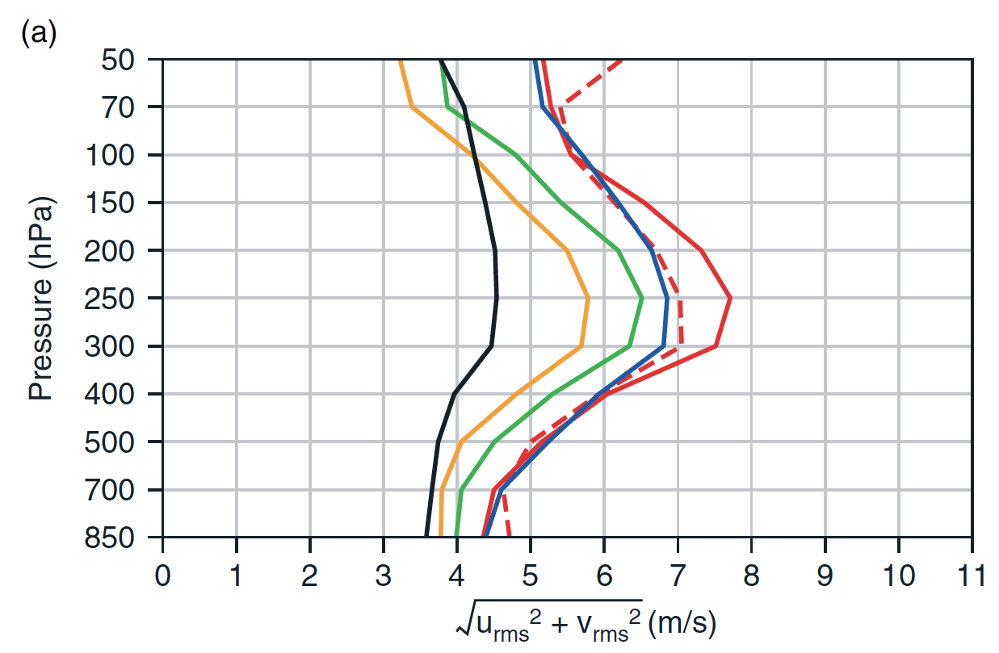
Disadvantage: non-stationary forecast errors in reforecasts?
If real climate or model-error statistics change significantly during reforecast period, decreased accuracy of post-processed estimates.
Short-term forecast fit to radiosondes
From Dee et al., QJRMS, 2011 article on ERA-Interim

Slide 28
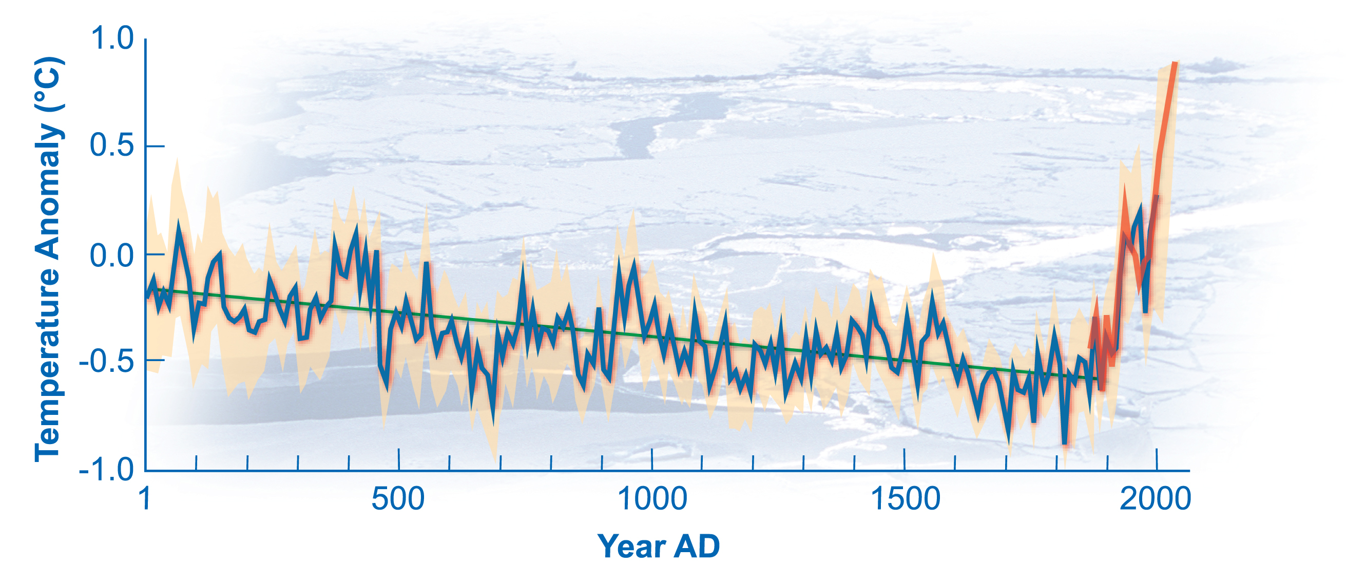
Changing climate: today’s forecasts warmer than those in training data set?
If forecast today is warmer than any in the reforecast training data set, we’ll be
“extrapolating the regression” when we apply statistical corrections.

Slide 29
Conclusions
Statistical post-processing (using reforecasts) may complement other methods of addressing model uncertainty.
  correct for model bias.
  generally large improvements in forecasts of rare events.
It’s not a solution for all problems, and it does increase system complexity, computational burden.
Worth considering how these data sets may be leveraged to facilitate model uncertainty research.

