Slide 1
What constrains spread growth in forecasts initialized from ensemble Kalman filters?
NOAA Earth System
Research Laboratory
Tom Hamill (& Jeff Whitaker)
NOAA Earth System Research Lab
Boulder, Colorado, USA
tom.hamill@noaa.gov
a presentation to AMS Annual Meeting, December 2010; accepted/major at MWR

Slide 2
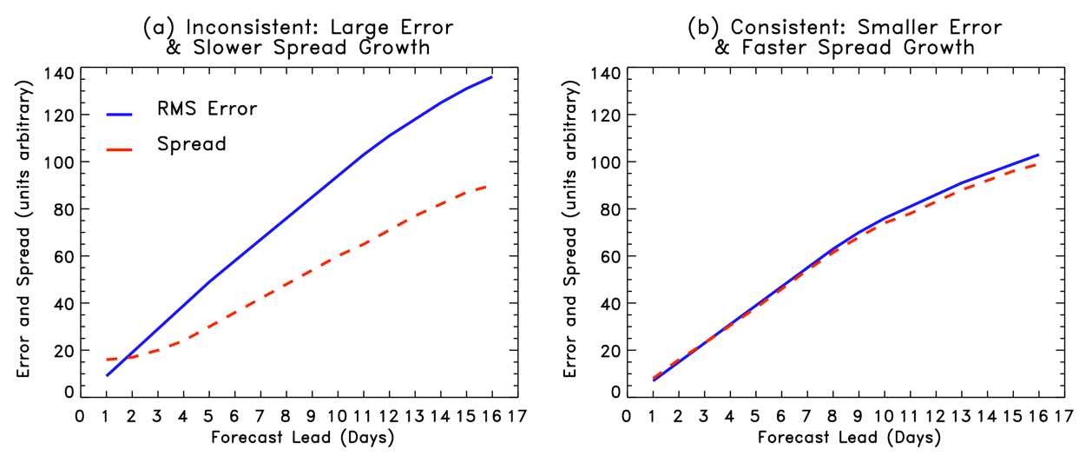
Spread-error consistency
Spread should grow as quickly as error; part of spread growth from manner in which initial conditions are generated,
some due to the model (e.g., stochastic physics, higher resolution increases spread growth). If you don’t have this consistency,
your ensemble-based probability estimates will be inaccurate.

Slide 3
Spread-error consistency
is part of the problem here the
fault of the initial conditions, that
they don’t appropriately project
onto the growing structures?
Spread should grow as quickly as error; part of spread growth from manner in which initial conditions are generated,
some due to the model (e.g., stochastic physics, higher resolution increases spread growth). If you don’t have this consistency,
your ensemble-based probability estimates will be inaccurate.

Slide 4
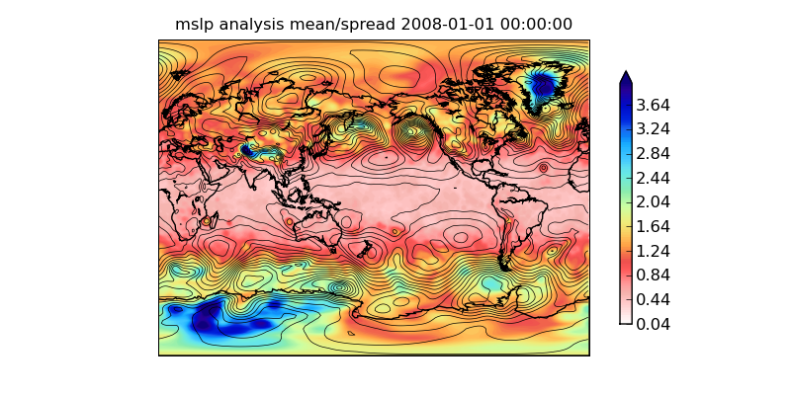
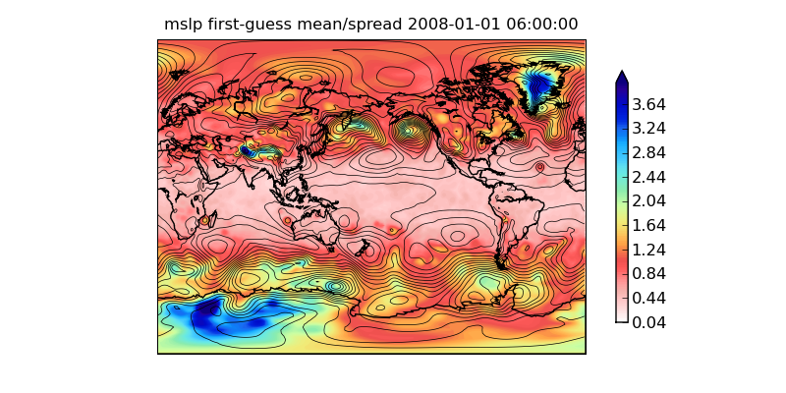
MSLP analysis spread, 2008-01-01 0600 UTC
Example: lack of growth of spread in ensemble square-root filter using NCEP GFS
First-guess spread 6 h later
Not much growth of
spread in forecast,
and decay in many
locations. Why?

Slide 5
Mechanisms that may limit spread growth from ensemble-filter ICs
Covariance localization used to improve EnKF performance introduces imbalances.
Method of treating model error (e.g., additive noise) projects onto non-growing structures.
Model attractor different from nature’s attractor; assimilation kicks model from own attractor, transient adjustment process.

Slide 6
Serial EnSRF (“ensemble square-root filter”)
Updates to the mean and
perturbations around the mean are handled separately, with “reduced” Kalman gain used for
perturbations. Rationale
in Whitaker and Hamill,
2002 MWR

Slide 7
Methodology
Apply EnSRF in toy 2-level primitive equation model, examine spread growth (& errors)
Perfect-model experiments
Imperfect model experiments
Check a key result in the full NCEP GFS with EnSRF

Slide 8
Toy model, assimilation details
Assimilation:
EnSRF; 50 members.
Ensemble forecasts at T31 resolution.
Observations: u,v at 2 levels every 12 h, plus potential temperature at 490 ~ equally spaced locations on geodesic grid. 1.0 m/s and 1.0 K observation errors σ.
Model: 2-level GCM following Lee and Held (1993) JAS
T31 resolution for perfect-model experiments; error-doubling time of 2.4 days
For imperfect model experiments, T42, with nature run that relaxes to different pole-to-equator temperature difference, different wind damping timescale.

Slide 9
Definitions
Covariance inflation:
Additive noise:
Energy norm:

Slide 10
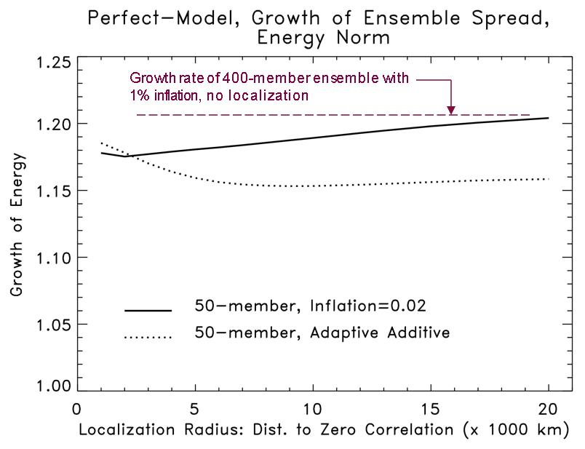
How does spread growth change due to localization? (perfect model)
Notes:
(1) Growth rate of 50-member covariance inflation ensemble over 12-h period with large localization radius is close to “optimal”
(2) Increasing the localization radius with constant inflation factor has relatively minor effect on growth of spread. Suggests that in this model, covariance localization is secondary factor in limiting spread growth.
(3) Additive noise reduces spread growth somewhat more than does localization.
Adaptive algorithm added virtually no additive noise at small localization radii, then more and more as localization radius increased. Hence, adaptive additive spread doesn’t grow as much as localization radius increases because the diminishing imbalances from localization are offset by increasing imbalances from more additive noise.
Growth rate of 400-member ensemble with
1% inflation, no localization

Slide 11
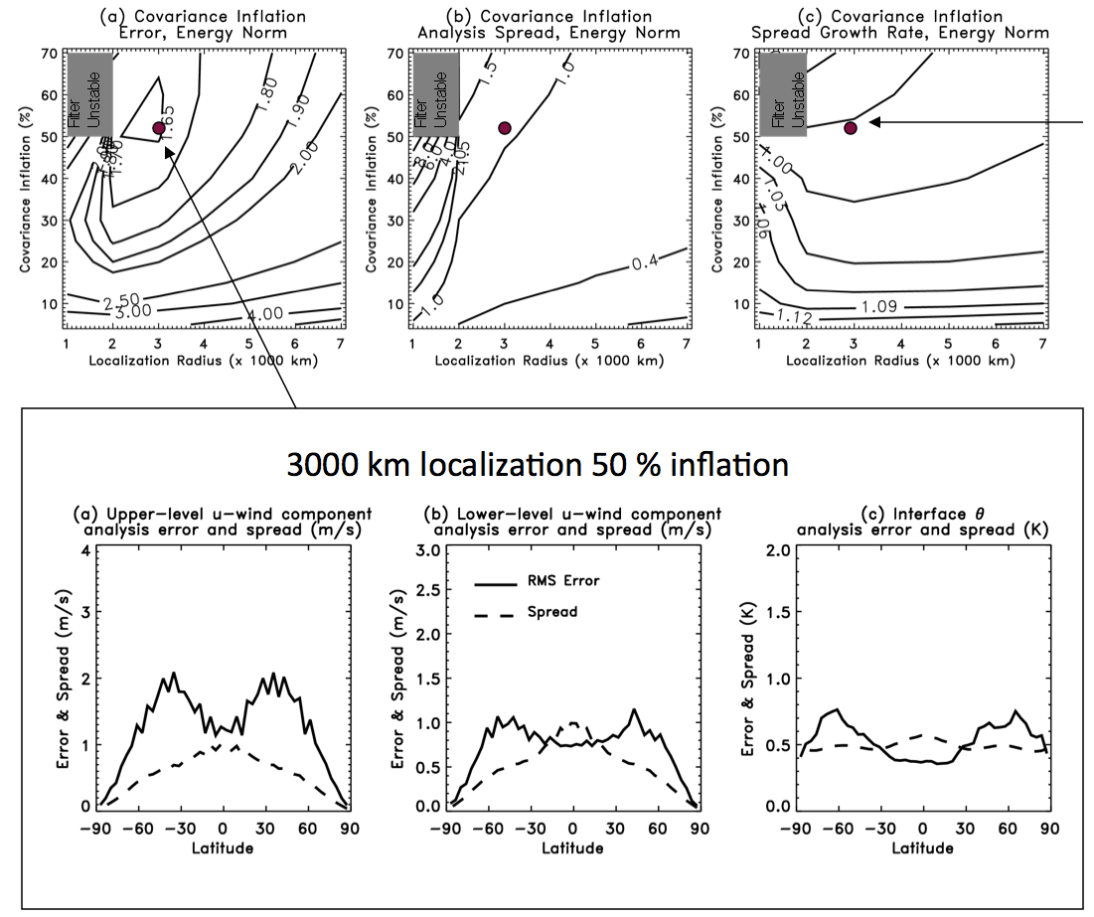
Covariance inflation, imperfect model
Spread decays in
region of parameter
space where analysis error is near its minimum.
Differential growth
rates of model error
result in difficulties
in tuning a globally
constant inflation
factor (see also
Hamill and Whitaker,
MWR, November
2005)

Slide 12
Covariance inflation, imperfect model
Spread decays in
region of parameter
space where analysis error is near its minimum.
Differential growth
rates of model error
result in difficulties
in tuning a globally
constant inflation
factor (see also
Hamill and Whitaker,
MWR, November
2005)
Bottom line:
globally constant covariance
inflation doesn’t work well
in this imperfect model
3000 km localization 50 % inflation

Slide 13
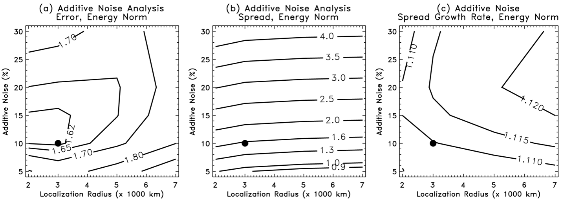
Additive noise, imperfect model
Spread growth is smaller than in perfect-model experiments, but is ~ constant over the parameter space.

Slide 14
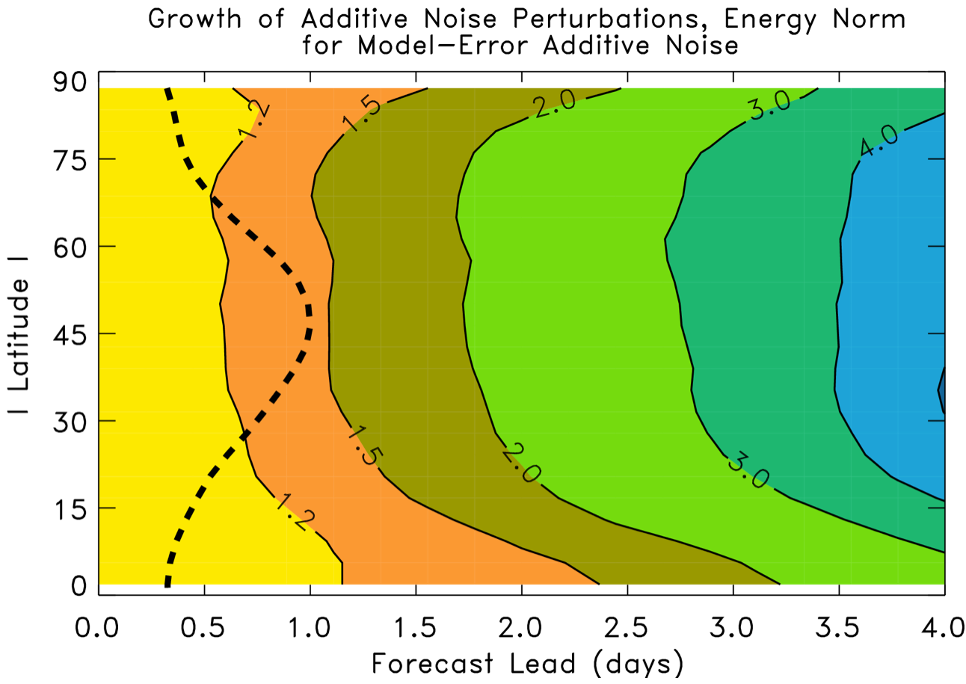
Average growth of additive noise perturbations around nature run
dashed line shows
magnitude of
initial perturbation
Lesson: it takes a while for the additive noise to begin to
project strongly onto system’s Lyapunov vectors

Slide 15
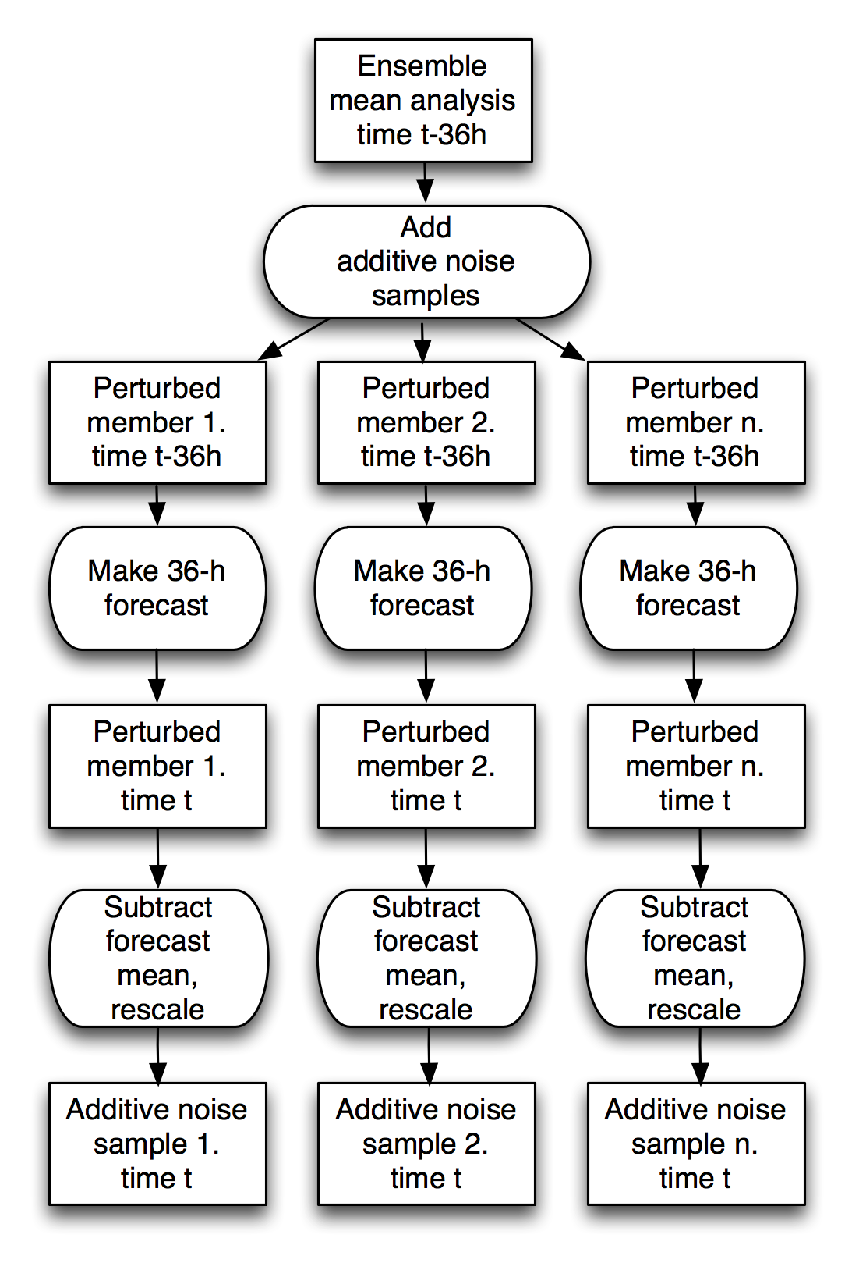
Suppose we evolve the additive noise for 36 h before adding to posterior?

Slide 16
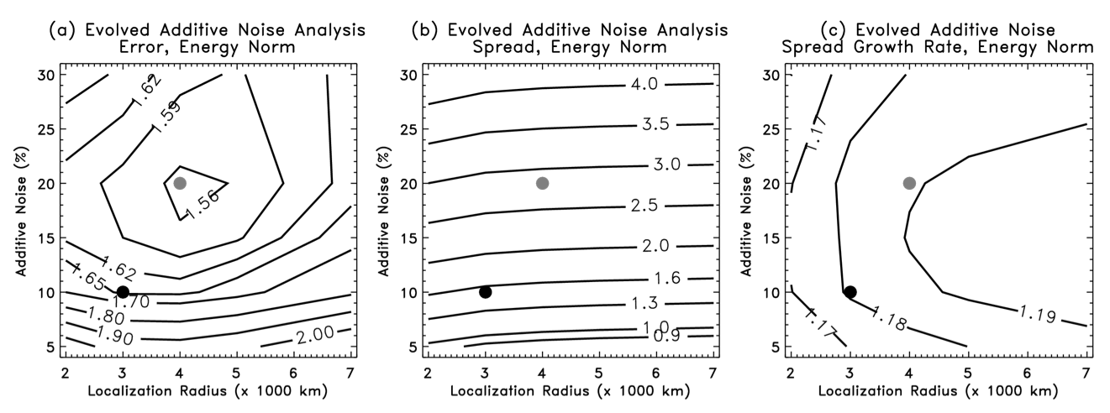
Suppose we evolve the additive noise for 36 h before adding to posterior?
For data assimilation at time t, evolved additive error was created by backing up to t-36 h, generating additive noise, adding this to the ensemble mean analysis at that time, evolving that 36 h forward, rescaling and removing the mean, and adding this to the ensembles of EnKF analyses.

Slide 17
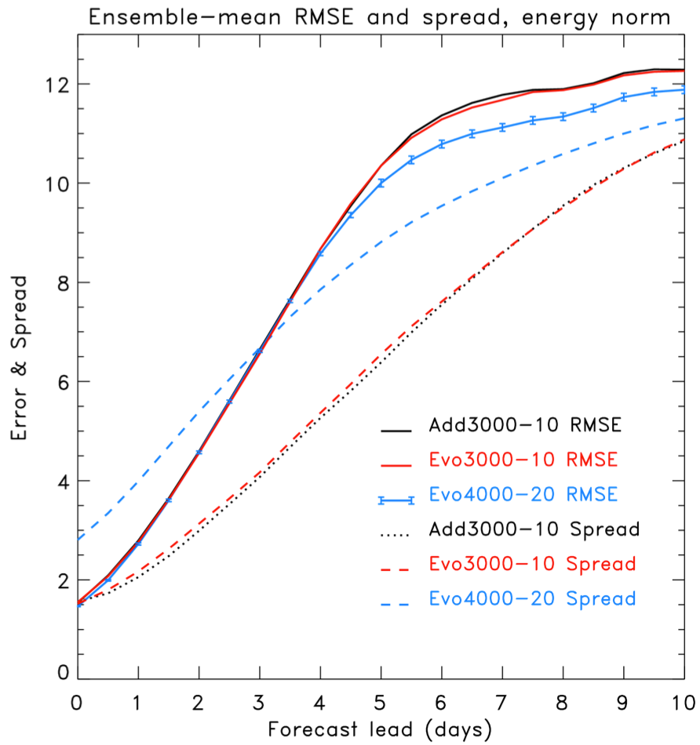
What is the
effect on
longer-lead
ensemble
forecasts?
Not much difference, evolved vs. additive, with same localization / additive noise size.
An improvement in error, more spread, bigger spread growth with longer localization, more evolved additive noise.

Slide 18
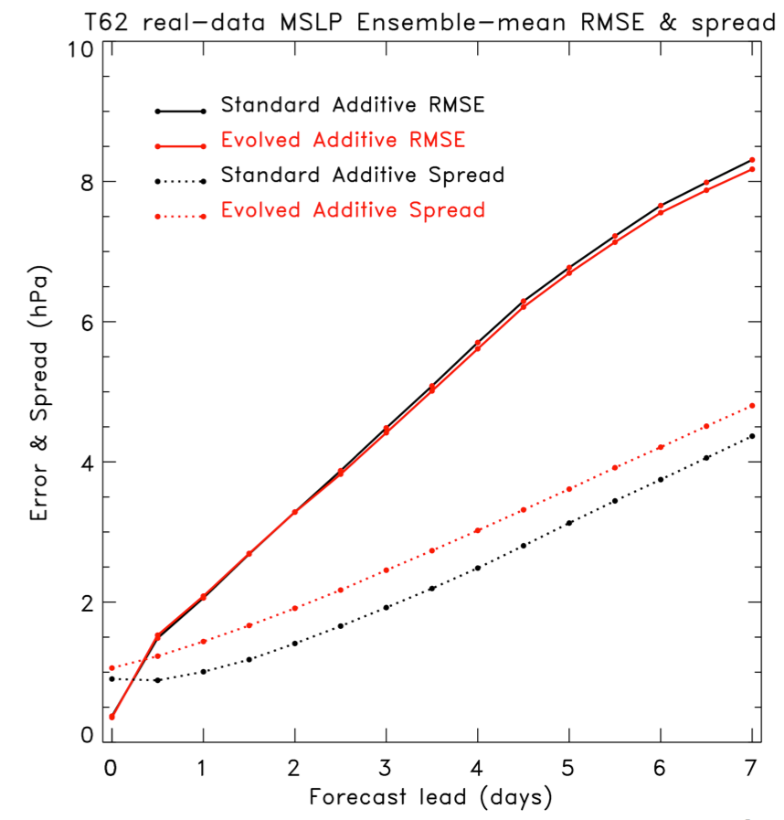
Will results hold with real model, real observations?
EnKF with T62 NCEP GFS, 10 Dec 2007 to 10 Jan 2008. Nearly full operational data stream.
24-h evolved additive error using NMC method (48-24h forecasts) multiplied by 0.5.
10-member forecasts 1x daily, from 00Z.
Main result: slightly higher spread growth at beginning of forecast.
Other results (T190L64) less encouraging, still being analyzed.

Slide 19
Conclusions
The non-flow dependent structure of additive noise may be a primary culprit in the lack of spread growth in forecasts from EnKFs.
Pre-evolving the additive noise used to stabilize the EnKF results in improved spread in the short-term forecasts, and possibly a reduction in ensemble mean error at longer leads.
operationally this would increase the cost of the EnKF, but perhaps the evolved additive noise could be done with a lower-resolution model.
More generally, the methods to treat system error will affect performance of EnKF for assimilation, ensemble forecasting; require more thought & research.

Slide 20
Covariance localization & imbalance
envision a covariance
matrix, here with winds
and temperatures at
n grid points
envision a covariance
localization at its most
extreme, a Dirac delta
function, i.e., the identity
matrix.
The localized covariance
matrix has totally
decoupled any initial
balances between winds
and temperature

Slide 21
Additive noise
Before additive noise:
ensembles may tend to lie on
lower-dimensional attractor
After additive noise:
some of the noise added
takes model states off
attractor; resulting transient
adjustment & spread decay

Slide 22
Model error
before data
assimilation
after data
assimilation
after short-range
forecasts
Nature’s
attractor
observations
forecast states snap
back toward model
attractor; perturbations
between ensemble
members fail to grow.
analyzed state,
drawn toward obs;
ensemble (with smaller
spread) off model attractor
forecast mean
background
and ensemble
members, ~ on
model attractor

Slide 23
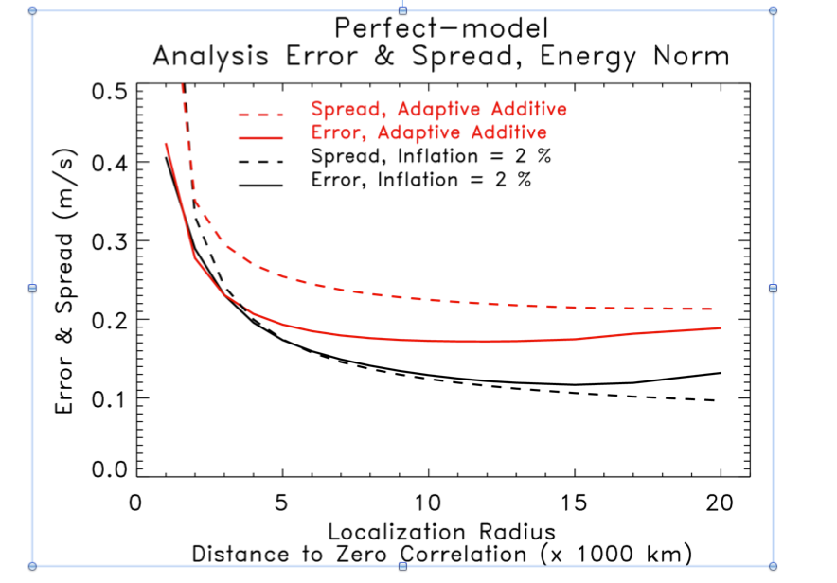
Error/spread as functions of localization length scale, T31 perfect model
Bottom line on errors: for perfect-model simulation, covariance inflation
is more accurate; deleterious effect of additive random noise.

Slide 24
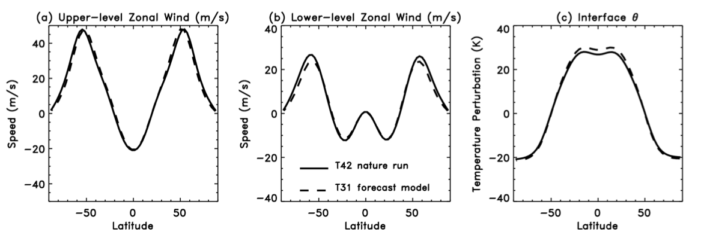
Imperfect-model results: nature run & imperfect model climatologies
6 K less difference in pole-to-equator temperature difference in T42 nature run
Less surface drag in T42 nature run results in more barotropic jet structure.

Slide 25
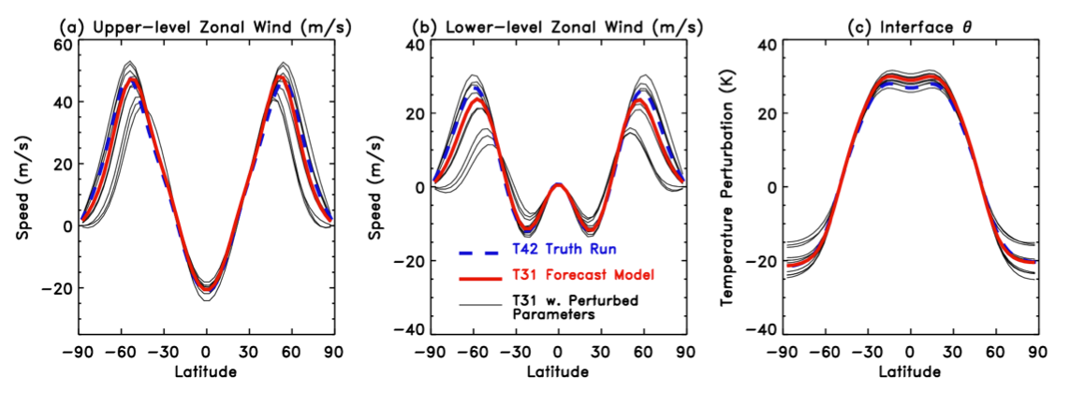
Model error additive noise zonal structure
Plots show the zonal-mean states of the various perturbed model integrations that were used to generate the additive noise for the imperfect-model simulations.
Additive noise for imperfect model simulations consisted of 50 random samples from nature runs from perturbed models; zero-mean perturbation enforced. 0-24 h tendencies as with perfect model did not work well given substantial model error.

Slide 26
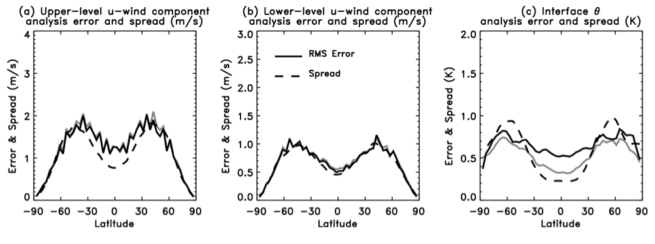
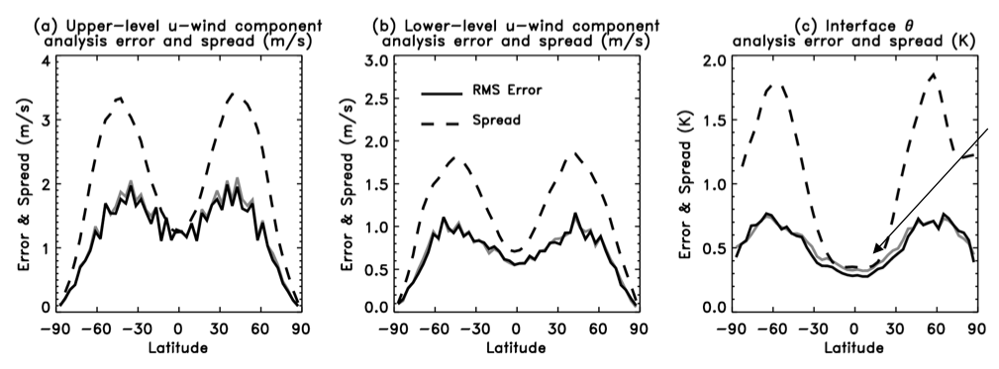
Evolved, 3000 km localization, 10% inflation
grey line is
error result from non-evolved
additive noise
(replicated from
slide 12)
higher error in
tropics, less
spread than error.
now slightly
reduced error
in tropics, much
greater spread
than error.
Evolved, 4000 km localization, 20% inflation

