Slide 1


Reforecasts: what are they good for?
Using multi-decadal reforecasts from the NCEP Global Ensemble Forecast System.
NOAA Earth System
Research Laboratory
Tom Hamill
NOAA ESRL, Physical Sciences Division
tom.hamill@noaa.gov
also: Jeff Whitaker, Gary Bates, Don Murray, Francisco Alvarez, Mike Fiorino, Tom Galarneau

Slide 2
Statistical post-processing for rare events is challenging without a large training sample
Say you want to statistically post-process your model precipitation forecast to improve it.
Heavy precipitation events like the one today are the ones you care about the most. How
do you calibrate today’s forecast given past short sample of forecasts and observations?

Slide 3
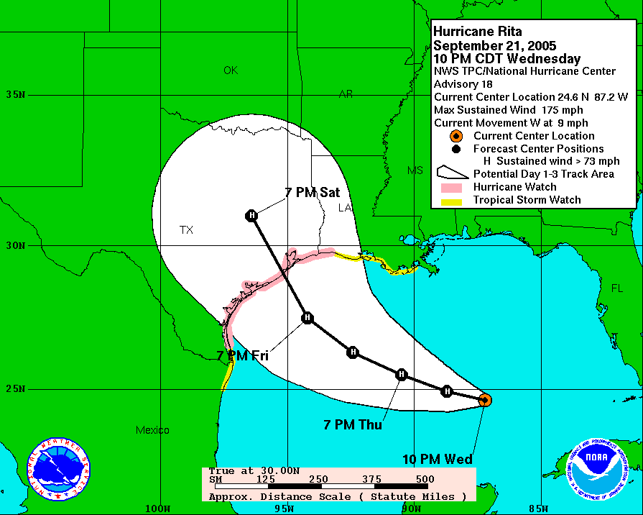
2005 Rita official forecast
(Houston, TX evacuated)

Slide 4
2005 Rita official forecast
(Houston, TX evacuated)
Is the model guidance for Rita
biased too far east or west?
Is the model guidance producing storms that are systematically less intense
than they should be? Does the model
spin up too many hurricanes in the Caribbean? How will you generate
enough samples to know?

Slide 5
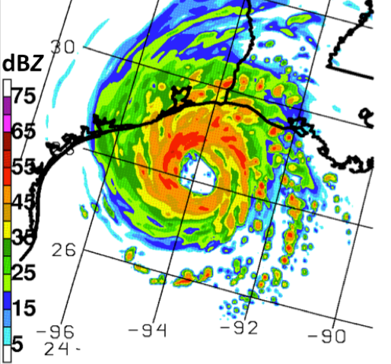
Regional simulations of past weather
Say you’d like to run a realistic, regional simulation of hurricane Rita at high resolution
and not get the false skill that you will get if you force it with observed lateral boundary
conditions. Where can you get lateral boundary conditions from a current-generation
larger-scale forecast?

Slide 6
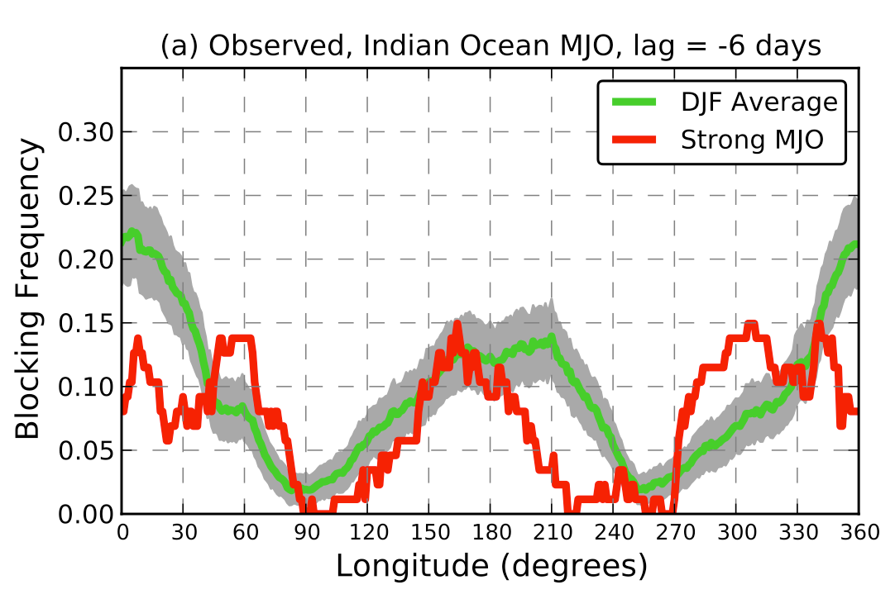
Change in blocking frequency under strong Indian Ocean MJO
The atmosphere suppresses blocking subsequent to an active Indian-Ocean Madden-
Julian Oscillation (MJO) during the Northern Hemisphere winter. Does the forecast
model suppress blocking as well? How can one detect that with only a season or so of
past forecasts and with both blocking and strong MJOs happening infrequently?

Slide 7
Reforecasts (hindcasts)
Numerical simulations of the past weather (or climate) using the same forecast model and assimilation system that (ideally) is used operationally.
  Common with climate, uncommon with weather models.
Say you run 20 ensemble members in real time this 1 Nov. You want 20 years of past 20-member 1 Nov reforecasts. 20x more computationally expensive. Is this the best use of computers?

Slide 8
GEFS reforecast v2 details
Seeks to mimic GEFS operational configuration as of February 2012.
Each 00Z, 11-member forecast, 1 control + 10 perturbed.\
Reforecasts produced every day, for 1984120100 to current (actually, working on finishing late 2012 now).
CFSR (NCEP’s Climate Forecast System Reanalysis) initial conditions (3D-Var) + ETR perturbations (cycled with 10 perturbed members). After ~ 22 May 2012, initial conditions from hybrid EnKF/3D-Var.
Resolution: T254L42 to day 8, T190L42 from days 7.5 to day 16.
Fast data archive at ESRL of 99 variables, 28 of which stored at original ~1/2-degree resolution during week 1. All stored at 1 degree. Also: mean and spread to be stored.
Full archive at DOE/Lawrence Berkeley Lab, where data set was created under DOE grant.

Slide 9
Status
00Z reforecasts 1985-2010 completed and publicly available.
2011- Sep 2012 reforecasts are being processed, available within weeks.
Within a month or two, we will be pulling real-time GEFS data over from NCEP and putting it in our archive.
Web sites are open to you now:
  NOAA/ESRL site: fast access, limited data (99 fields).
  US Department of Energy: slow access, but full data set
Soon: experimental probabilistic precipitation forecast graphics in real time.

Slide 10
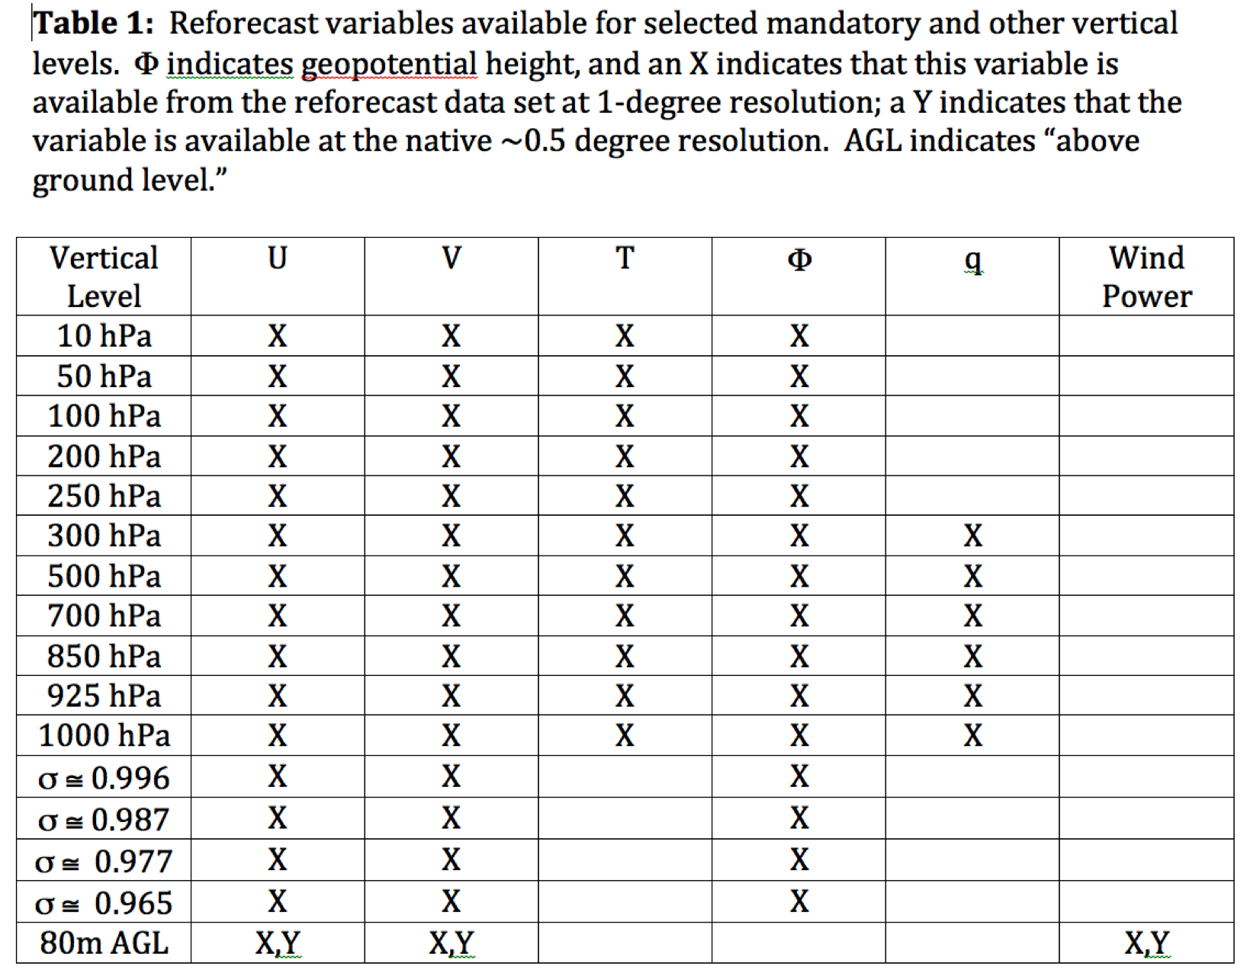
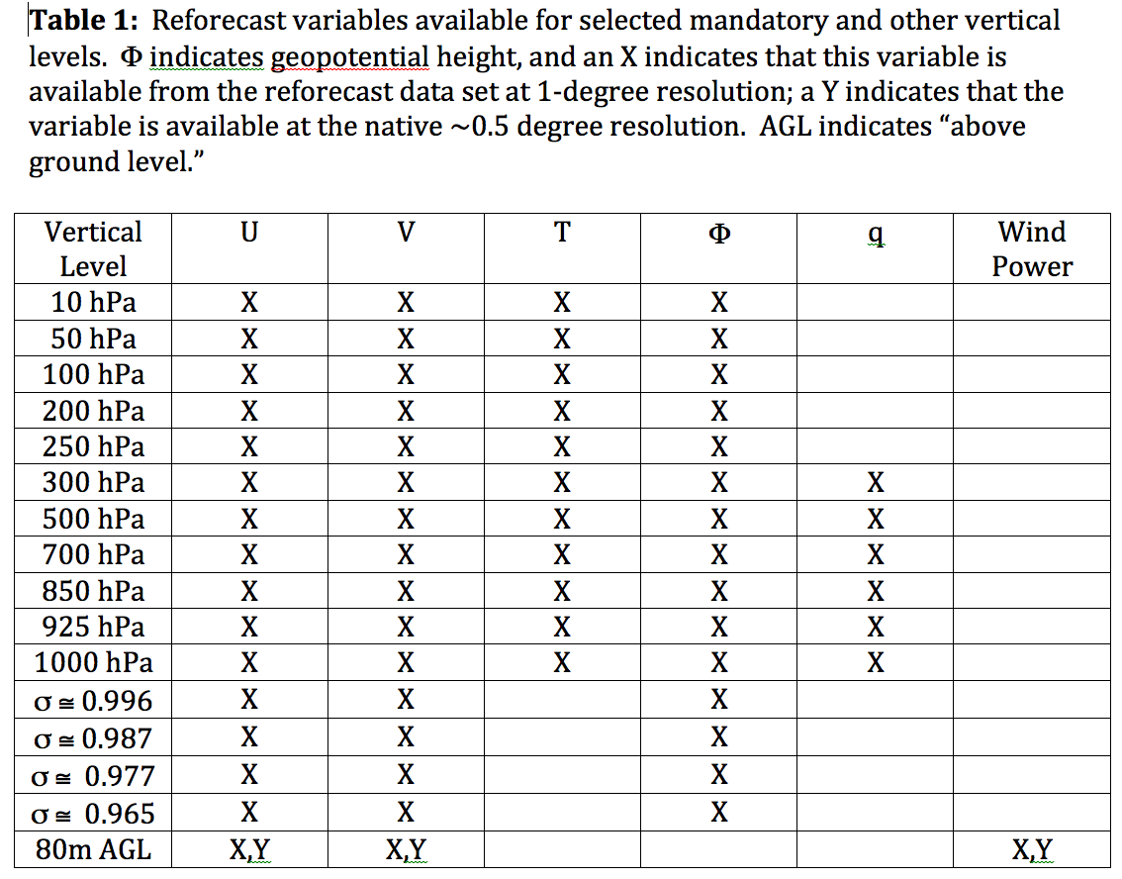
Data to be readily available from ESRL
Also: hurricane track files

Slide 11
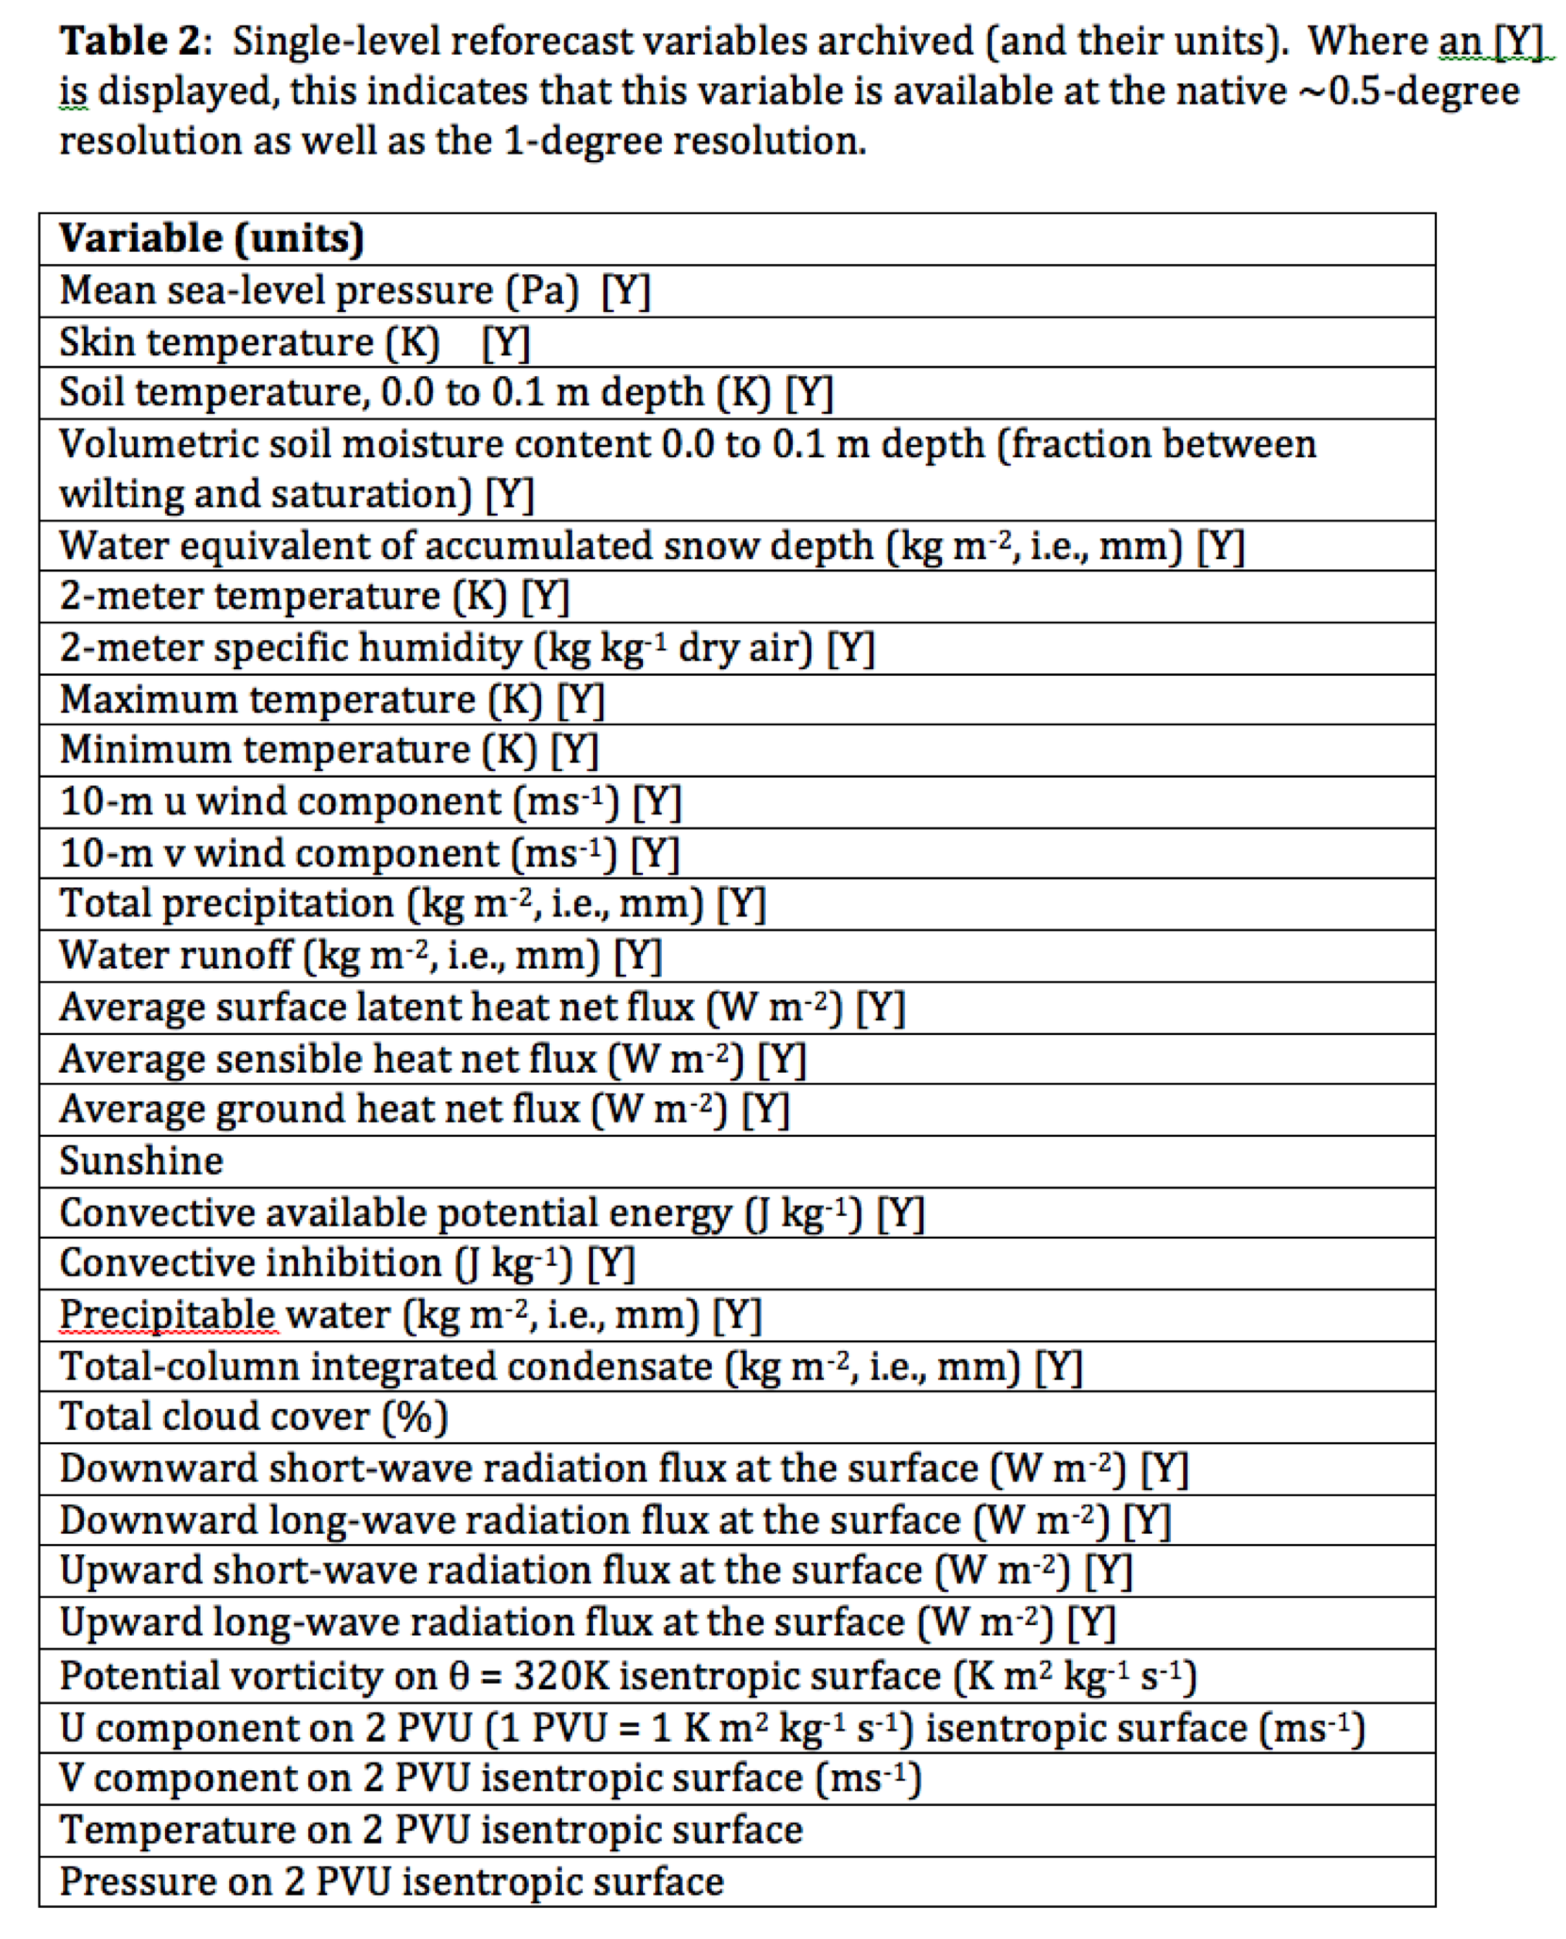
Data to be readily available from ESRL

Slide 12
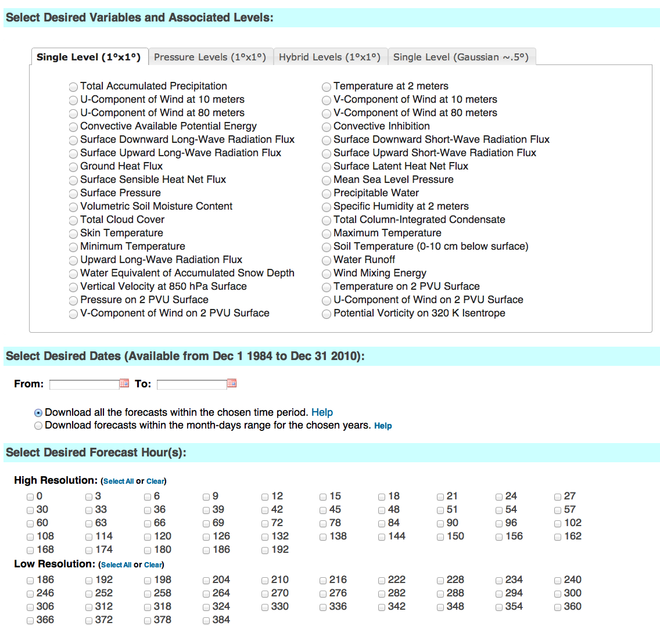
esrl.noaa.gov/psd/forecasts/reforecast2/download.html
Produces
netCDF files.
Also: direct
ftp access to
allow you to
read the raw
grib files.

Slide 13
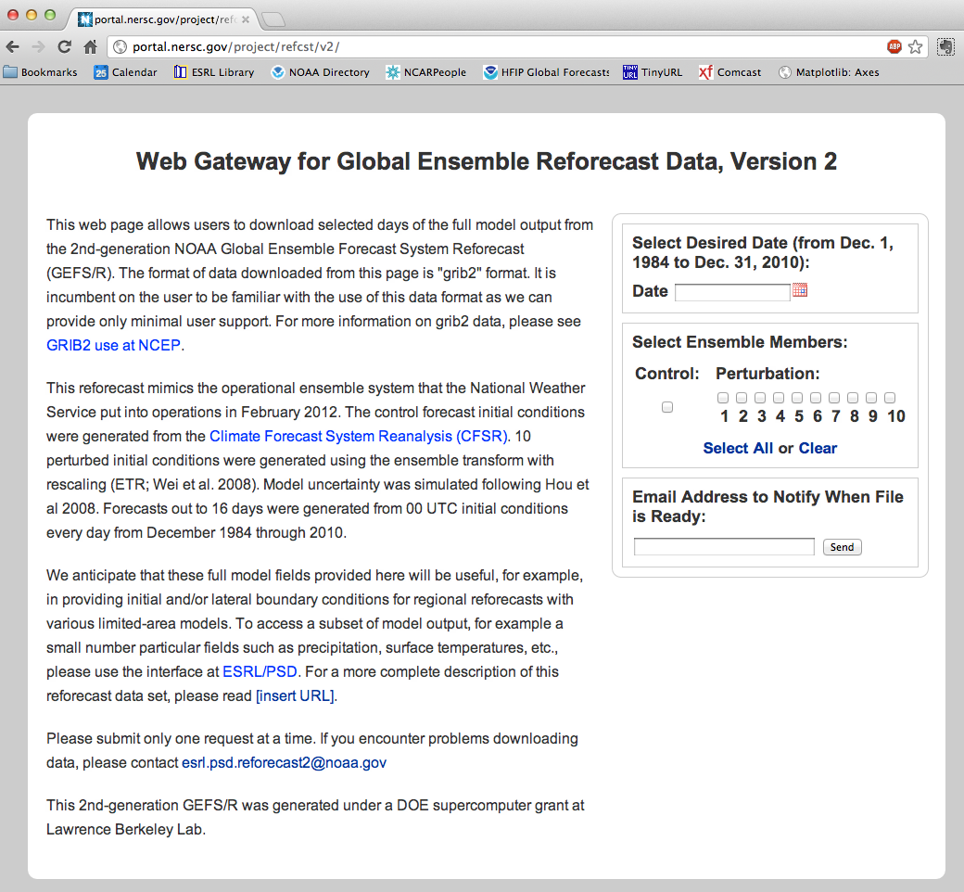
This DOE
site will be
ready for
access to
tape storage
of full data
(slower).
Use this to
access full
model state.

Slide 14
Skill of raw reforecasts
(no post-processing)

Slide 15
500 hPa Z anomaly correlation
(from deterministic control)
Lines w/o filled colors
for second–generation
reforecast (2012, T254)
Lines with filled colors
for first-generation
reforecast (1998, T62).
Perhaps a 1.5-2.5 day
improvement.

Slide 16
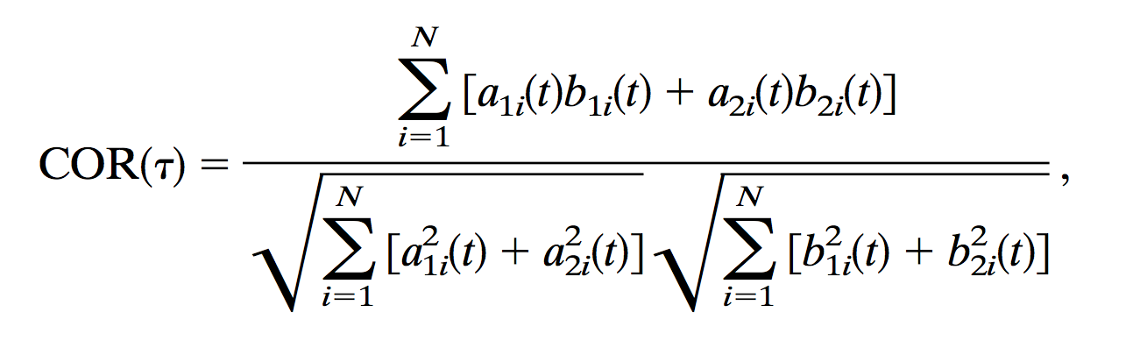
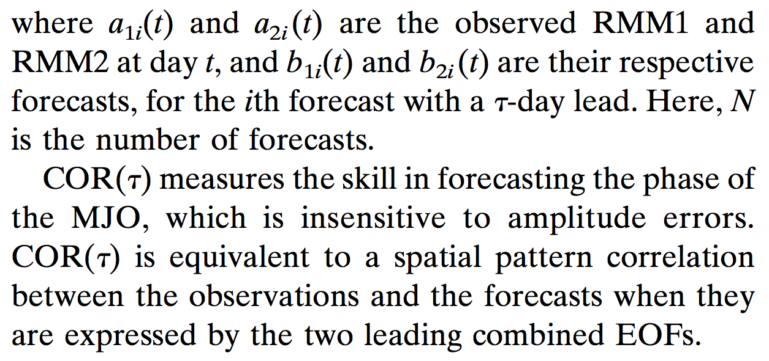
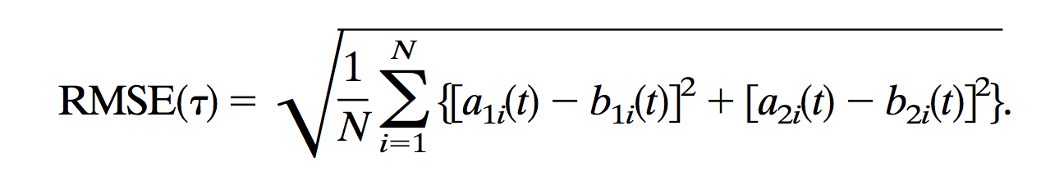
MJO deterministic verification metrics
from Lin et al., Nov 2008 MWR.

Slide 17
Bi-variate RMM1 and RMM2 correlation and RMSE by half decade
The first 10 years are much less skillful than the subsequent 16.

Slide 18
Dec-Jan-Feb 1985-2010 CFSR data. Blocks defined here by Tibaldi/Molteni algorithm.

Slide 19
N Hem. blocking: more common in winter, spring
Blocking as defined in Tibaldi and Molteni (1990) using Z500. Hereafter, let’s focus on
Dec-Jan-Feb. Grey bands defines Euro/Atlantic and Pacific blocking sectors in subsequent plots.

Slide 20
GEFS blocking skill by half decade
Blocking is evaluated using Tibaldi-Molteni algorithm for every longitude, every day. Skill
of the ensemble in predicting blocking is then evaluated.
Decreased Atlantic sector skill in 1985-1989 period stands out.

Slide 21
Statistical post-processing using reforecasts

Slide 22
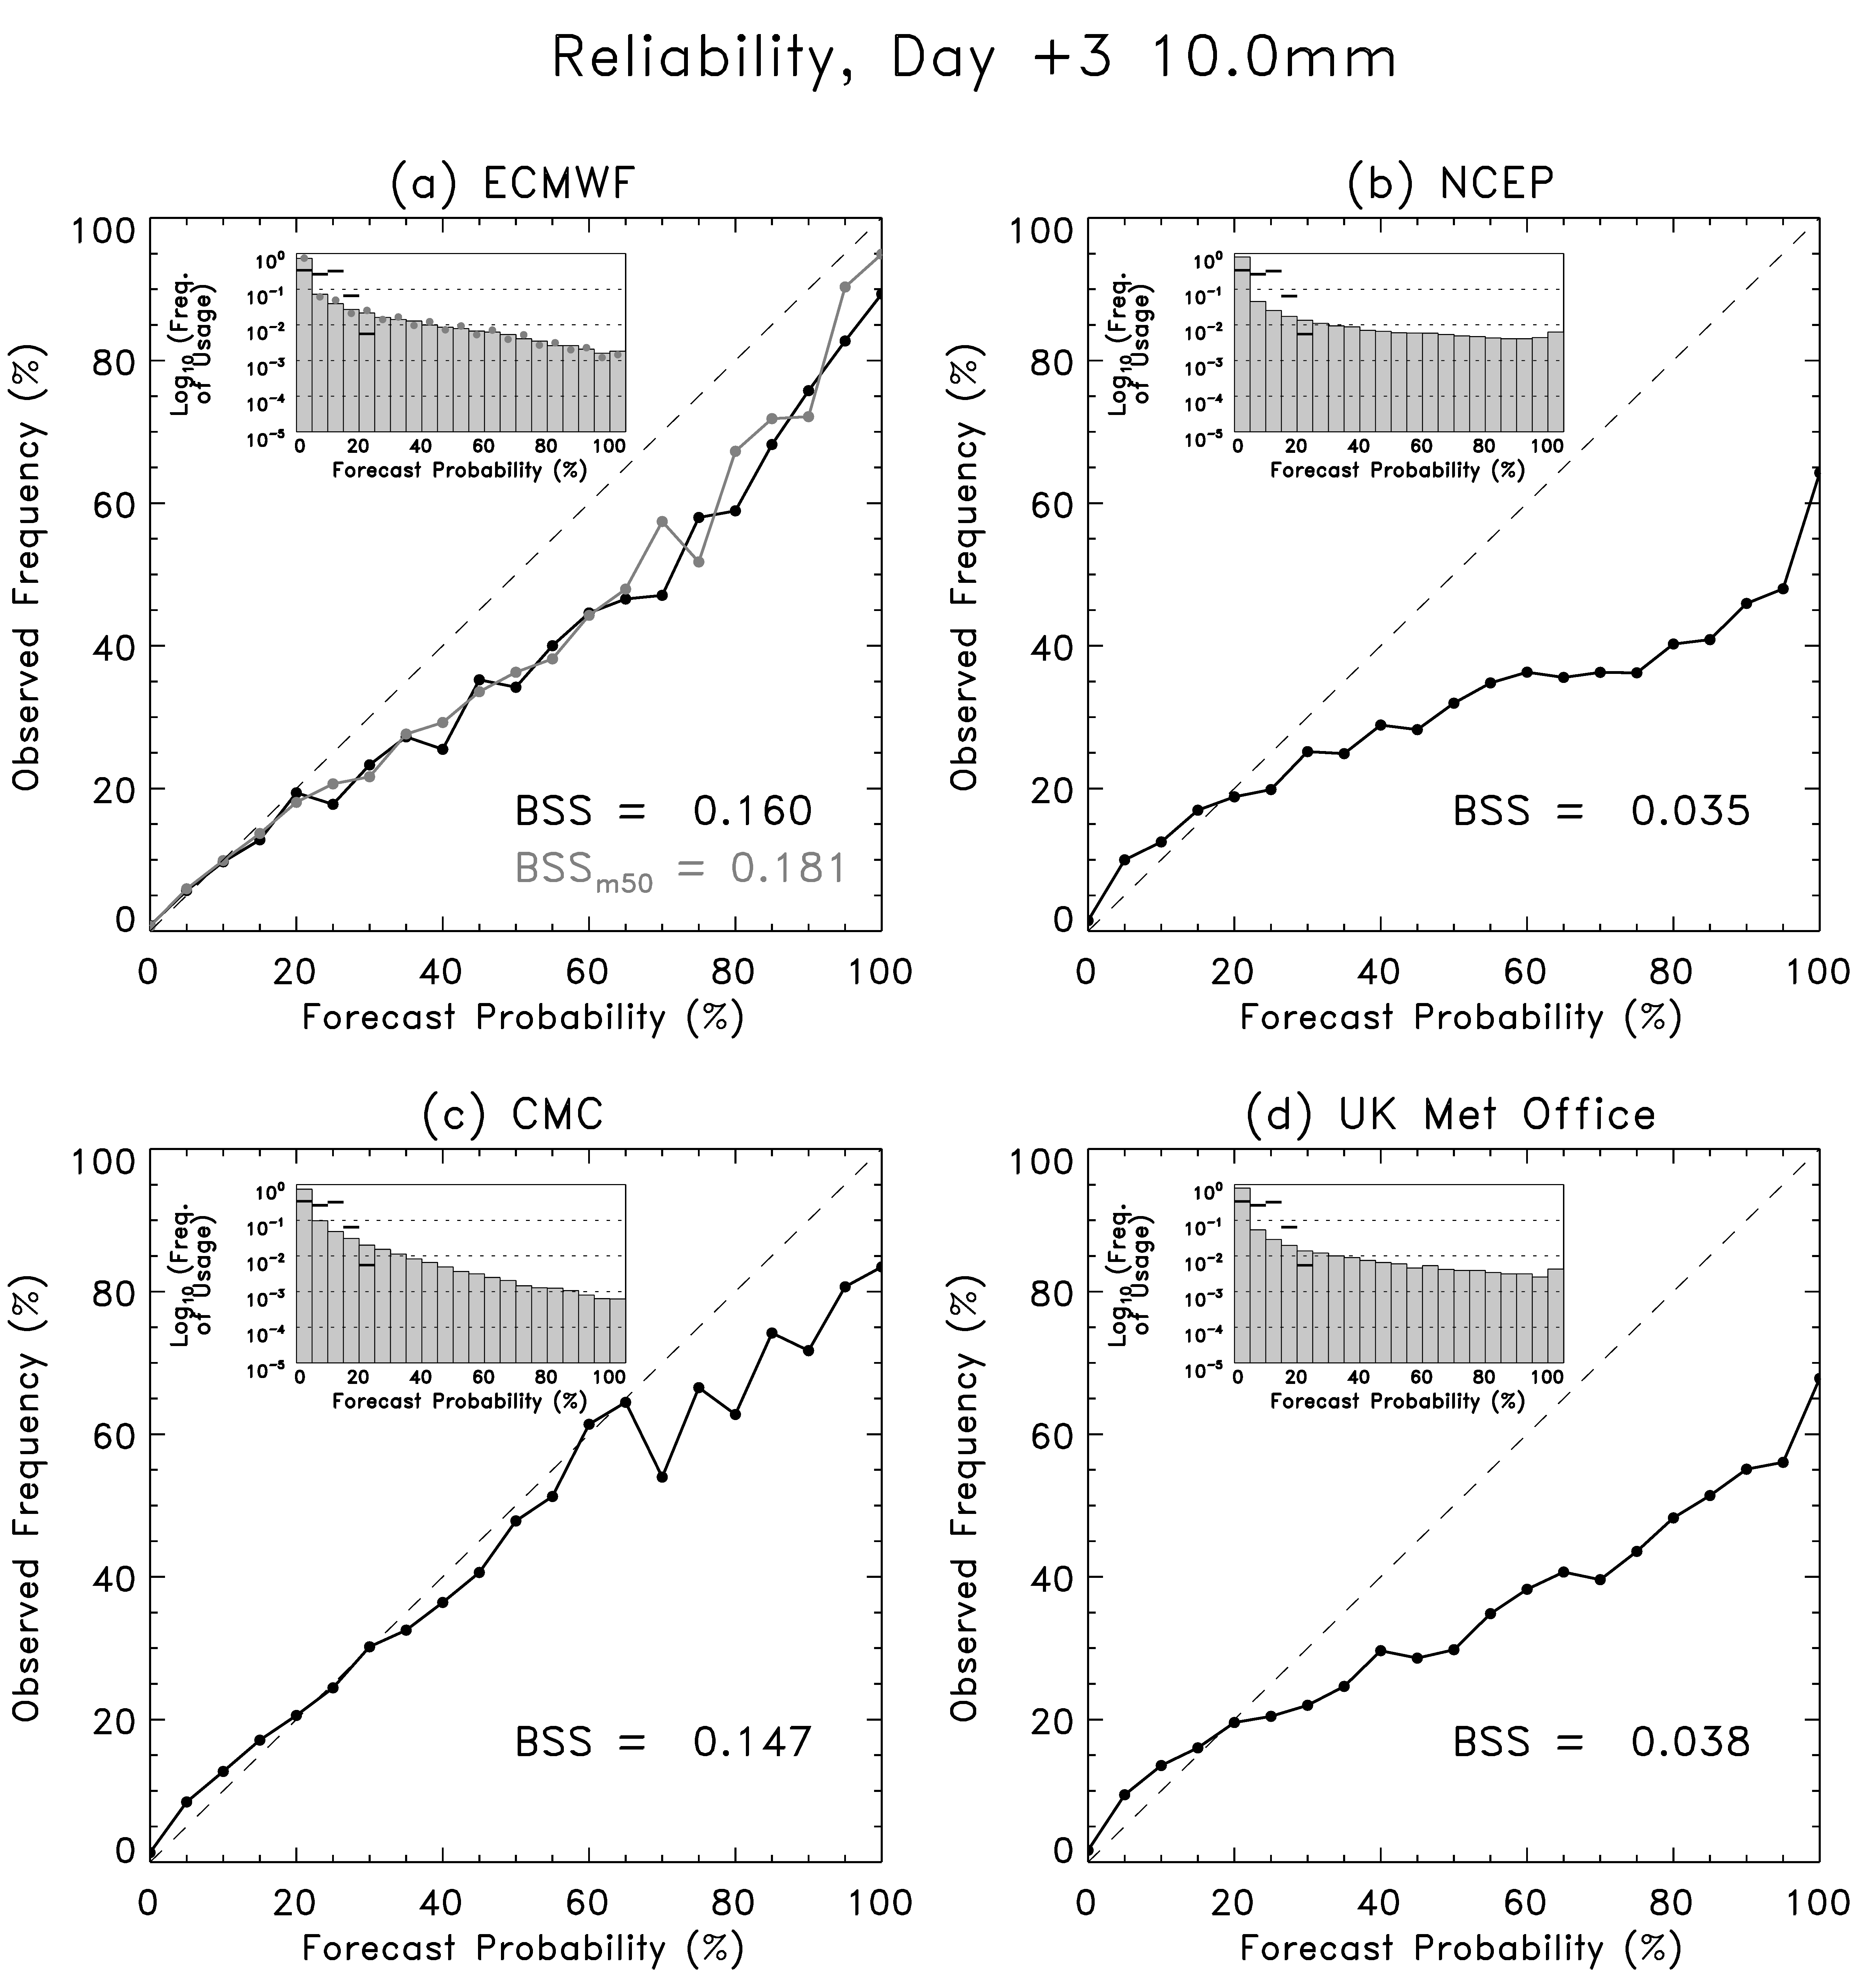
Statistical post-processing of precipitation forecasts
Probabilities directly estimated from ensemble prediction systems are often unreliable.
This is data from Jul-Oct 2010,
when the GEFS was T190.
Can we statistically post-process the current GEFS using reforecasts and improve reliability and skill?

Slide 23
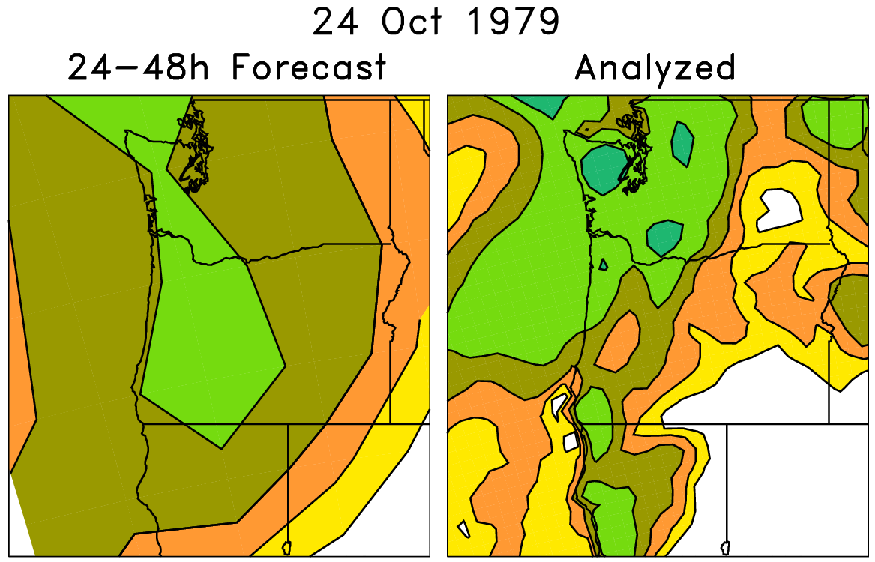
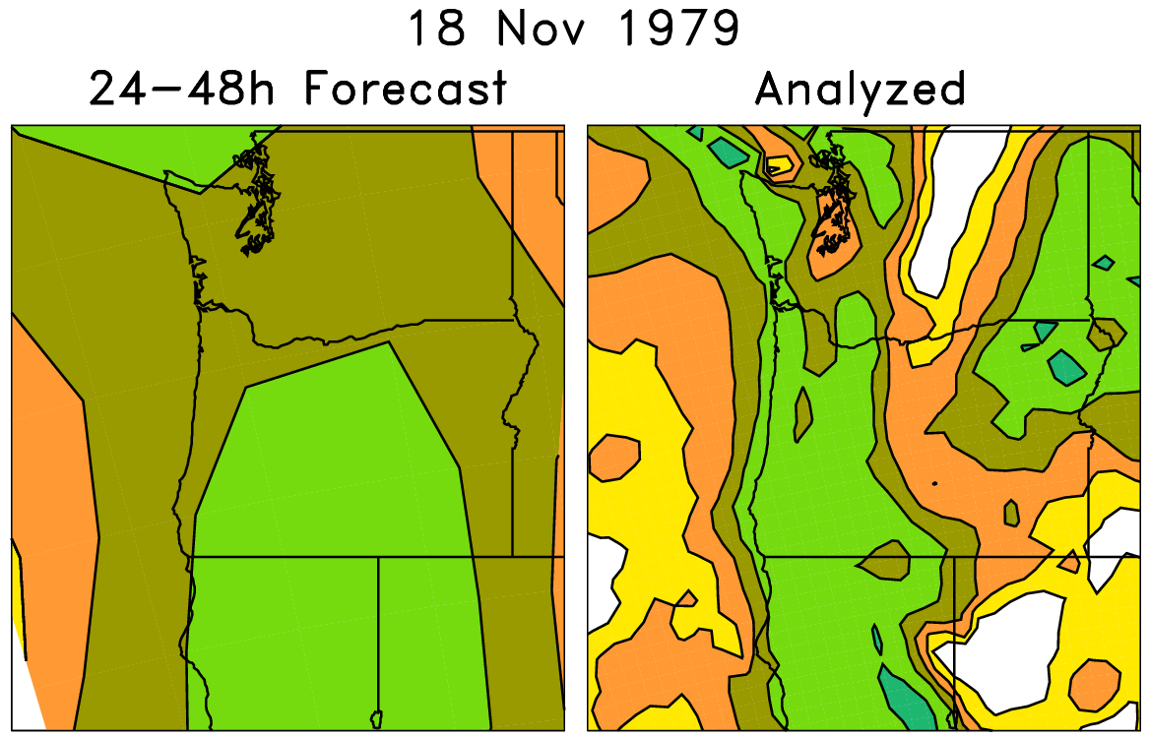
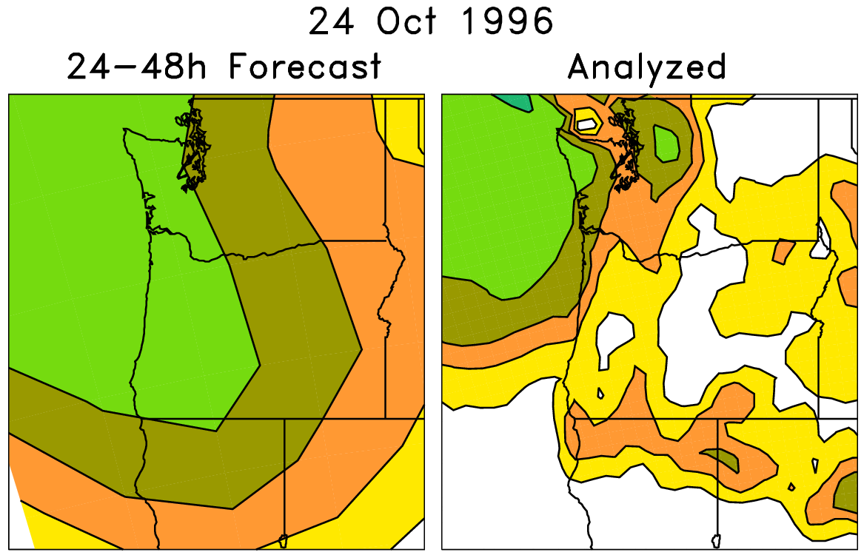
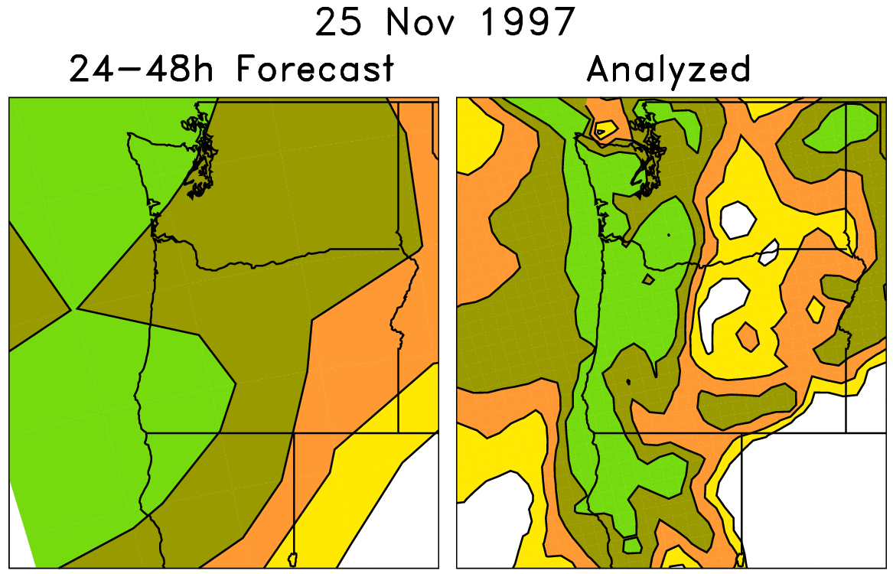
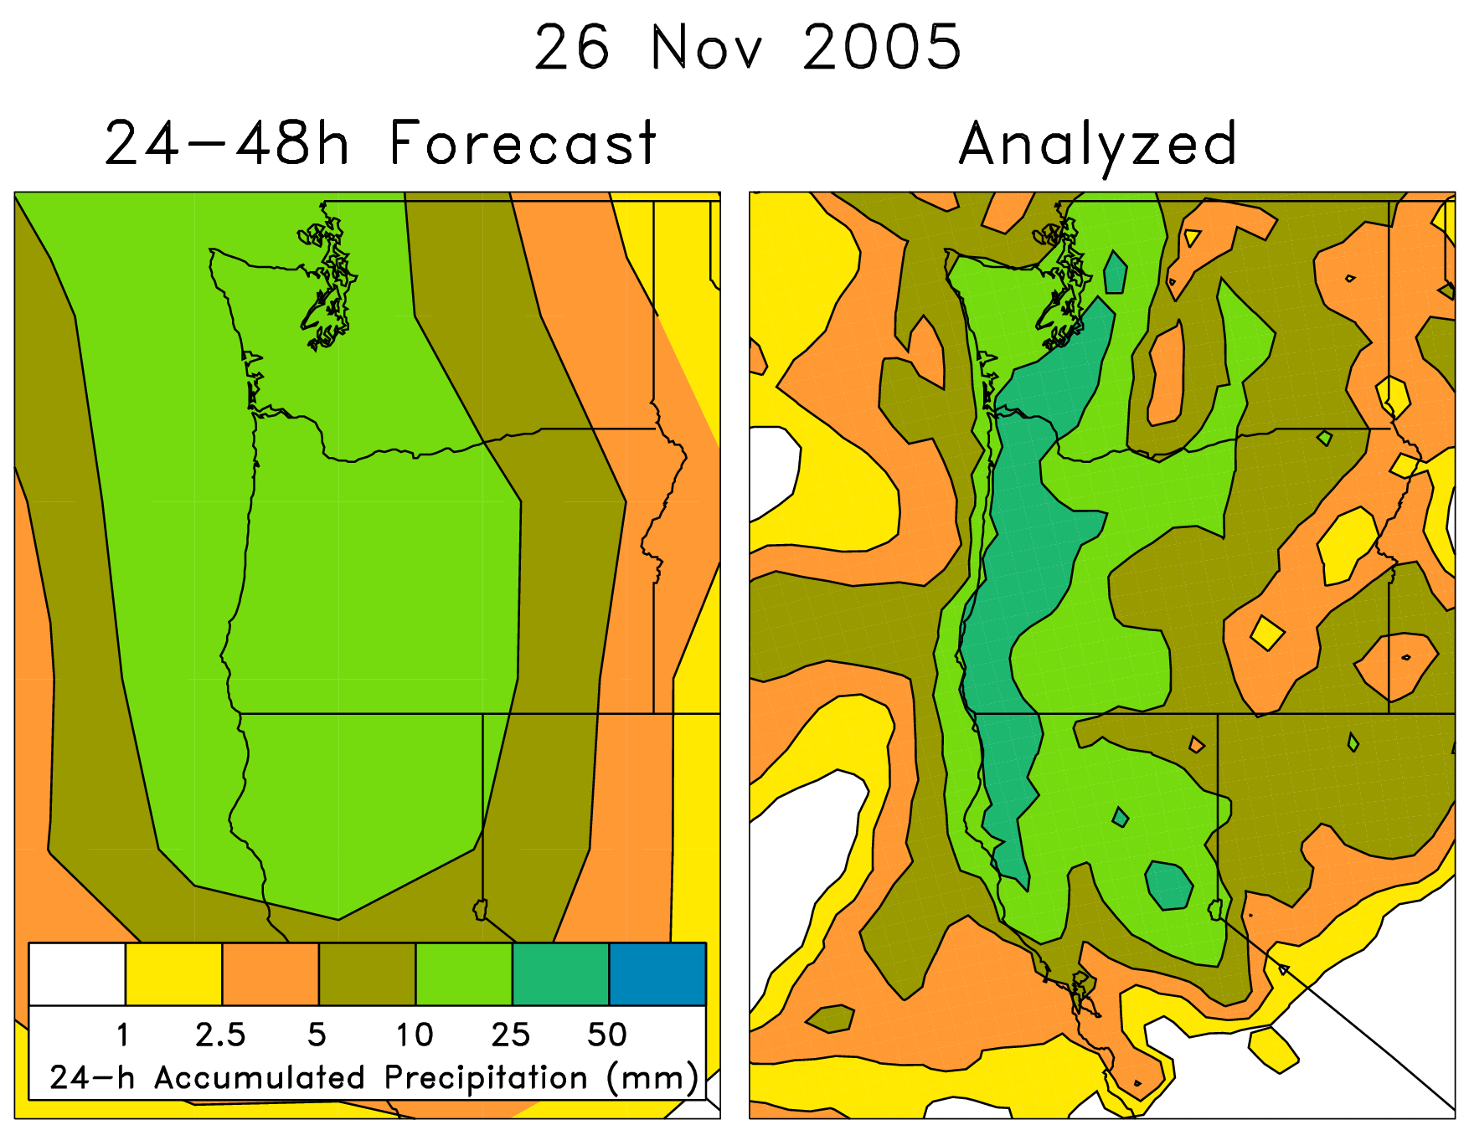
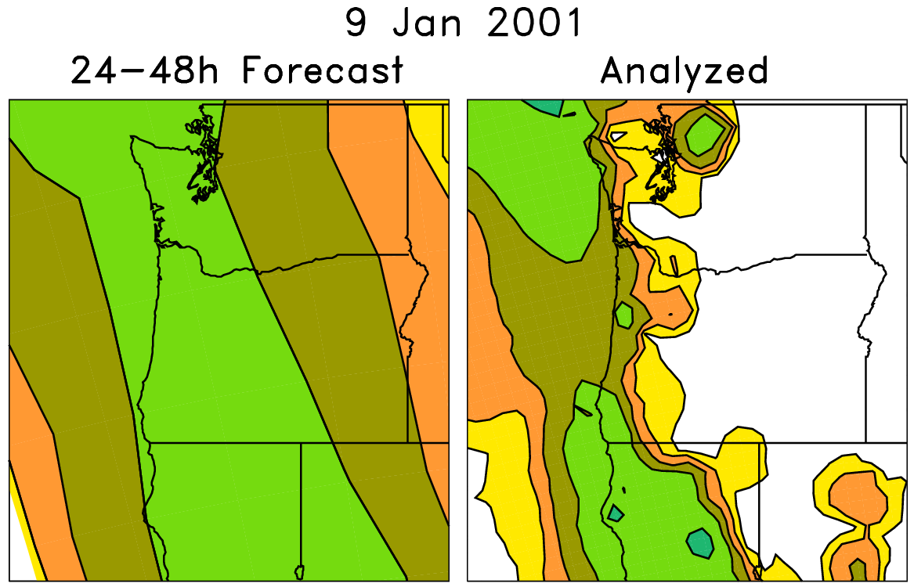
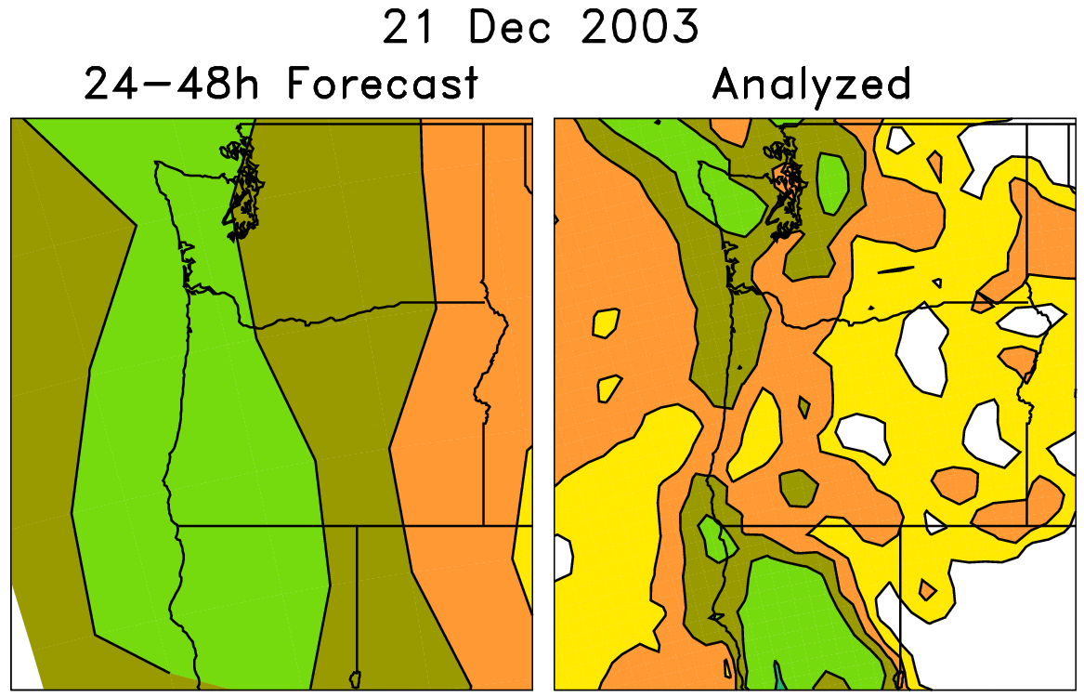
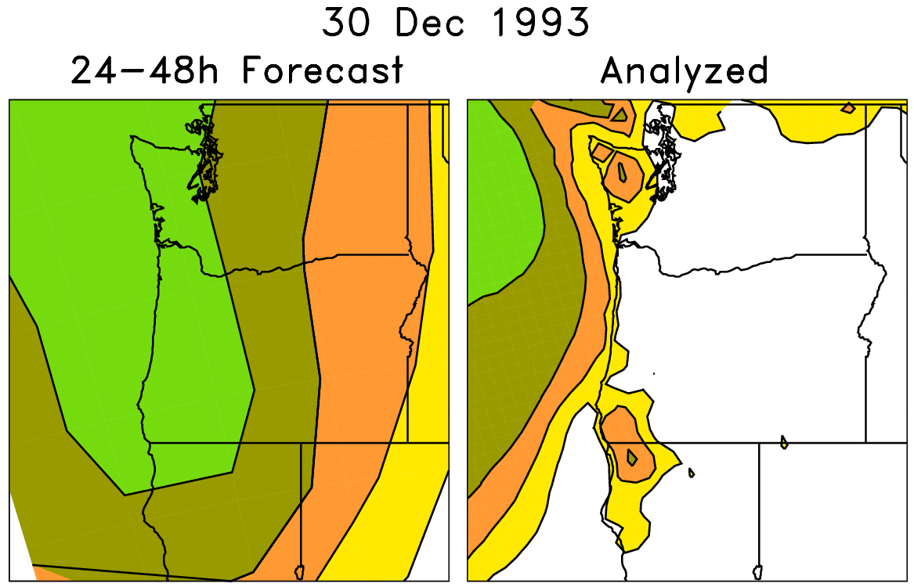
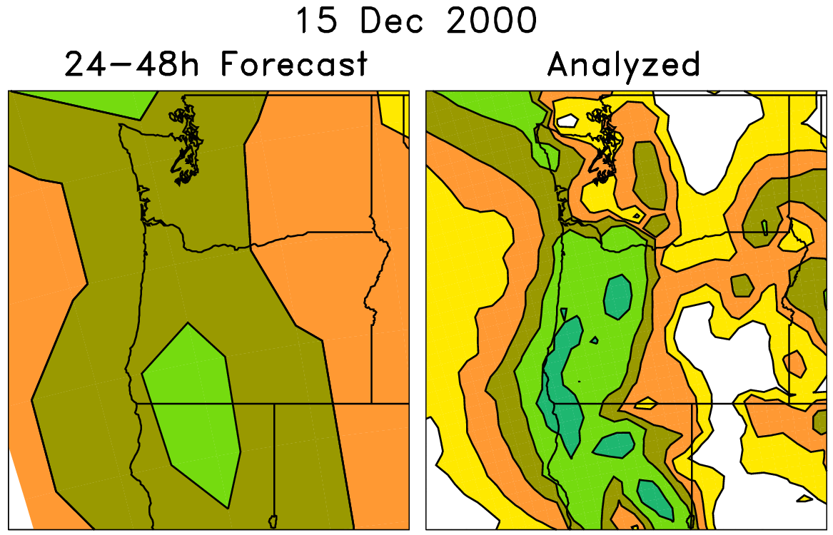
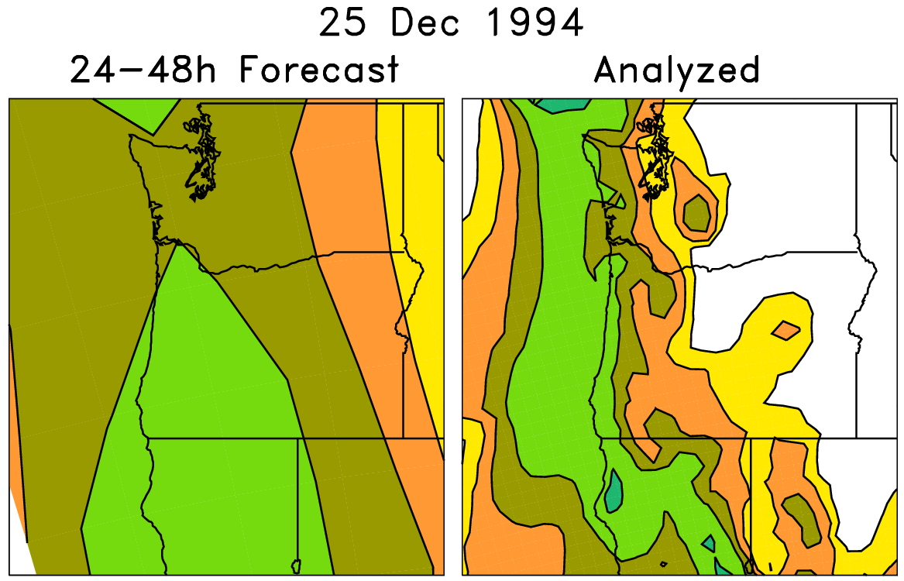
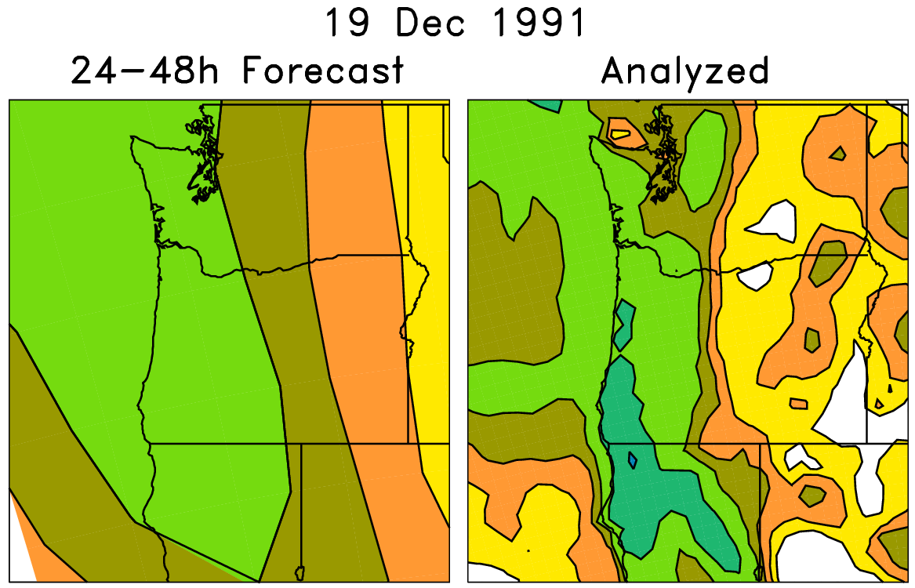
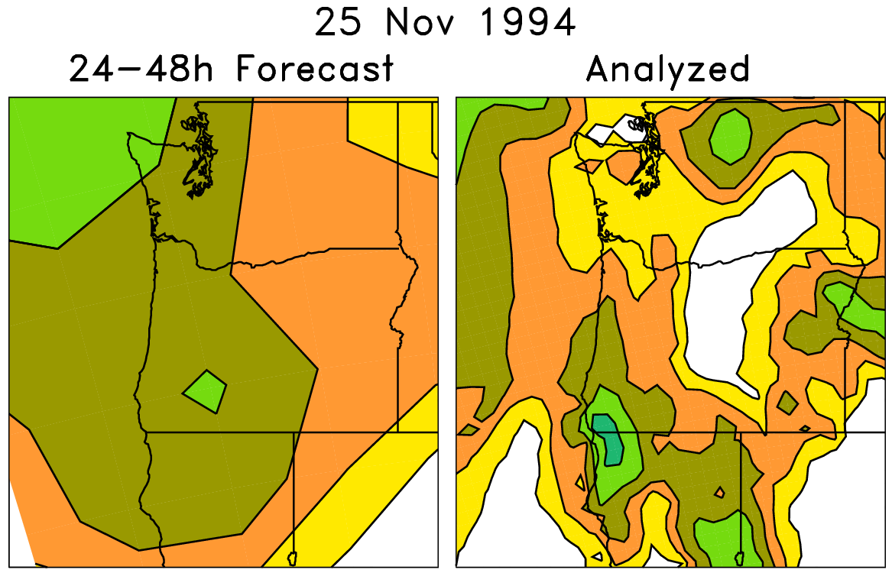
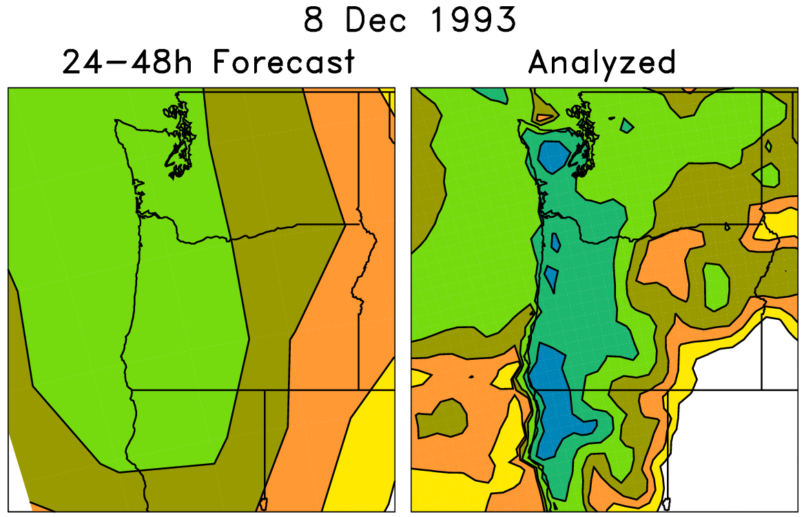
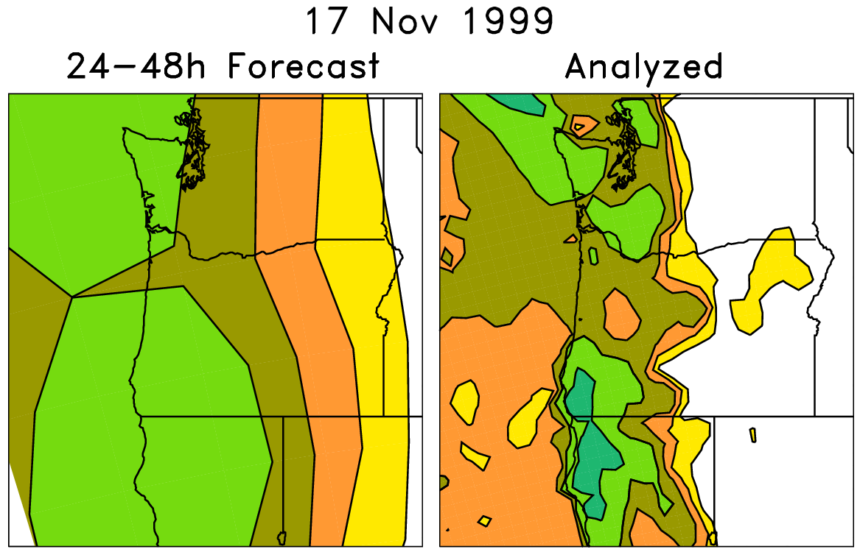
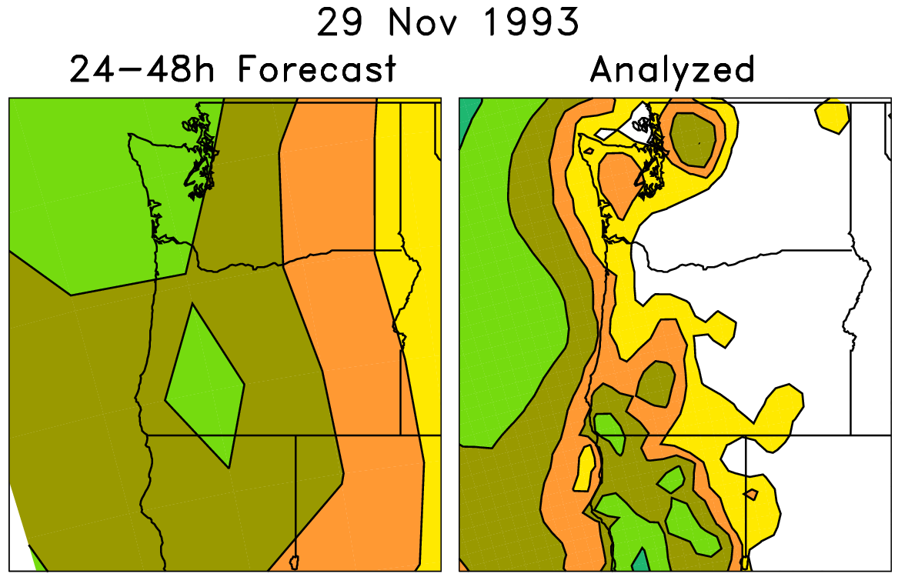
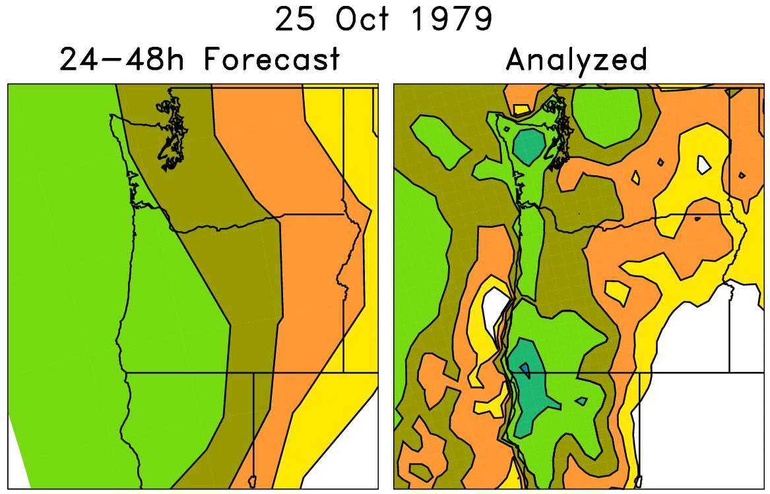
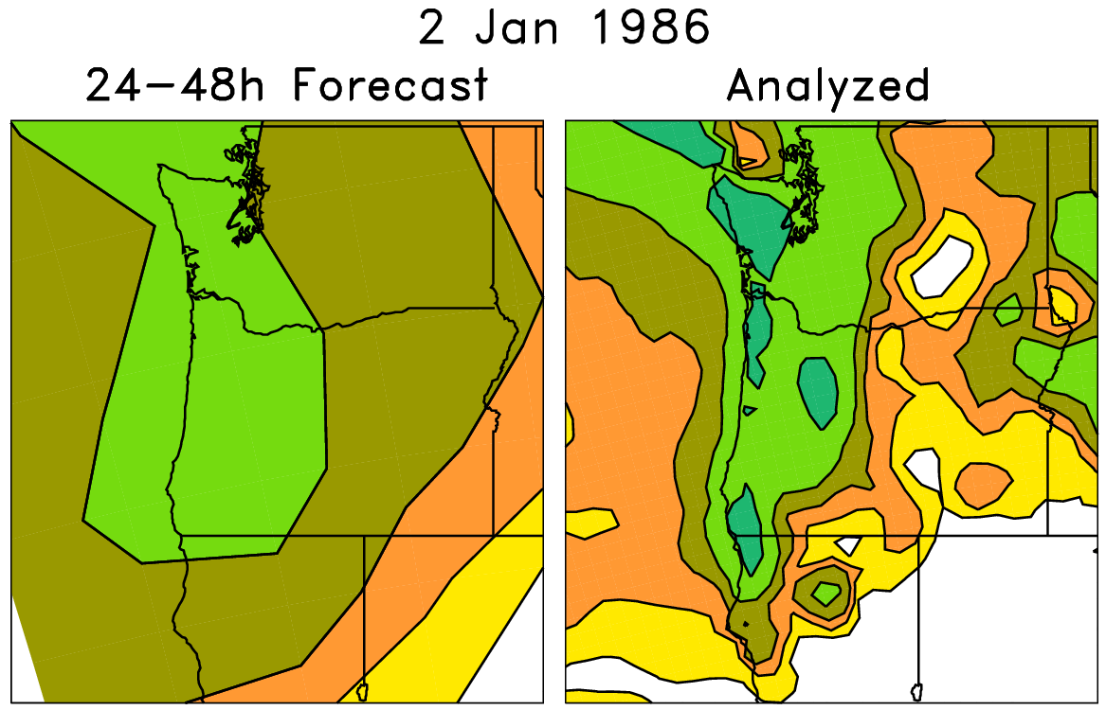
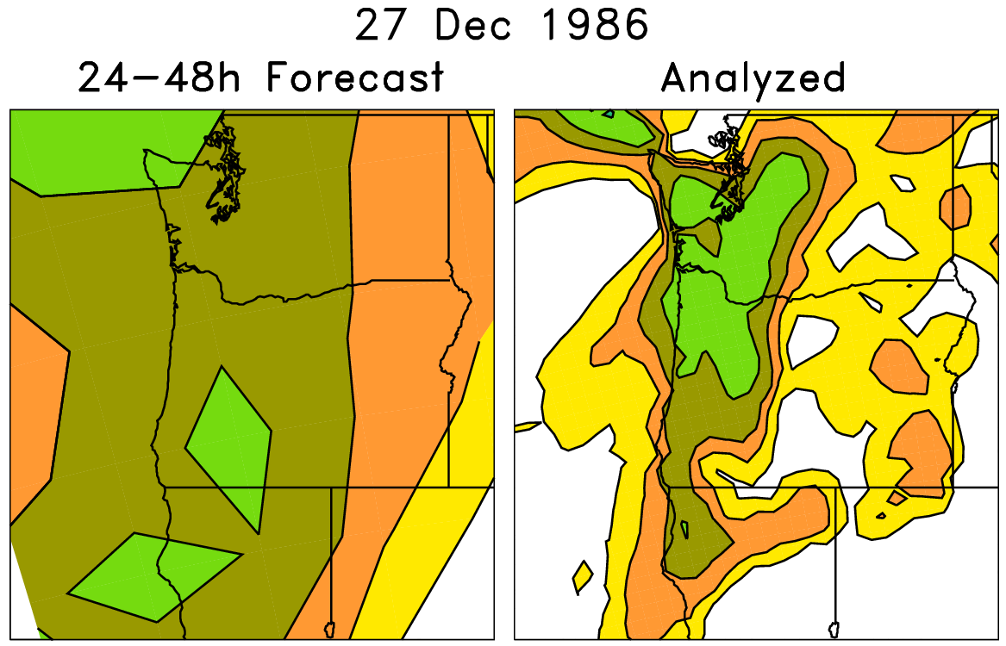
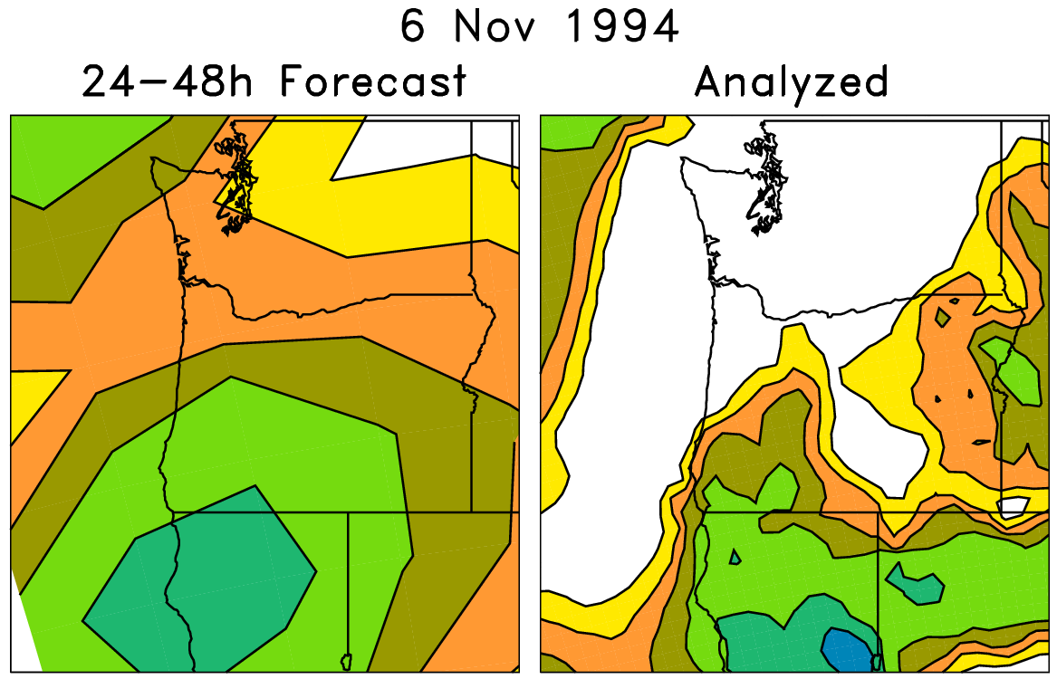
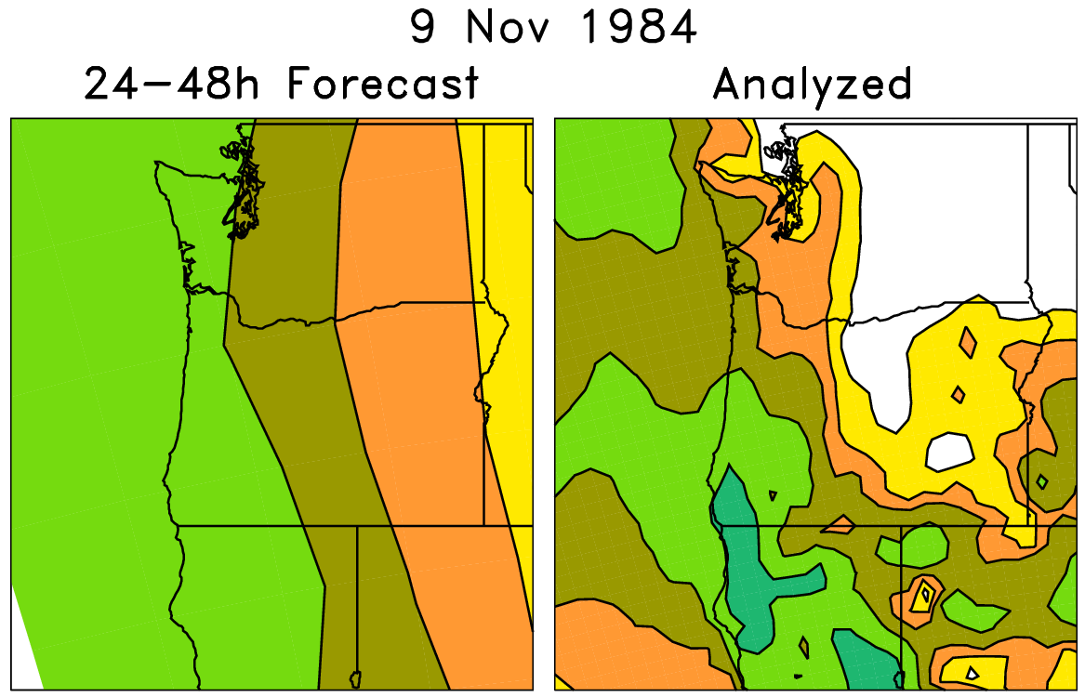
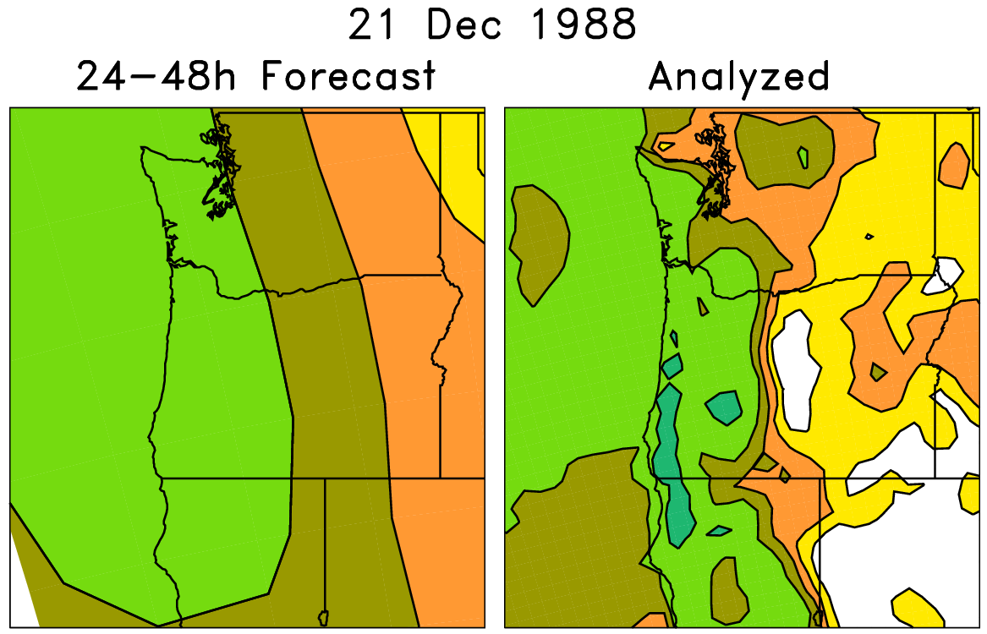
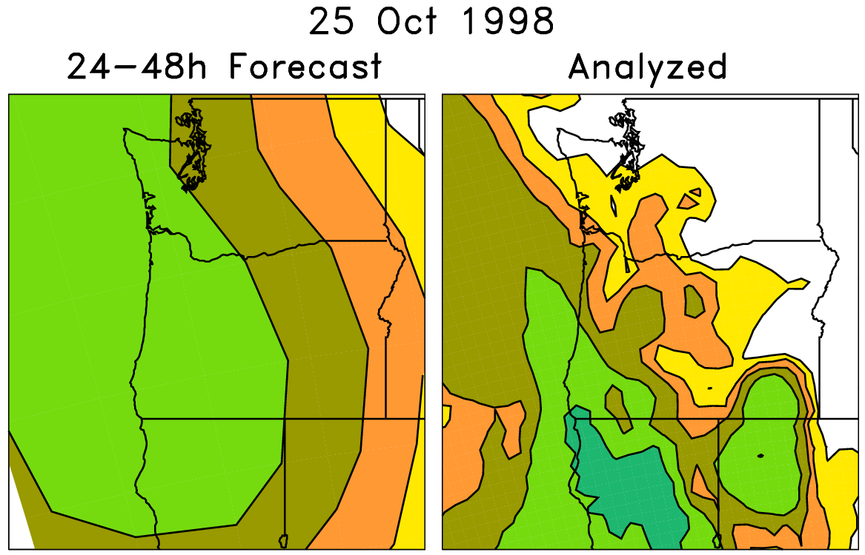
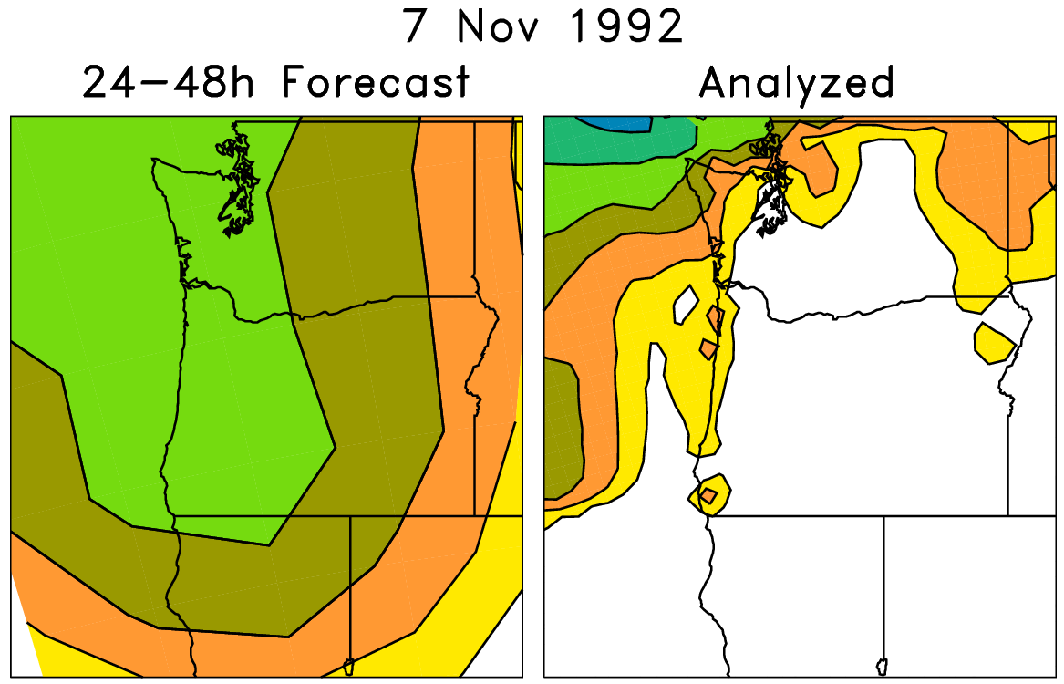
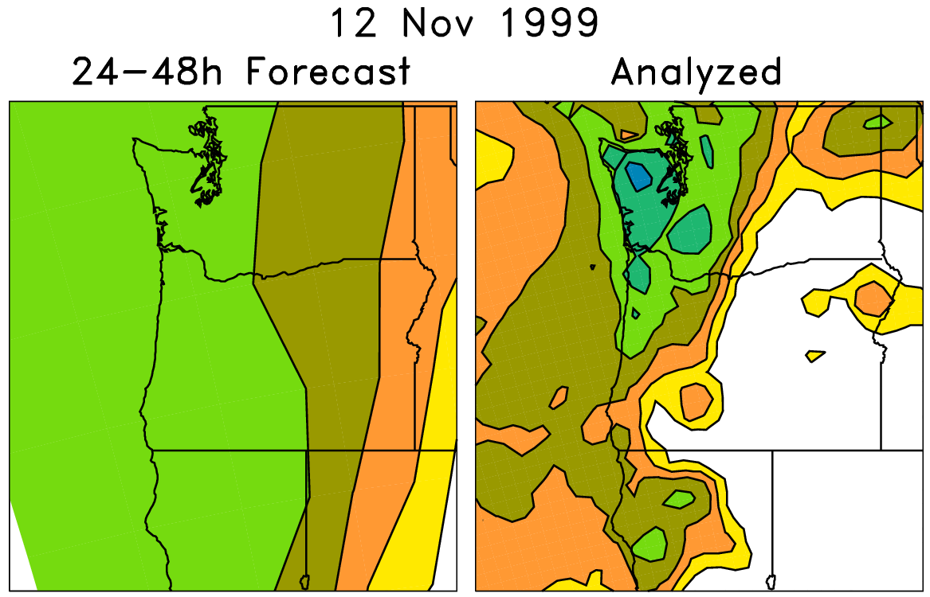
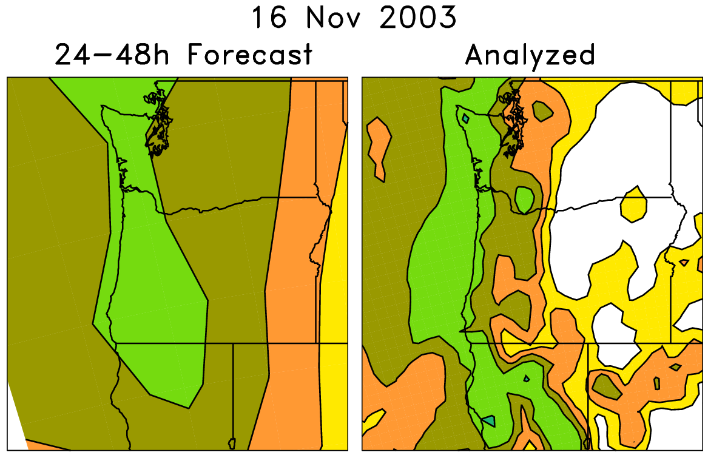
An example of a statistical correction technique using those reforecasts
Today’s forecast (& observed)
For each pair (e.g. red box), on the left are old forecasts that are somewhat similar to this day’s ensemble-mean forecast. The boxed data on the right, the analyzed precipitation for the same dates as the chosen analog forecasts, can be used to
statistically adjust and downscale the forecast.
Analog approaches like this
may be particularly useful for
hydrologic ensemble applications, where an ensemble of weather realizations is needed as inputs to a hydrologic ensemble streamflow system.

Slide 24
Skill of calibrated precipitation forecasts
(over US, 1985-2010, “rank analog” calibration method)
Verification here against 32-km North American Regional Reanalysis (tougher).
Verification in previous plot against 1-degree NCEP precipitation analysis (easier).

Slide 25
Reliability, > 10 mm precipitation 24 h⁻¹
Day +0-1
Day +2-3
Day +4-5
Version 2 (2012 GEFS)
Almost perfect reliability.

Slide 26
Reliability, > 50 mm precipitation 24 h⁻¹
Day +0-1
Day +2-3
Day +4-5
Version 2 (2012 GEFS)
5/95 CI’s
from
“block
bootstrap”

Slide 27
Post-processing to improve deterministic forecasts
Some further modifications to analog technique, including Ebert’s “probability-matched
mean” approach allow post-processed forecasts to improve significantly on deterministic
forecast guidance supplied by the model.

Slide 28
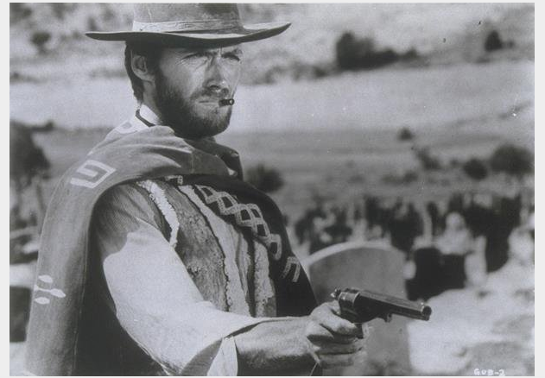
Case studies with
“atmospheric rivers” in the western US: the good, the bad and ugly

Slide 29
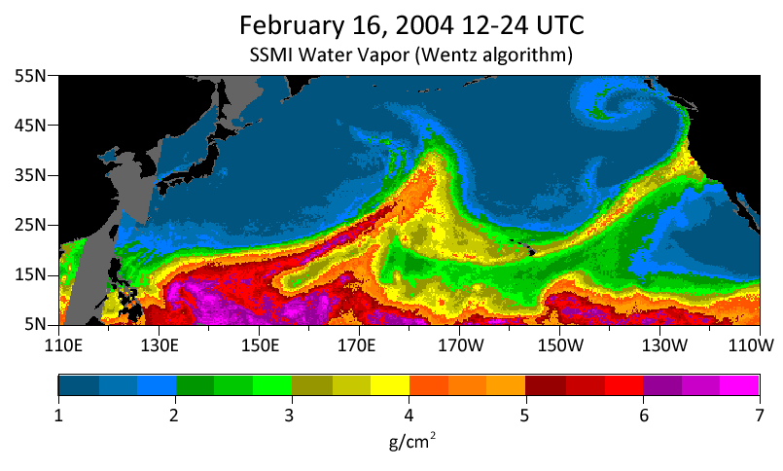
The bad and ugly atmospheric rivers case study
10” rain in the coastal mountains, 4-7” in Russian River
watershed. Streamflows in top 0.2% of historical observations.
Source: http://www.esrl.noaa.gov/psd/atmrivers/events/

Slide 30
+4-day forecast

Slide 31
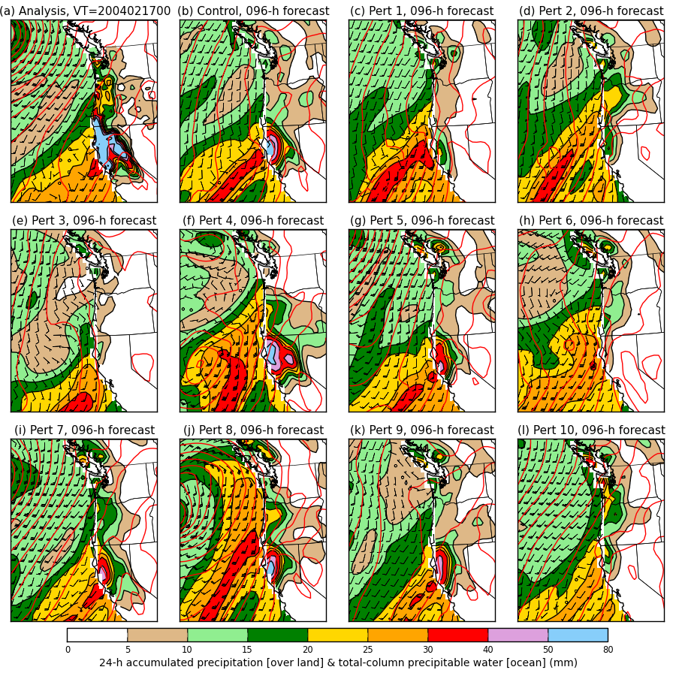
+4-day forecast
Colors: over the
ocean, the total-
column precipitable
water. Over land,
the 24-h accum.
precipitation.
Wind barbs for the
925 hPa level.
Red contours:
mean sea-level
pressure.

Slide 32
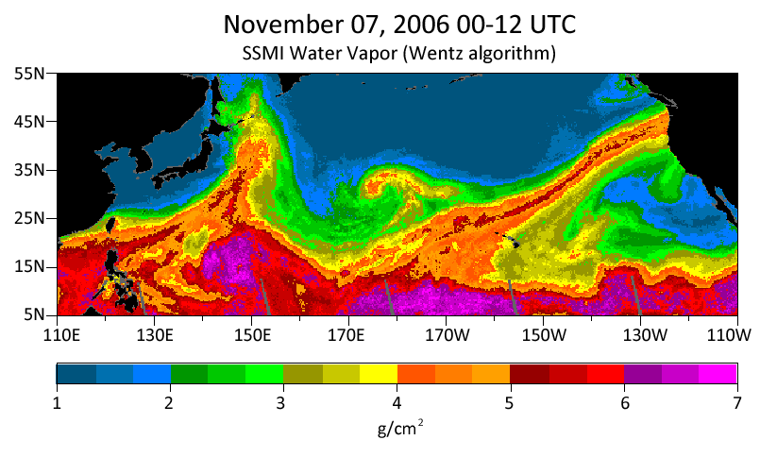
The “good” atmospheric rivers case study:
Nov 2006 Oregon-Washington floods
8-20 inches of rain in Cascades; flooded rivers; extensive damage to Mt. Rainier NP.

Slide 33
+4-day forecast

Slide 34
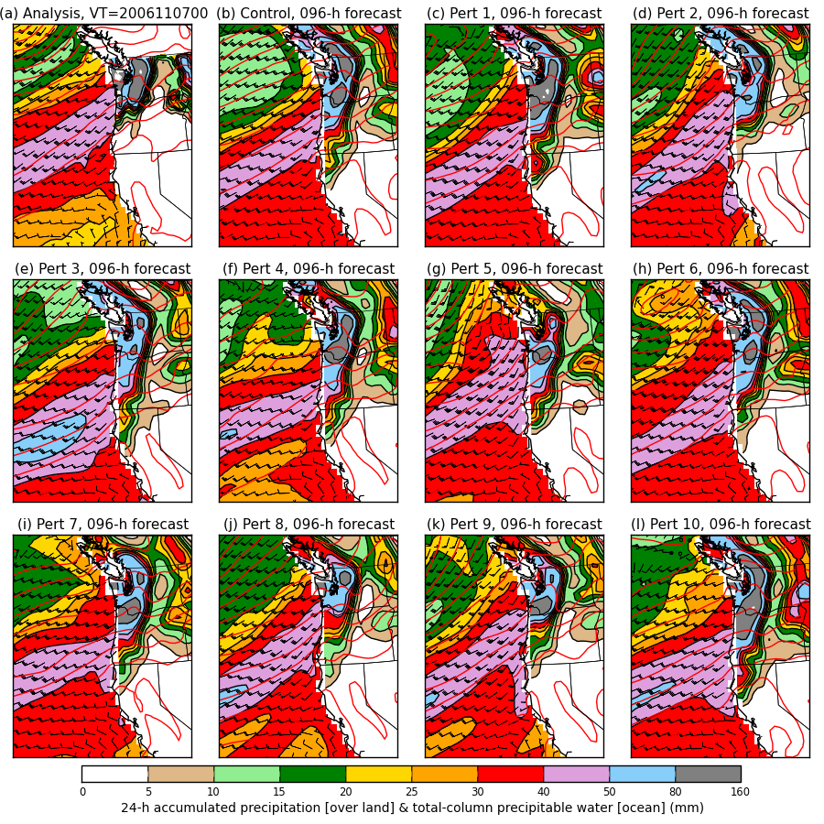
+4-day forecast

Slide 35
Spaghetti
Westerns
Inconsistent forecasts of
orientation of isobars
and hence wind direction
Consistent forecasts of
orientation of isobars
and hence wind direction
The bad and the ugly
Day + 6 ____
Day + 4 ____
Day + 2 ____
Analysis ____
The good

Slide 36
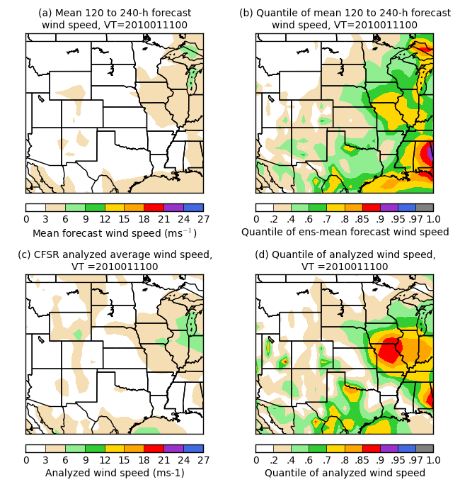
Other statistical post-processing work in progress
Say you don’t have observational
or analysis data widely available
for statistical post-processing.
How can you leverage reforecasts
to tell you whether or not today’s
weather is unusual?
Here’s an example quantifying
how unusual the forecast wind
speed is relative to past model
forecasts of wind speed for a
similar time of the year.
This might be useful for making
decisions for wind energy, for
example.

Slide 37
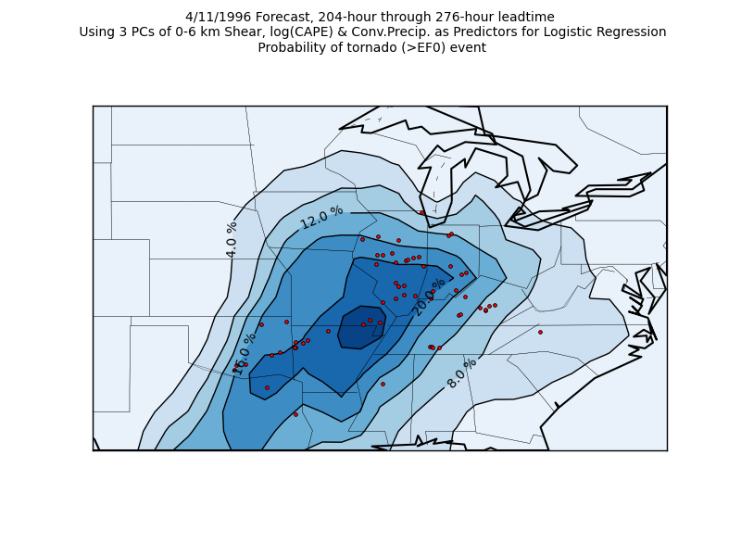
Application: extended-range tornado forecasting
Francisco Alvarez,
St. Louis University,
is working with me
and others on using the
reforecasts to make
extended-range
predictions of
tornado probabilities.
Ph.D. work,
in progress.

Slide 38
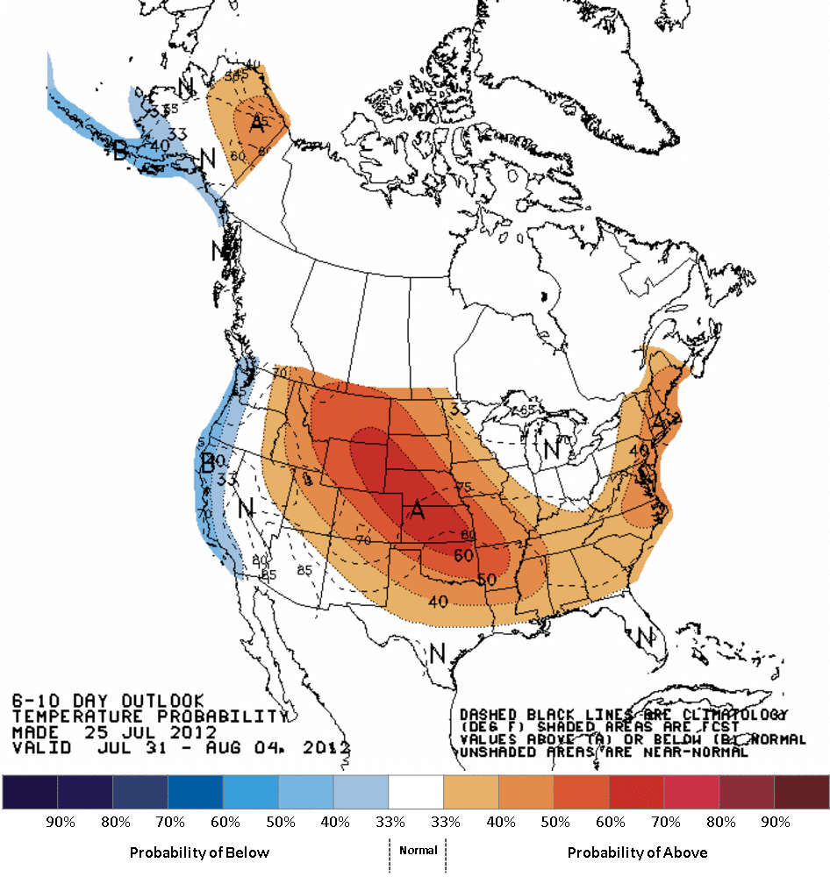
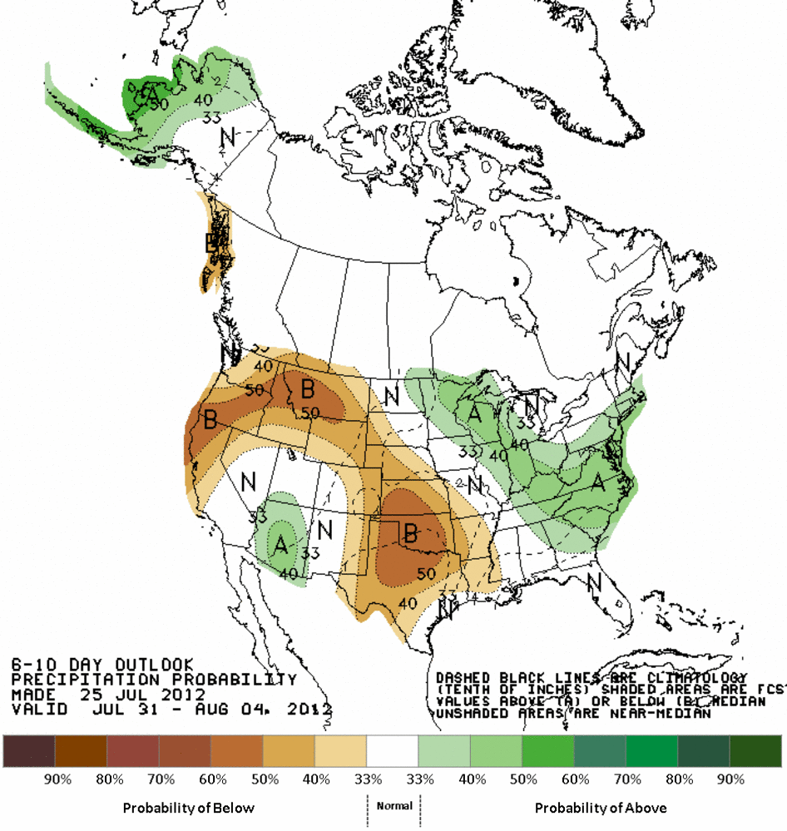
Application: Improved 6-10 day and week-2 forecast guidance from CPC
Dan Collins, CPC leading this effort.

Slide 39
Demo: Regional reforecast with WRF ARW v3.4 using global reforecast for initial, boundary conditions
2-way nested simulation 36-, 12- and 4-km with 36 vertical levels
  12- and 4-km moving nests
Time step: 180, 60, and 20 s
Initial and boundary condition: GFS reforecast ensemble member
Tiedtke cumulus scheme on 36 and 12 km; explicit on 4 km
YSU PBL scheme
HYCOM ocean analysis
WSM6 microphysics
Noah land surface
2D Smagorinsky turbulence scheme
Goddard shortwave radiation
RRTM longwave radiation
Second order diffusion
Positive definite scalar advection
Donelan wind-dependent drag formulation
Garratt wind-dependent enthalpy surface fluxes
c/o Tom Galarneau, NCAR & NOAA HFIP grant

Slide 40
2005 Rita official forecast
(Houston, TX evacuated)

Slide 41
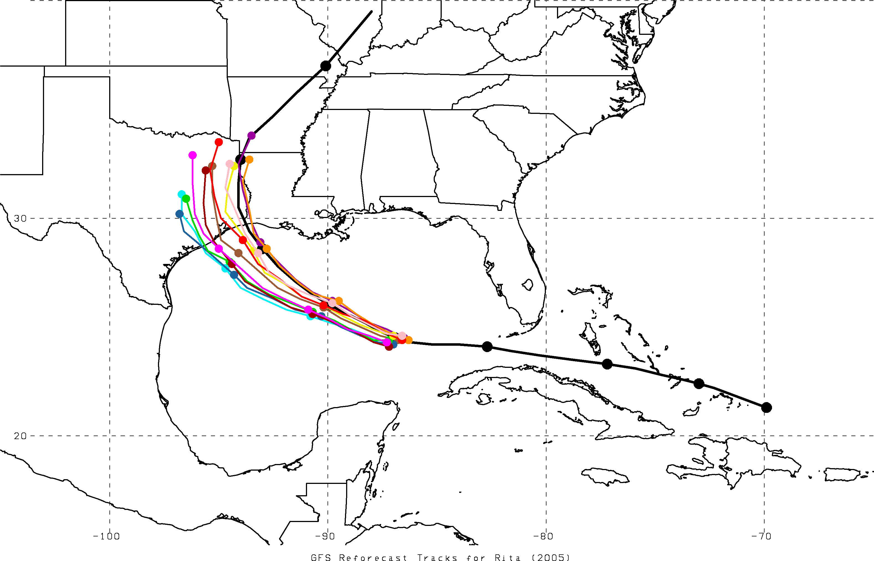
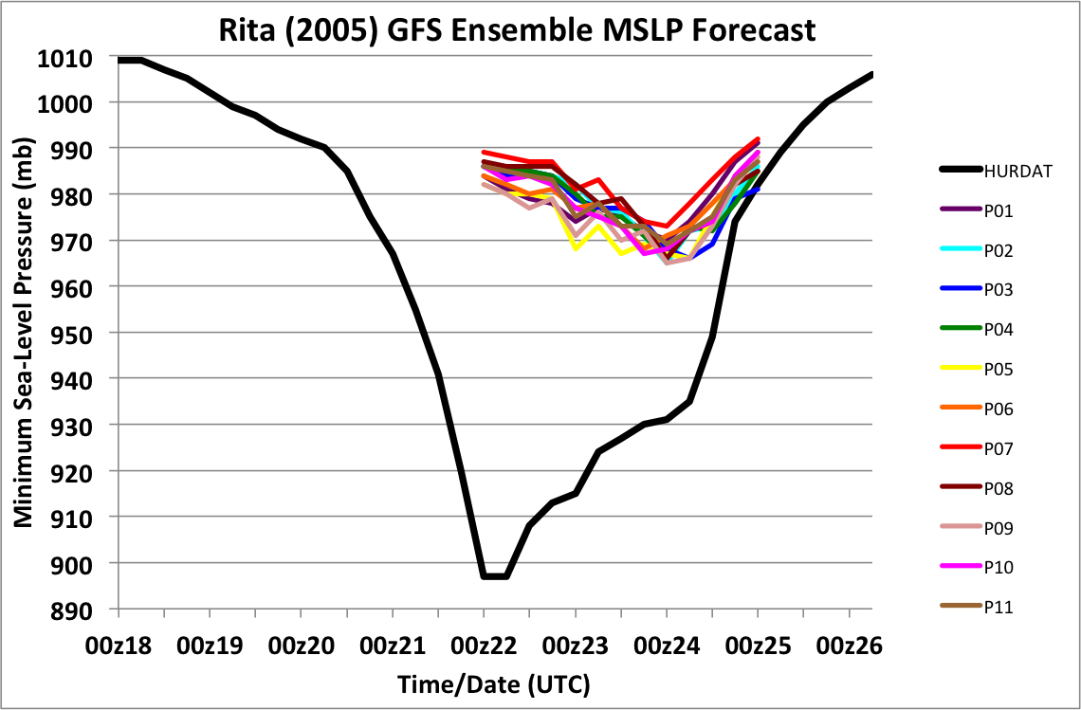
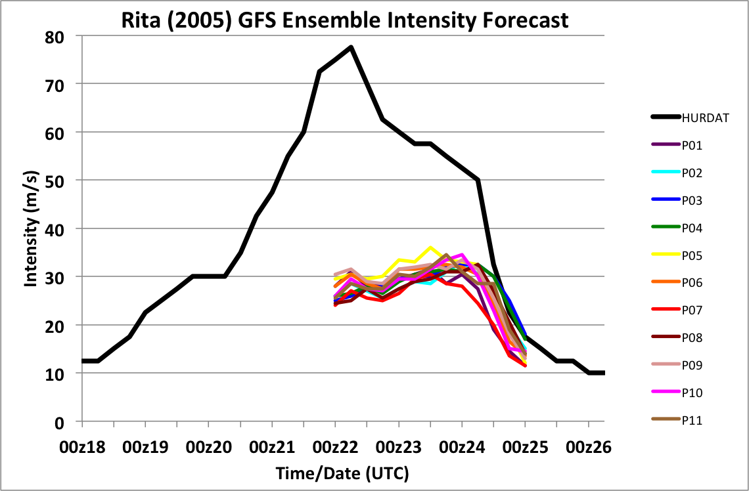
TC Rita (2005)
GFS reforecast ensemble
72-h forecast
initialized at 00Z 22 Sept
P01
P02
P03
P04
P05
P06
P07
P08
P09
P10
P11
OBS
00Z/22
00Z position

Slide 42

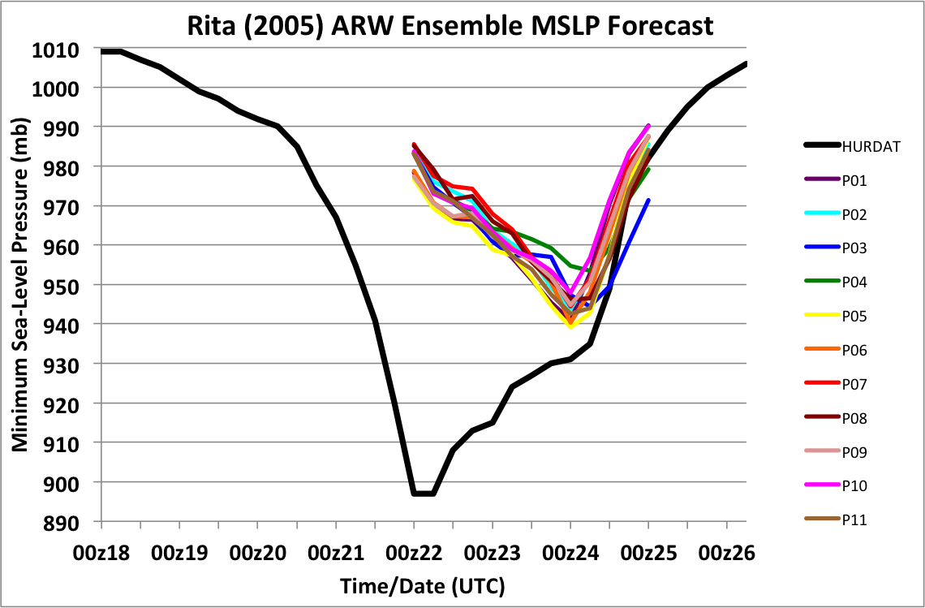

TC Rita (2005)
ARW ensemble with GFS reforecast ensemble as boundary and initial conditions
72-h forecast
initialized at 00Z 22 Sept
P01
P02
P03
P04
P05
P06
P07
P08
P09
P10
P11
OBS
00Z/22
00Z position

Slide 43



A synthetic example of using reforecasts
to make track error bias corrections
72-h Forecast Verifying 1200 UTC 9 September
Ensemble Mean, Reforecast Analog,
and Observed Positions
Reforecast Analog
Position Errors
N
Bias-Corrected Ensemble Mean Position
and Probability Ellipse
W
E
Observed
S
Error (km)
Red : mean forecast position
Blue dot: forecast positions of +72-h forecast analogs
End of red tail ___ : observed positions at +72 h

Slide 44
MJO – blocking interactions

Slide 45

My method of quantifying MJO phase
In subsequent plots you’ll see
I refer to the phase of MJO by
its angle from x axis, a θ in
conventional polar coordinates.
When examining statistics
for θ=θ₀ , I use RMM 1/2
samples with associated
θ₀ +/- 22.5 degrees.
Example below for θ₀=-90
uses samples in blue cone.
A “strong” MJO is in the
top 25% of RMM 1/2
amplitudes within the cone.
θ=+45
θ=0
θ=-45
θ=-135
θ=-90

Slide 46
Under-forecasting of Atlantic block frequency after day +3

Slide 47
Change in blocking frequency under strong Indian Ocean MJO
Shaded areas are confidence 5/95%
confidence intervals.
Suppression of blocking frequency
in the east Pacific and Atlantic
under strong MJO. Day +6 GEFS
nicely replicates this suppression.

Slide 48
Z500 anomalies under strong
(6-day lagged) Indian Ocean MJO

Slide 49
How does (observed) blocking frequency change according to the lag time of the MJO?
Top panel is unconditional DJF blocking
frequency, for reference. Bottom panel is
difference in strong MJO blocking frequency
from unconditional DJF average as a function
of latitude and time lag of MJO data
relative to blocking data. Blue = less blocks.
Here, θ= -90, i.e., ~ Indian Ocean MJO.
Here, n-day negative lag means the MJO data was preceding the blocking calculation by n days.
Again, note strong suppression of blocking
in Pacific both prior to and subsequent to
strong Indian Ocean MJO. Very strong
suppression of Atlantic block subsequent
to Indian Ocean MJO.
⬅data from previous 2 slides➔

Slide 50
How does (observed) blocking frequency change according to the lag time of the MJO?
What the heck is happening here?
3-10 days prior to active MJOs in
the Indian Ocean, there is a strong
suppression of blocking in the
Pacific, apparently.

Slide 51
Observed and forecast blocking frequency change according to the lag time of the MJO

Slide 52
Observed and forecast blocking frequency change according to the lag time of the MJO
forecast frequency of Pacific
blocks prior to Indian Ocean MJO
not suppressed like analyzed.

Slide 53
Flow anomalies associated with suppressed Pacific blocking 5 days prior to active Indian Ocean MJO

Slide 54
Conclusions
Reforecast data set created for current operational NCEP GEFS.
Reforecast data and real-time forecasts available now, or will be soon.
Useful for statistical calibration, regional reforecasting, understanding model biases, and much more.

Slide 55
Supplementary slides

Slide 56

Basic analog technique for statistical downscaling (here, v1)
Today’s ens. mean forecast + subsequent
analyzed precipitation
On the left are old forecasts
similar to today’s ensemble-
mean forecast. For making
probabilistic forecasts,
form an ensemble from
the accompanying
analyzed weather on the
right-hand side.

Slide 57
Analog technique for statistical downscaling
Form an
ensemble from
these

Slide 58
Problem with basic analog reforecast technique
Say today’s forecast is
for 20 mm. There
are more forecasts
slightly less than 20 mm
than slightly more than
20 mm.
Assuming correlation
between forecast and
observations, analogs
will be biased toward
lower precipitation
amounts.

Slide 59
“Rank” analog procedure
Convert precipitation forecast time series to ranks:
x = [0, 0, 7, 15, 1, 3, 6, 4, 1, 2, 12, 5, 6, 8]
x(r)= [1.5, 1.5, 11, 14, 3.5, 6, 9, 7, 3.5, 5, 13, 8,10,12]
today’s

Slide 60
“Rank” analog procedure
Convert precipitation forecast time series to ranks:
x = [0, 0, 7, 15, 1, 3, 6, 4, 1, 2, 12, 5, 6, 8]
x(r)= [1.5, 1.5, 11, 14, 3.5, 6, 9, 7, 3.5, 5, 13, 8,10,12]
today’s
with standard analog, these would be the two forecasts with the closest values.

Slide 61
“Rank” analog procedure
Convert precipitation forecast time series to ranks:
x = [0, 0, 7, 15, 1, 3, 6, 4, 1, 2, 12, 5, 6, 8]
x(r)= [1.5, 1.5, 11, 14, 3.5, 6, 9, 7, 3.5, 5, 13, 8,10,12]
today’s
with rank analog, these would be the two forecasts with the closest ranks.

Slide 62
Rank analog calibration details
24-h accumulated precipitation, validated on NARR grid (~32 km) over CONUS, 1985-2009.
Rank analog approach: at each grid point in CONUS, using that grid point and +/- 3 surrounding grid points in N-S, E-W direction, find dates of 75 past forecasts that are closest in average precipitation rank of ensemble mean forecast. Make probabilistic forecasts from analyzed NARR precipitation data on dates of those 75 analogs.
(Conventionally calculated) Brier Skill Scores, reliability diagrams, etc. NARR again used for verification.

Slide 63
Some known applications in development
Real-time web page of experimental PQPF forecasts (ESRL, in development to replace v1 web page)
Development of experimental forecast products for renewable energy sector (Hamill, ESRL).
6-10 day and 8-14 day forecasts (Dan Collins, CPC).
Detecting and correcting bias in hurricane track and intensity (Jiayi Peng, NCEP/EMC, Tom Galarneau, NCAR).
Objective probabilities for severe weather several days to weeks hence (Francisco Alvarez, St. Louis Univ. + Hamill)
Improving hydrologic predictions (Haksu Lee et al., NOAA/NWS/OHD).
Also: BAMS article once published will presumably spur wider usage.

Slide 64
Define BSS for evaluating blocking skill
The blocking Brier Skill score is calculated after summing forecast and climatological Brier scores over the relevant longitudes in either the Pacific or Atlantic basins, respectively, then averaged. For example (Pac):

Slide 65
Computing the CRPSS of
GEFS RMM1 and RMM2 forecasts
CRPSS = 1 – CRPS(forecast) / CRPS(climatology)
Φ(.) estimated from normal distribution fit to sample mean and standard deviation.

Slide 66


Blocking computation method: follows Tibaldi and Molteni, 1990 Tellus
There are alternatives, such as PV-based
index by Pelly and Hoskins. While these
may have some advantages, this old
standard used hereafter.

