Slide 1
Collaborating with hydrologic and prediction partners on GEFSv12 precipitation forecast calibration
Tom Hamill, Rob Cifelli
NOAA Physical Sciences Laboratory, Boulder CO
POC: tom.hamill@noaa.gov, +1 (303) 516-0340 during Covid.
23 Feb 2022

Slide 2
What we’re thinking
PSL has the capabilities to improve NOAA’s hydrologic predictions and FIRO, not just through GEFS improvement but by developing better connections with hydrologic prediction. And we have some in-house ability to test end to end.
GEFS system
Hydrologic prediction
R&D (HEFS, NWM, possible machine learning in future)
system design
reanalysis &
reforecast
statistical postprocessing
algorithms
Physical Sciences Lab

Slide 3
Outline
A quick review of MEFP and its approximations for hydrologic preprocessing.
Recent developments in NOAA’s global ensembles and their postprocessing.
GEFSv12 implementation, and reforecasts.
Ongoing project to develop reforecast-based quantile mapping for National Blend of Models.
Some intriguing preliminary results from integrating into CA hydro prediction.
A PSL straw concept for hydrometeorological collaboration.
Consensus on next steps, basic requirements definition.

Slide 4
MEFP for precipitation (highly simplified)
Single-valued forecast time series to +7 days
Normal
quantile transform
precipitation
intermittency
conditional
probability
of
F | O
Schaake
shuffle
synthetic
member 1
synthetic
member 2
ensemble mean from multiple forecast models up to +1 year
…
synthetic
member n
precipitation analyses

Slide 5
MEFP for precipitation (highly simplified)
Single-valued forecast time series to +7 days
Normal
quantile transform
precipitation
intermittency
conditional
probability
of
F | O
Schaake
shuffle
synthetic
member 1
synthetic
member 2
ensemble mean from multiple forecast models up to +1 year
…
synthetic
member n
precipitation analyses
Each of these imparts some statistical assumptions that may not be valid in all circumstances. We can work with your staff to collaboratively examine them.

Slide 6
Recent developments in NOAA:
GEFSv12 and its calibration.
Raw GEFSv12 ensemble forecasts are much higher quality than previous versions. And with more spread, there is more information in the ensemble members (next slide).
20-year reforecasts for it are available.
Ensemble data are now saved at 3-hourly time steps. Intermittency is there.
PSL has several research projects related to GEFSv12.
Quantile mapping, weighting, dressing for National Blend.
Testing Censored, Shifted Gamma Distributions (CSGD) as alternative to MEFP.
Testing effects of swapping out Schaake Shuffle with ensemble copula coupling.
Testing statistical downscaling method from GEFSv12 grid.
Up for discussion: building an experimental web page for real-time, calibrated GEFSv12 products so that we can get feedback from customers, iteratively refine.

Slide 7
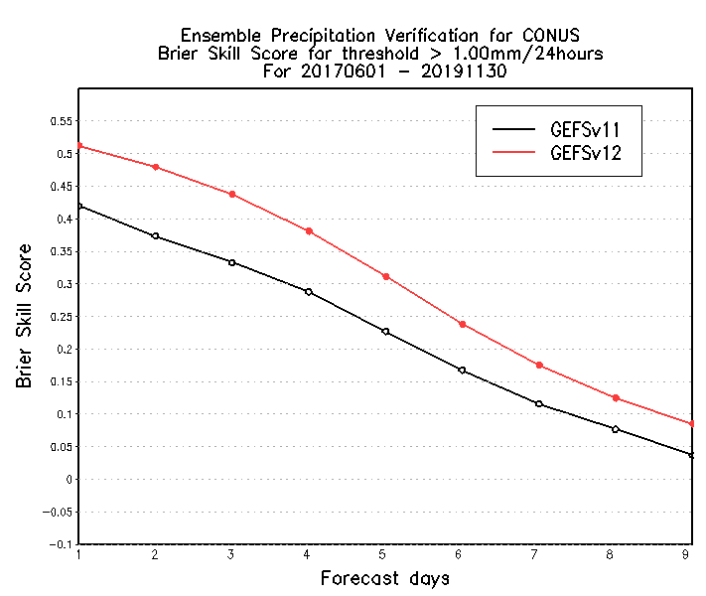
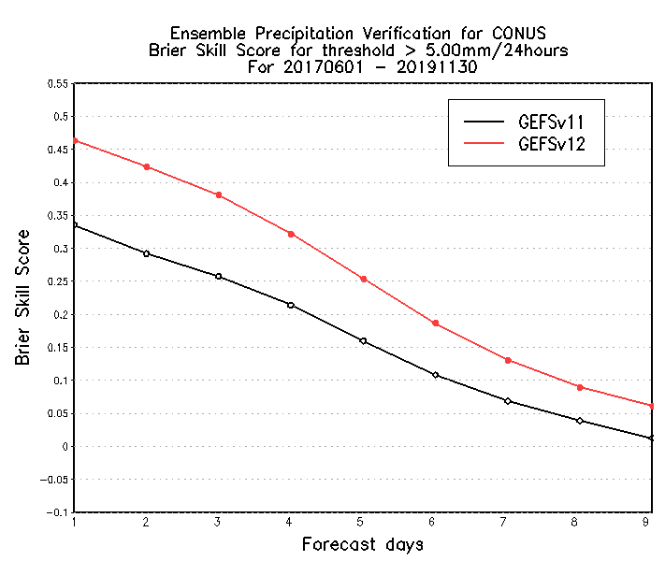
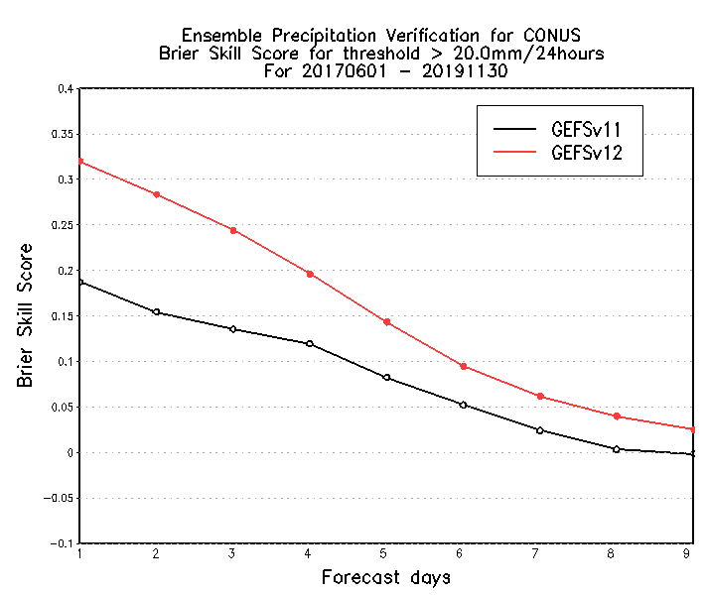
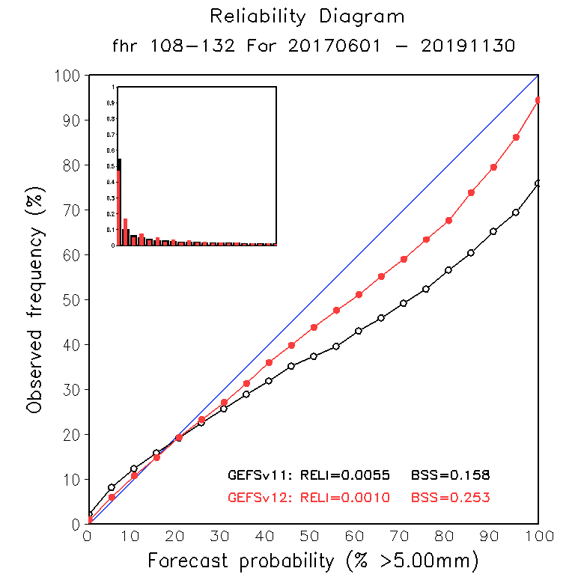
Brier Skill Scores and reliability of CONUS PQPF for raw GEFSv12
> 1 mm / 24 h
> 5 mm / 24 h
> 10 mm / 24 h
0.628
0.601
0.603
0.581
Extends skill ~ 1 day
Extends skill >1 day
Extends skill > 1 day
South Hemisphere
0.214
0.179
0.239
0.209
BSS = 1 is for perfect forecast,
BSS = 0 is for no skill from reference climatology.
GEFSv12 forecasts are more reliable than GEFSv11.
c/o Yuejian Zhu and NWS/EMC verification team

Slide 8
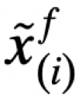
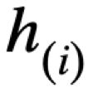
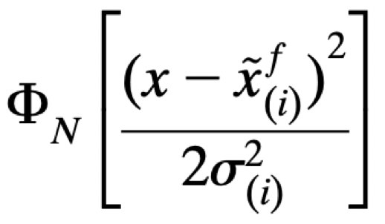
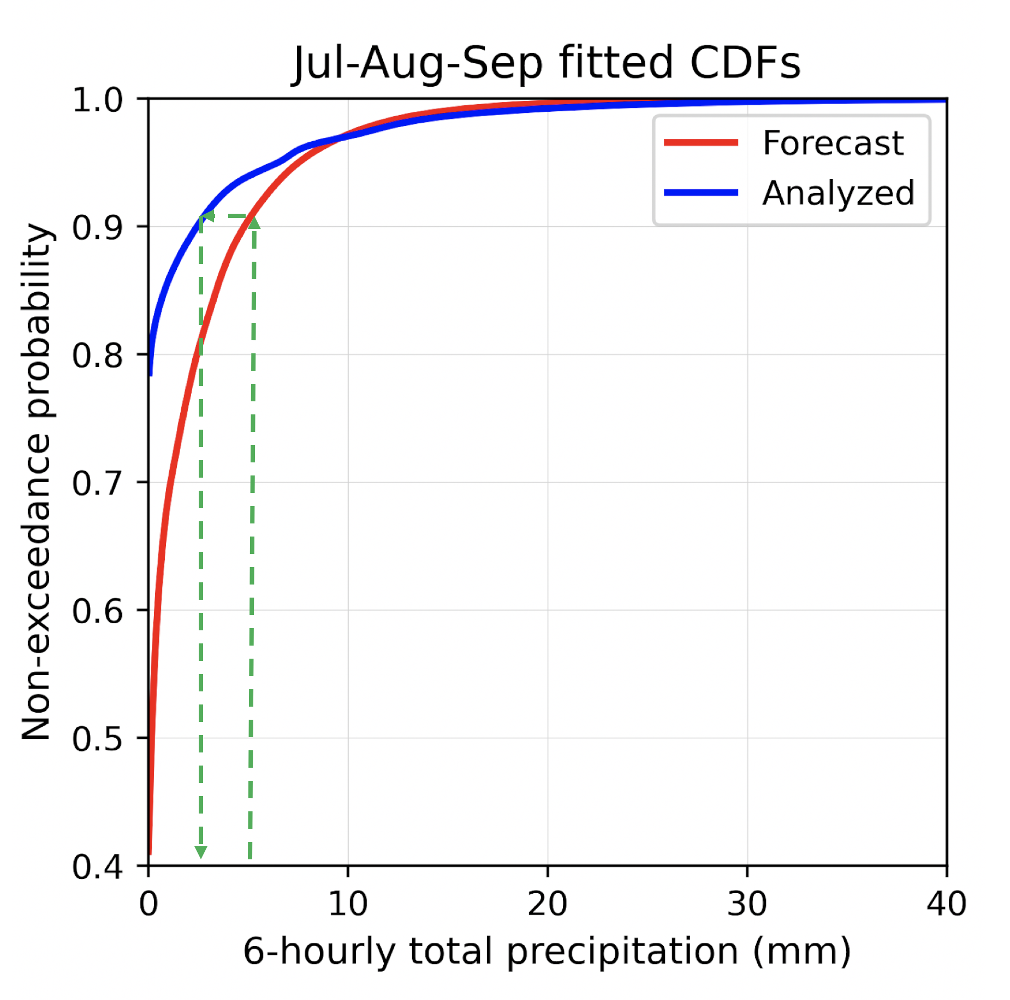
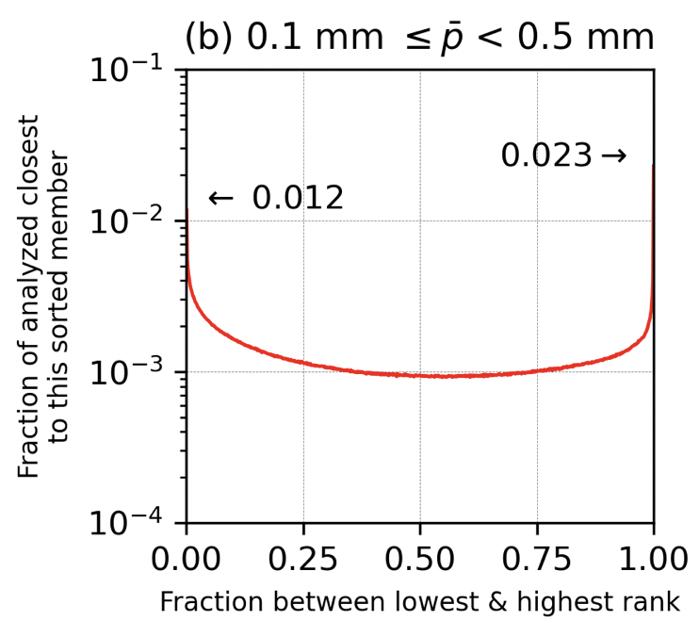
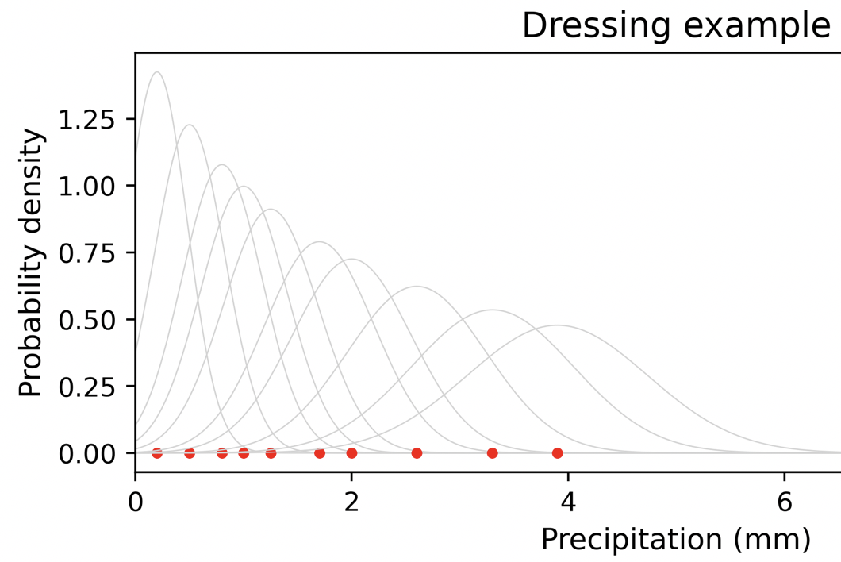
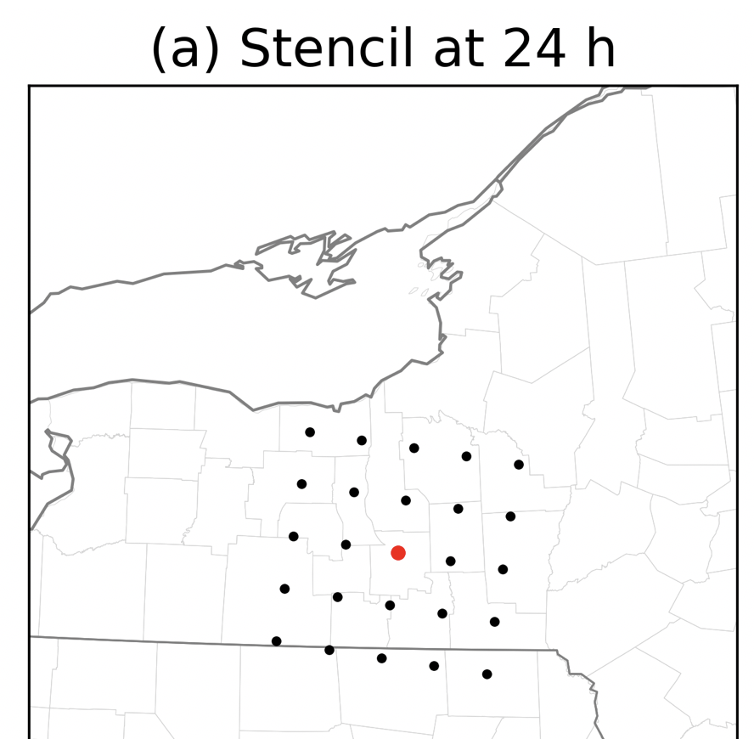
Three steps to the revised GEFSv12 National Blend of Models precipitation procedure.
Quantile mapping
each member of the forecast to account for amount-dependent bias.
2. Weighting the sorted
members to account
for ensemble over-
confidence before
determining probability
Replacing the quantile-mapped
point estimates with a kernel of
probability density when computing
event probabilities, i.e., “dressing”.

Slide 9
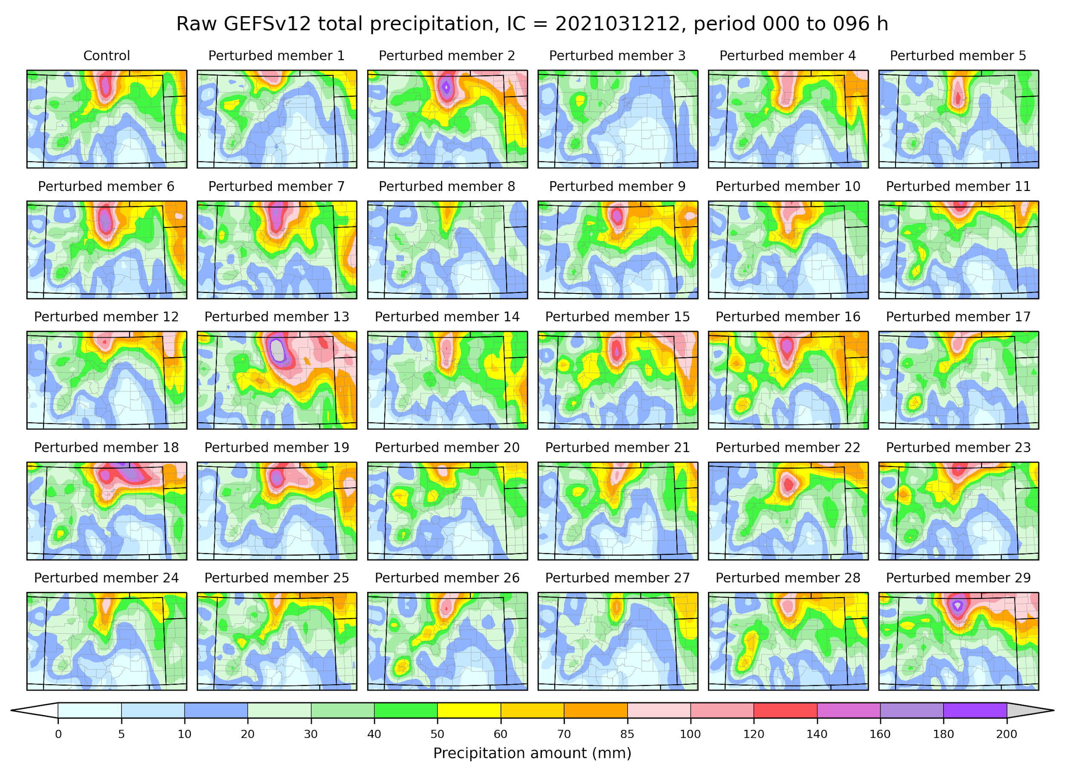
Quantile mapping
With GEFSv12 system
improvements, there
is now useful spatio-
temporal information
in individual ensemble
members, not just in
the ensemble mean.
Hypothesis: Hydrologic
prediction quality could
be improved by
using GEFSv12 ensemble
with simple statistical
corrections instead of
applying the many
MEFP approximations
(normal quantile
transform, intermittency,
modeling F|O, Schaake
Shuffle)

Slide 10
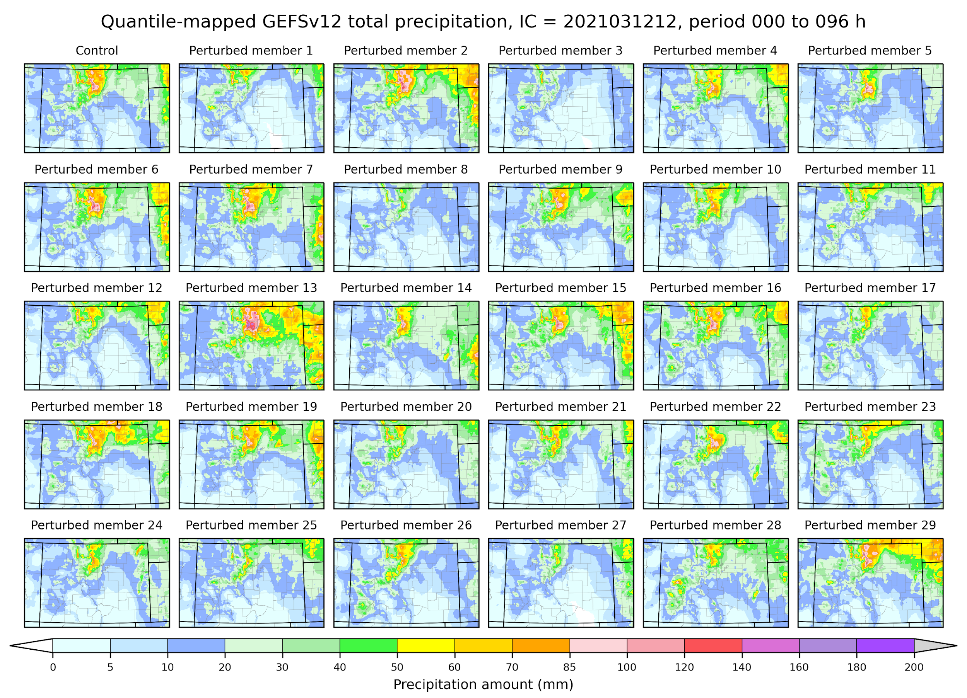
Quantile mapping
This approach (a) bias corrects, (b) statistically downscales, (c) provides ensemble forcing scenarios for hydrology.

Slide 11
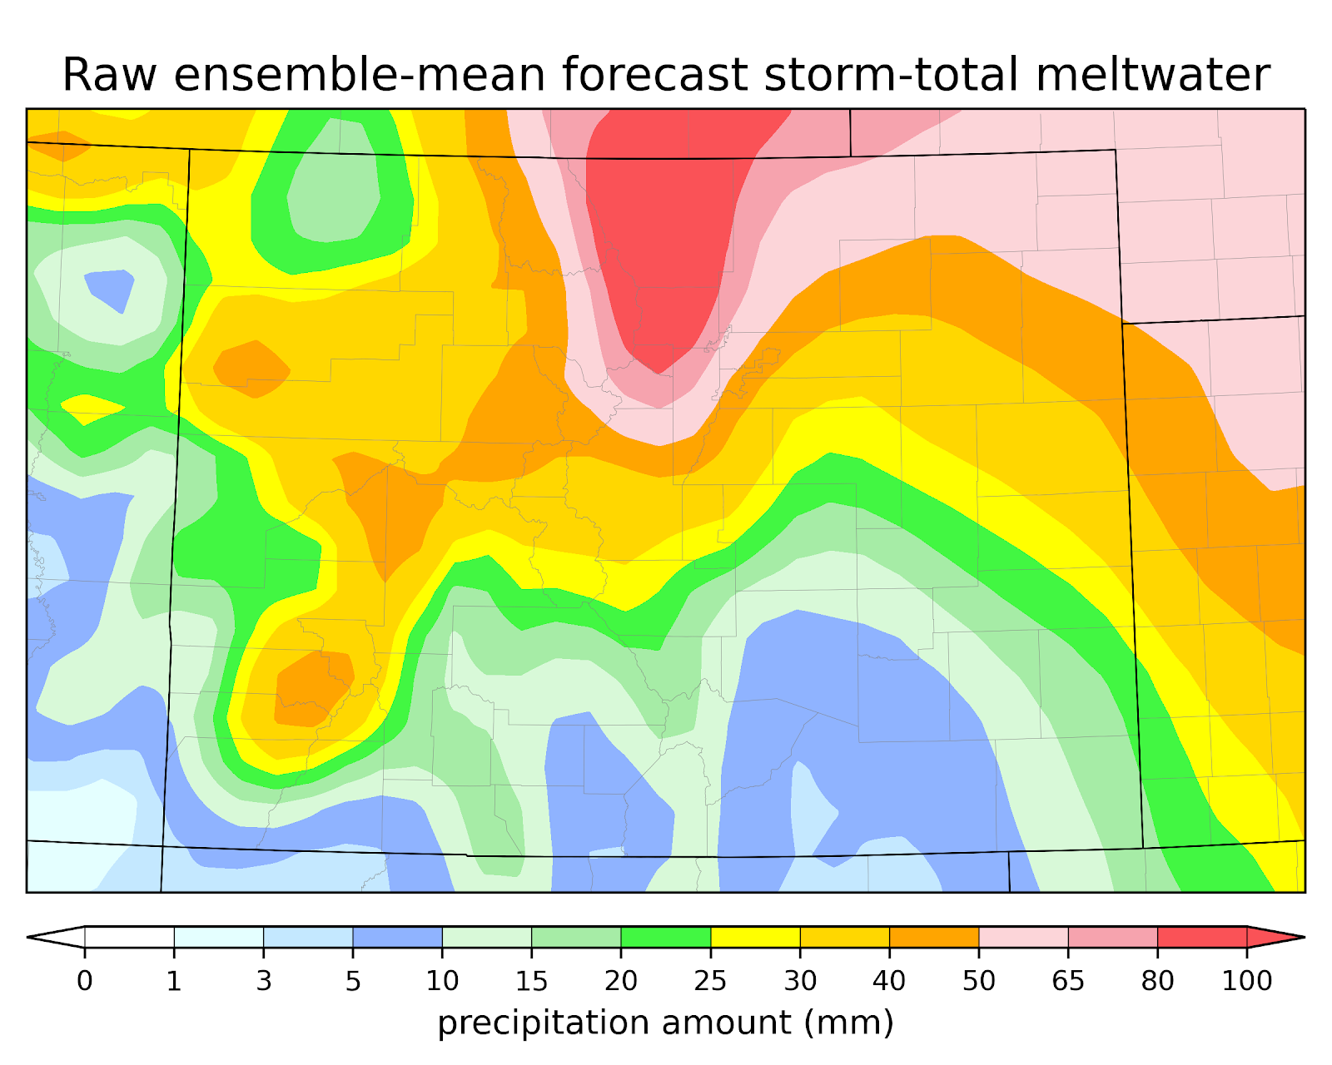
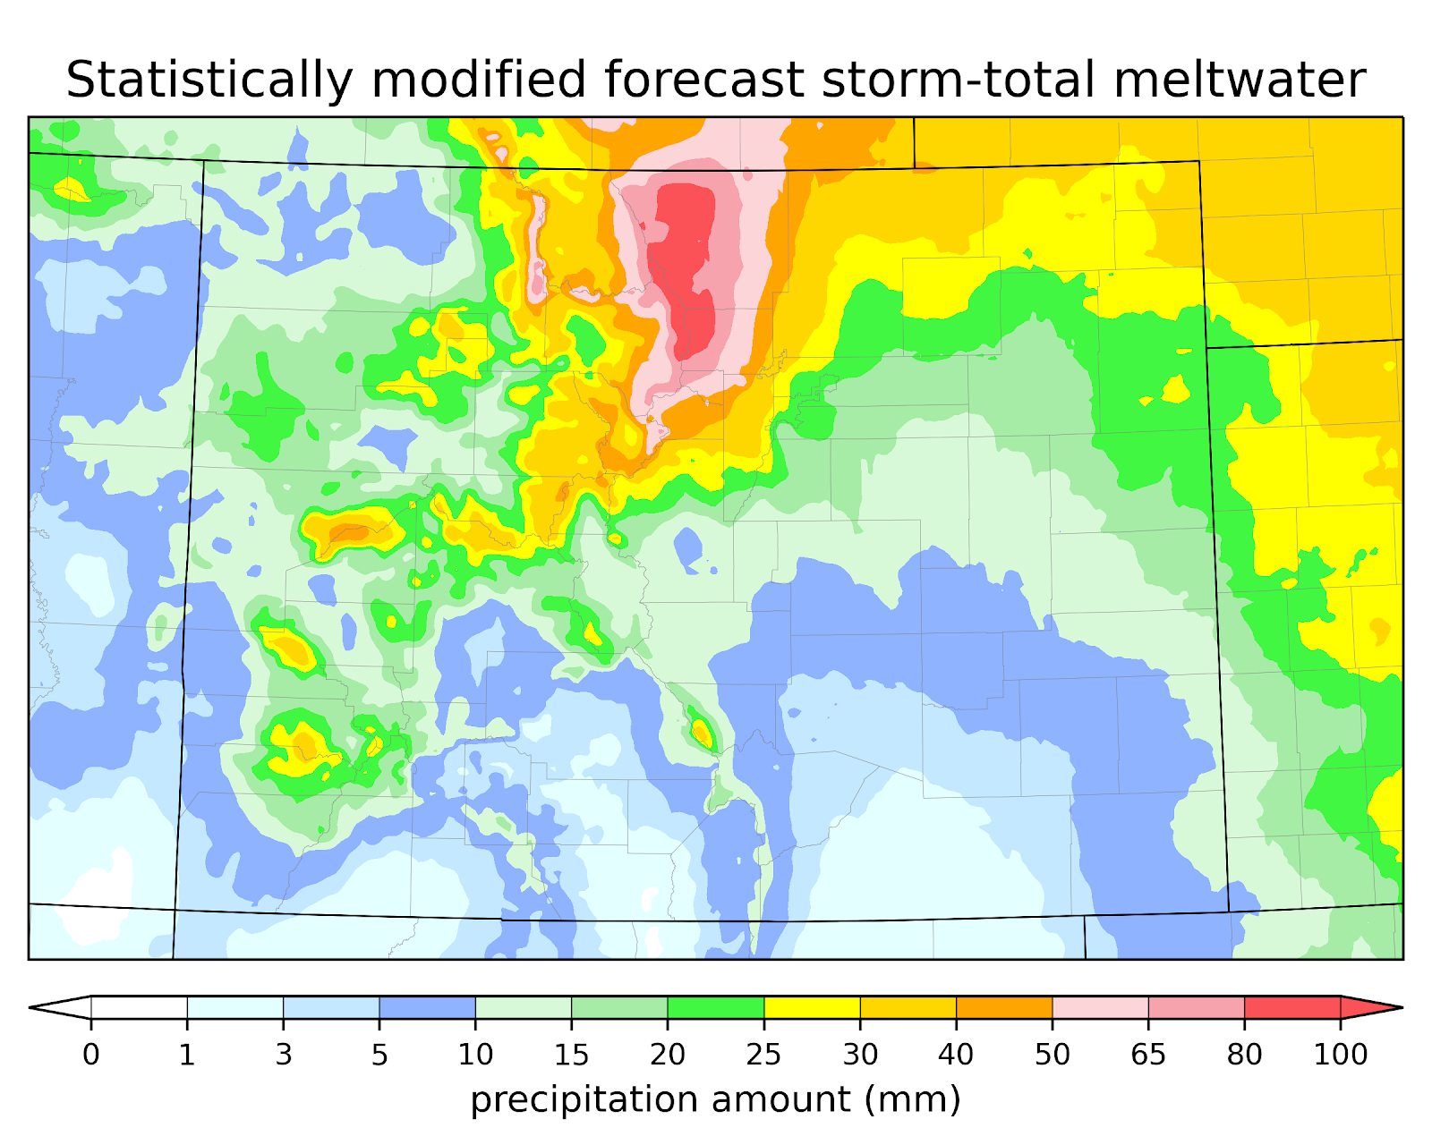
The associated ensemble mean.

Slide 12
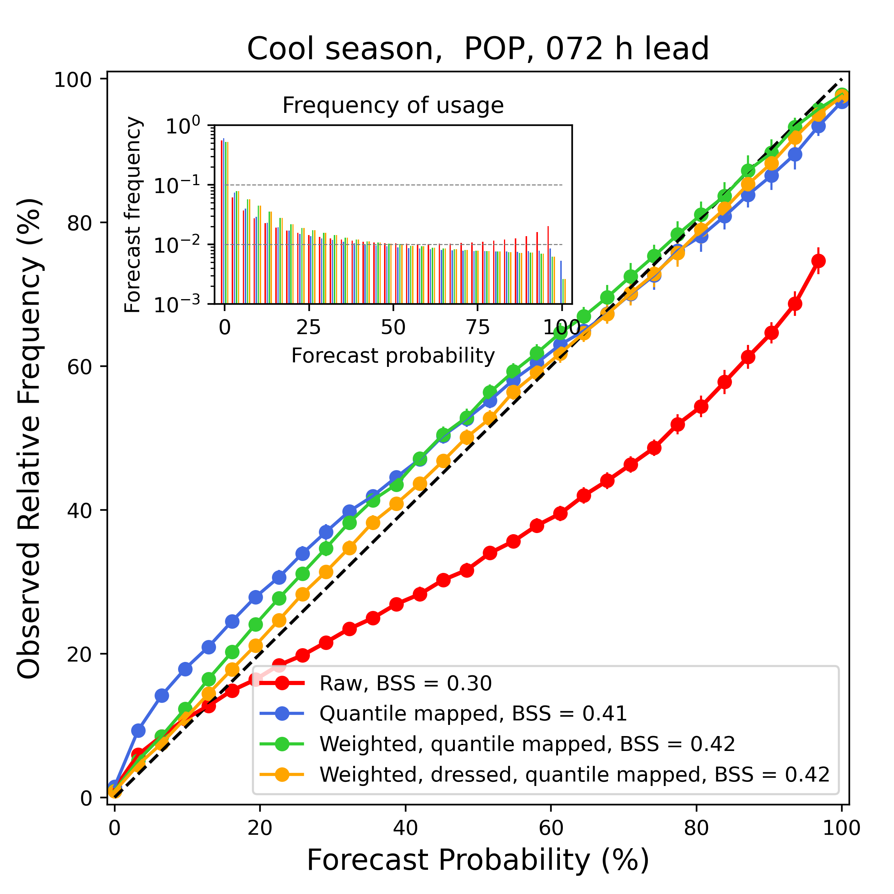
Each step of the process slightly improves
the reliability of POP.

Slide 13
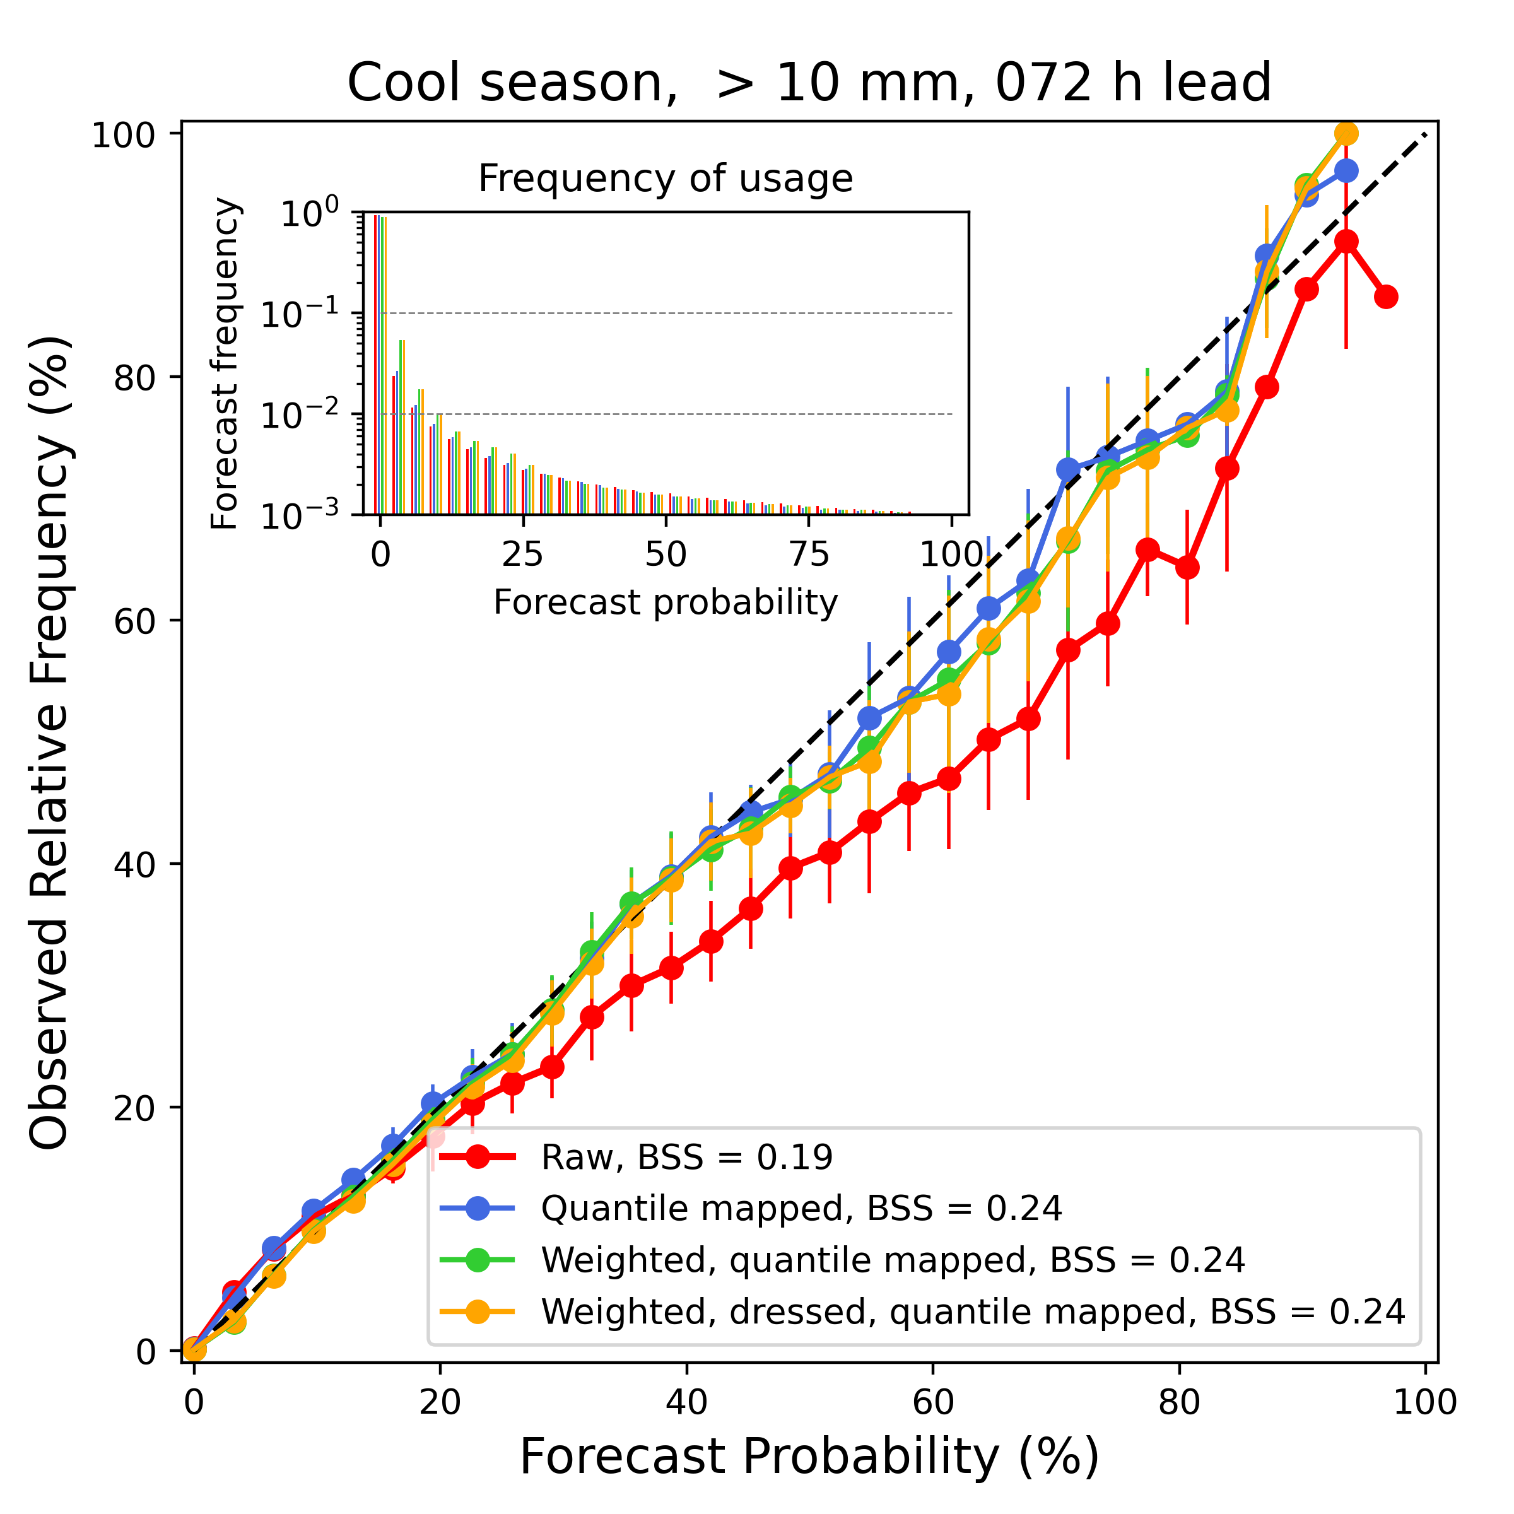
10 mm forecasts are reliable after
only quantile mapping.

Slide 14
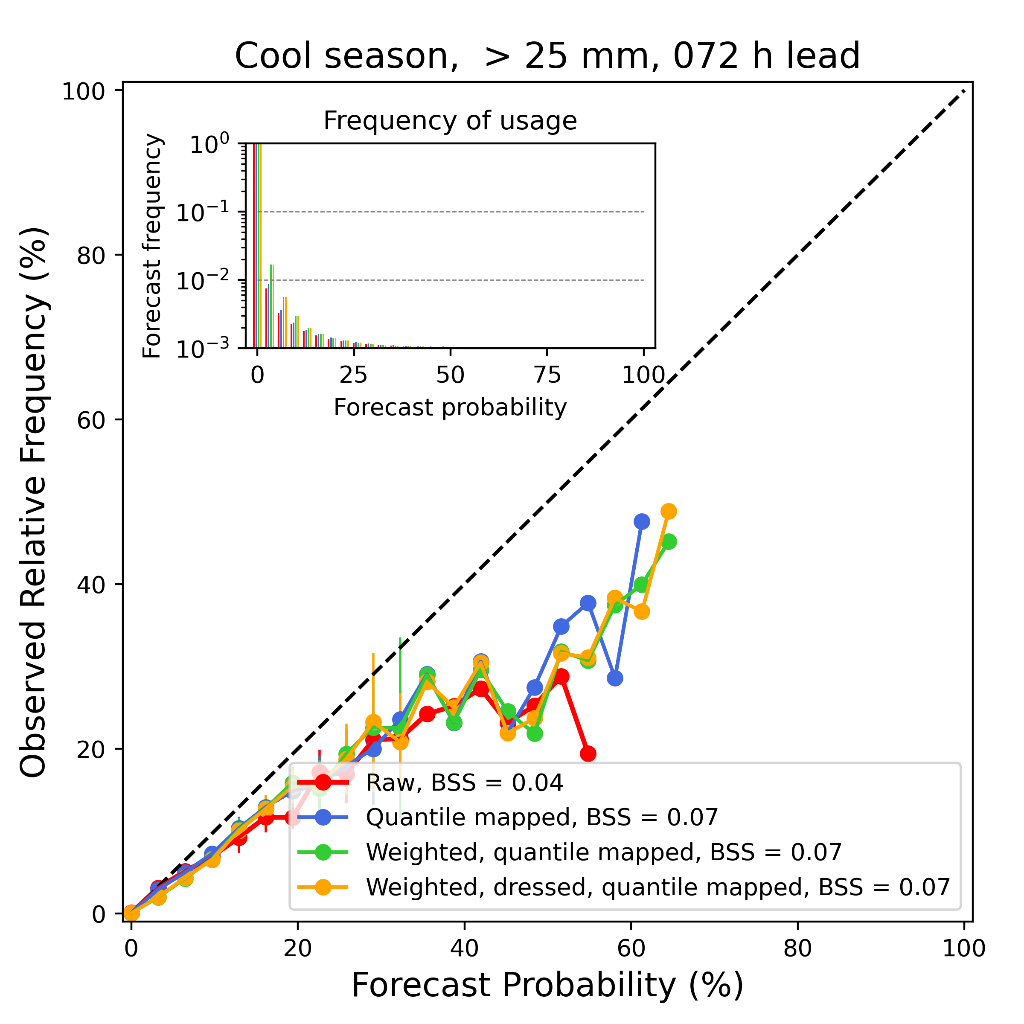
Very heavy amounts are not as reliable as
one would hope. This can be ameliorated
by more careful weighting of sorted members
based on mean precipitation amount
(discussed in supplemental slides).

Slide 15
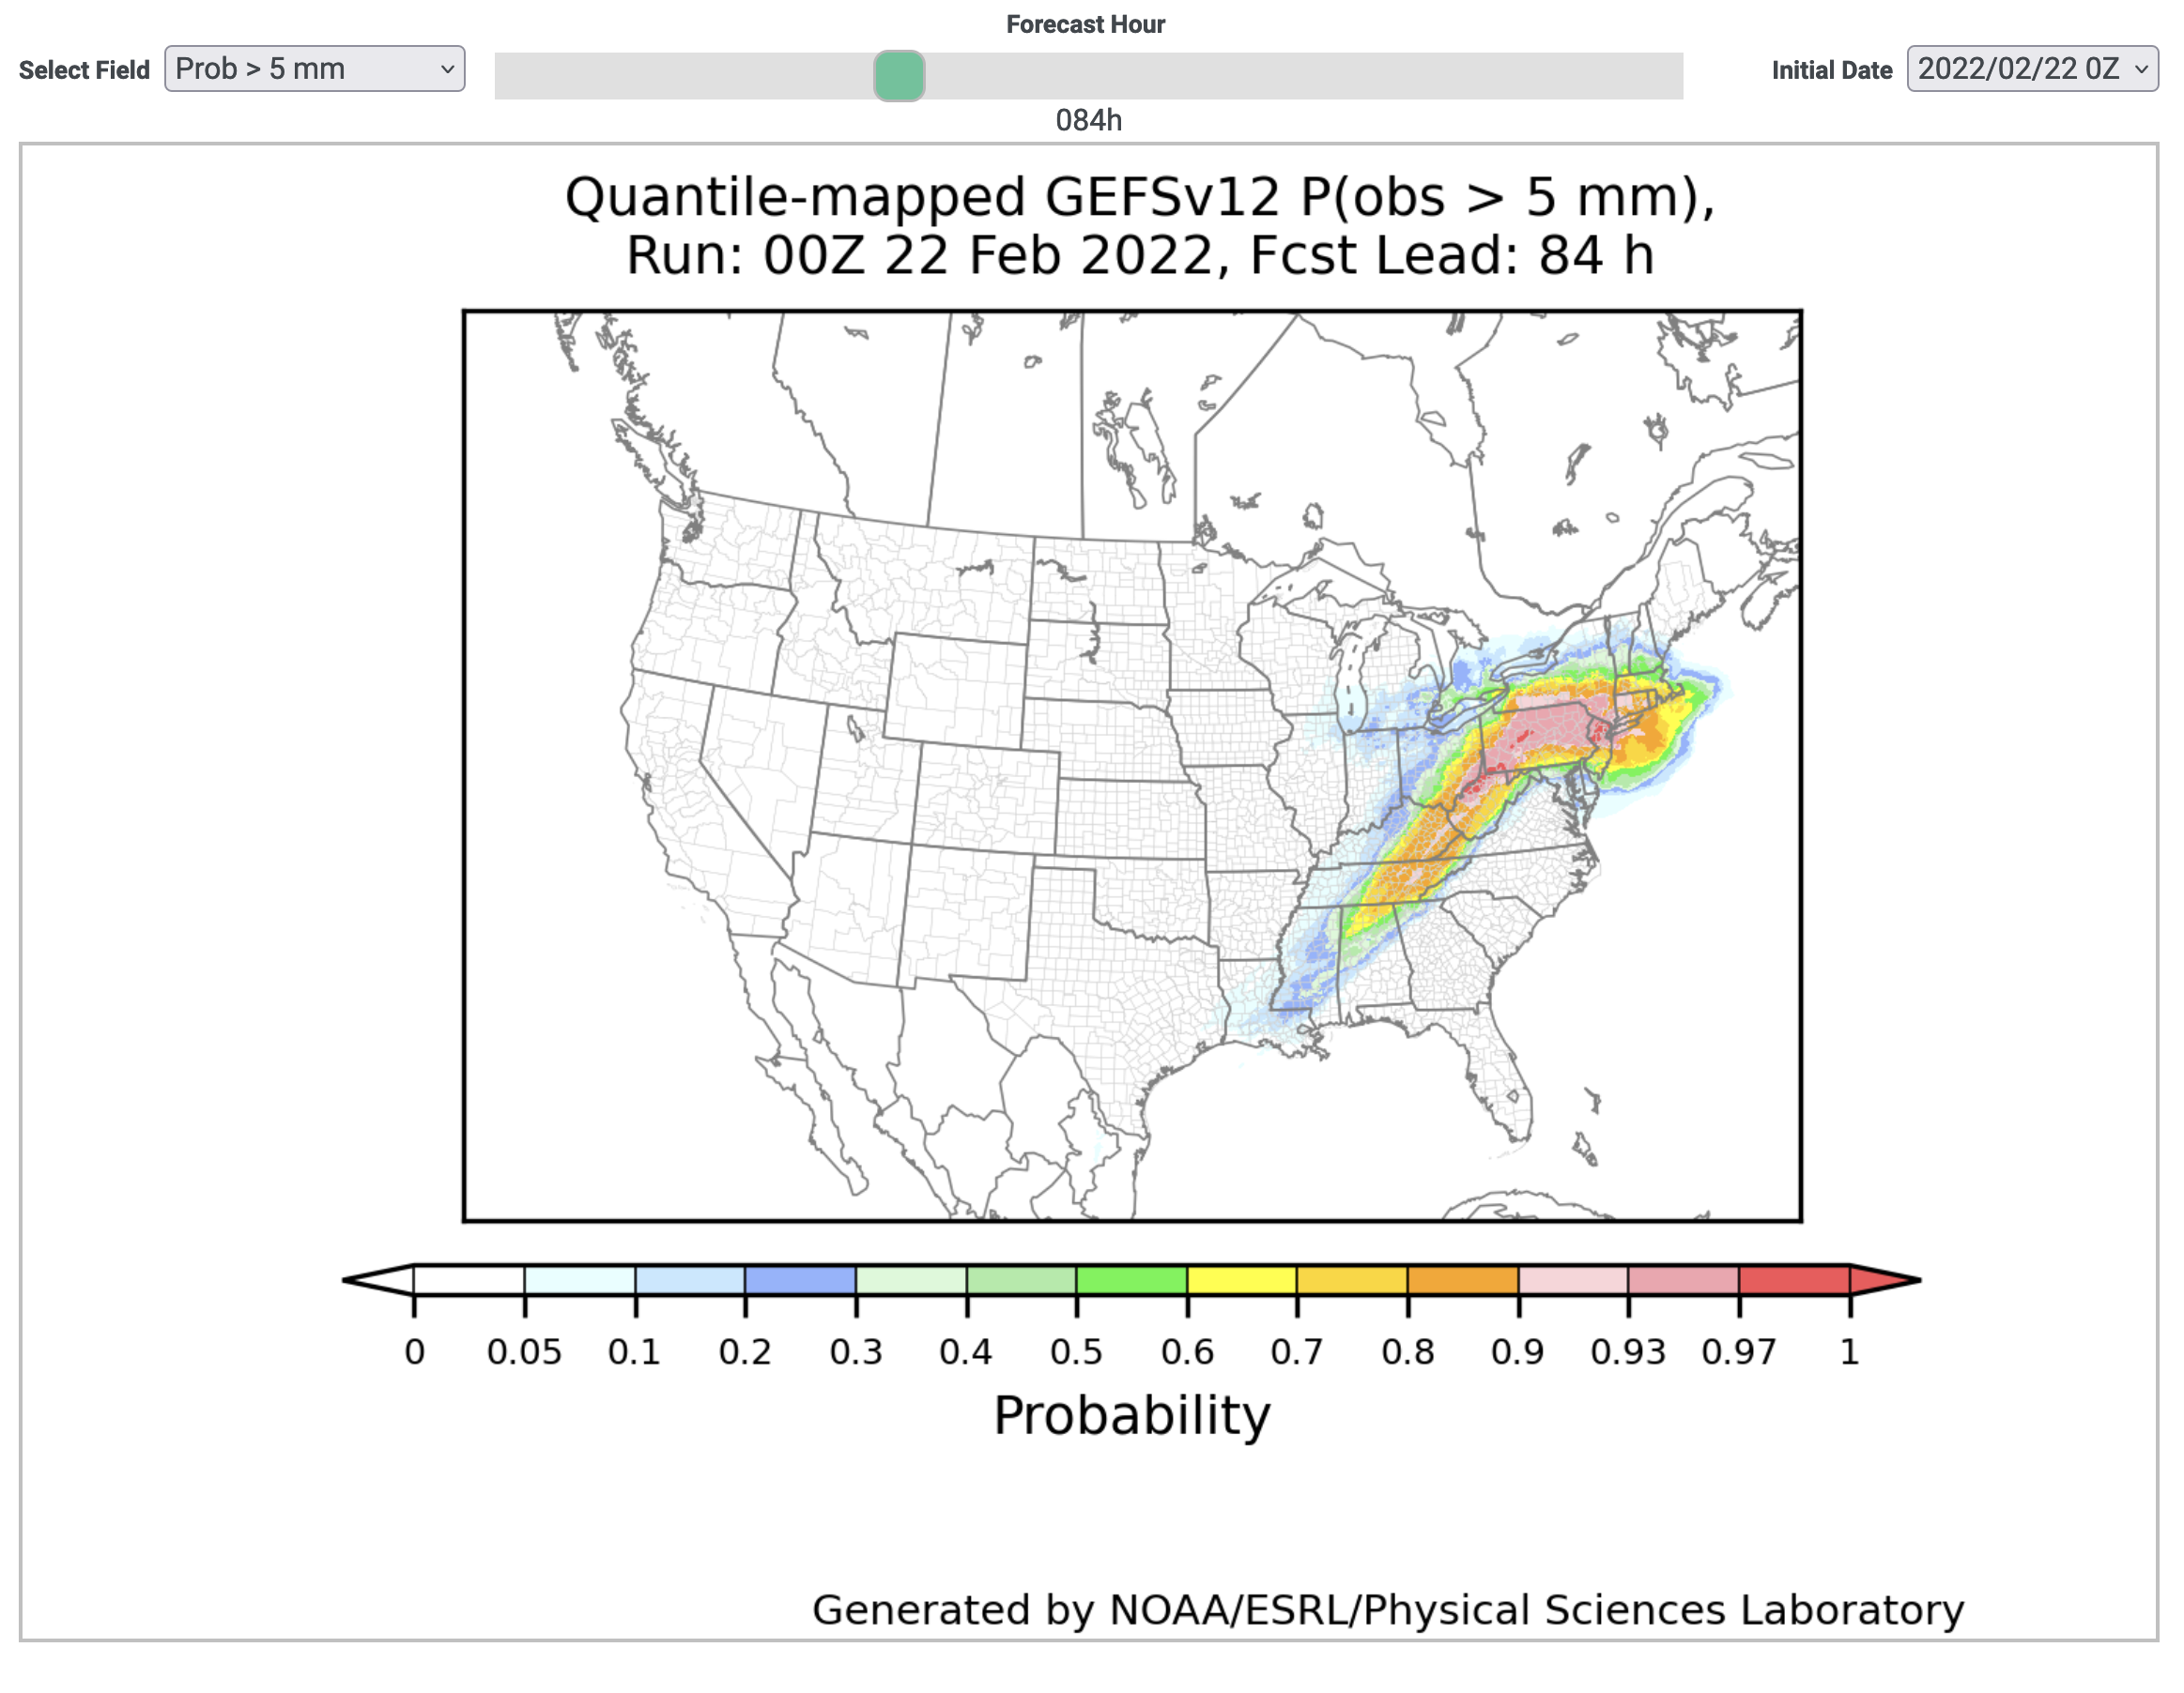
A web page for real-time GEFSv12 postprocessed forecasts (under construction).
https://www.psl.noaa.gov/forecasts/GQM/
c/o Diana Stovern

Slide 16
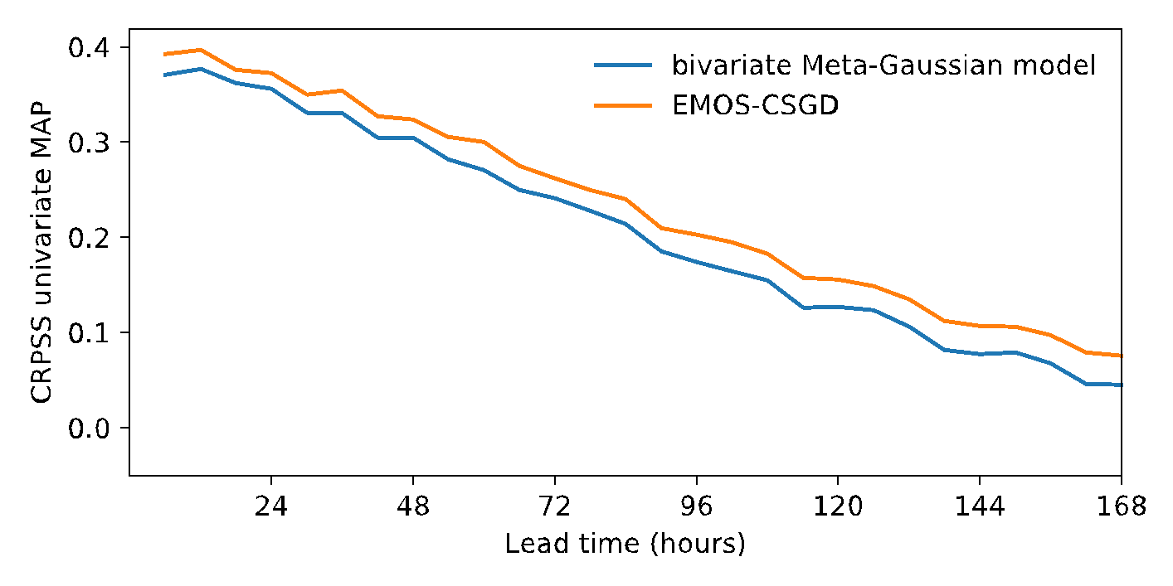
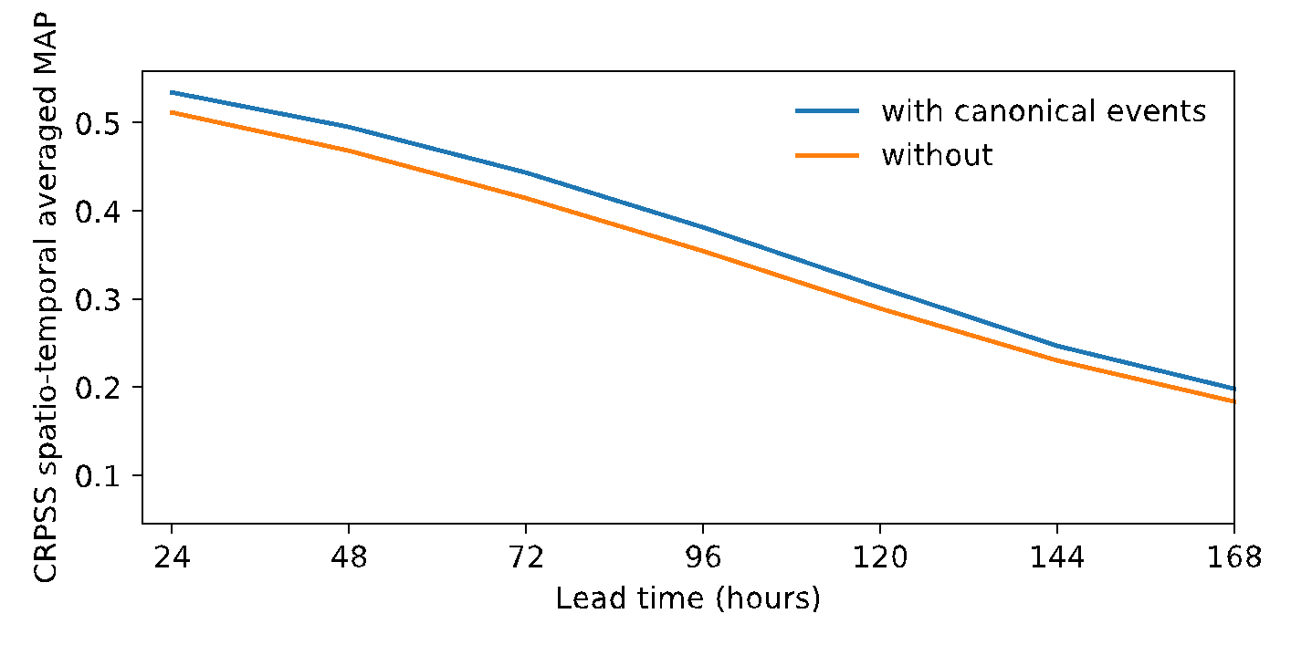
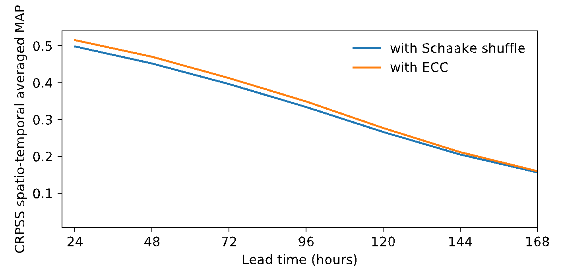
Joseph Bellier’s (formerly PSL/CIRES) and Brett Whitin’s (CNRFC) work to understand
what parts of MEFP provide skill relative to newer methods.
If we replace the Meta-Gaussian model by an EMOS-CSGD:
MEFP made of “inner” features, including:
Bivariate Meta-Gaussian model (univariate post-processing mechanism)
Canonical events (to capture forecast skill at multiple temporal scales of aggregation)
Schaake shuffle (to reconstruct spatio-temporal dependencies)
Experiments (with GEFSv10, on CNRFC basins):
If we replace the Schaake shuffle by ensemble copula coupling (ECC):
If we deactivate the canonical events:
℅ Joseph Bellier (PSL) and Bret Whitin (CNRFC)

Slide 17
Another nascent PSL project with NWM (Mimi Hughes, Diana Stovern, others)
Postprocess GEFS precipitation on its native 25-km grid with CSGD; provide reconstructed ensembles with ensemble copula coupling.
Apply a statistical downscaling (with terrain detail) to each member using Joseph Bellier’s application of Gibbs Sampling Downscaling Method (GSDM) https://doi.org/10.1175/JHM-D-20-0069.1
Test impact of high-resolution downscaled forcings on NWM.
ADV: Statistical downscaling may provide more realistic small-scale uncertainty compared to quantile mapping to CCPA (with deterministic PRISM/Mountain Mapper).
DIS: GSDM is computationally expensive and complicated, as is NWM.

Slide 18
Summary to this point. PSL has a breadth of experience at the interface between ensemble prediction and hydrologic prediction. What can PSL do next to best serve the interests of NWS and its hydrologic stakeholders?

Slide 19
A straw proposal for discussion. PSL proposes:
quantile-mapped
members
(P, tmax, tmin, other)
quantile mapping,
(+ possibly weighting and dressing)
probability generation, ensemble mean
PSL
web, ftp, https
interface
GEFSv12 real-time data
maps of ensemble
mean
…
Ancillary training data, e.g., spline-fitting functions, weighting functions
maps of probabilities
While not addressing every shortcoming in this simple calibration process, it provides internally consistent, hi-res precip forcings. Variety of customers (OWP, RFCs, WPC, CPC, MDL) can view what GEFSv12 quantile mapped guidance looks like; provide feedback, make informed decisions about incorporating it into their own products.

Slide 20
Another straw proposal: testing hydrologic impact in first 10 days of forecast.
ensemble-
mean quantities
MEFP
HEFS
reference
ensemble
stream flow
evaluation
quantile-mapped or other PSL-processed
members
(P, tmax, tmin, other)
alternative
ensemble
stream flow
This is more involved, possibly beyond the ability of PSL to take on without identification of new resources.

Slide 21
Questions on our mind.
Are hydrologists ready to ID partners we can work with to flesh this out?
The inevitable tension between completeness and project expense. Sweet spot?
Longer record: hydrologists like to test many significant cases in the past.
ADV: robust results.
DIS: fewer reforecast members, greater compute and work scope all around if PSL does retro testing.
Fewer vs. more forcing variables post-processed by PSL:
Precip only: simple, comparatively inexpensive, most impact from this variable.
6-hourly temp is reasonably straightforward, but more work.
Freezing level would involve quite a bit of extra data processing.
Longer leads? To +10 days is straightforward. Work scope could also expand to include longer leads, e.g., out to 35 days, of course with greater expense.
Test at selected RFCs? Across CONUS?
Can we meet diverse needs of other organizations (CPC, WPC, MDL) as we build this?

Slide 22
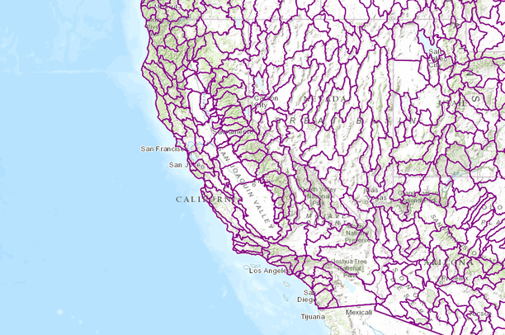
If this makes sense, what are some preliminary requirements?
What information in real-time web page will be the most useful?
Presume you want our GEFSv12 calibrated data mapped to HUC level 8 watersheds? Other?
Variables: P. Also T_{max}, T_{min}, freezing level, etc?
Forcing temporal frequency (6 h)?
Test to what lead time initially (240 h?)
Saved in netCDF format?
Which forecast cycles? 00 UTC only?
Real-time, reforecast, specific past cases?
Roles and responsibilities of partners.
Timeline.
HUC level 8 basins in Southwest US

Slide 23
Conclusions
We think it’s timely to re-evaluate meteorological preprocessing, as GEFSv12 quality has changed substantially since construction of MEFP.
PSL hypothesizes it has capabilities that may improve hydrologic forcings relative to MEFP, but we can make more rapid progress to test hypotheses in collaboration with you.
Collaboration could be minimal (few resources) to quite involved (will need to ID more resources).

Slide 24
Supplementary slides.

Slide 25
MEFP and its assumptions
“The MEFP aims to generate unbiased ensembles that capture the skill of the forecasts from multiple sources for individual basins while preserving the space–time properties of hydrometeorological variables (e.g., precipitation and temperature) across all basins.”
Therefore, the MEFP uses the single-valued forecasts modified by human forecasters for short-range forecast horizon (up to 7 days) and the ensemble mean forecasts from multiple NWP models for mid- to long range to generate seamless and calibrated hydrometeorological ensembles up to a 1-yr forecast horizon.
MEFP uses the normal quantile transform (NQT) to transform observed and forecast precipitation variables into normal variates. The precipitation part of MEFP also includes an explicit treatment of precipitation intermittency using the mixed-type bivariate meta- Gaussian model (Herr and Krzysztofowicz 2005), parametric and nonparametric modeling of the marginal probability distributions, and a parameter optimization under the continuous ranked probability score (CRPS; Hersbach 2000) and other criteria (see Wu et al. 2011 for details)
For temperature, the MEFP procedure first generates ensembles of daily maximum and minimum temperatures, and then generates ensembles at subdaily time steps from the daily ensembles through a diurnal variation model. The above scheme is based on the same interpolation procedures used to calculate sub-daily historical temperature time series and account for the diurnal cycle assumed in the operational calibration process (Anderson 1973).
For each hydrometeorological variable for a given basin (i.e., precipitation, maximum temperature, and minimum temperature), a specific forecast source, and a given forecast lead time, MEFP estimates the joint probability distribution of observations and single-valued forecasts based on a multiyear archive of the observations and forecasts. This calibration is performed for each day of the year by pooling historical observed–forecast pairs from a time window centered on that day in order to account for seasonality. In real time, given the current single-valued forecast, MEFP derives the conditional probability distribution of the observations, from which ensemble members are sampled. The ensemble members are generated for each individual time step, and then the Schaake shuffle (Clark et al. 2004) is applied to arrange the ensemble values according to the ranks of the historical observations.
from DeMargne et al BAMS article

Slide 26
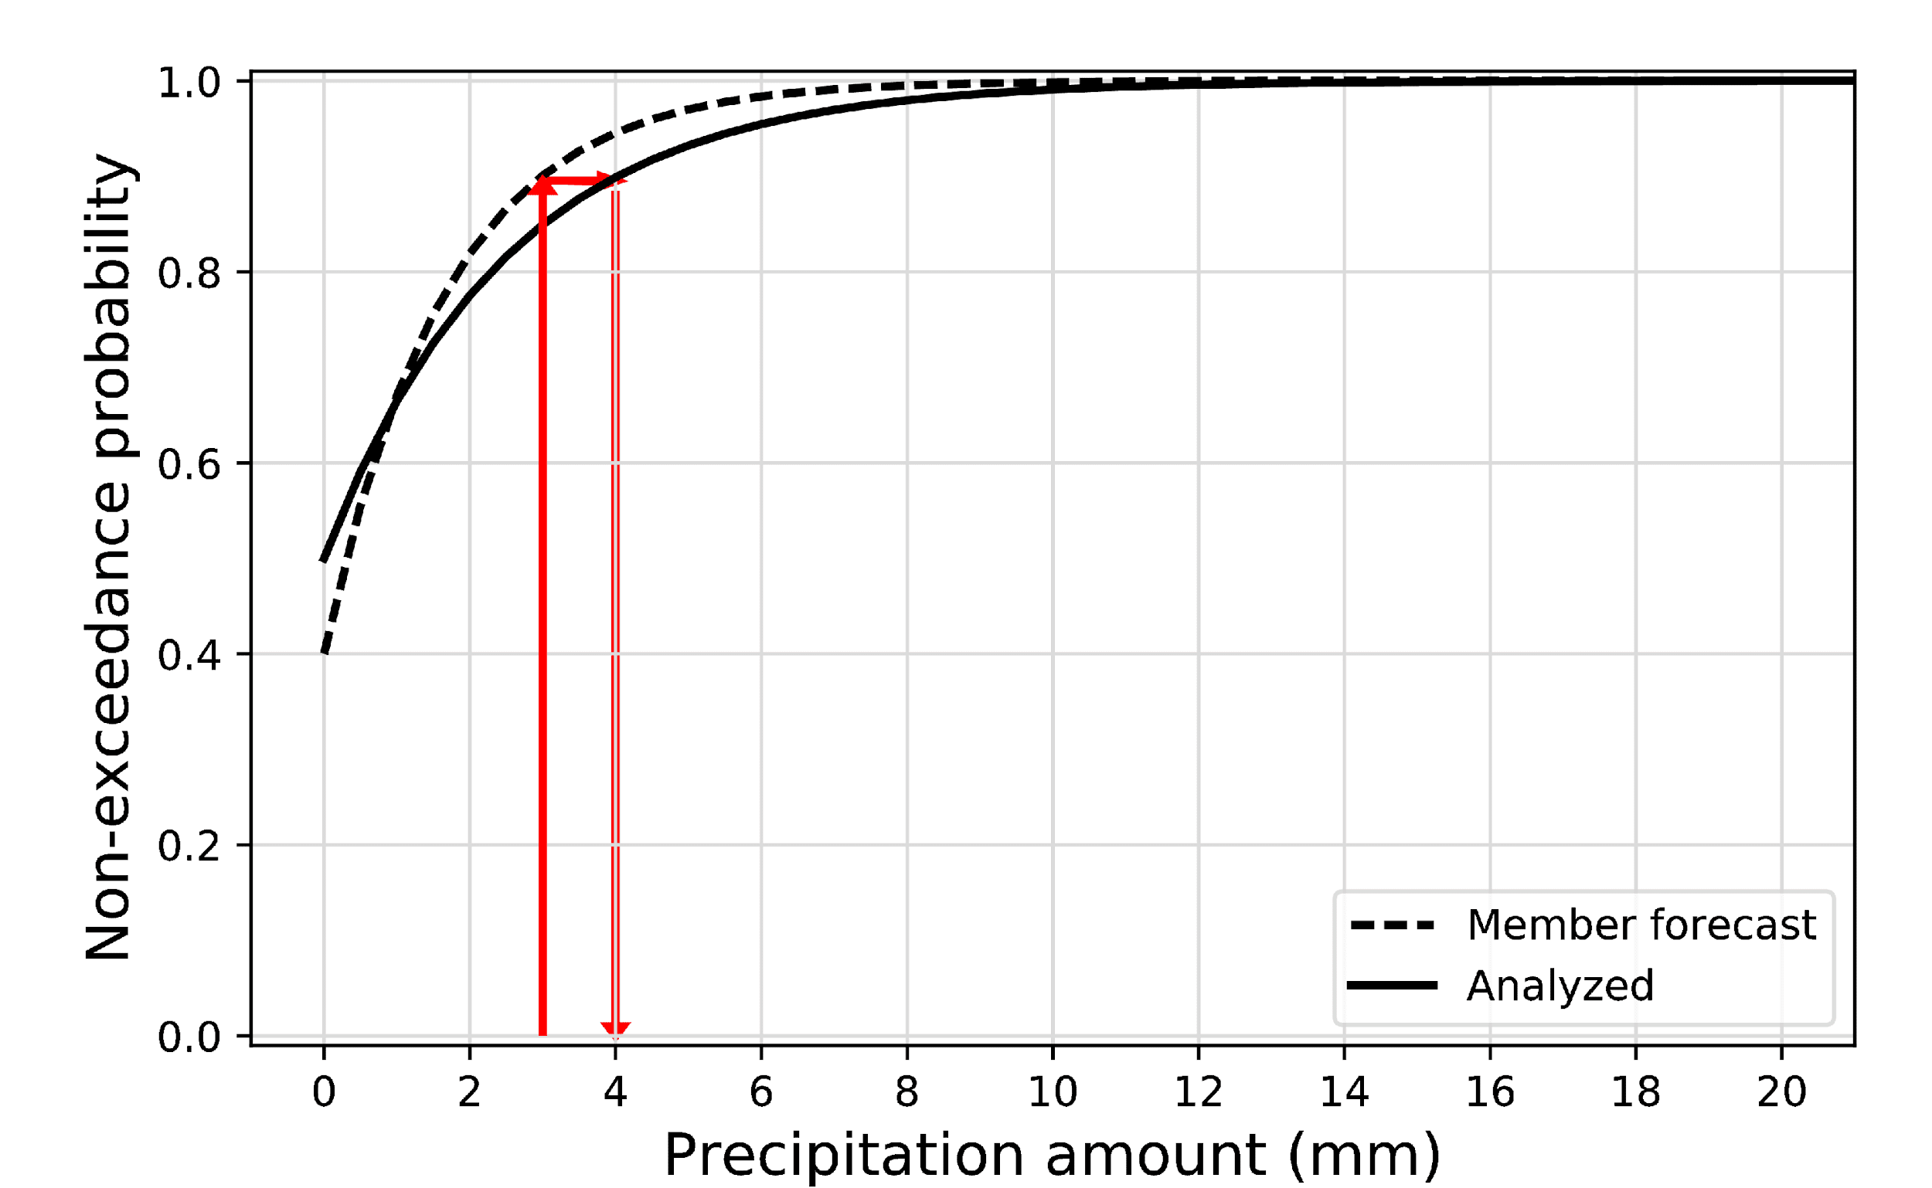
Quantile mapping
The challenging aspect is to develop a procedure for estimating the CDFs
as accurately as possible, especially at the highest
quantiles.
ADV: (a) simplicity,
(b) preserves rank-order relationships; quantile-mapped ensembles can be used directly as hydro inputs.
DIS: doesn’t account for all sources of ensemble errors, e.g., overconfidence.

Slide 27
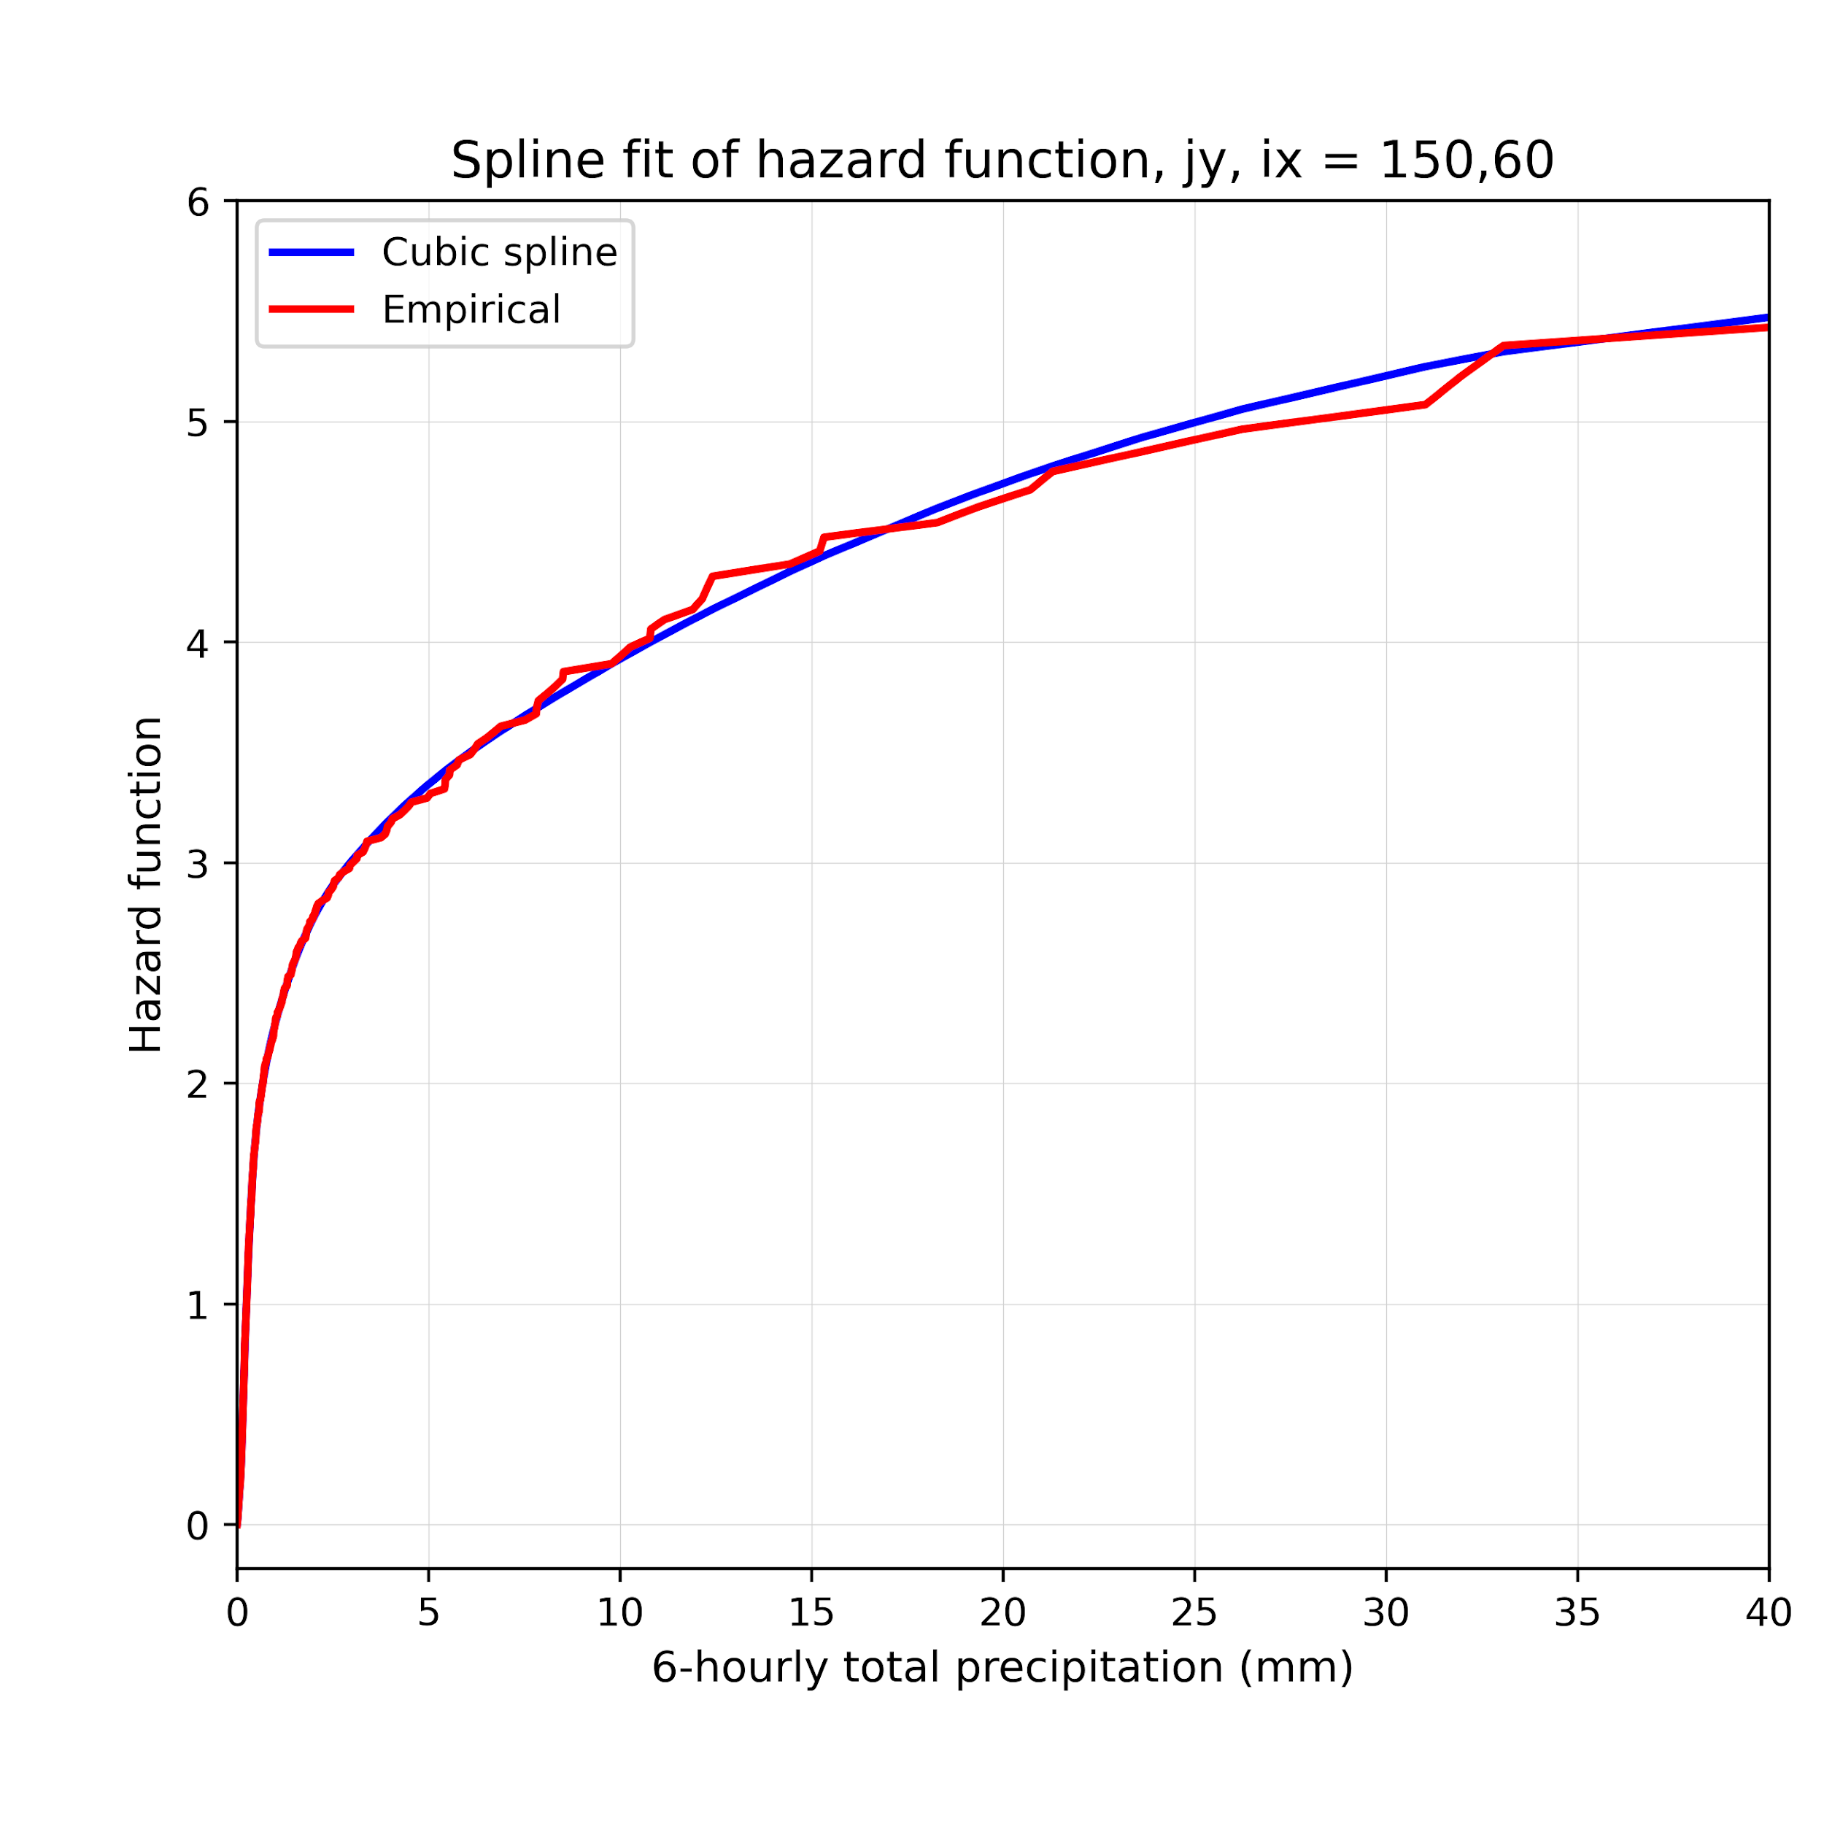
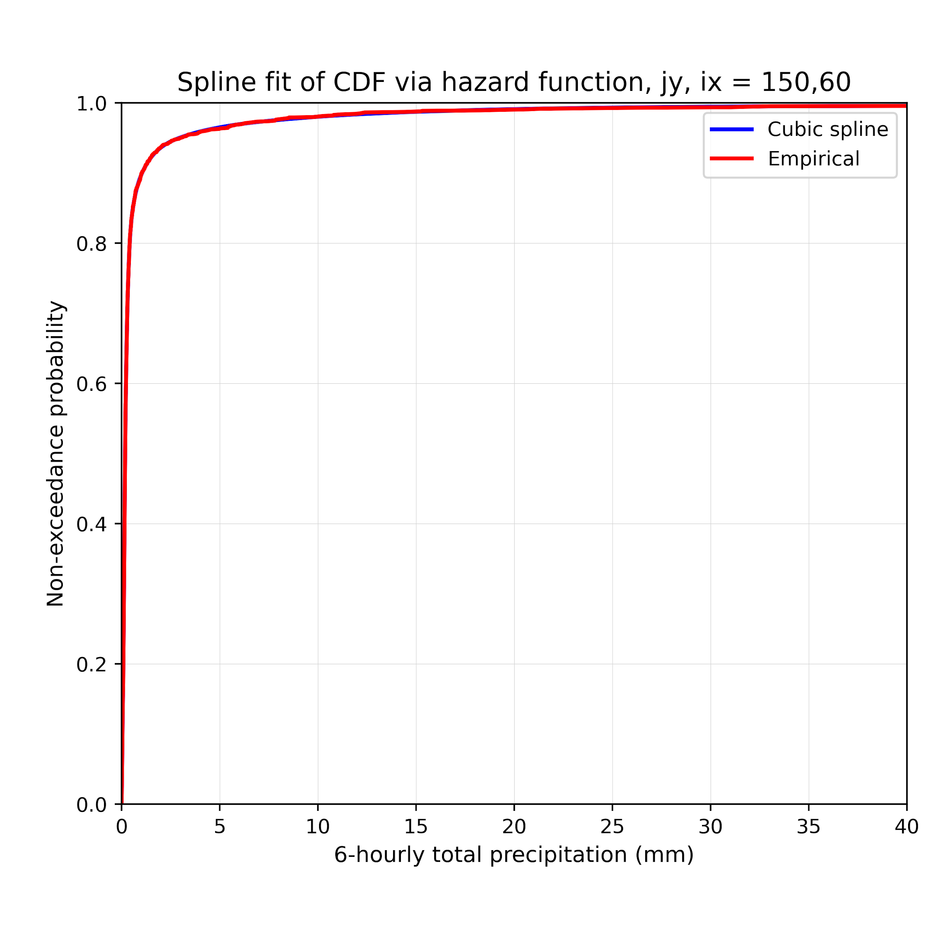
Estimate CDFs in quantile mapping with “cumulative hazard function” applied to 6-hourly precipitation.
Fit a cubic spline to the cumulative hazard function, H(x) = -log[1-F(x)], where F(x) is the empirical cumulative distribution. Then can transform back after the spline fit. This follows Scheuerer et al. (2020) here; see Fig. 3 therein. Separately estimate for each month, lead time, and each model grid point.
(fit using this “cumulative
hazard function,” which is more linear in the tail)
… transform back to this CDF

Slide 28
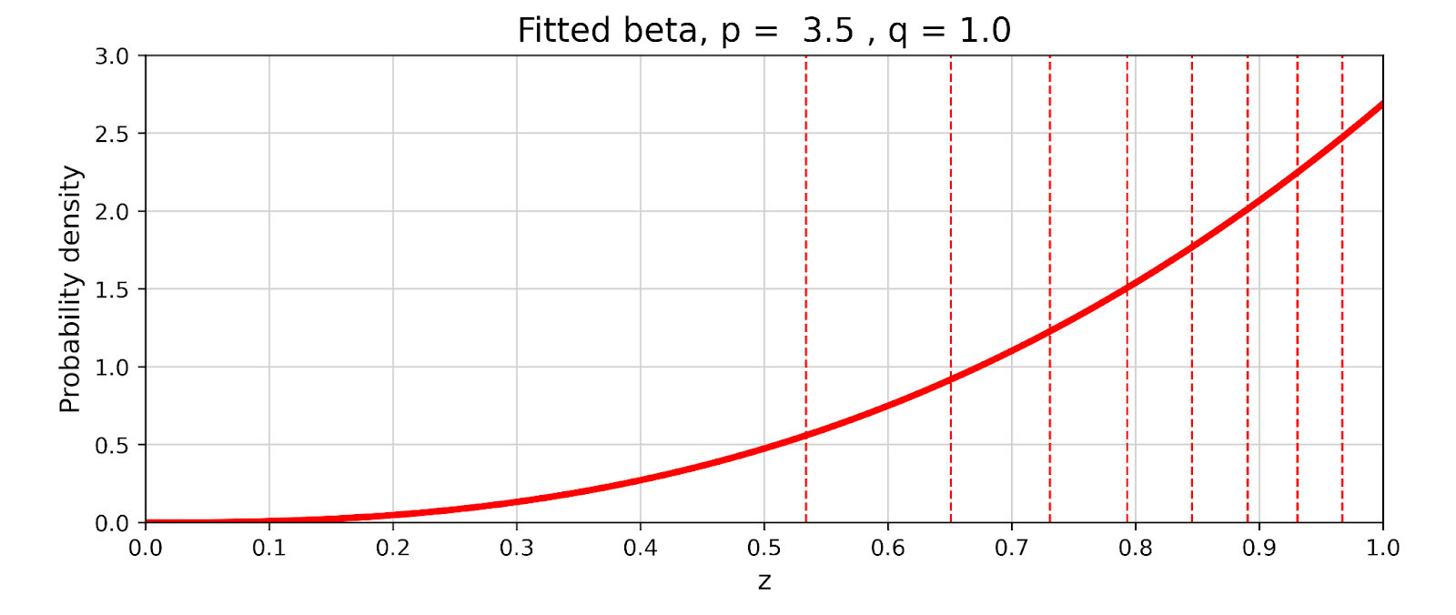
Defining more spline knots at higher precipitation amounts? Here’s how.
Both CDFs and beta distributions are defined on the interval [0,1]. Sampling quantiles of a beta distribution with the shape below will emphasize choosing knot locations toward upper quantiles. Here, 8 interior knots (dashed lines).
The number of knots
is determined by the
number of precipitation
samples with non-zero
precipitation. More
precipitation, more interior knots, up to a maximum of 9.

Slide 29
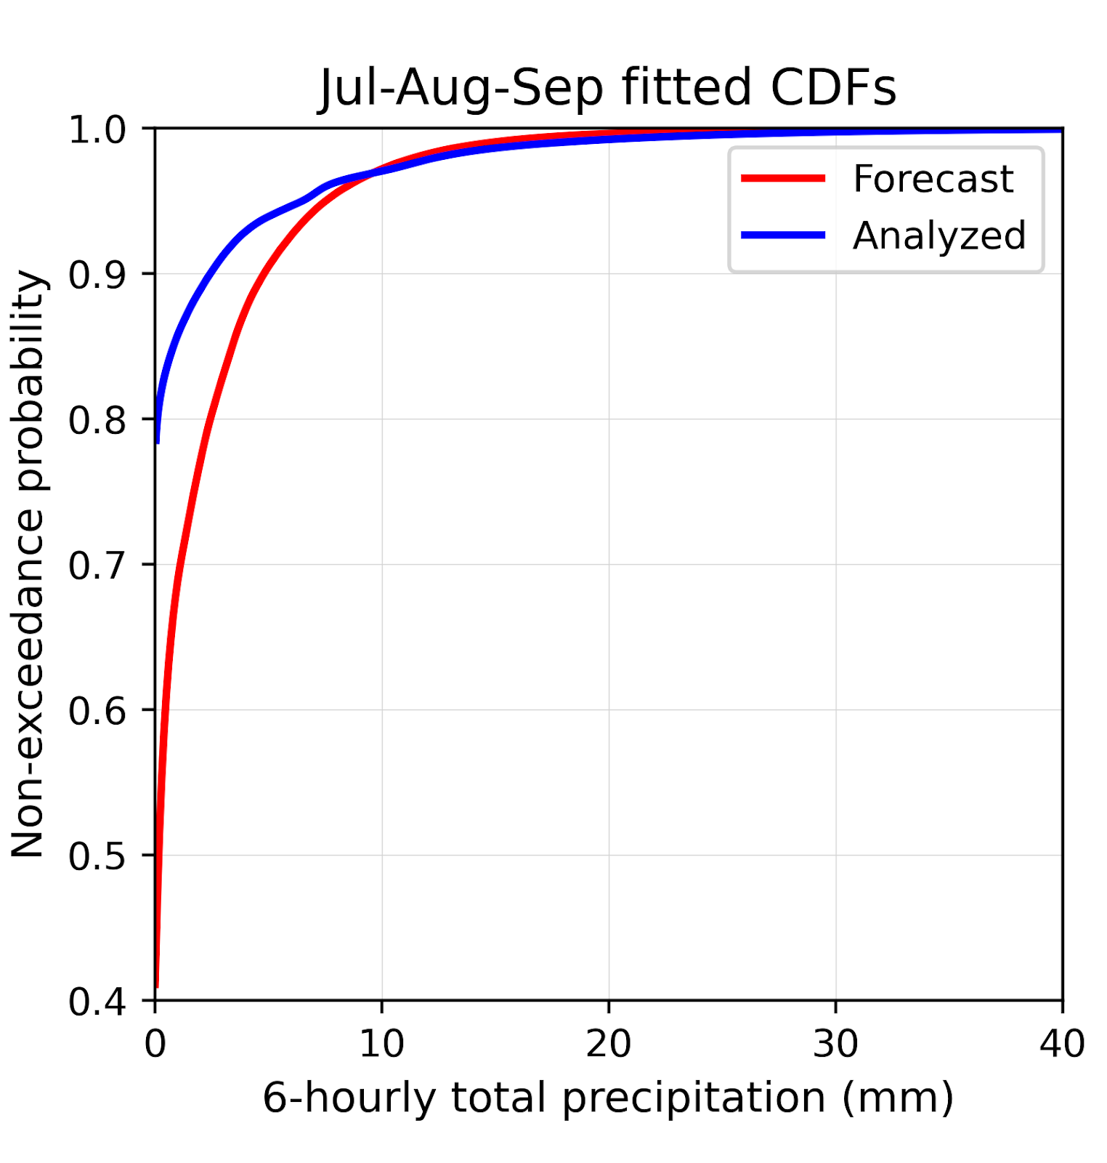
Example of spline-fitted CDFs applied to quantile mapping.
Ithaca, NY again as an example.
As opposed to plots on previous slides,
these CDFs now include zero values,
defined with the empirical count of
samples that have zero precipitation.

Slide 30
A very small change in the slope can have a
big impact on the quantile mappings for
these high precipitation amounts.
Accordingly, we’ve made a few conservative assumptions.
Past the 99th percentile of samples with precipitation, use the quantile mapping correction at the 99th percentile added to the raw forecast amount.
Use a variable number of spline knots, fewer for locations that are drier.
If the point is really dry, spline-fitting isn’t realistic, and we default to the use of Gamma distribution fitting.
Ithaca, NY again.

Slide 31
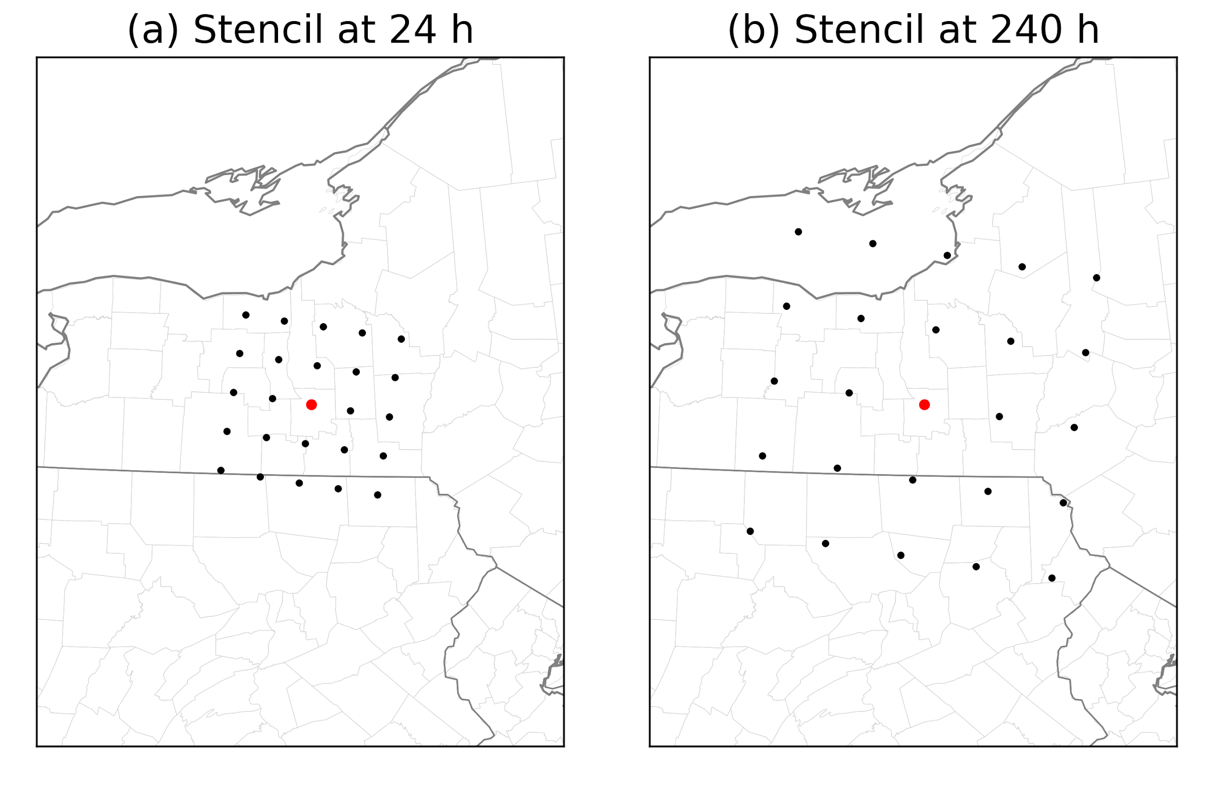
Stencil size: a tune-able hyperparameter
Forecast quantiles were computed at each of the 25 dots, quantile mapped to analyzed value at the
central dot. The rational was to account for overconfidence in precipitation position errors.

Slide 32
Training the 06, 12, 18 UTC initialization times with only reforecast initialization at 00 UTC?
Assume precipitation biases vary with diurnal cycle, so ….
Forecast hours accumulation period | 00 UTC initialization training data | 06 UTC initialization training data | 12 UTC initialization training data | 18 UTC initialization training data000-
000-006 | 000-006 hours, 00 UTC init | 006-012 hours, 00 UTC init | 012-018 hours, 00 UTC init | 018-024 hours, 00 UTC init
006-012 | 006-012 hours, 00 UTC init | 012-018 hours, 00 UTC init | 018-024 hours, 00 UTC init | 024-030 hours, 00 UTC init
012-018 | 012-018 hours, 00 UTC init | 018-024 hours, 00 UTC init | 024-030 hours, 00 UTC init | 030-036 hours, 00 UTC init
018-024 | 018-024 hours, 00 UTC init | 024-030 hours, 00 UTC init | 030-036 hours, 00 UTC init | 036-042 hours, 00 UTC init
024-030 | 024-030 hours, 00 UTC init | 030-036 hours, 00 UTC init | 036-042 hours, 00 UTC init | 042-048 hours, 00 UTC init
030-036 | 030-036 hours, 00 UTC init | 036-042 hours, 00 UTC init | 042-048 hours, 00 UTC init | 048-054 hours, 00 UTC init
036-042 | 036-042 hours, 00 UTC init | 042-048 hours, 00 UTC init | 048-054 hours, 00 UTC init | 054-060 hours, 00 UTC init
etc.
In other words, use 00 UTC data at the appropriate period of the diurnal cycle.

Slide 33
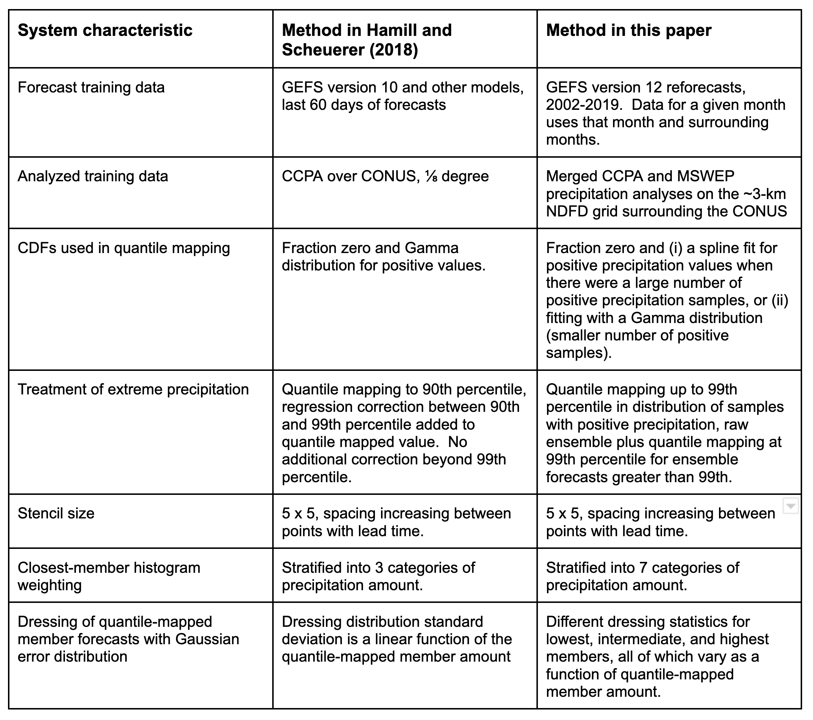
Summary of proposed changes for GEFSv12-based quantile mapping.

Slide 34
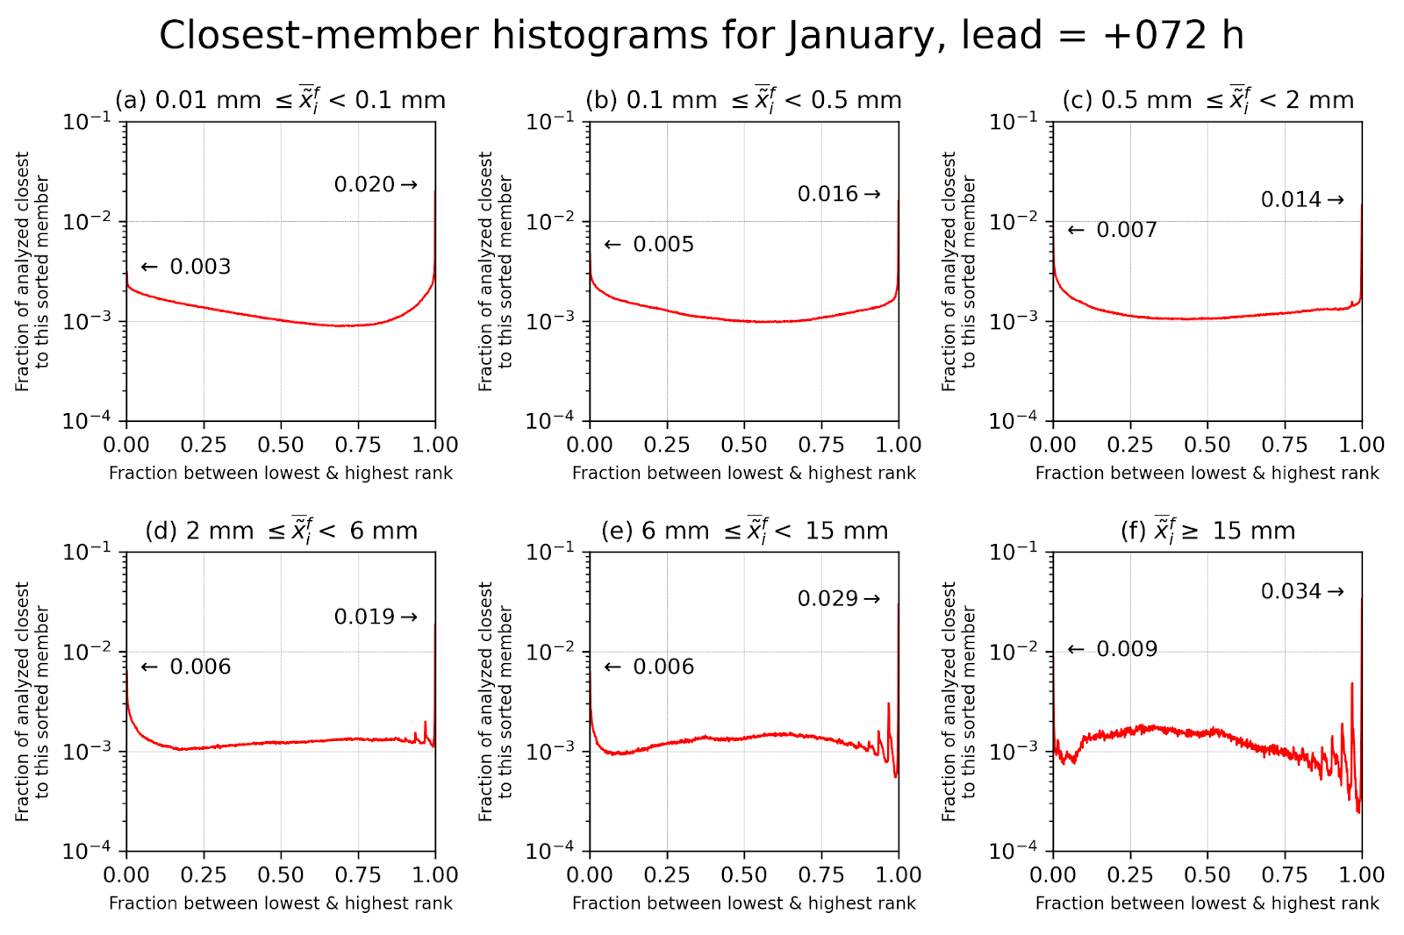
Revised closest-member histograms: more categories based on ensemble-mean precipitation amount.

Slide 35
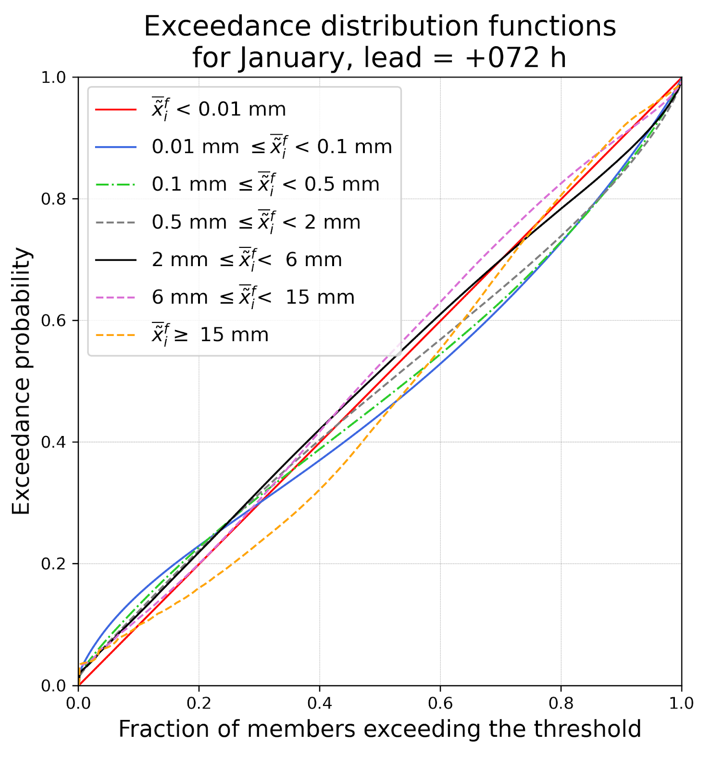
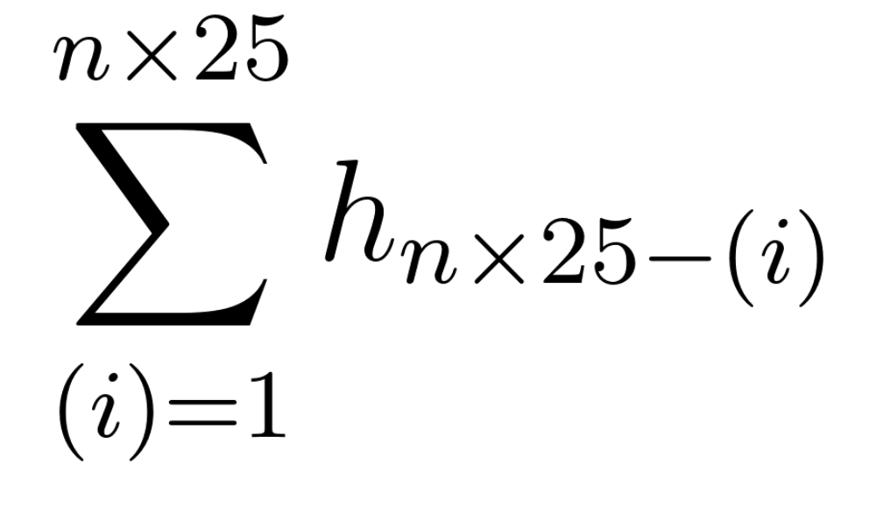
Exceedance distribution functions derived from closest-member histograms. Ignore the dressing for the moment. Then probabilities of exceeding Z are effectively:
The diagram shows
as function
of

Slide 36
Exceedance distribution functions derived from closest-member histograms
Suppose:
We’re making a prediction of exceeding 25 mm.

Slide 37
Exceedance distribution functions derived from closest-member histograms
Suppose:
We’re making a prediction of exceeding 25 mm.
The ensemble mean is 20 mm.

Slide 38
Exceedance distribution functions derived from closest-member histograms
Suppose:
We’re making a prediction of exceeding 25 mm.
The ensemble mean is 20 mm.
50 percent of the quantile mapped members
exceed 25 mm.
So, the revised weighted probability is ~ 43%.

Slide 39
This over-simplifies the
procedure that’s actually
applied.
We objectively generated
dressing statistics for
the lowest sorted member,
intermediate members, and
the highest member as a
function of the ensemble-
mean precipitation amount
(next slide).
inspired by Roulston and Smith, Tellus A, 2002,
and the concept of Bayesian Model Averaging,
e.g. Raftery et al., MWR, 2005.

Slide 40
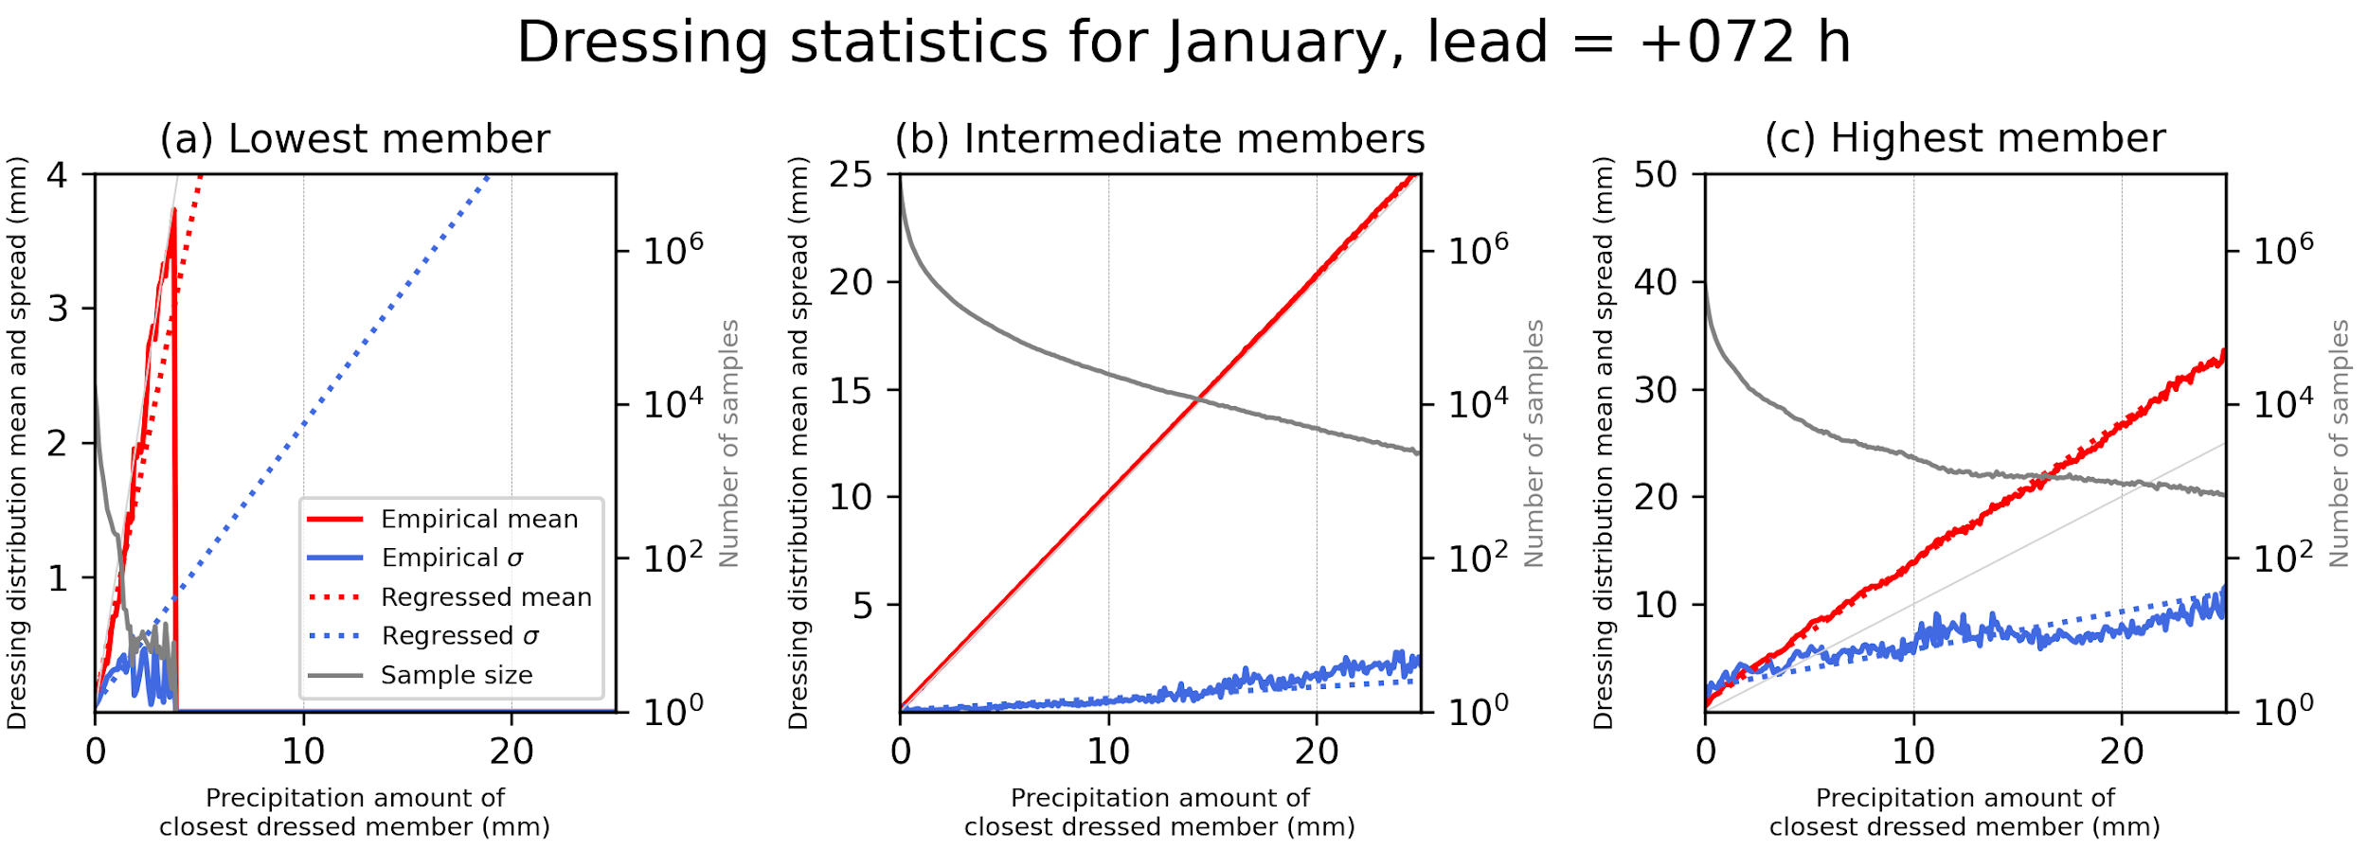
Dressing statistics were computed separately by comparing the value of the analyzed when (a) the lowest member was
the best member, or (b) an intermediate member, or (c) the highest member.
The regressed mean of the dressed distribution for the lowest member is actually lower than the value of the member
itself. Similarly, the regressed mean for the highest member is larger than the member value. In this way, it slightly
increases the ensemble spread.
Separate statistics were computed for each lead time, each month of the year.

Slide 41
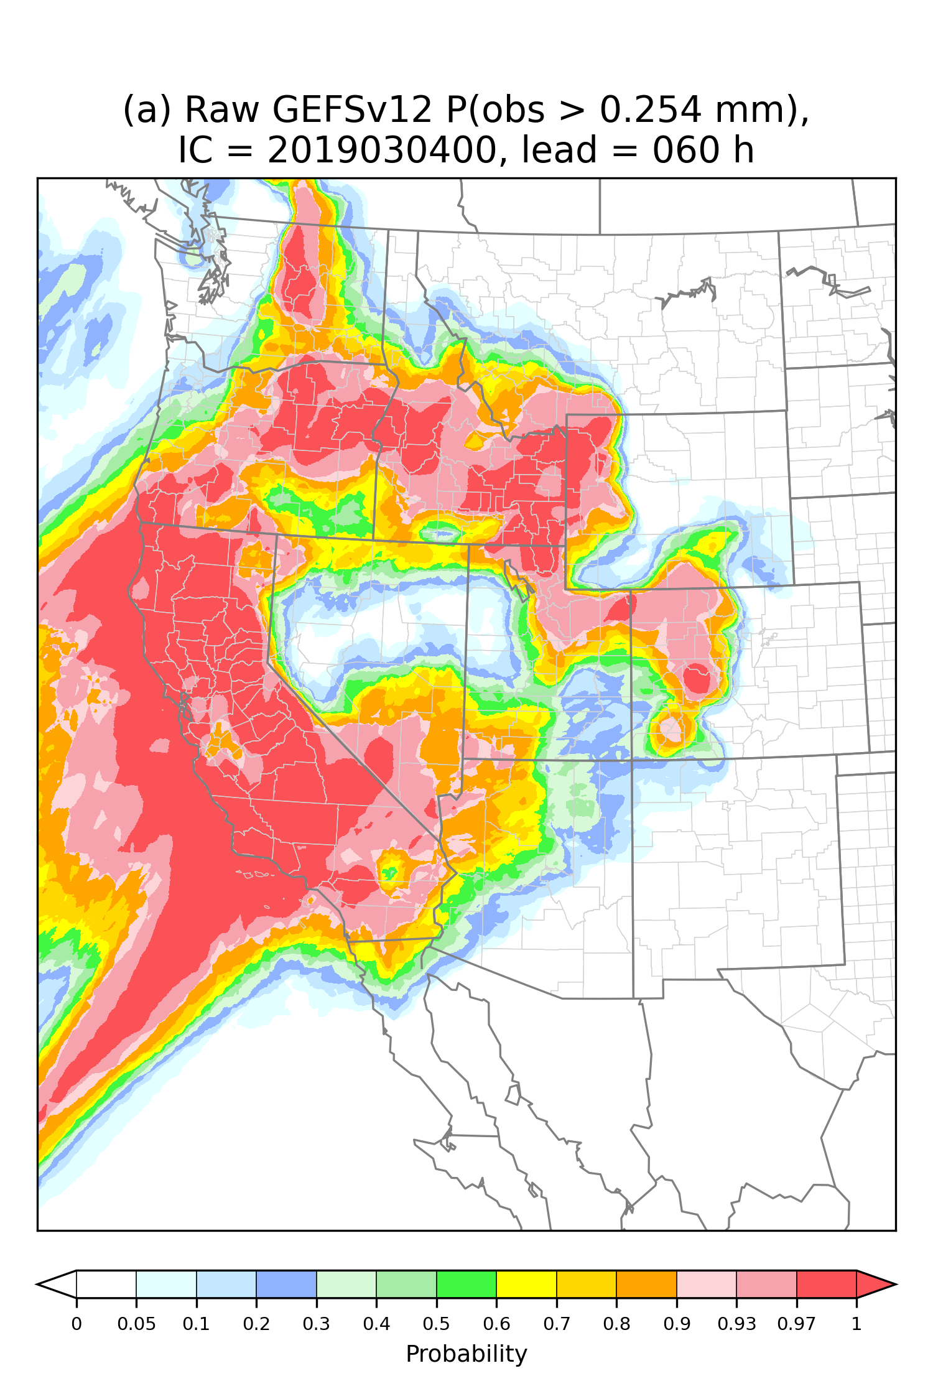
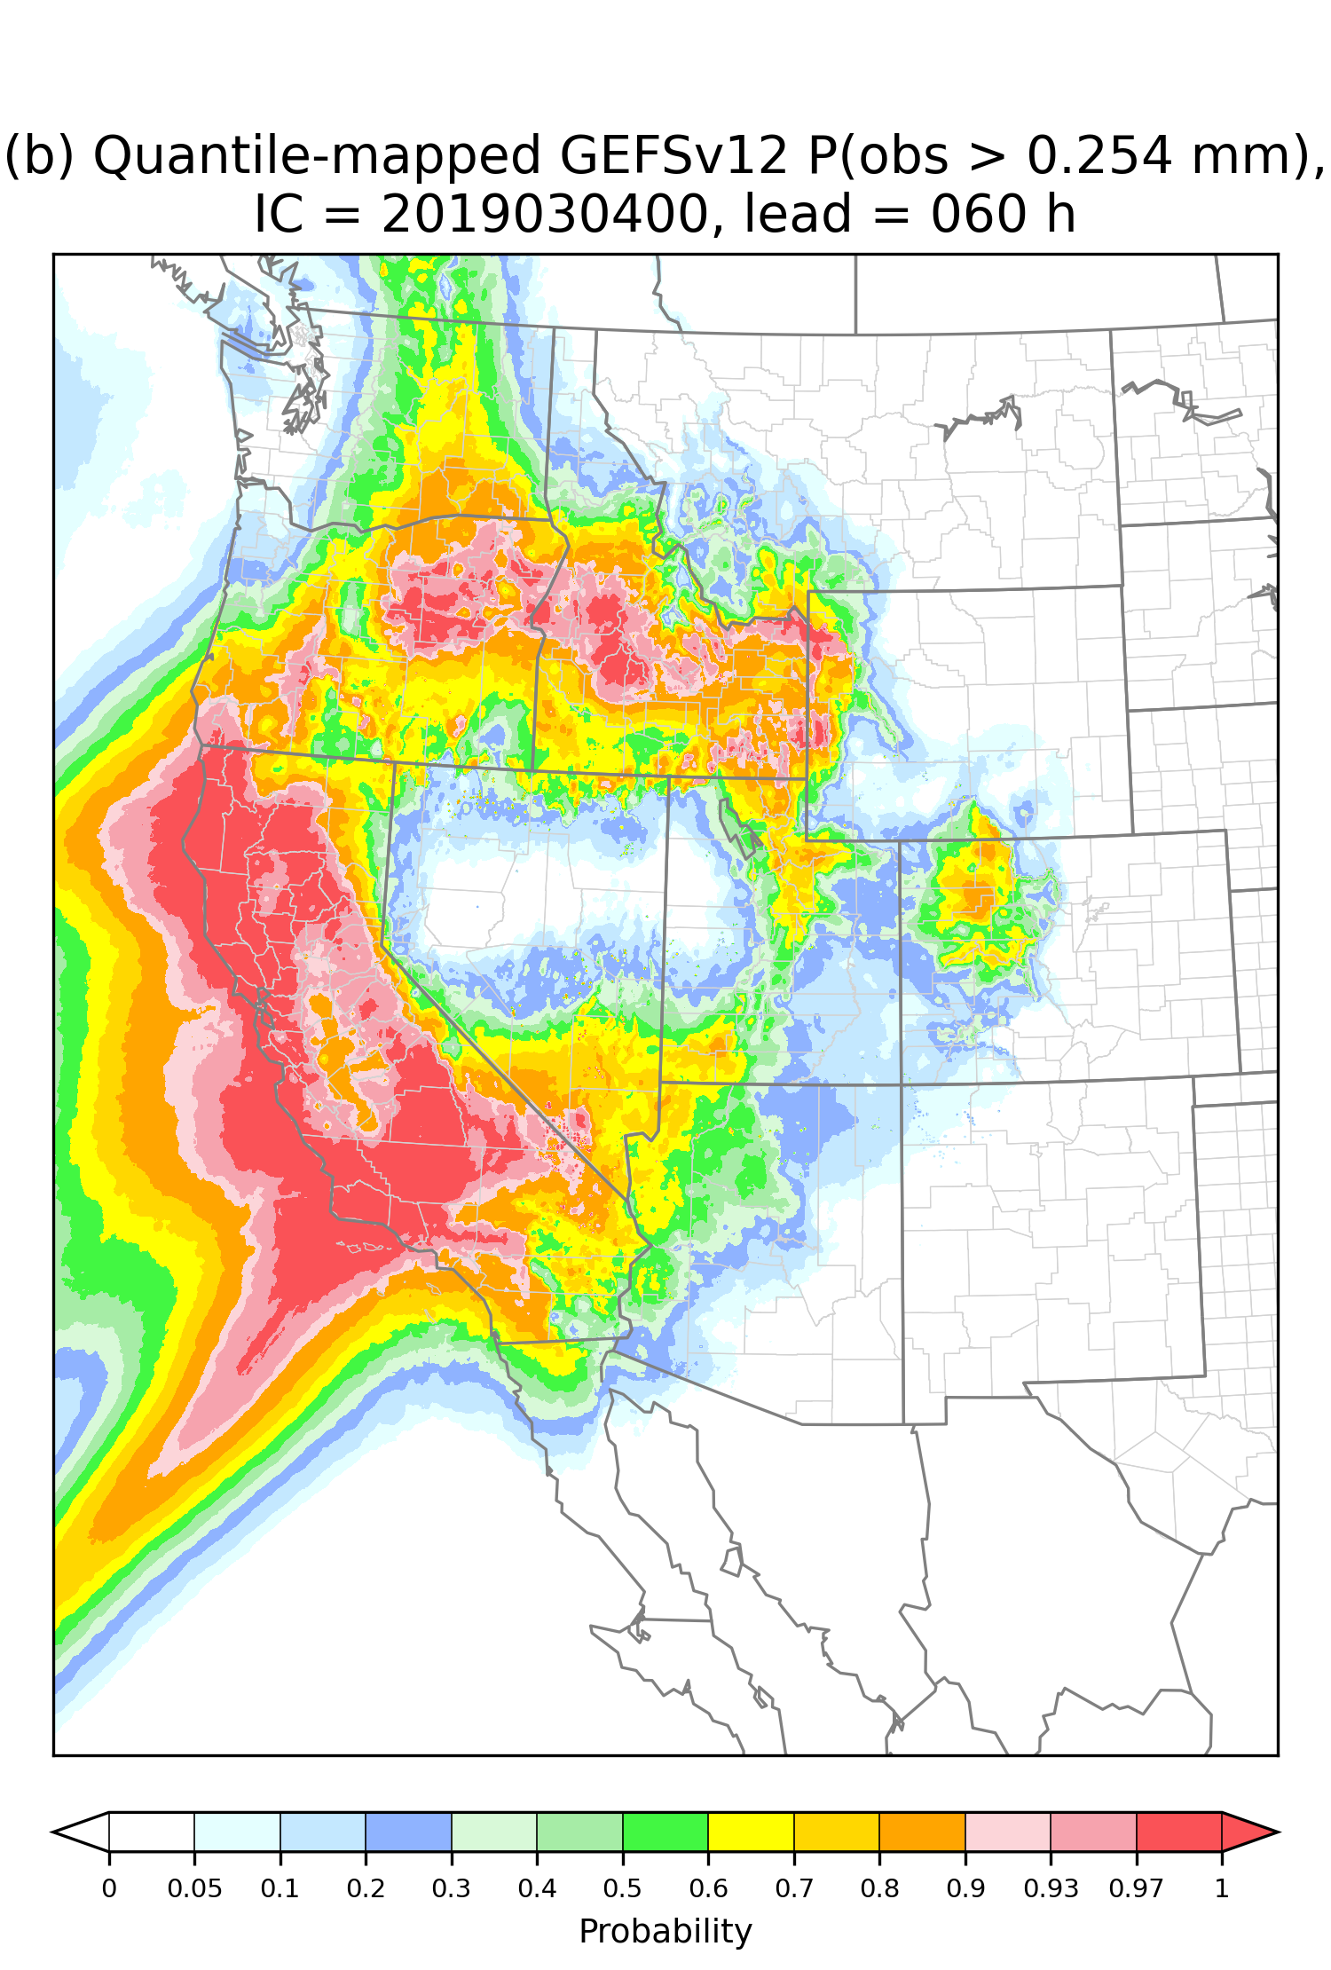
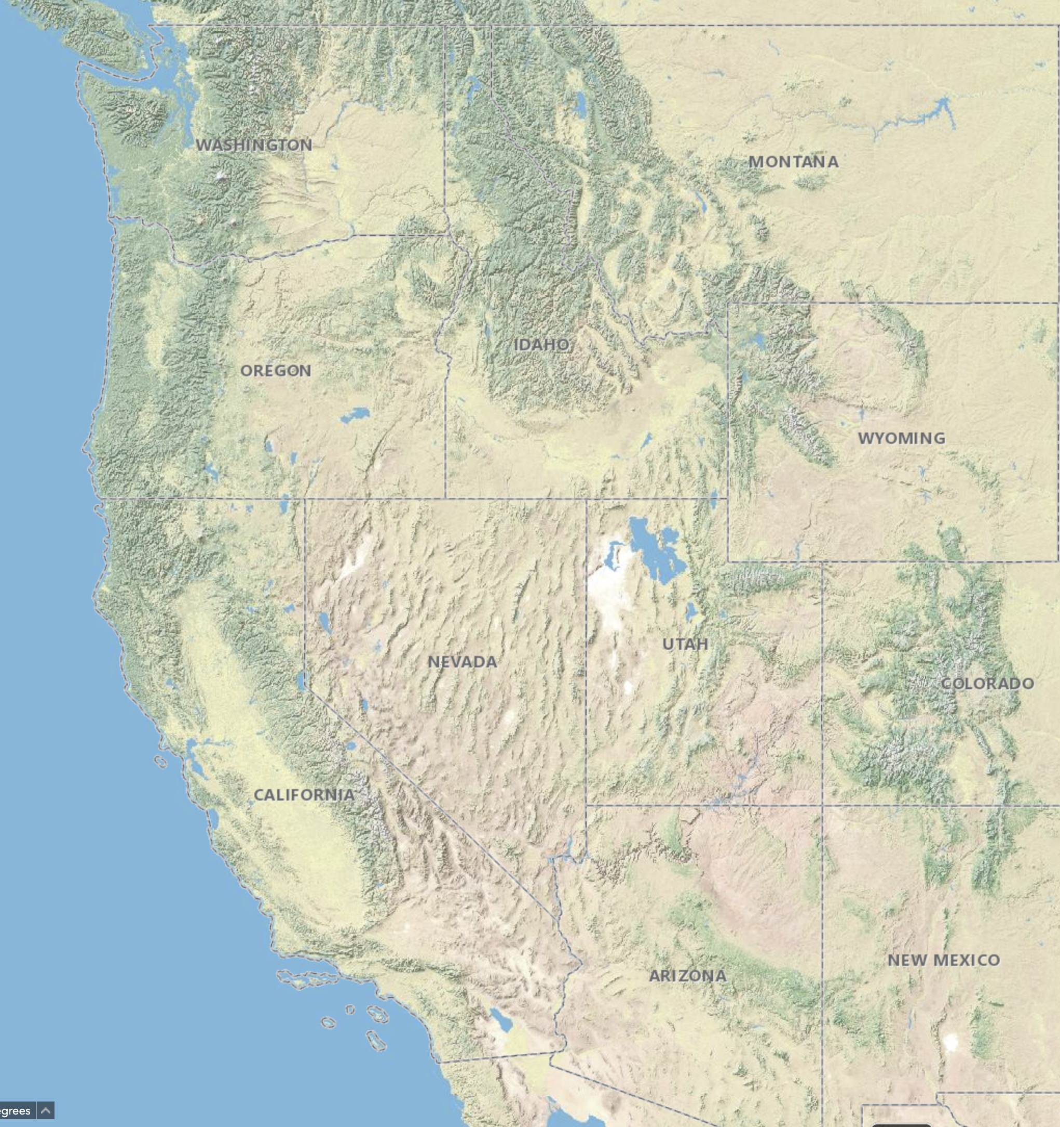
Case study, probability of non-zero precipitation, 54-60 h forecast from 00 UTC 4 March 2019

Slide 42
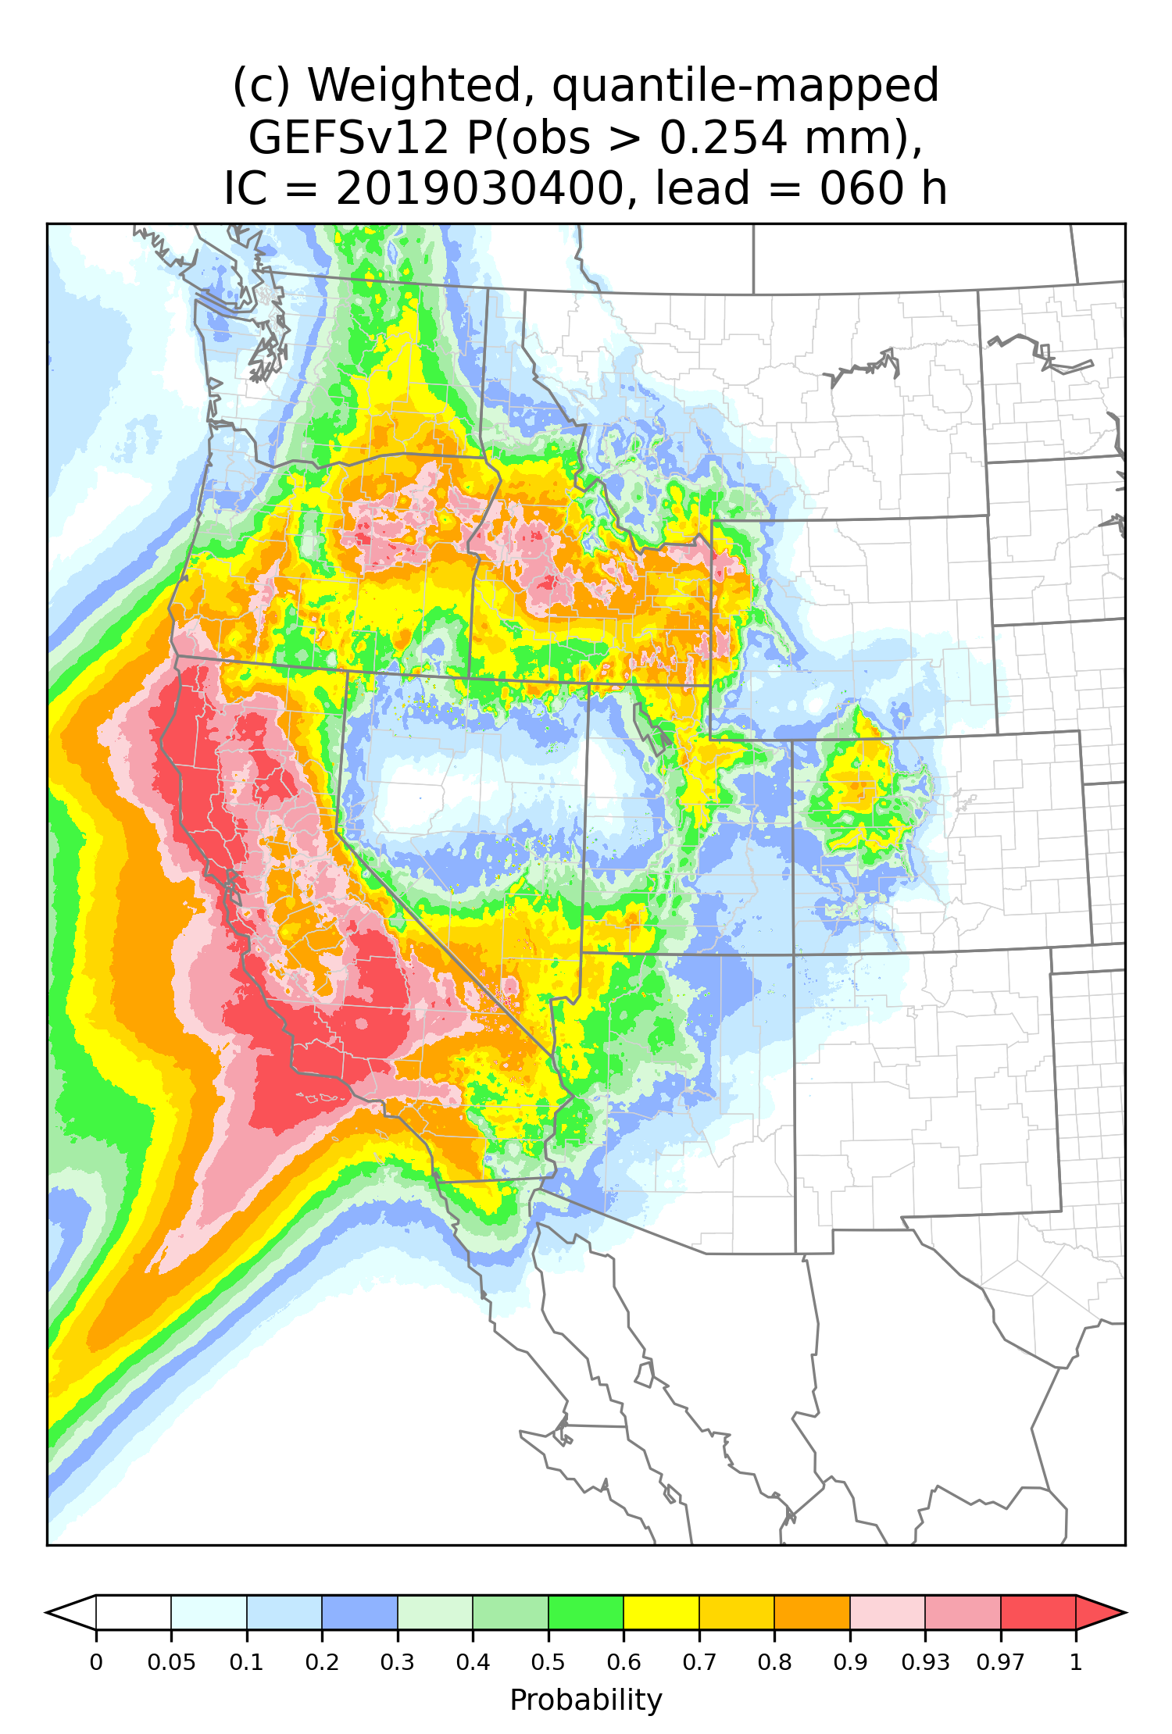
Case study, probability of non-zero precipitation, 54-60 h forecast from 00 UTC 4 March 2019

Slide 43
Case study, probability of non-zero precipitation, 54-60 h forecast from 00 UTC 4 March 2019

Slide 44
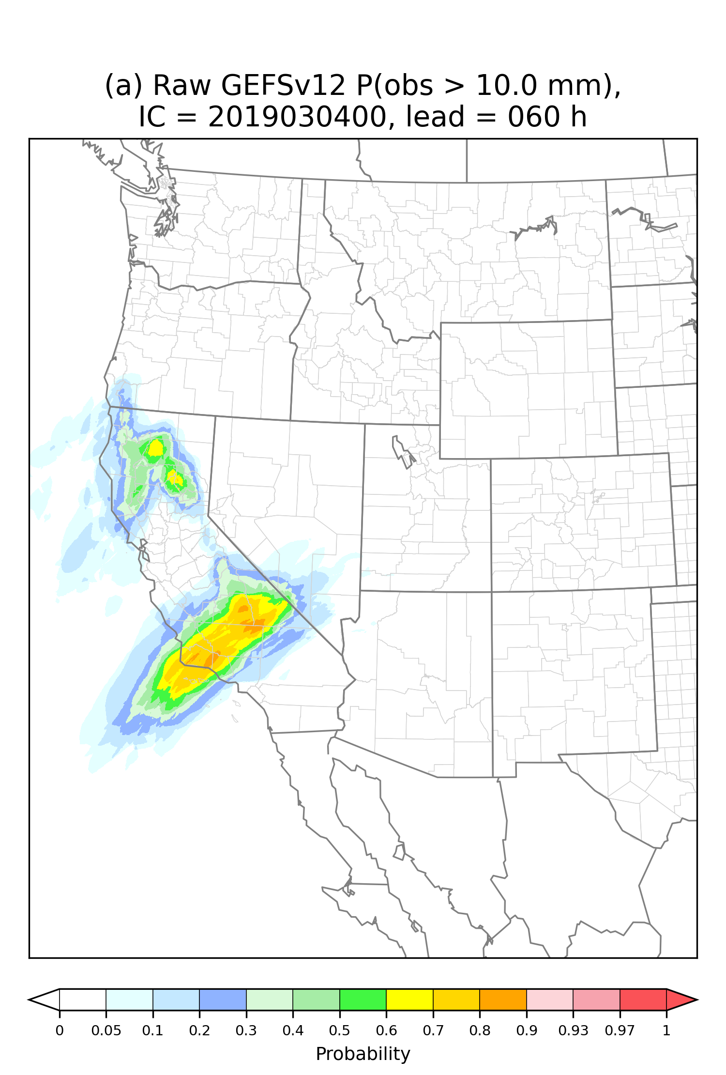
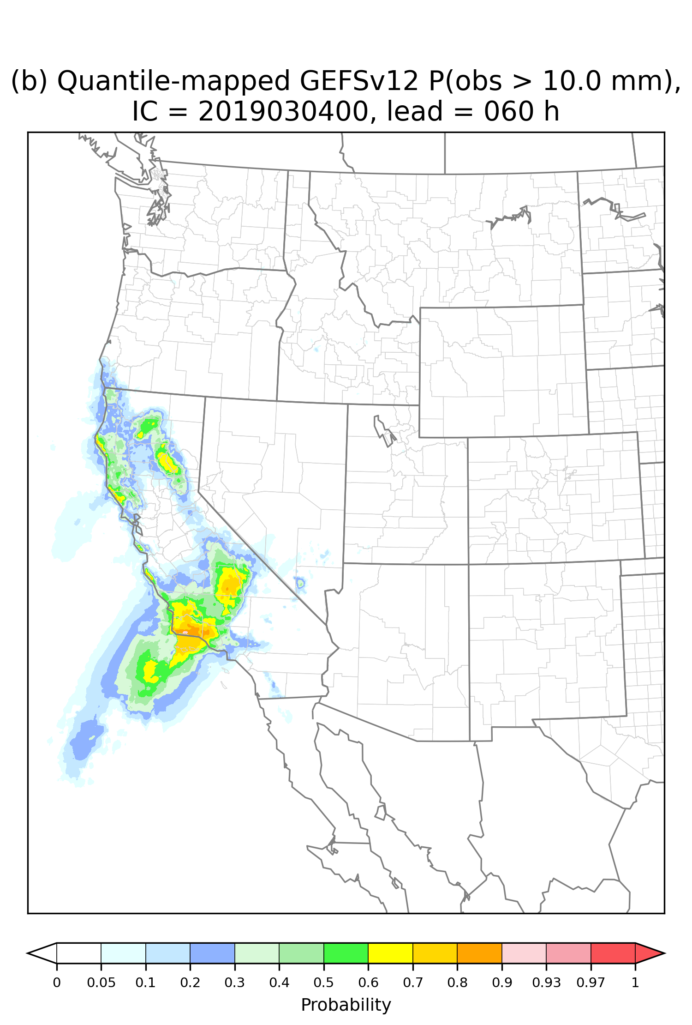
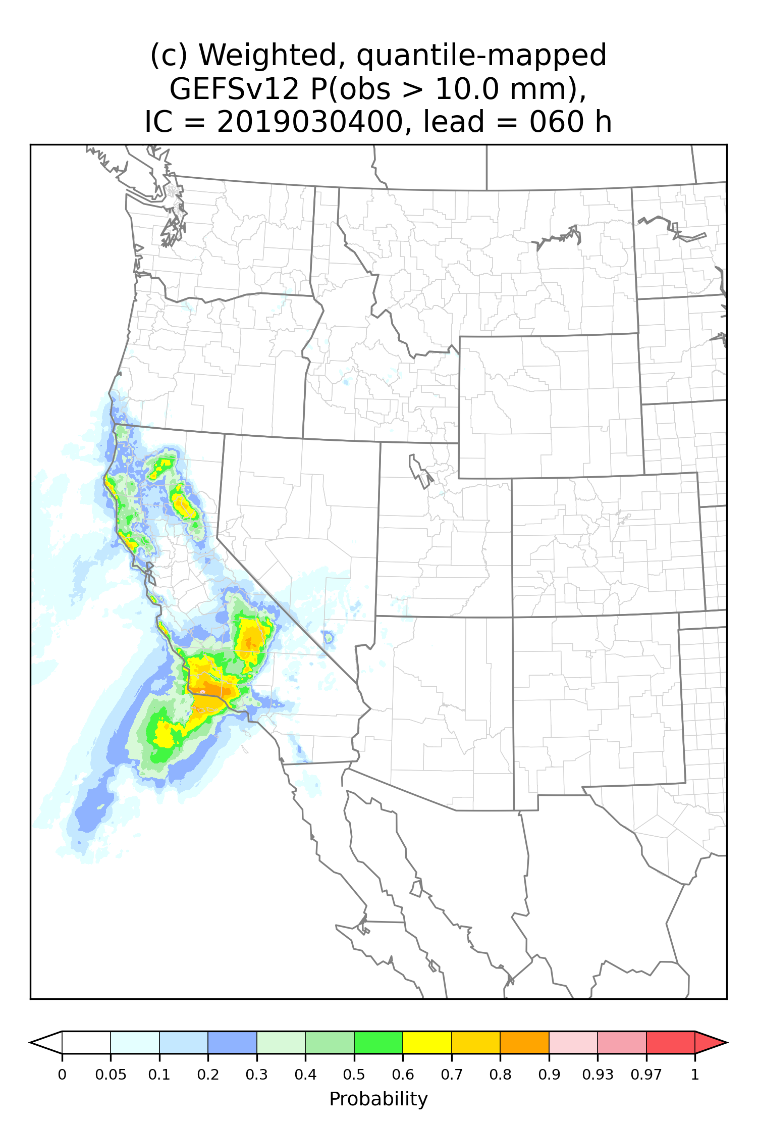
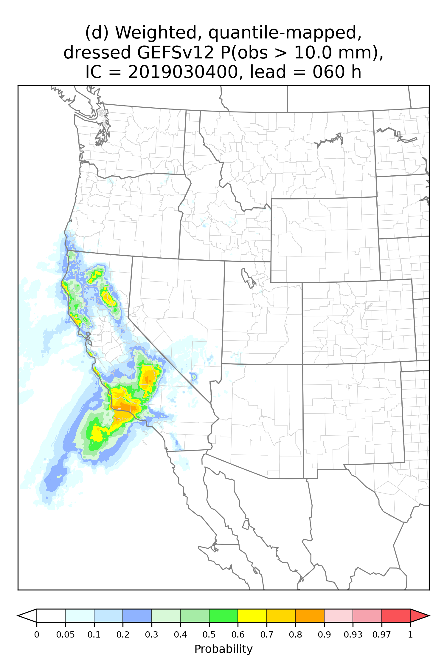
Case study, probability of non-zero precipitation, 54-60 h forecast from 00 UTC 4 March 2019
> 10 mm
Raw
Quantile mapped
+weights to sorted members
+dressing

Slide 45
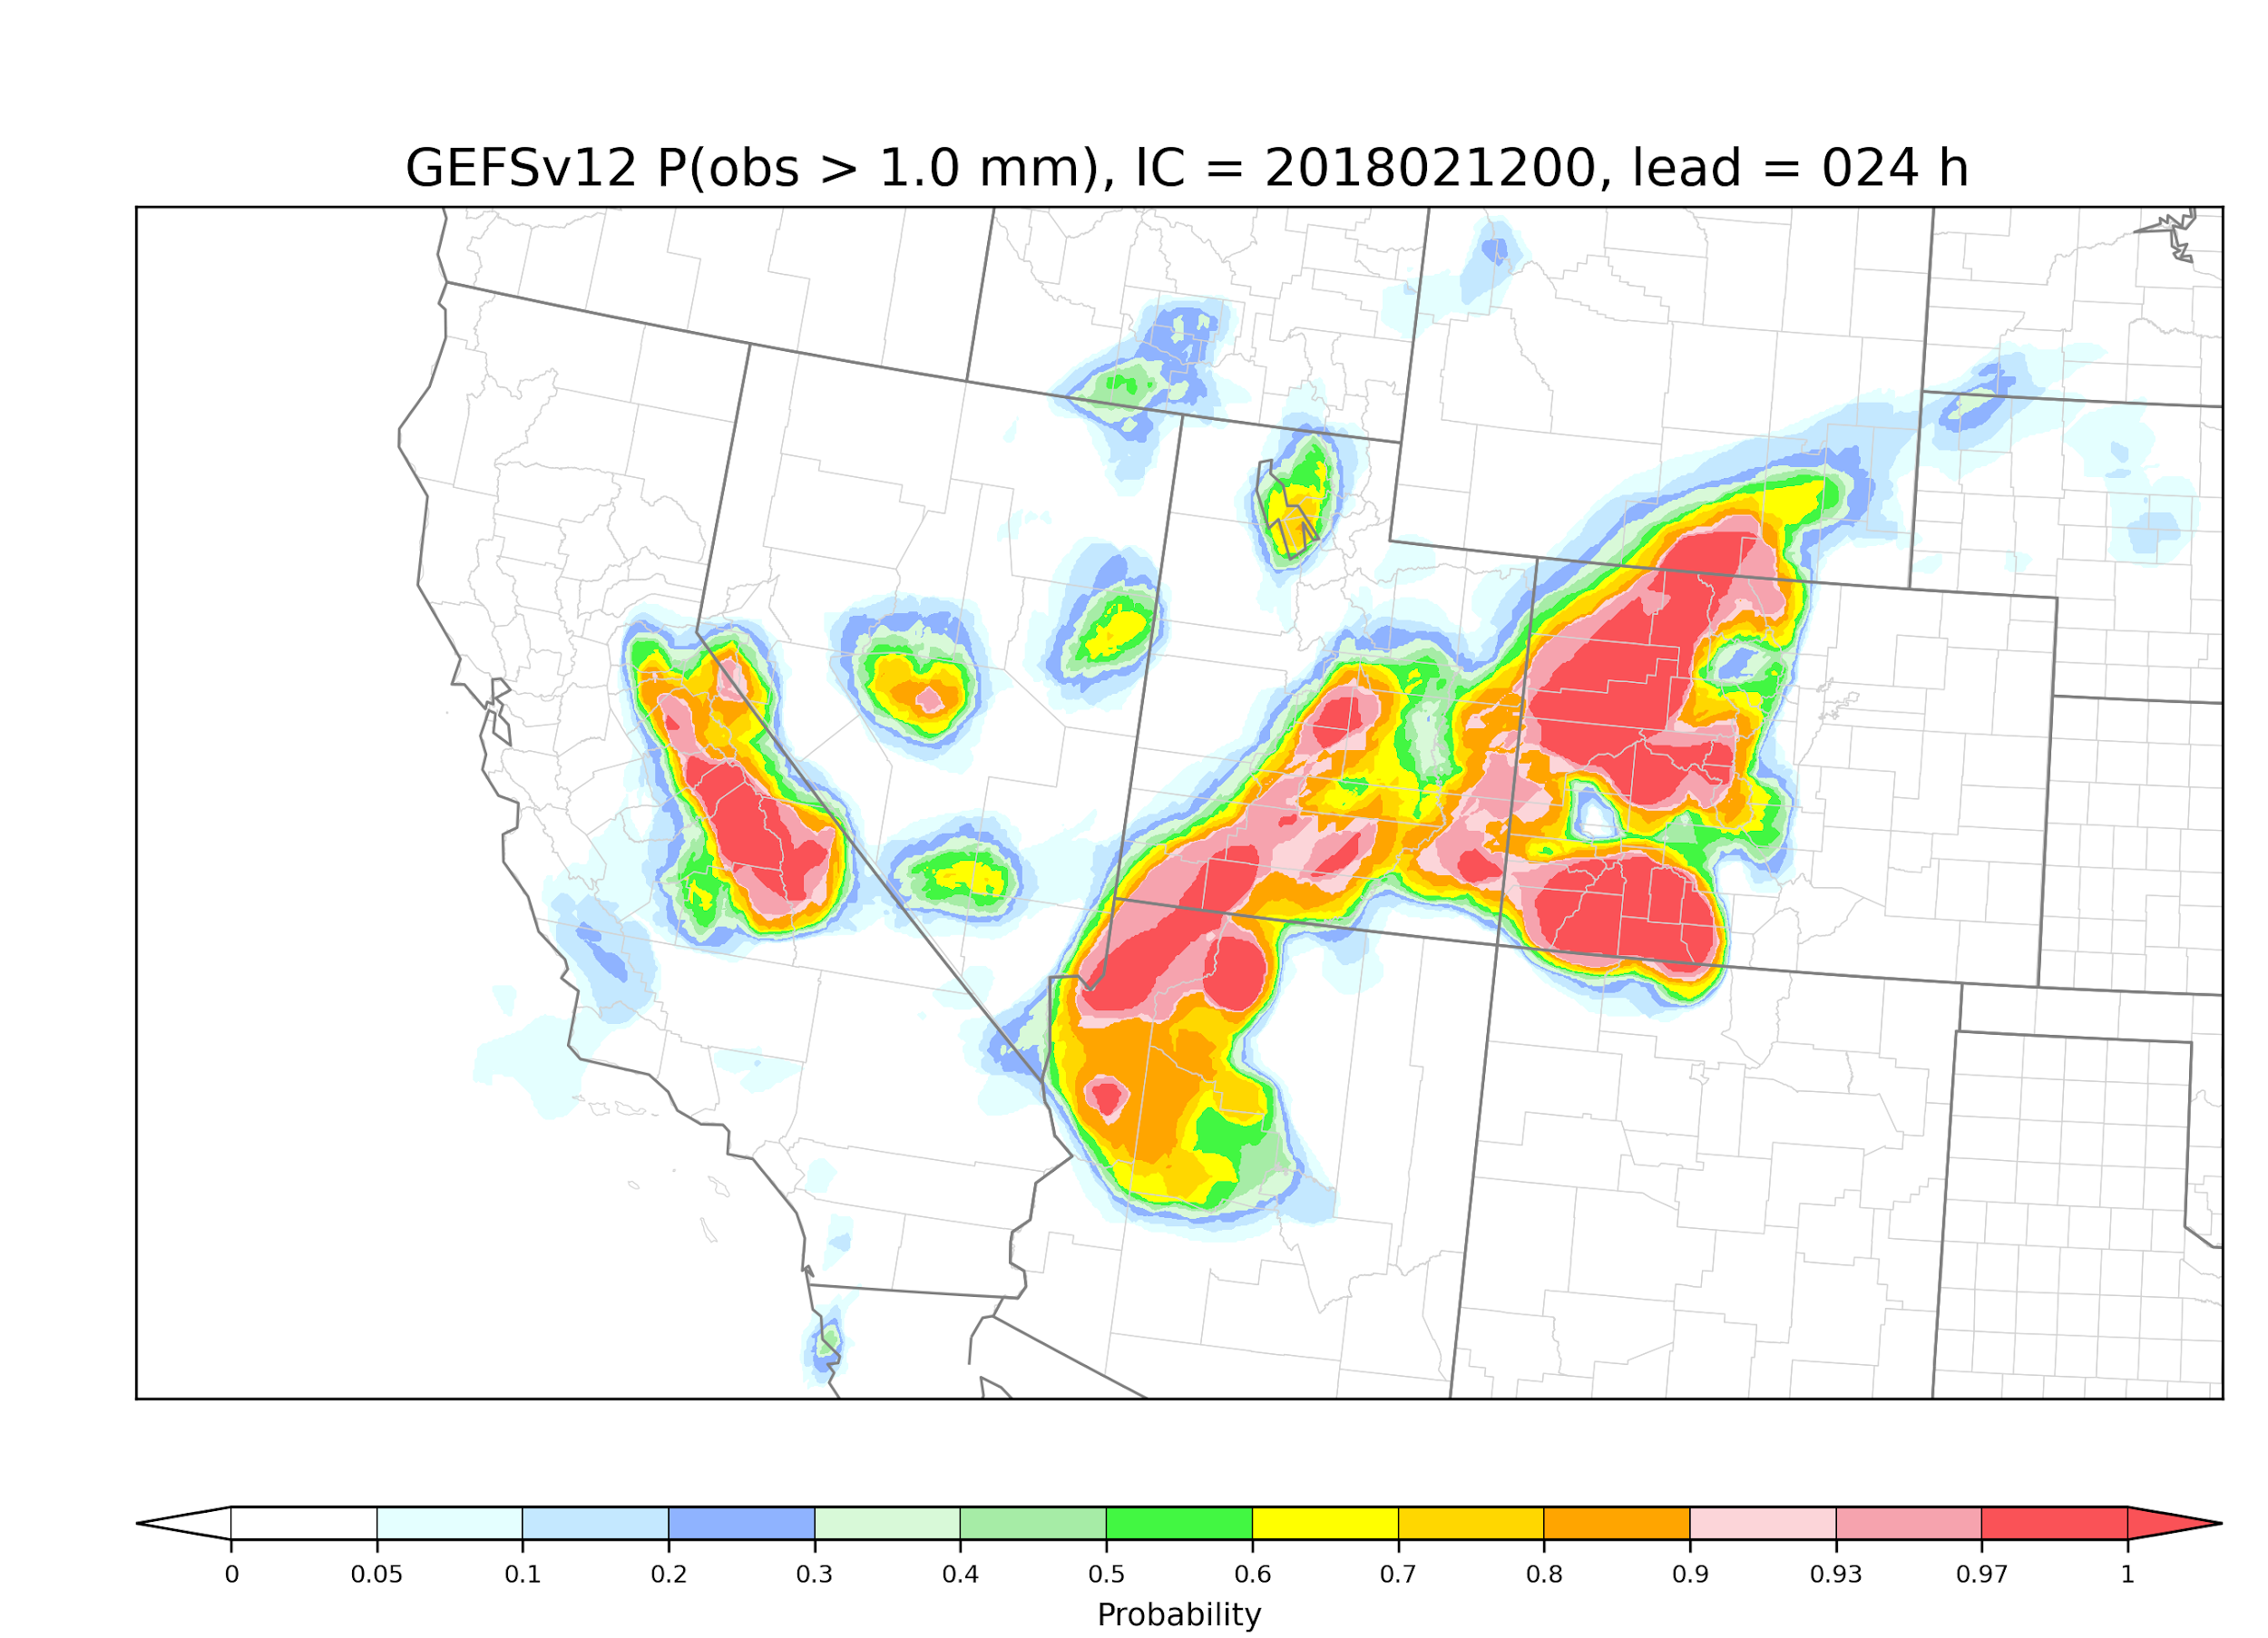
Case study, raw ensemble, probability > 1 mm

Slide 46
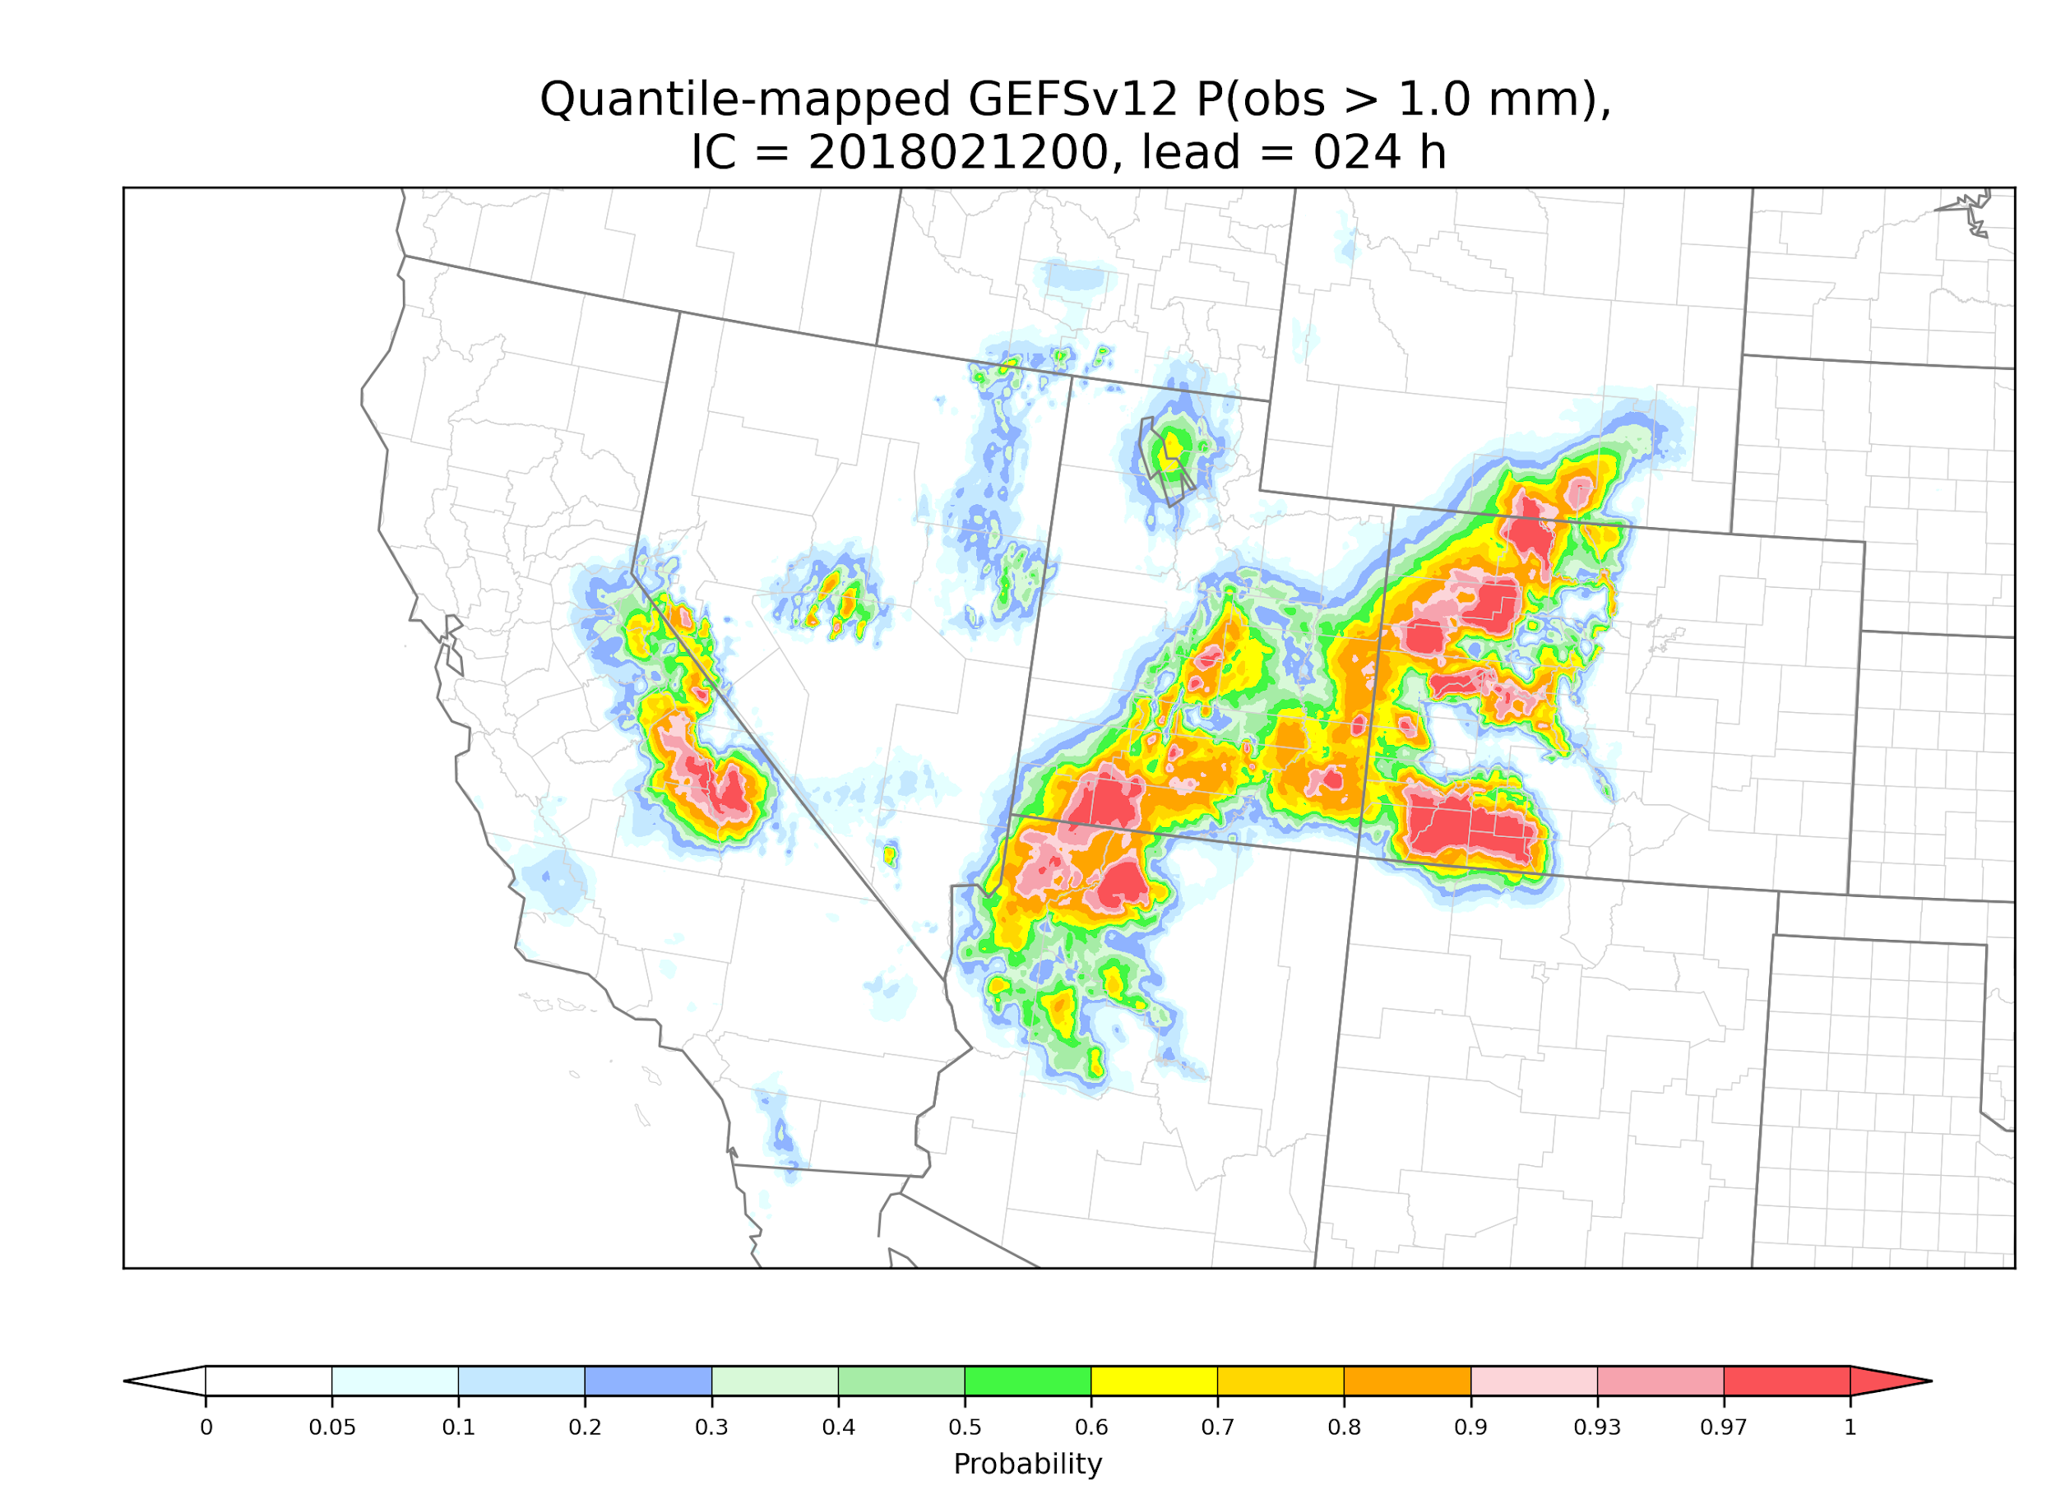
Case study, quantile-mapped ensemble, probability > 1 mm
The increase in terrain-related
detail relative to raw in the
mountainous western US is
the major difference you’ll
see in the following slides.

Slide 47
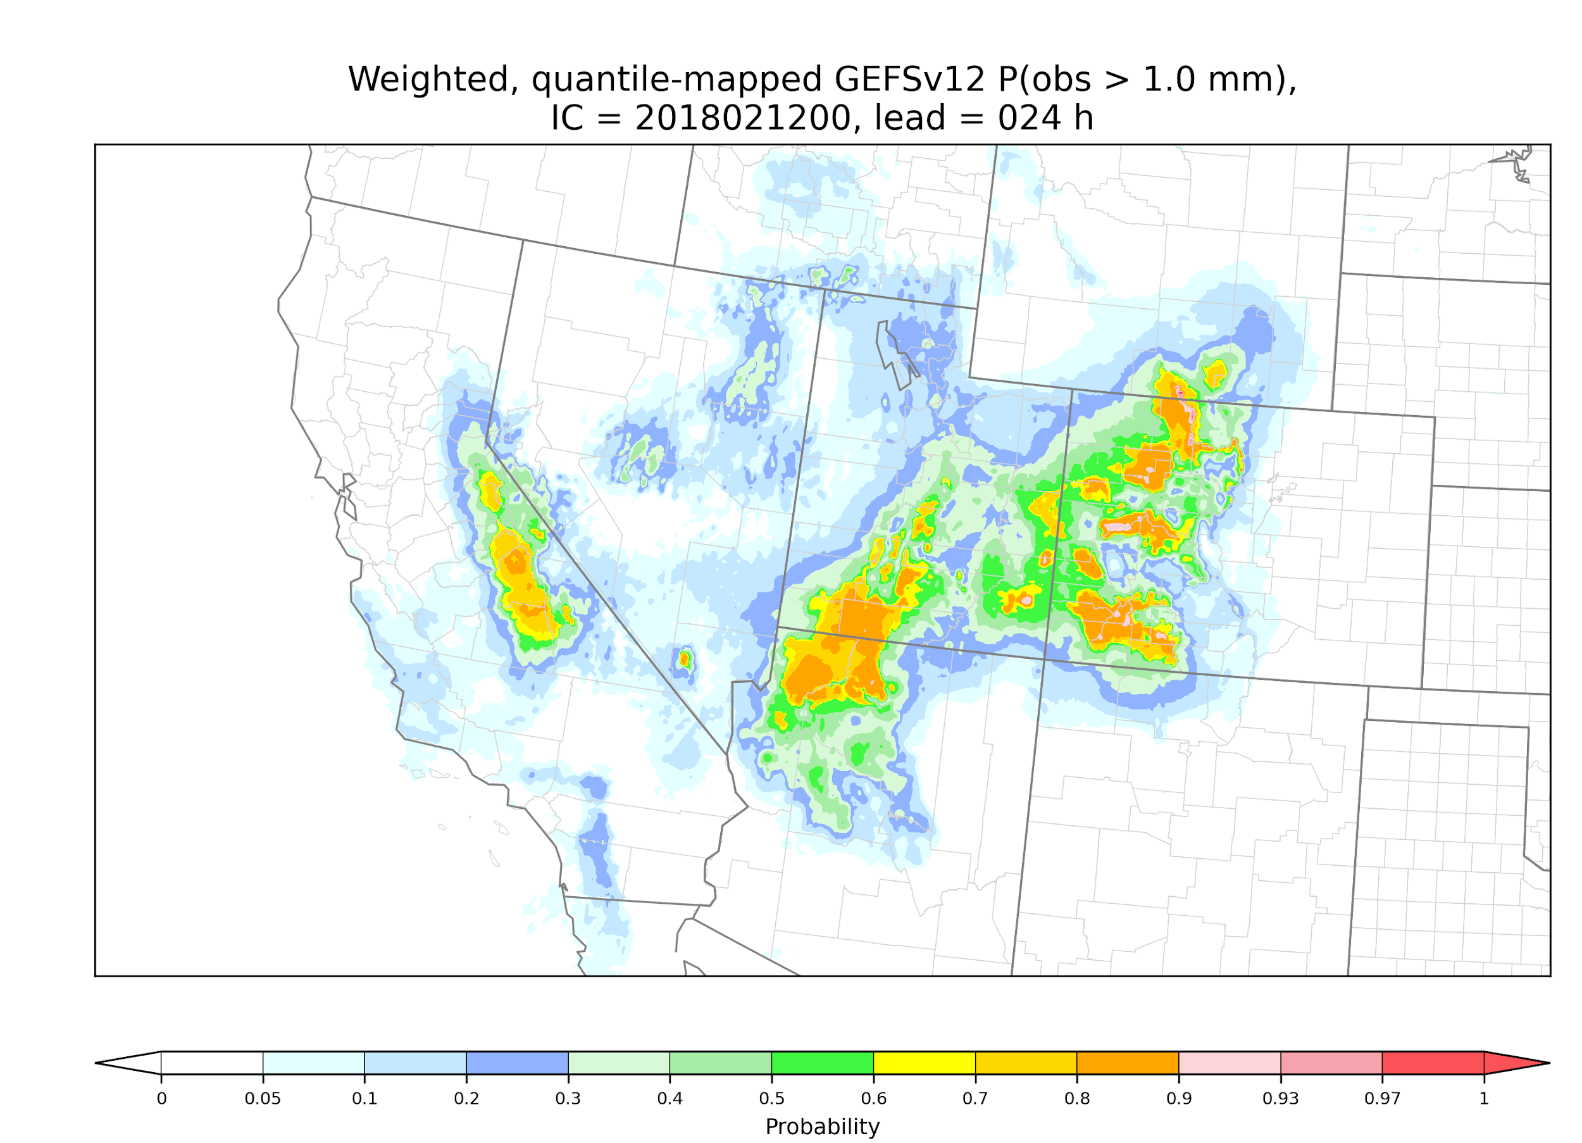
Case study, quantile-mapped & weighted ensemble, probability > 1 mm
The weighting tends to make
the forecasts less sharp.

Slide 48
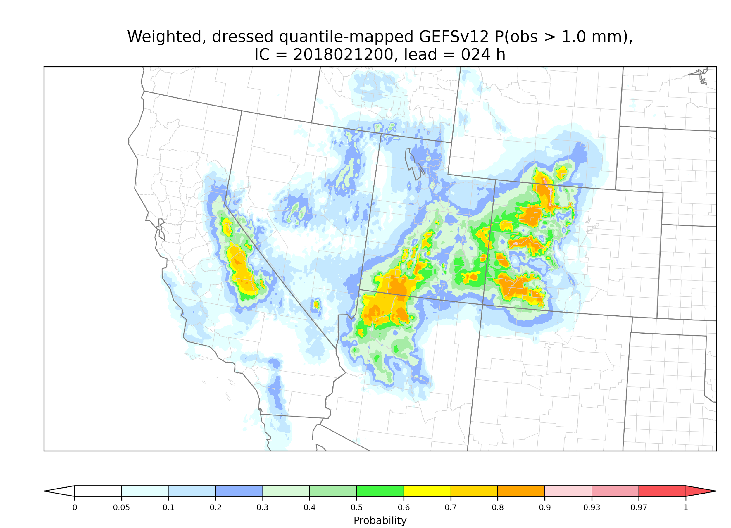
Case study, quantile-mapped & weighted, dressed ensemble, probability > 1 mm
For this particular 1 mm
threshold, there isn’t much
change with the inclusion of
dressing.

Slide 49
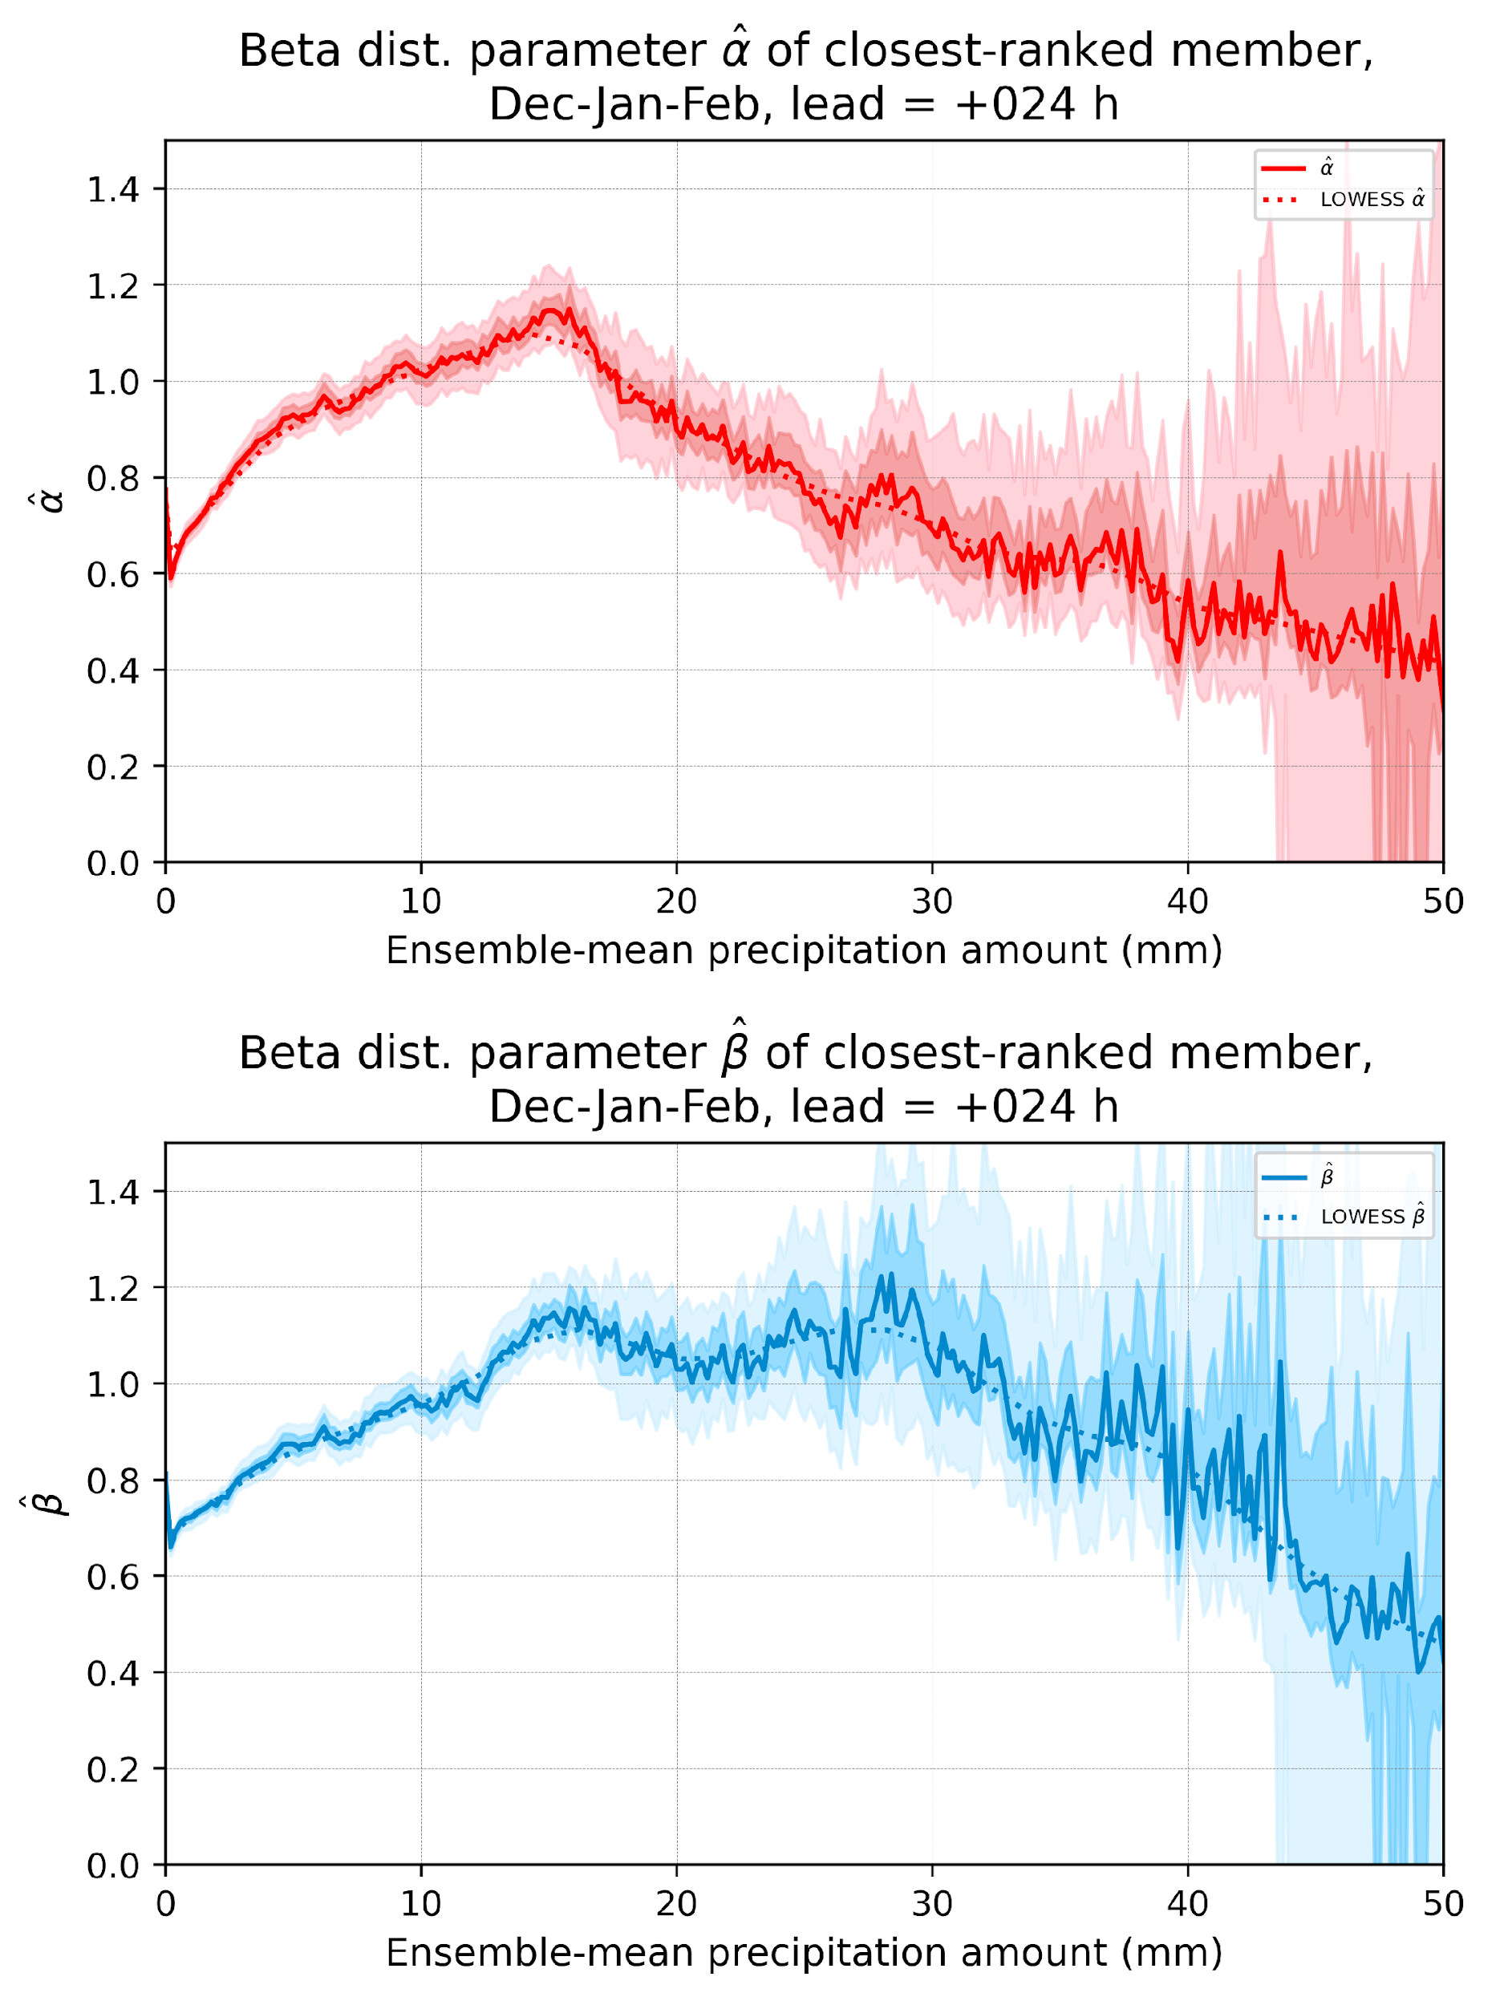
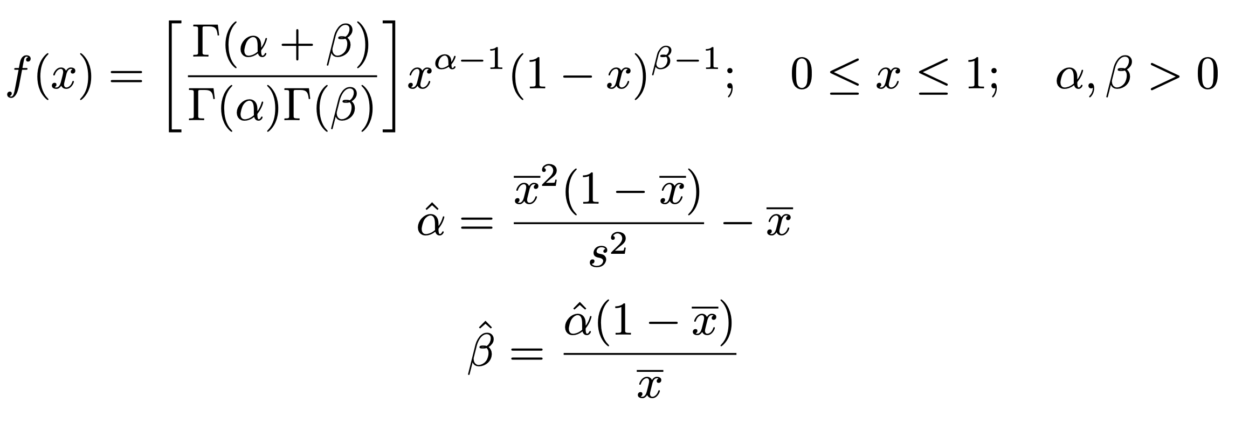
Estimating closest-member histograms from fitted
beta distributions.
1. Closest-ranked member statistics converted to a fraction between 0 and 1. Repeat over many cases, grid points.
2. Mean and standard deviation of this statistic is tallied as
a function of quantile-mapped ensemble-mean amount.
3 Beta distribution parameters are fit based on the sample mean and variance.
4. LOWESS smoothed parameter estimates also

Slide 51
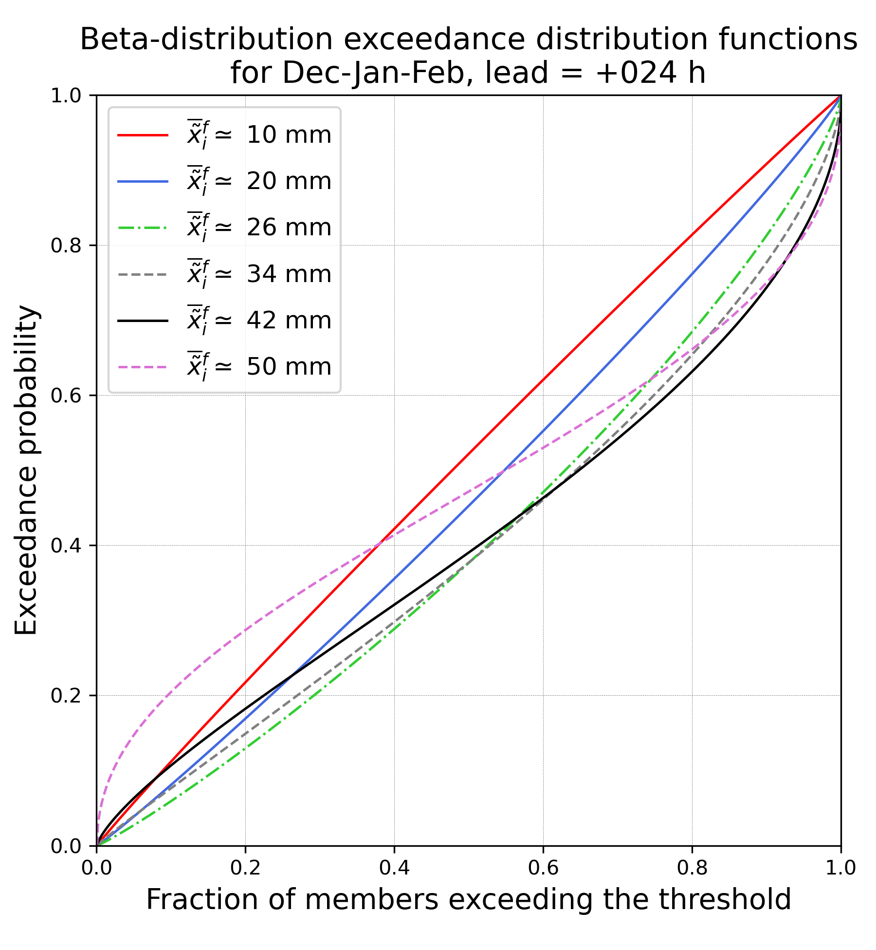
To the extent that we can use fitted distributions
to estimate the closest-member histograms and
their exceedance distribution function, they
do suggest that the shapes of these functions
may change radically at higher precipitation
amounts.
This suggests that the closest-member histograms
highest category of 15 mm isn’t very useful
for re-weighting ensembles with means of 25 or
50 mm.

Slide 52
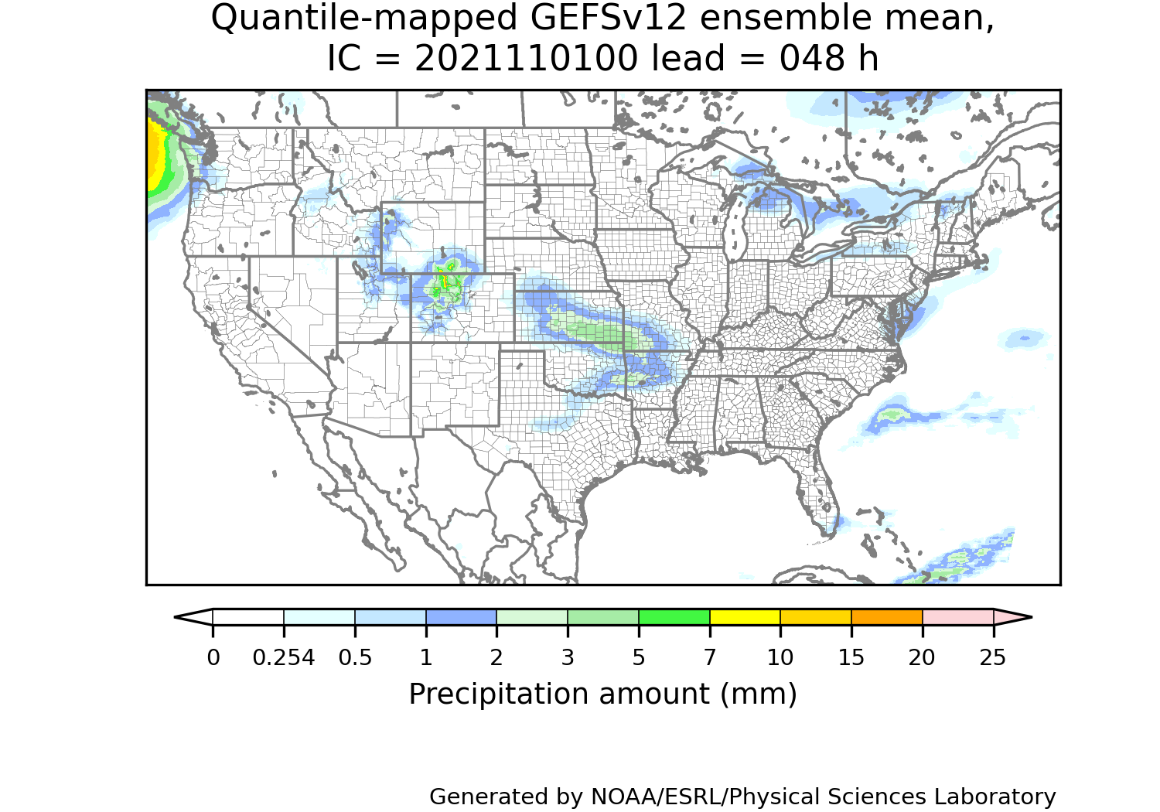
A web page for real-time GEFSv12 postprocessed forecasts (under construction).
https://www.psl.noaa.gov/forecasts/GQM/
c/o Diana Stovern

