Slide 1

The US National Blend of Models
POP12 and QPF06 algorithm
Tom Hamill (NOAA ESRL Physical Sciences Division)
with help from Eric Engle, Matt Peroutka, Dave Myrick (MDL) and Chrissy Finan (CPC)
presentation to UK Met Office, 28 Sep 2016

Slide 2
Objectives
Describe the procedures well enough so that you understand it (we can share code with you to replicate some or all of it if desired).
Get your feedback as to whether you see areas for improvement in the algorithm that I might have missed.
Continue to develop a more collaborative relationship between NOAA and UK Met Office, following recent visit by MDL staff.

Slide 3
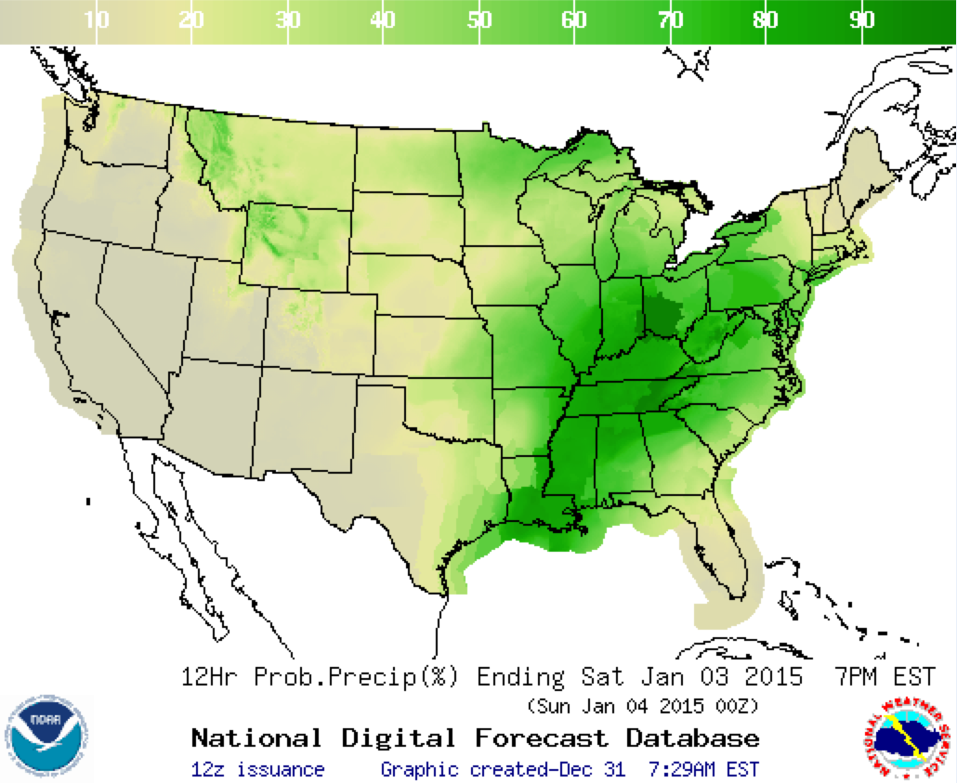
National Blend of Models (NBM) project
Using national and international guidance, produce high-quality, high-resolution post-processed guidance that greatly ameliorates model biases and improves skill and reliability.
The product should be of such high quality that manual forecaster intervention will become much less necessary, improving spatial continuity of forecasts.
Our group in ESRL was responsible for a basic probability of precipitation and deterministic precipitation amount. Others at MDL worked on winds, temperature, and other elements.

Slide 4
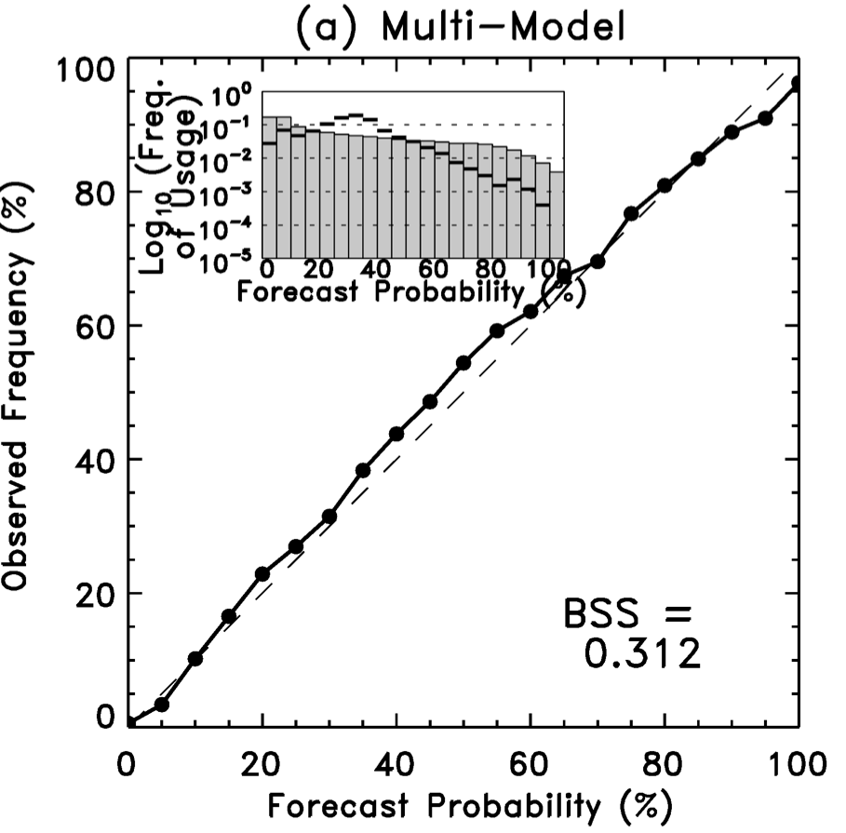
Previously: raw multi-model ensemble 24-h POPs produced reliable and skillful forecast guidance.
Multi-model reliability, Day +5, > 1 mm
Why this algorithm won’t work in NBM:
  Models in this situation were CMC, NCEP, ECMWF, and UK Met Office (latter two not available to us currently).
  Verification of global models was at 1-degree (somewhat resolved) and 24-h accumulation, while NBM needs 2.5-km gridded data, 12-h accumulation. Can’t expect global models to provide higher spatial resolution yet.
ref: Hamill, 2012 MWR

Slide 5
POP12 and QPF06 problems | Potential solutions
Frequent model changes. | Post-process using only very recent forecast data to minimize chances of using forecasts from previous version, with different biases ( → sample-size issues). Generate many reforecasts or retro runs before model implementations, and use that data in the post-processing (CPU, disk-expensive).
Systematic errors such as the over-forecasting of light precipitation. | Fix the model (hard; biases are stubbornly persistent). Statistical post-processing; use past forecasts, analyses to adjust current forecast.
Provide high-resolution details, including terrain-related detail. | Incorporate HRRR or other hi-res. production system data where available (dynamical downscaling, only to 18 h). Statistical downscaling (post-process the larger-scale precipitation forecast to higher-resolution analyses).
Model uncertainties are not simulated well with only two prediction systems, resulting in insufficient spread and over-confident forecasts. | increase the number of systems, e.g. HRRR, Met Office, ECMWF (But: NOAA not willing to pay other providers). Improve the existing EPS systems (hard). Statistically post-process in ways to broaden the range of forecasts.
Deterministic forecasts from ensemble mean tend to smooth out the amplitudes of forecast maxima, especially at longer leads. | Abandon deterministic precipitation products, or Develop post-processing methods to restore amplitudes of maxima (though perhaps with greater RMS error).

Slide 6
Frequent model changes? Statistical post-processing for rare events is challenging without a large training sample.
Say you want to statistically post-process your model precipitation forecast to improve it.
Heavy precipitation events like the one today are the ones you care about the most. How
do you post-process today’s forecast given past short sample of forecasts and observations?

Slide 7
“Supplemental locations” to address issues caused by short time series of training data?
To enlarge the training sample size, what would happen if one supplements with training data from nearby locations just based on distance?
Biases can be very different even with nearby locations, so physical proximity alone is not a wise way to choose supplemental locations. Were location (a) used to supplement location (b), this would make the bias correction worse.
Assumption: forecast biases are likely to be similar at two grid points if they:
have similar analyzed precipitation climatologies (not one wet, the other dry).
have similar terrain elevation and terrain “facet” (orientation).
all other things being equal, are close but not too close to each other (for independence of samples).

Slide 8
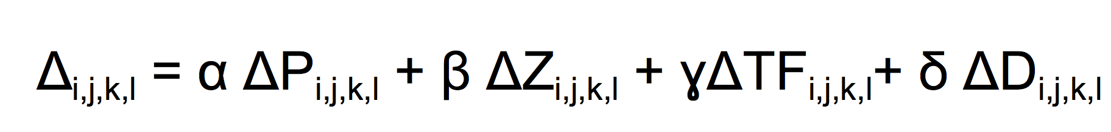
More carefully defining the supplemental locations to increase sample size.
Let Δ_{i,j,k,l} = penalty function measuring the difference in precipitation, terrain characteristics, and geography between two grid locations (i,j) and a potential supplemental location (k,l), both inside the domain. The overall penalty is defined as:
α ΔP_{i,j,k,l} penalizes differences between the precipitation amounts. α provides a precipitation weighting coefficient, here set to α=0.1.
β ΔZ_{i,j,k,l} penalizes difference in terrain heights, and currently β=0.4.
ɣ ΔTF_{i,j,k,l} penalizes differences in terrain “facet” orientations, with terrain smoothed and evaluated for facet at three different scales, and ɣ=0.15.
δ ΔD_{i,j,k,l} measures differences in the horizontal distance between the supplemental and original grid point, and its weighting coefficient is set to δ=0.001.
First supplemental location is one with smallest Δ_{i,j,k,l}
Any (k,l) that is less than or equal to 0.75 degrees from (i,j) or from any other previously specified supplemental location for (i,j) is not evaluated. This forces supplemental locations to be a minimum distance from each other so that their data has some greater amount of independence.

Slide 9
Here are the
terrain elevations
used in the
calculation of
supplemental
locations.

Slide 10
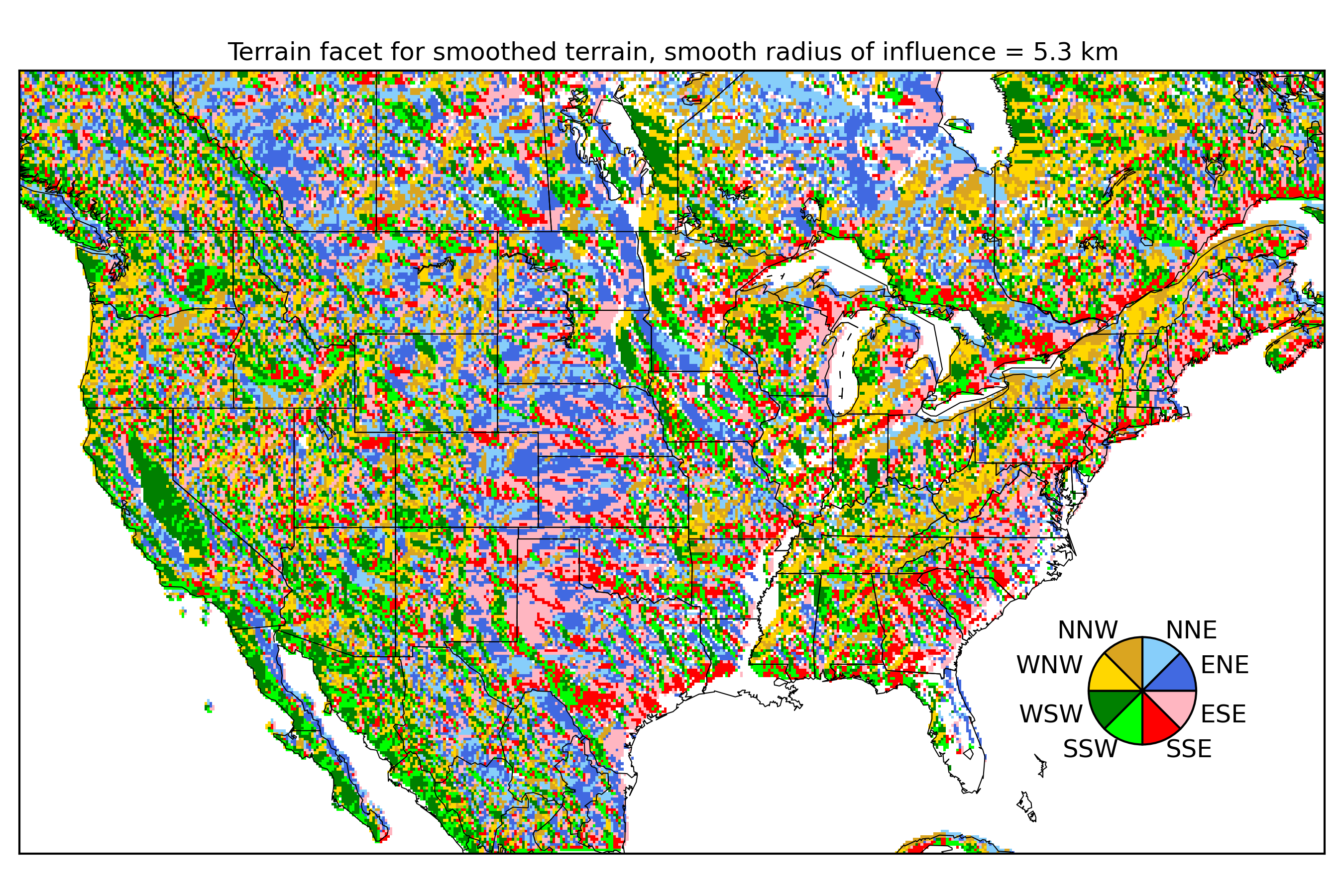
Terrain “facet” at fine scale.
We will also choose the
supplemental locations
based on similarity of
terrain orientation at
three different levels
of smoothing. Here is
the finest level (effectively
no smoothing).
This procedure was inspired
by the work of Chris Daly
and the PRISM group at
Oregon St. University, who
use terrain facets in developing precipitation climatologies.

Slide 11
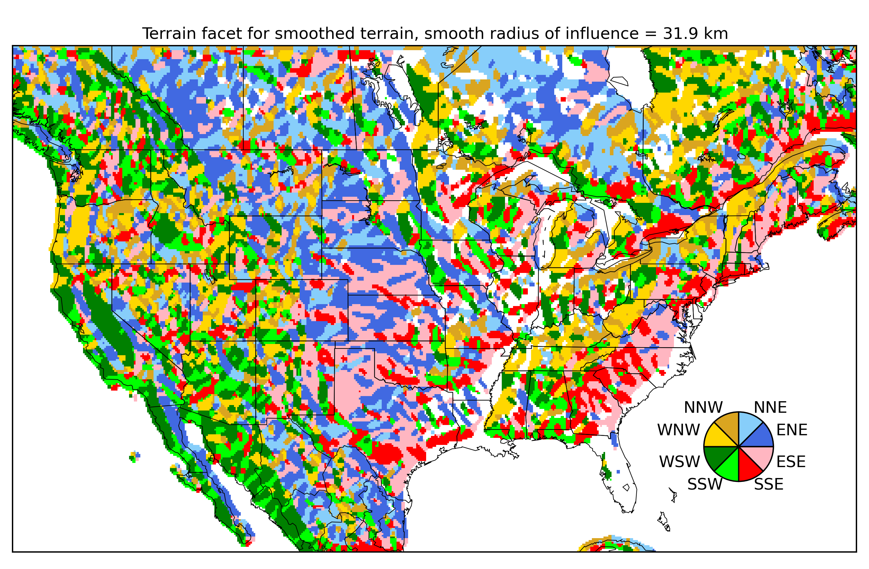
Terrain facet, medium scale.
We want a supplemental
location, if possible, to
match not only the fine-scale
terrain orientation, but the
larger-scale terrain orientation.

Slide 12
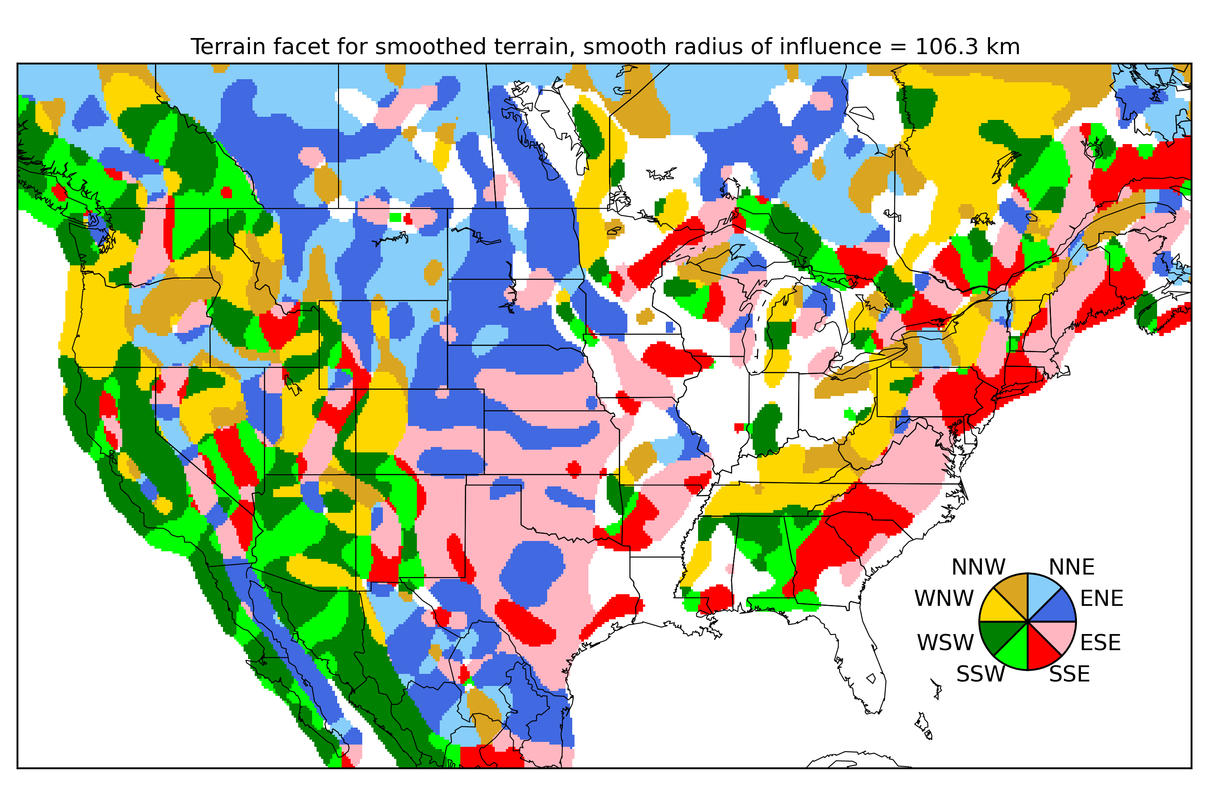
Terrain facet, largest scale.

Slide 13
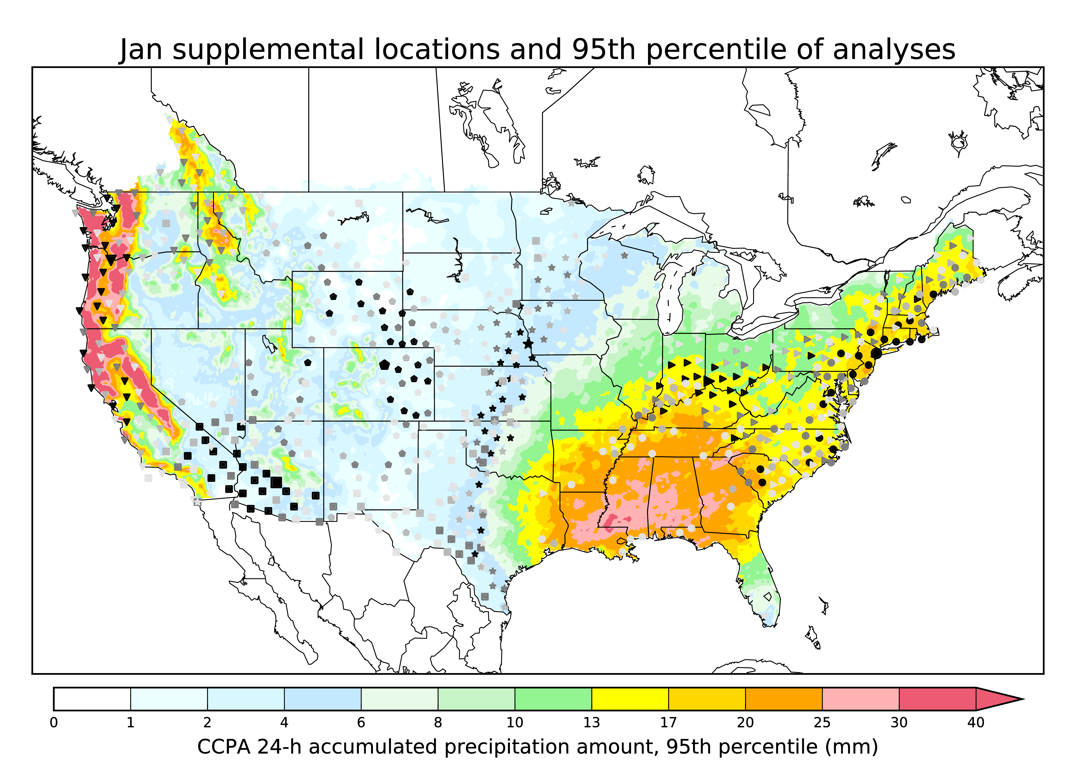
Sample map of supplemental locations (January).
Large symbol = where we are defining the supplemental locations.
Small symbol = supplemental locations.
Darkness of the symbol indicates the penalty function (lighter symbols are a poorer fit).
While only a few locations are shown, this procedure was used to define suppplemental locations for every 1/8-degree grid point across the CONUS.
These were then used to populate the CDFs used in the later quantile mapping step.

Slide 14
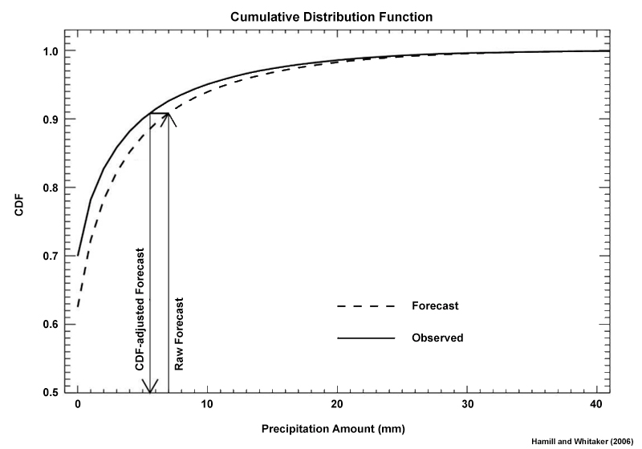
Addressing systematic errors with “quantile mapping”
(which permits amount-dependent bias correction)
Presuming that we have enough data to estimate
the climatology of the forecast and observed (in this application, using the last 60 days, bolstered by supplemental locations), if there are systematic differences in their CDFs, under quantile mapping we replace the forecast value with the observed value associated with the same cumulative percentile of the distribution.
This procedure is repeated independently for each ensemble member. Different CDFs are possible for different members (Canadian system doesn’t have members that are exchangeable, with similar biases for similar members).
What could go wrong? Big assumption that biases from the last 60 days = current biases.

Slide 15
Challenge: CDFs and quantile mapping relationships may change from cool to warm season.
Here, CDFs are based on our GEFS reforecast data.

Slide 16
POP12 adjustments to this basic quantile mapping procedure.
Use 3 x 3 set of grid points surrounding the region of interest to enlarge ensemble size and account for position errors, given that ensemble systems are often over-confident about phasing of precipitation features.
“Stochastic quantile mapping” - perturb each quantile-mapped member with some random noise to account for overconfidence of ensemble predictions.

Slide 17
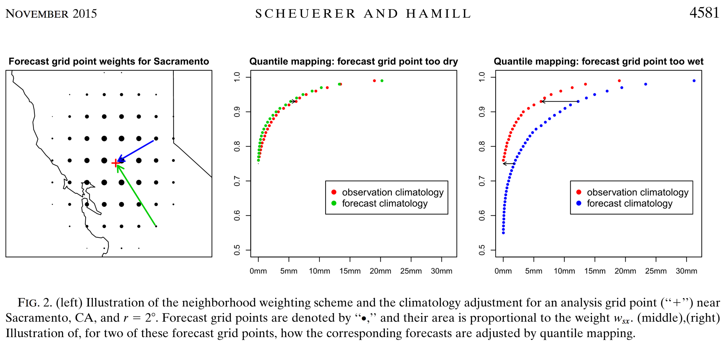
Quantile mapping using surrounding grid points.
Here’s a page from Michael Scheuerer’s recent MWR article describing the inspiration for a procedure to leverage data
from surrounding points in the quantile mapping.

Slide 18
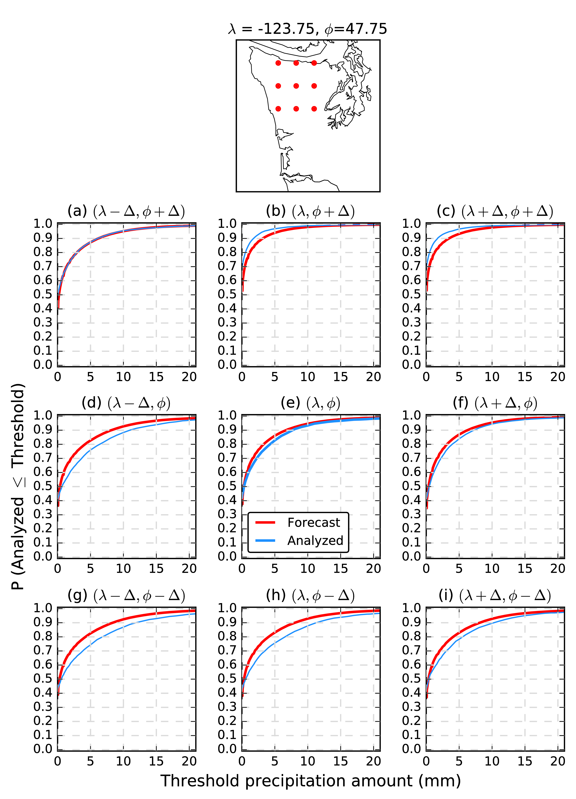
Our quantile mapping in the Blend using 3 x 3 neighboring grid points.
Say we want to bias correct a forecast at the center grid point.
Ensembles may have: (a) position errors, or (b) small-scale features that lead to speckles in the output probability field associated with small sample sizes. So why not use forecasts from nearby grid points as well to increase the effective ensemble size?
One reason is that the neighboring grid point may have a different precipitation climatology in regions with varied terrain.
The procedure here will actually perform quantile mapping of the forecast at each of the nine red dots (using the forecast CDF associated with that red dot) to the analyzed CDF in the center red dot.
This will: (a) enlarge the ensemble sample size, and (b) make sure that the re-mapped ensemble members are consistent with the climatology at the central grid point in question, and (c) provide different qualitative POP12 results when the precipitation shield is scattered relative to when it is more uniform over the area; higher POP12’s in the latter case.

Slide 19
“Stochastic” quantile mapping.
When we perform the quantile mapping, we will do a stochastic
rather than a deterministic quantile mapping, drawing from a
probability distribution centered on the quantile mapped value,
and with a standard deviation of 0.22 x the quantile mapped value.
Effects:
Larger perturbations are added for heavier precipitation forecasts, which are more uncertain than lighter events.
The procedure has the effect of increasing the overall spread in the ensemble, thereby accounting for model uncertainty that cannot be addressed well with a two-system MME.
Yet to do: an objective methodology for setting the standard
deviations as a function of precipitation amount. Right now
they are crudely tuned.

Slide 20
Synthesizing the POP12 methodology so far.
Before new forecasts are available:
  Determine supplemental locations for every 1/8-degree grid point.
  Populate CDFs for every grid point and every ensemble member using past 60 days of available forecasts and CCPA analyses (with sample sizes increased by supplemental locations).
As soon as the new forecasts are available:
  Read in the precipitation forecasts of all members.
  Stochastically quantile map the forecasts using the 3 x 3 array of surrounding data to produce an ensemble of bias and spread corrected forecasts.
  Produce a POP12 forecast from the ensemble relative frequency.
  Smooth that forecast (next slide).

Slide 21
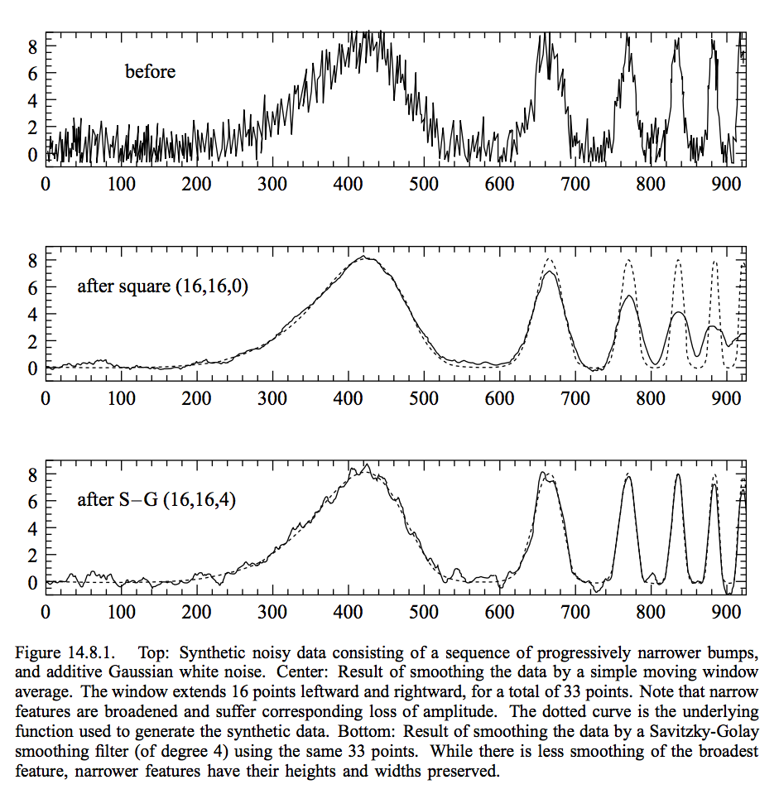
“Savitzky-Golay” filter
designed to preserve amplitudes of coherent phenomena, unlike more common n x n block smoothers.
from Press et al. Numerical Recipes text

Slide 22
Smoothing of the POP12 field
“Savitzky-Golay” smoother, with more smoothing applied over flat areas.
This has a minor positive effect on reliability and skill (not shown) but improves visual appearance of the forecasts.

Slide 23
Case study, 72-84 h forecasts from 00 UTC 6 April 2016
Notice significantly lower
POP12 in the final product
in the inter-mountain
Southwest US relative to
raw multi-model ensemble
probabilities.

Slide 24
Case study, 132-144 h forecasts from 00 UTC 6 April 2016

Slide 25
Reliability and skill for 24, 72, 120, 168-h lead times April-June 2016.
Raw multi-model ensemble
Post-processed

Slide 26
Deterministic QPF06
Typically ensemble members have some variety in the position and intensity of the forecasts, illustrated at right.
The ensemble mean (dashed), relative to the ensemble members:
has a broader spatial area with non-zero precipitation.
a maxima less than that of the average member.
Consequently, the CDFs for ensemble-mean forecasts
have a different shape than for the analyzed, even
in the absence of any forecast bias. Those shapes may look like this:
It implies that if we quantile-map the ensemble-mean forecast to the observations, then:
light forecasts get mapped to zero, and
heavy mean forecasts become much heavier.
This makes the forecasts ~unbiased, but potentially with larger RMS errors. We assume forecasters accept the tradeoff of higher for better information on the expected maximum.

Slide 27
Deterministic
QPF06 example
(also with Savitzky-Golay smoothing)
At early leads, there isn’t a
tremendous diversity in the
position of precipitation maxima, and hence the quantile mapping of heavy precipitation is not
pronounced.
Notice that there is substantial
trimming of the area of light
precipitation, sometime for the
better (MI) and sometimes for the worse (OH).

Slide 28
Deterministic
QPF06 example
(also with Savitzky-Golay smoothing)
Some increase in the heavy
precipitation amounts, though
in this case not as much as
warranted by the verifying analysis.

Slide 29
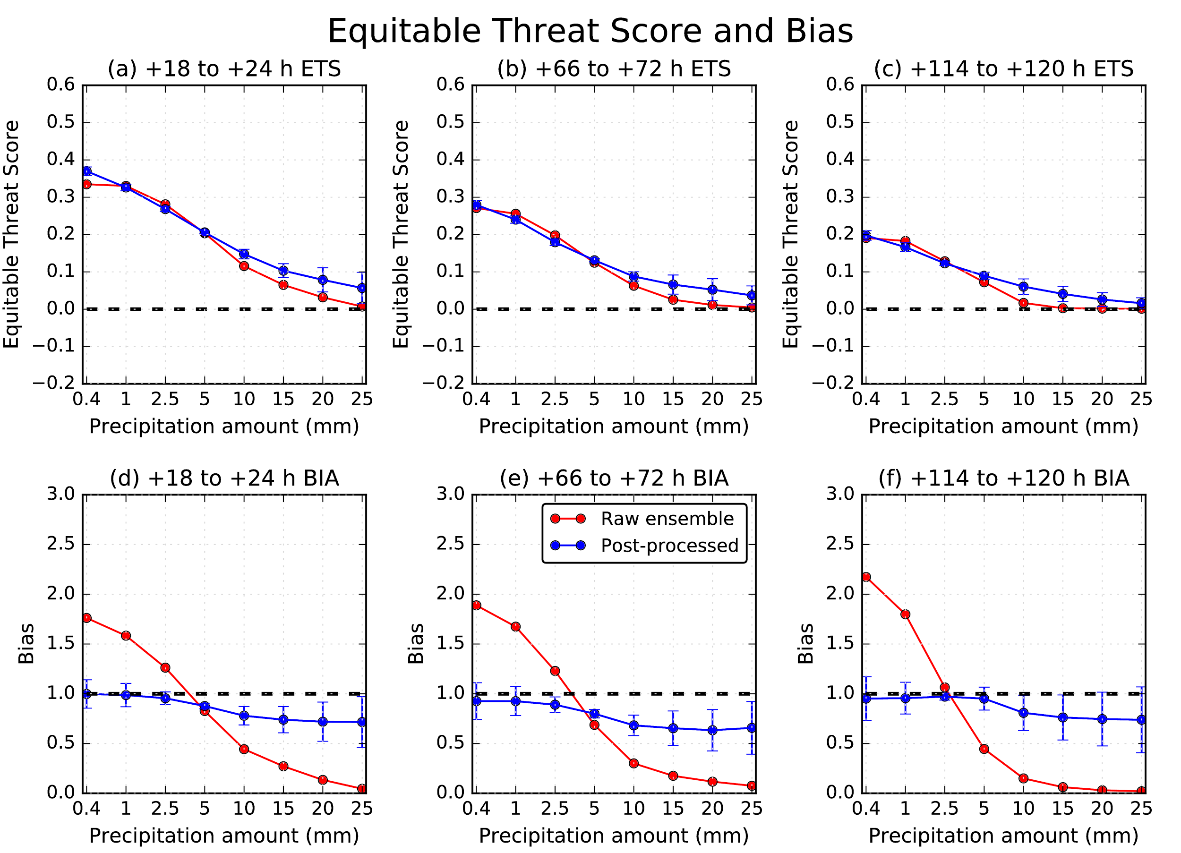
Verification statistics for QPF06 for raw multi-model ensemble and post-processed.
I’m pretty sure that some of the apparent skill is fictitious and is due to combining data over regions with different climatological event frequencies. See
Hamill, T. M., and J. Juras, 2006Measuring forecast skill: is it real skill or is it the varying climatology? Quart. J. Royal Meteor. Soc., 132, 2905-2923.
Still, there is an improvement relative to raw MME, and a marked decrease in bias.

Slide 30
Conclusions
We have an algorithm for the US National Blend that performs well for providing QPF06 and POP12 guidance.
Near-term work we expect to perform:
  Moving from the current ad-hoc “tuning” of the method’s parameters (e.g., amount of stochastic noise added) to a more statistically rigorous method of setting them (see Vincent Fortin article on best-member dressing, here).
  Comparing against other established methodologies such as Michael Scheuerer’s (ESRL/PSD) recent censored, shifted Gamma distribution procedure.
  Extend the procedure beyond the CONUS (with help from MDL putting together alternative precipitation analyses).
Larger concerns:
  Will algorithm produce reliable PQPF at higher thresholds?
  How to blend in the (eventual) reforecast information with GEFS system together with models with shorter training data sets.

