Slide 1
Review of ensemble prediction fundamentals
NOAA Earth System
Research Laboratory
Tom Hamill
NOAA ESRL, Physical Sciences Division
tom.hamill@noaa.gov

Slide 2
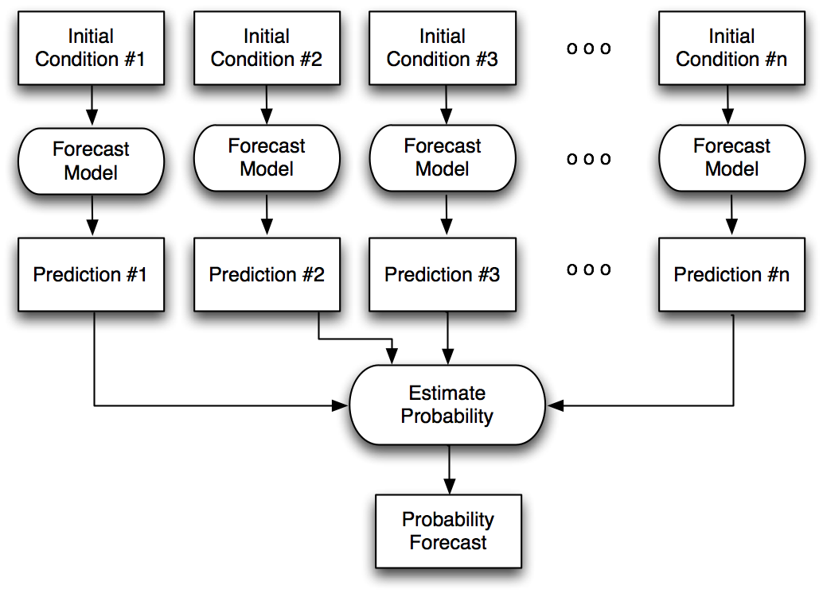
“Ensemble weather prediction”
possibly
different
models
or models
with
“stochastic”
elements so
that if two
initial
conditions
are the same,
forecasts
can still be
different.
Synthesize

Slide 3
Topics
Brief primer on chaos theory
Desired properties of ensembles
Initializing ensembles
Dealing with model error
mostly in Carolyn Reynolds’ talk
Ensembles & hurricanes
Some product ideas

Slide 4
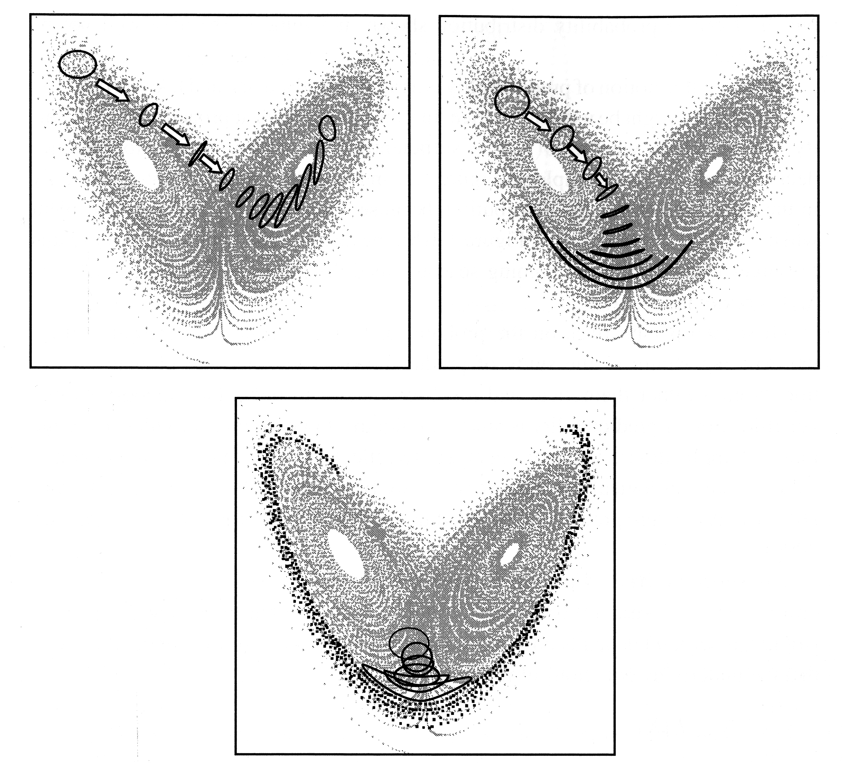
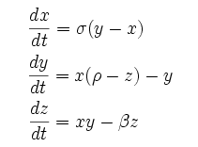
“Chaos” – why we use ensembles
A toy dynamical system that
has some characteristics of
the weather
The Lorenz (1963) model
σ, ρ, β αρε φιξεδ.
Select initial conditions within range of
analysis uncertainty. Result: errors grow more quickly for some initial conditions than others. Would be nice to quantify situational uncertainty.
from Tim Palmer’s
2006 book chapter

Slide 5
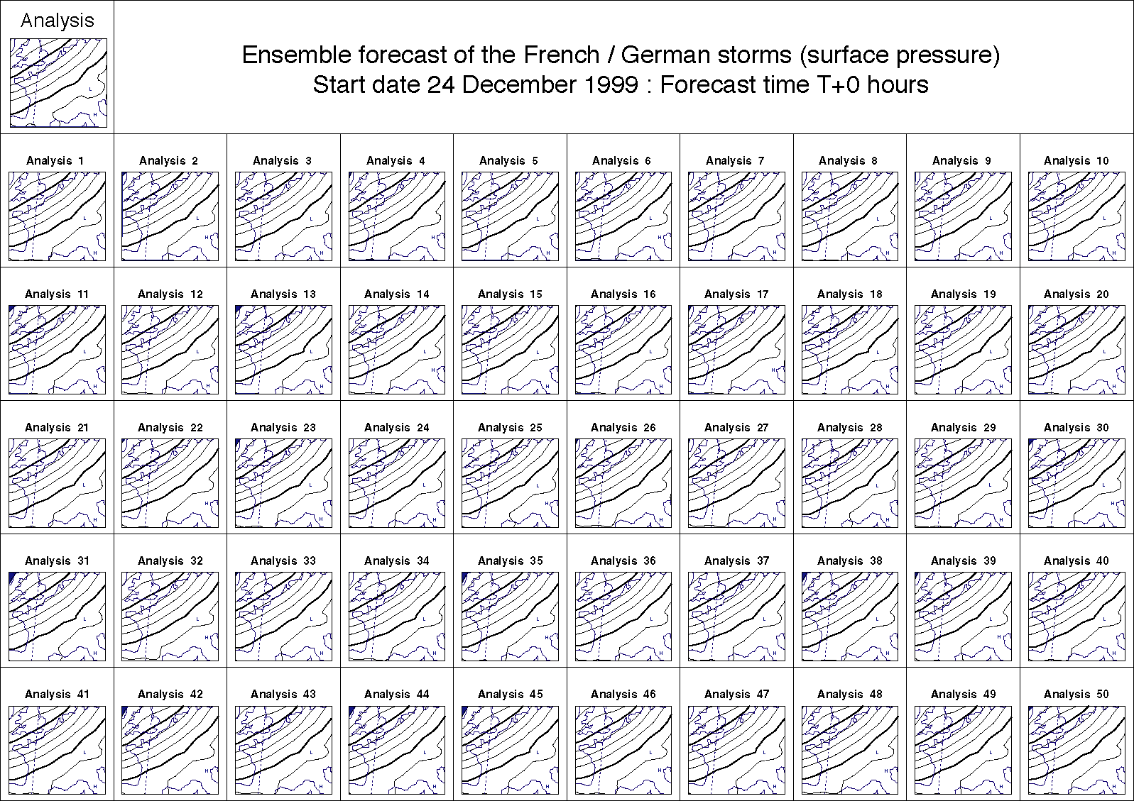
Initial conditions for “Lothar” ensemble forecasts

Slide 6
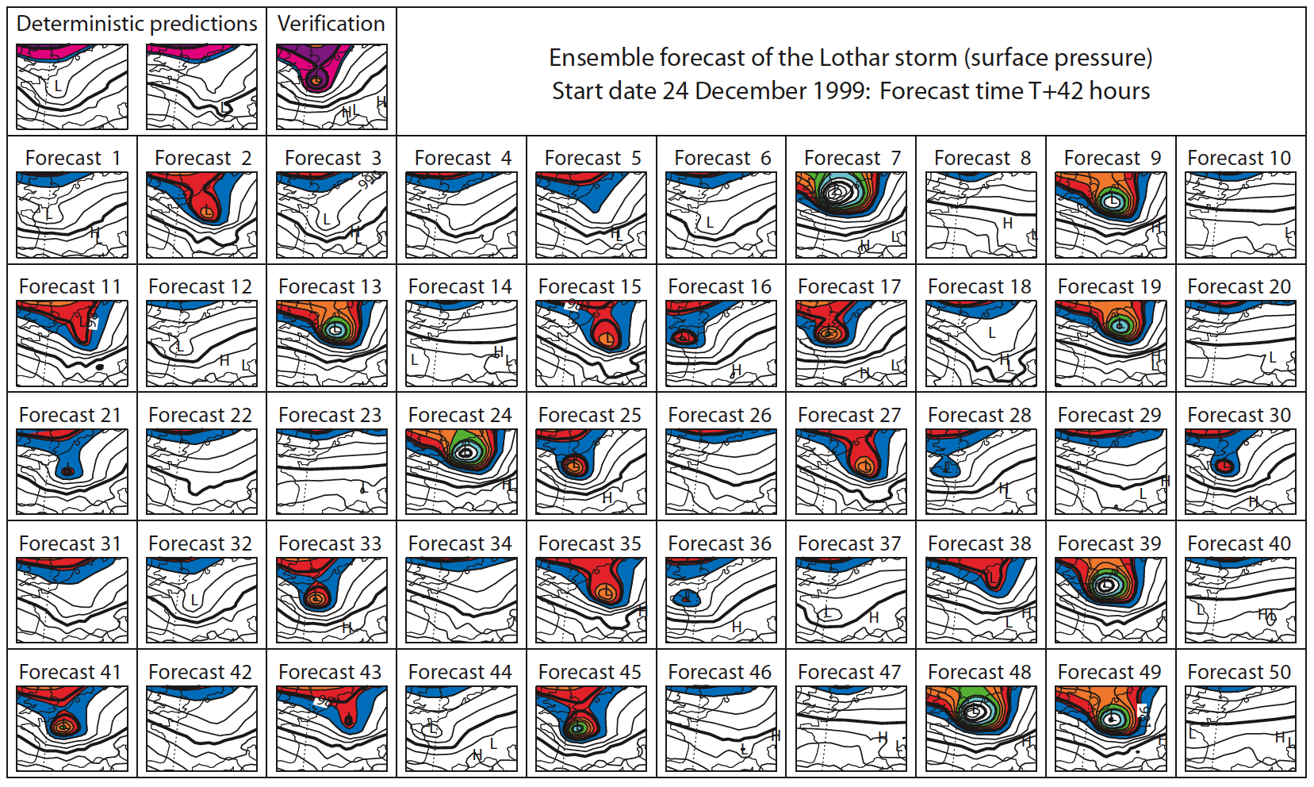
Lothar 42-h MSLP forecasts
deterministic
forecast
totally misses
damaging
storm over
France; some
ensemble
members
forecast it
well.
from Tim Palmer’s
book chapter, 2006.

Slide 7
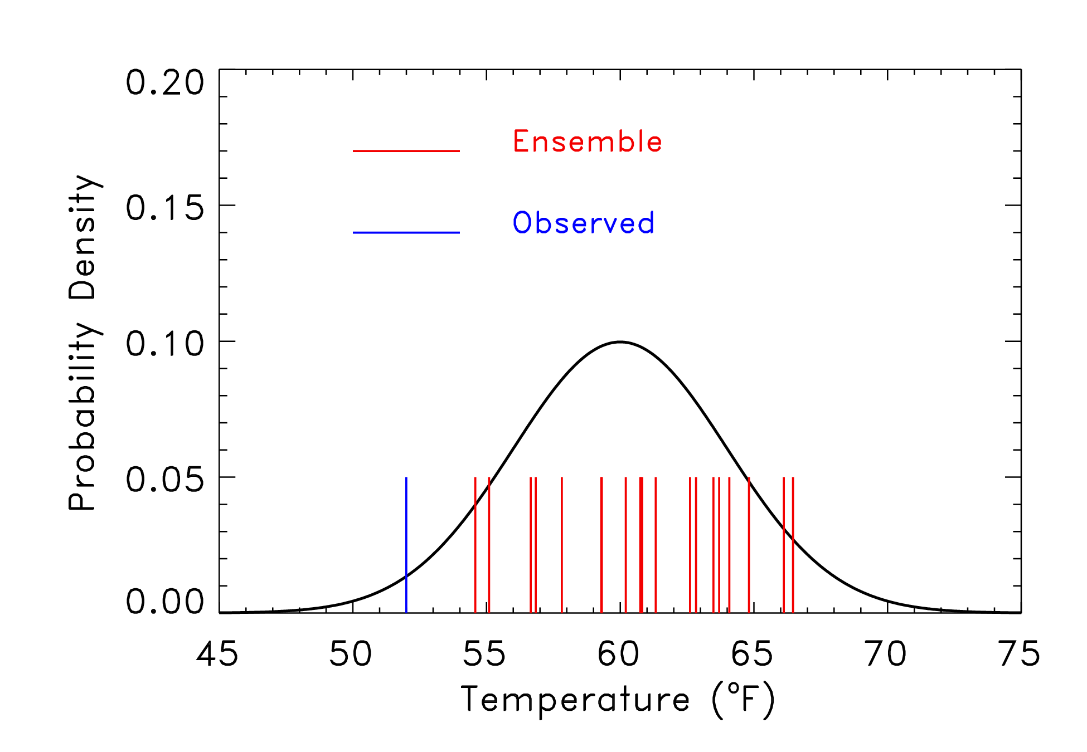
Question: what constitutes a “good” ensemble forecast?
Here, the observed is outside of the range of the ensemble,
which was sampled from the pdf shown. Is this a sign of
a poor ensemble forecast?
7
Notes:
7

Slide 8
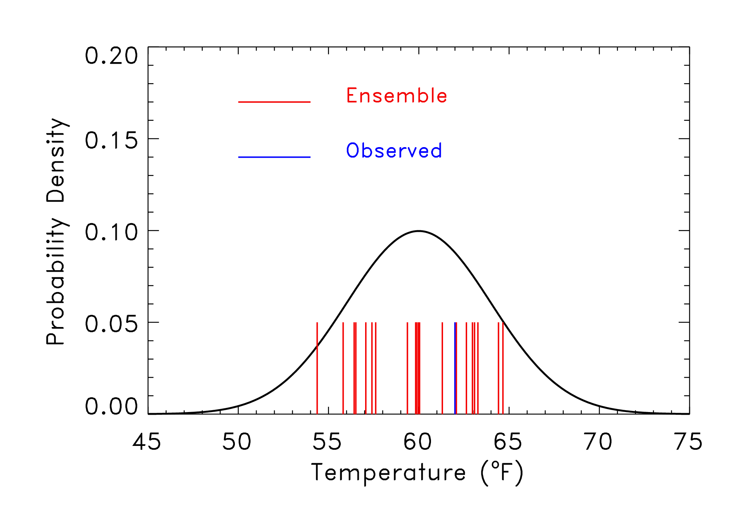
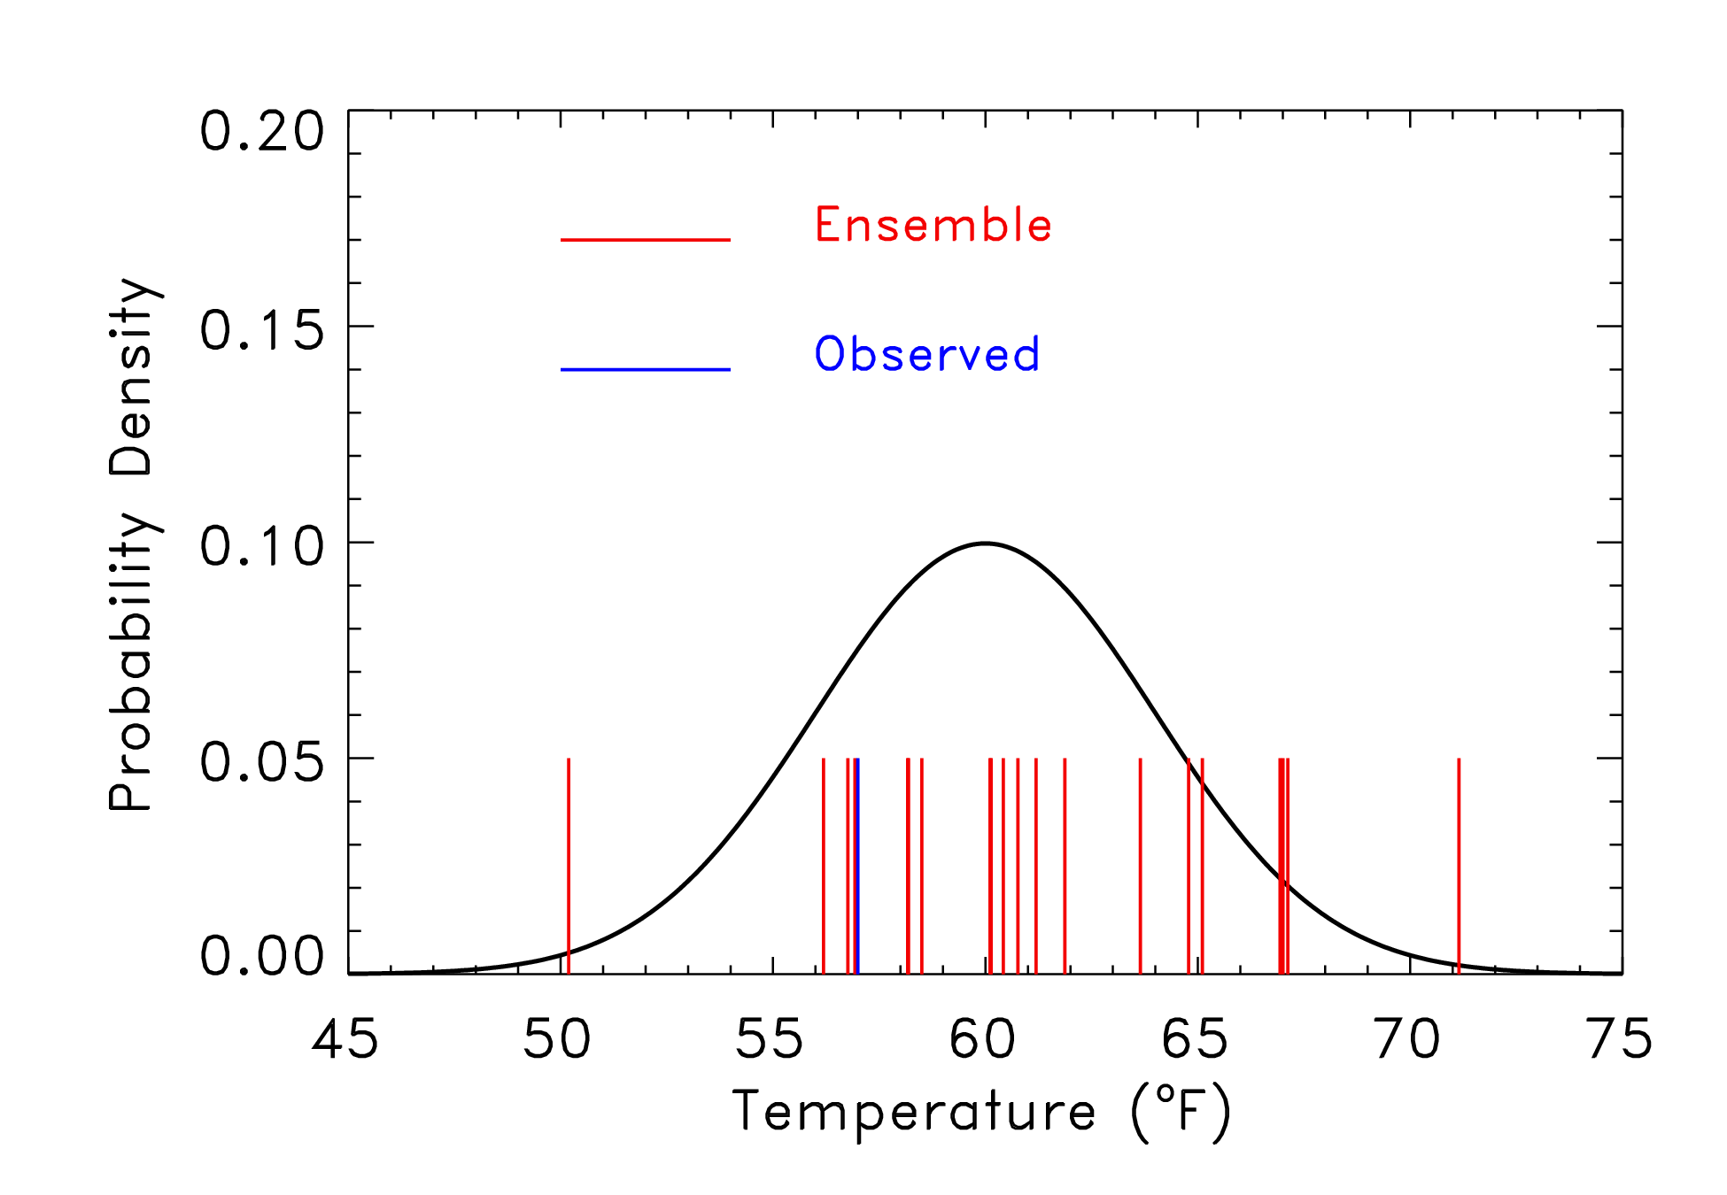
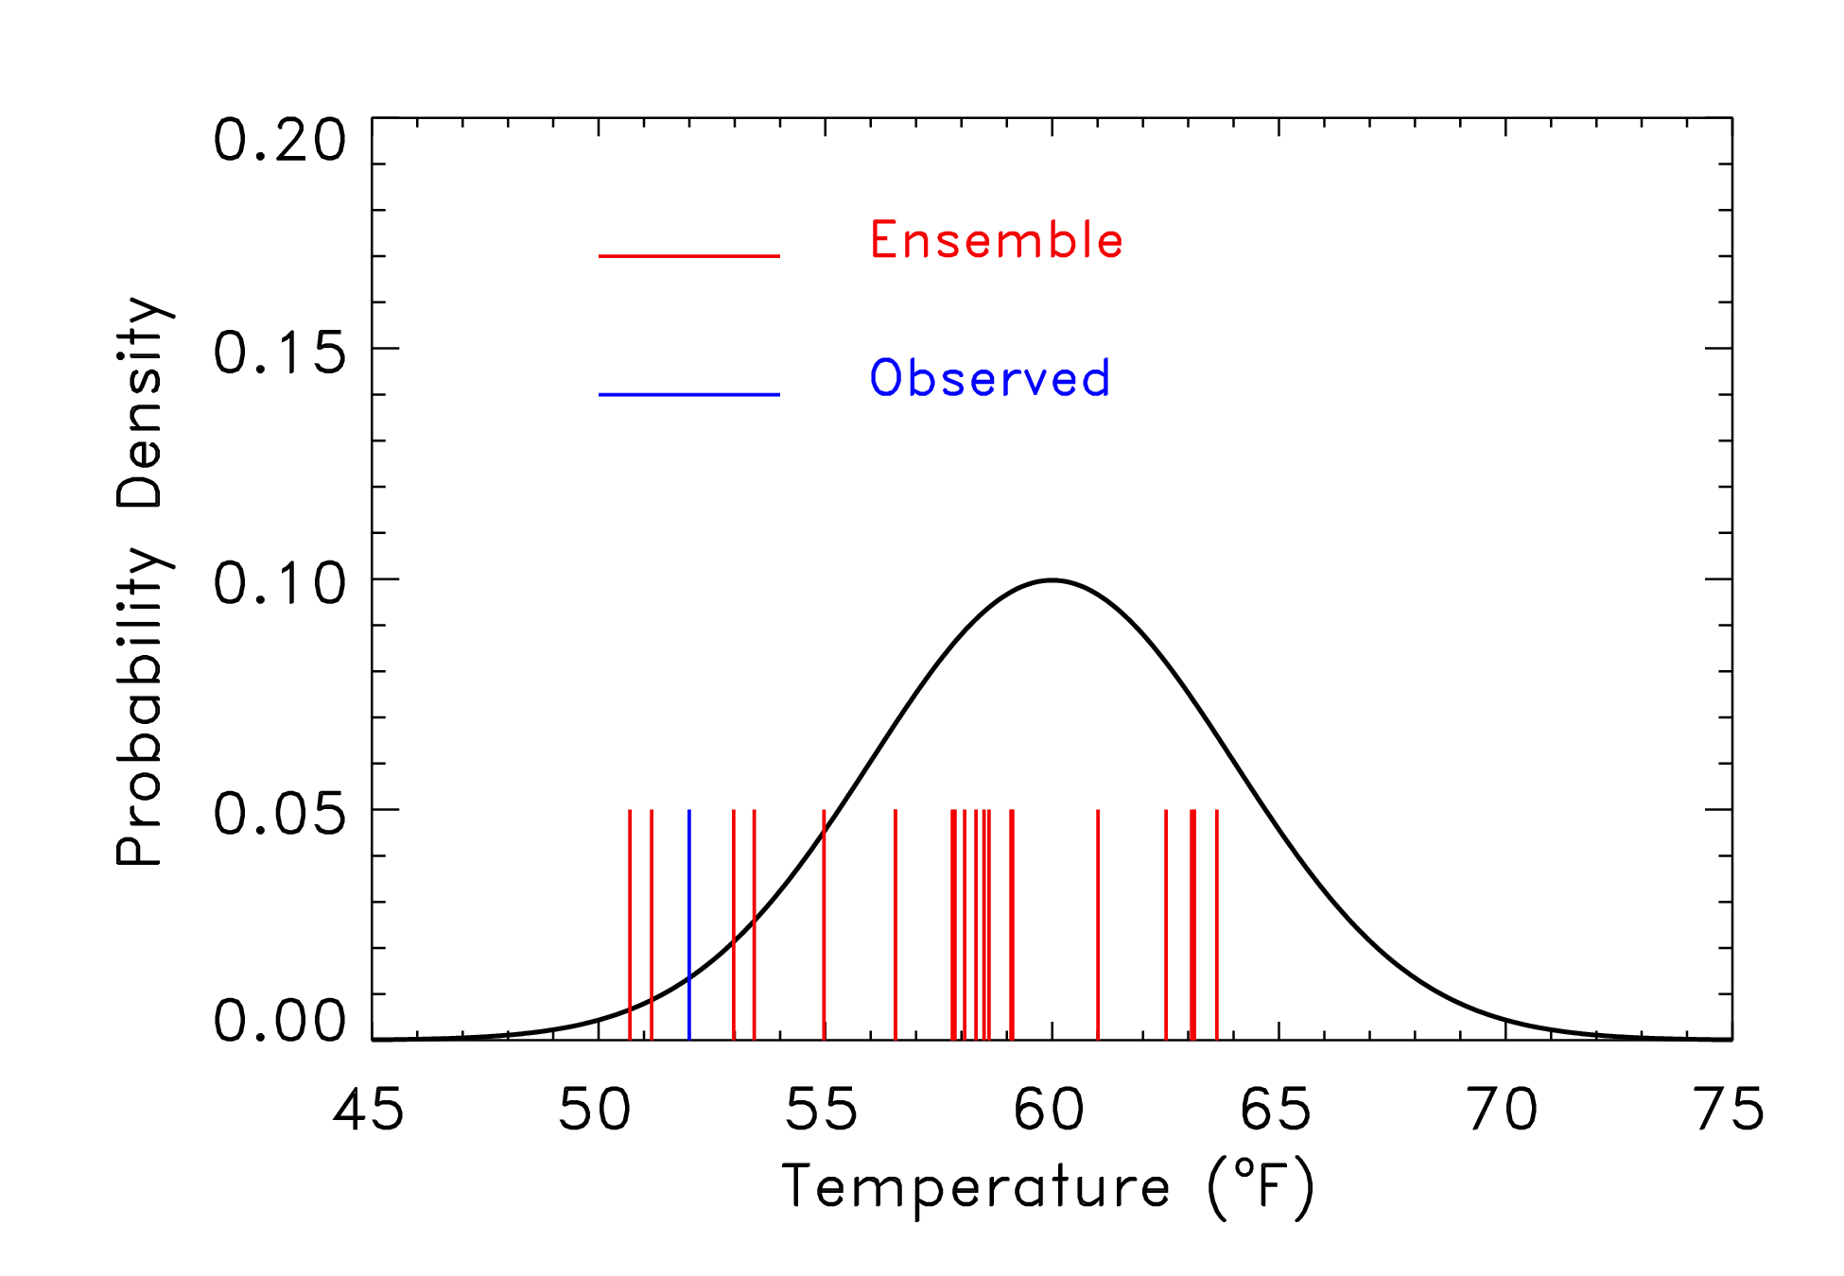
Rank 1 of 21
Rank 14 of 21
Rank 5 of 21
Rank 3 of 21
8
Notes:
8

Slide 9
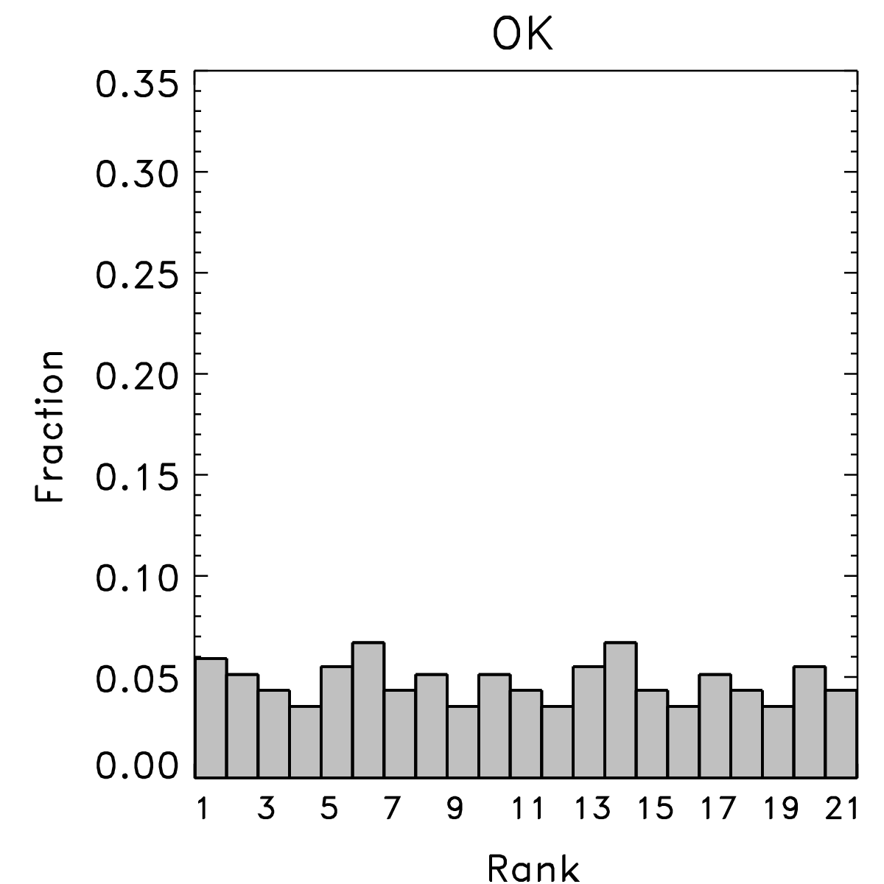
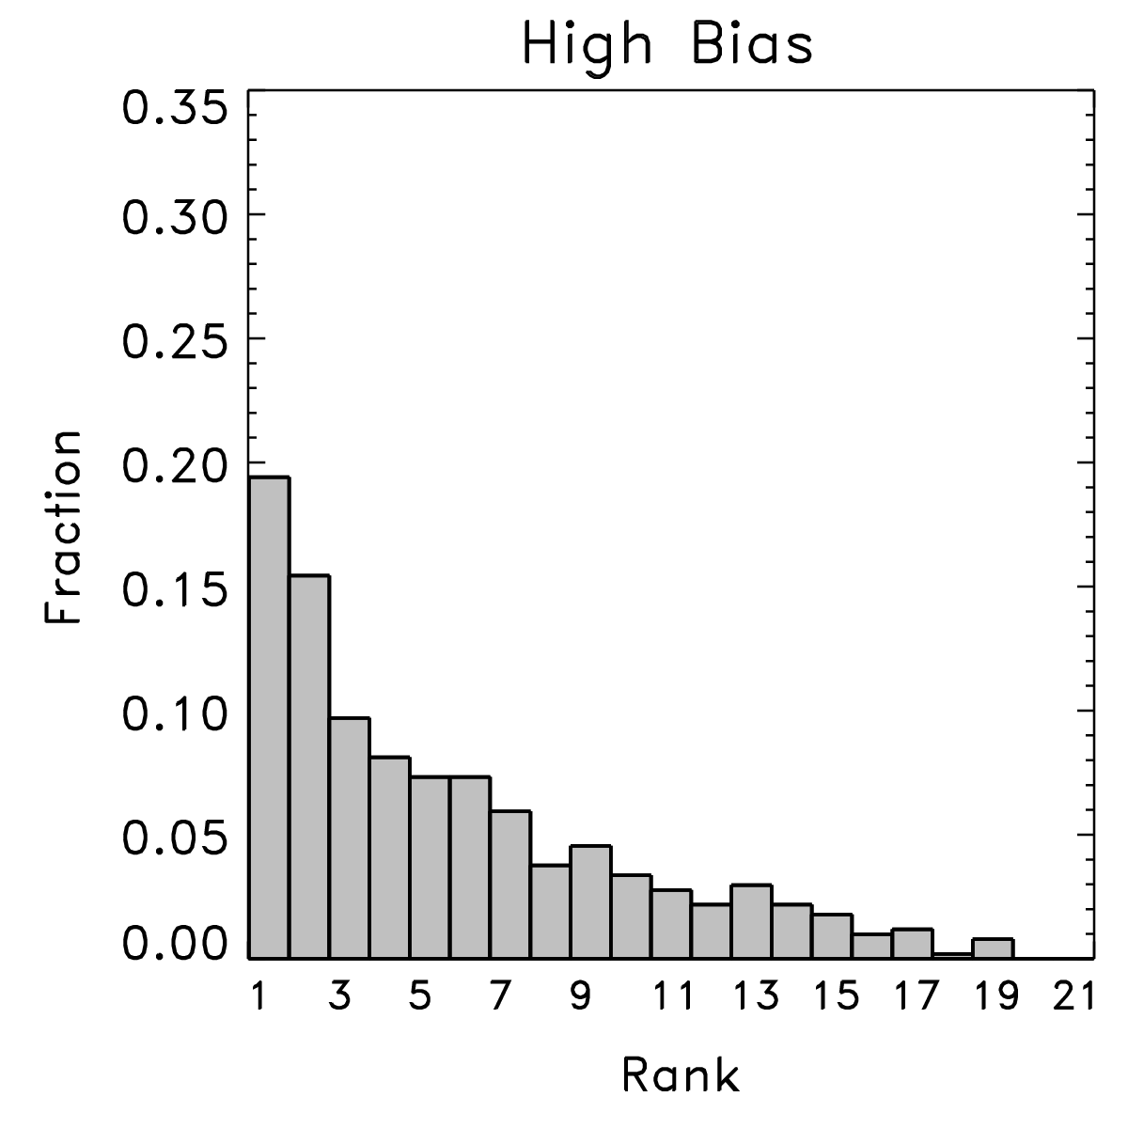
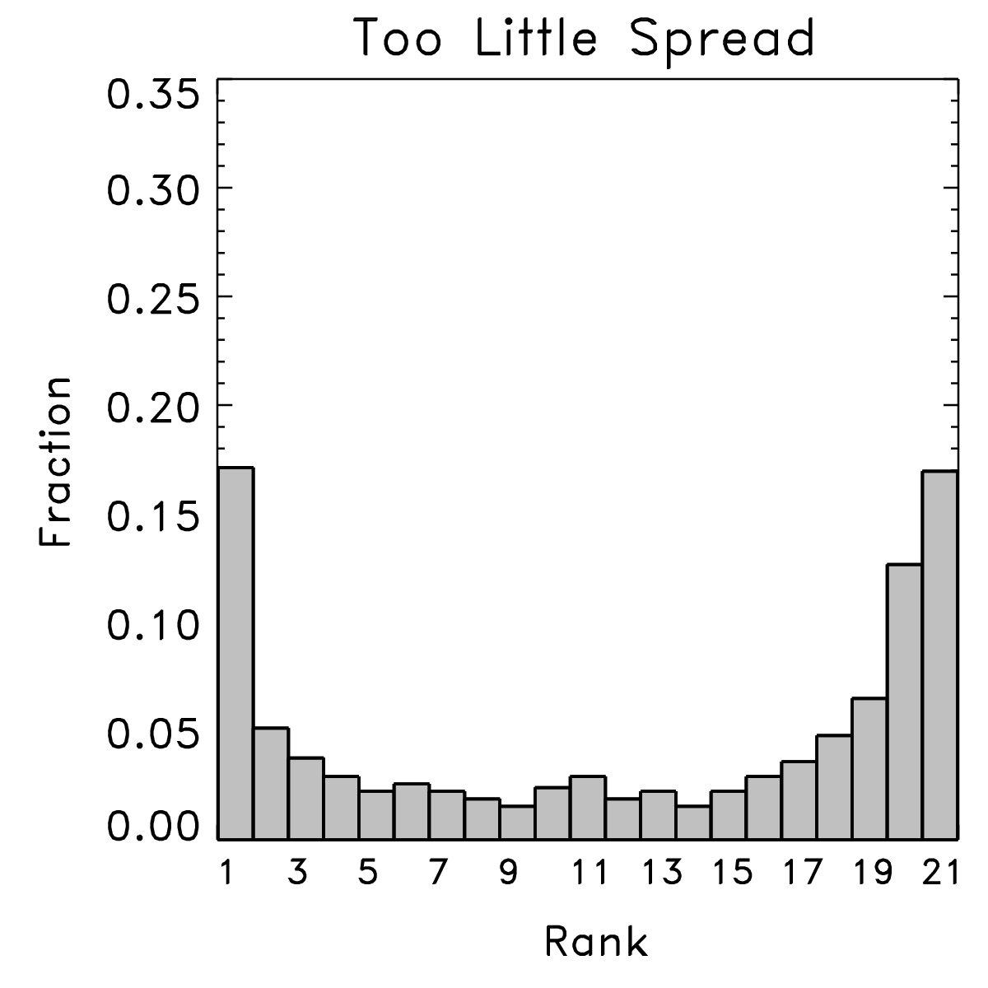
Ensembles and truth should be draws from the same distribution
We can only evaluate the quality of an ensemble when we have lots of samples
from many situations to evaluate the characteristics of the ensemble.
Happens when
truth is
indistinguishable
from any other
member of the
ensemble.
Happens when
observed too
commonly is
lower than the
ensemble members.
Happens when
there are either
some low and some
high biases, or when
the ensemble doesn’t
spread out enough.
9
ref: Hamill, MWR, March 2001
Notes:
9

Slide 10
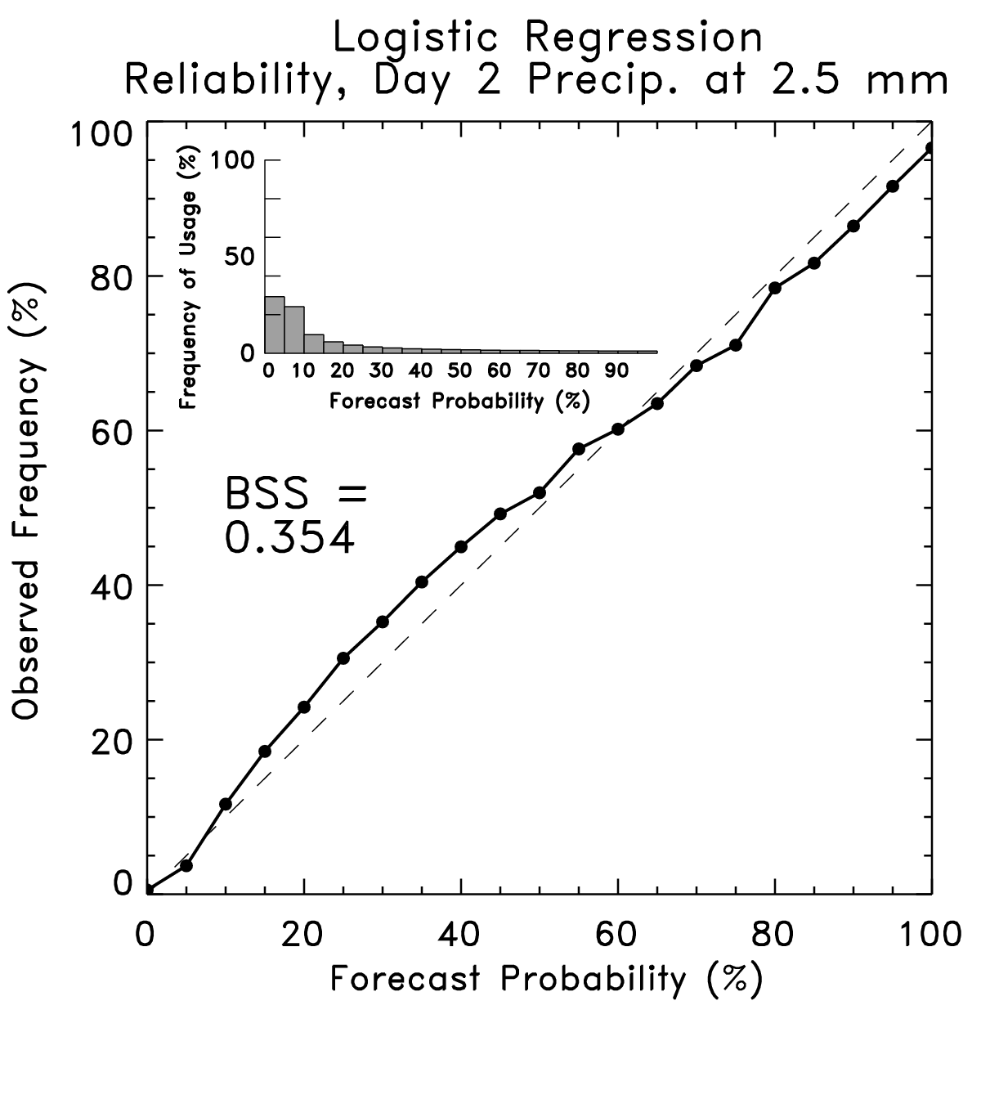
Such ensemble forecasts will be “reliable” (if there are enough members)
In a reliable forecast, the event
occurs at the same relative
frequency as the probability you
forecast.
Note: even if the ensemble and the
truth are drawn from the same
distribution, with a small ensemble
you won’t get reliable probabilities
due to sampling error (Richardson,
QJRMS, 2001)
10
Notes:
10

Slide 11
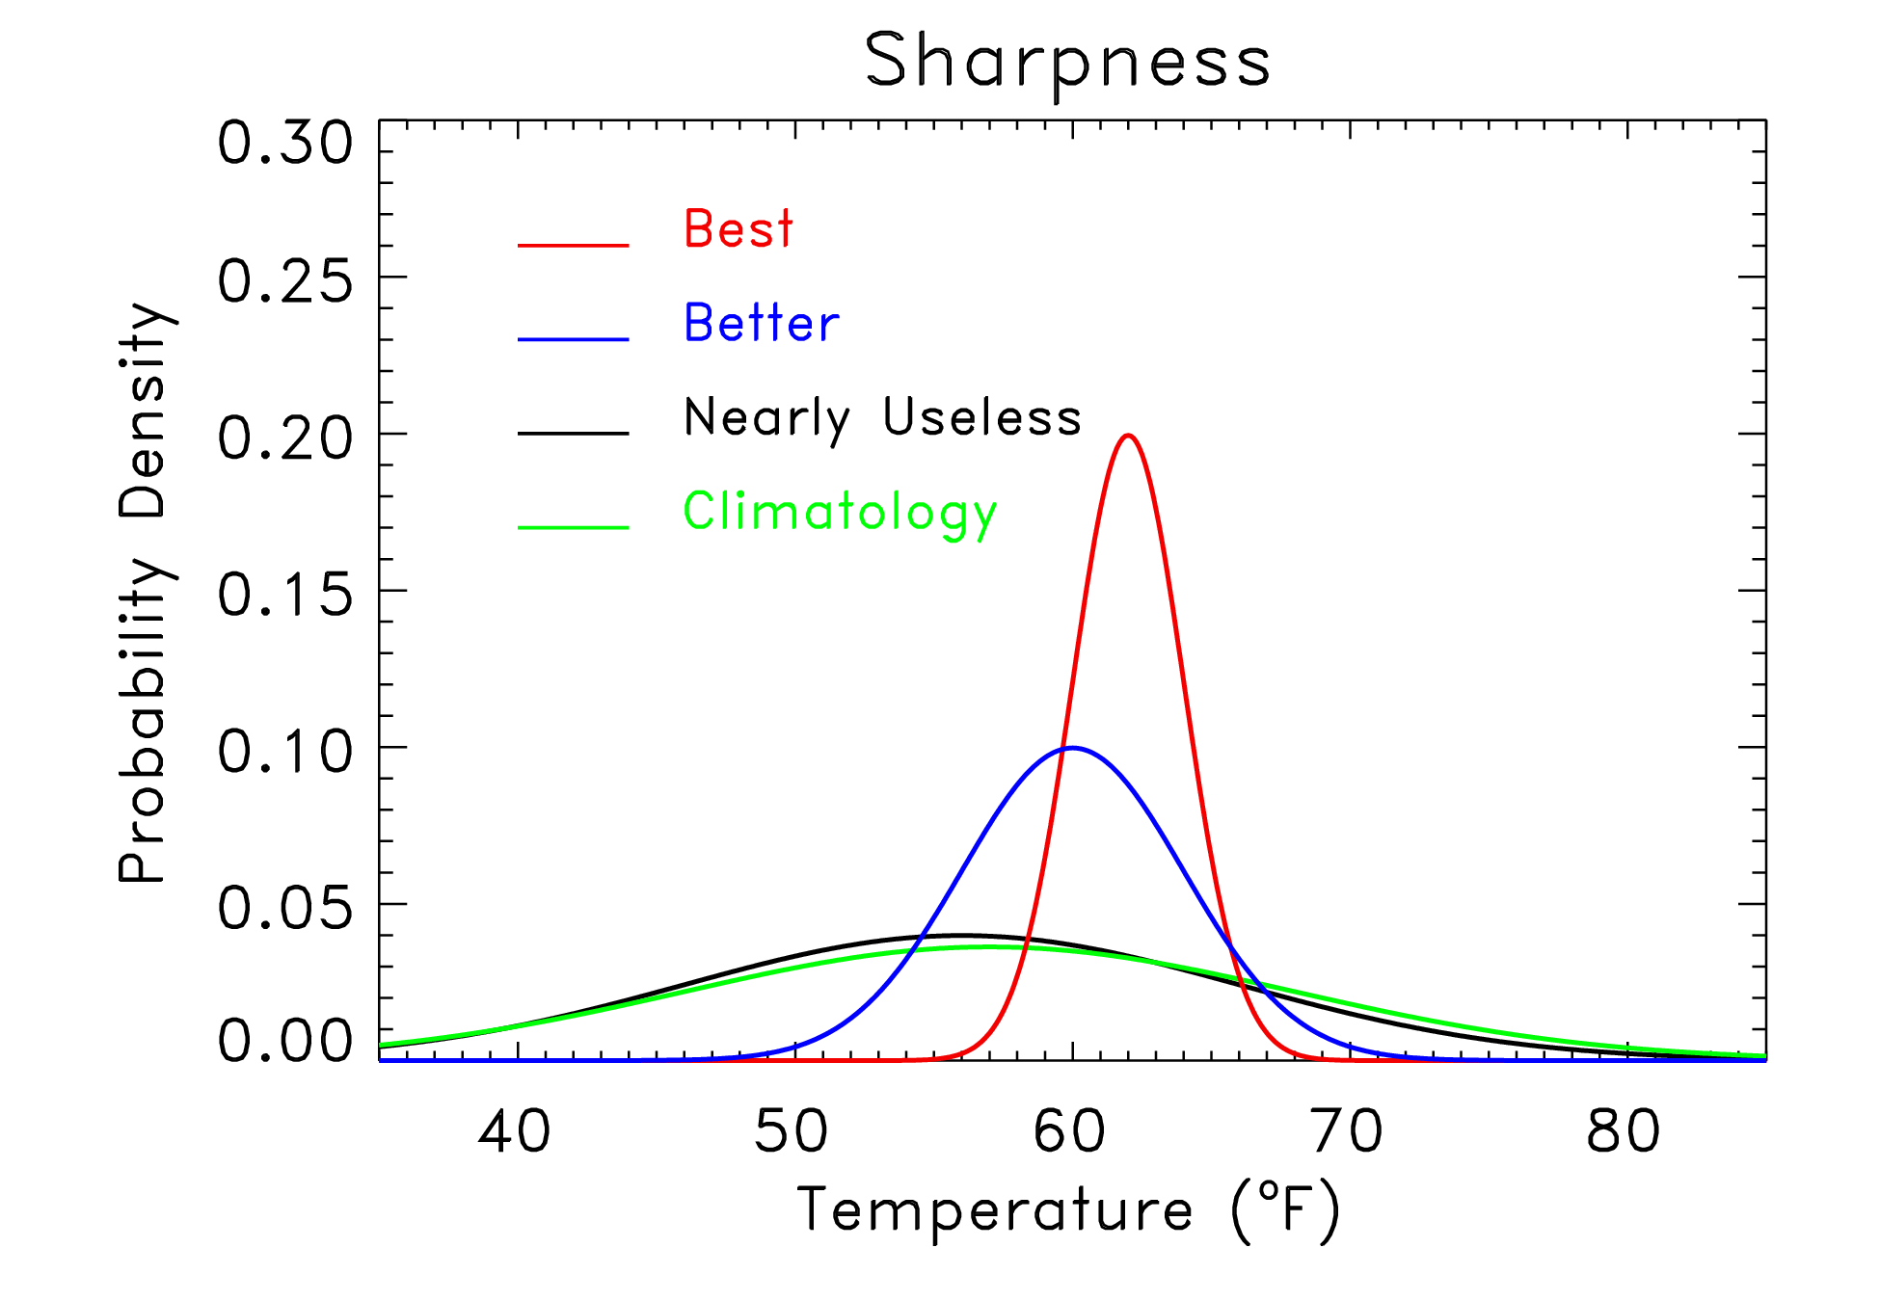
“Sharpness” another desired characteristic of ensembles
“Sharpness”
measures the
specificity of
the probabilistic
forecast. Given
two reliable forecast
systems, the one
producing the
sharper forecasts
is preferable.
But: don’t want
sharp if not reliable.
Implies unrealistic
confidence.
11
Notes:
11

Slide 12
“Spread-skill” relationships
Small-spread ensemble forecasts should have less ensemble-mean error than large-spread forecasts. Demonstrate that ensembles can quantifying situational uncertainty.
ensemble-mean
error from a sample
of this pdf on avg.
should be low.
ensemble-mean
error should be
moderate on avg.
ensemble-mean
error should be
large on avg.
12
Notes:
12

Slide 13
How we think about the process of generating an initial ensemble
Observations
Data
Assimilation
Forecast
Model
First Guess
Analysis

Slide 14
How we think about the process of generating an initial ensemble
observations have errors,
and they aren’t available everywhere
Observations
Data
Assimilation
Forecast
Model
First Guess
Analysis

Slide 15
How we think about the process of generating an initial ensemble
observations have errors,
and they aren’t available everywhere
Observations
Data
Assimilation
Forecast
Model
First Guess
Analysis
this will inevitably have some errors, else
why assimilate new observations?

Slide 16
How we think about the process of generating an initial ensemble
observations have errors,
and they aren’t available everywhere
hence the “initial condition”
will inevitably have some
error; it will inherit some
characteristics of the forecast
error and the observations.
Observations
Data
Assimilation
Forecast
Model
First Guess
Analysis
this will inevitably have some errors, else
why assimilate new observations?

Slide 17
How we think about the process of generating an initial ensemble
observations have errors,
and they aren’t available everywhere
hence the “initial condition”
will inevitably have some
error; it will inherit some
characteristics of the forecast
error and the observations.
Observations
Data
Assimilation
Forecast
Model
First Guess
Analysis
and of course
errors tend to
grow with time,
so it’d be helpful
to have a sense
of the diversity of
possible outcomes
this will inevitably have some errors, else
why assimilate new observations?

Slide 18
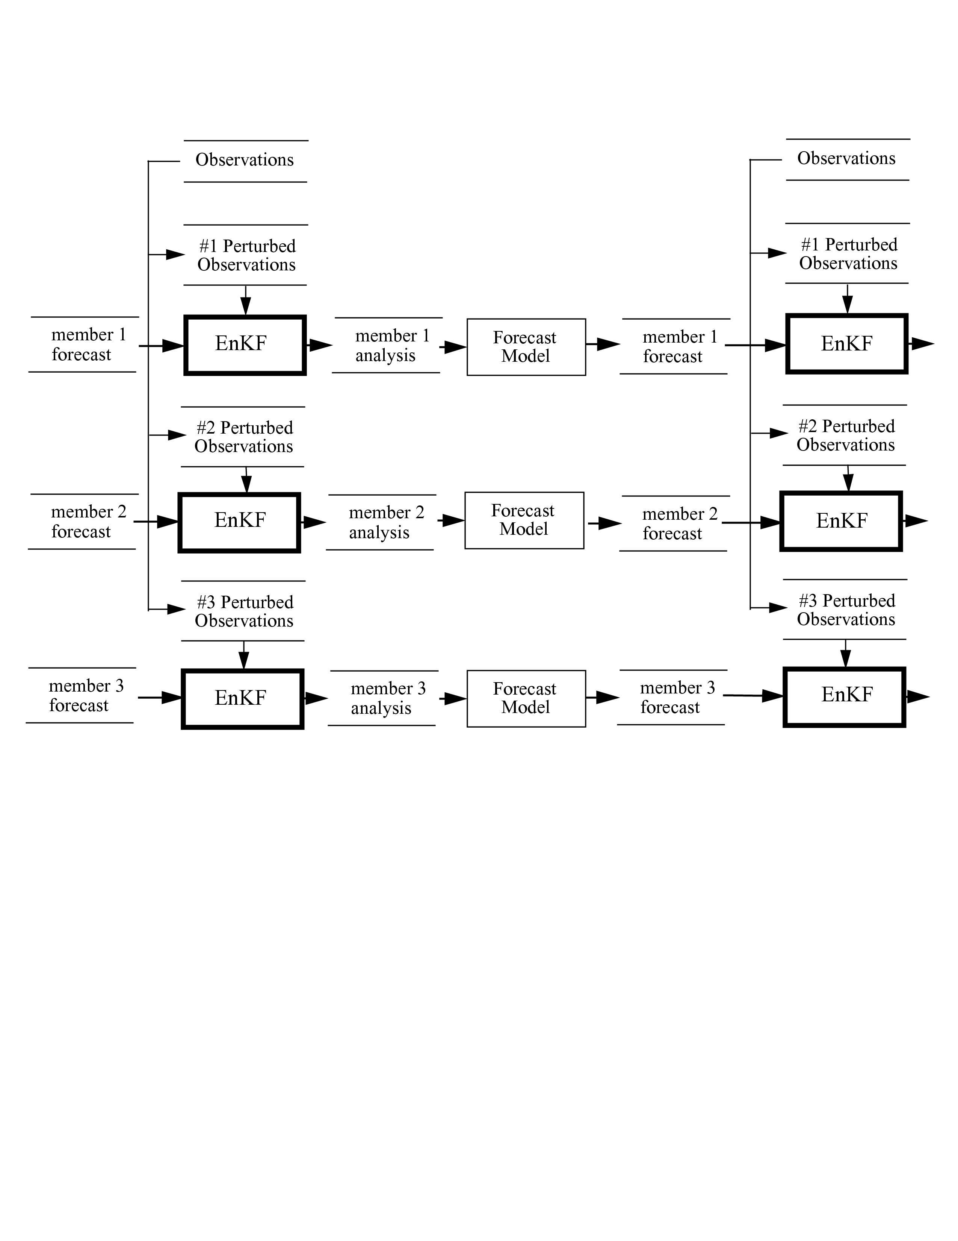
EnKF (Ensemble Kalman Filter)
naturally simulates uncertainty in observations, prior forecast
(This schematic
is a bit of an
inappropriate
simplification,
for EnKF uses
every member
to estimate
background-
error covariances)

Slide 19
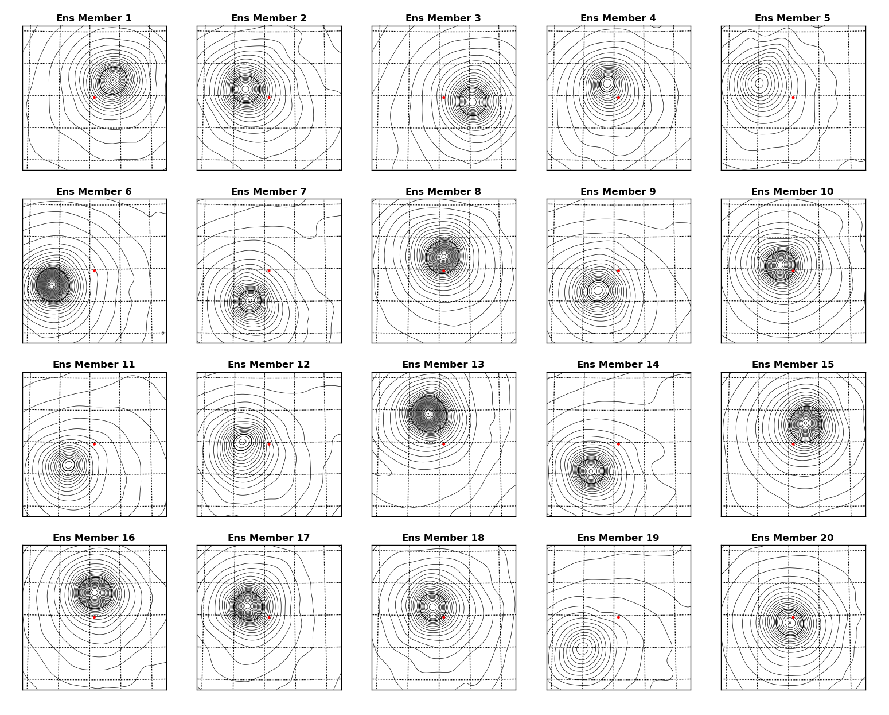
Ensembles provide estimates of forecast error & their correlation structure in the EnKF
here, 20-member ensemble of short-term
forecasts, showing uncertainty
in the forecast position and
structure of a
hurricane vortex.
Note, for example, more spread in MSLP
in center of domain than on the edges.
Notes:
Examples: top bullet: Insert ECMWF Lothar IC and forecast
2nd bullet: 1930’s drought reanalysis?

Slide 20
An example of “analysis increment” from EnKF and 3D-Var
This shows the adjustment to a wind observation 1 m/s greater
to the background (at dot) in EnKF and in more classical “3D-Var”
figure c/o Xuguang Wang, formerly CIRES/ESRL, now University of Oklahoma

Slide 21
Desirable properties for ensembles of initial conditions
(1) true model state and ensemble are random draws from the same distribution (same as before).
i.e., ensemble samples “analysis uncertainty.”
implies larger differences between members in data voids, or where prior forecast differences were growing.
(2) differences between subsequent forecasts ought to grow quickly enough that ensemble-spread consistent with ensemble mean error.
with perfect forecast model, (2) will happen naturally if you take care of (1)

Slide 22
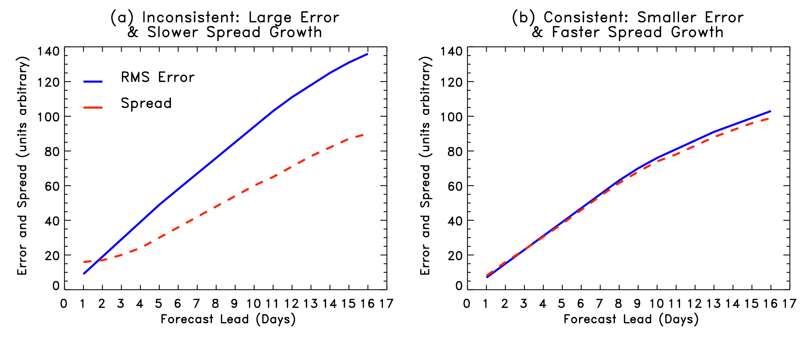
Spread-error consistency
Spread should grow as quickly as error; part of spread growth from manner in which initial conditions are generated, some due to the model (e.g., stochastic physics, higher resolution increases spread growth). Focus on initial-condition aspect.

Slide 23
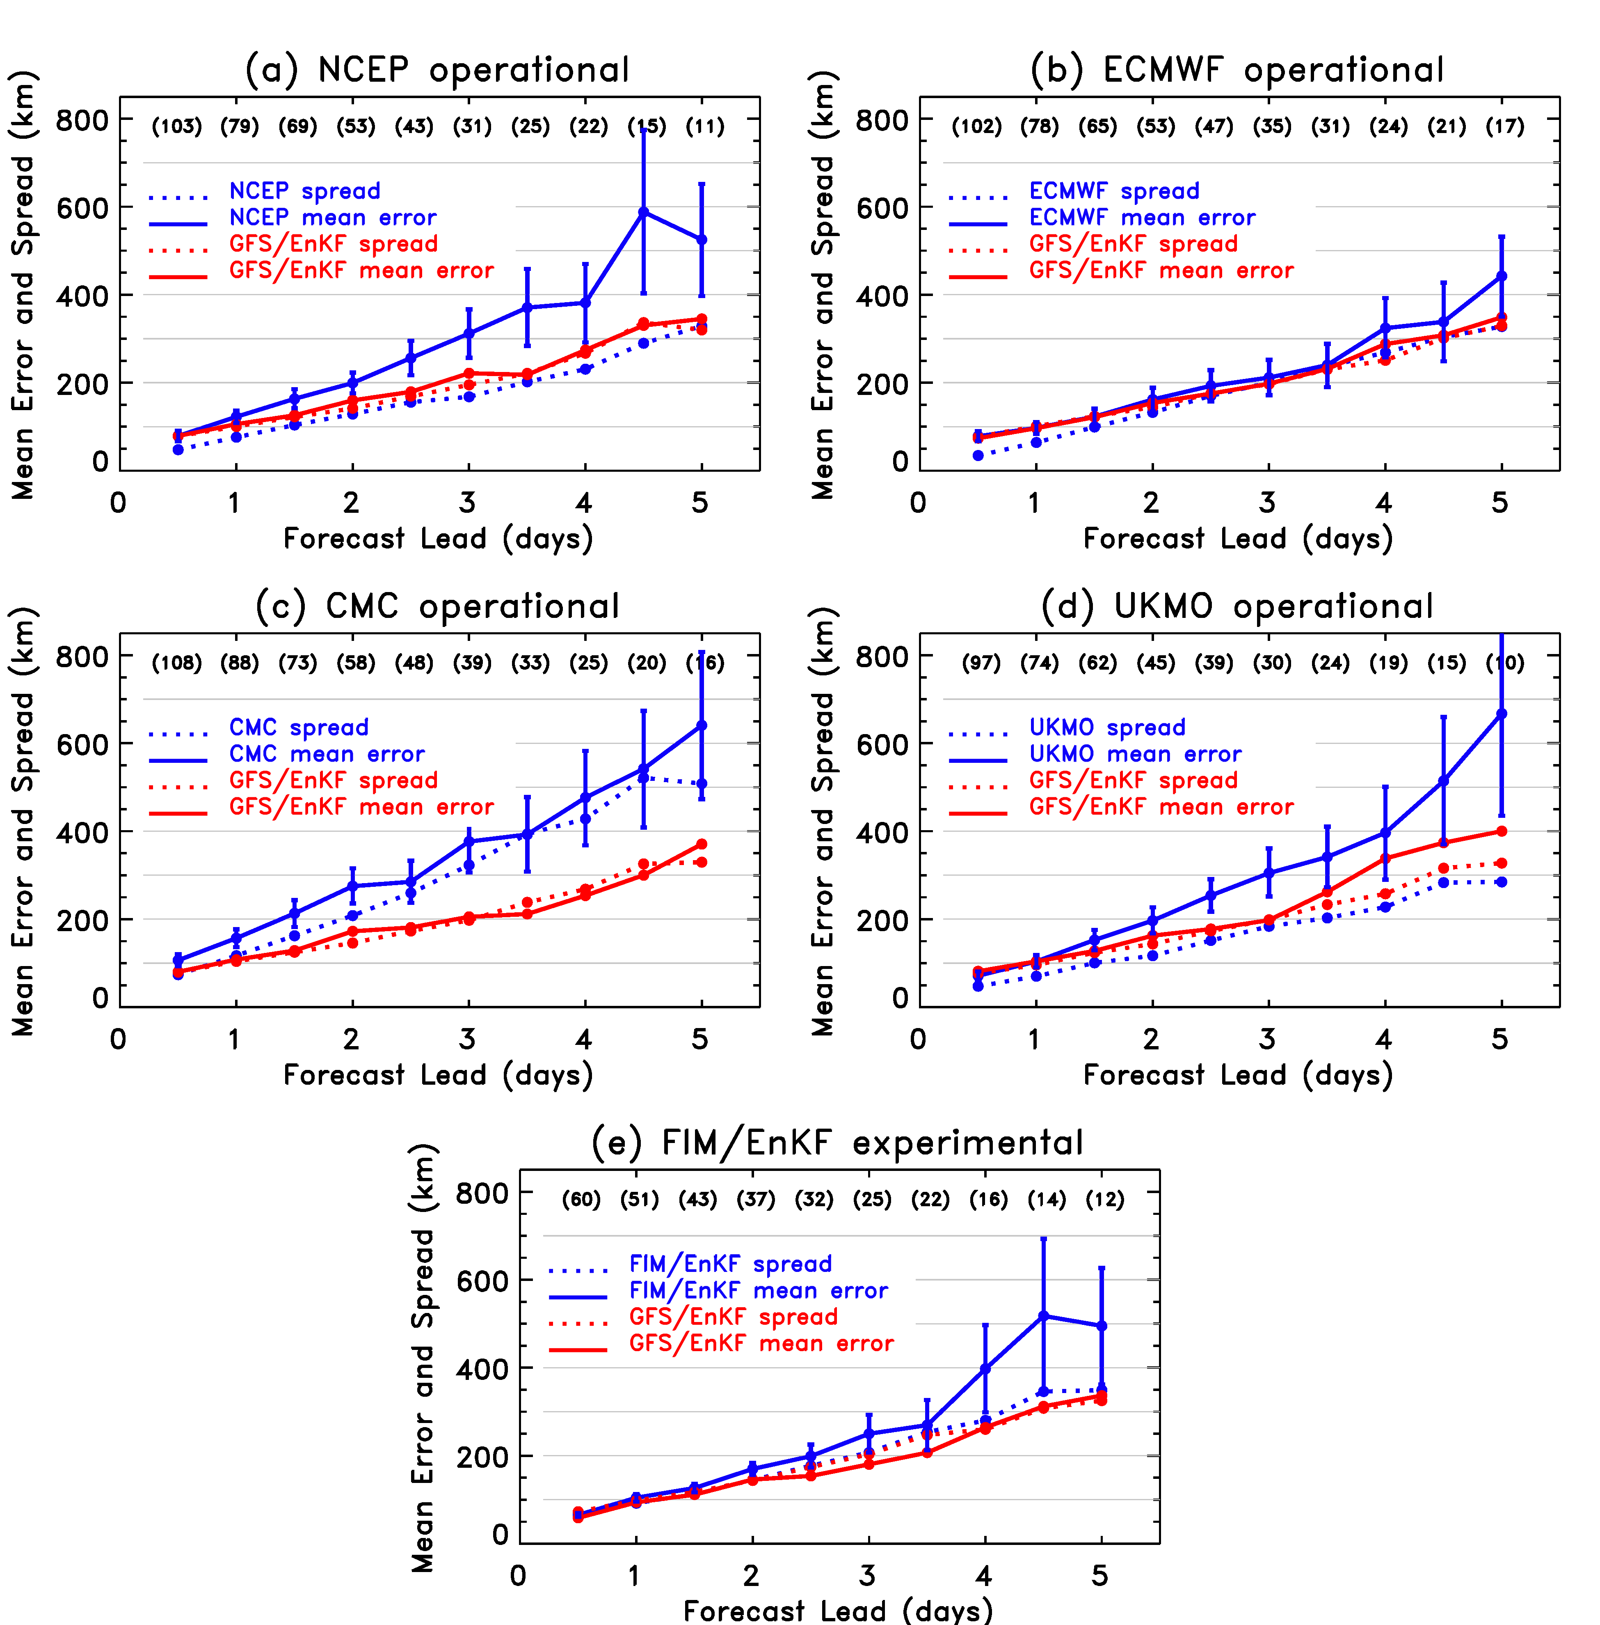
from recently submitted
Hamill et al. (2012) MWR
manuscript
For most models, spread of hurricane tracks is smaller than track ensemble-mean error.

Slide 24
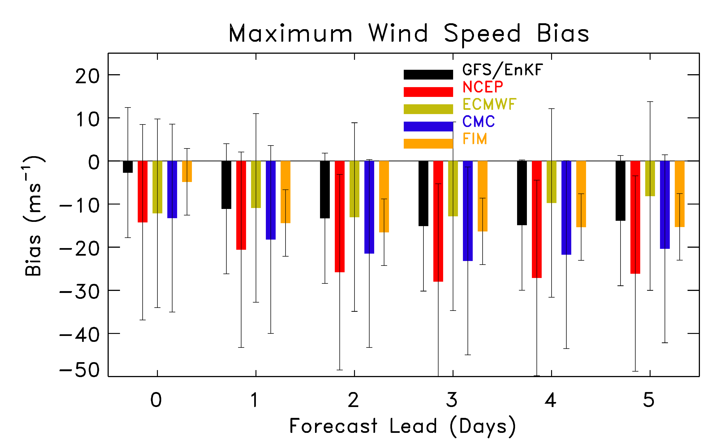
Global ensemble forecast models have systematic under-estimation of maximum
wind speed. Lesson: we’re far from conquering model error in NWP and ensembles.

Slide 25
“Model error”
Imperfections in the forecast model, due to:
inadequate resolution
unduly simple physical parameterizations
deterministic may be inappropriate
coding bugs
lack of coupling, e.g., ocean-atmosphere
use of limited-area nested model
boundary-condition imperfections
one-way nesting of outer domain, lack of ability for resolved scales to interact with planetary scales
etc.

Slide 26
Addressing model error (Carolyn Reynolds will review further)
Improve your model
Incorporate stochastic parameterizations where appropriate
Multi-parameterization
Multi-model
Post-processing using prior forecasts, obs
upcoming talk by Zoltan Toth

Slide 27
Ensemble products (what we’re here to discuss)
For the fields where we are starting to have some confidence in ensemble guidance, what can we do to convey that information in useful ways to the forecaster and to the public?

Slide 28
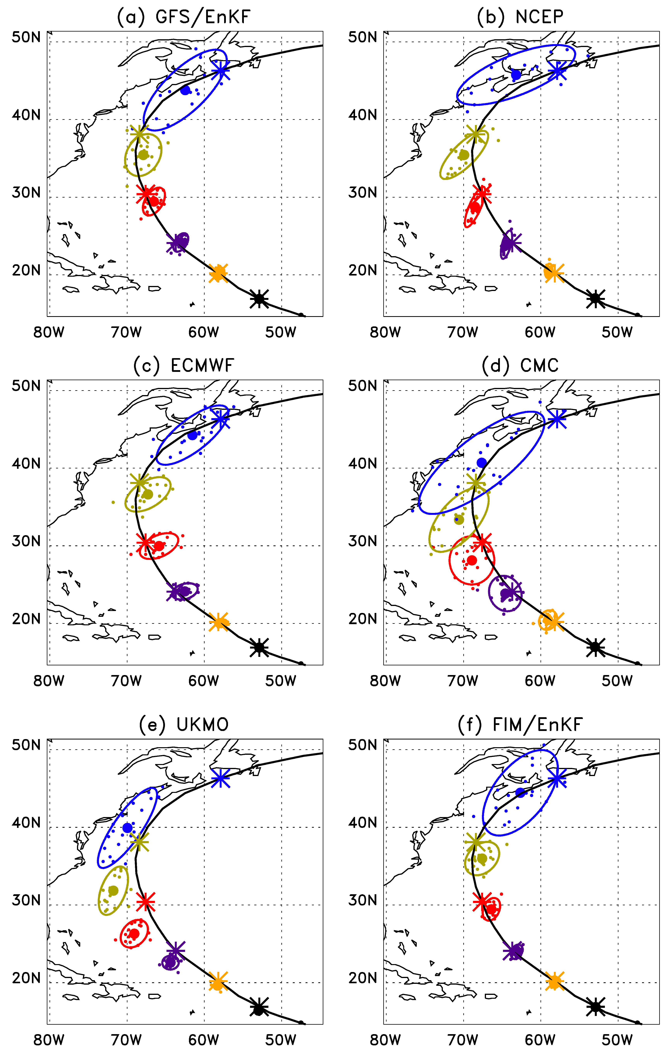
Example: Hurricane Bill
Day 5
Day 4
Day 3
Day 2
Day 1
Initialized 00 UTC 19 August 2009.
Contours provide fit of bivariate normal to ensemble data. Encloses 90% of the probability.
All models slow, to varying extents.
GEFS/EnKF, ECMWF, NCEP, FIM tracks decent.
UKMO, CMC have westward bias.

Slide 29
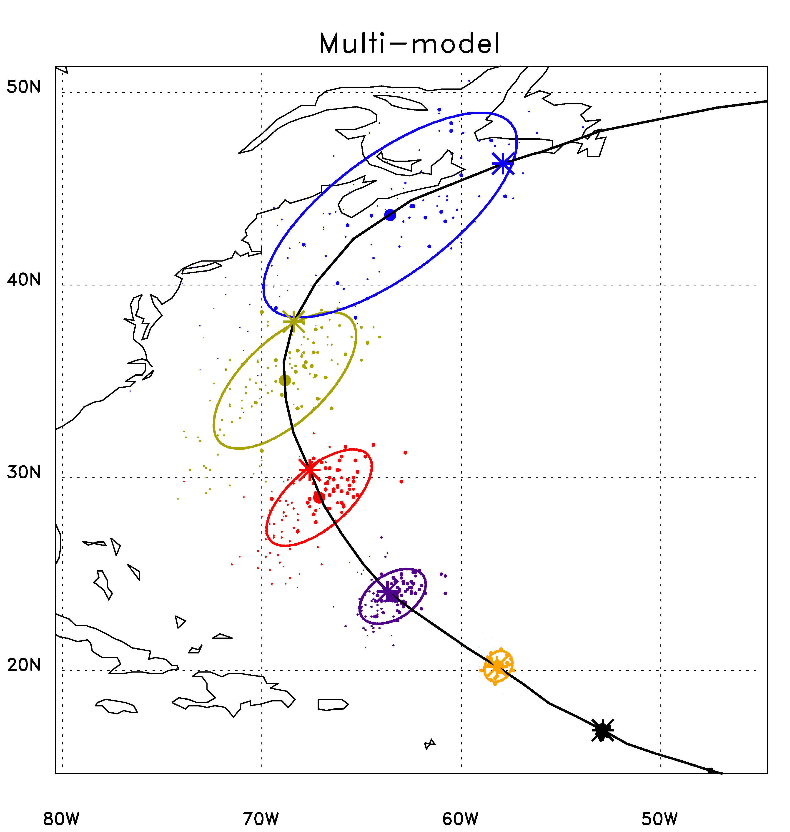
An experimental multi-model product
Dot area is proportional to the weighting applied to that member
= ens. mean position
* = observed position
Day 5
Day 4
Day 3
Day 2
Day 1
Day 0

Slide 30
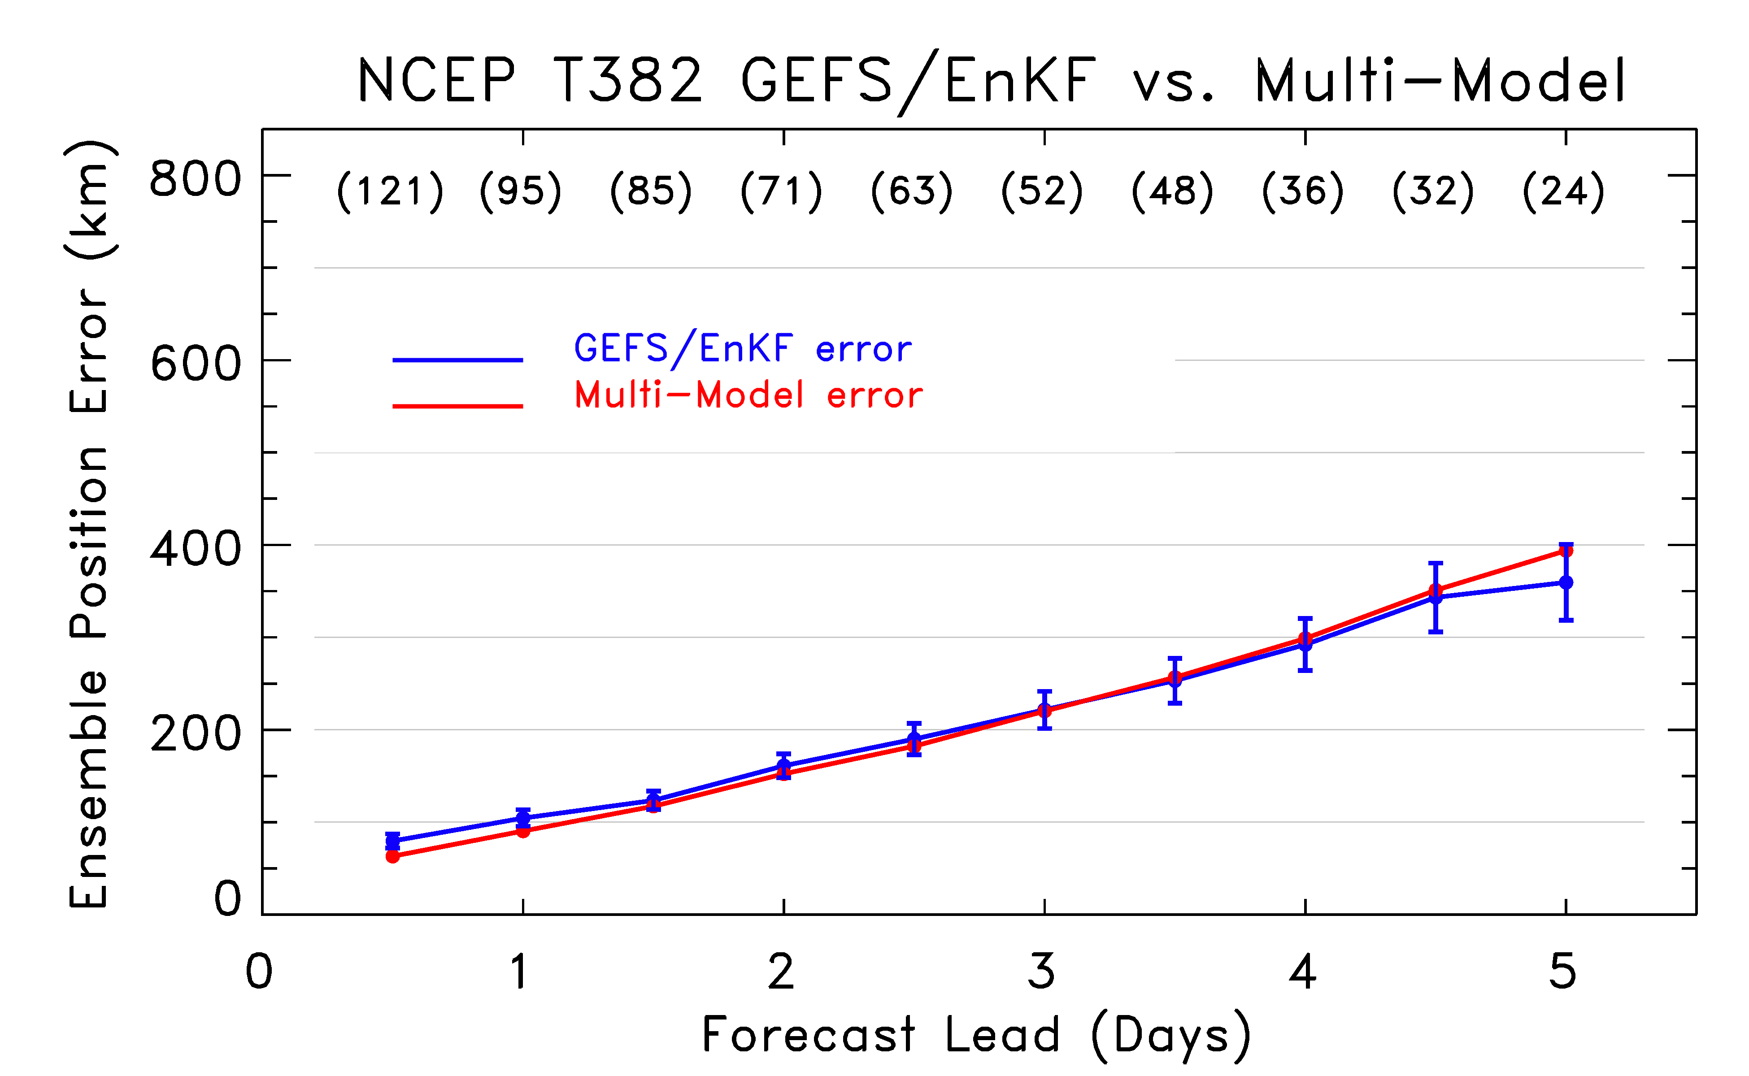
Multi-model error (GEFS/EnKF, ECMWF, FIM, UKMO, CMC, NCEP)
Not much improvement from multi-model (poorer models don’t seem to help much here)

Slide 31
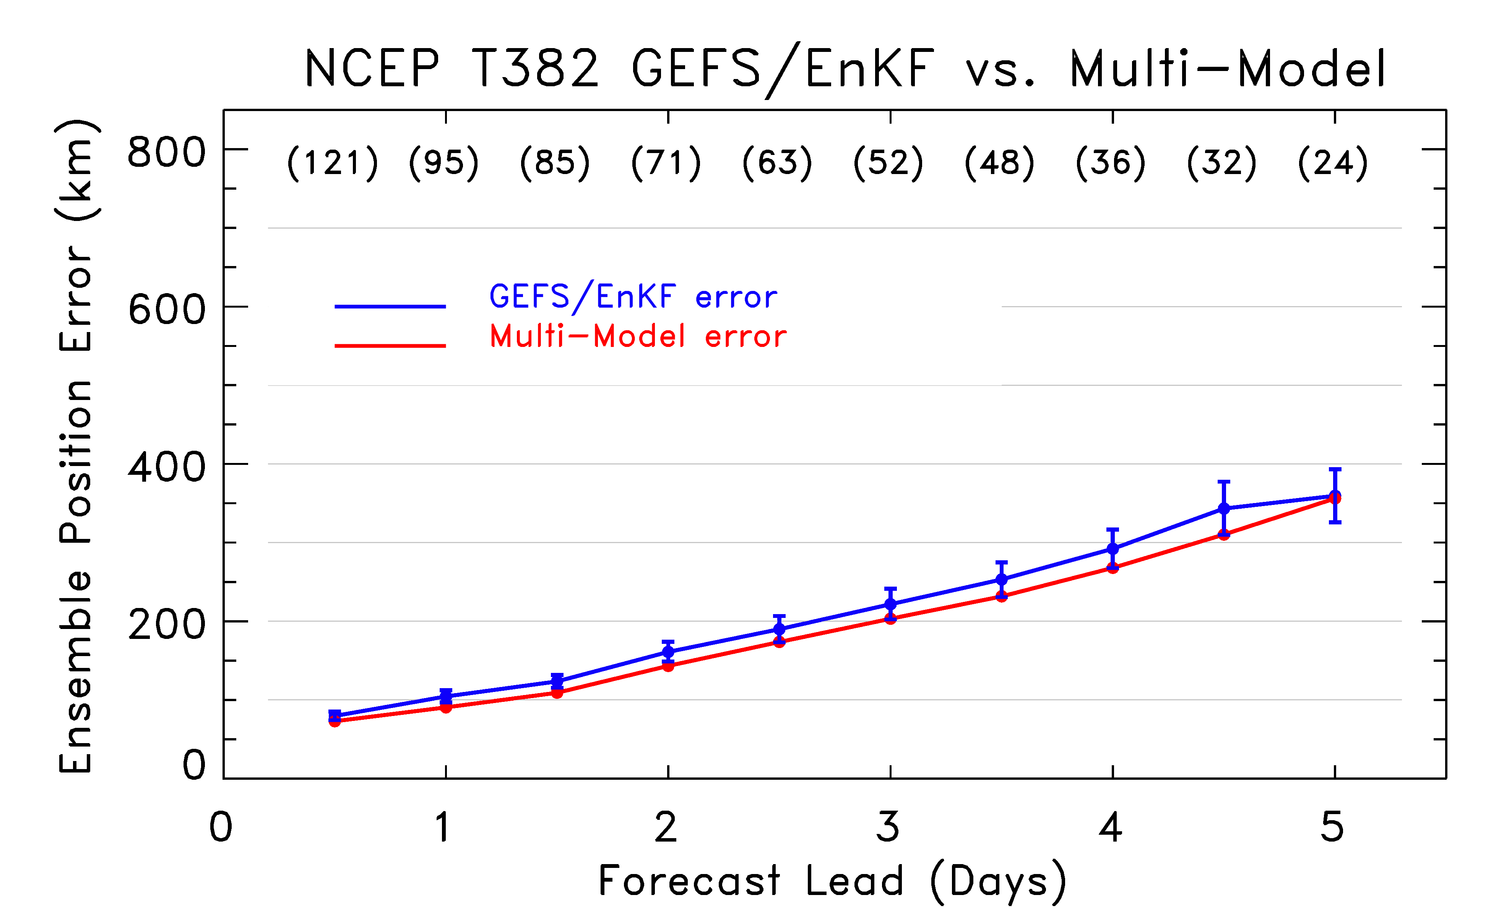
Multi-model error (GEFS/EnKF, ECMWF only)
Now some improvement, ~ 6 - 9 hours lead.

Slide 32
Questions
Mine:
Are ellipses, colors useful way of conveying ensemble information?
Are products like the multi-model synthesis shown here potentially useful to forecasters?
Should we only develop products just for hurricane aspects where we have some confidence (track), or also for those where we lack confidence (intensity)?
Yours

Slide 33
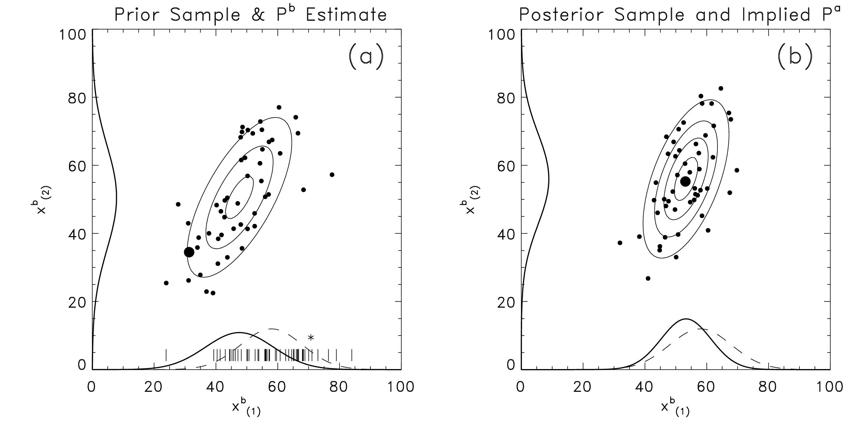
How the EnKF works: 2-D example
Start with a random sample from bimodal distribution used
in previous Bayesian data assimilation example. Contours reflect
the Gaussian distribution fitted to ensemble data.

Slide 34
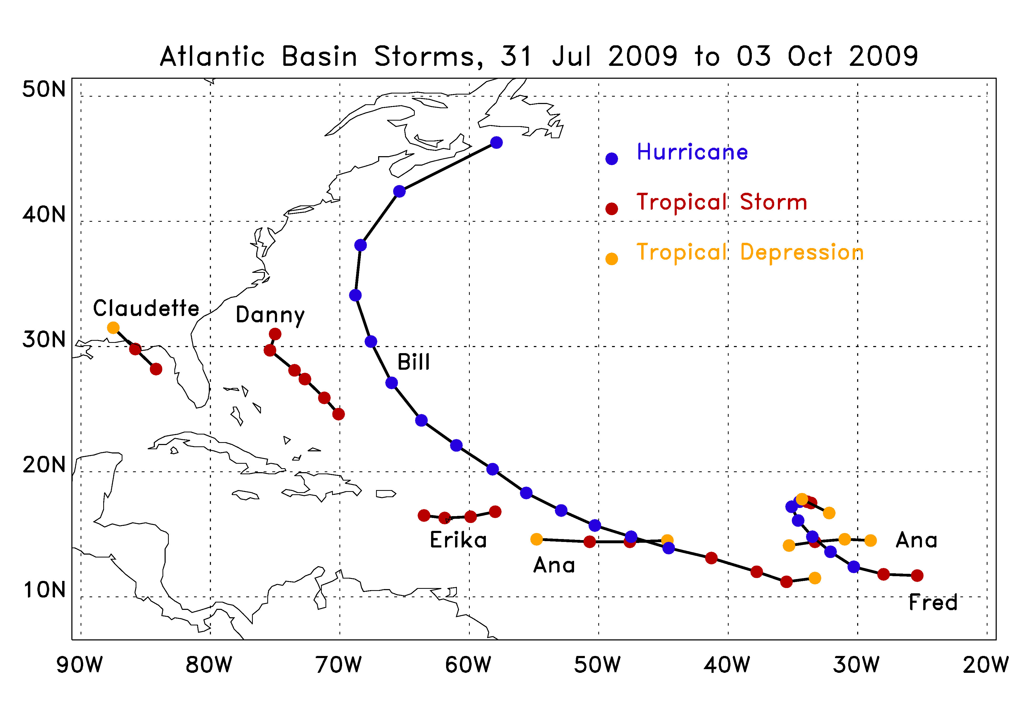
Review of Atlantic Basin activity

Slide 35
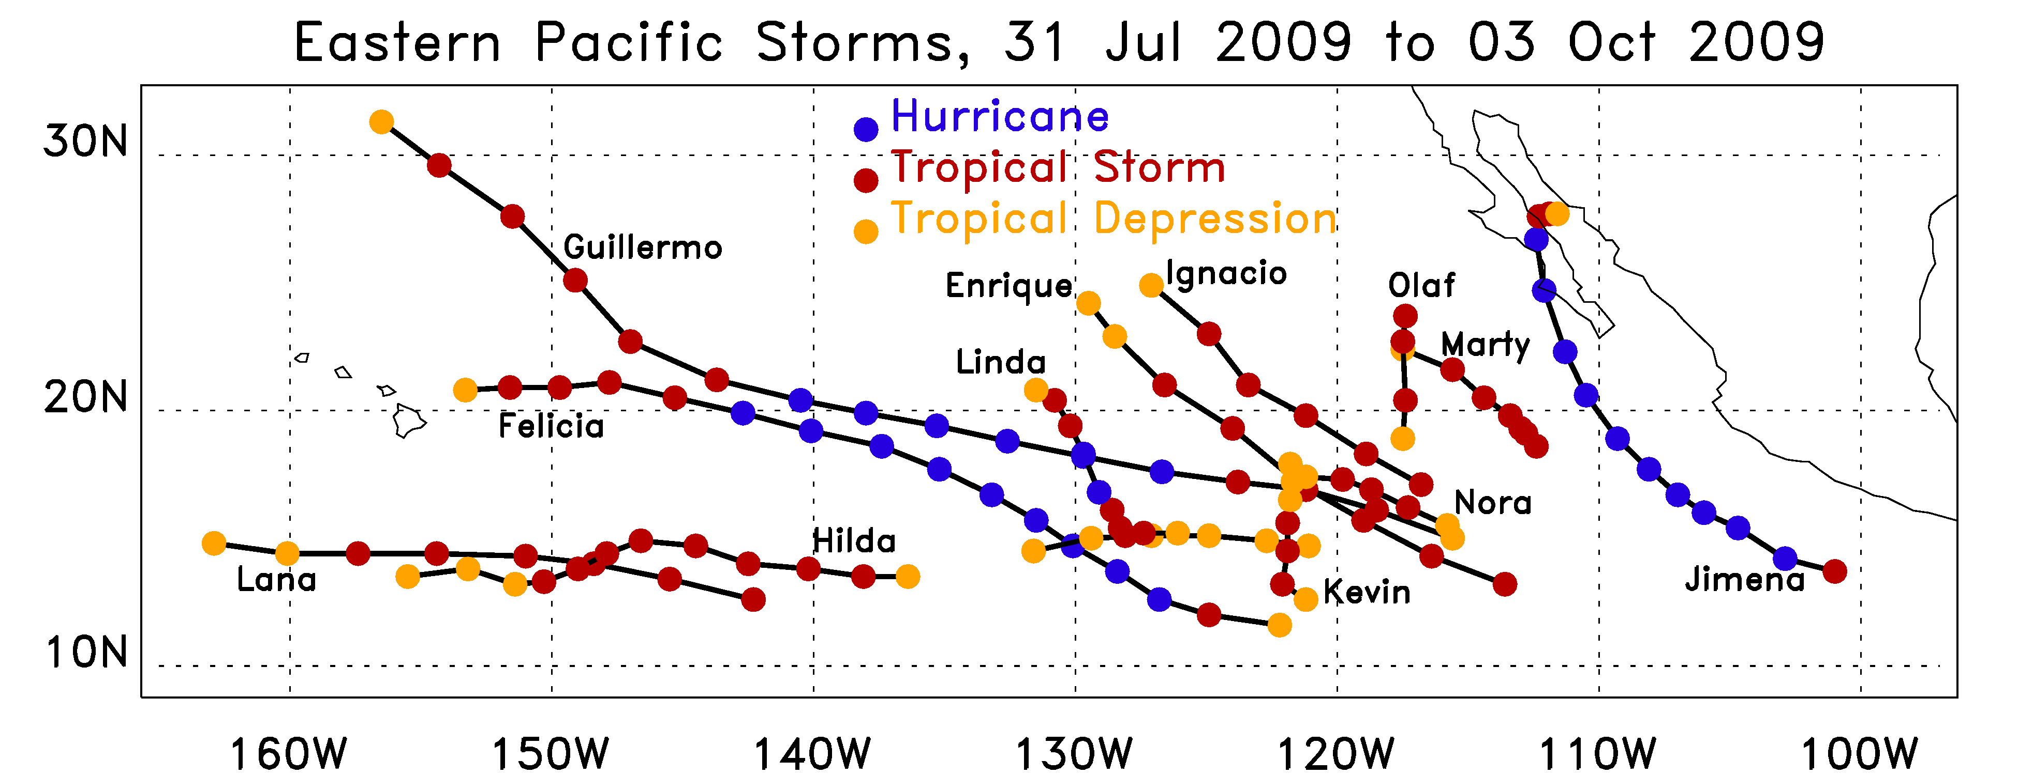
Review of Eastern-Pacific activity

Slide 36
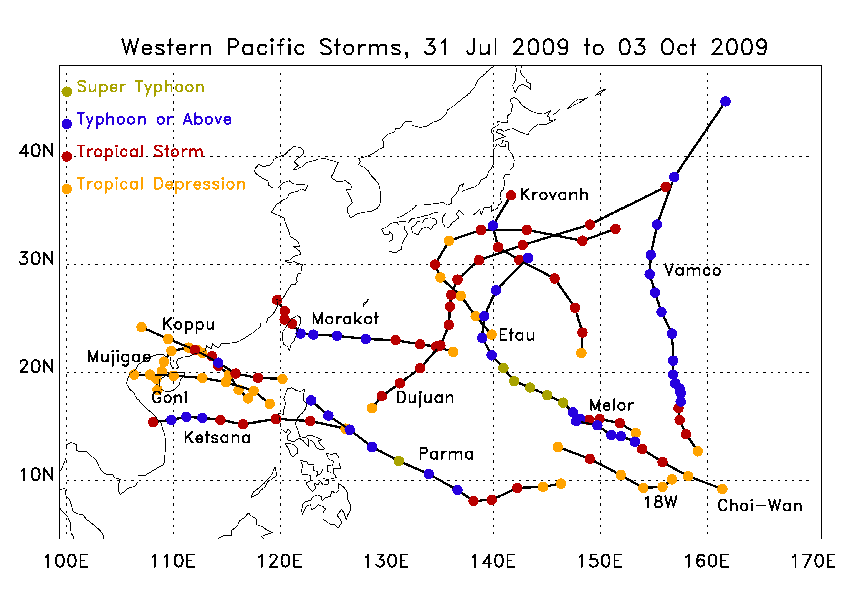
Review of Western-Pacific activity

