Slide 1


NOAA’s 2nd-generation reforecast data set for the NCEP
Global Ensemble Forecast System
NOAA Earth System
Research Laboratory
Tom Hamill
NOAA ESRL, Physical Sciences Division
tom.hamill@noaa.gov
other contributors: Jeff Whitaker, Gary Bates, Don Murray

Slide 2
Reforecast background
1st-gen reforecast and CFSR have demonstrated utility of reforecasts for weather-climate applications (see previous GMB talks).
A GEFS reforecast would be a nice complement to CFSR, especially to help with shorter-lead forecasts.
Were such a data set available, it would have other uses:
  Spur research in hydrologic prediction, calibration, statistical post-processing methods.
  Facilitate labs and universities to work with GEFS, improving R2O to EMC.
  Help diagnose GEFS model error characteristics, especially for low-frequency phenomena, possibly feeding back into GFS development.
  Help EMC decide on its long-term strategy for reforecasting. How many members, how often?

Slide 3
GEFS reforecast v2 details
Seeks to mimic GEFS operational configuration as of February 2012.
Each 00Z, 11-member forecast, 1 control + 10 perturbed.\
Reforecasts produced every day, for 1984120100 to current (actually, working on 2011 and 2012 now).
CFSR initial conditions (GSI) + ETR perturbations (cycled with 10 perturbed members). After ~ 22 May 2012, initial conditions from hybrid EnKF/GSI.
Resolution: T254L42 to day 8, T190L42 from days 7.5 to day 16.
Fast data archive at ESRL of 99 variables, 28 of which stored at original ~1/2-degree resolution during week 1. All stored at 1 degree. Also: mean and spread to be stored.
Full archive at DOE/Lawrence Berkeley Lab, where data set was created under DOE grant.
Web interfaces to each coming soon. Links from TIGGE download pages?

Slide 4
Status
00Z reforecasts 1985-2010 completed.
2011-12 reforecasts mostly computed, but not yet downloaded to ESRL/PSD and reprocessed.
Dick Wobus has submitted change request to NCO to save extra GEFS data so we can start archiving real-time data stream.
We are a few weeks away from opening our ftp/web sites to public access for 1985-2010:
  NOAA/ESRL site: fast access, limited data (99 fields).
  US Department of Energy: slow access, but full data set

Slide 5
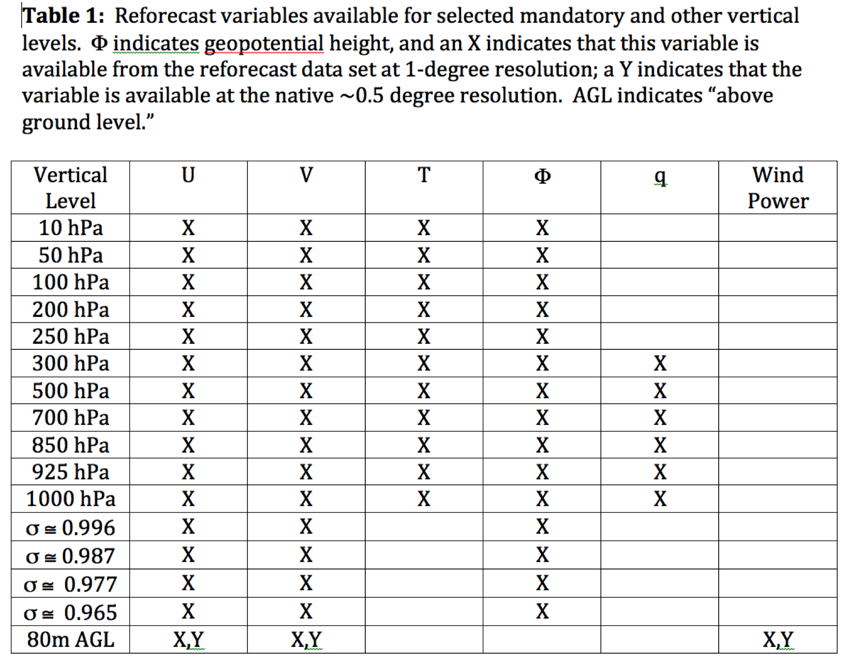
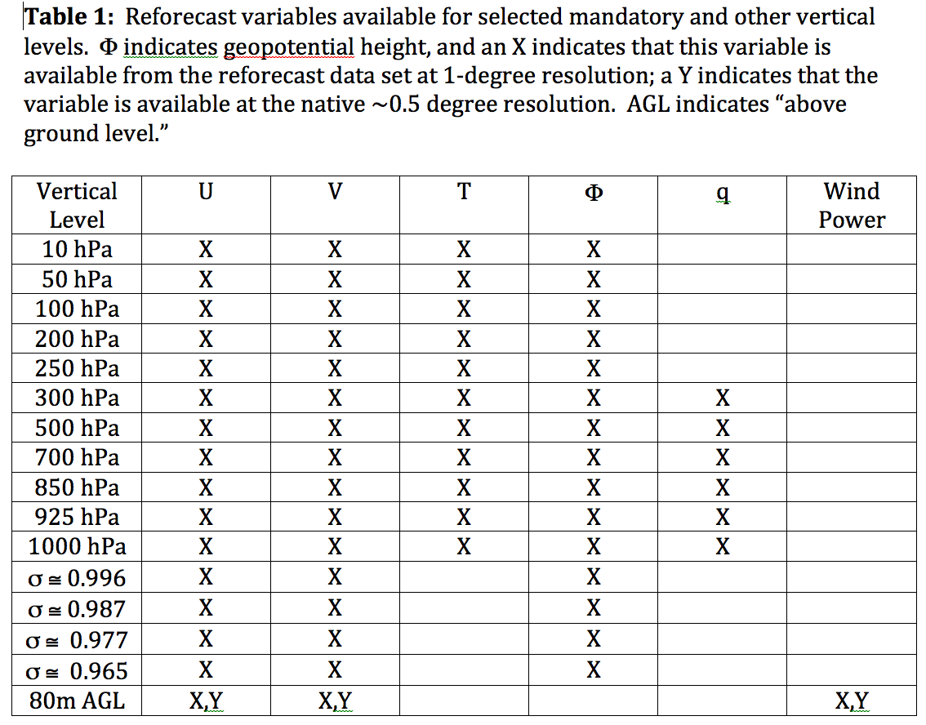
Data to be readily available from ESRL
Also: hurricane track files

Slide 6
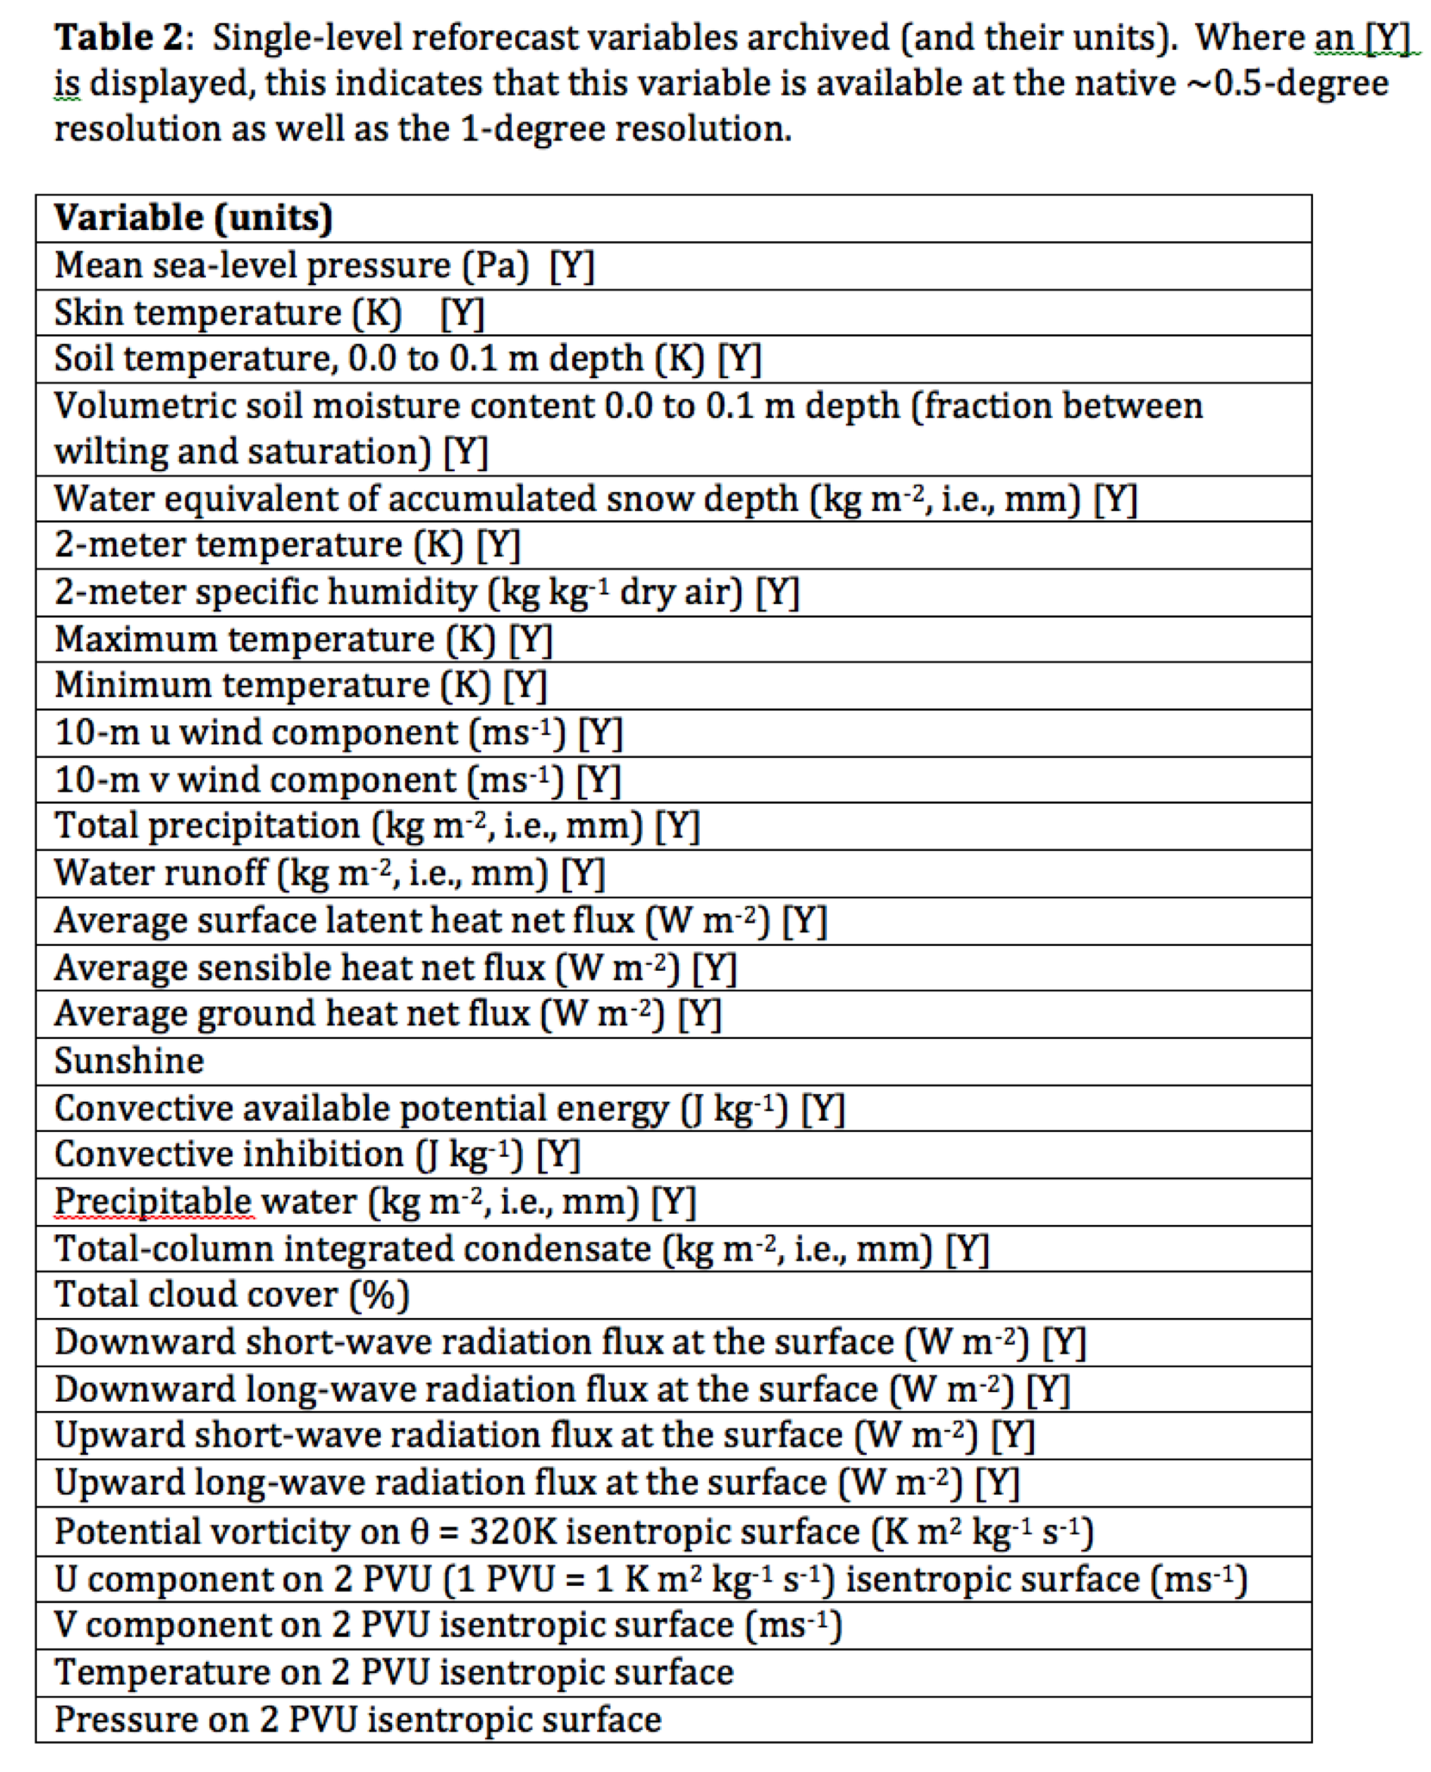
Data to be readily available from ESRL

Slide 7
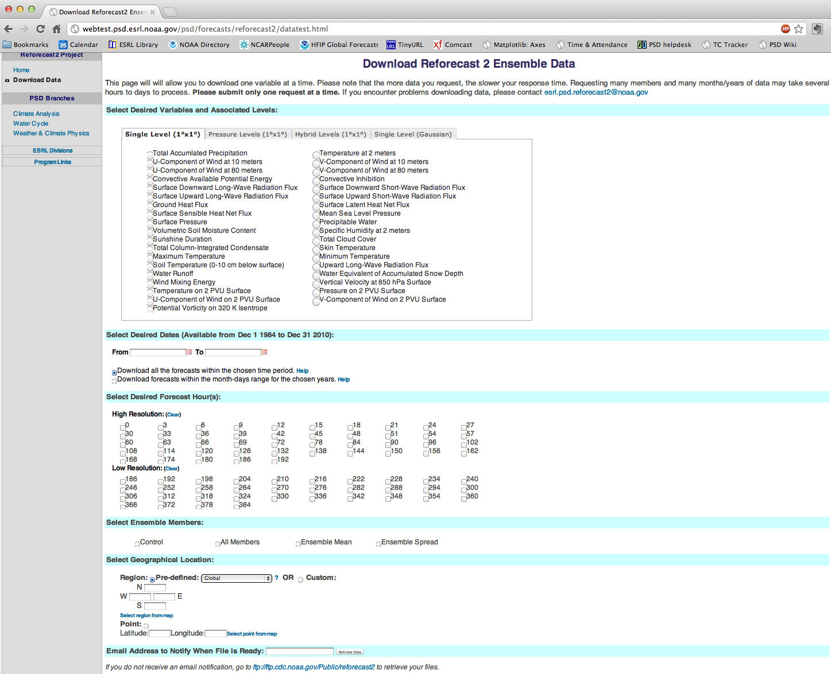
Prototype of our web form (creates netCDF4)

Slide 8
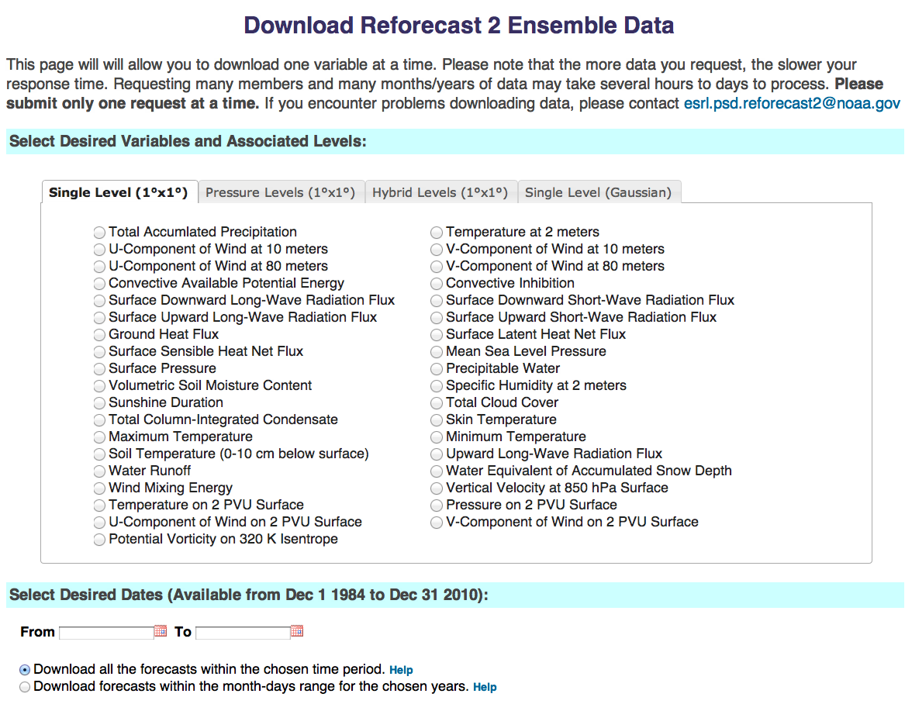

Slide 9
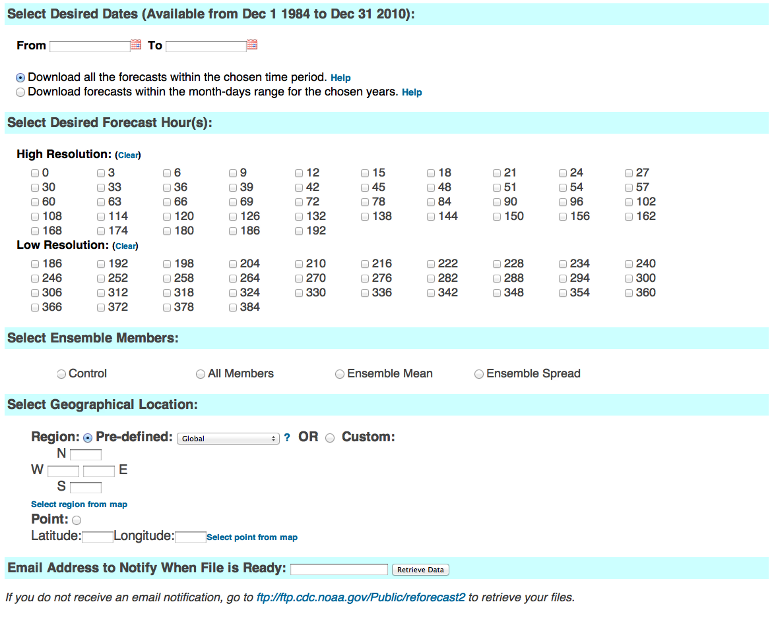

Slide 10
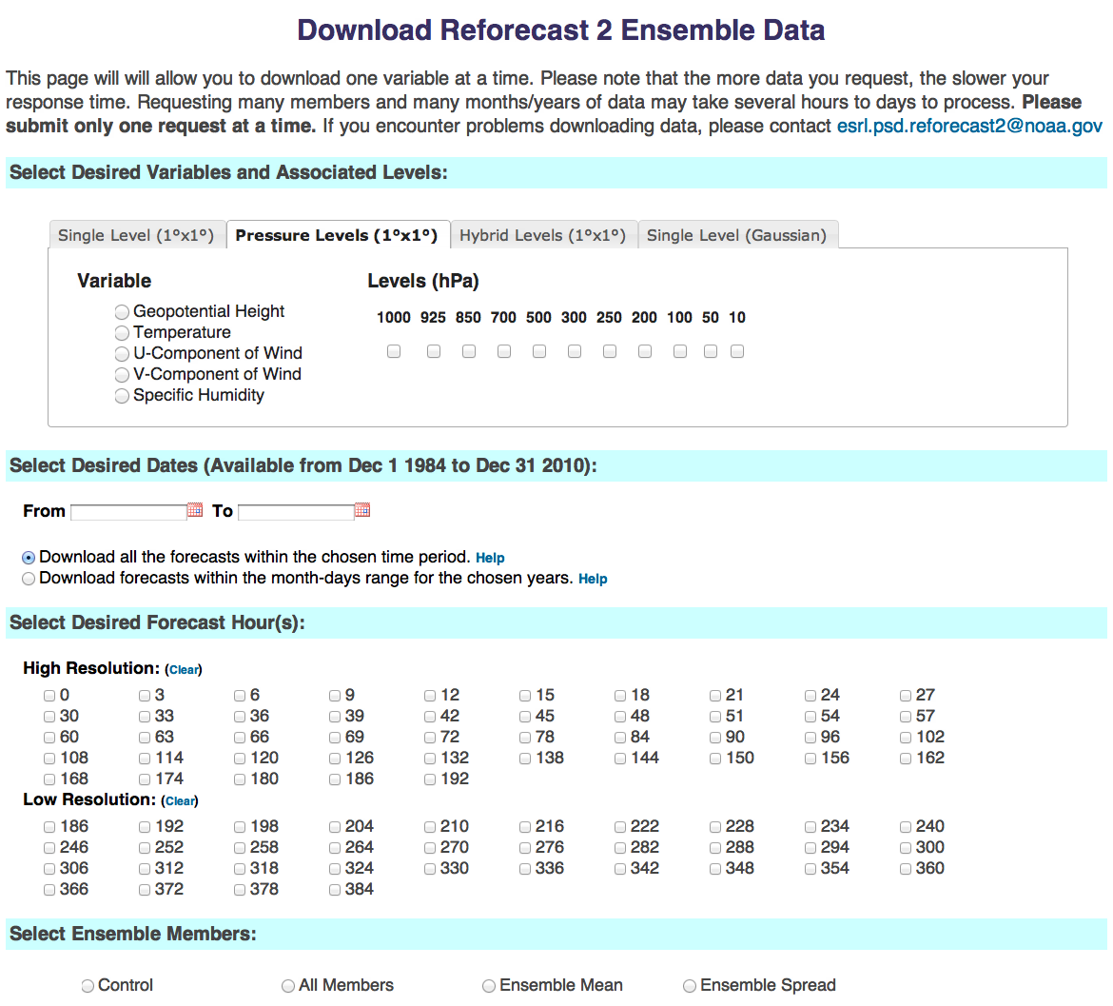

Slide 11
Other ways of accessing reforecast data
ftp or gftp into our ftp.cdc.noaa.gov server (if you want lots of the original grib files). [soon]
Pending Zeus grant, we intend to copy grib fields on Zeus mass store. [MDL plans to use]
Data written out on external disk here within PSD for special customers (EMC/CPC, OHD), shipped back to them.
DOE portal to get full dump of single day’s grib data (next page).

Slide 12
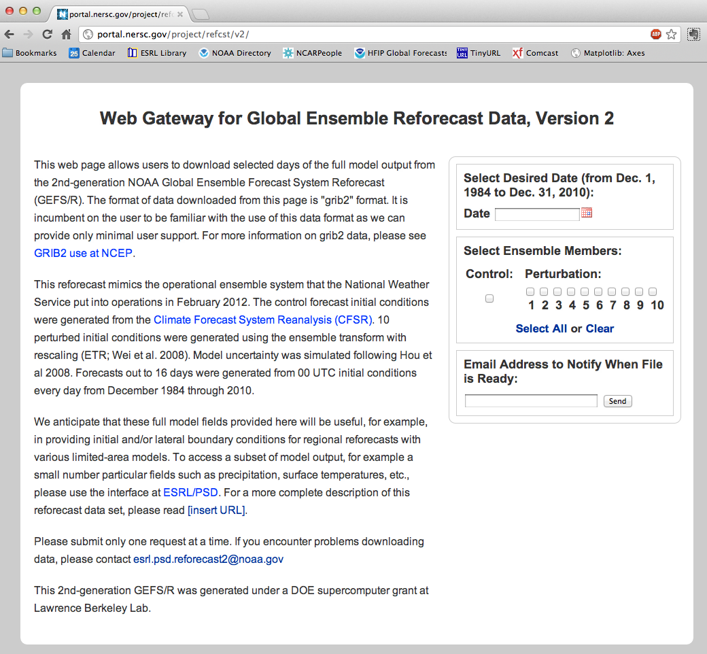
This DOE
site will be
ready for use
in a few
weeks for
access to
tape storage
of full data
(slower).
Use this to
access full
model state.
Later in this
presentation
we will show
a regional
WRF
reforecast
initialized
from GEFS
reforecast.

Slide 13
500 hPa Z anomaly correlation
(from deterministic control)
Lines w/o filled colors
for second–generation
reforecast (2010, T254)
Lines with filled colors
for first-generation
reforecast (1998, T62).
Perhaps a 1.5-2.5 day
improvement.

Slide 14
How does the skill of post-processed forecasts change from reforecast v1 to v2?
Let’s look at post-processed 24-h precipitation forecast guidance.
Will use a “rank analog” approach for post-processing (description in supplementary slides)

Slide 15
Skill of calibrated precipitation forecasts
(over US, 1985-2009, “rank analog” calibration method)

Slide 16
Skill of calibrated precipitation forecasts
(over US, 1985-2009, “rank analog” calibration method)
Improvements of 1 to 1.5 days
in post-processed forecasts
from reforecast v1 to v2

Slide 17
Reliability, > 10 mm precipitation 24 h⁻¹
Day +0-1
Day +2-3
Day +4-5
Version 2 (2012 GEFS)
Version 1 (1998 GEFS)

Slide 18
Reliability, > 50 mm precipitation 24 h⁻¹
Day +0-1
Day +2-3
Day +4-5
Version 2 (2012 GEFS)
Version 1 (1998 GEFS)
5/95 CI’s
from
“block
bootstrap”

Slide 19
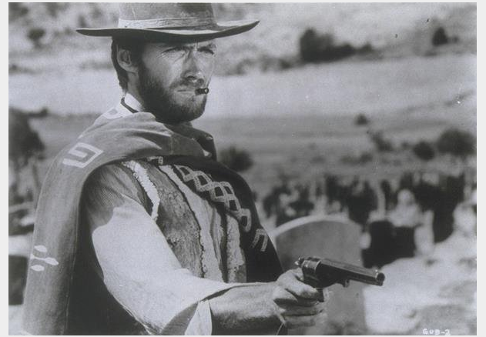
Case studies with
“atmospheric rivers” in the western US: the good, the bad and ugly

Slide 20
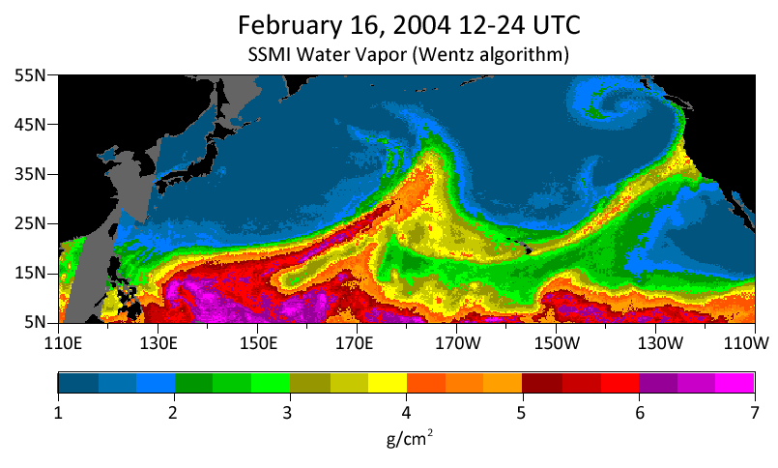
The bad and ugly atmospheric rivers case study
10” rain in the coastal mountains, 4-7” in Russian River
watershed. Streamflows in top 0.2% of historical observations.
Source: http://www.esrl.noaa.gov/psd/atmrivers/events/

Slide 21
6-day forecast

Slide 22
4-day forecast

Slide 23
2-day forecast

Slide 24
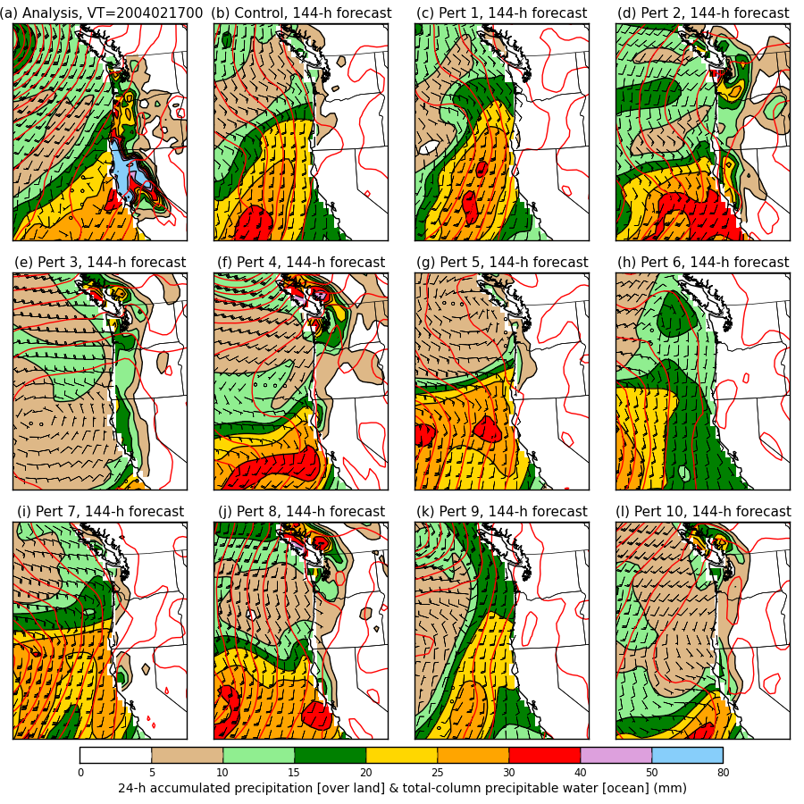
6-day forecast
Colors: over the
ocean, the total-
column precipitable
water. Over land,
the 24-h accum.
precipitation.
Wind barbs for the
925 hPa level.
Red contours:
mean sea-level
pressure.

Slide 25
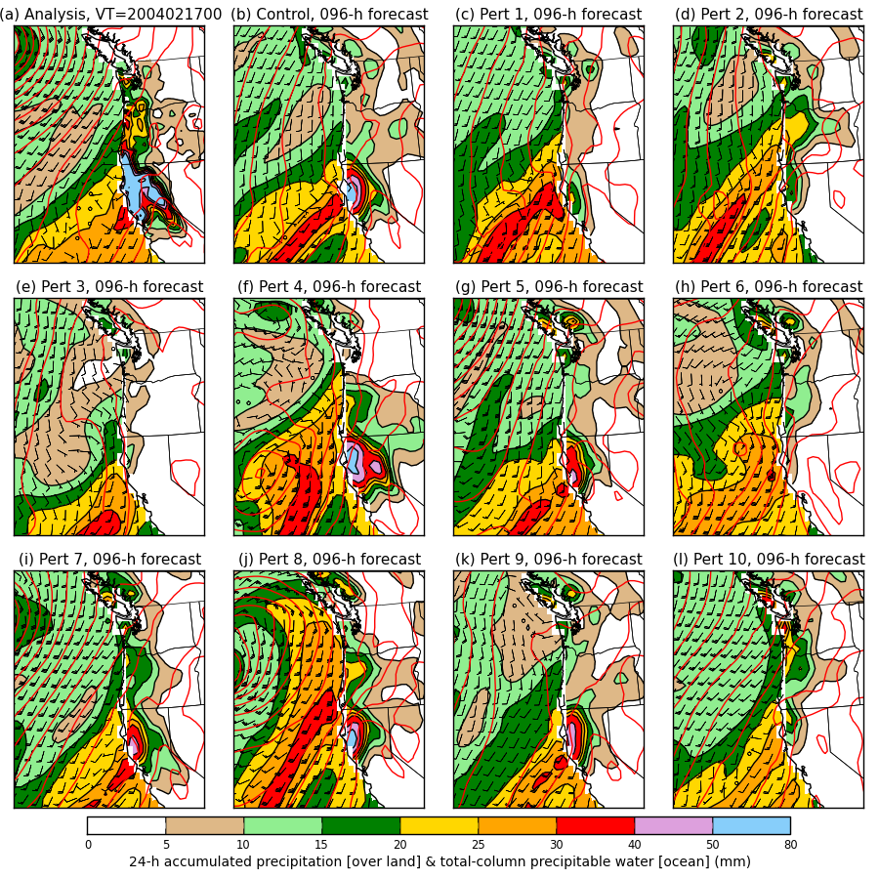
4-day forecast

Slide 26
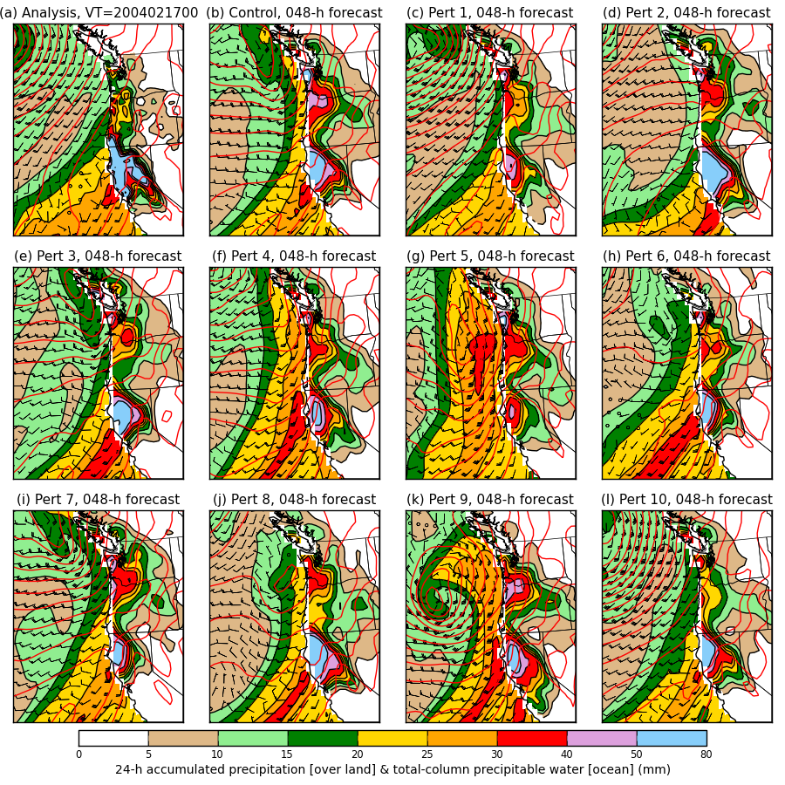
2-day forecast

Slide 27
Case study, tentative conclusions
Statistical post-processing will not be able to correct for everything. In this case, the synoptic-scale predictability was apparently quite low.
Improvements to post-processed probabilistic forecasts in such a case will require improved ensemble guidance.

Slide 28
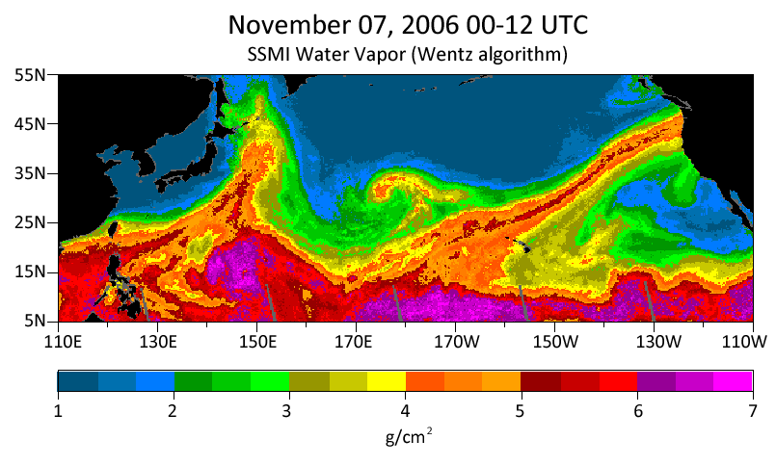
The “good” atmospheric rivers case study:
Nov 2006 Oregon-Washington floods
8-20 inches of rain in Cascades; flooded rivers; extensive damage to Mt. Rainier NP.

Slide 29
6-day forecast

Slide 30
4-day forecast

Slide 31
2-day forecast

Slide 32
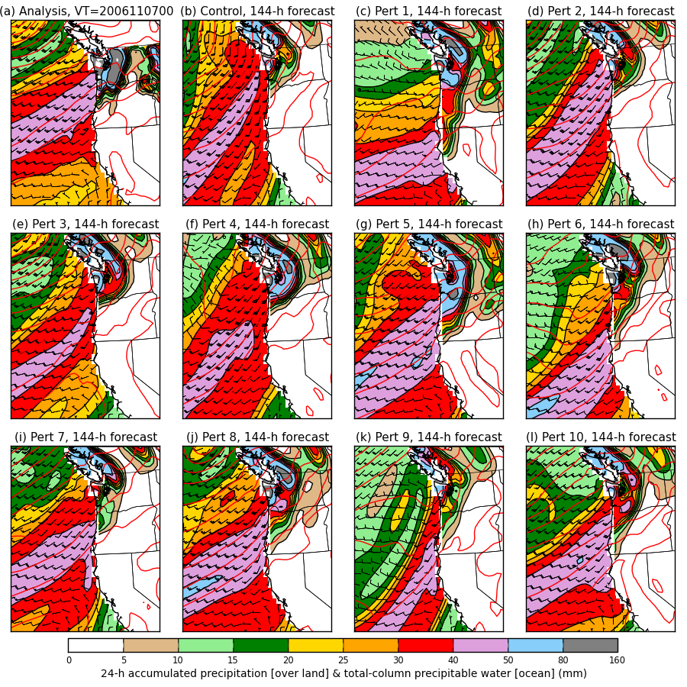
6-day forecast
Colors: over the
ocean, the total-
column precipitable
water. Over land,
the 24-h accum.
precipitation.
Wind barbs for the
925 hPa level.
Red contours:
mean sea-level
pressure.

Slide 33
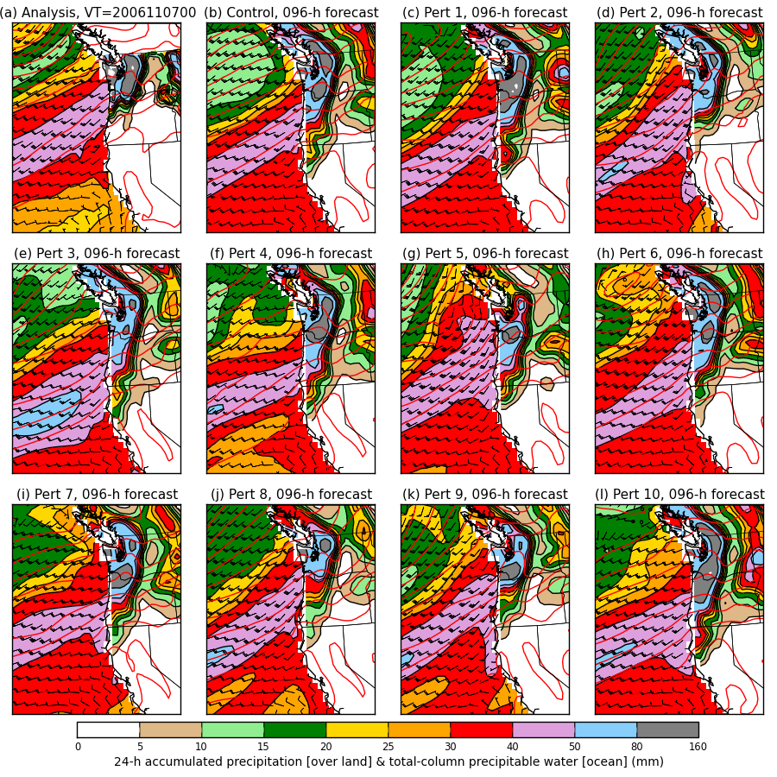
4-day forecast

Slide 34
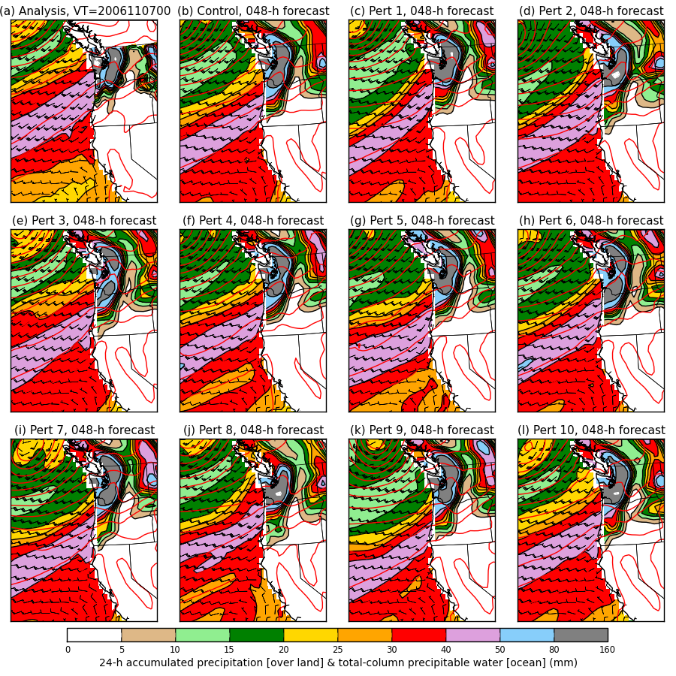
2-day forecast

Slide 35
Spaghetti
Westerns
Inconsistent forecasts of
orientation of isobars
and hence wind direction
Consistent forecasts of
orientation of isobars
and hence wind direction
The bad and the ugly
Day + 6 ____
Day + 4 ____
Day + 2 ____
Analysis ____
The good

Slide 36
Demo: Regional reforecast with WRF ARW v3.4 using global reforecast for initial, boundary conditions
2-way nested simulation 36-, 12- and 4-km with 36 vertical levels
  12- and 4-km moving nests
Time step: 180, 60, and 20 s
Initial and boundary condition: GFS reforecast ensemble member
Tiedtke cumulus scheme on 36 and 12 km; explicit on 4 km
YSU PBL scheme
HYCOM ocean analysis
WSM6 microphysics
Noah land surface
2D Smagorinsky turbulence scheme
Goddard shortwave radiation
RRTM longwave radiation
Second order diffusion
Positive definite scalar advection
Donelan wind-dependent drag formulation
Garratt wind-dependent enthalpy surface fluxes
c/o Tom Galarneau, NCAR & HFIP grant (pending)

Slide 37
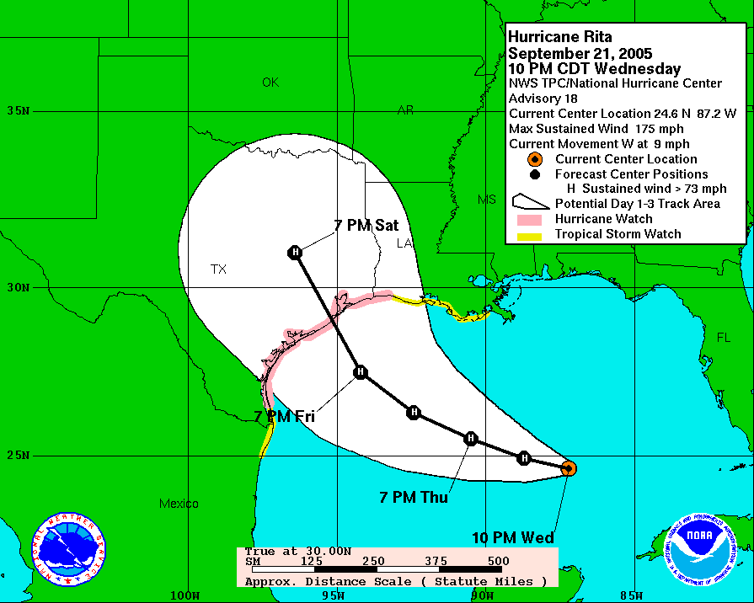
2005 Rita official forecast
(Houston, TX evacuated)

Slide 38
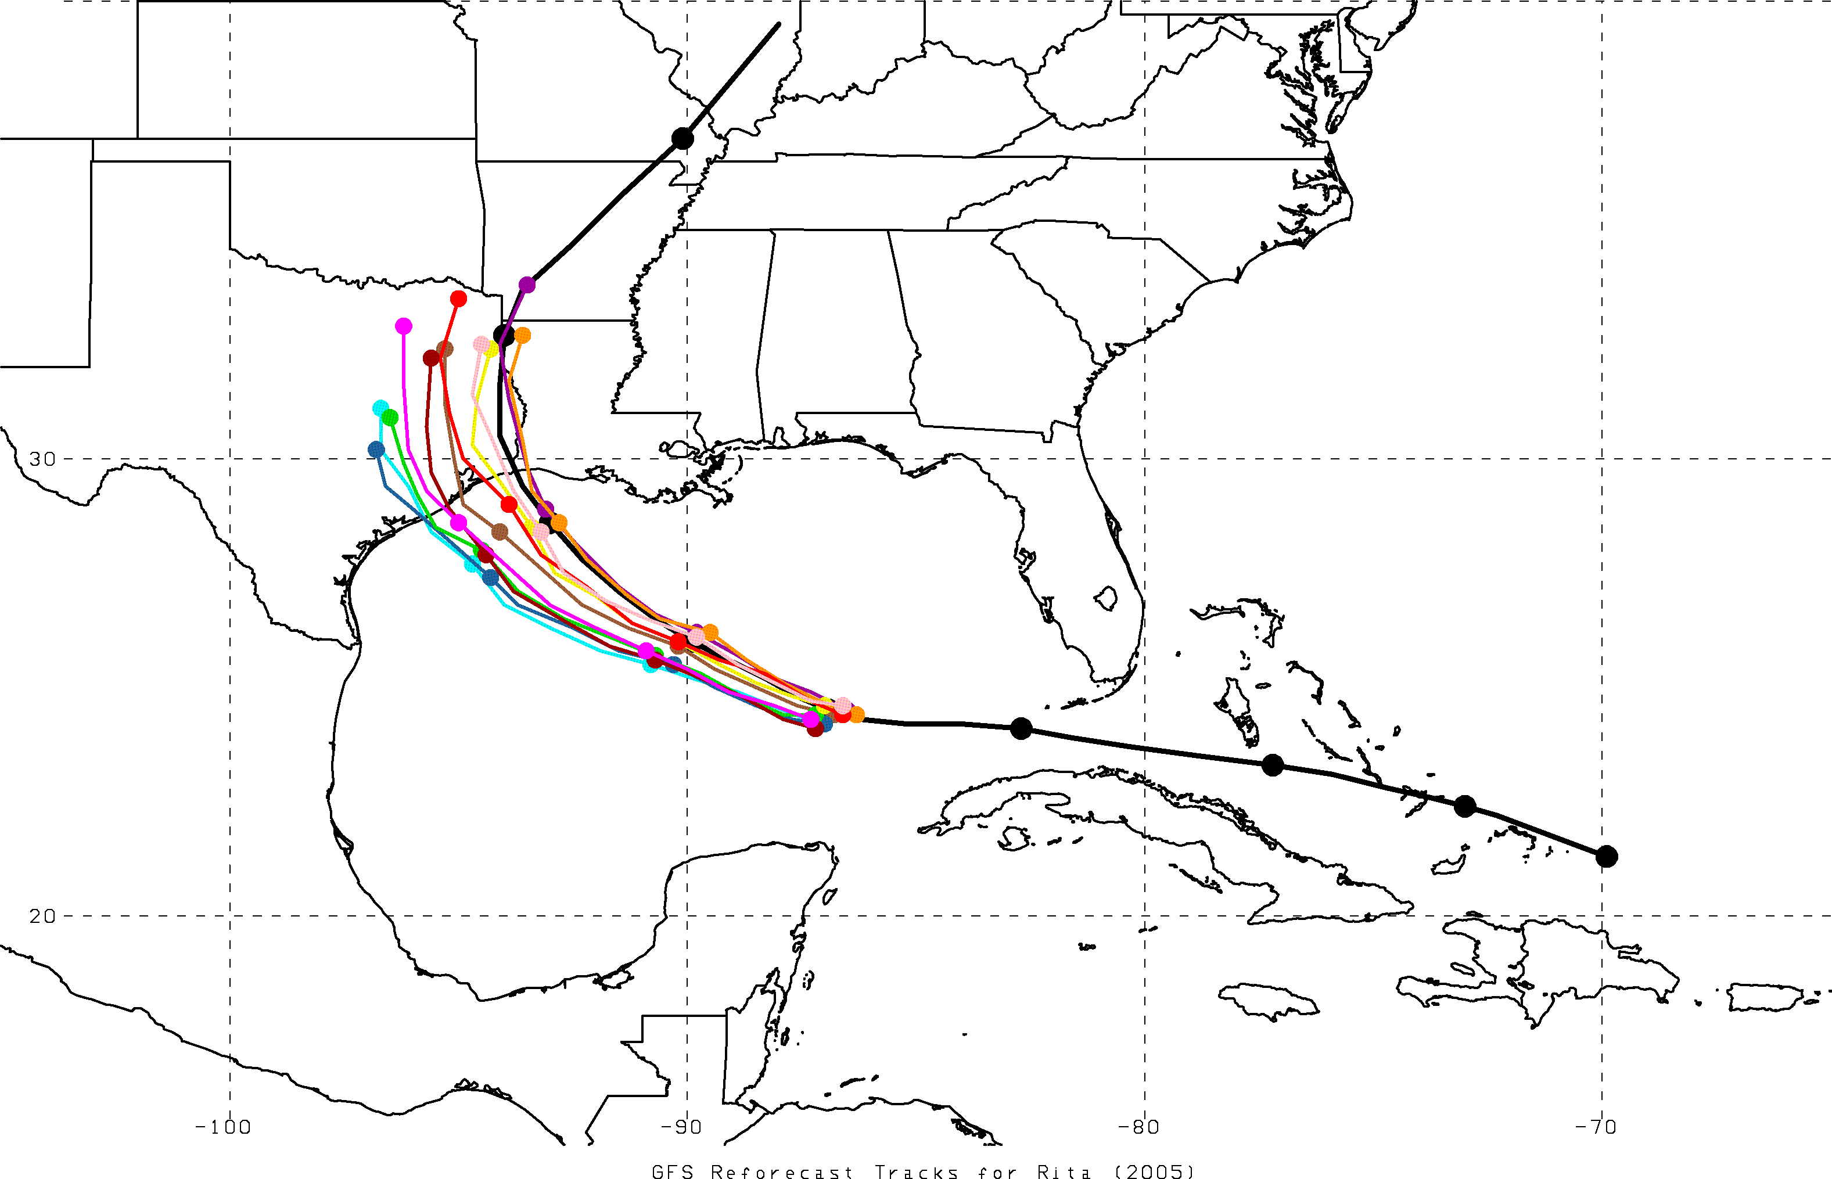
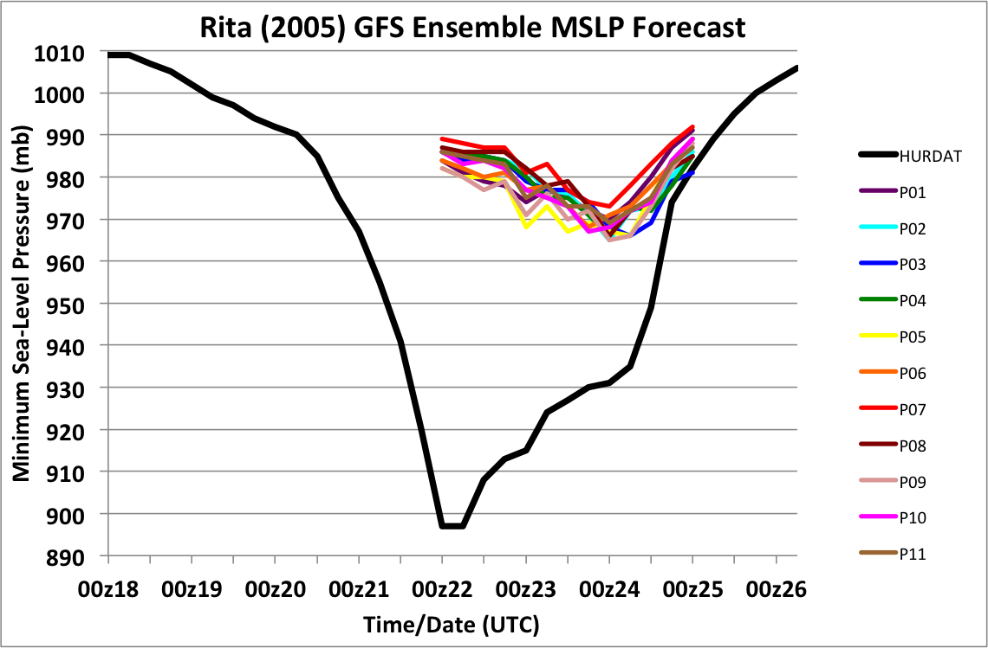
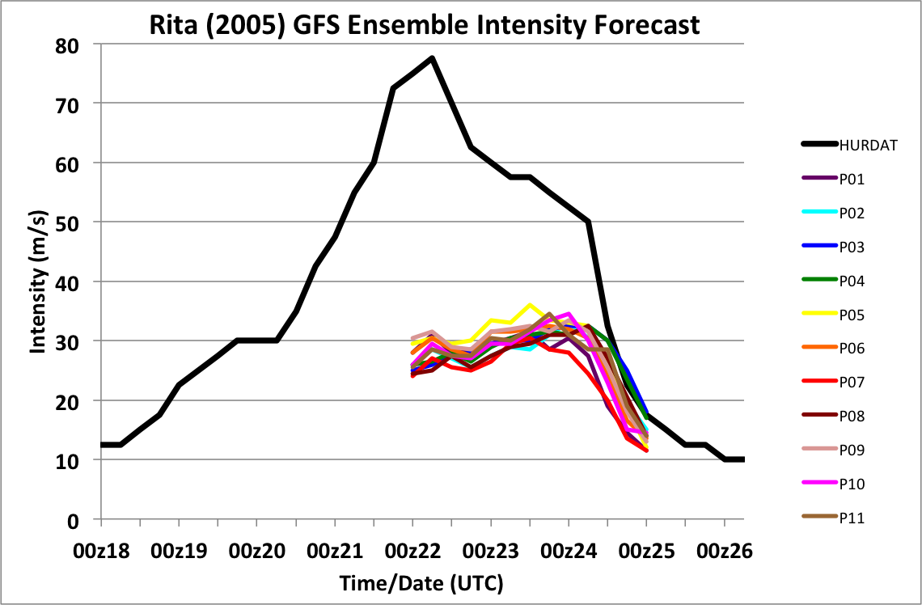
TC Rita (2005)
GFS reforecast ensemble
72-h forecast
initialized at 00Z 22 Sept
P01
P02
P03
P04
P05
P06
P07
P08
P09
P10
P11
OBS
00Z/22
00Z position

Slide 39

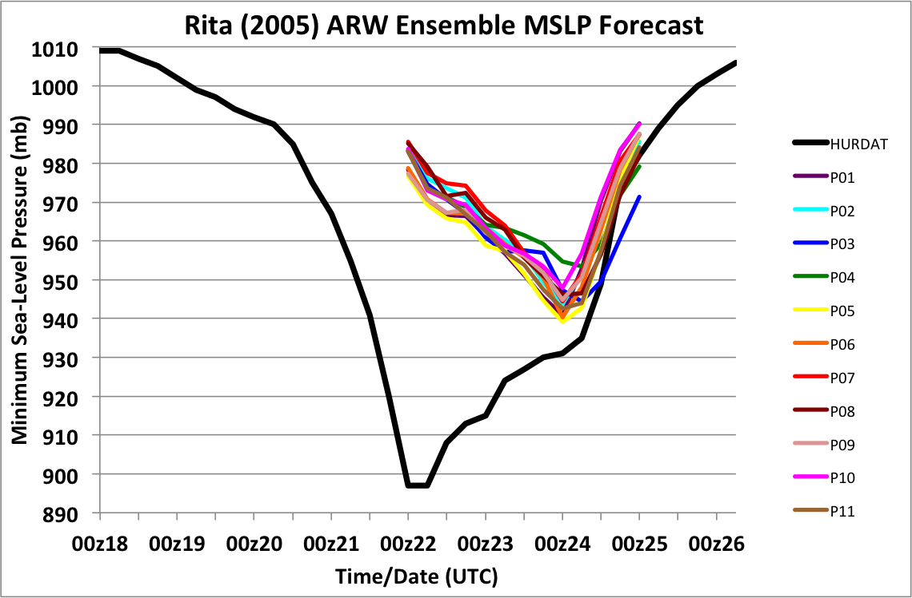
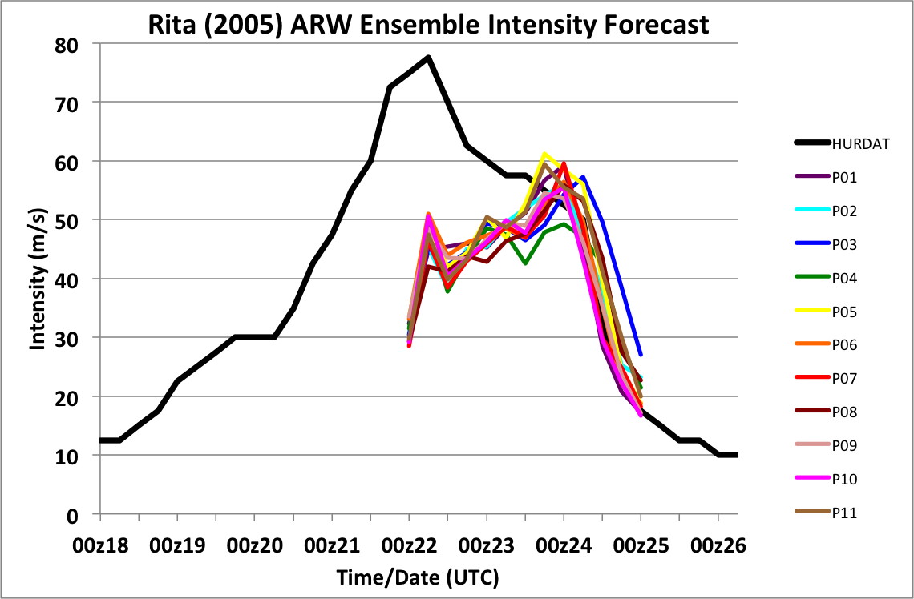
TC Rita (2005)
ARW ensemble with GFS reforecast ensemble as boundary and initial conditions
72-h forecast
initialized at 00Z 22 Sept
P01
P02
P03
P04
P05
P06
P07
P08
P09
P10
P11
OBS
00Z/22
00Z position

Slide 40
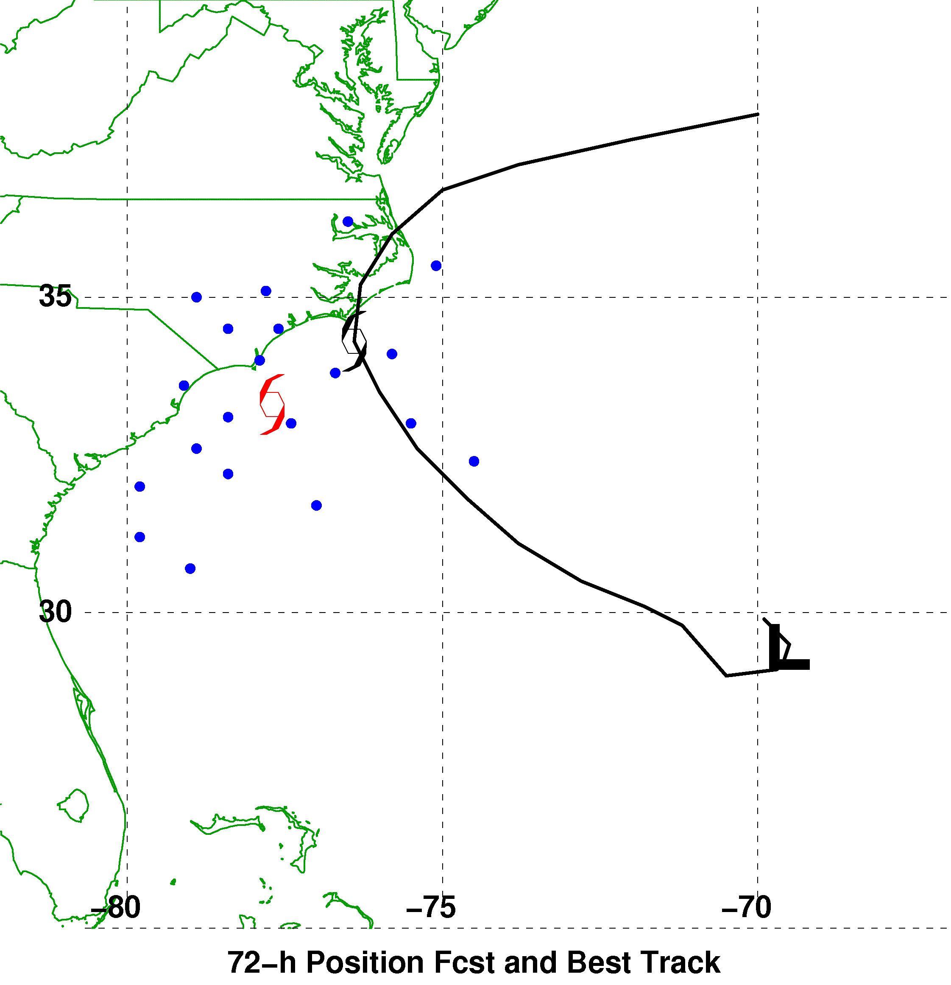
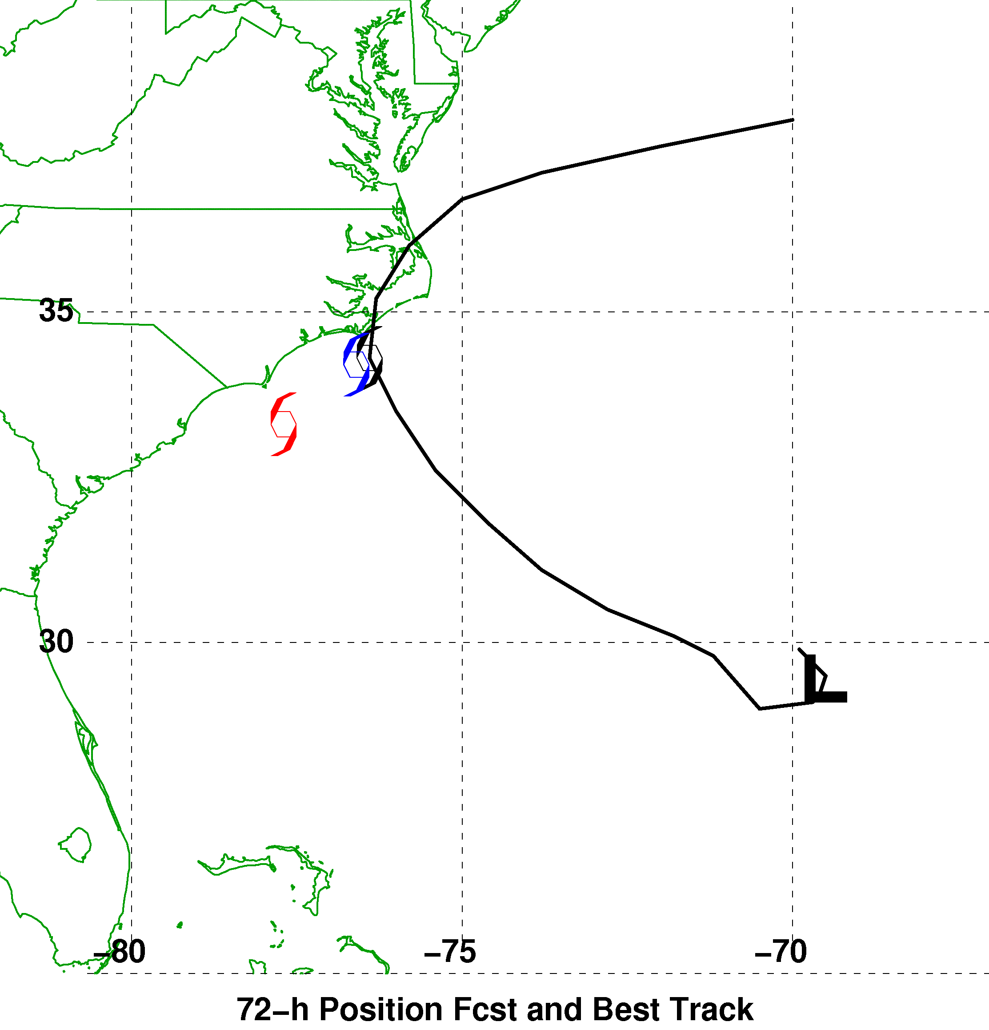

A synthetic example of using reforecasts
to make track error bias corrections
72-h Forecast Verifying 1200 UTC 9 September
Ensemble Mean, Reforecast Analog,
and Observed Positions
Reforecast Analog
Position Errors
N
Bias-Corrected Ensemble Mean Position
and Probability Ellipse
W
E
Observed
S
Error (km)
Red : mean forecast position
Blue dot: forecast positions of +72-h forecast analogs
End of red tail ___ : observed positions at +72 h

Slide 41
Application: diagnosis of MJO
Let’s examine subset of cases that start off with initial conditions that project onto
relatively strong MJO emerging from African continent.
We have lots of cases of this afforded by multi-decadal reforecasts.
It appears that GEFS is too regular with its RMM1/RMM2 forecasts, while the
analyzed evolution is more scattered with its trajectories.

Slide 42
Other work in progress
Blocking diagnostics (w. Steve Colucci, Cornell U.)
Development of forecast tools to support extended-range renewable-energy forecasts
Example of ECMWF’s Extreme Forecast
Index, where the current ensemble
guidance is compared to the model
forecast climatology. Values near 1.0
indicate that ensemble forecasts are
consistently higher than forecasts
populating the climatology.
This can be useful especially in situations
where there isn’t observational data
available for calibration.

Slide 43
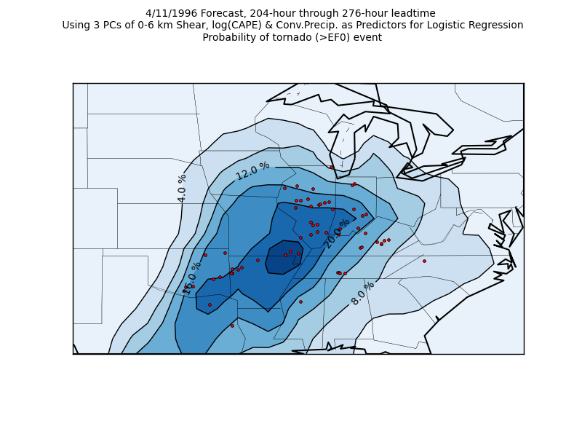
Application: extended-range tornado forecasting
Francisco Alvarez,
St. Louis University,
is working with me
and others on using the
reforecasts to make
extended-range
predictions of
tornado probabilities.
Ph.D. work,
in progress.

Slide 44
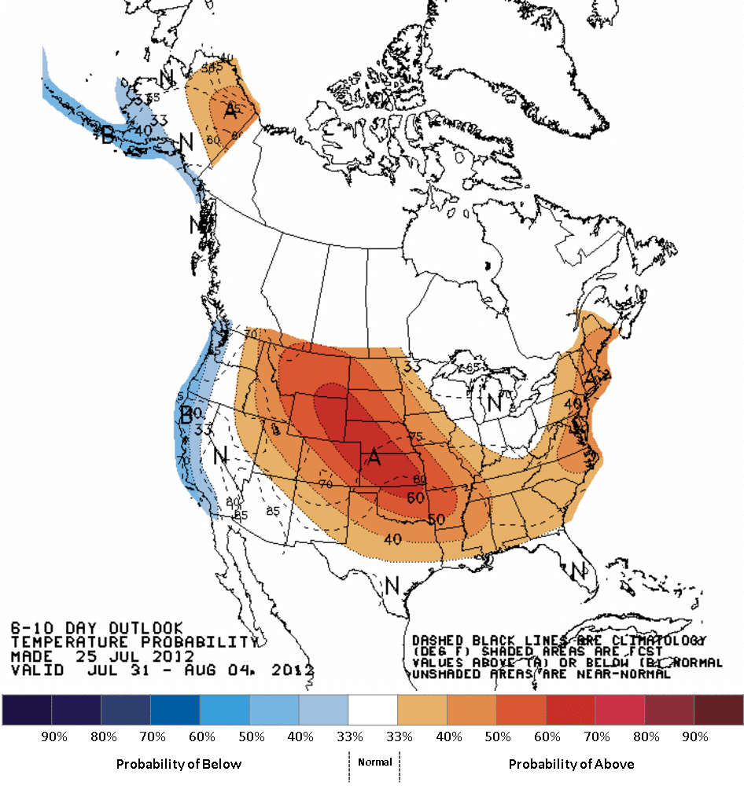
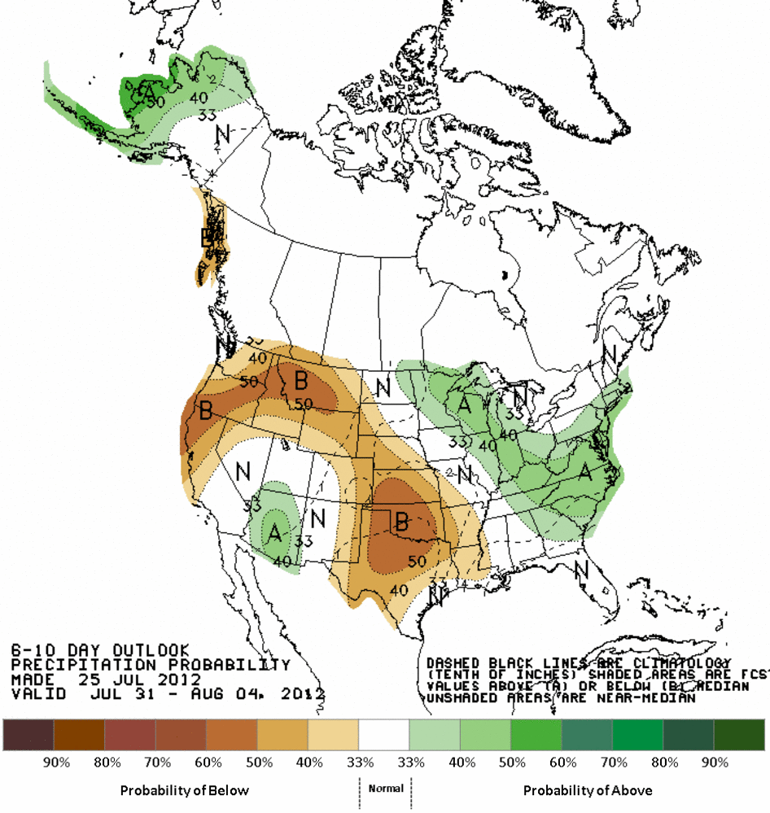
Application: Improved 6-10 day and week-2 forecast guidance from CPC
Dan Collins, CPC leading this effort.

Slide 45
Conclusions
Reforecast data set created for current operational NCEP GEFS.
Reforecast data and real-time forecasts available shortly.
Useful for statistical calibration.
Helpful for determining how you may choose to configure real-time reforecasts in the future.

Slide 46
Supplementary slides

Slide 47
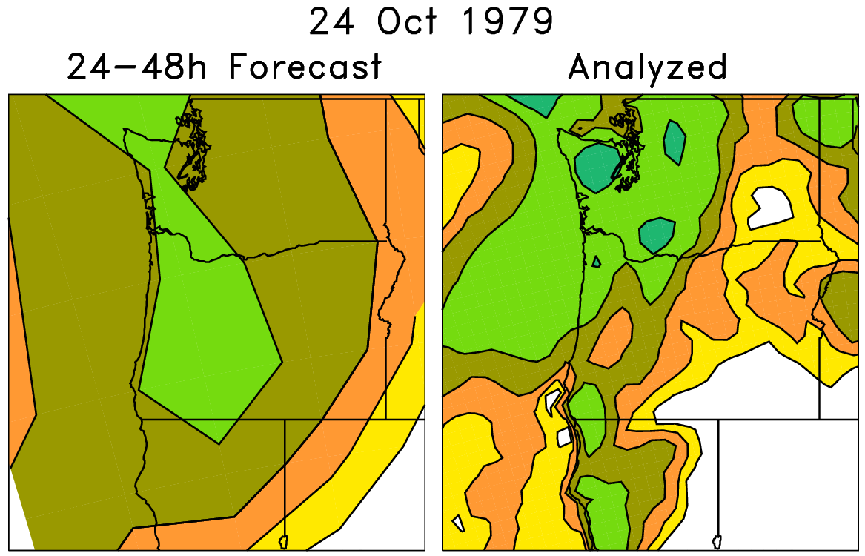
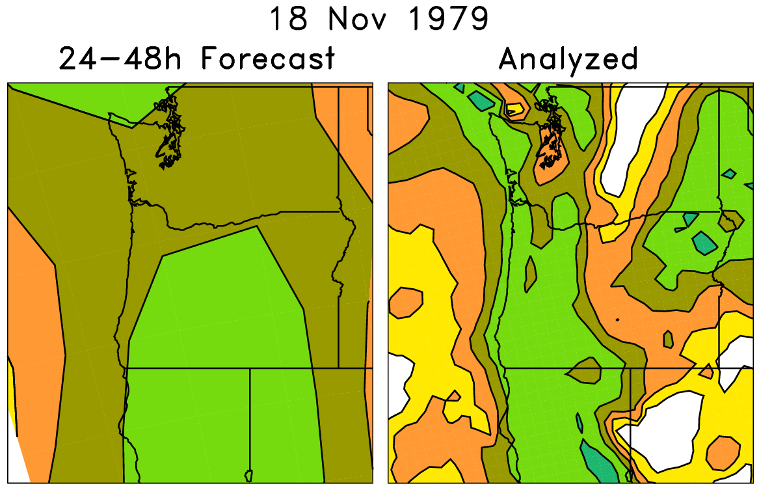
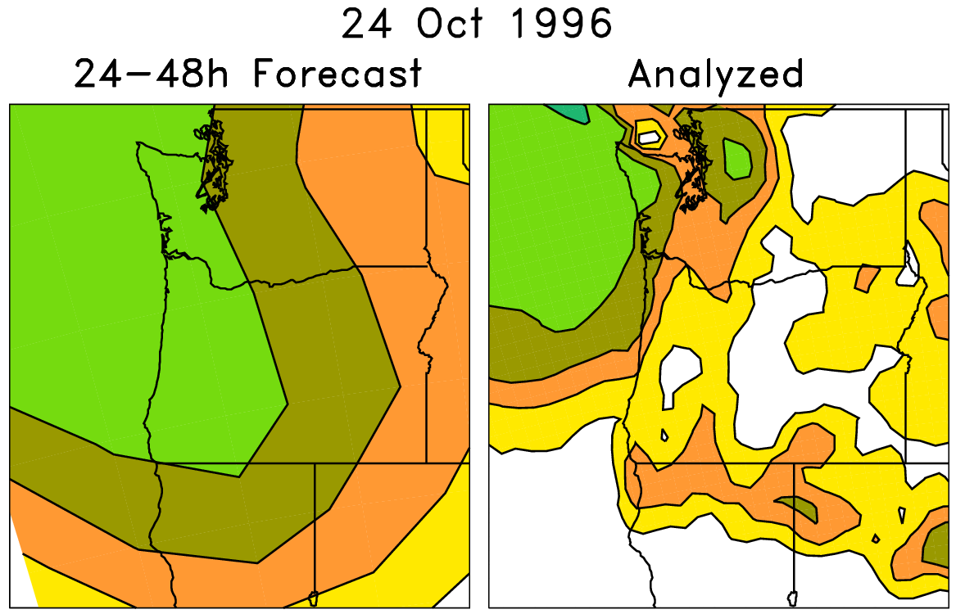
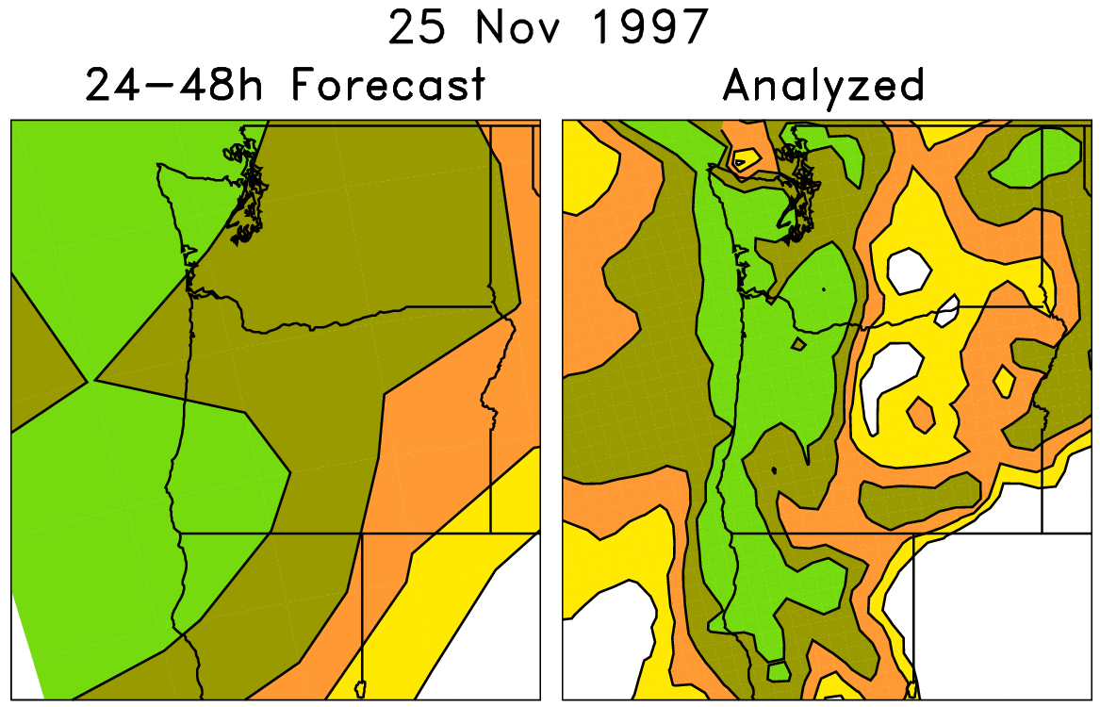
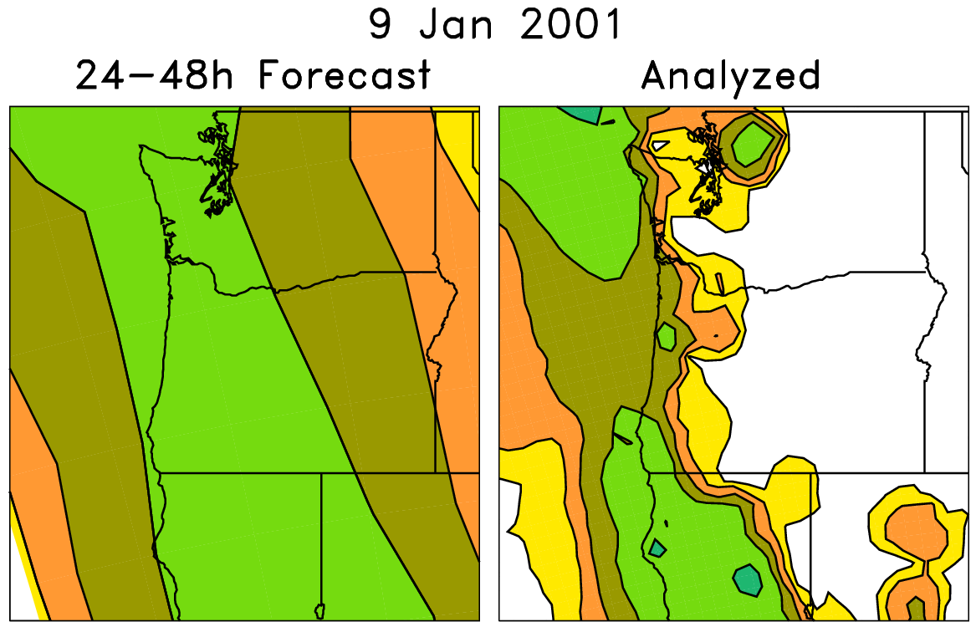
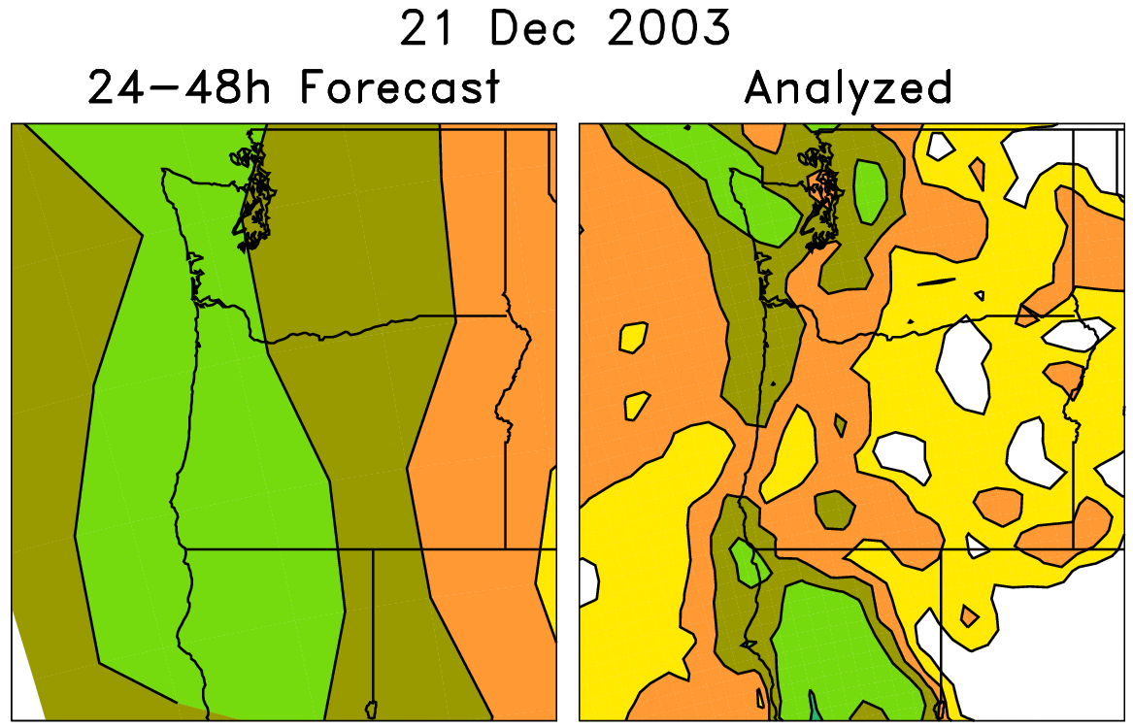
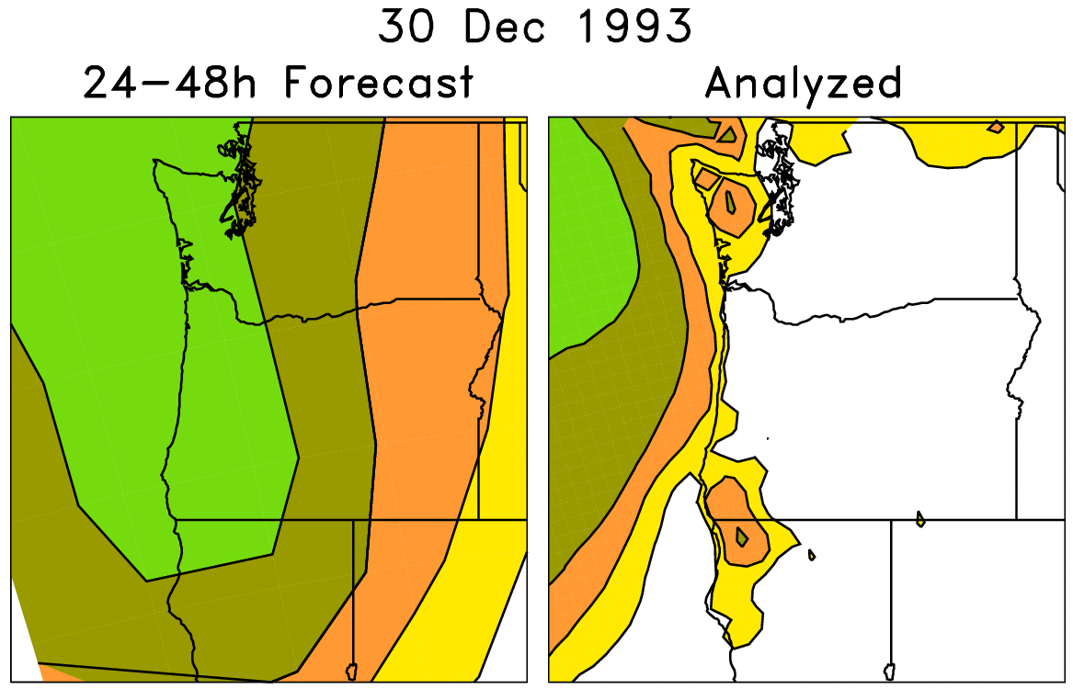
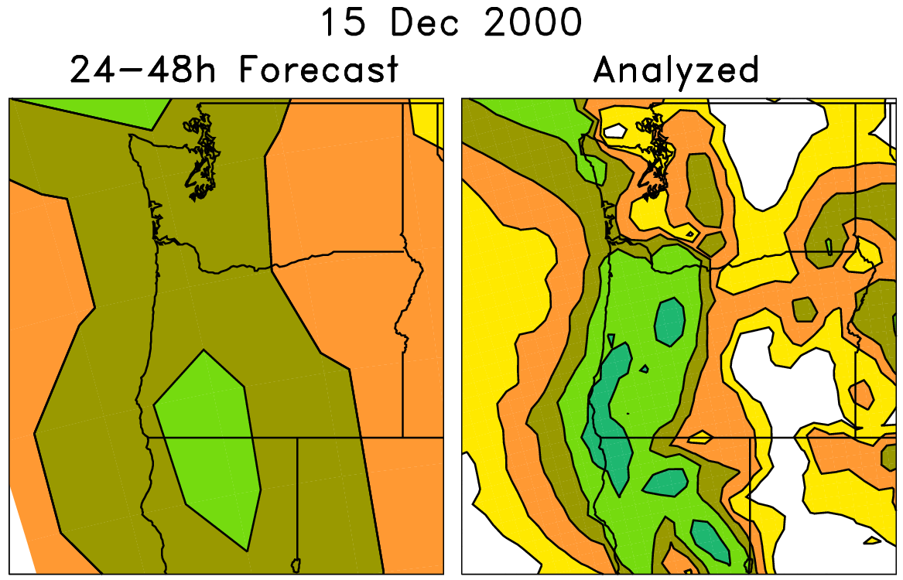
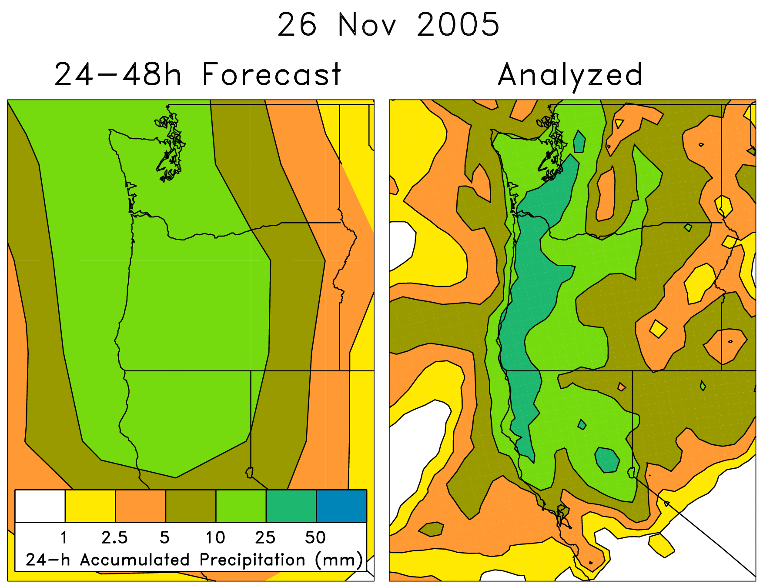
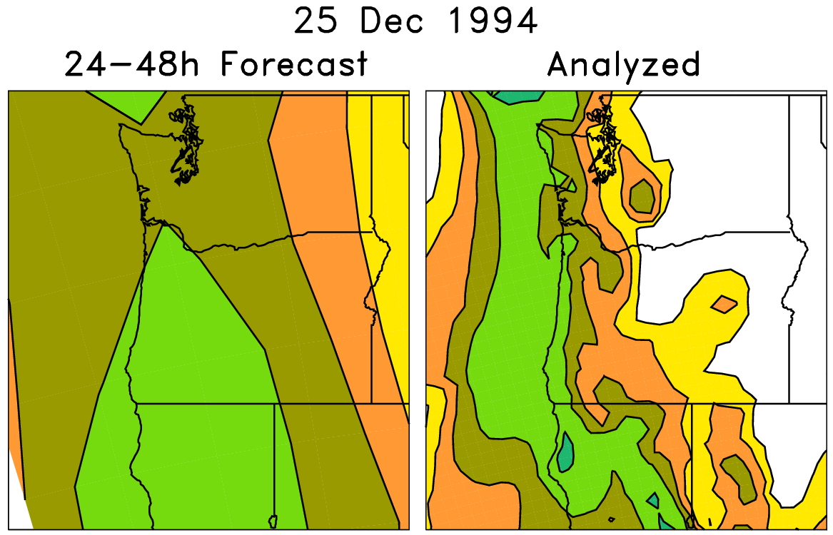
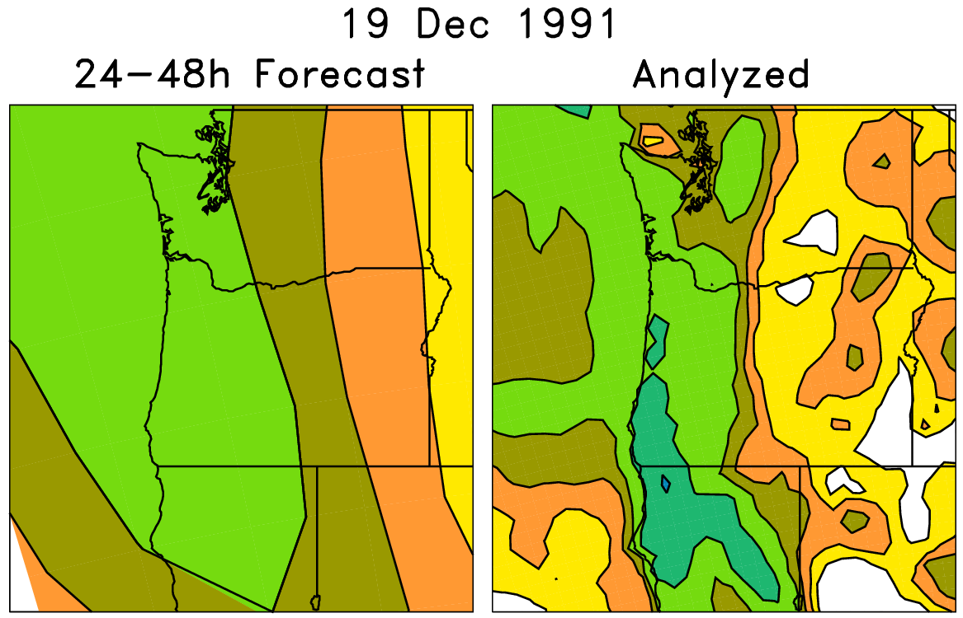
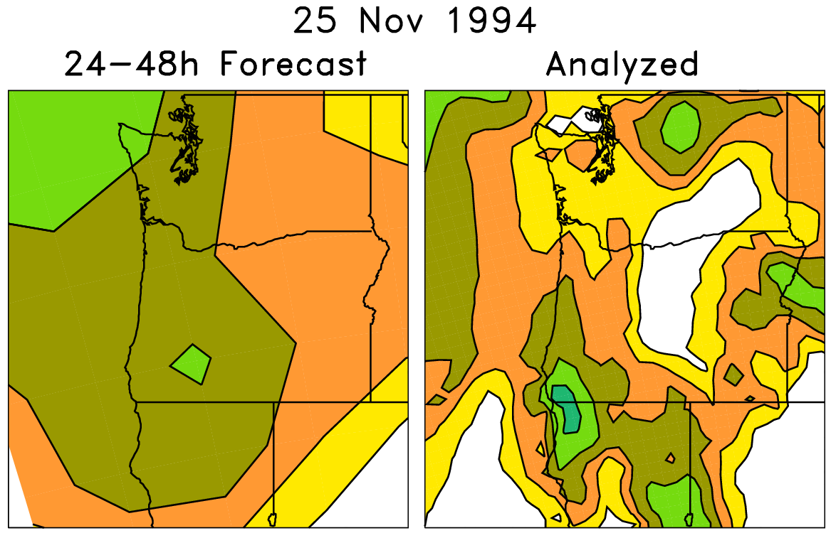
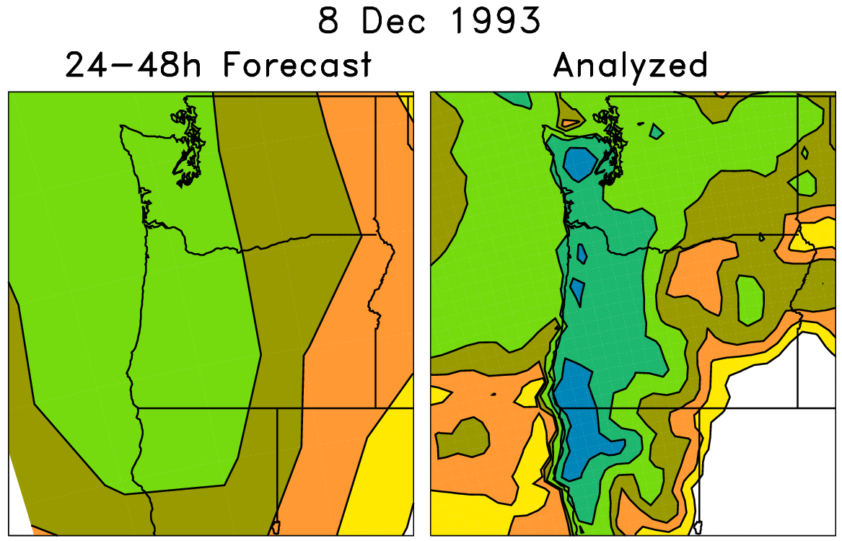
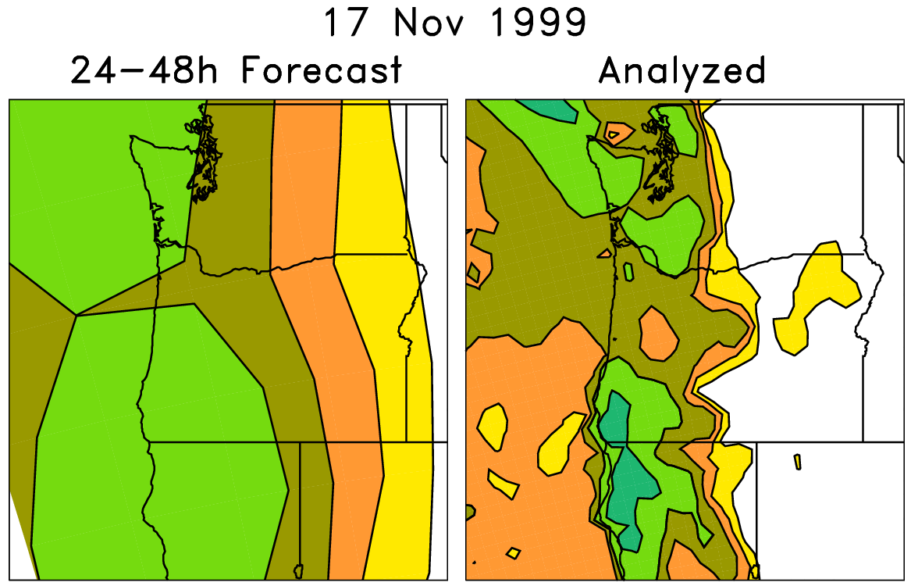
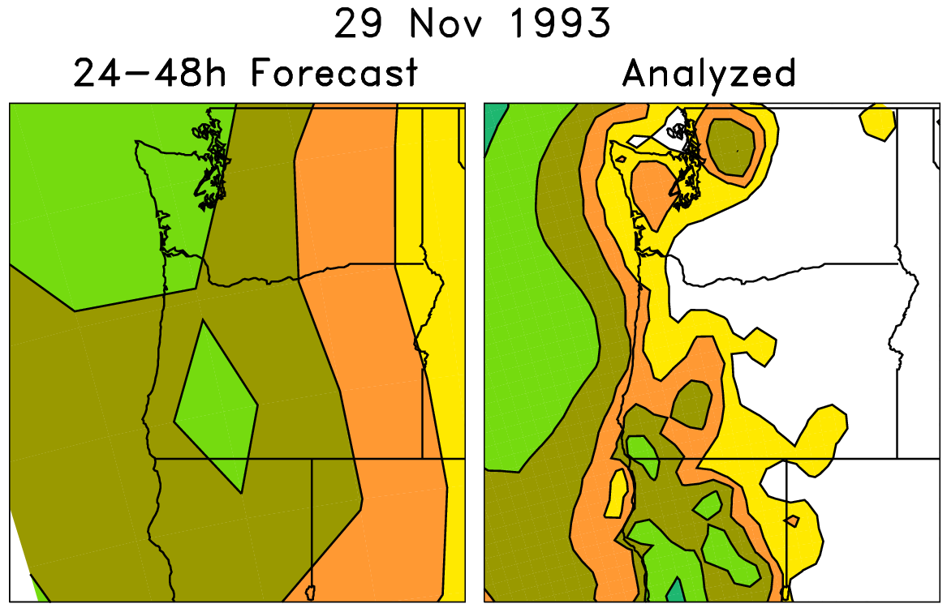
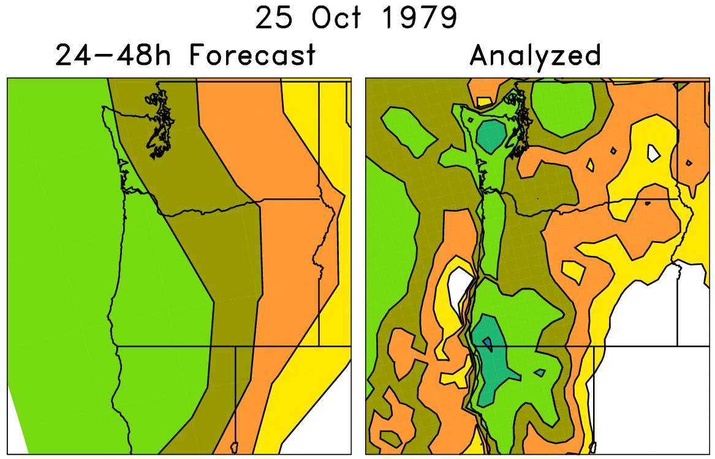
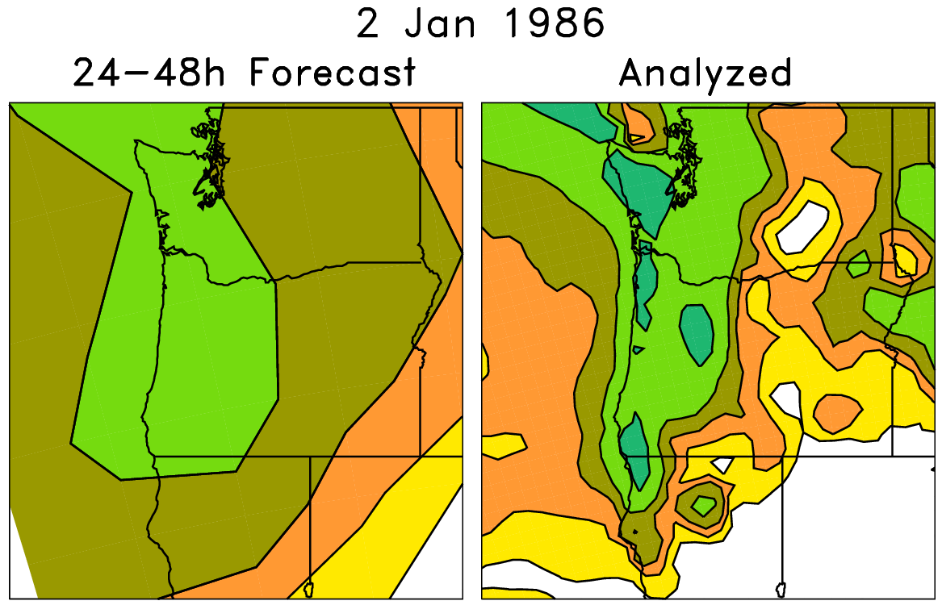
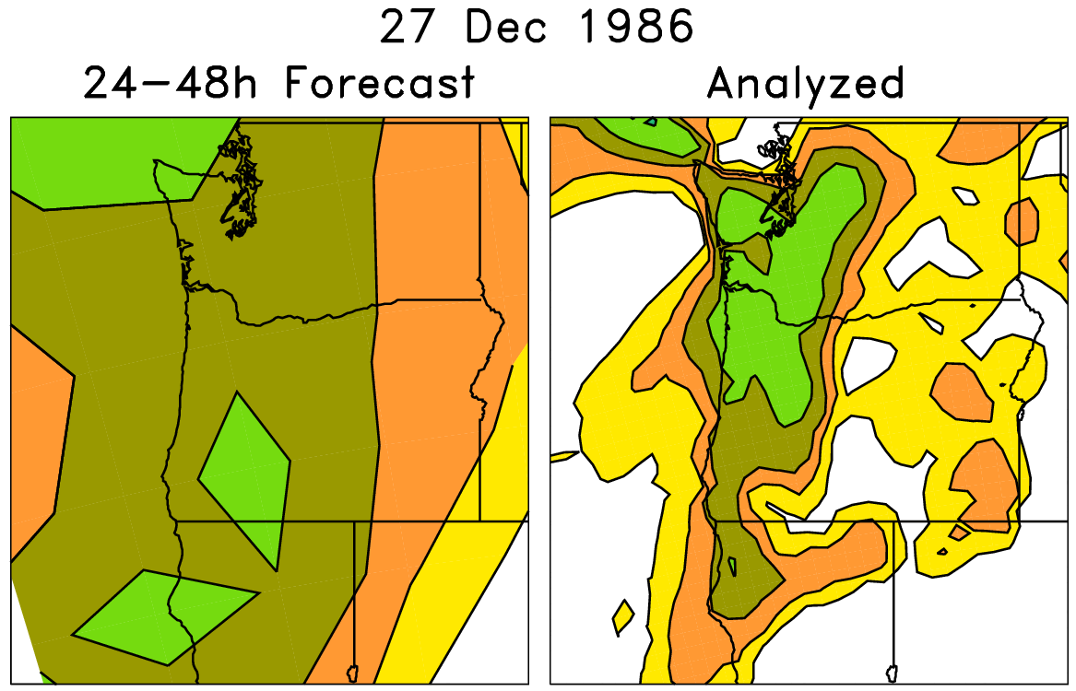
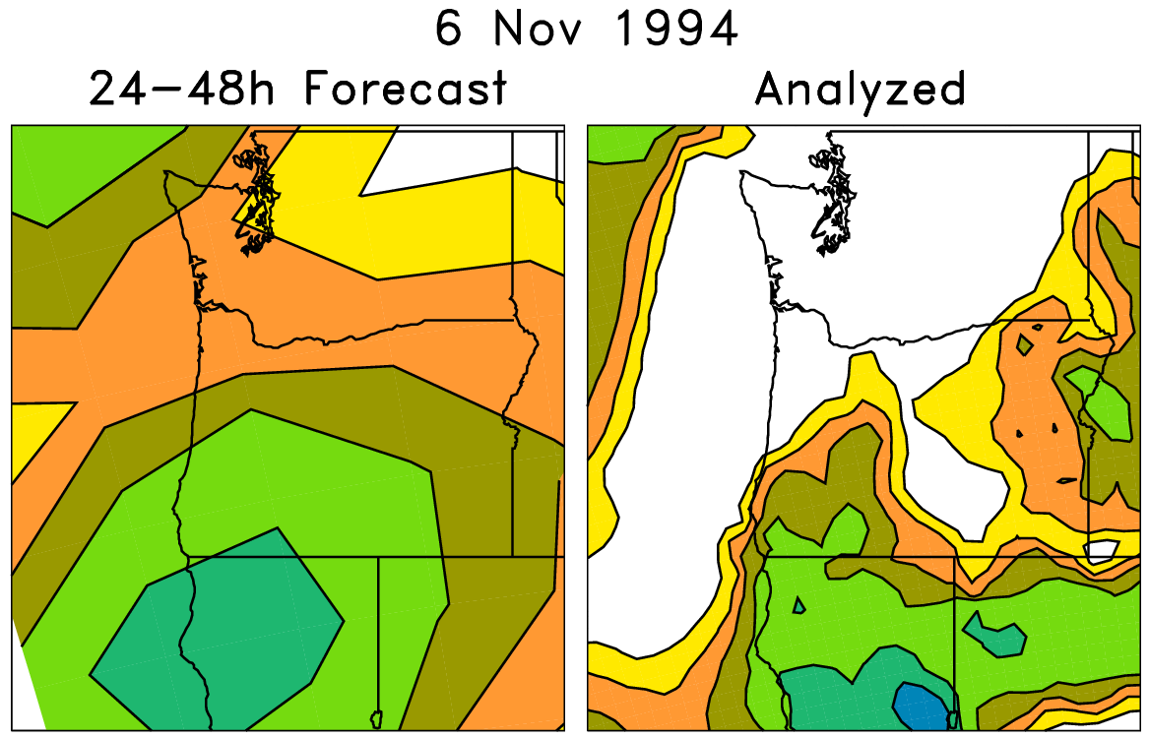
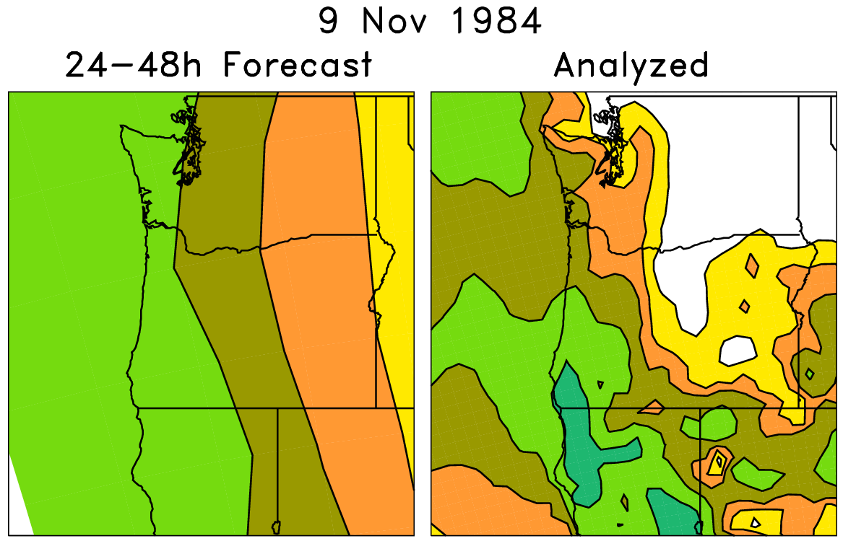
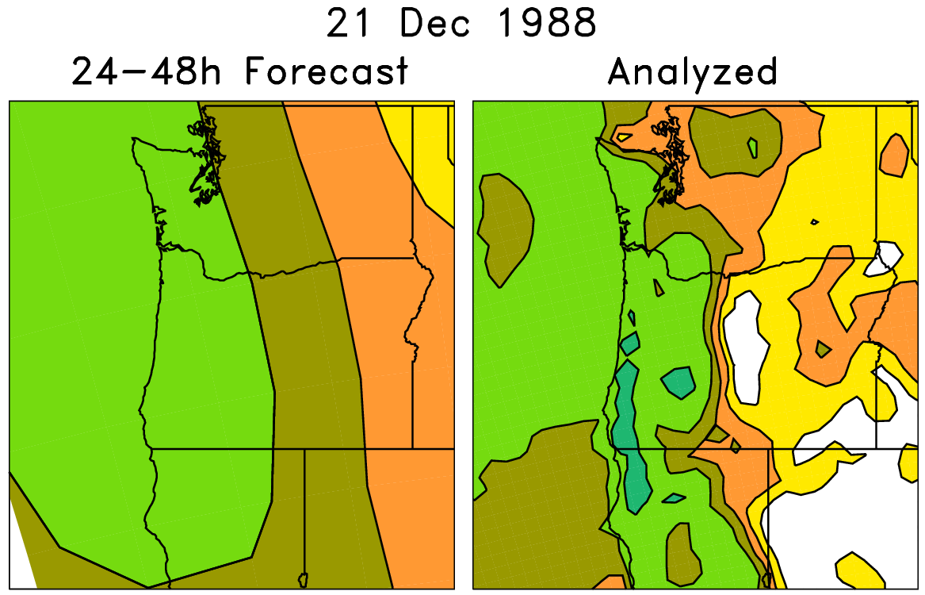
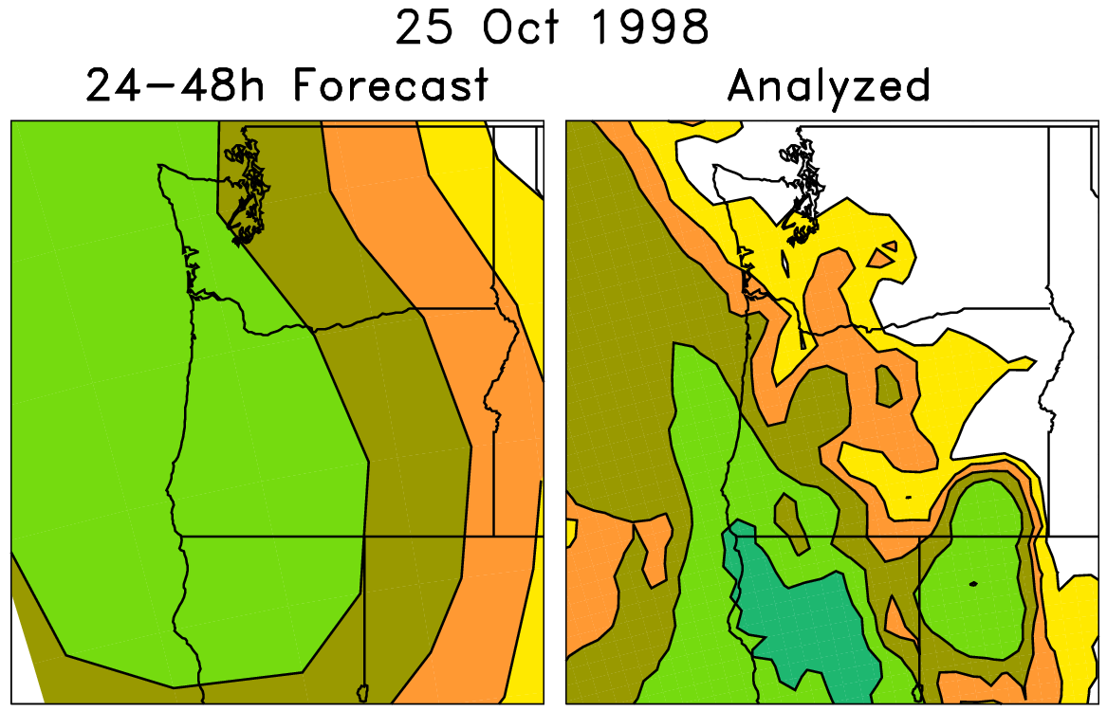



Basic analog technique for statistical downscaling (here, v1)
Today’s ens. mean forecast + subsequent
analyzed precipitation
On the left are old forecasts
similar to today’s ensemble-
mean forecast. For making
probabilistic forecasts,
form an ensemble from
the accompanying
analyzed weather on the
right-hand side.

Slide 48
Analog technique for statistical downscaling
Form an
ensemble from
these

Slide 49
Problem with basic analog reforecast technique
Say today’s forecast is
for 20 mm. There
are more forecasts
slightly less than 20 mm
than slightly more than
20 mm.
Assuming correlation
between forecast and
observations, analogs
will be biased toward
lower precipitation
amounts.

Slide 50
“Rank” analog procedure
Convert precipitation forecast time series to ranks:
x = [0, 0, 7, 15, 1, 3, 6, 4, 1, 2, 12, 5, 6, 8]
x(r)= [1.5, 1.5, 11, 14, 3.5, 6, 9, 7, 3.5, 5, 13, 8,10,12]
today’s

Slide 51
“Rank” analog procedure
Convert precipitation forecast time series to ranks:
x = [0, 0, 7, 15, 1, 3, 6, 4, 1, 2, 12, 5, 6, 8]
x(r)= [1.5, 1.5, 11, 14, 3.5, 6, 9, 7, 3.5, 5, 13, 8,10,12]
today’s
with standard analog, these would be the two forecasts with the closest values.

Slide 52
“Rank” analog procedure
Convert precipitation forecast time series to ranks:
x = [0, 0, 7, 15, 1, 3, 6, 4, 1, 2, 12, 5, 6, 8]
x(r)= [1.5, 1.5, 11, 14, 3.5, 6, 9, 7, 3.5, 5, 13, 8,10,12]
today’s
with rank analog, these would be the two forecasts with the closest ranks.

Slide 53
Rank analog calibration details
24-h accumulated precipitation, validated on NARR grid (~32 km) over CONUS, 1985-2009.
Rank analog approach: at each grid point in CONUS, using that grid point and +/- 3 surrounding grid points in N-S, E-W direction, find dates of 75 past forecasts that are closest in average precipitation rank of ensemble mean forecast. Make probabilistic forecasts from analyzed NARR precipitation data on dates of those 75 analogs.
(Conventionally calculated) Brier Skill Scores, reliability diagrams, etc. NARR again used for verification.

Slide 54
Regional Reforecast with ARW v3.4
2-way nested simulation 36-, 12- and 4-km with 36 vertical levels
  12- and 4-km moving nests
Time step: 180, 60, and 20 s
Initial and boundary condition: GFS reforecast ensemble member
Tiedtke cumulus scheme on 36 and 12 km; explicit on 4 km
YSU PBL scheme
HYCOM ocean analysis
WSM6 microphysics
Noah land surface
2D Smagorinsky turbulence scheme
Goddard shortwave radiation
RRTM longwave radiation
Second order diffusion
Positive definite scalar advection
Donelan wind-dependent drag formulation
Garratt wind-dependent enthalpy surface fluxes

Slide 55
TC Rita (2005)
GFS reforecast ensemble
72-h forecast
initialized at 00Z 22 Sept
P01
P02
P03
P04
P05
P06
P07
P08
P09
P10
P11
OBS
00Z/22
00Z position

Slide 56
TC Rita (2005)
ARW ensemble with GFS reforecast ensemble as boundary and initial conditions
72-h forecast
initialized at 00Z 22 Sept
P01
P02
P03
P04
P05
P06
P07
P08
P09
P10
P11
OBS
00Z/22
00Z position

Slide 57
Some known applications in development
Real-time web page of experimental PQPF forecasts (ESRL, in development to replace v1 web page)
Development of experimental forecast products for renewable energy sector (Hamill, ESRL).
6-10 day and 8-14 day forecasts (Dan Collins, CPC).
Detecting and correcting bias in hurricane track and intensity (Jiayi Peng, NCEP/EMC, Tom Galarneau, NCAR).
Objective probabilities for severe weather several days to weeks hence (Francisco Alvarez, St. Louis Univ. + Hamill)
Improving hydrologic predictions (Haksu Lee et al., NOAA/NWS/OHD).
Also: BAMS article once published will presumably spur wider usage.

Slide 58
Scores, > 10 mm and > 50 mm

Slide 59
Brier Skill Scores, Day +0-1, 1.0 mm 24h⁻¹
(reforecast version 2)

Slide 60
Brier Skill Scores, Day +0-1, 1.0 mm 24h⁻¹
(reforecast version 1)

Slide 61
NARR climatology, > 1-mm 24 h⁻¹
a modest relationship
between where
precipitation is
common and the
magnitude of skill.
Also, note
relationship with
terrain forcing.

Slide 62
Brier Skill Scores, Day +0-1, 10.0 mm 24h⁻¹
(reforecast version 2)
?

Slide 63
Brier Skill Scores, Day +0-1, 10.0 mm 24h⁻¹
(reforecast version 1)
?

Slide 64
NARR climatology, > 10 mm 24 h⁻¹
Climatology seems anomalously dry.
NARR precipitation analyses after
snowfall are somewhat
untrustworthy; precipitation
registered only as snow melts, so
precipitation can be off by days.
Improvements to Stage IV may
correct this in the future, but this
data goes back only to 2002.

Slide 65
Reliability, > 1 mm precipitation 24 h⁻¹
Day +0-1
Day +2-3
Day +4-5
Version 2 (2012 GEFS)
Version 1 (1998 GEFS)

Slide 66
Reliability, > 1 mm precipitation 24 h⁻¹
Day +0-1
Day +2-3
Day +4-5
Blue lines: distribution of
climatological forecast
probabilities across US &
all 12 months.
Version 2 (2012 GEFS)
Version 1 (1998 GEFS)

