Slide 1


Verification and validation of precipitation forecasts from the
2nd-generation GEFS reforecast
NOAA Earth System
Research Laboratory
Tom Hamill
NOAA ESRL, Physical Sciences Division
tom.hamill@noaa.gov
also: Jeff Whitaker, Gary Bates, Don Murray

Slide 2
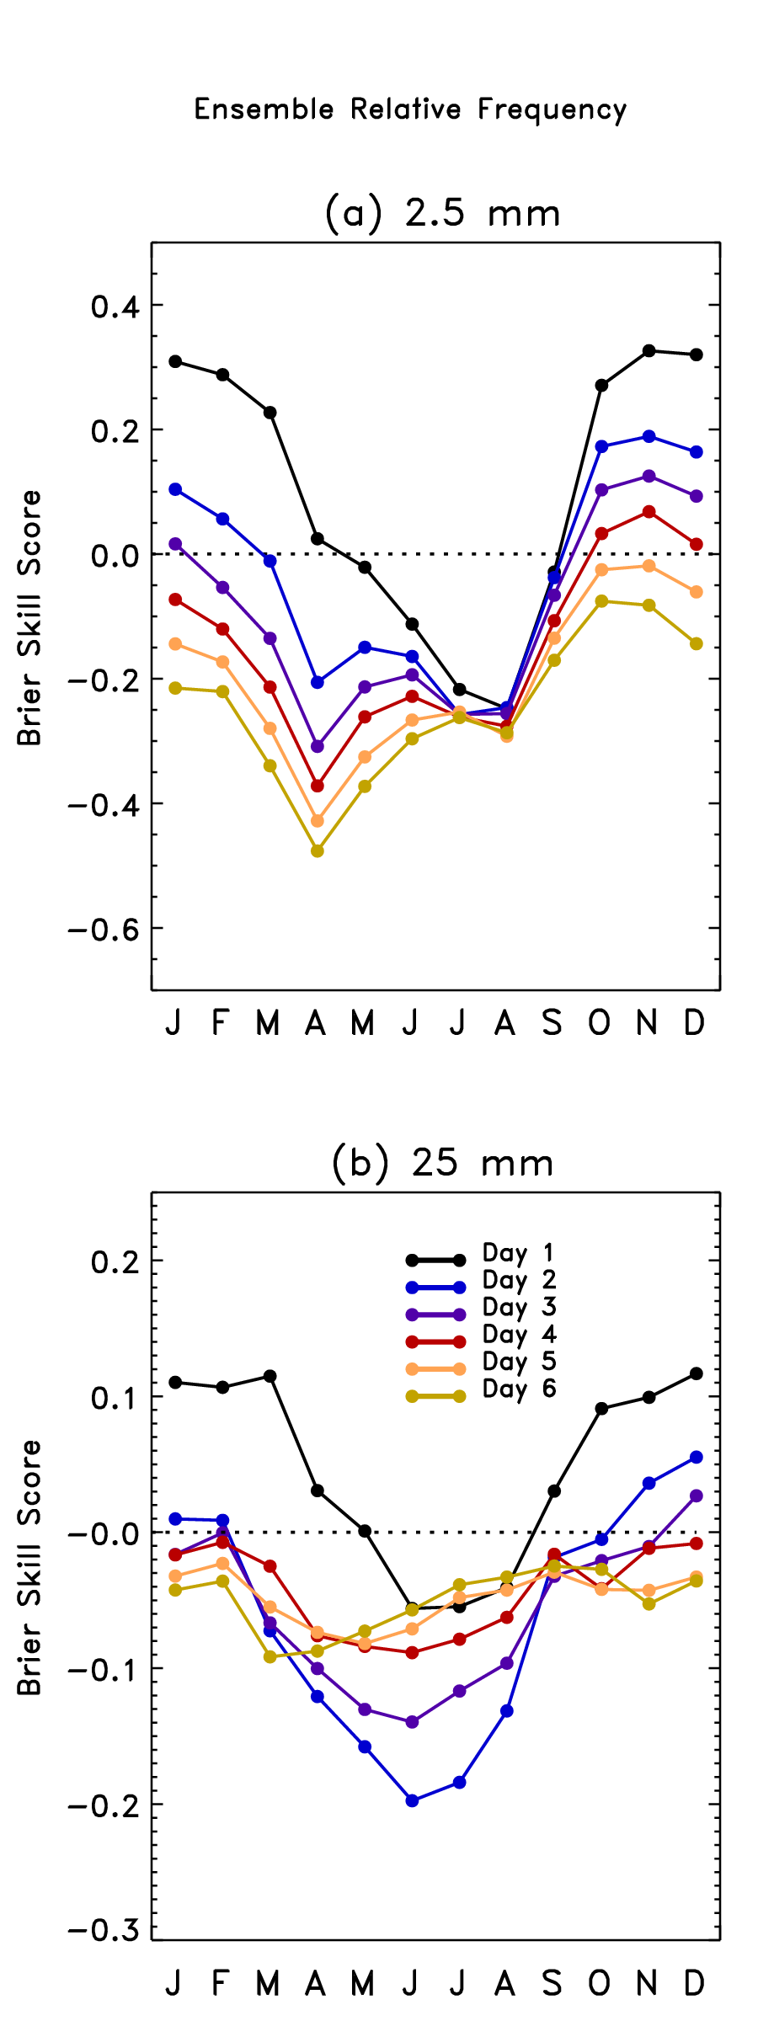
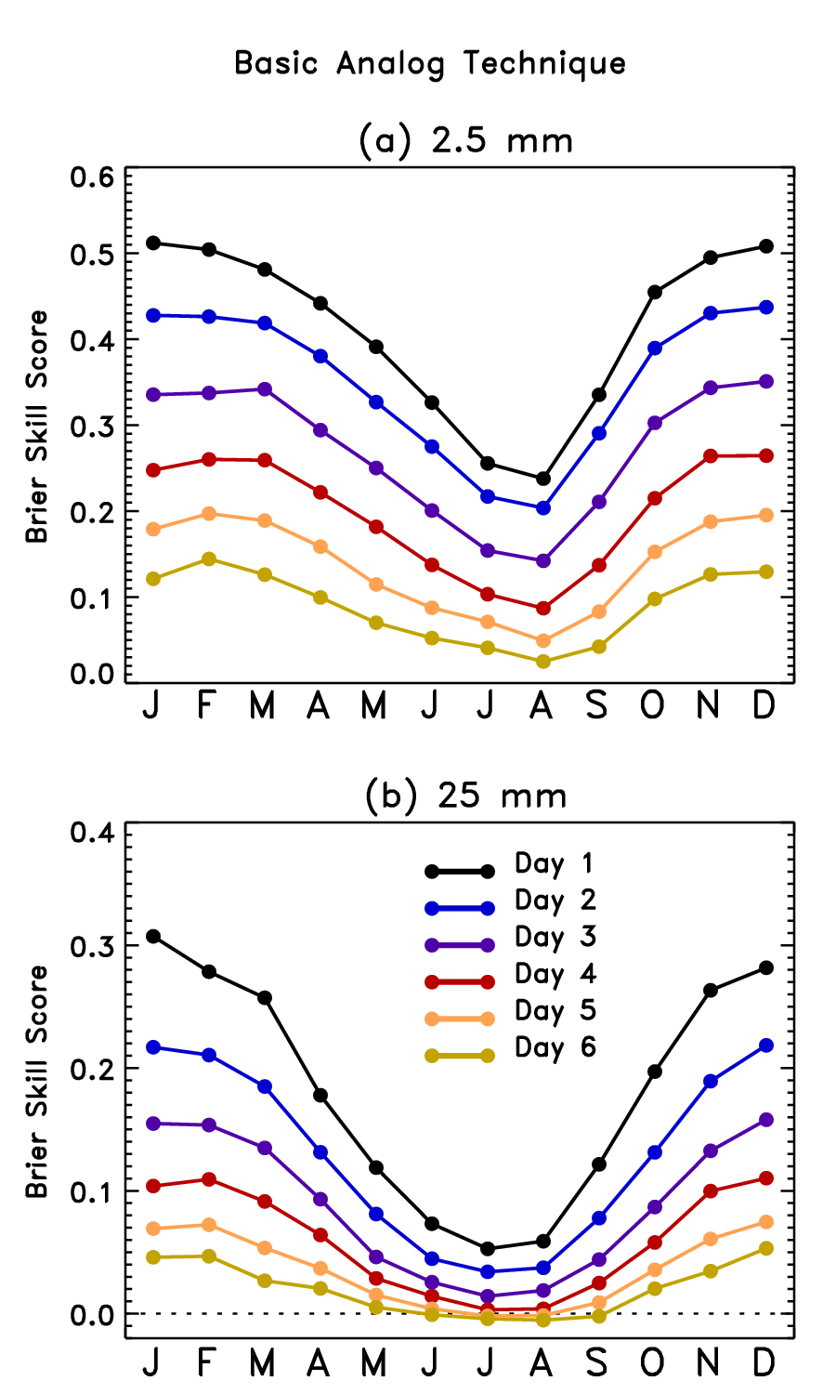
Why reforecast?
Potential for large
improvements in
skill from post-processing
to remove systematic
errors, statistically
downscale.
Here, “analog” approach
used as discussed in
Hamill and Whitaker,
MWR, 2006.
But: first-generation reforecast used 1998 T62 GEFS; out of date, not many variables saved.

Slide 3
GEFS reforecast v2 basics
Seeks to mimic GEFS operational configuration as of February 2012.
Reforecasts produced every day, for 1984120100 to current (actually, working on 2011 and 2012 now).
Each 00Z, 11-member forecast, 1 control + 10 perturbed.
CFSR initial conditions (GSI) + ETR perturbations (cycled with 10 perturbed members). After ~ 22 May 2012, initial conditions from hybrid EnKF/GSI.
Resolution: T254L42 to day 8, T190L42 from days 7.5 to day 16.
Fast data archive at ESRL of 99 variables, 28 of which stored at original ~1/2-degree resolution during week 1. All stored at 1 degree. Also: mean and spread to be stored.
Full archive at DOE/Lawrence Berkeley Lab, where data set was created under DOE grant.

Slide 4
Status
00Z reforecasts 1985-2010 completed.
2011-12 and archiving real-time GEFS in progress.
We are a few weeks away from opening our ftp/web site (ESRL, fast access, limited data, + DOE, slow access with full data set) to full public usage.
We have written some select fields of reforecast data to external hard disks for important customers, e.g., OHD, CPC/EMC in order to jumpstart their product development.
We will be working to convert our web-based experimental precipitation forecast products over to the new reforecast data set (several months before this is ready; aiming for next cool season).
Several other groups are working on product development, e.g.,for improved hurricane and tornado forecasts.

Slide 5
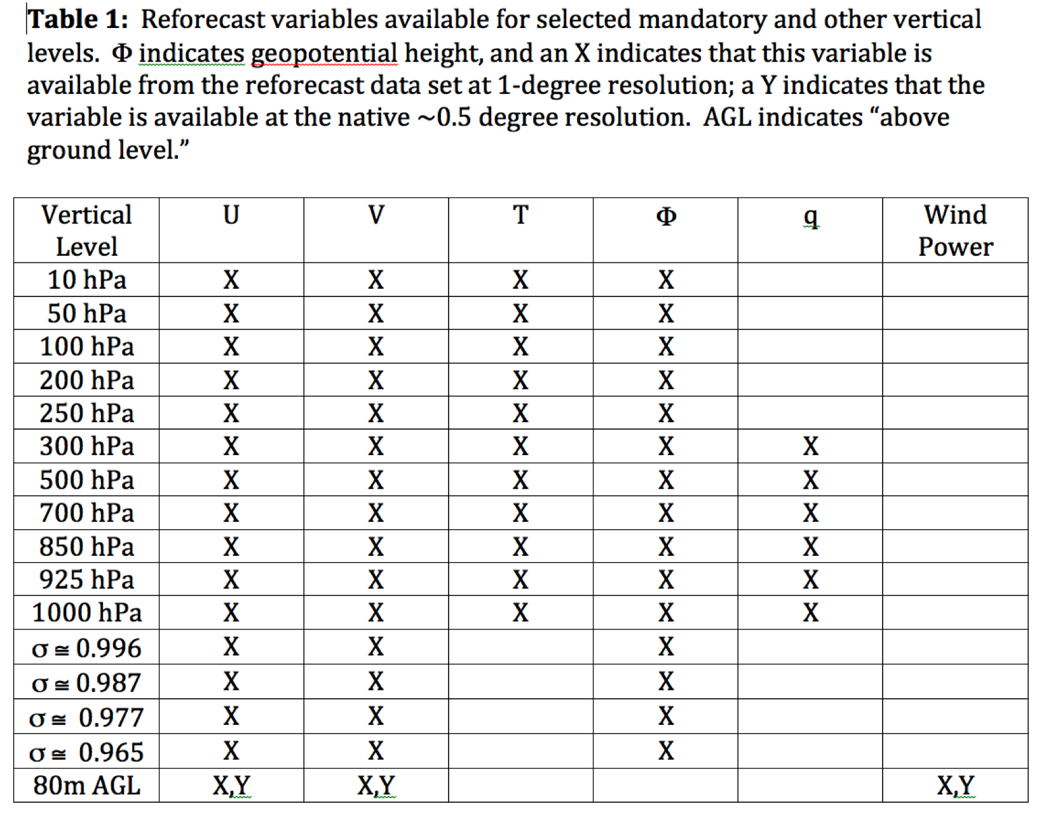
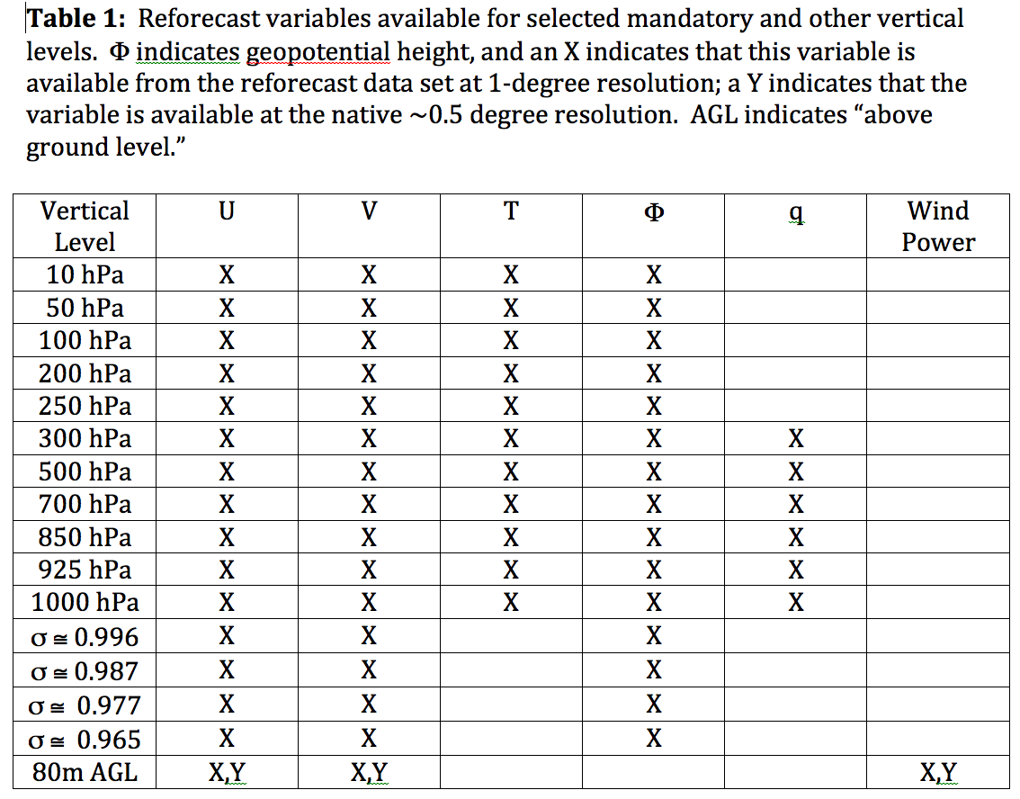
Data to be readily available from ESRL
Also: hurricane ATCF files

Slide 6
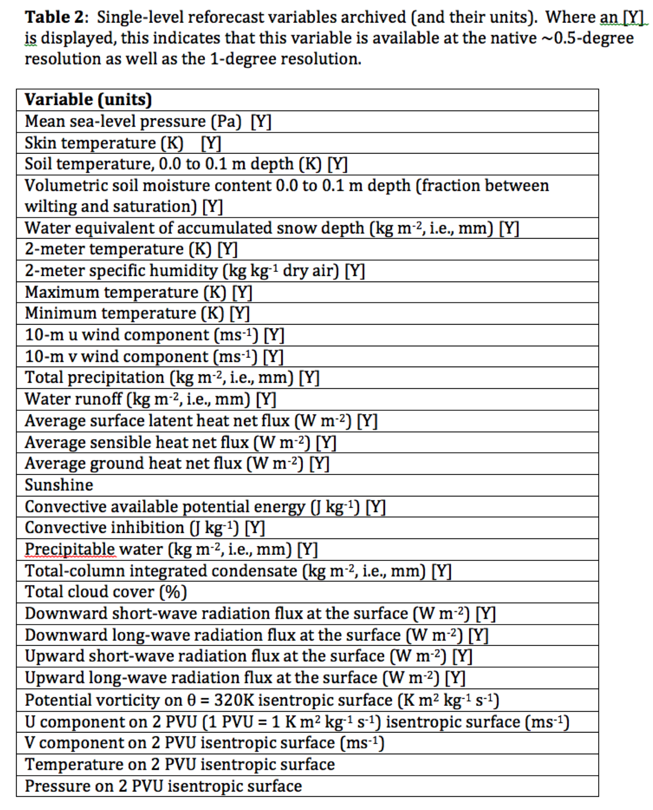
Data to be readily available from ESRL

Slide 7
500 hPa Z anomaly correlation
(from deterministic control)
Lines w/o filled colors
for second–generation
reforecast (2010, T254)
Lines with filled colors
for first-generation
reforecast (1998, T62).
Perhaps a 1.5-2.5 day
improvement.

Slide 8
How does the skill of post-processed forecasts change from reforecast v1 to v2?
Let’s look at post-processed 24-h precipitation forecast guidance.
Will use a “rank analog” approach for post-processing (description to follow)

Slide 9
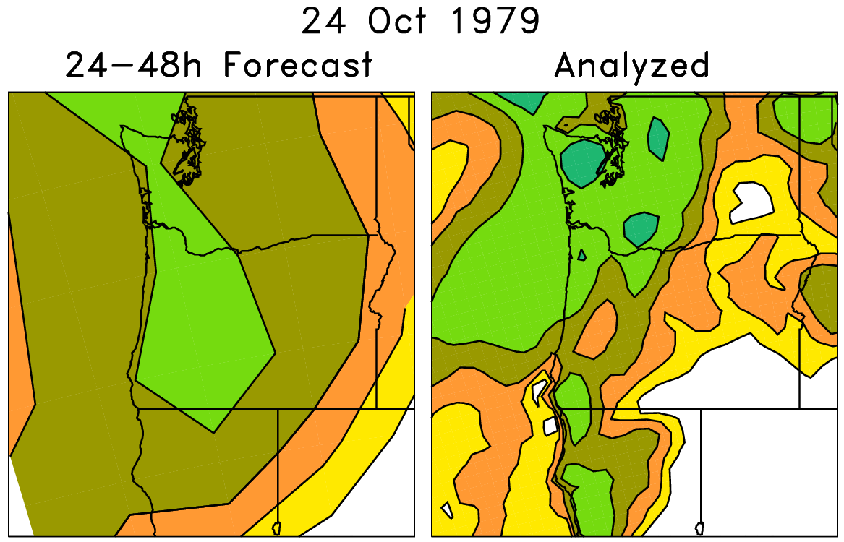
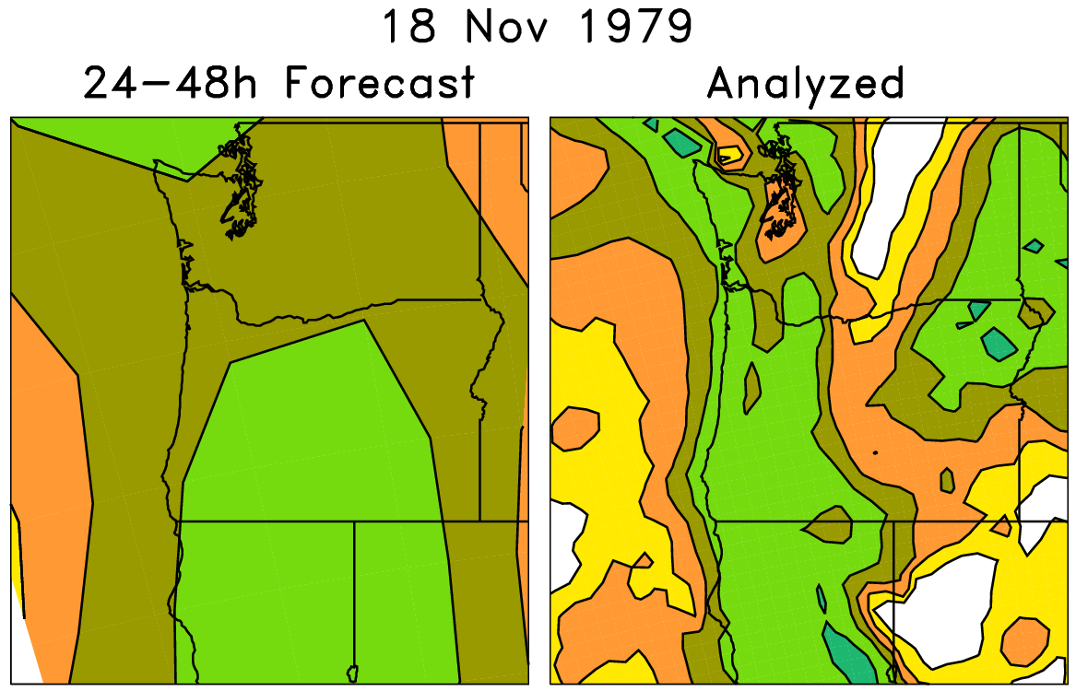
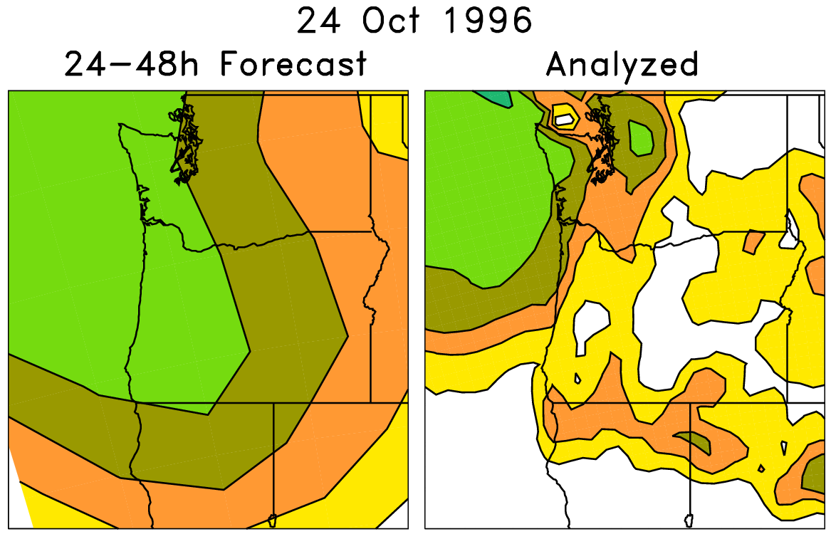
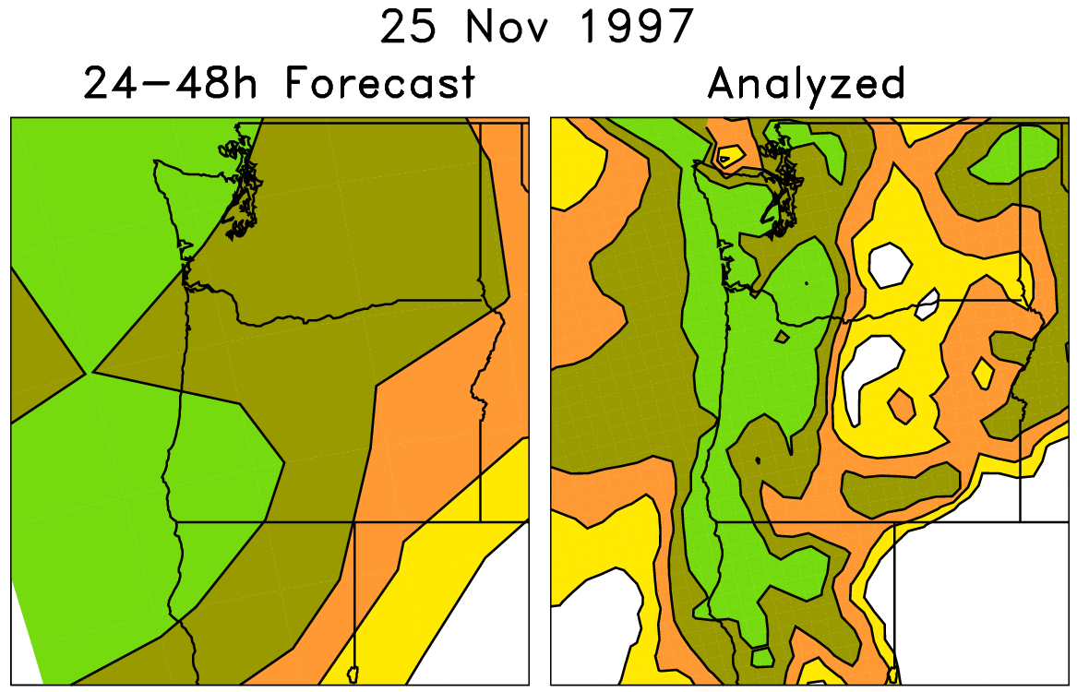
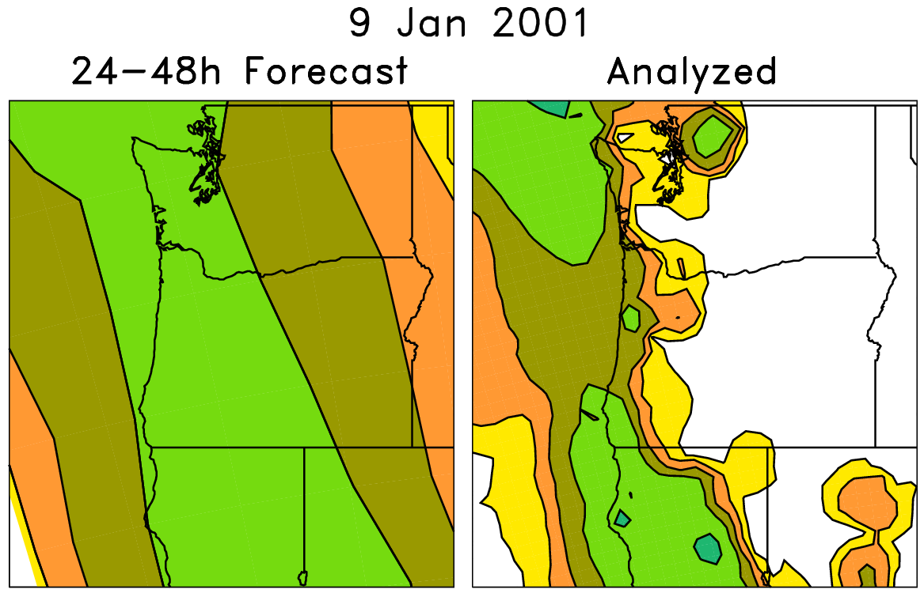
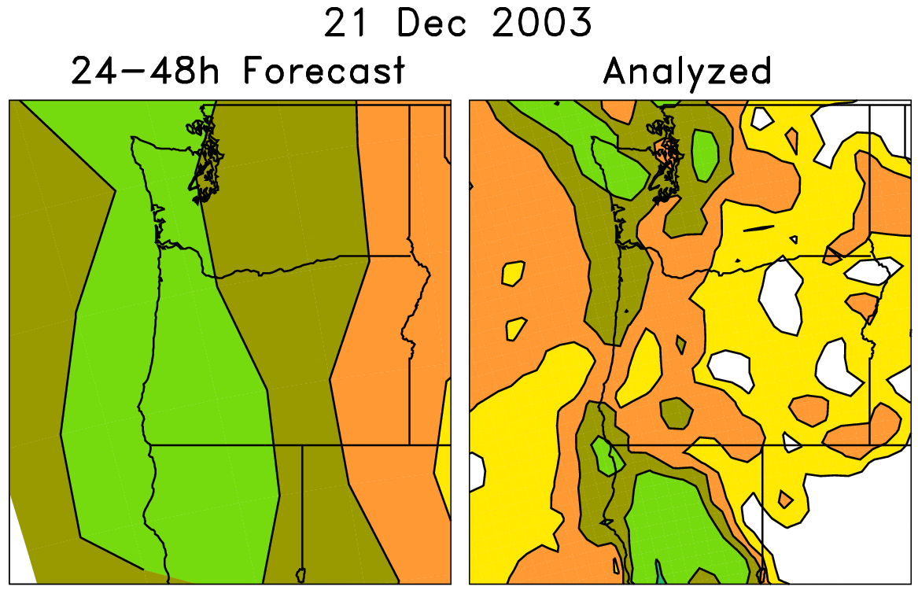
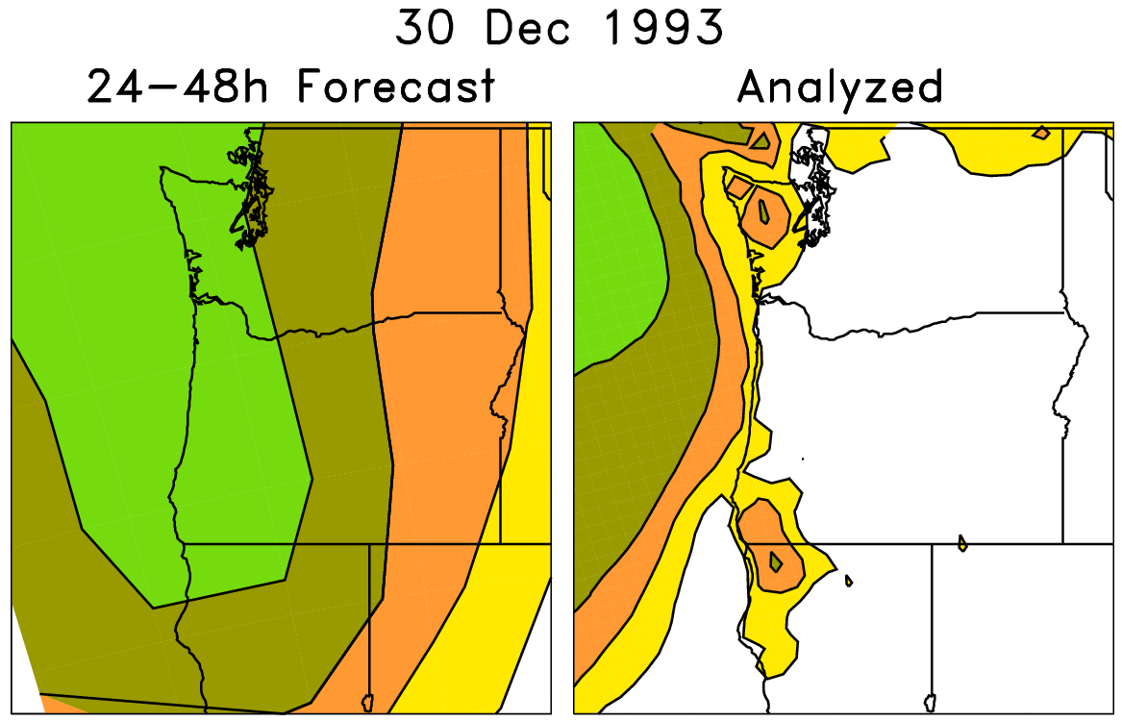
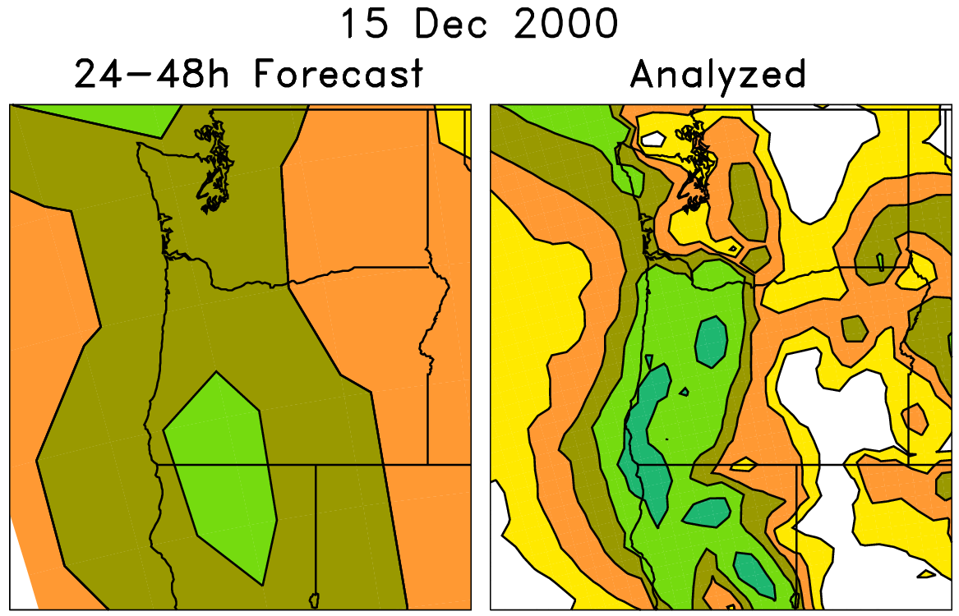
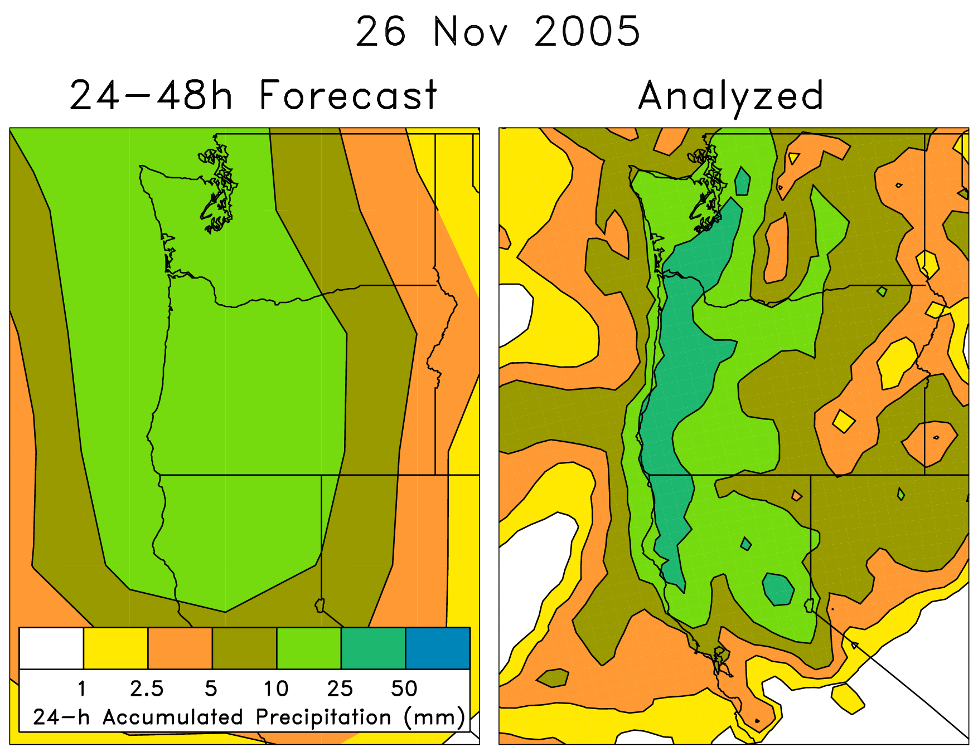
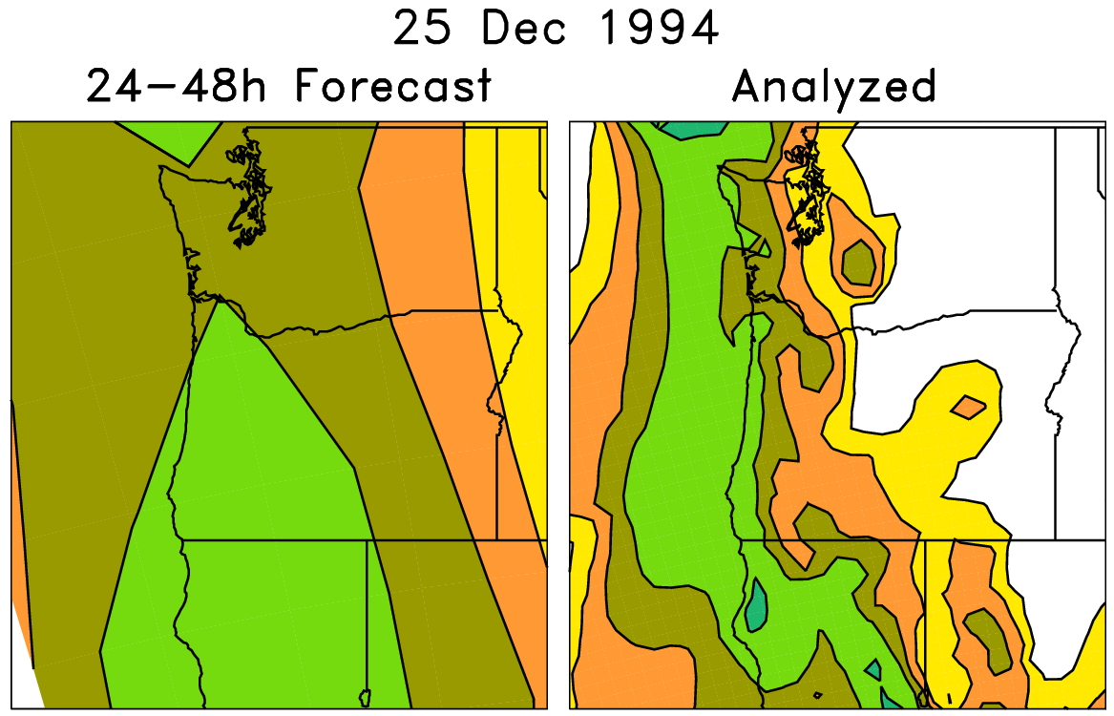
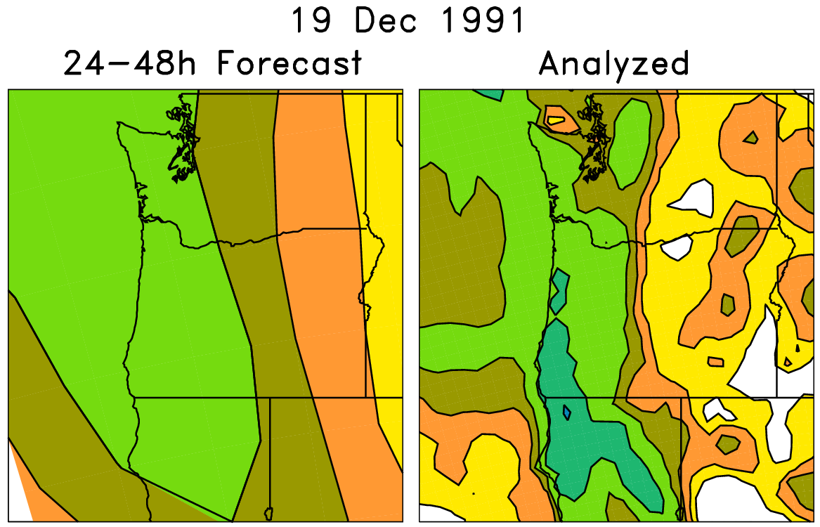
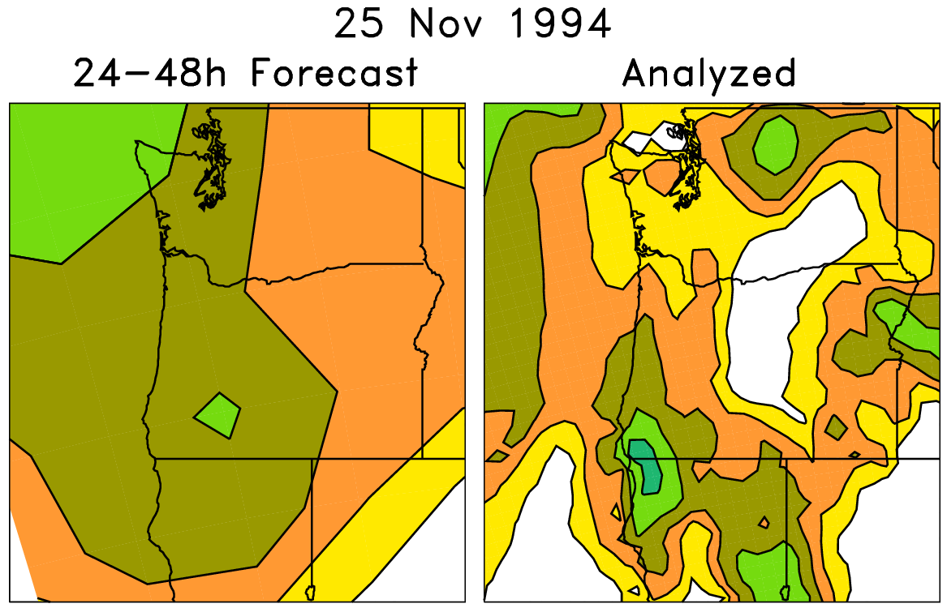
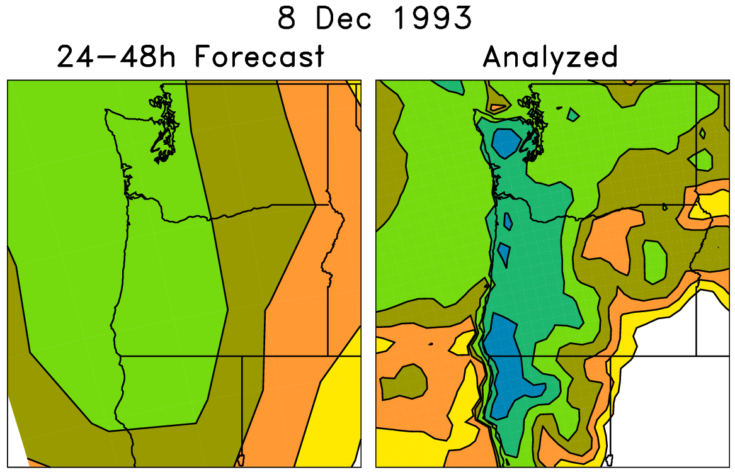
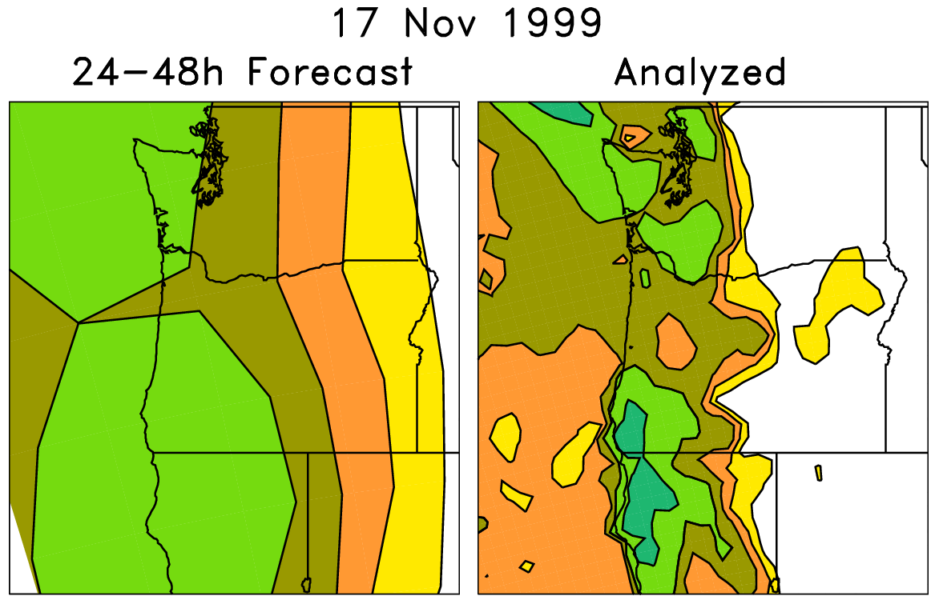
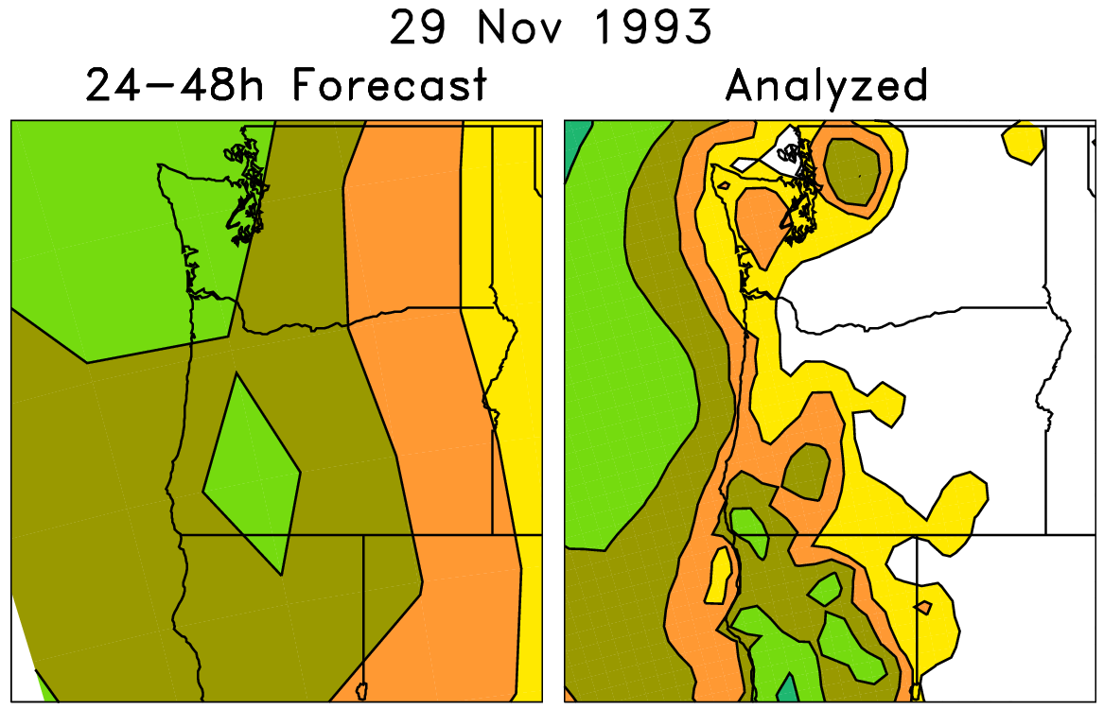
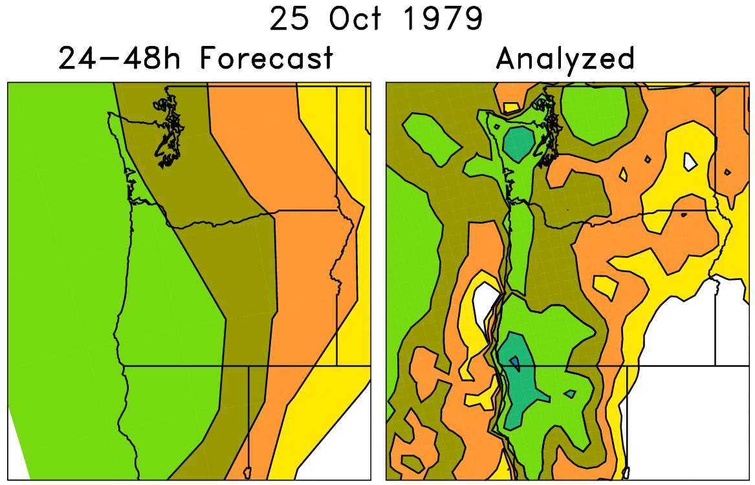
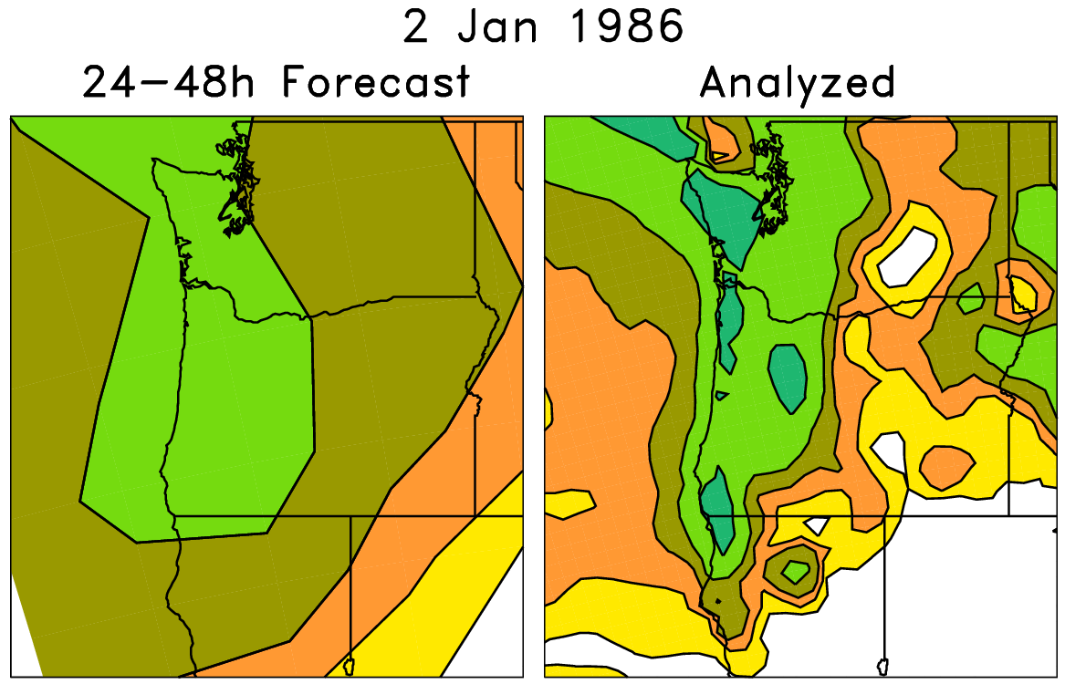
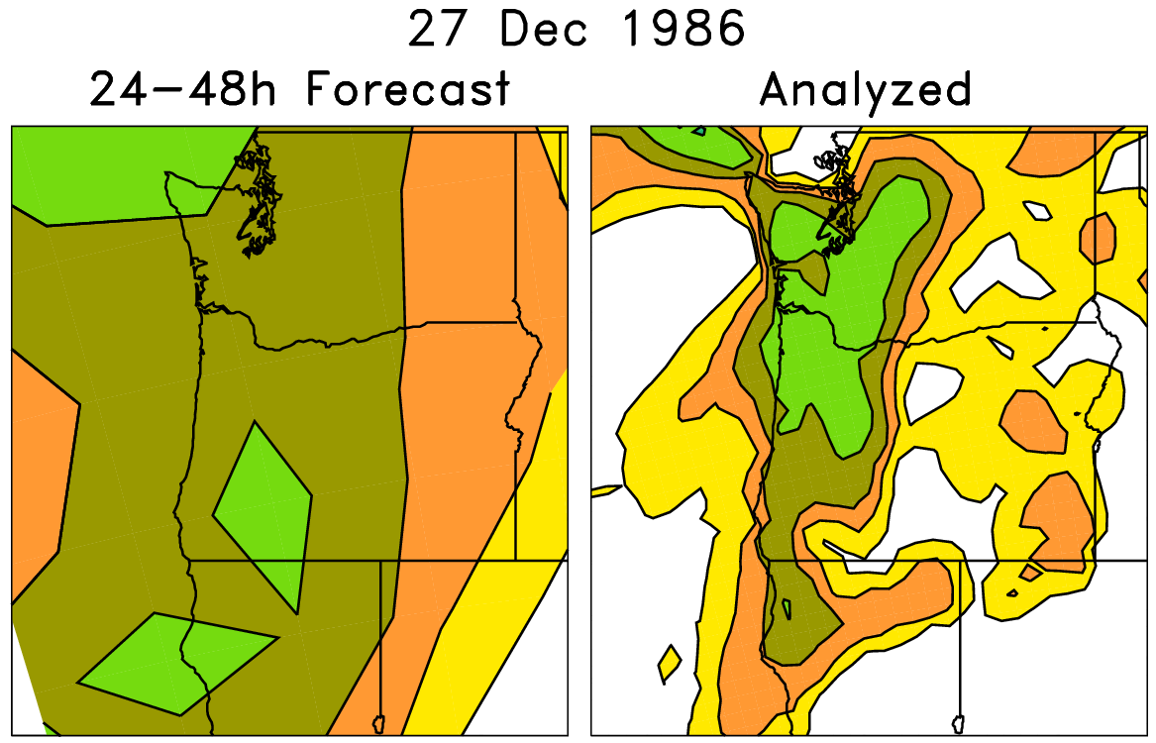
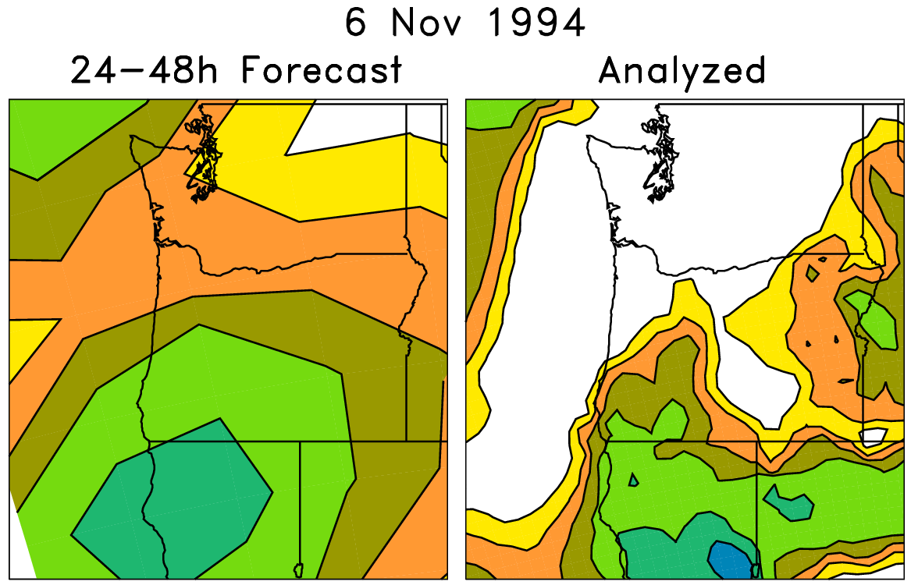
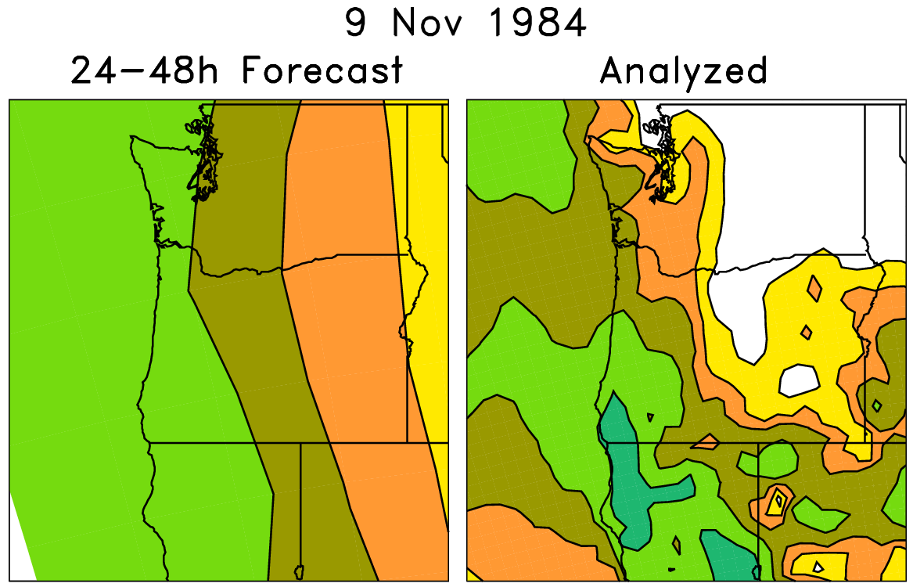
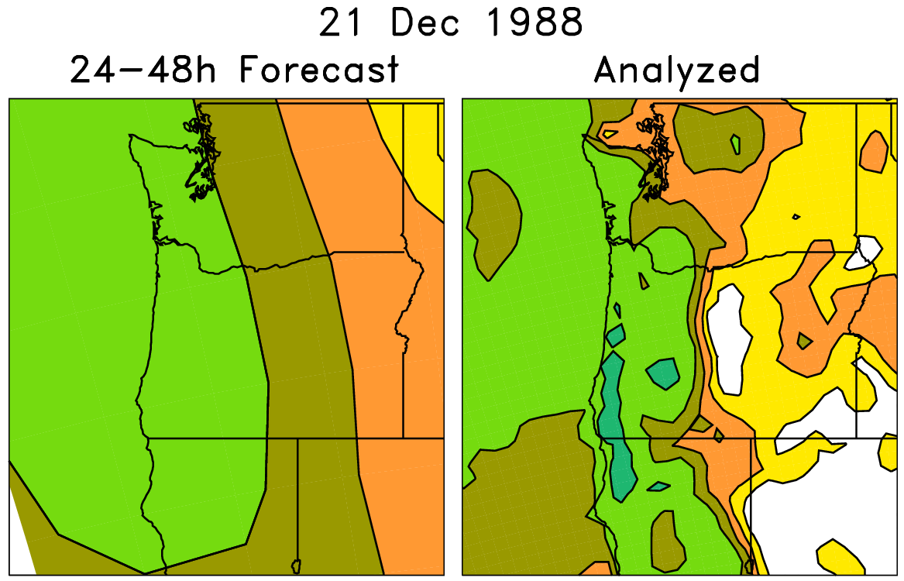
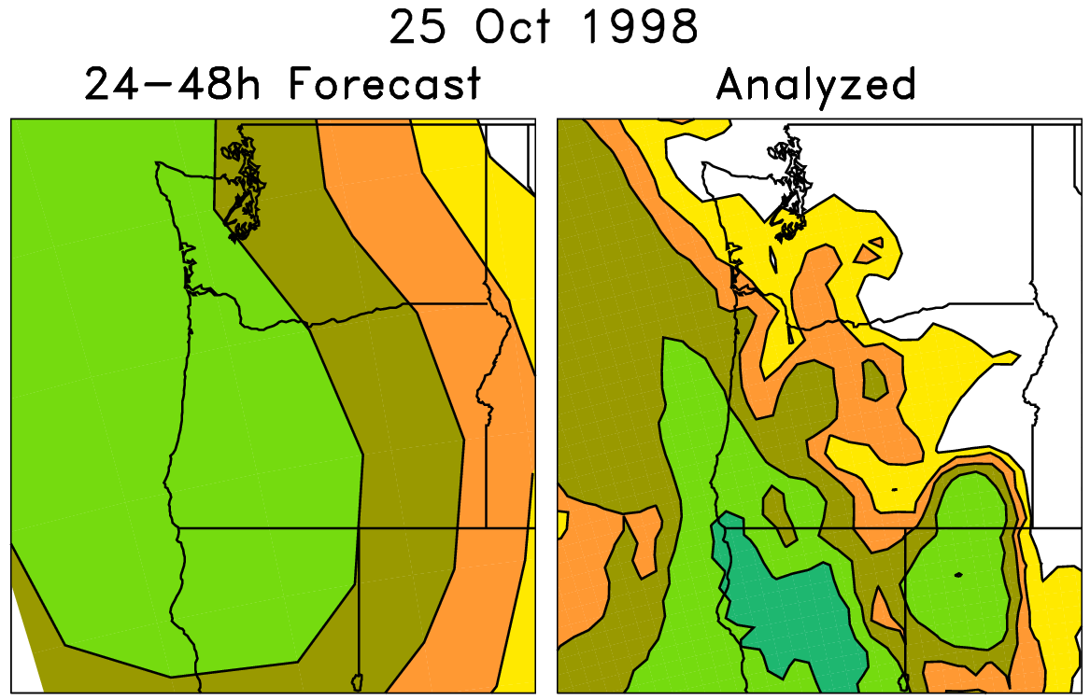
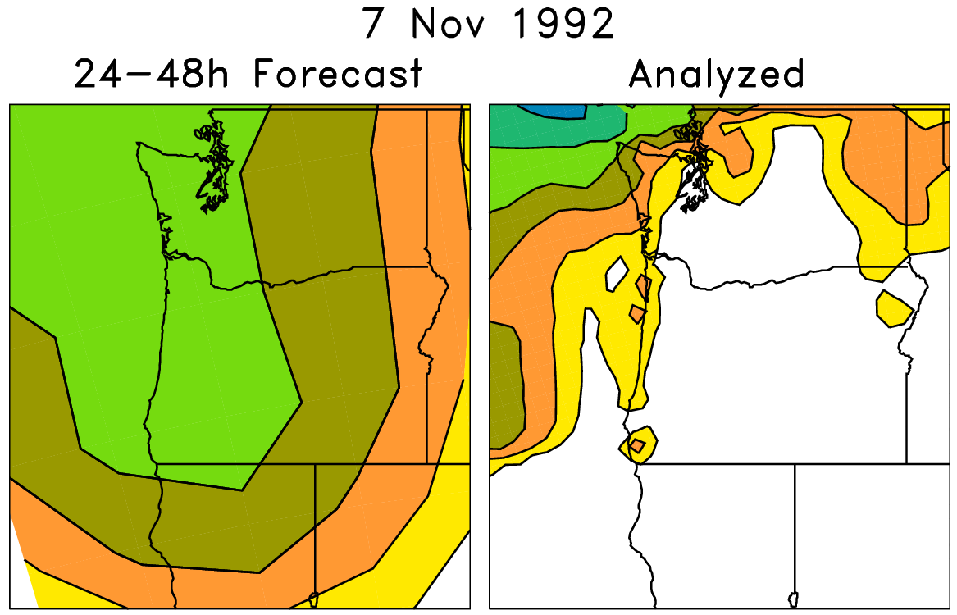
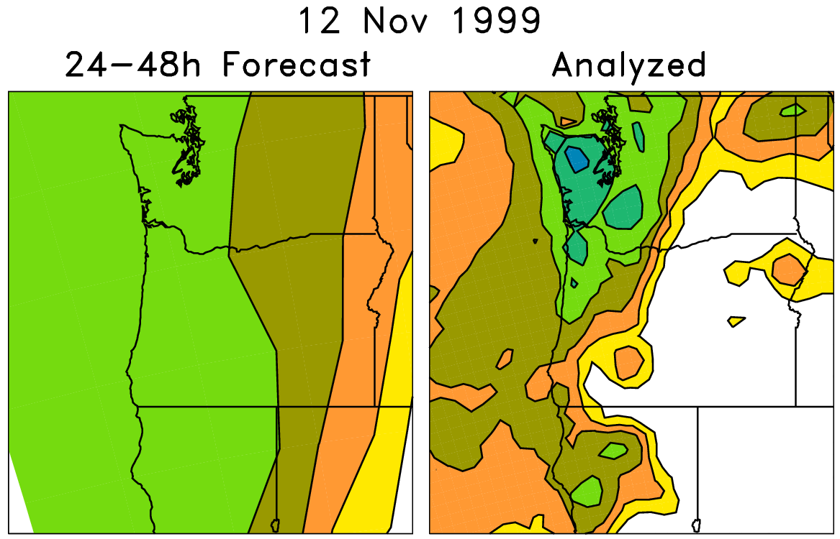
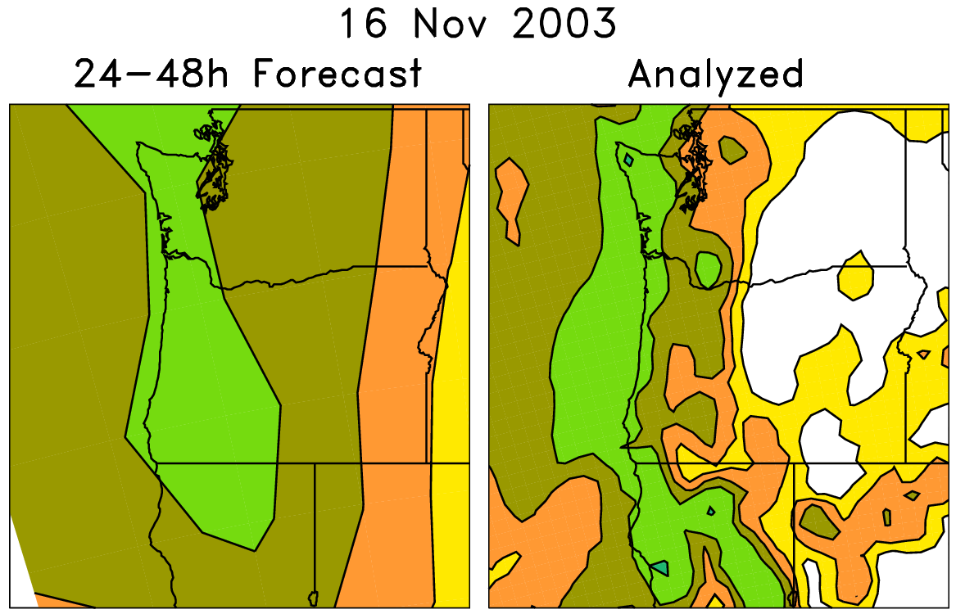
Basic analog technique for statistical downscaling (here, v1)
Today’s ens. mean forecast + subsequent
analyzed precipitation
On the left are old forecasts
similar to today’s ensemble-
mean forecast. For making
probabilistic forecasts,
form an ensemble from
the accompanying
analyzed weather on the
right-hand side.

Slide 10
Analog technique for statistical downscaling
Form an
ensemble from
these

Slide 11
Problem with basic analog reforecast technique
Say today’s forecast is
for 20 mm. There
are more forecasts
slightly less than 20 mm
than slightly more than
20 mm.
Assuming correlation
between forecast and
observations, analogs
will be biased toward
lower precipitation
amounts.

Slide 12
“Rank” analog procedure
Convert precipitation forecast time series to ranks:
x = [0, 0, 7, 15, 1, 3, 6, 4, 1, 2, 12, 5, 6, 8]
x(r)= [1.5, 1.5, 11, 14, 3.5, 6, 9, 7, 3.5, 5, 13, 8,10,12]
today’s

Slide 13
“Rank” analog procedure
Convert precipitation forecast time series to ranks:
x = [0, 0, 7, 15, 1, 3, 6, 4, 1, 2, 12, 5, 6, 8]
x(r)= [1.5, 1.5, 11, 14, 3.5, 6, 9, 7, 3.5, 5, 13, 8,10,12]
today’s
with standard analog, these would be the two forecasts with the closest values.

Slide 14
“Rank” analog procedure
Convert precipitation forecast time series to ranks:
x = [0, 0, 7, 15, 1, 3, 6, 4, 1, 2, 12, 5, 6, 8]
x(r)= [1.5, 1.5, 11, 14, 3.5, 6, 9, 7, 3.5, 5, 13, 8,10,12]
today’s
with rank analog, these would be the two forecasts with the closest ranks.

Slide 15
Rank analog calibration details
24-h accumulated precipitation, validated on NARR grid (~32 km) over CONUS, 1985-2009.
Rank analog approach: at each grid point in CONUS, using that grid point and +/- 3 surrounding grid points in N-S, E-W direction, find dates of 75 past forecasts that are closest in average precipitation rank of ensemble mean forecast. Make probabilistic forecasts from analyzed NARR precipitation data on dates of those 75 analogs.
(Conventionally calculated) Brier Skill Scores, reliability diagrams, etc. NARR again used for verification.

Slide 16
Skill of calibrated precipitation forecasts

Slide 17
Scores, > 10 mm and > 50 mm

Slide 18
Brier Skill Scores, Day +0-1, 1.0 mm 24h⁻¹
(reforecast version 2)

Slide 19
Brier Skill Scores, Day +0-1, 1.0 mm 24h⁻¹
(reforecast version 1)

Slide 20
NARR climatology, > 1-mm 24 h⁻¹
a modest relationship
between where
precipitation is
common and the
magnitude of skill.
Also, note
relationship with
terrain forcing.

Slide 21
Brier Skill Scores, Day +0-1, 10.0 mm 24h⁻¹
(reforecast version 2)
?

Slide 22
Brier Skill Scores, Day +0-1, 10.0 mm 24h⁻¹
(reforecast version 1)
?

Slide 23
NARR climatology, > 10 mm 24 h⁻¹
Climatology seems anomalously dry.
NARR precipitation analyses after
snowfall are somewhat
untrustworthy; precipitation
registered only as snow melts, so
precipitation can be off by days.
Improvements to Stage IV may
correct this in the future, but this
data goes back only to 2002.

Slide 24
Reliability, > 1 mm precipitation 24 h⁻¹
Day +0-1
Day +2-3
Day +4-5
Version 2 (2012 GEFS)
Version 1 (1998 GEFS)

Slide 25
Reliability, > 1 mm precipitation 24 h⁻¹
Day +0-1
Day +2-3
Day +4-5
Blue lines: distribution of
climatological forecast
probabilities across US &
all 12 months.
Version 2 (2012 GEFS)
Version 1 (1998 GEFS)

Slide 26
Reliability, > 10 mm precipitation 24 h⁻¹
Day +0-1
Day +2-3
Day +4-5
Version 2 (2012 GEFS)
Version 1 (1998 GEFS)

Slide 27
Reliability, > 50 mm precipitation 24 h⁻¹
Day +0-1
Day +2-3
Day +4-5
Version 2 (2012 GEFS)
Version 1 (1998 GEFS)
5/95 CI’s
from
“block
bootstrap”

Slide 28
Reliability, > 50 mm precipitation 24 h⁻¹
Day +0-1
Day +2-3
Day +4-5
Why is there the tendency
to under-forecast
probabilities at these
high precipitation thresholds?
Version 2 (2012 GEFS)
Version 1 (1998 GEFS)

Slide 29
Problem at extreme forecast amounts
Say today’s forecast is
for ~ 50 mm, and suppose this is the higher in amount than any forecast in the
reforecast time series. The analogs will be comprised of nothing but observed on dates when prior forecasts had lower than 50 mm. Hence there may be a strong tendency to under-forecast.

Slide 30
Example of forecast / analysis data
Today’s
forecast

Slide 31
Example of forecast / analysis data
Today’s
forecast
Is THIS an appropriate model for the general relationship between forecast & analyzed?

Slide 32
Example of forecast / analysis data
Today’s
forecast
And if so, is this sample of the observed given the forecasts biased too low
for today’s forecast?

Slide 33
Example of forecast / analysis data
Today’s
forecast
Perhaps this sample of the regression-shifted observed given the forecasts is better?

Slide 34
Example of forecast / analysis data
Today’s
forecast
Yet the best regression relationship at high amounts is uncertain. Perhaps
THIS instead is a better model than THAT? Highlights a general problem:
“extrapolating the regression.”

Slide 35

Danger!
One can spend multiple lifetimes fiddling…

Slide 36
Example of forecast / analysis data
Here is the actual data point. In this circumstance, most seemingly plausible
regression corrections would have made the forecast worse.

Slide 37
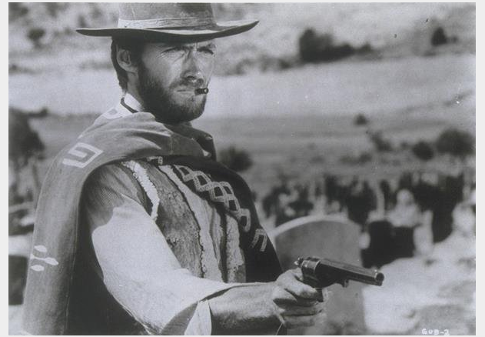
Case studies with atmospheric rivers in the western US: the good, the bad and ugly

Slide 38
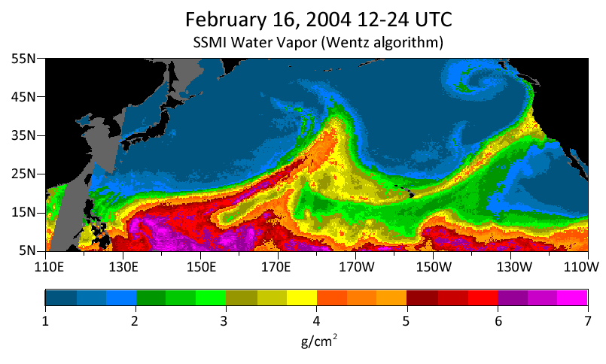
The bad and ugly atmospheric rivers case study
10” rain in the coastal mountains, 4-7” in Russian River
watershed. Streamflows in top 0.2% of historical observations.
Source: http://www.esrl.noaa.gov/psd/atmrivers/events/

Slide 39
6-day forecast

Slide 40
5-day forecast

Slide 41
4-day forecast

Slide 42
3-day forecast

Slide 43
2-day forecast

Slide 44
1-day forecast
Why did it take till so
close to the event to start
forecasting even moderate
probabilities of heavy
rain near the Russian River
basin in northwest CA?

Slide 45
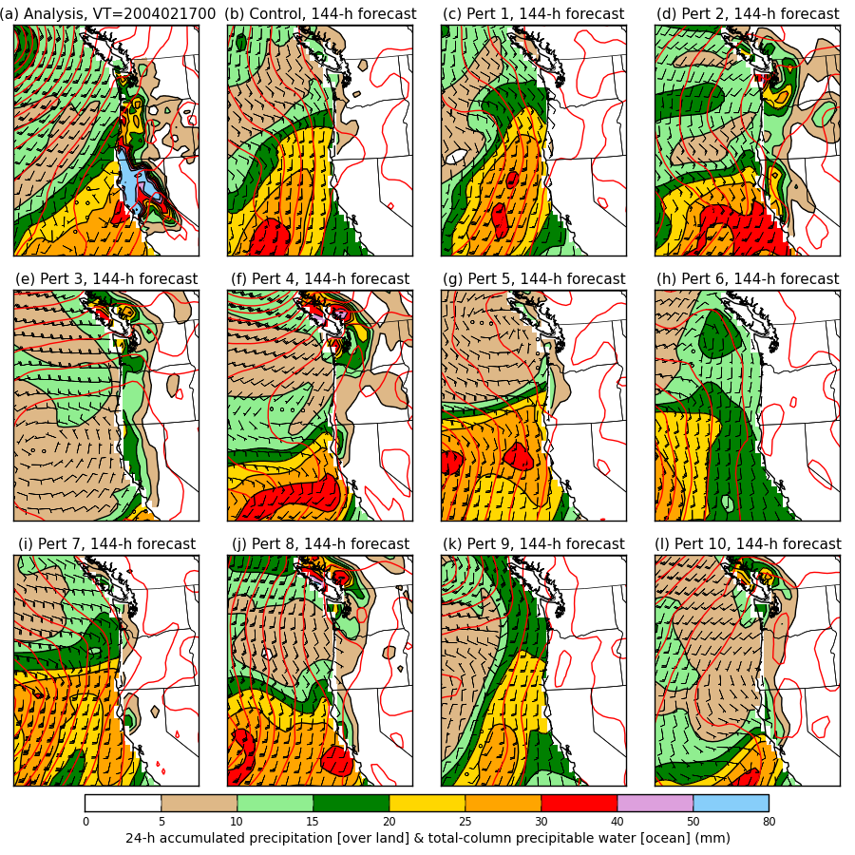
6-day forecast
Colors: over the
ocean, the total-
column precipitable
water. Over land,
the 24-h accum.
precipitation.
Wind barbs for the
925 hPa level.
Red contours:
mean sea-level
pressure.

Slide 46
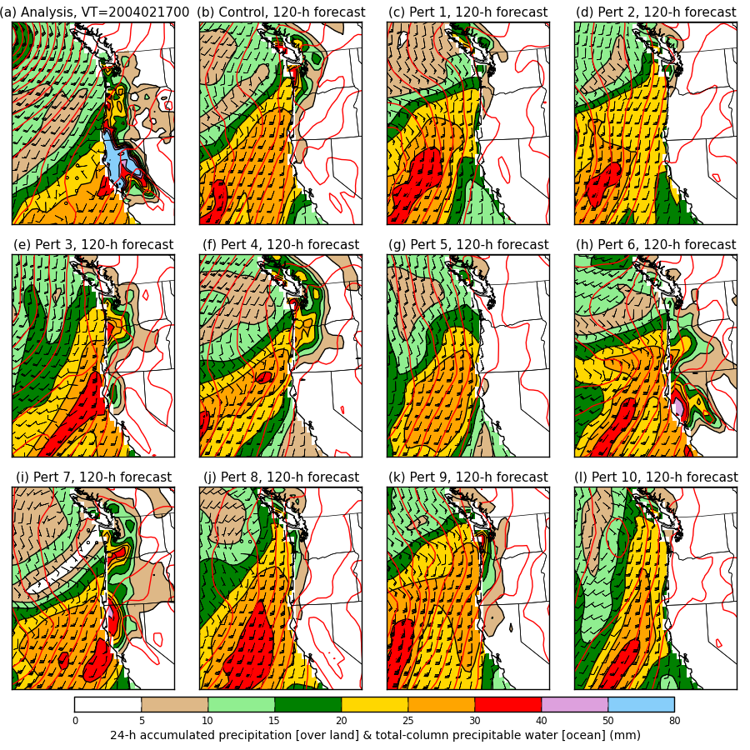
5-day forecast

Slide 47
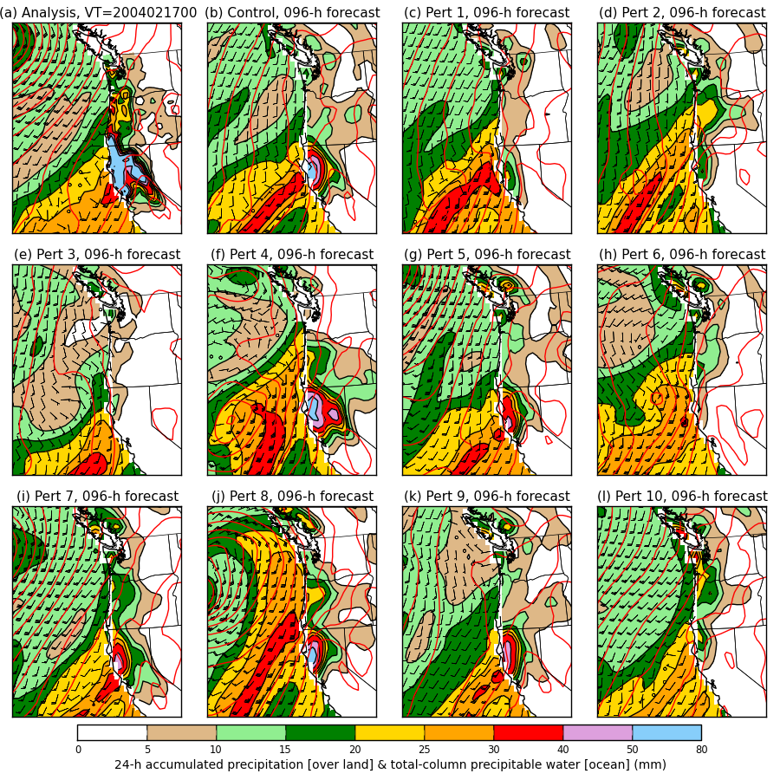
4-day forecast

Slide 48
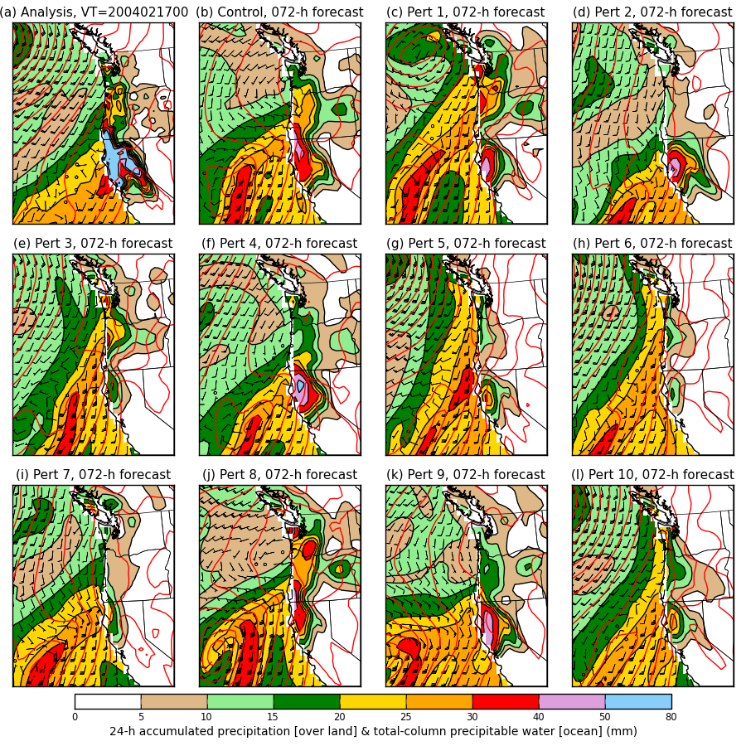
3-day forecast

Slide 49
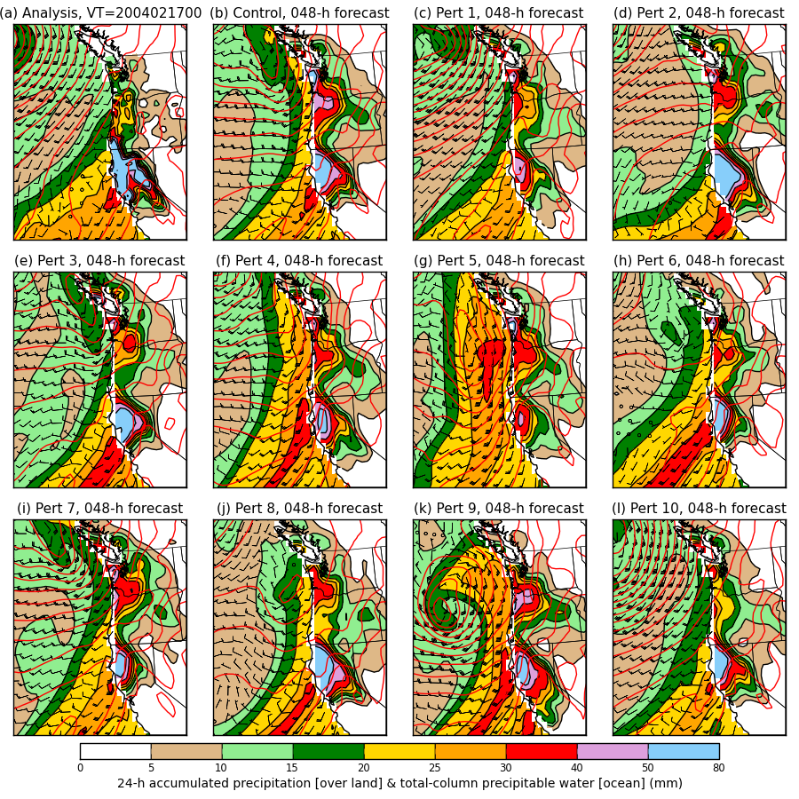
2-day forecast

Slide 50
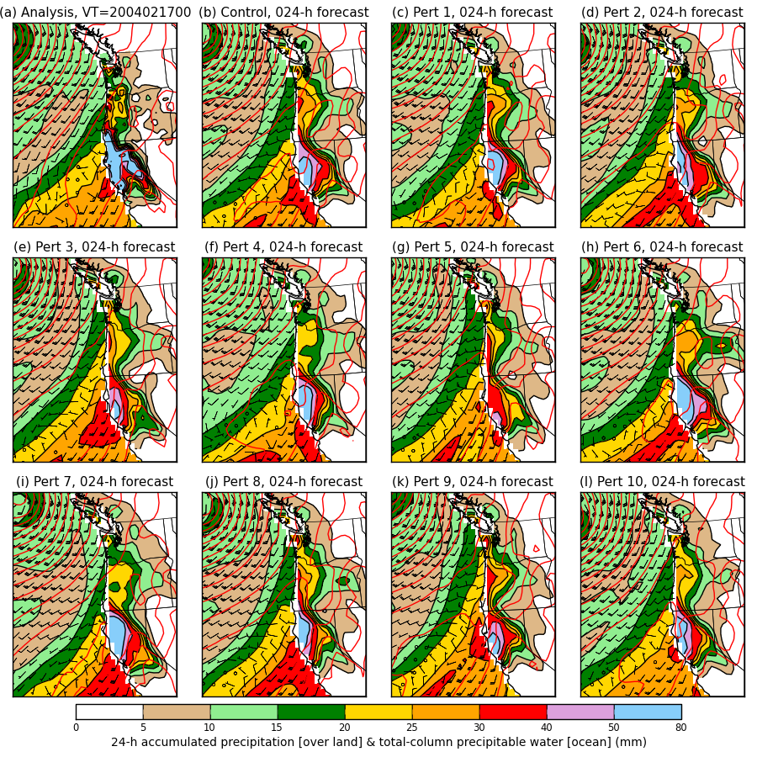
1-day forecast

Slide 51
Case study, tentative conclusions
Statistical post-processing will not be able to correct for everything. In this case, the synoptic-scale predictability was apparently quite low.
Improvements to post-processed probabilistic forecasts in such a case will require improved ensemble guidance.

Slide 52
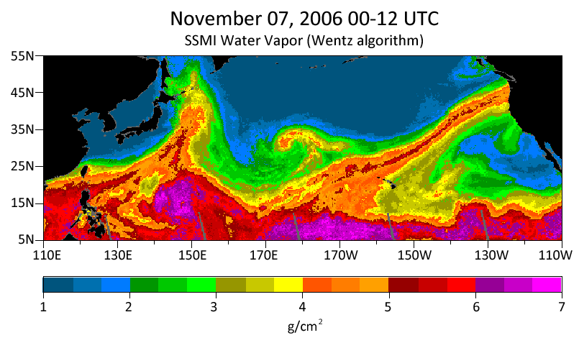
The “good” atmospheric rivers case study:
Nov 2006 Oregon-Washington floods
8-20 inches of rain in Cascades; flooded rivers; extensive damage to Mt. Rainier NP.

Slide 53
6-day forecast

Slide 54
5-day forecast

Slide 55
4-day forecast

Slide 56
3-day forecast

Slide 57
2-day forecast

Slide 58
1-day forecast
Comparatively, this event
was much more consistently
forecast as a heavy precipitation
event even at the long leads.

Slide 59
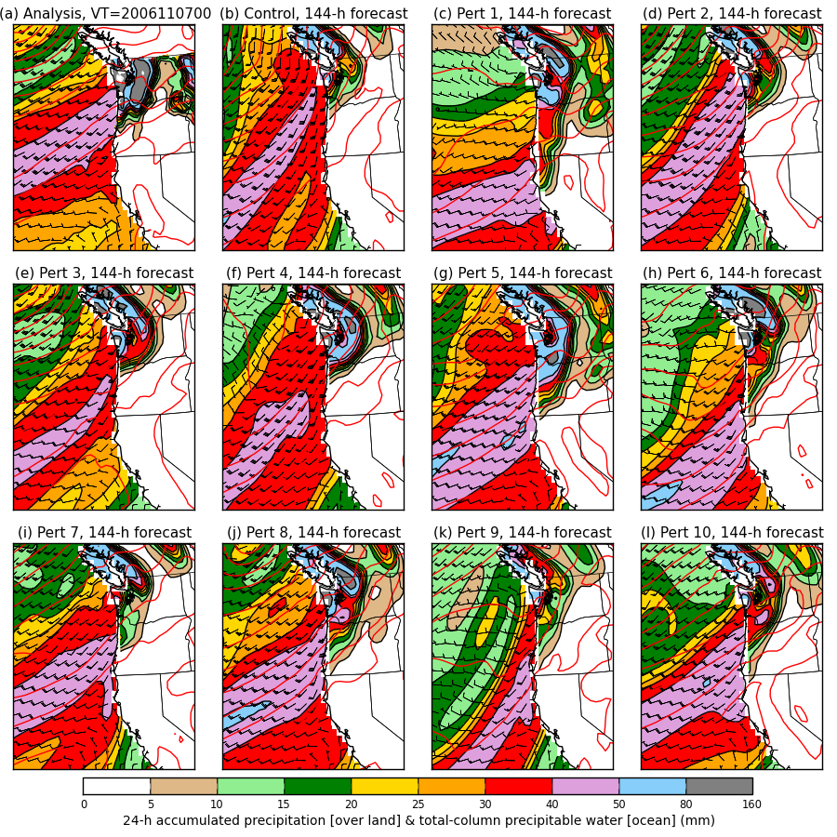
6-day forecast
Colors: over the
ocean, the total-
column precipitable
water. Over land,
the 24-h accum.
precipitation.
Wind barbs for the
925 hPa level.
Red contours:
mean sea-level
pressure.

Slide 60
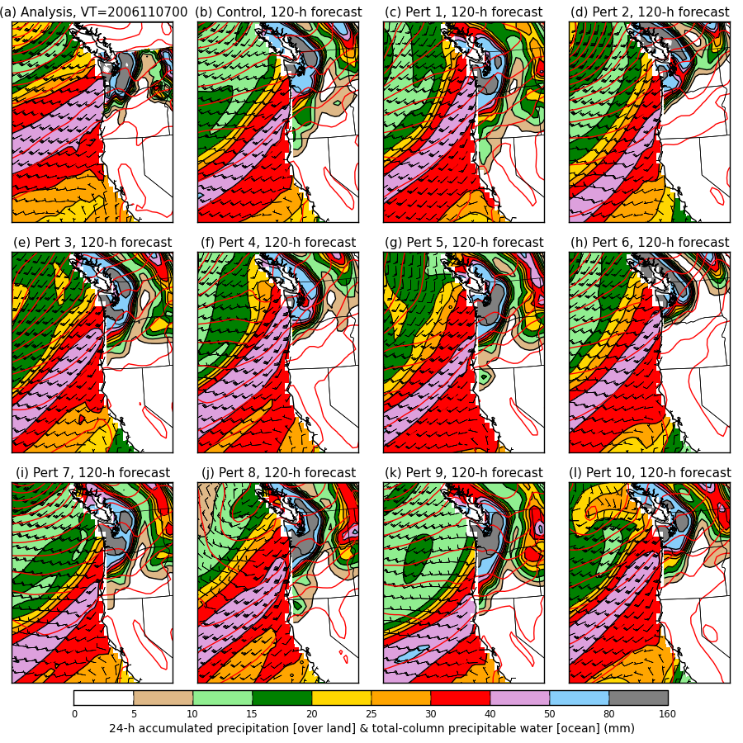
5-day forecast

Slide 61
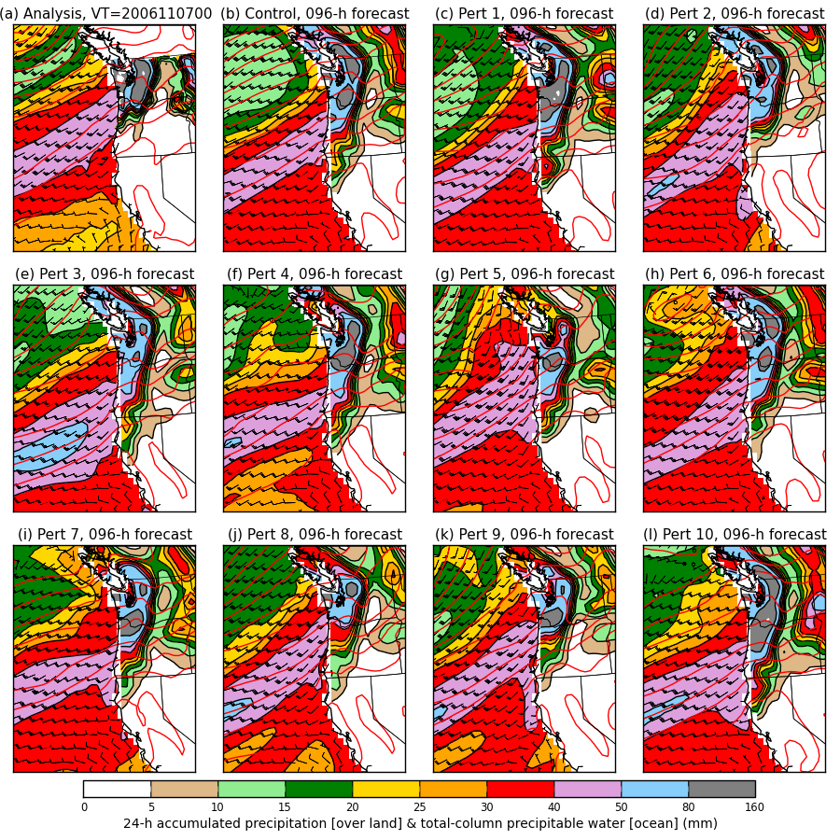
4-day forecast

Slide 62
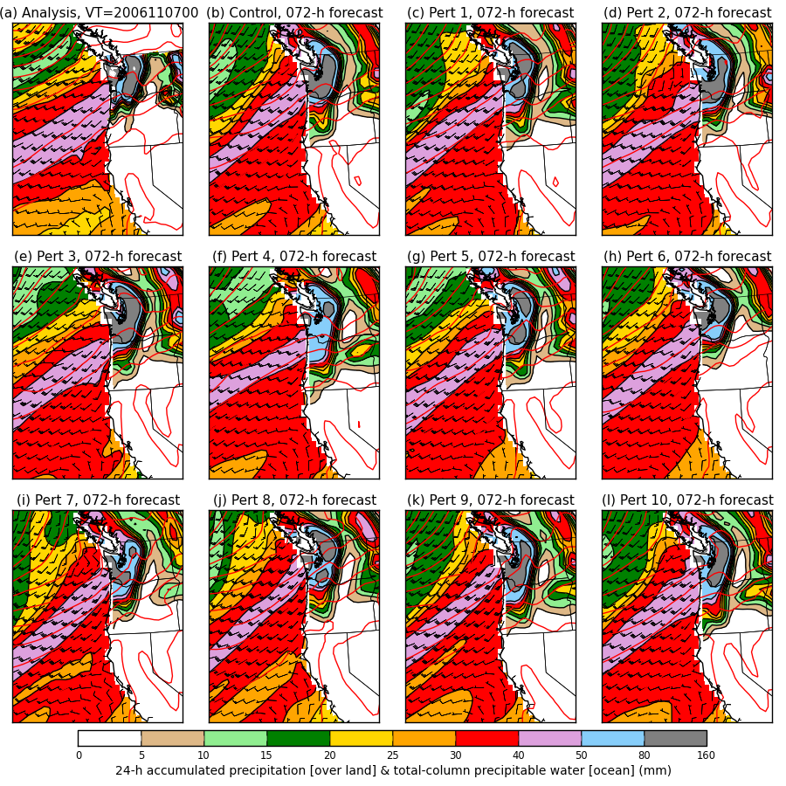
3-day forecast

Slide 63
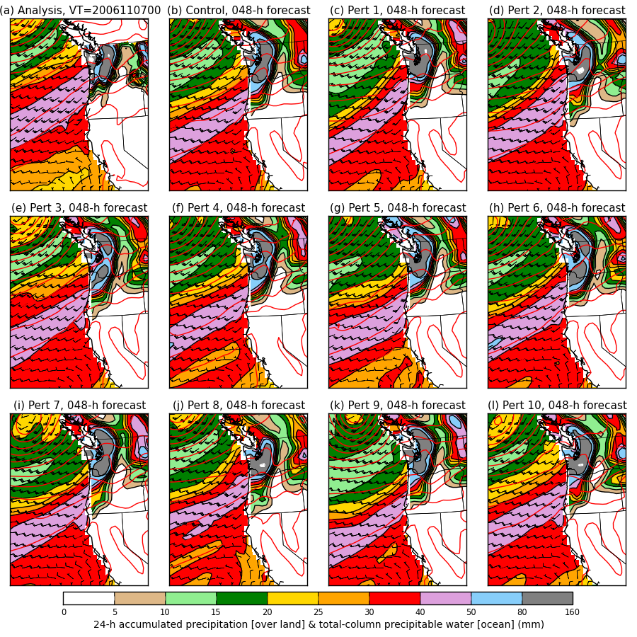
2-day forecast

Slide 64
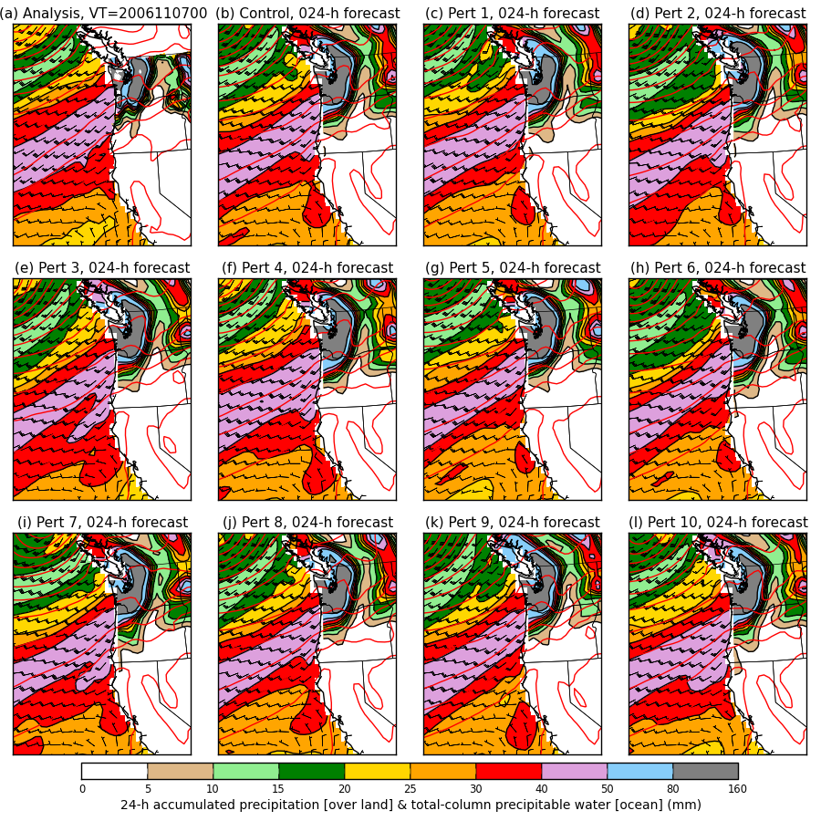
1-day forecast

Slide 65
Spaghetti
Westerns
Day + 6 ____
Day + 4 ____
Day + 2 ____
Analysis ____
The bad and the ugly
The good

Slide 66
Spaghetti
Westerns
Inconsistent forecasts of
orientation of isobars
and hence wind direction
Consistent forecasts of
orientation of isobars
and hence wind direction
The bad and the ugly
Day + 6 ____
Day + 4 ____
Day + 2 ____
Analysis ____
The good

Slide 67
Fruitful avenues for further near-term work in ESRL/PSD
Verification on more rivers cases.
Development of web-based applications to show relevant real-time ensemble forecast data and post-processed information.
Development of refinements to statistical post-processing algorithms.
  Appropriate statistical downscaling to ~4 km, and validation of forecasts at this resolution.
  Use of alternative verification data sets
  Additional predictors, different methods.

Slide 68
Conclusions
Reforecasts should help with longer-lead precipitation forecasts in the western US.
Web-based applications for displaying real-time ensemble data and post-processed data ought to be a priority.

Slide 69
other slides

Slide 70
ESRL interface to data

Slide 71
DOE/Lawrence Berkeley interface

Slide 72
Facilitating regional reforecasting
With full model states downloaded from DOE site, can initialize models like WRF to produce regional reforecasts.
[insert WRF picture]

Slide 73
Some known applications in development
Real-time web page of experimental PQPF forecasts (ESRL, in development to replace v1 web page)
Development of experimental forecast products for renewable energy sector (Hamill, ESRL).
6-10 day and 8-14 day forecasts (Dan Collins, CPC).
Detecting and correcting bias in hurricane track and intensity (Jiayi Peng, NCEP/EMC, Tom Galarneau, NCAR).
Objective probabilities for severe weather several days to weeks hence (Francisco Alvarez, St. Louis Univ. + Hamill)
Improving hydrologic predictions (Haksu Lee et al., NOAA/NWS/OHD).
Also: BAMS article once published will presumably spur wider usage.

