Slide 1
Common verification methods for ensemble forecasts, and how to apply them properly
NOAA Earth System
Research Laboratory
Tom Hamill
NOAA Earth System Research Lab,
Physical Sciences Division, Boulder, CO
tom.hamill@noaa.gov

Slide 2
Part 1: two desirable properties of ensembles, and the challenges of evaluating these properties
Property 1: Reliability, no matter how you slice and dice your ensemble data.
Property 2: Specificity, i.e., sharpness.

Slide 3
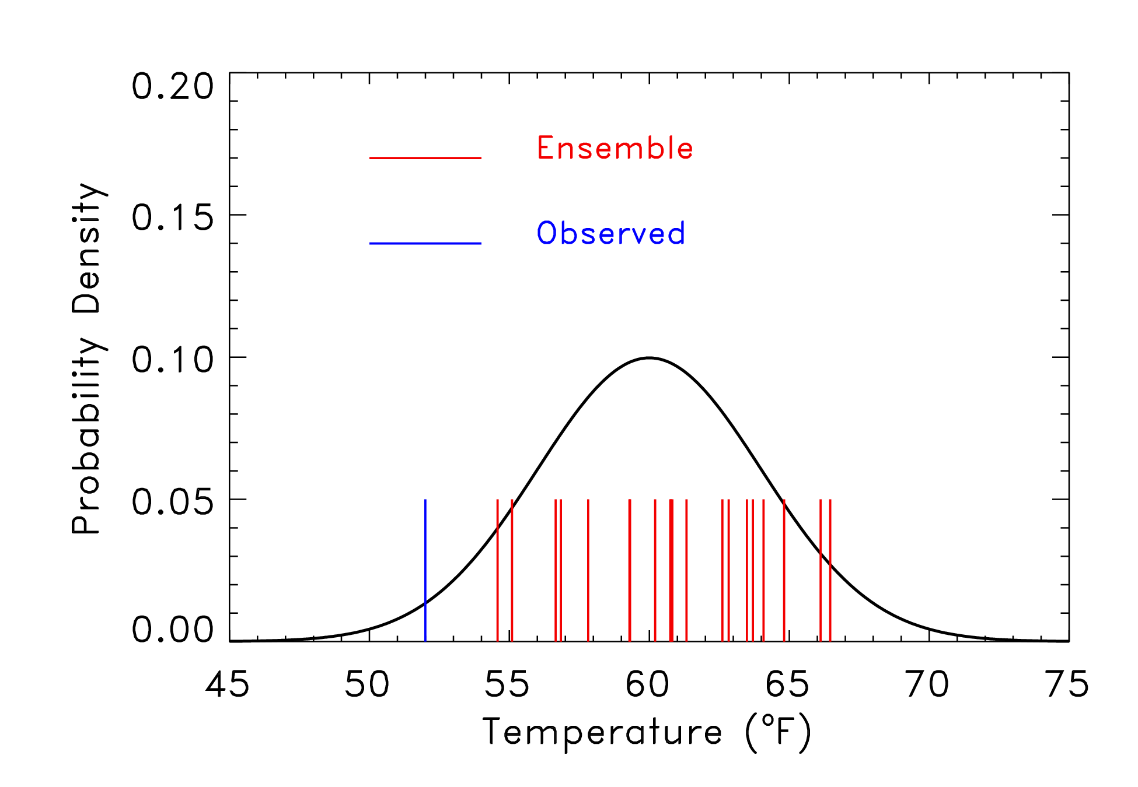
Unreliable ensemble?
Here, the observed is outside of the range of the ensemble,
which was sampled from the pdf shown. Is this a sign of
a poor ensemble forecast?

Slide 4
Unreliable ensemble?
You just don’t know; it’s only one sample.
You just don’t know…it’s only one sample
Here, the observed is outside of the range of the ensemble,
which was sampled from the pdf shown. Is this a sign of
a poor ensemble forecast?

Slide 5
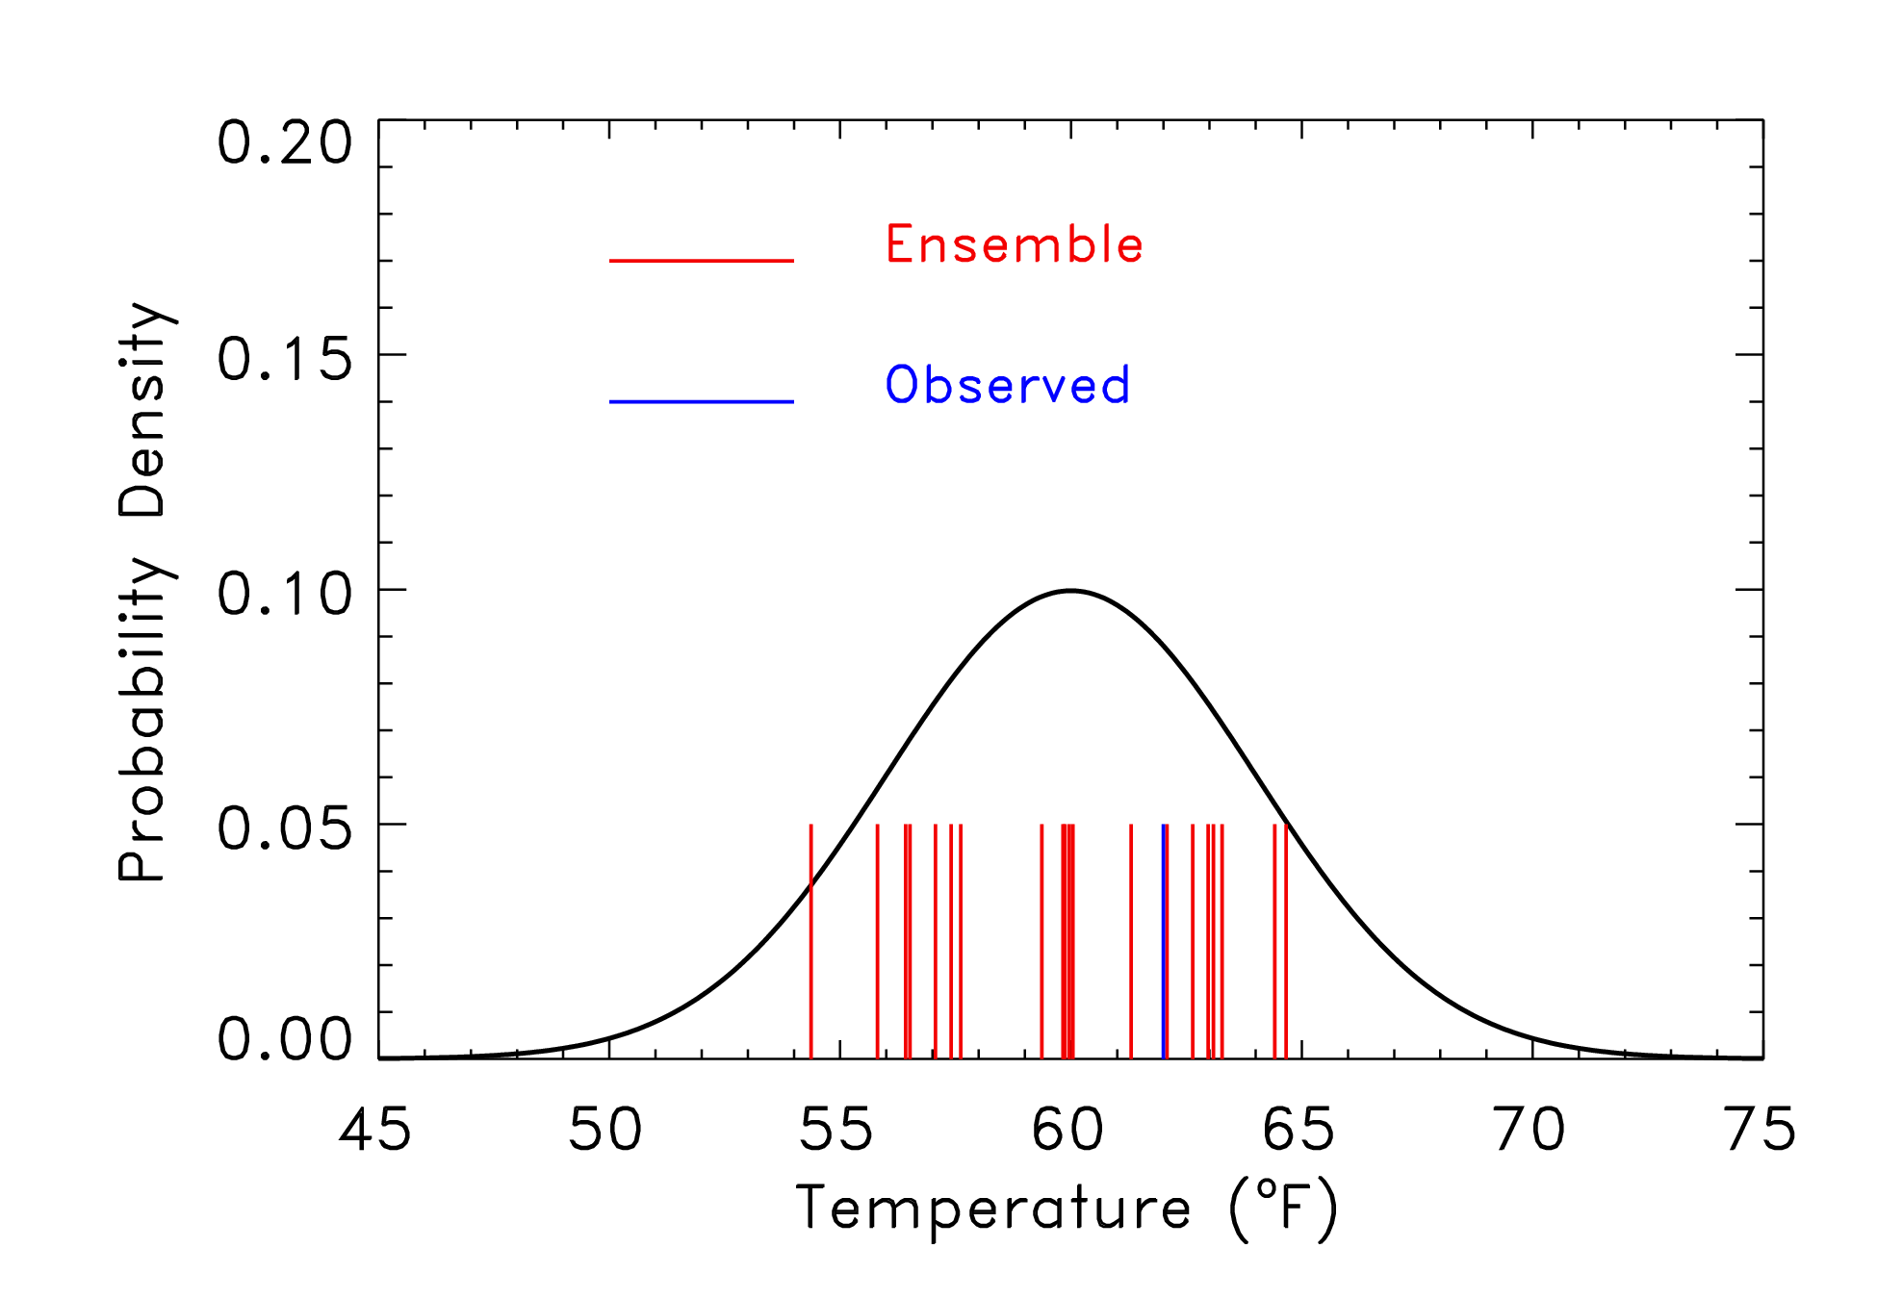
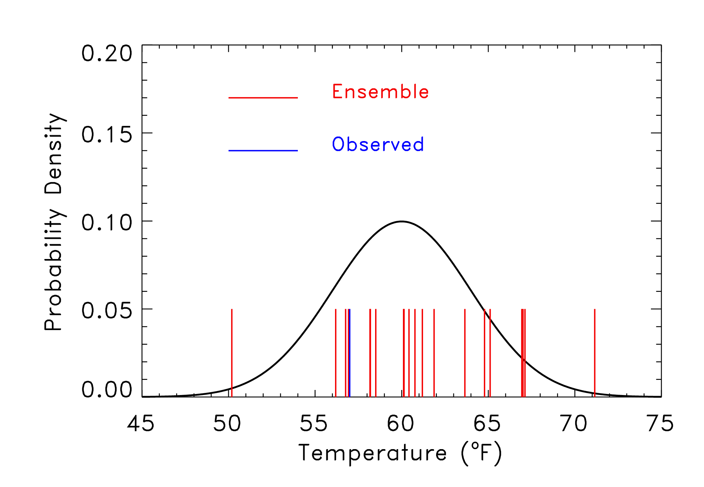
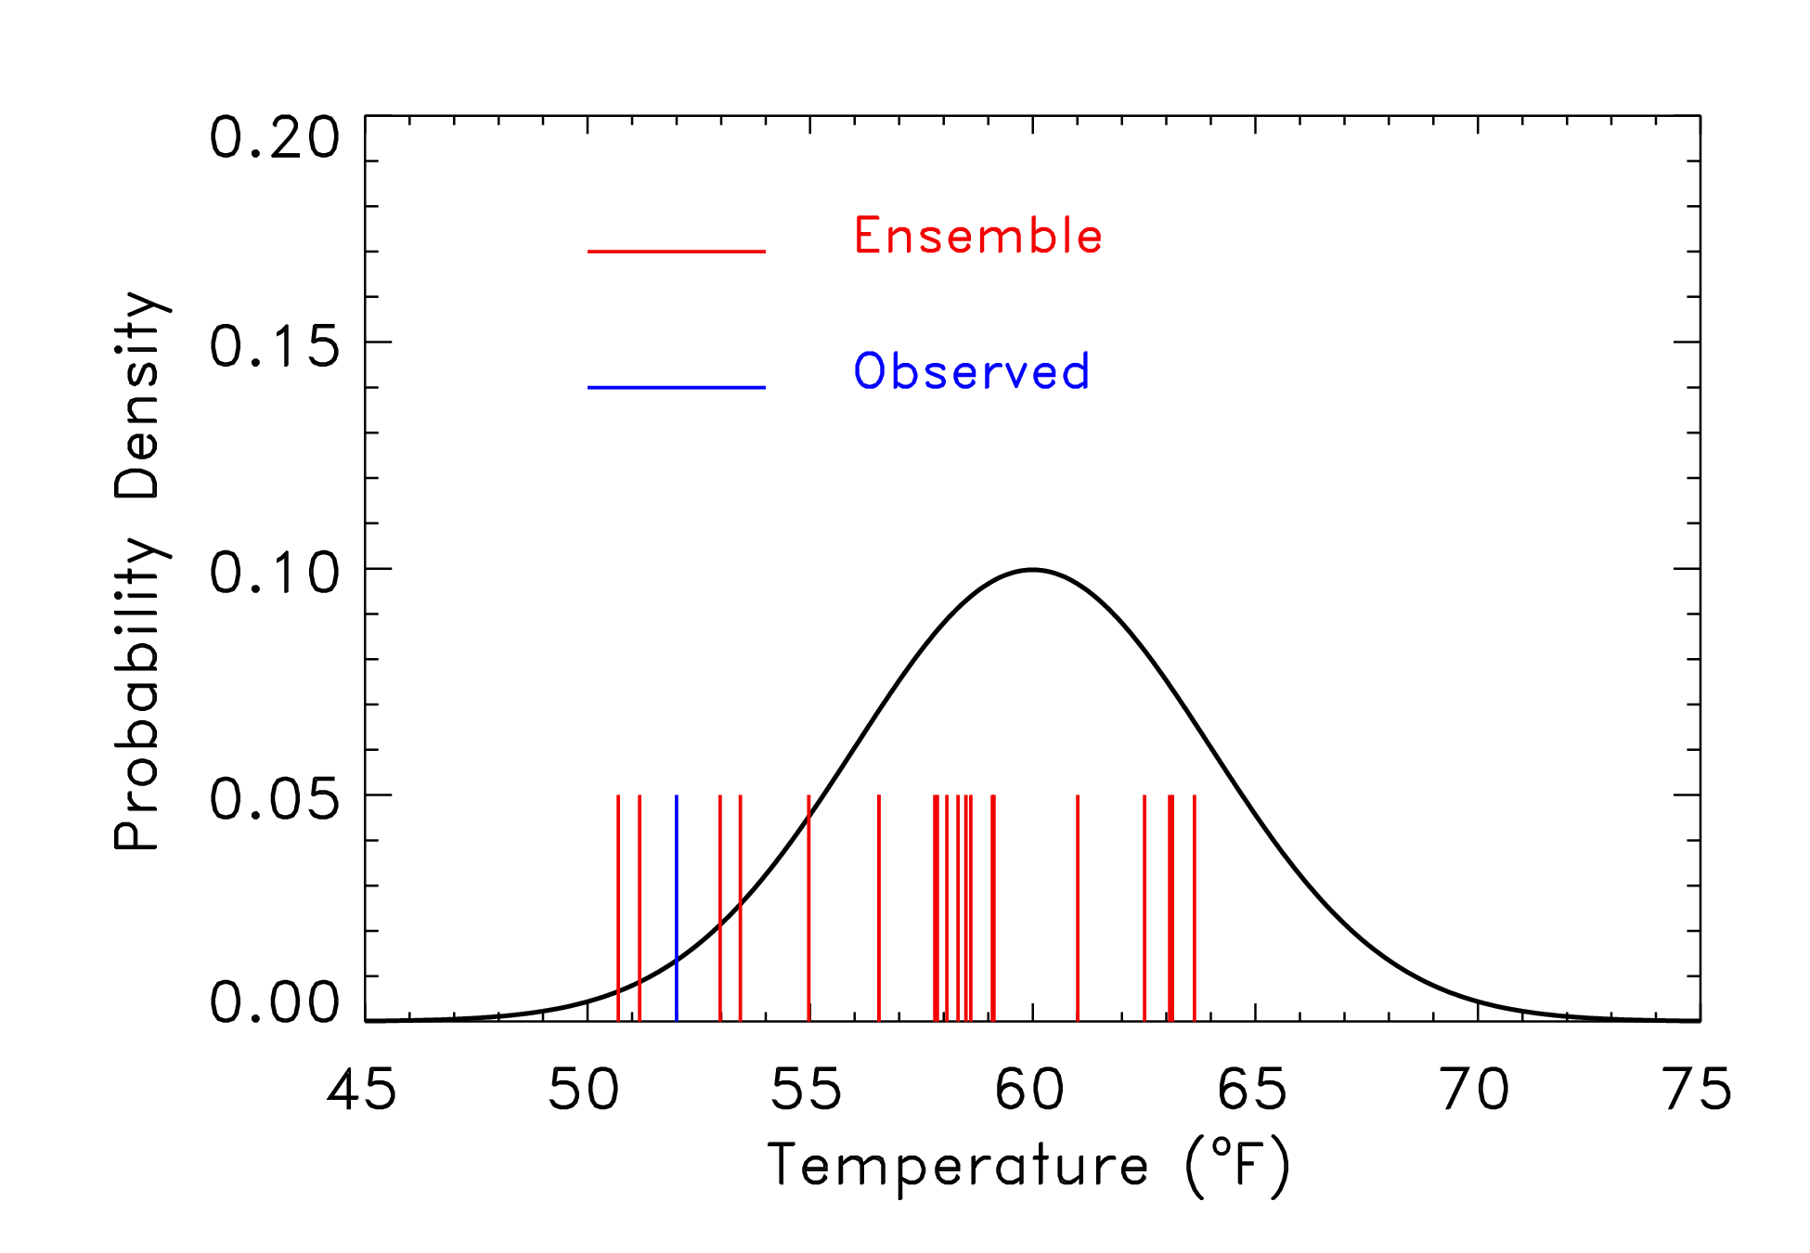
Rank 1 of 21
Rank 14 of 21
Rank 5 of 21
Rank 3 of 21

Slide 6
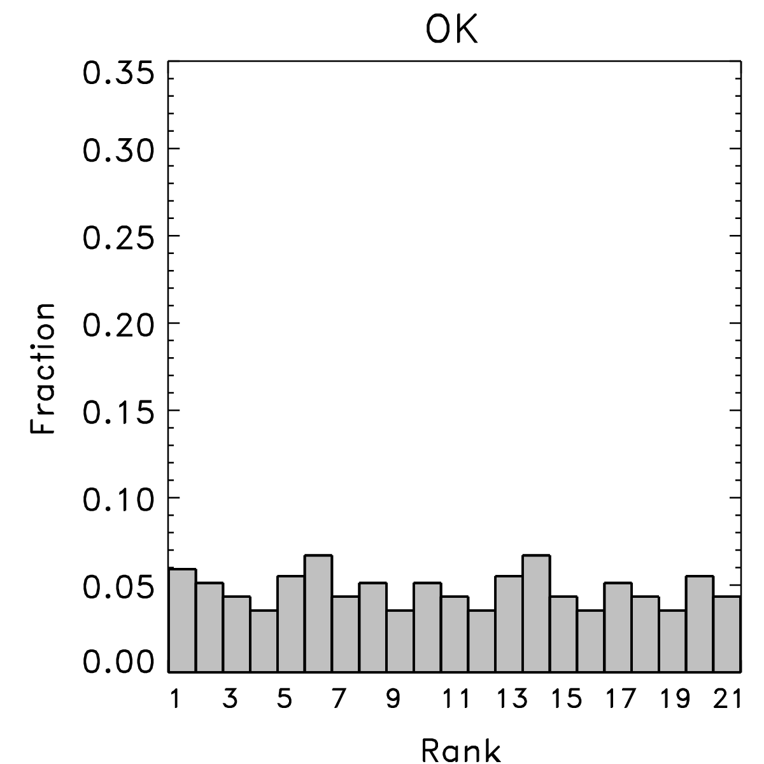
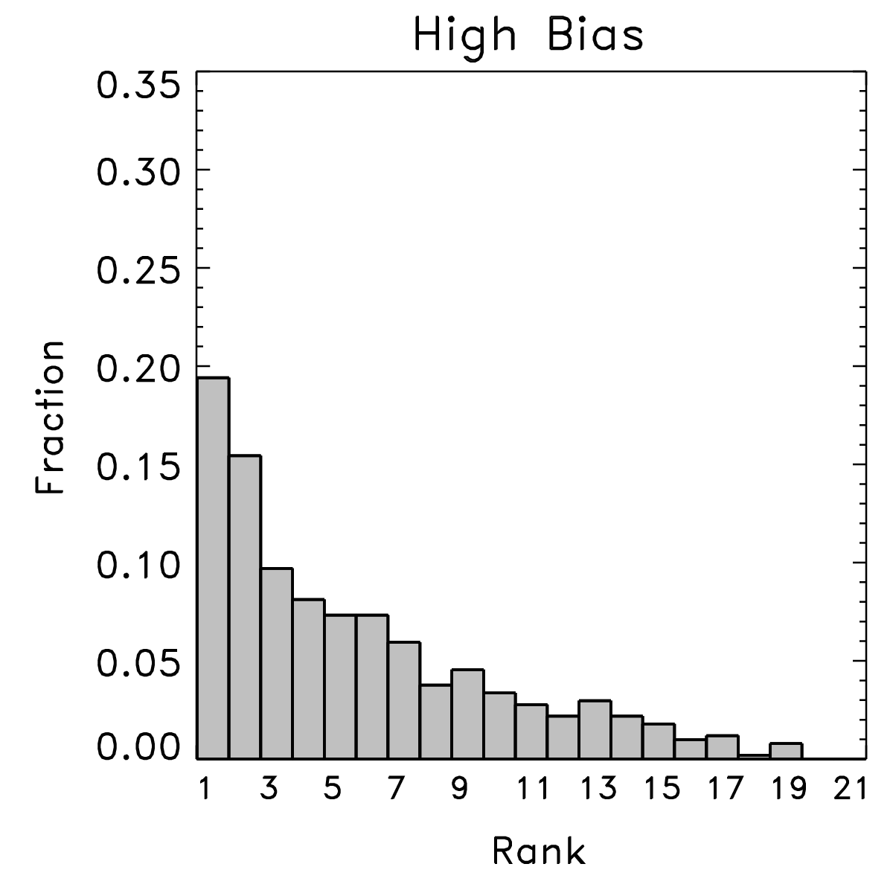
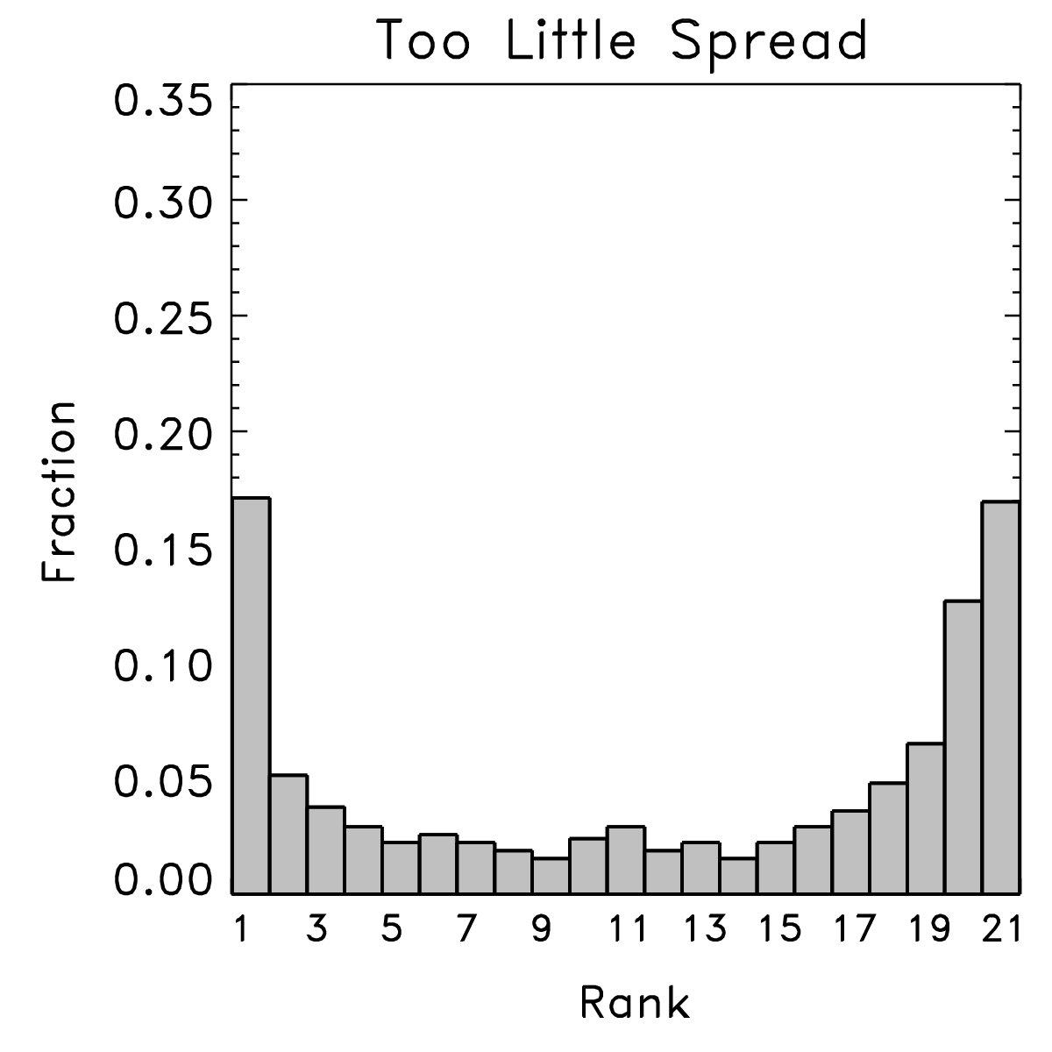
“Rank histograms,” aka “Talagrand diagrams”
With lots of samples from many situations, can evaluate the characteristics of the ensemble.
Happens when
observed is
indistinguishable
from any other
member of the
ensemble. Ensemble
hopefully is reliable.
Happens when
observed too
commonly is
lower than the
ensemble members.
Happens when
there are either
some low and some
high biases, or when
the ensemble doesn’t
spread out enough.
ref: Hamill, MWR, March 2001

Slide 7
Underlying mathematics
n-member sorted ensemble at
some point
probability the truth V is less than the
ith sorted member if V and X’s
members sample the same distribution
… equivalently
our rank histogram vector
overbar denotes the sample average
over many (hopefully independent)
samples
ref: ibid.

Slide 8
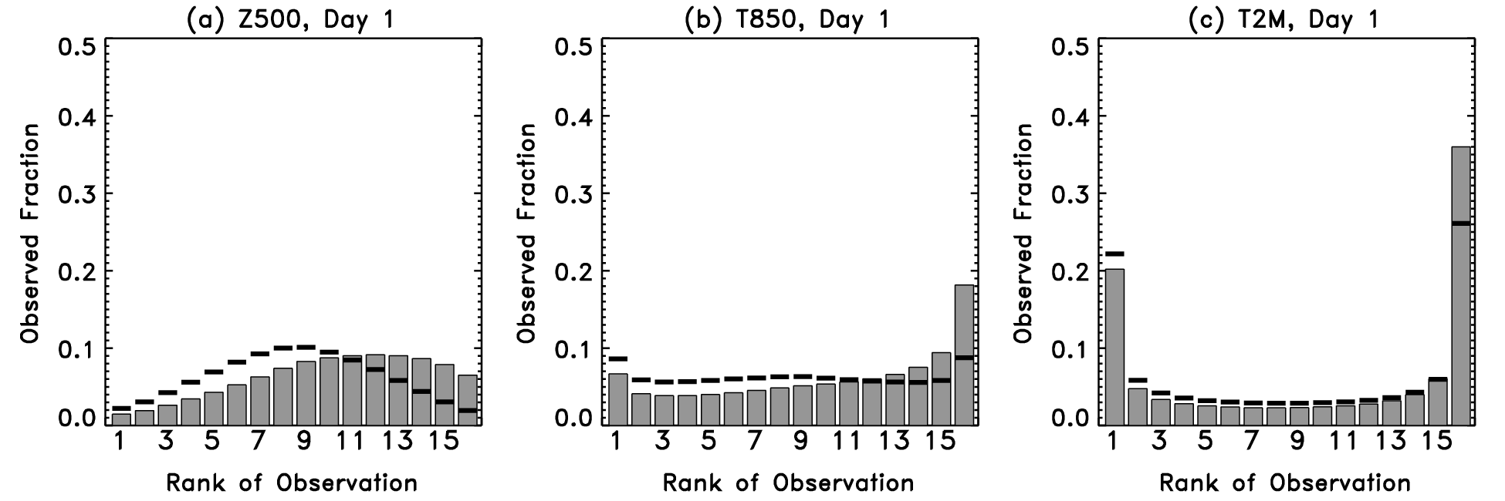
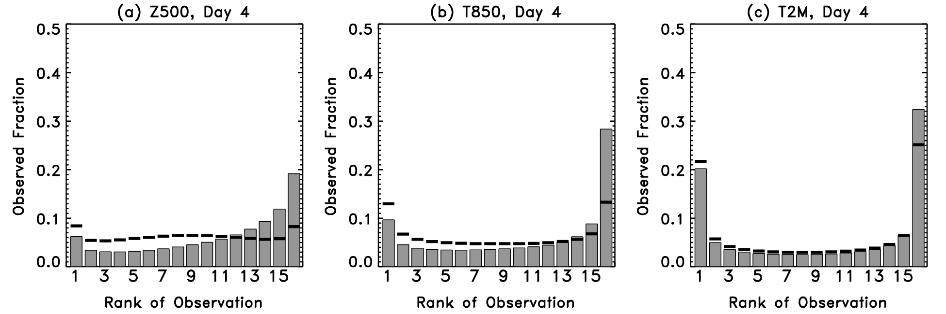
Rank histograms of Z₅₀₀, T₈₅₀, T_{2m} (from 1998 reforecast version of NCEP GFS)
Solid lines indicate
ranks after bias
correction.
Rank histograms
are particularly
U-shaped for T2M.
Ref: Hamill and Whitaker, MWR, Sep 2007.

Slide 9
Rank histograms… pretty simple, right?
Let’s consider some of the issues involved with this one seemingly simple verification metric.

Slide 10
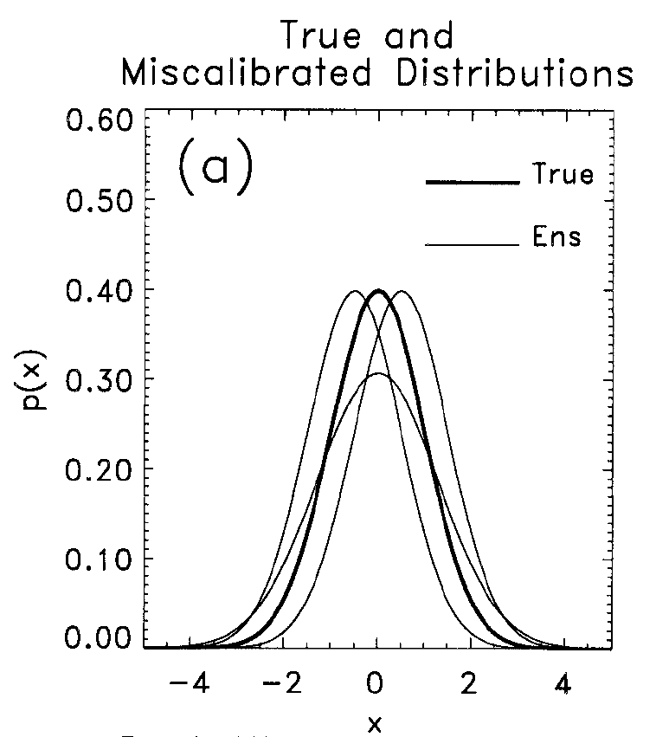
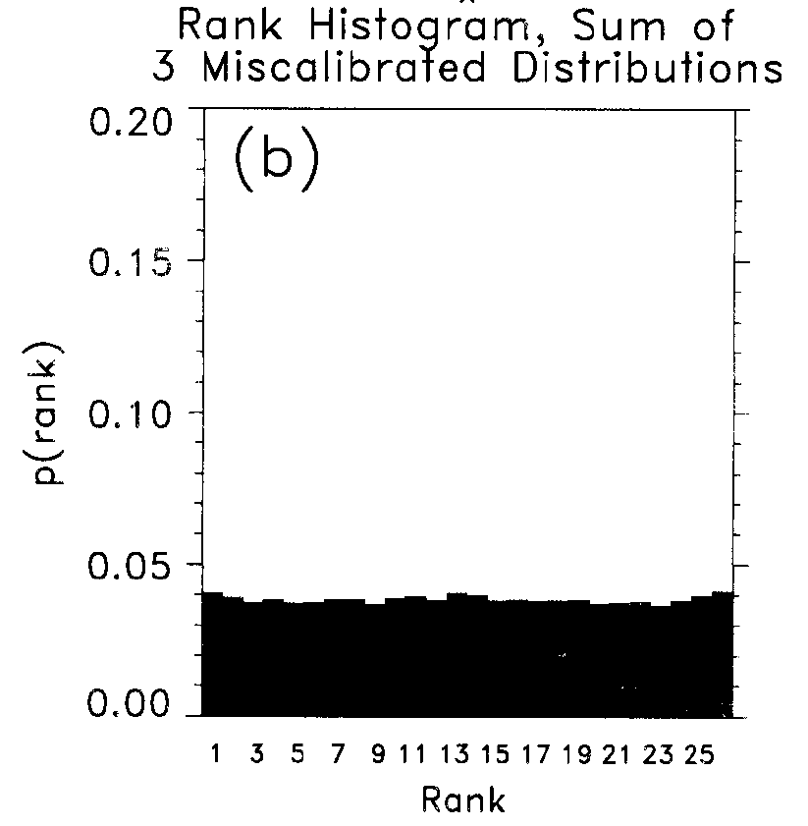
Issues in using rank histograms
(1) Flat rank histograms can be created from combinations of uncalibrated ensembles.
Lesson: you only be confident you have reliability if you see flatness of rank histogram having sliced the data many different ways.
Ref: Hamill, MWR, Mar 2001

Slide 11
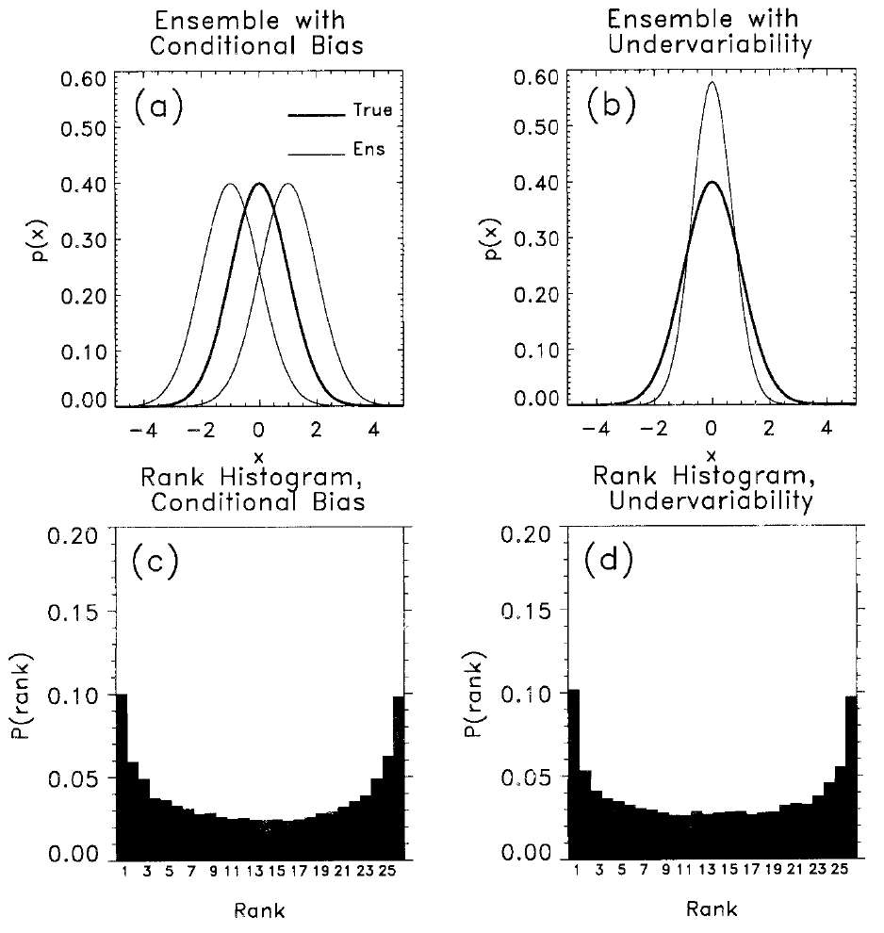
Issues in using rank histograms
(2) Same rank histogram shape may result from ensembles with different deficiencies
Here, half of
ensemble
members
from low-biased
distribution, half from
high-biased
distribution
Here, all of
ensemble
members from
under-spread
distribution.
Ref: ibid

Slide 12
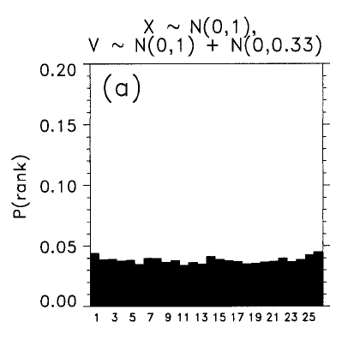
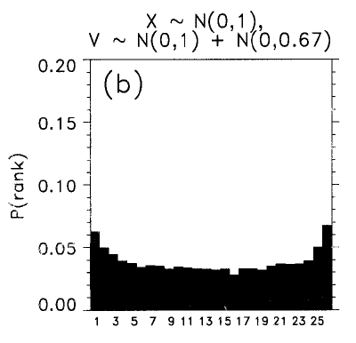
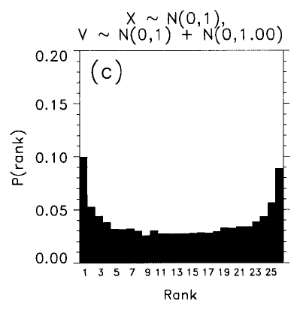
Issues in using rank histograms
(3) Evaluating ensemble relative to observations with errors distorts shape of rank histograms.
small obs error
medium
obs error
large obs error
A solution of sorts is to dress every ensemble member with
a random sample of noise, consistent with the observation errors.
Ref: ibid.

Slide 13
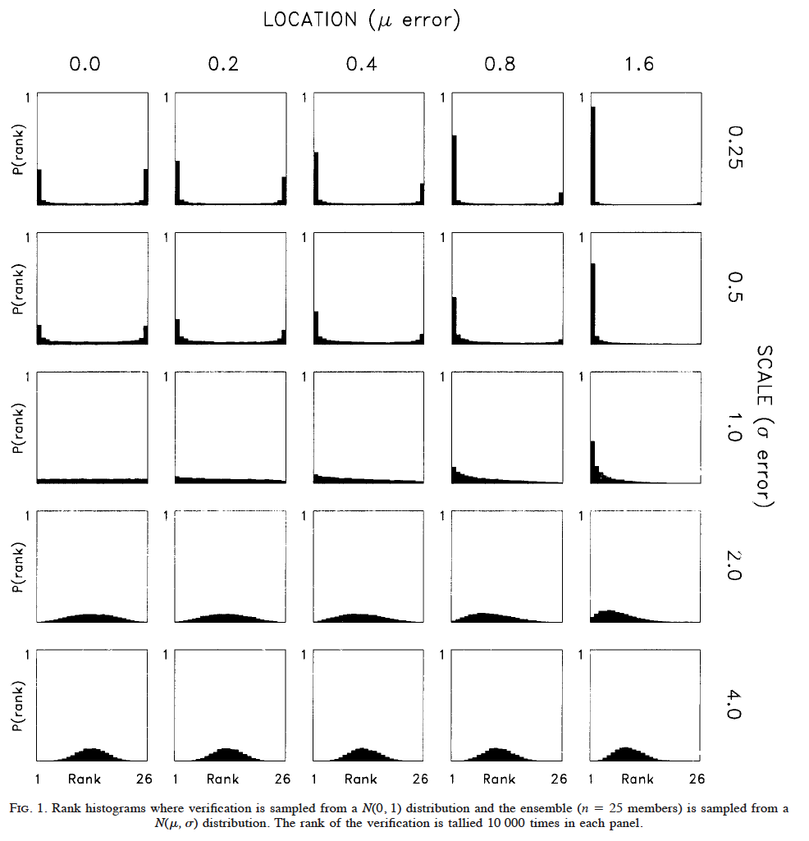
Rank histogram shapes under “location” and “scale” errors
truth from N(0,1)
forecast from
N(μ,σ); no implicit
correlations between
members or between
member and truth
Ref: ibid.

Slide 14
Caren Marzban’s question: what if we did have correlations between members, and w. truth?
r is correlation between
ensemble members
R is correlation between
ensemble member and
the observation
Ref: Marzban et al., MWR 2010, in press.

Slide 15
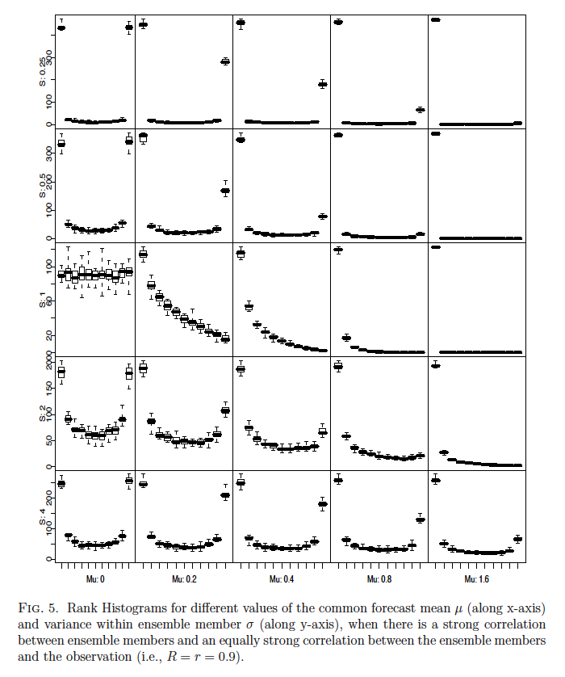
Rank histograms, r = R = 0.9
μ=0.0
μ=0.2
μ=0.4
μ=0.8
μ=1.6
Marzban’s rank
histograms include
box & whiskers to
quantify sampling
variability (nice!).
σ =0.25
σ =0.5
σ =1.0
σ =2.0
σ =4.0

Slide 16
Rank histograms, r = R = 0.9
μ=0.0
μ=0.2
μ=0.4
μ=0.8
μ=1.6
Marzban’s rank
histograms include
box & whiskers to
quantify sampling
variability (nice!).
σ =0.25
σ =0.5
What’s going on
here? Why do we
now appear to have
diagnosed
under-spread
with an ensemble
with apparent
excess spread?
σ =1.0
σ =2.0
σ =4.0

Slide 17
Dan Wilks’ insight into this curious phenomenon…
Property of multivariate Gaussian distribution:
(= 0, since in this case
assumed y ~ N(0,1))
When μ_{x}= 0 (unbiased forecast), and given σ_{y} =1, expected
value for ensemble member is Rσ_{x}y, which will be more
extreme (further from origin) than y for relatively large σ_{x}.
Ref: Wilks, 2010 MWR, submitted.

Slide 18
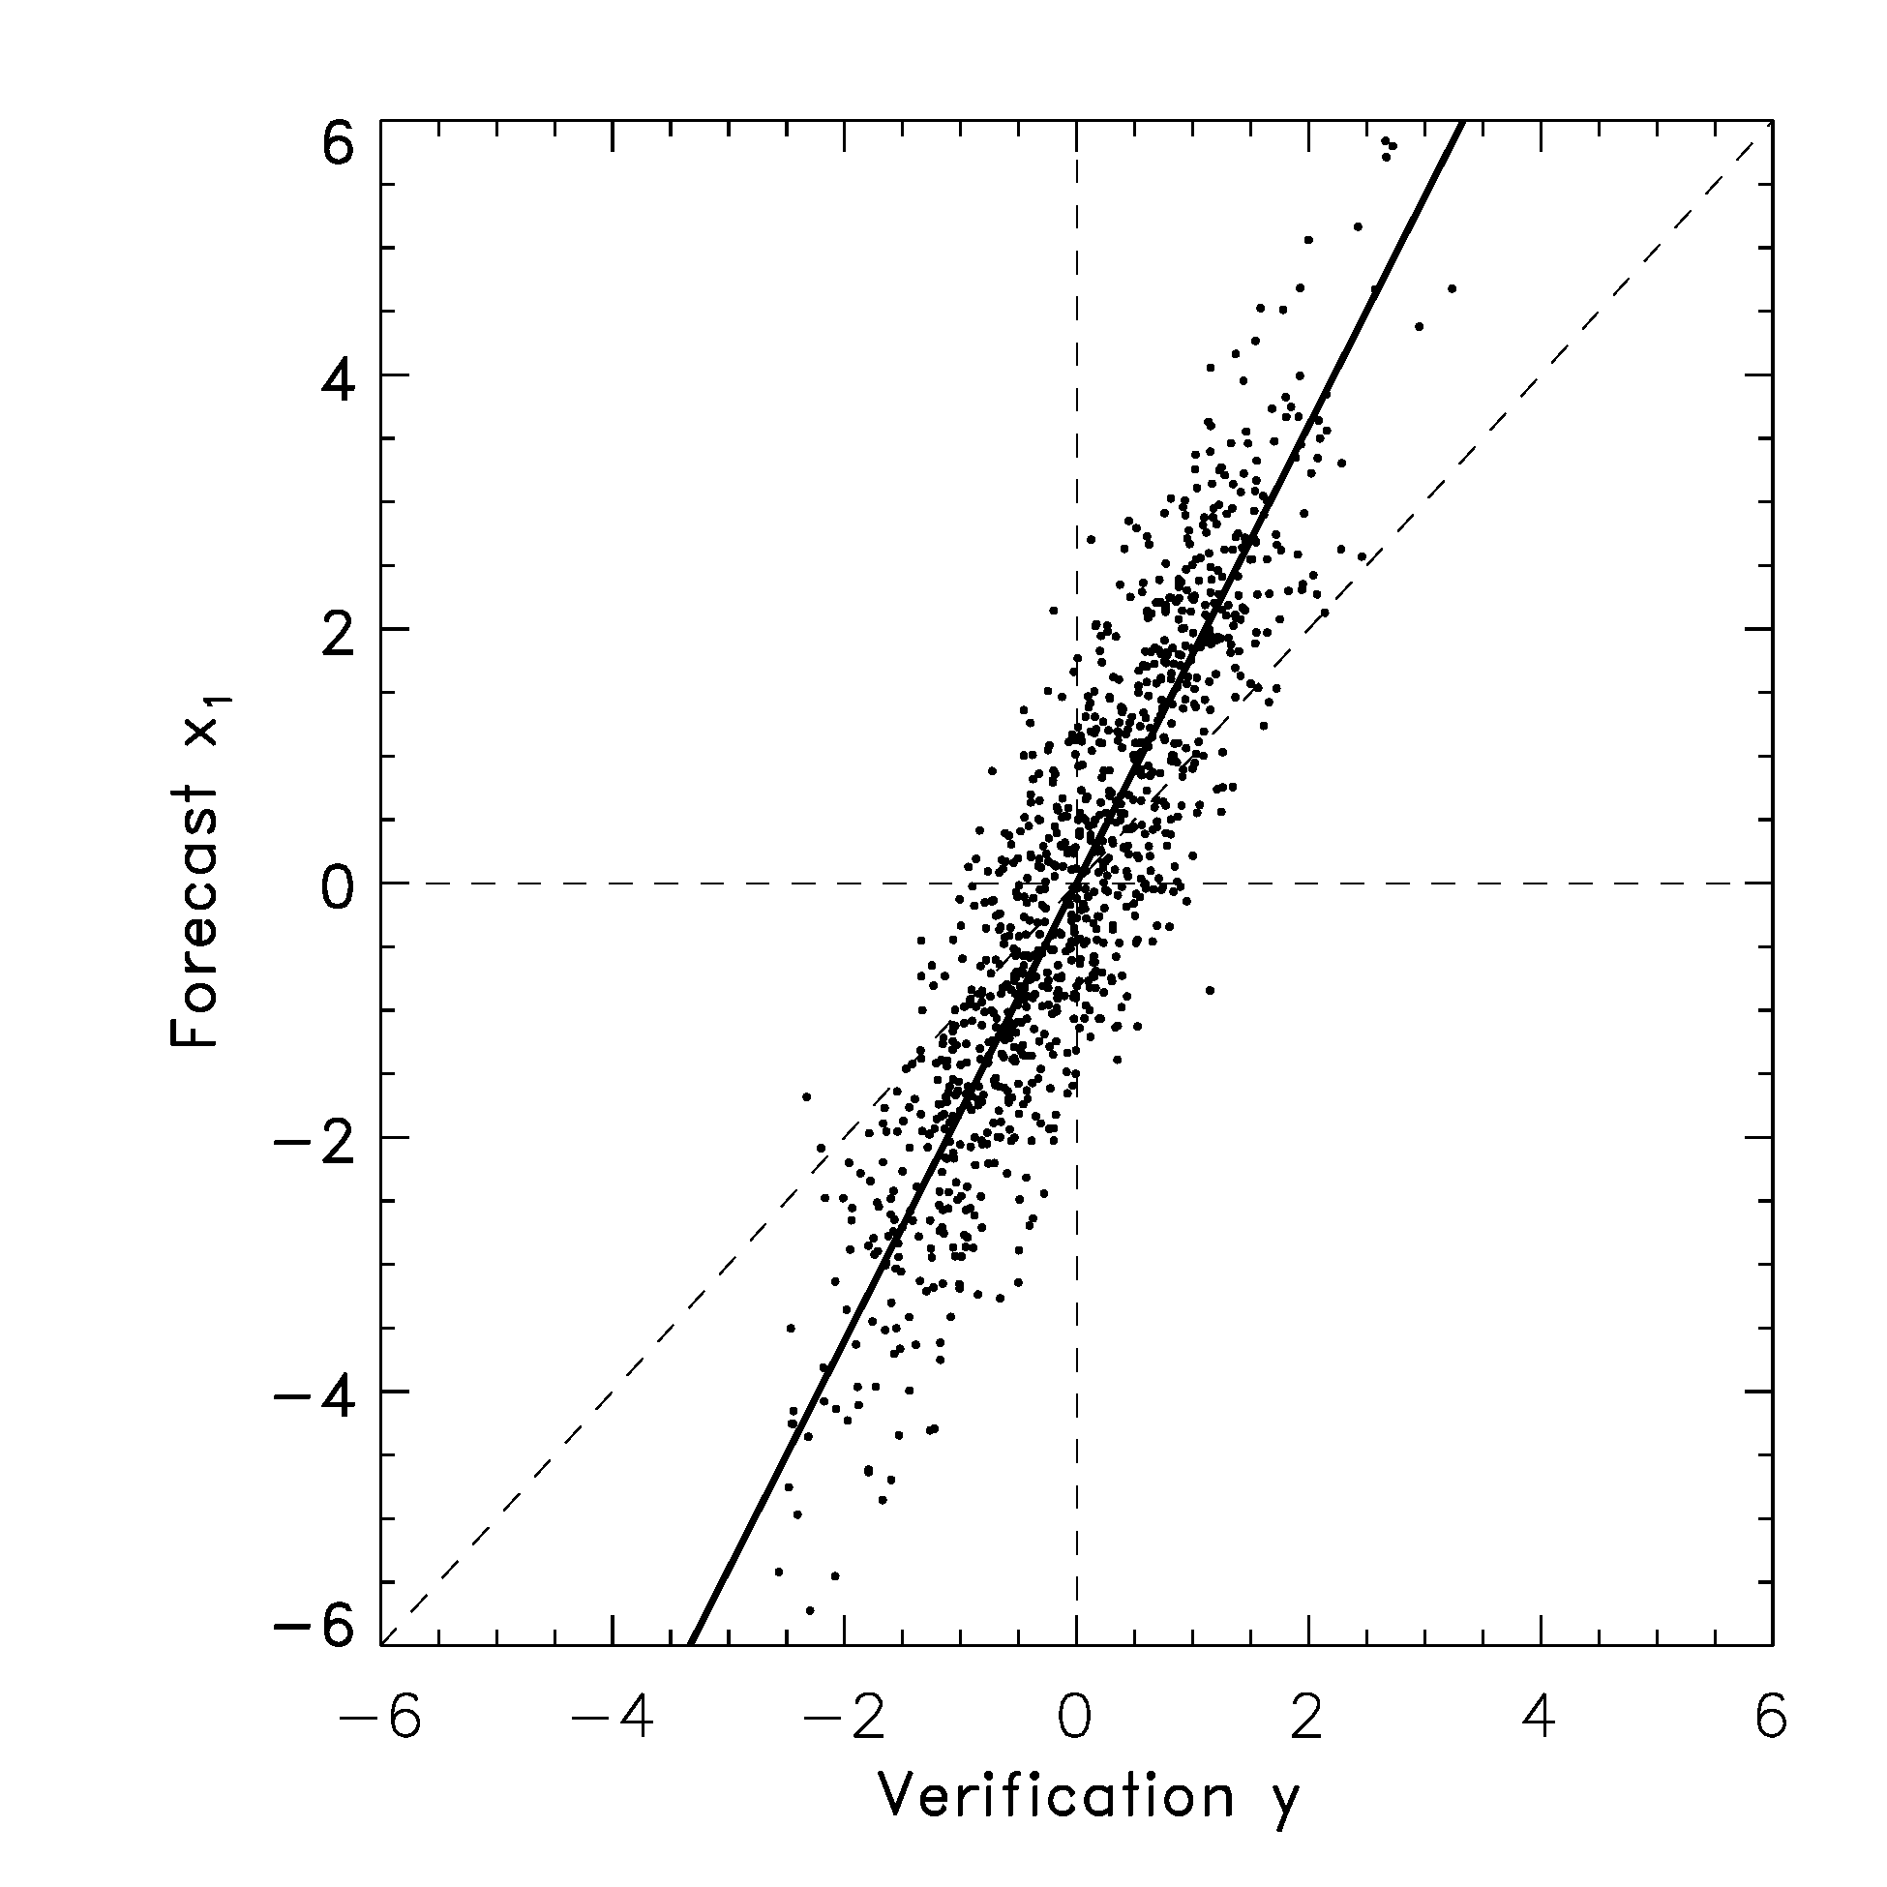
Illustration, μ_{x}=0
Many realizations of truth
and synthetic 1-member
ensemble were created,
μ_{x} = 0,σ_{x} = 2, r = R = 0.9
slope
Rσ_{x}
Here, for a 1-member
ensemble, that forecast member x₁tends to be further from the origin than the verification y. If we generated another ensemble member, it would tend to be further from the origin in the same manner. Hence, you have an ensemble clustered together, away from the origin, and the verification near the origin, i.e., at extreme ranks relative to the sorted ensemble.

Slide 19
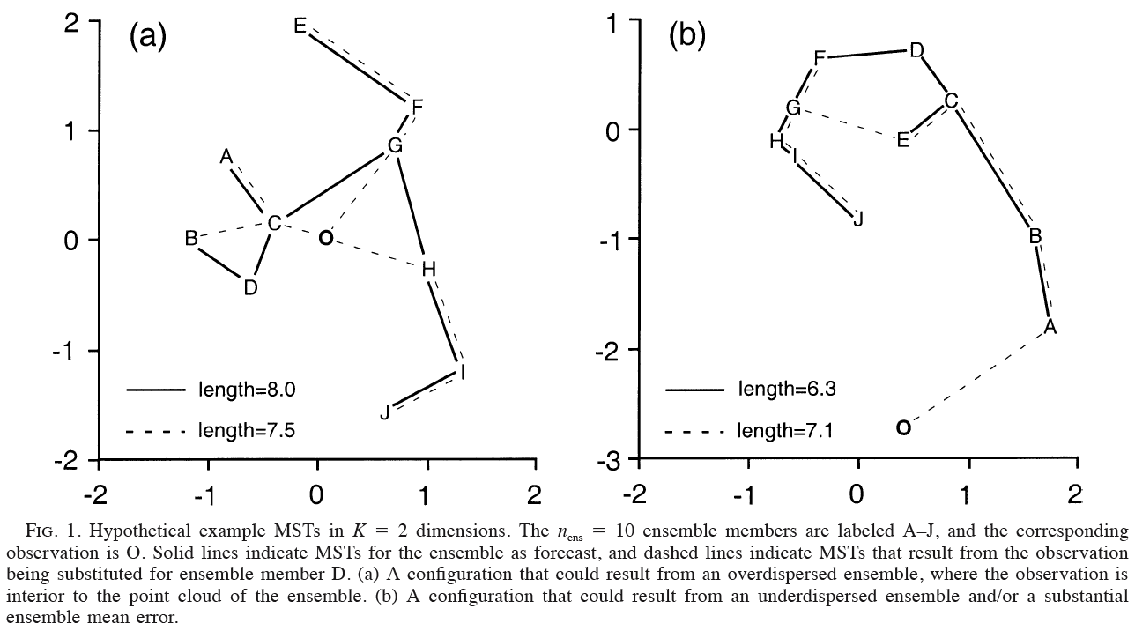
Rank histograms in higher dimensions: the “minimum spanning tree” histogram
Solid lines: minimum spanning tree (MST) between 10-member forecasts
Dashed line: MST when observed O is substituted for member D
Calculate MST’s sum of line segments for all forecasts, and observed replacing each forecast member. Tally rank of pure forecast sum relative to sum where observed replaced a member.
Repeat for independent samples, build up a histogram
Ref: Wilks, MWR, June 2004. See also Smith and Hansen, MWR, June 2004

Slide 20
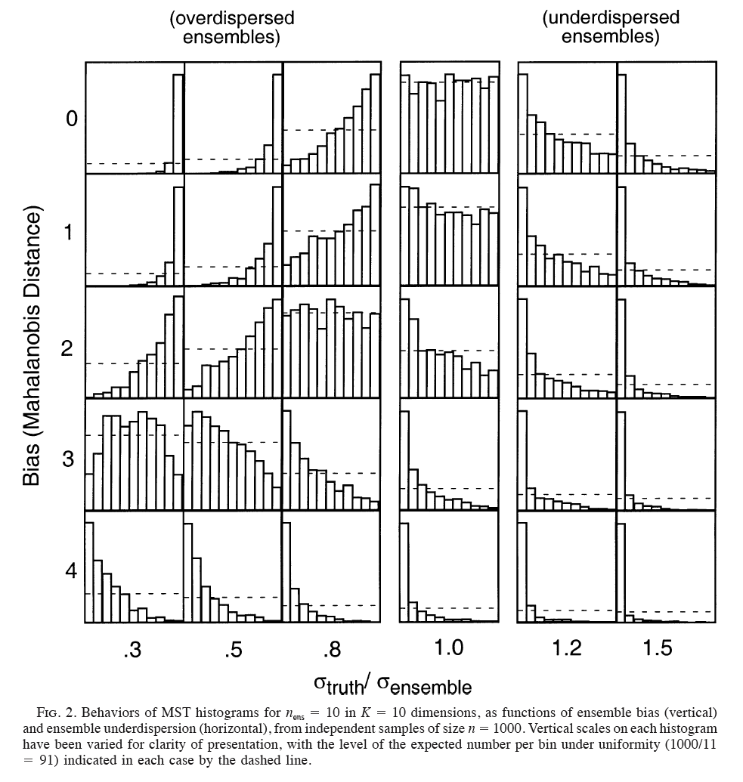
Rank histograms in higher dimensions: the “minimum spanning tree” histogram
Graphical interpretation of MST is different and perhaps less intuitive than it is for uni-dimensional rank histogram.
Ref: Wilks, MWR, June 2004. See also Smith and Hansen, MWR, June 2004

Slide 21
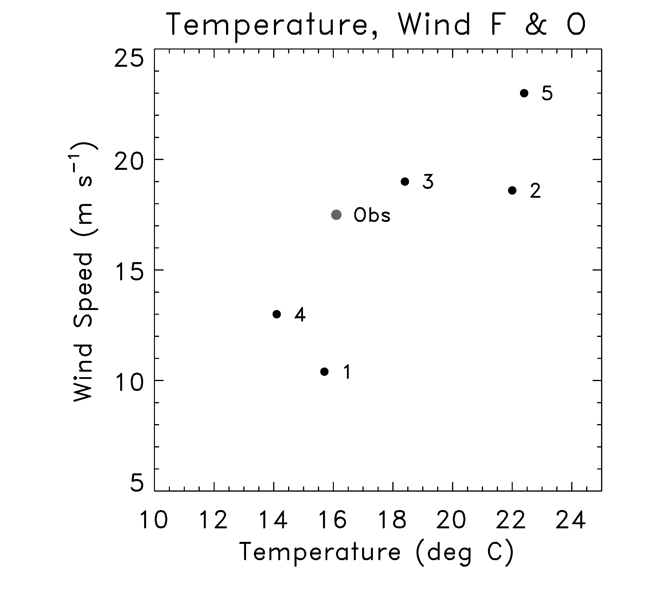
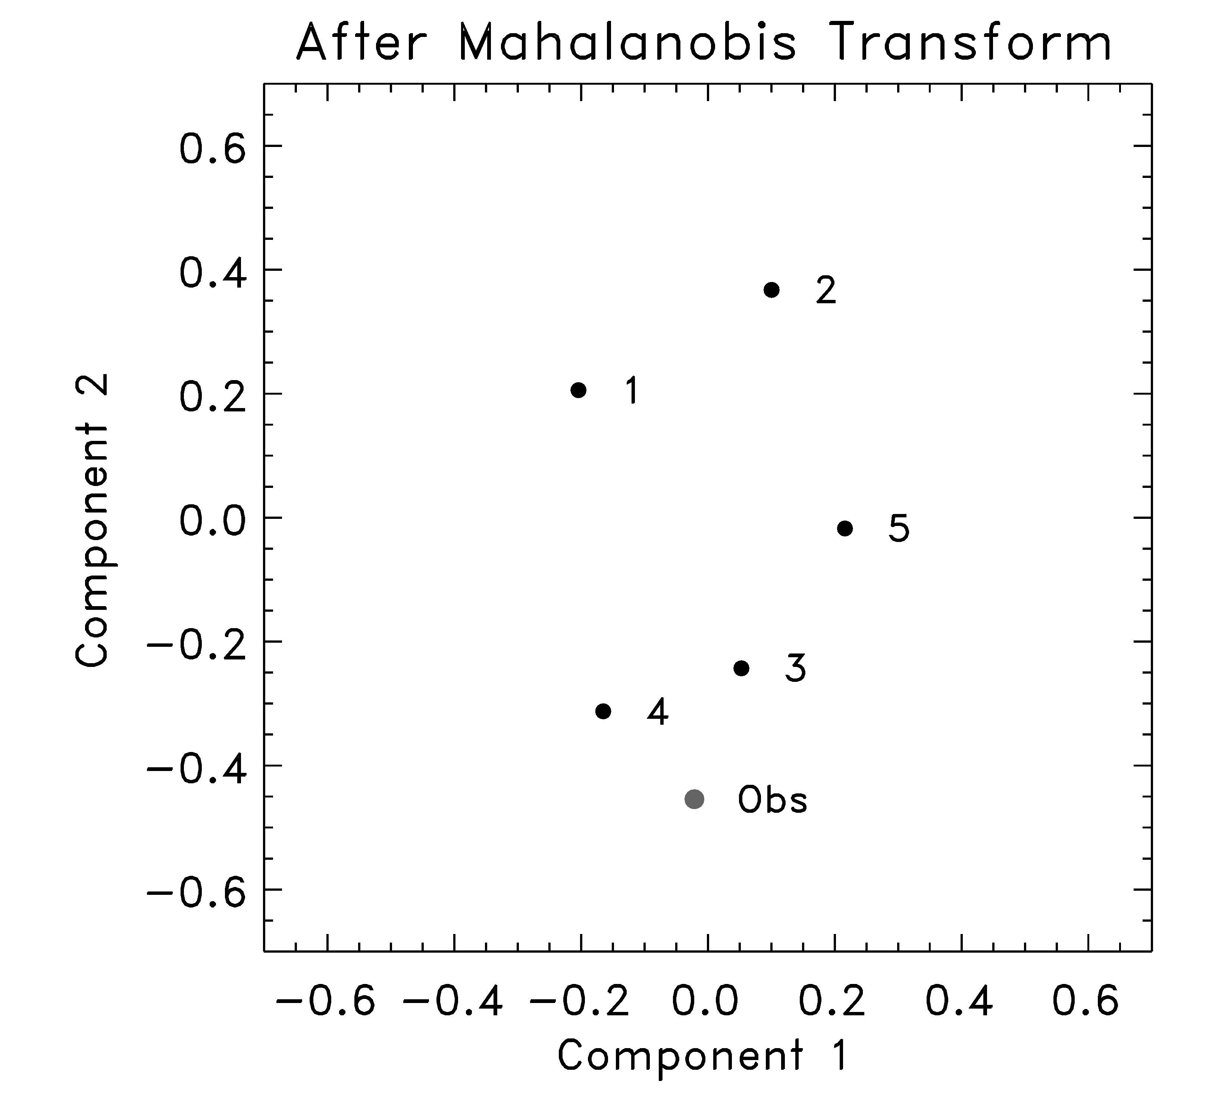
Multi-variate rank histogram
“Mahalanobis”
transform
(S is forecasts’
sample
covariance)
Standardize and rotate using Mahalanobis transformation (see Wilks 2006 text).
For each of n members of forecast and observed, define “pre-rank” as the number of vectors to its lower left (a number between 1 and n+1)
The multi-variate rank is the rank of the observation pre-rank, with ties resolved at random
Composite multi-variate ranks over many independent samples and plot rank histogram.
Same interpretation as scalar rank histogram (e.g., U-shape = under-dispersive).
based on Tilmann Gneiting’s presentation at Probability and Statistics, 2008 AMS Annual Conf., New Orleans.
and http://www.springerlink.com/content/q58j4167355611g1/

Slide 22
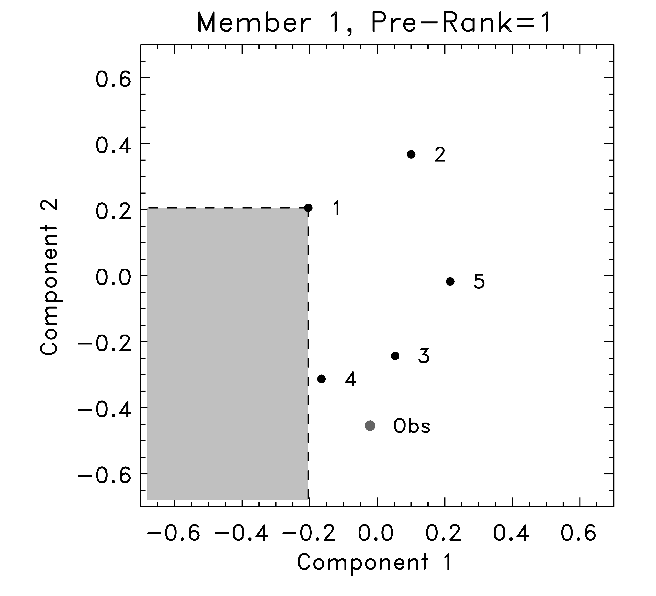
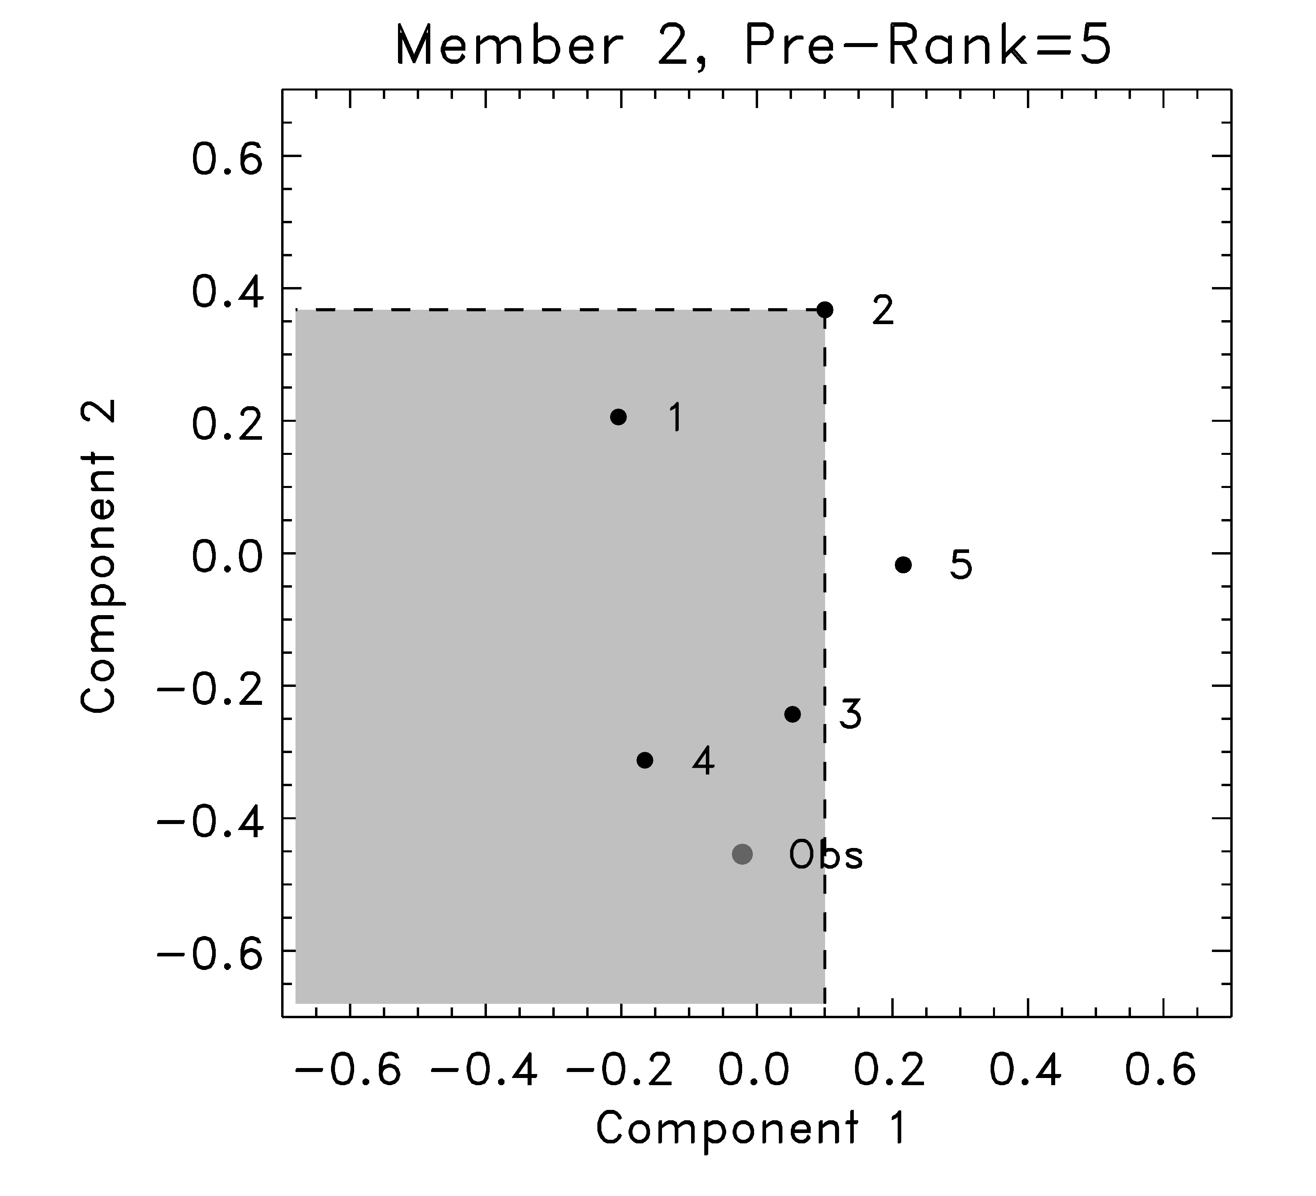
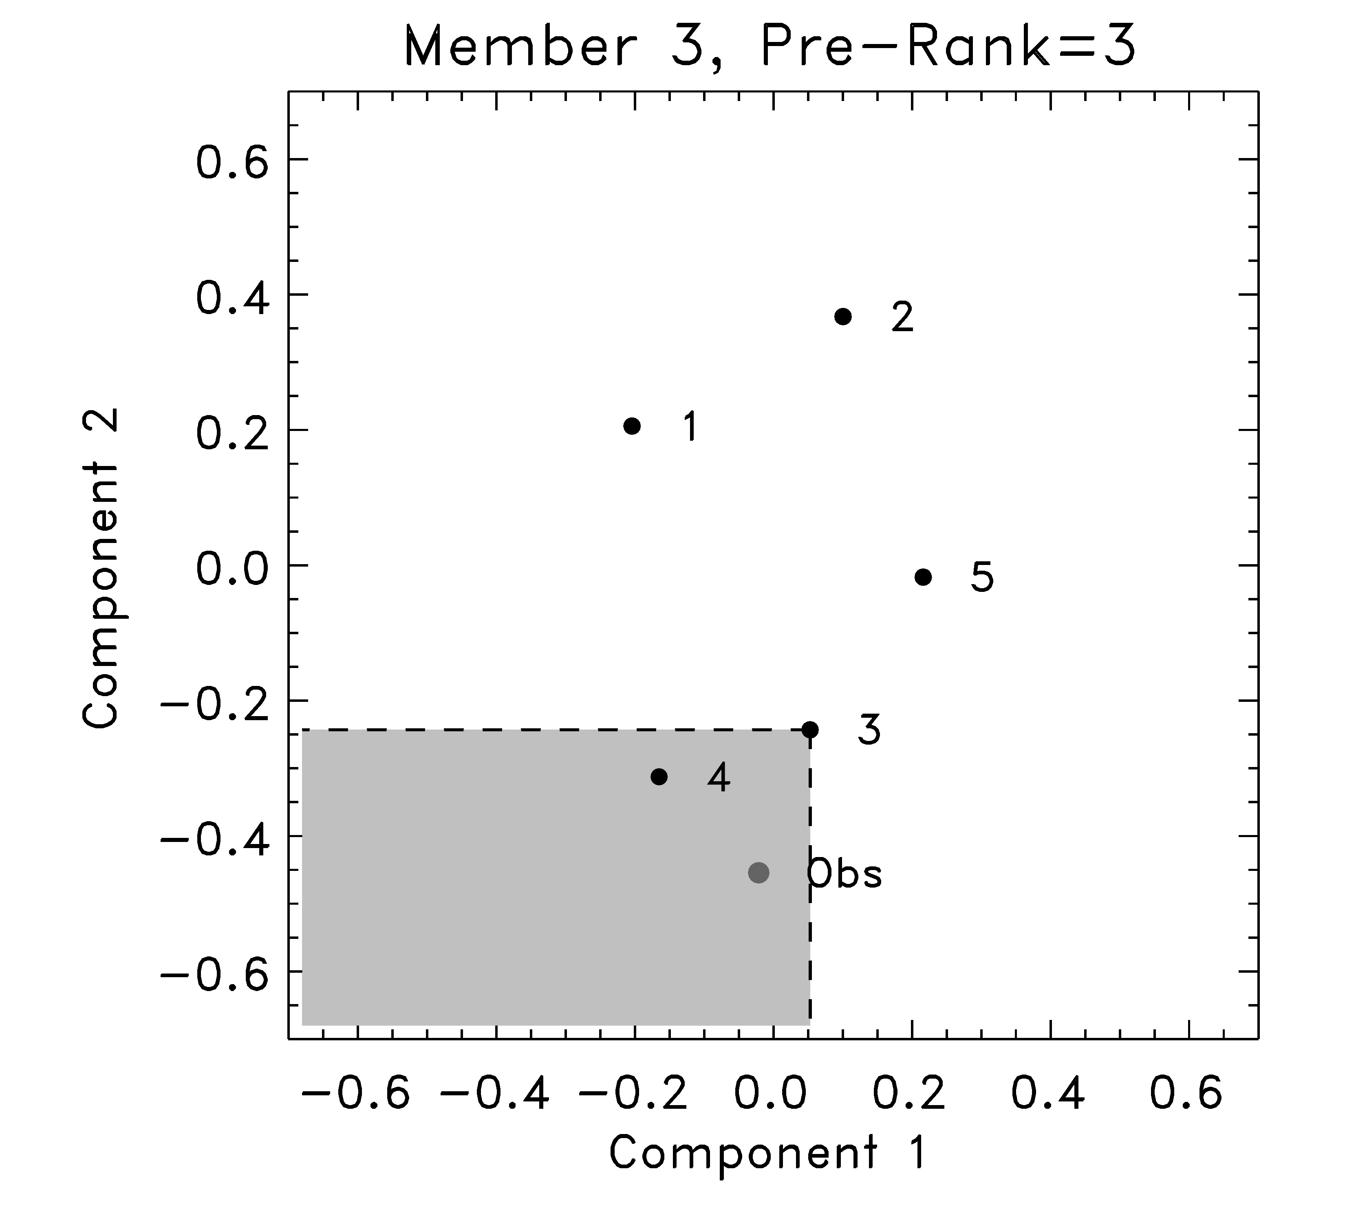
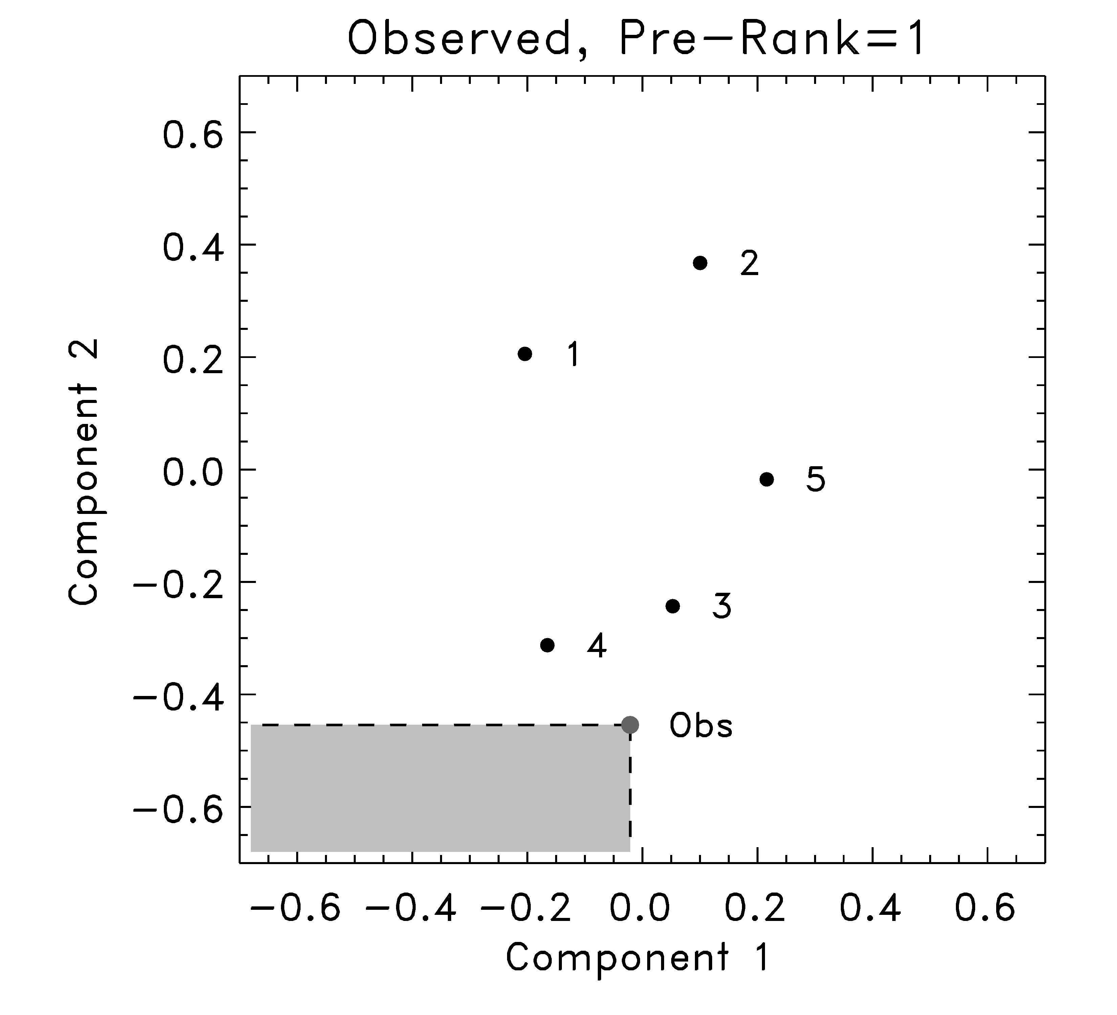
Multi-variate rank histogram calculation
F₁, F₂, F₃, F₄, F₅, O pre-ranks: [1, 5, 3, 1, 4, 1] ; sorted: obs = either rank 1, 2, or 3 with p=1/3.
based on Tilmann Gneiting’s presentation at Probability and Statistics, 2008 AMS Annual Conf., New Orleans

Slide 23
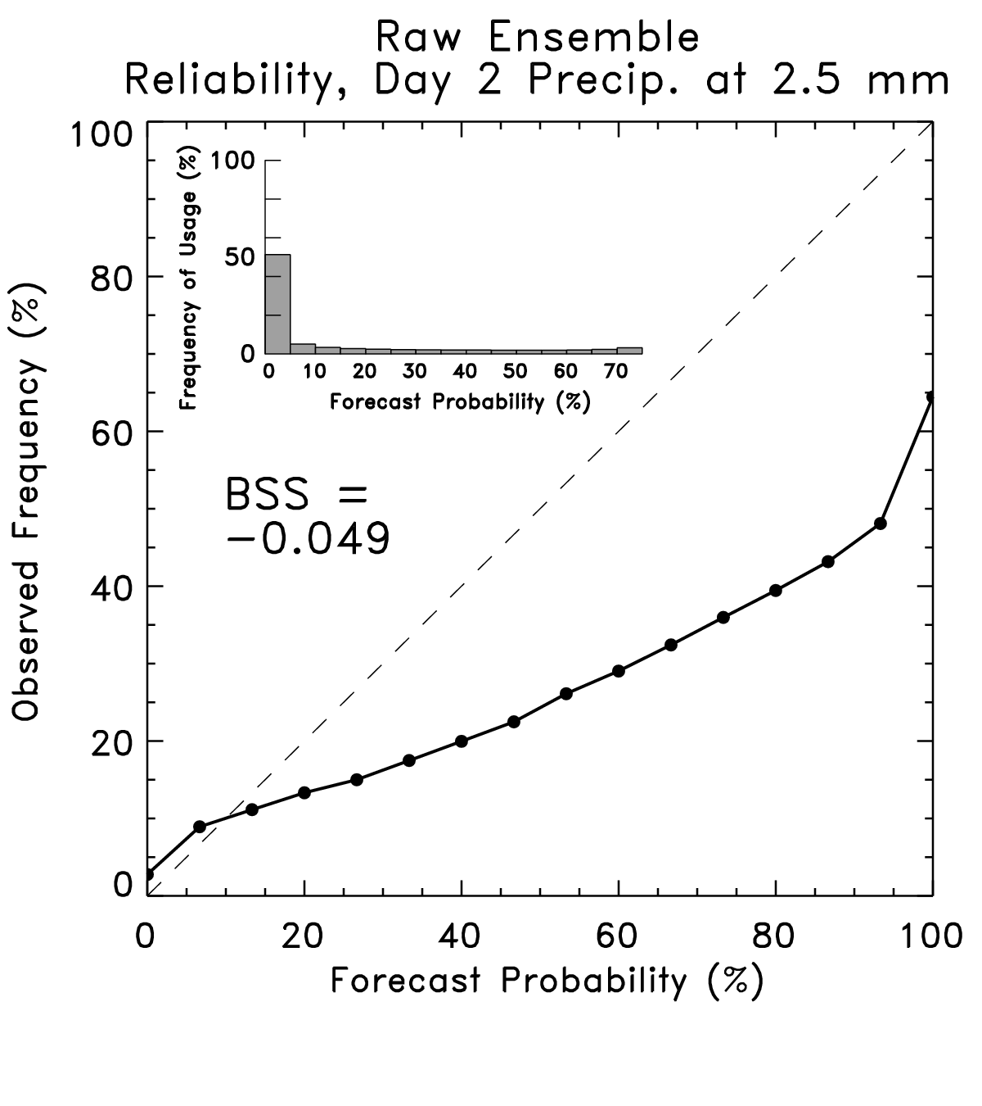
Reliability diagrams

Slide 24
Reliability diagrams
Curve tells you what
the observed frequency
was each time you
forecast a given probability.
This curve ought to lie
along y = x line. Here this
shows the ensemble-forecast
system over-forecasts the
probability of light rain.
Ref: Wilks text, Statistical Methods in the Atmospheric Sciences

Slide 25
Reliability diagrams
Inset histogram tells
you how frequently
each probability was
issued.
Perfectly sharp:
frequency of usage
populates only
0% and 100%.
Ref: Wilks text, Statistical Methods in the Atmospheric Sciences

Slide 26
Reliability diagrams
BSS = Brier Skill Score
BS(•) measures the
Brier Score, which you
can think of as the
squared error of a
probabilistic forecast.
Perfect: BSS = 1.0
Climatology: BSS = 0.0
Ref: Wilks text, Statistical Methods in the Atmospheric Sciences

Slide 27
Brier score
Define an event, e.g., precip > 2.5 mm.
Let be the forecast probability for the ith forecast case.
Let be the observed probability (1 or 0). Then
(So the Brier score is the averaged squared error of
the probabilistic forecast)
Ref: Wilks 2006 text

Slide 28
Brier score decomposition
Ref: 2006 Wilks text

Slide 29
Brier score decomposition
Decomposition only makes sense when every sample
is drawn from a distribution with an overall climatology
of . For example, don’t use if your forecast sample
mixes together data from both desert and rainforest
locations. For more, see Hamill and Juras, Oct 2006 QJ

Slide 30
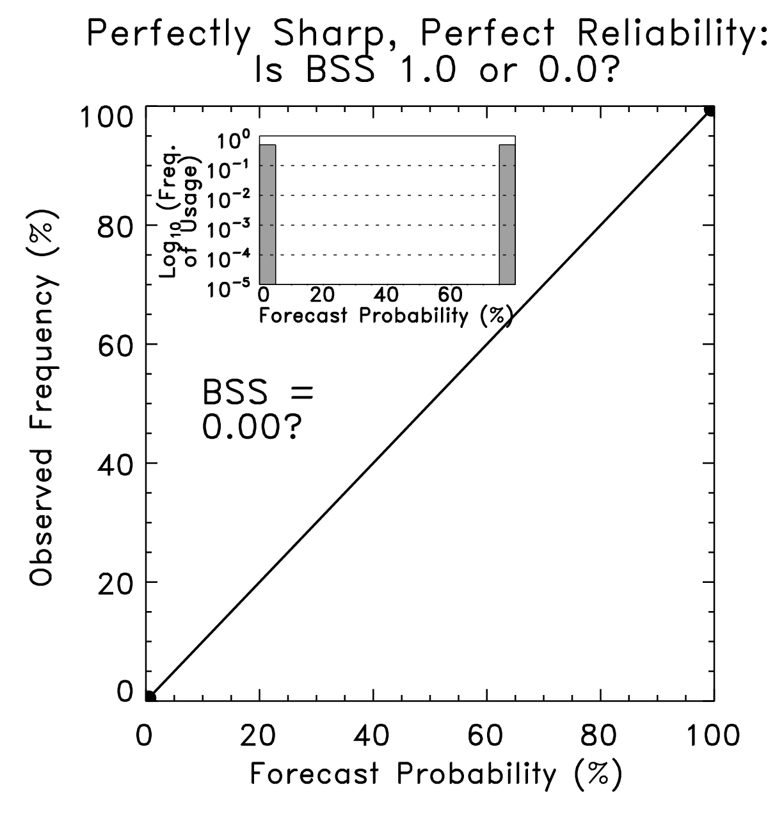
Degenerate case:
Skill might
appropriately
be 0.0 if all
samples with
0.0 probability
are drawn from
climatology with
0.0 probability,
and all samples
with 1.0 are
drawn from
climatology with
1.0 probability.

Slide 31
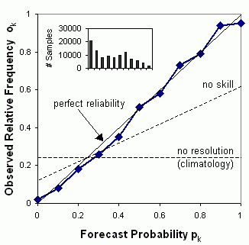
“Attributes diagram”
Uncertainty term always positive, so probability forecasts will exhibit positive skill if resolution term is larger in absolute value than reliability term. Geometrically, this corresponds to points on the attributes diagram being closer to 1:1 perfect reliability line than horizontal no-resolution line (from Wilks text, 2006, chapter 7)
Again, this geometric interpretation of the attributes diagram makes sense only if all samples used to populate the diagram are drawn from the same climatological distribution.If you are mixing samples from locations with different climatologies, this interpretation is no longer correct! (Hamill and Juras, Oct 2006 QJRMS)
www.bom.gov.au/bmrc/wefor/staff/eee/verif/ReliabilityDiagram.gif,
from Beth Ebert’s verification web page,
http://www.bom.gov.au/bmrc/wefor/staff/eee/verif/verif_web_page.html
based on Hsu and Murphy, 1986, Int’l Journal of Forecasting

Slide 32
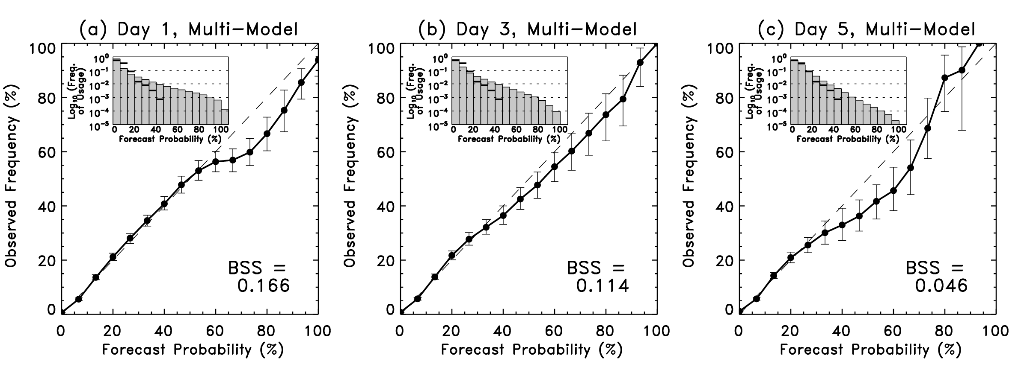
Proposed modifications to standard reliability diagrams
(1) Block-bootstrap techniques (perhaps each forecast day is a block) to provide confidence intervals. See Hamill, WAF, April 1999, and Bröcker and Smith, WAF, June 2007.
(2) BSS calculated in a way that does not attribute false skill to varying climatology (talk later this morning)
(3) Distribution of climatological forecasts plotted as horizontal bars on the inset histogram. Helps explain why there is small skill for a forecast that appears so reliable (figure from Hamill et al., MWR, 2008).

Slide 33
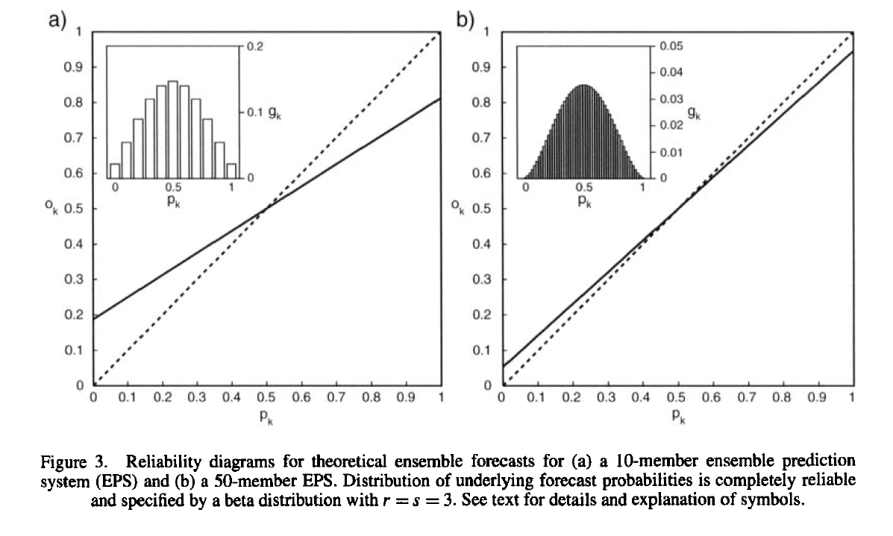
When does reliability ≠ reliability?
10 members
50 members
Probabilities directly estimated from a “reliable” ensemble system
with only a few members may not produce diagonal reliability curves
due to sampling variability.
ref: Richardson 2001 QJRMS

Slide 34
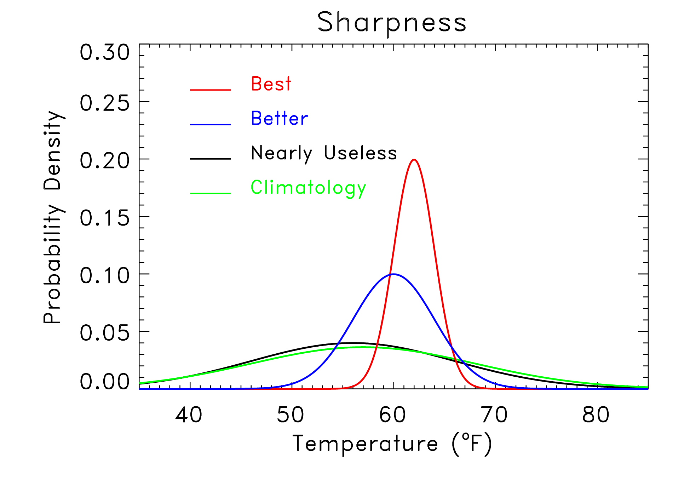
Sharpness also important
“Sharpness”
measures the
specificity of
the probabilistic
forecast. Given
two reliable forecast
systems, the one
producing the
sharper forecasts
is preferable.
But: don’t want
sharp if not reliable.
Implies unrealistic
confidence.

Slide 35
Sharpness ≠ resolution
Sharpness is a property of the forecasts alone; a measure of sharpness in Brier score decomposition would be how populated the extreme N_{i}’s are is.

Slide 36
“Spread-error” relationships are important, too.
Small-spread ensemble forecasts should have less ensemble-mean error than large-spread forecasts, in some sense a conditional reliability dependent upon amount of sharpness.
ensemble-mean
error from a sample
of this pdf on avg.
should be low.
ensemble-mean
error should be
moderate on avg.
ensemble-mean
error should be
large on avg.

Slide 37
Why would you expect spread-error relationship?
Ensemble-mean error ought to be the same expected value as ensemble spread.
If V, x_{i} are sampled from the same distribution, then
Sometimes quantified with a correlation between spread and error.
(spread)²
(ens. mean error)²

Slide 38
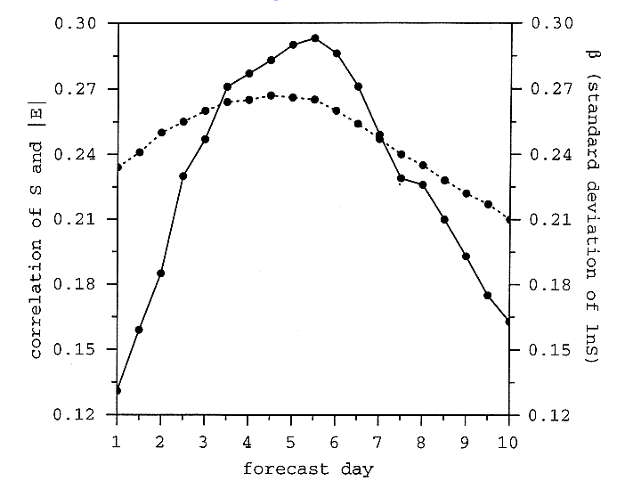
Spread-error correlations with 1990’s NCEP GFS
At a given grid point, spread
S is assumed to be a random
variable with a lognormal
distribution
where S_{m} is the mean spread
and β is its standard deviation.
As β increases, there is a
wider range of spreads
in the sample. One would
expect then the possibility for
a larger spread-skill correlation.
β
corr
Lesson: spread-error correlations inherently limited by amount of variation in spread
Ref: Whitaker and Loughe, Dec. 1998 MWR

Slide 39
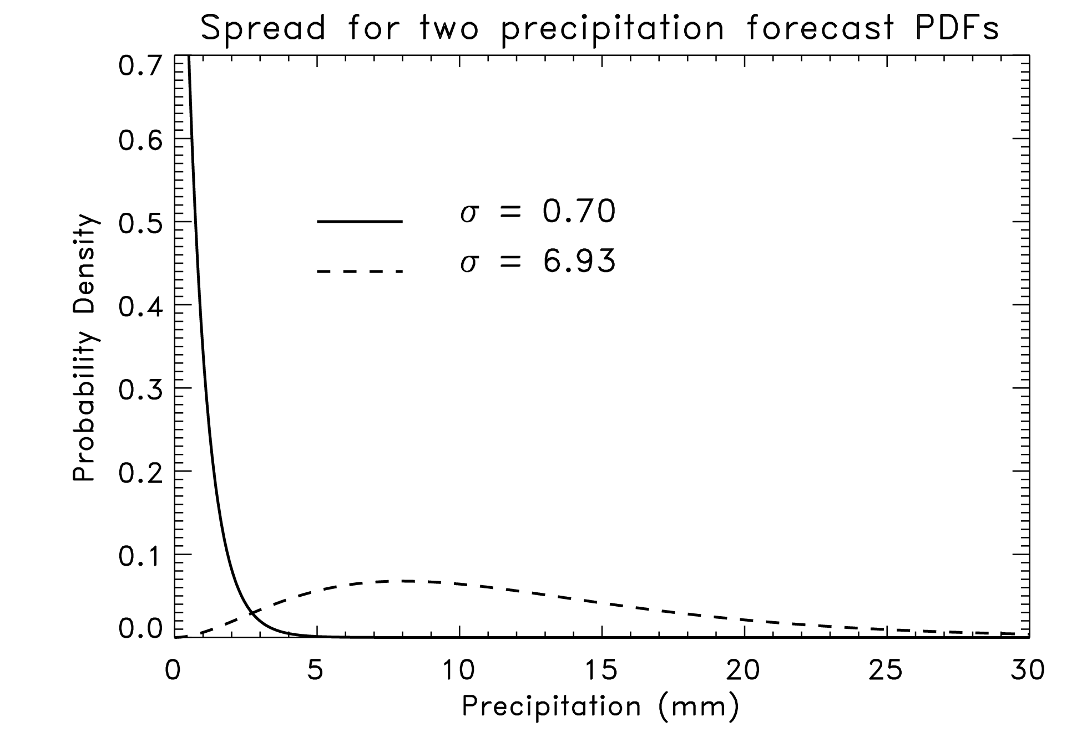
Spread-error relationships and precipitation forecasts
True spread-skill relationships
harder to diagnose if forecast
PDF is non-normally distributed,
as they are typically for
precipitation forecasts.
Commonly, spread is no longer
independent of the mean value;
it’s larger when the amount is
larger.
Hence, you may get an apparent
spread-error relationship, but
this may reflect variations in the
mean forecast rather than
real spread-skill.
Ref & possible solution: Hamill and Colucci, MWR, Mar. 1998

Slide 40
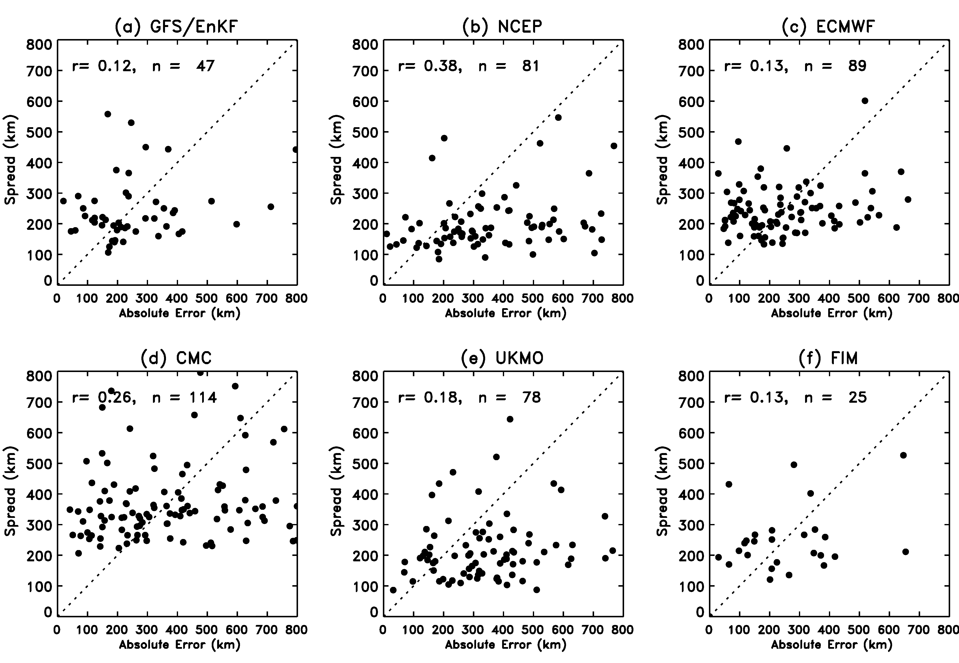
Is the spread-error correlation as high as it could be?
Hurricane track error and spread
40
Ref: Hamill et al., MWR 2010 conditionally accepted.

Slide 41
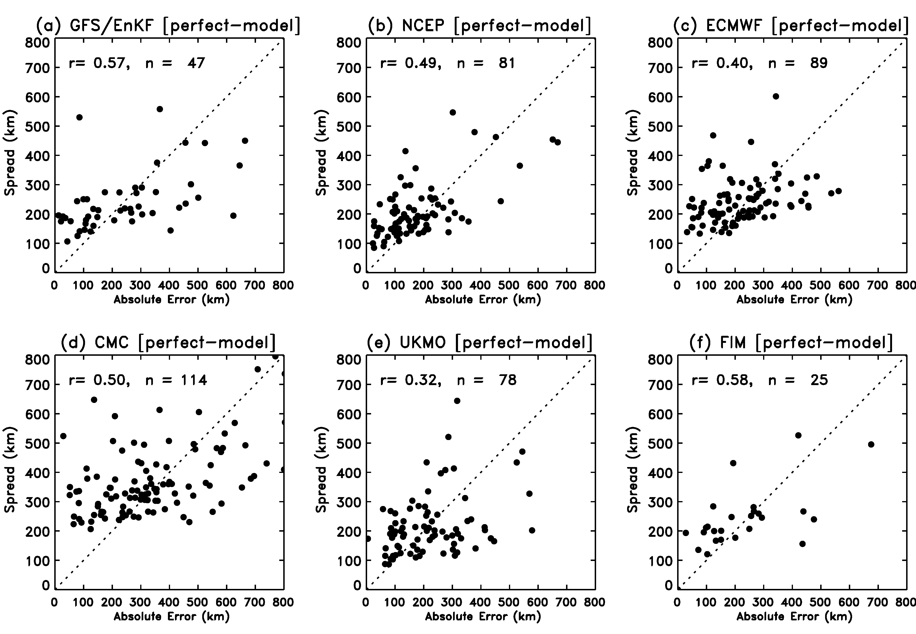
…use one member as synthetic verification to gauge potential spread-error correlation

Slide 42
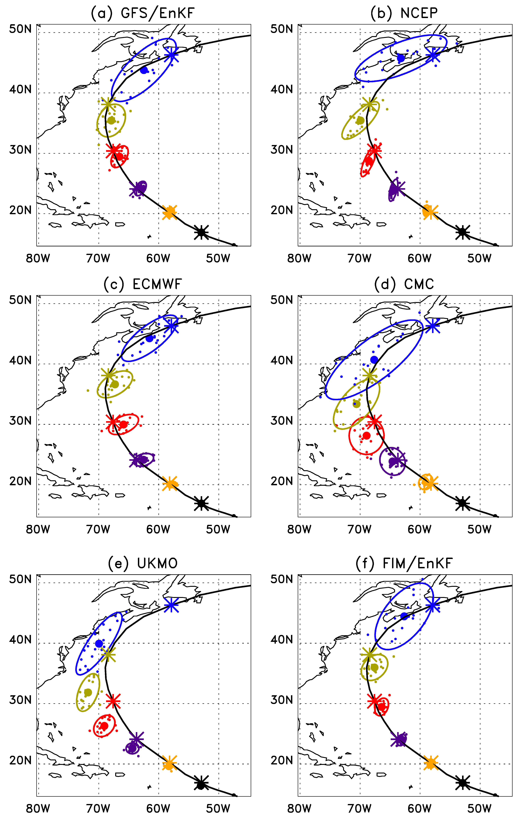
Spread vs. error in more than one dimension: verification of ellipse eccentricity
Hurricane Bill, initialized
00 UTC 19 August 2009.
Fitted bi-variate normal
to each ensemble’s
forecast track positions.
Ellipse encloses 90% of
the fitted probability.
Ref: Hamill et al., MWR 2010 conditionally accepted.

Slide 43
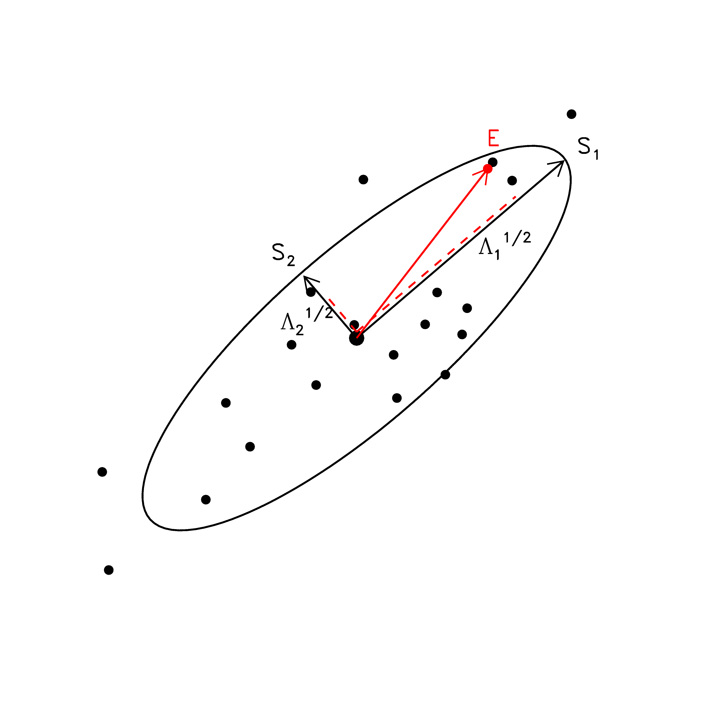
Ellipse eccentricity analysis
Question: are errors projections larger along the direction
where the ellipse is stretched out?

Slide 44
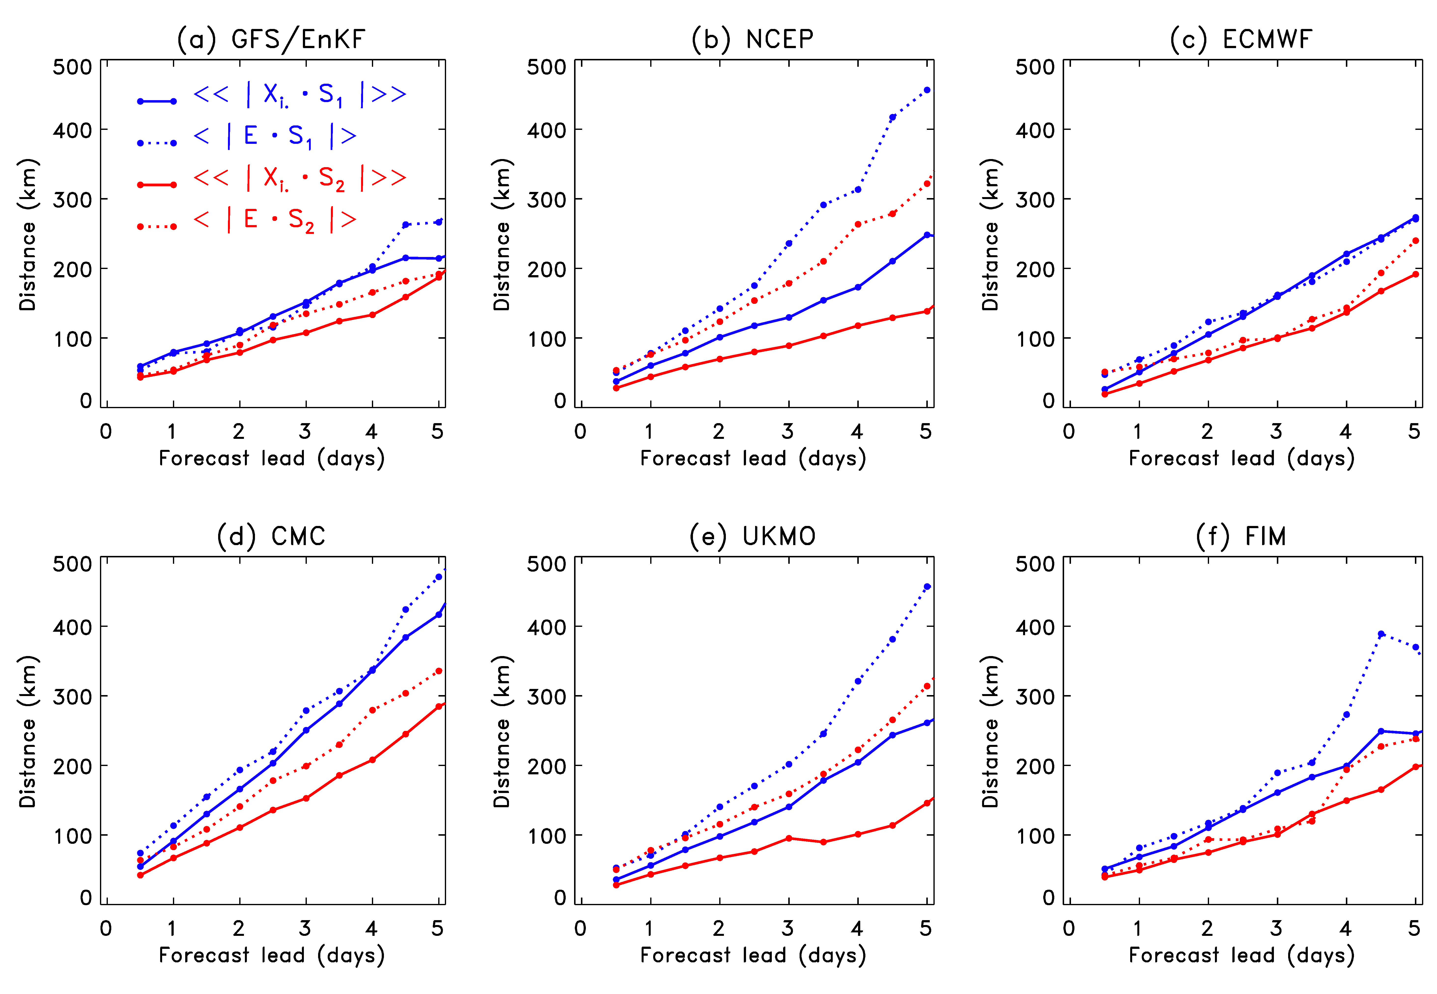
Ellipse eccentricity analysis
(non-homogeneous)

Slide 45
Ellipse eccentricity analysis
Notes for GFS/EnKF:
Along major axis of ellipse, consistent average projection error of errors and projection of members; spread well estimated.
Along minor axis of ellipse, slightly larger projection of errors than projection of members. Too little spread.
Together, imply more isotropy needed.
Still (dashed lines) some separation of projection of error onto ellipses indicates there is some skill in forecasting ellipticity.
(non-homogeneous)

Slide 46
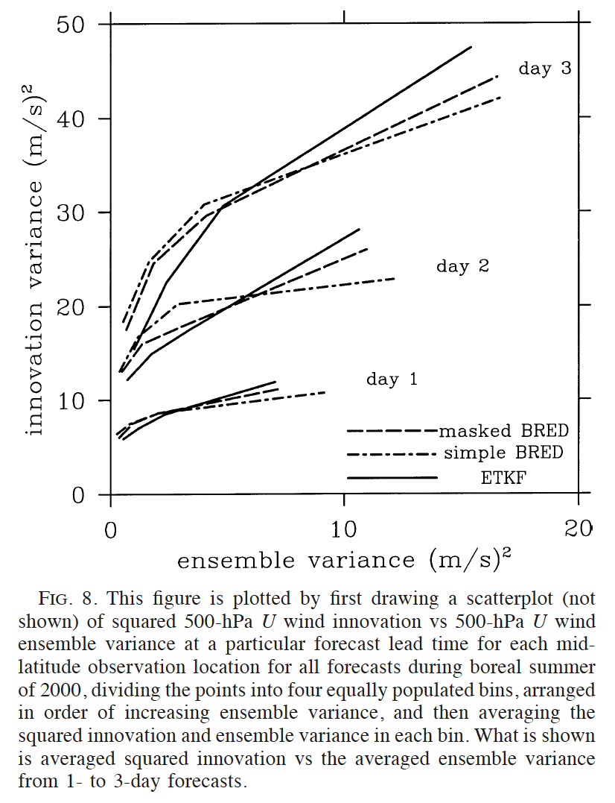
Another way of conveying spread-error relationships.
Averaging the individual
samples into bins, then
plotting a curve.
Ref: Wang and Bishop,
JAS, May 2003.

Slide 47
Part 2: other common (and uncommon) ensemble-related evaluation tools
What do they tell us about the ensemble?
How are they computed?
Is there some relation to reliability, sharpness, or other previously discussed attributes?
What are some issues in their usage?

Slide 48
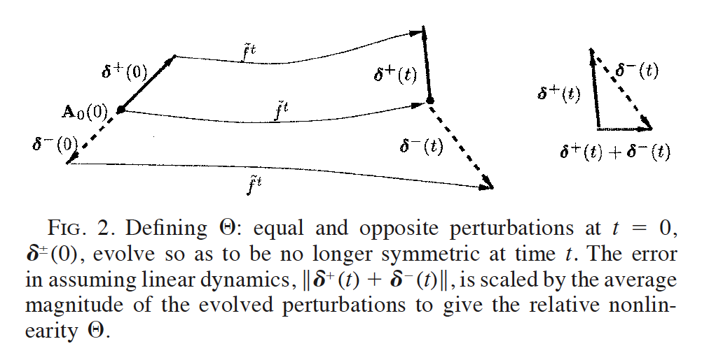
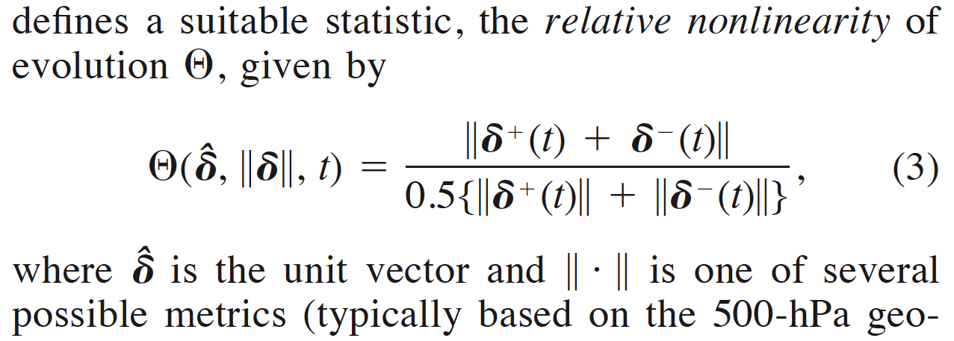
Isla Gilmour’s non-linearity index
how long does a linear regime persist?
Ref: Gilmour et al., JAS, Nov. 2001

Slide 49
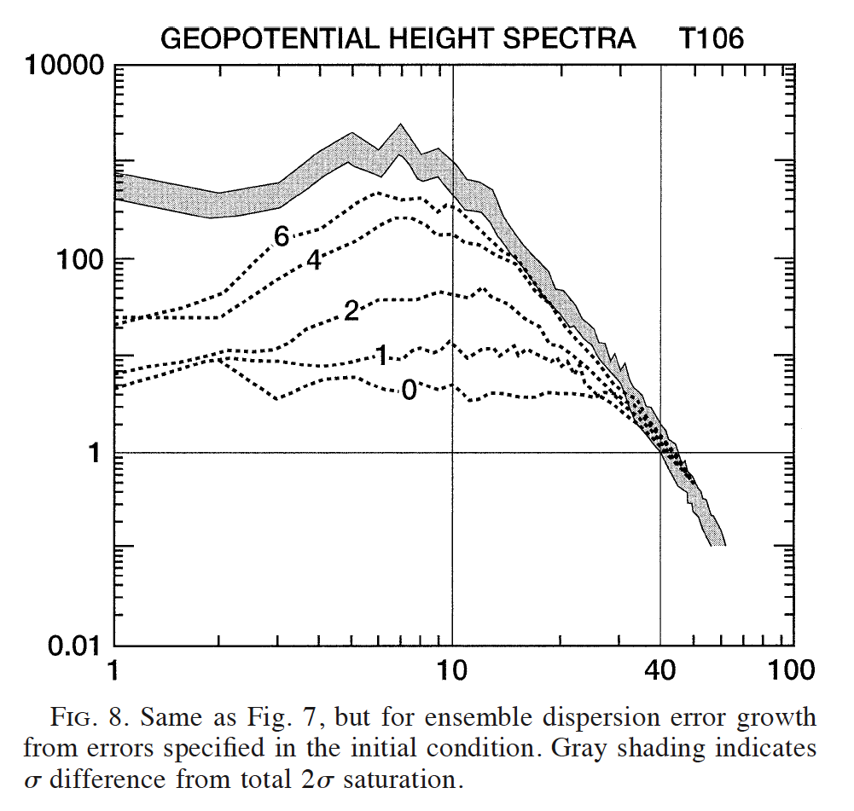
Power spectra and saturation
The 0–curve represents the
power difference between
analyses as a function of
global wavenumber.
Other numbered curves
indicate the power difference at
different forecast leads, in days.
Diagnostics like this can be
useful in evaluating upscale
growth characteristics of
ensemble uncertainty.
Ref: Tribbia and Baumhefner, MWR, March 2004

Slide 50
Satterfield and Szunyogh’s “Explained Variance”
How much of the error ξ (difference of truth from ens. mean)
lies in the space spanned by the ensemble (||) vs. orthogonal
to it ( )? (calculation is done in a limited-area region).
Would expect that as EV decreases, more U-shaped
multi-dimensional rank histograms would be encountered.
Ref: Satterfield and Szunyogh, MWR, March 2010

Slide 51
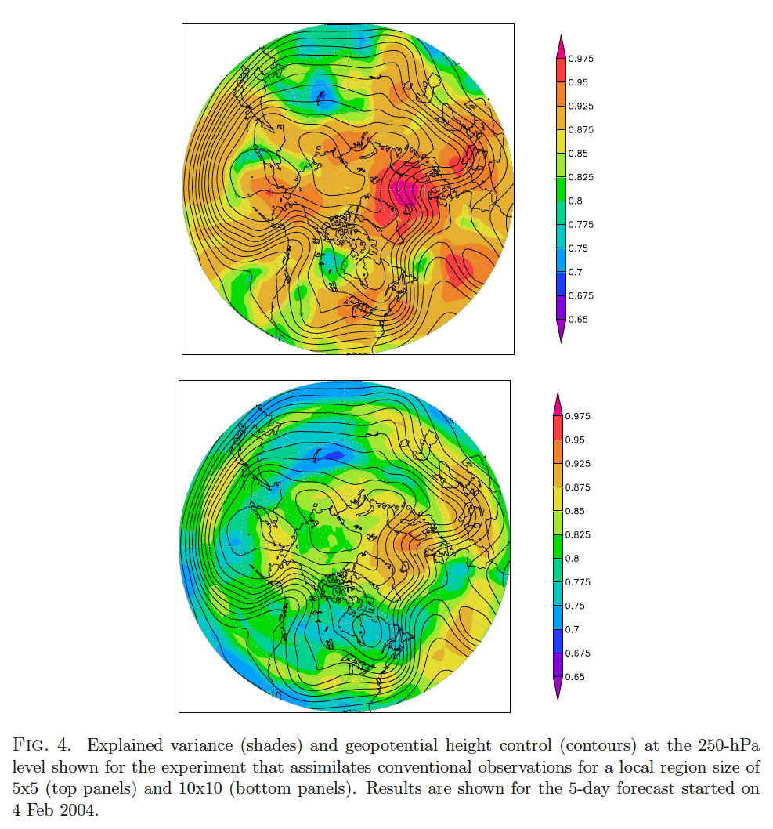
Example with forecasts from “local ETKF”
top: 5x5 degree
boxes
bottom: 10x10
boxes.
the larger the
box, the smaller
the EV, but
patterns similar.

Slide 52
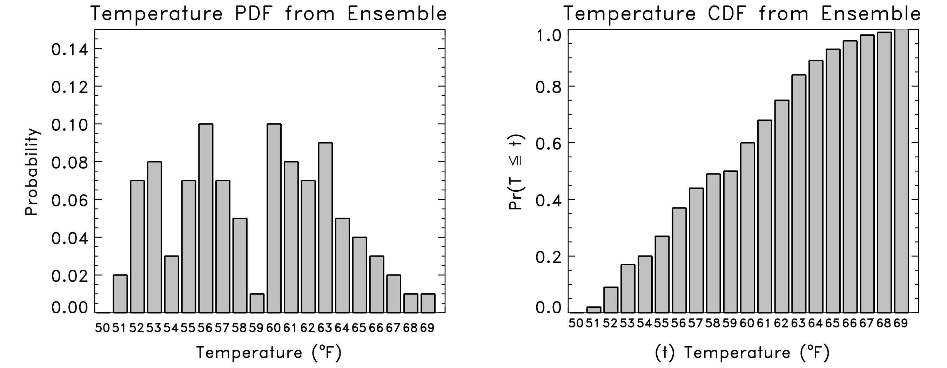
Cumulative distribution function (CDF); used in CRPS
F^{f}(x) = Pr {X ≤ x}
where X is the random variable, x is some specified threshold.

Slide 53
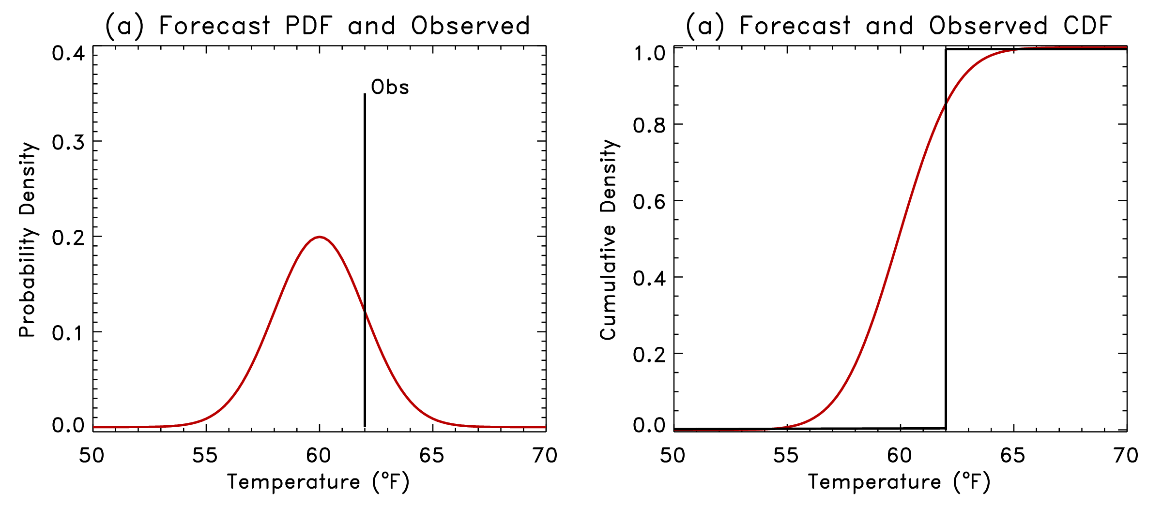
Continuous Ranked Probability Score
Let be the forecast probability CDF for the ith forecast case.
Let be the observed probability CDF (Heaviside function).
b

Slide 54
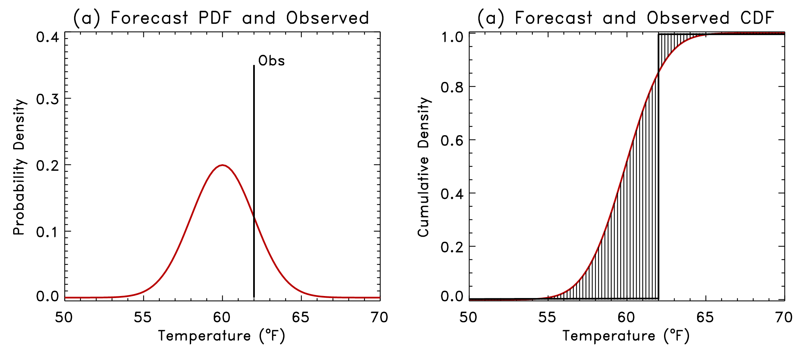
Continuous Ranked Probability Score
Let be the forecast probability CDF for the ith forecast case.
Let be the observed probability CDF (Heaviside function)*.
(difference
squared)
b
* or incorporate obs error; see Candille and Talagrand, QJRMS,2007

Slide 55
Continuous Ranked Probability Skill Score (CRPSS)
Like the Brier score, it’s common to convert this to
a skill score by normalizing by the skill of a reference
forecast, perhaps climatology.
Danger: can over-estimate forecast skill. See
later presentation on this.

Slide 56
Decomposition of CRPS
Like Brier score, there is a decomposition of CRPS into reliability, resolution, uncertainty.
Like Brier score, interpretation of this decomposition only makes sense if all samples are draws from a distribution with the same climatology.
Ref: Hersbach, WAF, Oct 2000, + Hamill and Juras, QJ, Oct 2006

Slide 57
Relative Operating Characteristic (ROC)
Hit Rate = H / (H+M) FAR = F / (F+C)

Slide 58
Relative Operating Characteristic (ROC)

Slide 59
Method of calculation of ROC: parts 1 and 2
(1) Build contingency tables for each sorted ensemble member
T
F
Obs
F
F
F
F
F
55 56 57 58 59 60 61 62 63 64 65 66
Obs ≥ T?
Obs ≥ T?
Obs ≥ T?
Obs ≥ T?
Obs ≥ T?
Obs ≥ T?
 | Y | N
Y | 0 | 0
N | 0 | 1
 | Y | N
Y | 0 | 0
N | 0 | 1
 | Y | N
Y | 0 | 0
N | 0 | 1
 | Y | N
Y | 0 | 1
N | 0 | 0
 | Y | N
Y | 0 | 1
N | 0 | 0
 | Y | N
Y | 0 | 1
N | 0 | 0
Fcst ≥ T?
Fcst ≥ T?
Fcst ≥ T?
Fcst ≥ T?
Fcst ≥ T?
Fcst ≥ T?
(2) Repeat the process for other locations, dates, building
up contingency tables for sorted members.

Slide 60
Method of calculation of ROC: part 3
(3) Get hit rate and false alarm rate for each from contingency table
for each sorted ensemble member.
Obs ≥ T?
 | Y | N
Y | H | F
N | M | C
HR = H / (H+M) FAR = F / (F+C)
Fcst ≥ T?
Sorted
Member 1
Sorted
Member 2
Sorted
Member 3
Sorted
Member 4
Sorted
Member 5
Sorted
Member 6
Obs ≥ T?
Obs ≥ T?
Obs ≥ T?
Obs ≥ T?
Obs ≥ T?
Obs ≥ T?
 | Y | N
Y | 1106 | 3
N | 5651 | 73270
 | Y | N
Y | 3097 | 176
N | 3630 | 73097
 | Y | N
Y | 4020 | 561
N | 2707 | 72712
 | Y | N
Y | 4692 | 1270
N | 2035 | 72003
 | Y | N
Y | 5297 | 2655
N | 1430 | 70618
 | Y | N
Y | 6603 | 44895
N | 124 | 28378
Fcst ≥ T?
Fcst ≥ T?
Fcst ≥ T?
Fcst ≥ T?
Fcst ≥ T?
Fcst ≥ T?
HR = 0.163
FAR = 0.000
HR = 0.504
FAR = 0.002
HR = 0.597
FAR = 0.007
HR = 0.697
FAR = 0.017
HR = 0.787
FAR = 0.036
HR = 0.981
FAR = 0.612

Slide 61
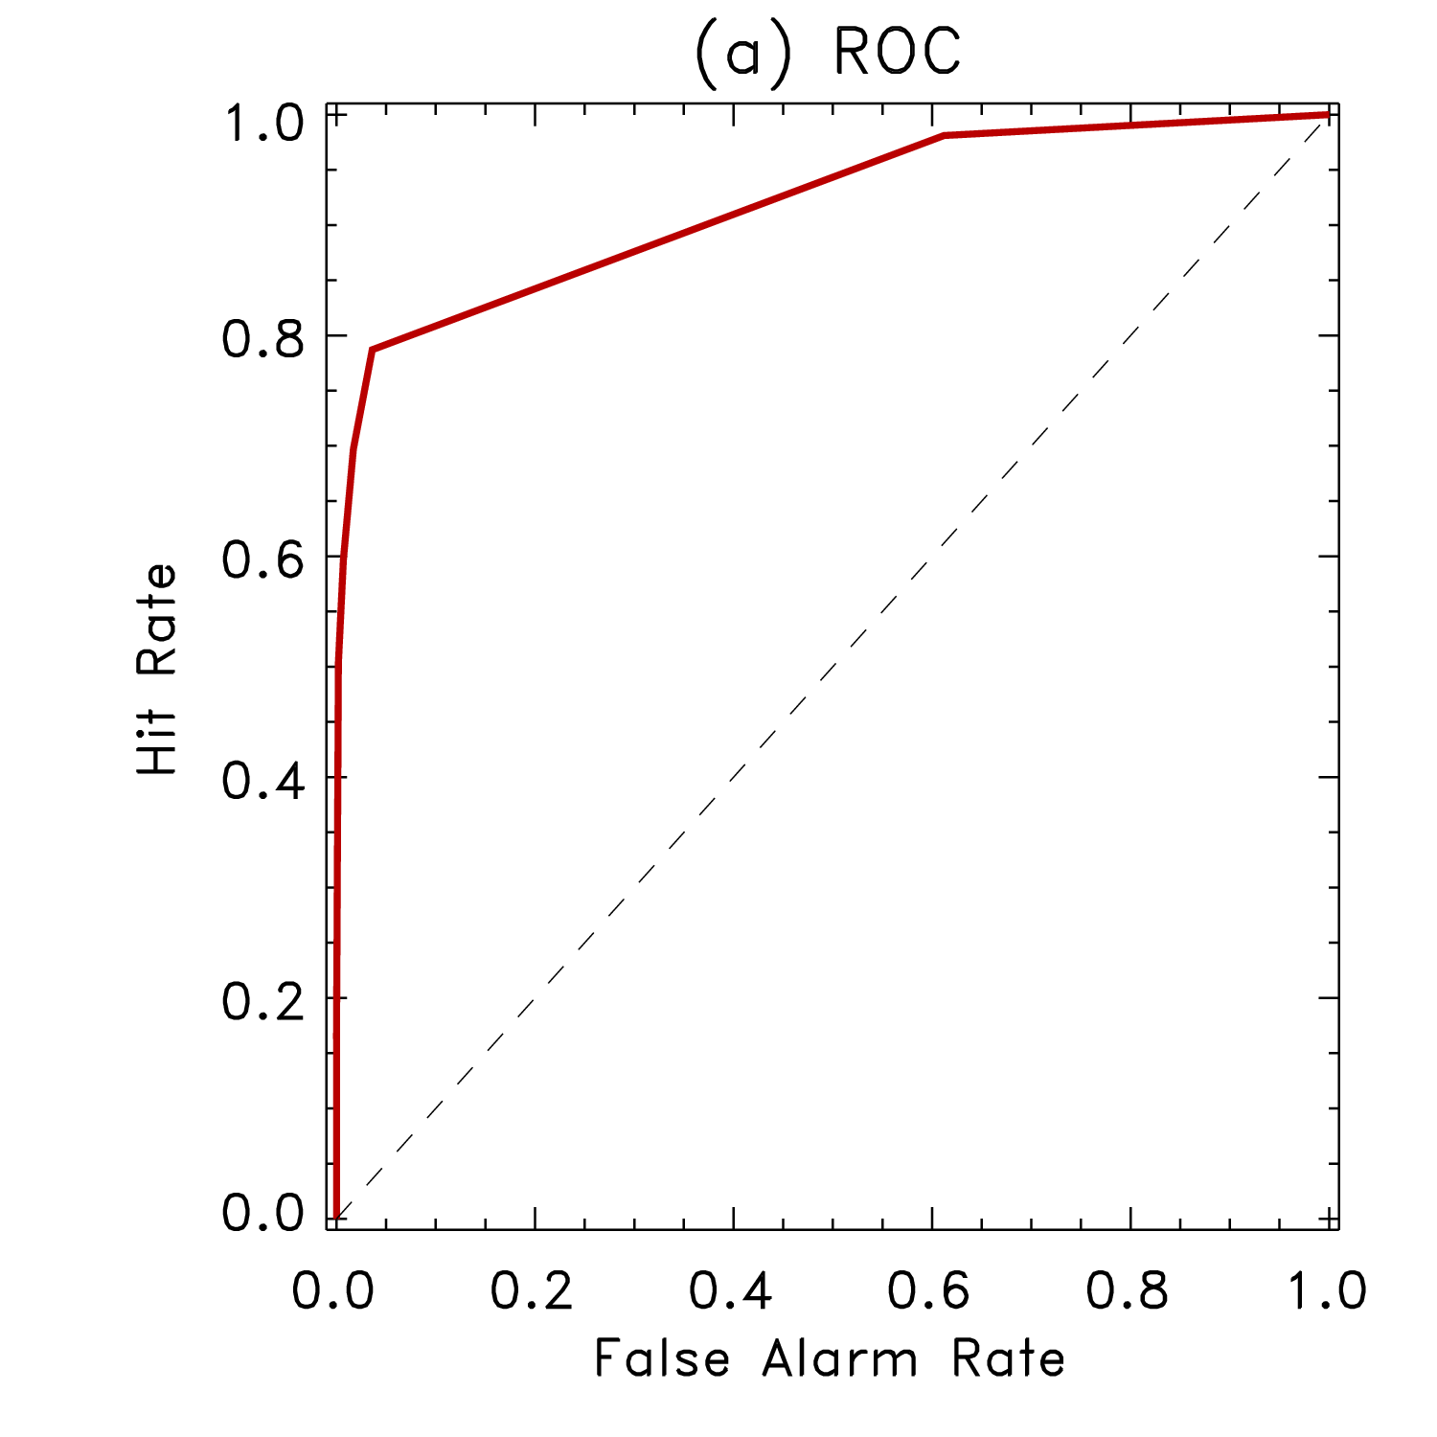
Method of calculation of ROC: part 3
HR = 0.163
FAR = 0.000
HR = 0.504
FAR = 0.002
HR = 0.597
FAR = 0.007
HR = 0.697
FAR = 0.017
HR = 0.787
FAR = 0.036
HR = 0.981
FAR = 0.612
HR = [0.000, 0.163, 0.504, 0.597, 0.697, 0.787, 0.981, 1.000]
FAR = [0.000, 0.000, 0.002, 0.007, 0.017, 0.036, 0.612, 1.000]
(4) Plot hit rate
vs. false alarm
rate
Again, can overestimate
forecast skill.

Slide 62
ROC connection with hypothesis testing
Observed ≥ T?
 | YES | NO
YES | H (HIT) | (F) FALSE ALARM
NO | (M) MISS | (C) CORRECT NO
Point on ROC curve provides evaluation of Type I (inappropriate rejection of null hypothesis, which here is Obs < T) vs. 1. - Type II statistical errors (inappropriate acceptance of alternate hypothesis, Obs ≥ T). ROC curve provides tradeoff as different ensemble data is used as test statistic.
Fcst ≥ T? (our test statistic)
FAR = F / F+C = P(Type I error)
HR = H / H+M = 1 - P(Type II error)

Slide 63
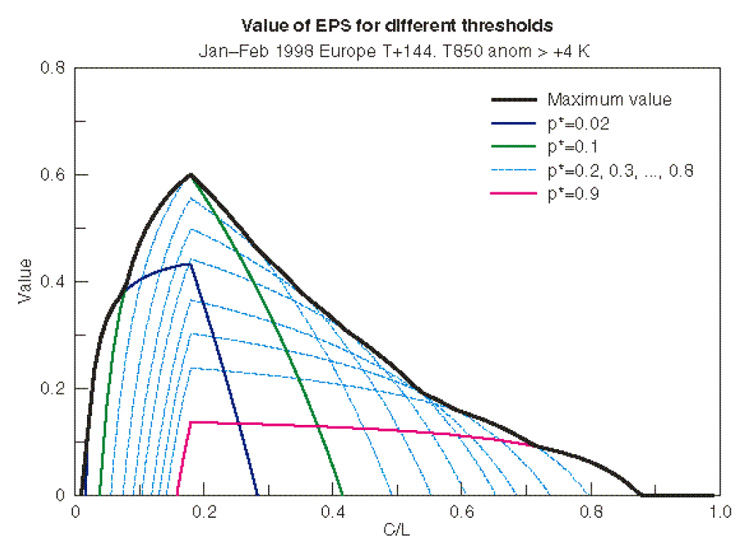
Economic value diagrams
Motivated by search for a metric that relates ensemble forecast
performance to things that customers will actually care about.
These diagrams
tell you the
potential economic
value of your
ensemble forecast
system applied to
a particular forecast
aspect. Perfect
forecast has value
of 1.0, climatology
has value of 1.0.
Value differs with
user’s cost/loss
ratio.

Slide 64
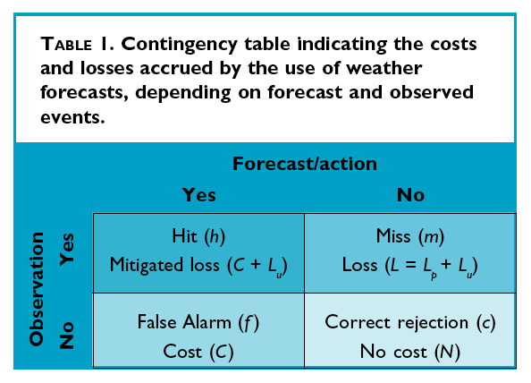
Economic value: calculation method
Assumes decision maker
alters actions based on
weather forecast info.
C = Cost of protection
L = L_{p}+L_{u} = total cost of
a loss, where …
L_{p} = Loss that can be
protected against
L_{u} = Loss that can’t be
protected against.
N = No cost

Slide 65
Economic value, continued
Suppose we have the contingency
table of forecast outcomes, [h, m, f, c].
Then we can calculate the expected
value of the expenses from a forecast,
from climatology, from a perfect forecast.
Note that
value will vary
with C, L_{p}, L_{u;}
Different users
with different
protection costs
may experience
a different value
from the forecast
system.
Ref: Zhu et al. 2002 BAMS

Slide 66
From ROC to economic value
Value is now seen to be related to FAR and HR, the
components of the ROC curve. A (HR, FAR)
point on the ROC curve will thus map to a
value curve (as a function of C/L)
Ref: ibid.

Slide 67
The red curve is
from the ROC
data for the member
defining the 90th
percentile of the
ensemble distribution.
Green curve is for
the 10th percentile.
Overall economic
value is the maximum
(use whatever member
for decision threshold
that provides the
best economic value).

Slide 68
Conclusions
Many ensemble verification techniques out there.
A good principle is to thought-test every verification technique you seek to use; is there some way it could be misleading you about the characteristics of the forecast (commonly, the answer will be yes).

Slide 69
Useful references
Good overall references for forecast verification:
(1): Wilks, D.S., 2006: Statistical Methods in the Atmospheric Sciences (2nd Ed). Academic Press, 627 pp.
(2) Beth Ebert’s forecast verification web page, http://tinyurl.com/y97c74
Rank histograms: Hamill, T. M., 2001: Interpretation of rank histograms for verifying ensemble forecasts. Mon. Wea. Rev., 129, 550-560.
Spread-skill relationships: Whitaker, J.S., and A. F. Loughe, 1998: The relationship between ensemble spread and ensemble mean skill. Mon. Wea. Rev., 126, 3292-3302.
Brier score, continuous ranked probability score, reliability diagrams: Wilks text again.
Relative operating characteristic: Harvey, L. O., Jr, and others, 1992: The application of signal detection theory to weather forecasting behavior. Mon. Wea. Rev., 120, 863-883.
Economic value diagrams:
(1)Richardson, D. S., 2000: Skill and relative economic value of the ECMWF ensemble prediction system. Quart. J. Royal Meteor. Soc., 126, 649-667.
(2) Zhu, Y, and others, 2002: The economic value of ensemble-based weather forecasts. Bull. Amer. Meteor. Soc., 83, 73-83.
Overforecasting skill: Hamill, T. M., and J. Juras, 2006: Measuring forecast skill: is it real skill or is it the varying climatology? Quart. J. Royal Meteor. Soc., Jan 2007 issue. http://tinyurl.com/kxtct

