Slide 1


Ensemble prediction and winter weather
(with some attention to Sandy)
NOAA Earth System
Research Laboratory
Tom Hamill
NOAA Earth System Research Lab
tom.hamill@noaa.gov
(303) 497-3060
Presentation to October 2012 COMET Winter Weather Course

Slide 2
Organization of this talk.
Part 1: Ensemble theory and nuts and bolts.
  Motivation for ensembles
  How we construct them.
  Advantages/disadvantages of some various ensemble approaches.
Part 2: Using ensembles for winter weather.

Slide 3
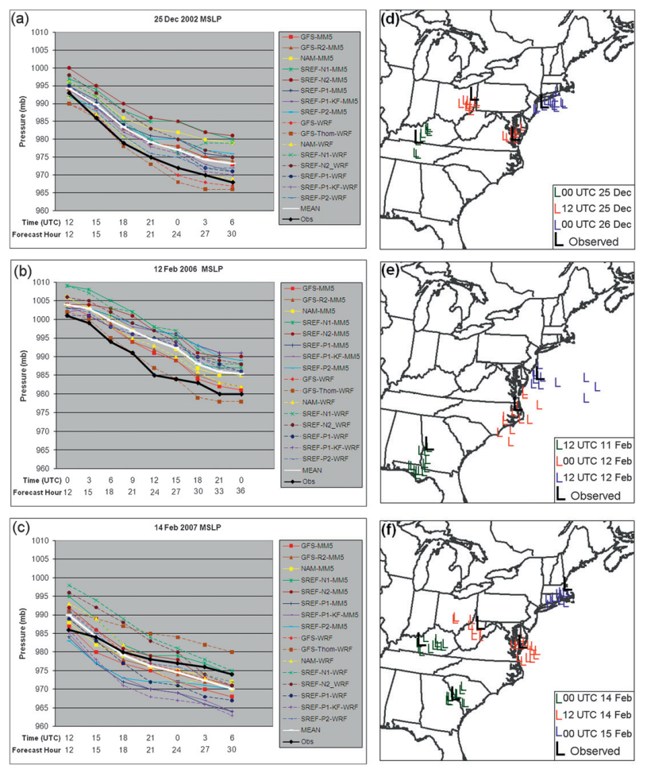
Reminder: ensemble guidance
provides you with (probably)
a lower bound for the forecast
uncertainty.
One of the more dangerous
practices is to assume a high
level of confidence based
on a low spread in the ensemble.
This will be (and is) getting less
and less true with each
passing year.
Novak and Colle, WAF
June 2012

Slide 4
Observed was out of
the range of the
ensemble
Novak and Colle, WAF
June 2012

Slide 5
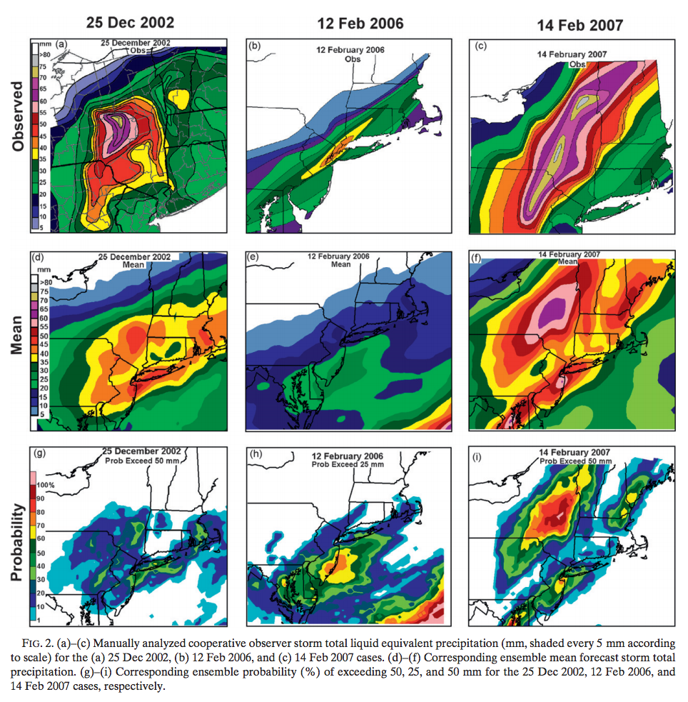
Snowfall with
three winter storms
and SREF forecasts.
ref: ibid.

Slide 6
Snowfall with
three winter storms
and SREF forecasts.
Probabilities for
the heaviest snow
regions were not
well forecast in
two of these three
storm.
ref: ibid.

Slide 7
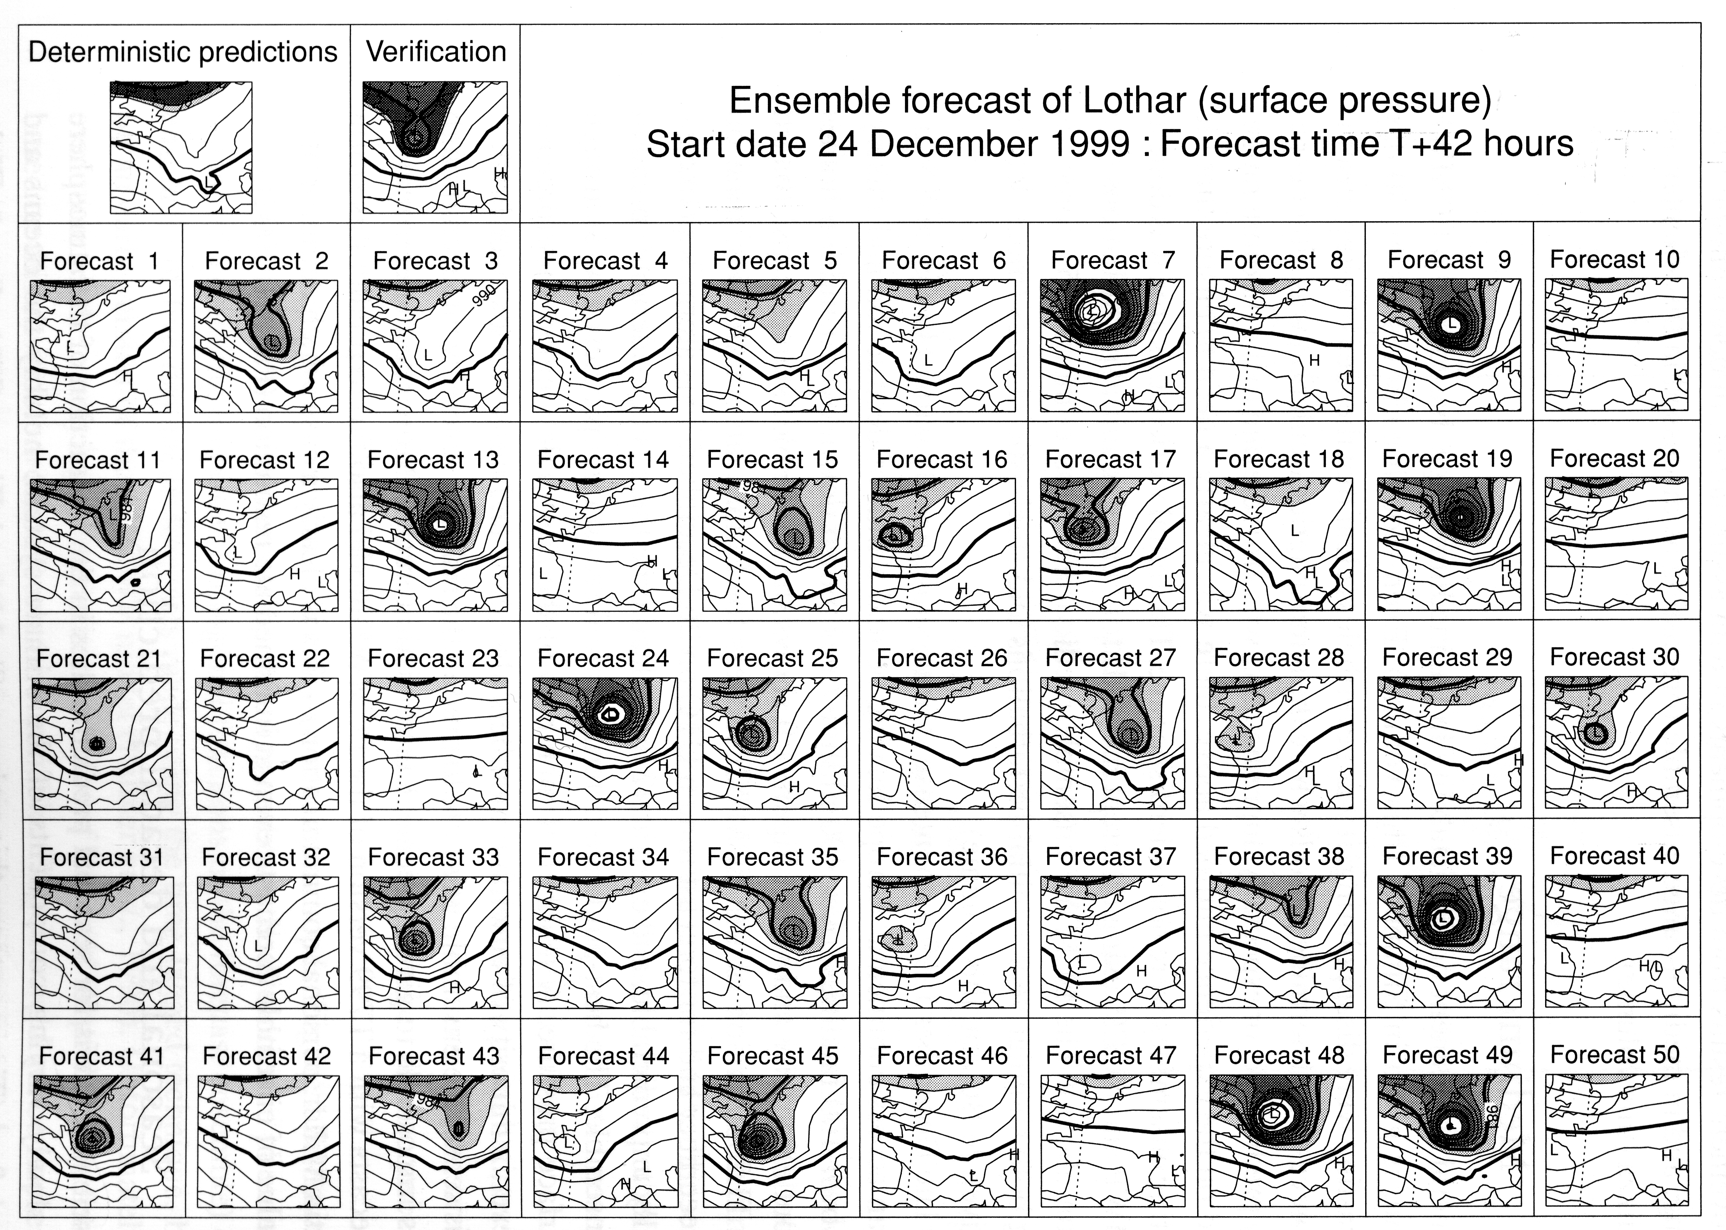
“Stamp maps”

Slide 8
“Stamp maps”
Busy, right? Too small to see
much detail on any member.

Slide 9
“Stamp maps”
Still, this may provide a useful overview of the range of conditions
one should anticipate.

Slide 10
“Stamp maps”
Enhancements I like:
ability to animate stamp maps.
e.g., http://tinyurl.com/sandy-anim

Slide 11
“Stamp maps”
Enhancements I’d like to see:
(2) Ability to click on a particular
member and load that data
for more in-depth analysis.

Slide 12

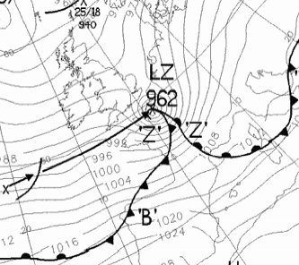
Stamp maps
Zoom
capability
with mouse
over event
from Tim Palmer’s
book chapter, 2006,
in “Predictability of Weather and Climate”.

Slide 13
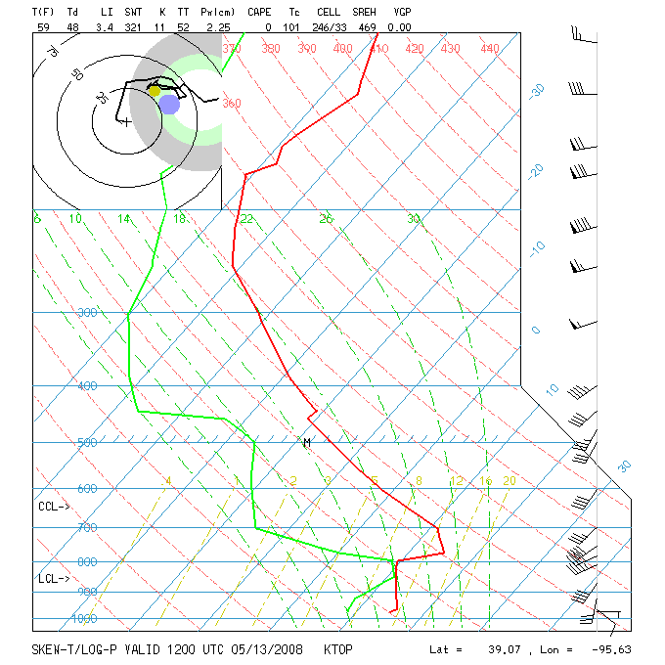
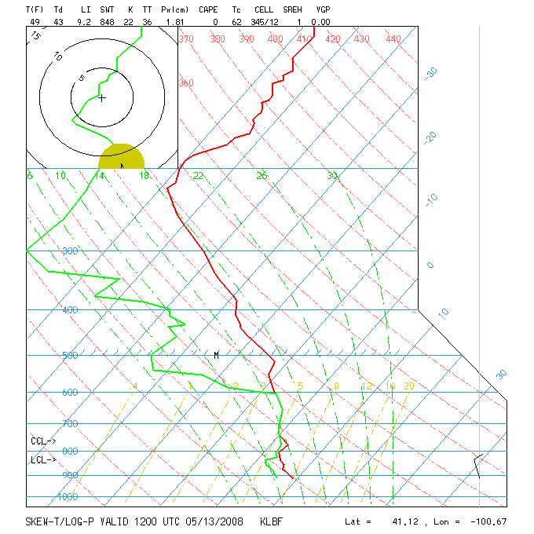
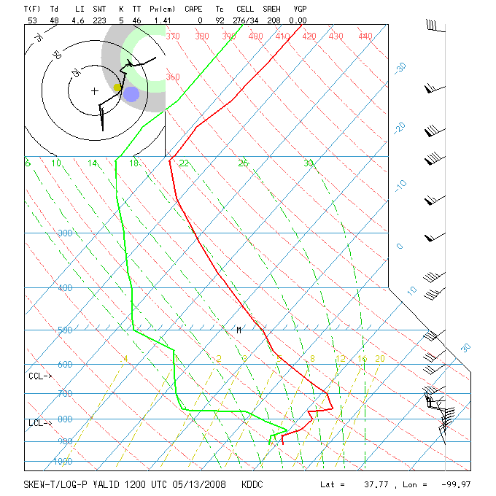
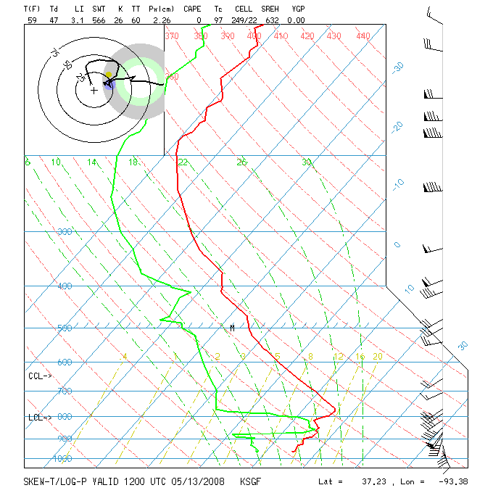
Stamp Skew-T’s with mouse-over

Slide 14
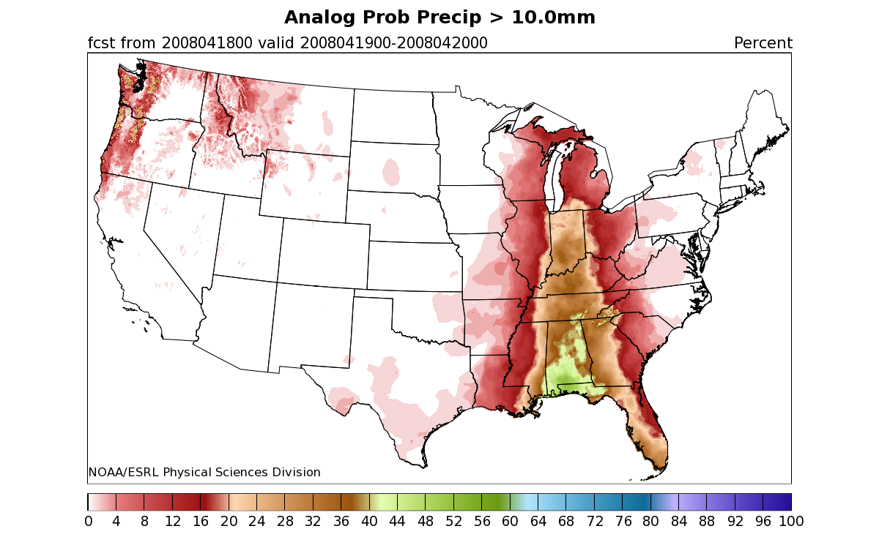
Probability plots
Provides a graphical display of probabilities for a particular event, here for probability of greater than 10 mm rainfall in 24 h.
Advantage: simple, relatively intuitive.
Disadvantages: no sense of the meteorology involved, doesn’t provide information on whole pdf.
from Hamill & Whitaker’s analog reforecast technique web page, www.cdc.noaa.gov/reforecast/narr.

Slide 15
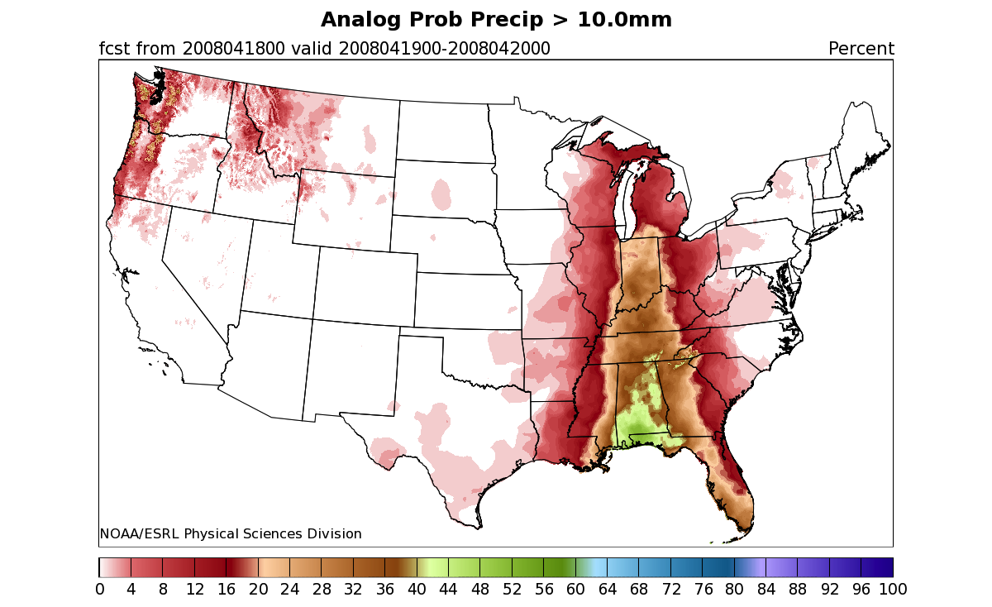
Probability plots
With mouse-over
event capability
Probability Density
Precipitation amount
15
from Hamill & Whitaker’s analog reforecast technique web page, www.cdc.noaa.gov/reforecast/narr.

Slide 16

Hurricane Sandy
“Sandy, you hurt me real bad”

Slide 17
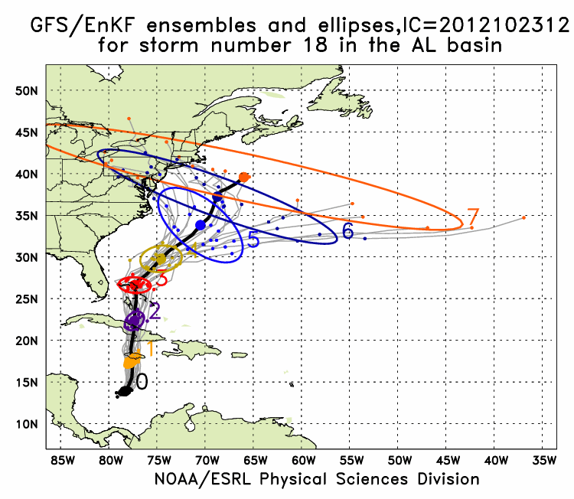
Hurricane Sandy
at this lead, ~6 days
prior to the landfall,
there was tremendous
uncertainty as to the
track of Sandy.
Plots like these
could be done for
winter storm tracks,
too.

Slide 18
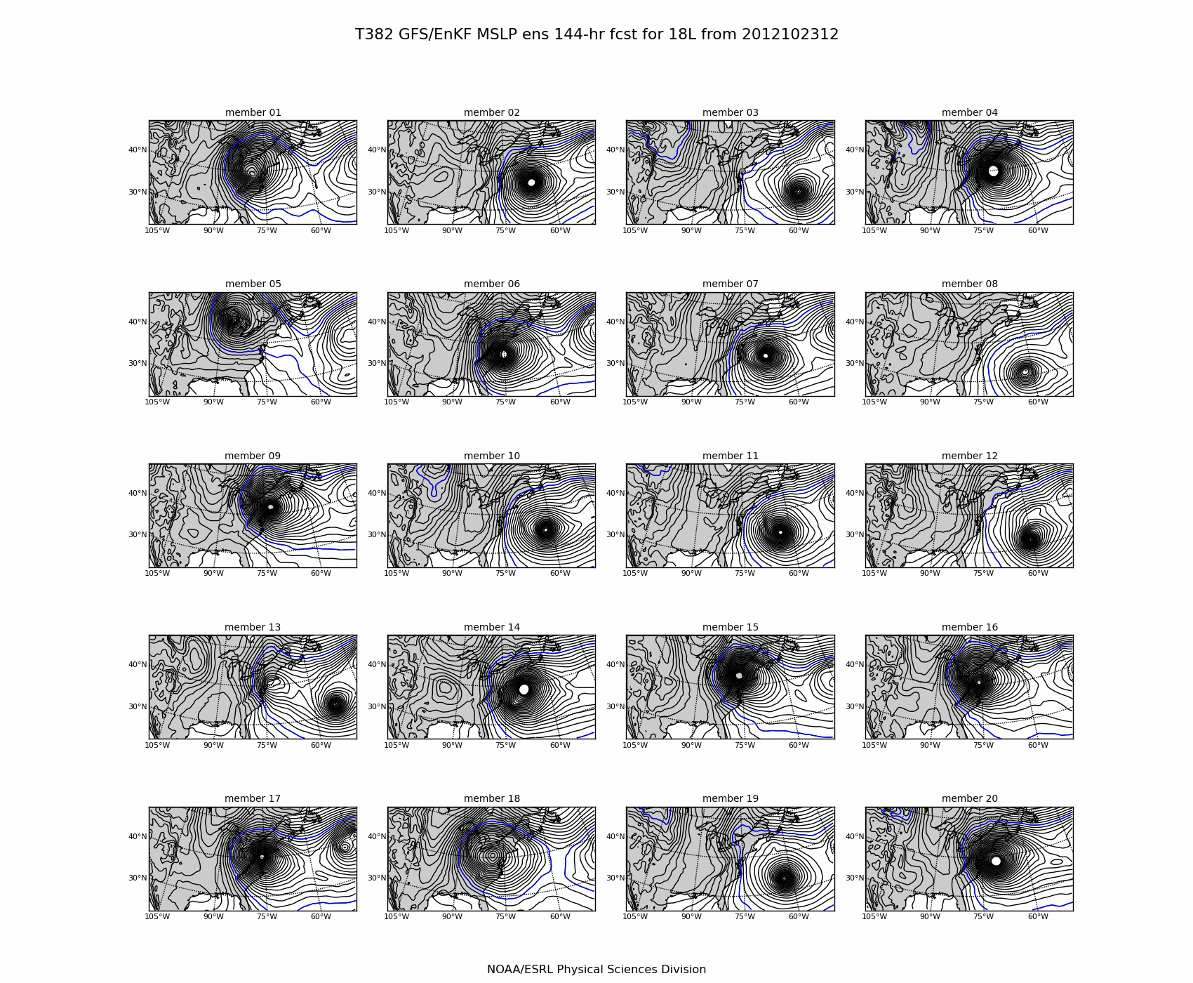
+ 6 day forecast stamp maps of MSLP

Slide 19
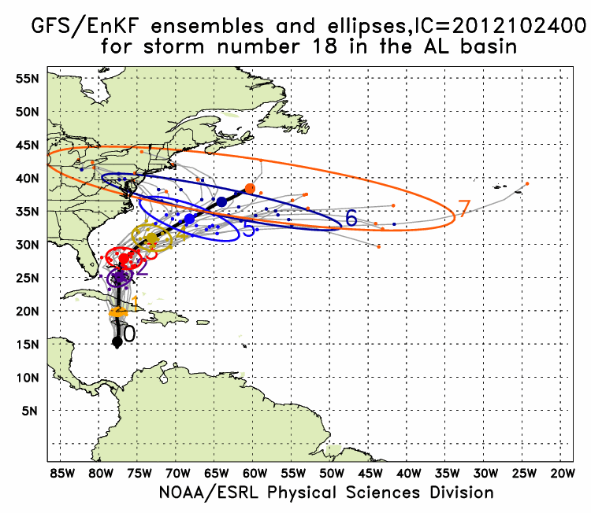
Hurricane Sandy
at this lead, ~ 5.5 days
prior to the landfall,
there was tremendous
uncertainty as to the
track of Sandy.

Slide 20
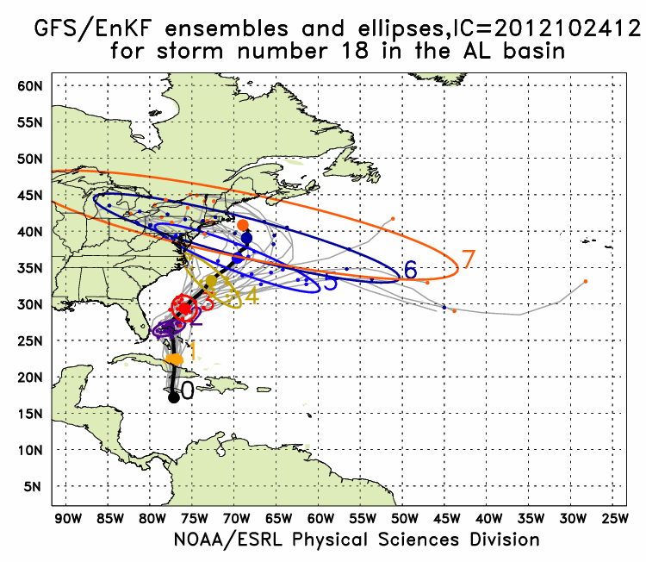
Hurricane Sandy
at this lead, ~ 5.0 days
prior to the landfall,
there was tremendous
uncertainty as to the
track of Sandy.

Slide 21
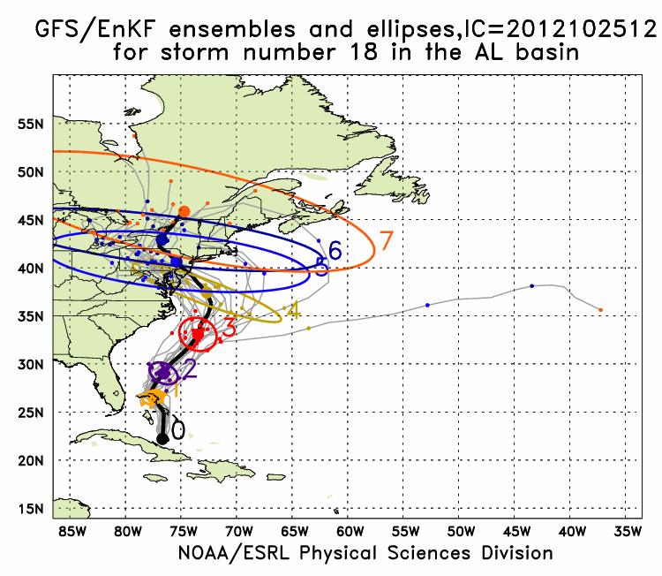
Hurricane Sandy
at this lead, ~ 4.5 days
prior to the landfall,
finally a reduction in
uncertainty as to the
track of Sandy.

Slide 22
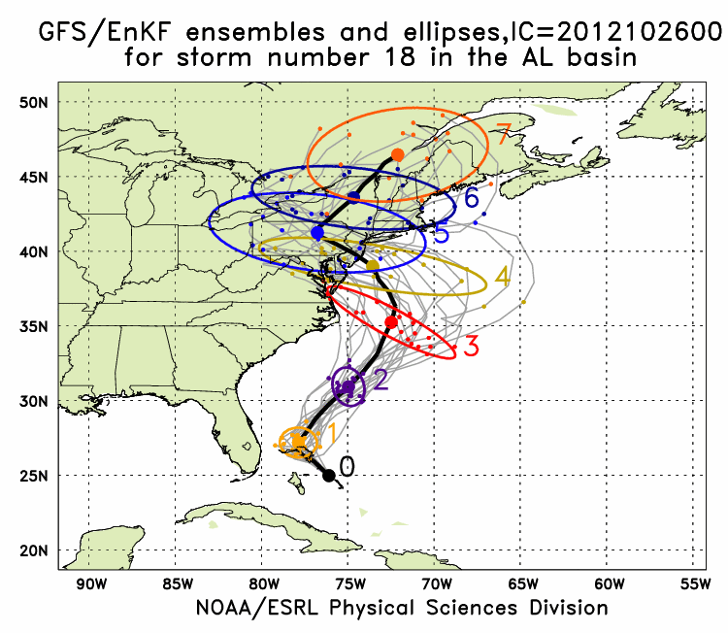
Hurricane Sandy

Slide 23
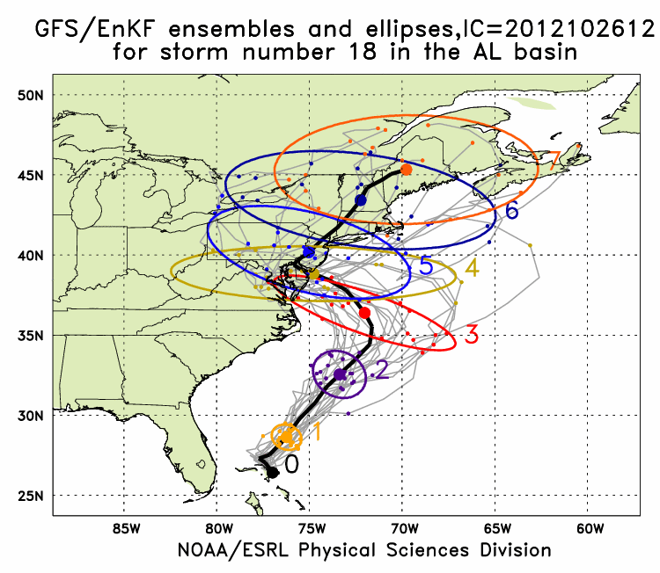
Hurricane Sandy

Slide 24
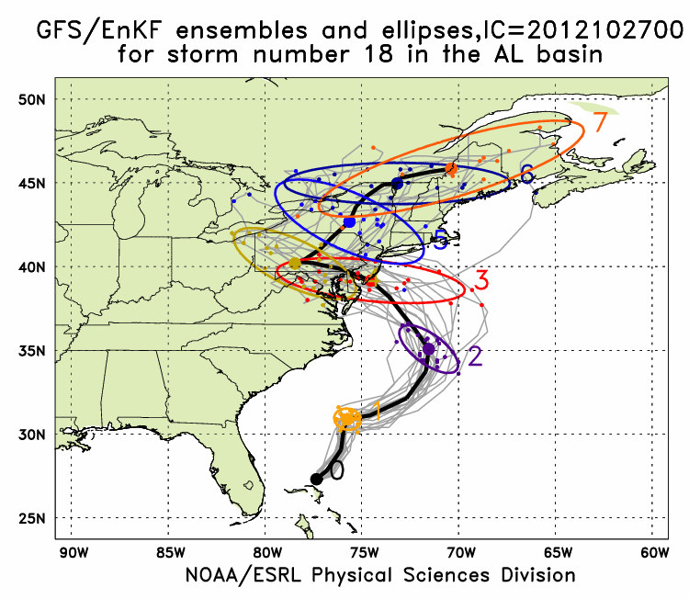
Hurricane Sandy

Slide 25
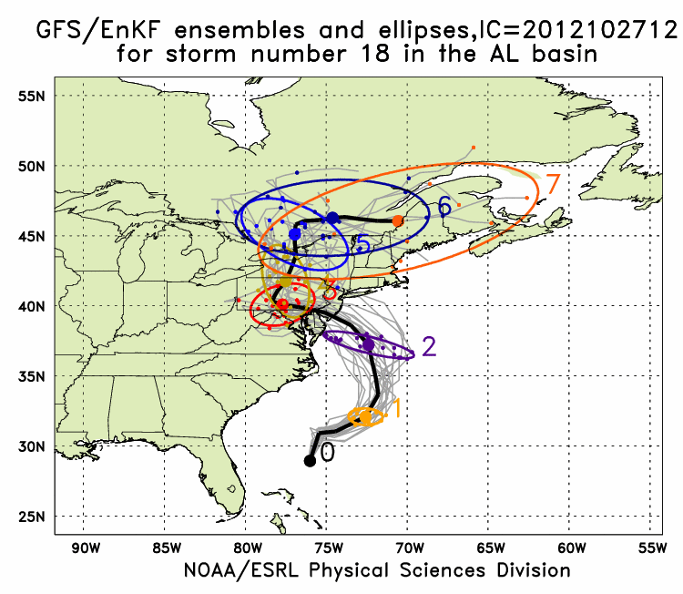
Hurricane Sandy

Slide 26
Previously: “Spaghetti plots”, NCEP ensemble
(546 dam contour, + 5 day forecast)
__ day +0 __day +1 __day +3 __ day +5
NCEP ensemble has only a hint in a few members
of a major system affecting the southwest US.

Slide 27
Previously: “Spaghetti plots”, ECMWF ensemble
(546 dam contour + 5 day forecast)
__ day +0 __day +1 __day +3 __ day +5
ECMWF system much better at predicting event in central Rockies. Lessons:
(1) Probabilistic, not deterministic forecasts, are definitely needed.
(2) A high-quality ensemble prediction system is a necessity for weather-climate prediction.

Slide 28
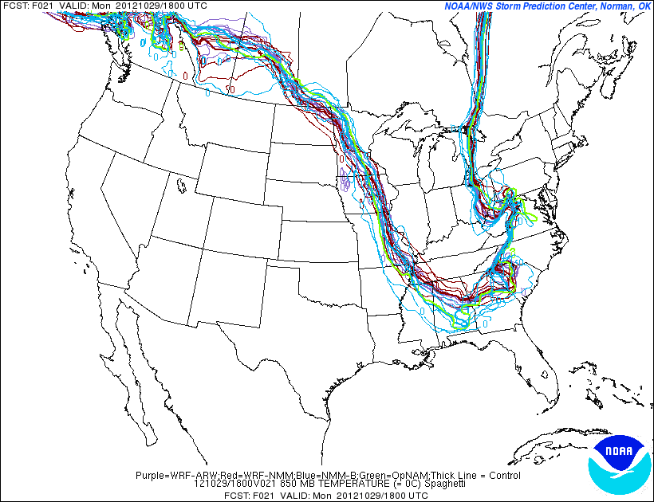
Spaghetti of 0°C 850 +21 h isotherms for Hurricane Sandy from NCEP SREF

Slide 29
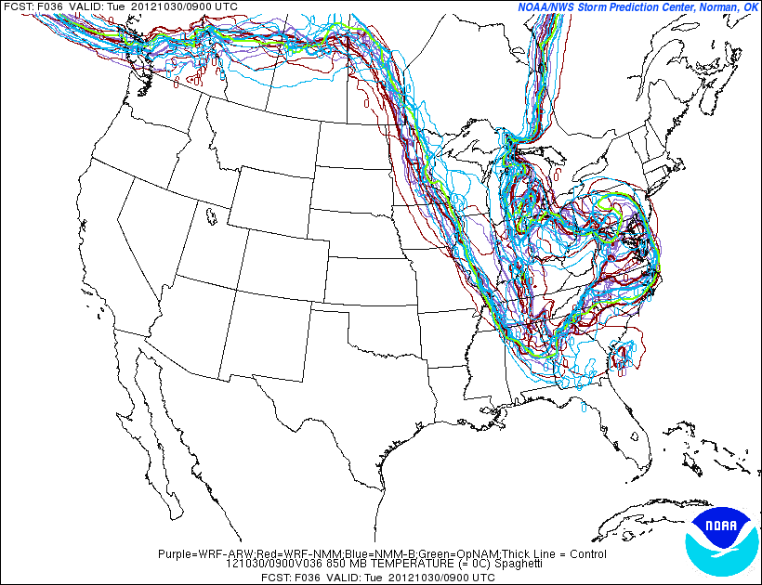
Spaghetti of 0°C 850 +36 h isotherms for Hurricane Sandy from NCEP SREF

Slide 30
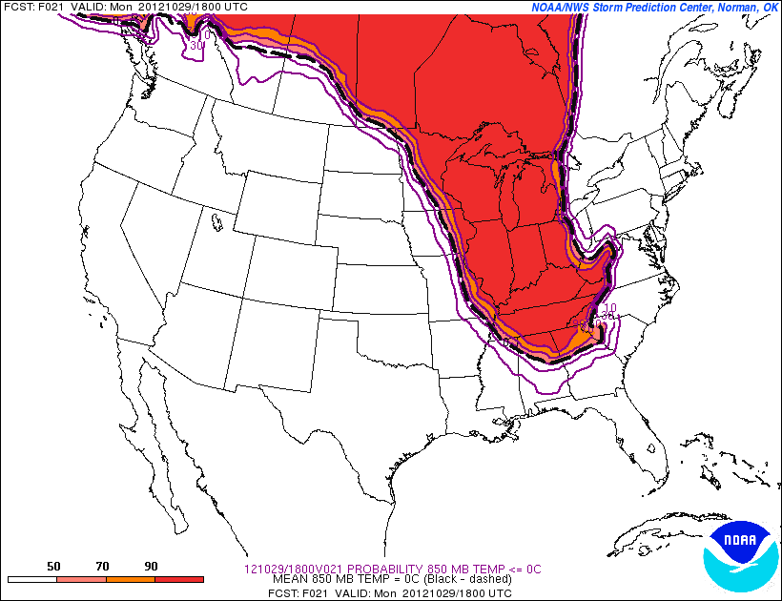
Probabilities of < 0°C at 850 hPa estimated directly from the SREF
+21 h forecast

Slide 31
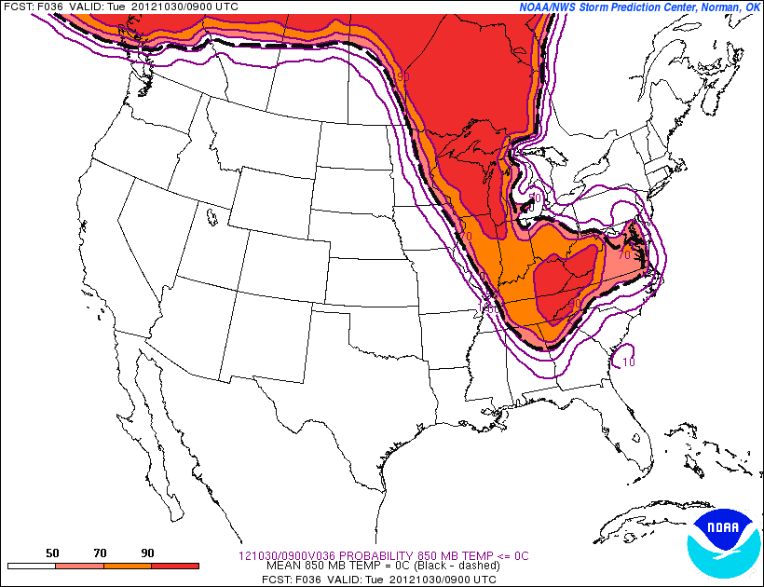
Probabilities of < 0°C at 850 hPa estimated directly from the SREF
+36 h forecast

Slide 32
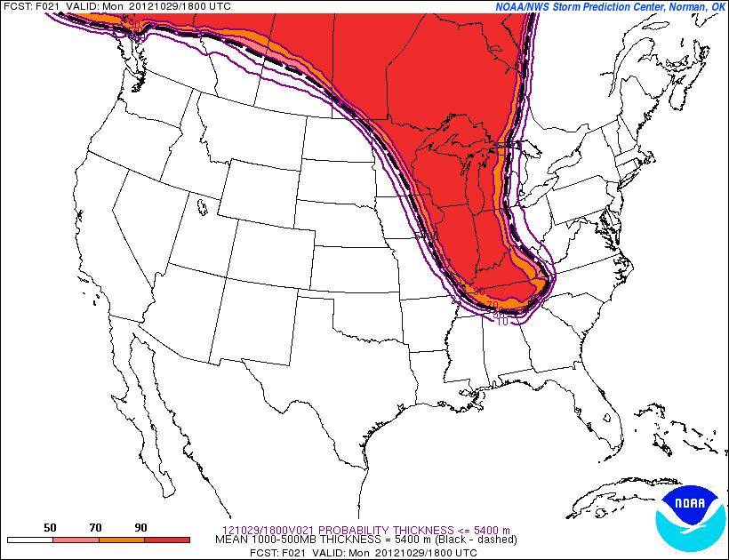
Probability < 5400 m
1000-500 thickness
+21 h forecast

Slide 33
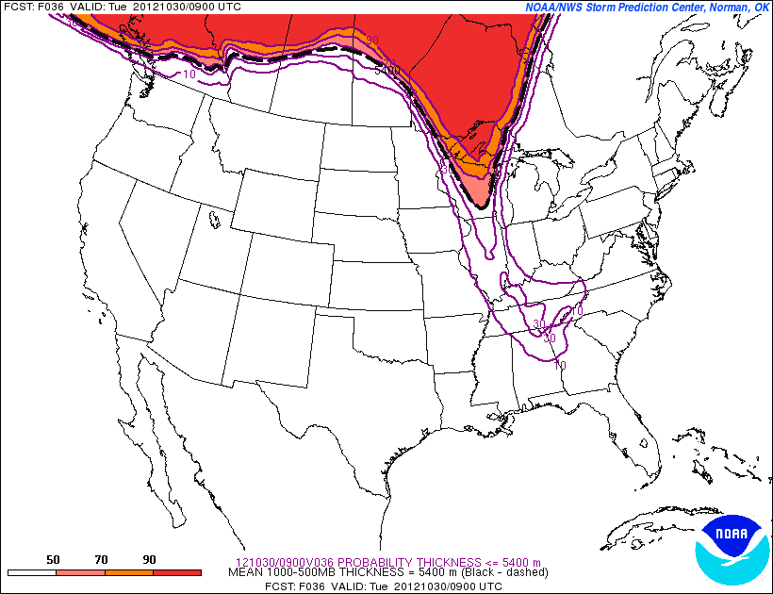
Probability < 5400 m
1000-500 thickness
+36 h forecast
Probability < 5400 m
1000-500 thickness
+36 h forecast

Slide 34
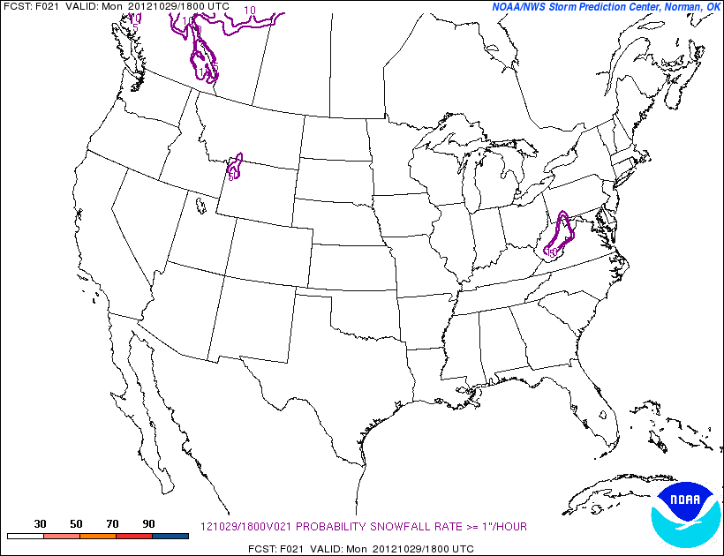
Snowfall rate > 1” (25.4 mm) per hour,.+21 h forecast

Slide 35
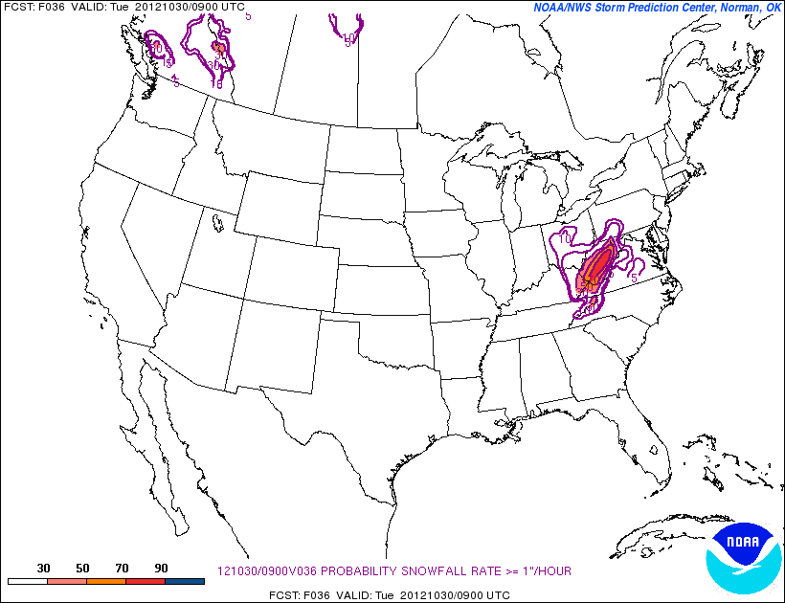
Snowfall rate > 1” (25.4 mm) per hour,.+36 h forecast

Slide 36
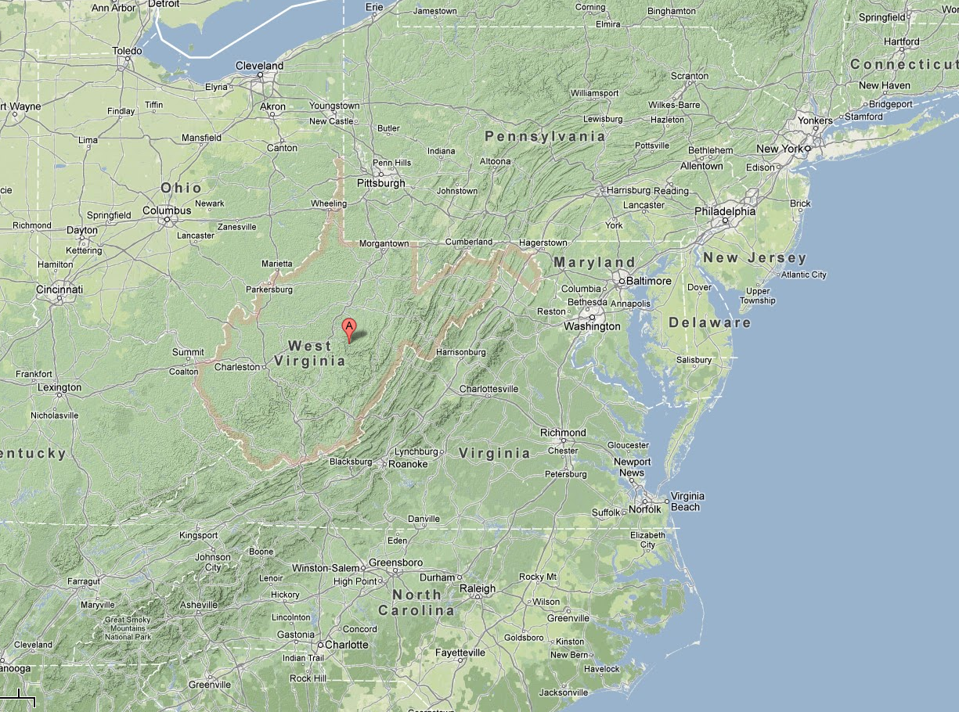

Slide 37
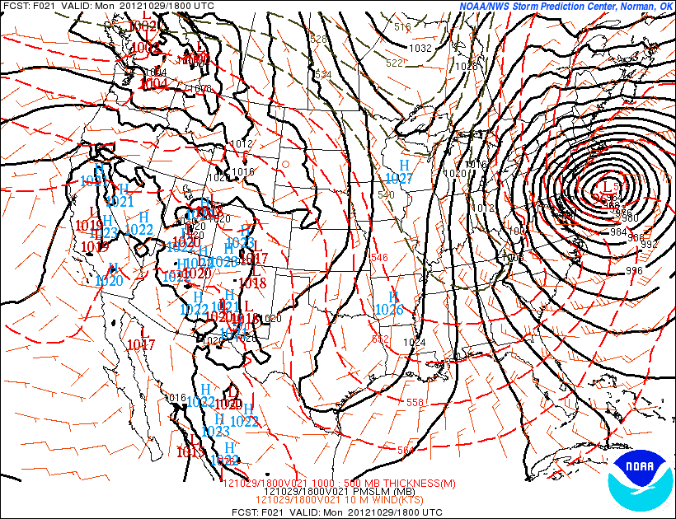
Reverse cold-air damming

Slide 38
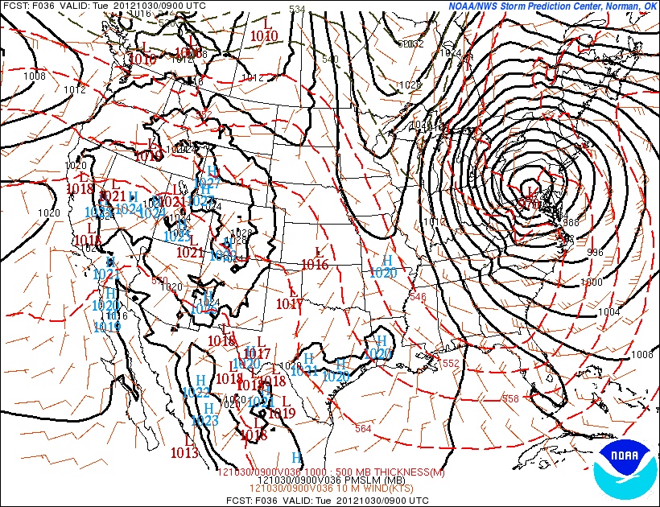
Reverse cold-air damming

Slide 39
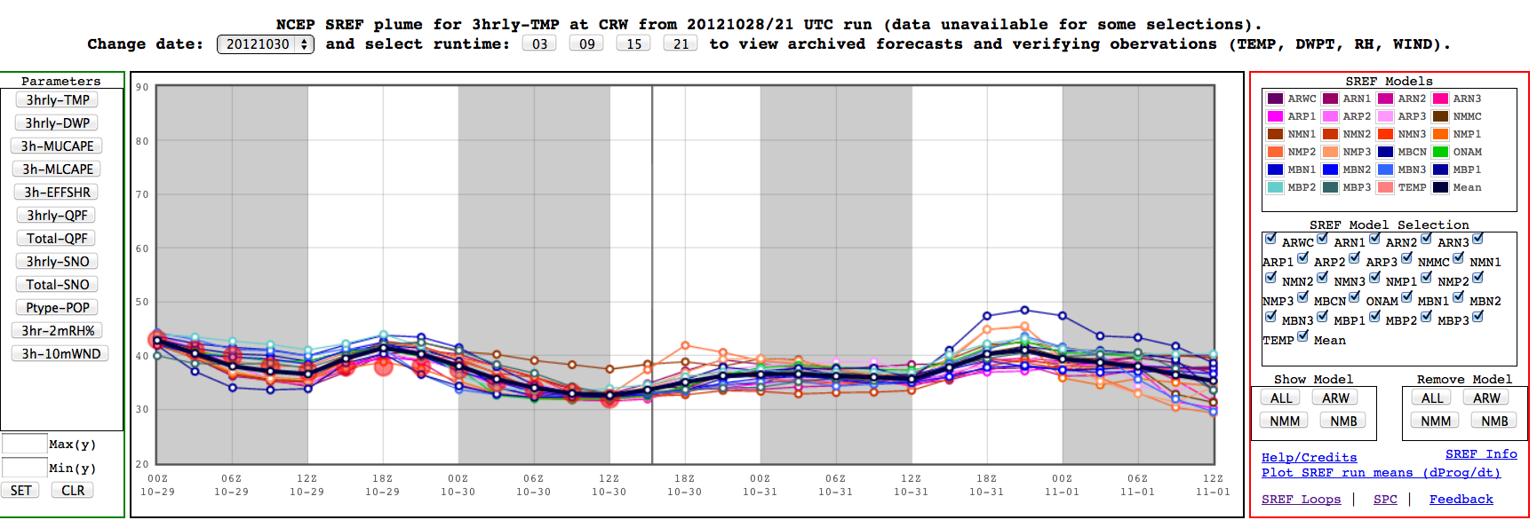
2-m temperature “plume diagrams” for CRW (Charleston) West Virginia

Slide 40
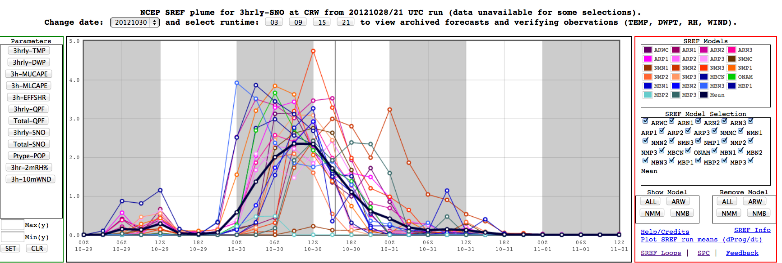
3-hourly snowfall accumulation for CRW (Charleston) West Virginia
Provides you with information on the range of possible starting and ending times,
peak snowfall rates.

Slide 41
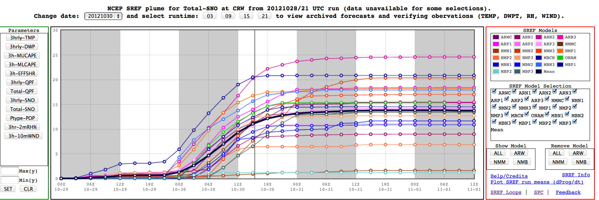
Accumulated snowfall “plume diagrams” for CRW (Charleston) West Virginia
Provides you with help in estimating the range of total snowfall

Slide 42
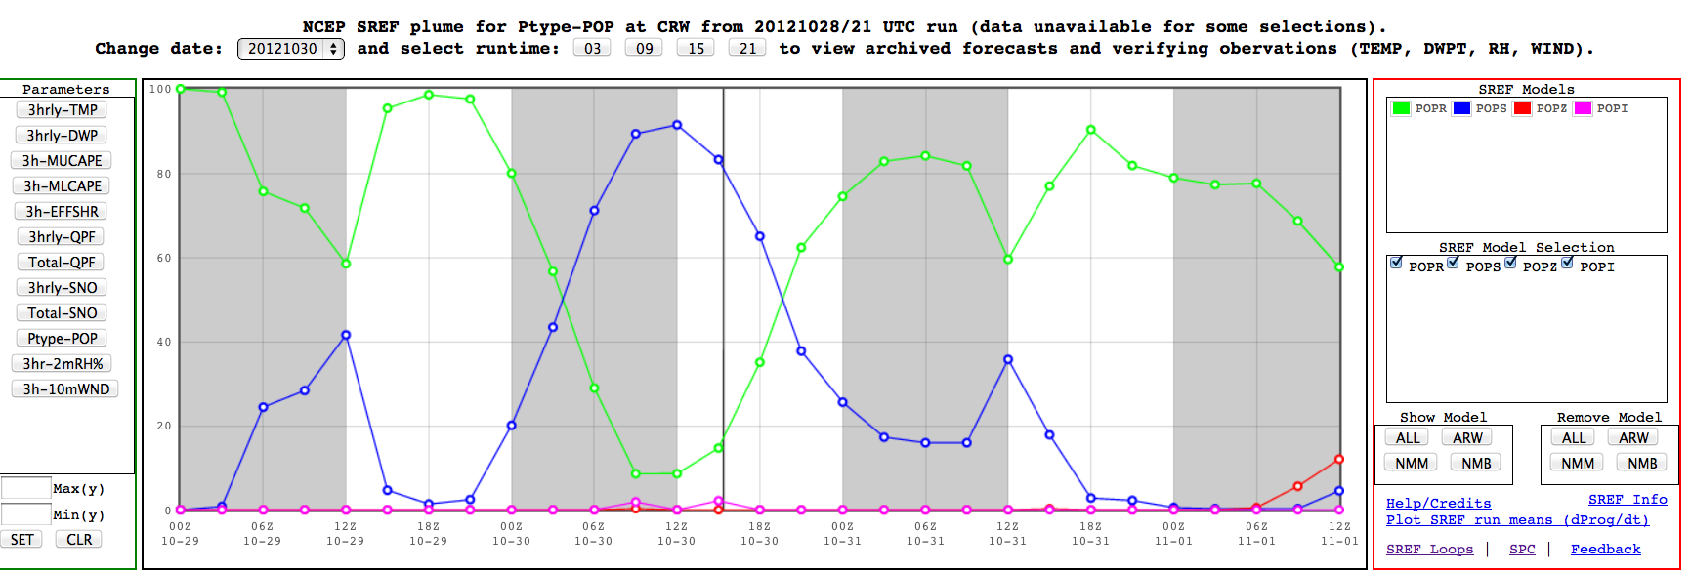
Probability of precipitation type for CRW (Charleston) West Virginia
Helpful in estimating probability of precipitation type.

Slide 43
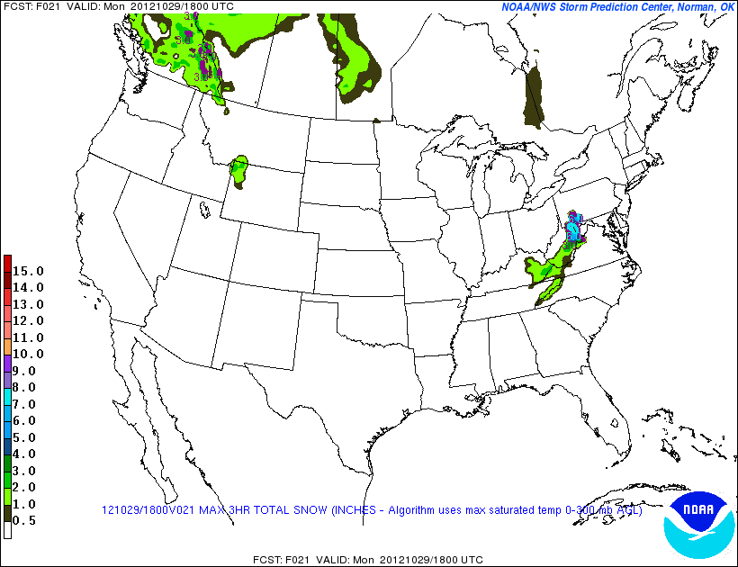
SREF max snowfall
+21 h

Slide 44
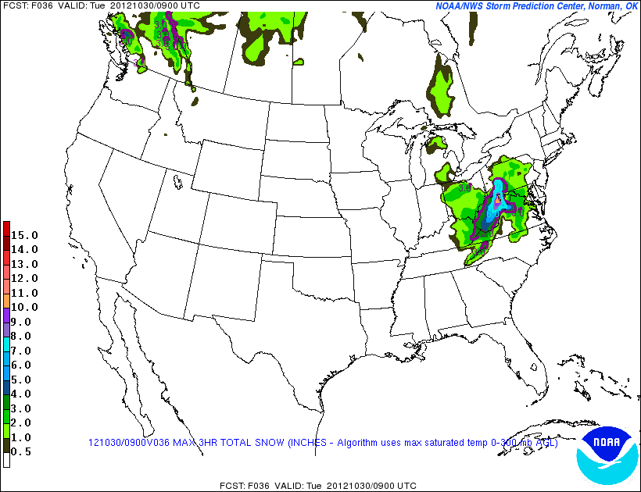
SREF max snowfall
+36 h

Slide 45
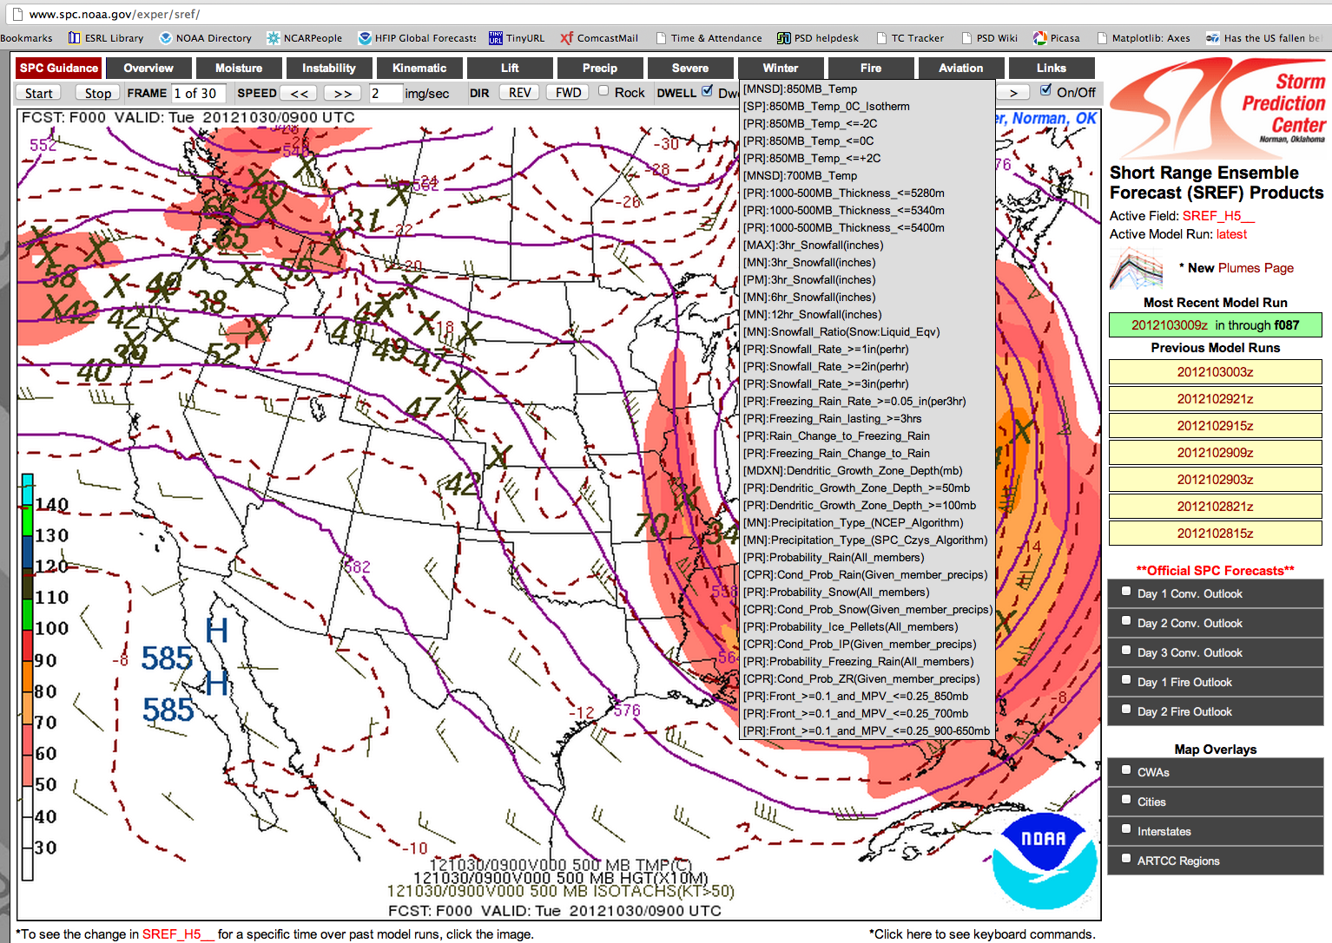
Many other products at http://www.spc.noaa.gov/exper/sref/

Slide 46
Some other ideas for creatively displaying and using ensemble data

Slide 47
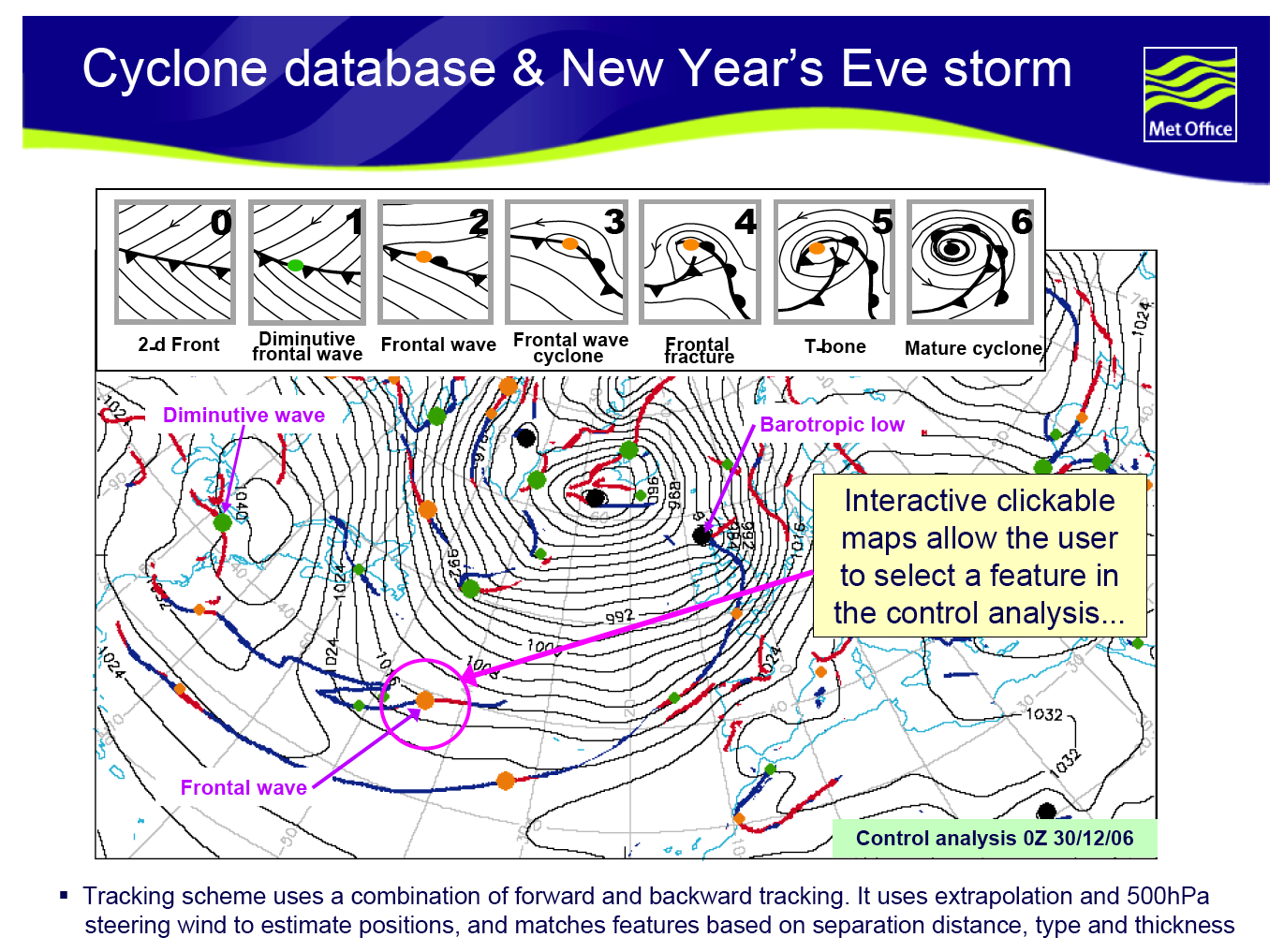
from Christine Johnson’s presentation at Nov 2007 ECMWF workshop on ensemble prediction

Slide 48
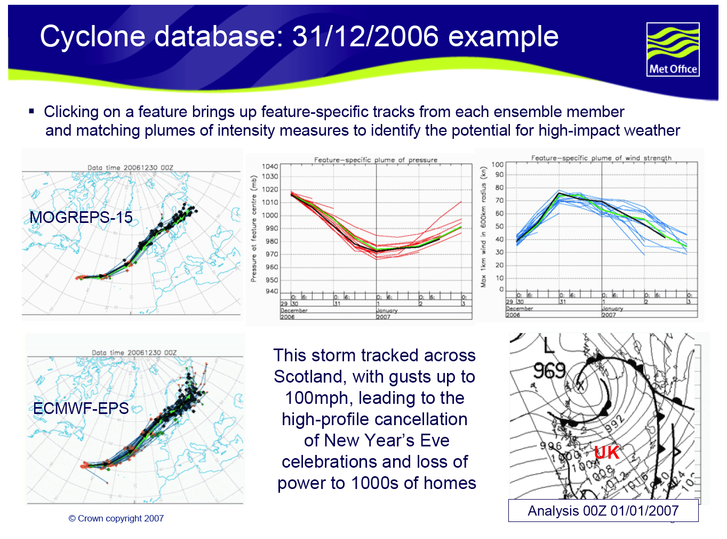
from Christine Johnson’s presentation at Nov 2007 ECMWF workshop on ensemble prediction

Slide 49
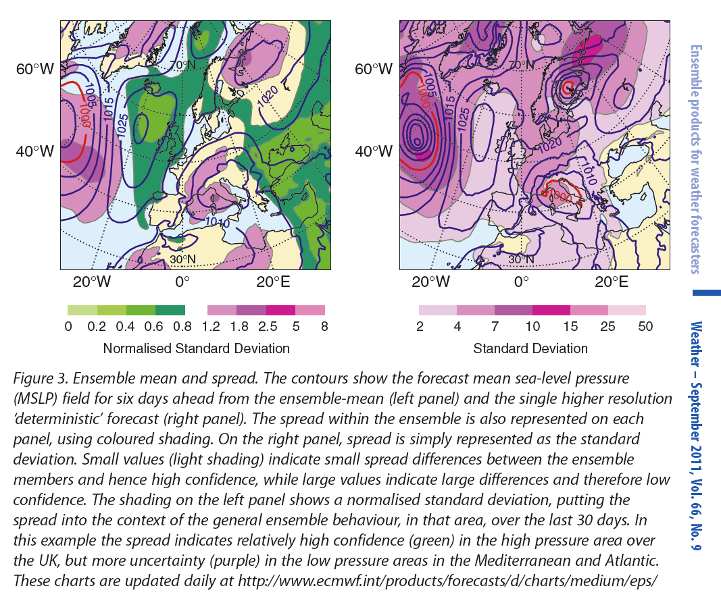
Mean and (normalized) standard deviation
c/o D. Richardson &
ECMWF Newsletter

Slide 50
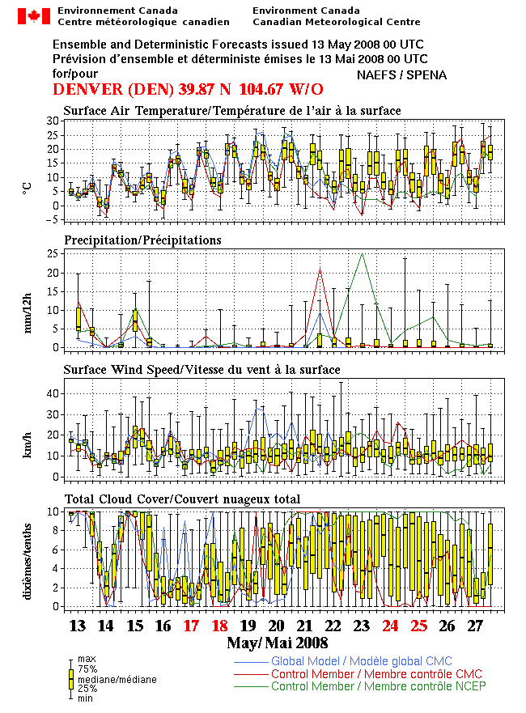
EPSgrams from
RPN Canada

Slide 51
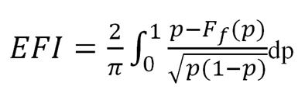
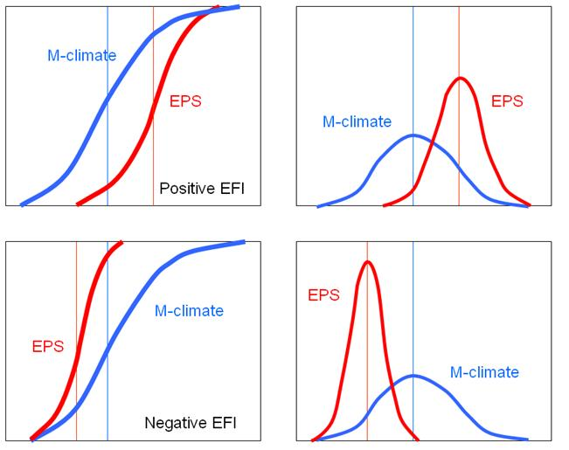
Using reforecasts in the absence of observations: the “Extreme Forecast Index”
We previously talked about
statistical post-processing as
a way of dealing with model
bias.
But what if you do have
reforecasts but you don’t have
a long time series of observed/
analyzed data.
Can you leverage your
reforecast to tell you something
about how unusual today’s
weather forecast is?
ECMWF’s Extreme Forecast
Index does this.
http://www.ecmwf.int/products/forecasts/guide/Calculating_the_EFI.html

Slide 52
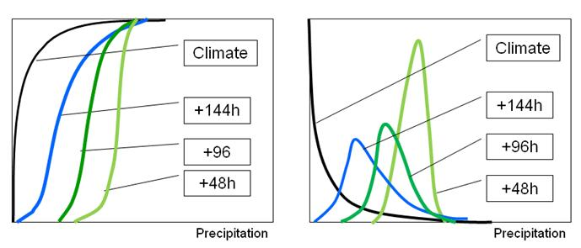
EFIs typically get more extreme in advance of a high-impact event
c/o ECMWF

Slide 53
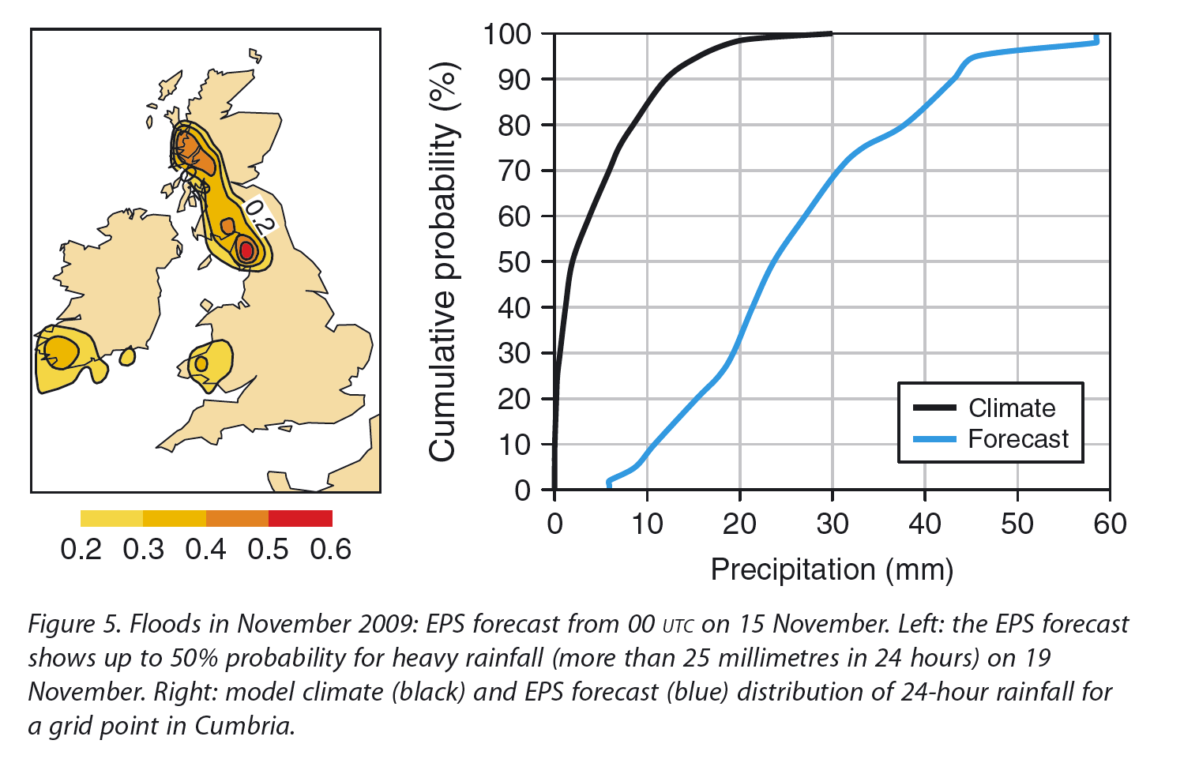
EFI

Slide 54
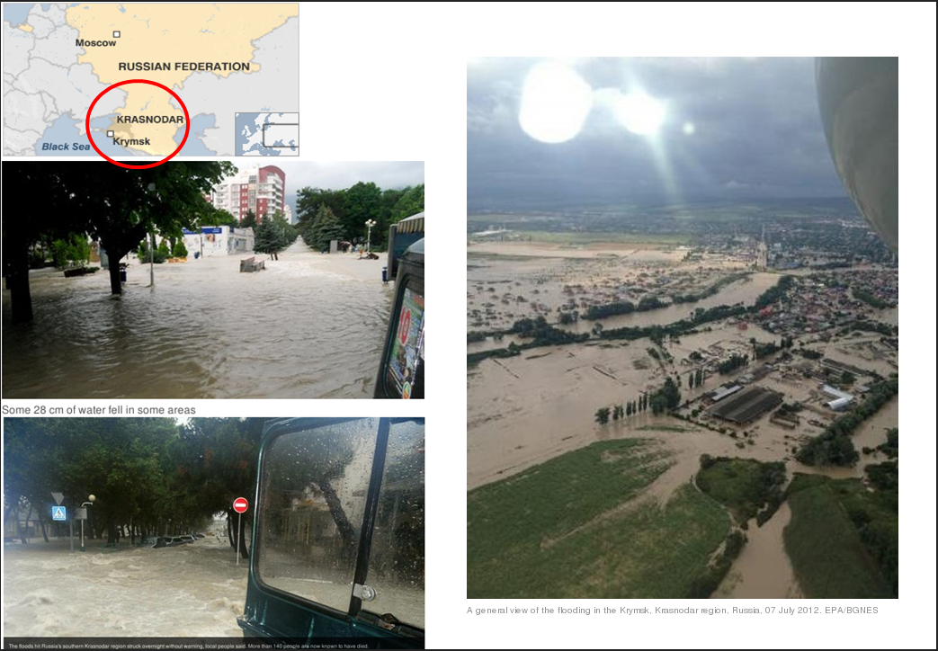
Krasnodar region, Russia, 6-7 July 2012
Severe flash floods caused by torrential rain killed more than 140 people in Krasnodar region in the early hours of Saturday morning, 7 July 2012. Some 280 mm of rain fell in some areas according to the local authorities.

Slide 55
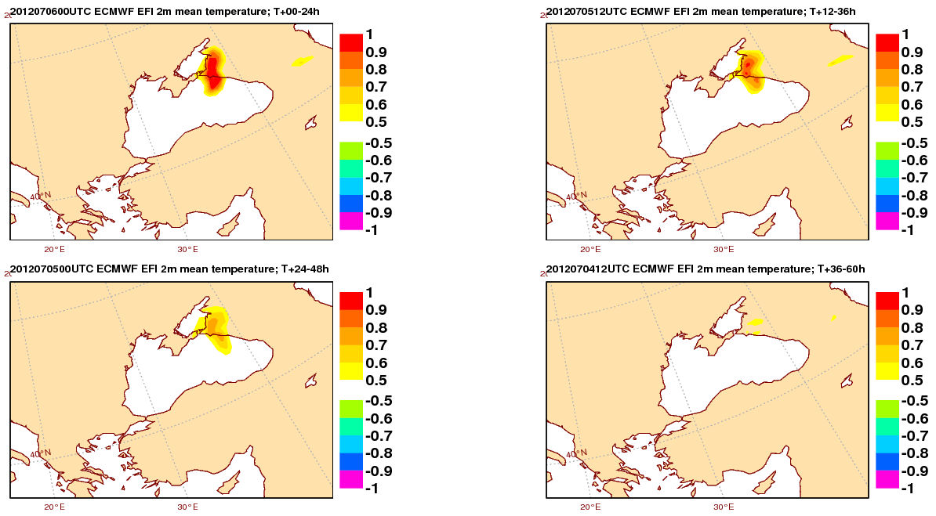
EFI for total precipitation
t+0-24h
t+12-36h
t+24-48h
t+36-60h
Very strong signal of heavy precipitation on the day of the event. Some indications 2 days in advance.

Slide 56
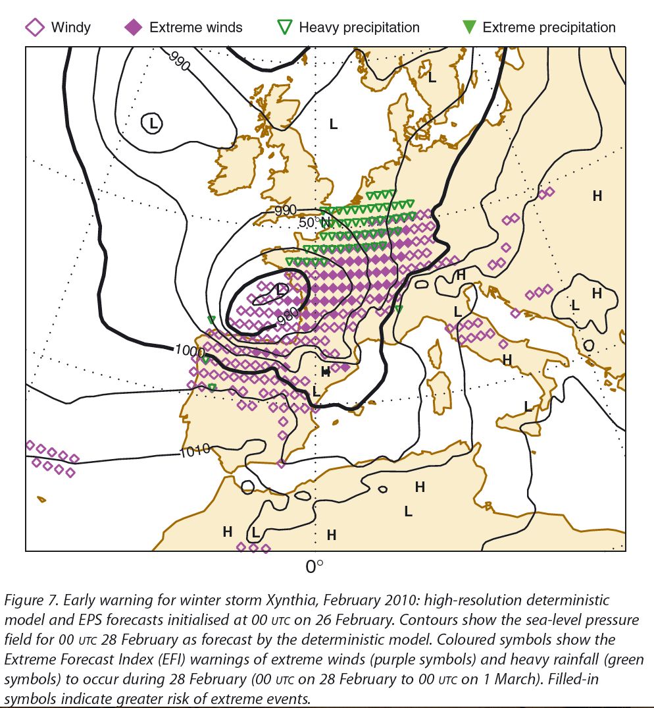
EFI display combining wind and precipitation
c/o David Richardson,
ECMWF

Slide 57
Will your meteorological display system have the sorts of plots
I’ll show you here?
I don’t know.
If you like these, push your weather services to make these graphics more readily available.

Slide 58
Conclusions
Many ensemble display techniques out there.
Understanding how ensembles work and their limitations can help you learn to use the ensemble guidance more productively.

Slide 59
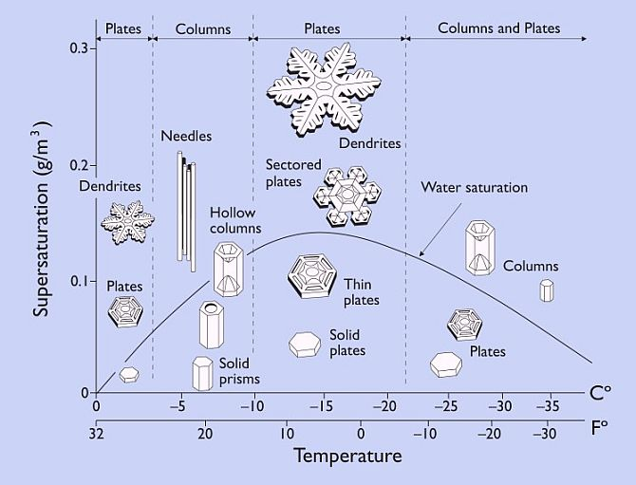
Dendritic growth zone: depth of -12 to -18C layer

