Slide 1
Statistical Post-Processing of Ensemble Weather Predictions
NOAA Earth System
Research Laboratory
Tom Hamill
NOAA Earth System Research Lab
tom.hamill@noaa.gov

Slide 2
Statistical post-processing, holistic view
Would like probability distribution ϕ of true state T (or samples thereof) given all available information, including today’s ensemble forecast
z might be past observations and/or forecasts, output from other modeling systems, your intuition, etc.
ϕ might be a field rather than a scalar

Slide 3
Statistical post-processing, in terms of specific rationales.
Rationale 1: Infer large-sample probabilities from small ensemble, assuming ensemble is calibrated (truth and ensemble drawn from same distribution).
Rationale 2: Remove biases, increase forecast reliability while preserving as much sharpness as possible. Guided by discrepancies between past observations and forecasts.
Rationale 3: Predict probabilities of a variable that may not be forecast by the model using variables that are forecast by the model, e.g., tornado probability from CAPE, shear.
Combinations of these three, or perhaps others.

Slide 4
Rationale 1: Infer large-sample probabilities from small ensemble, assuming ensemble is calibrated

Slide 5
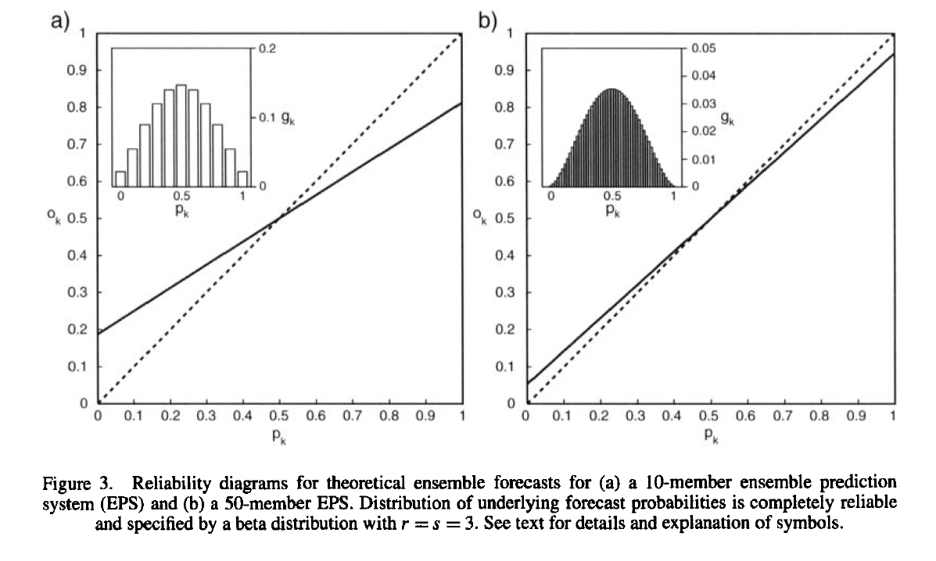
Perfect model, but finite ensemble size → unreliable probabilities
10 members
50 members
Probabilities directly estimated from an ensemble system where truth and ensemble members drawn from the same distribution. With only a few members, you may not produce reliable probabilities.
ref: Richardson 2001 QJRMS

Slide 6
Imagine: your
20-member
storm-scale ensemble
(which is a calibrated
system, truth consistent
with a random draw
from ensemble)
Your job: estimate
reliable probabilities
on the grid.

Slide 7
Imagine: your
20-member
storm-scale ensemble
(which is a calibrated
system, truth consistent
with a random draw
from ensemble)
Your job: estimate
reliable probabilities
on the grid.
Zero probability
for this cell? Yes if
you use ensemble
relative frequency

Slide 8
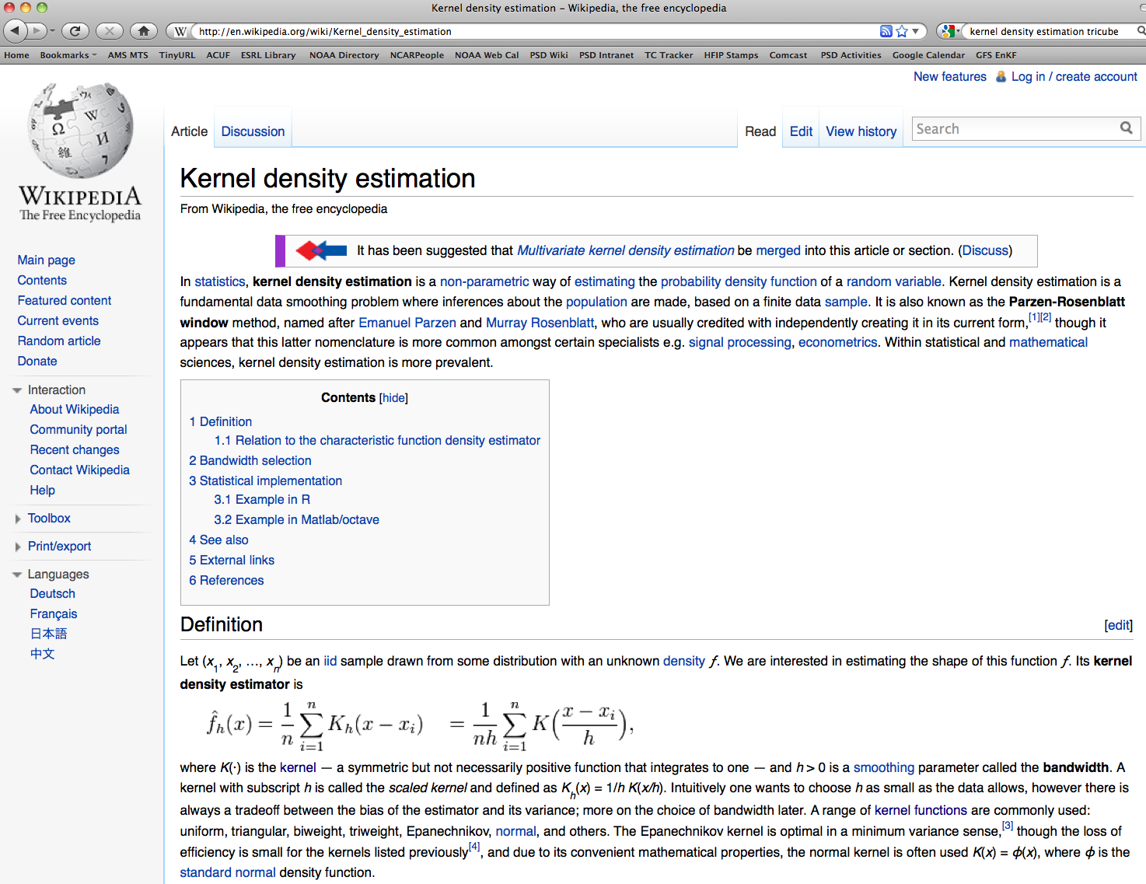
There are many ways to estimate probabilities you’d get
with a large sample, such as with kernel density estimation.

Slide 9
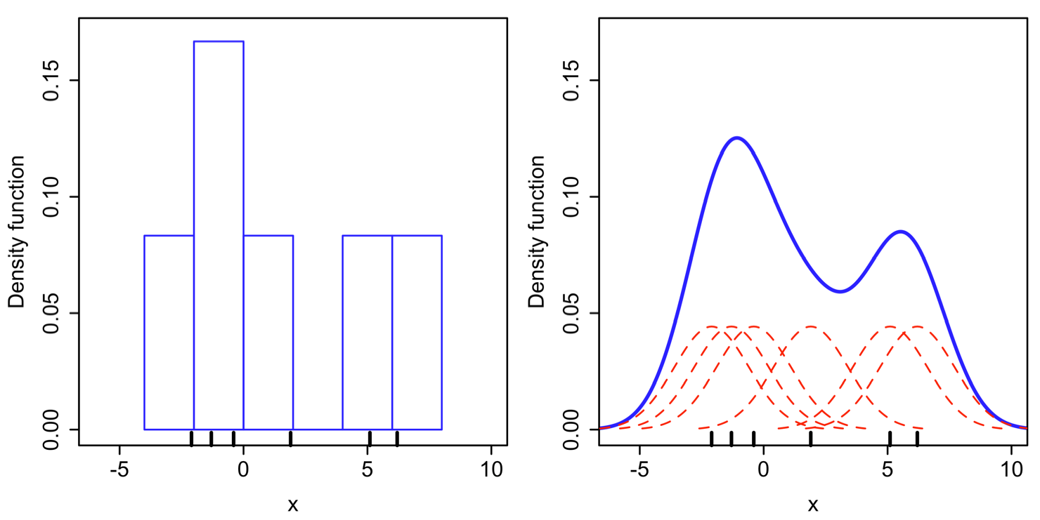
Density estimate from histogram
and from kernel density estimation.

Slide 10
Density estimate from histogram
and from kernel density estimation.
Key question: how do you set the “kernel width?”

Slide 11
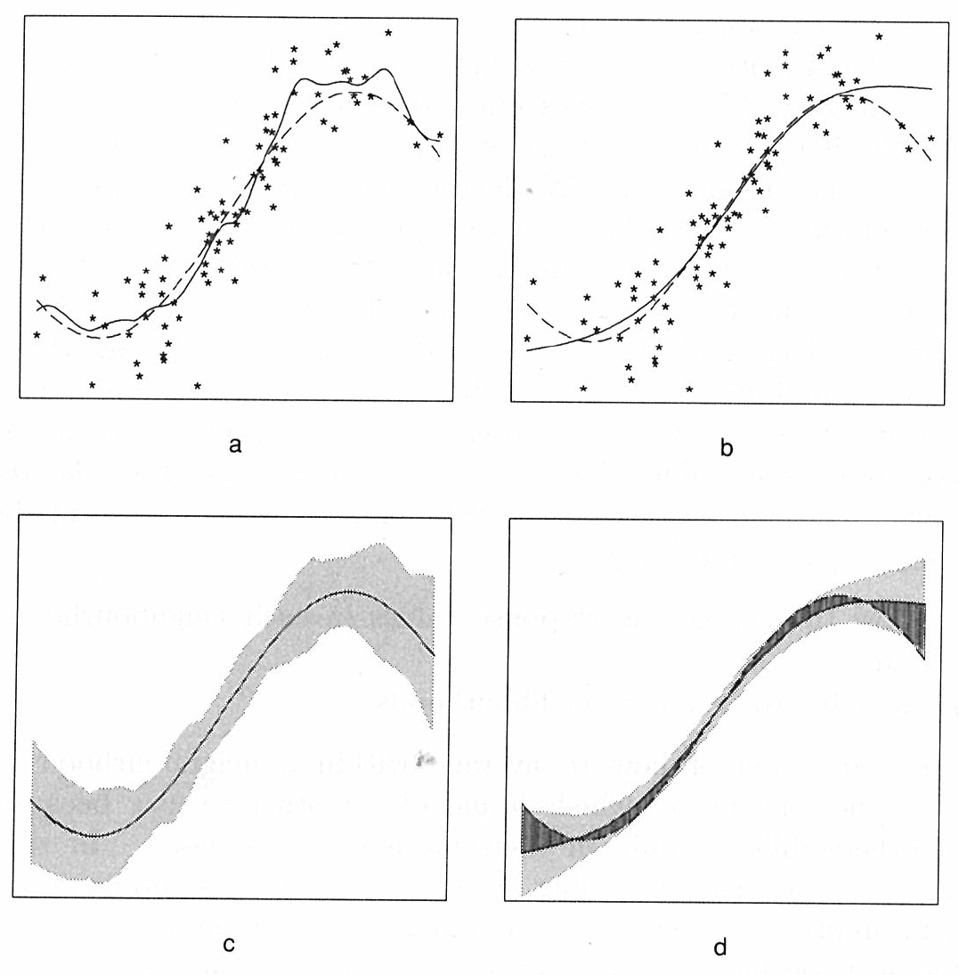
“Bias-variance tradeoff”
Narrow kernel width
Wider kernel width
Example: 80 samples from
Y = sin(X) + e, where X~N(0,1), e~N(0,1/9).
Large grey area shows twice the standardized pointwise errors, reflect the variance under repeated samplings of 80 pairs.
Darker grey region shows bias, difference between generating curve and average value of the estimated function.
Ref: Hastie and Tibshirani, “Generalized Additive Models” (an excellent book)

Slide 12
More on “bias-variance tradeoff”
Same dilemma in the decision of how many predictors to use in a linear regression.
Need to select some criteria to decide the optimal tradeoff. Perhaps to minimize mean squared error (MSE)?
estimated value
at data point x _{i}
actual value
at data point x _{i}
variance of
estimate
value, perhaps
by “jackknife”
squared bias of
estimated value
Ref: ibid.

Slide 13
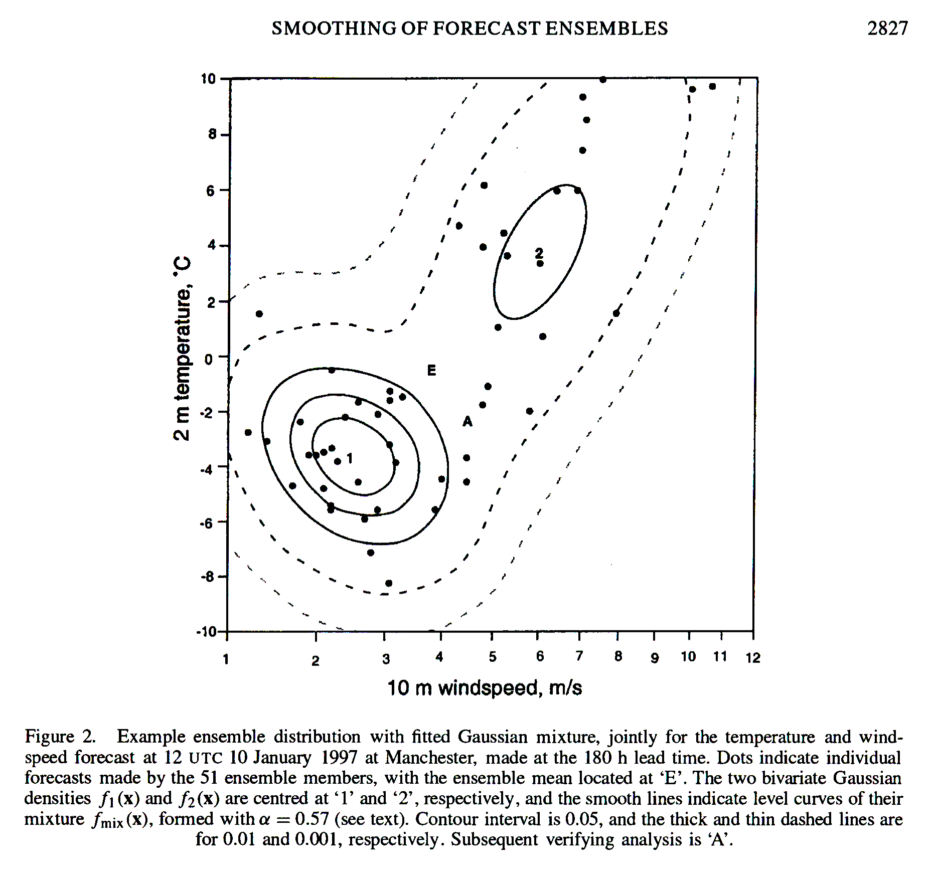
2-D example of inferring large-sample pdf from small-sized ensemble
Wilks (QJRMS, 128, p 2821)
explored fitting parametric
distributions, or mixtures
thereof, to ECMWF forecasts
in perfect-model context.
Power-transformed non -
Gaussian variables prior to
fitting.

Slide 14
Inferring large-sample pdf from small-sized ensemble
kernels of probability density
around each sample, pdf
constructed from sum of these
Wilks (QJRMS, 128, p 2821)
explored fitting parametric
distributions, or mixtures
thereof, to ECMWF forecasts
in perfect-model context.
Power-transformed non -
Gaussian variables prior to
fitting.

Slide 15
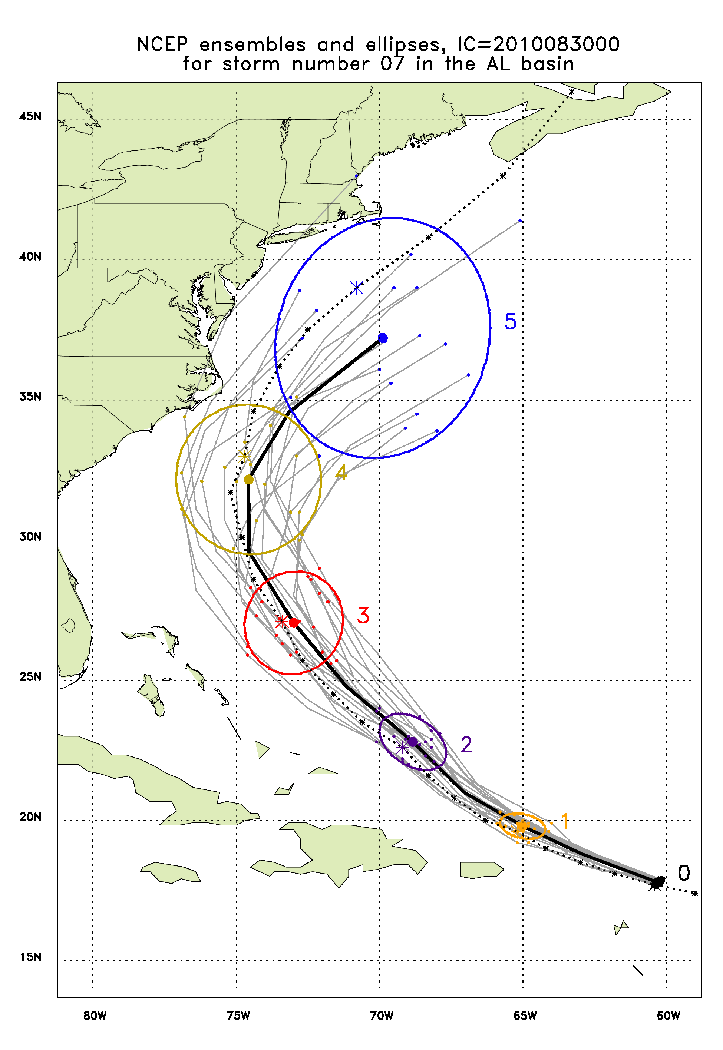
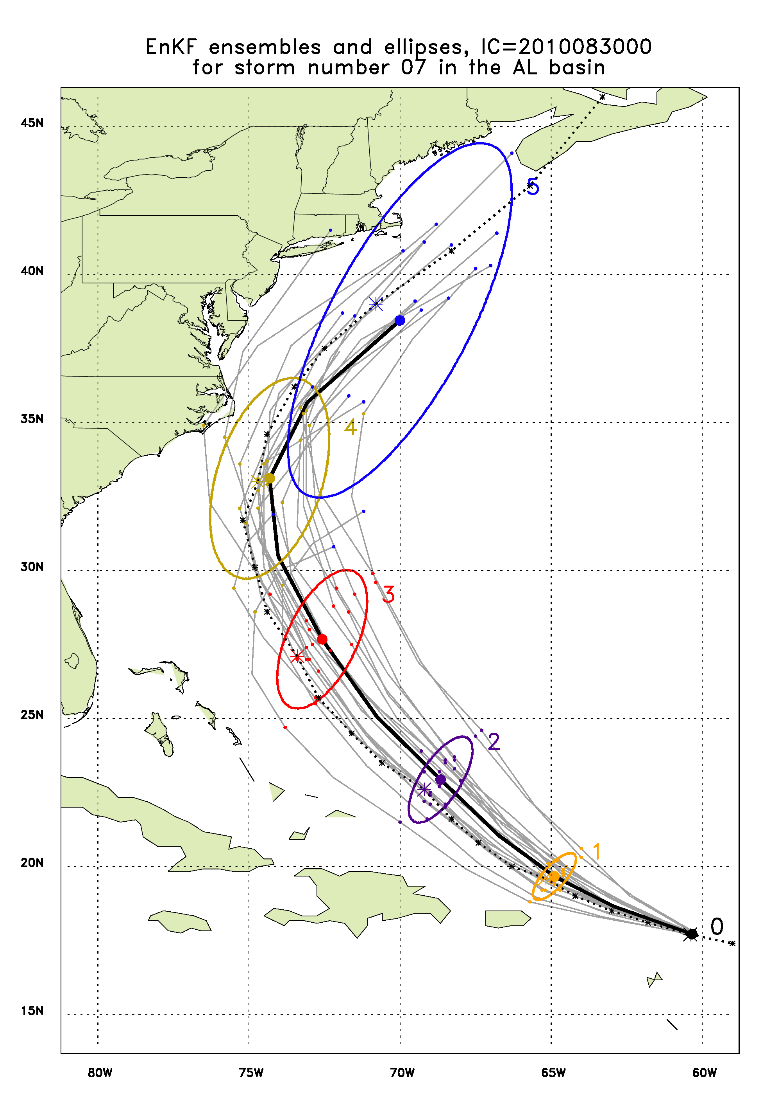
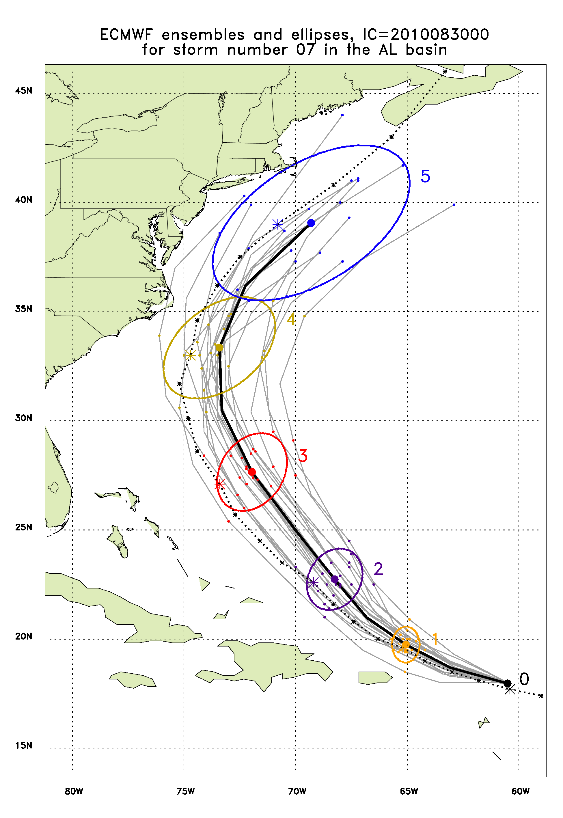
Earl, 2010/08/30/00Z
ellipses from a bivariate normal distribution fit
to the ensemble data. Contours enclose 90%
of the fitted probability.

Slide 16
Rationale 2: Remove biases, increase forecast reliability while preserving as much sharpness as possible. Guided by discrepancies between past observations and forecasts. [let’s call this “post-processing” now]

Slide 17
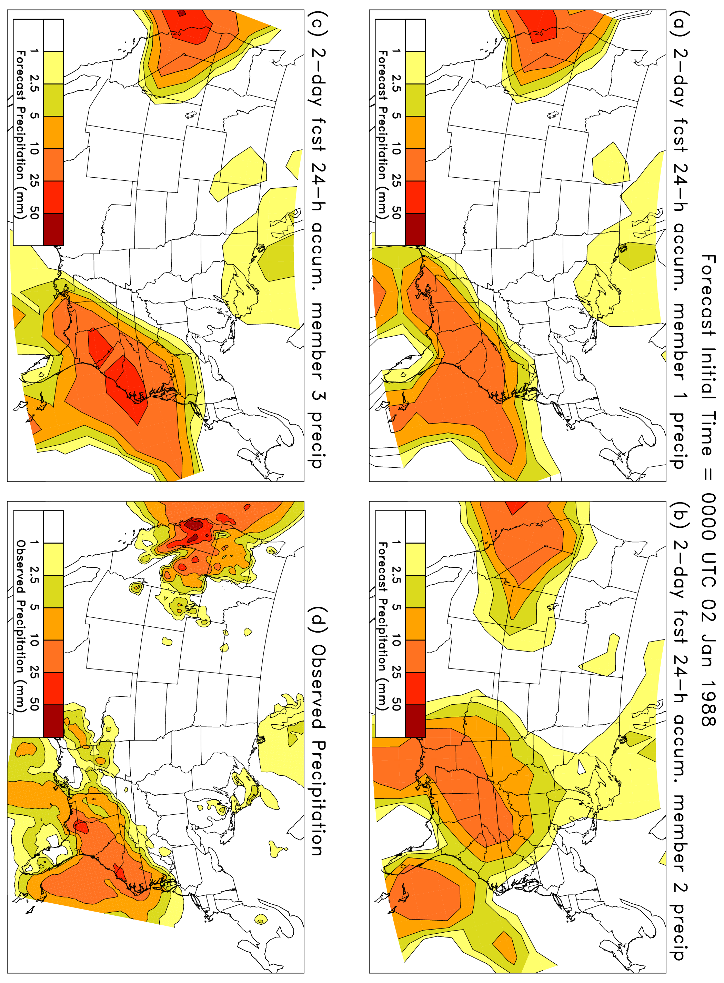
Ensemble-base probabilistic forecasts: problems we’d like to correct through post-processing

Slide 18
possible conditional bias (drizzle over-forecast)

Slide 19
(2) ensemble members too
similar to each other (or
ensemble size too small).

Slide 20
(3) Ensembles are too smooth, not capturing intense local
precipitation due to orographic forcing. Downscaling needed.

Slide 21
Post-processing of PQPF & rare events: importance of sample size
Want lots of old forecast cases that were similar to today’s forecast. Then the difference between the observed and forecast on those days can be used to calibrate today’s forecast.
(this has motivated our exploration of reforecasts)

Slide 22
Key post-processing questions
Is there a best technique, or best for this particular forecast problem?
How much training data (past forecasts & obs/analyses) do you have / need?
Generally, more needed to do good job with rare events, longer-lead forecasts where chaotic noise is large.
Tradeoff between the two:
Lots more algorithm development involved in trying to get a good result with a short training data set, but less computations required.

Slide 23
Disadvantages to post-processing
Post-processing won’t correct the underlying problem. Prefer to achieve unbiased, reliable forecasts by doing numerical modeling correctly in the first place.
No one general approach that works best for all applications.
Corrections may be model-specific; the calibrations for NCEP v 2.0 may not be useful for ECMWF, or even NCEP v 3.0.
Simple techniques applied to date mostly focus on point-by-point post-processing, may lose spatial correlation information of original ensemble.
Could constrain model development. Calibration ideally based on long database of prior forecasts (reforecasts) from same model. Upgrading model good for improving raw forecasts, may be bad for skill of post-processed forecasts.
Users beware: Several calibration techniques that have been recently proposed may only work properly in certain circumstances. Can’t use naively.

Slide 24
A quick survey of common post-processing techniques
Simpler methods
Gross bias correction
Kalman-inspired filters
CDF-based bias corrections
Linear regression
Some more complex methods
Logistic regression
Analog approach
Bayesian model averaging (MDL’s EKDMOS very similar)
Bayesian processor of forecasts
Non-homogeneous Gaussian regression
Rank histogram-based calibration

Slide 25
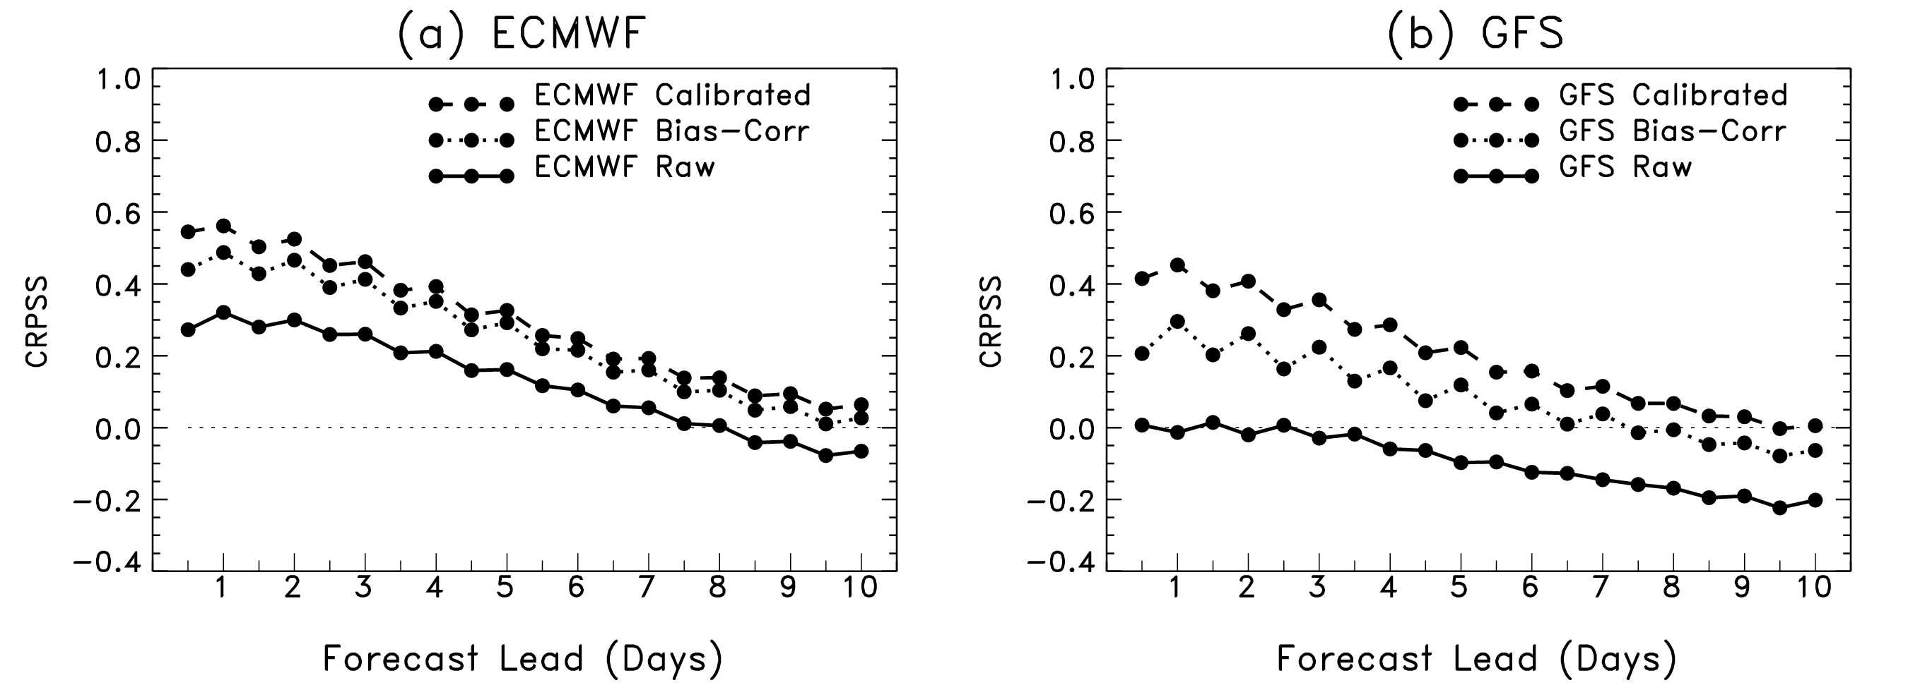
Gross bias correction
Given sample of past forecasts x₁, … , x_{n} and observations y₁, … , y_{n} , gross bias correction is simply
In surface-temperature calibration experiments with NCEP’s GFS and ECMWF,
simple gross bias correction achieved a large percentage of the improvement
that was achieved through more sophisticated, bias+spread correction.
Ref: Hagedorn et al., MWR, 2008, in press.

Slide 26
Gross bias correction
Effectively, the implied statistical model is the following:
assumes normality of errors; uncorrelated errors, error not state dependent (next slide).

Slide 27
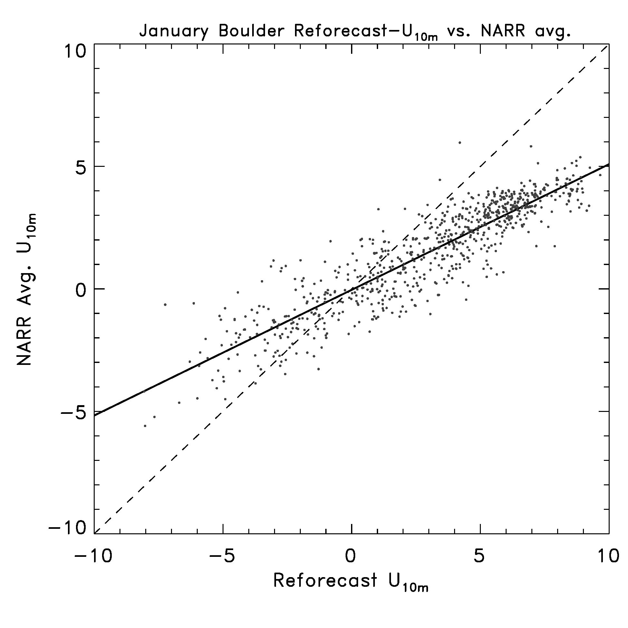
State-dependent errors
For this 10-m wind,
the bias is conditional,
depends on the forecast
amount. Linear regression
(discussed later) a
much better choice.

Slide 28
“Kalman-inspired” filter
Today’s
forecast bias
estimate
Yesterday’s
bias estimate
Yesterday’s
observed bias
Kalman gain: weighting applied
to residual. Larger K_{t}, more weight
to recent data, and vice versa.
Pro:
memory in system, amount tunable through K_{t}
adaptive
Con:
assuming there is state-dependent bias, takes time to adapt
after regime change and change of state.
Ref: Cheng and Steenburg, conferences.dri.edu/WxPrediction/Weather12/Cheng_Steenburgh.ppt

Slide 29
An alternative “analog” formulation
PRED
Standard Kalman-type filter
OBS
day₋₇
day₋₆
day₋₅
day₋₄
day₋₃
day₋₂
day₋₁
t = 0
PRED
Analog
Kalman-type filter
OBS
day₋₆
day₋₅
day₋₃
day₋₂
day₋₁
day₋₇
day₋₄
farthest analog
closest analog
c/o Luca delle Monache, NCAR/RAL, MWR, submitted.

Slide 30
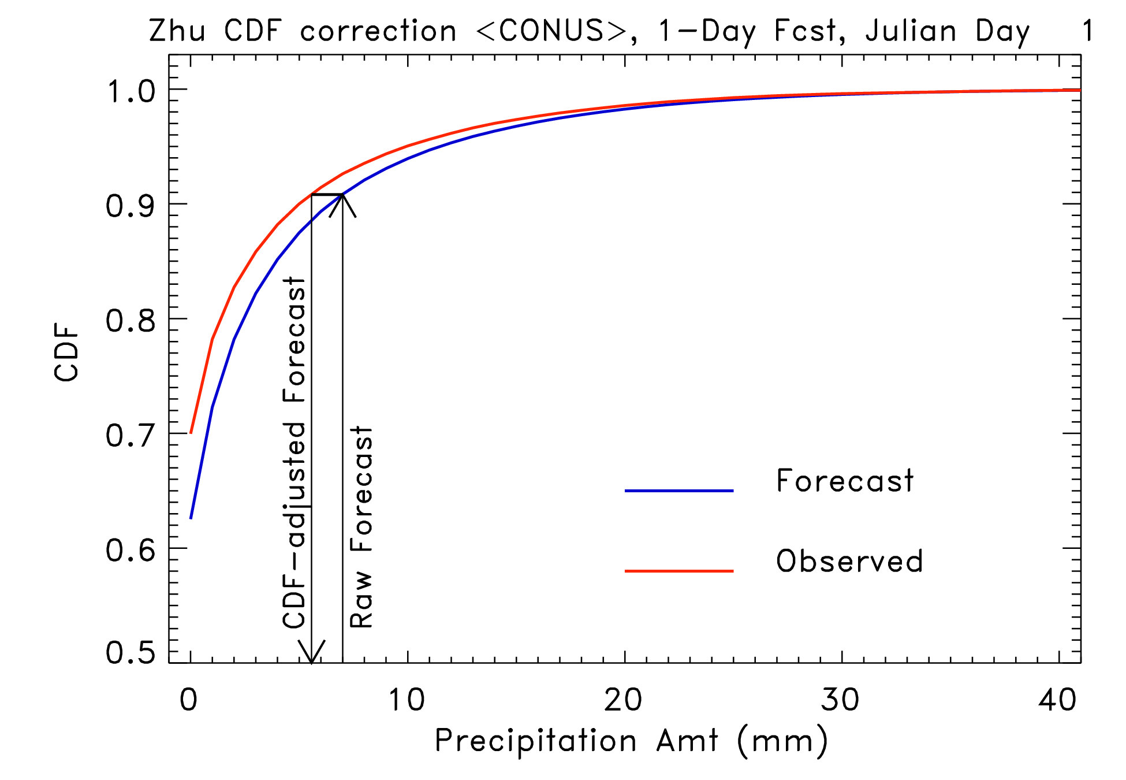
CDF-based bias corrections
Use difference
in CDFs to correct
each ensemble
member’s forecast.
In example shown,
raw 7-mm forecast
corrected to ~5.6 mm
forecast.
NOTE: bias only, not
spread correction or
downscaling.
Ref: Zhu and Toth, 2005 AMS Annual Conf., and many others

Slide 31
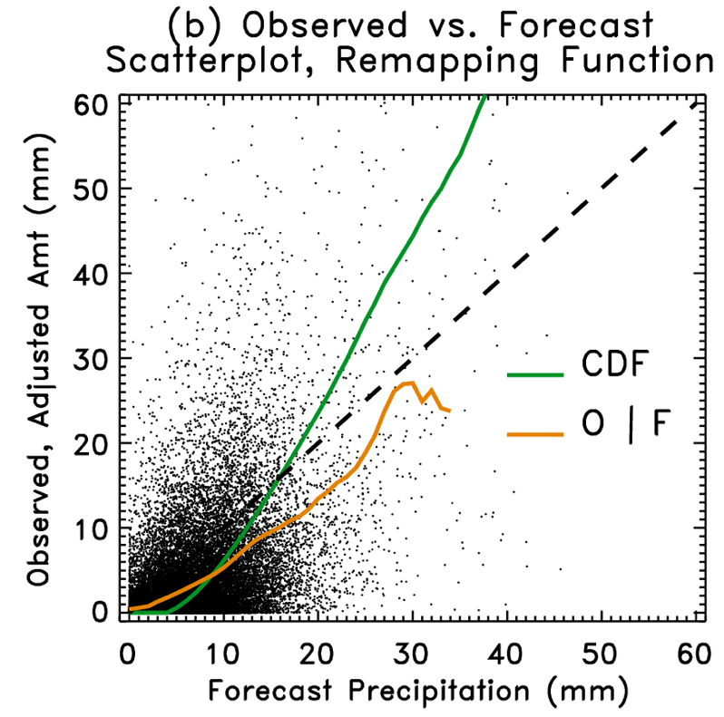
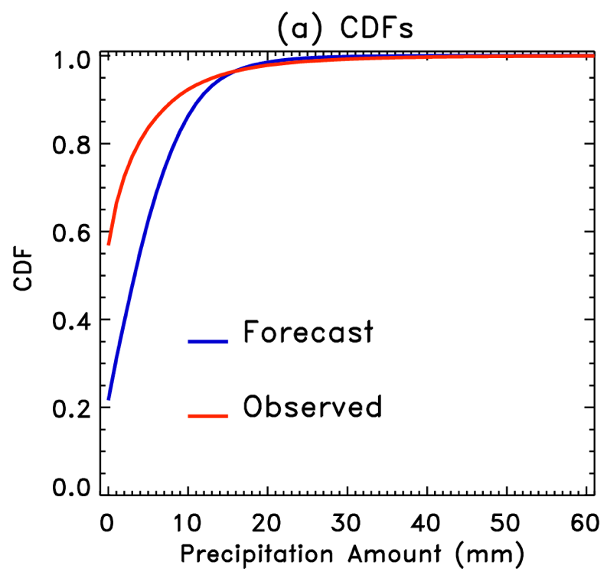
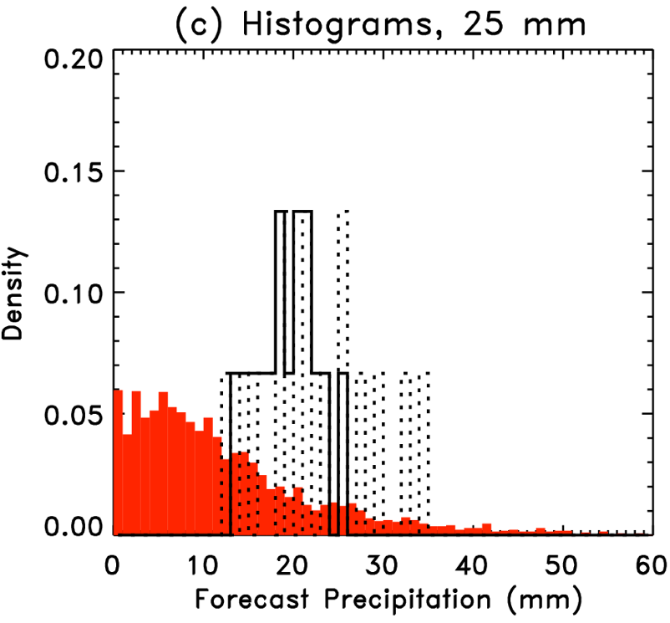
CDF corrections: example of problem
1-day forecasts in Northern Mississippi (US), mid-August.
Consider a forecast precipitation of 25 mm.
Raw
CDF bias
corrected
O | F
CDF-based corrections at high amounts suggest further increasing precipitation amount forecast. O|F indicates
decrease.
At root of problem is assumption that Corr (F,O) ≅ 1.0

Slide 32
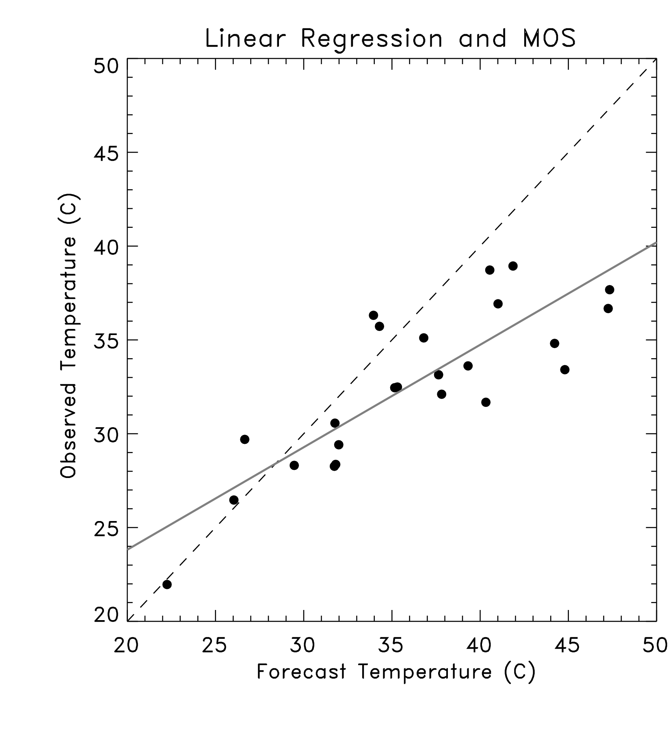
Linear regression
Corrects for state-dependent
bias; when no predictive
skill of forecast, regresses
to observed sample climatology.
Diagnostics include statistics
on error, so can infer (largely
non-state dependent) pdf.
Ref: any applied statistics textbook

Slide 33
When is linear regression approach useful?
Some assumptions:
Normality of errors.
Linear relation between predictors and predictand.
Homoscedasticity, error variance doesn’t depend on state x.
Errors are uncorrelated between samples.
Ref: any applied stats text, e.g., Neter, Wasserman, and Kutner, Applied Linear Statistical Models.

Slide 34
When is linear regression approach useful?
Some assumptions:
Normality of errors.
Linear relation between predictors and predictand.
Homoscedasticity, error variance doesn’t depend on state x.
Errors are uncorrelated between samples.
Well, there goes using
this for precipitation!
Ref: any applied stats text, e.g., Neter, Wasserman, and Kutner, Applied Linear Statistical Models.

Slide 35
When is linear regression approach useful?
Some assumptions:
Normality of errors.
Linear relation between predictors and predictand.
Homoscedasticity, error variance doesn’t depend on state x.
Errors are uncorrelated between samples.
Problematic for weather, if samples every day.
“Serial correlation,” smaller “effective sample size.”
But can deal with this problem.
Ref: any applied stats text, e.g., Neter, Wasserman, and Kutner, Applied Linear Statistical Models.

Slide 36
Linear regression – big assumption!
unknown,
with error
known, assumed no error
In our practice, the Y’s typically have some small error (obs)
and the X’s have larger error (forecast model state).
Practically, the method works well enough to gloss over what
error ε_{i} represents, but there is a whole branch of statistics
(regression with “errors in variables”) that deals with this more
formally. This incorrect assumption applies to most of the rest
of the methods discussed, too.
Ref: Casella and Berger, Statistical Inference, 1990. Also Vannitsem & Nicolis, Feb 2008 MWR (though I
think their analysis is unfairly critical of MOS)

Slide 37
Model Output Statistics (“MOS”) most elements based on multiple linear regression
KBID GFS MOS GUIDANCE 2/16/2005 1800 UTC
DT /FEB 17 /FEB 18 /FEB 19
HR 00 03 06 09 12 15 18 21 00 03 06 09 12 15 18 21 00 03 06 12 18
N/X 32 40 25 35 19
TMP 42 39 36 33 32 36 38 37 35 33 30 28 27 30 32 31 28 25 23 19 27
DPT 34 29 26 22 19 18 17 17 17 17 17 15 14 13 11 8 7 6 5 2 4
CLD OV FW CL CL SC BK BK BK BK BK BK BK SC BK BK BK BK FW CL CL CL
WDR 26 30 32 32 32 31 29 28 30 32 31 31 31 31 30 29 31 32 33 33 27
WSP 12 12 12 11 08 08 09 08 09 09 10 10 10 12 13 13 15 16 15 09 08
P06 17 0 0 0 4 0 10 6 8 0 0
P12 17 0 10 17 8
Q06 0 0 0 0 0 0 0 0 0 0 0
Q12 0 0 0 0 0
T06 0/ 2 0/ 0 1/ 0 1/ 2 0/ 1 0/ 1 1/ 0 0/ 1 0/ 0 0/ 0
T12 1/ 0 1/ 2 1/ 1 0/ 1 0/ 0
POZ 0 0 0 0 0 0 0 0 0 0 0 0 0 0 0 0 0 0 0 0 0
POS 13 47 70 84 91100 96100100100100 92100 98100100100 94 92100100
TYP R S S S S S S S S S S S S S S S S S S S S
SNW 0 0
CIG 7 8 8 8 8 8 8 8 8 7 7 7 8 7 7 7 8 8 8 8 8
VIS 7 7 7 7 7 7 7 7 7 7 7 7 7 7 7 7 7 7 7 7 7
OBV N N N N N N N N N N N N N N N N N N N N N
US: Statistical corrections to operational US NWS models, some fixed (NGM),
some not (Eta, GFS). Refs: http://www.nws.noaa.gov/mdl/synop/index.htm,
Carter et al., WAF, 4, p 401, Glahn and Lowry, JAM, 11, p 1580. Canadian models discussed in Wilson and Vallee, WAF, 17, p. 206, and WAF, 18, p 288. Britain: Met Office uses “updateable MOS” much like perfect prog.

Slide 38
Logistic regression
Useful for making probabilistic forecasts for some binary event, e.g, precip above threshold.
For each grid point (or station) let x = continuous predictor data (ens. mean forecast value), y = binary predictand data (1.0 if predicted event happened, 0.0 if not).
Problem: Compute P( y =1.0 | x ) as a continuous function of x.
Logistic Regression:
Ref: any applied statistics text.
Notes:
We tried various methods for statistically correcting the model output, Tom suggested Logistic regression - turned out to be the best as well as the simplest.
This is how it works --
• given x and y the problem is to determine P(y=1 | x).
• many people use ordinary linear regression (NGM MOS) - but it really isn’t well suited to this problem.
• Logistic regression was designed specifically for this problem - P is modelled as ??
(don’t ask me where this equation comes from - it’s a long and irrelevant story).

Slide 39
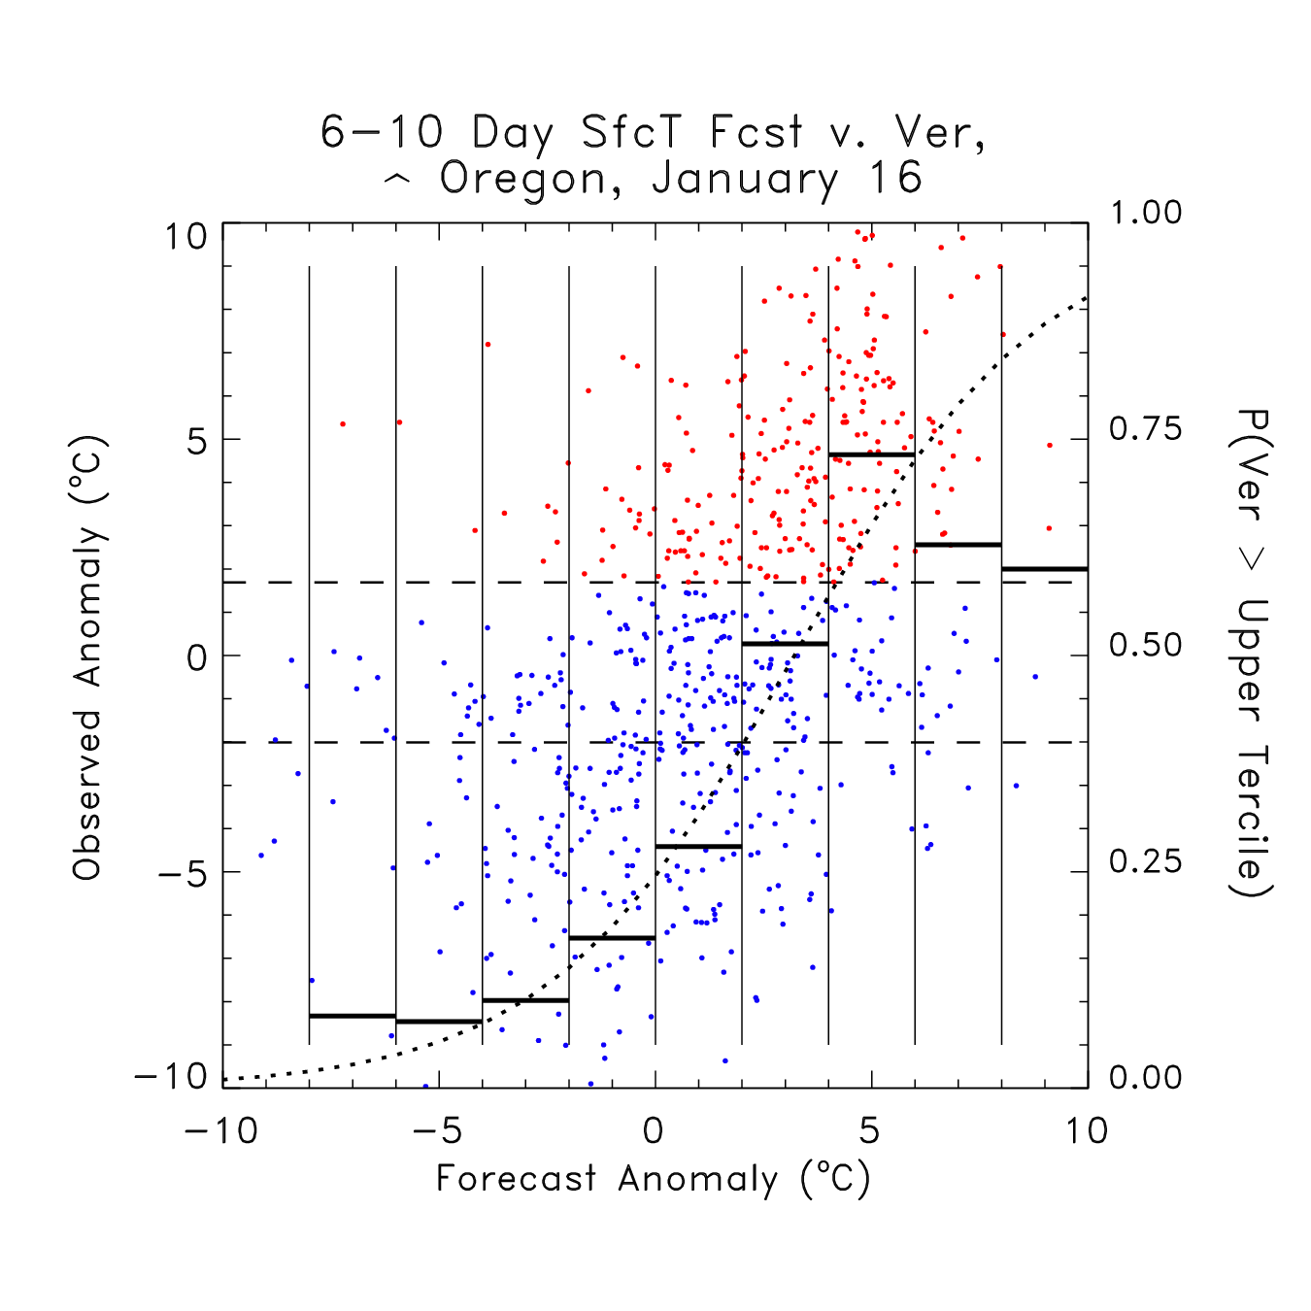
Logistic regression using a long data set of observed and forecast anomalies
Seeking to predict probability of warmer than normal conditions (upper tercile of observed). Using reforecasts
(a later talk), we have 23 years of data. Let’s use old data in a 31-day window around the
date of interest to make statistical corrections.
Dashed lines: tercile boundaries
Red points: samples above upper tercile
Blue points: samples below upper tercile
Solid bars: probabilities by bin count
Dotted line: logistic regression curve
Ref: Hamill et al. MWR, June 2004
Notes:
A concrete example to illustrate how we do this:
T850 for a given grid point - scatter plot of all forecasts and verifications over 23*31 cases.
If we just calculate the observed frequency for discrete bins, you get probs given by the solid horiz lines. If you use logistic regression, you get the smooth dotted curve
Note there may be problems with extrapolation - over-forecast extreme probs

Slide 40
Logistic regression drawbacks
Doesn’t generate full pdf (though see Wilks, 2009, Met Apps, p. 361).
With ensembles, what do you use as predictors? Ens. mean? Spread? Every member?
Iterative technique, can be slower.
Better have training set with distribution of 1’s and 0’s, otherwise software will croak.

Slide 41
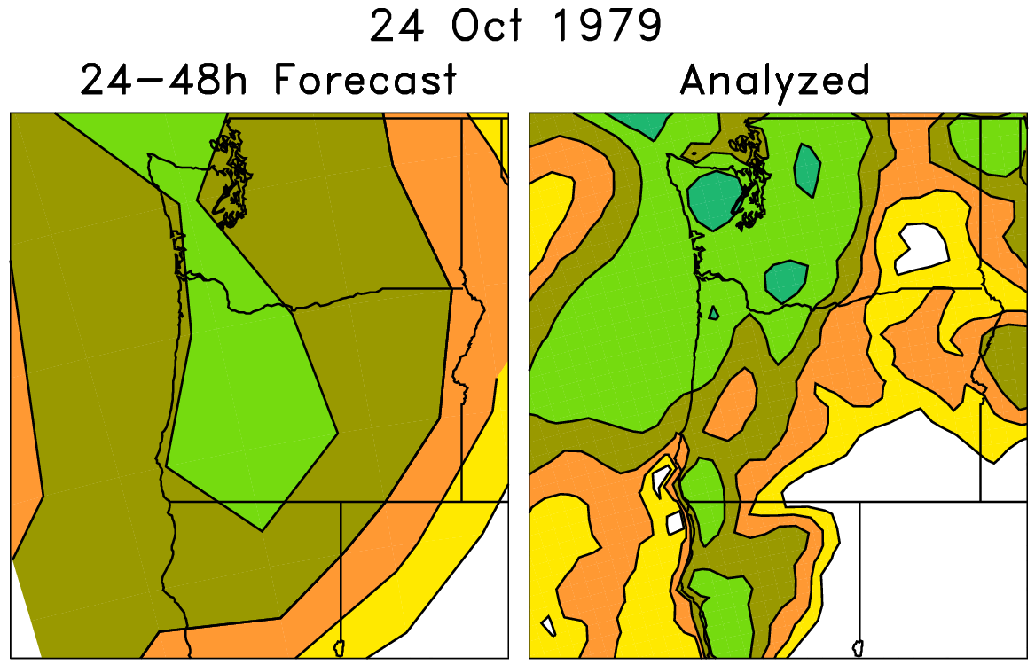
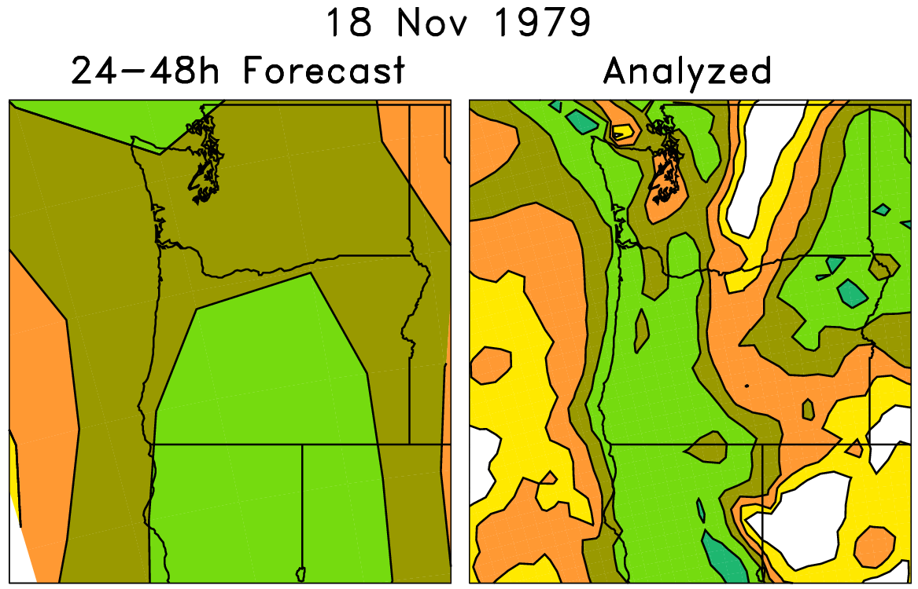
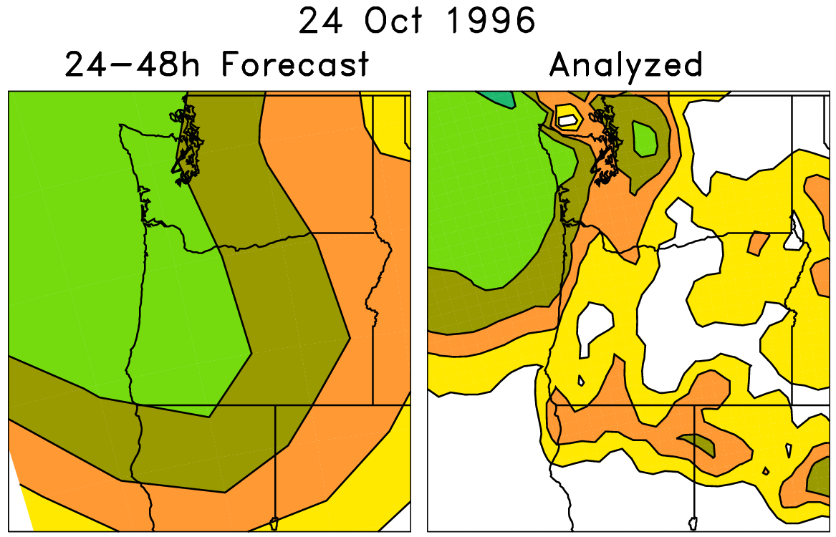
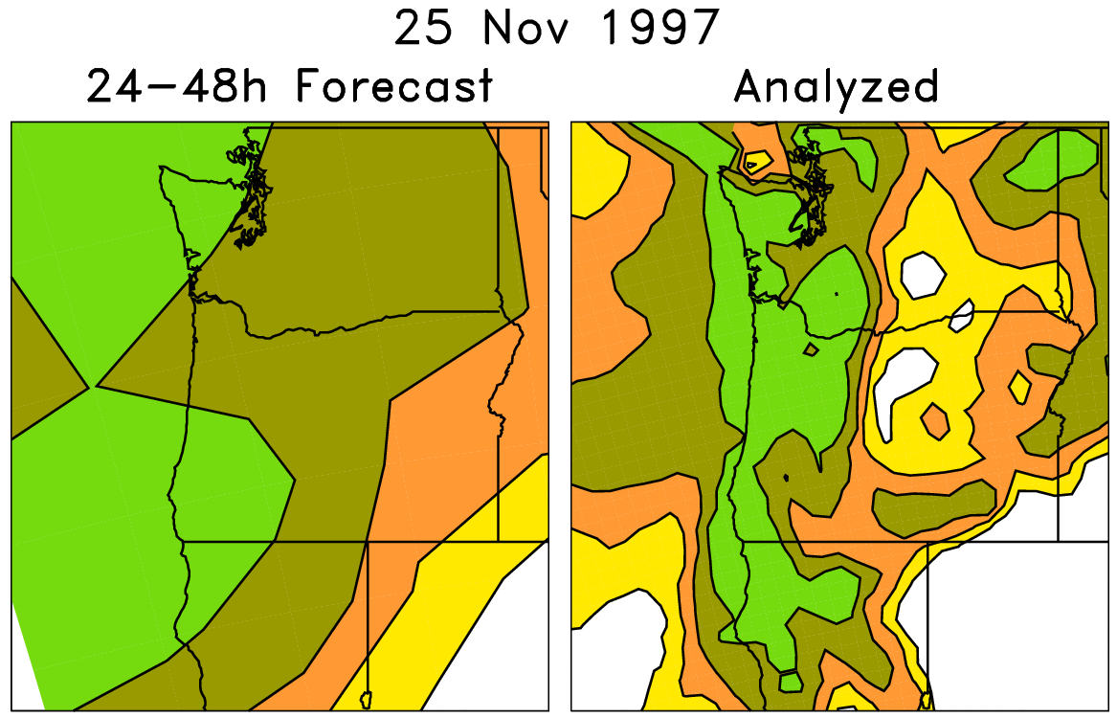
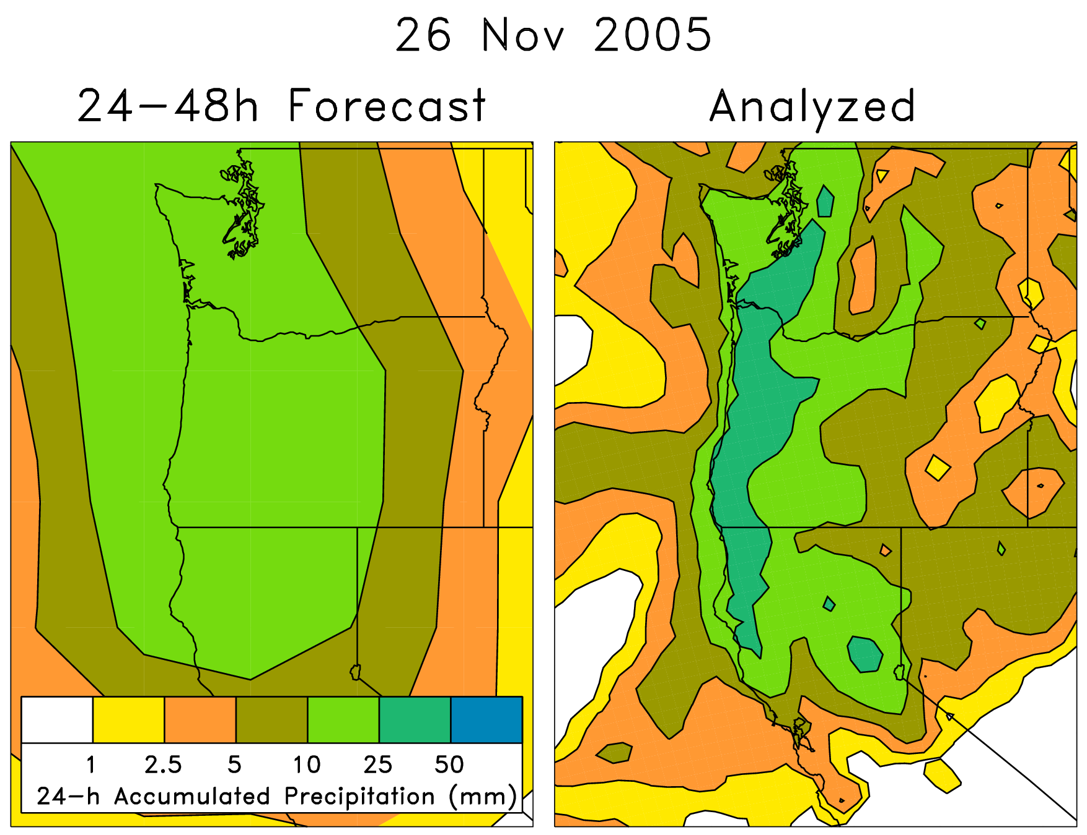
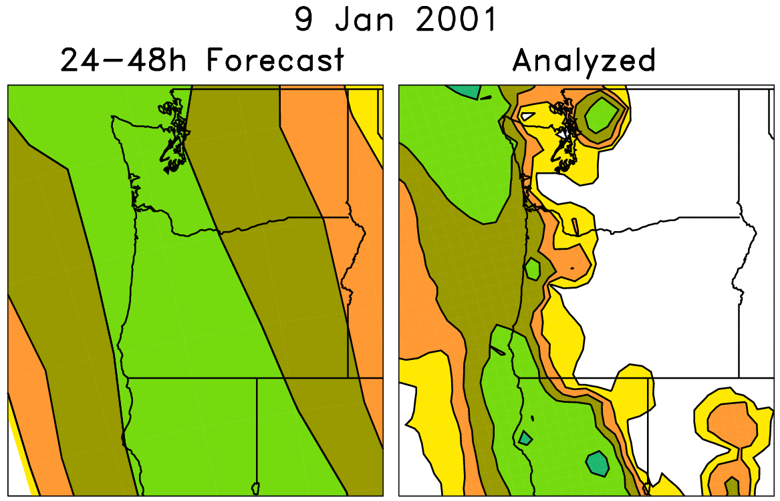
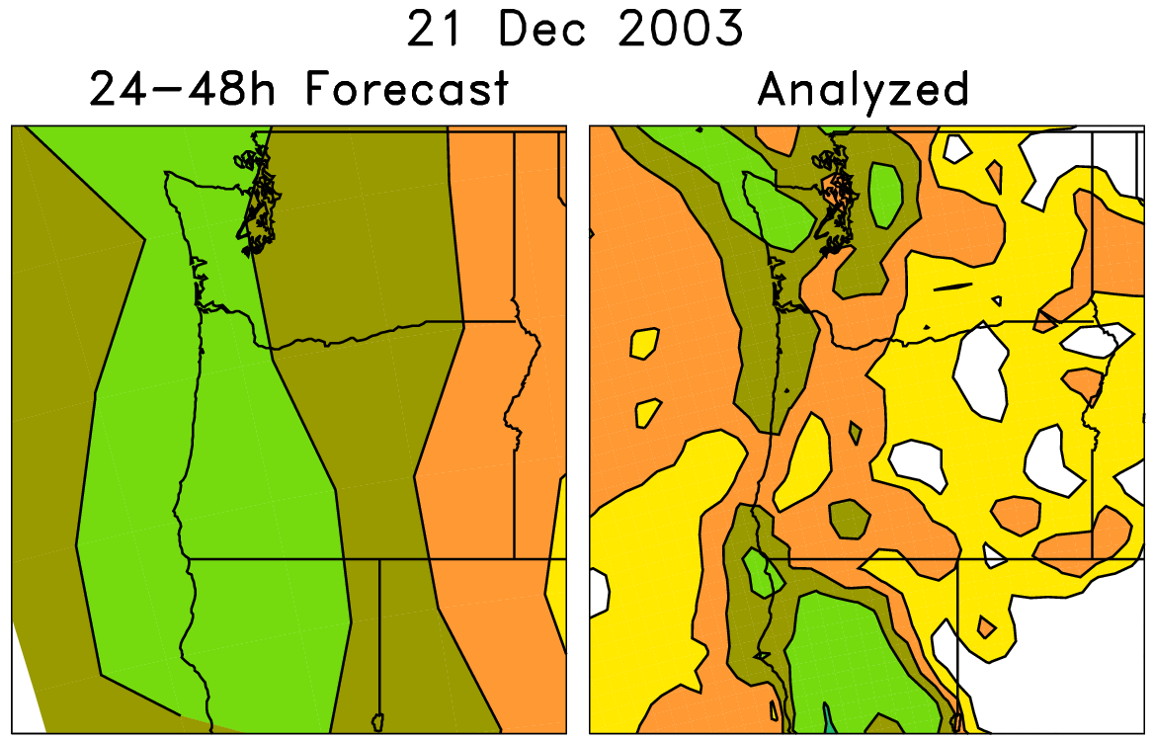
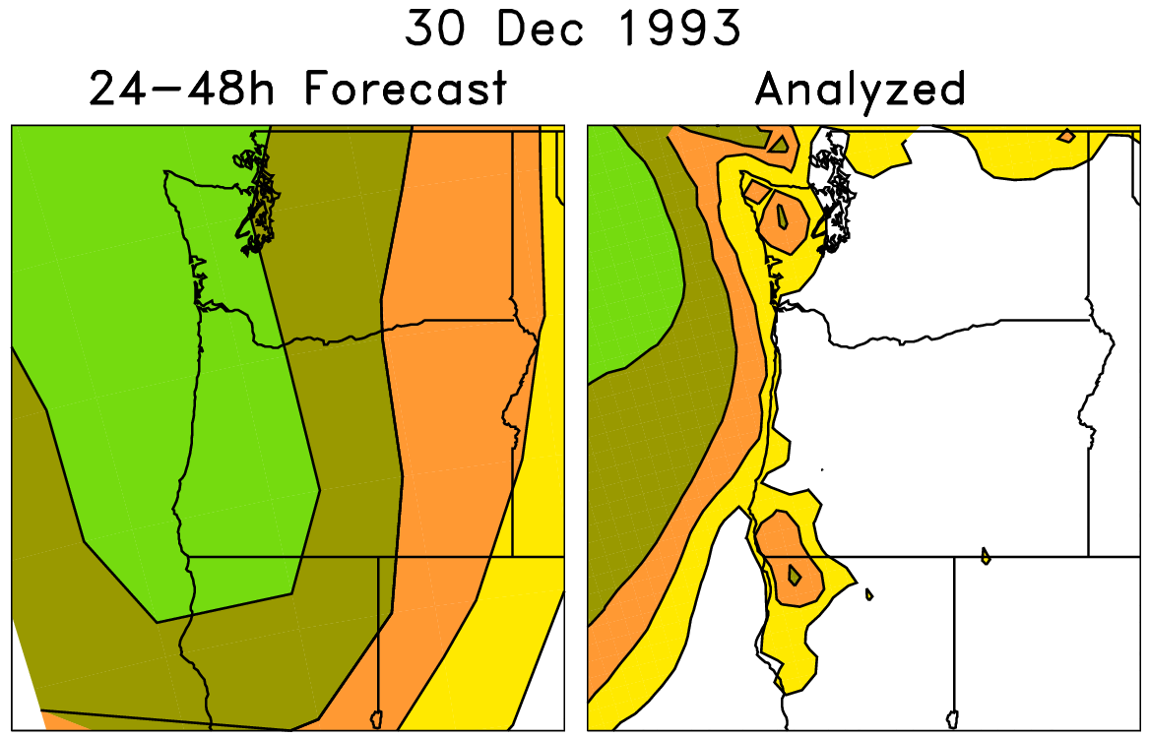
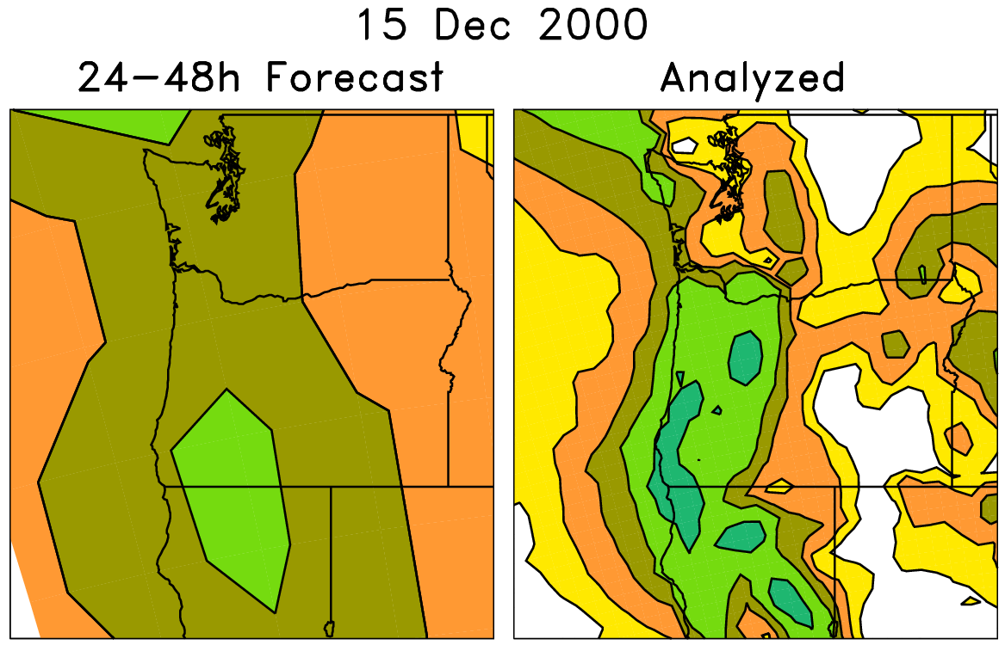
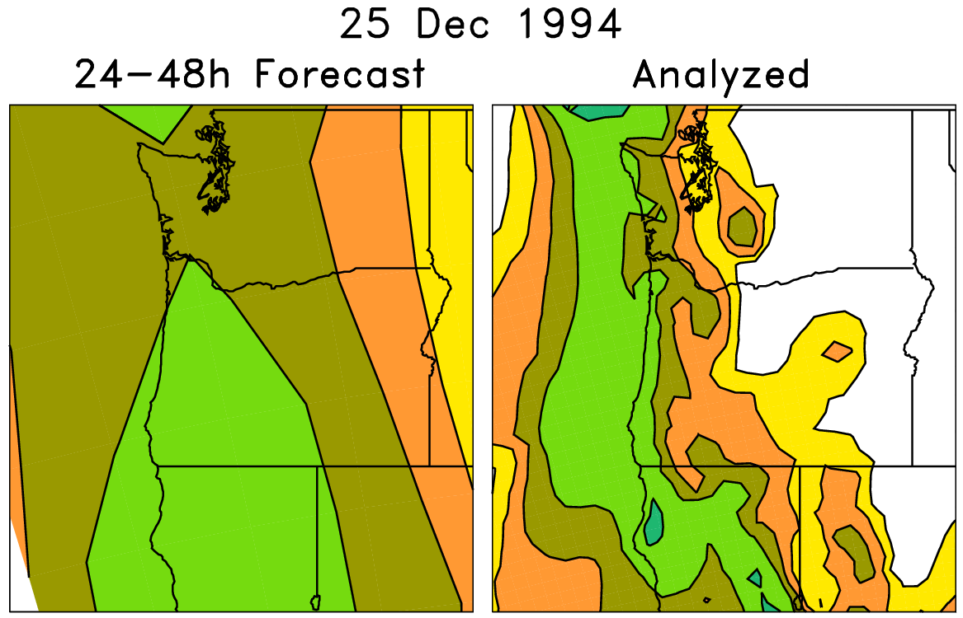
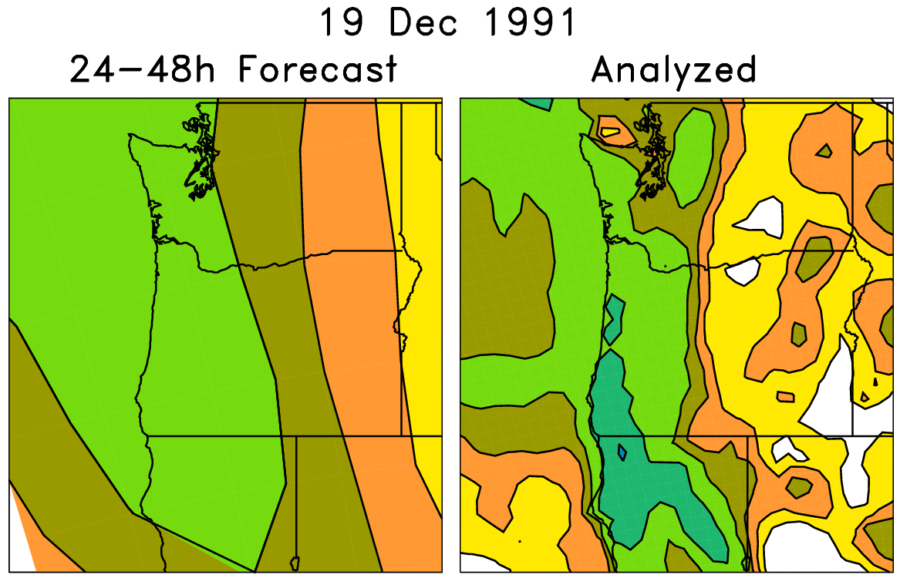
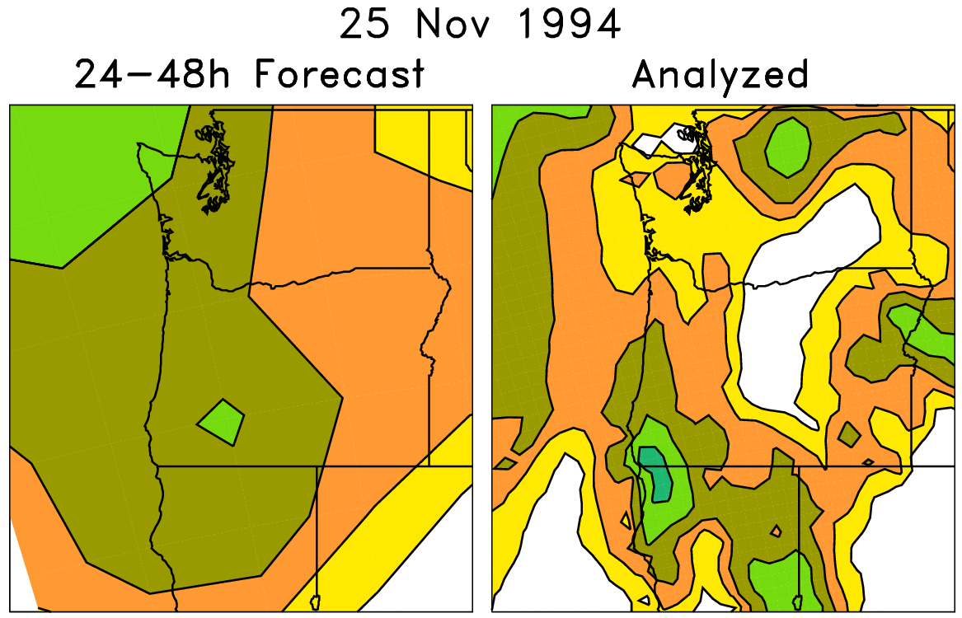
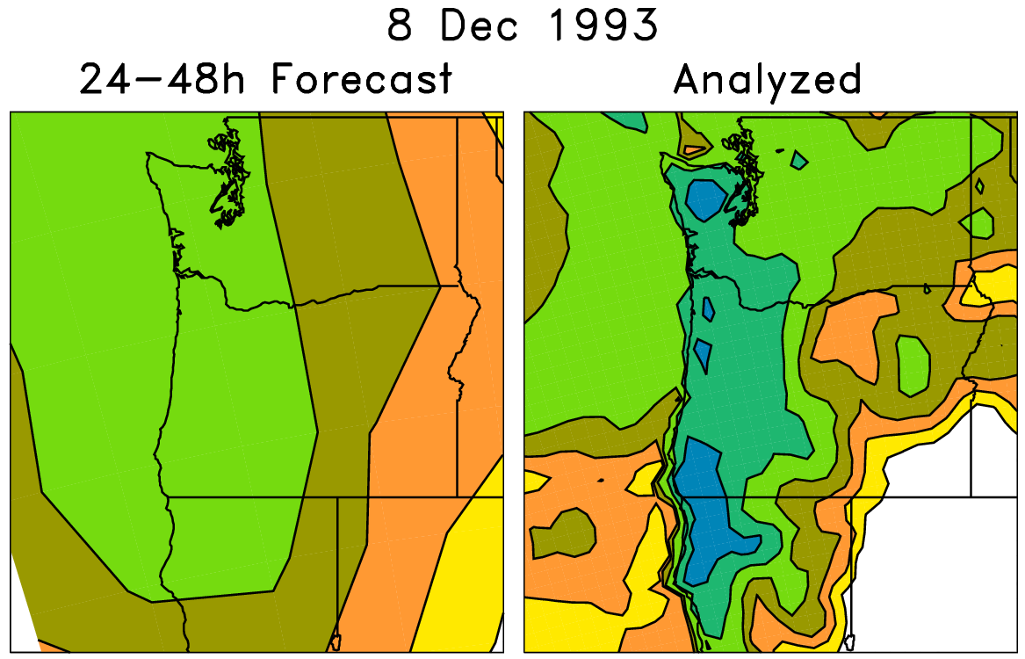
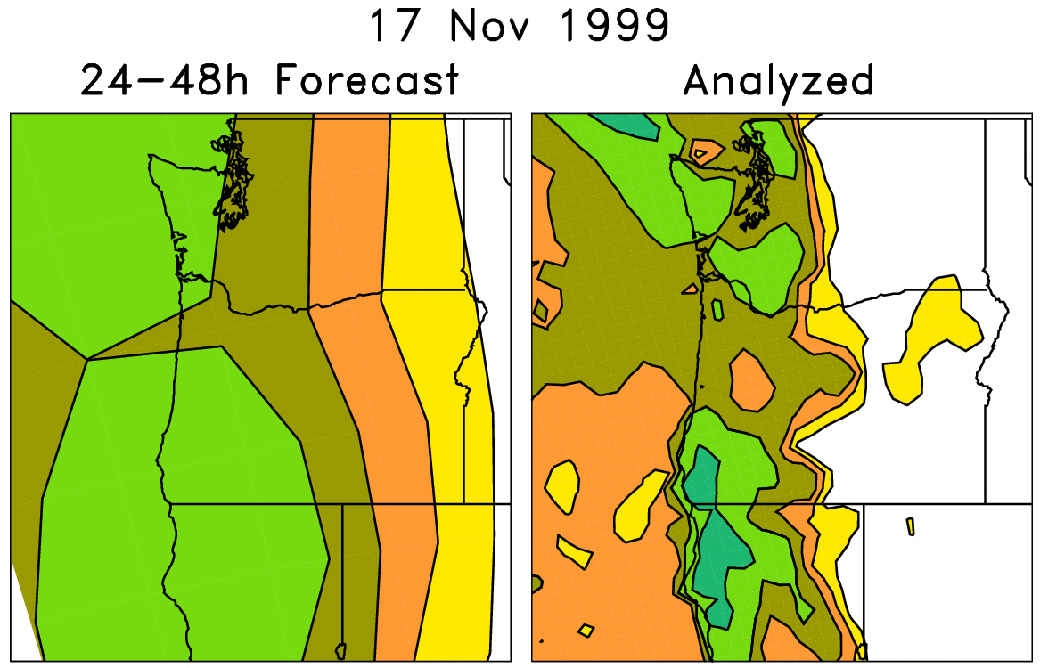
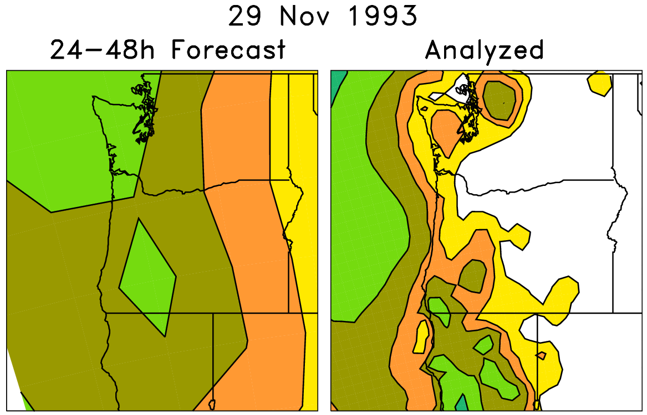
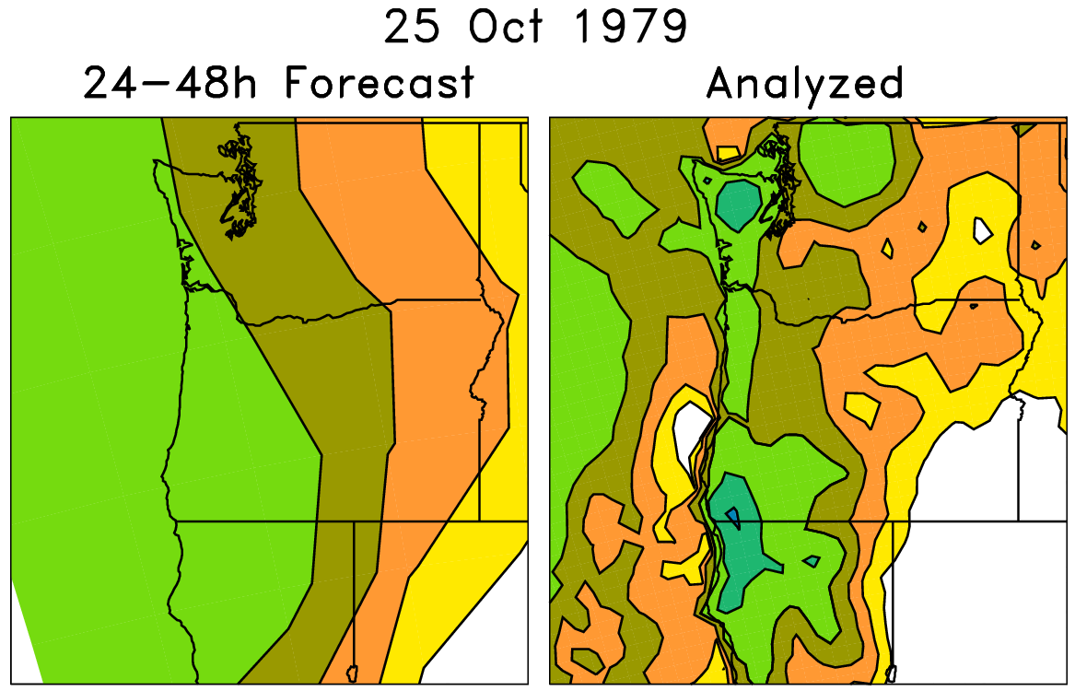
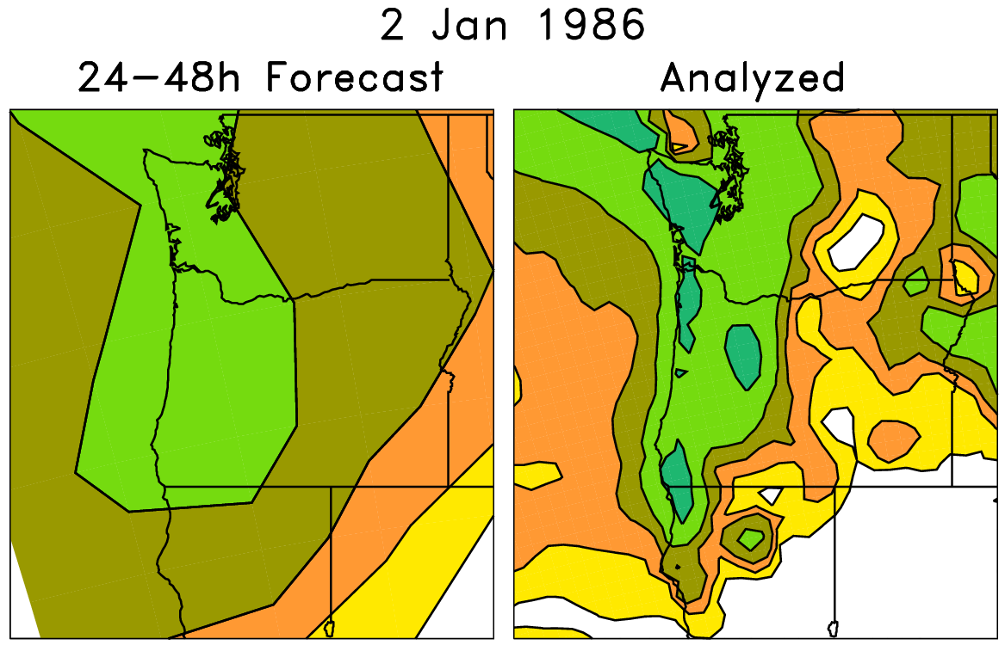
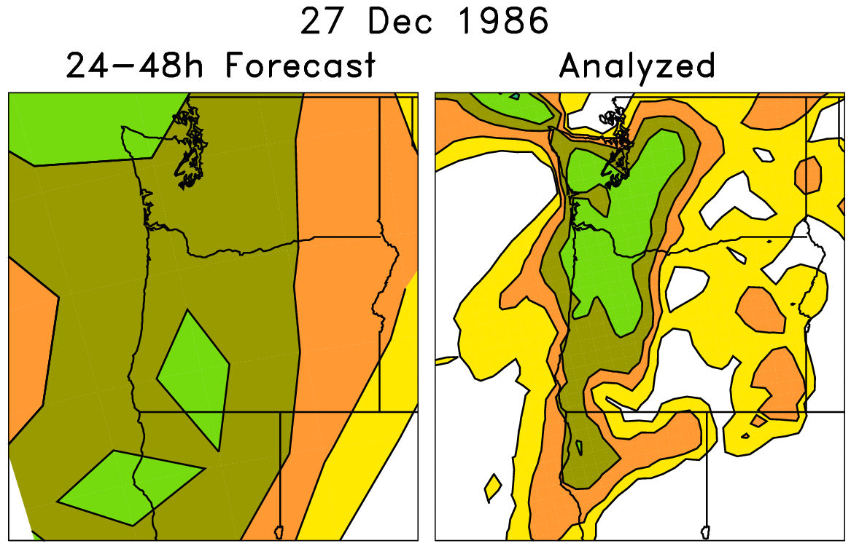
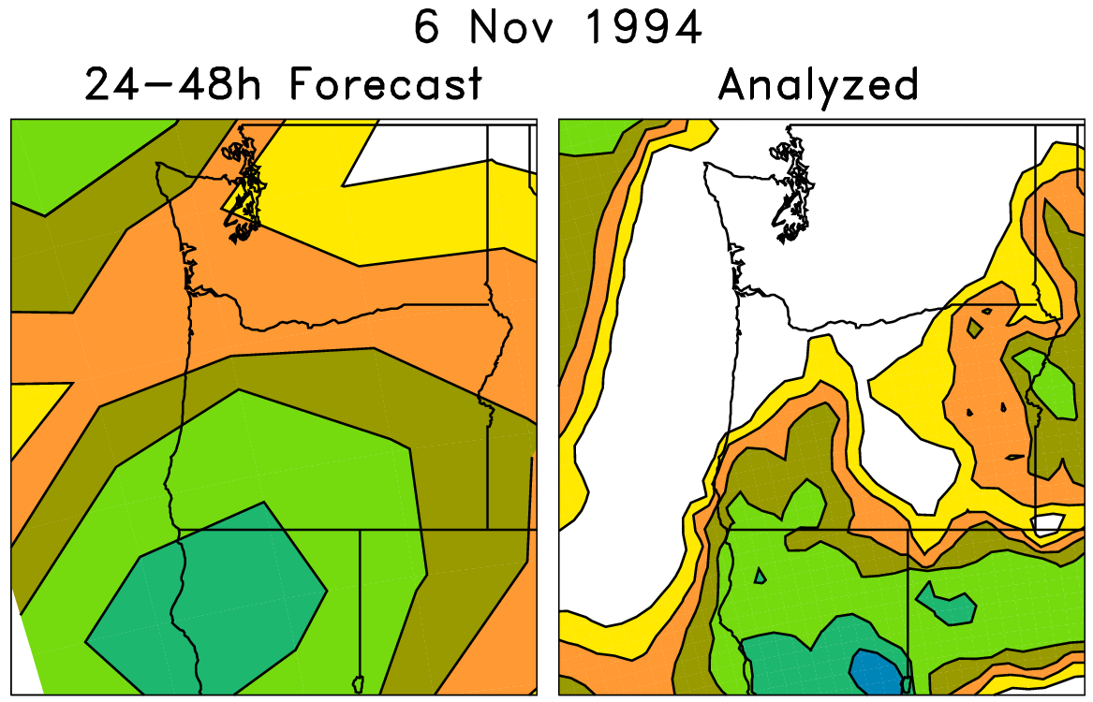
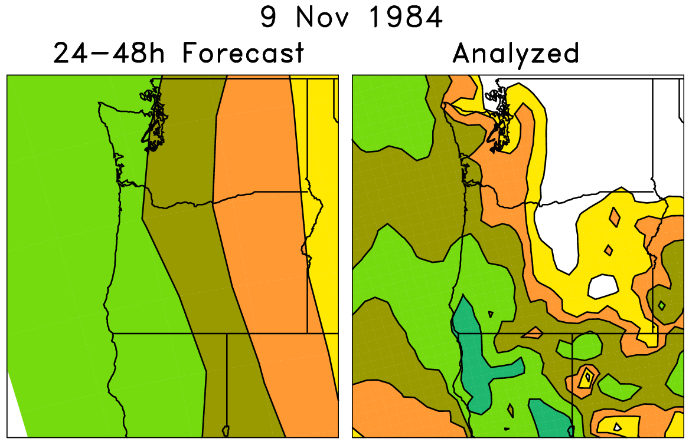
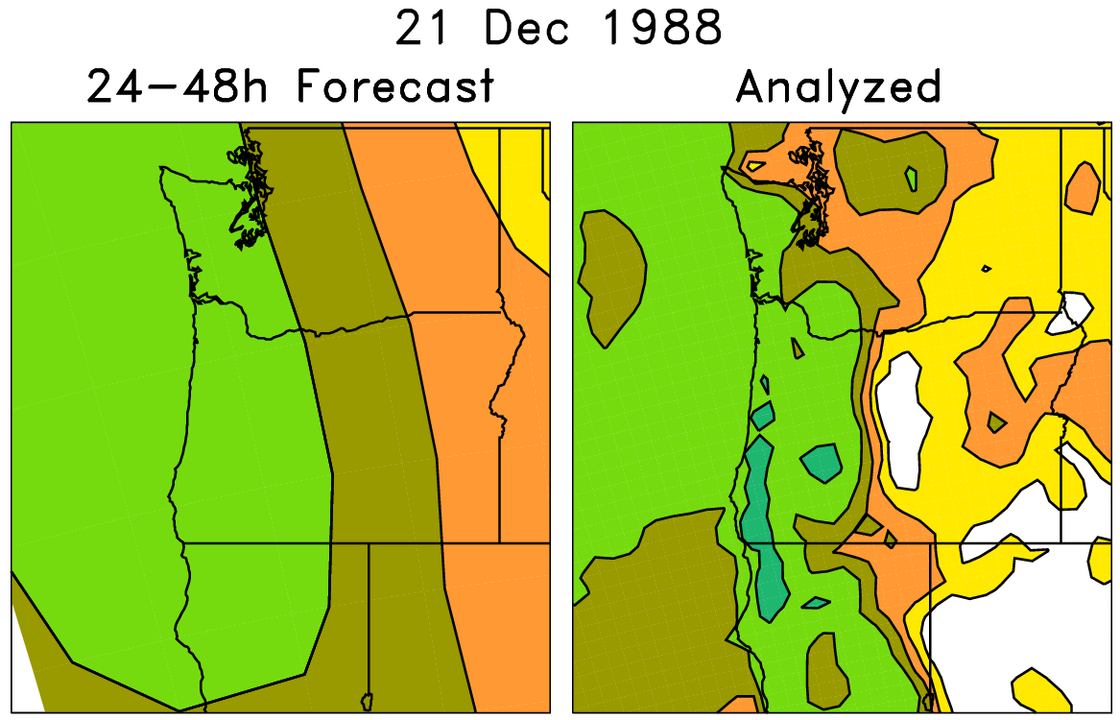
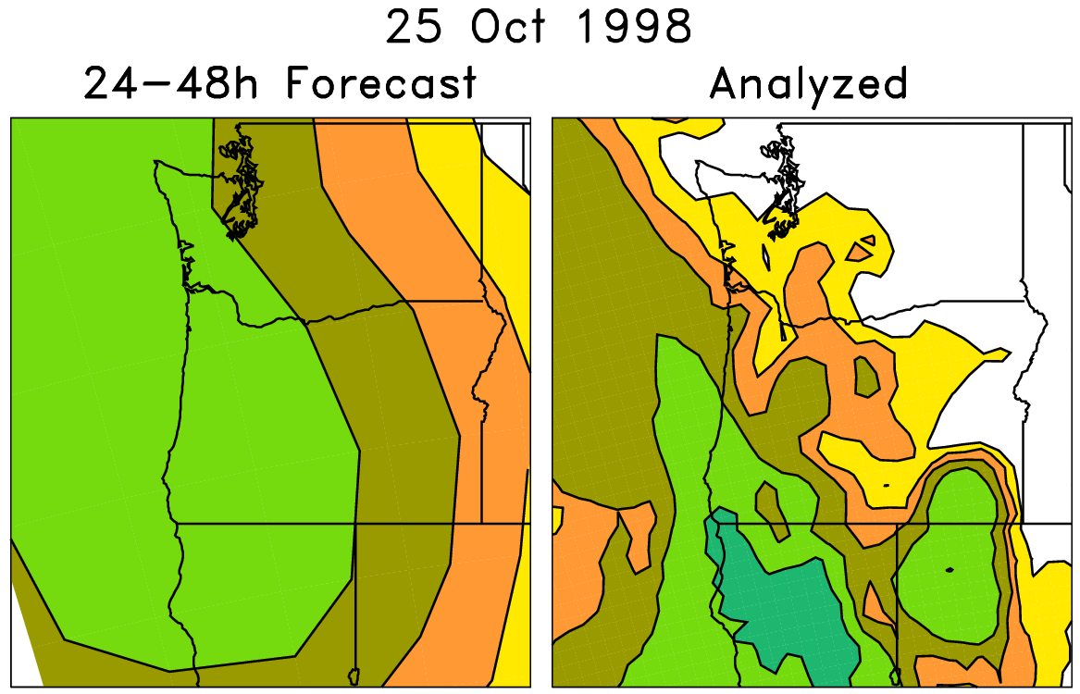
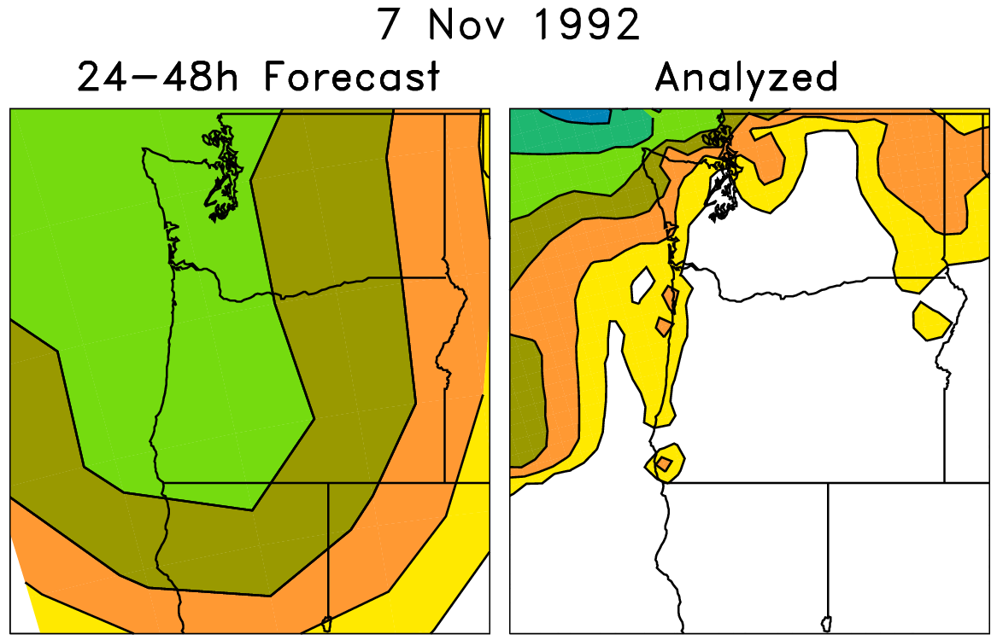
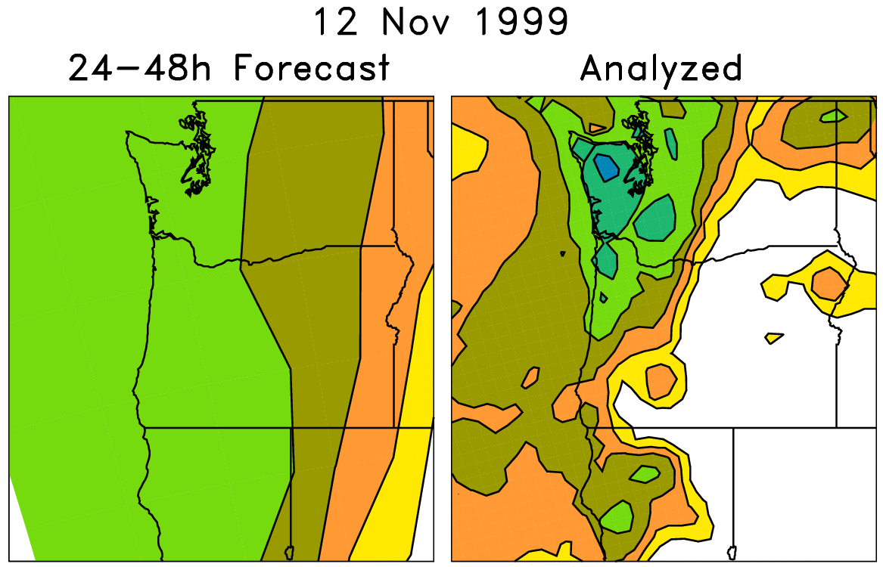
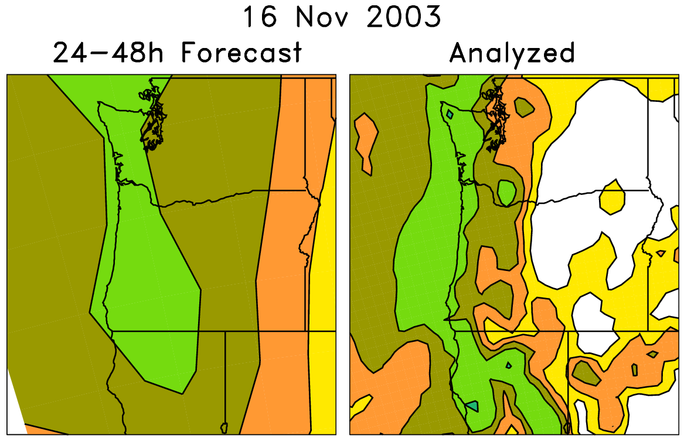
Analog technique using reforecasts
On the left are old forecasts
similar to today’s ensemble-
mean forecast. The data on
the right, the analyzed
precipitation conditional upon
the forecast, can be used to
statistically adjust and
downscale the forecast.
Analog approaches like this
may be particularly useful for
hydrologic ensemble applications, where an ensemble of realizations is needed.

Slide 42
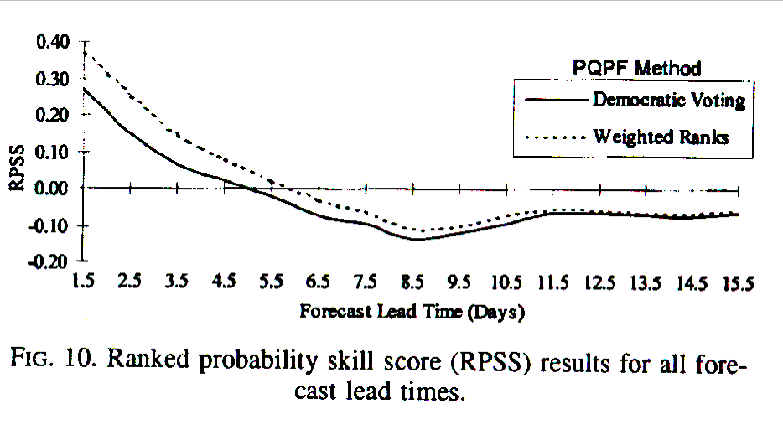
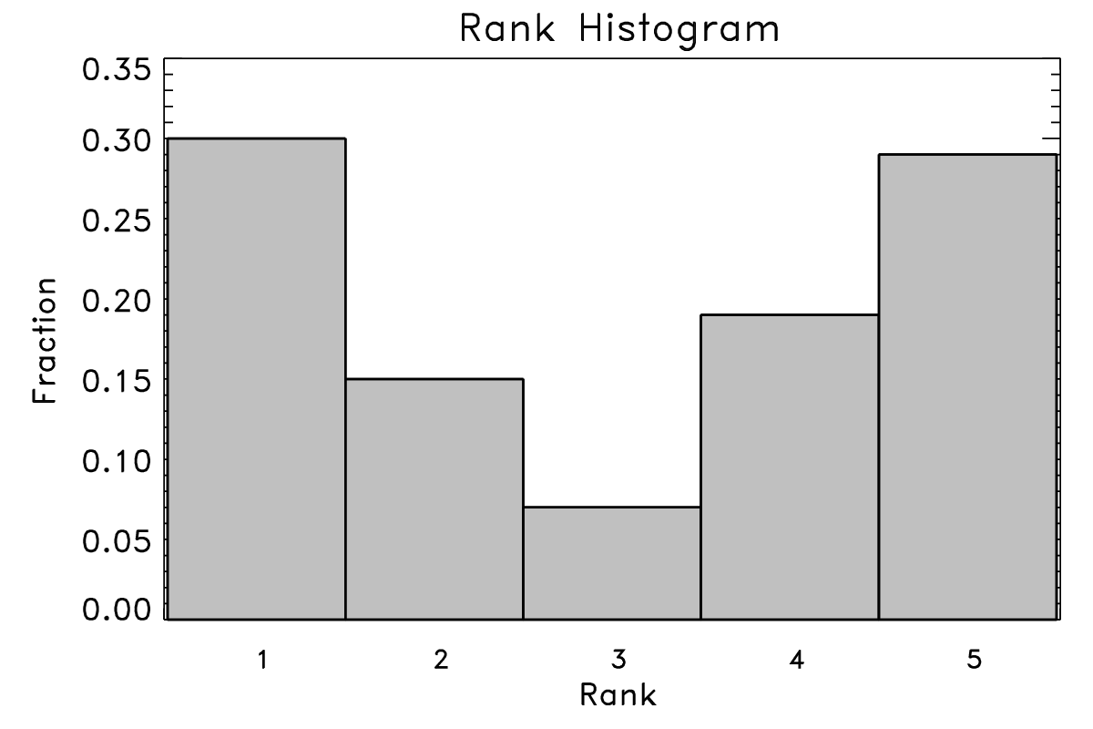
Rank histogram technique for ensemble calibration
NCEP MRF precipitation forecasts,
from Eckel and Walters, 1998
-4 -2 0 2 4 6 8
P(T < -4)
= 0.30
P(3 ≤ T < 5)
= 0.19
P(-4 ≤ T < -1)
= 0.15
P(-1 ≤ T < 3)
= 0.07
P(5 ≤ T)
= 0.29
Advantages: Demonstrated skill gain
Disadvantages:
Odd pdfs, especially when two ensemble members close in value.
Sensitive to shape of rank histogram, and shape of histogram may vary with aspects like precip amount --> sample size issues.
Fitted parametric distributions as skillful
References: Hamill and Colucci (MWR, 1997, 1998; Eckel and Walters, WAF, 1998; used at Met Office)

Slide 43
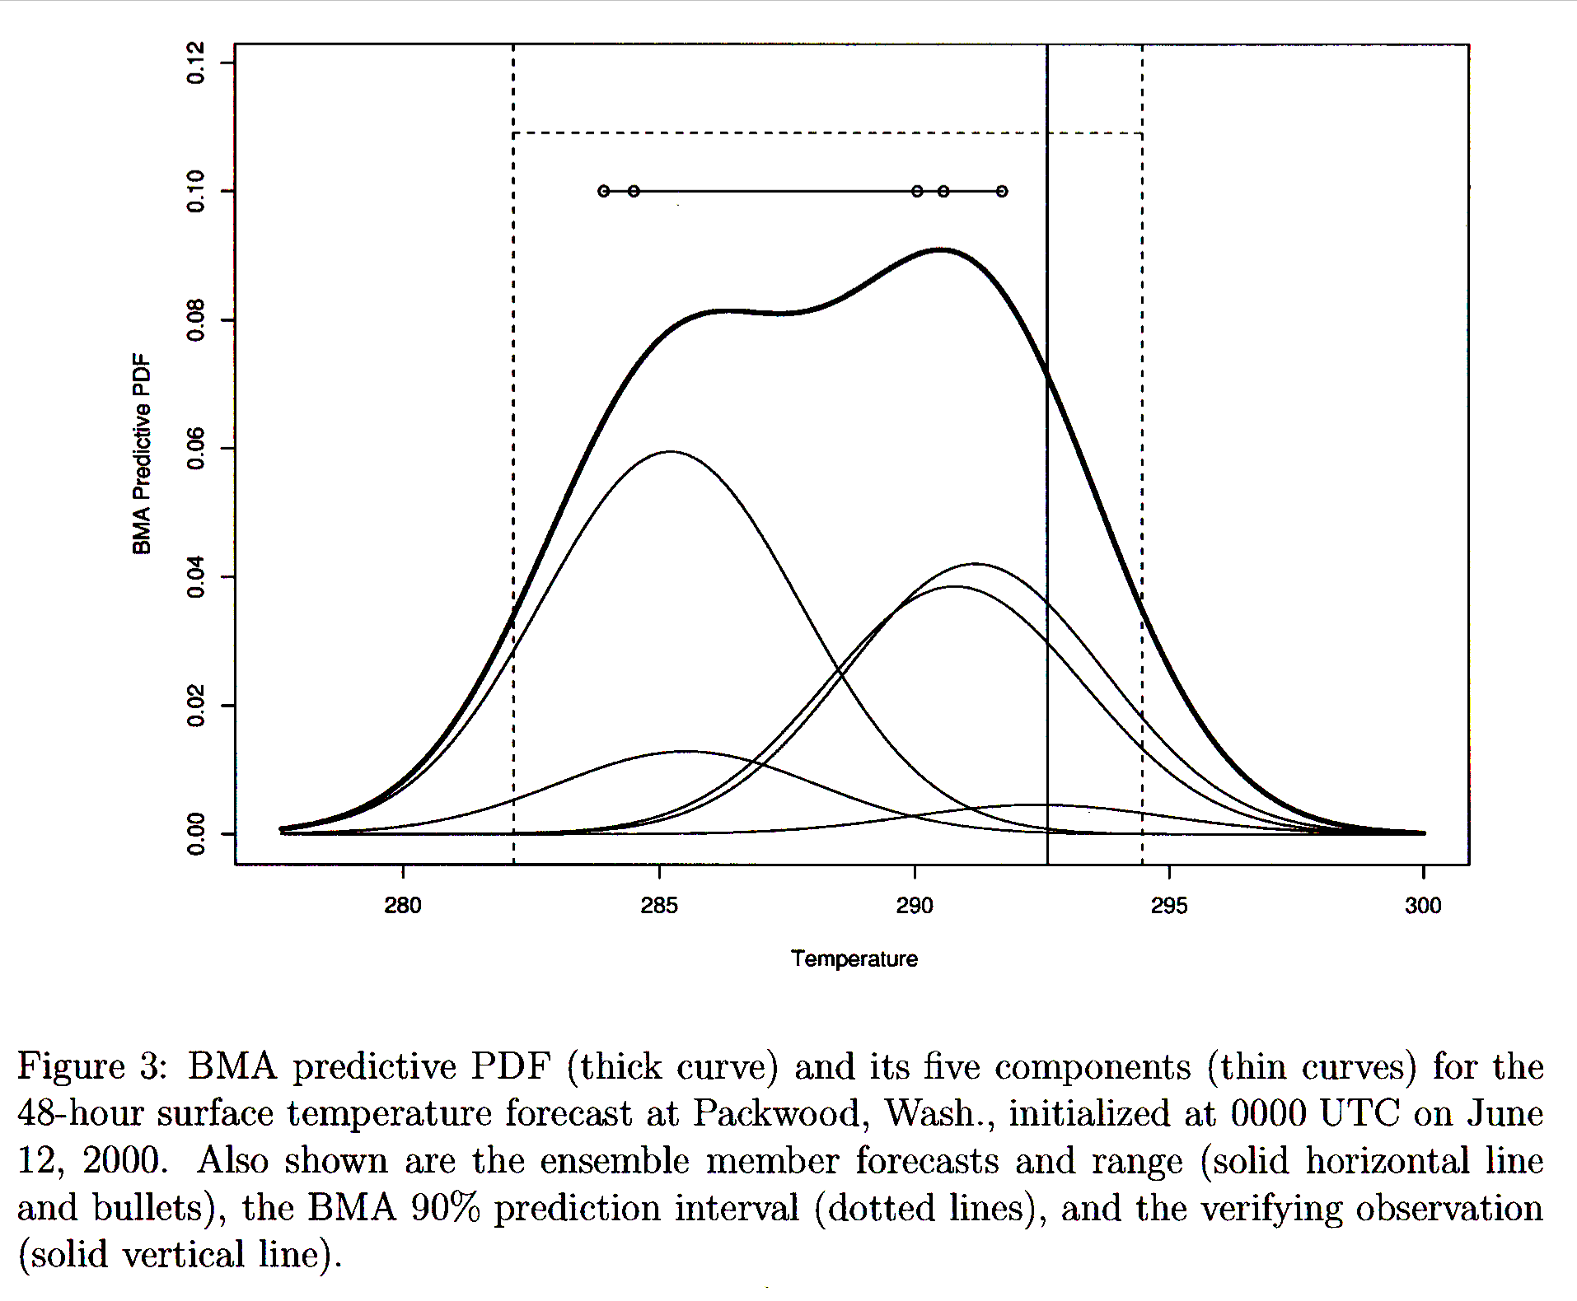
Bayesian model averaging (BMA)
Weighted sum of kernels
centered around individual,
bias-corrected forecasts.
Advantages: Theoretically
appealing. No parameterized
distribution assumed, weights
applied proportional to their
independent information
(in concept).
Disadvantages: When trained
with small sample, BMA radically
de-weighted some members
due to “overfitting” See Hamill,
MWR, Dec. 2007.
MM5/GFS
MM5/Eta
MM5/Canada
MM5/Navy
MM5/NGM
Ref: Raftery et al.,
MWR, 2005. Wilson
et al., MWR, 2007

Slide 44
Why BMA’s unequal weights? (1) regression correction accentuates error correlations.
Ref: Hamill,
MWR, Dec. 2007

Slide 45
Why BMA’s unequal weights? (2) E-M overfits with little training data
An “estimation-minimization” (E-M) algorithm is used to determine the weights applied to ensemble members. If two forecasts have highly co-linear errors, E-M will weight one very highly, the other very little.
E-M is an iterative technique, and we can measure
the accuracy of the fit to the data through the
log-likelihood. Something odd happens here; as
the E-M convergence criteria is tightened, the fit
of the algorithm to independent data gets worse.
This plots the ratio of the weights of the highest-weighted member to the lowest-weighted member. As the convergence criterion is tightened, the method increasingly weights a few select members and de-weights others.

Slide 46
(BMA overfitting not a problem with 2+ decades training data)
With reforecast data set, we can train with a very large amount of data. When we do so, the weights applied to individual members are much more equal. This indicates that the unequal weighting previously is incorrect.

Slide 47
BMA’s problem: an example
BMA
pdf
Climo
pdf
Bias-corrected
members
Here’s a test of BMA in the winter season for a grid point
near Montreal. BMA ends up highly weighting the warmest
members (inappropriately so), thus producing a very high
probability of a warm forecast.
Ref: Laurie Wilson, Met Service Canada, personal correspondence. See also upcoming Bishop et al. MWR manuscript.

Slide 48
“Bayesian Processor of Forecasts”
Two key ideas:
(1) Bayes’ Rule: leverage prior non-NWP information, whether from climatology, persistence, whatever. Update with NWP information
(2) If data non-normally distributed, transform data to space where normally distributed before performing regression analysis.
Ref: Krzysztofowicz and Evans, WAF, April 2008

Slide 49
Non-homogeneous Gaussian regression
Reference: Gneiting et al., MWR, 133, p. 1098
Predictors: ensemble mean and ensemble spread
Output: mean, spread of calibrated Gaussian distribution
Advantage: leverages possible spread/skill relationship appropriately. Large spread/skill relationship, c ≈ 0.0, d ≈1.0. Small, d ≈ 0.0
Disadvantage: iterative method, slow…no reason to bother (relative to using simple linear regression) if there’s little or no spread/skill relationship.

Slide 50
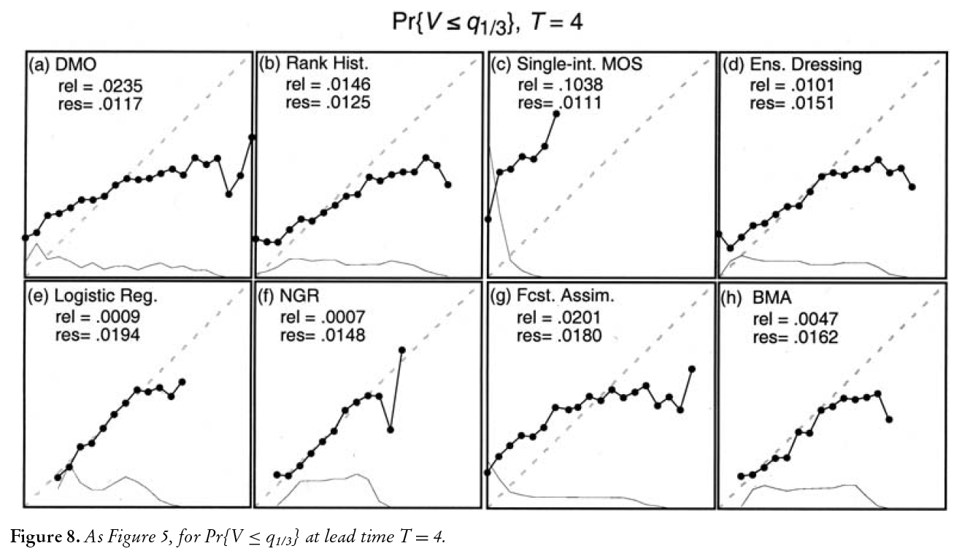
Is there a “best” calibration technique?
Using Lorenz ‘96 toy model, direct model output (DMO), rank histogram technique, MOS applied to each member, dressing, logistic regression, non-homogeneous Gaussian regression (NGR), “forecast assimilation”, and Bayesian model averaging (with perturbed members assigned equal weights) were compared. Comparisons generally favored logistic regression and NGR, though differences were not dramatic, and results may not generalize to other forecast problems such as ones with non-Gaussian errors.
Ref: Wilks, Met. Apps, 2006, 13, p. 243

Slide 51
Rationale 3 for post-processing: Predict probabilities of a variable that may not be forecast by the model using variables that are forecast by the model, e.g., tornado probability from CAPE, CIN, shear.

Slide 52
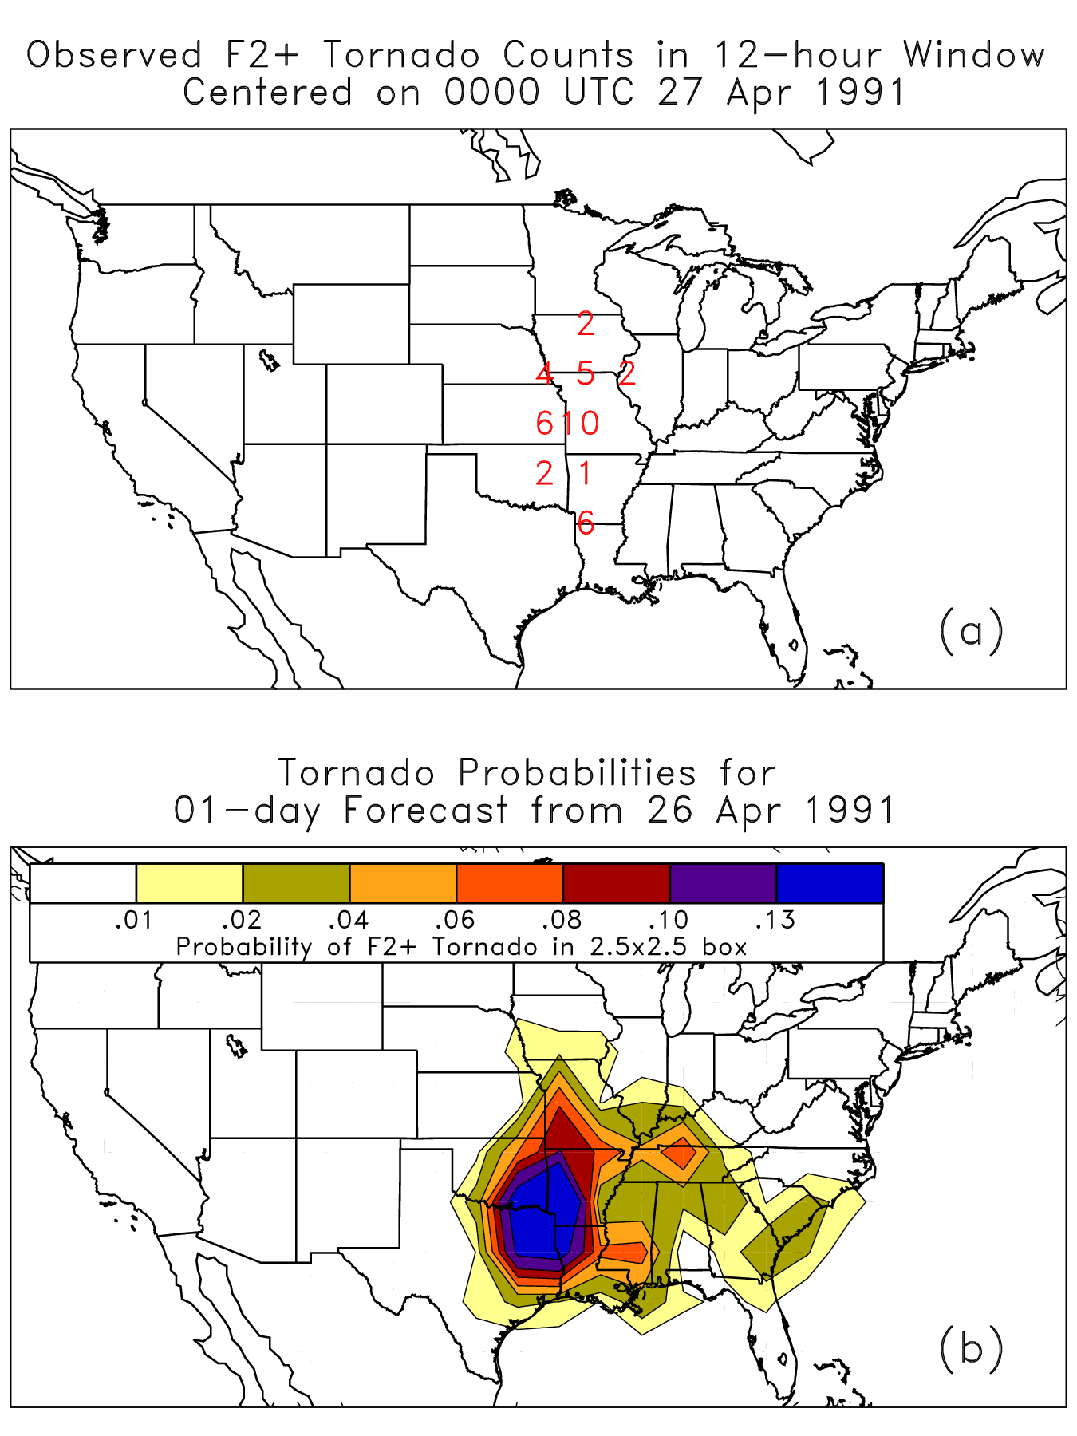
Tornado probabilities from analogs
For each grid point, in a region
around the point I compared that
day’s forecast ensemble-mean shear,
CAPE, and CIN to the values of shear,
CAPE, CIN from past days at a similar
time of the year in the reforecast
data set. This provided a set of
dates. The probability of F2+
tornadoes for that box was
determined by counting the
number of analog days with
tornadoes in that box divided
by the number of analog days (50).
(details in supplementary slides
after conclusion).

Slide 53
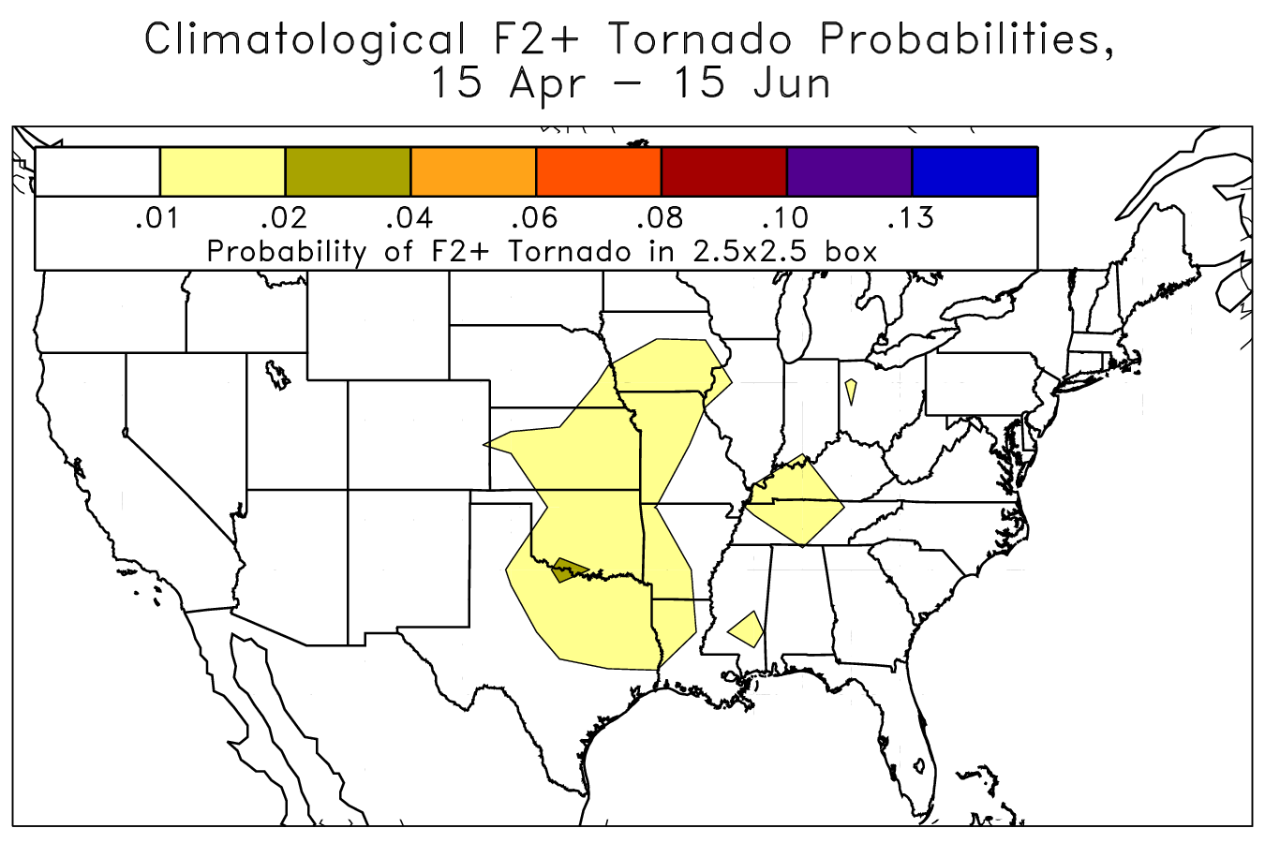
Climatology of F2+ tornadoes

Slide 54
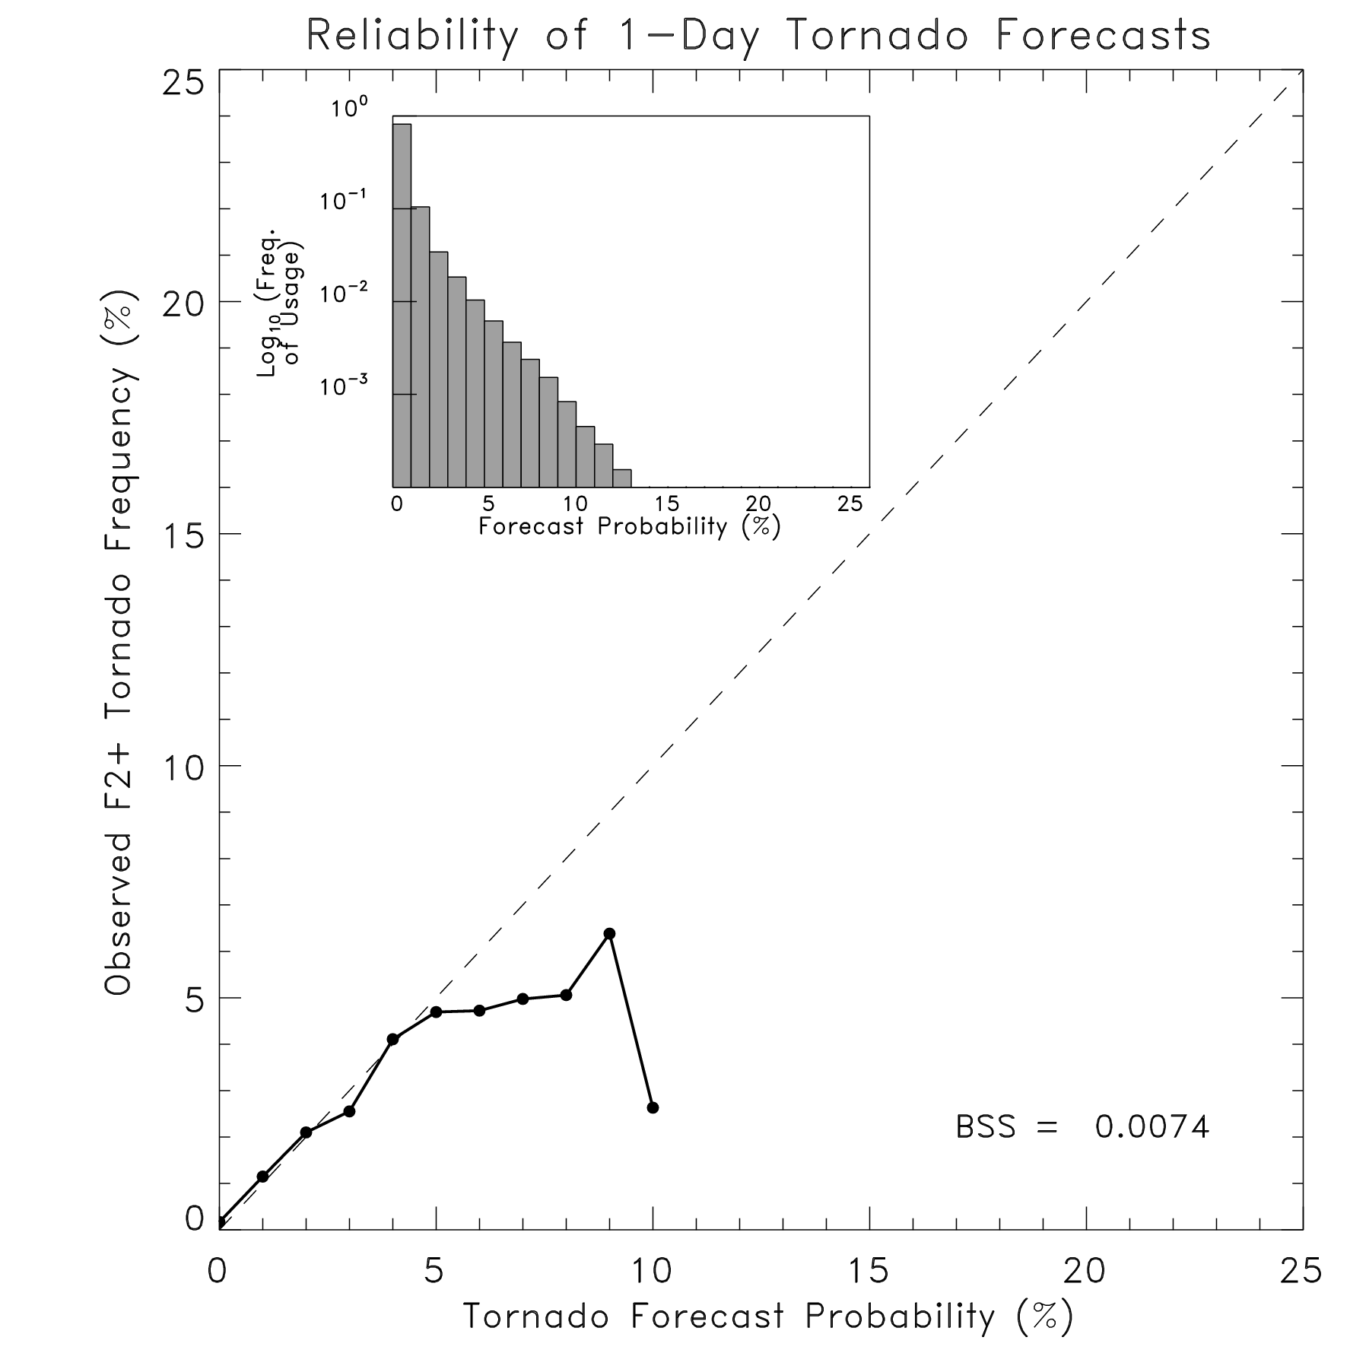
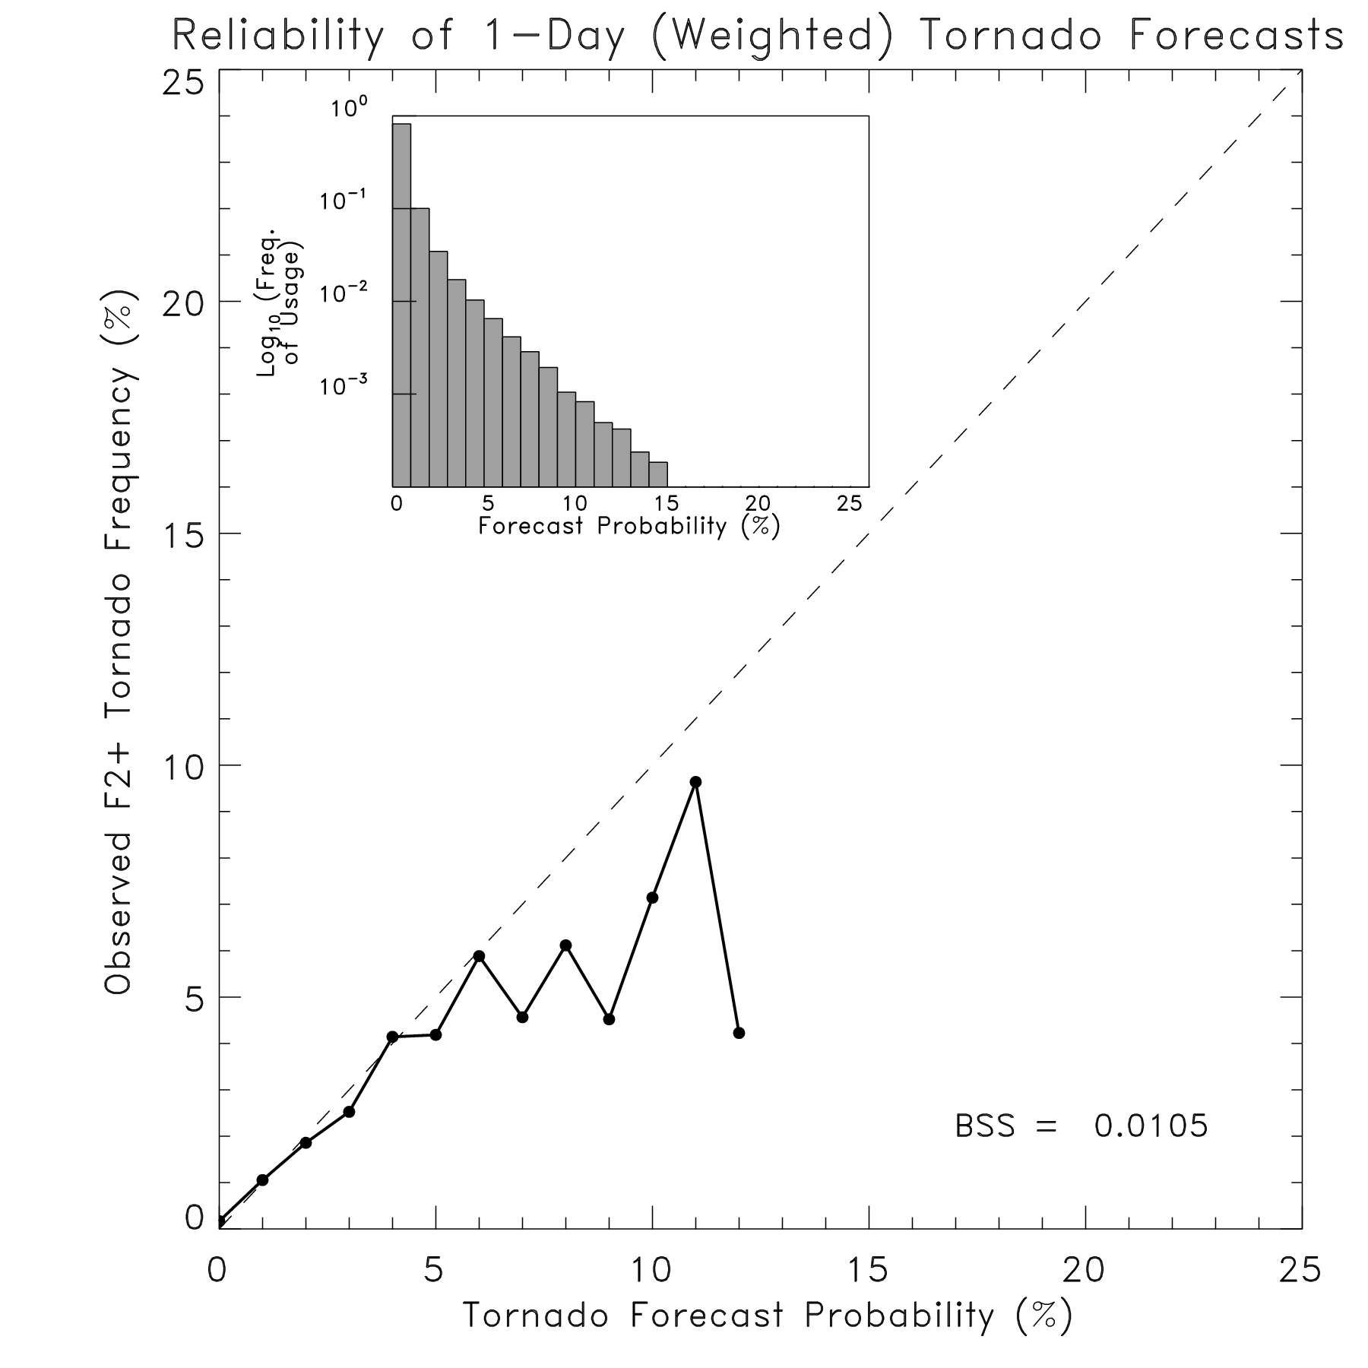
Reliability and skill of tornado analog probabilities
Note: low BSSes inevitable
when verifying rare events.
here, closer analogs are
weighted more than further ones

Slide 55
Tradeoffs between reforecast sample size and statistical sophistication
Large reforecast: almost any reasonable post-processing approach gives some benefit.
Smaller training data set: you have to find ways such as “compositing” to increase the sample size.

Slide 56
Example: precipitation calibration with ECMWF reforecasts
NARR CONUS 12-hourly data used for training, verification. ~32 km grid spacing
Logistic regression
Use all of their 20 year * 1x/week Sep-Dec training data, except for data from the year being forecast.

Slide 57
Problem: patchy probabilities when grid point X trained with only grid point X’s forecasts / obs
Even 20 years of
weekly forecast data
(260 samples after
cross-validation)
is not enough for
stable regression
coefficients, especially
at higher precipitation
thresholds.

Slide 58
Tested method: add in training data at other grid points that have similar analyzed climatologies
Big symbol:
grid point
where we
do regression
Small symbols:
analog locations
with similar
climatologies

Slide 59
When is it proper to use training data at location B to supplement regression analysis at location A?
(1) When location B’s errors are independent of location A’s errors.
(2) When observed CDF at A and B are very similar.
(3) When forecast CDF at A and B are very similar.
(4) When corr(forecast, observed) at A and B are similar.

Slide 60
When is it proper to use training data at location B to supplement regression analysis at location A?
(1) When location B’s errors are independent of location A’s errors.
(2) When observed CDF at A and B are very similar.
(3) When forecast CDF at A and B are very similar.
(4) When corr(forecast, observed) at A and B are similar.
Make sure location
A is not too close to
location B

Slide 61
When is it proper to use training data at location B to supplement regression analysis at location A?
(1) When location B’s errors are independent of location A’s errors.
(2) When observed CDF at A and B are very similar.
(3) When forecast CDF at A and B are very similar.
(4) When corr(forecast, observed) at A and B are similar.
Need lots of samples.
Luckily, ~28 year
NARR provides them.

Slide 62
When is it proper to use training data at location B to supplement regression analysis at location A?
(1) When location B’s errors are independent of location A’s errors.
(2) When observed CDF at A and B are very similar
(3) When forecast CDF at A and B are very similar.
(4) When corr(forecast, observed) at A and B are similar.
Judging this would be
tough with ECMWF
forecasts. Only
14 weeks*20 years,
not a large sample
for non-normally
distributed data. Can
be fooled by rare events.

Slide 63
When is it proper to use training data at location B to supplement regression analysis at location A?
(1) When location B’s errors are independent of location A’s errors.
(2) When observed CDF at A and B are very similar
(3) When forecast CDF at A and B are very similar.
(4) When corr(forecast, observed) at A and B are similar.
Tricky to compute in
dry regions, where
overwhelming bulk
of the samples are
zero’s.

Slide 64
Conclusions #1: post-processing can be very beneficial if you have the following:
Enough training data (past forecasts with the same model as you are running operationally, plus quality obs/analyses)
more data needed for rare events, long-lead forecasts.
A reasonable statistical correction method.
Poorly post-processed guidance is worse than nothing at all; misleading, another thing the forecaster must compensate for.

Slide 65
Conclusions #2: What’s the best post-processing technique?
Enlarging training sample size has a bigger effect for many variables than changing the post-processing technique.
Preferred techniques may vary from user to user. Hydrologists want bias-corrected and downscaled members, others want smooth pdfs.
If possible, KISS (Keep it simple, stupid). Increasing focus on complicated techniques. Often parametric distributions, linear techniques work just fine.
We are just learning how to begin to do joint post-processing in multiple dimensions; no idea yet what’s best.

Slide 66
Technique for finding tornado forecast analogs For a given grid point, match today’s ensemble mean fields with past forecast fields. Find n closest analog dates.
•
•
•
•
•
Shear / 25 ms⁻¹
(normalized so CAPE doesn’t
overwhelm shear)
•
•
•
•
•
•
•
•
•
•
•
•
•
•
•
•
•
•
•
•
CAPE / 3000 J kg⁻¹
•
•
•
•
•
•
•
•
•
•
•
•
•
•
•
•
•
•
•
•
CIN / 500 J kg⁻¹
•
•
•
•
•
•
•
•
•
•
•
•
•
•
•
•
•
•
•
•
•
•
•
•
•
blue dot: point to find analogs for
pink dots: points to match up
current forecasts with old ones.
Note: can vary weights horizontally
•
•
•
•
•
Result:
Dates of n analogs
Numerical quantification of how
good the pattern match is for each of n.

Slide 67
Finding analogs, cont’d: horizontal weighting 5x5 arrays of shear, CAPE, CIN weighted by distance from center grid point; controlled by e-folding distance
E-folding of 7.5 grid points
0.867 0.915 0.931 0.915 0.867
0.915 0.965 0.982 0.965 0.915
0.931 0.982 1.000 0.982 0.931
0.915 0.965 0.982 0.965 0.915
0.867 0.915 0.931 0.915 0.867
E-folding of 4.5 grid points
0.674 0.781 0.821 0.781 0.674
0.781 0.906 0.952 0.906 0.781
0.821 0.952 1.000 0.952 0.821
0.781 0.906 0.952 0.906 0.781
0.674 0.781 0.821 0.781 0.674
E-folding of 1.5 grid points
0.029 0.108 0.169 0.108 0.029
0.108 0.411 0.641 0.411 0.108
0.169 0.641 1.000 0.641 0.169
0.108 0.411 0.641 0.411 0.108
0.029 0.108 0.169 0.108 0.029
(Comparing skill using
many e-folding distances
this will indicate if the local
information is of primary
importance, or the
larger-scale pattern.)

Slide 68
Making probabilistic forecasts from analogs
Method 1: Use raw relative frequency of observed tornado occurrence in n analogs
Method 2: Use weighted relative frequency of observed tornado occurrence in n analogs
T_{i} = 1 if F2+ occurred,
T_{i} = 0 if no F2+ occurred

Slide 69
Observed
shear and LI
from NCEP-NCAR
reanalysis
Nowcast tornado
probabilities based
on analyzed shear, LI
(see upcoming BAMS article
on May ‘03 outbreak)

Slide 79
Other results
Better to use large e-folding distance, e.g., nearly equal weights for 5x5 box of grid points (not shown).
CIN useful as predictor.
n=100 much better than n=50.
sfc-650 shear not as good as sfc-500 shear
No skill (yet) beyond day 2.

Slide 80
Possible ways to improve
Rarity of events part of the problem; use F1+, not F2+

