Slide 1
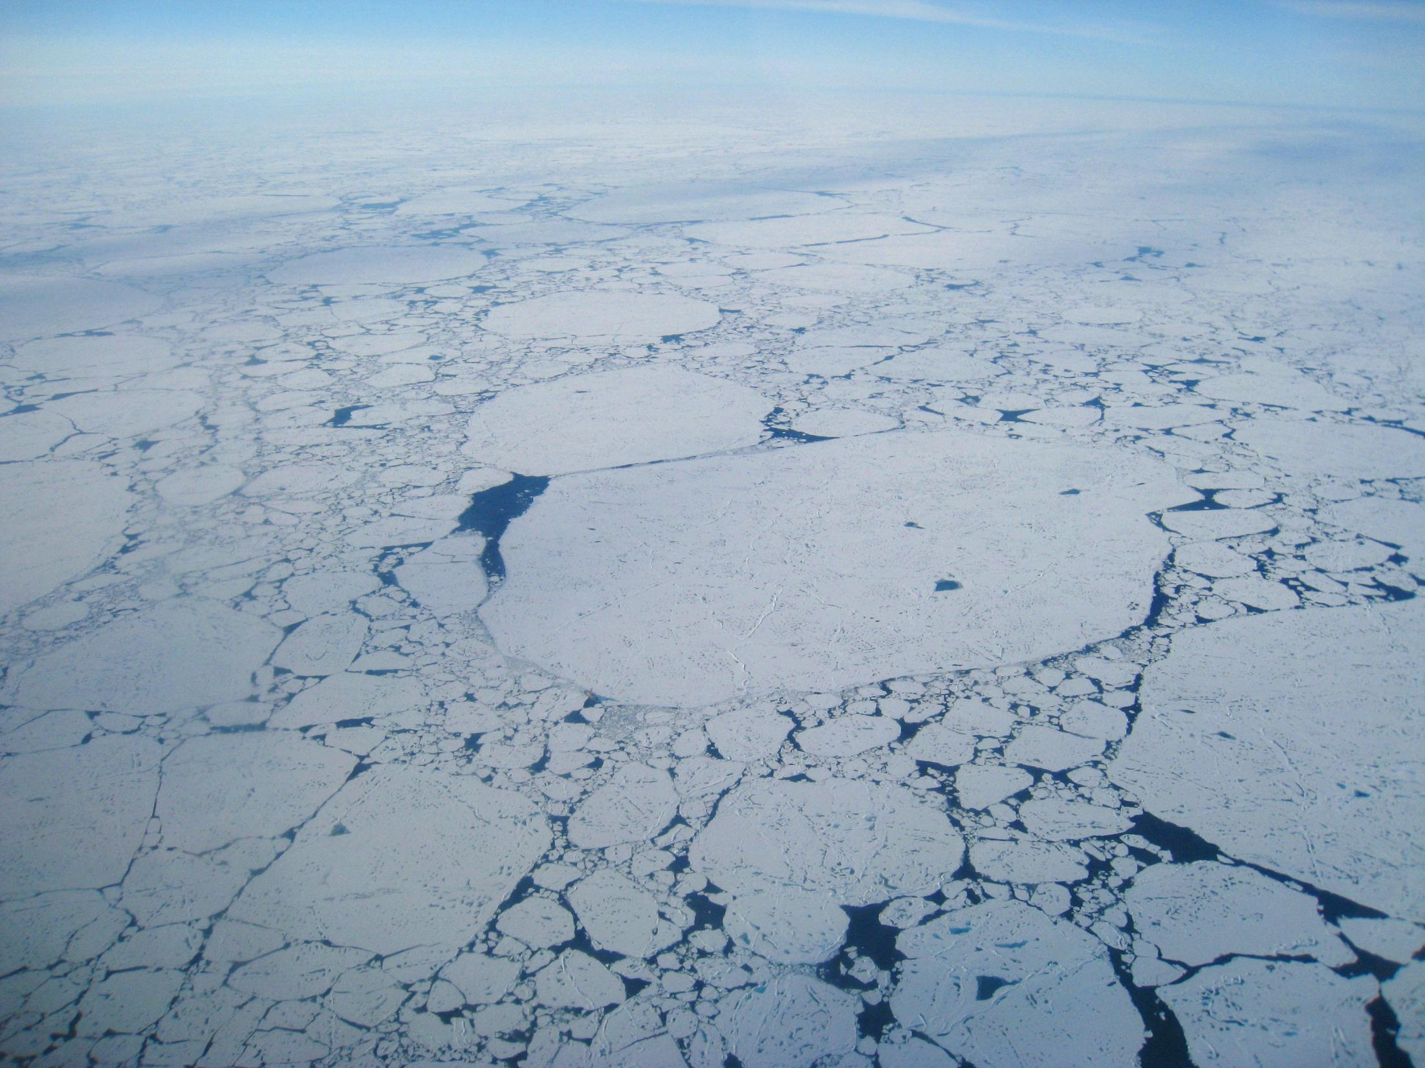


Observations at MOSAiC
The Multidisciplinary drifting Observatory
for the Study of Arctic Climate
Matthew Shupe
on behalf of the MOSAiC Coordination Team
5 September 2016

Slide 2
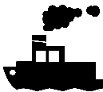
Science Focus Areas
Central Arctic Coupled System
Ozone Layer
Vertical and meridional
dynamical coupling
Cloud, aerosol radiative properties
Cloud-aerosol interactions
Interactions with boundary layer
Precipitation
Dynamical coupling
Clouds
Radiation
Vertical fluxes through boundaries
between ocean, sea ice and atmosphere
Meridional fluxes in atmosphere and ocean
Aerosols
Ocean, ice & atmos chemistry, interactions w/ aerosols
Thermal structure
Small scale processes
Energy & momentum
fluxes
Chemistry
Boundary layer
Biogeochemical fluxes
Sea ice
Ecosystem
Formation
Drift
Deformation
Melting
Full seasonal cycle:
Ecosystem dynamics
Populations in ocean & sea ice

Slide 3
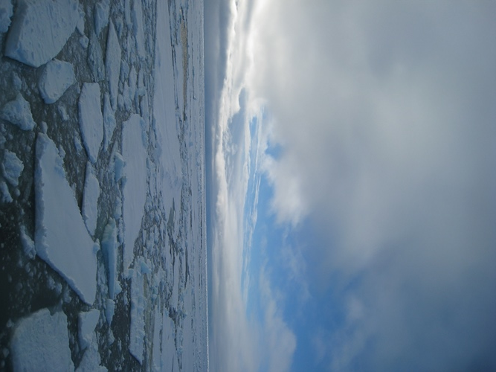
MOSAiC Operational Drivers
Enhanced Observing System
Interfacing w/ Satellites
Data Assimilation
Multi-scale Modeling & Forecasting
Large-scale Implications
Outreach/Education
Notes:
The top level science question is listed here. Sea-ice is the central focus, and specifically the sea-ice lifecycle, where the ice integrates the forcings/fluxes from above and below. Ultimately, the balance/budget of these forcings must be changing in order for the observed sea-ice decline to occur.

Slide 4
Meeting Societal Needs
Year round observations
in the Central Arctic
Evaluation, Development
Process studies
Enhanced observing system and satellites
Pan-Arctic Observations
Improved process models of Arctic sub-systems
Assessment
Operational products,
Monitoring
Assimilation
Upscaling
Coupling
System understanding
Parameterizations for Earth System Models
Services for stakeholders and society
Climate services
Improved Weather & Sea-Ice forecasting

Slide 5
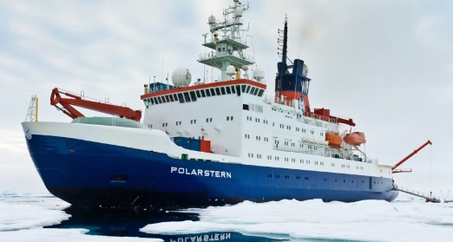
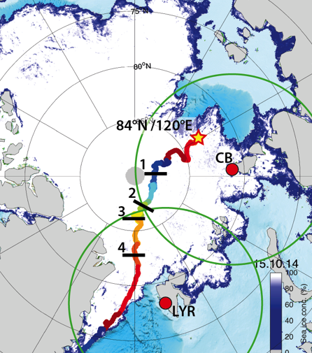
MOSAiC Plan
Drifting, interdisciplinary process study in central Arctic sea ice:
Central observatory: intensive atmos-ice-ocean-ecosystem observations
Distributed Network: Heterogeneity on model grid-box scale
Coordinated, multi-scale analysis & modeling activities, Links with YOPP
2019-2020, annual cycle
Central Arctic Basin ice pack
Notes:
Sea ice is the integrator of fluxes in the system

Slide 6
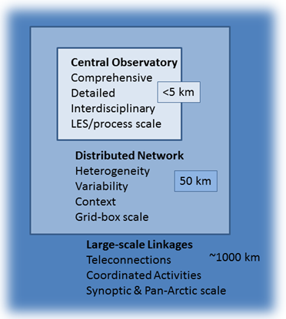
Multiscale Design
Full Annual Cycle
Coupled-system Interactions
Spatial Variability
Notes:
The three-part plan for MOSAiC: all critical elements.

Slide 7
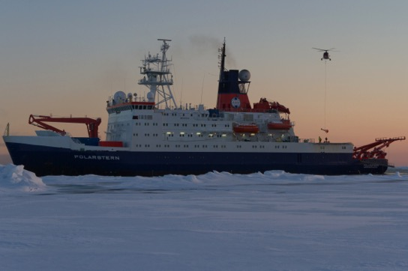
Central Observatory
Polarstern Icebreaker
From Alfred Wegener Institute, Germany
Atmospheric remote sensing
Radiosondes
Air sampling
Ocean profiling/ADCP
Laboratories for analysis (biological, chemical, etc.)
Base of operations
Safety
Data/sample storage

Slide 8

Ice Camp
Limited access zone
Met tower
Ocean flux
ITP
Met City
Turbulence
IMB
Snow surveys / ice optics / mass balance
Buoy Node
Ocean
Small CTD
Turbulence
Net sampling
ROV
ARM
Radiation
SEBS
Low atmosphere
Surface energy budget
Snow / precip
Sea-ice properties
Gas exchange
Ocean profiling
Ocean heat fluxes
Ocean/ice samples
Ice Hut
snow
ICE CORE
FARM
90º Contaminated turbulence zone
Power line
(~500m)
Snow surveys / ice optics / mass balance
+ ice sites at different ice types
Notes:
Why have a camp? Some measurements need to be away fro the ship influence (turbulence, pollution), access to ice
Balance of distance from ship vs. accessibility for people/power/equipment/safety

Slide 9
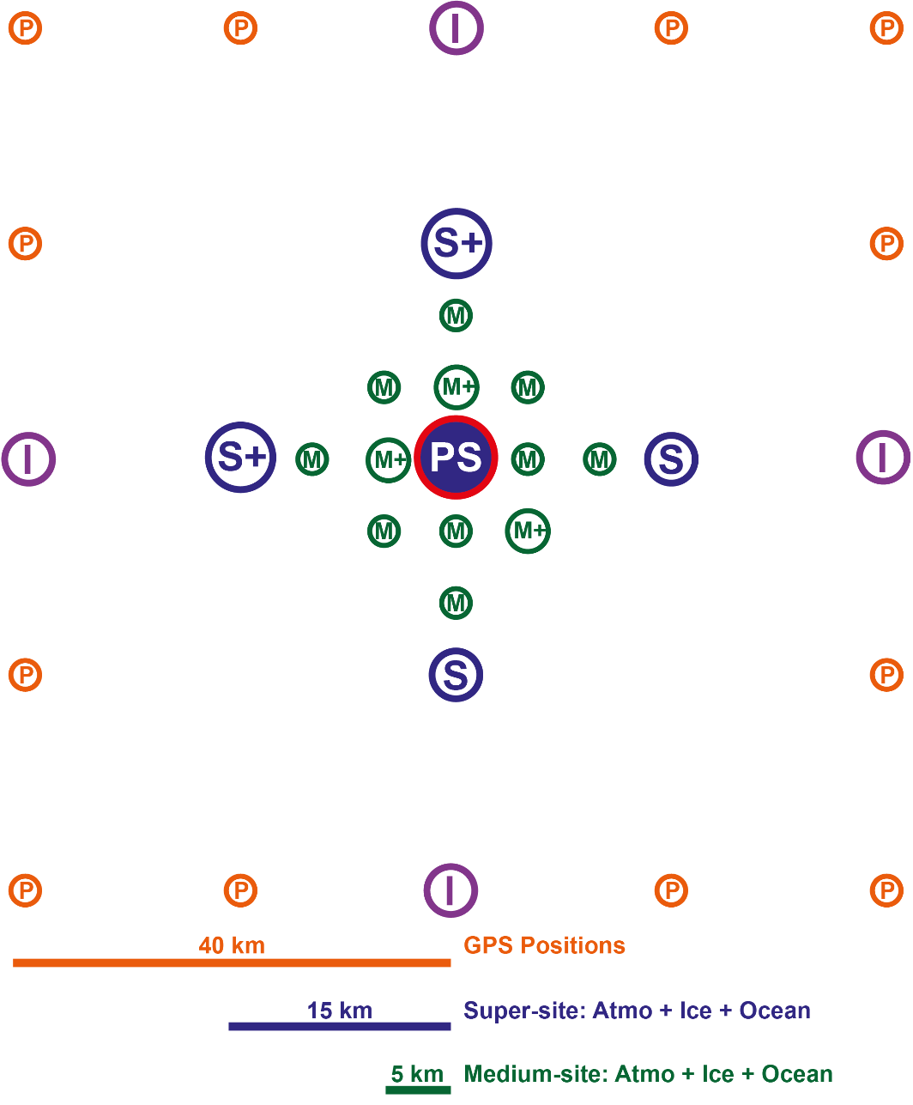
Distributed Network
Enhanced coupled-system: >5 nodes, 15km, (ocean profiling, ice mass balance, ocean and atmos heat fluxes)
Coupled-system: 5-40 km (upper ocean, ice mass, met)
Ice deformation: 1-40 km (gps)
Spatial mapping: UAS, glider, AUV, helicopter, scanning
Periodic visits for ocean/ice sampling & maintenance
Larger-scale network: pan-Arctic network of surface pressure buoys

Slide 10
Measurement Requirements
Needed to address the science questions & objectives outlined in the MOSAiC Science Plan. (* provide enhanced impacts)
Described according to disciplines, but implemented in an interdisciplinary design across the Central Observatory, Distributed Network, and beyond.

Slide 11
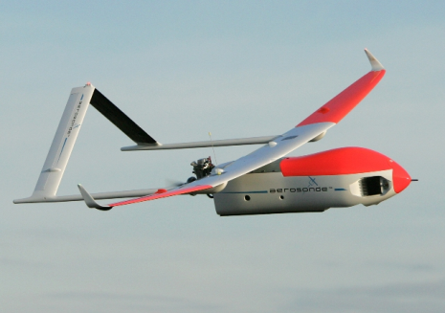
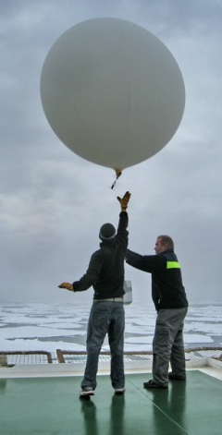
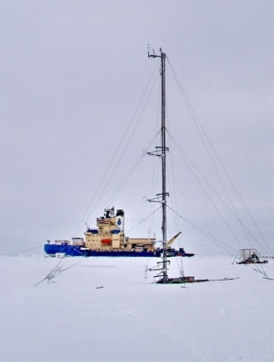
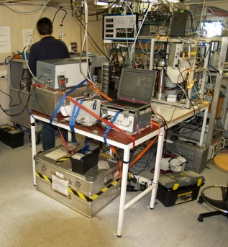
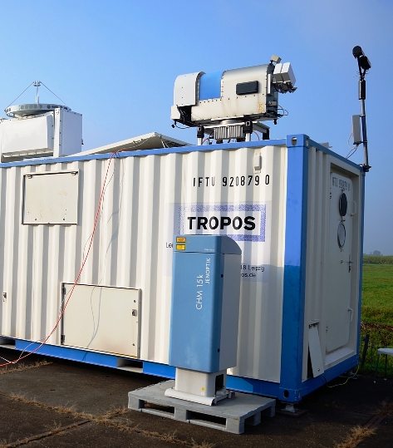
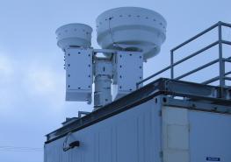
Atmosphere
ABL/Atmos Structure: 4-times daily sondes, 10-20m met. Tower, UAV
Dynamics: Doppler lidar, sodar
Clouds/precip: Radar, lidar, IR/microwave, gauges, etc.
Aerosols: Air sampling of CN, CCN, composition, IN*

Slide 12
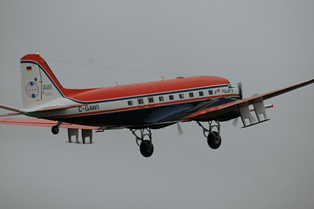
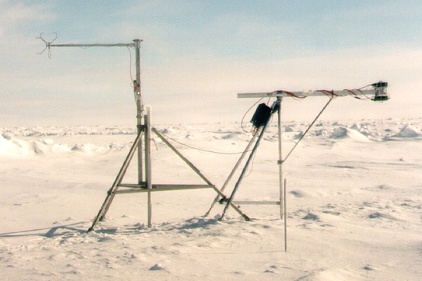
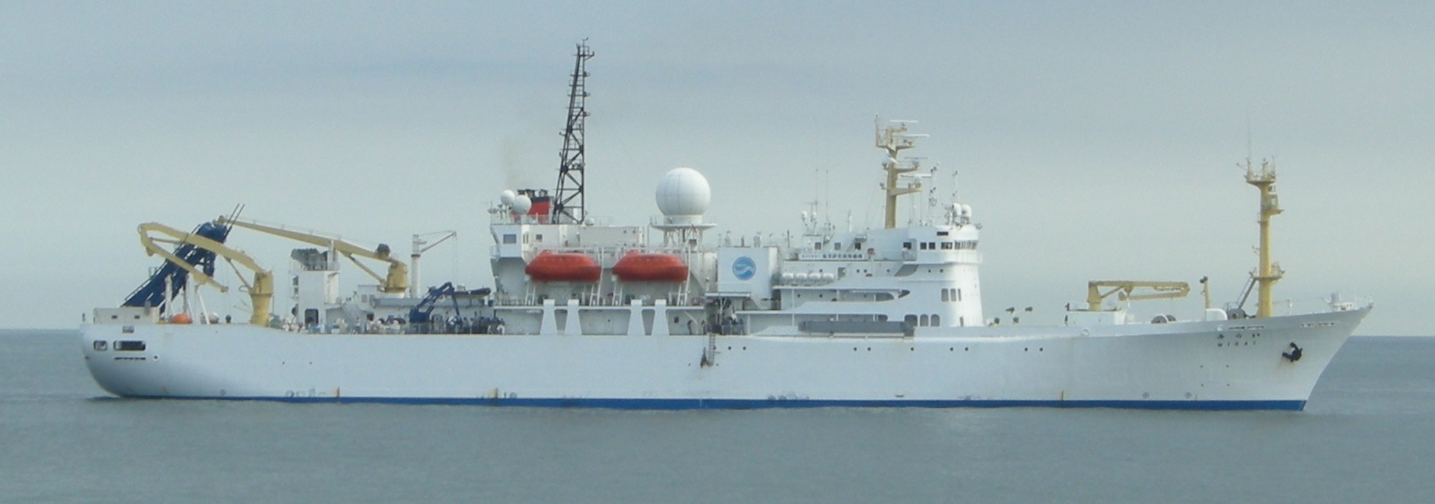
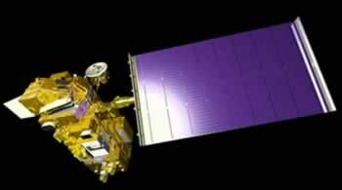
Atmosphere
Surface Energy Budget: Radiation, turbulence, remote stations, UAV, satellite
Opportunistic*: Lead energy budget
Aircraft campaigns*: radiation, clouds, aerosols, airmass transitions
Large-scale: Links with land stations, other ships*, pressure buoy array*

Slide 13
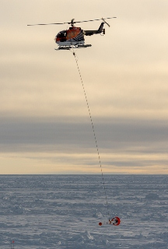
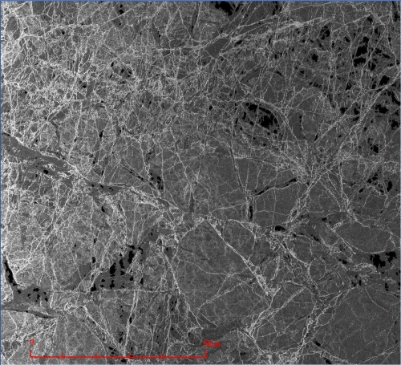
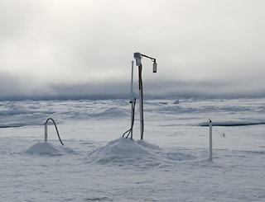
Sea-Ice and Snow
Surface type distribution: Manual and aerial surveys, vis/IR cameras, SAR
Ice thickness / snow depth: IMBs, manual surveys, EM surveys
Thermodynamics, mass, freshwater: IMBs, …
Radiative properties/optics: Radiometers, albedo surveys, ROV

Slide 14
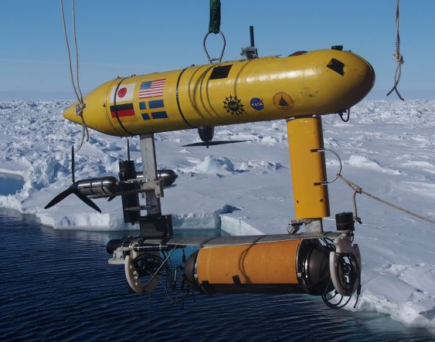
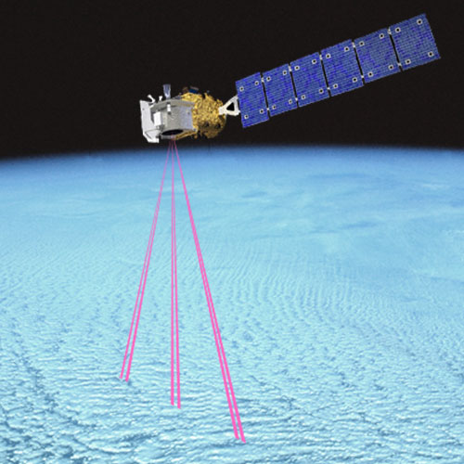
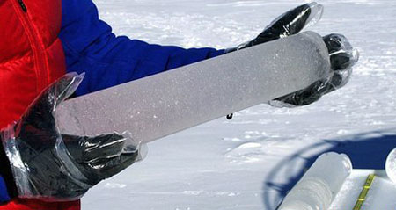
Sea-Ice and Snow
Physical properties: snow pits / ice cores
Deformation: GPS bouy array, SAR
Roughness/topography: AUV sonar
Opportunistic*: Lead, ridge, pond processes
Large-scale*: Satellites, aircraft campaigns

Slide 15
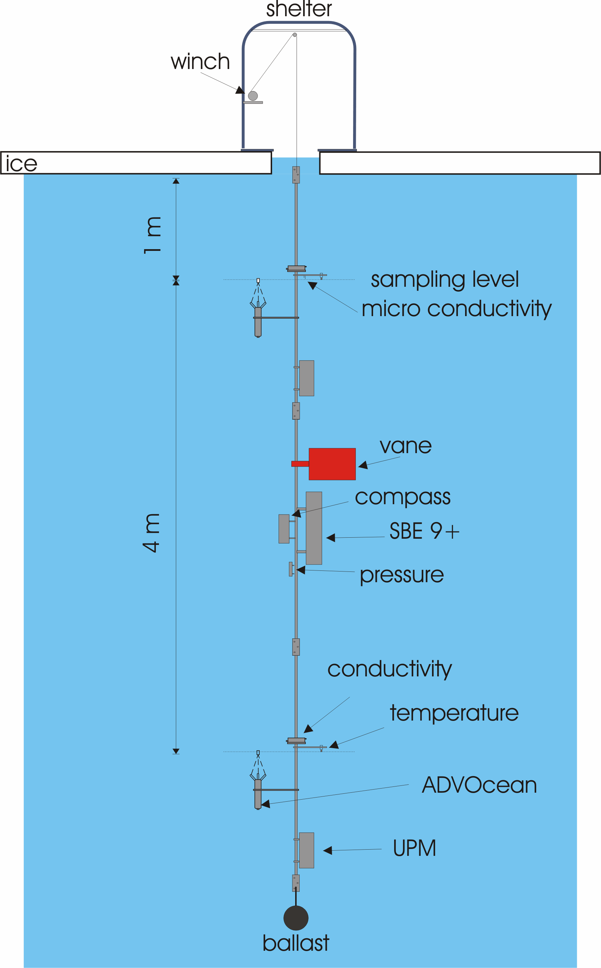
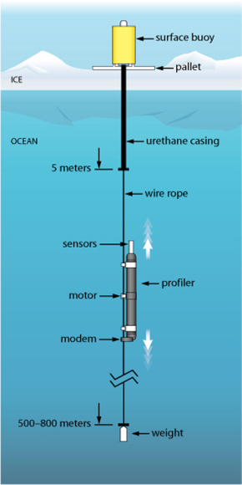
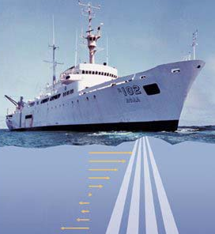
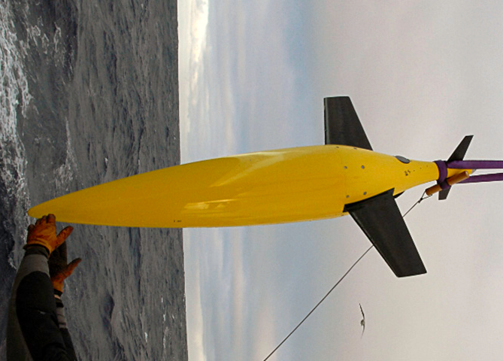
Ocean
Ocean structure: heat, salinity/freshwater, periodic deep ocean profilers, frequent upper ocean, CTD profiling
Heat flux: flux buoys
Dynamics: ADCP, turbulence mast/profiler
Spatial transects: Gliders
Opportunistic*: Lead structure, ocean surface
Large-scale*: Pan-Arctic network of ocean profilers

Slide 16
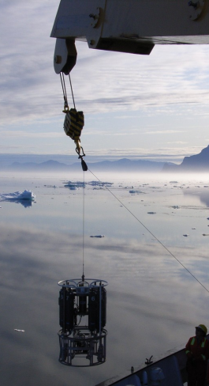
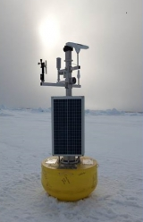
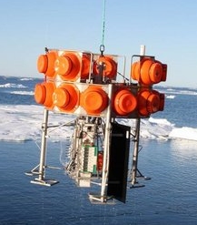
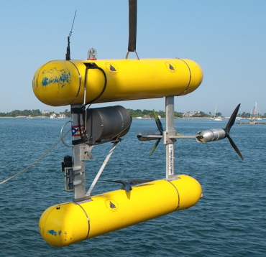
Biogeochemistry
Carbon: CO₂, CH₄, CO
Sulfur: DMS, DMSO
Nitrogen: N₂O, NO_{x}
Sampling: Air intake, ice/snow samples near and away from ship, Rosette
Trace Gases: GC analysis, and flux measurements
Photochemistry: halogen/mercury cycle
Radionuclides: ⁷Be, ²²²Rn, ²¹⁰Po

Slide 17
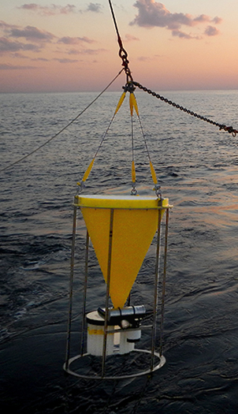
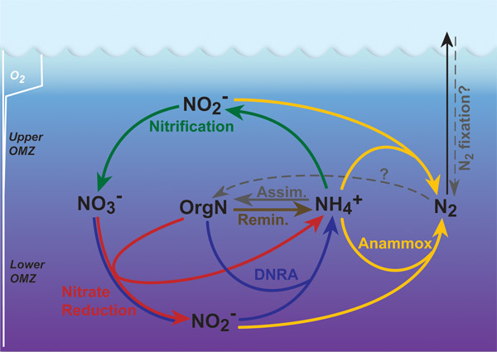
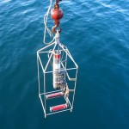
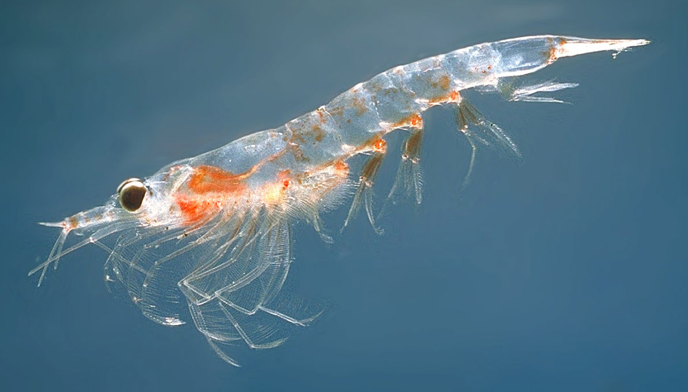
Ecosystem
Profiling, ocean/ice sampling: Oxygen, chl-a, nutrients, DOM, POC, PN, BSi, Chl-a, flow cytometry, light, ….
Primary production: carbon/nitrogen uptake, oxygen release
Particle fluxes: UVP, sediment traps, ²³⁴Th
Plankton: Rosette, net hauls
Opportunistic*: Sampling at leads
Transects*: Sampling via re-supply vessels

Slide 18
Intensive Operation Periods (tentative)
Arctic Haze (late winter–early spring 2020): Coordinated aircraft campaign for atmos. chemistry and radiation.
Spring bloom (May 2020): Linking increase light to productivity
Lead Processes (Opportunistic): Heat fluxes, dynamics
Melt Season (May-Sept 2020): Events, melt pond distribution, surface type transects, etc.
Freeze up (Sept 2020): Heat release through ocean and ice surfaces

Slide 19
Getting the Data Out
Data Policy: TBD (Intention for data to be freely available as soon as possible).
Archival: Interface with PANGEA, US DOE ARM, and other archives
Operational Data: 4 daily soundings on GTS
Community input on other operational needs (i.e., surface fluxes for real-time model eval)

Slide 20
Team Coordination
Role | AWI | International
Project Leader Assistance | M. Rex A. Sommerfeld | M. Shupe (CU/NOAA) V. Rachold (IASC)
Atmosphere | M. Rex | M. Shupe (CU/NOAA)
Sea ice / snow | M. Nicolaus | D. Perovich (CRREL)
Ocean | B. Rabe | C. Provost (UPMC)
Biogeochem | E. Damm | B. Loose (URI)
Ecosystem | A. Waite | TBD (Norway)
Model Integration | A. Rinke | W. Maslowski (NPS)
Data Management | A. Macario | TBD
Media/Outreach | F. Mertens | TBD
Remote Sensing | G. Spreen (UHB) | Ron Kwok (JPL)
Logistics | M. Hirsekorn U. Nixdorf | TBD
Contacts for getting involved

Slide 21
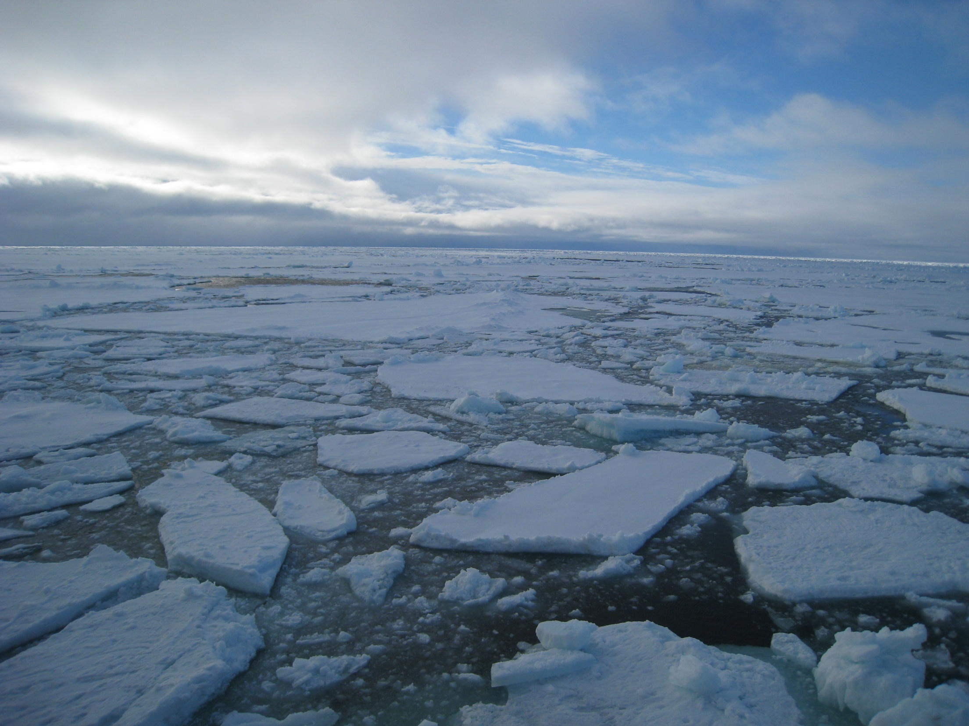
Many opportunities for engagement.
Thanks!
Science and Implementation Plans
www.mosaicobservatory.org
Notes:
Engage with partners and reach out to funding agencies to express interest.

