Slide 1
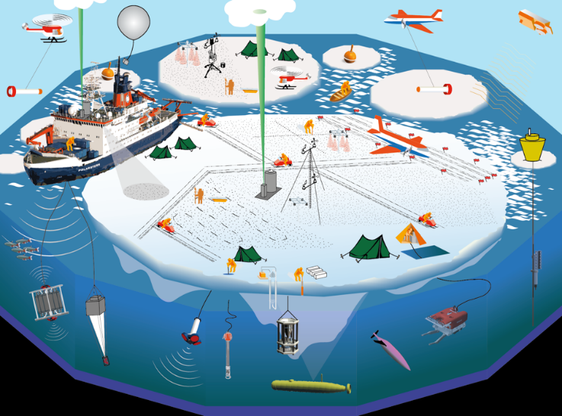
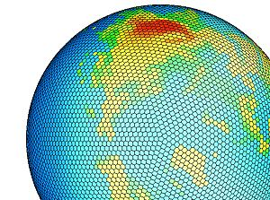
MOSAiC and Modeling
Matthew Shupe, Klaus Dethloff, Markus Rex, and many others

Slide 2
Goals
Process-level, coupled-system understanding to enable weather, climate, and sea-ice forecasting models
Sub-grid parameterizations
Process understanding and evaluation
Coupling and feedbacks
ABL, clouds, ice rheology, ocean mixing, BGC processes, fluxes
Large scale context for measurements
Inform large-scale linkages
Assimilation and operational data
Unique assimilation assessment
Enhance observing system / satellite products

Slide 3
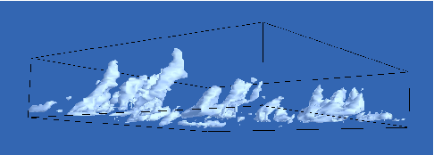
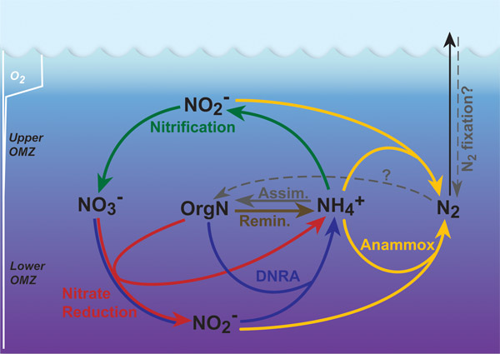
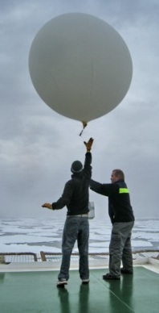
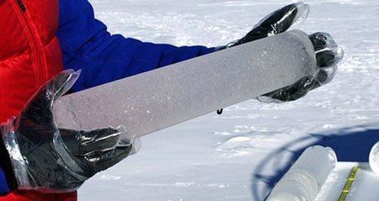
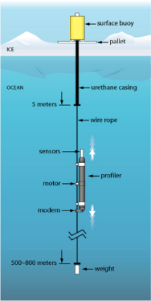
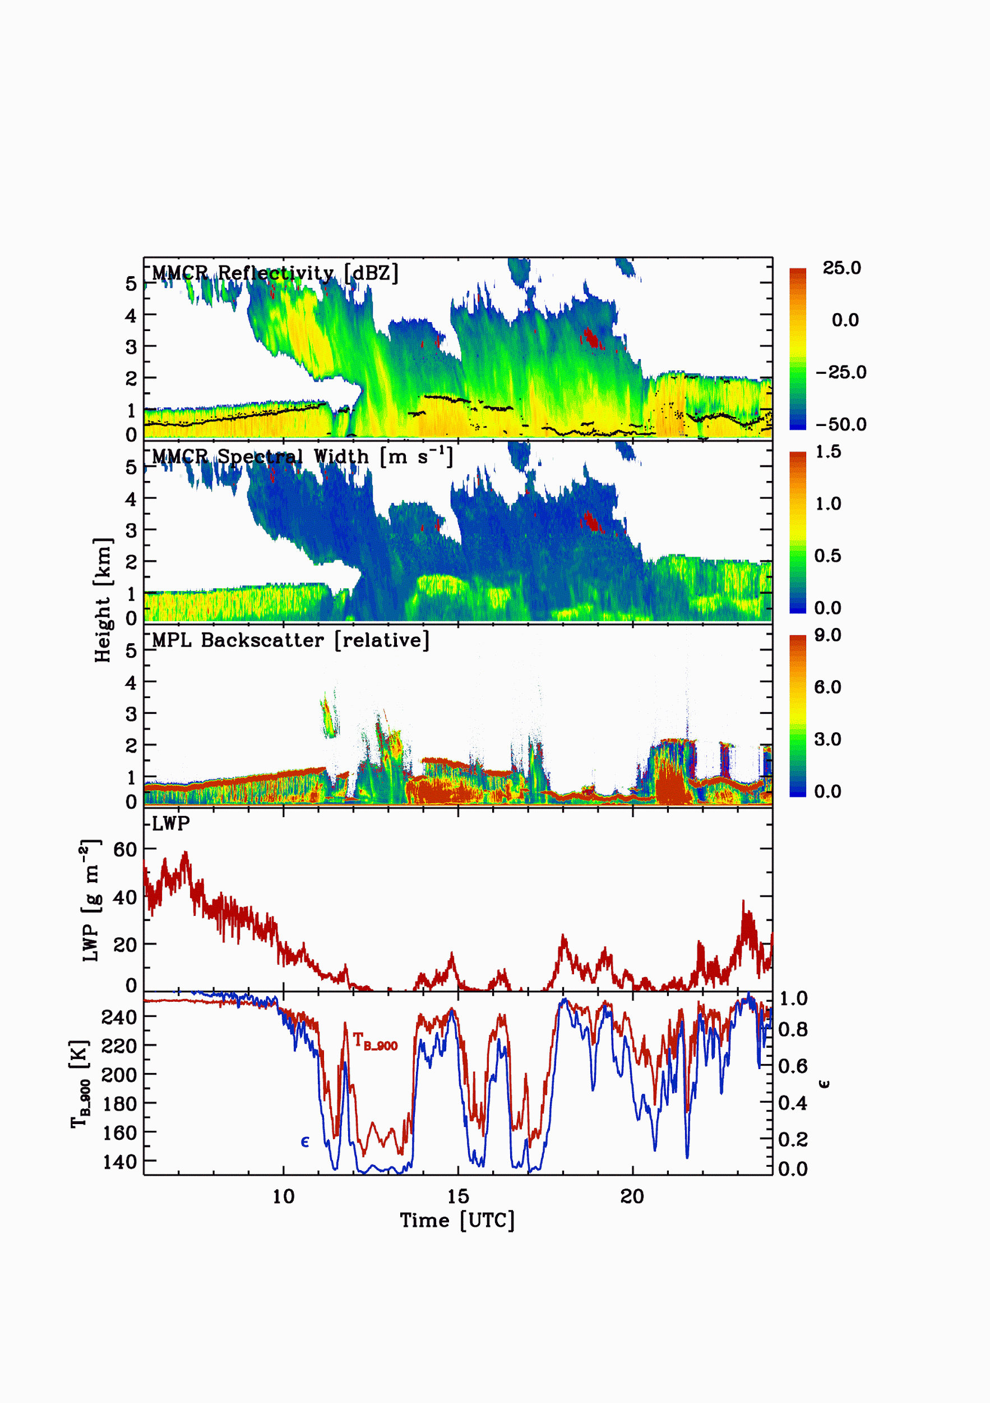
Modeling Pathway
Projections Predictions
Regional System Understanding
Validation Evaluation
Process Understanding
3D-GCM
3D-RCM
1D-SCM
Process, large-eddy, & mesoscale simulations
Detailed observational foundation

Slide 4
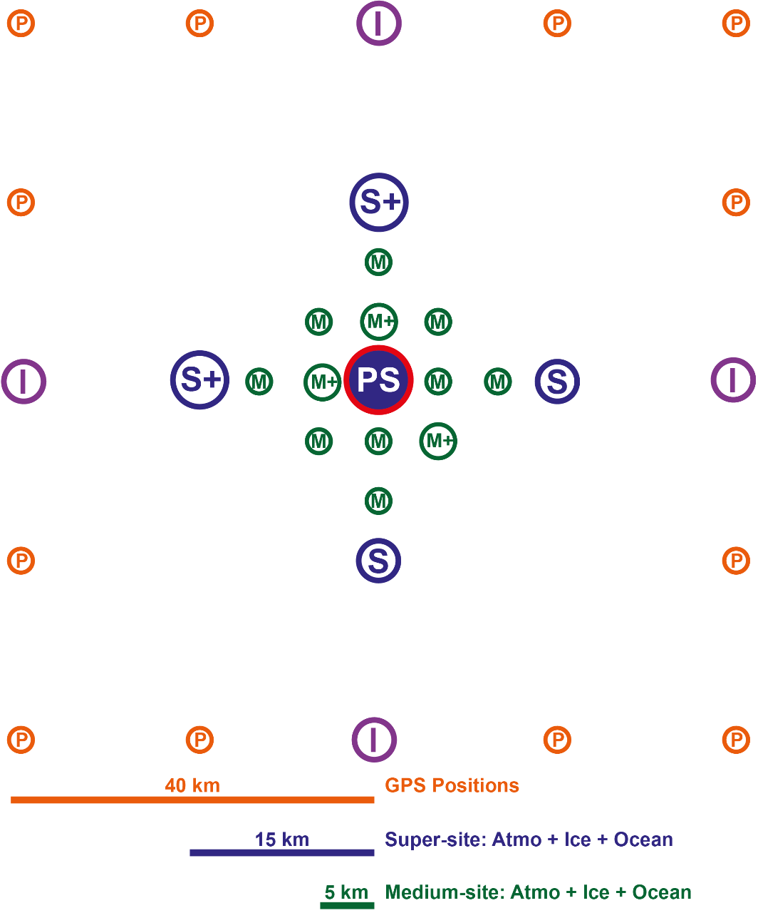
Designed for Modeling
Multi-scale nodes to represent grid-box heterogeneity and support upscaling
Opportunities for input on length scales!

Slide 5
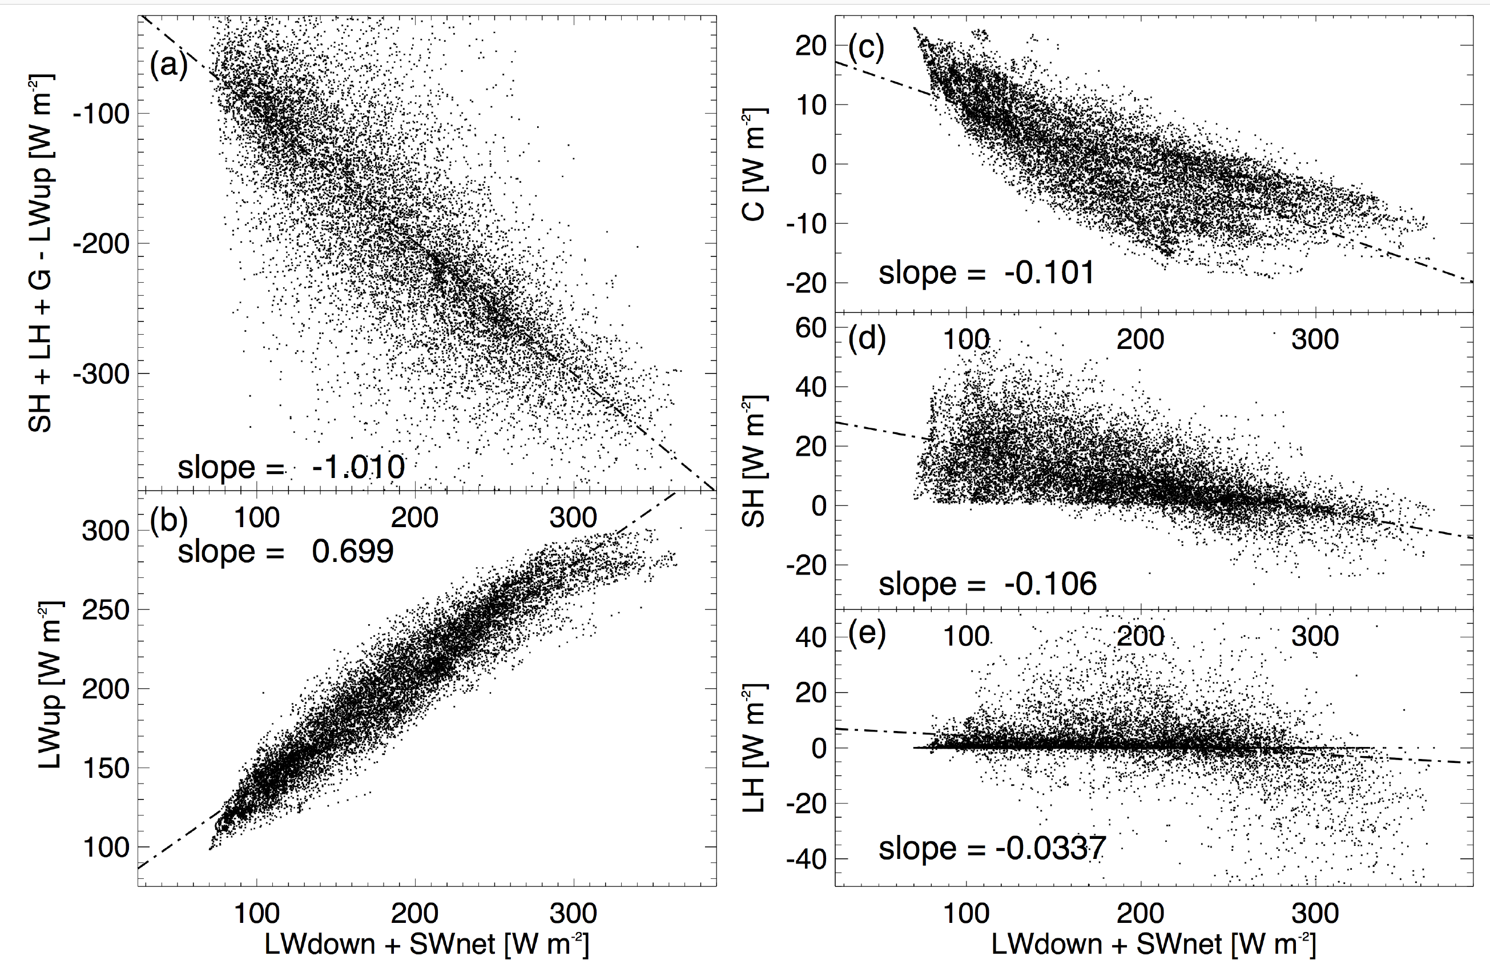
Process Evaluation
Detailed process evaluation over full annual cycle
Surface Energy Budget
Response terms vs. forcing terms as a function of month

Slide 6
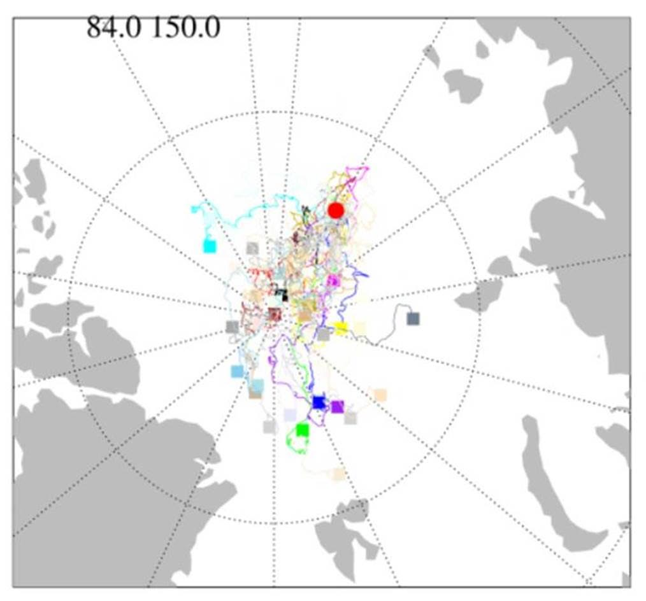
Operational support
Pre-drift planning for optimal install
Real-time ice drift forecasting > planning, targeted imagery
Real-time weather forecasting > operations, planning

Slide 7
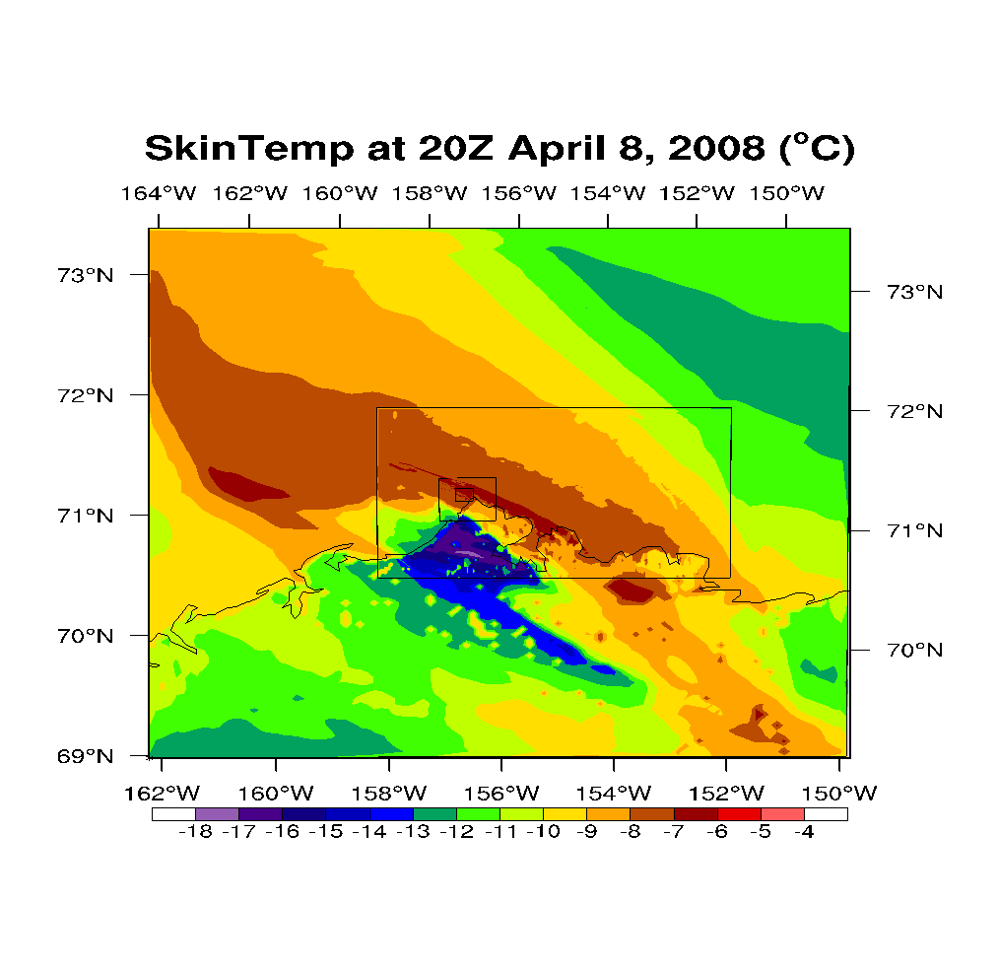
Process Modeling
Solomon et al.
Nested domains link mesoscale to LES
LES and/or nested mesoscale models
Process understanding / fluxes
Idealized studies
Link across scales
LES <-> Obs
Synergy

Slide 8
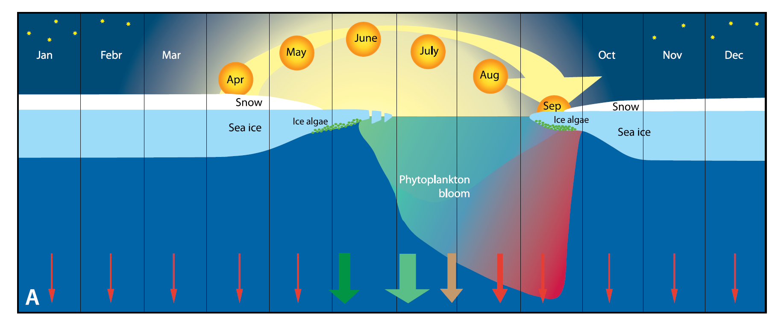
BGC/Eco Modeling
Arctic BGC-E Model SINMOD
3-D chemical & biological model coupled to Arctic Ocean-sea ice model
Forced by atmospheric driving data and freshwater input
Wassman, Reigstad et al.
Understanding effects of melting sea ice on carbon and nutrient cycles and marine ecosystem responses

Slide 9
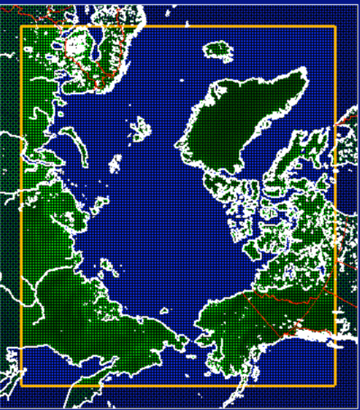
Regional Model Intercomparison
Arctic CORDEX
Circum-Arctic domain
Horiz. resol. of 0.44° or higher
Driven by ERA-Interim
13 participating institutes
AWI | Potsdam, Germany
CCCma | Victoria, Canada
Colorado Uni. | Boulder, USA
DMI | Copenhagen, Denmark
EMUT | Trier, Germany
GERICS | Hamburg, Germany
ISU | Iowa, USA
Lund Uni. | Lund, Sweden
MGO | St. Petersburg, Russia
SMHI | Norrkoping, Sweden
UNI | Bergen, Norway
Ulg | Liège, Belgium
UQAM | Montreal, Canada
Rinke et al.

Slide 10
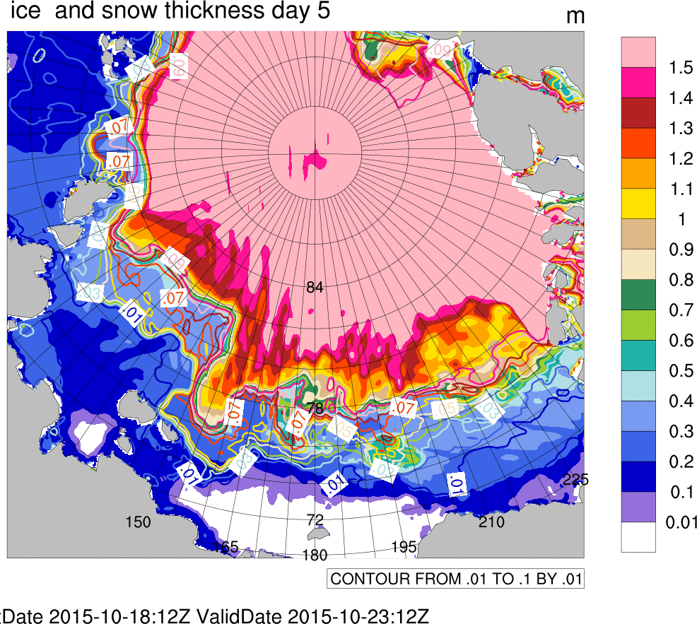
Experimental Sea-Ice Forecasting
Solomon et al.
RASM-ESRL
Based on RASM
10km res.
Forced by GFS
For MOSAiC
Daily 5-14 day forecasts
Forecast and assessment for full year

Slide 11
Assimilation
Inoue, Dethloff et al.
JAMSTEC ALERA2
Observing system experiments
Global observations
Extra Observations
(radiosondes)
Control Reanalysis
Atmospheric
forecast
Sea-ice
forecast
Reanalysis
w/o extra obs
Atmospheric
forecast
Sea-ice
forecast
Data assimilation
Predictability of extreme events
Predictability of sea ice over NSR

