Slide 1
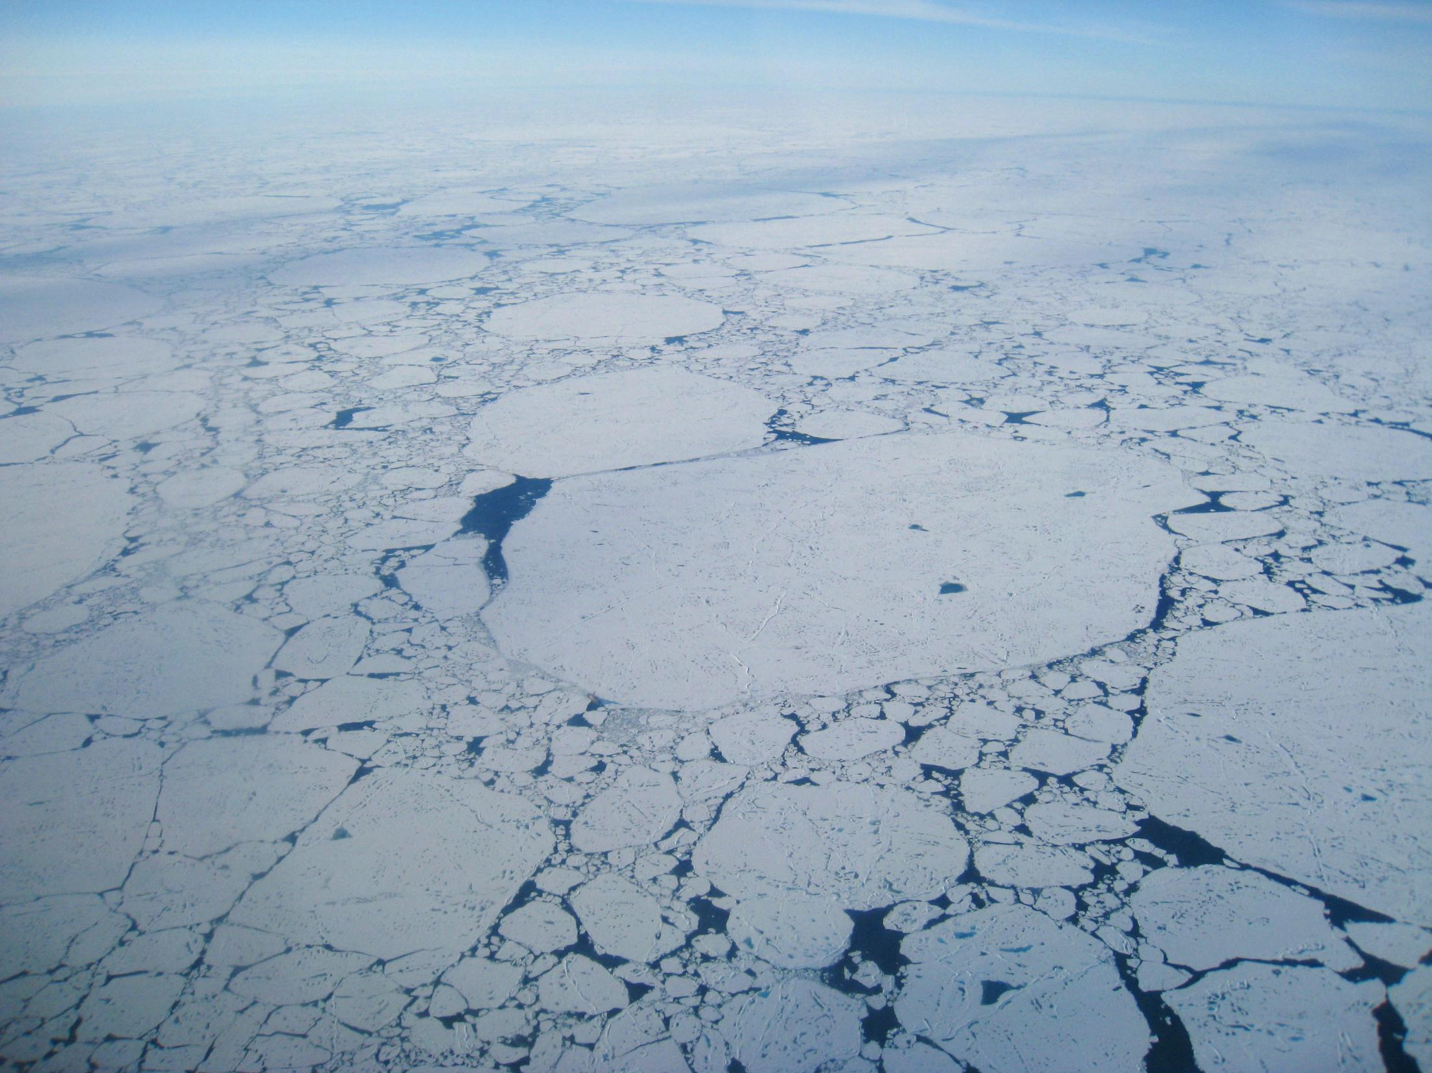
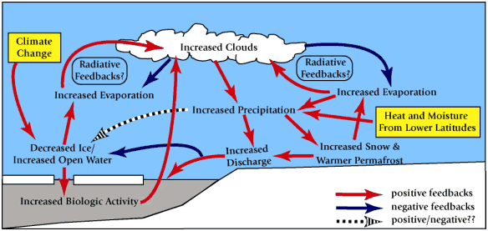
Dukhovskoy et al. 2006
www.iarc.uaf.edu
Francis et al. 2009
Notes:
The Arctic sea-ice pack looks like a mosaic itself, and the Arctic climate system is comprised of a mosaic of complex, interdependent processes.

Slide 2


MOSAiC
Multidisciplinary drifting Observatory
for the Study of Arctic Climate
Matthew Shupe – Univ. of Colorado/CIRES/NOAA
On behalf of many…..
International Coordination Team
D. Barber, K. Dethloff, S. Gerland, J. Inoue, C. Lee, B. Loose, A. Makshtas,
W. Maslowski, M. Nicolaus, D. Notz, I. Peeken, D. Perovich, O. Persson,
J. Schmale, M. Shupe, M. Tjernström , T. Vihma, J. Zhao
US Science Development Team
M. Alkire, C. Ashjian, B. Blomquist, J. Bowman, J. Creamean, G. de Boer,
C. Fairall, D. Helmig, E. Hunke, J. Hutchings, J. Intrieri, J. Kay, J. Key, R. Kwok, C. Lee, B. Loose, W. Maslowski, A. McComiskey, D. Noone, D. Perovich, O. Persson, C. Polashenski, D. Randall, A. Roberts, M. Shupe, T. Stanton, M. Steele, M.-L. Timmermans, J. Toole, D. Turner, J. Verlinde
And many more international partners
Notes:
Introduce the organizing team and science plan writing team.

Slide 3
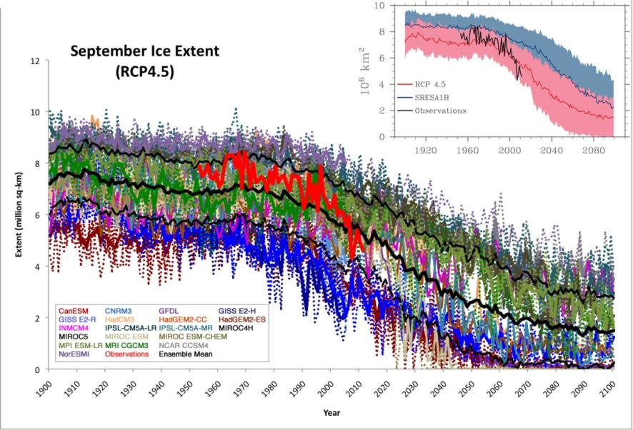
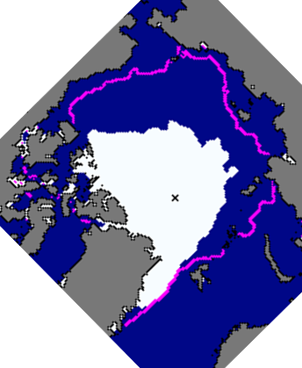
Arctic in Transition
The central Arctic is changing dramatically,
characterized by major sea-ice decline & more younger ice.
Do we know why? and (importantly) how?
Sept. 2012
1979-2000
median
Courtesy J. Stroeve
nsidc.org
Notes:
It is critical to not only understand that the Arctic is changing, but to understand HOW it is changing. This requires a process-level understanding of the many interdependent processes.

Slide 4
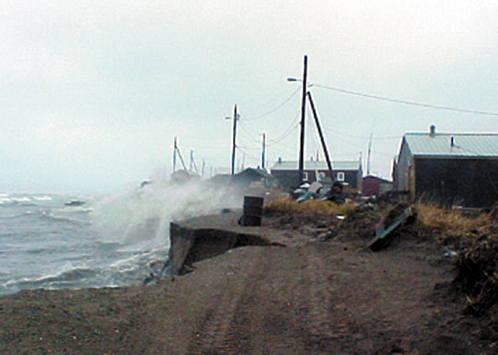
Implications of Change
We lack a system- and process-level understanding of change
Poor model representation of coupled system, and change
Potential emergence of new processes, tipping points
Feedbacks with “globally significant consequences” (IPCC)
Implications for regional and lower-latitude weather
Implications for resource development, commerce, ecosystems, productivity, communities
Francis et al. 2009
noaa.gov
Notes:
Geopolitical, economic, commercial, ecosystem, and human factors.

Slide 5
Sea-Ice Energy Budget
ARCTIC ENERGY BUDGET (φ > 65°N)
reflected solar radiation
115 W m²
Incoming solar radiation
200 W m²
Outgoing longwave radiation 183 W m²
-100
Reflected by clouds, aerosol
& atmosphere
20
45
30
133
Absorbed by atmosphere
emitted by atmosphere
+98
59
237
Reflected by surface
3
3
back radiation
96
231
20
70
26
3
3
257
231
Absorbed by surface
Turbulence
Evapo-transpiration
Surface radiation
Absorbed by surface
+2
Sea ice
2
Sea ice
Decadal decline can be explained by ~1 W/m² excess.
Kwok and Untersteiner 2011
Notes:
Energy budgets of the system are a complex balance of processes with large fluxes. Excess needed to lead to the observed melt is very small relative to many of the individual fluxes AND our ability to measure/understand them.

Slide 6
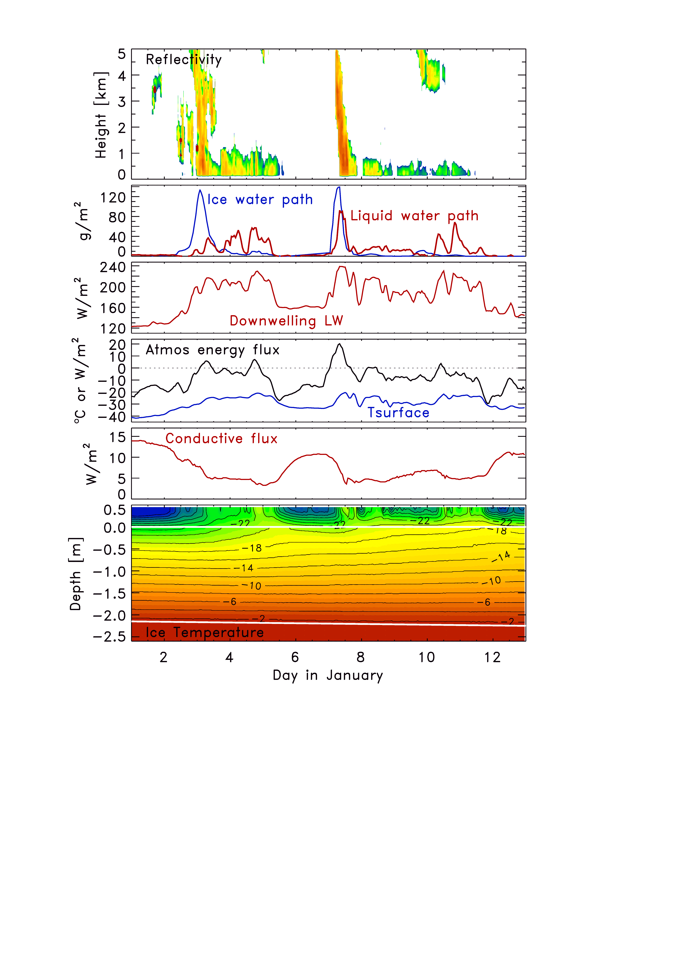
Coupling
Mixed-phase clouds accompany warm moist advection aloft;
Impacts BL structure.
Liquid clouds increase LW_{down} by 40-70 W/m²
>>
Significant change in surface energy budget.
Thermal structure of snow and ice responds
>>
Conduction of heat through ice responds
after Persson et al. 2016
Notes:
Points: One cannot really understand the variability in the sea-ice temperatures without understanding variability in SEB that is related to atmospheric conditions leading to liquid water clouds.

Slide 7
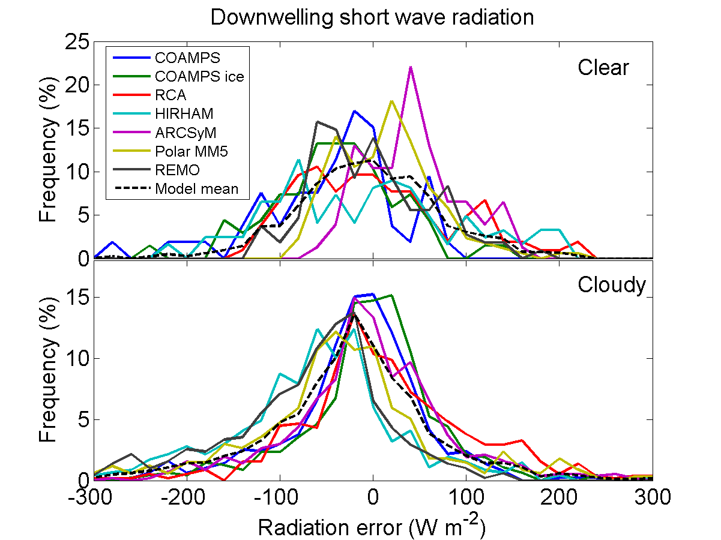
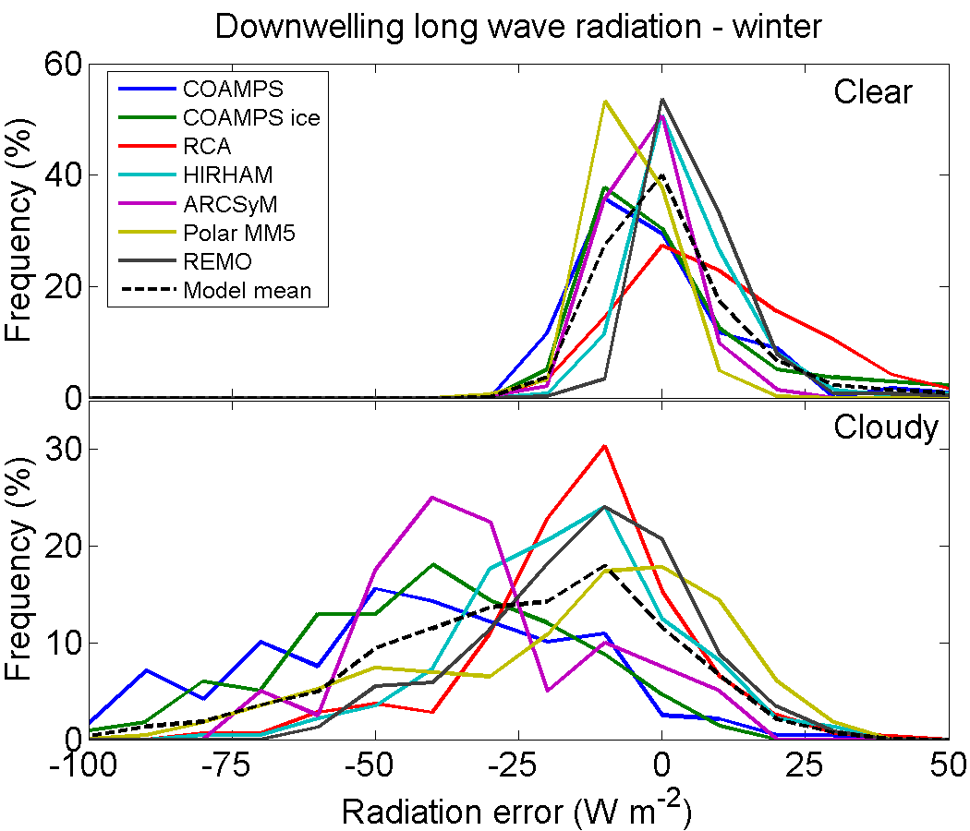
Critical Model Shortcomings
Regional Climate Models evaluated against SHEBA radiative fluxes reveal major biases and spreads, especially under clouds.
Such biases can have serious implications for sea-ice concentrations.
~ 0 W m⁻²
~ 0 W m⁻²
~-10 W m⁻²
~-25 W m⁻²
Tjernström et al. 2008
Notes:
Important point to note is that models show dramatic BIASES that can have serious implications for sea-ice melt and that clouds are a primary culprit. (On the other hand, the variability from models is somewhat expected and somewhat less concerning because they may not capture the timing of specific events, etc.).

Slide 8
Critical Model Shortcomings
Inhibit our Understanding
IPCC: “Further, understanding of the polar climate system is still incomplete due to its complex atmosphere-land-cryosphere-ocean-ecosystem interactions involving a variety of distinctive feedbacks…. A serious problem is the lack of observations against which to assess models, and for developing process knowledge……”
Among the primary causes of biases in simulated sea ice:
High-latitude winds
Vertical and horizontal mixing in the ocean
Surface heat flux errors
Atmospheric boundary layer
High-latitude cloudiness
Notes:
Cloud feedbacks remain one of the largest contributors to model uncertainty, globally. Role of clouds in the Arctic is relatively unknown (IPCC couldn’t even comment on it one way or another because of so little information).
Aerosol implications are complicated by long transport distances, limited local sources, mixed-phase processees
IPCC emphasizes the need to further develop models that can represent the drastic changes that are occurring, particularly handling issues such as abrupt changes, feedbacks, non-linear responses, etc.

Slide 9
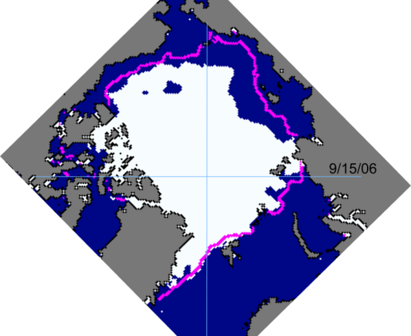
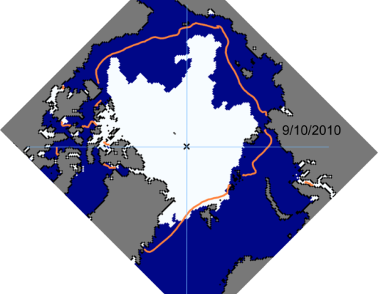
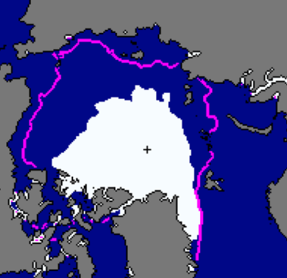
Challenge of Sea-Ice Prediction
2006
Physics matter
Thermodynamics & Dynamics
Coupled processes matter
Interseasonal coupling
The ice is changing
2010
2012
Notes:
“Everyone” wants to predict sea ice (agencies, private and public sector, communities)
To make better models requires improved representation of physics
These both occur year round
Ice does not act in isolation…. Constantly integrating both heat and momentum fluxes
Integrated effects means ice is preconditioned for future seasons.
System processes may be changing; knowledge from the past may be less relevant today.

Slide 10
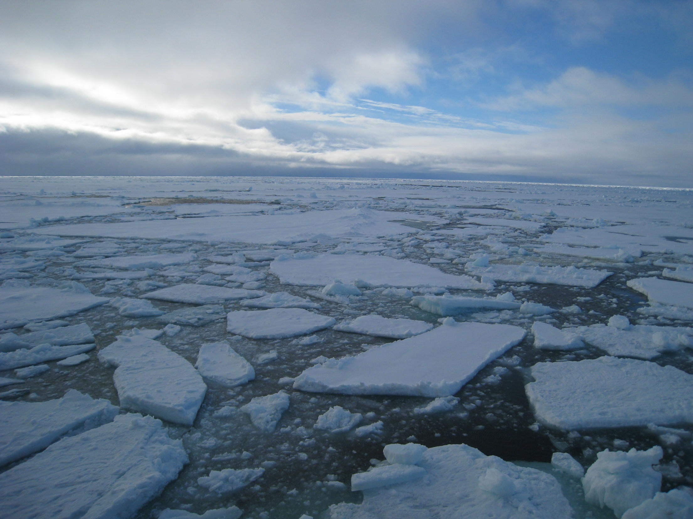
MOSAiC Concept
Year-round, coordinated, and comprehensive measurements, extending from the atmosphere through the sea ice and into the ocean, are needed in the central Arctic Basin to provide a process-level understanding of the changing central Arctic coupled climate system that will contribute towards improved modeling of Arctic climate and weather, and prediction of Arctic sea-ice.
Notes:
This is the basic thesis statement.

Slide 11
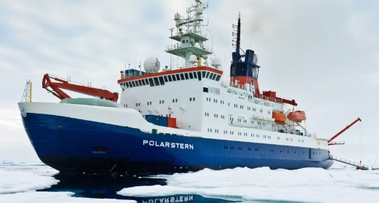
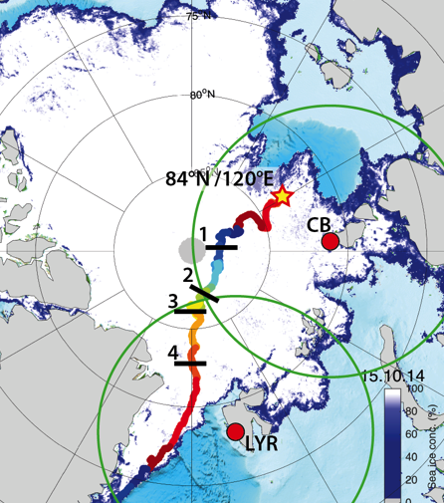
MOSAiC Plan
Drifting, interdisciplinary process study in central Arctic sea ice:
Central observatory: intensive atmos-ice-ocean-ecosystem observations
Distributed Network: Heterogeneity on model grid-box scale
Coordinated, multi-scale analysis & modeling activities, Links with YOPP
2019-2020, annual cycle
Central Arctic Basin ice pack
Notes:
Sea ice is the integrator of fluxes in the system

Slide 12
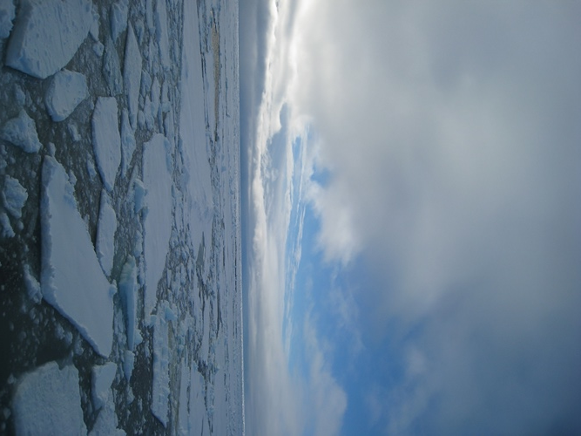
MOSAiC Science Drivers
Leading Science Question:
“What are the causes and consequences of an evolving and diminished Arctic sea ice cover?”
Sea-ice Lifecycle as a Theme.
Use a sea-ice “Lagrangian” perspective, where ice processes integrate forcings from atmos and ocean
Notes:
The top level science question is listed here. Sea-ice is the central focus, and specifically the sea-ice lifecycle, where the ice integrates the forcings/fluxes from above and below. Ultimately, the balance/budget of these forcings must be changing in order for the observed sea-ice decline to occur.

Slide 13
Sea-Ice Energy Budgets
Incoming solar radiation
Outgoing LW
Reflected solar
emitted by atmosphere
Energy Budgets
Radiation
Upper Ocean Heat Storage
Mixing Processes
Turbulence
Stratification
Boundary Layers
Absorbed by atmosphere
Atmosphere
back
radiation
Reflected surface
Turbulence
Large-scale advection
Sea ice
Absorbed by ice
Emitted-Absorbed by ice
Sea ice
Transmitted
Turbulence
Ocean

Slide 14
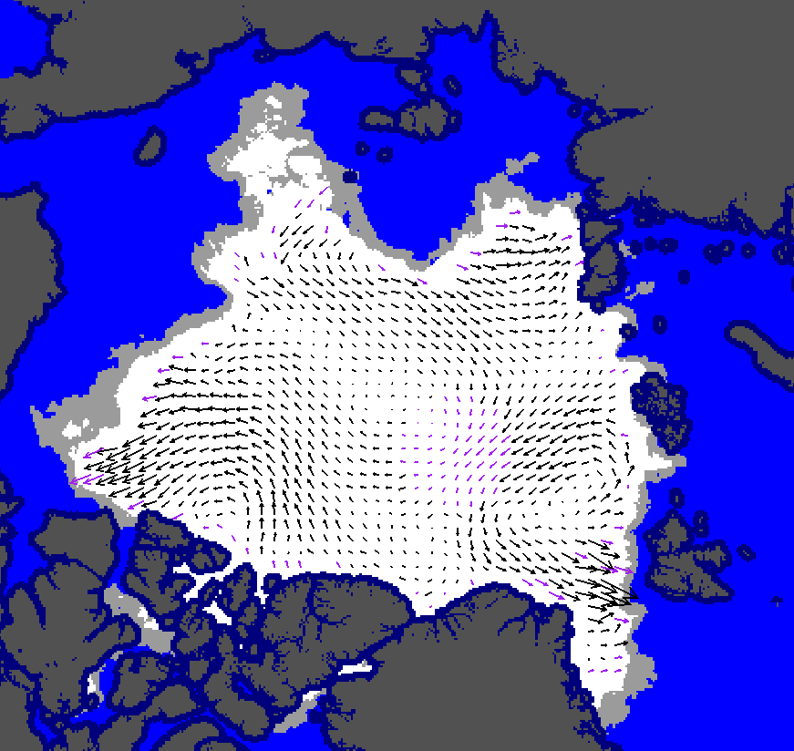
Ice Motion / Deformation
Ice Age
Ice Thickness Dist’n
Floe Size Dist’n
Ridging / Leads
Roughness / Drag
Momentum Transfer
Dynamics / Velocity
Ice –Wave Interactions
met.no

Slide 15
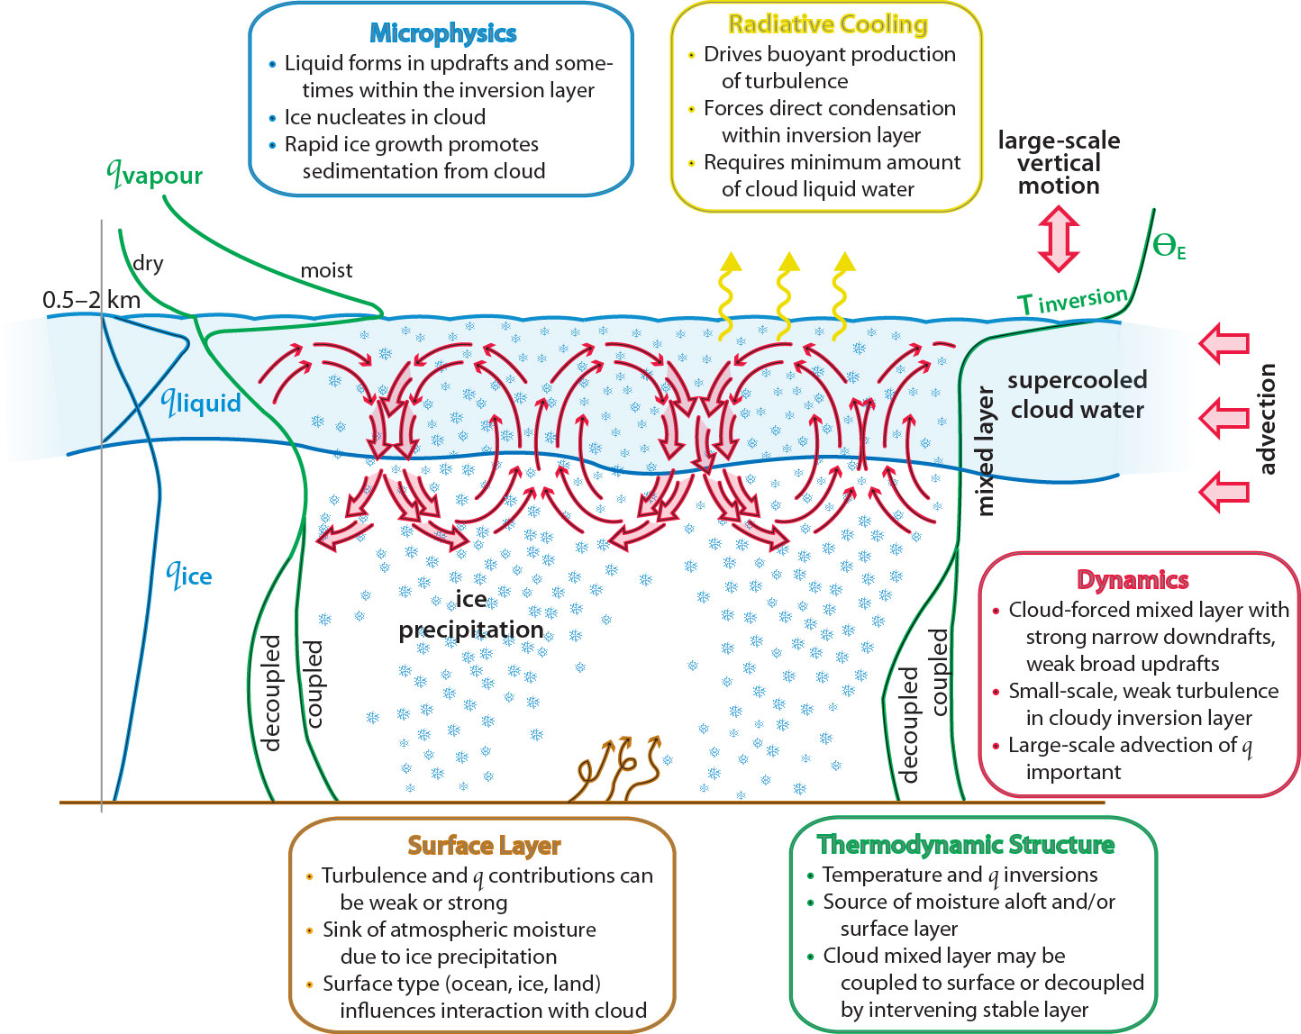
Clouds/Precip/Aerosols
Phase Partitioning / Mixed-phase
Radiative Processes
Cloud dynamics / Turbulence
Spatial Organization
Cyclogenesis
Aerosol Conc. / Source attribution
Precipitation
Morrison et al

Slide 16
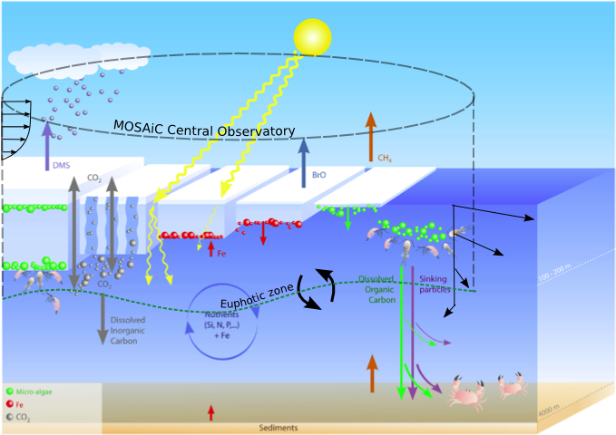
Biological/Chemical Cycles
Ecosystems and Communities
Primary Productivity
Elemental Cycles
Vertical Export and Mixing
Surface Gas Exchange
Photochemistry
DMS and Aerosol Precursors

Slide 17
MOSAiC Operational Drivers
Notes:
The top level science question is listed here. Sea-ice is the central focus, and specifically the sea-ice lifecycle, where the ice integrates the forcings/fluxes from above and below. Ultimately, the balance/budget of these forcings must be changing in order for the observed sea-ice decline to occur.

Slide 18
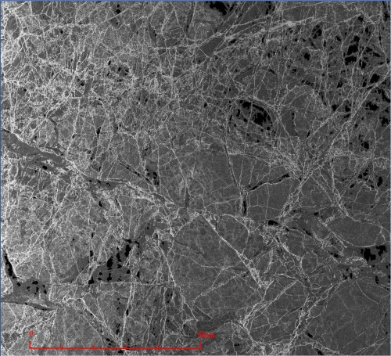
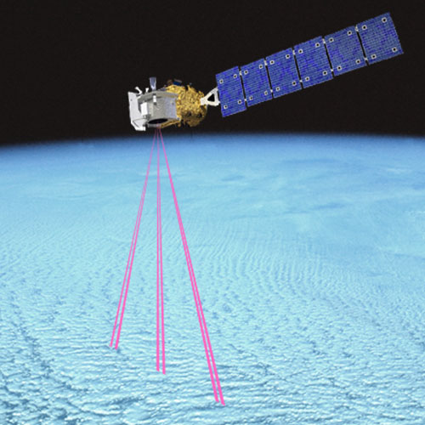
Interfacing with Satellites
Operational strategies
Ground validation
Method development
Upscaling

Slide 19



Data Assimilation
JAMSTEC ALERA2
Observing system experiments
Impact of additional observations
Operational forecasts
Re-analyses
Global observations
Extra Observations
(radiosondes)
Control Reanalysis
Atmospheric
forecast
Sea-ice
forecast
Reanalysis
w/o extra obs
Atmospheric
forecast
Sea-ice
forecast
Data assimilation
Predictability of extreme events
Predictability of sea ice over NSR

Slide 20
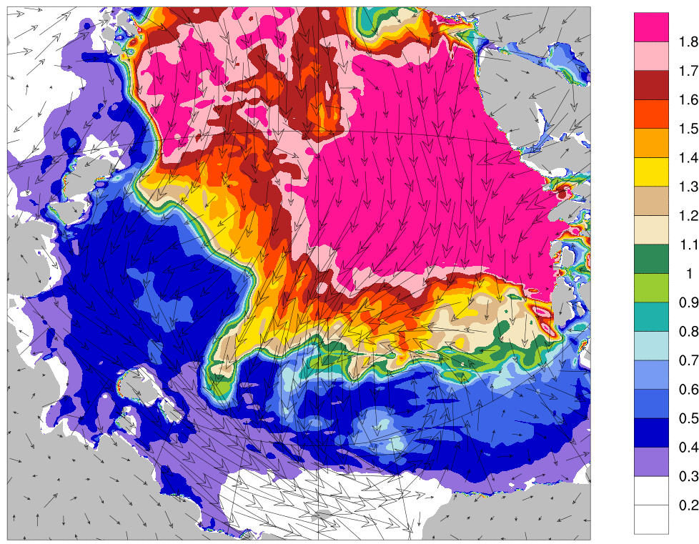
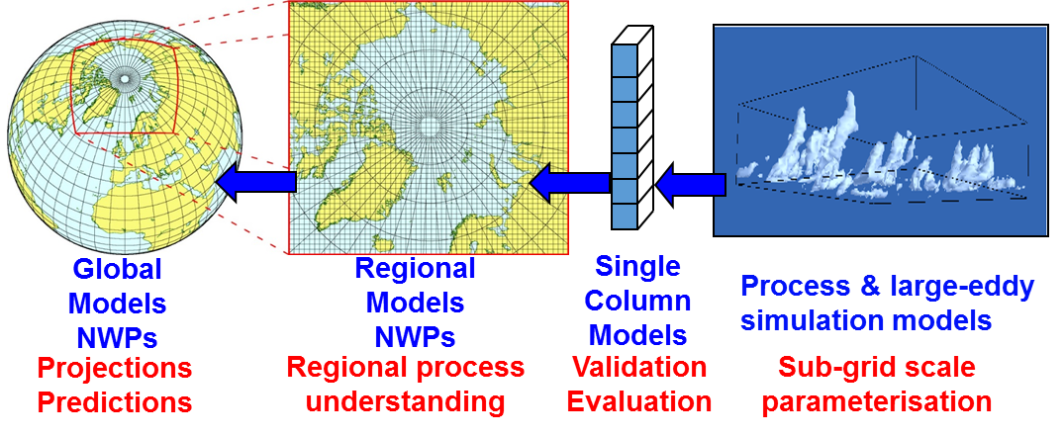
Multiscale Modeling
LES & process modeling
SCM for evaluating parameterizations
CORDEX: Regional model intercomparison
Experimental, operational sea-ice forecasting
YOPP: Global coupled system modeling
NOAA-ESRL

Slide 21
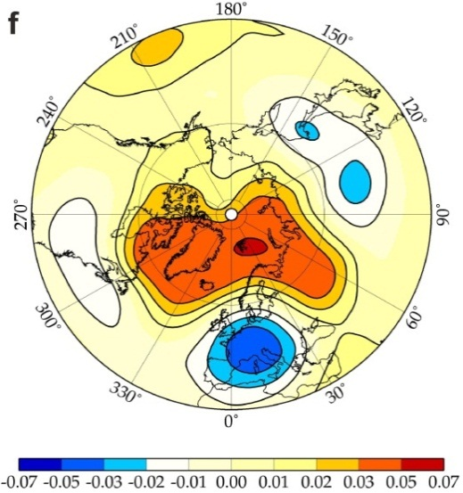
Large-Scale Implications
Large-scale Transport
Linking local processes & hemispheric patterns
Upscaling
Implications of regional change
Col-der
War-mer
War-mer
Col-der
Jaiser et al.

Slide 22
Stakeholder Services
Year round observations
in the Central Arctic
Evaluation, Development
Process studies
Enhanced observing system and satellites
Pan-Arctic Observations
Improved process models of Arctic sub-systems
Assessment
Operational products,
Monitoring
Assimilation
Upscaling
Coupling
System understanding
Parameterizations for Earth System Models
Services for stakeholders and society
Climate services
Improved Weather & Sea-Ice forecasting

Slide 23
Implementation
Notes:
The top level science question is listed here. Sea-ice is the central focus, and specifically the sea-ice lifecycle, where the ice integrates the forcings/fluxes from above and below. Ultimately, the balance/budget of these forcings must be changing in order for the observed sea-ice decline to occur.

Slide 24
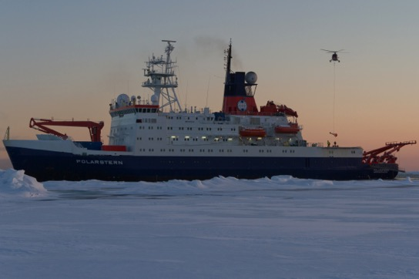
Central Observatory
Polarstern Icebreaker
From Alfred Wegener Institute, Germany
Atmospheric remote sensing
Radiosondes
Air sampling
Ocean profiling/ADCP
Laboratories for analysis (biological, chemical, etc.)
Base of operations
Safety
Data/sample storage

Slide 25

Ice Camp
Limited access zone
Met tower
Ocean flux
ITP
Met City
Turbulence
IMB
Snow surveys / ice optics / mass balance
Buoy Node
Ocean
Small CTD
Turbulence
Net sampling
ROV
ARM
Radiation
SEBS
Low atmosphere
Surface energy budget
Snow / precip
Sea-ice properties
Gas exchange
Ocean profiling
Ocean heat fluxes
Ocean/ice samples
Ice Hut
snow
ICE CORE
FARM
90º Contaminated turbulence zone
Power line
(~500m)
Snow surveys / ice optics / mass balance
+ ice sites at different ice types
Notes:
Why have a camp? Some measurements need to be away fro the ship influence (turbulence, pollution), access to ice
Balance of distance from ship vs. accessibility for people/power/equipment/safety

Slide 26
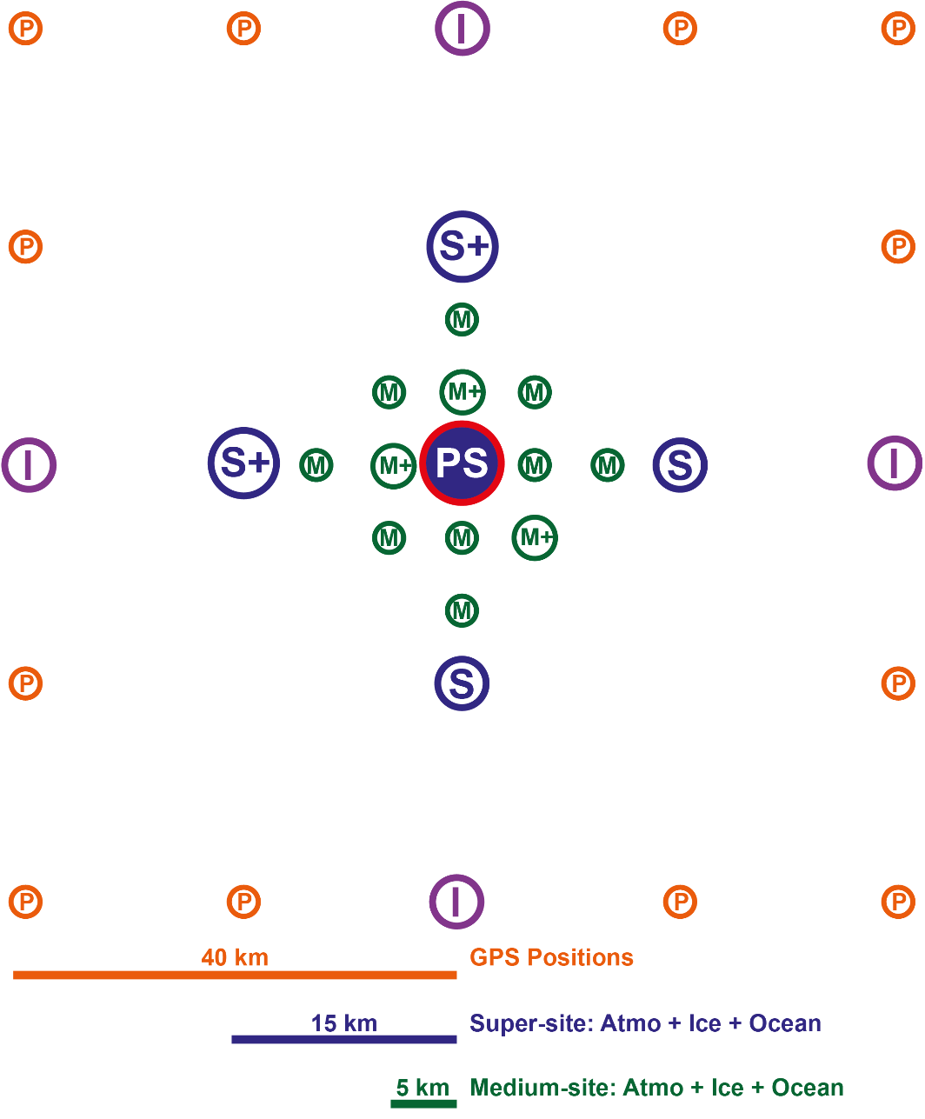
Distributed Network
Enhanced coupled-system: >5 nodes, 15km, (ocean profiling, ice mass balance, ocean and atmos heat fluxes)
Coupled-system: 5-40 km (upper ocean, ice mass, met)
Ice deformation: 1-40 km (gps)
Spatial mapping: UAS, glider, AUV, helicopter, scanning
Periodic visits for ocean/ice sampling & maintenance
Larger-scale network: pan-Arctic network of surface pressure buoys

Slide 27
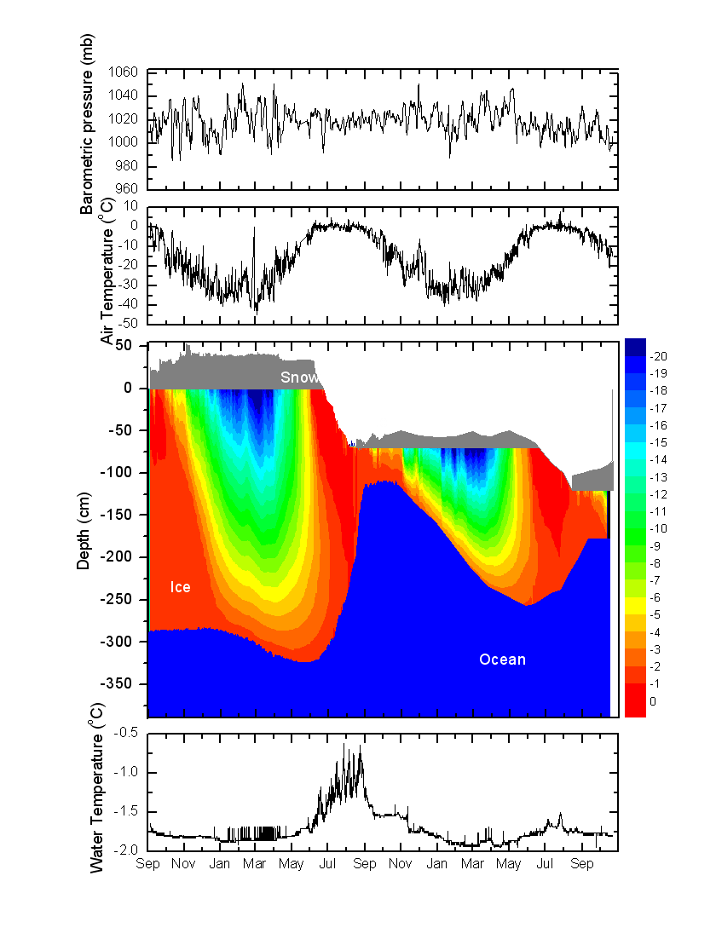
Full Annual Cycle
Perovich et al. 2008
Persson et al. 2002
Arctic climate system has memory. Sea-ice integrates energy budgets.
Processes vary over the annual cycle.
Important to understand all phases of the sea-ice life cycle: Formation > growth > transport/deformation > melt/decay/export
Past observations biased towards summer (warm, easy);
  Relatively little understanding of winter processes.
Notes:
It is critical to make observations over at least a full annual cycle, and preferably longer. And importantly, in all seasons continuously. These plots show that the system is constantly changing, and that what happens before impacts what will happen in the future; ie., the system has memory and is pre-conditioned from one season to the next. We can’t just make measurements when and where it is easy and convenient (summer, near shore) if we want to understand the life cycle of sea-ice at a process level.

Slide 28
Broad Support
Identified as a priority activity:
  IASC > ICARPIII
  WWRP – Polar Prediction Project
  WMO Climate and Cryosphere (CliC)
  US Arctic Observing “Showcase Project”
  NOAA/NASA/DOE Arctic priorities workshops
  ECMWF modeling priorities workshop
  Links to US IARPC priorities
  Links to US SEARCH 5-year goals

Slide 29





Commitments
AWI: Polarstern for 13 months
AWI: Ice, Ocean, Bio, Eco science contributions
US DOE ARM: Atmospheric Facility
TROPOS: Atmospheric Facility
Norway: Dedicated funding call
China/PRIC: Xuelong for resupply
Russia/AARI: Akademik Federov for install
NOAA-PSD/CIRES: Planning support

Slide 30
US Interagency Concept
DOE
2-3
NASA
0-1
Ice-BGC model
NOAA
2-3
Cloud-aerosol-precip
Aircraft: radiation, surface
Coupled model
Assim. studies
Ice Energy Budgets
Ice model
Reanalysis Eval
Satellite cal/val
UAS: Atmos/Sfc Mapping
Ice morphology and optics
Large-scale model
Snow accum. & dist.
ABL dynamics
Sea-ice fore-casts
Ice dynamic-thermodynamic interactions
Regional Model
Marine methane cycle
Momentum transfer
Plankton, light & carbon cycle
Ocean mixing and stratification
NSF
7-10
OML interactions with ice
Atmos Chem
Sfc gas fluxes
ONR
2-3
12-15 berths total

Slide 31

Vision for NOAA Role
Observations: Surface energy fluxes (tower, autonomous stations), surface gas exchange, aerosols, UAS,
Operational satellite product evaluation and technique development
Coupled system observation/model studies
Experimental sea-ice and surface flux forecasting and assessment
Coupled system model evaluation and assimilation studies
Engage with YOPP

Slide 32
Thanks!
www.mosaicobservatory.org

