Slide 1
Atmospheric Data Recovery
and Biases in Observations
Russell S. Vose
Product Development Branch
National Climatic Data Center

Slide 2
Managing Expectations
Identify typical problems
A refresher for many
An introduction for others
Not a comprehensive talk
But an optimistic talk
By an in situ guy
Illustrate through example
Ongoing NCDC work
Input from those who actually do reanalysis

Slide 3
What Are the Problems?
Data are scattered all over the place
No single repository
Some digital, some not
But major data integration efforts are underway
Data contain errors (applause from modelers)
Basic data quality problems
Systematic biases over extended periods
But there is progress here as well

Slide 4
Examples of Data Integration

Slide 5
Integrated Global
Radiosonde Archive
Variables:
pressure
geopotential height
temperature
dew point depression
wind direction/speed

Slide 6
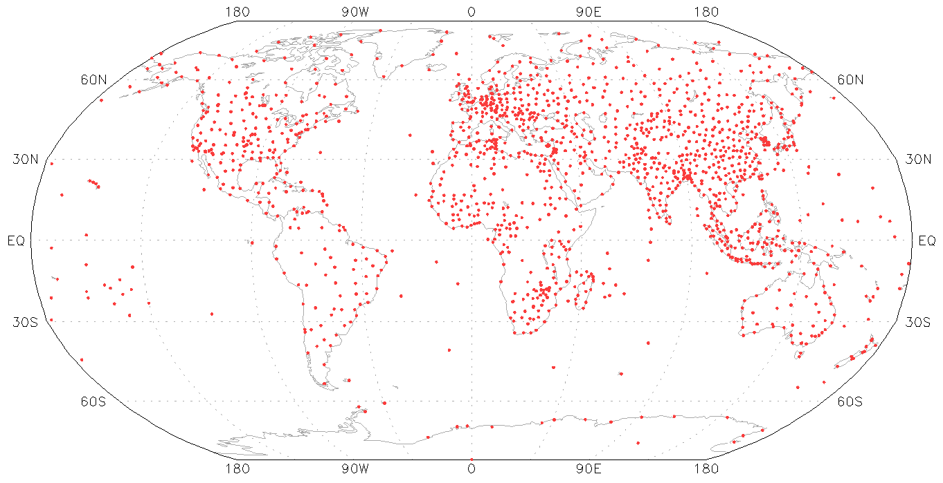
IGRA v1

Slide 7
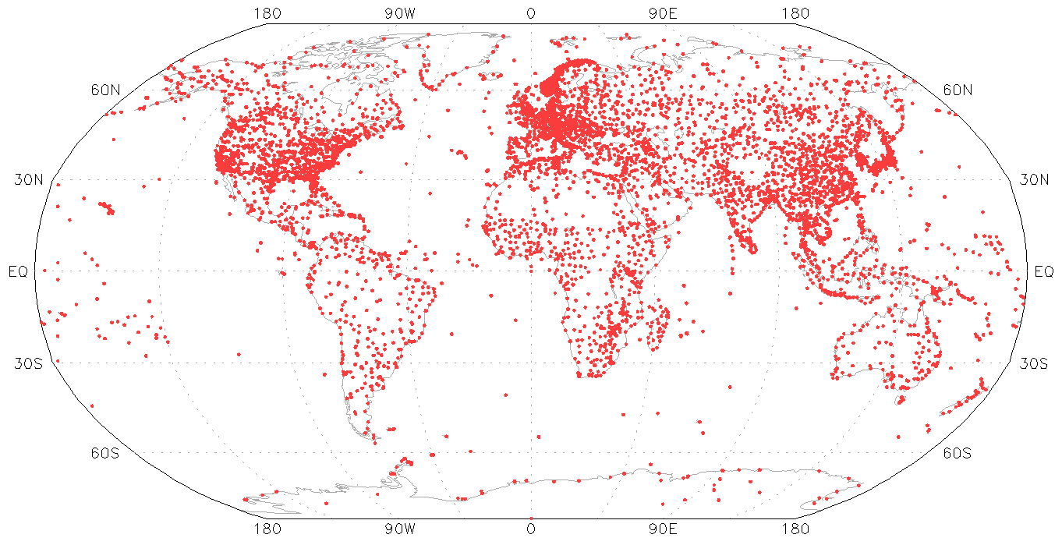
IGRA v1
IGRA v2

Slide 8
New Data Sets for IGRA
Other data sets from NCDC archive
MIT and C-CARDS from NCAR (pre-1963)
Bronnimann acquisitions (primarily Europe)
British Antarctic Survey, Historical Arctic Radiosonde Archive
CDMP data
Malawi, Senegal, Kenya, Mozambique, Niger, U.S., Zambia
French West African data
Benin, Burkina Faso, Cameroon, CAR, Chad, Congo, Gabon, Ivory Coast, Guinea, Mauritania, Niger, Senegal, Togo

Slide 9
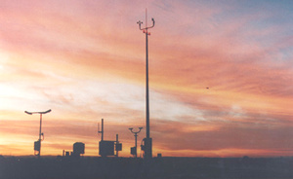
International Surface Pressure Databank
GCOS/AOPC/OOPC Surface Pressure Working Group (SPWG)
Identify, retrieve, digitize, integrate, and Q/A subdaily surface pressure data
Basis for improved circulation fields and new reanalysis products (C20R, ERA-CLIM)

Slide 10
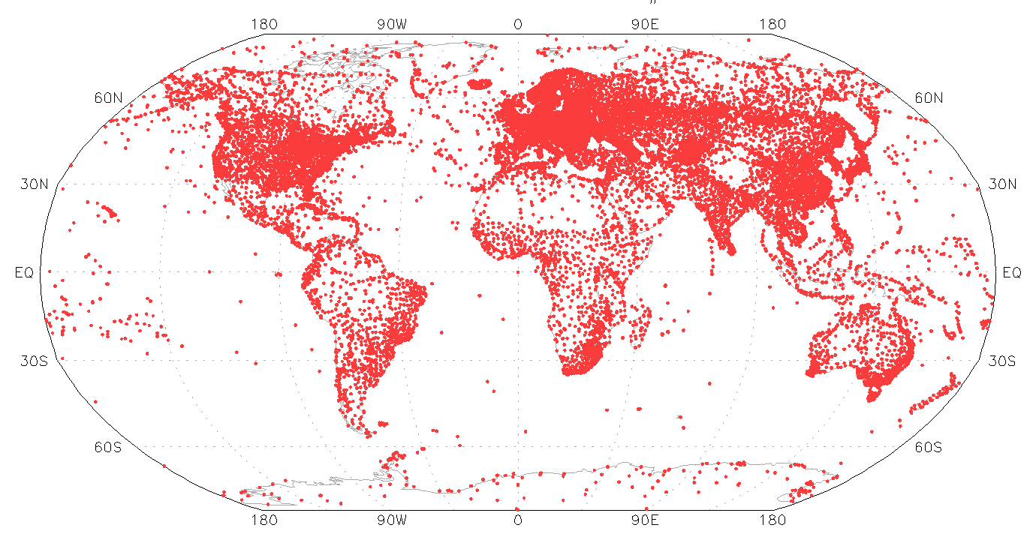
ISPD 2

Slide 11
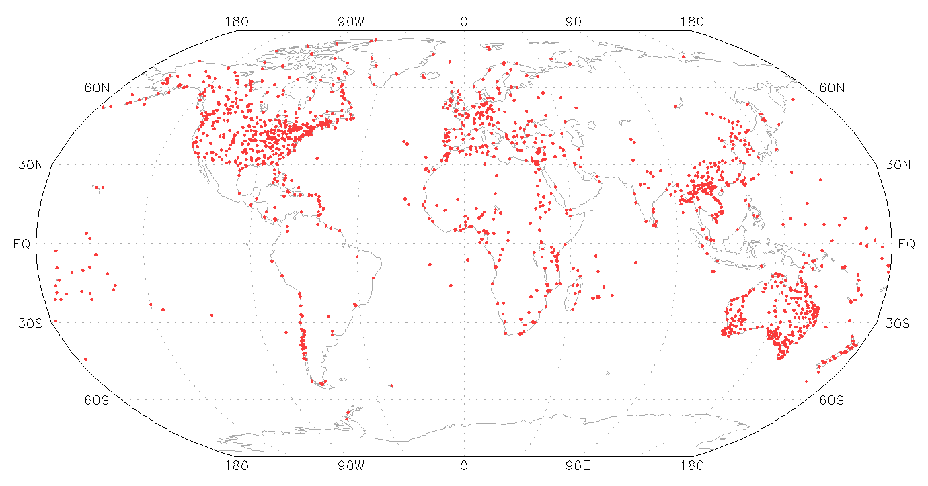
ISPD 2
ISPD 3+

Slide 12
New Data Sets for ISPD 3+
CDMP data (Mexico, Uruguay, U.S., Vietnam)
GLOBE student data
Hadley Centre collections
KNMI station collection
MeteoFrance National Data Rescue Activity
Seiki University collection for Asia
And many others – all coordinated by ACRE!

Slide 13
International “Best Track” Archive
A comprehensive global best track dataset
Contains information on all documented tropical cyclones
Users no longer must get data from disparate sources
Utilizes complex merging techniques
Accounts for inherent differences in datasets
Standardized quality control
Position, time, wind, and sea-level pressure
Provides full range of reported values for intensity and position every 6 hrs

Slide 14
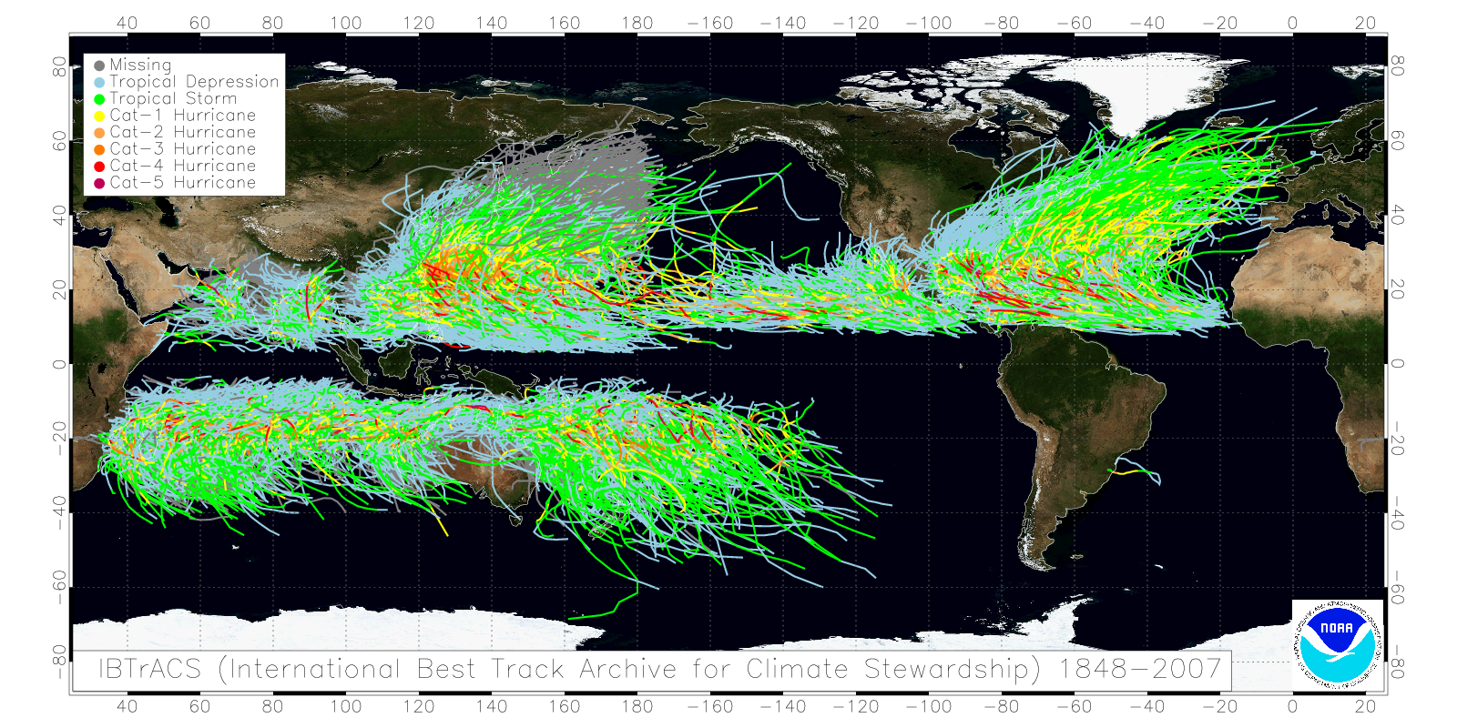
All Basins from One Source
1945-2007
1851-2007
1945-2007
1949-2007
1848-2008
1907-2007
Notes:
Next release will extend Western Pacific and North Indian basins back to ~1900

Slide 15
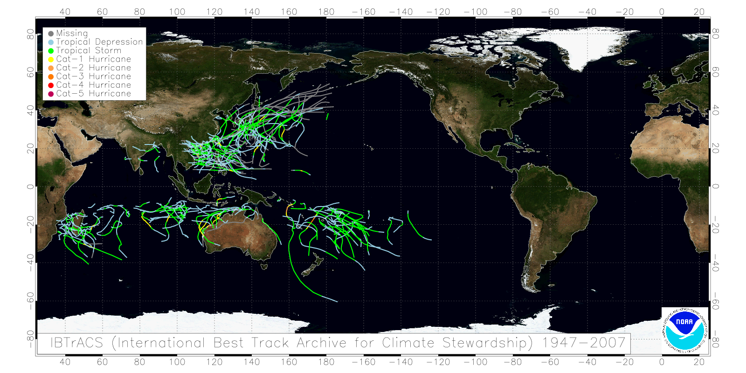
Storms Unique to IBTrACS

Slide 16
Problems with Observations

Slide 17
Problems with Observations
Basic data quality problems
A few illustrations from the radiosonde record
Systematic deltas (observations vs. reanalysis)
Appetizers from a few observational records

Slide 18
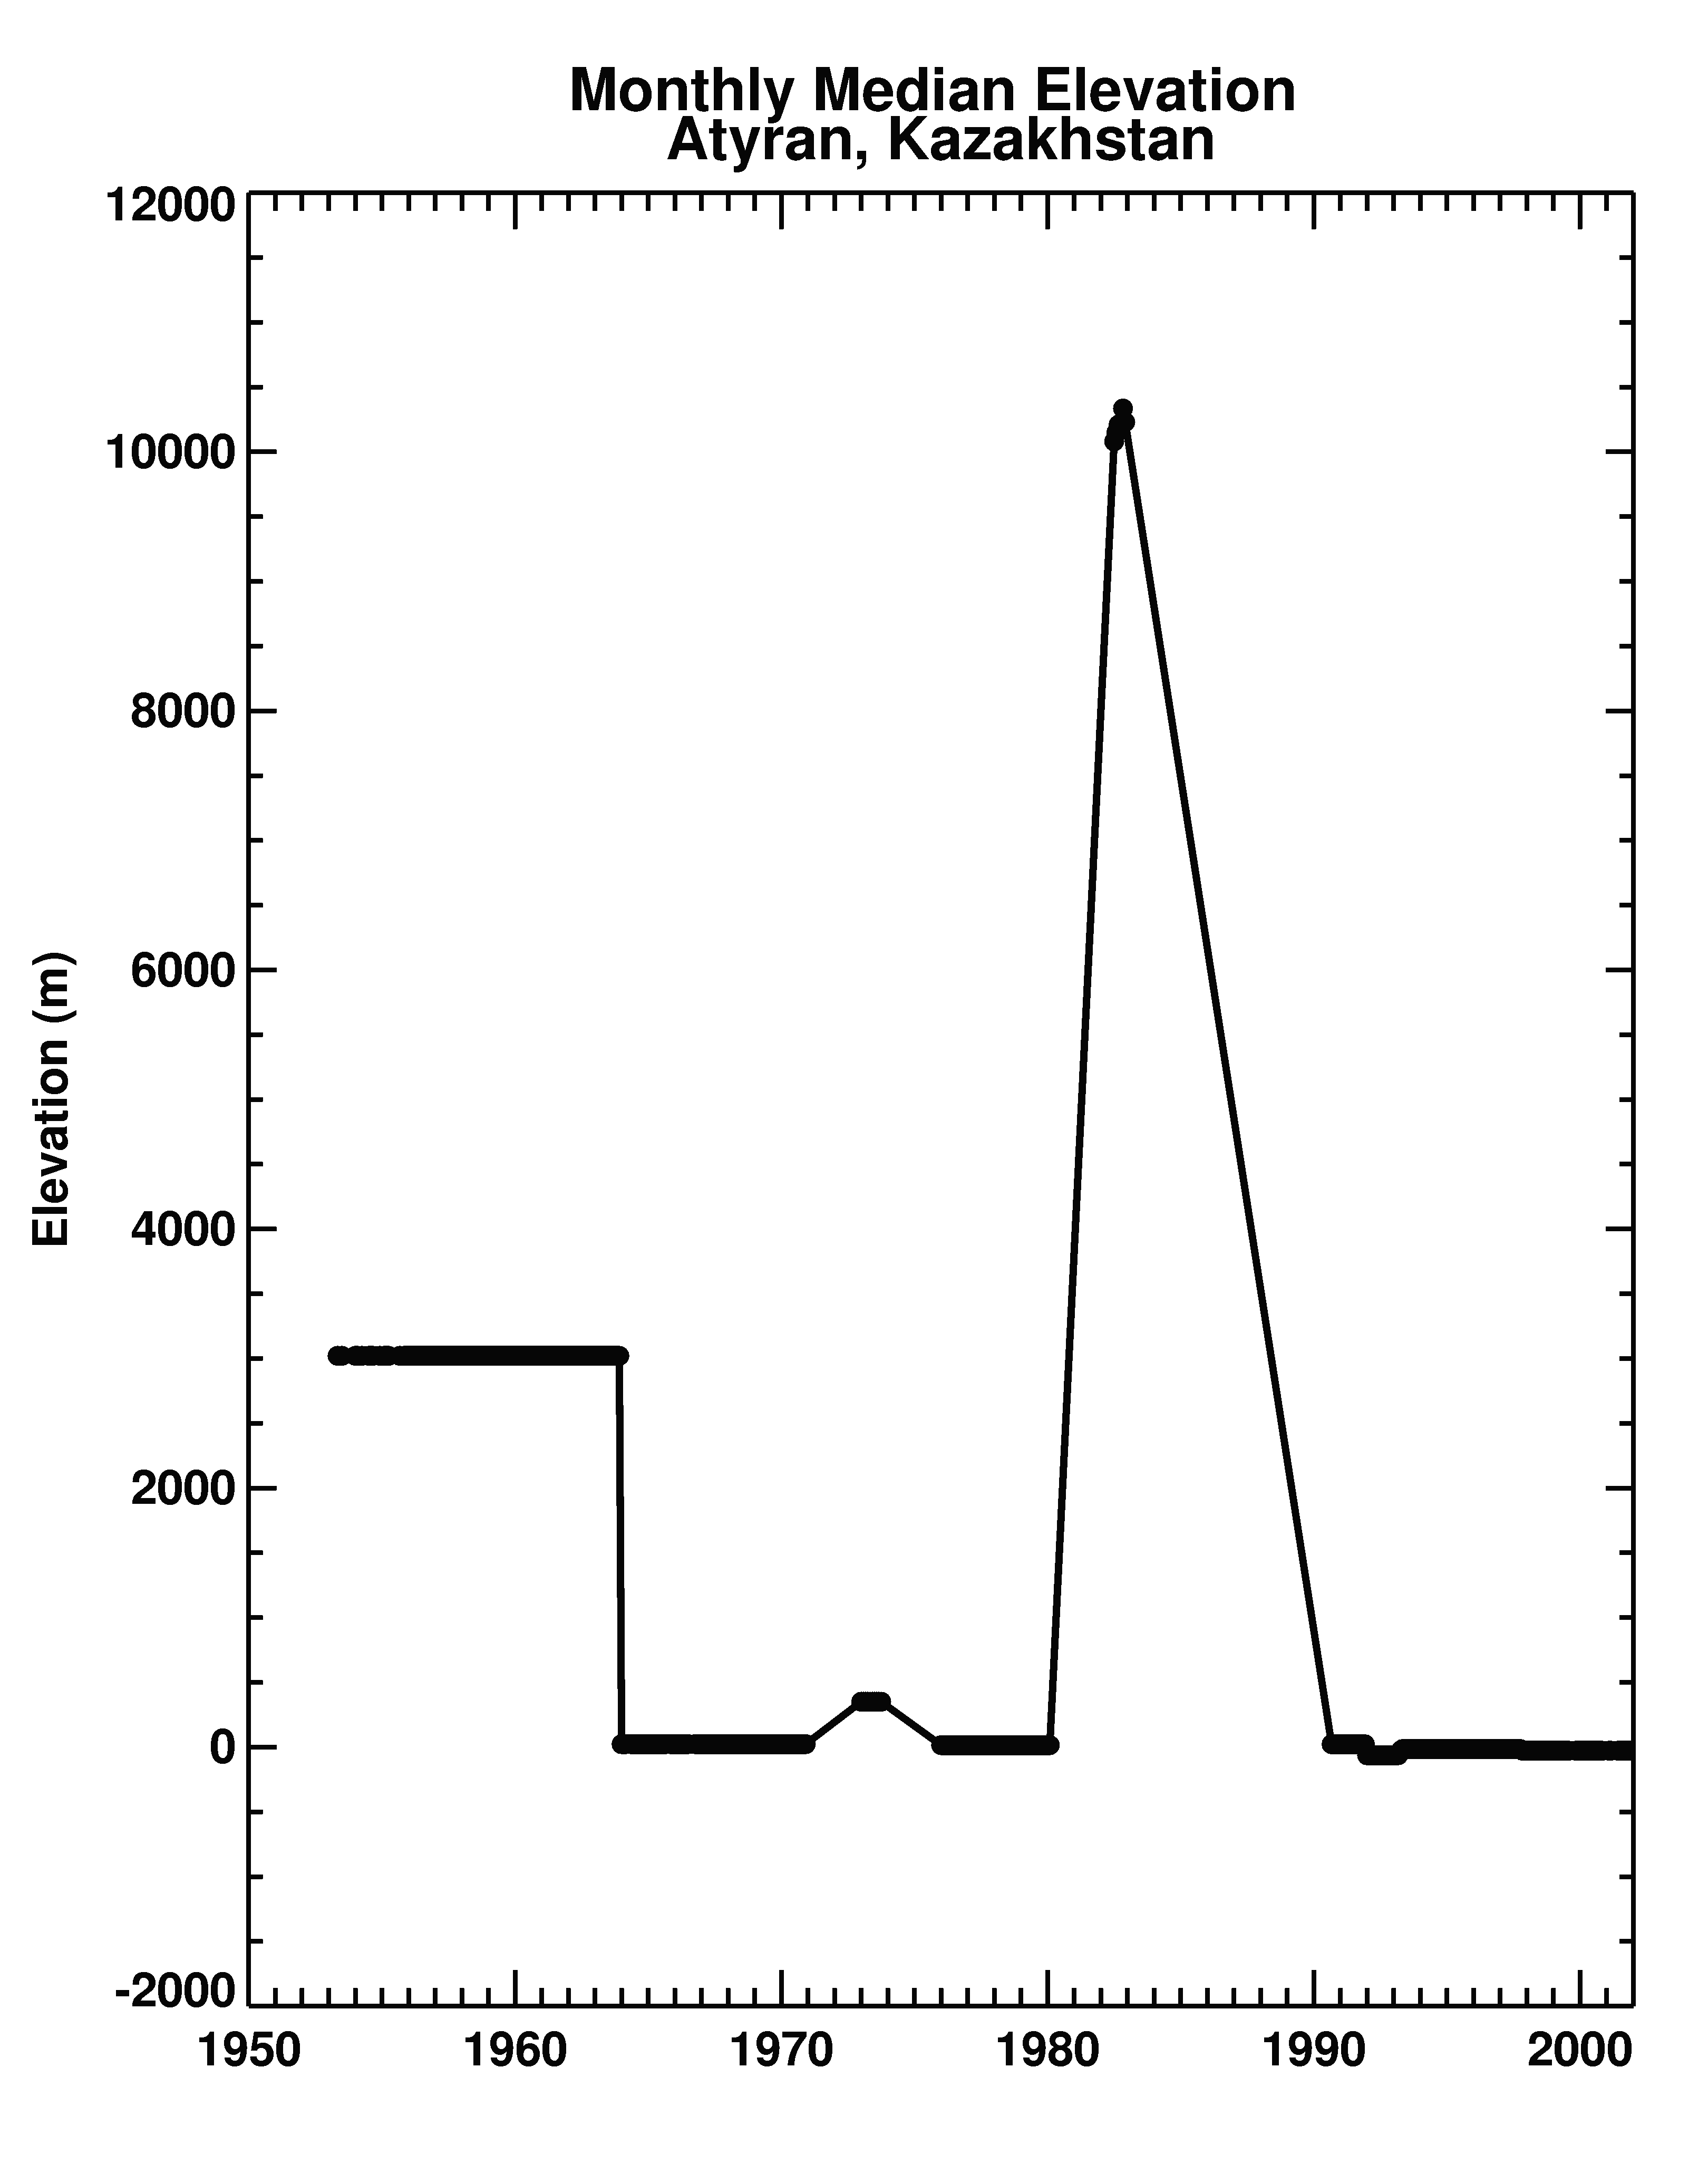
Changing Surface Heights

Slide 19
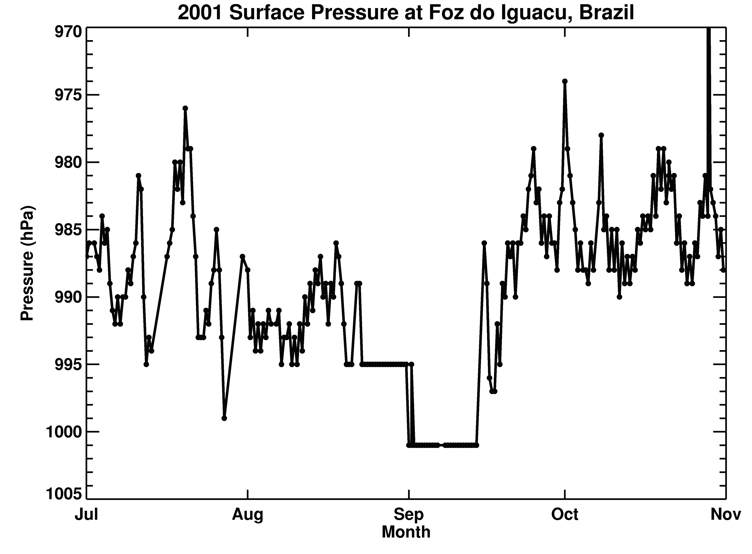
Repetition of Values

Slide 20
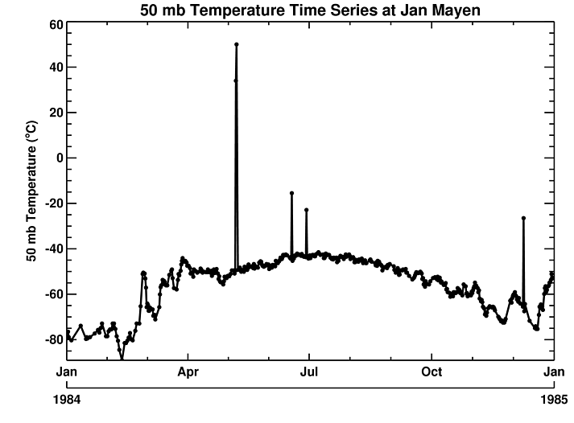
Outliers in a Temporal Sense

Slide 21
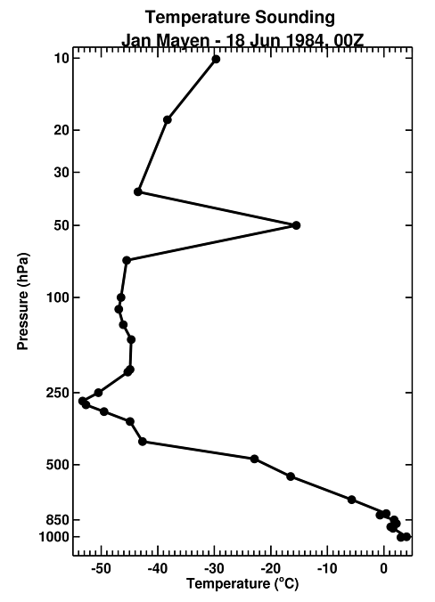
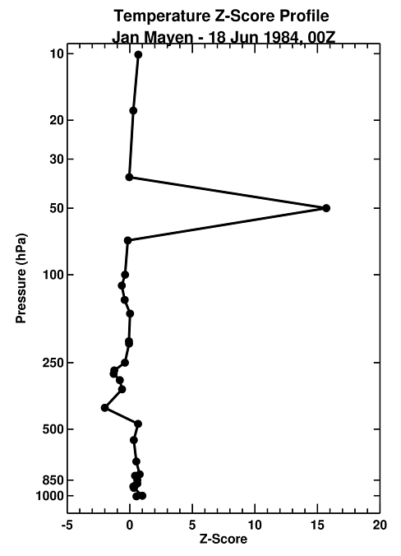
Outliers in a Profile Sense

Slide 22
Outright Biases

Slide 23
Central African Precipitation

Slide 24
Radiosonde Humidity Biases

Slide 25
Radiosonde Wind Biases
Identification of biases in radiosonde wind direction using ERA-40
(station data from Aktjubinsk, Russia; courtesy Leo Haimberger)

Slide 26
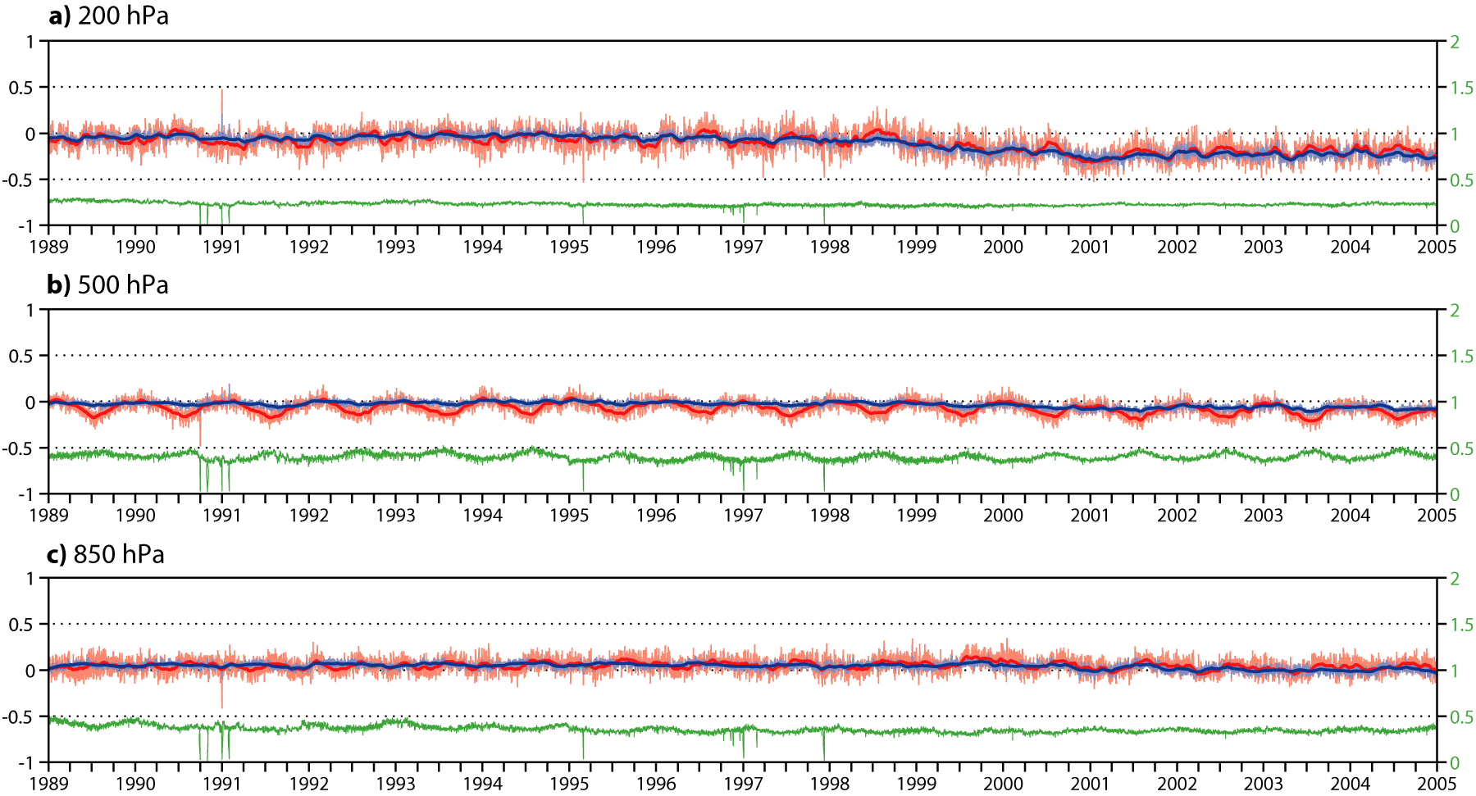
Global Mean Errors in ERA-Interim Temperatures Relative to Radiosondes
Development of a warm bias in the upper troposphere
The problem is caused by the assimilation of growing numbers of aircraft data, many of which are biased warm.

Slide 27
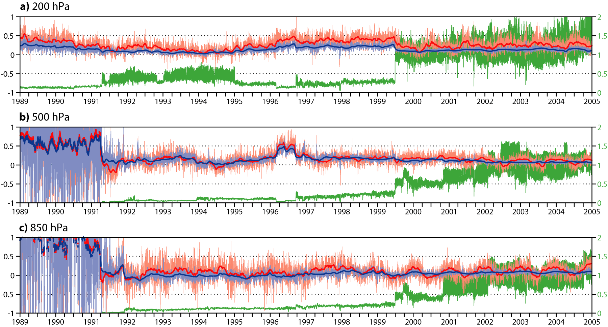
Global Mean Errors in ERA-Interim Temperatures
Relative to Aircraft Reports
The mean temperatures are mostly controlled by aircraft reports.
The aircraft temperature data need bias-correction (work in progress)...

Slide 28
MSU Radiance Biases
Underlying cause: orbit drift, hence unstable warm target
These biases were identified and corrected in ERA-Interim. They were removed in subsequent radiance datasets (e.g., for MERRA).

Slide 29
Take-Away Messages
Data are imperfect
Scattered around quite a bit
Contain quality issues and systematic biases
Progress is being made
Major data integration efforts
Improved provider-reanalysis communication

