Slide 1
An Overview of Atmospheric Analyses and Reanalyses
for Climate Kevin E. Trenberth NCAR
Boulder CO

Slide 2
Analysis
Data Assimilation merges observations & model predictions to provide a superior state estimate.
It provides a dynamically- consistent estimate of the state of the system using the best blend of past, current, and perhaps future observations.
Experience mainly in atmosphere; developing in ocean, land surface, sea ice.

Slide 3
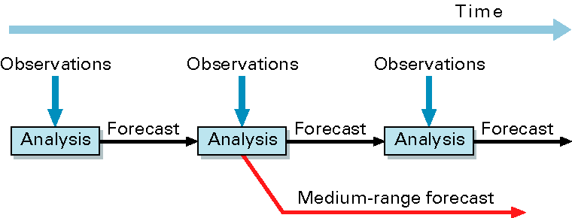
Data assimilation system
The observations are used to correct errors in the short forecast from the previous analysis time.
Every 12 hours ECMWF assimilates 7 – 9,000,000 observations to correct the 80,000,000 variables that define the model’s virtual atmosphere.
This is done by a careful 4-dimensional interpolation in space and time of the available observations; this operation takes as much computer power as the 10-day forecast.
ECMWF 2009

Slide 4
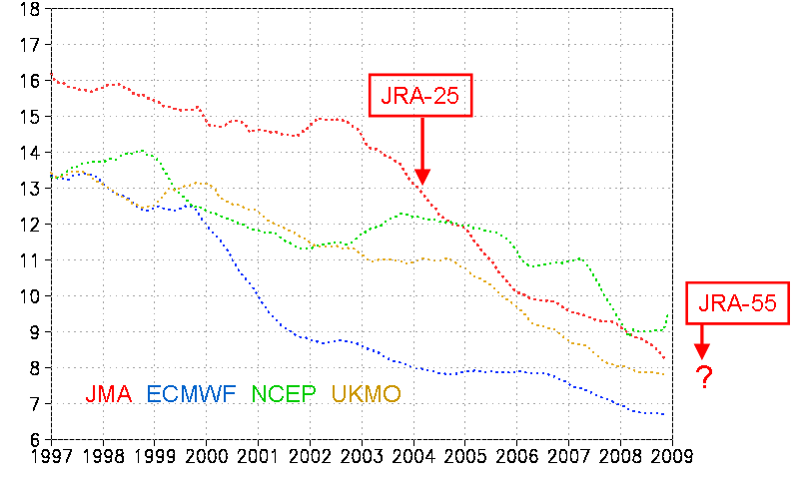
NWP models and data assimilation continues to improve
Operational forecast scores of major NWP centers. RMSE of geopotential height at 500hPa in NH (m) for 24-hour forecasts are displayed. The scores of forecasts have improved over time.

Slide 5
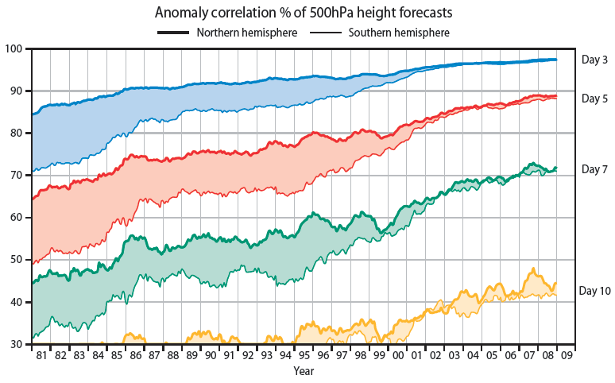
NWP Forecast skill scores continue to improve
Extratropical NH and SH forecasts: 12 month means plotted at last month. Updated from Simmons and Hollingsworth 2002
SH skill became comparable to NH after about 2002!

Slide 6
Reanalysis
Operational four dimensional data assimilation continually changes as methods and assimilating models improve, creating huge discontinuities in the implied climate record.
Reanalysis is the retrospective analysis onto global grids using a multivariate physically consistent approach with a constant analysis system.
Reanalysis has been applied to atmospheric data covering the past five decades. Although the resulting products have proven very useful, considerable effort is needed to ensure that reanalysis products are suitable for climate monitoring applications.
From: Executive Summary of “The Second Report on the Adequacy of The Global Observing Systems for Climate in Support of the UNFCCC”.

Slide 7
1) Call for reanalysis:
Trenberth, K. E., and J. G. Olson, 1988: An evaluation and intercomparison of global analyses from NMC and ECMWF. Bull.Amer.Meteor.Soc.,69,1047-1057. Bengsston, L. and J. Shukla, 1988: Integration of space and in situ observations to study global climate change. Bull. Amer. Meteor. Soc., 69, 1130-1143. 2) First generation Schubert, S.D., R. B. Rood and J. Pfaendtner, 1993: An Assimilated Data Set for Earth Science Applications Bull. Amer. Meteor. Soc., 74, 2331-2342. Gibson, J.K., P. Kallberg, A. Nomura, and S. Uppala, 1994: The ECMWF re-analysis (ERA) project- Plans and current status. 10th Int. Conf. Interactive Inf. and Proc. Syst. Meteor., Oceanogr. and Hydrol., Nashville, TN, AMS, 164-167. Kalnay,E., et al, 1996: The NMC/NCAR 40-year Reanalysis Project. Bull.Amer.Meteor.Soc., 77,437-471. Kanamitsu, M, W. Ebisuzaki, J. Woollen, S-K Yang, J .J. Hnilo, M. Fiorino, and G. L. Potter, 2002: NCEP-DOE AMIP-II Reanalysis (R-2),. Bull. Amer. Met. Soc., 83, 1631-1643.
3) Second generation ERA40, JRA 4) Next generation: MERRA, ERA-interim, CFSR

Slide 8
Atmospheric Reanalyses
Current atmospheric reanalyses, with the horizontal resolution (latitude; T159 is equivalent to about 0.8° ), the starting and ending dates, the approximate vintage of the model and analysis system, and current status.
Reanalysis | Horiz.Res | Dates | Vintage | Status
NCEP/NCAR R1 | T62 | 1948-present | 1995 | ongoing
NCEP-DOE R2 | T62 | 1979-present | 2001 | ongoing
CFSR (NCEP) | T382 | 1979-present | 2009 | thru 2009, ongoing
C20r (NOAA) | T62 | 1875-2008 | 2009 | Complete, in progress
ERA-40 | T159 | 1957-2002 | 2004 | done
ERA-Interim | T255 | 1989-present | 2009 | ongoing
JRA-25 | T106 | 1979-present | 2006 | ongoing
JRA-55 | T319 | 1958-2012 | 2009 | underway
MERRA (NASA) | 0.5° | 1979-present | 2009 | thru 2010, ongoing

Slide 9
What have we gained and what are the benefits?
Prior to reanalyses, the analyzed climate record was beset with major discontinuities from changes in the data assimilation systems. It was difficult, if not impossible, to reliably infer anomalies and to analyze climate variability.
The use of a stable data assimilation system has produced fairly reliable records for monitoring, research and improved prediction that have enabled :
climatologies to be established
anomalies to be reliably established
time series, empirical studies and quantitative diagnostics
exploration of, improved understanding of processes
model initialization and validation
test bed for model improvement on all time scales, especially seasonal-to-interannual forecasts
Greatly improved basic observations and data bases.

Slide 10
What have we learned? Observing system changes affect variability Trends and low frequencies unreliable Exacerbated by model bias Budgets don’t balance Impacts many diagnostic studies Problems with hydrological cycle Sensitivity to model physics (e.g., convection) Exacerbated by insertion of observations Problems with warm season continental climates precipitation diurnal cycle Unrealistic surface fluxes Ocean (radiative, freshwater) Land (precipitation, radiative) Limits usefulness for offline forcing; e.g. ocean modeling Limits ability to do coupled assimilation Quantities/regions not a priority for weather centers Surface Stratosphere Polar regions Many aspects of tropics

Slide 11
Reanalysis
A MAJOR challenge remains the continually changing observing system in spite of substantial improvements in bias correction in the latest generation of reanalyses

Slide 12
Satellite Data Streams assimilated
Dec
Feb
TIROS-N
TOVS
Jul
Apr
Nov
Oct
NOAA-6
Sep
Feb
NOAA-7
May
Jun
Jul Oct
NOAA-8
Jan
Nov
NOAA-9
NOAA-10
Dec
Sep
Nov
Jan
Sep
Sep
NOAA-11
Sep
Jun
NOAA-12
NOAA-14
Jan
Dec
ATOVS
NOAA-15
Sep
NOAA-16
Nov
NOAA-17
Jul
EOS Aqua
NOAA-18
Nov
EOS Aqua
Oct
GOES
Sounders
GOES-08
Apr
Jul
GOES-10
Apr
Jun
F08
GOES-12
Jul
Jul
F10
Dec
SSM/I
Dec
Nov
F11
Dec
Dec
F13
May
F14
May
F15
Dec
Aug
78 79 80 81 82 83 84 85 86 87 88 89 90 91 92 93 94 95 96 97 98 99 00 01 02 03 04 05 06 07 08

Slide 13
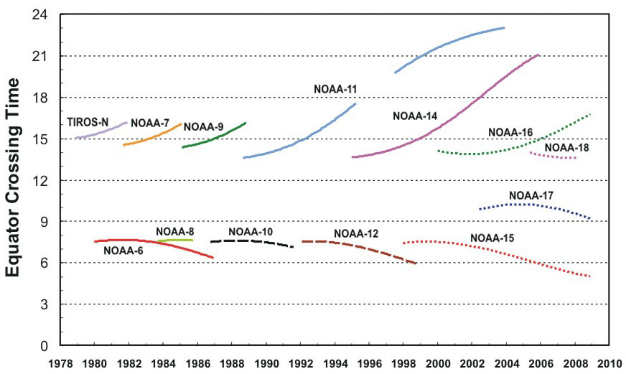
Example: Satellite based observations
Satellites typically last 3-5 years and have to be replaced
Orbits decay
Equator crossing times change
New satellite orbits differ
Instrument calibrations drift and can be changed by launch
Interference can occur from other instruments

Slide 14
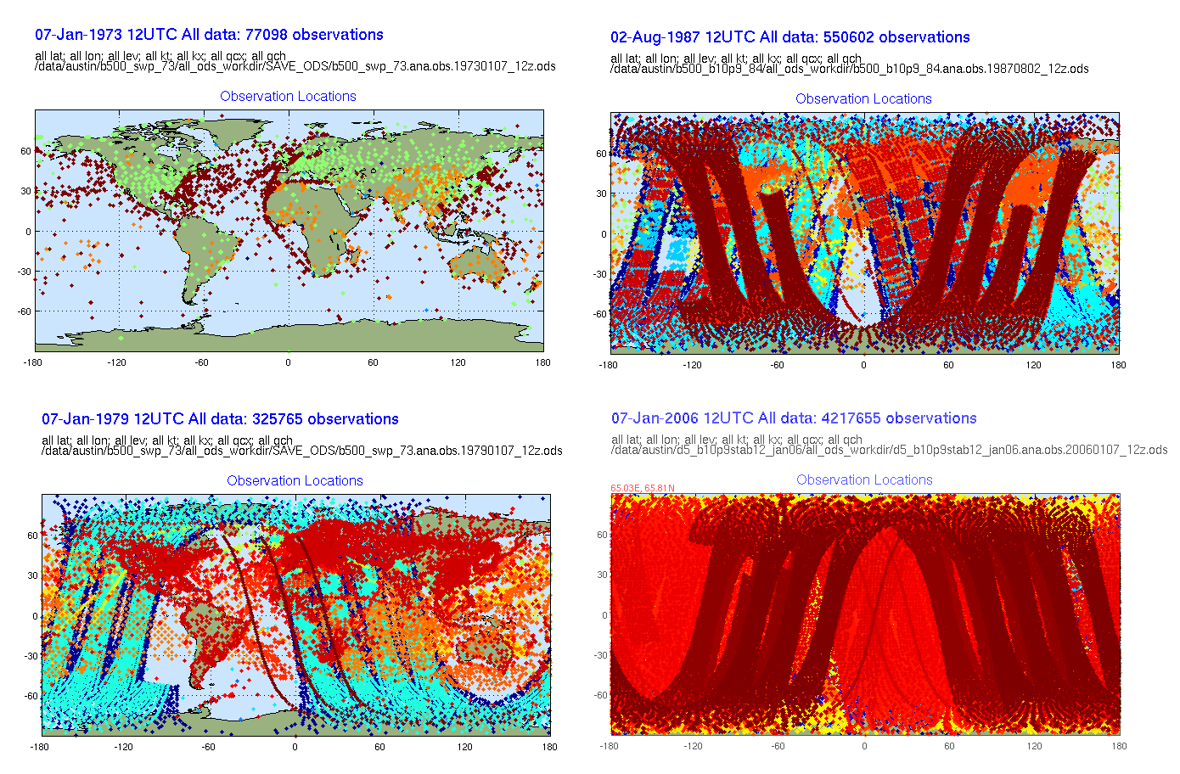
The Changing Observing System
1973 77k/6h 1987 550k
1979 324k 2006 4,220k
1973 – 77K Obs every 6hrs
1987 – 550K Obs every 6hrs
1979 – 325K Obs every 6hrs
2006 – 4.2M Obs every 6hrs
Notes:
The total observing system has changed dramatically in the last 30 years. 1973 shows the state of the conventional observing system at that time. While the increase in observations are an incredible source of information, they are highly irregular in space, time and quality. A fixed reanalysis system synthesizes the observations, applying additional layers of quality control and providing to users a continuous and regular global time series. The numbers in the slide are what is available every 6 hours. When AIRS is available, the system is analyzing 4.2M observations every 6 hours.

Slide 15
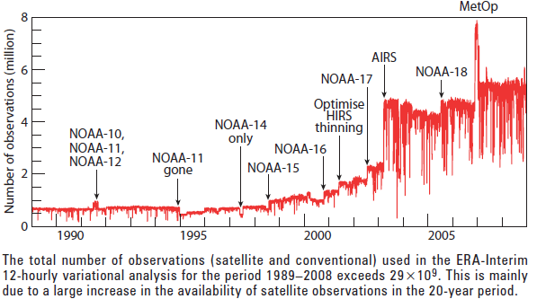

Slide 16
Bias corrections are needed
But how good are they?
Is there a baseline to establish real trends?
Bias corrections should be applied to satellite
and radiosonde data.
Potential for unintended perturbations or bad data
to be perpetuated.
Most radiosonde stations do NOT have adequate records
of changes
Need to document bias correction changes to almost all observing systems.

Slide 17
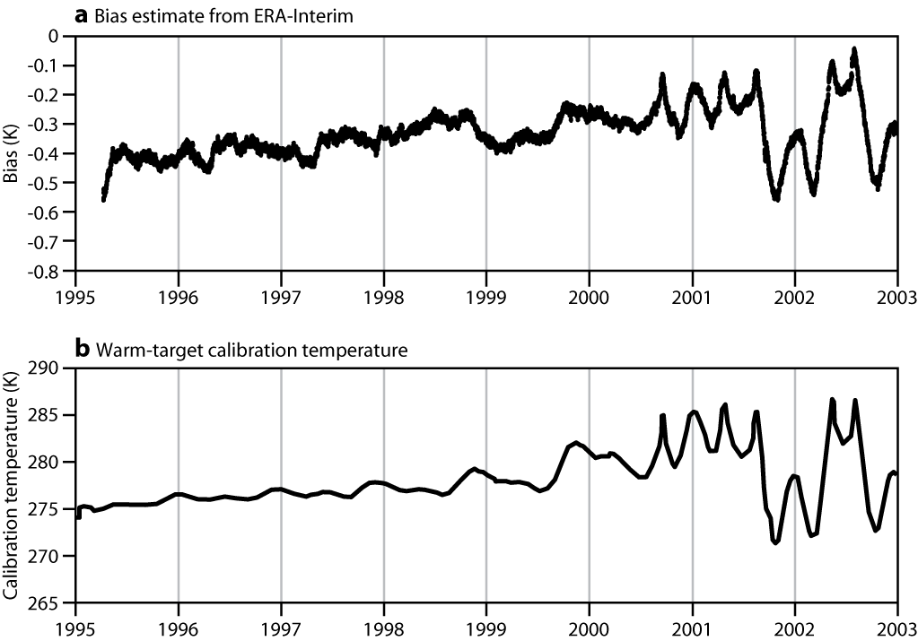
Bias correction procedures have greatly improved
Top: Global mean bias estimates for MSU channel 2 computed in ERA-Interim using new bias correction procedures (top) and recorded warm-target temperatures used for on-board instrument calibration (bottom) show remarkable agreement
Dee et al 2009.

Slide 18
Examples of results from reanalyses
with emphasis on problems

Slide 19
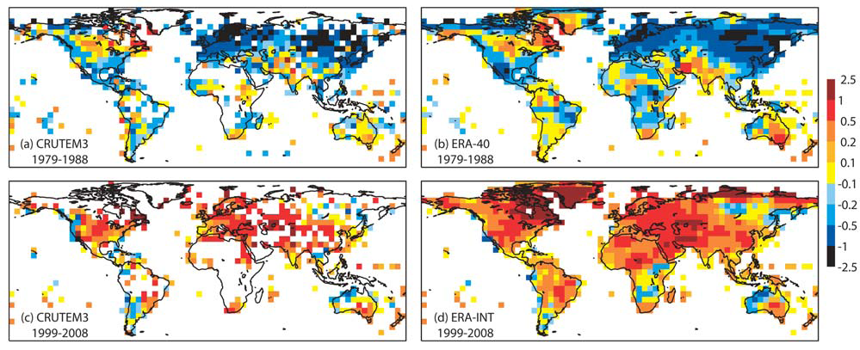
Surface Temperature: filled in gaps
Ten year mean anomalies in 2 m temperature (K) relative to the 1989–1998 mean for (a) CRUTEM3 for 1979–1988, (b) ERA-40 for 1979–1988, (c) CRUTEM3 for 1999–2008, and (d) ERA Interim for 1999–2008. Reanalysis values are plotted for all 5 grid squares for which there are CRUTEM3 data and for all other grid squares with more than 10% land. Simmons et al 2010.
Missing data for CRUTEM3 => underestimate trends vs full ERA

Slide 20
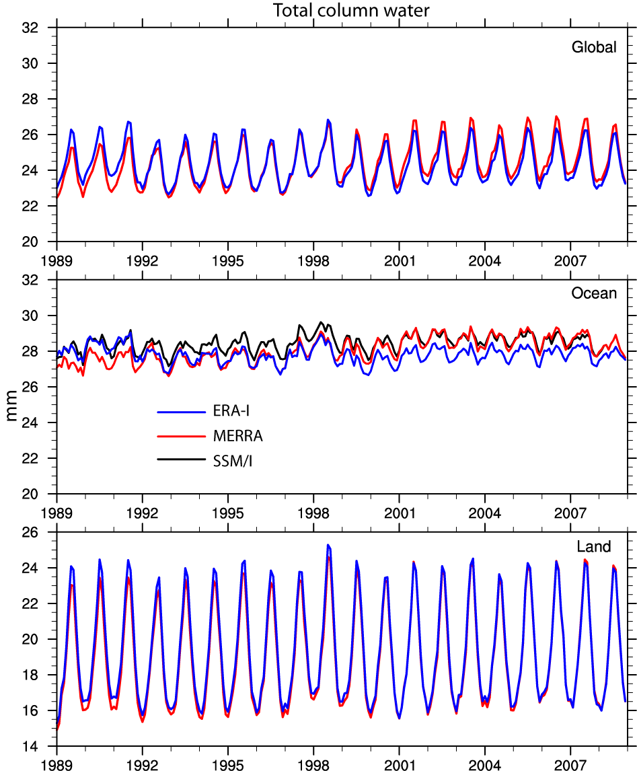
Focus on:
MERRA and
ERA-I
Which have smooth evolving moisture fields
(no spinup):
4Dvar
nudging

Slide 21
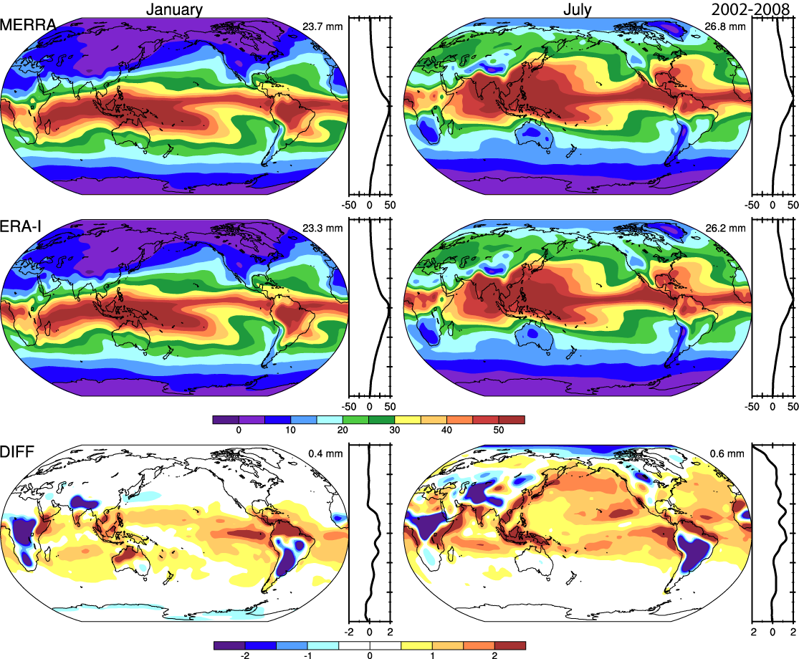
Precipitable water

Slide 22
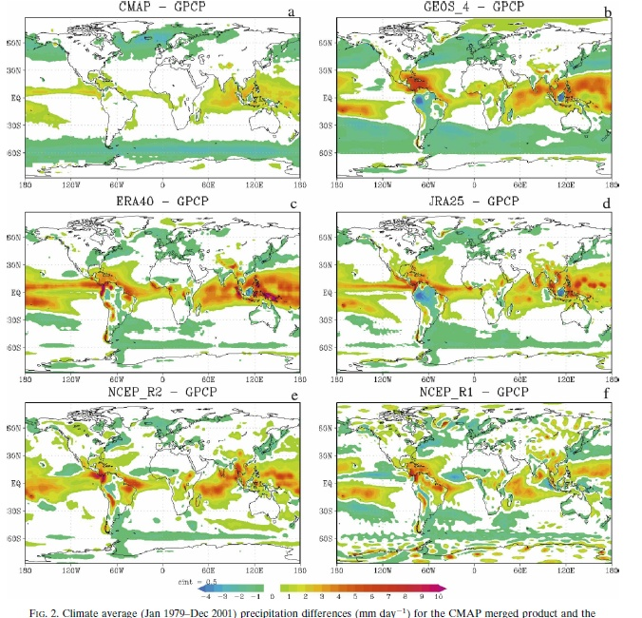
Precipitation errors in reanalyses
Bosilovich et al 2008

Slide 23
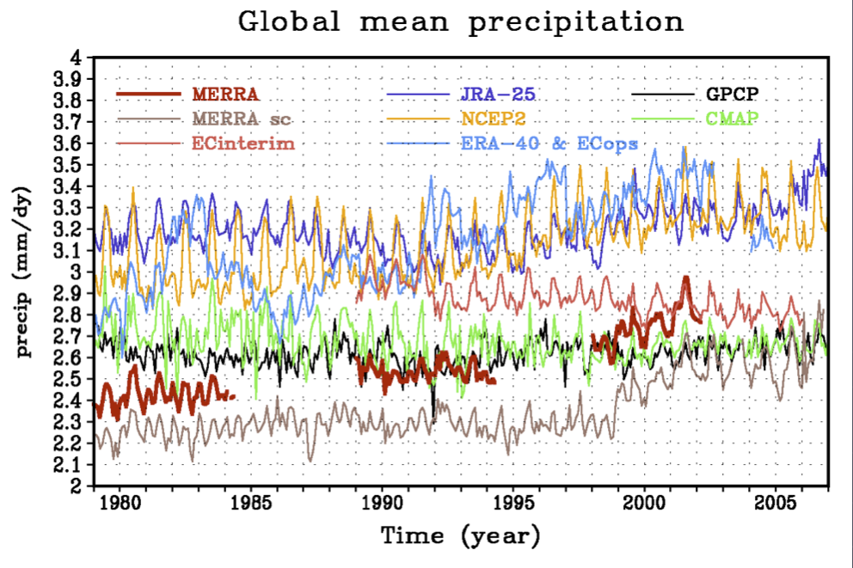
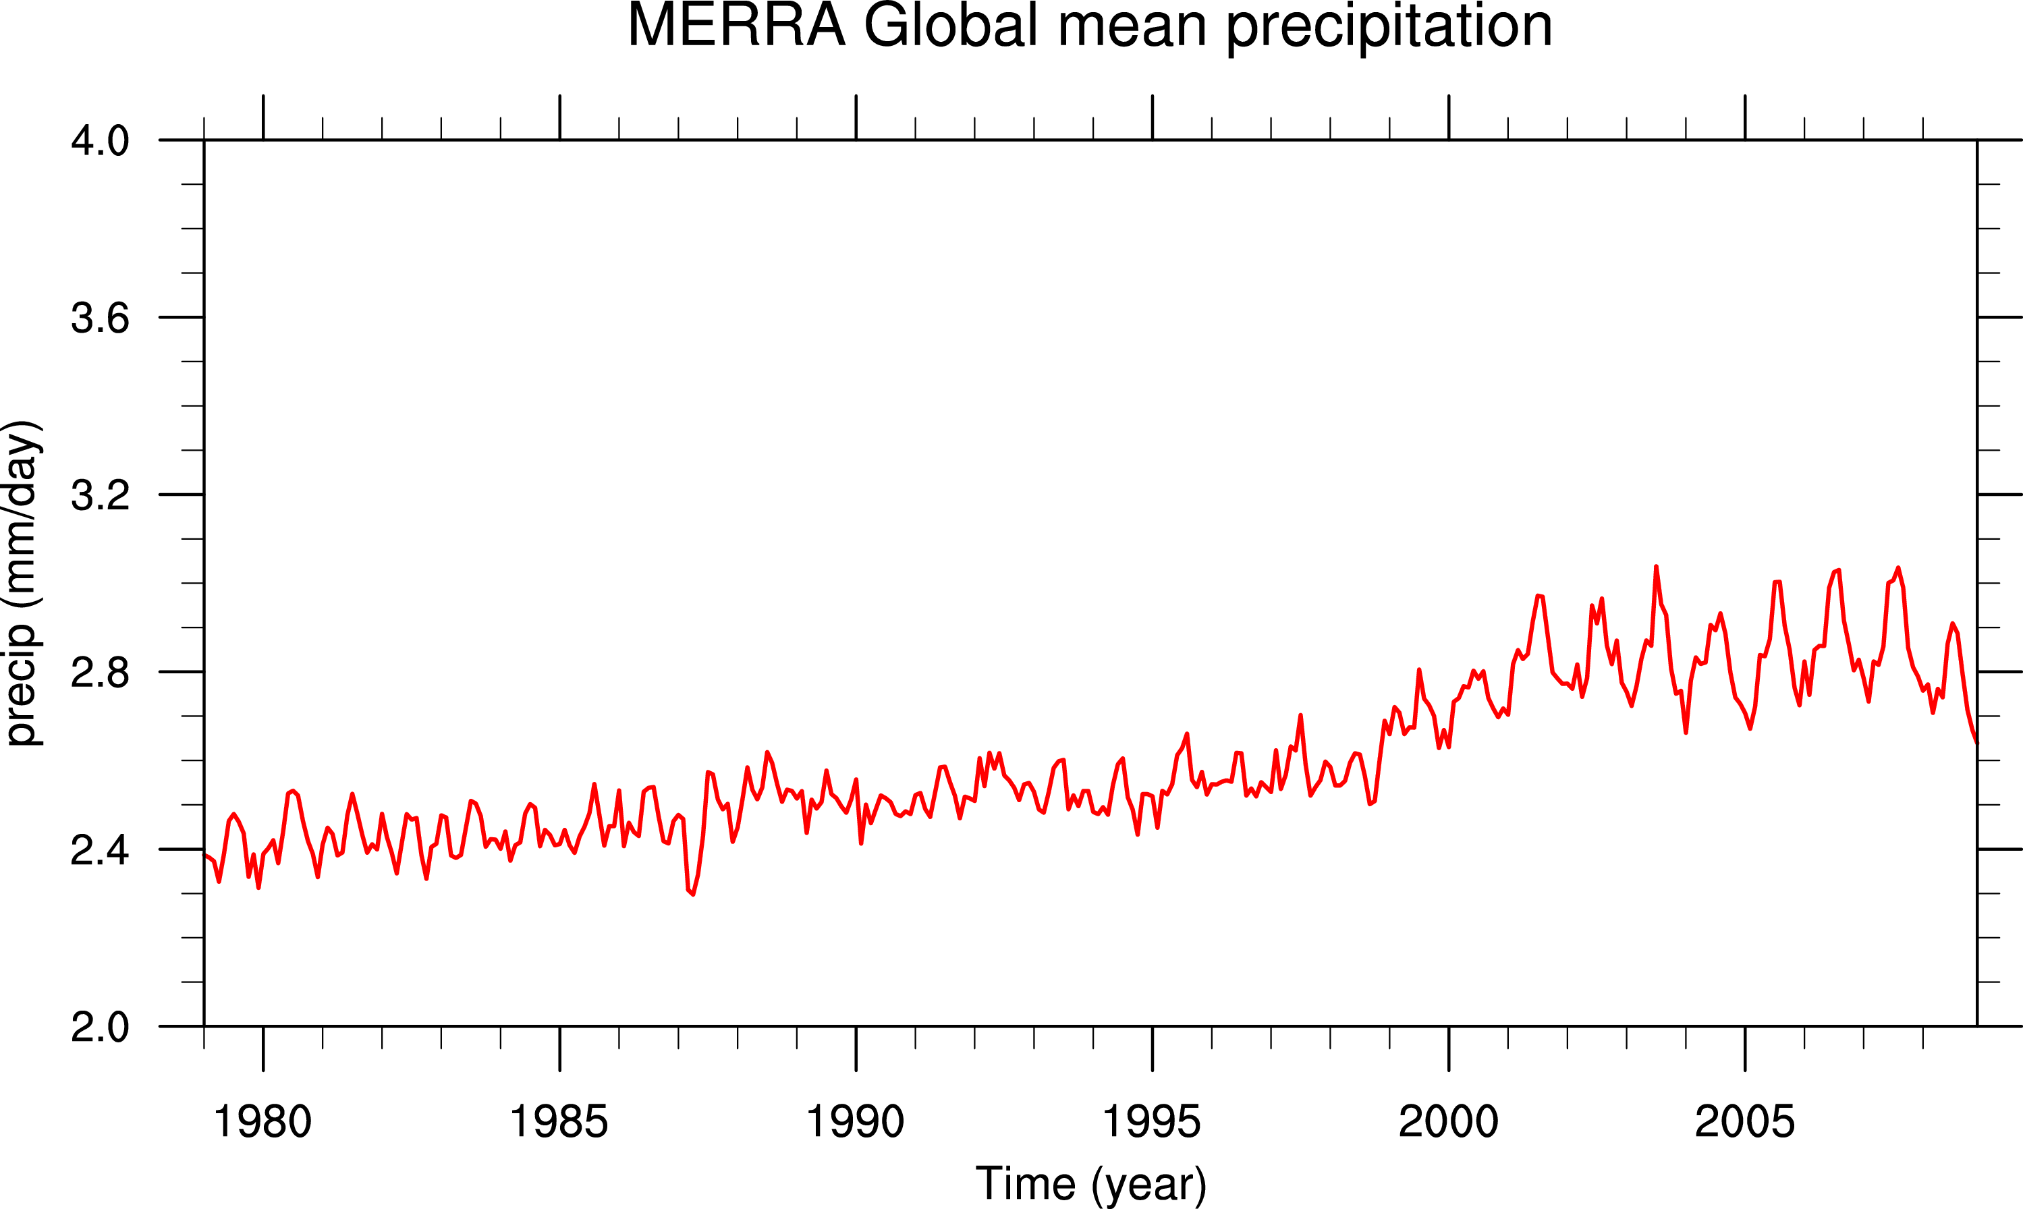
MERRA

Slide 24
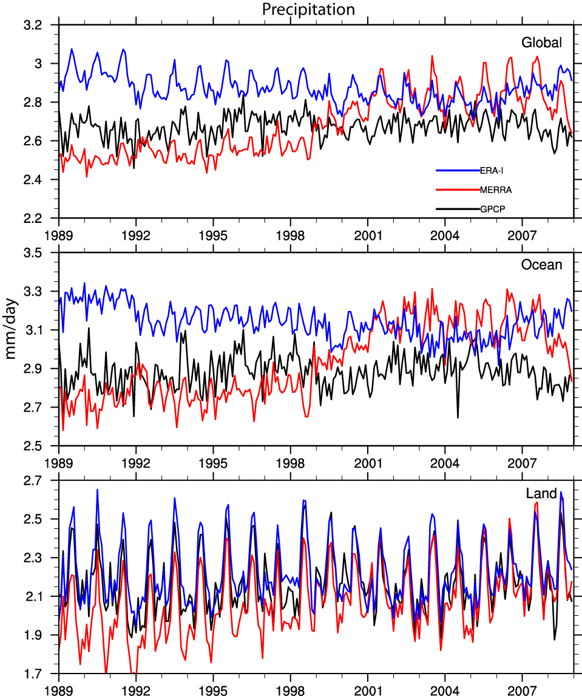
Identifiable discons:
SSM/I mid-1987,
TOVS to ATOVS:
AMSU-A,AMSU-B
late 1998 to 2001
(NOAA 15 =>NOAA 12
NOAA 16 => NOAA 14, March 20, 2001),
AIRS late 2002,
GPS RO 2002 on,
COSMIC April 2006.

Slide 25
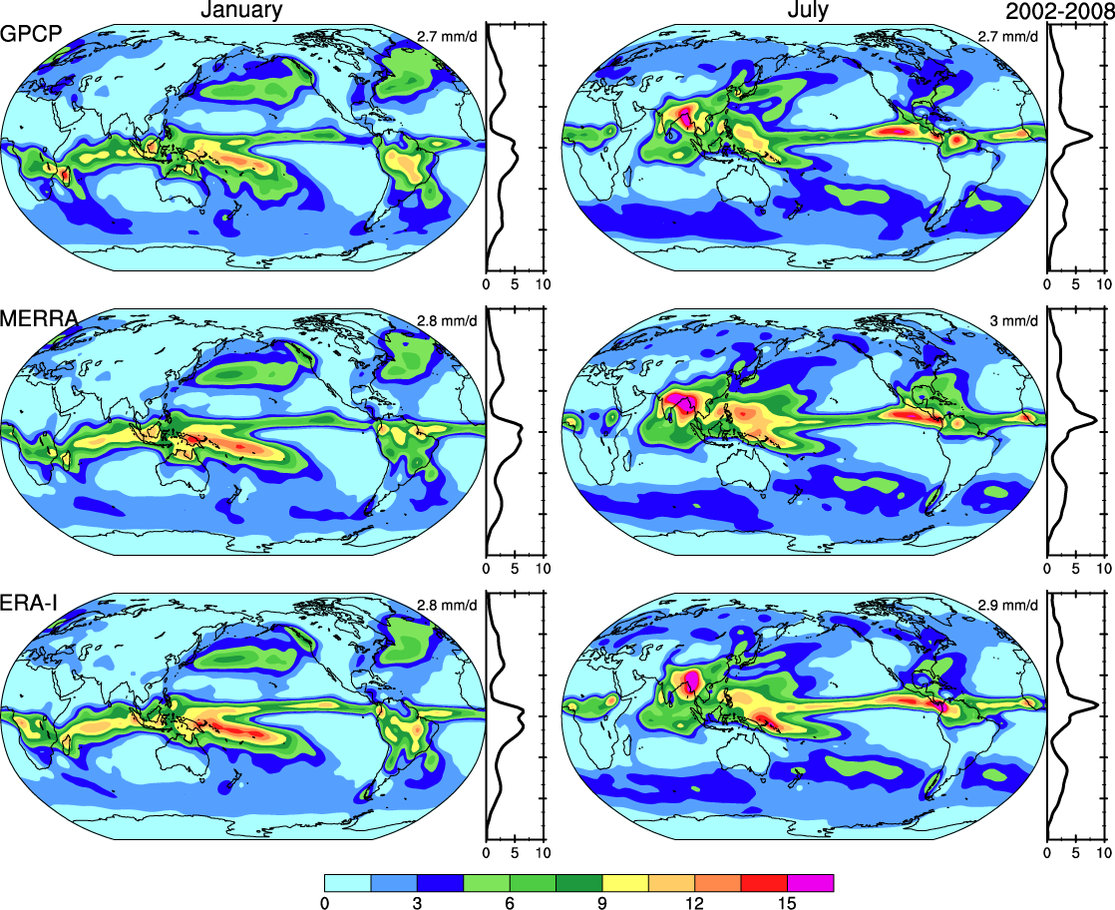
Precipitation

Slide 26
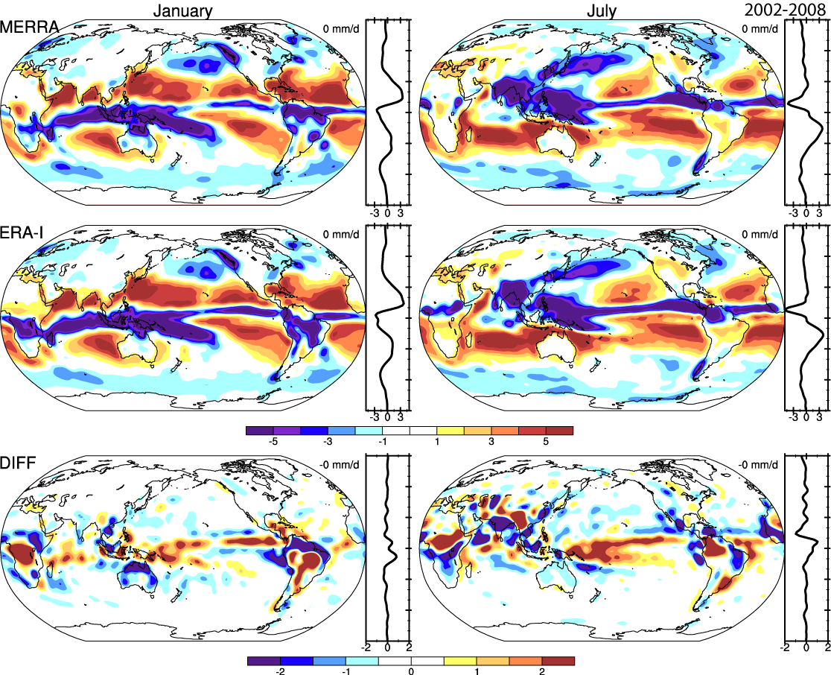
Freshwater flux E-P
From moisture budget

Slide 27
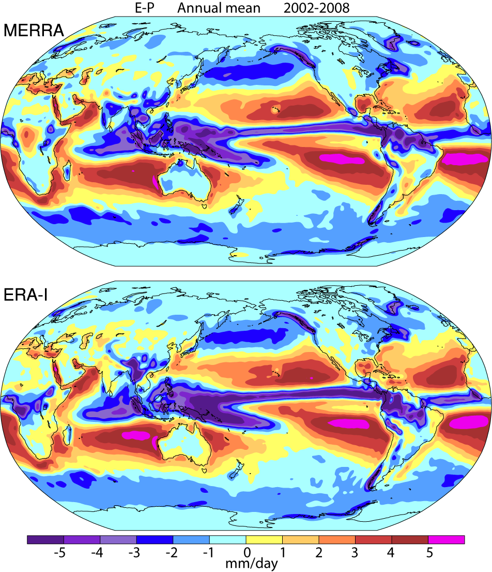

Slide 28
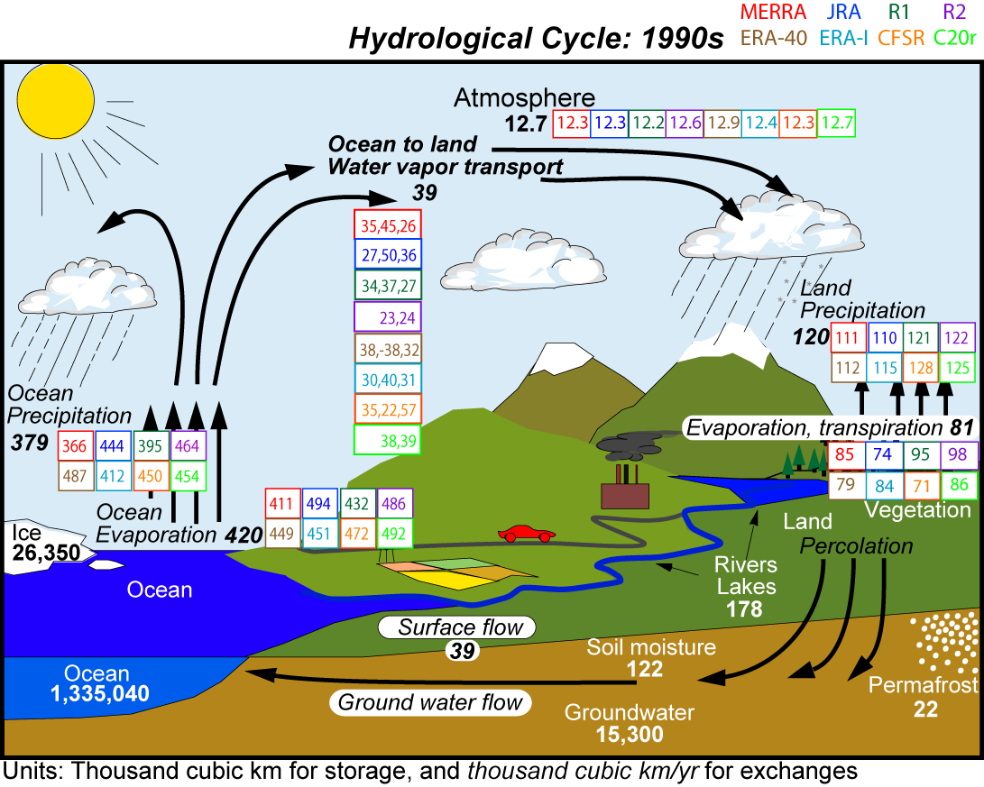
Transport
E-P_{ocean}
P-E_{land}

Slide 29
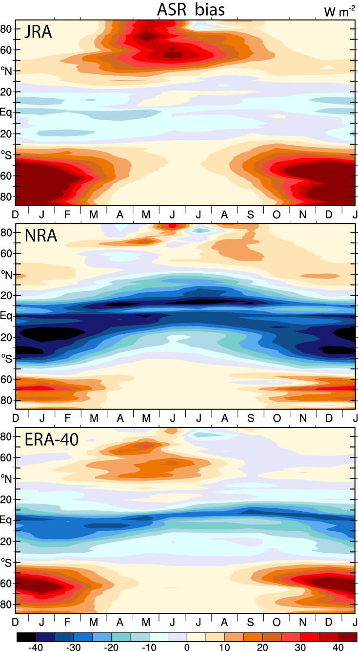
Energy budget: Reanalyses ASR bias 1990s Biggest in summer
All reanalyses have too much incoming solar radiation in southern oceans
Caused by too few clouds
Implies too much heating of ocean which should diminish poleward heat transports when models are coupled
Has implications for storm tracks and ocean transports
Trenberth and Fasullo 2010

Slide 30
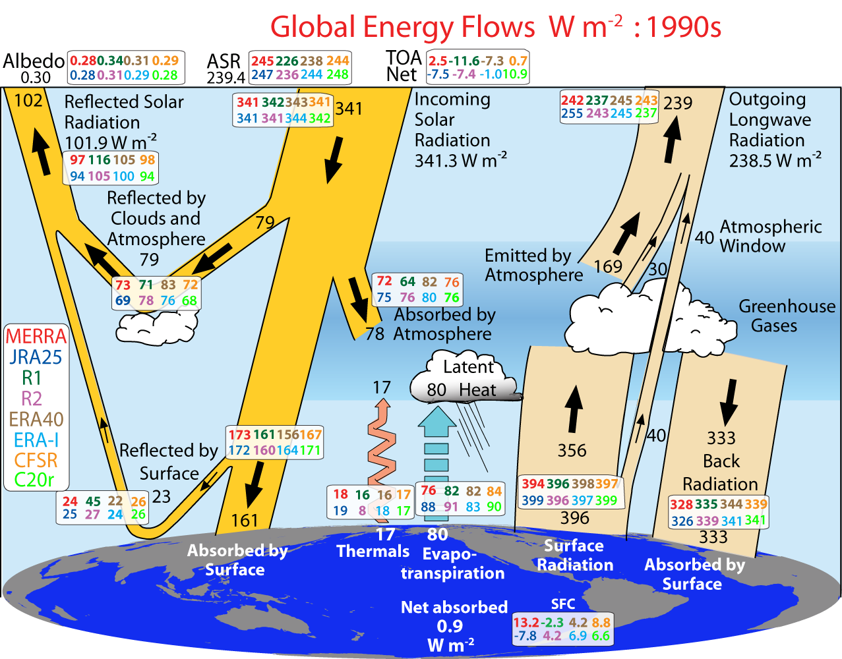
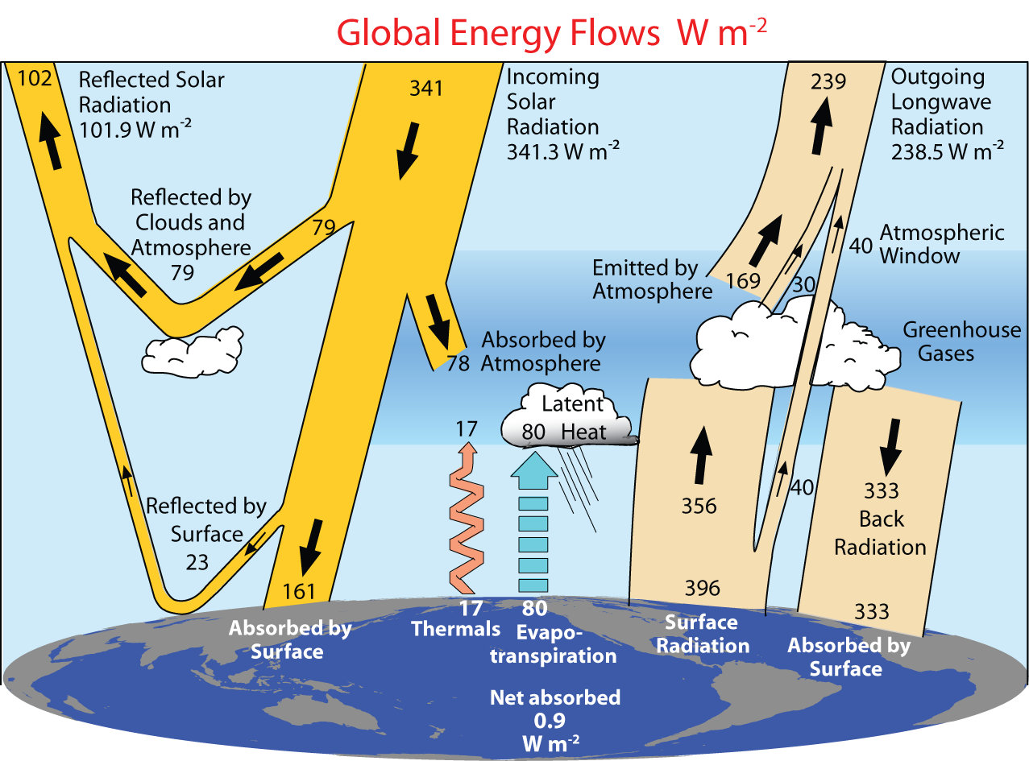
0.6

Slide 31
Energy budget: Reanalyses
At TOA, most climate models are tuned to get balance or replicate ERBE/CERES
Depends on equilibrium simulation
No longer works in reanalyses
Specified SSTs
Global imbalances (hide even bigger local)
R1 ERA-40 ERA-I JRA MERRA CFSR
Resolution 1.9° 0.8° 0.5° 1.1° 0.5° 0.5°
ASR -13 -1 +5 +8 +6 +5 W m⁻²
OLR -2 +6 +6 +16 +3 +4
Net(TOA) -12 -8 -2 -8 +2 0
Net (sfc) -3 +4 +6 -8 +13 +8
For 1990s vs climatology

Slide 32
Reanalyses
Even if the assimilating model has a balanced energy budget, when SSTs are specified there is an infinite heat and moisture source or sink
There is no feedback on the SSTs from surface fluxes
The result is potentially large energy imbalances at TOA and at surface
The TOA and surface energy balances can be strong diagnostics of model bias problems

Slide 33
Reanalysis
The next (4th) International reanalysis conference is planned to be in April 2012 in Washington DC area.
There is not a problem with lack of reanalyses, indeed there is a proliferation. The problems are:
lack of an end to end program with adequate evaluation of products (and the funding), and
Reanalysis is all done in a research domain and not sustained, so that key personnel can be lost.
Lack of adequate vetting and diagnosis
Reanalysis is an essential part of climate services, especially in monitoring, attribution and prediction

